Slide 1
Comparison of MODIS and VIIRS in detecting a harmful algal bloom in the NE Gulf of Mexico
Chuanmin Hu¹, Brian B. Barnes¹, Lin Qi¹, Alina A. Corcoran²
¹University of South Florida
²Florida Fish and Wildlife Conservation Commission
NASA MODIS/VIIRS team meeting, May 18 – 22, 2015

Slide 2
MODIS and VIIRS ocean bands
MODISA has two more bands than VIIRS at 531 and 678 nm
Sensor | Res. (km) | Swath | Revisit | Ocean Bands* | Duration
MODISA | 1.1 x 1.1 | 2330 km | 1-2 day | 9, 412-869 nm | 2002 – now
VIIRS | 0.75 x 0.375 | 3300 km | 1 day | 7, 410-862 nm | 2011 – now
Notes:
2

Slide 3
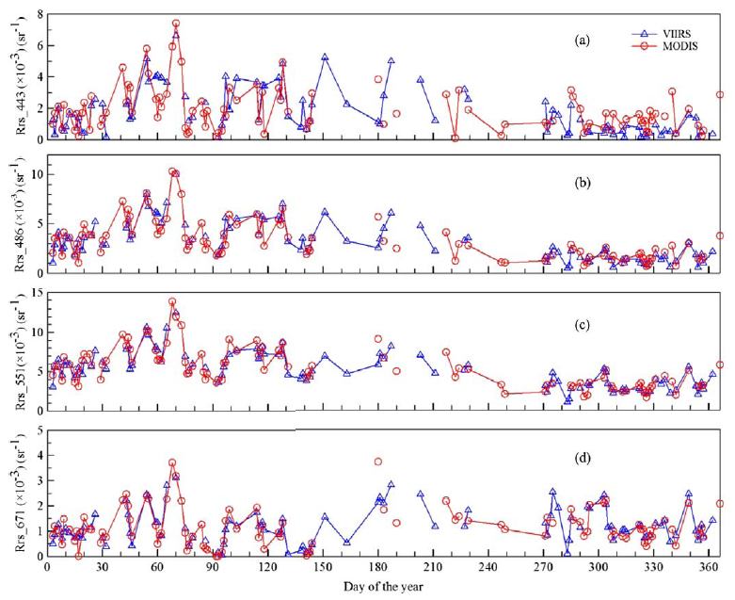
Cross-sensor comparison for Tampa Bay
NASA OBPG reprocessing 2013.0
Notes:
3
Same day measurements over one location in Tampa Bay

Slide 4
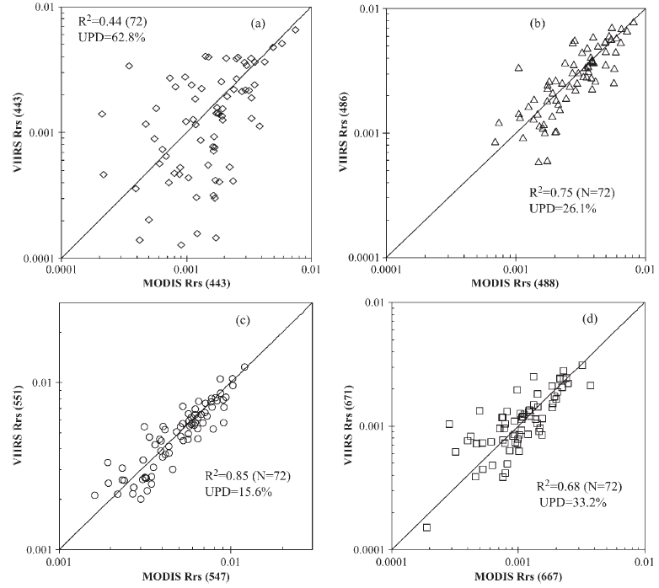
Cross-sensor comparison for Tampa Bay
NASA OBPG reprocessing 2013.0
Notes:
4
Same day measurements over one location in Tampa Bay

Slide 5
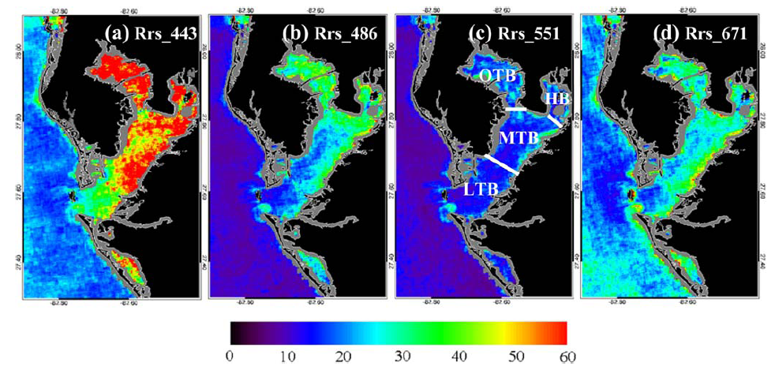
Cross-sensor comparison for Tampa Bay
NASA OBPG reprocessing 2013.0
Notes:
5
Same day measurements over one location in Tampa Bay

Slide 6
Question: How does VIIRS perform in detecting HABs?
One case study in CDOM-rich dark waters
Notes:
6

Slide 7
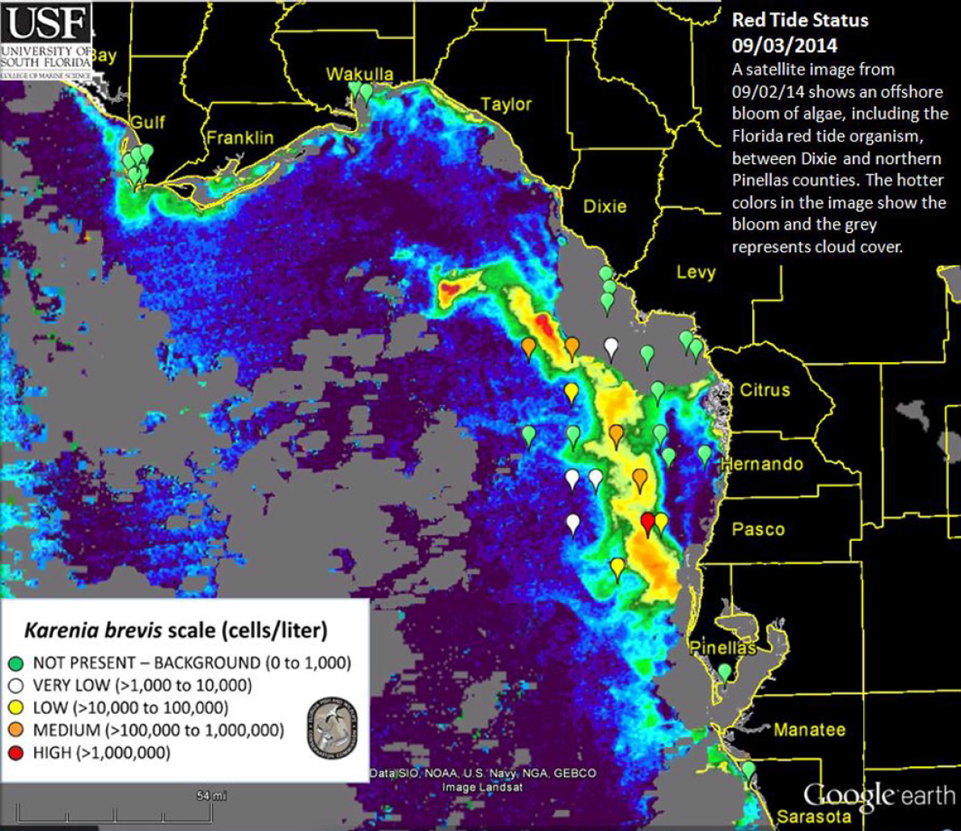
A Karenia brevis bloom in NEGOM

Slide 8
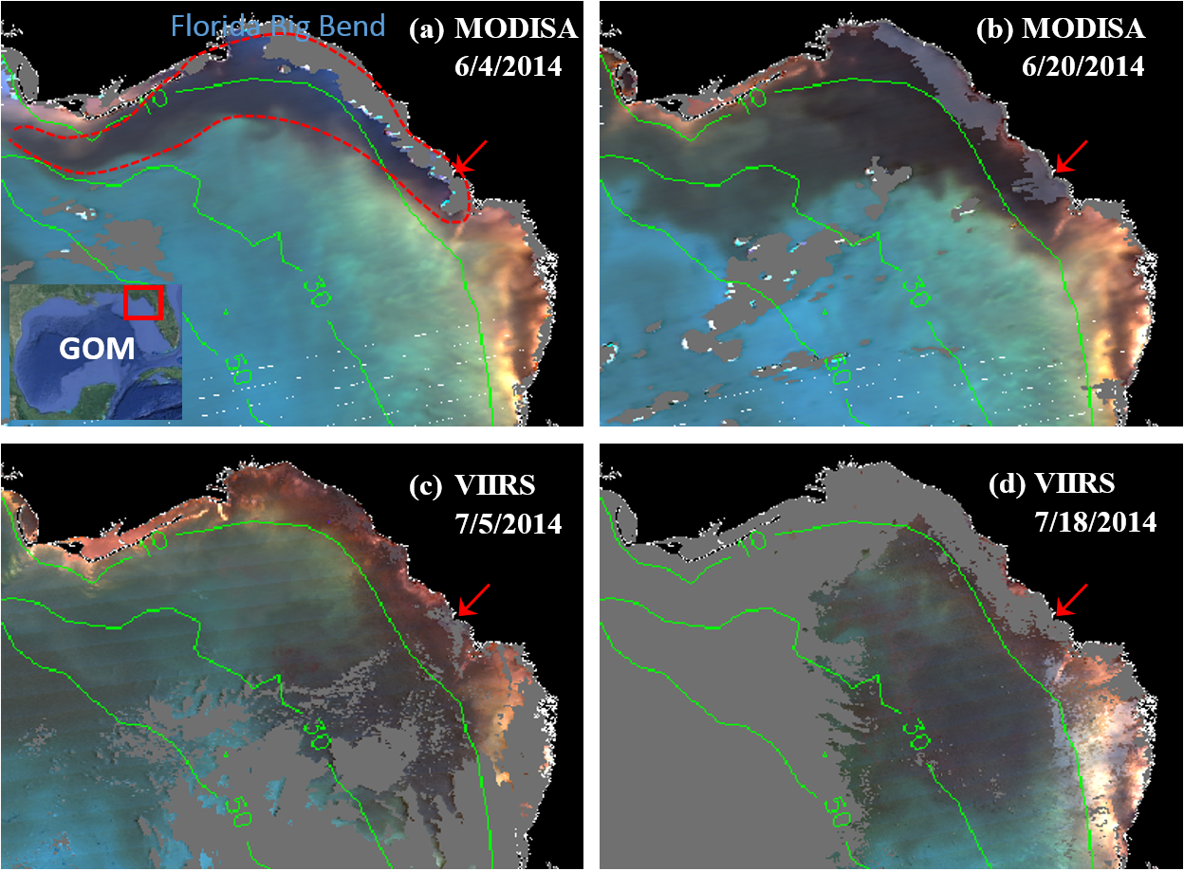
ERGB image series showing dark waters

Slide 9
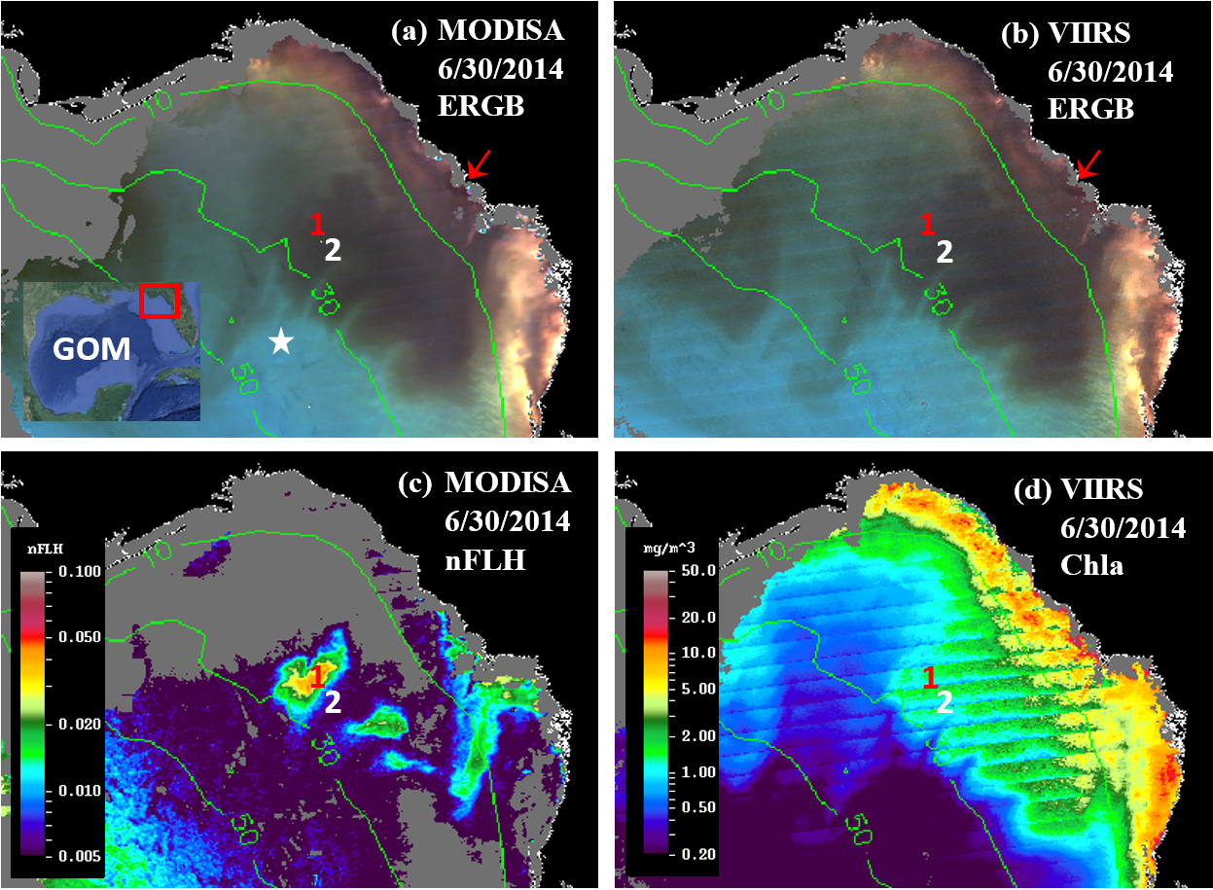
Similarity and contrast between MODIS and VIIRS

Slide 10
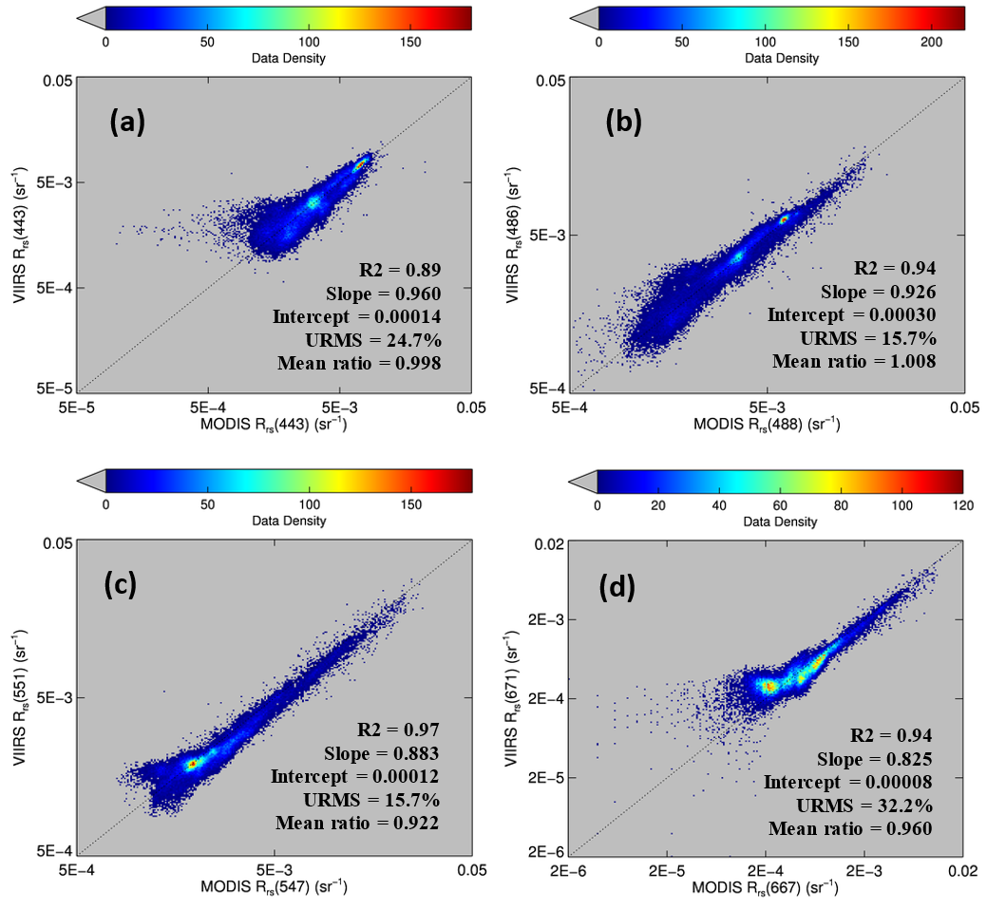
Similarity and contrast between MODIS and VIIRS

Slide 11
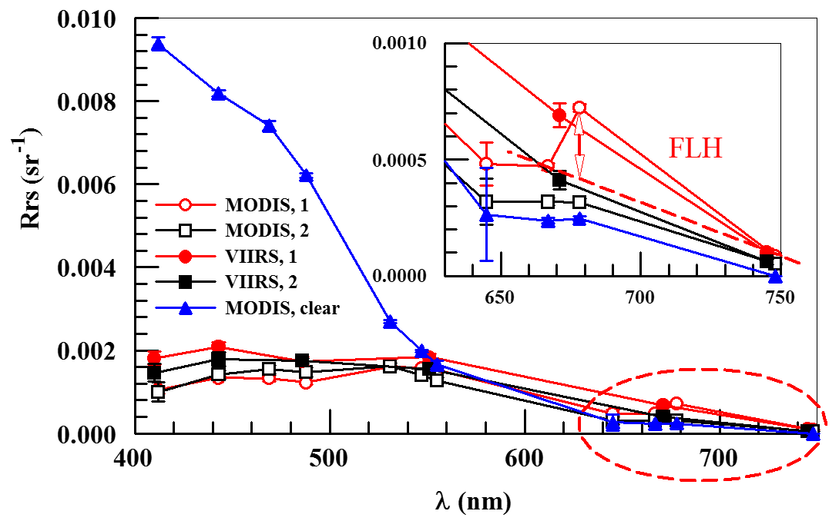
Similarity and contrast between MODIS and VIIRS

Slide 12
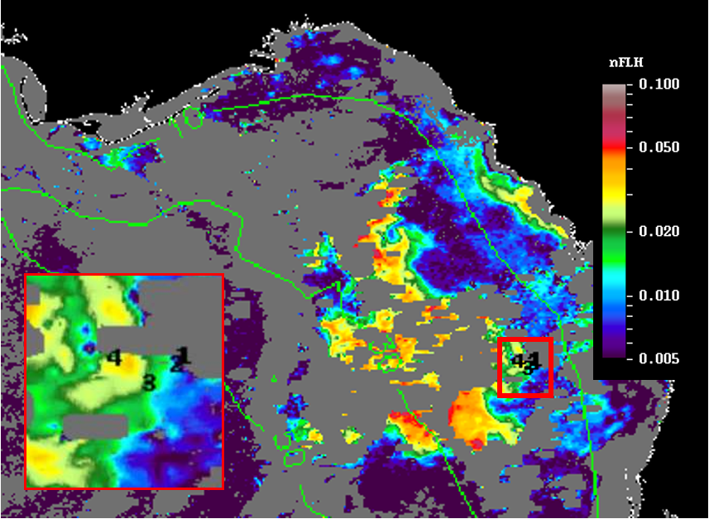
Validation using field measurements
MODISA nFLH 7/23/2014

Slide 13
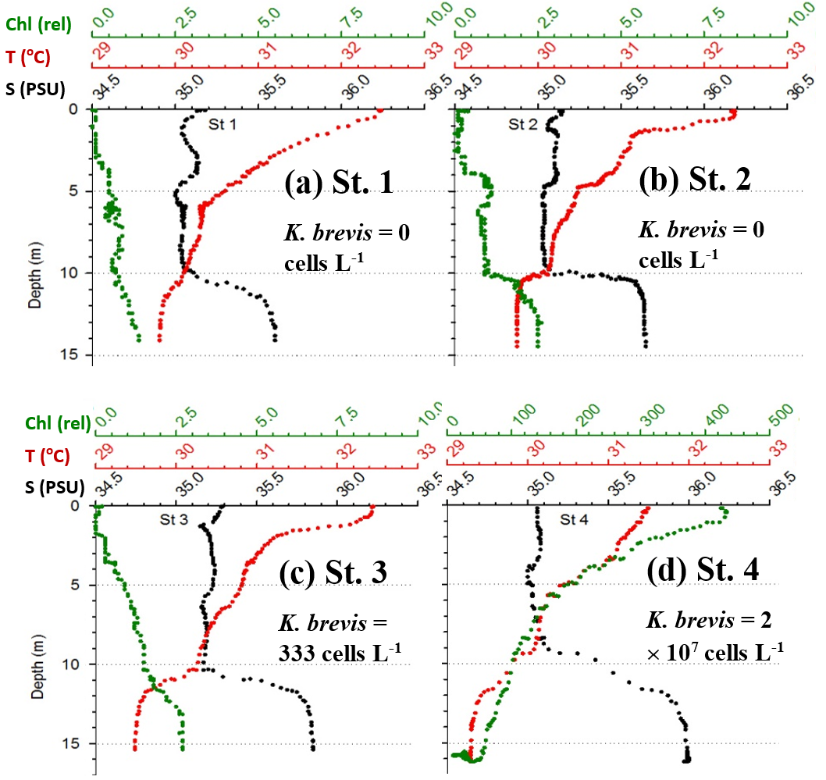
Validation using field measurements

Slide 14
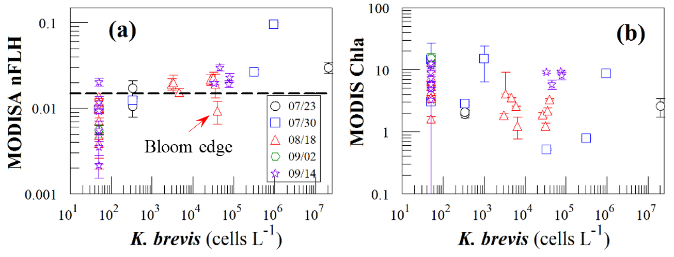
Validation using water sample analysis

Slide 15
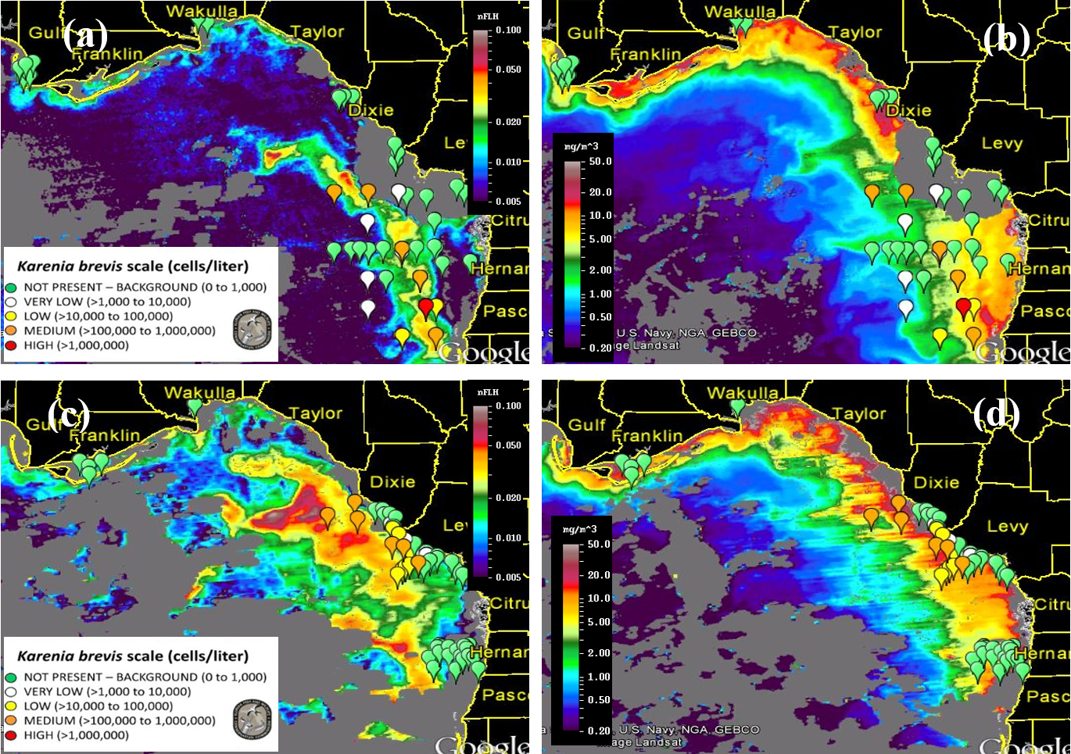
Validation using water sample analysis

Slide 16
Validation using water sample analysis
Chla:
July 23
K. brevis:
July 18-24
nFLH:
July 23
K. brevis:
July 18-24
Chla: July 30
K. brevis:
July 24 – Aug 1
nFLH:
July 30
K. brevis:
July 24 – Aug 1

Slide 17
Validation using water sample analysis
Chla: Aug 8
K. brevis:
July 31 –
Aug 8
nFLH: Aug 8
K. brevis:
July 31 –
Aug 8
Chla: Aug 18
K. brevis:
Aug 14 - 21
nFLH: Aug 18
K. brevis:
Aug 14 - 21

Slide 18
Conclusions
VIIRS and MODISA show consistent Rrs retrievals in Tampa Bay and NEGOM
However, VIIRS shows some deficiency in detecting Karenia brevis HABs in dark waters due to its lack of a fluorescence band
New approaches need to be developed to overcome such a deficiency for HAB detection
Notes:
18

Slide 19
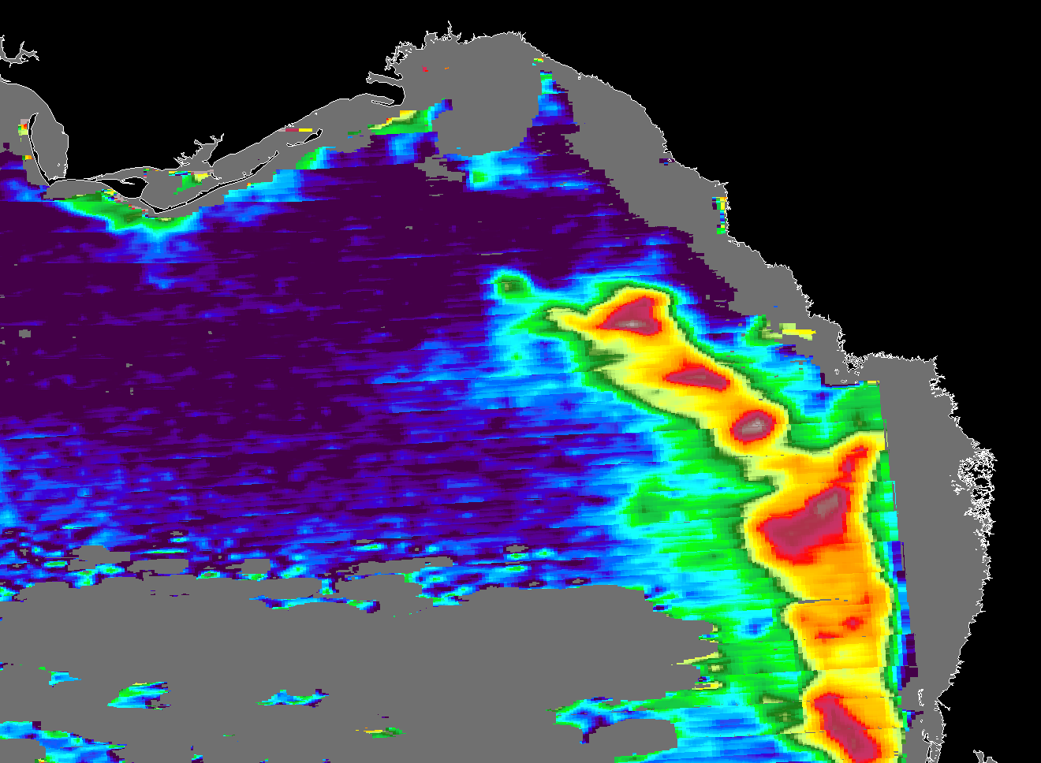
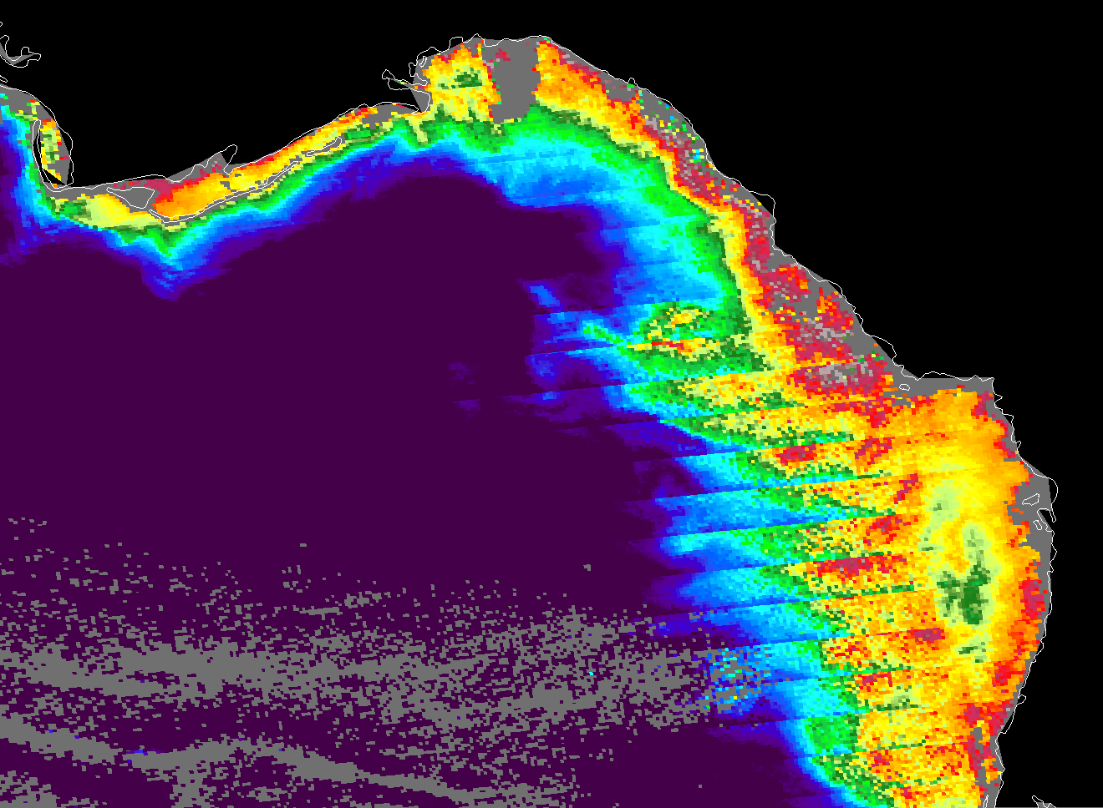
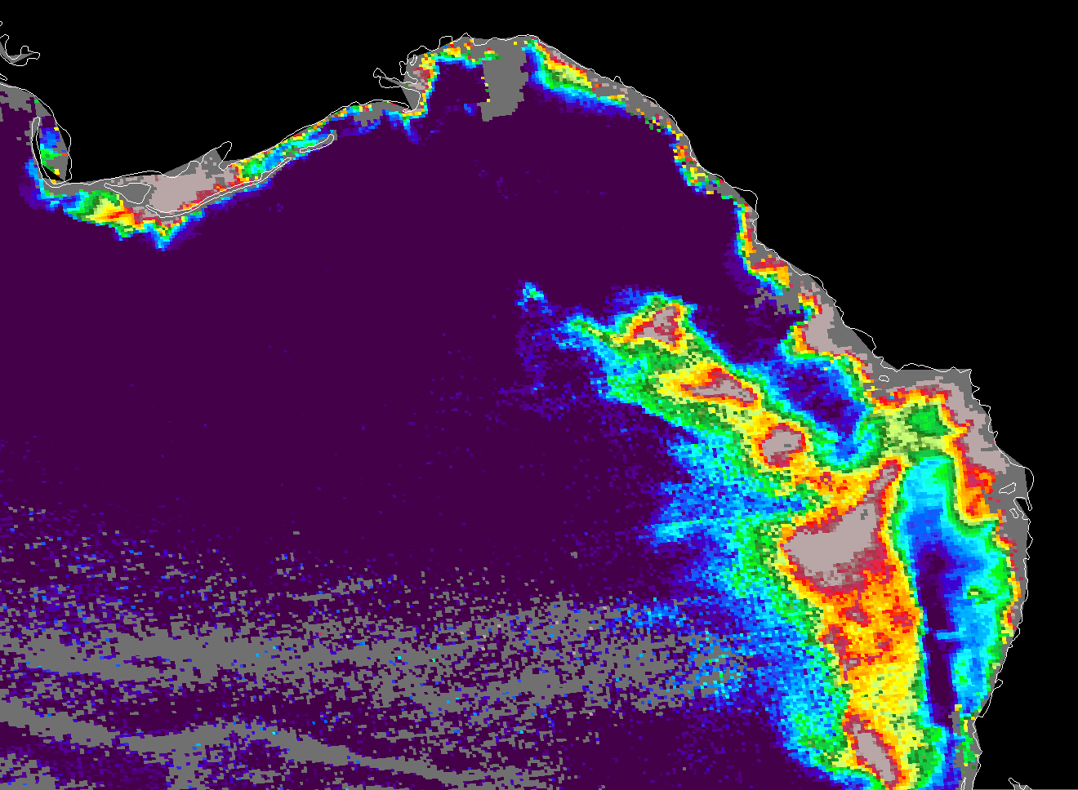
To be continued…
MODIS nFLH VIIRS Chl_OC3 VIIRS HAB index
All images taken on 8/27/2014

