Slide 1
VIIRS Nighttime Lights Algorithm Development 2015
Chris Elvidge
Earth Observation Group (EOG)
NOAA National Centers for Environmental Information
(formerly NGDC)
Kimberly Baugh, Feng Chi Hsu, Mikhail Zhizhin, Tilottama Ghosh
Cooperative Institute for Research in Environmental Science
University of Colorado
Emails: kim.baugh@noaa.gov, chris.elvidge@noaa.gov

Slide 2
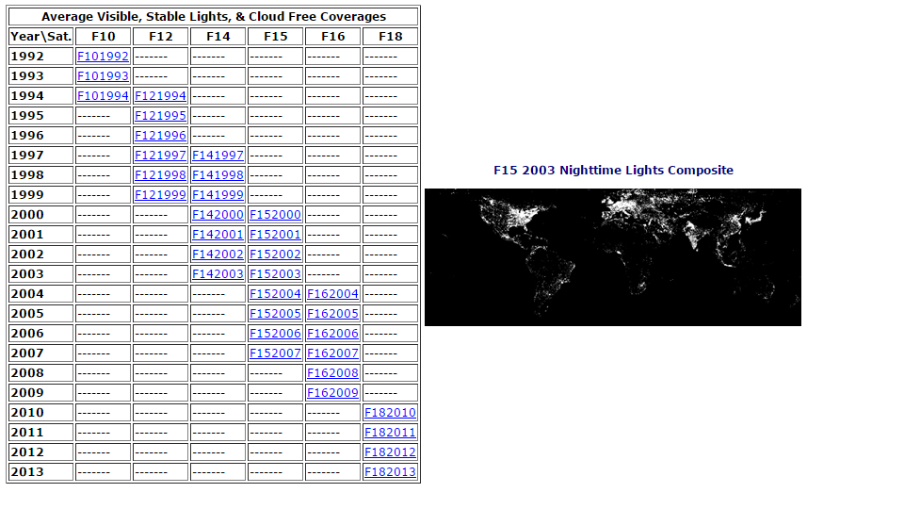
Nighttime Lights Composites
(Historical OLS Products)
The EOG Group at NCEI has a long history of making global annual nighttime lights composite products using DMSP-OLS data.
http://www.ngdc.noaa.gov/eog/dmsp/downloadV4composites.html

Slide 3
Nighttime Lights Composites
What are they?
A nighttime lights composite is made to serve as a baseline of persistent light sources.
Composites are made as an average of the highest quality nighttime lights imagery over desired time period – usually monthly or annually.
“Stable Lights” composites have ephemeral light sources and non-light (background) areas are removed from a composite.
EOG group is producing current monthly cloud-free/no-moon DNB nighttime lights composites and is doing algorithm development to turn these in to Stable Lights composites.

Slide 4
Nighttime Lights Composites
What goes in?
Only the “highest quality” nighttime data gets averaged into a composite
Currently this is defined as DNB data that is:
Cloud-free (using the VIIRS cloud-mask (VCM) product)
Nighttime with solar zenith angles greater than 101
Not affected by moonlight (lunar illuminance < 0.0005 lux)
Middle of swath (DNB has increased noise at edge of scan)
Free of lights from lightning
Free of “lights” from South Atlantic Anomaly

Slide 5
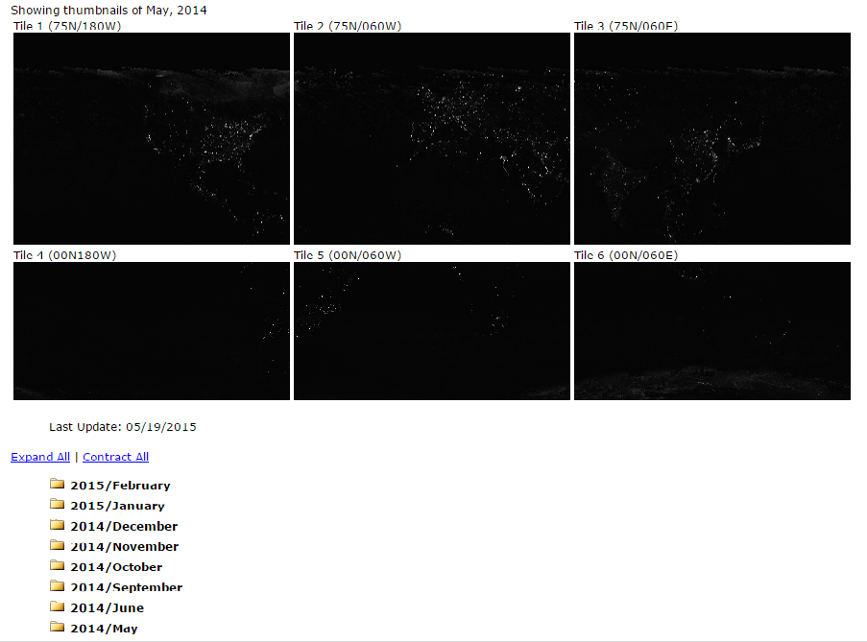
Nighttime Lights Composites
(Monthly DNB Products)
Monthly DNB nighttime lights composites are available online
Globe is cut into 6 tiles to reduce individual file sizes
These products still contain ephemeral lights and non-lights (background).
http://www.ngdc.noaa.gov/eog/viirs/download_monthly.html

Slide 6
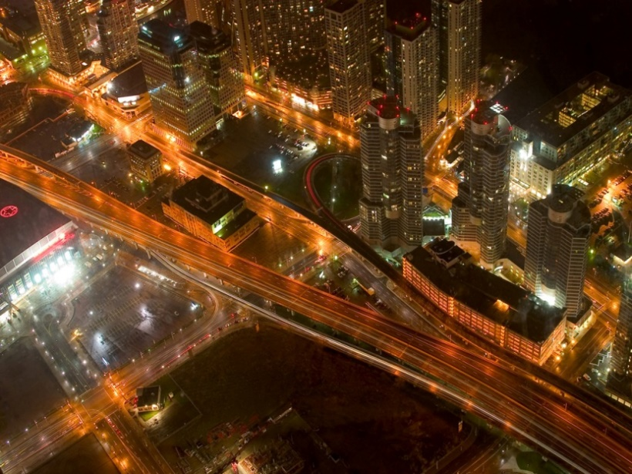
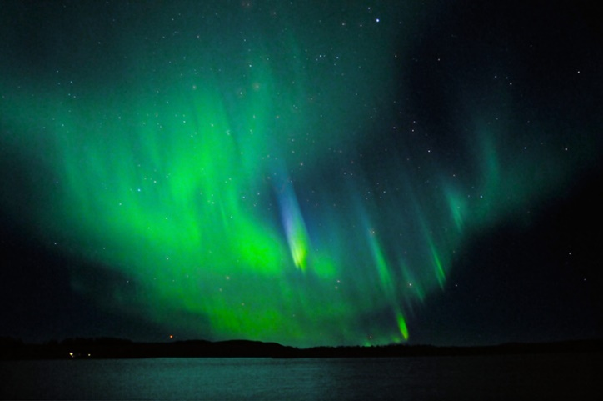
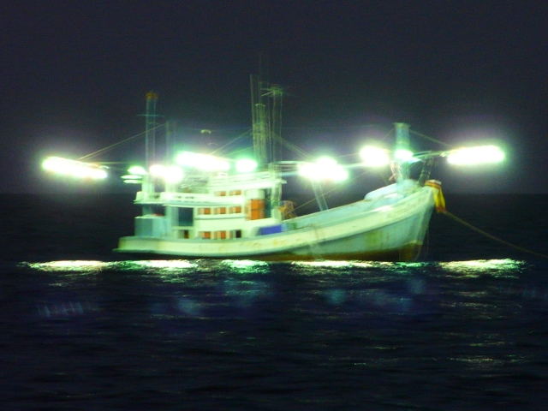
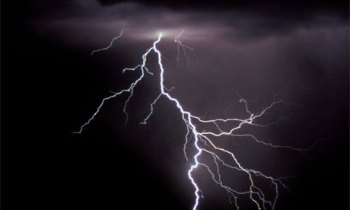
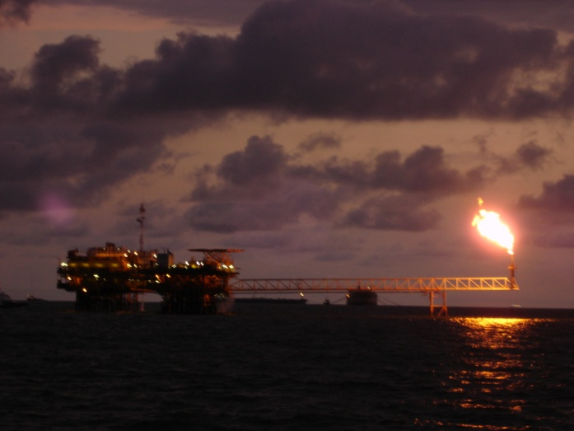
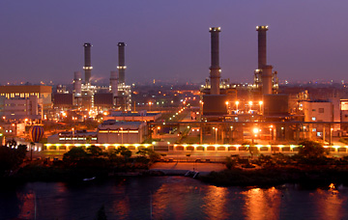
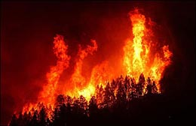
Sources of Nighttime Lights
Aurora
Boats
Cities and human settlements
Lightning
Gas Flares
Industrial Sites
Fires

Slide 7
Stable Sources of Nighttime Lights
Aurora
Boats
Cities and human settlements
Lightning
Gas Flares
Industrial Sites
Fires

Slide 8
DNB Image Artifacts
In addition to ephemeral lights, there are sensor specific image artifacts that need to be removed.
The four most troublesome artifacts:
Stray Light
High energy particle hits to detector – most common in South Atlantic Anomaly (SAA) region
Cross talk – across lines within a scan when imaging very large gas flares
DNB aggregation zones 29-32

Slide 9
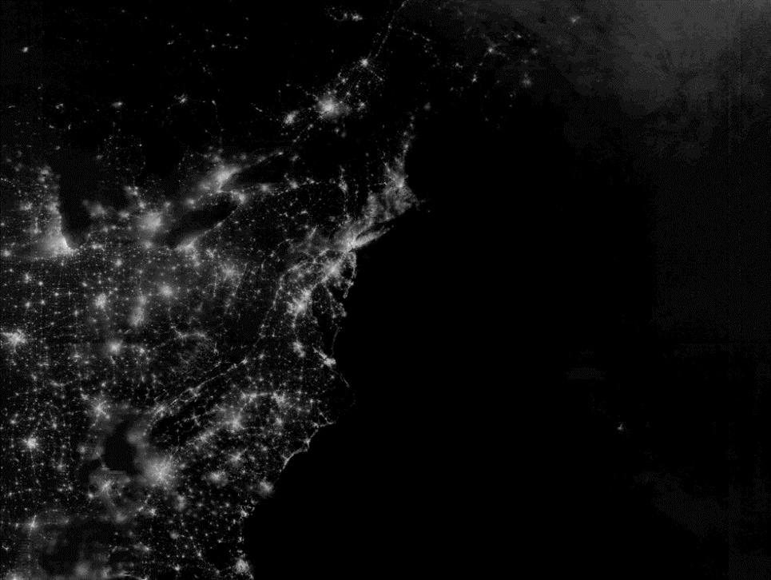
DNB Image Artifacts: Stray Light
Northrup Grumman algorithm was implemented at the IDPS in August 2013.
Does a good job of mitigating stray light effects for visual interpretation.
Some issues for algorithm development within the stray light corrected region:
Can under/over-correct, especially at transition into stray light and in Southern hemisphere
Variance of data across scan is altered
Correction quality is dependent on time from correction lookup table generation
Stray light corrected regions are identified and processed separately

Slide 10
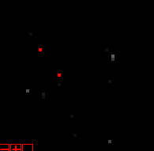
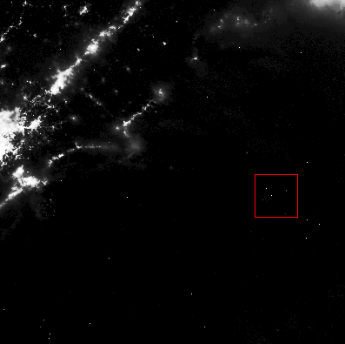
DNB Image Artifacts: SAA Hits
Example of high values in DNB due to high energy particles in South Atlantic Anomaly region.
Red pixels were labelled as SAA hits because they exceeded the average of neighboring pixels by more than 99.5%
This algorithm removes most of the SAA noise
In prototype composites, there appears to be remaining SAA noise with low radiance values. Further investigation is warranted.
March 31, 2012 – off coast of Brazil

Slide 11
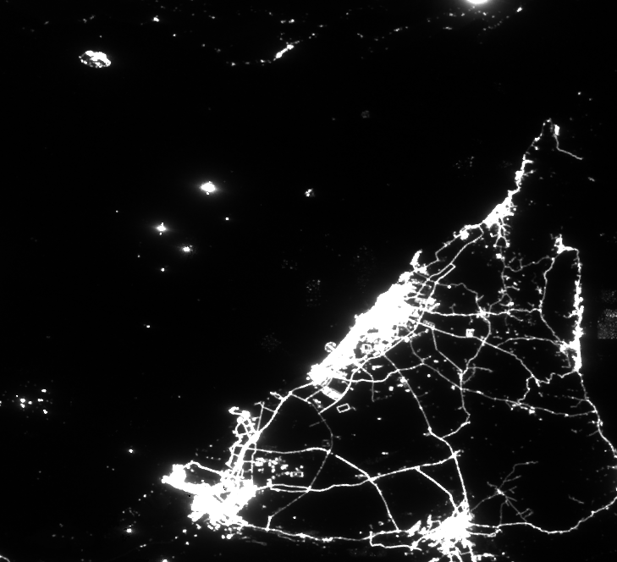
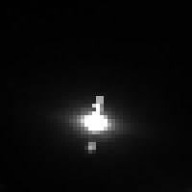
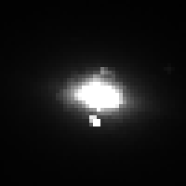
DNB Image Artifacts: Crosstalk
Crosstalk is only an issue in High Gain State (HGS) DNB data
Crosstalk manifests as spurious signal in the same sample position in other detectors within the scan.
Crosstalk is seen mainly (only?) over large gas flares
Both positive and negative crosstalk occurs
Algorithm for detection of crosstalk events is TBD
Crosstalk shows up as pairs of small “lights” around large gas flares in Persian Gulf DNB composite.
May 2014 average DNB composite

Slide 12
DNB Image Artifacts: Agg. Zones 29-32
Edge-of-swath pixels are discarded due to increased noise
(DNB aggregation zones 29-32).
DNB
Increased noise
at edge of scan
Aggregate SVDNB_npp_d20121018_t0749150_e0754554_b05050_c20121018135455638495_noaa_ops.h5

Slide 13
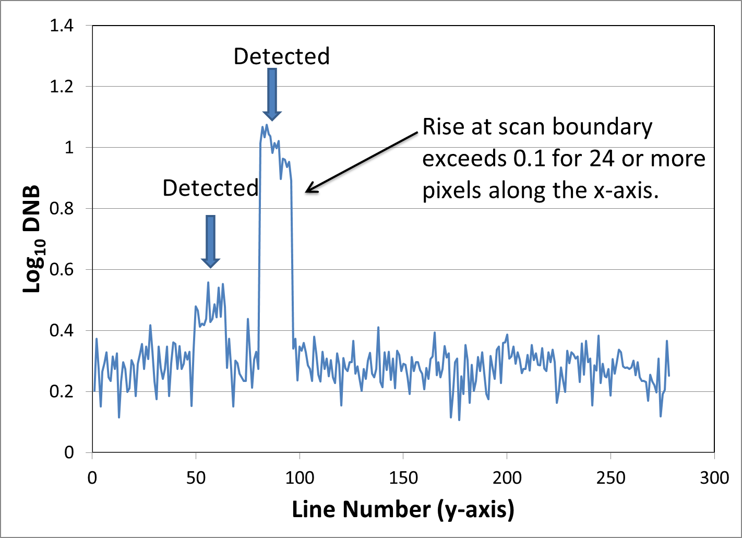
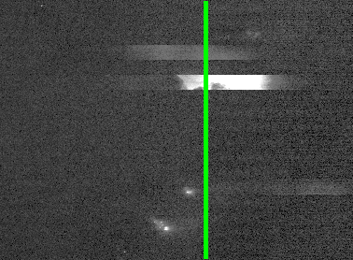
DNB Ephemeral Lights: Lightning
Lightning appears in DNB imagery as horizontal ribbons of lighting.
These features are generally one scan (16 lines) wide.
When lightning features are in adjacent scans, they are generally offset and the brightness values differ, so algorithm still holds.
A
Rise at scan boundary exceeds threshold for N consecutive along-scan pixels
Lightning
Detected
Lightning
A
B
B

Slide 14
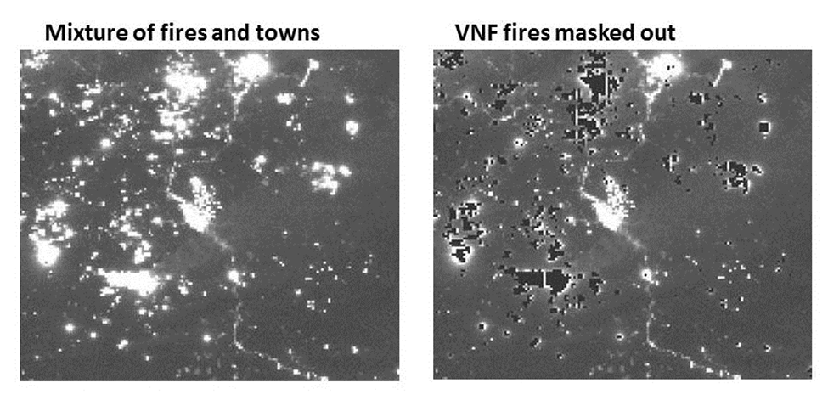
DNB Ephemeral Lights: Fires/Flares/Volcanos
First approach:
Separate fires from lights using VIIRS NightFire (VNF) product
VNF algorithm uses VIIRS M-band data, collected simultaneously with DNB
Issues:
1) Remaining glow around VNF detections need to be addressed.
2) DNB has lower detection limits than the M-bands and picked up some fires that VNF did not detect.
Some fires not detected by VNF

Slide 15
DNB Ephemeral Lights
Second approach:
Create histograms of DNB radiances using an extended time series (annual)
Use histograms to identify and remove outliers
Similar to algorithm developed for DMSP-OLS Stable Lights
Advantages: This algorithm removes ANY outliers, including fires, boats, unfiltered-SAA, crosstalk, …
Disadvantages: Persistent flares and volcanic activity can remain. Method requires long time-series of data.

Slide 16
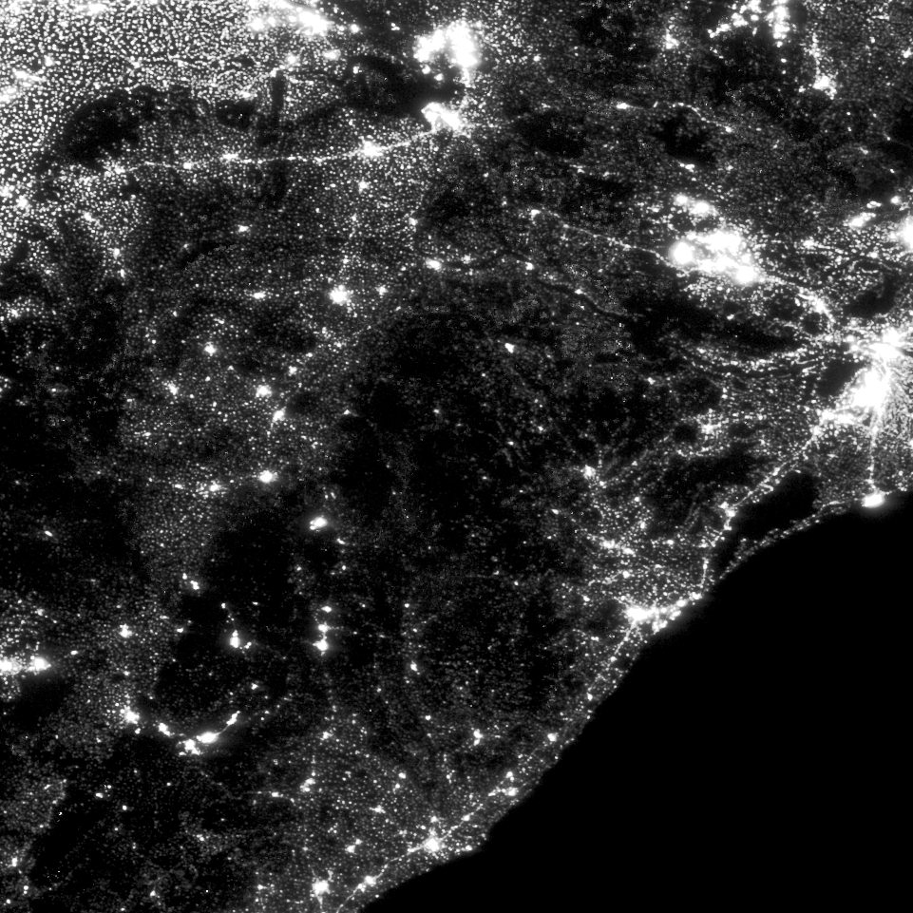
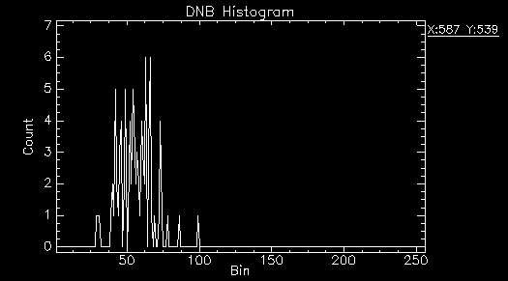
DNB Ephemeral Lights: Outlier Removal
Odisha, India 2014 DNB Composite
Histograms are made for each grid cell in composite
DNB radiance values are placed in discrete bins based on log transform. Bin=floor(100*(log(1E9*Rad+1.5))
Example histogram of small village

Slide 17
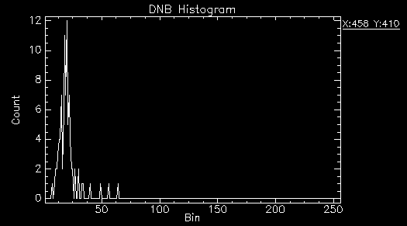
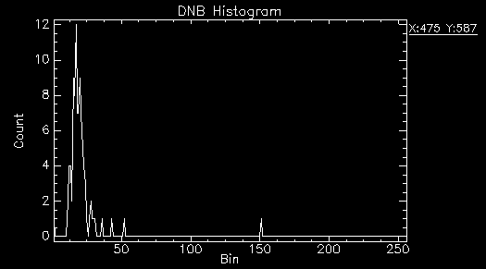
DNB Ephemeral Lights: Outlier Removal
Example histograms of grid cells containing fires

Slide 18
DNB Ephemeral Lights: Outlier Removal
Algorithm:
Compute standard deviation of observations
Remove highest observation
Re-compute standard devation
Repeat steps 2-3 if difference in standard deviations > threshold
Re-compute average of remaining observations
Outlier removal algorithm removed top 4 observations:

Slide 19
DNB Ephemeral Lights: Before Outlier Removal
Toggle with next slide
Notice how regions with fire activity return to background radiance levels after outlier removal

Slide 20
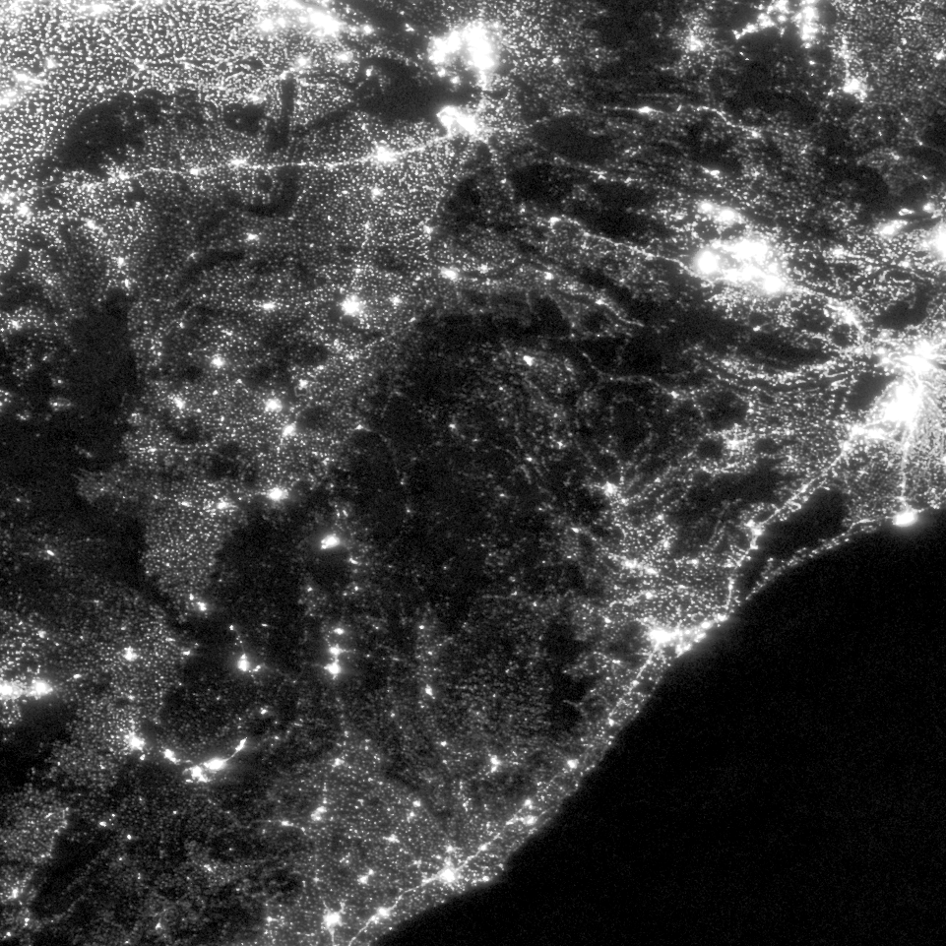
DNB Ephemeral Lights: Before Outlier Removal
Toggle with previous slide
Notice how regions with fire activity return to background radiance levels after outlier removal

Slide 21
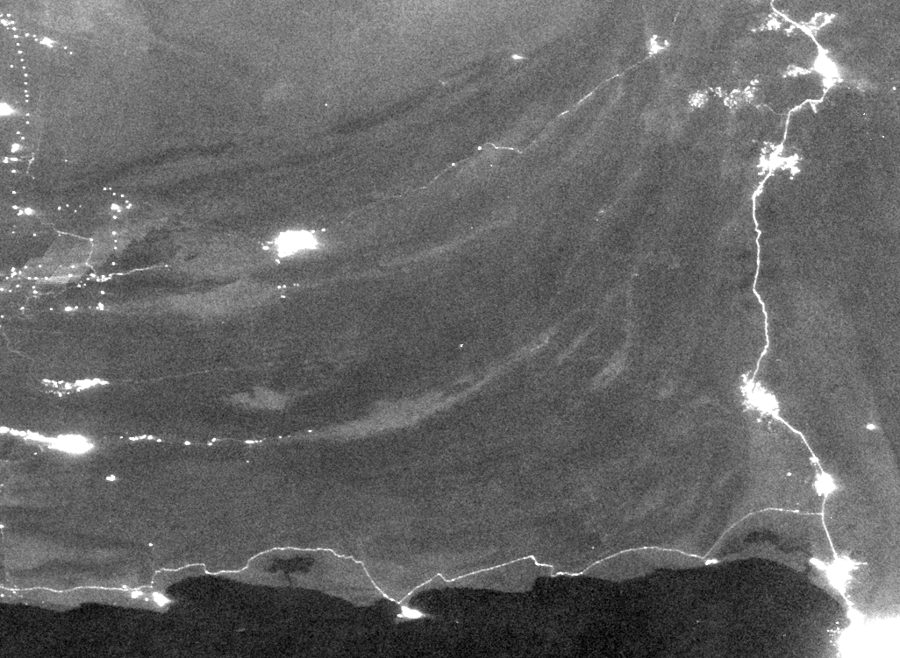
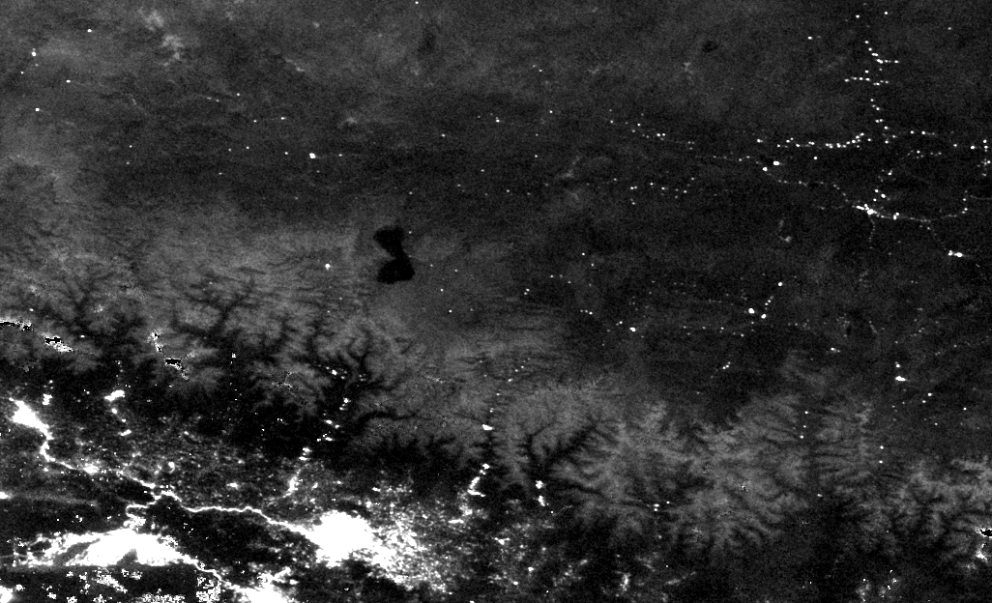
DNB Background Removal
The DNB’s detection limits are low enough, that even without moonlight present, nocturnal airglow can light up terrain and high albedo surfaces, making it challenging to separate dim lights from high albedo surfaces.
2014 DNB Composite over Southern Pakistan – some road features have lower average radiance values than no-light areas with high albedo
2014 DNB Composite over Himalayas – snow-covered peaks have higher average radiances than some of the villages

Slide 22
DNB Background Removal
Current approach:
Create 5X5 pixel histograms of DNB radiances after outlier removal using an extended time series (annual)
Analyze histograms for existence of a “pure background” grid cell using mean and standard deviation.
For each composite grid cell, get “closest” pure background grid cell. Remove its background and re-average to get lights-only average.
Foreseen challenges
Known discontinuities in offsets of DNB calibration (monthly?)
SRF changes in DNB over time could affect this work
Defining “closest” in terms of which background grid cell to use

Slide 23
Nighttime Lights Composites: Next Steps
Finalize background characterization/removal algorithm
Test outlier removal algorithm on aurora
Add in Nightfire detections to identify locations of persistent flares and volcanos
Apply atmospheric correction algorithm to DNB radiances

Slide 24
Questions?
Emails:
Kim.Baugh@noaa.gov
Chris.Elvidge@noaa.gov

Slide 25
Backup Slides

Slide 26
VIIRS Nighttime Lights Composite – 2015/01 Excluding Stray Light Corrected Areas

Slide 27
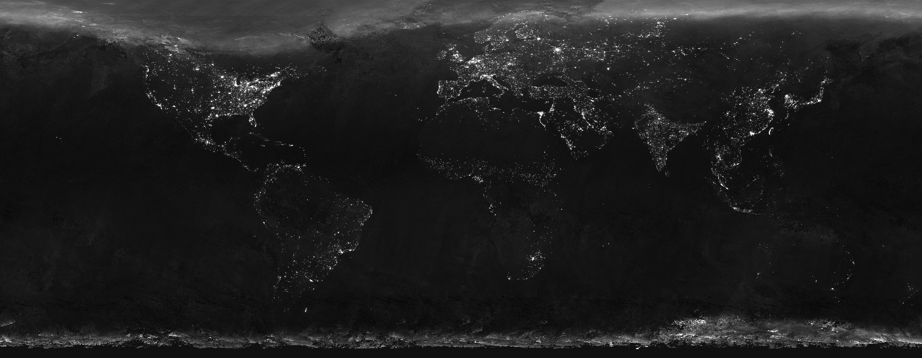
VIIRS Nighttime Lights Composite – 2015/01 Including Stray Light Corrected Areas

