Slide 1
MODIS Vegetation
Continuous Fields 2015
University of Maryland
Charlene DiMiceli, John Townshend, Rob Sohlberg, Mark Carroll, Do-Hyung Kim, Maureen Kelly

Slide 2
Vegetation Continuous Fields
Version 5.1 Improvements
All three layers completed:
-- Tree
-- Non-Tree Vegetation
-- Non-Vegetated
Improvements to northern high latitudes
Available from the LP-DAAC: MOD44B.051

Slide 3

Percent Tree Cover

Slide 4

Percent Non-Tree Vegetation

Slide 5

Percent Non-Vegetated

Slide 6




Revisiting the 2002 Oregon Biscuit Fire
Patterns of Vegetation Regrowth
Notes:
Burned area emergency recovery. Mark Carroll, Rob Sohlberg, Bethany Semeiks

Slide 7

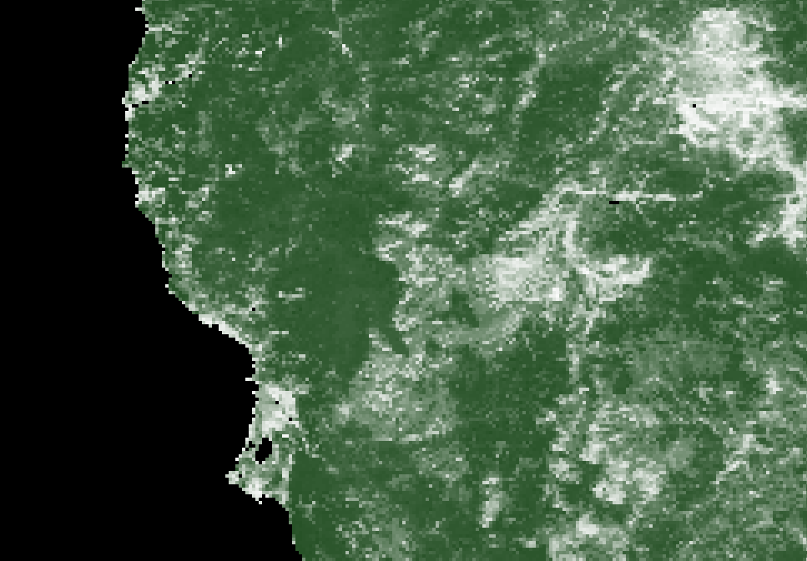

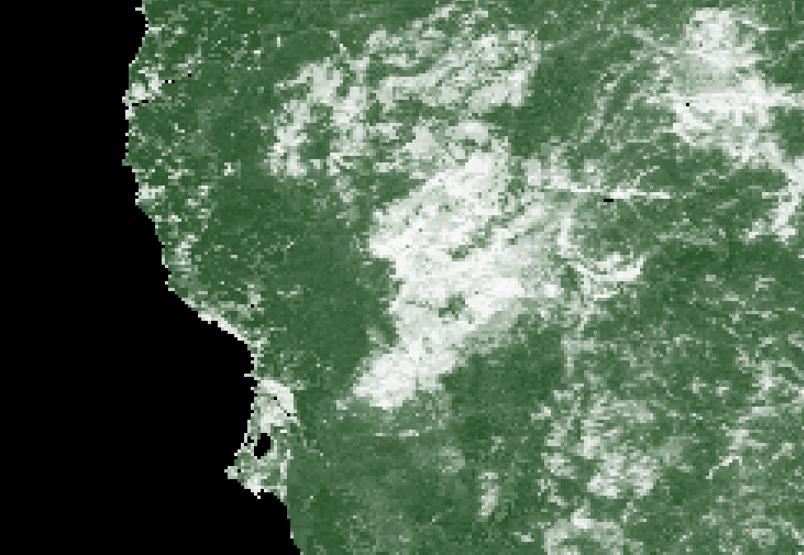
VCF Percent Non-Vegetated
VCF Percent Tree Cover
2001
2003

Slide 8

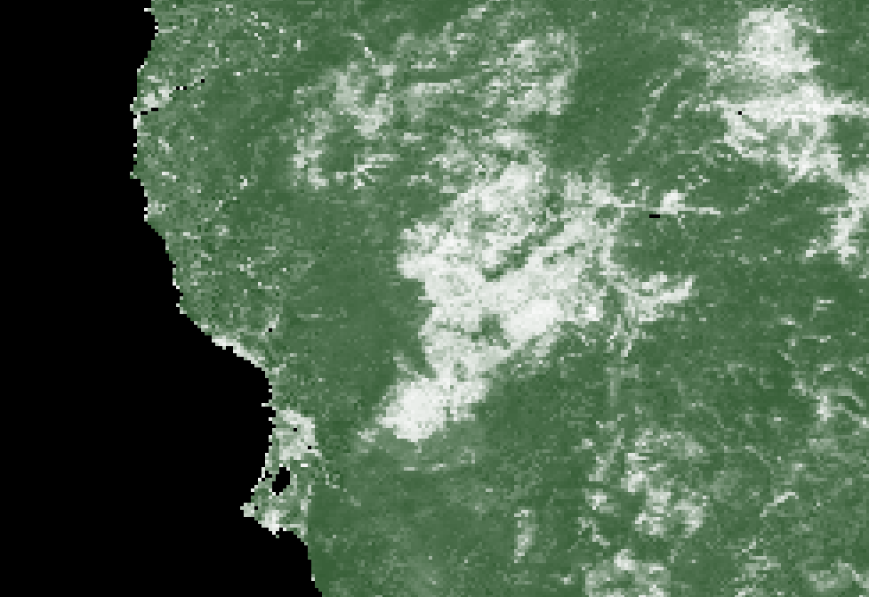
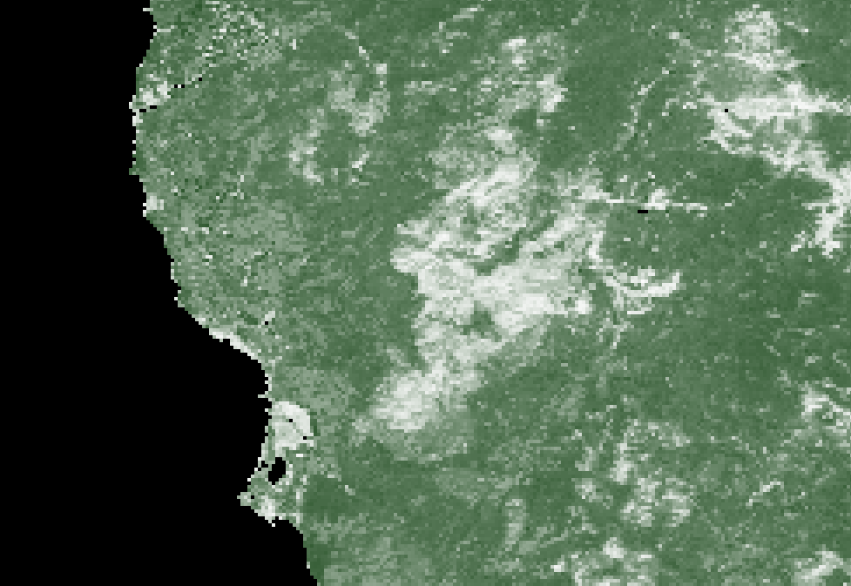
VCF Percent Non-Vegetated
VCF Percent Tree Cover
2008
2014

Slide 9


VCF Tree Cover 2010
Version 5.0
VCF Tree Cover 2010
Version 5.1

Slide 10
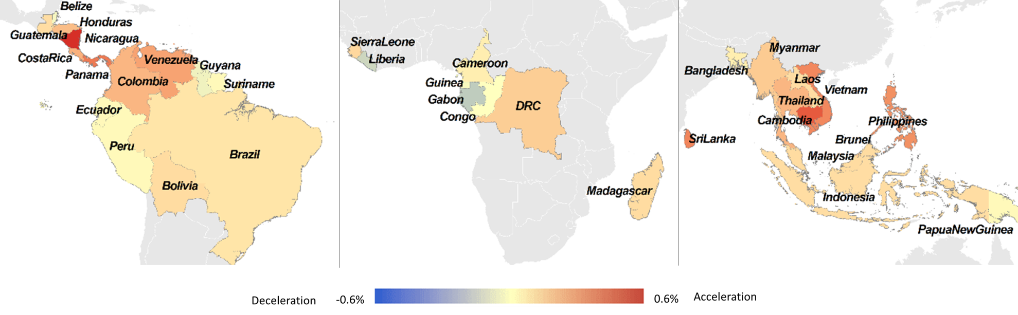
Accelerated Deforestation in the Humid Tropics from the 1990s to the 2000s
Acceleration and deceleration of net forest loss for the humid tropics between 1990-2000 and 2000-2010 periods. The values represent the difference in annual net forest area loss between the periods as a percent of land area.
Kim, Do‐Hyung, Joseph O. Sexton, and John R. Townshend. "Accelerated Deforestation in the Humid Tropics from the 1990s to the 2000s." Geophysical Research Letters (2015).
Notes:
Rates of net forest loss in the tropics were 62% higher in the 2000s than in the 1990s, increasing from 4 million hectares per year to 6½ million hectares per year. This contradicts FAO estimates of a decrease in forest loss rates of 25%. Several local and regional studies have been made of changing rates of deforestation between the 1990s and 2000s, but this is the first pan-tropical analysis.

Slide 11
Current Activities
Evaluation of C6 VCF products
C6 compositing algorithm refinements
Validation of all layers
Application of VCF algorithms to VIIRS
Notes:
We composite the MODIS daily surface reflectance data to 16-day composites customized for VCF processing. Differences in upstream products will require tuning of the compositing rules.

