Slide 1
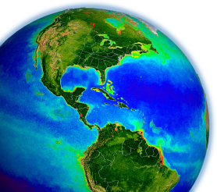
Remote Sensing Reflectance
and Derived Ocean Color Products from MODIS to VIIRS
Bryan Franz
Ocean Ecology Laboratory
NASA Goddard Space Flight Center
MODIS Science Team Meeting
19-22 May 2015, Silver Spring, MD

Slide 2
Proposal Team: MODIS & VIIRS
Team Member | Primary Role
Bryan Franz | project lead & quality assessment
Zia Ahmad | atmospheric correction
Sean Bailey | vicarious calibration & software
Gene Eplee | VIIRS calibration
Gerhard Meister | MODIS calibration
Chris Proctor | in situ validation
Kevin Turpie | VIIRS prelaunch
Jeremy Werdell | bio-optical algorithms
and the Ocean Biology Processing Group ...
Notes:
draw on expertise of entire team for software development, processing, analysis, and documentation

Slide 3
2014.0 Multi-Mission Ocean Reprocessing
Scope
OC from CZCS, OCTS, SeaWiFS, MERIS, MODIS(A/T), and VIIRS
SST from MODIS
Motivation
improve interoperability and sustainability of the product suite by adopting modern data formats, standards, and conventions
incorporate algorithm updates and advances from community and last MODIS Science Team developed since 2010 (last algorithm change)
incorporate knowledge gained in instrument-specific radiometric calibration and updates to vicarious calibration
Status
OC from OCTS & VIIRS done, MODISA in progress
SST from MODISA and MODIST done (not yet released)
Notes:
tied to MODIS science team, new algorithm development
7 instruments

Slide 4
Remote Sensing Reflectance (Rrs; sr⁻¹)
Rrs is the ratio of upwelling “water-leaving” radiance to downwelling irradiance, just above the sea surface
Rrs is the fundamental remote sensing quantity from which most ocean color products are derived (e.g., chlorophyll, particulate organic and inorganic carbon, inherent optical properties)
foam & whitecaps
water-leaving
aerosol + Ray-aer
Sun glint
observed TOA
Rayleigh
Atmospheric Correction

Slide 5
adaptation to VIIRS
algorithm modifications limited to adjustment for sensor-specific spectral band centers and relative spectral responses
same Ahmad-Fraser vector radiative transfer code used to derive MODIS & VIIRS-specific Rayleigh and aerosol model tables
bands used for aerosol determination
  MODIS: 748 & 869 nm
  VIIRS: 745 & 862 nm

Slide 6
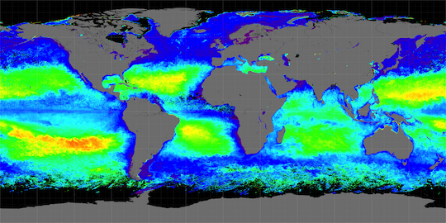
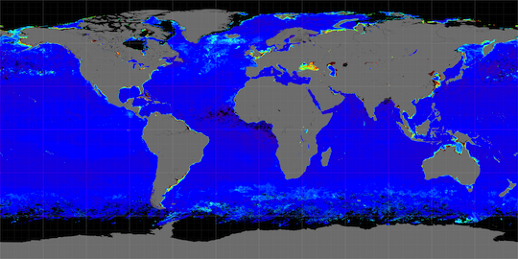
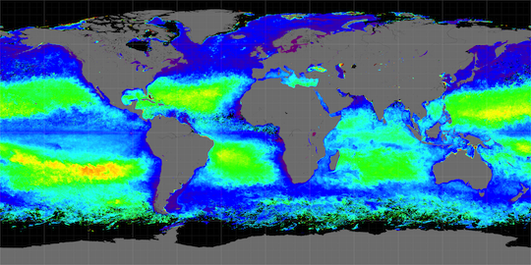
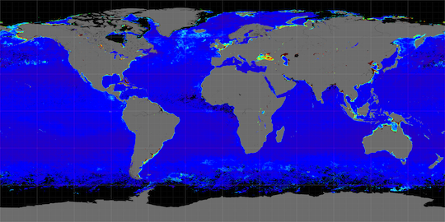
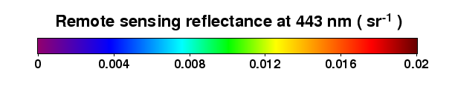
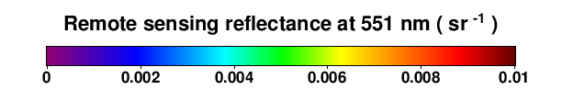
Rrs(λ) for Spring 2012
MODISA 443 nm
MODISA 547 nm
VIIRS 443 nm
VIIRS 551 nm

Slide 7
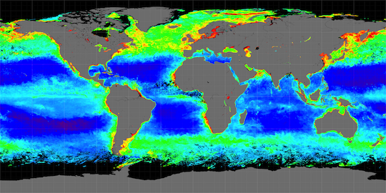
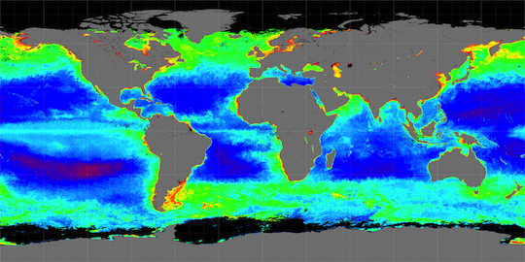
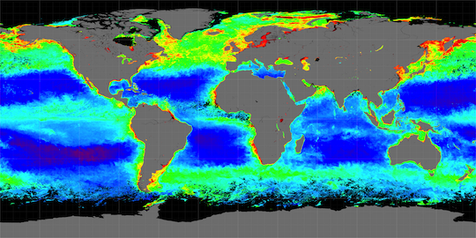
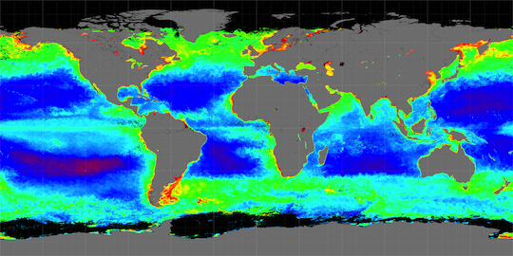
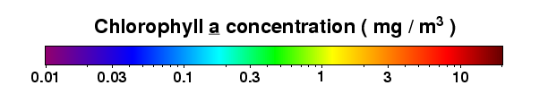
Chl_{a} for Spring and Fall 2012
MODISA Spring
MODISA Fall
VIIRS Spring
VIIRS Fall

Slide 8
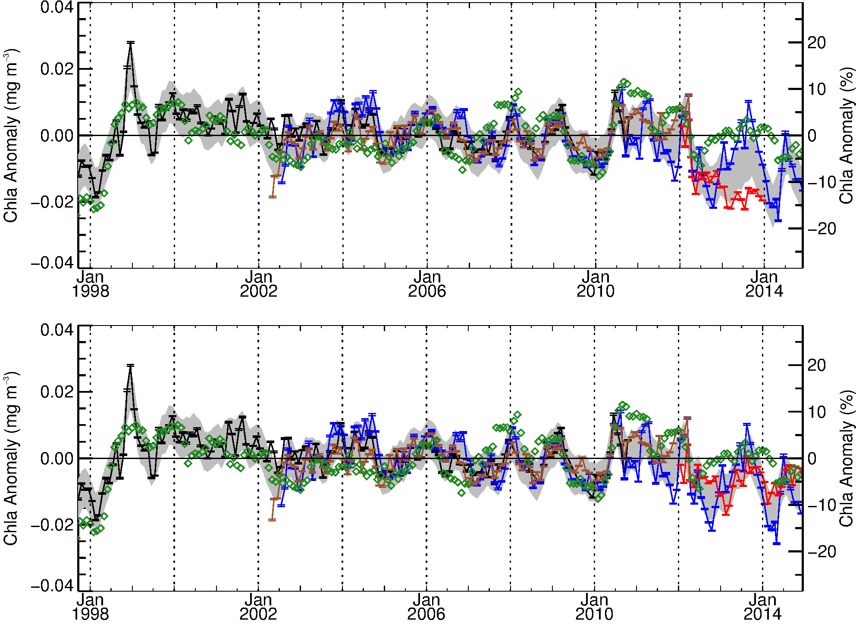
Global Mid-Latitude (+/- 40°) Chlorophyll Anomaly showing suspect trend in VIIRS R2013.1
Multivariate Enso Index (MEI)
SeaWiFS
MERIS
MODISA
NASA VIIRS
before latest reprocessing
VIIRS
trend issue
VIIRS
trend issue
Following Franz, B.A., D.A. Siegel, M.J. Behrenfeld, P.J. Werdell (2014). Global ocean phytoplankton [in State of the Climate in 2013]. Bulletin of the American Meteorological Society, 95(7), S78-S80.

Slide 9
VIIRS R2014.0 calibration
Significantly improved instrument calibration developed for ocean color through re-analysis of VIIRS prelaunch and on-orbit calibration.
Based on solar calibration, corrected with lunar calibration.
Incorporating advancements in solar and lunar calibrator knowledge (solar diffuser stability, solar unit vector fix, lunar libration corrections, etc.).
implemented as a continuous calibration model that allows for extrapolation into the future (improved NRT calibration quality).
Including corrections for relative detector and mirror-side calibration to reduce image striping artifacts.
Robert E. Eplee, Kevin R. Turpie, Gerhard Meister, Frederick S. Patt, Bryan A. Franz, and Sean W. Bailey, "On-orbit calibration of the Suomi National Polar-Orbiting Partnership Visible Infrared Imaging Radiometer Suite for ocean color applications," Appl. Opt. 54, 1984-2006 (2015)
Notes:
lunar-based
exponential model allows forward-stream extrapolation
relatively accurate NRT retrievals
destriping

Slide 10
VIIRS Reduced Image Striping
Version R2013.1
Version R2014.0
Revised instrument calibration includes detector relative calibration to reduce image striping artifacts.
Notes:
improved front detection

Slide 11
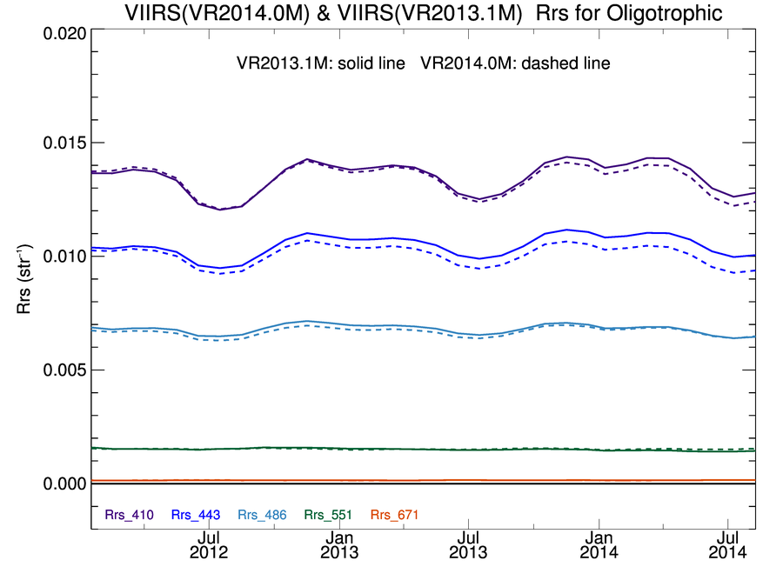
VIIRS Clear-Water Rrs(λ) Time-Series Comparison
Before & After R2014.0 Reprocessing
before
412
443
486
after
551

Slide 12
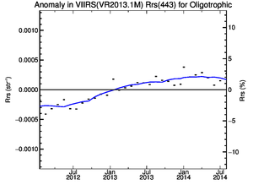
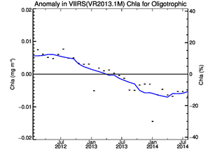
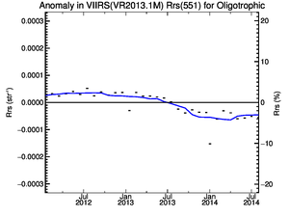
VIIRS Clear-Water Rrs Anomaly Trends
Before Reprocessing
R2013.1
Rrs(443)
Chlorophyll
Rrs(551)

Slide 13
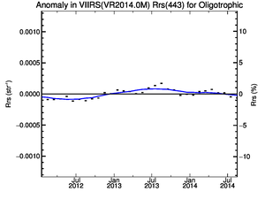
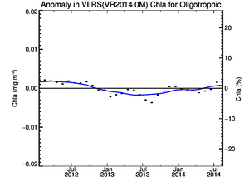
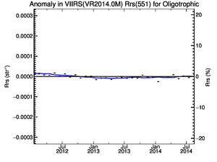
VIIRS Clear-Water Rrs Anomaly Trends
After Reprocessing
R2014.0
Rrs(443)
Chlorophyll
Rrs(551)

Slide 14
Global Mid-Latitude (+/- 40°) Chlorophyll Anomaly showing improved agreement of VIIRS with MODISA, MEI, and historical norms after R2014.0 reprocessing
VIIRS R2013.1
Multivariate Enso Index (MEI)
VIIRS R2013.1
SeaWiFS
MERIS
MODISA
NASA VIIRS
calibration issue
resolved
VIIRS R2014.0
Multivariate Enso Index (MEI)
VIIRS R2014.0
SeaWiFS
MERIS
MODISA
NASA VIIRS
Following Franz, B.A., D.A. Siegel, M.J. Behrenfeld, P.J. Werdell (2015). Global ocean phytoplankton [in State of the Climate in 2014]. Bulletin of the American Meteorological Society, submitted.

Slide 15
MODISA Calibration Issues
Collection 6 calibration and subsequent updates are being applied, but standard calibration may not be sufficient to fully characterize late-mission temporal calibration changes to level required for ocean color.
MODIS/Aqua Rrs showing increased temporal variability in blue (412, 443) water-leaving reflectance trends after 2011. Is it real?

Slide 16
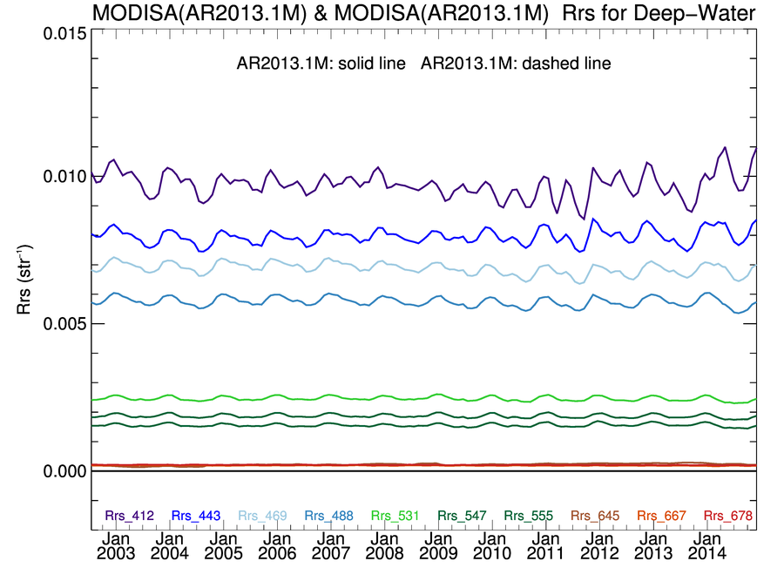
MODISA Rrs(λ) Deep-Water Time-Series
Processing Version R2013.1
increasing variability
412
443

Slide 17
MODIS Calibration Issues
Collection 6 calibration and subsequent updates are being applied, but standard calibration may not be sufficient to fully characterize late-mission temporal calibration changes to level required for ocean color.
MODIS/Aqua Rrs showing increased temporal variability in blue (412, 443) water-leaving reflectance trends after 2011. Is it real?
In 2014, all radiometry shifted (up in blue, down in green), with commensurate decline of 10% in clear-water chlorophyll.

Slide 18
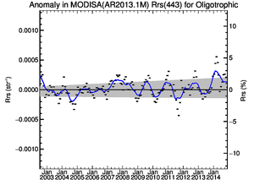
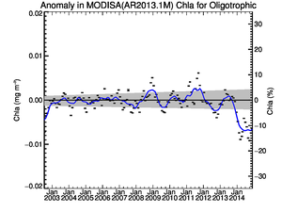
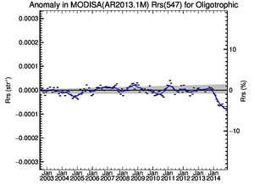
MODISA Clear-Water Rrs Anomaly Trends
Current Operational
R2013.1
Rrs(443)
Chlorophyll
Rrs(547)
2014 anomaly
“calibration issue”

Slide 19
MODIS Calibration Issues
Collection 6 calibration and subsequent updates are being applied, but standard calibration may not be sufficient to fully characterize late-mission temporal calibration changes to level required for ocean color.
MODIS/Aqua Rrs showing increased temporal variability in blue (412, 443) water-leaving reflectance trends after 2011. Is it real?
In 2014, all radiometry shifted (up in blue, down in green), with commensurate decline of 10% in clear-water chlorophyll.
Our team and MCST have been working to resolve these issues in preparation for MODISA reprocessing 2014.0, with some success.

Slide 20
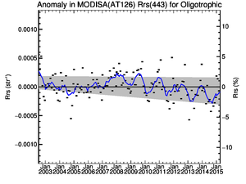
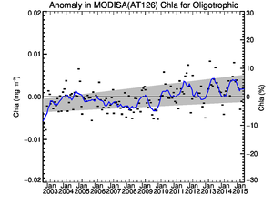
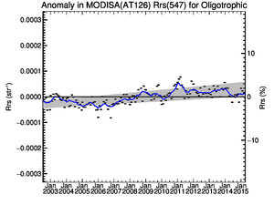
MODISA Clear-Water Rrs Anomaly Trends
Reprocessing Test Results
MCST LUT V6.1.33.8_OC2
+ OBPG cross-scan corrections
Rrs(443)
Chlorophyll
Rrs(547)
2014 anomaly
“resolved”
Notes:
more variability in early mission

Slide 21
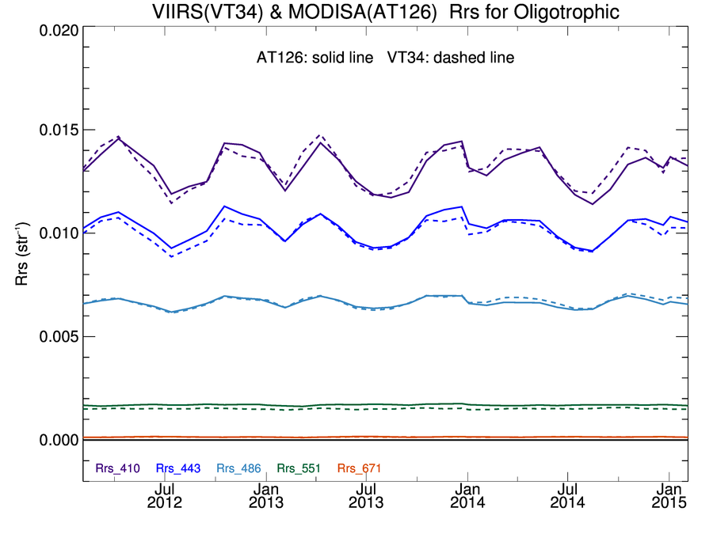
MODISA & VIIRS Rrs(λ) Clear-Water Time-Series showing “good” agreement
MODISA Processing Test Results
412
443
486-488
547-551

Slide 22
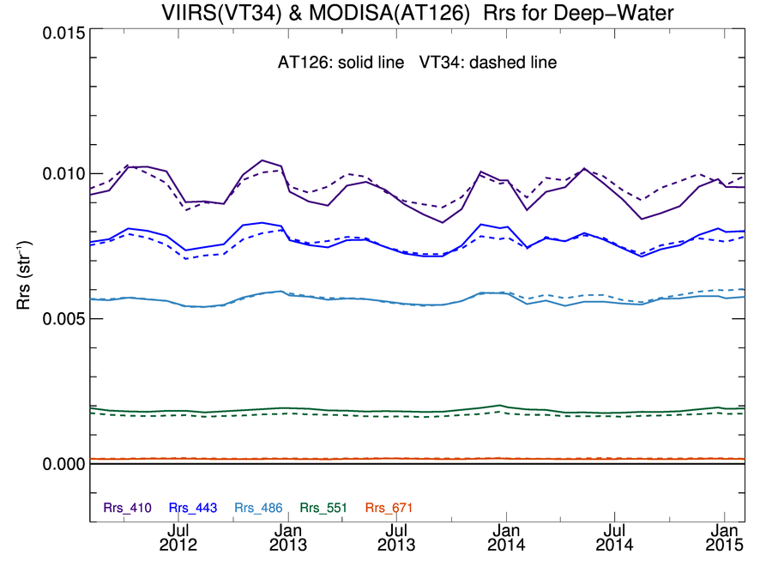
MODISA & VIIRS Rrs(λ) Deep-Water Time-Series showing “good” agreement
MODISA Processing Test Results
412
443
486-488
MODIS
VIIRS
Ratio
547-551

Slide 23
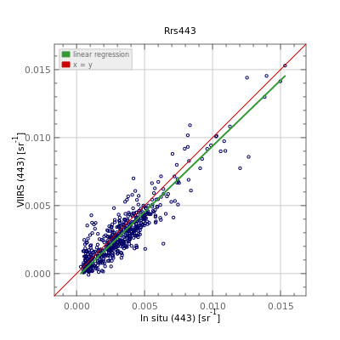
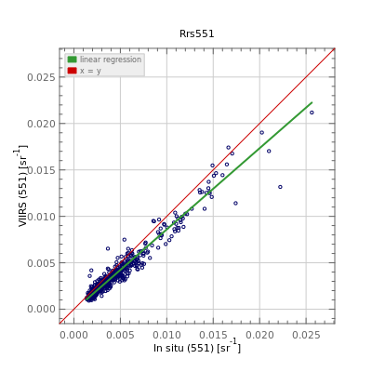
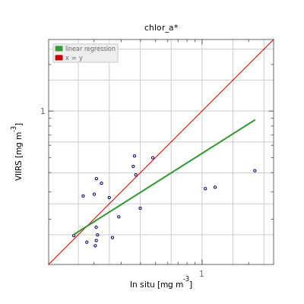
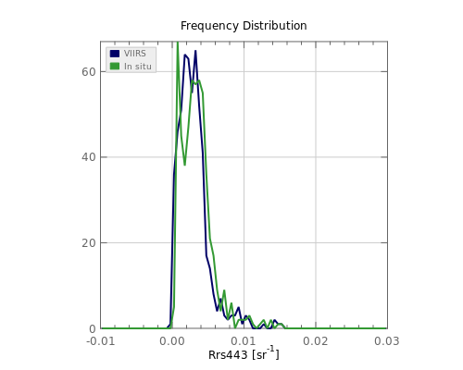
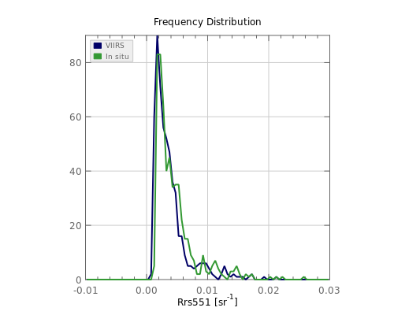
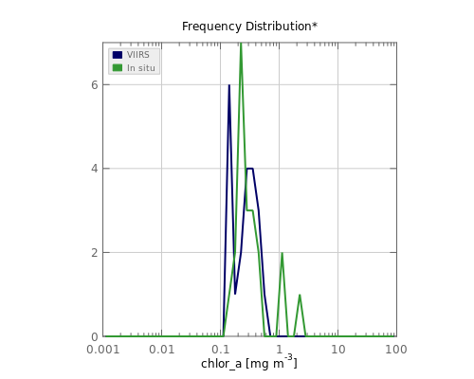
VIIRS R2014.0 In Situ Validation
Rrs(443)
Rrs(547)
Chl_{a}

Slide 24
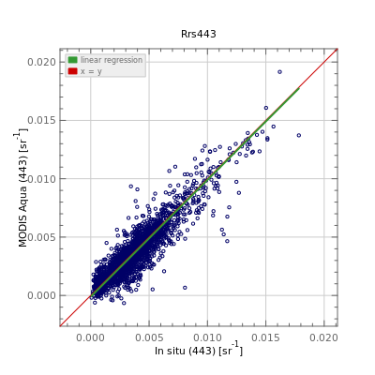
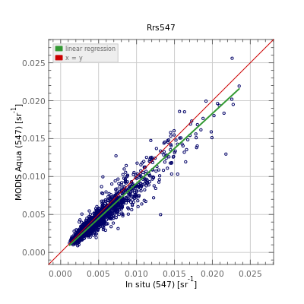
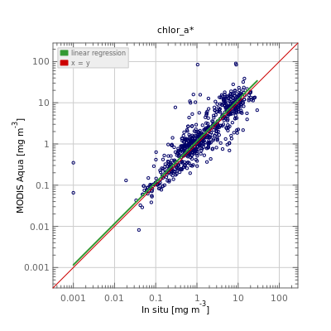
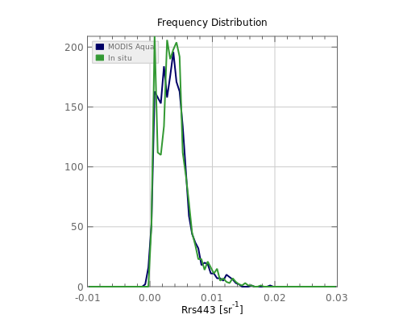
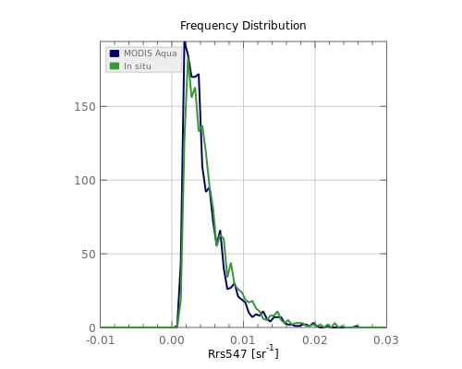
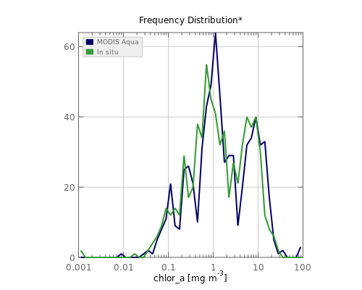
MODISA R2013.1 In Situ Validation
Rrs(443)
Rrs(547)
Chl_{a}

Slide 25
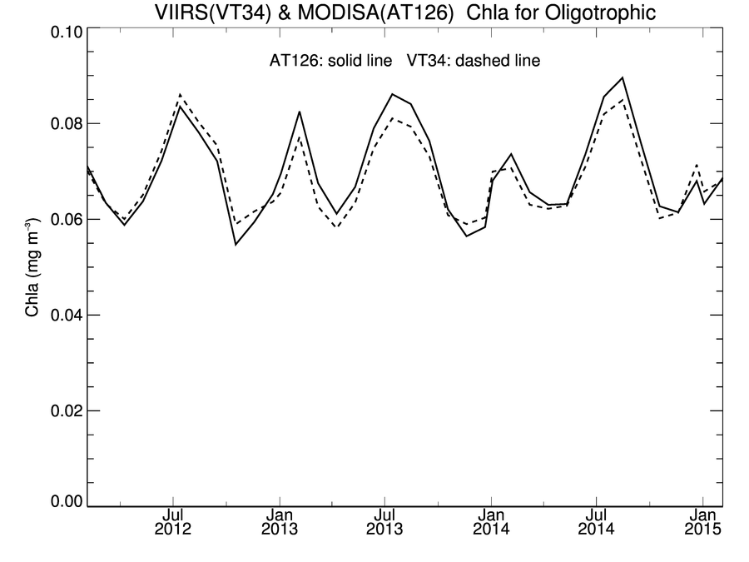
MODISA showing agreement with R2014.0 VIIRS
Chlorophyll (OCI) Deep-Water Time-Series
MODISA & VIIRS R2014.0 Test Results
4-day means (not monthly)
VIIRS
 | Mean | Stdv
MODISA | 0.069 | 0.009 | mg m⁻³
VIIRS | 0.068 | 0.008 | mg m⁻³
VIIRS/MODISA | 0.99 | 0.04
MODISA

Slide 26
Summary
MODIS continuity algorithm for the retrieval of Rrs and Chlorophyll (and other derived products) has been implemented for VIIRS.
VIIRS Rrs temporal stability is much improved following extensive recalibration effort, and range of variability is now consistent with historical norms following VIIRS Reprocessing 2014.0.
MODIS-Aqua temporal variability has increased in the blue since 2011, with a large departure in all bands in 2014. Efforts have been made to address these issues with some success.
MODIS-Aqua and VIIRS Rrs and derived Chlorophyll are comparable in magnitude and spatial distribution, show a similar level of agreement with in situ validation, and show good temporal consistency (based on latest test results).
MODISA Reprocessing 2014.0 in progress!

Slide 27
Summary
MODIS-Terra calibration updates and reprocessing will be addressed once MODIS-Aqua reprocessing is complete.

Slide 28
back-up

Slide 29
determining aerosol contribution
assume L_{w}(λ) = 0 at two NIR (or SWIR) bands, or that it can be estimated with sufficient accuracy.
retrieve aerosol reflectance in each NIR band as
use spectral dependence of retrieved NIR aerosol reflectance (ε) to select the most appropriate aerosol model from a suite of pre-computed models
use NIR aerosol reflectance and selected aerosol model to extrapolate aerosol reflectance to visible wavelengths
known

Slide 30
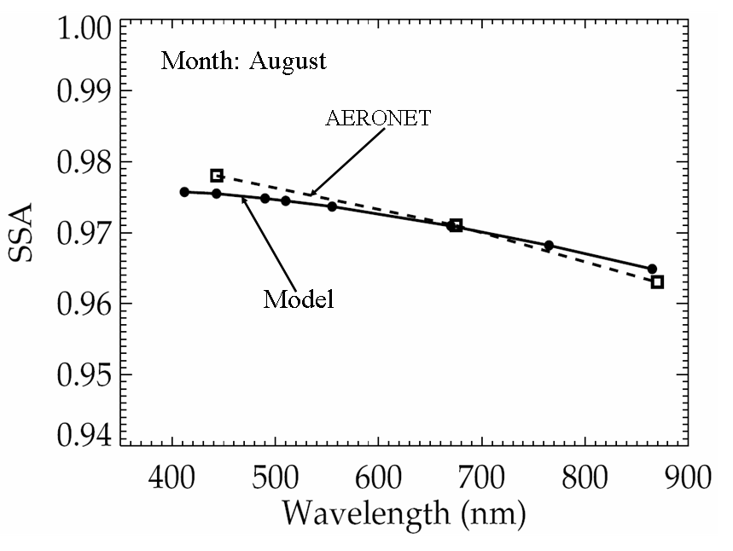
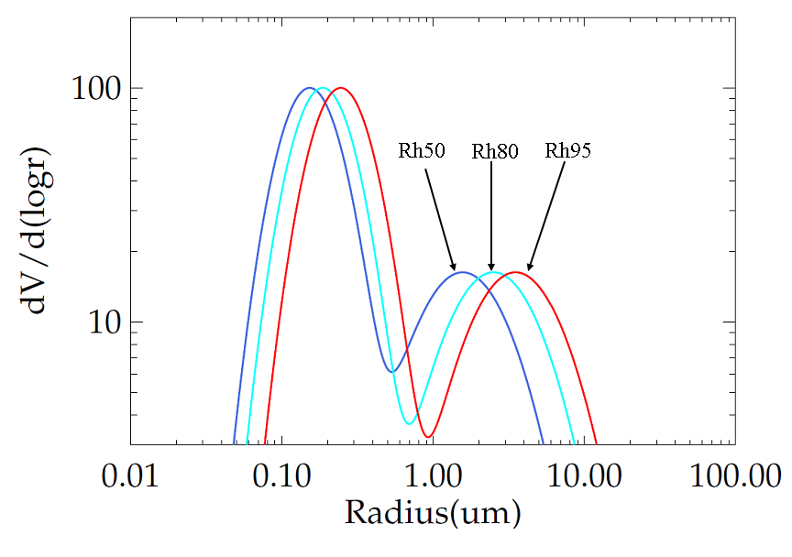
aerosol model tables
Fine Mode Albedo
vector RT code (Ahmad-Fraser)
based on AERONET size distributions & albedos
80 models (10 size fractions within 8 humidities)
  100% coarse mode to 95% fine mode
  non- or weakly absorbing
LUT: extinction, albedo, phase function, ss->ms, t_{d}
  function of path geometry (or scattering angle)
model selection discriminated by relative humidity
Typical Size Distributions
Mean AERONET Fine & Coarse Modal Radii
Rh r_{vf} σ_{f} r_{vc} σ_{c} r_{vf}/r_{ovf} r_{vc}/r_{ovc}
0.30 0.150 0.437 2.441 0.672 1.006 1.009
0.50 0.152 0.437 2.477 0.672 1.019 1.024
0.70 0.158 0.437 2.927 0.672 1.063 1.210
0.75 0.167 0.437 3.481 0.672 1.118 1.439
0.80 0.187 0.437 3.966 0.672 1.255 1.639
0.85 0.204 0.437 4.243 0.672 1.371 1.753
0.90 0.221 0.437 4.638 0.672 1.486 1.917
0.95 0.246 0.437 5.549 0.672 1.648 2.293
Ahmad et al. 2010, Appl. Opt.

Slide 31
aerosol model selection & application
select the two sets of 10 models (10 size fractions) with relative humidity (RH) that
bound the RH of the observation.
find the two models that bound the observed epsilon within each RH model family.
*
model epsilon
use model epsilon to extrapolate to visible.
compute weighted average, , between
models within each RH family, and then again between bounding RH solutions.
*actually done in single scattering space and transformed to multi-scattering

Slide 32
we estimate L_{w}(NIR) using a bio-optical model
guess
L_{w}(670) = 0
  1) convert L_{w}(670) to b_{b}/(a+b_{b})
  via Morel f/Q and retrieved Chl_{a}
  2) estimate a(670) = a_{w}(670) + a_{pg}(670)
  via NOMAD empirical relationship
  3) estimate b_{bp}(NIR) = b_{bp}(670) (λ/670)^{η}
  via Lee et al. 2002
  4) assume a(NIR) = a_{w}(NIR)
  5) estimate L_{w}(NIR) from b_{b}/(a+b_{b})
  via Morel f/Q and retrieved Chl_{a}
model
L_{w}(NIR) = func L_{w}(670)
correct
L'_{a}(NIR) = L_{a}(NIR) – t L_{w}(NIR)
retrieve
L^{i}_{w}(670)
test
|L_{w}^{i+1} (670) - L^{i}_{w}(670)|
< 2%
no
done
Bailey et al., Optics Express, 2010

Slide 33
brdf correction
to account for shape of sub-surface light-field due to position of the
Sun and optical properties of the water column.
based on pre-computed look-up tables from hydrolight simulations of
Morel et al. 2002, Appl. Opt.
given radiant path geometry (θ₀,θ,Δϕ), windspeed (w) and Chl
Chl = f (R’_{rs}(λ))
f_{b}(λ,θ₀,θ,Δϕ,Chl,w) = (R₀ f₀/Q₀) / (R f/Q)
f/Q relates subsurface irradiance reflectance to radiance reflectance
R includes all reflection/refraction effects of the air-sea interface
θ₀=0, θ=0,Δϕ=0
iteration
R_{rs}(λ) = R’_{rs}(λ) f_{b}(λ,θ₀,θ,Δϕ,Chl,w)
Chl = f (R_{rs}(λ))
Notes:
may not want to apply brdf for IOP retrieval

Slide 34
adaptation to VIIRS
standard MODIS atmospheric correction software was modified (previous S-NPP science team) to also process VIIRS
starts from VIIRS pseudo Level-1A (SDR with no temporal calibration), and applies instrument calibration in Level-1A to Level-2
  pseudo Level-1A to be replaced by NASA Level-1A (when operational)
  instrument calibration developed by OBPG (Eplee et al. 2015)
algorithm modifications limited to adjustment for sensor-specific spectral band centers and relative spectral responses
same Ahmad-Fraser vector radiative transfer code used to derive MODIS & VIIRS-specific Rayleigh and aerosol model tables
bands used for aerosol determination
  MODIS: 748 & 869 nm
  VIIRS: 745 & 862 nm

