Slide 1
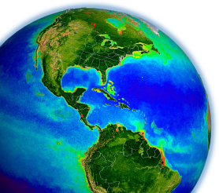
MODIS & VIIRS
Ocean Science Team Break-out
Report
MODIS Science Team Meeting
19-22 May 2015, Silver Spring, MD

Slide 2
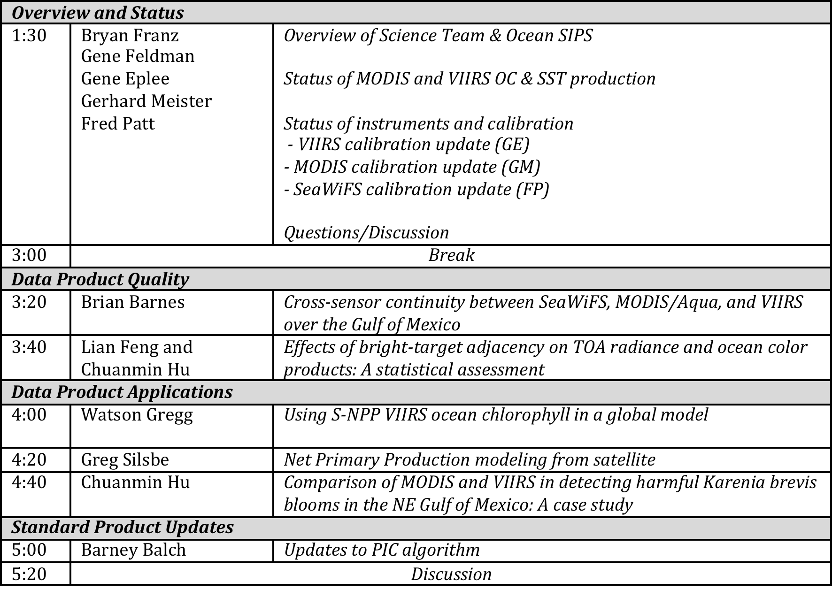
Ocean Break-out Agenda
May 20

Slide 3
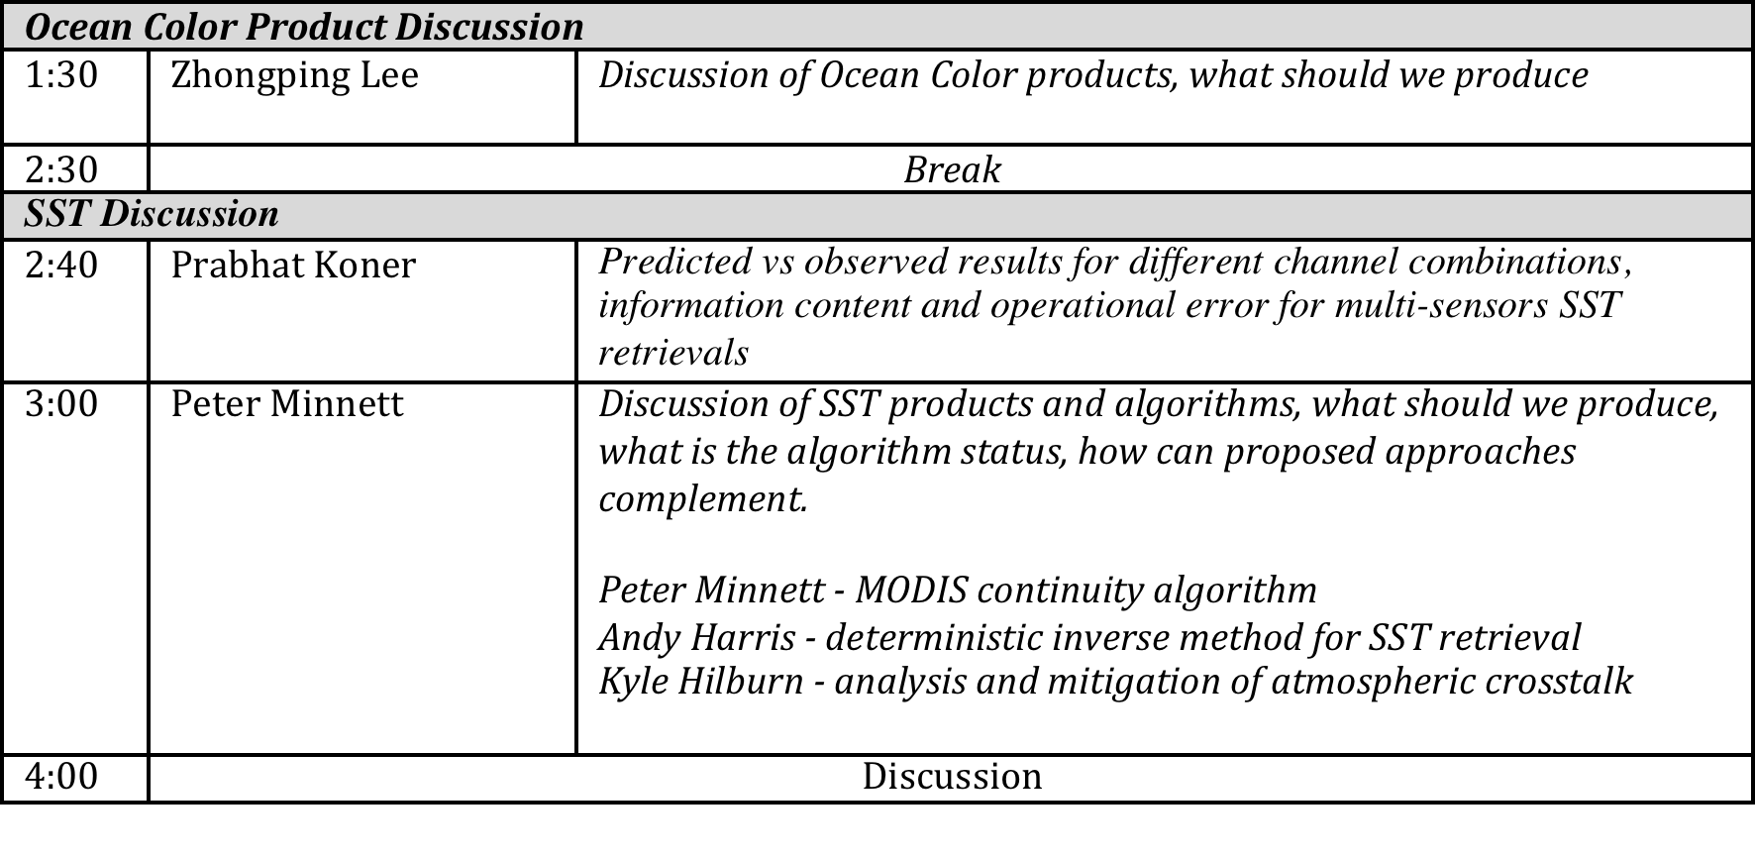
Ocean Break-out Agenda
May 21

Slide 4
MODIS & VIIRS Ocean Processing Status

Slide 5
2014.0 Multi-Mission Ocean Reprocessing
Scope
OC from CZCS, OCTS, SeaWiFS, MERIS, MODIS(A/T), and VIIRS
SST from MODIS
Motivation
improve interoperability and sustainability of the product suite by adopting modern data formats, standards, and conventions
incorporate algorithm updates and advances from community and last MODIS Science Team developed since 2010 (last alg. update).
incorporate knowledge gained in instrument-specific radiometric calibration and updates to vicarious calibration
Status
OC from OCTS & VIIRS done, MODISA in progress
SST from MODISA and MODIST done (not yet released)
Notes:
tied to MODIS science team, new algorithm development
7 instruments

Slide 6
Product Development and Documentation

Slide 7
Standard, Evaluation, and Test Products
a standard product is one that the SIPS is committed to maintain, and the DAAC is committed to archive and distribute, at the ultimate discretion of Program Management
an evaluation product is one that the SIPS/DAAC may produce and distribute, if resources allow, to support community assessment of a new product or alternative product algorithm
a test product is one that the SIPS may produce to support the algorithm PI in implementation verification and product testing
in practice, OC standard products are made at Level-2 and Level-3, while
eval products are made only at Level-3 (usually from Level-3 Rrs dailies).

Slide 8
OC Implementation
NASA Standard Processing Code
ancillary data
sensor-specific tables:
Rayleigh, aerosol, etc.
SeaWiFS L1A
MODISA L1B
MODIST L1B
OCTS L1A
MOS L1B
OSMI L1A
CZCS L1A
MERIS L1B
OCM-1 L1B
OCM-2 L1B
VIIRS L1A
GOCI L1B
OLI L1T
observed
radiances
L2GEN
Level-1 to Level-2
(common algorithms)
Δ
in situ water-leaving
radiances (MOBY)
water-leaving
reflectances &
derived prods
predicted
at-sensor
radiances
Level-2 Scene
vicarious calibration
gain factors
Level-3 Global
Product
Level-2 to Level-3
Notes:
we do not typically run independent code, we integrate algorithms into a standard code

Slide 9
SST Implementation
NASA Standard Processing Code
ancillary data
sensor-specific tables:
radiance/temperature
MODISA L1B
MODIST L1B
VIIRS L1A
observed
radiances
L2GEN
Level-1 to Level-2
(common algorithms)
Δ
brightness temps &
derived SST prods
Level-2 Scene
Level-3 Global
Product
Level-2 to Level-3
Notes:
we do not typically run independent code, we integrate algorithms into a standard code

Slide 10
Product Documentation
MODIS has historically required that every standard product have associated with it an Algorithm Theoretical Basis Document (ATBD)
The original MODIS ATBDs are extremely out of date and in many cases they are not relevant to current standard products
This is largely due to the fact that the MODIS processing was awarded to the NASA OBPG in 2004 with the mandate to adopt the SeaWiFS heritage processing, as documented in SeaWiFS TMs
It is also the case that the ocean algorithms are predominantly sensor-independent, evolved from broad community contributions
To satisfy NASA Program Management and better serve the research community, we need to establish a new set of product documentation for the current standard product suite of MODIS & VIIRS, and maintain that level of documentation going forward
To that end, Ocean SIPS is developing a set of online documents that can be easily updated and will include dynamic links to ensure that implementation and validation information remains current

Slide 11
Product and Algorithm Description Document standardized elements
Product Summary
  defines what it is and what it’s for
Algorithm Description
  as detailed as necessary to ensure full traceability to algorithm basis and heritage (e.g., links to published literature)
  if applicable to multiple sensors, include any sensor-specific modifications required (e.g., adjustments for band passes)
  algorithm failure conditions and associated product flags
Implementation
  how is the product distributed (product suite, file-types, encoding)
  direct links to source code and/or software flow charts

Slide 12
Product and Algorithm Description Document
standardized elements
Assessment
  validation analyses (e.g., direct link to dynamic match-ups)
  uncertainties
References
  links to previous ATBD(s) or TM(s), if relevant
  links to published literature (DOIs)
Product History
  document version (date)
  product change log

Slide 13
Product and Algorithm Description Documents

Slide 14
Algorithm Description

Slide 15
Implementation Details

Slide 16
Assessment

Slide 17
Product Lifecycle from concept to standard product
PI develops new algorithm or modification, demonstrates feasibility, perhaps publishes results.
If PI and Ocean Team Leader agree, PI works with SIPS to implement in NASA processing code and to develop a test plan for verification and large-scale testing.
If PI is satisfied with implementation tests, and SIPS confirms that required computing resources are available, evaluation products and documentation will be produced and distributed, and the algorithm will be incorporated into SeaDAS.
  PI works with SIPS to develop or update the Product Description Document (to be hosted under “evaluation products”).
  SIPS/DAAC begins production and distribution of product
  PI performs assessment of results (validation, global dist., trends)
Before the next mission reprocessing opportunity, PI/SIPS/DAAC and Program Management review the performance evaluation, documentation, and appropriateness for standard production.

Slide 18
Ocean Color Products Discussion

Slide 19
R2014.0 Changes to OC Standard Product Suite
Level-2 OC Product
Algorithm Changes
R_{rs}(λ)
Ångstrom
AOT
Chlorophyll a
K_{d}(490)
POC
PIC
CDOM_index
PAR
iPAR
nFLH
calibration updates, ancillary data updates, improved land/water masking, terrain height, other minor fixes
λ = 412, 443, 469, 488, 531, 547, 555, 645, 667, 678
new algorithm (Hu et al. 2012)
coefficient update
no change
updated algorithm and LUT
remove product (redundant with new IOP suite)
consolidated algorithm, minor fixes
MODIS-only, no change
MODIS-only, flagging changes (allow negatives)
12. IOPs
added suite of inherent optical property products (Werdell et al. 2013)

Slide 20
R2014.0 VIIRS OC Standard Product Suite
Level-2 OC Product
Algorithm Reference
R_{rs}(λ)
Ångstrom
AOT
Chlorophyll a
K_{d}(490)
POC
PIC
PAR
Spectral water-leaving reflectance and derived aerosol optical properties
λ = 410, 443, 486, 551, 671
Phytoplankton chlorophyll concentration
Marine diffuse attenuation at 490nm
Particulate organic carbon concentration
Particulate inorganic carbon concentration
Daily mean photosynthetically available radiation
12. IOPs
Suite of inherent optical property products (Werdell et al. 2013)

Slide 21
Expanded Product Suite - IOPs
proposed IOP product suite
a(λ) total absorption at all visible wavelengths
b_{b}(λ) total backscatter at all visible wavelengths
a_{ph}(λ) phytoplankton absorption at all vis. wavelengths
a_{dg}(443) absorption due to colored-detritus at 443nm
S_{dg} exponential spectral slope for a_{dg}
b_{bp}(443) particle backscattering at 443nm
S_{bp} power-law spectral slope for b_{bp}
uncertainties uncertainties in a_{dg}, a_{ph}, b_{bp} at 443nm
rationale
provides total a and b_{b} for input to IOP-based derived product algorithms (e.g., Lee et al. spectral K_{d}, euphotic depth)
provides sufficient information to compute full spectral component absorption and scattering coefficients and uncertainties
VIIRS λ = 410, 443, 486, 551, 671
MODIS λ = 412, 443, 469, 488, 531, 547, 555, 645, 667, 678

Slide 22
Current Evaluation Products
Products | Algorithm
Chl, a_{dg}(443), b_{bp}(443) | Maritorena (GSM)
IOPs (a(443), a_{ph}(443), a_{dg}(443), b_{bp}(443)) | Lee (QAA)
K_{d}(412),K_{d}(443),K_{d}(490) | Lee
Zeu | Lee
Zeu | Morel
K_{PAR} | Morel
Produced at Level-3 only (from daily binned Rrs)

Slide 23
Stop producing K_{d}(PAR)
K_{d}(PAR) [m⁻¹]
K_{d}(USR) [m⁻¹]
PAR_{d}(z)/PAR(0⁻)
USR_{d}(z)/USR(0⁻)
(Lee et al 2013)
PAR: 400-700 nm
USR: 400-560 nm

Slide 24
SST Coordination Discussion

Slide 25
SST Discussion
Three SST PIs selected for VIIRS:
Andy Harris : A Deterministic Inverse Method for SST Retrieval from VIIRS
Frank Wentz: Analysis and Mitigation of Atmospheric Crosstalk (using AMSR-2 microwave measurements)
Peter Minnett: Sea-Surface Temperature from VIIRS-Extending the MODIS Time Series For Climate Data Records.
All are directed to deriving accurate SST from VIIRS; three very different approaches to achieve the same goal.
Good progress has been made by all groups in the first months of the projects.

Slide 26
Next steps
All projects require independent in situ measurements to validate the different approaches to correct for the effects of the intervening atmosphere.
Subsurface measurements provided by drifting and moored buoys provide the most numerous validating measurements.
A provisional set of matchups between VIIRS brightness temperatures (from NOAA CLASS) has been developed at RSMAS.
  This will be shared with the other groups.
Ocean SIPS plans to generate NASA VIIRS BT’s; and a more comprehensive match-up data base will be generated.
Additional variables in the new match-up data base will be included to enhance its utility.
  SST groups will coordinate with Ocean SIPS for contents of new database
  The breakout session was a very useful way of each group sharing ideas and reporting progress. A dialogue with the Ocean SIPS has begun

Slide 27
Questions?

