Slide 1
Snow Cover and Sea Ice: Extending MODIS to VIIRS
Dorothy K. Hall¹, George A. Riggs^{2,1}, Mark Tschudi³, Miguel O. Román⁴ and Jeffrey R. Key⁵
¹Cryospheric Sciences Laboratory, NASA / GSFC, Greenbelt, Md.,
²SSAI, Lanham, Md.,
³University of Colorado, Boulder, Colo.,
⁴Terrestrial Information Systems Laboratory, NASA / GSFC, Greenbelt, Md.,
⁵NOAA Center for Satellite Applications and Research, Madison, Wisc.
MODIS – VIIRS Team Meeting Silver Spring, Md. 20 May 2015

Slide 2
Outline
MODIS Collection-6 (C6) snow products*
VIIRS snow and sea ice products
SIPS test runs
Some preliminary validation results
Conclusions and future work
*There were no substantial changes to the MODIS sea ice IST algorithm for C6
Notes:
Ways to improve snow detection and to provide logic to decreasethe uncertainty in mapping snow.

Slide 3
MODIS Snow Cover
Notes:
These will be produced after the standard C6 snow and ice products have been tested and evaluated.

Slide 4
Primary MODIS Snow-Cover Collection-6 (C6) Revisions
Drop binary snow-cover product; detect snow using the Normalized Difference Snow Index (NDSI); drop fractional snow cover (FSC) terminology
Develop screens to alleviate snow commission errors. (A non-snow feature with NDSI > 0.0 will cause a snow commission error.)
Output will be:
An NDSI snow cover extent map
It will be thematic, including cloud mask, ocean mask, etc.
A general QA value for each pixel
QA bit flags for screens applied in the algorithm
Notes:
Ways to improve snow detection and to provide logic to decrease the uncertainty in mapping snow. Snow cover has NDSI values in range of 0.0 < NDSI ≤ 1.0.
However a pixel with 0.0 < NDSI ≤ 1.0 is not always snow.

Slide 5
MODIS Snow-Cover Screens to Reduce Snow Commission Errors in C6
Develop screens based on reflectance characteristics to prevent false snow detections on non-snow features
Re-evaluate use of the surface temperature screen which is very effective at alleviating snow commission errors on warm features, but has the drawback that it can reverse snow detection of mountain snow cover in spring and summer
Probably apply surface temperature screen at elevations lower than 1300 m
Screens are needed for:
Low illumination and/or reflectance situations, e.g. cloud-shadowed landscape
Some bright surface mineral features
Cloud/snow discrimination; will use the MOD35_L2 cloud mask
Notes:
Ways to improve snow detection and to provide logic to decrease the uncertainty in mapping snow.

Slide 6
Screens developed to prevent snow commission errors based reflectance characteristics - India and Himalayas
MODO2HKM 2003003.0440
MOD10_L2 FSC
Top - image has snow commission errors (blue) in snow free region. Only the low visible reflectance screen is applied and results in no decision, the orange pixels.
Spectral screens applied prevent snow commission errors in above situations and have minimal effect on snow cover detection in the Himalayas (below).
Top - regions of low reflectance;
Bottom - snow covered Himalayas
Screens are set as bit flags in the QA to track which screen(s) were applied. Shades of gray indicate which flag(s) were set to on.
Notes:
Flags set on for a pixel shown in shades of gray, black if no flags set on.

Slide 7
MODIS Snow-Cover C6 Revisions, cont’d.
Use more information from the MOD35_L2 cloud mask:
Reduce cloud mask detection of snow as ‘certain cloud’ in some situations by examining MOD35 processing path and cloud spectral tests results, to reduce snow/cloud confusion
Notes:
Ways to improve snow detection and to provide logic to decrease the uncertainty in mapping snow.
Interpret cloud confidence of ‘certain’ and ‘probably cloudy’ as ‘cloud’ for snow-cover detection to reduce snow commission errors

Slide 8
MODIS Snow Products used in SnowPEX
Satellite Snow Products intercomparison and evaluation Exercise (SnowPEX) consists of an international team that will evaluate and compare current global / hemispheric snow-cover products to quantify uncertainty of long-term trends in snow-cover extent (SCE) and snow-water equivalent (SWE)
ESA initiated SnowPEX, a high priority for the Global Cryosphere Watch (GCW)
The MODIS snow project has so far contributed five years of MOD10A1 SCE products in the format required by SnowPEX
Snow map validation for SnowPEX will be accomplished using Landsat and other high-resolution imagery
The standard MODIS snow-cover product, MOD10A1, is one of the key products of interest to SnowPEX

Slide 9
MODIS Collection-6 (C6) status
Implemented the Quantitative Image Retrieval (QIR) algorithm* for Aqua MODIS band 6 (1.6 µm). Terra and Aqua will use same snow algorithm in C6. MODAPS has implemented the QIR algorithm for testing and production. This should greatly improve the MODIS Aqua snow-cover product.
Increased accuracy of the UMD land/water mask has improved the accuracy of the snow products
When evaluation of the C6 algorithm has been completed, MODAPS will make the product in Tier 2 processing
*Developed by Irina Gladkova et al. - QIR url: csdirs.ccny.cuny.edu/csdirs/projects/multi-band-statistical-restoration-aqua
Notes:
Unacceptable occurrence of snow commission errors on non-snow features was found in C6 MODAPS land chain tests run without application of the surface temperature screen in the algorithm. This prompted re-evaluation of the use of the surface temperatures screen

Slide 10
New C6 snow products
The following new products will be requested for Tier 2 C6 processing:
Daily cloud-gap-filled (CGF) snow maps at 500-m and 5-km resolution, and
Daily snow-cover map (MOD10A1S), using surface reflectance input (MOD09GA)
These products have no downstream product dependencies.
Notes:
These will be produced after the standard C6 snow and ice products have been tested and evaluated.

Slide 11
VIIRS Snow Cover, Sea Ice Ice-Surface Temperature (IST) and Sea Ice Extent
Notes:
These will be produced after the standard C6 snow and ice products have been tested and evaluated.

Slide 12
Snow Cover – NASA VIIRSNP10_L2
The NASA VIIRS NP10_L2 snow map has been made for a one day global test run
SIPS* has collaborated with the VIIRS Snow Team to adapt the MODIS snow cover MOD10_L2 algorithm (C5) to create the NASA VIIRS snow cover algorithm and data product VIIRSNP10_L2, and evaluate test runs
Draft of ATBD has been completed
* Science Investigator-led Processing System
Notes:
These will be produced after the standard C6 snow and ice products have been tested and evaluated.

Slide 13
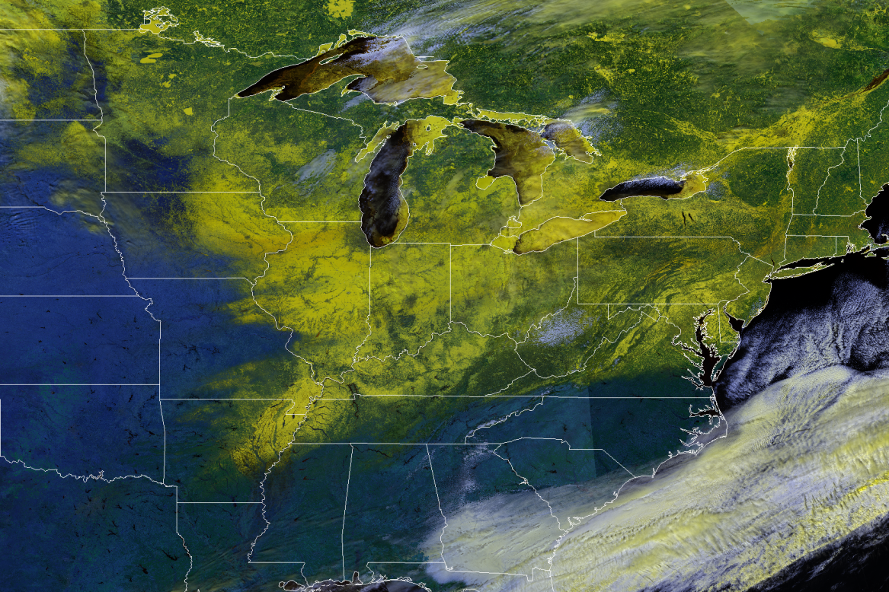
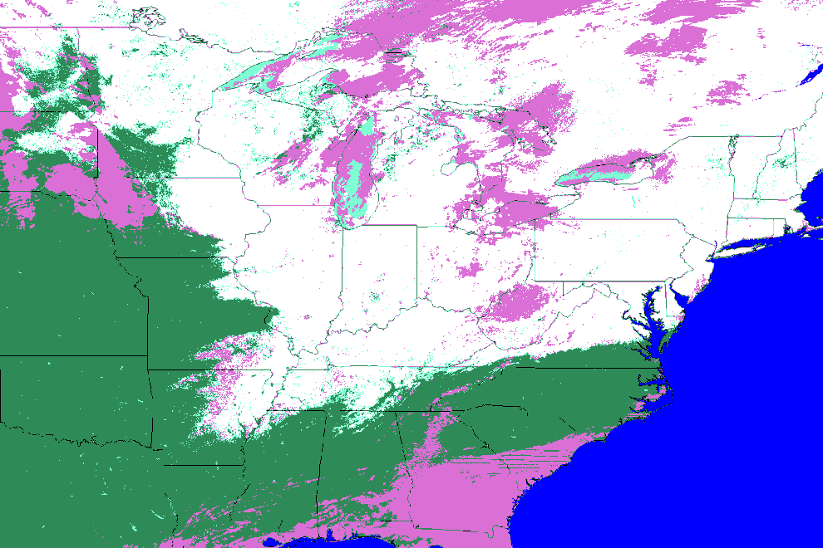
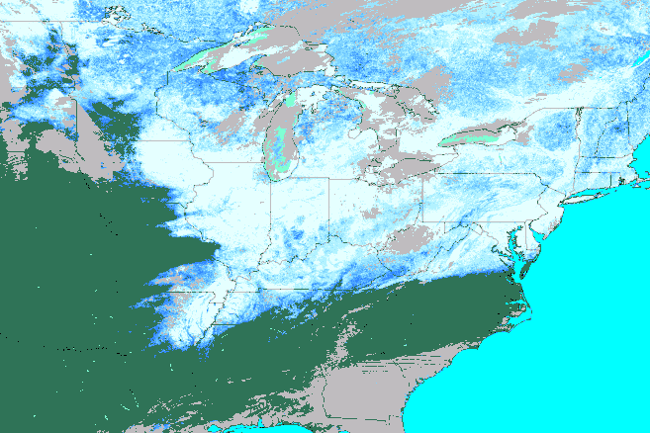
VIIRS false color image and snow-cover maps of the Eastern United States
6 March 2015
NDSI>0.4
NPP_VSCM NPP_VSCM_L2_2015065_thematic_SCA_500m_subset_mosaic
VIIRS map of fractional snow cover derived from the C5 MODIS FSC algorithm

Slide 14
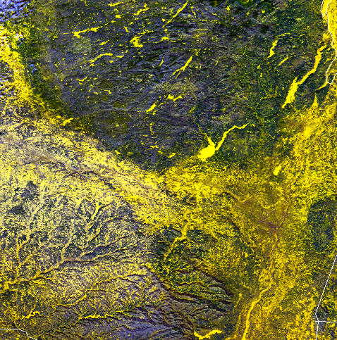
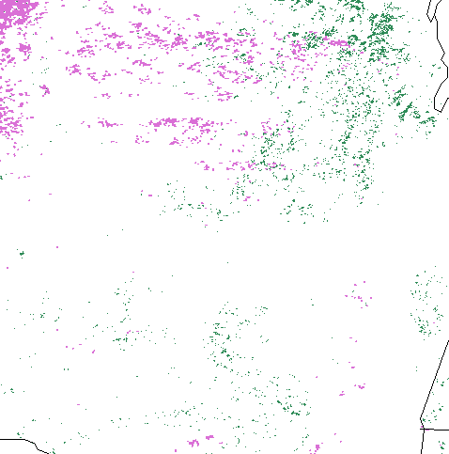
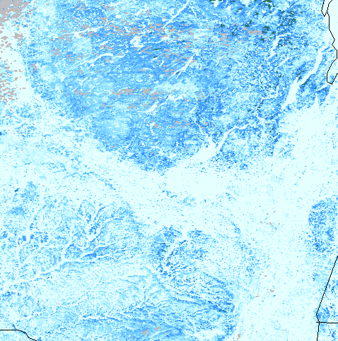
Snow cover extent is mapped more accurately with the NDSI-based FSC vs the binary snow covered area (SCA)
Point we must emphasize is that in MODIS C6 and in VIIRS the observable amount of snow cover is reported based on the NDSI, and index. It is not the physical amount of FSC on the ground.
Snow cover in the Hudson River Valley (near Albany)
6 March 2015
Dense forests
Binary snow map
FSC snow map
False color VIIRS VIAE bands I1,I2,I3
Standard NPP VIIRS VSCM SCA
NASA VIIRS FSC
For MODIS C6 and VIIRS Snow-cover extent, snow will be reported based on the NDSI, not FSC because we cannot see the actual amount of snow on the ground from above.
Notes:
FSC is detected across full NDSI range of 0.0 to 1.0. SCA is restricted to NDSI range of 0.4 to 1.0, but also uses an empirical relationship of NDSI and NDVI to improve snow detection in dense vegetation. FSC the observable amount of snow on the landscape has an association with the landscape based on visual

Slide 15
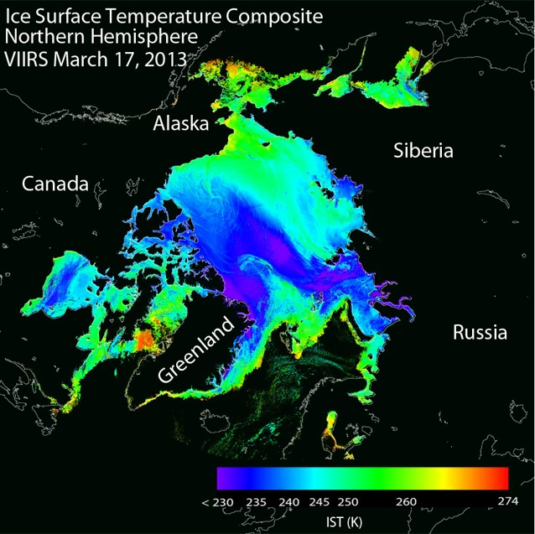
VIIRS Sea Ice - Ice Surface Temperature (IST) Product
The operational Suomi-NPP VIIRS IST product for the Arctic Ocean on March 17, 2013 is shown at left, before application of the VIIRS cloud mask.
The VIIRS IST provides surface temperatures:
For Arctic and Antarctic
For ice-covered oceans both day and night
Retrieved at VIIRS moderate resolution (750 m at nadir)
The desired measurement uncertainty is 1 K over a measurement range of 213–275 K.
Notes:
NOAA CLASS operational product shown; not NASA product

Slide 16
VIIRS IST
The NASA VIIRS IST is computed using a split window algorithm that employs two VIIRS Infrared bands, 10.76 μm (M15) and 12.01 μm (M16). This technique is based on the AVHRR heritage IST algorithm (Key and Haefliger, 1992):
IST = a₀ + a₁*T_{M15} + a₂*(T_{M15} - T_{M16}) + a₃*(T_{M15} - T_{M16}) (sec(z)-1),
where T_{M15} and T_{M16} are the brightness temperatures for VIIRS bands M15 and M16, respectively, and a₀, a₁, a₂, and a₃ are regression coefficients determined empirically.
Notes:
Split window

Slide 17
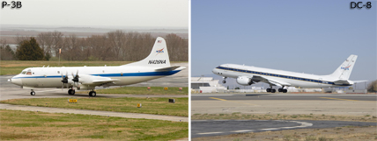
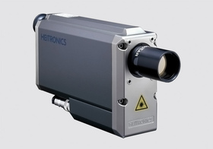
VIIRS IST Validation Approach - IceBridge
The IceBridge aircraft campaign commenced in 2009 and is ongoing, typically deploying a P-3 aircraft (left) over the Arctic during the spring and the NASA DC-8 over the Antarctic in the fall.
The aircraft deploys a Heitronics, Inc. KT-19 (left), which measures surface temperature with a resolution of 0.1° C.
To obtain IST measurements, the aircraft flies about 460m above the surface, resulting in a KT-19 spot size of 15m. This pyrometer records at 10Hz.

Slide 18
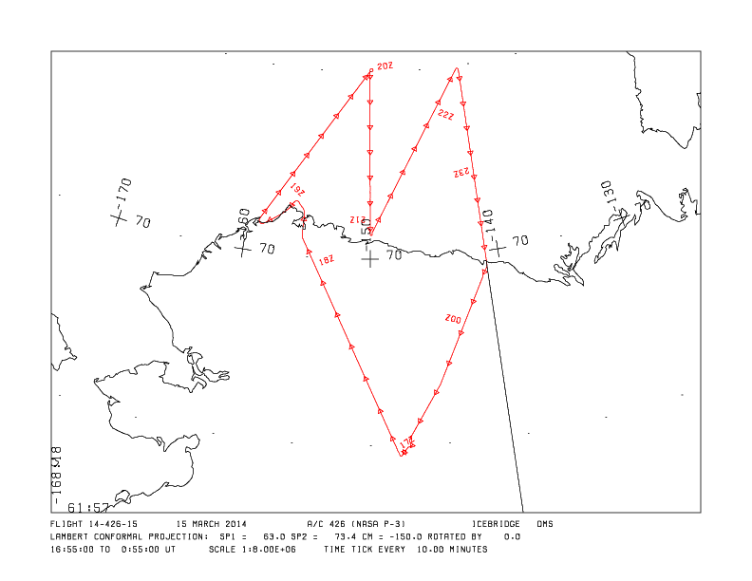
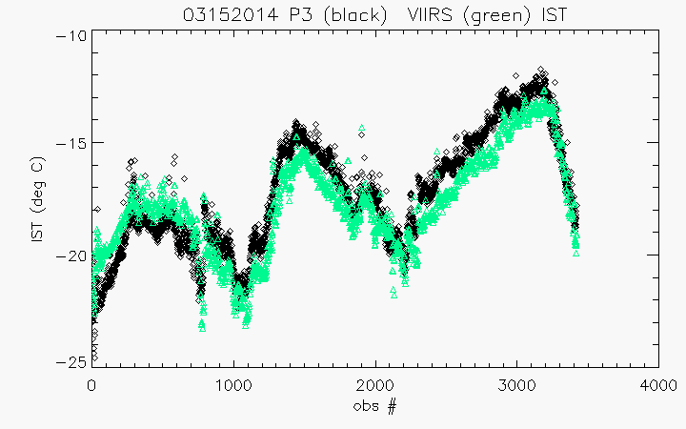
VIIRS IST validation - IceBridge
Example of validation efforts between IceBridge and the current operational VIIRS IST product
The map at left shows a flight track by the P-3 on March 15, 2014
Comparison of the IceBridge KT-19 IST data and the VIIRS operational IST (left) is favorable for this flight

Slide 19
VIIRS IST Inter-comparison Approach
MODIS IST
MERRA surface temperature
NCEP surface temperature
IABP drifting buoys

Slide 20
VIIRS Ice Extent
There is no current VIIRS Ice Extent product
The new NASA VIIRS Ice Extent product will follow the approach to the MODIS product:
Reflectance-based (daytime): identification of sea ice uses the NDSI, which for VIIRS is:
NDSI = (M4-M10)/(M4+M10),
where M4 is VIIRS band 4 (0.555 µm), M10 band 10 (1.61 µm)
IST-based: Utilize the IST product to identify sea ice (polar night)

Slide 21
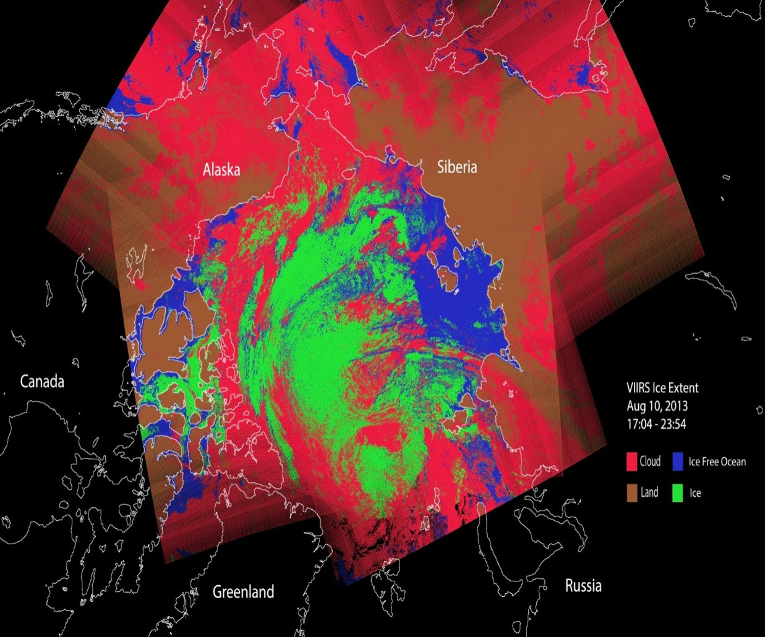
VIIRS Ice Extent
Simulated VIIRS Ice Extent using VIIRS Ice Age Product
Aug 10, 2013
Notes:
There is a current VIIRS ice age product that will probably be replaced

Slide 22
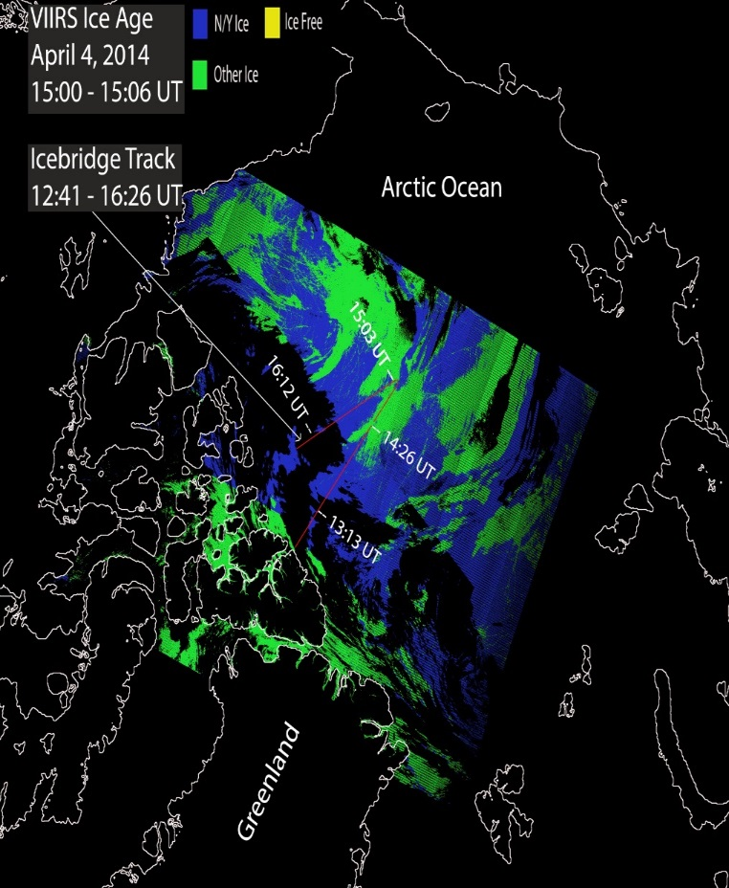
VIIRS Ice Extent
Validation Approach:
IceBridge
Digital Globe imagery
Inter-comparison Approach:
MODIS Ice Extent
VIIRS Ice Age
VIIRS IST (flag to identify sea ice)
NIC Ice charts
IceBridge flight tracks over VIIRS ice cover (ice age product), April 4, 2014
Notes:
Slides 17-22: we’ve used this approach for the VIIRS operational IST and ice age products, and will continue in this approach for the NASA VIIRS IST and ice extent products.
Using icebridge to validate presence of sea ice

Slide 23
Science Investigator-led Processing System (SIPS) Test Runs for Snow Cover and Sea Ice IST
Notes:
These will be produced after the standard C6 snow and ice products have been tested and evaluated.

Slide 24
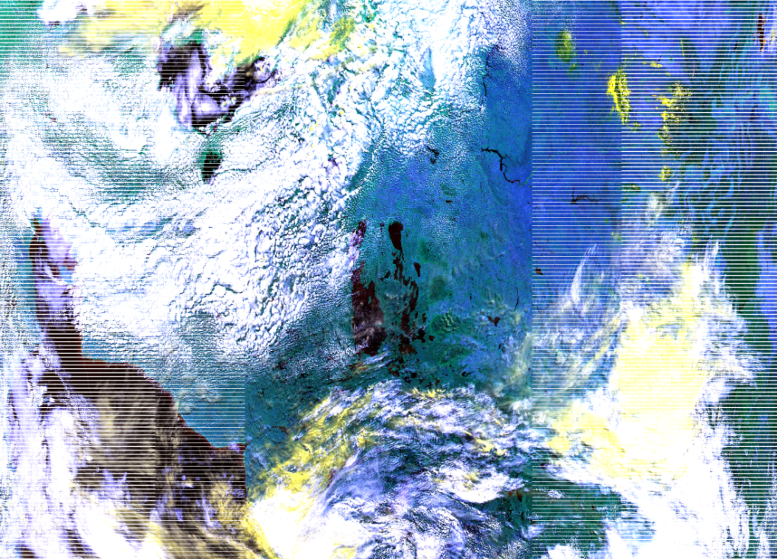
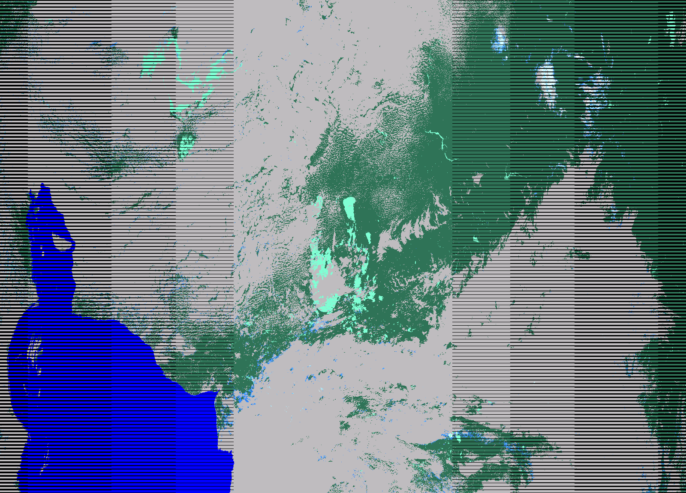
SIPS* snow cover global day test run of VIIRSNP10_L2 FSC (swath) Snow Cover for 12 September 2014
cloud
Snow in Rocky Mts.
cloud
Hudson Bay
cloud
VIAE image of bands I1,I2,I3
Snow cover from SIPS global day test run
Accurate detection of snow cover in Rocky Mountains. There are snow commission errors associated with cloud edges or broken/scattered cloud cover.
* Science Investigator-led Processing System
Notes:
VIIRS Cloud Mask Intermediate Product (CMIP) snow/cloud confusion, detecting snow as certain cloud is a problem.

Slide 25
NASA VIIRS Ice Surface Temperature - VIIRSNP29_L2
SIPS has begun adapting the MODIS sea ice surface temperature (IST) MOD29_L2 algorithm (C6) to create the NASA VIIRS IST algorithm and data product, VIIRSNP29_L2
SIPS and VIIRS Cryosphere Team collaborate to convert the algorithm code and evaluate test runs
Notes:
These will be produced after the standard C6 snow and ice products have been tested and evaluated.

Slide 26
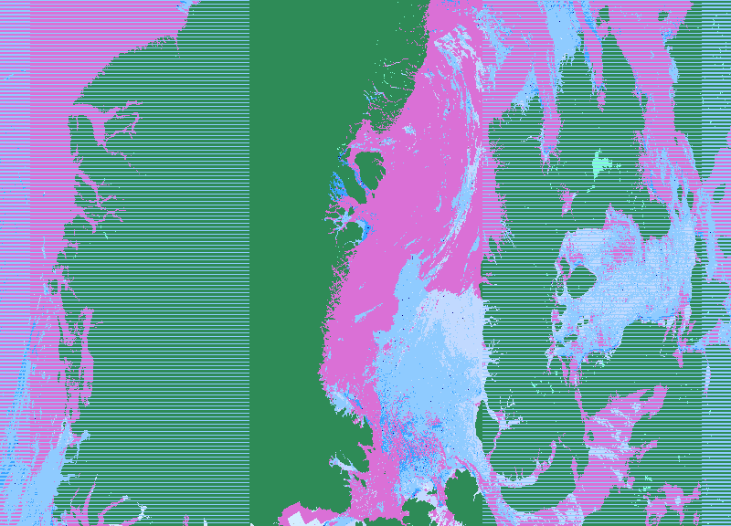
SIPS* test run of NASA VIIRSNP29_L2 (swath) Ice Surface Temperature (IST)
cloud
6 March 2014
1520 UTC
cloud
Greenland
K
* Science Investigator-led Processing System

Slide 27
Preliminary Validation of MODIS, VIIRS and Landsat-7 surface-temperature products

Slide 28
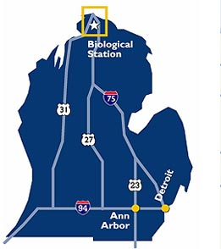
MODIS, VIIRS & Landsat-7 LST Validation – Preliminary Results
Satellite and in-situ temperatures on Douglas Lake, Michigan, 28 March 2015
Satellite | Time (local) | Satellite-derived temperature (°C) at time of overpass | Thermochron temperature (°C) at time of overpass (avg of both)* | Difference between satellite-derived temperature and thermochron temperature (°C)
Terra MODIS | 12:35 | -2.25 | -2.93 | 0.68
Aqua MODIS | 14:20 | -1.07 | -0.77 | 0.30
VIIRS | 13:40 | -0.29 | -1.42 | 1.13
VIIRS | 15:20 | +0.84 | -1.22 | 2.06
Landsat-7 | 12:20 | -2.78*** | -3.02** | 0.24
*average of temperatures from two thermochrons
**average of 10 minutes (12:15:01 to 12:25:01) and average of both thermochrons
***using Yale Center for Earth Observation, 2010 document
Landsat-8 OLI image of Douglas Lake
Douglas Lake
Lower Peninsula of Michigan

Slide 29
There is good continuity between MODIS and VIIRS snow-cover algorithms, and between MODIS and VIIRS sea ice algorithms for development of climate-data records (CDRs)
Notes:
Ways to improve snow detection and to provide logic to decreasethe uncertainty in mapping snow.

Slide 30
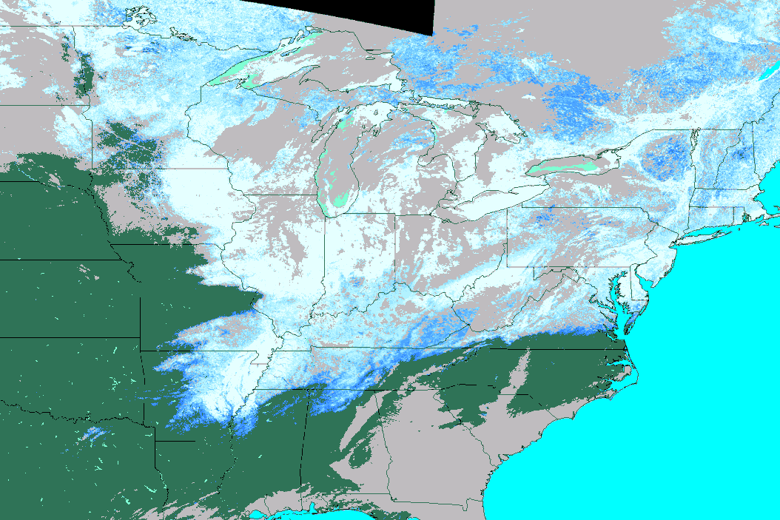
NASA VIIRS FSC (left) and MODIS FSC (right) of the Eastern United States at 500-m resolution
Excellent progress toward development of a CDR
cloud
cloud
cloud
6 March 2015
cloud
MOD10_L2 MOD10_L2_2015065_Fractional_Snow_Cover_500m_subset_mosaic
VIIRS map of fractional snow cover derived from the MODIS FSC algorithm
Notes:
Results are spatially similar

Slide 31
Conclusions - Snow
Drop binary snow-cover product for MODIS C6; detect snow using the NDSI; drop fractional snow cover (FSC) terminology
Develop screens to alleviate snow commission errors
Re-evaluate use of the surface temperature screen for C6
For SnowPEX, the MODIS snow project has so far contributed five years of MOD10A1 SCE products in the required format
No substantial changes in MODIS sea ice IST algorithm for C6
There is good continuity between MODIS and VIIRS snow-cover algorithms and products
A SIPS test run of snow cover has been conducted successfully
Notes:
Ways to improve snow detection and to provide logic to decreasethe uncertainty in mapping snow.

Slide 32
Conclusions – Sea Ice
The NASA VIIRS IST is computed using a split window algorithm that is based on the AVHRR heritage IST algorithm and the MODIS IST algorithm (Key and Haefliger, 1992)
Comparison of the IceBridge KT-19 IST and the VIIRS operational IST has been favorable
The new NASA VIIRS Ice Extent product will follow the algorithm approach of the MODIS product
Both intercomparison and validation are being conducted to evaluate the VIIRS sea ice products
A SIPS test run of sea ice IST has been successfully conducted

Slide 33
Future Work
MODIS snow and sea ice
MODIS C6 snow cover will be provided as NDSI, not FSC
the binary snow cover and regression calculated FSC will no longer be output
MODIS snow-cover changes for C6 focus on creating additional screens to prevent snow commission errors, and reducing cloud/snow confusion
Deliver algorithms for the new snow cover products for Tier 2 processing
Notes:
Ways to improve snow detection and to provide logic to decreasethe uncertainty in mapping snow.

Slide 34
Future Work
VIIRS snow and sea ice
Next version of VIIRS snow cover algorithm will include revisions from MODIS C6 algorithm
Will develop daily gridded NASA VIIRSNP10* (snow) and NASA VIIRSNP29* (sea ice) tiled and CMG products
Will evaluate and adjust coefficients for NASA VIIRS IST algorithm
Develop, along with SIPS, initial VIIRS sea ice extent algorithm based on the MODIS sea ice extent algorithm
Validate and intercompare NASA VIIRS snow sea ice extent products
Continue validation and intercomparison of surface temperature using IceBridge aircraft and in-situ measurements
Write ATBDs and user guides for the NASA VIIRS cryospheric products
Notes:
Ways to improve snow detection and to provide logic to decrease the uncertainty in mapping snow.

