Slide 1
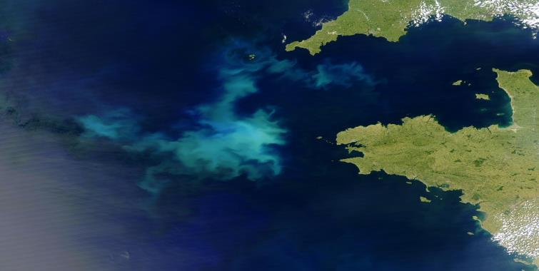


Using AQUA MODIS PIC concentration to determine coccolithophore bloom phenology
http://visibleearth.nasa.gov/
Jason Hopkins
Post doctoral researcher
Bigelow Laboratory for Ocean Sciences
jhopkins@bigelow.org

Slide 2
ACKNOWLEDGEMENTS
University of Southampton
NASA
Stephanie Henson & Alex Poulton, NOC Southampton
Barney Balch, Bruce Bowler, Dave Drapeau, Laura Lubelczyk, Meredith White & Catherine Mitchell, BLOS
NASA OBPG

Slide 3
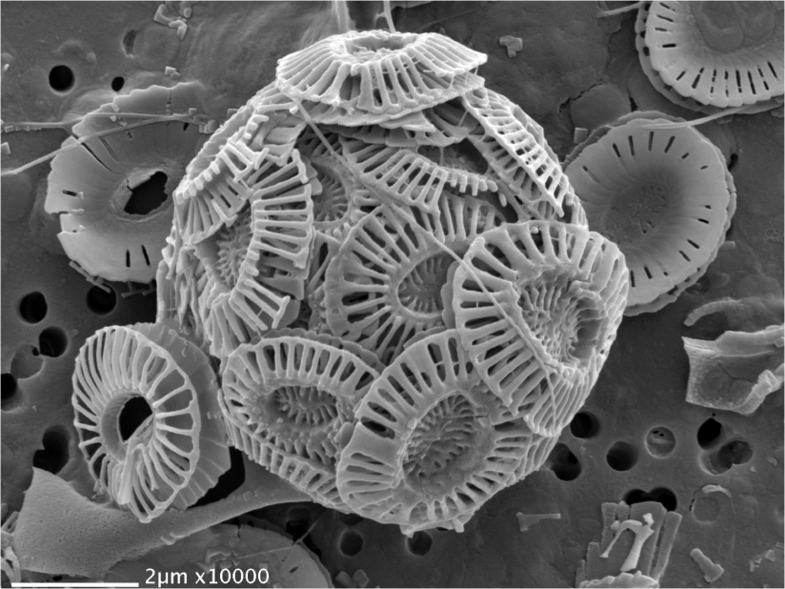
Emiliania huxleyi
Image: A Poulton, NOCS

Slide 4
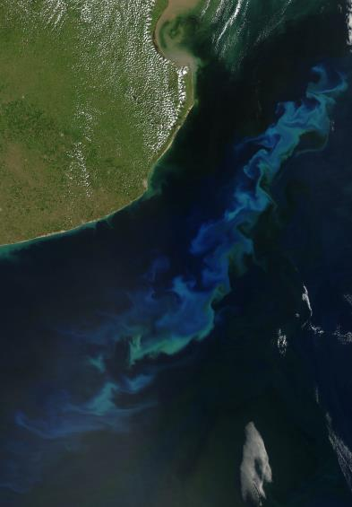

Coccolithophore blooms from space
UK
South America
http://earthobservatory.nasa.gov/
http://visibleearth.nasa.gov

Slide 5
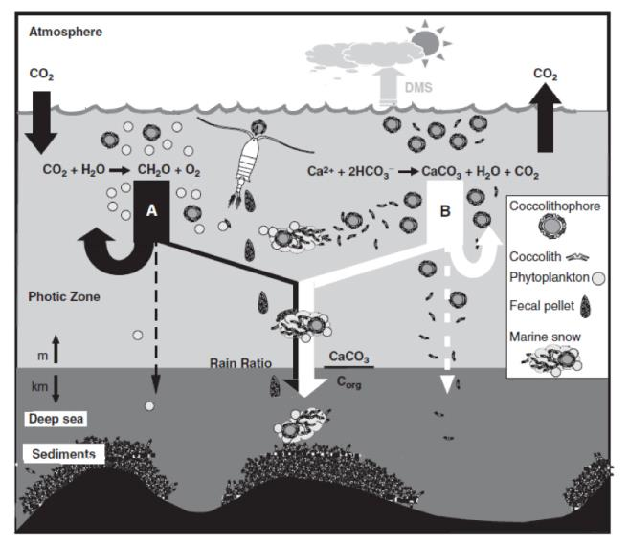
Why are we interested in PIC?
Image adapted from de Vargas et al., 2007

Slide 6
The merged PIC algorithm
Balch et al., 2005 - Two-band algorithm. Uses LUT generated from forward modelling of the optical properties of chlorophyll-a and PIC. Good in relatively low PIC concentrations.
Gordon et al., 2001 - Three-band algorithm. Uses 3 NIR wavebands to estimate atmospheric effects and backscatter from coccolithophores. Good in relatively high PIC concentrations.
Notes:
2 band Howard Gordon

Slide 7
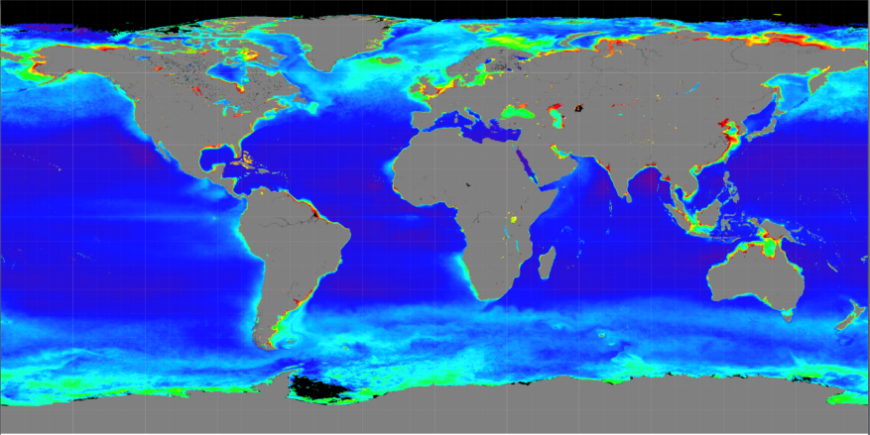

Global PIC
Mission composite PIC from http://oceancolor.gsfc.nasa.gov

Slide 8
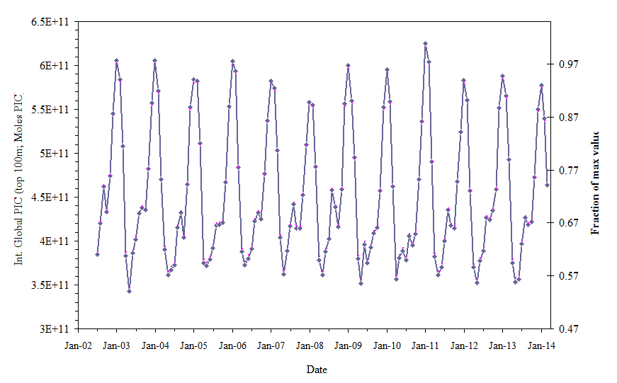
PIC Global Time Series (MODIS-Aqua)
Mission record- Highest PIC during austral summer
Integrated Global PIC (top 100m; moles PIC)
Fraction of Maximum Value
Date
Notes:
Avg global PIC =~5E11 moles PIC or 6E12 grams. Turning over daily means 6e12 * 365 =2.19*10^15 g per year produced (or 2.2Pg/year) = the same CO2 produced. Total Global annual NPP=~105.9 x 10^15g/y(Longhurst et al., 1995) and marine NPP is ~47.5E15 gC/y. 2.19E15/47.5E15 = 4.6% of total marine NPP;

Slide 9
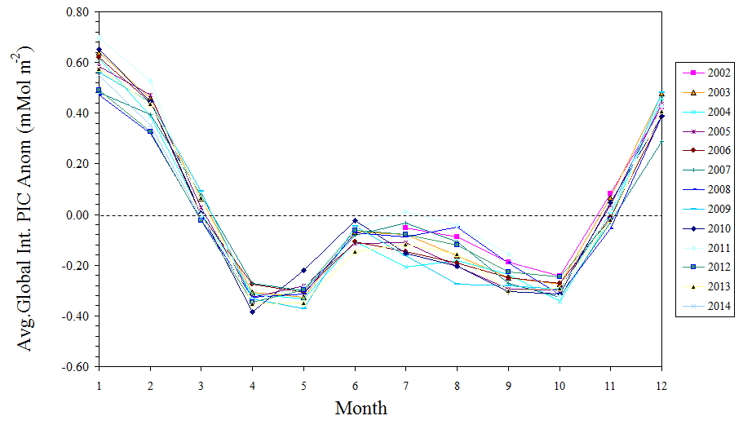
PIC Global Time Series (MODIS-Aqua)
Annual coccolithophore phenology

Slide 10
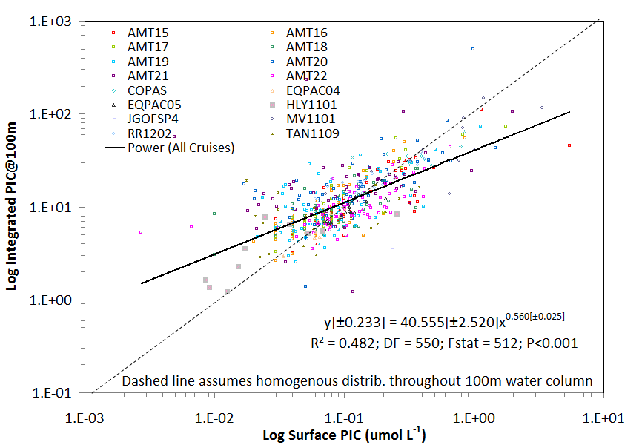
Relating surface to integrated PIC
Integrated PIC > expected if
surface PIC homogenously dist.
Integrated PIC (to 100m depth; mmol m⁻²)
Integrated PIC < expected if
surface PIC homogenous dist.
The more surface PIC, the more likely it is confined to the surface layer
Surface PIC (µmol L⁻¹)

Slide 11
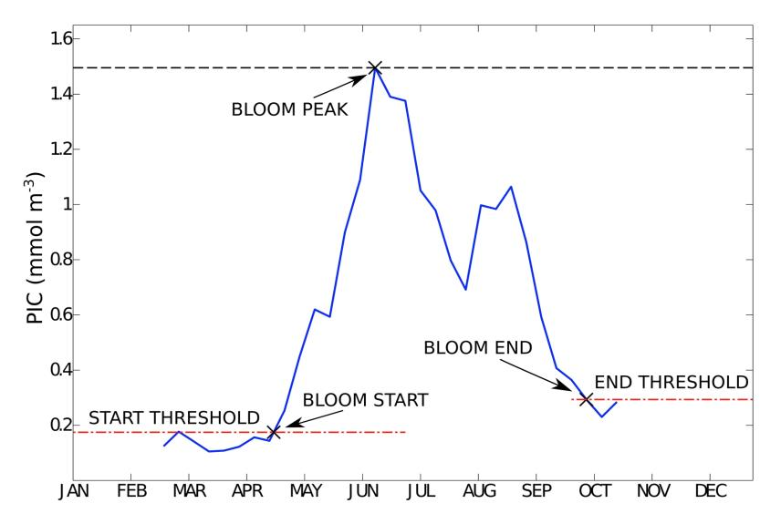
Coccolithophore bloom phenology
North Atlantic
Hopkins et al., 2015, GBC

Slide 12
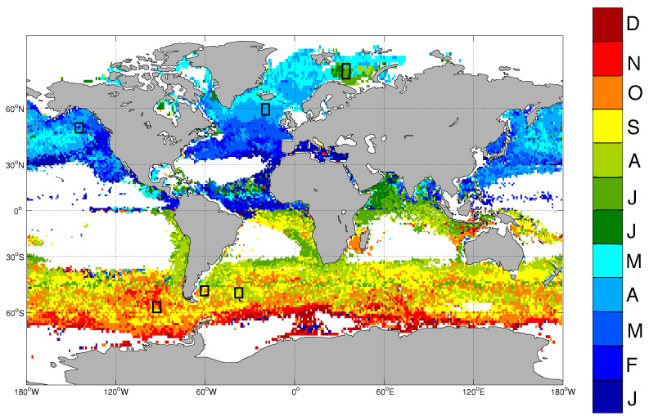
Bloom start date
Hopkins et al., 2015, GBC

Slide 13
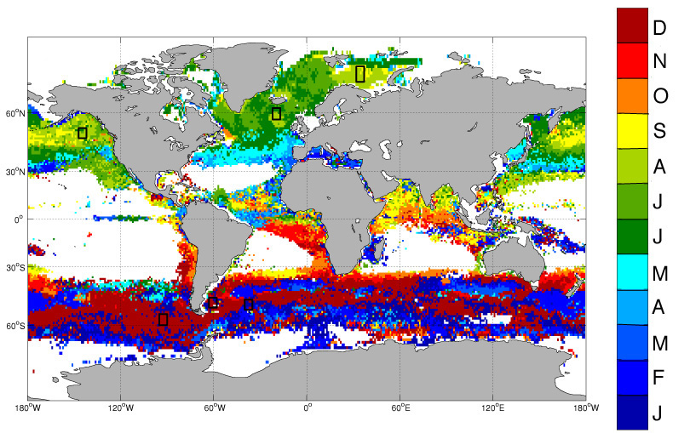
Bloom peak date
Hopkins et al., 2015, GBC

Slide 14
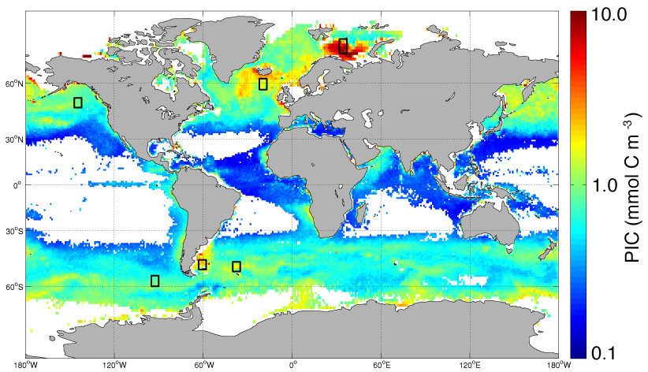
Bloom peak concentration
Hopkins et al., 2015, GBC

Slide 15
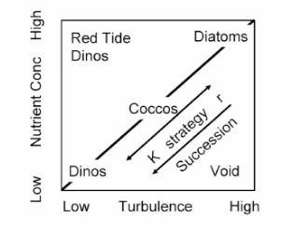
Phytoplankton succession
Margalef, Oceanologica acta.,1978 (Image: Balch, 2004)
Notes:
Paradigm

Slide 16
Succession in peaks
Species succession

Slide 17
Co-occurrence of peaks
Species co-existence

Slide 18
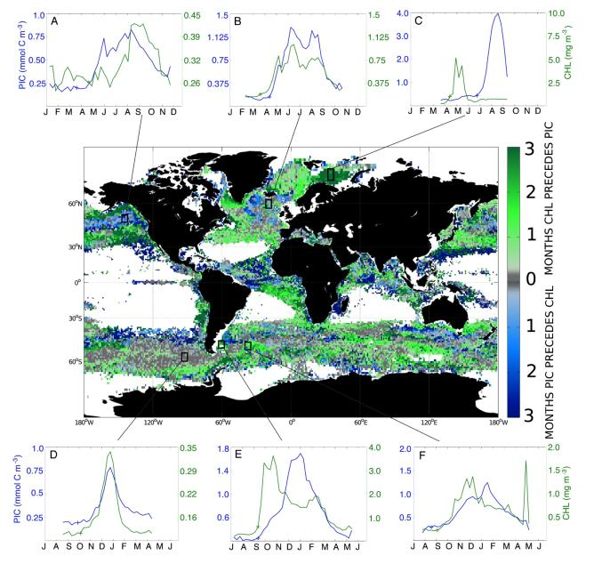
PIC and chlorophyll time-series

Slide 19
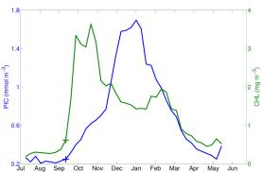
Succession in peaks
>24 DAYS

Slide 20
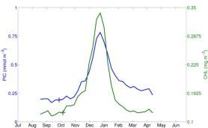
Co-occurrence of peaks
<16 DAYS

Slide 21
Pixels with succession in peaks
White bounded areas represent regions with low variability, persistent periods of missing data or water column depths <150 m

Slide 22
Peaks that co-occur
White bounded areas represent regions with low variability, persistent periods of missing data or water column depths <150 m

Slide 23
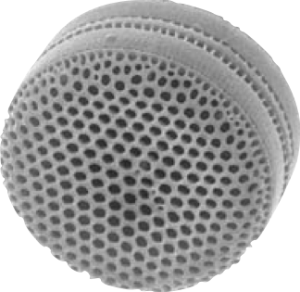
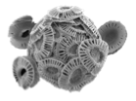
Coccolithophores and diatoms
LARGE
SMALL
Silicate
Relatively high Fe
No silicate
Relatively low Fe

Slide 24
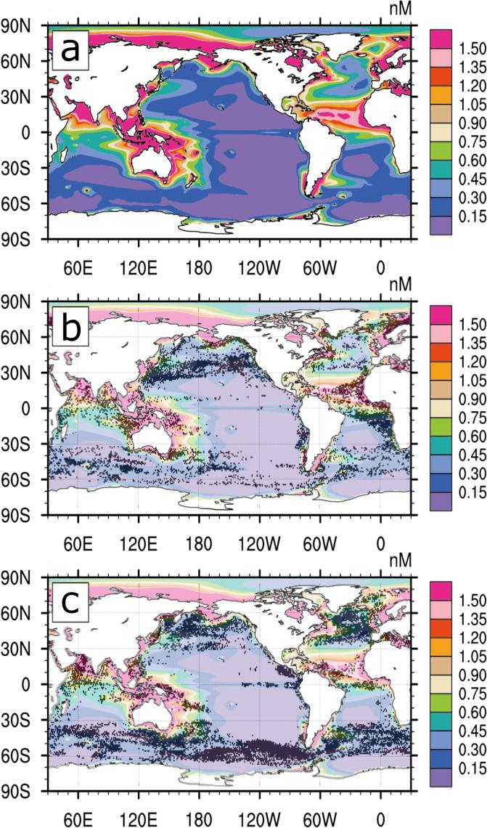
The case for Fe?
Timing gap between chlorophyll peak and PIC peak
Misumi et al., 2014 Biogeosciences

Slide 25
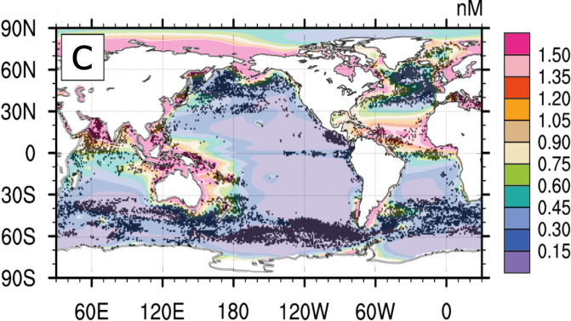
The case for Fe?
No timing gap between chlorophyll peak and PIC peak
Misumi et al., 2014 Biogeosciences

Slide 26
Coccolithophores and diatoms
HIGH Fe
LOW Fe
Large diatoms dominate
Coccolithophores have to wait until diatom population has diminished
Large diatoms unable to establish dominance in bloom
Coccolithophores can bloom with other phytoplankton taxa

Slide 27
Ongoing work

Slide 28
The merged PIC algorithm
Recent changes to PIC algorithm
LUT modified to reflect data from increased number of in-situ acid labile b_{b} measurements
New b_{b}* implemented (now 1.628 m² mol⁻¹)

Slide 29
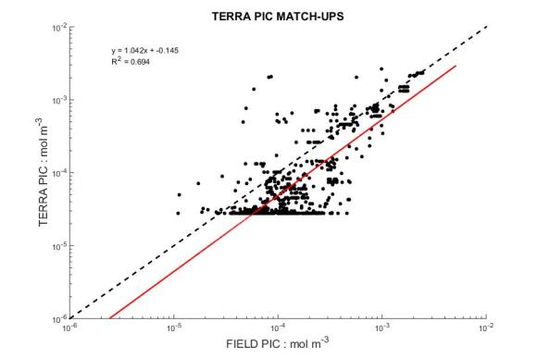
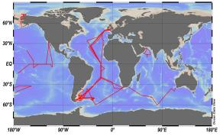
Satellite PIC and in-situ PIC matchups –Terra MODIS
MODIS TERRA PIC MATCHUPS
y = 1.042x-0.145
R² = 0.694
TERRA PIC (mol m⁻³)
Field PIC (mol m⁻³)

Slide 30
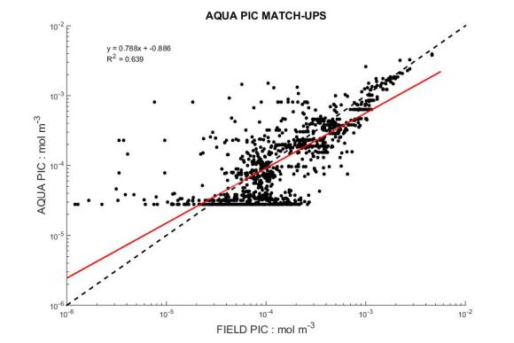
Satellite PIC and in-situ PIC matchups –Aqua MODIS
MODIS AQUA PIC MATCHUPS
y = 0.7885x-0.886
R² = 0.639
AQUA PIC (mol m⁻³)
Field PIC (mol m⁻³)

Slide 31
Ongoing work - MISR
https://www-misr.jpl.nasa.gov/
Notes:
High resolution for sub-mesoscale processes

Slide 32
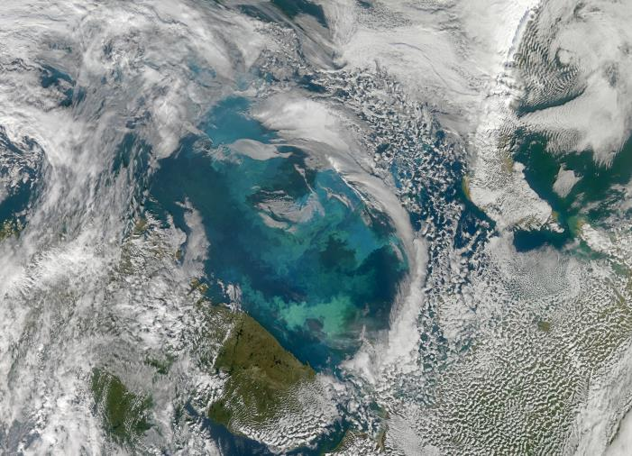
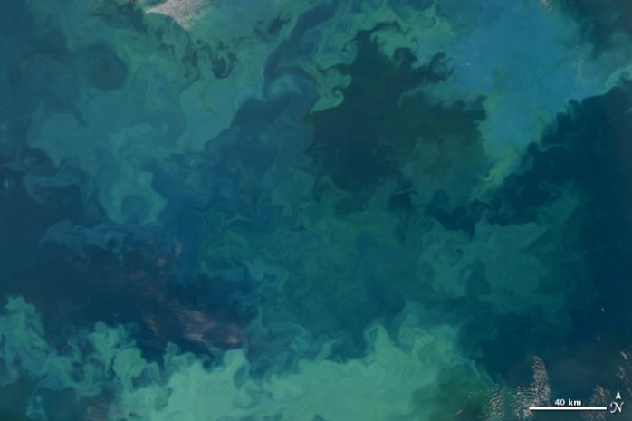
Ongoing work – PIC at sub-kilometer resolution
http://earthobservatory.nasa.gov
Notes:
High resolution for sub-mesoscale processes

Slide 33
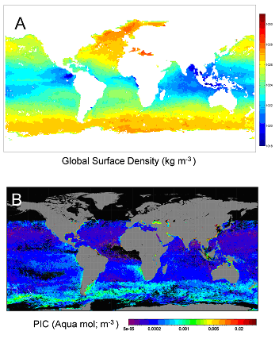
Ongoing work – Edge detection algorithm
Density
T from MODIS
S from Aquarius
Edge Detection
Cayula & Cornillon, 1991

Slide 34
Thank you
jhopkins@bigelow.org

Slide 35
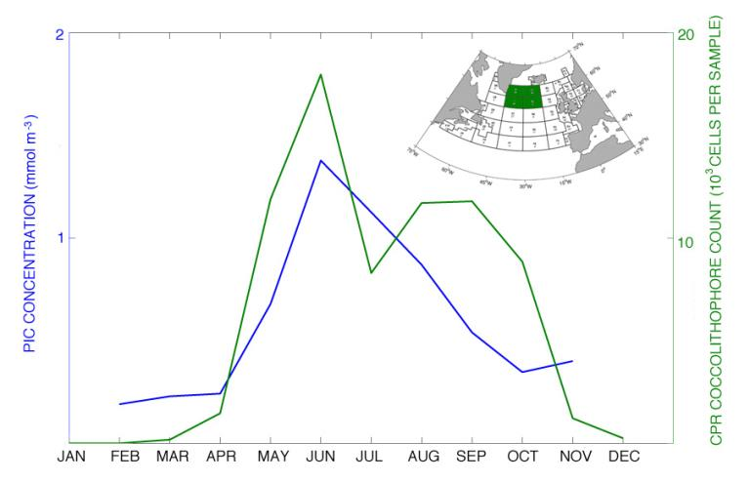
PIC and coccolithophores

Slide 36
Two band LUT
Adapted from Balch et al, 2005, JGR

Slide 37
Coccolithophores and chlorophyll
Bloom PIC content = 0.75 mmol m⁻³
Coccolith PIC content = 0.016 pmol C [Poulton et al, 2011]
Bloom coccolith total = 0.75x10⁻³÷ 0.016x10⁻¹² = 4.7x10¹⁰ coccoliths m⁻³ = 47000 ml⁻¹
Assuming 12 coccoliths per cell & 100 loose coccoliths per cell = 112 coccoliths for every cell
No. of cells in bloom = 420 cells ml⁻¹
Assuming chl content per cell = 0.1pg [Stolte et al, 2000]
Chl contribution to bloom = 0.04 mg m⁻³

Slide 38
PIC concentration seasonality
North Atlantic
MODIS PIC data; 8-day, 9km composites for 2003-2012

