Slide 1

National Aeronautics and Space Administration
Land Surface Temperature and Emissivity (LST&E) products for MODIS and VIIRS Continuity
Glynn Hulley, Nabin Malakar, Tanvir Islam
Simon Hook, Pierre Guillevic
Jet Propulsion Laboratory, California Institute of Technology, Pasadena, CA
(c) 2015 California Institute of Technology. Government sponsorship acknowledged.
MODAPS: Virginia Kalb, Sadashiva Devadiga, Teng-Kui Lim, Robert Wolfe, Kurt Hoffman, Jerry Shiles
MODIS/VIIRS Science Team Meeting, Silver Spring, MD, 19 – 22 May, 2015

Slide 2
Outline
MOD21 LST&E Product
MOD21 LST&E Updates
New NASA VIIRS LST&E Product
MODIS-VIIRS Continuity

Slide 3
Current MODIS/VIIRS LST&E Products
Core Products | Status | Spatial | Formats | Algorithm | SDS
MOD11 (C4, 5, 6*) | Collection 6 in processing | 1-km | L2 Swath, L2G 2X Daily | Generalized Split Window (GSW) Wan et al. 1996, 2008 | - LST
MOD11B1 (C4, 4.1, 5) | ? | 5-km (C4*) 6-km (C5) | Sinusoidal 2X Daily | Day/Night Algorithm Wan and Li, 1997 | - LST - Emissivity bands 20-23, 29, 31, 32
VIIRS VLST (IDPS) | Mx8* | 750 m | L2 Swath, L2G 2X Daily | Single Split-Window Yu et al. 2005 | - LST
New MODIS/VIIRS LST&E Products (JPL)
New Products | Status | Spatial | Formats | Algorithm | SDS
MODIS-TES (MOD21 C6) | Final testing, released with Collection 6 (Tier-2) | 1-km | L2 Swath, L2G 2X Daily L3G Monthly | Temperature Emissivity Separation (TES) | - LST Emissivity bands 29, 31, 32
VIIRS-TES | Under production at JPL (Algorithm delivery First quarter 2016) | 750 m | L2 Swath, L2G 2X Daily L3G Monthly | Temperature Emissivity Separation (TES) | - LST Emissivity bands 14, 15, 16
Notes:
Number of different flavors of LST/E products

Slide 4
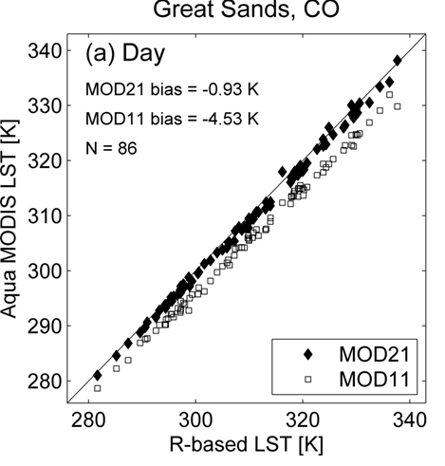
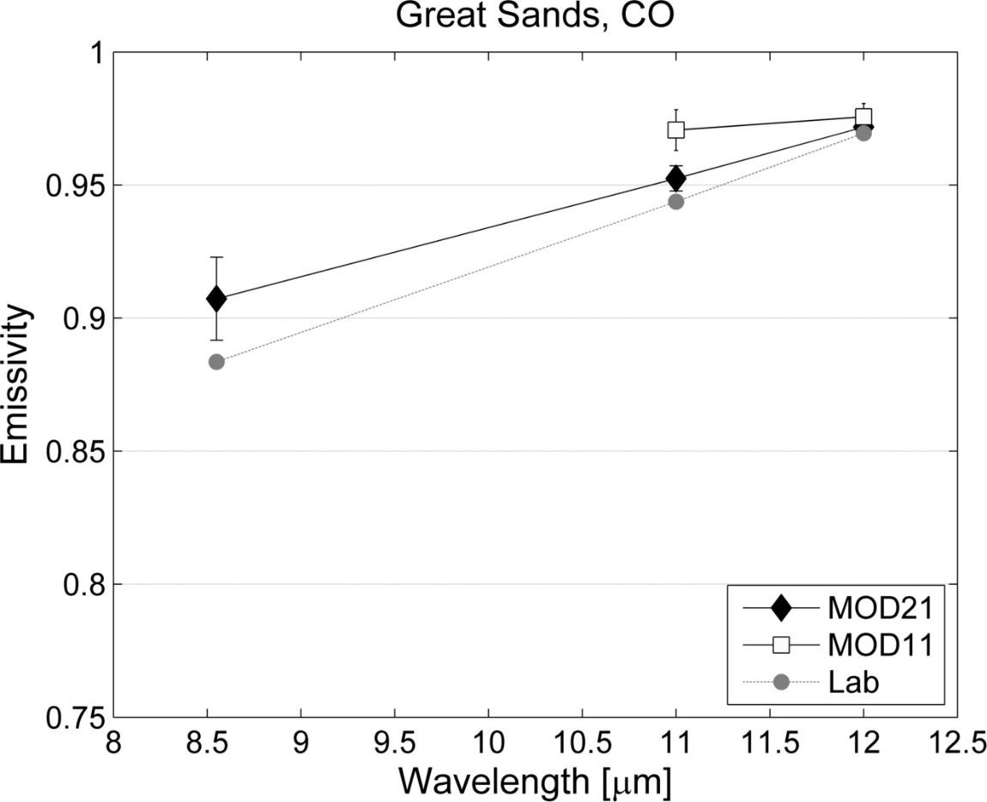
LST/Emissivity Error Dependency
Overestimation of emissivity leads to underestimation of LST and vice versa.
Split-window (11-12 micron) fixes emissivity based on land cover classification (IGBP)
TES physically retrieves emissivity and temperature (minimum 3 bands)
MOD11 emissivity too high (2%)
MOD21 (TES) 0.5% too high
Great Sands National Park
In Situ LST
Notes:
Initial retrieval or assignment of emissivity crucial for accurately retrieving temperature

Slide 5
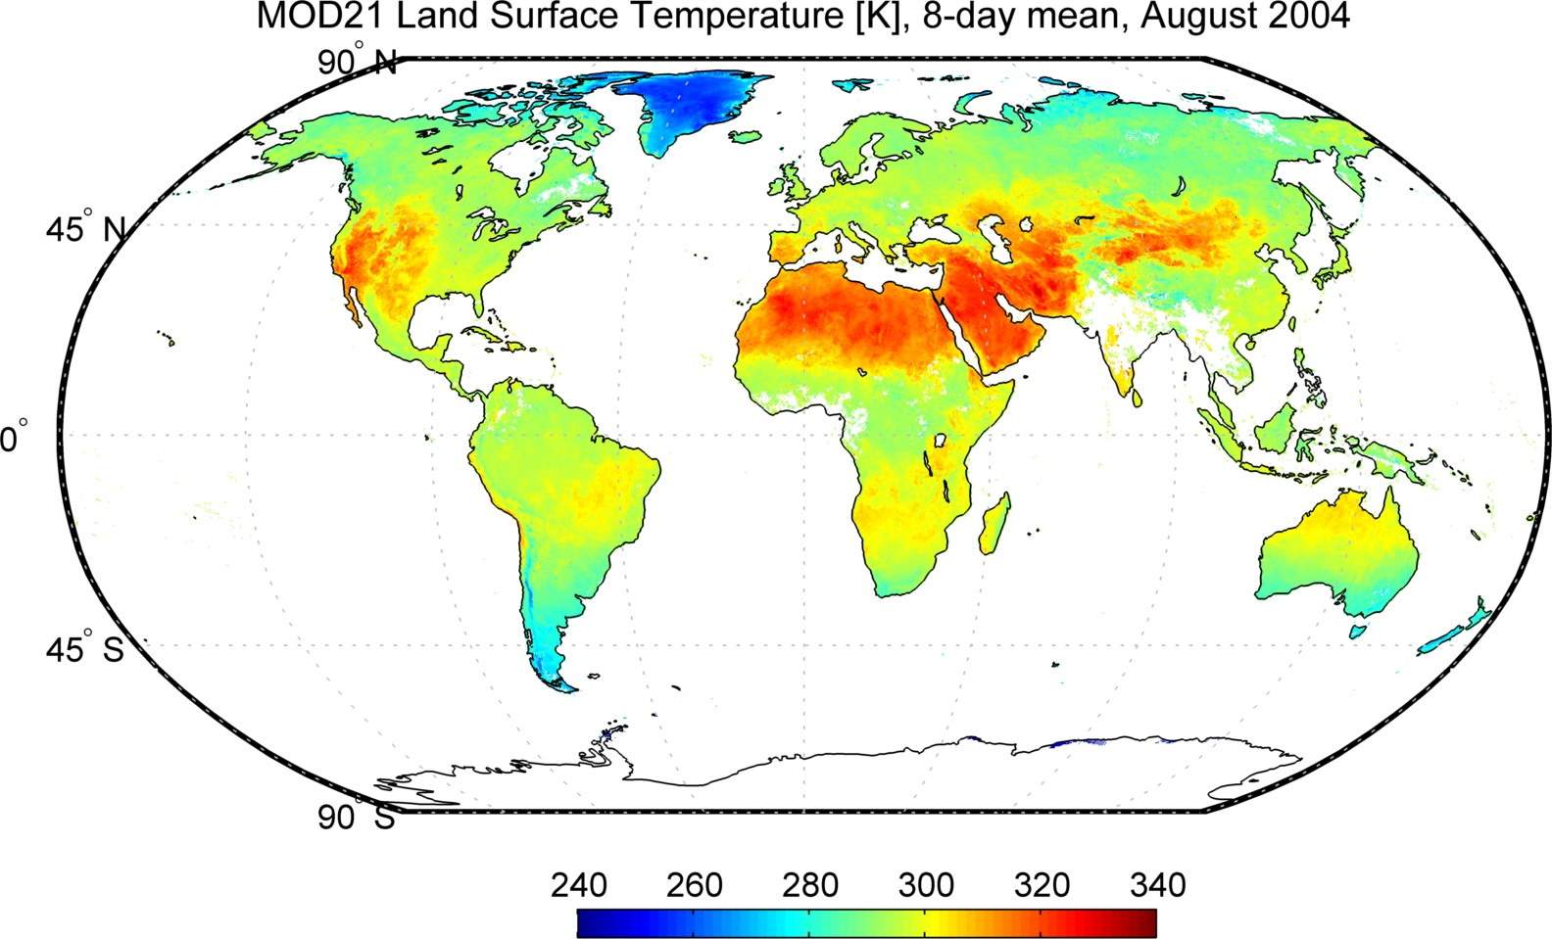
MOD21 LST
Generated using prototype MOD21 algorithm at MODAPS

Slide 6
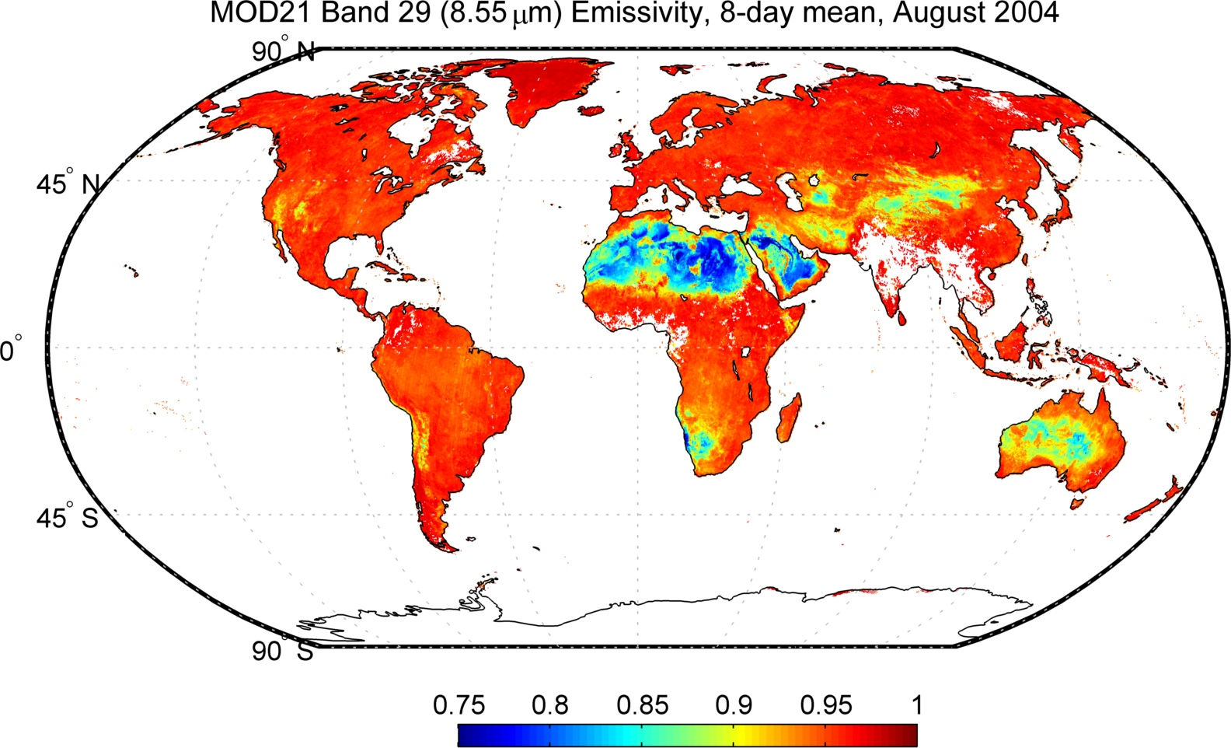
MOD21 Band 29 Emissivity
Generated using prototype MOD21 algorithm at MODAPS

Slide 7
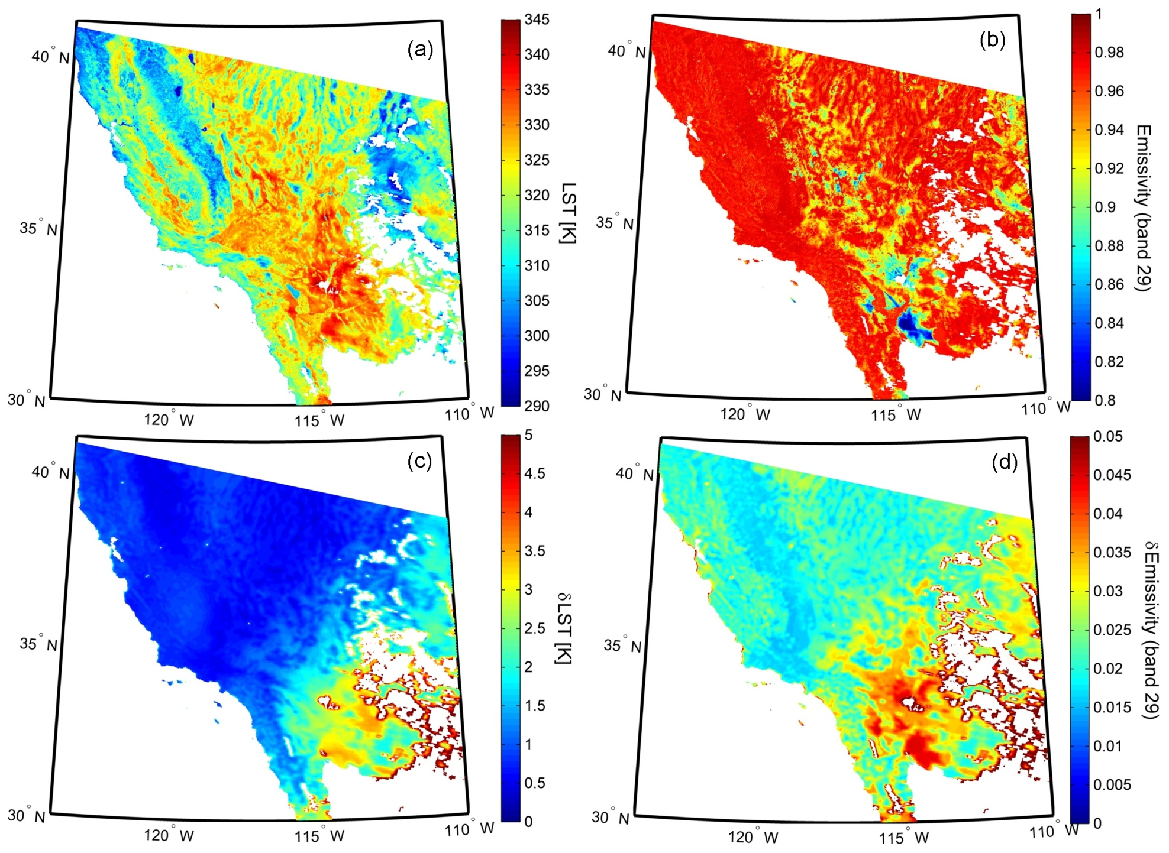
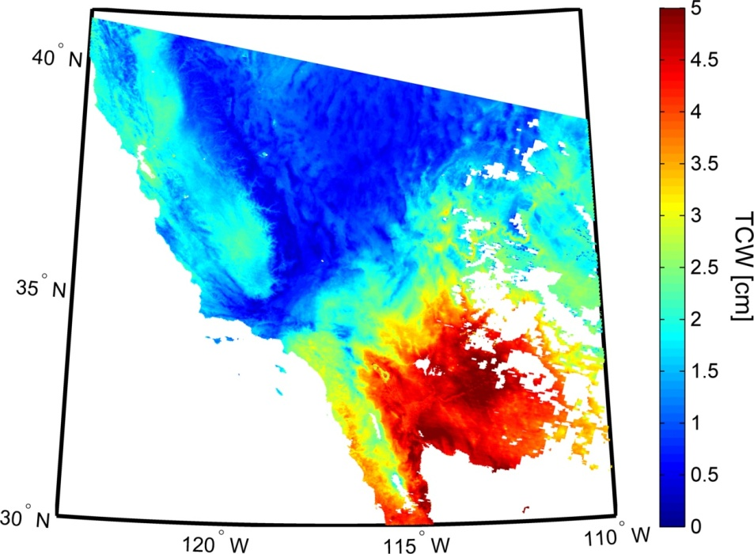
MOD21 C6 LST&E Uncertainty estimates
ROSES 2009: Earth System Data Records Uncertainty Analysis
LST
Emissivity
δLST
δEmissivity
Notes:
Special feature of MOD21 Product is well characterized uncertainty estimates

Slide 8
Outline
MOD21 LST&E Product
MOD21 LST&E Updates
New NASA VIIRS LST&E Product
MODIS-VIIRS Continuity

Slide 9
MOD21 Updates and Refinements
Parameter | MOD21 (JPL v2) | MOD21 (JPL v5) (C6)
Radiative Transfer Model | MODTRAN (MOD07 at 25 km) | RTTOV (MOD07 at 5 km)
Water Vapor Scaling (WVS) coefficients | V2 | V5 (day/night and view angle dependent)
TES algorithm | One calibration for all surfaces | Two calibrations for Graybody and Bare surface types

Slide 10
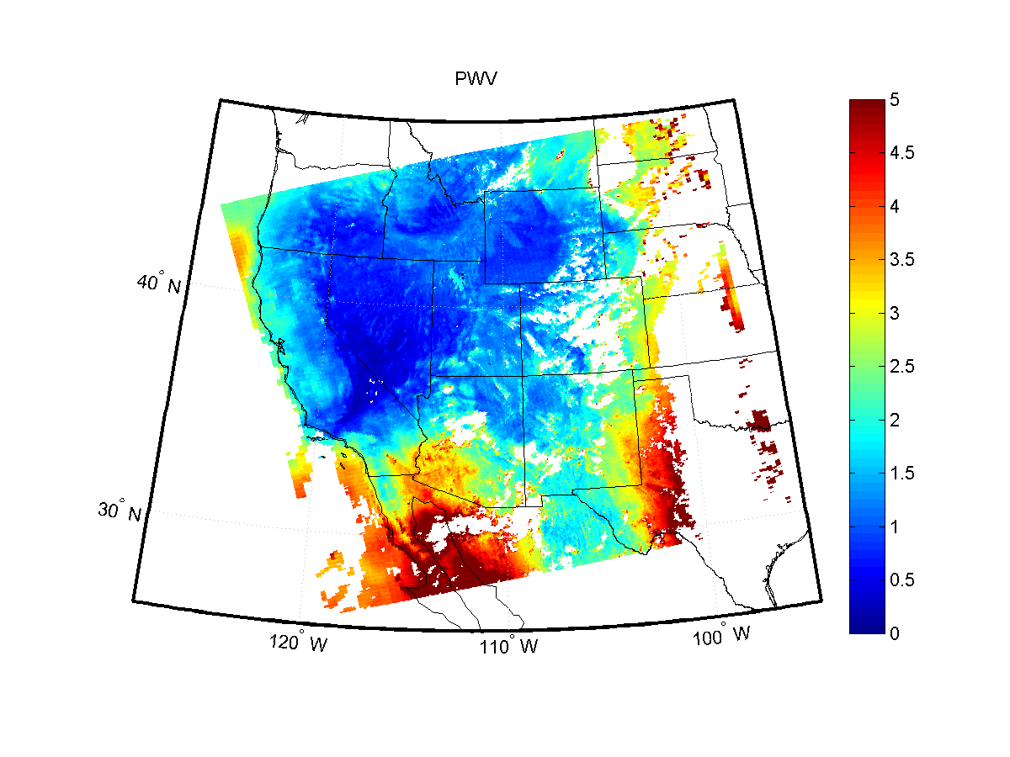
Problem Case: Very humid/warm conditions
Precipitable Water Vapor – MYD07
Summertime monsoonal conditions

Slide 11
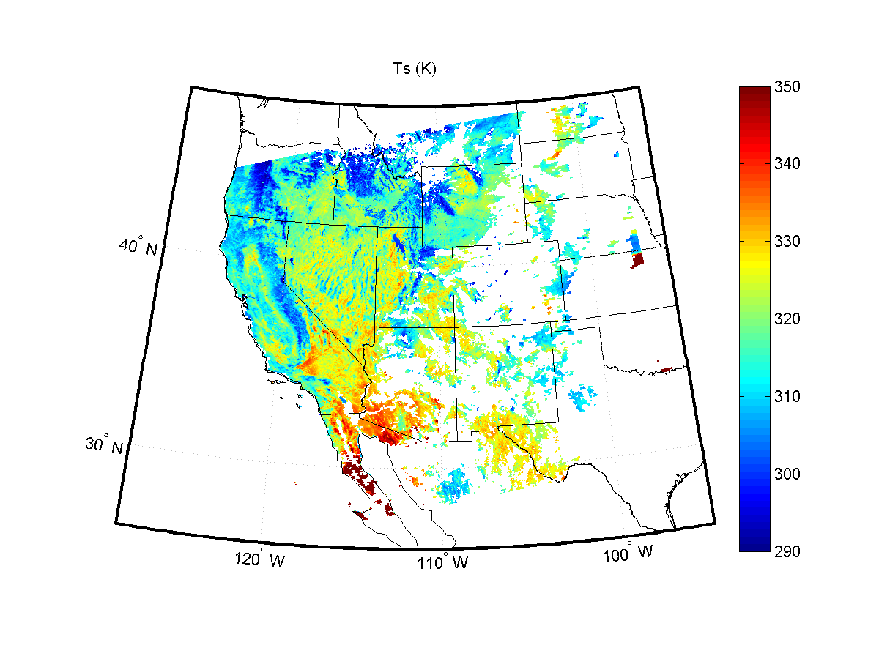
MODTRAN Atmospheric Correction
Degraded MOD07 C6 Resolution (25 km)
Temperatures overestimated in very humid conditions!

Slide 12
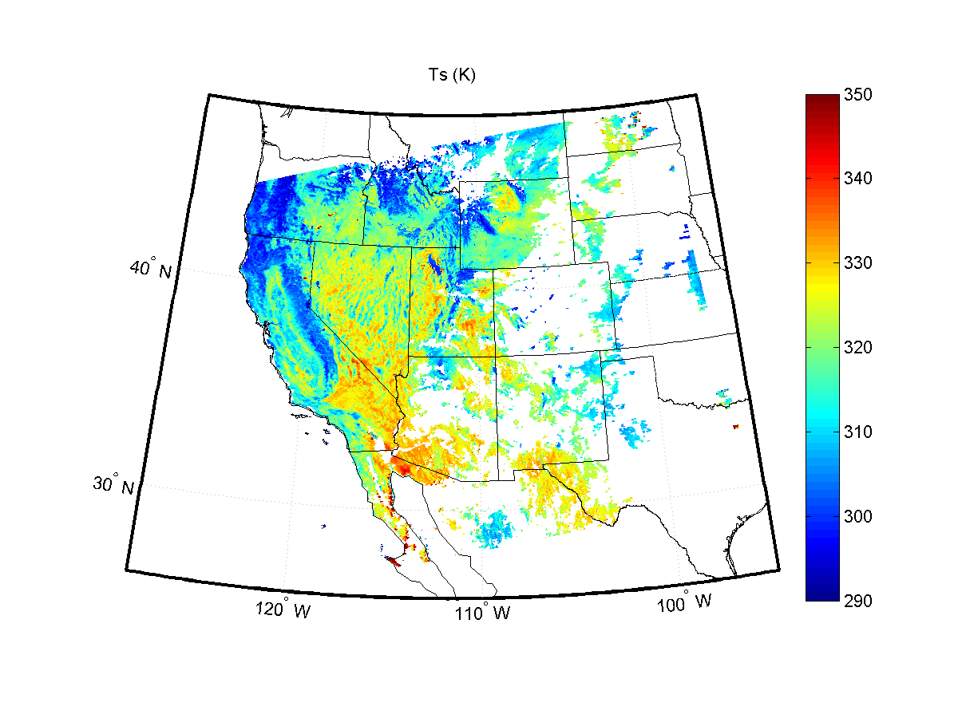
RTTOV Atmospheric Correction
Full MOD07 C6 Resolution (5 km)
Improved with RTTOV Implementation
Notes:
James Hocking (UK MetOffice)

Slide 13
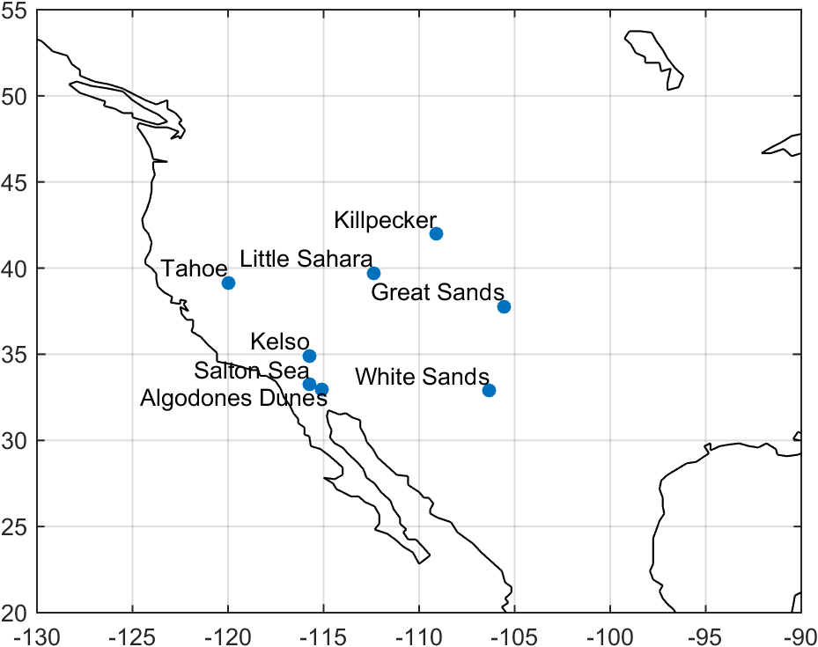
LST&E Validation Sites (Stage 1)
Redwood
Texas Grassland

Slide 14
Land Surface Temperature RMSE (K)
2003-2005
MOD21(v2) total = 1.21 K
MOD21(v5) total = 1.02 K
?

Slide 15
Land Surface Temperature RMSE (K)
2003-2005
MOD11 cold bias over Barren sites
(3-4 K)
Comparable accuracy over water, vegetation (1 K)

Slide 16
Outline
MOD21 LST&E Product
MOD21 LST&E Updates
New NASA VIIRS LST&E Product
MODIS-VIIRS Continuity

Slide 17
NASA VIIRS/MODIS Products
LST&E Product Characteristics | MOD21 (C6) | VIIRS-TES
Algorithm | Temperature Emissivity Separation (TES) | Temperature Emissivity Separation (TES)
Bands used | 29 (8.55 µm) 31 (11 µm) 32 (12 µm) | 14 (8.55 µm) 15 (10.76 µm) 16 (12 µm)
Radiative Transfer Model | RTTOV | RTTOV
Atmospheric Profiles (T, RH) | MOD07 C6 | MERRA, NUCAPS? ECMWF?, NCEP?
Algorithm Software | C++/Matlab | C++/Matlab
Data Product Types | L2, L2G Daily (1 km) L3 8-day, (1 km) L3 Monthly (0.05°) | L2, L2G Daily (750 m) L3 8-day, (1 km) L3 Monthly (0.05°)
Science Data Products | - LST - Emissivity (bands 29, 31, 32) | - LST - Emissivity (bands 14, 15, 16)
Primary difference

Slide 18
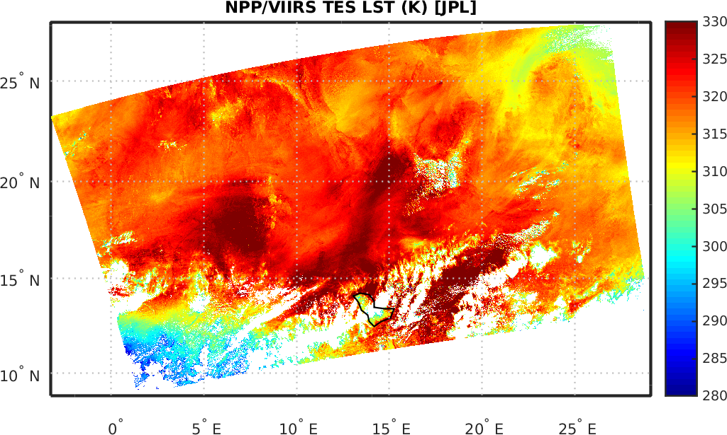
Prototype VIIRS-TES LST&E Retrieval:
Sahel-Sahara test granule

Slide 19
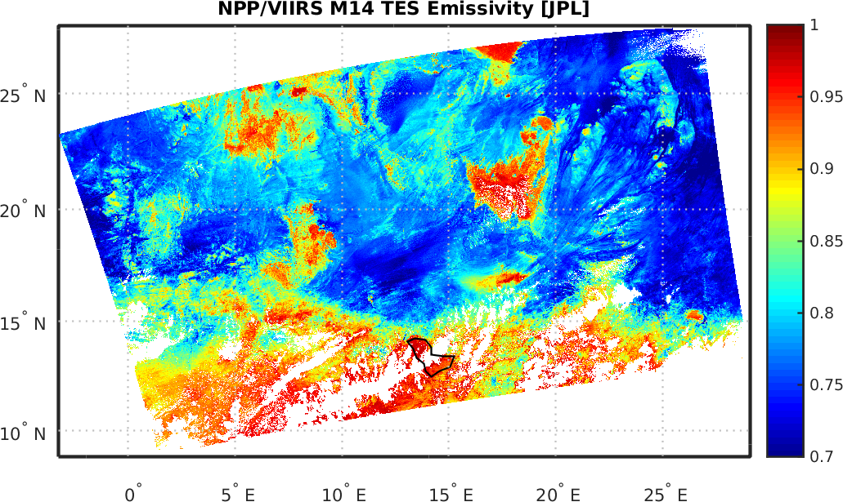
VIIRS M14 (8.55 micron) Emissivity
First use of VIIRS M14 other than cloud mask, RGB’s?
Past Studies have shown 8.55 micron emissivity useful for:
Land Degradation (desertification) monitoring
e.g. French et al. 2008, Hulley et al. 2012
Soil Moisture relationships
e.g. Mira et al. 2007, Hulley et al. 2009, Masiello et al. 2013
Land cover, land use change
e.g. French et al. 2008, French et al. 2012
Notes:
A lot of structure and variation in emissivity of quartz sands not seen in temperature. Emissivity and temperature data are independent. Emissivity more indicative of surface composition, while temperature more related to weather conditions and solar irradiance history.

Slide 20
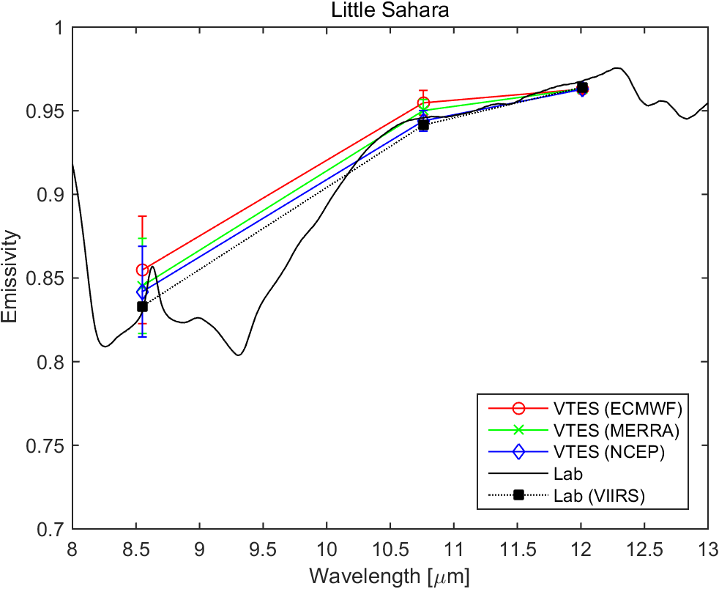
VIIRS Emissivity
Validation (2014 data)

Slide 21
VIIRS
LST Validation
Site | NWP Model | Bias (K) | RMSE (K)
Lake Tahoe (2014) | ECMWF | -0.14 | 1.06
 | MERRA | -0.13 | 1.15
 | NCEP | -0.23 | 1.13

Slide 22
Outline
MOD21 LST&E Product
MOD21 LST&E Updates
New NASA VIIRS LST&E Product
MODIS-VIIRS LST&E Continuity?

Slide 23
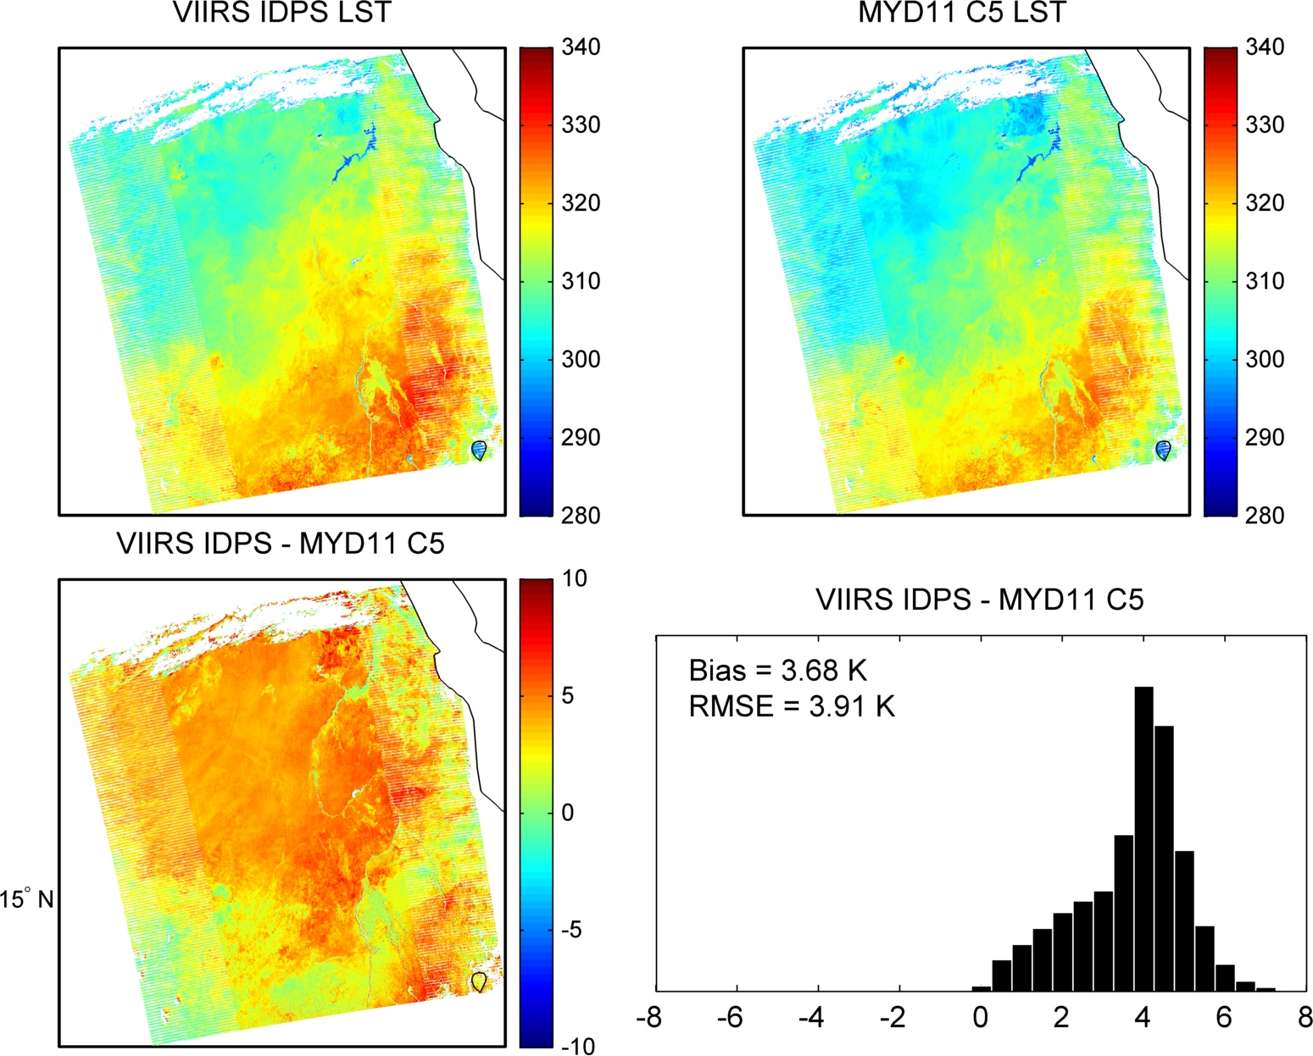
MODIS/VIIRS Split-window Continuity (current)
Egypt
Large discrepancy mostly due to inconsistent emissivity correction

Slide 24
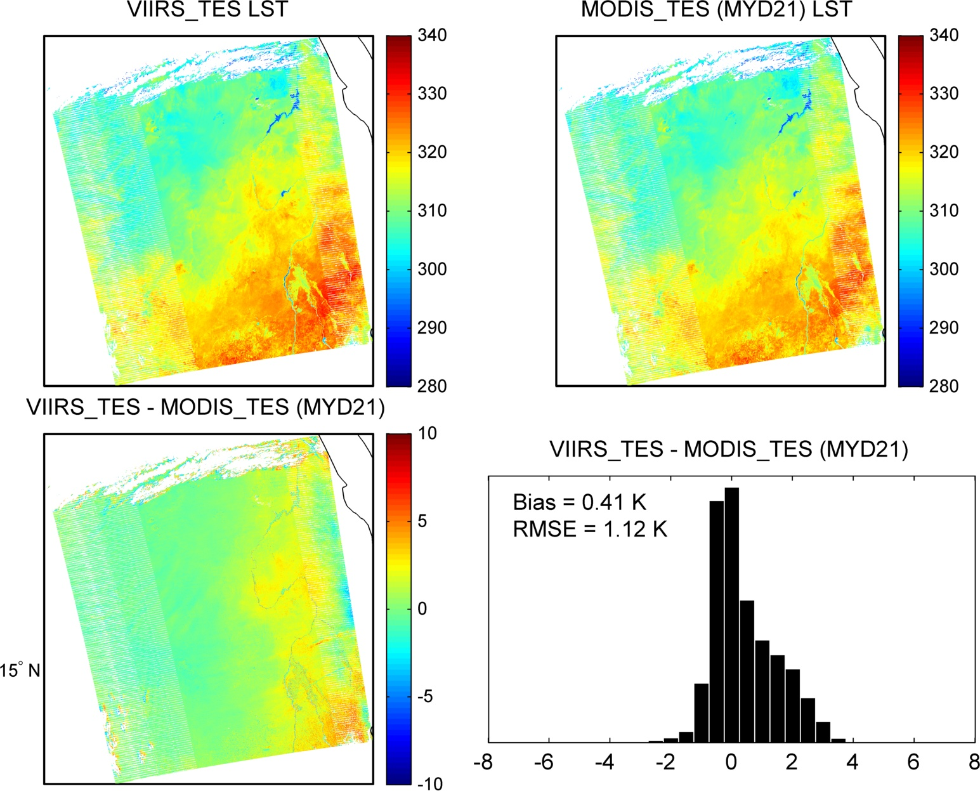
MODIS/VIIRS TES Continuity (planned)
Egypt
Very good agreement.
Gives confidence in future continuity of LST time series

Slide 25
Future Goal(s):
Reduce total number of standard LST products for VIIRS/MODIS (currently 3 different MODIS LST!).
Generate Unified products for MODIS and VIIRS standard LST products using uncertainty analysis approach.
Evaluate MOD/MYD11 C6 LST
Unified MODIS LST:
  Merge MOD11 and MOD21 products (Aqua and Terra)
  MEaSURES Project Objective (2016)
Unified VIIRS LST:
  Merge VLST (IDPS) and VIIRS-TES products**
  ** Contingent upon characterization of VLST Uncertainty
  ROSES VIIRS Projective Objective (2017)

Slide 26
The End
National Aeronautics and Space Administration
Jet Propulsion Laboratory
California Institute of Technology
Pasadena, California
www.nasa.gov

Slide 27
MODIS LST&E Heritage
MODIS LST Products | Dimensions | Spatial Resolution | Temporal Resolution | Algorithm | Output Products
MOD11 | 2030 lines 1354 pixels/line | 1 km at nadir | Swath 2x daily | Split-Window | - LST
MOD11B1 | 200 rows 200 columns | ~5 km (C4) ~6 km (C5) | Sinusoidal 2x daily | Day/Night | - LST - Emissivity (bands 20-23, 29, 31,32)
MOD21 (Collection 6) | 2030 lines 1354 pixels/line | 1 km at nadir | Swath 2x daily 8-day | Temperature Emissivity Separation (TES) | - LST - Emissivity (bands 29, 31, 32)
Why MOD21?
  Consistent LST accuracy across all surfaces
  Higher spatial resolution dynamic emissivity (1-km)
  **Current plan is to merge MOD21/MOD11 using Uncertainty Analysis (MEaSUREs)
VIIRS LST&E (Hulley)

Slide 28
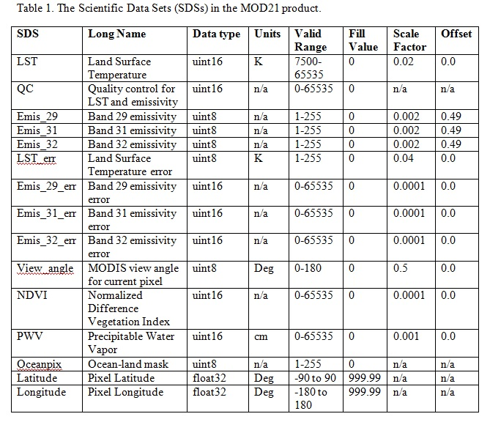
MOD21 Science Data Sets
Well characterized uncertainties!

Slide 29
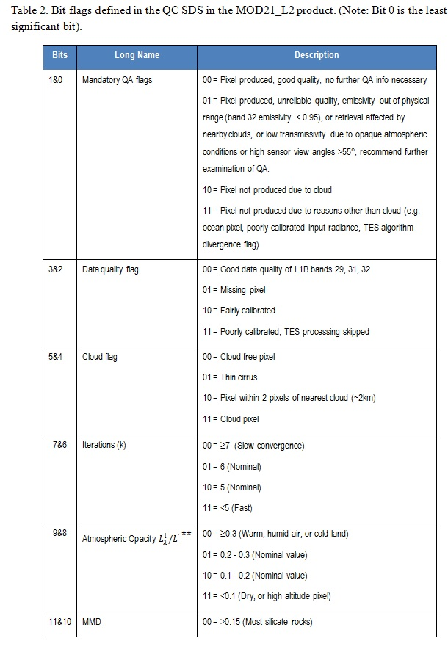
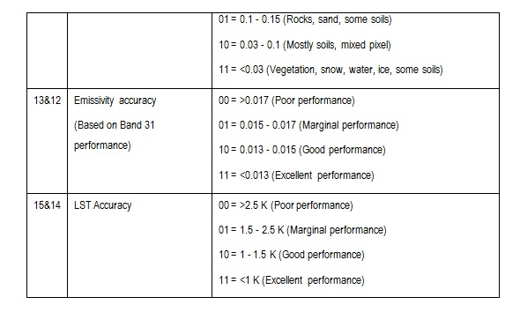
MOD21 QC
MOD21 has well defined Quality Control (QC) parameters based on TES algorithm outputs

Slide 30
JPL LST&E Validation Sites

Slide 31
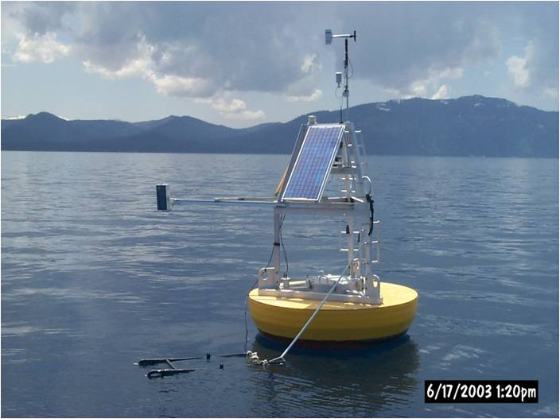
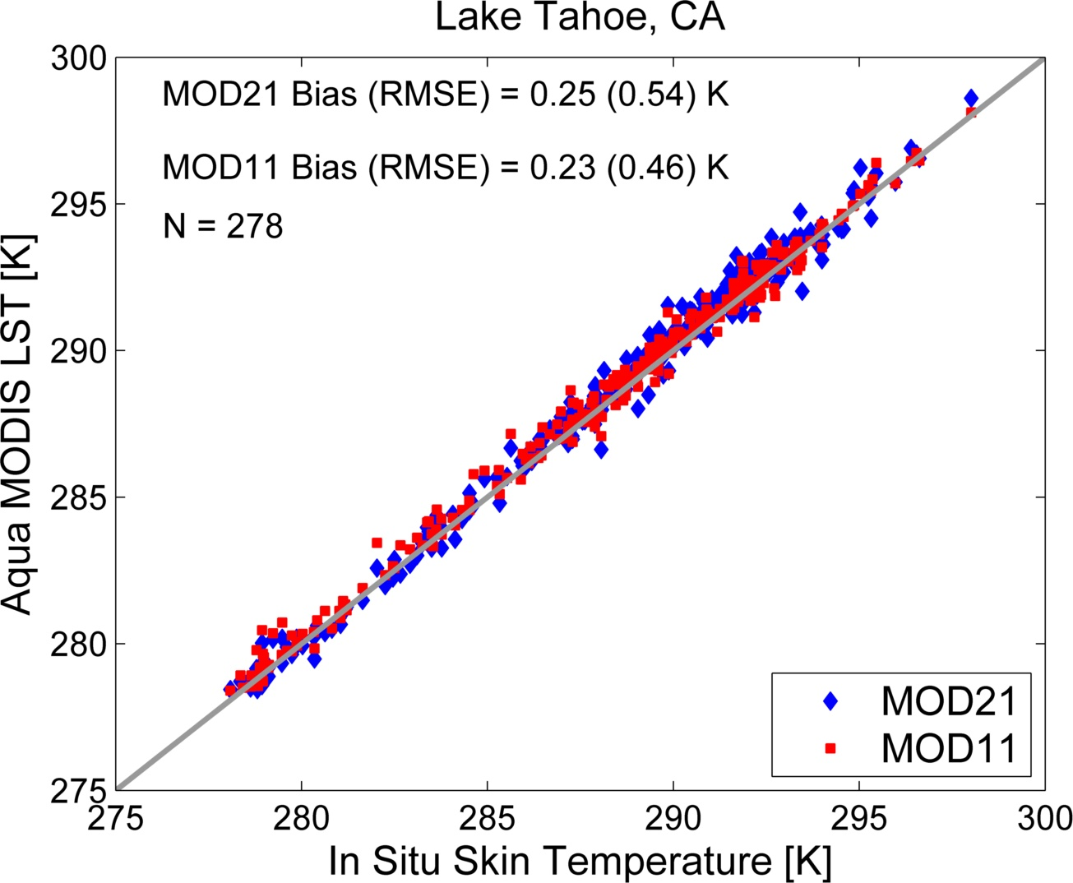

Slide 32
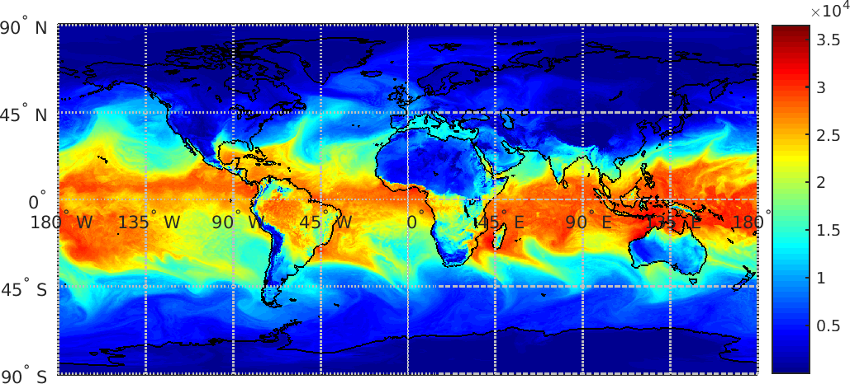
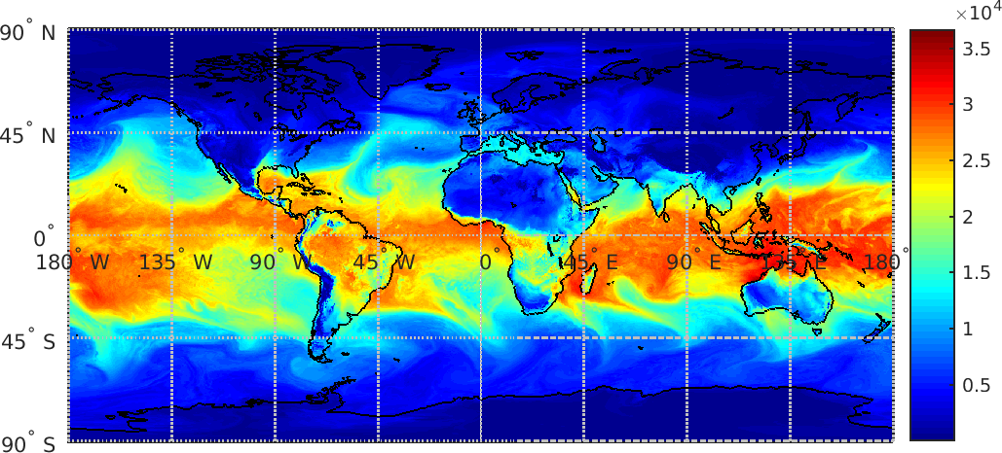
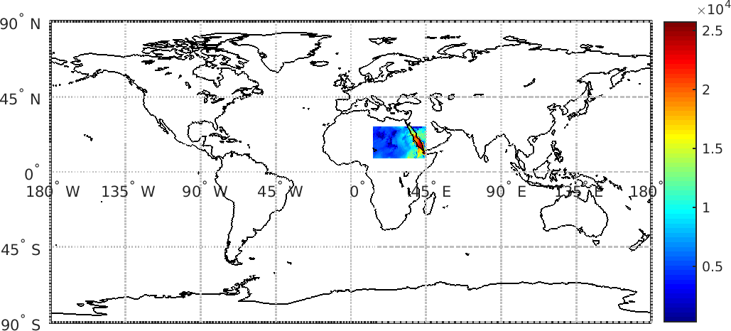
MERRA Global Water Vapor (2m)
06hr UTC
12hr UTC
Time Interpolated at 11hr VIIRS UTC

Slide 33
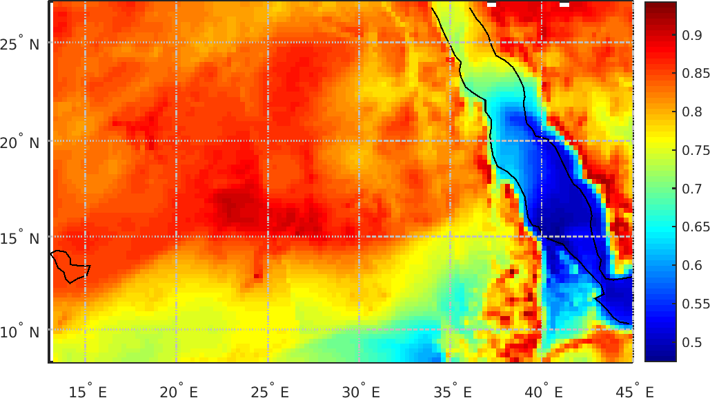
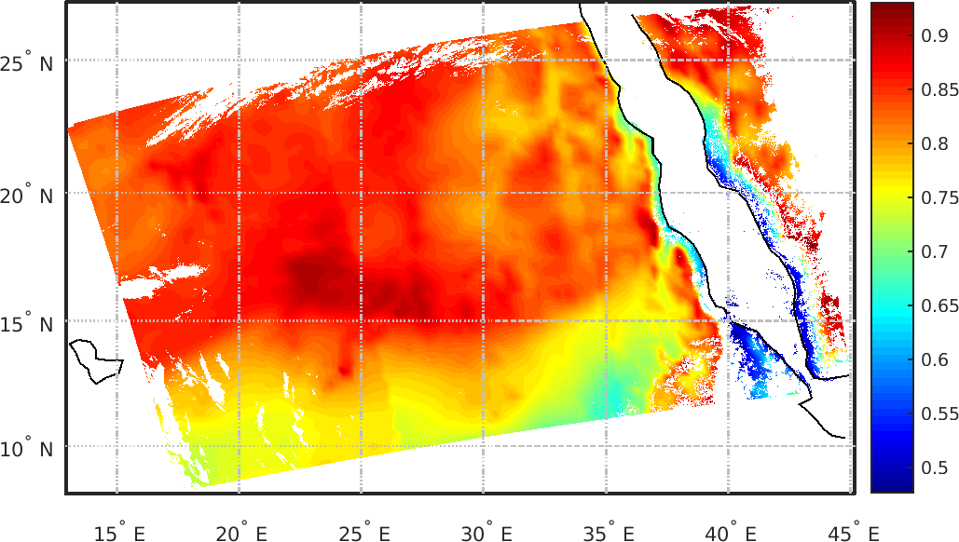
Final Transmittance Field
Native Grid – 11hr UTC
Geolocated to VIIRS – 11hr UTC
Triangulation-based Interpolation

Slide 34
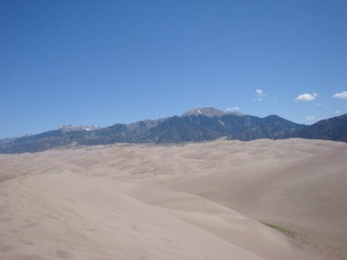
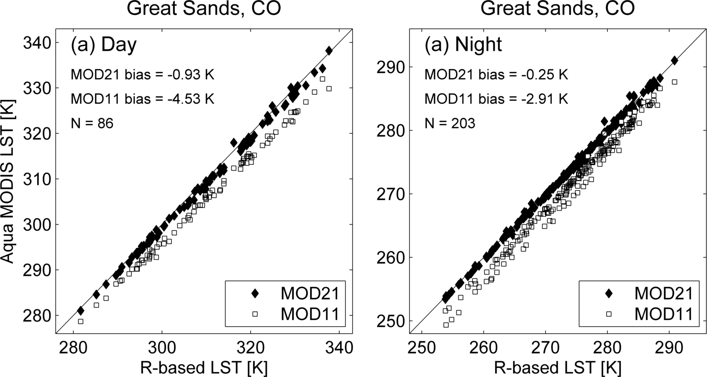
MODIS LST Validation:
Great Sands, Colorado
** Radiance-based LST validation using lab-measured sand samples collected at dune site

Slide 35

MODIS Emissivity Validation:
Great Sands, Colorado
MOD11 classification set too high resulting in cold LST bias (>2-5 K)

Slide 36
MOD21/MOD11 LST Validation summary: Graybody surfaces (forest, snow/ice, grassland)
MOD21 and MOD11 have similar accuracy over graybody surfaces (<1 K)

Slide 37
MOD21/MOD11 LST Validation summary:
Bare surfaces (pseudo-invariant sand sites)
Sites | Obs | MOD11 |  | MOD21 |  | MOD11 | MOD21
 |  | Bias (K) |  |  |  | RMSE (K)
Algodones, CA | 956 | -2.89 | -0.05 |  |  | 3.04 | 1.07
Great Sands, CO | 546 | -4.53 | -0.93 |  |  | 4.63 | 1.17
Kelso, CA | 759 | -4.55 | -1.48 |  |  | 4.62 | 1.67
Killpecker, WY | 463 | -4.51 | -1.19 |  |  | 4.58 | 1.42
Little Sahara, UT | 670 | -3.71 | -0.60 |  |  | 3.79 | 0.89
White Sands, NM | 742 | -0.73 | -0.29 |  |  | 1.07 | 0.95
MOD11 C5 cold bias of up to ~5 K over bare sites
(due to overestimated classification emissivity)

Slide 38
Future Work and Summary
MOD21 PGE in final stages of testing and development in preparation for Collection 6
Reprocessing of MODIS Terra/Aqua to begin May/June
Development and optimization of MOD21 algorithm will continue under NASA TERAQ award from 2014-2016
MOD21 LST&E products are physically retrieved with TES algorithm resulting in similar accuracy (<1.5 K) over all land cover types and a dynamic spectral emissivity product for detection and monitoring of landscape changes
A unified MOD21/MOD11 LST product is in production for a NASA MEaSUREs project at JPL

Slide 39
Theoretical Basis: Planck Function
Thermal Infrared (TIR)
As the temperature increases the peak in the Planck function shifts to shorter and shorter wavelengths
Notes:
Describes electromagnetic radiation emitted from a blackbody at some defined temperature

Slide 40
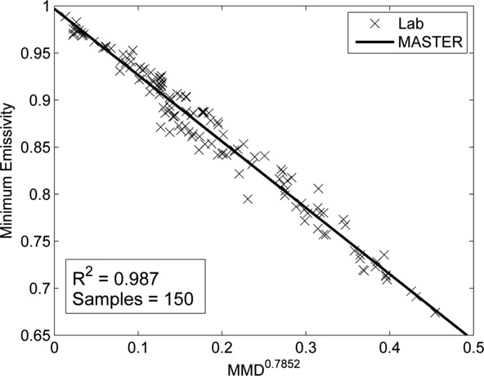
Temperature/Emissivity retrieval algorithms
To solve the under-determined temperature-emissivity problem:
N spectral measurements (N radiances) with N + 1 unknowns (N emissivity, 1 Temperature)
  Split window approach
    Requires 2 bands
    Prescribed spectral emissivity
    Regression coefficients should represent all configurations
    (atmospheric water content, view angle, surface T_{air}, …)
  Temperature-Emissivity Separation (TES) – ASTER approach
    Multispectral (minimum 3 bands)
    Requires atmospheric profiles for full atmospheric
    correction with Radiative Transfer Model
    Based on Emissivity model (Calibration Curve)
TES Calibration Curve
Notes:
TES – full radiative transfer equation solved on a pixel-by-pixel basis with atmospheric correction plus TES-calibration approach.

Slide 41
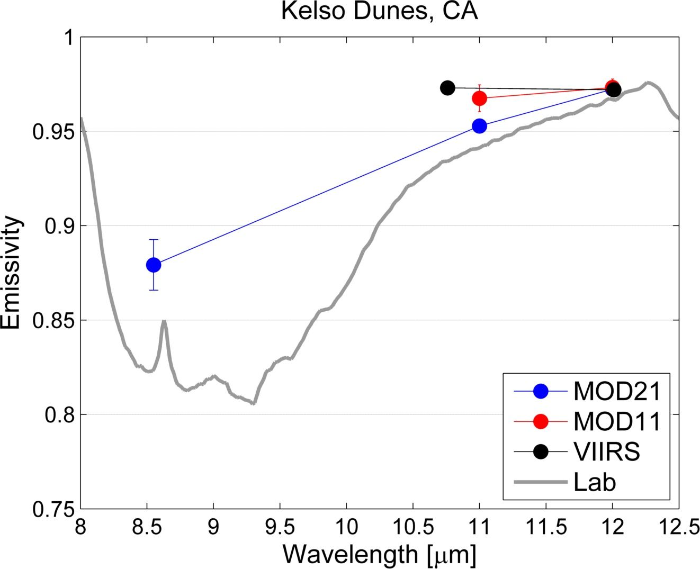
ASTER

Slide 42
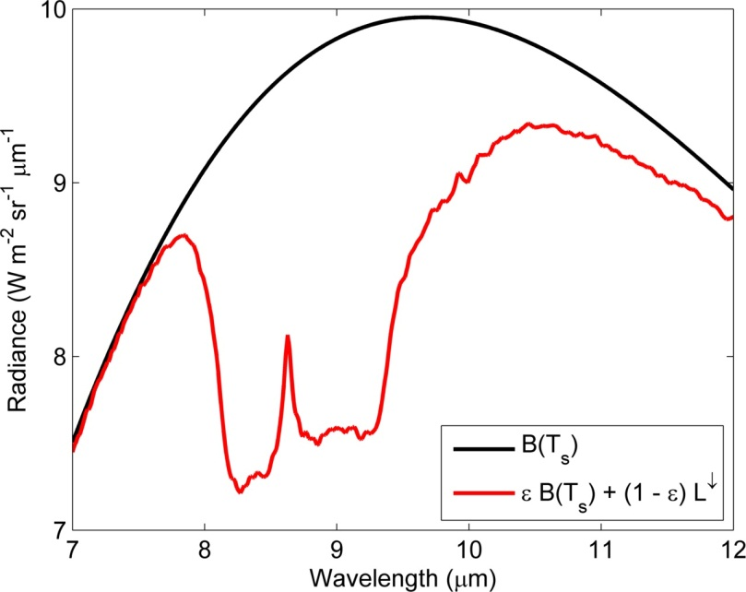
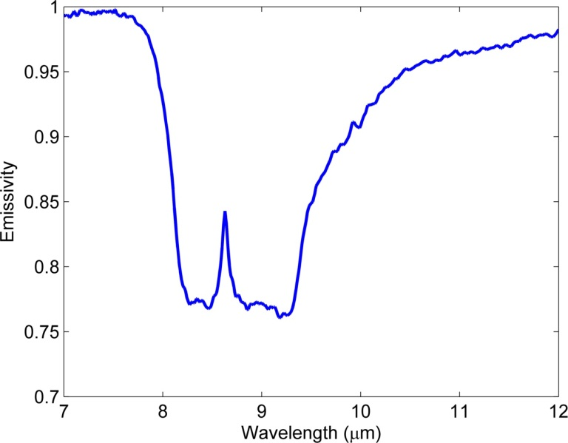
Spectral Emissivity
Emissivity: ratio of the spectral radiance of a material to that of a blackbody at the same temperature:
= Spectral Radiance

Slide 43
VIIRS –TES Processing Steps | Test Code Implementation | Evaluation
Read L1B and Cloud Mask Data (Fill radiances – bowtie) | ✓ | ✓
NWP atmospheric data (read, geolocate, interpolate) | ✓ | ✓
Run RTTOV Radiative Transfer | ✓ | ✓
Test NWP Accuracy (ECMWF, MERRA, NCEP) | ✓ | In progress
Implement Water Vapor Scaling (WVS) Model | ✗ | ✗
Temperature Emissivity Separation (TES) | ✓ | ✓
Validation | ✓ | In progress

