Slide 1
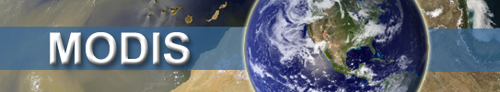

Creating a global aerosol data time series from MODIS, VIIRS and beyond
Robert C. Levy (NASA-GSFC)
robert.c.levy@nasa.gov
Shana Mattoo, Leigh Munchak and Richard Kleidman (SSAI/GSFC)
Lorraine Remer (UMBC/JCET), Falguni Patadia (MSU/GSFC),
Pawan Gupta (USRA/GSFC), Robert Holz (SSEC/UWisc), and others
Presented to MODIS meeting - 19 May 2015 @ Silver Spring, MD

Slide 2

Aerosol Climate Data Records (CDRs)?
“A time series of measurements of sufficient length, consistency, and continuity to determine climate variability and change.”
From: Climate Data Records from Environmental Satellites: Interim Report (2004)
  Some requirements
Measurements sustained over decades
Measurement of measurement performance (e.g. calibration, stability)
Acquired from multiple sensors / datasets

Slide 3
aerosols in the climate system
Understanding climate requires accurate and complete aerosol characterization
… which requires accurate and complete global aerosol data
… which requires global observations.
… which requires high quality techniques to retrieve aerosol properties
… which requires accurate global measurements
… which requires detailed characterization of the sensors and algorithms being used
MODIS is 15+ years, how do we extend across decades?

Slide 4
Outline
MODIS Collection 6 updates (algorithm wise)
  DT ocean
  DT land
Terra vs Aqua (and calibration and trends)
Onward to S-NPP VIIRS and climate data records?
Summary, challenges, etc

Slide 5
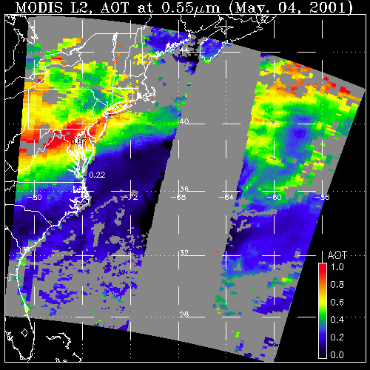
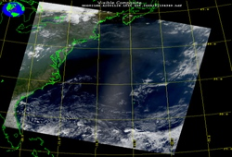
Aerosol retrieval from MODIS
What MODIS observes
Attributed to aerosol (AOD)
May 4, 2001; 13:25 UTC
Level 1 “reflectance”
May 4, 2001; 13:25 UTC
Level 2 “product”
LAND
OCEAN
GLINT
AOD
1.0
0.0
There are many different “algorithms” to retrieve aerosol from MODIS
Dark Target (“DT” ocean and land; Levy, Mattoo, Munchak, Remer, Tanré, Kaufman)
Deep Blue (“DB” desert and beyond; Hsu, Bettenhousen, Sayer,.. )
MAIAC (coupled with land surface everywhere; Lyapustin, Wang, Korkin,…)
Land/Atmospheric correction (Vermote, …)
Ocean color/atmospheric correction (McClain, Ahmad, …)
Etc (neural net, model assimilation, statistical, … )
Your own algorithm (many groups around the world)
Notes:
Talk about DT

Slide 6
MODIS Collection 6 updates
(Dark target)
Specifically, the 10 km standard product (MxD04_L2)
There is also a higher resolution product (3km: MxD04_3K), aimed at air quality applications.
There is also a new Deep Blue/ Dark-target “merge” product
and Deep Blue is improved greatly everywhere (Next talk!)

Slide 7
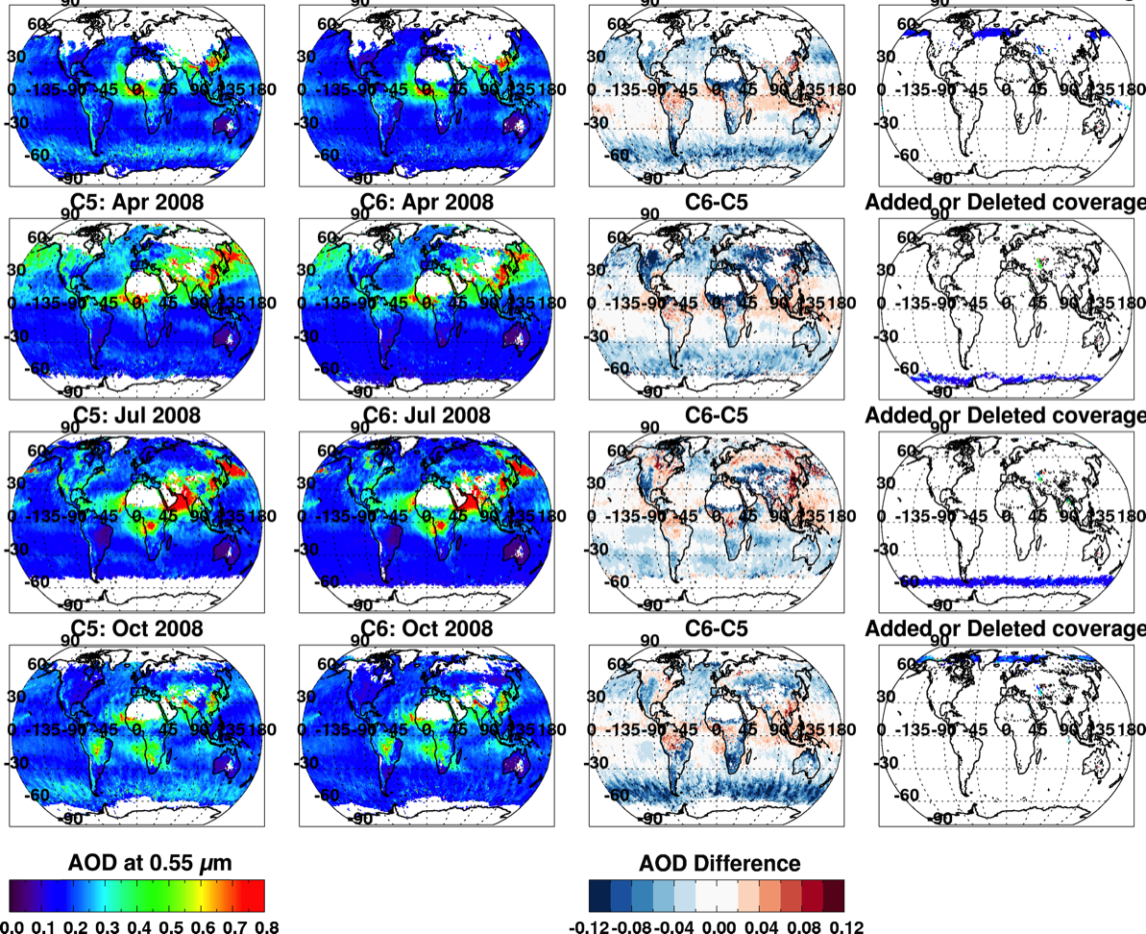
Overall changes (C6 vs C5): Aqua, 2008
Jan
Apr
Jul
Oct
DETAILS?? →
0.0 0.8
-0.1 0.0 0.1

Slide 8
MODIS (MxD04) Collection 6!
Levy, R. C., Mattoo, S., Munchak, L. A., Remer, L. A., Sayer, A. M., Patadia, F. and Hsu, N. C.: The Collection 6 MODIS aerosol products over land and ocean, Atmos Meas Tech, 6(1), doi:10.5194/amt-6-2989-2013, 2013.
Sayer, A. M., Munchak, L. A., Hsu, N. C., Levy, R. C., Bettenhausen, C. and Jeong, M. J.: MODIS Collection 6 aerosol products: Comparison between Aqua's e-Deep Blue, Dark Target, and ‘merged’ data sets, and usage recommendations, J Geophys Res-Atmos, doi:10.1002/2014JD022453, 2014.
Munchak, L. A., Levy, R. C., Mattoo, S., Remer, L. A., Holben, B. N., Schafer, J. S., Hostetler, C. A. and Ferrare, R. A.: MODIS 3 km aerosol product: applications over land in an urban/suburban region, Atmos Meas Tech, 6(1), doi: 10.5194/amt-6-1747-2013,2014.
Remer, L. A., Mattoo, S., Levy, R. C. and Munchak, L. A.: MODIS 3 km aerosol product: algorithm and global perspective, Atmos Meas Tech, 6(7), doi:10.5194/amt-6-1829-2013, 2013.
Collection 6 “Webinars”: http://aerocenter.gsfc.nasa.gov/ext/registration/
New “dark-target” website: http://darktarget.gsfc.nasa.gov
MODIS product website: http://modis-atmos.gsfc.nasa.gov

Slide 9
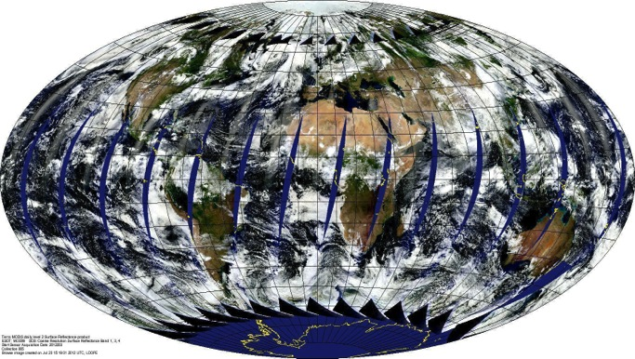
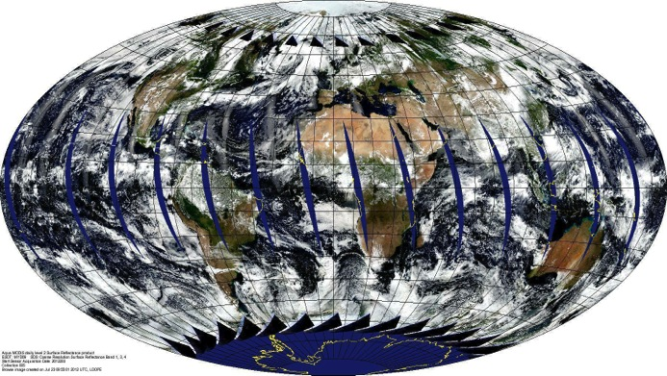
Focus on Trends/Calibration
Terra (since spring 2000)
Aqua (since summer 2002)
  Same instrument hardware (optical design)
  Same spatial and temporal sampling resolution
  Same calibration/processing teams
  Same aerosol retrieval algorithms
  Identical twins!

Slide 10
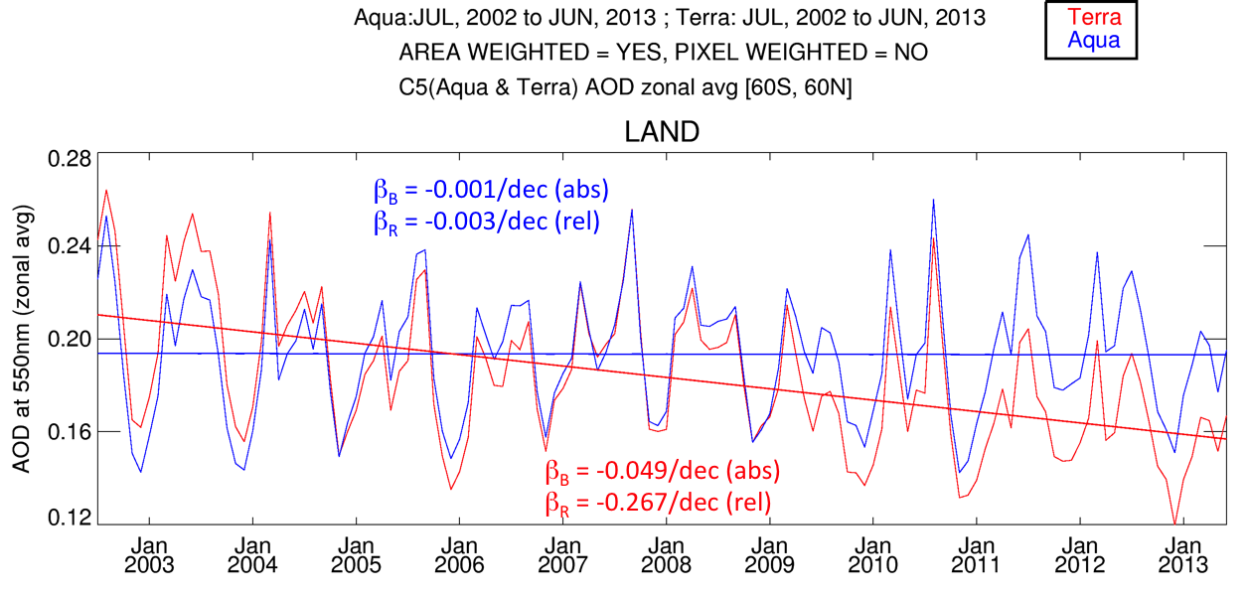
Aerosol Trends: If based on Collection 5
Over land, Terra decreased (-0.05/decade), Aqua constant
Terra / Aqua divergence was similar everywhere on the globe!
Like identical human twins, the twin MODIS sensors aged differently.

Slide 11
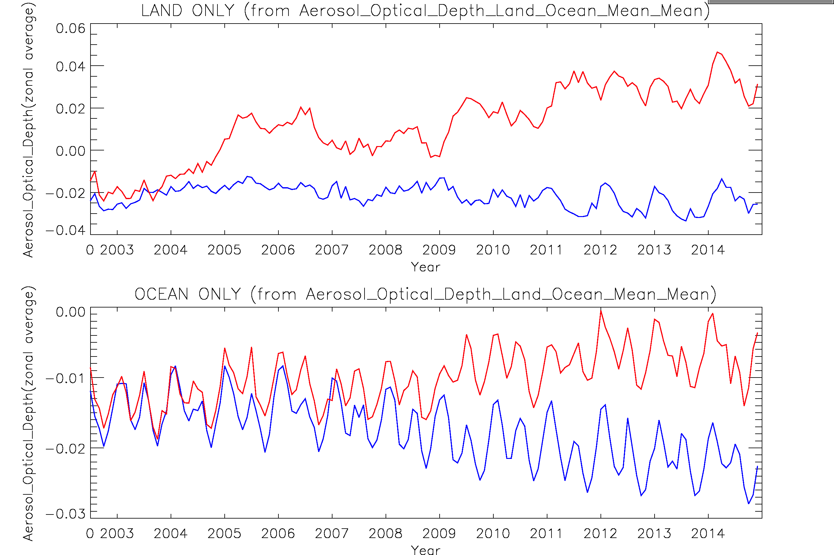
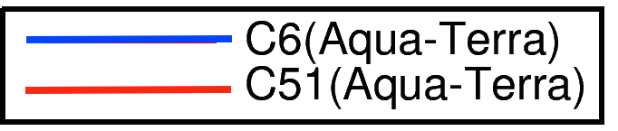
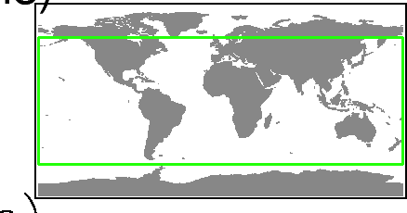
Impact of new calibration on C6 Aqua-Terra AOD
Zonal average 60°N-60°S
LAND
OCEAN
Terra/Aqua divergence “mostly” removed for C6
Terra offset by 0.02 (both land and ocean), THIS IS >10% of AOD!
There is still residual trending
Something seasonal after 2011 over land.
Figure by:
Vani Starry Manoharan

Slide 12
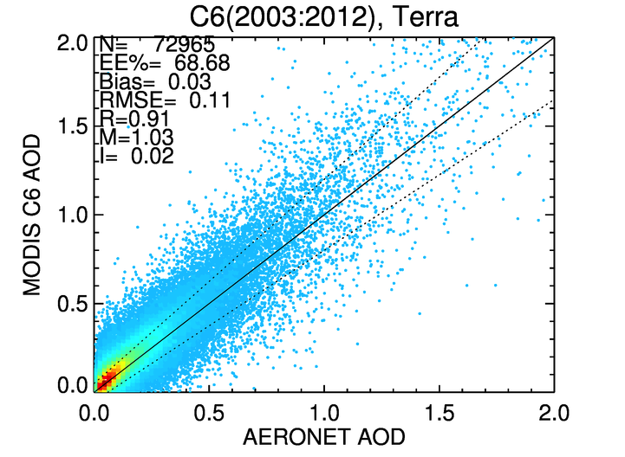
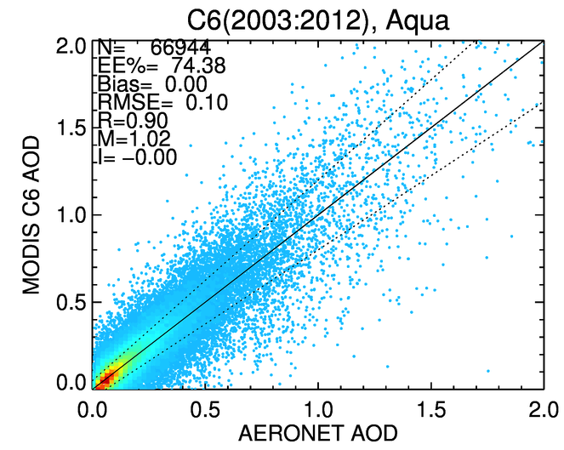
Some “validation” (2003-2012): Land
1400
1050
700
350
1
AOD compared with AERONET (2003-2012, overlapping periods).
EE% > 68%: Both Terra and Aqua meet “expected error” of ±(0.05 + 15%)
Many metrics nearly identical:
  Corr = R=0.91, Slope=M=1.02, RMSE=0.10
Terra is biased high by 0.03 (intercept = 0.02 vs 0.00)
N_{Terra} = 73K versus N_{Aqua}=67K. Why?
Not “proof” that Terra is biased high, but that Terra is biased compared to Aqua.

Slide 13
Summary (MODIS C6)
MODIS aerosol retrieval (“MxD04_L2”) has many upgrades for Collection 6.
Aqua/Terra level 2 and 3 are available now
Dark target (DT) updates
Trending issues reduced with C6 calibration
But still significant offsets (~0.02). Why?
Still residual co-trending (<0.01 / decade)
Lyapustin, A., Wang, Y., Xiong, X., Meister, G., Platnick, S., Levy, R., Franz, B., Korkin, S., Hilker, T., Tucker, J., Hall, F., Sellers, P., Wu, A. and Angal, A.: Scientific impact of MODIS C5 calibration degradation and C6+ improvements, Atmos Meas Tech, 7(12), 4353–4365, doi:10.5194/amt-7-4353-2014, 2014.

Slide 14


Beyond MODIS?
Terra just celebrated its 15th birthday!
At twelve - Aqua ain’t no spring chicken!
Terra and Aqua MODIS instruments are both 3x original mission lifetimes
MODIS won’t be here forever
How do we get to 20+ year aerosol data records?

Slide 15
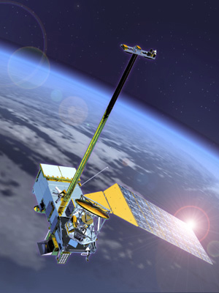
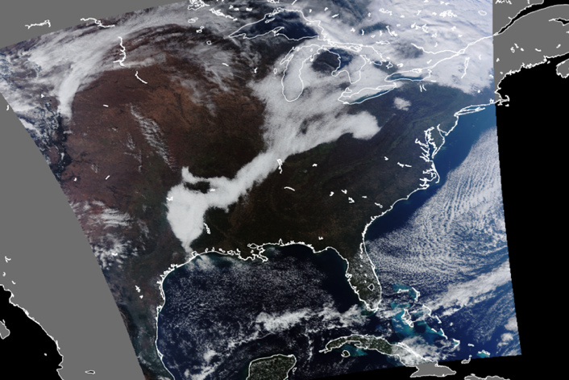
VIIRS?
Suomi-NPP (and future JPSS) VIIRS
Visible Infrared Imager Radiometer Suite
Can VIIRS “continue” the MODIS aerosol data record?

Slide 16
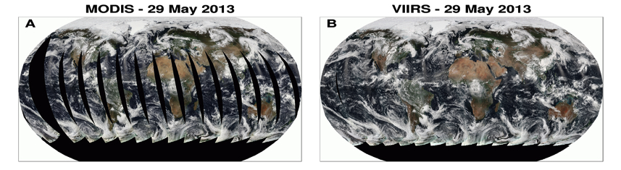
VIIRS versus MODIS
Orbit: 825 km (vs 705 km), sun-synchronous, over same point every 16 days
Equator crossing: 13:30 on Suomi-NPP, since 2012 (vs on Aqua since 2002)
Swath: 3050 km (vs 2030 km); Granule size: 86 sec (vs 5 min)
Spectral Range: 0.412-12.2μm (22 bands versus 36 bands)
Spatial Resolution: 375m (5 bands) 750m (17 bands): versus 250m/500m/1km
Aerosol retrieval algorithms: “Physics” similar, but different strategies
Wavelength bands (nm) that could be used for DT aerosol retrieval: 482 (466), 551 (553) 671 (645), 861 (855), 2257 (2113) → differences in Rayleigh optical depth, surface optics, gas absorption.
Aqua (13:30 Local Time, 14.6 revs/day)
Suomi-NPP (13:30 Local Time 14.1 revs/day);

Slide 17
VIIRS Aerosol Algorithm (NOAA-IDPS)
Multi-spectral over dark surface
Separate algorithms used over land and ocean
Algorithm heritages
  over land: MODIS atmospheric correction (e.g. the MOD09 product)
  over ocean: MODIS aerosol retrieval (MOD04 product)
Many years of development work:
Retrieves: AOD (at 0.55 μm and spectral), Ångström Exponent (AE), Suspended Matter (aerosol classification), etc
NOAA CLASS: The Primary Gateway for the VIIRS Data Distribution
“Validated Stage 2” (published) since 23 Jan 2013.
Provides data in HDF5 format (compared to HDF4-ish for MODIS)

Slide 18
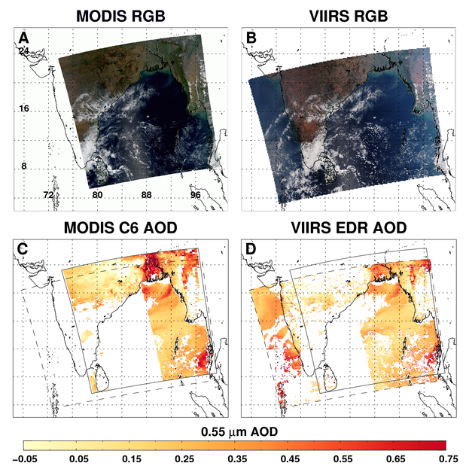
Aerosol retrieval: Different algorithms
Granules over India (Mar 5, 2013, 0735/0740 UTC)
Ocean retrieval algorithm
“heritage” circa 1997
(Tanré, Kaufman, Remer,… )
MODIS: C6 assumptions
(Levy et al., 2013)
VIIRS: C5-like assumptions
  (Remer et al., 2005)
VIIRS
MODIS
Land retrieval algorithm
“heritage” circa 1997
(Kaufman, Tanré, Vermote,…)
MODIS: C6 “dark-target”
(Levy et al., 2007, 2013)
VIIRS: C5 “atmos. correction” (Vermote et al., 2008).
Differences in wavelengths, cloud masks, pixel selection technique, quality assurance etc:
Also, not exactly overlapping orbits (note 5 min difference).
Note, 86 second VIIRS granules aggregated to 5 minutes.

Slide 19
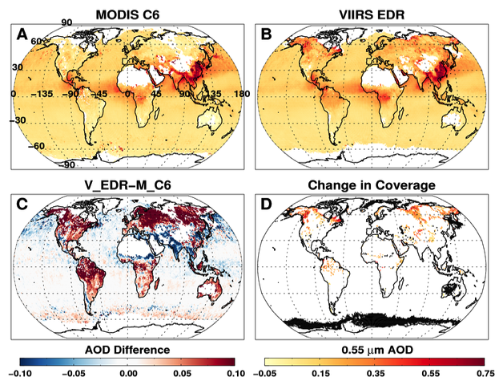
Monthly mean AOD for Spring 2013 (Mar-May)
MODIS C6 and VIIRS-EDR are similar, yet different
Notes:
Monthly (or spring 2013 season) mean map for M-C6, V-IDPS, diffs and differing coverage. These are for our QA thresholds for MODIS and QA=3 for VIIRS. M-C6 data : /f001/lmunchak/projects/levy_calibration/land_ocean_separate/data/C6_V2/MYD04_M3
C6_V2 included fix for land sea mask = 1,2 for splitting land & ocean

Slide 20
Create a MODIS like algorithm for VIIRS?
The Intermediate file format (IFF) puts MODIS and VIIRS in “same common denominator” (University of Wisconsin)
MODIS-IFF is 1 km resolution for all bands, VIIRS-IFF is 750 m (no high-resolution bands for either MODIS or VIIRS)
Use 10 x 10 pixel retrieval boxes (so 10 km for MODIS; 7.5 km for VIIRS).
Run lookup tables to account for different wavelengths

Slide 21
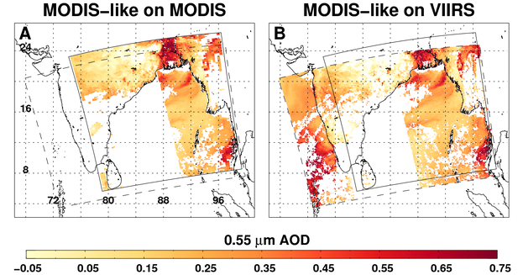
Same algorithm on both platforms?
Apply C6-like thresholds for cloud masking, pixel selection and aggregation
Run “MODIS-like” algorithm on both M-IFF and V-IFF data
Much more similar AOD structure
Still differences in coverage and magnitude. We are learning why. (Cloud masking/spatial variability thresholds?)

Slide 22
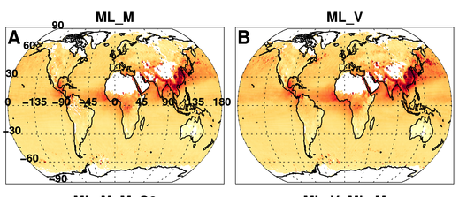
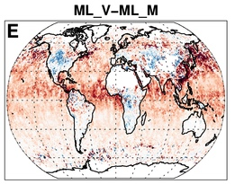
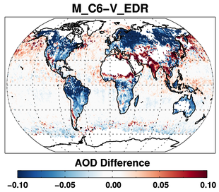
Gridded seasonal AOD (Spring 2013)
MODIS
MODIS-like on VIIRS
Difference M - V
Versus…
Running MODIS-like on VIIRS has reduced global AOD differences and has similar global sampling
Systematic bias over ocean (VIIRS high by 15%)
Not systematic bias over land (MODIS high by 5%)

Slide 23
Comparing gridded AOD (Spring 2013)
VIIRS_EDR vs MODIS
MODIS-like (VIIRS) vs MODIS
New data
More like MODIS
But 1.15 slope over ocean!
Notes:
Our MODIS-like on VIIRS looks more like MODIS than VIIRS-EDR does, especially over land.

Slide 24
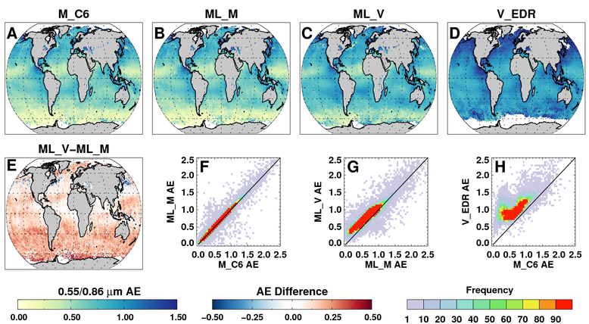
Angstrom Exponent (0.55 / 0.86 μm)
MODIS-like on VIIRS has Angstrom Exponent that looks much more like MODIS

Slide 25
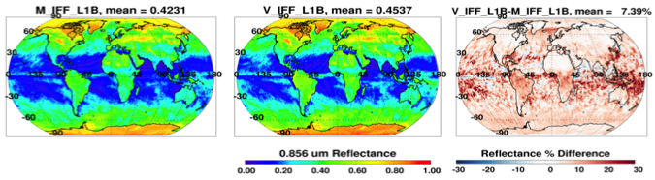
Comparing to AERONET and calibration (2013)
MODIS-like on VIIRS has great correlation (R² > 0.9) but 1.17 slope!
VIIRS reflectance may be 2% high in some bands? (e.g. Uprety et al., 2013)
2% high bias can give a 1.17 slope over ocean without the adding bias to land.
MODIS: 0.856 um Reflect
VIIRS: 0.861 um Reflect
VIIRS – MODIS Reflect
0.856 or 0.861 Reflectance
% Difference Reflectance

Slide 26
Will VIIRS continue MODIS?
How would we know?
Convergence of gridded (Level 3 –like) data?
  For a day? A month? A season?
  What % of grid boxes must be different by less than X?
    in AOD? In Angstrom Exponent?
What about “sampling”?
  Even if the mean, histograms and gridded data looked similar, what about the “retrievability?”
  Fraction of retrieved pixels / total pixel
Comparison (validation) with AERONET?

Slide 27
A time series (of sorts) so far
Beta
Validated

Slide 28
Summary
MODIS-DT Collection 6 –
  Aqua/Terra level 2, 3 available now;
  Extended diagnostics, DT/DB merge, science improvements
  “Trending” issues reduced, but 15% or 0.02 Terra/Aqua offset remains .
VIIRS-IDPS (MODIS-ish over ocean; not over land)
  VIIRS is “similar” instrument, yet different then MODIS
  The NOAA product has similar global EE to MODIS (over ocean).
  With 50% wider swath, VIIRS has daily coverage
VIIRS-DT – now,
  Ensures algorithm consistency with MODIS DT.
  IFF-based granules are being processed now (we are sharing)
  20% NPP/Aqua offset over ocean.
  Paper will be submitted by end of May!
VIIRS-DT - future,
  We don’t have “continuity” yet.
  Move towards full resolution (includes I-bands)
  Discussion here at MODIS-VIIRS Science Team meeting (formats, delivery, ATBDs, documentation, etc…)

Slide 29
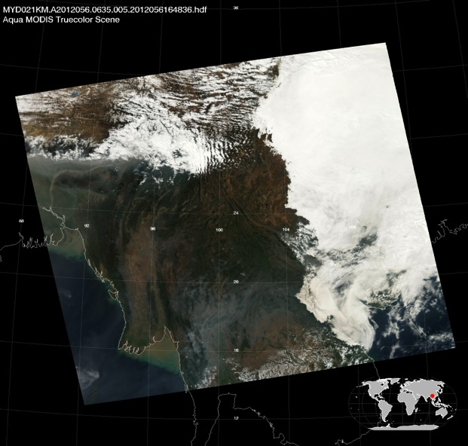
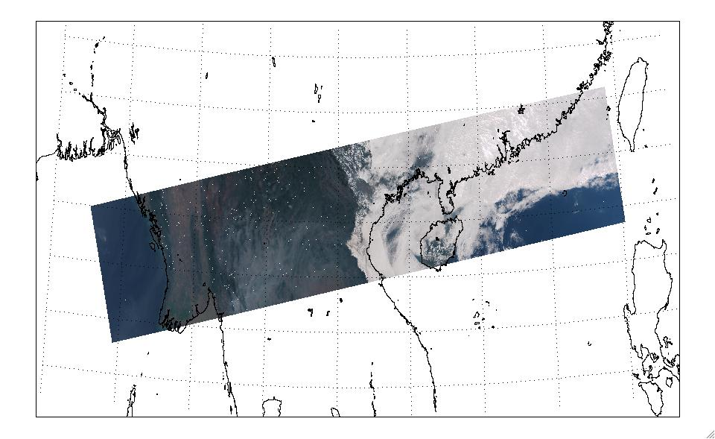
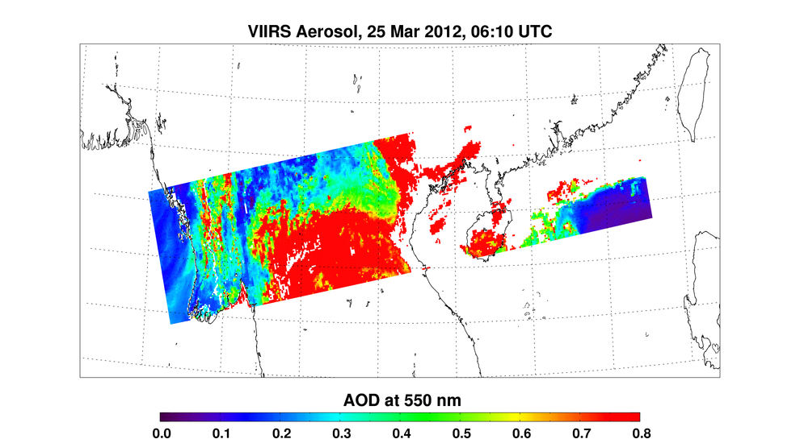
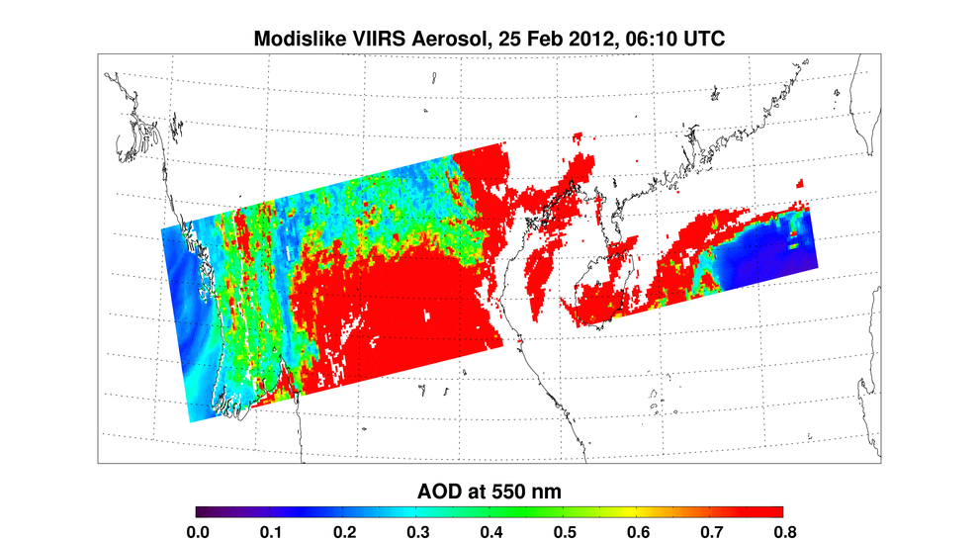
Summary (cont)
Can VIIRS continue the MODIS record?
  We believe we need to apply the same algorithm
  Calibration is a concern.
We still need to define “how similar is good enough”?
Which statistics must converge?
  Expected error (validation)
  Sampling
  Means/variance
  At 0.55 μm only? At other wavelengths?
  Etc
Keep open discussion with our “super-users” (modelers, assimilators, CERES team, etc). What do they need?
MODIS RGB
MODIS Aerosol (06:35 UT)
MODIS RGB
MODIS Aerosol (06:35 UT)
The MODIS aerosol
cloud mask is more
conservative than
the VIIRS VCM.
The MODIS aerosol
cloud mask is more
conservative than
the VIIRS VCM.
VIIRS RGB
VIIRS Aerosol EDR
MODIS Algorithm, VIIRS Input
VIIRS RGB
VIIRS Aerosol EDR
MODIS Algorithm, VIIRS Input

Slide 30
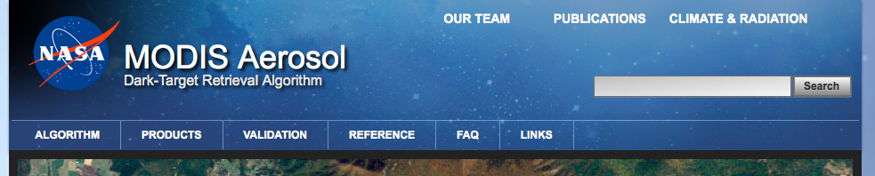
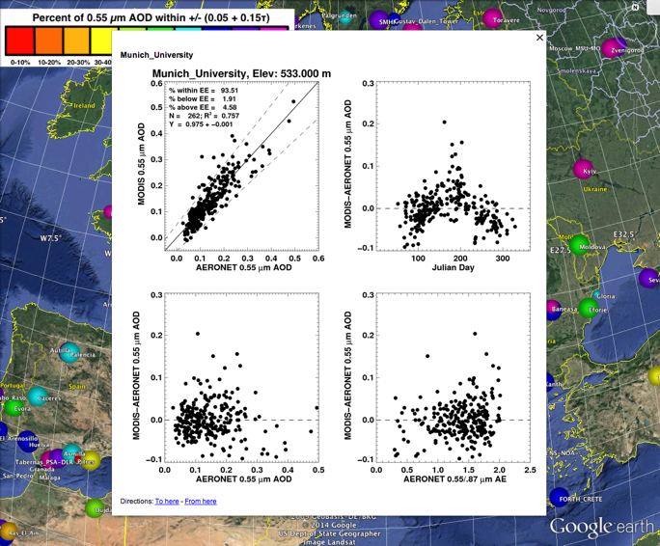
http://darktarget.gsfc.nasa.gov
Web site in development/ATBDs being updated
Reference for all things “dark target”
  The algorithms and assumptions
  Examples
  Validation
  Primary publications
  Educational material
  FAQ
  Links to data access
  Considering a “forum”

