Slide 1
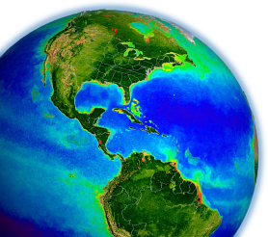
Marine inherent optical properties (IOPs)
from MODIS & VIIRS with Extension to
Optically Shallow Waters
Lachlan McKinna & Jeremy Werdell
Ocean Ecology Laboratory
NASA Goddard Space Flight Center
MODIS Science Team Meeting
Silver Spring, Maryland
21 May 2015

Slide 2
what are marine inherent optical properties (IOPs)?
spectral absorption & scattering coefficients
what can marine IOPs tell me?
they describe the contents of the upper ocean
- phytoplankton abundance & community structure
- non-algal suspended particles
- particulate & dissolved carbon
- diffuse attenuation / water clarity
why study marine IOPs from space?
satellite time-series provide “big picture” views to better understand responses to climate change & for inclusion in bio-hydrographic models

Slide 3
presentation outline
Part 1: implementation review
Part 2: validation matchup
Part 3: algorithm updates
Part 4: status overview

Slide 4
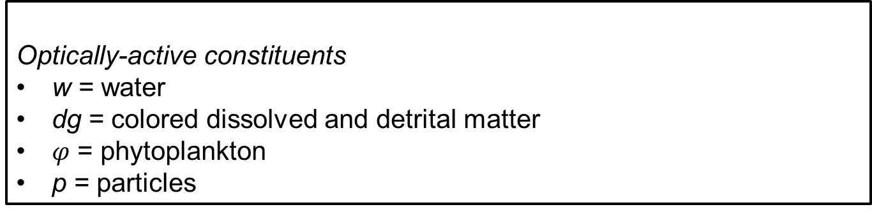
relating ocean color & in-water optical properties
Optically-active constituents
w = water
dg = colored dissolved and detrital matter
$φ$ = phytoplankton
p = particles

Slide 5
relating ocean color & in-water optical properties
Spectral shapes
Magnitudes
Constants*
3 unknowns: M_{dg}, M_{φ}, M_{bp}
6 knowns ( the 6 visible MODISA R_{rs}), or, 5 for VIIRS
solve for unknown M coefficients → non-linear least squares

Slide 6
relating ocean color & in-water optical properties
power-law, η:
Fixed; Lee et al. (2002)
Ciotti et al. (1999);
Hoge & Lyon (1996);
Loisel & Stramski (2001);
Morel (2001)
SAAs developed routinely over 30 yrs
many successfully retrieve three components
many overlapping approaches exist
Inverse method:
Levenberg-Marquardt
SVD matrix inversion
exponential, S_{dg}:
fixed (= 0.018)
  Lee et al. (2002)
  Werdell (2010)
  tabulated a*_{dg}(λ)
  tabulated a*_{φ}(λ)
Bricaud et al. (1998)
Ciotti & Bricaud (2006)
Morel f/Q
Gordon quadratic

Slide 7
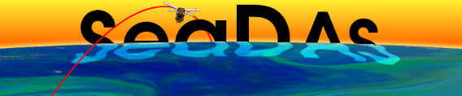
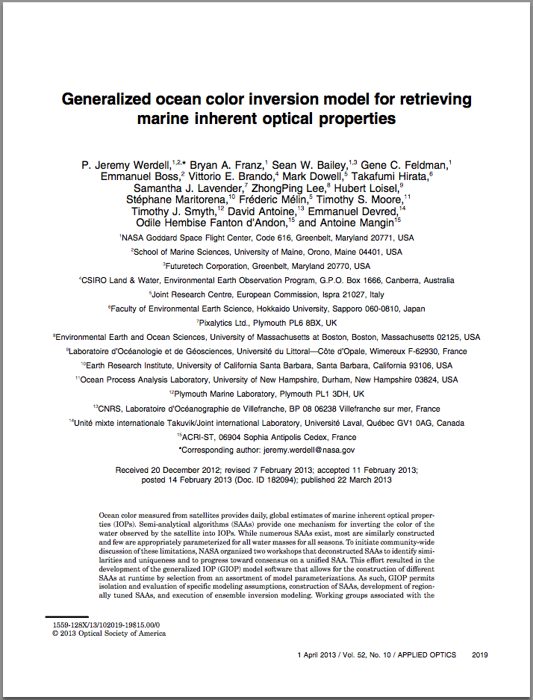
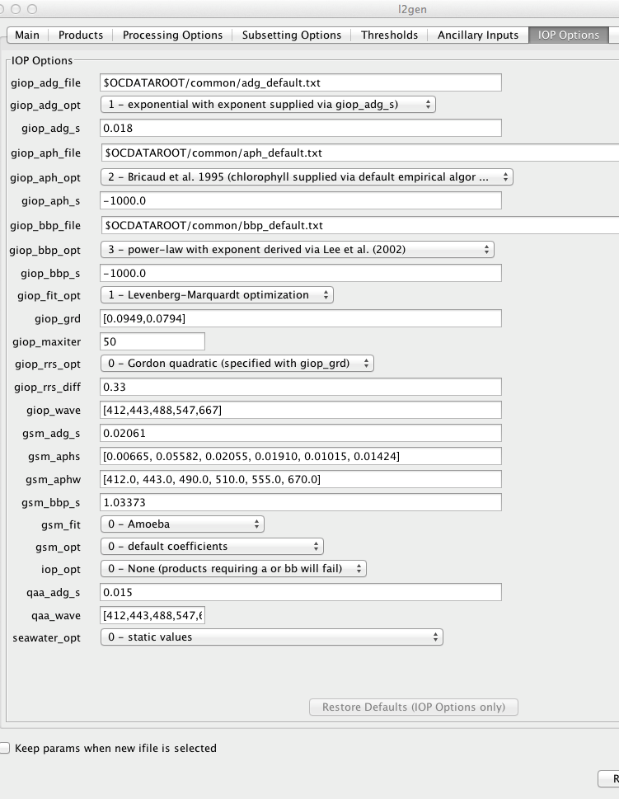
Implementation
default, global GIOP configuration assigned for operational MODIS-Aqua, MODIS-Terra & VIIRS processing
end-user can customize GIOP parameterizations
- test new parameterizations or combinations
- regional configurations
first comprehensive evaluation of SAA similarities/differences
generalized IOP (GIOP) framework available through SeaDAS

Slide 8
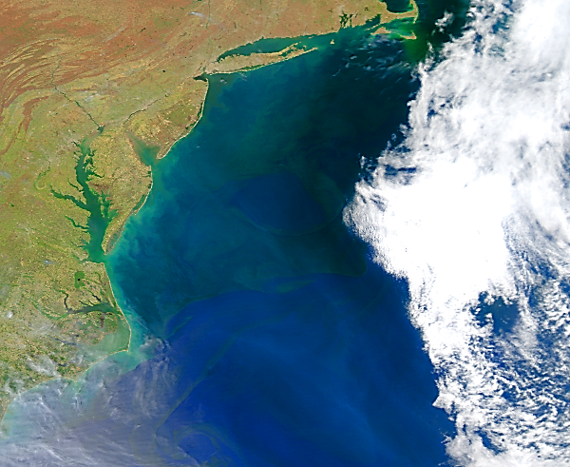

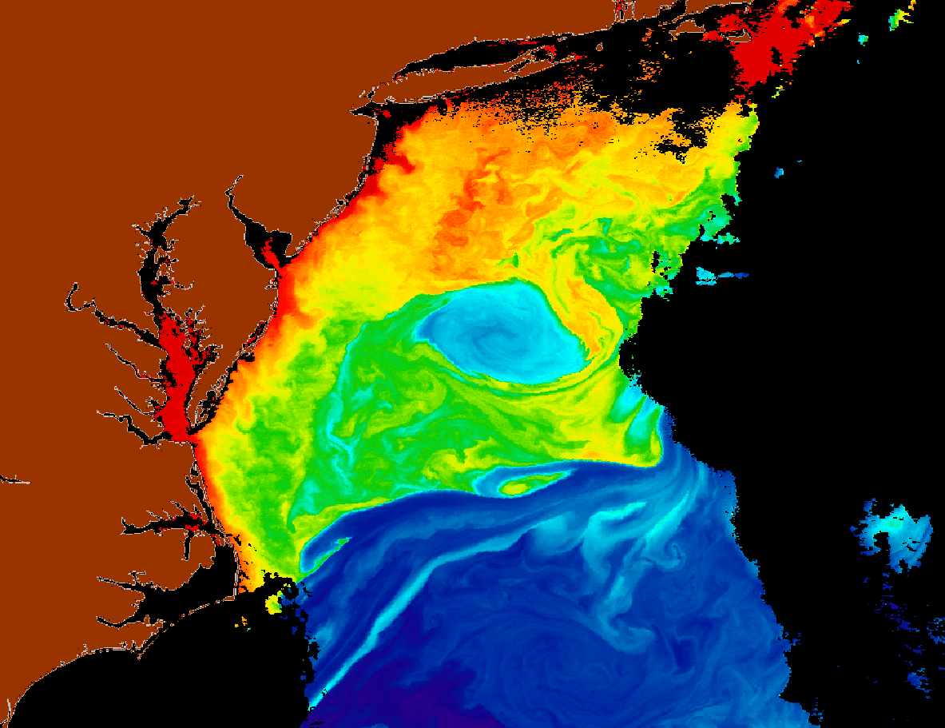
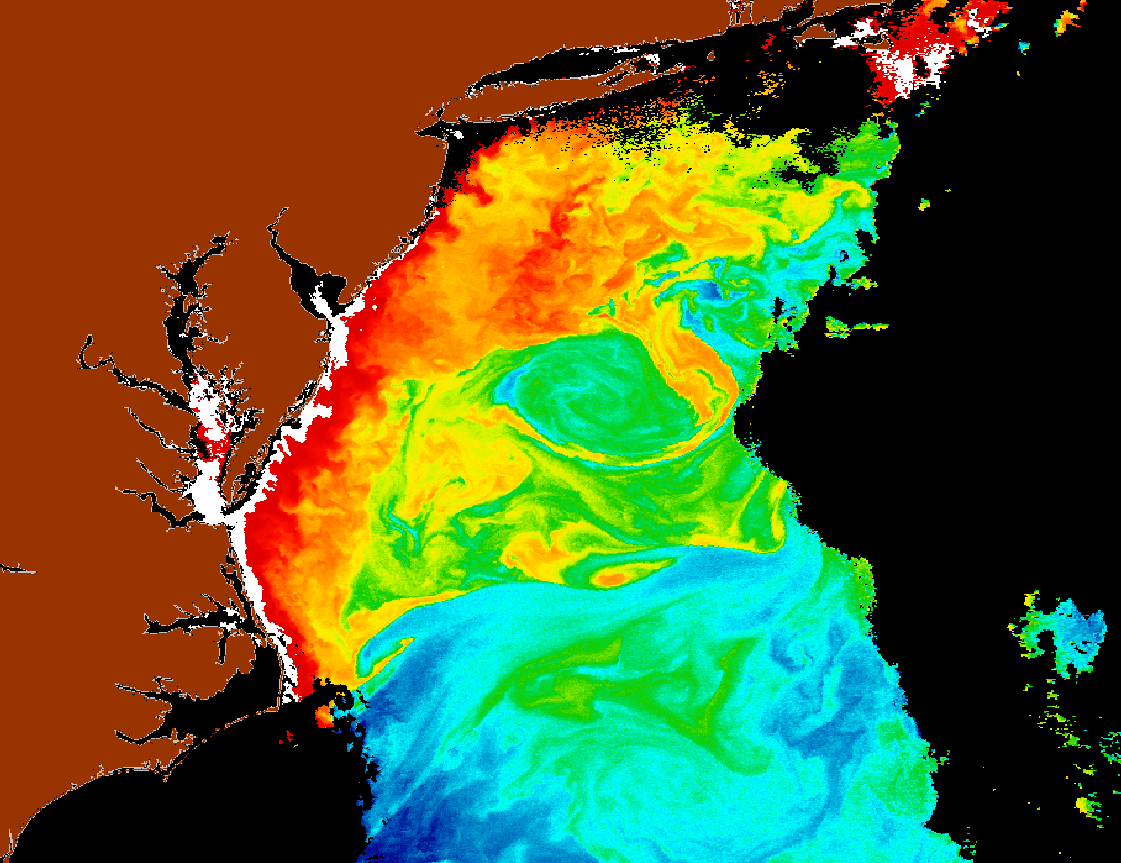
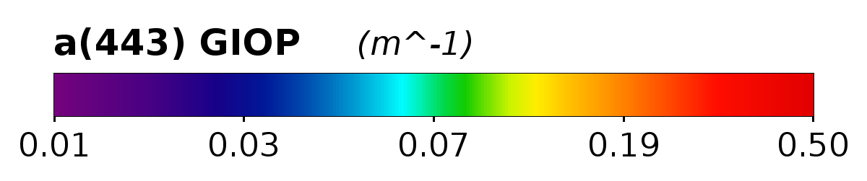

MODIS Aqua 18 April 2008
Data: NASA OBPG
Processing: SeaDAS, GIOP Algorithm with default options
Features: Eddies, fronts, mixing

Slide 9
presentation outline
Part 1: implementation review
Part 2: validation matchup
Part 3: algorithm updates
Part 4: status overview

Slide 10
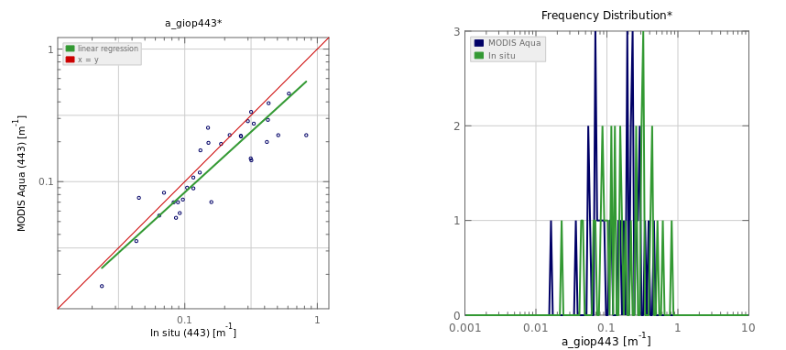
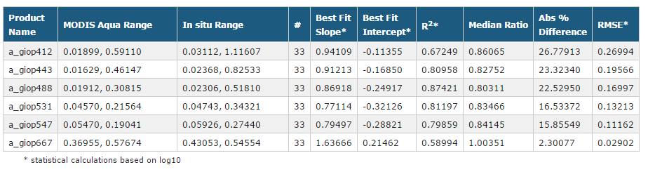
a(443) MODIS Aqua
R²=0.81
Slope=0.91
Intercept =-0.17
Ratio = 0.83
seabass.gsfc.nasa.gov

Slide 11
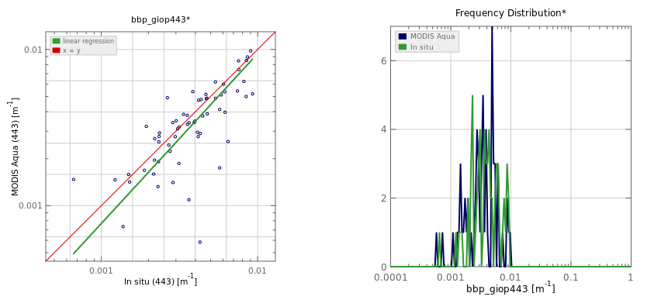
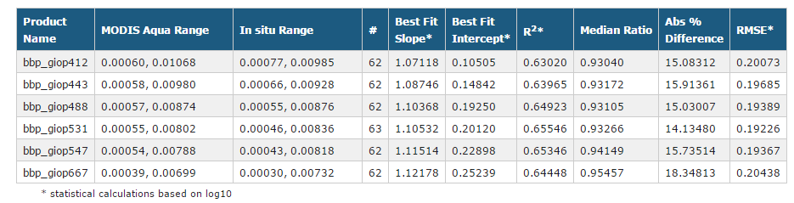
b_{bp}(443) MODIS Aqua
R²=0.64
Slope=1.09
Intercept =0.15
Ratio = 0.93
seabass.gsfc.nasa.gov

Slide 12
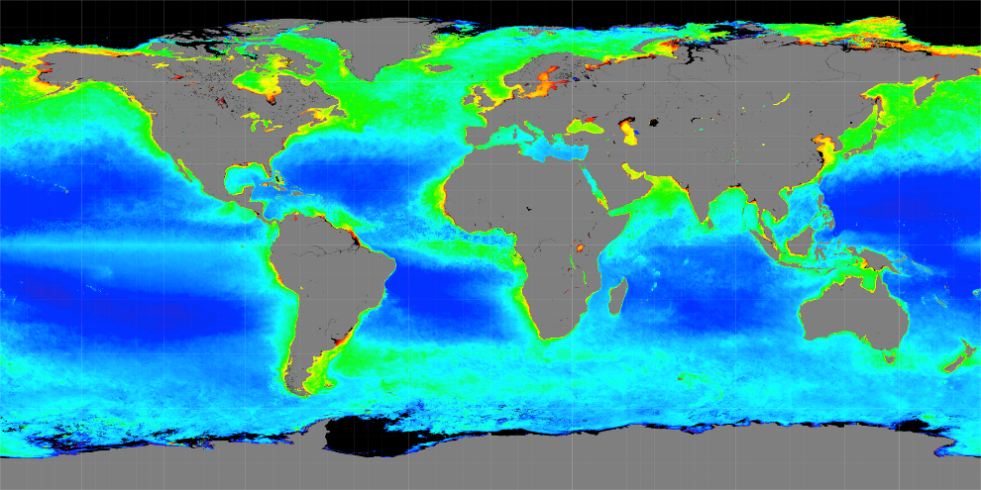
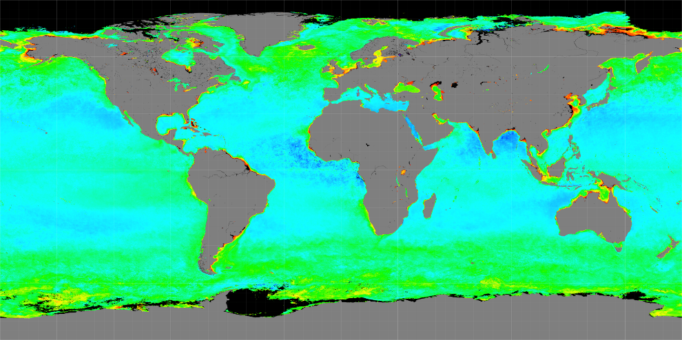
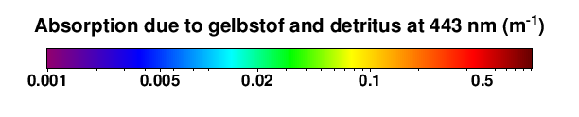
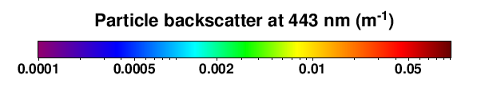
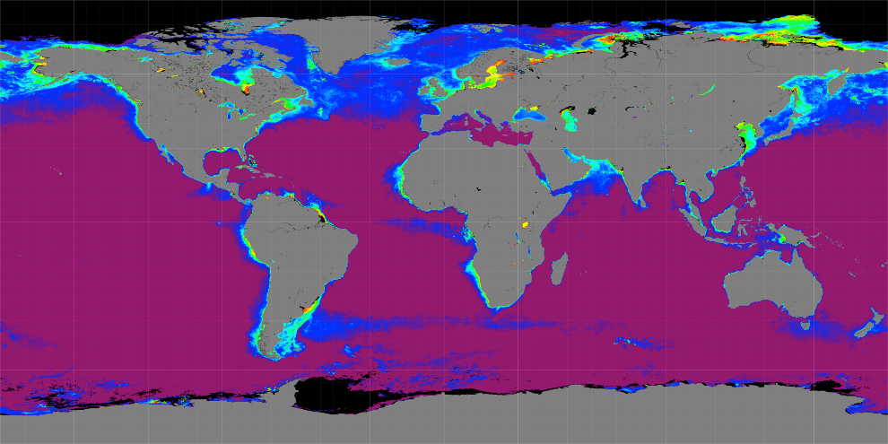
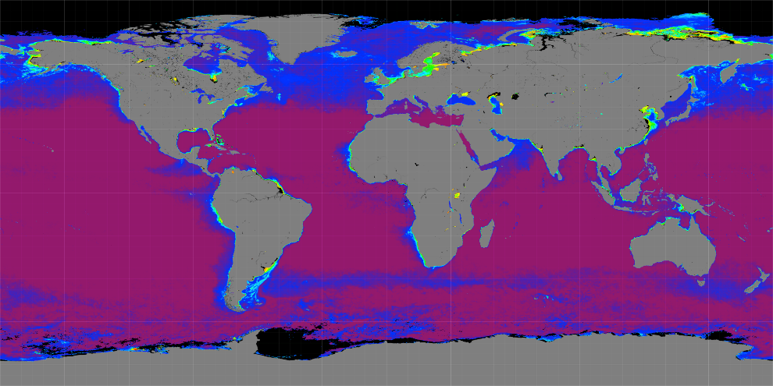

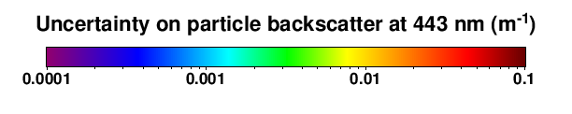
MODIS Aqua IOP Products & Uncertainties

Slide 13
presentation outline
Part 1: implementation review
Part 2: validation matchup
Part 3: algorithm updates
Part 4: status overview

Slide 14
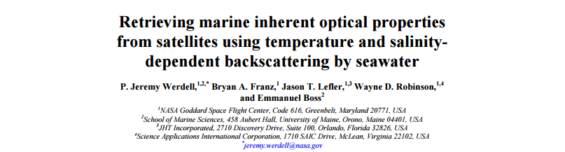
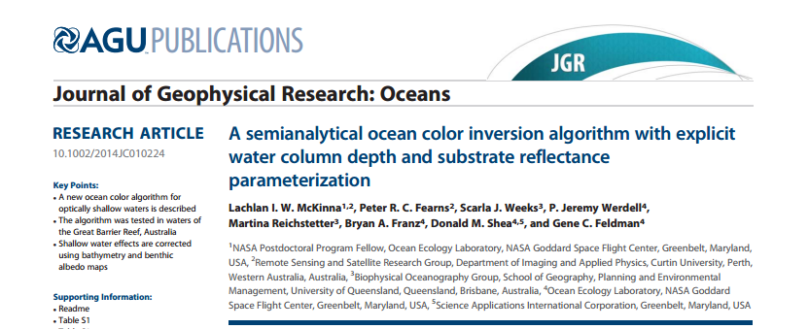
Algorithm updates
Temperature-salinity dependence of b_{bw}
Optically shallow waters

Slide 15
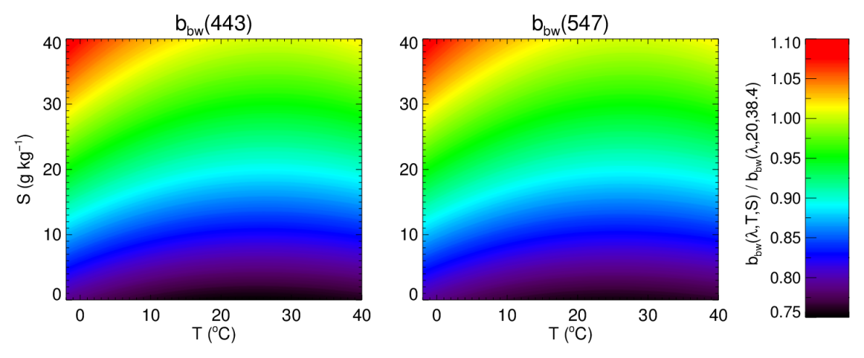
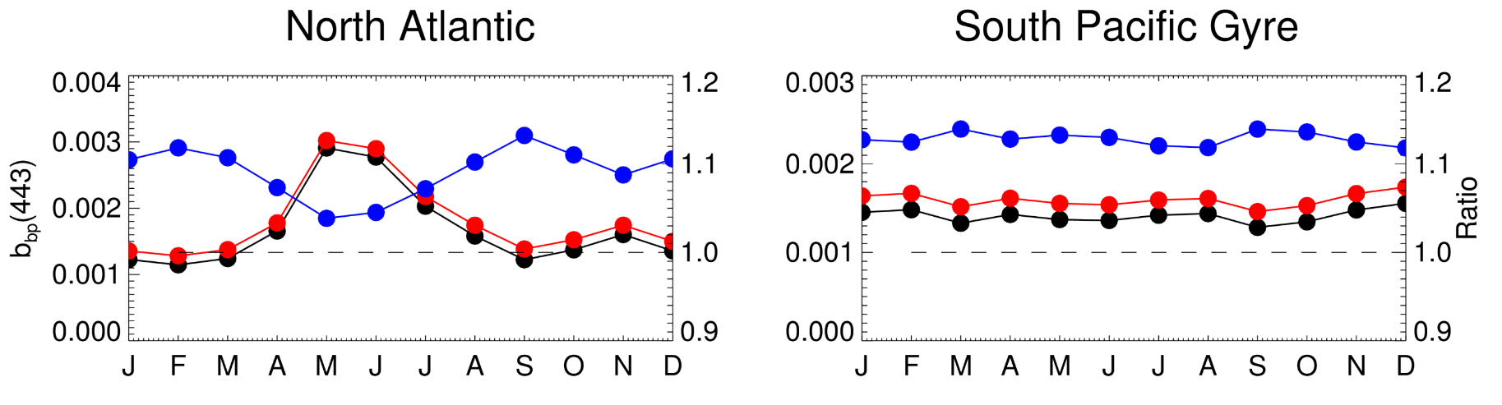
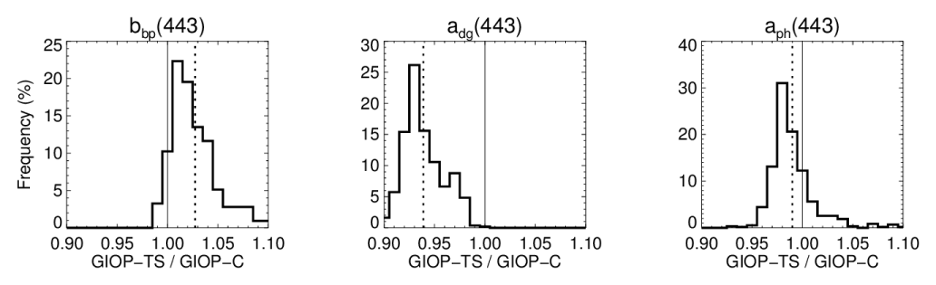
Algorithm updates:
temperature & salinity dependence of b_{bw}

Slide 16
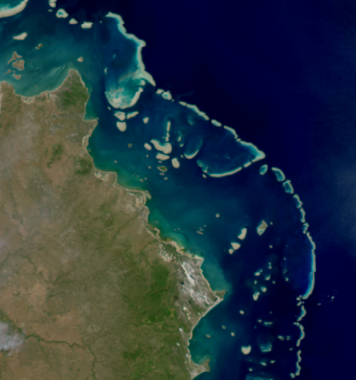
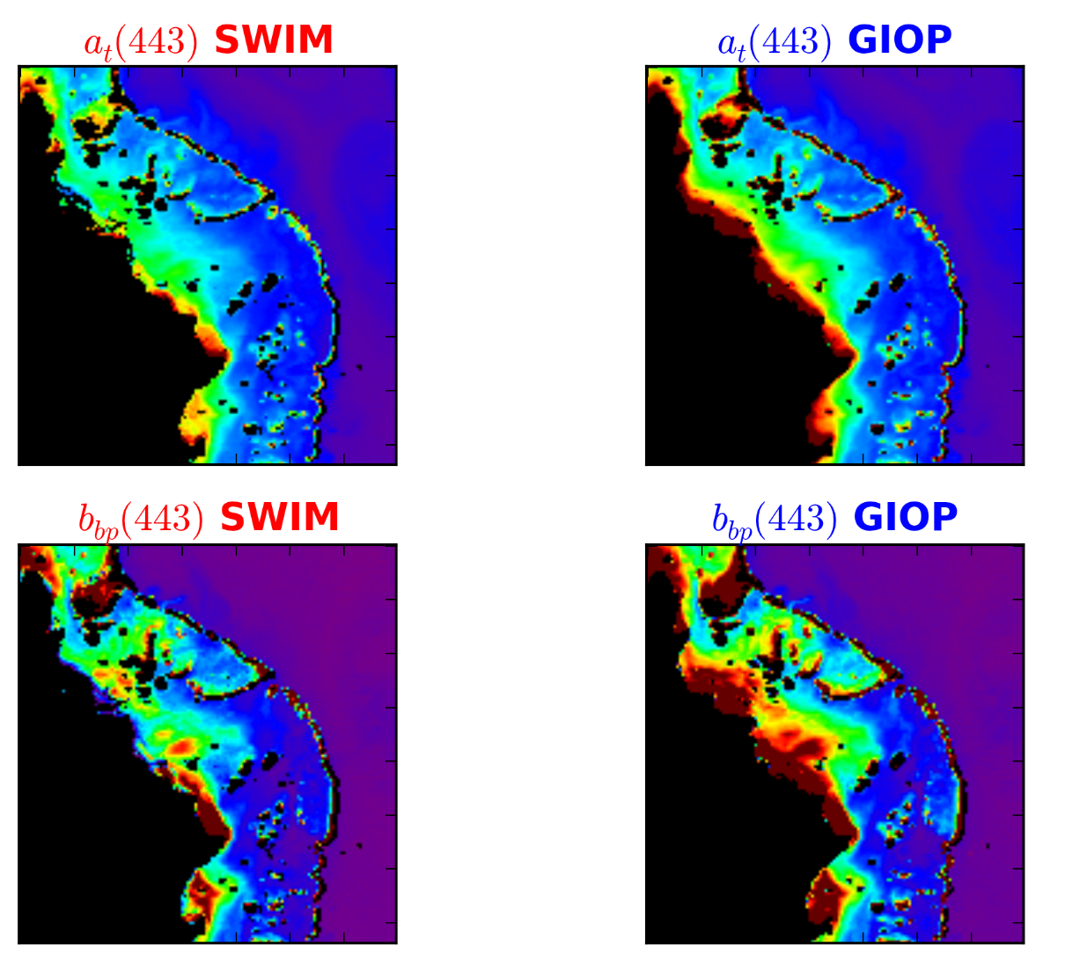
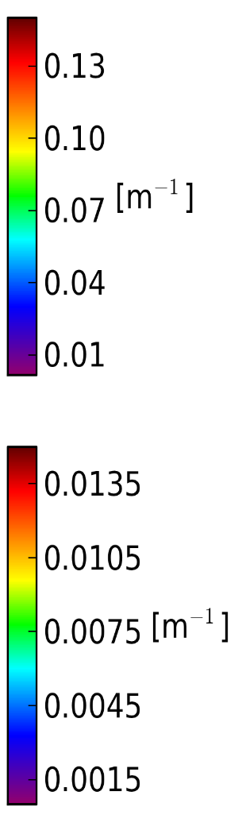
Sample scene: MODIS Aqua 22 May 2009
Algorithm updates:
Shallow Water Inversion Model (SWIM):
Clear, shallow water
Light reflected off seafloor contaminates R_{rs}
Solution: use Ancillary data inputs (depth and seafloor albedo).

Slide 17
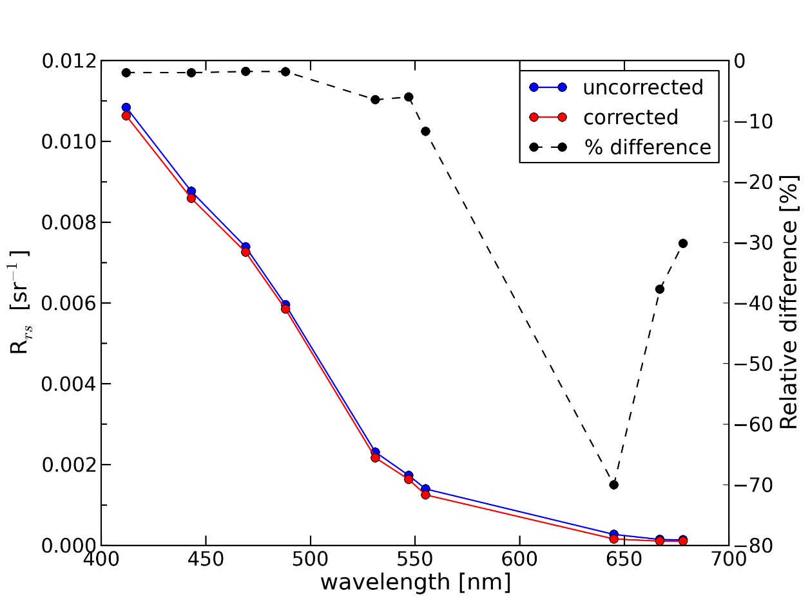
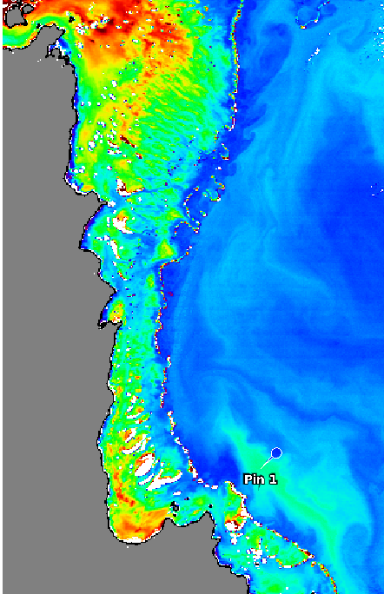
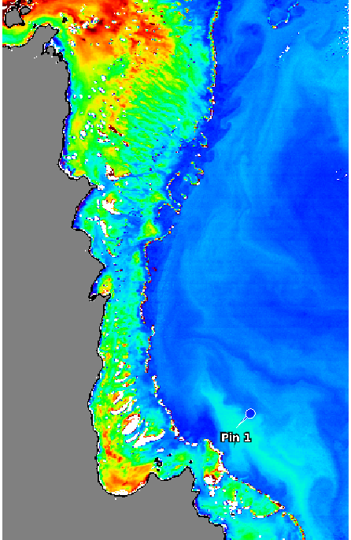
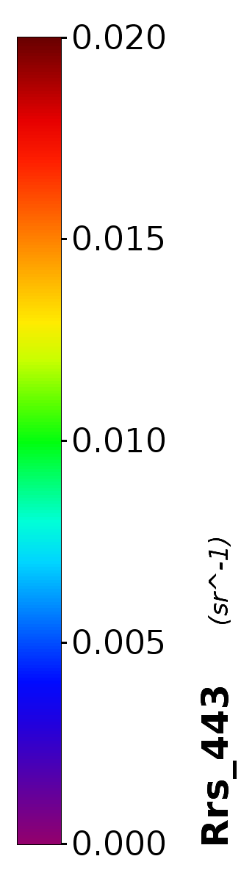
Algorithm updates:
Raman scattering correction for Rrs
Example outputs: Rrs(443)
Uncorrected R_{rs}(443)
Corrected R_{rs}(443)
Sample scene: MODIS Aqua 22 May 2009

Slide 18
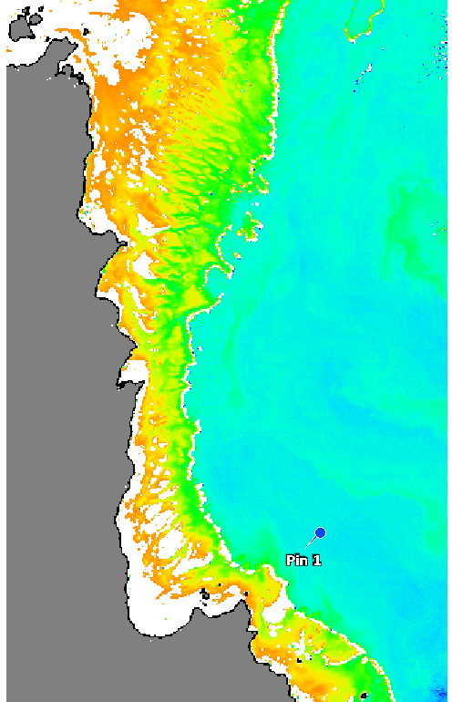
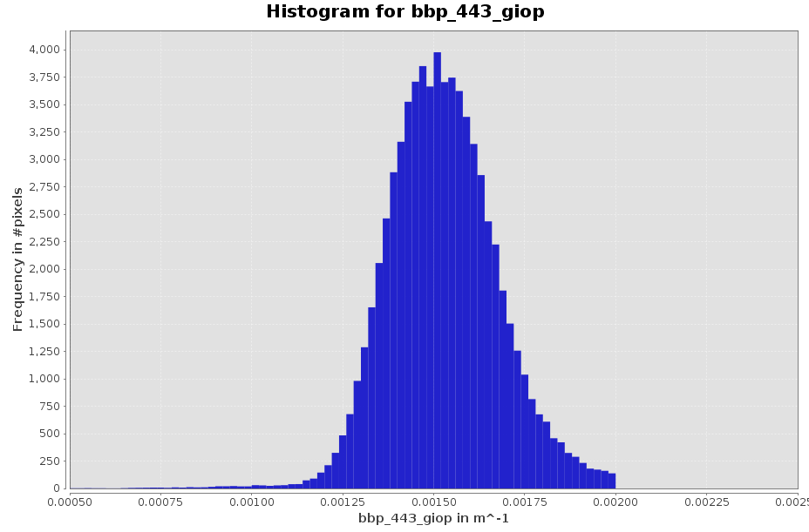
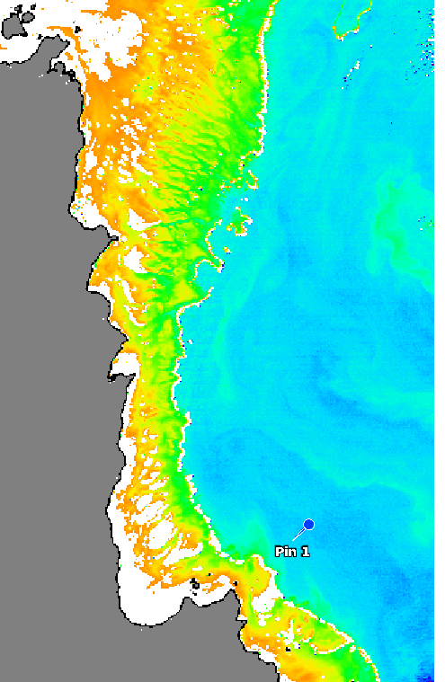
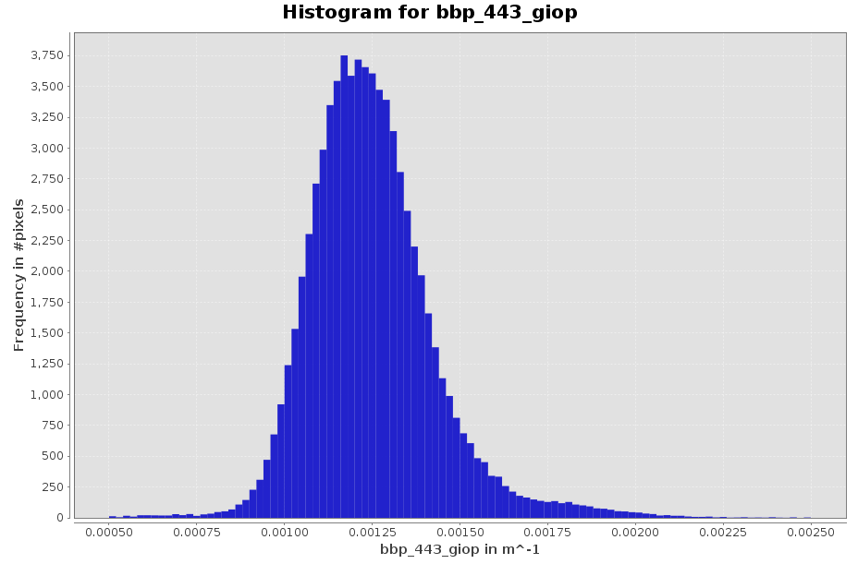
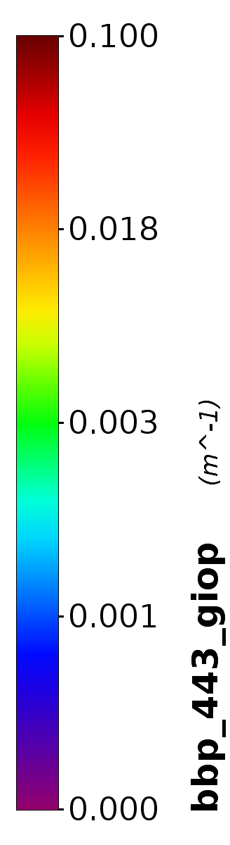
Sample scene: MODIS Aqua 22 May 2009
Algorithm updates:
Raman scattering correction for Rrs
Example outputs: GIOP-derived b_{bp}(443)
Uncorrected b_{bp}(443)
Corrected b_{bp}(443)
Median:
0.0015 m⁻¹
Median:
0.0012 m⁻¹
0.0015 m⁻¹
0.0011 m⁻¹

Slide 19
presentation outline
Part 1: implementation review
Part 2: validation matchup
Part 3: algorithm updates
Part 4: status overview

Slide 20
Status overview
Temperature-salinity correction
Shallow water inversion module
Raman scattering correction
Ensemble methods – aLMI
Spectral decomposition a total absorption – e.g. Zheng et al. (2015)
Bayesian optimization – uncertainties
Multi-mission algorithm compatibility
Hyperspectral extension – PACE mission

Slide 21
thanks

Slide 22
Extras…

Slide 23
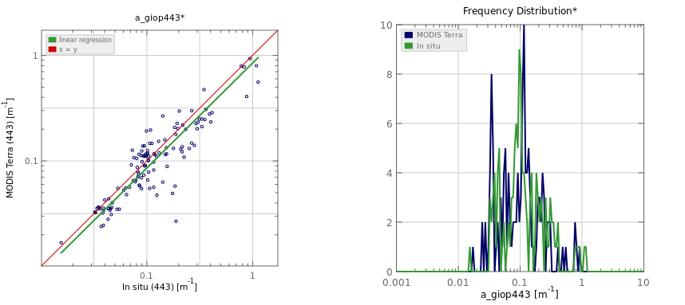
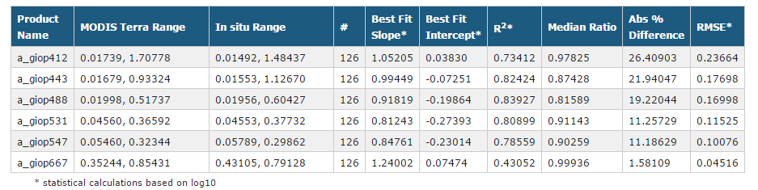
a(443) MODIS Terra
R²=0.82
Slope=0.99
Intercept -0.07
Ratio = 0.87
seabass.gsfc.nasa.gov

Slide 24
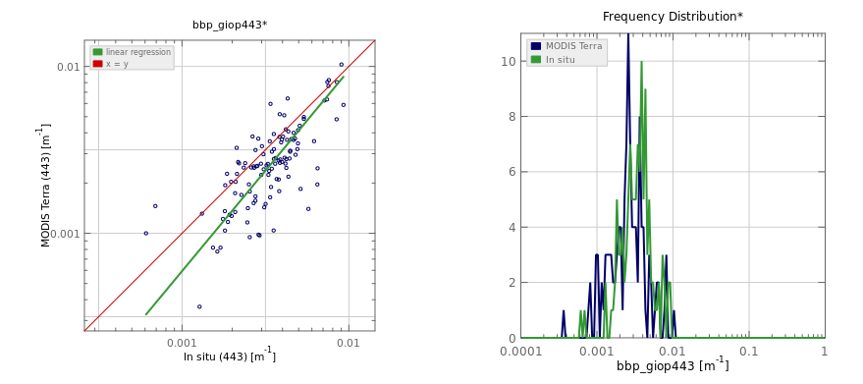
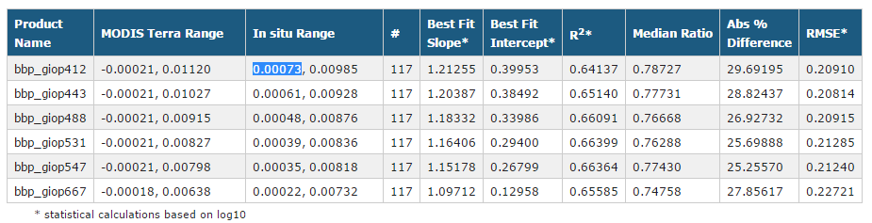
b_{bp}(443) MODIS Terra
R²=0.65
Slope=1.2
Intercept =0.38
Ratio = 0.77
seabass.gsfc.nasa.gov

Slide 25
a generalized IOP (GIOP) inversion model
in situ (NOMAD) & synthesized (IOCCG) data
SeaWiFS & MODISA data

Slide 26
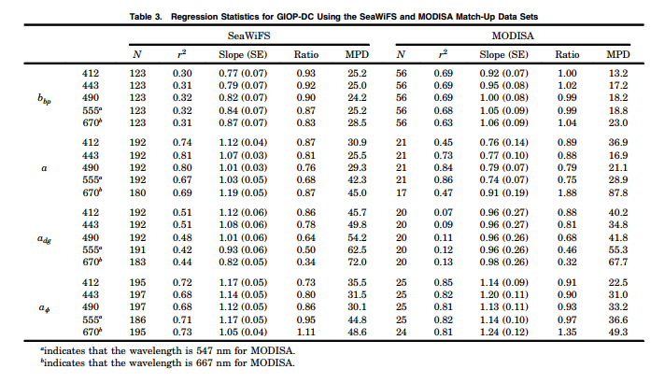
Werdell et al. (2013)

Slide 27
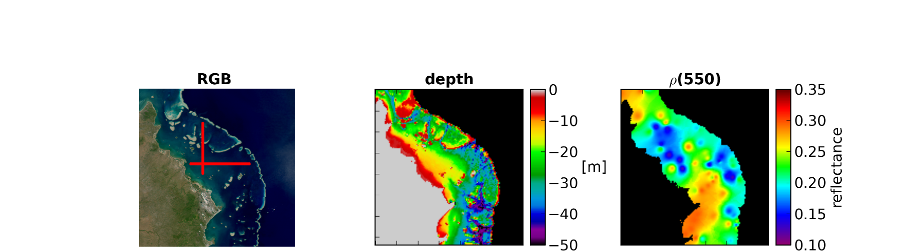
Sample scene: MODIS Aqua 22 May 2009
Algorithm updates:
Optically shallow waters:
Semi-analytical algorithm following Lee et al. (1998, 1999)
Spectral matching type algorithm (other approaches exist – e.g. Barnes et al. (2013))
Water-column depth and benthic albedo maps used as ancillary data inputs
Clear waters of northern Great Barrier Reef, Australia
Geometrically shallow shelf waters
Bright silica sand near-shore

Slide 28
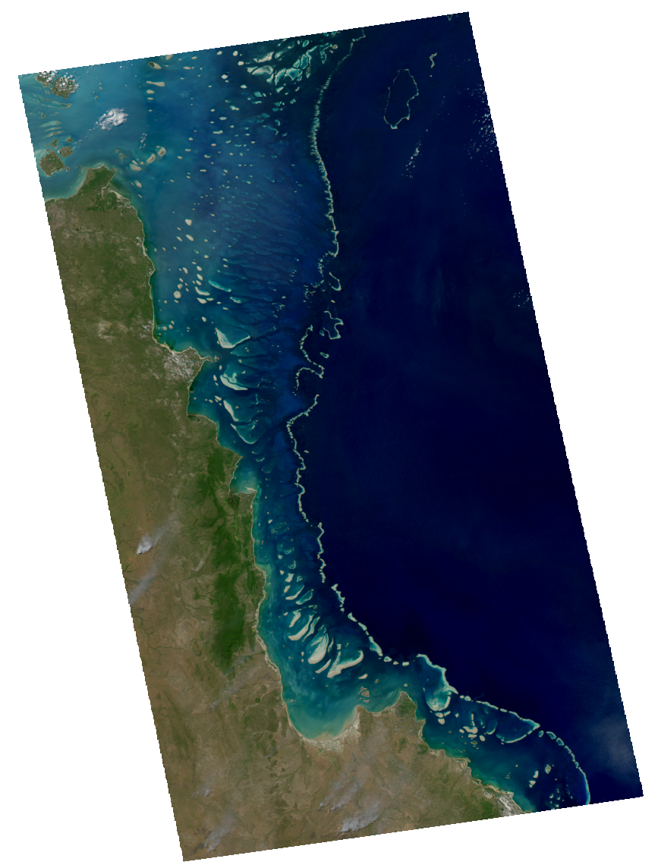
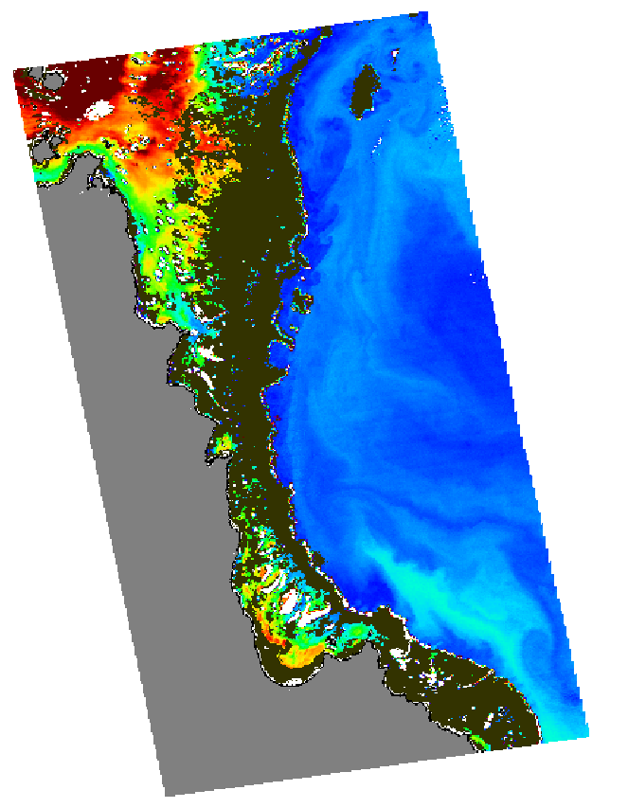
Sample scene: MODIS Aqua 22 May 2009
Algorithm updates:
Optically Shallow Flag – function of IOPs and geometric depth
Optically Shallow:
Apply SWIM
Not optically shallow:
Apply GIOP
Flagged pixels (23%)

Slide 29
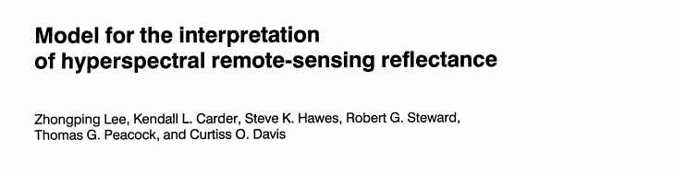

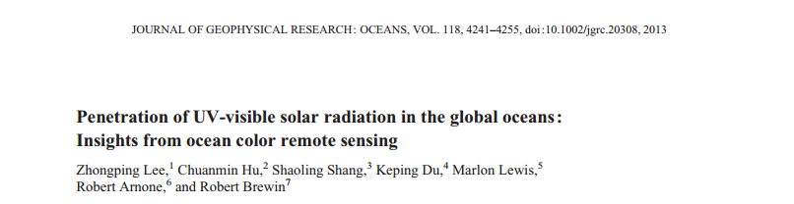


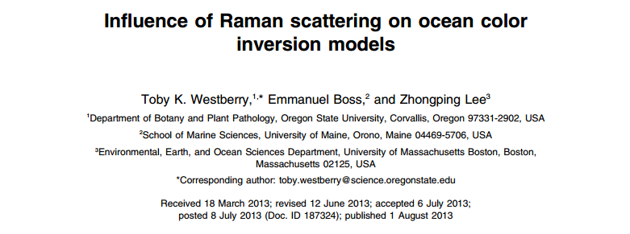
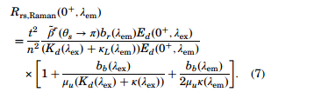
Algorithm updates:
Raman scattering correction for Rrs
Semianalytical
1994
Empirical
2013
Semianalytical
2013

Slide 30
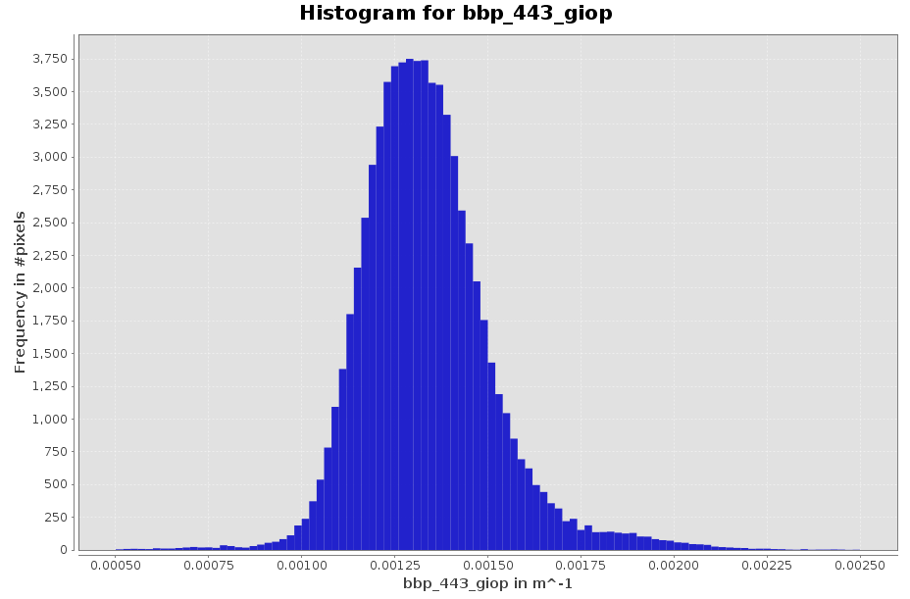

Algorithm updates: Raman scattering correction for Rrs
Example implementations: GIOP-derived b_{bp}(443)
Median:
0.0015 m⁻¹
No correction
Median:
0.0013 m⁻¹
Lee et al. 2013
Median:
0.0012 m⁻¹
Westberry et al. 2013
Median:
0.0013 m⁻¹
Lee et al. 1994

