Slide 1
The 2015 Aqua and Terra Senior Review Activities
Claire L. Parkinson and Kurt Thome,
Aqua and Terra Project Scientists
NASA Goddard Space Flight Center
Presented at the MODIS/VIIRS Science Team Meeting, Sheraton Silver Spring Hotel, Silver Spring, Maryland, May 19, 2015

Slide 2
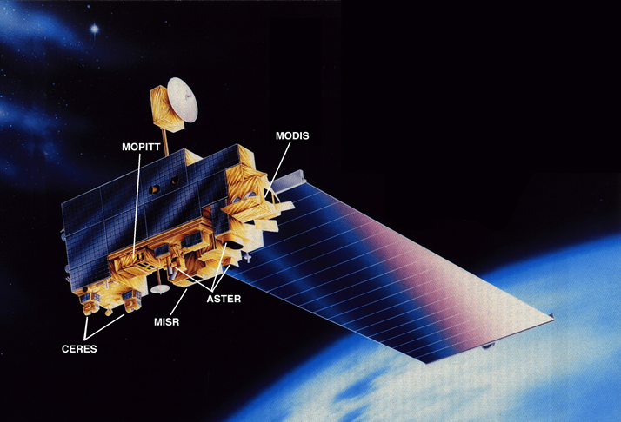
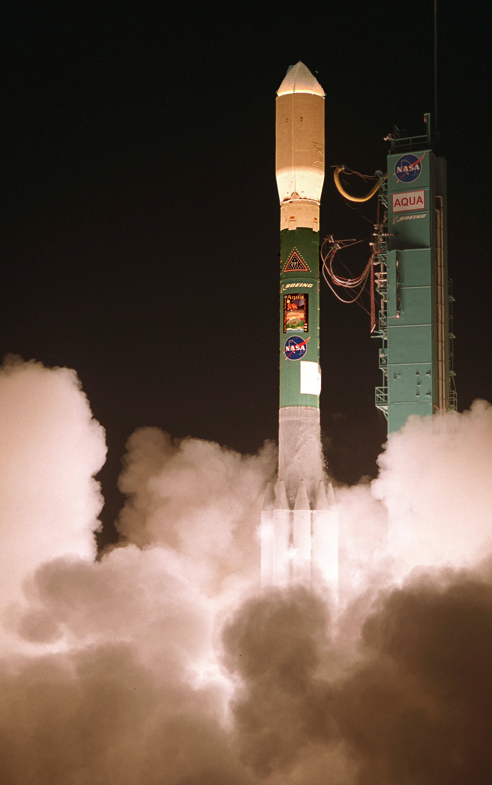
Terra and Aqua Overview
Terra
Terra was launched on December 18, 1999, Aqua on May 4, 2002.
Both are at an altitude of 705 km with a period of 98.8 minutes and a 16-day repeat cycle. Terra crosses the equator north to south at 10:30 a.m. (originally 10:45 a.m.), Aqua crosses south to north at 1:30 p.m.
Many thousands of scientific publications have used the Terra and/or Aqua data, revealing considerable new information about the Earth system. The data have also provided wide-ranging practical benefits, including for weather forecasting, deployment of fire fighters, routing of aircraft around volcanic ash, sea ice monitoring, and numerous others.
Mission success depends on many people.
Terra is predicted to be functional through 2025, based on predicted battery performance and available fuel (requires a Level 1 waiver for crossing time in 2022). Enough fuel remains on board Aqua for operations at least through 2021.
Aqua launch May 4, 2002
(photo by Bill Ingalls)

Slide 3
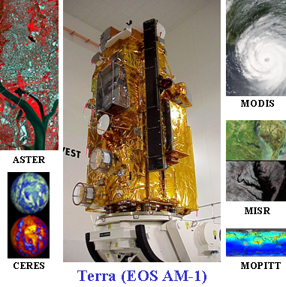
Terra’s Instrument Suite
ASTER: Advanced Spaceborne Thermal Emission and Reflection Radiometer
  Hi-resolution, multi-spectral images, 15 m - 90 m resolution, plus stereo
CERES: Clouds and the Earth’s Radiant Energy System
  Measures Earth’s reflected shortwave and outgoing longwave radiation
MISR: Multi-angle Imaging Spectroradiometer
  Global multiangle images of aerosol, cloud, and surface characteristics
MODIS: Moderate Resolution Imaging Spectroradiometer
  1-2 day global coverage in 36 wavelengths, 250 m - 1 km resolution
MOPITT: Measurements of Pollution in the Troposphere
  Global measures of CO
All instruments except ASTER’s shortwave infrared (SWIR) bands are fully operational

Slide 4
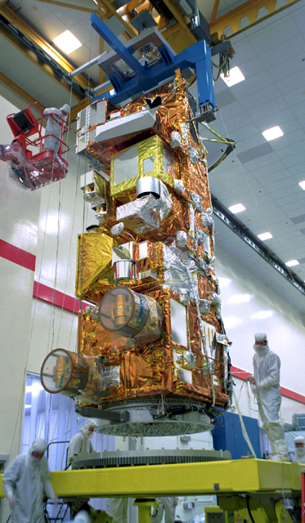
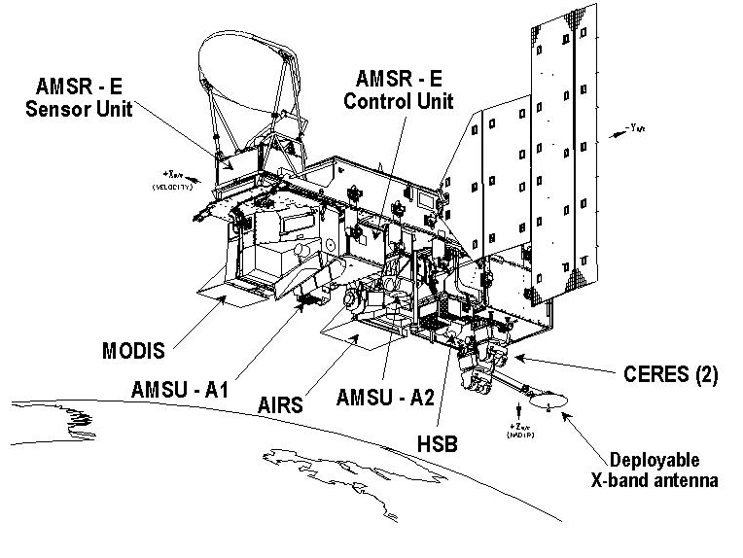
Aqua’s Instrument Suite
AIRS: Atmospheric Infrared Sounder (Excellent health)
AMSU: Advanced Microwave Sounding Unit (Good health)
HSB: Humidity Sounder for Brazil (Nonfunctional)
CERES: Clouds and the Earth’s Radiant Energy System (FM-3, Excellent health; FM-4, Marginal health)
MODIS: Moderate Resolution Imaging Spectroradiometer (Excellent health)
AMSR-E: Advanced Microwave Scanning Radiometer for the Earth Observing System (Marginally functional)
Aqua pre-launch, courtesy of
Northrop Grumman

Slide 5
2015 Senior Review Schedule
12/16/14 Senior Review Kickoff at AGU.
12/22/14 Senior Review Call for Proposals from Mike Freilich, Director of the Earth Science Division, NASA Headquarters (HQ).
3/3/15 Proposals due to NASA HQ.
4/13/15 Receipt by the missions of the questions from the Senior Review Panels.
4/28-30/15, meeting of the Senior Review Panel.
  1:15 – 2:30 p.m., 4/29/15, Terra presentation.
  2:30 – 3:40 p.m., 4/29/15, Aqua presentation
June 2015, Release of the Panel report.
August 2015, New budget guidelines and instructions from NASA HQ.
September 2015, Revised implementation plans due to NASA HQ.

Slide 6
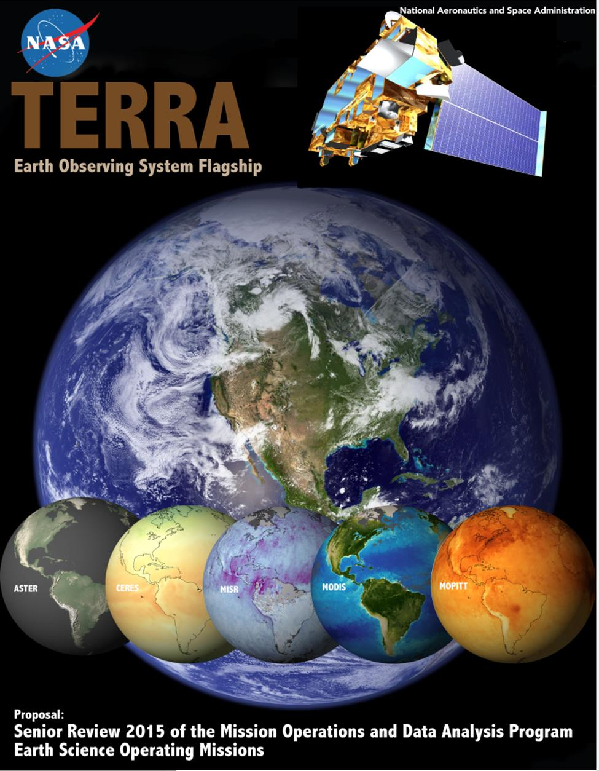
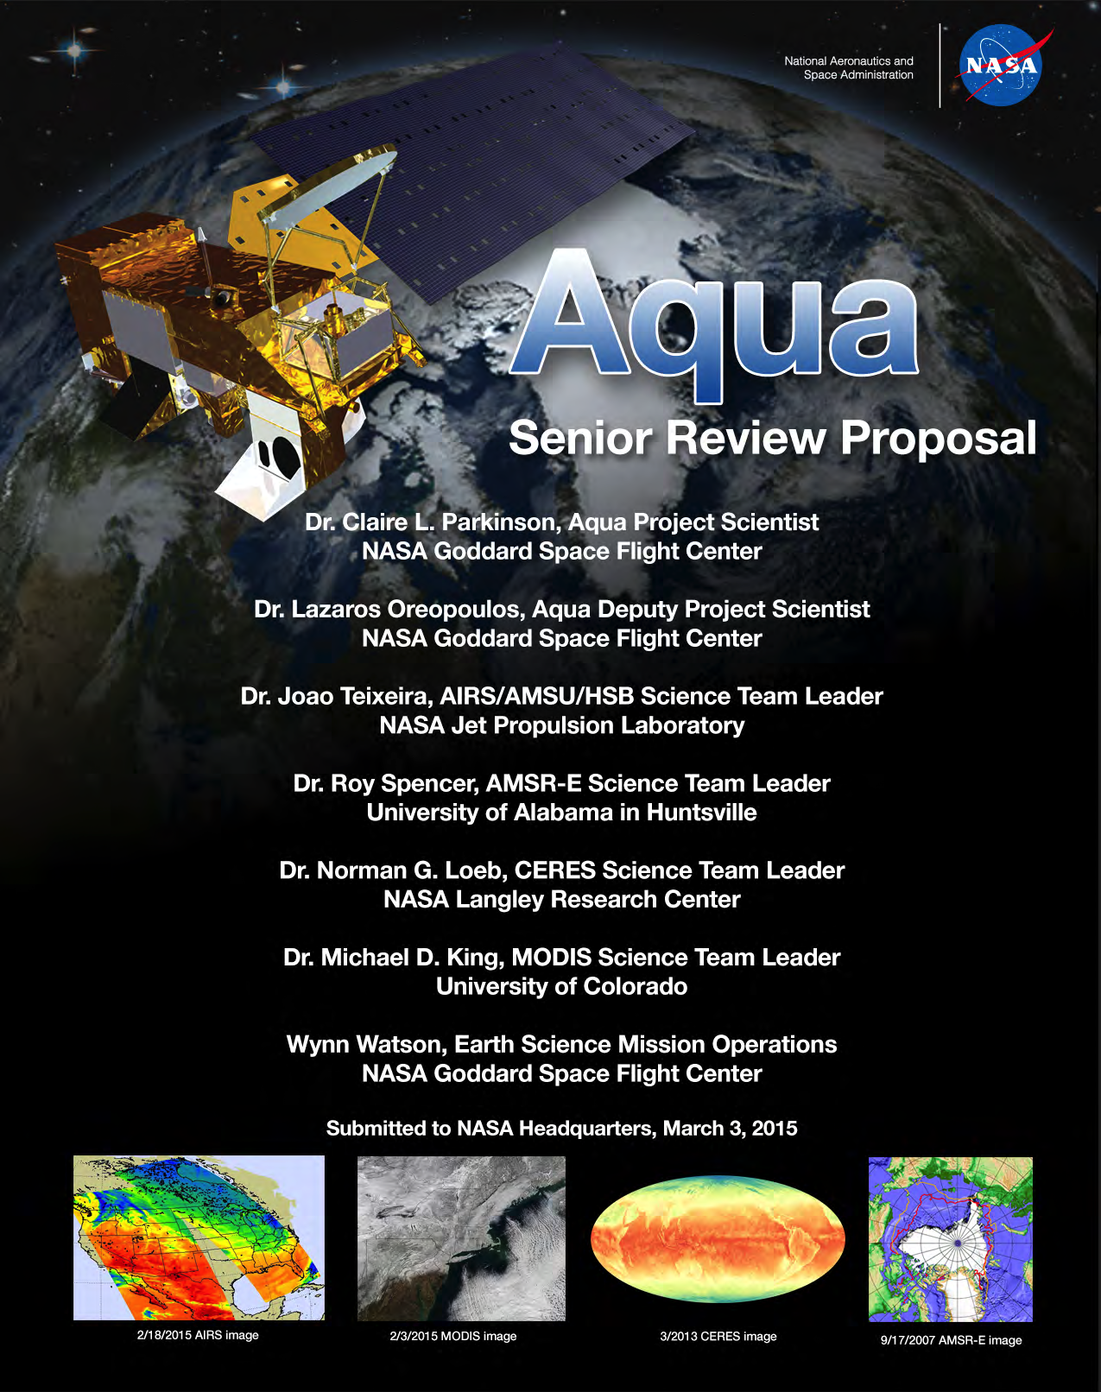
Both proposals were major collaborative efforts among many contributors.
Both present the status of the spacecraft and instruments and discuss the value of the missions for science (e.g., extending the baseline for climate and environmental data records and adding value to other missions) and for numerous practical applications.
Both include required data product summaries, budget spreadsheets, and engineering data.

Slide 7
Overview of Senior Review Panel Questions/Requests to Terra and Aqua
Questions were received by the missions on 4/13/15, and answers were provided in presentations to the Panel on 4/29/15.
Terra received 14 questions/requests, with only one specifically related to MODIS; Aqua received 19, with many specifically related to MODIS (see following slides).
The Panel was highly complimentary toward both missions.
The Panel report is expected to be completed and released in June.

Slide 8
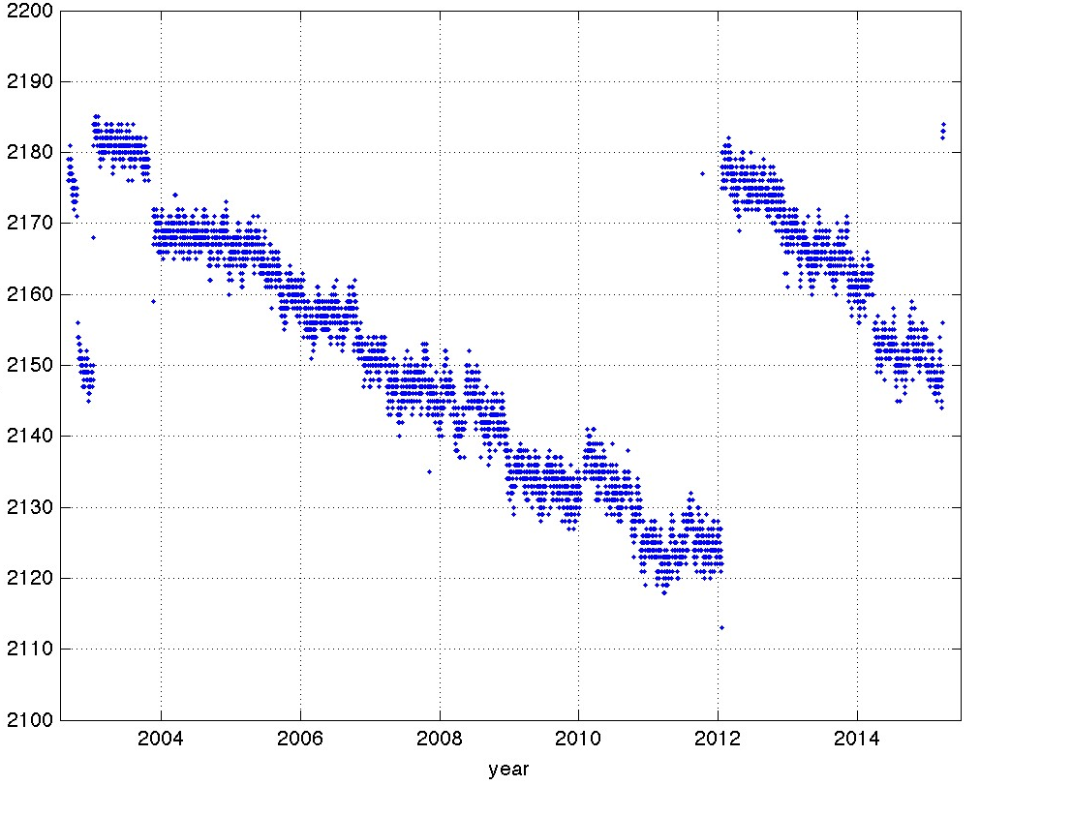
General Request 1 to both Terra and Aqua: Please describe any changes or updates in mission status, and any significant progress or milestones completed, that has occurred since your proposal was written and submitted in early March.
...
A new gain table was uploaded to the AIRS instrument, recovering about 30 channels whose noise had increased due to radiation effects in the detectors (see figure).
...
No significant updates for AMSR-E, CERES, MODIS, or the instruments on Terra.
Number of AIRS Infrared Channels (out of 2378) That Are Working Well
Recent
Table
Upload
General Request 2 to both Terra and Aqua: Describe what you consider to be your highest priority activity in the next 2 years, with rationale for the priority, and your approach to accomplish the activity.

Slide 9
Science Panel #1: … instrument health assessment.
Science Panel #2: Please describe the impact on Aqua science for the loss of the AMSU channels.
Science Panel #3: Please describe the impact on Aqua science for the loss of the CERES FM-4 shortwave channel.
Science Panel #4: It is recognized that the loss of AMSR-E had a significant impact on Aqua science after its degradation in October 2011. The proposal describes that the Japanese GCOM-W1 satellite with AMSR2 was launched into the A-Train in May 2012. Please explain why there is no discussion of using AMSR2 to replace AMSR-E and thereby restoring Aqua science capability.

Slide 10
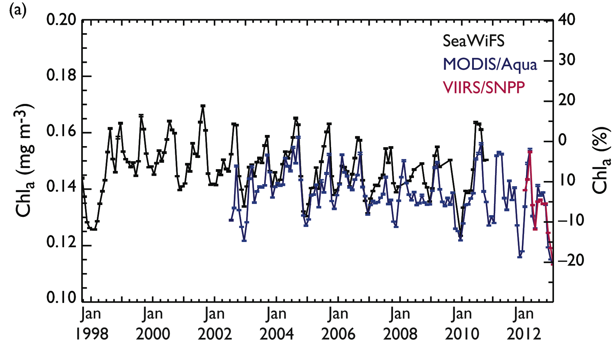
Science Panel #5: There is limited discussion in 2.4.4 MODIS Science Team about MODIS ocean work, for example with regards to Collection 6 algorithms or future work, please provide more detail on the ocean side of MODIS and instrument science for next phase of activities.
An Aqua MODIS Ocean Color reprocessing was completed in 2012, incorporating the MODIS Characterization Support Team (MCST) Collection 6 calibration.
Plans for 2015 include complete reprocessing of the Aqua MODIS Ocean Color (next three slides) and SST (slide after next three) datasets.
The focus of the Ocean Color efforts is to maintain a consistent long-term time series of ocean color products from SeaWiFS to MODIS and VIIRS.
SeaWiFS = Sea-viewing Wide-Field-of-View Sensor
VIIRS = Visible Infrared Imaging Radiometer Suite

Slide 11
Current MODIS Ocean Color Standard Product Suite
Spectral water-leaving reflectance [R_{rs}(λ)]
Aerosol Angstrom Exponent
Aerosol Optical Thickness (AOT)
Phytoplankton chlorophyll concentration (Chlorophyll a)
Marine diffuse attenuation at 490 nm [K_{d}(490)]
Particulate organic carbon concentration (POC)
Particulate inorganic carbon concentration (PIC)
Daily mean photosynthetically available radiation (PAR)
Instantaneous photosynthetically available radiation (iPAR)
Chlorophyll normalized fluorescence line height (nFLH)
Colored dissolved organic matter index (CDOM index)

Slide 12
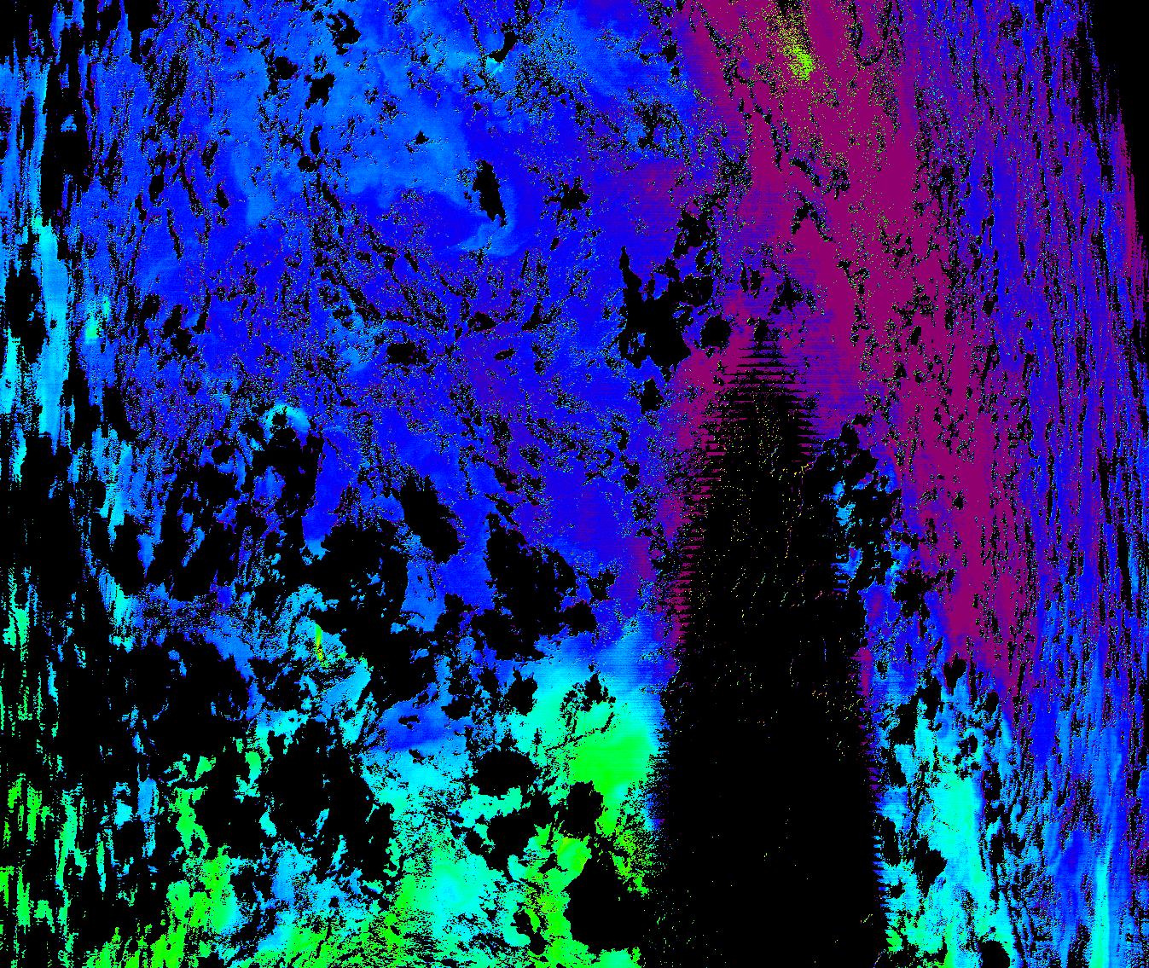
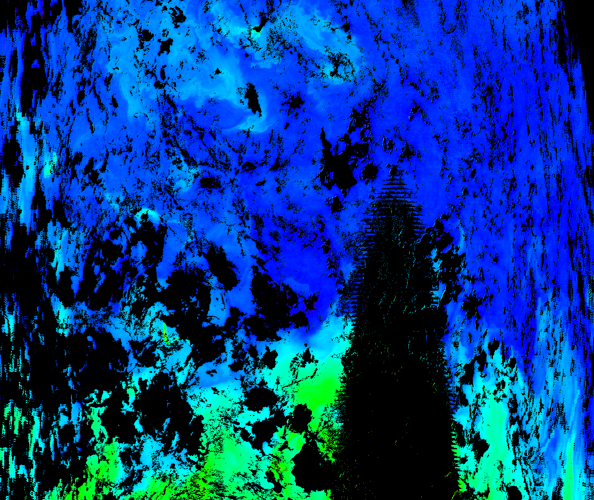

Planned Changes to the MODIS Ocean Color Product Suite
(Slide 1 of 2)
Do calibration updates, ancillary data updates, improved land/water masking, and other minor fixes to R_{rs}(λ), the Aerosol Angstrom Exponent, and AOT.
Implement an improved Chlorophyll a algorithm from Hu, Lee, and Franz (2012, J. Geophys. Res.) (see figure).
Implement a coefficient update for K_{d}(490).
Update the algorithm and look-up table for PIC.
Sample Improved Retrieval with new Chlorophyll a algorithm
Old algorithm
uncorrected
sun glint
New algorithm

Slide 13
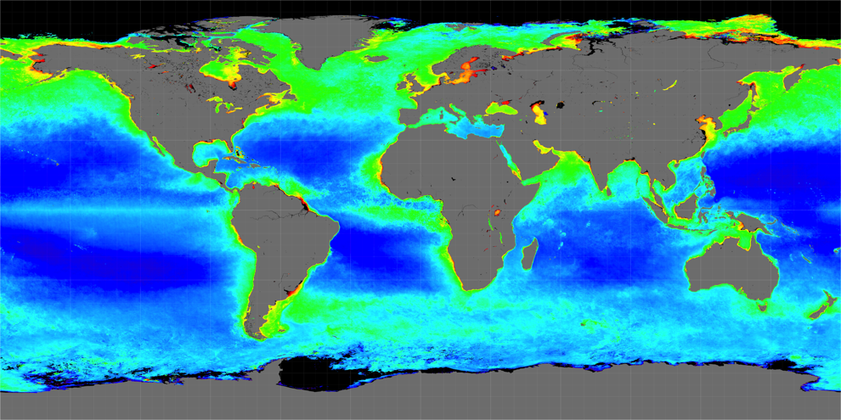
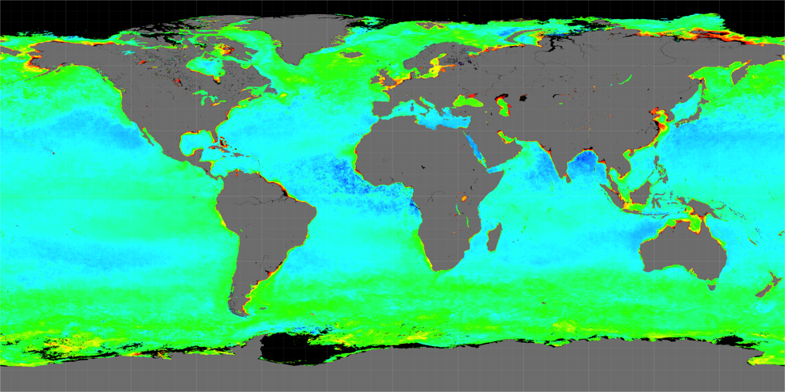
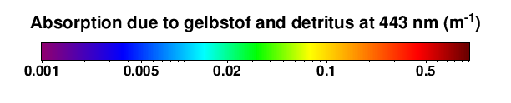
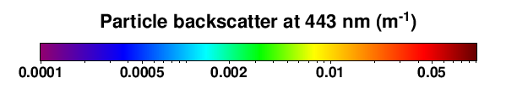
Planned Changes to the MODIS Ocean Color Product Suite
(Slide 2 of 2)
Implement a consolidated algorithm and minor fixes to PAR.
Change the flagging procedure for nFLH, to allow small negative values.
Delete the CDOM index.
Add a suite of inherent optical property (IOP) products.
  Absorption by phytoplankton at all visible wavelengths
  Absorption by colored dissolved organic matter (gelbstof) and detritus (left figure)
  Particle backscatter (right figure)
  Associated uncertainties
Two New Ocean Color Products

Slide 14
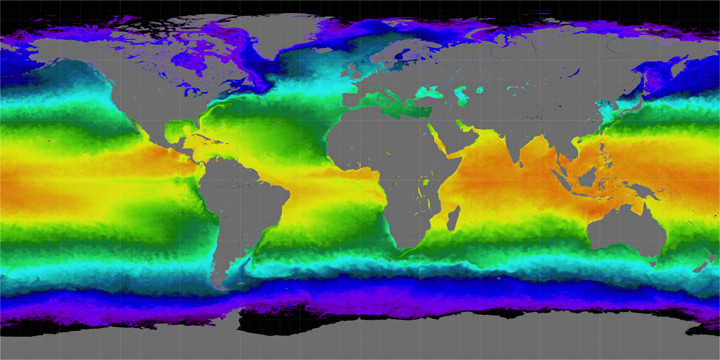
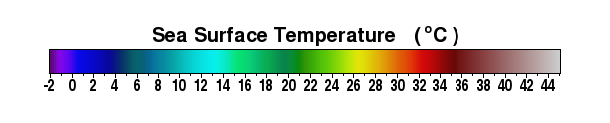
Aqua MODIS Sea Surface Temperature (SST) Status and Plans
Aqua MODIS SSTs are stable and of good accuracy.
Full-mission Aqua SST reprocessing is in progress.
  MCST Collection 6 calibration
  Algorithm refinements from the MODIS SST Principal Investigator (PI)
  Uncertainty estimates (root mean square and bias)
Refinements include latitudinal dependence in algorithm coefficients, which should improve accuracy, especially near swath edges and in polar latitudes, and reduce residual mirror and response-versus-scan-angle (RVS) artifacts.
Aqua MODIS Spring 2014 SST Seasonal Composite

Slide 15
Cost Panel #9: What was the rationale behind the 54-46 MODIS management and costing negotiated between Aqua and Terra? How long is this allocation to be maintained?
The Aqua/Terra split for MODIS had been almost exactly 50/50 until 2009, when it changed to 52/48, after which further adjustments were made that have brought it at present to 54/46.
No one intentionally changed the split from 50/50.
  The Aqua and Terra missions have been and still are both quite willing to split the costs 50/50.
  When Aqua and Terra suffer budget cuts, they each distribute the cuts through the respective missions, and how they do so can differ in such a way that the 50/50 split for MODIS gets disrupted.
If necessary, we could bring the MODIS split back to 50/50 by Aqua moving half the current difference from MODIS to ESMO and Terra moving the same amount from ESMO to MODIS.
Even if a 50/50 split is reestablished, it could unintentionally be brought out of balance through future budget adjustments within the two missions.

Slide 16
Cost Panel #10: How long has MODIS been operating at 35.9 FTE/year as compared to its ~54 FTE/year during its peak years?
MODIS has been operating at ~35 FTE/year since 2014 (see plot).
MODIS was operating at 54 FTE/year in 2003, the year following the Aqua launch.
By the time of the Aqua launch, MODIS staffing was well below its peak of 86.8 FTE/year, which occurred in 1998.
100
90
80
70
60
50
40
30
20
10
0
MODIS Support Team Staffing
SDST = Science Data Support Team
MCST = MODIS Characterization Support Team
MAST = MODIS Administrative Support Team
SDST
MCST
MAST
1991 1993 1995 1997 1999 2001 2003 2005 2007 2009 2011 2013 2015 2017

Slide 17
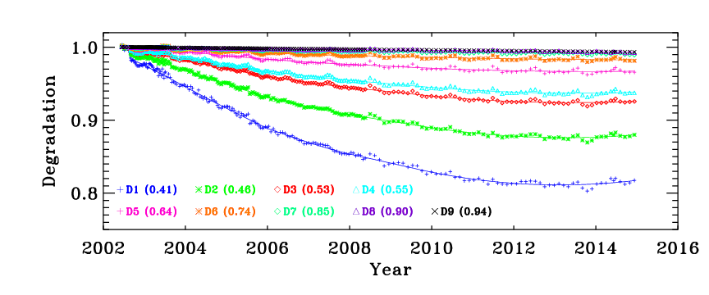
Cost Panel #11: Nearly 12 FTEs are dedicated to MODIS characterization and support, please expand on the new and more challenging issues expected for the MODIS instrument.
Solar Diffuser (SD) degradation (see plot) has reached the point where degradation can begin to be expected for wavelengths above 0.94 μm, warranting new corrections. (Degradation at 0.94 μm has reached 1%.)
Frequent updates of calibration lookup tables (LUTs) are needed for both Collection 5 (C5) and Collection 6 (C6).
The Terra MODIS has experienced on-orbit changes in sensor polarization sensitivity and associated large impacts on Earth view response trending. Such changes could start occurring with the Aqua MODIS as well.
For accurate calibration, it is necessary to accurately track changes in sensor response versus the scan angle, or angle of incidence (AOI), for each of the 36 MODIS bands and each mirror side.

Slide 18
National Interest Panel #13: Is it possible to derive additional products for ecosystem modeling? Products may be the combination of two or more data types from Aqua or another spacecraft which is a part of the A-Train constellation.
It is possible to derive products for ecosystem modeling beyond those in the standard Aqua data product list; indeed some are already being derived. Examples include: Vegetation Optical Depth, Land Freeze/Thaw Surface Condition, and Spring Frost Damage Index.
NASA’s peer-review process (e.g., ROSES) helps NASA prioritize the development of standard products for the Earth Science community and includes calls for products from multiple instruments and spacecraft. In addition, a panel for the Land and Atmosphere Near-real-time Capability for EOS (LANCE) system meets regularly to select and fund products that are appropriate for near-real-time applications.
The next slide provides an example of a recent new ecosystem modeling result incorporating Aqua data.
The new Inherent Optical Property (IOP) MODIS Ocean Color products [see response (above) to Science Panel #5] use backscatter instead of absorption as a proxy for phytoplankton biomass, and this could prove to enable an improved means of modeling marine net primary productivity.

Slide 19
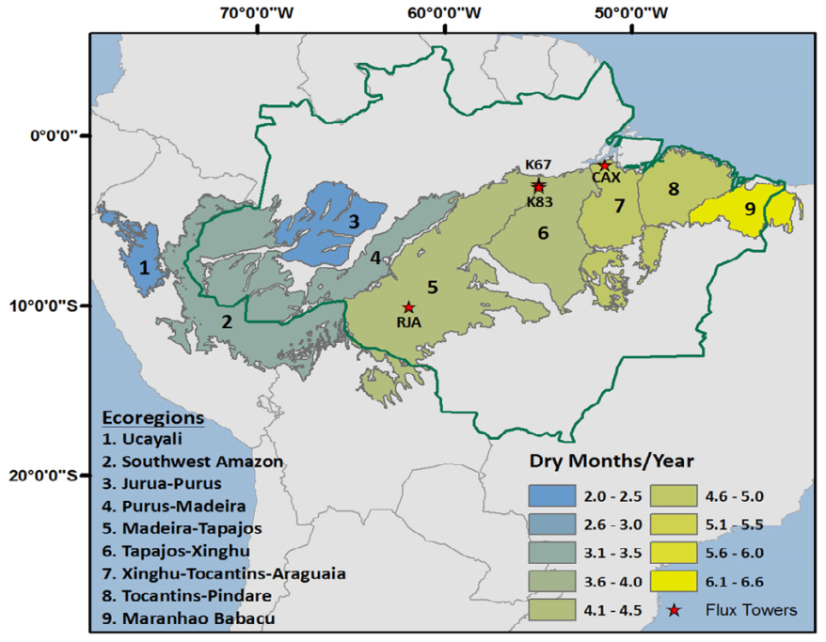
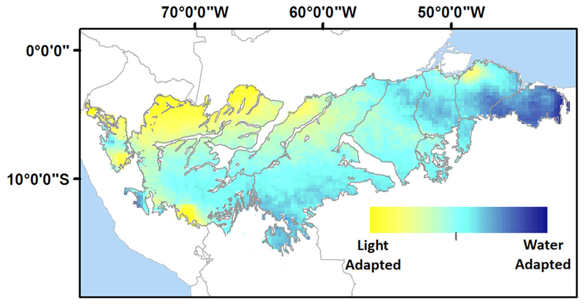
Example of a New Ecosystem Modeling Result Using A-Train and Other Satellite Data
Asynchronous Amazon forest canopy phenology indicates adaptation to both water and light availability, M. O. Jones, J. S. Kimball and R. R. Nemani, 2014, Environ. Res. Lett.
NASA Satellite Data Used:
GRACE - Terrestrial water storage
AMSR-E - Vegetation optical depth
MODIS - Leaf area index and Enhanced vegetation index
CERES - Photosynthetically active radiation
TRMM - Precipitation

Slide 20
National Interest Panel #14: Could there be further classification of the errors (magnitude, type, statistics used) associated with the MODIS data/observations and products?
Overview Slide, followed by 2 Atmosphere, 2 Land, and 1 Ocean Slide
The MODIS Science Team has undertaken extensive validation efforts for many of its products, obtaining various error indications.
MODIS uses two general approaches to data product uncertainties.
  Statistical comparisons with data from other satellite instruments and in situ and aircraft measurements.
  Pixel-level analysis that accounts for individual error sources.
The following five slides provide more details, including examples from each of the three MODIS Science Team science groups (MODIS Atmosphere, MODIS Land, and MODIS Ocean).

Slide 21
MODIS Atmosphere Product Retrieval Uncertainty Overview
Aerosol Optical Depth (AOD) (MYD04): Dark Target (DT) and Deep Blue (DB)
Primary method: Statistical assessments derived from colocated AERONET sun photometers, including Maritime Aerosol Network (MAN) data. Secondary: Airborne campaign datasets.
Magnitude (1-σ):
  DT: Land: ± (0.15*AOD + 0.05), Ocean: ± (0.05*AOD +0.04).
  DB: Provided for each retrieval; of order ± (0.03+0.2*AOD).
Cloud Mask (MYD35) and Cloud-Top Properties (MYD06)
Primary method: Statistical assessments with colocated CALIOP observations in the A-Train.
Magnitude: See Ackerman et al. (2008, J. Atmos. Oceanic Technol.), Holz et al. (2008, JGR).
Cloud Optical Properties (MYD06)
Primary method: pixel-level uncertainties derived for several error sources. Secondary: Airborne datasets for cloud radiative model development; IR vs. solar reflectance closure studies and CALIOP comparisons.
Magnitude: No simple meaningful value. Depends on view/solar geometry, cloud properties, and surface type (see next slide for sample figures).
Clear Sky Properties (MYD05/07)
Primary method: Statistical assessments. State variables (T, q, TPW): Radiosondes, DoE Southern Great Plains (SGP) Cloud and Radiation Testbed (CART) site (µwave radiometer), reanalysis, HIRS intercomparisons. O₃: Ground-based Brewer spectrometer, OMI and AIRS intercomparisons.
Magnitude: See next slide for example for Total Precipitable Water (TPW).

Slide 22
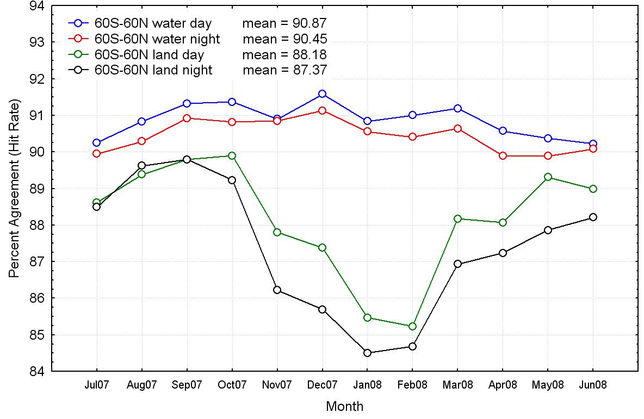
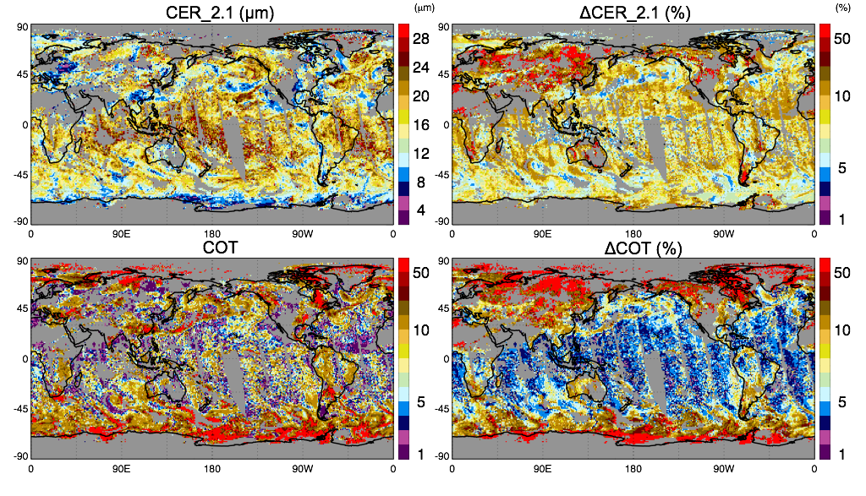
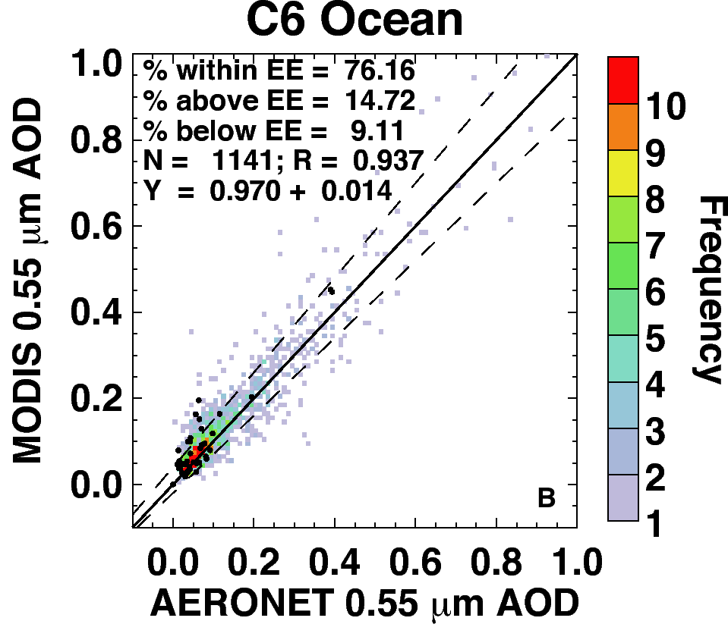
MODIS Atmosphere Product Retrieval Uncertainty Examples
MOD35 C6 vs. CALIOP (7/2007–6/2008)
MOD05 C6 TPW vs. ARM SGP microwave radiometer, 317 clear sky Aqua cases from 4/2001 to 8/2005
RMS (wet cases)
Bias (wet)
RMS (dry)
Bias (dry)
Agreement (%)
TPW (mm)
MYD04 DT vs. AERONET & MAN
(Jan+July 2003, 2008; Apr+Oct 2008)
MYD06 Daily Mean CER, COT
Uncertainty in Mean (%)
C6 = MODIS Collection 6
CER = Cloud Effective Radius COT = Cloud Optical Thickness
Liquid Water Clouds, 1 April 2005

Slide 23
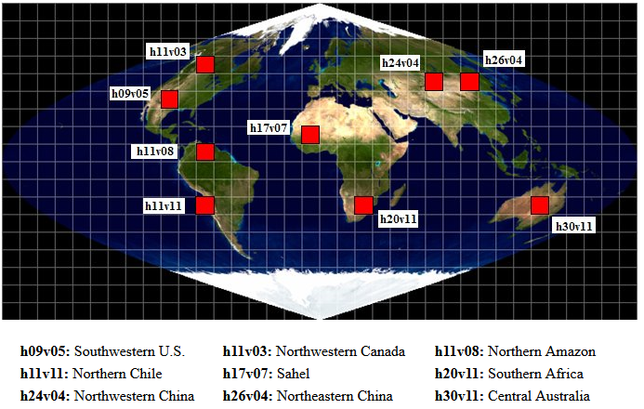
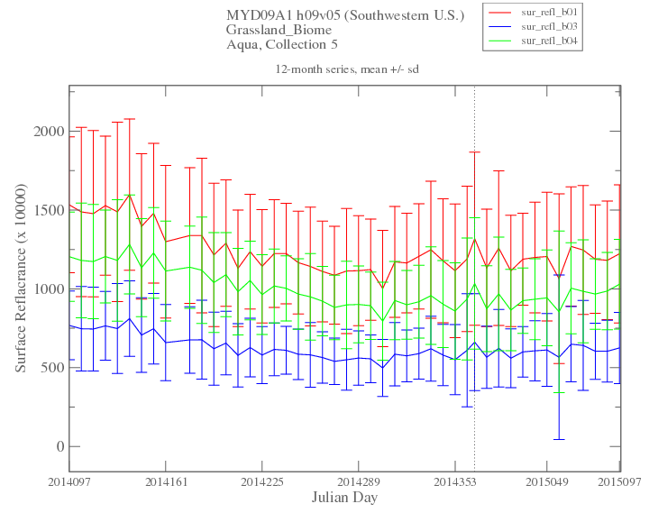
MODIS Land Product Accuracies (Slide 1 of 2)
Validation techniques used to develop uncertainty information for MODIS Land products include comparisons with in situ data collected over a distributed set of 37 validation test sites, comparisons with data products from other sensors (e.g., ASTER, AVHRR, MISR, TM/ETM+), and comparison with trends derived from independently-obtained reference data.
Statistics from nine 1000 km x 1000 km gridded tiles (see map) are maintained and monitored by quality assessment personnel.
Plots of time series statistics are available for each biome and land cover type within a gridded tile. When a large change occurs in a statistic, it is automatically flagged for further examination.
Map of MODIS Land Quality-Assurance Locations
Sample Plot of Time Series Statistics
(Southwestern U.S., Grassland Biome, mean ± std. dev.)
– Band 1
– Band 3
– Band 4
0.20
0.15
Surface Reflectance
0.10
0.05
0.0
4/7/14 6/10/14 8/13/14 10/16/14 12/19/14 2/18/15 4/7/15

Slide 24
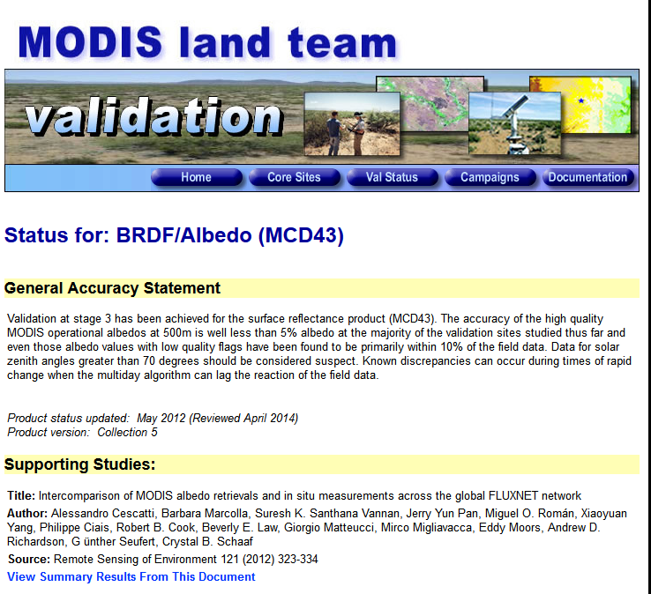
MODIS Land Product Accuracies (Slide 2 of 2)
Land product accuracies are described in detail at landval.gsfc.nasa.gov.
For each product there is a General Accuracy Statement, followed by a list and summary of published supporting studies (sample at right).
Regarding further classification of the errors, work is underway in three areas:
  For Land Surface Reflectance products, studies are being conducted to partition the contributions of calibration uncertainty, spectral aspects, and spatial sampling in the overall error budget of the product.
  Protocols are being developed for in situ data products, e.g., aerosols from AERONET stations, that can then be used to assess the performance of atmospheric correction in Land Surface Reflectance.
  Validation protocols continue to be developed for inter-comparison of product suites between instruments on different Earth observing missions, such as Aqua, JPSS, and the Sentinel satellites.
Sample Product Page on the MODIS Land Validation Website

Slide 25
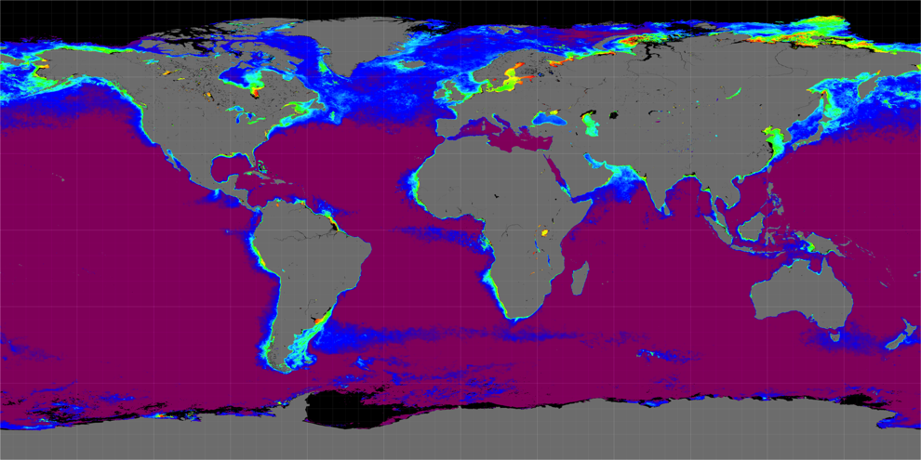
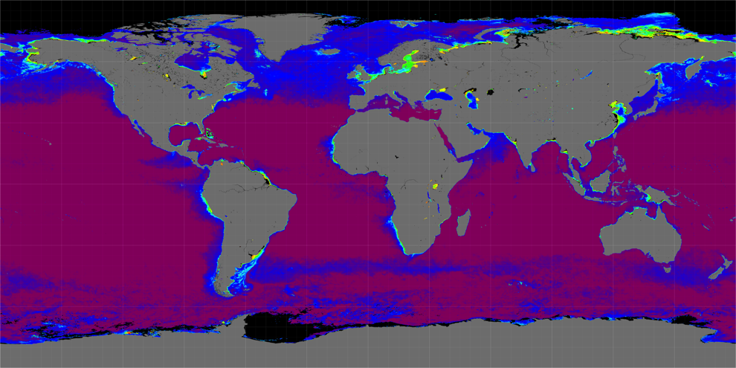
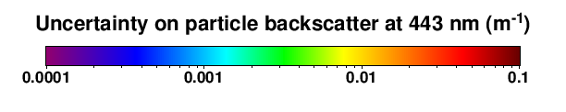

MODIS Ocean New Uncertainty Estimates
The new Aqua MODIS inherent optical properties (IOP) products will include root-mean-square uncertainty estimates for each pixel (see sample images below).
The enhanced Aqua MODIS SST product suite will include uncertainty estimates (root mean square and bias) for each pixel.
Mapped uncertainties for the gelbstof and backscatter global images provided above in the response to Science Panel #5
Uncertainty on absorption due to gelbstof and detritus at 443 nm (m⁻¹)

Slide 26
National Interest Panel #15: EPA and CDC asked if MODIS/AOD products could be provided at the same resolution as the Community Multi-scale Air Quality (CMAQ) model. CMAQ operates at a 4 km and 12 km resolution.
There are technical reasons for the two resolutions that are currently being used for the MODIS aerosol products, 10 x 10 km for the standard (traditional) product and 3 x 3 km for a newer product.
  Original MODIS data used for aerosol retrieval are collected at either 500 m or 1 km resolutions, depending on the band. The MODIS mirror covers 10 scan lines of 1 km pixels or 20 scan lines of 500 m pixels, enabling a 10 km product to keep scan lines together.
  The 3 km resolution was primarily chosen because of tests in the cloud-masking algorithm that use the spatial variability of 3 x 3 pixel arrays. Since one of these tests is performed using the 1378 nm band, at 1 km resolution, 3 km x 3 km was the minimum size that could be used to perform 3 x 3 tests in this channel.
Resolutions of 4 x 4 km or 12 x 12 km would better match CMAQ, but would be harder to adopt in practice and are not planned at the moment.
MODIS aerosol optical depth (AOD) in the Chesapeake Bay region on August 7, 2010, at resolutions of 10 km (left image) and 3 km (right image).
AOD color scale

Slide 27
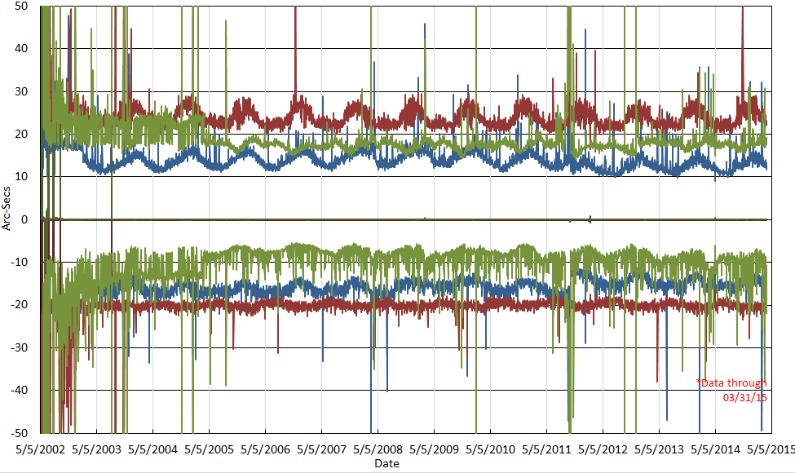
Technical Panel #17: Please provide status of the Guidance, Navigation, and Control (GN&C) subsystem performance with supporting trending and threshold data. Please discuss how well pointing performance has been maintained. [Here showing a 1-slide summary of 3 slides.]
The GN&C subsystem, which controls the spacecraft pointing, is performing excellently, with no degradation since the beginning of the mission.
There has been no observable long-term trend showing any problems with attitude determination or control functions.
Daily Maximum, Minimum, and Mean Aqua Pointing Errors (in arc-seconds) for the Roll (blue), Pitch (red), and Yaw (green)

