Slide 1
I. MODIS Atmosphere Discipline Team:
C6 Status
II. MODAWG: MODIS-VIIRS Product Continuity for Cloud Mask, Cloud-Top
& Optical Properties
MODIS/VIIRS Science Team Mtg.
Silver Spring, MD

Slide 2
I. MODIS Atmosphere Discipline Team:
C6 Status
MOD06: S. Platnick, G. Wind, N. Amarasinghe, B. Marchant, J. Riedi, G. T. Arnold, K. Meyer, M. D. King, Z. Zhang, C. Wang, R. Holz, S. A. Ackerman, P. Yang, B. Baum, et al.
MODATML2: S. Platnick, B. Ridgway
MOD08: P. Hubanks, S. Platnick, B. Ridgway
MYD02 1km re-registration: R. Wolfe, R. Bennartz, S. Platnick
QA: S. Monoharan, B. Ridgway, S. Platnick

Slide 3
I. MODIS Atmosphere Team C6 Status
Main Tasks as of last Science Team Meeting
  Completing L3 algorithm code and testing
  Finalize Terra L1 & L2 codes (Terra B5 RVS de-trending update – in addition to other VNIR bands; MOD04 Deep Blue).
Collection 6 reprocessing completed
  Release in January 2014 (Aqua L2), April 2015(Aqua L3)
  May 2015 (Terra L2/L3)
  Collection 5 forward processing will continue to May 2016
Updated Browse Imagery
  L2 global browse
  L3 w/improved image quality, user interface and new datasets
C6 documentation page includes L2 and L3 user guides, webinars, etc.: modis-atmos.gsfc.nasa.gov/products_C006update.html
Notes:
Other vnir: B1-4, 8,9

Slide 4
C6 L3 Browse
(S. Monoharan, B. Ridgway, et al.)
gridded
means
uncertainty
in means
sdev
Notes:
gridded
means for
different phases/population

Slide 5
Atmosphere Team
C6 Webinar Series
June–Oct. 2014
(organized by
R. Kleidman)
Notes:
14 webinars
Session/Topic:
MODIS C6 overview, web resources, etc.: Platnick, Xiong
MOD04 Dark Target: Levy
MOD04 Deep Blue: Sayer
MOD04 Overview/Combined DB-DT and 3 km product: Levy, Sayer
MOD35 Cloud Mask: Ackerman
MOD06 Cloud-Top/Optical properties: Ackerman, Platnick
MOD06 Optical Properties: Platnick
MOD08 Atmosphere Team L3 products: Hubanks, Ridgway, Platnick
Data Acquisition LAADS, LANCE, WorldView, MIRADOR, ECHO–REVERB: TBD
Giovanni – Aerosols Express: Chris Lynnes
MODIS Atmo Educational Materials and Resources: Kleidman

Slide 6
II. MODAWG: MODIS-VIIRS Product Continuity for Cloud Mask¹, Cloud-Top²
& Optical Properties³
¹ Steve Ackerman, Rich Frey, Bob Holz [UW/CIMSS]
² Andy Heidinger, Yue Li, Steve Wanzong [UW/CIMSS, NOAA STAR]
³ Steve Platnick, Kerry Meyer, Gala Wind, Nandana Amarasinghe, Ben Marchant, Tom Arnold [GSFC]
Atmosphere SIPS: Bob Holz, Steve Dutcher, Liam Gumley, et al. [UW/CIMSS]

Slide 7
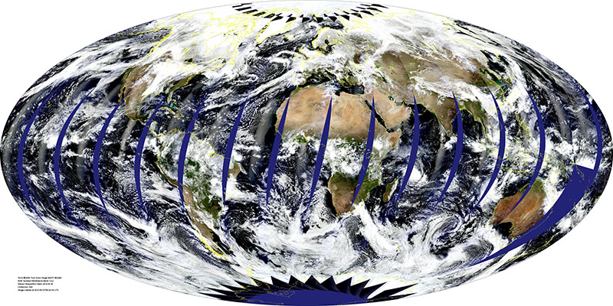
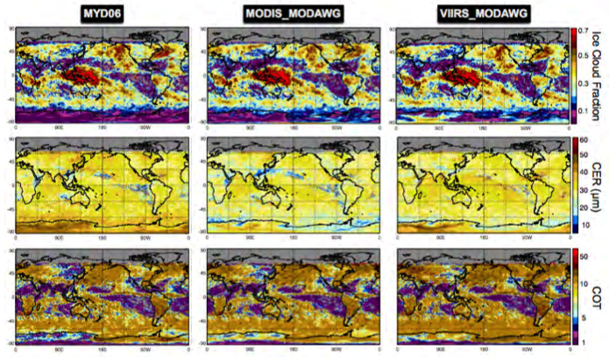
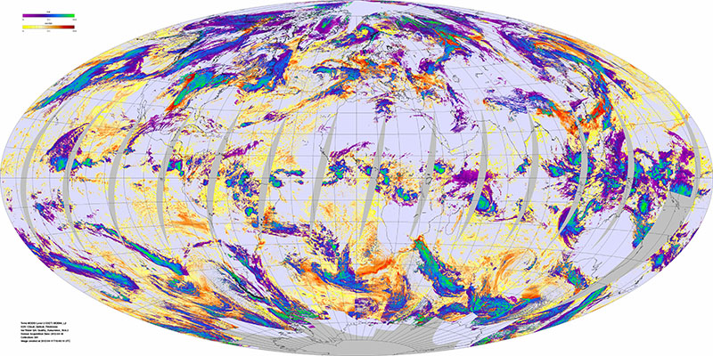
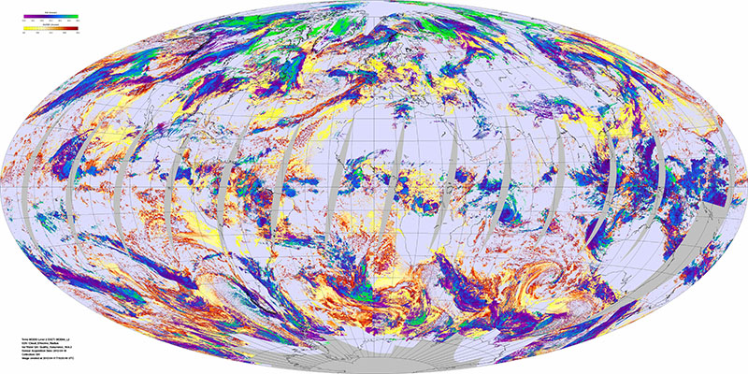
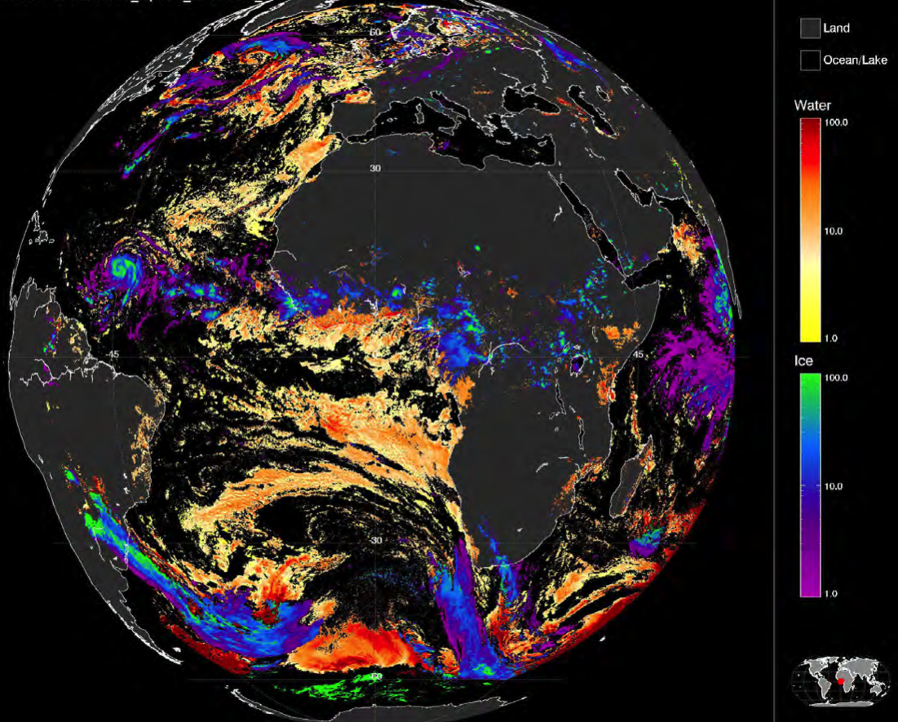
Level-2 Cloud Optical Property Retrievals
(CHIMAERA Multi-sensor Retrieval Package, see poster)
MODAWG: common VIIRS/MODIS algorithm
MOD/MYD06
eMAS
SEVIRI

Slide 8
C6 Cloud Optical Property Algorithm
L1B: Aqua VNIR “re-registration”, Terra RVS radiometric stability
New radiative transfer and ice cloud models.
New cloud retrieval phase algorithm (SWIR + IR).
Additional spectral cloud effective radius retrievals included explicitly.
Full processing and separate datasets for lower quality “partly cloudy” pixels. Failed retrieval information also provide.
Additional/improved error sources in pixel-level uncertainty calculations. Dropped use of Confidence QA assignments!
Surface: New gap-filled C5 land spectral surface albedo, multiple wind speed Cox-Munk ocean model.

Slide 9
MODIS Atmosphere Team C6 Status
Terra C6 RVS L1B De-Trending Impact: Ice Cloud Optical Thickness
Land
B1 dependence
— C51
— C6
Ocean
B2 dependence
Notes:
Other vnir: B1-4, 8,9

Slide 10
MODIS Atmosphere Team C6 Status
Terra C6 RVS L1B De-Trending Impact: DT Aerosol Optical Depth
Land
B3 dependence
— C51
— C6
Ocean
Notes:
Other vnir: B1-4, 8,9

Slide 11
MODIS Atmosphere Team C6 Status
Terra C6 RVS L1B De-Trending Impact: %/dec, ±60° latitude
 | Terra C5 | AquaC5 | Terra C6 | Aqua C6
COT Ice/land | -11.4 |  | -1.0
COT Ice/ocean | -13.5 |  | 4.0
DT AOD land | -22.4 |  | 4.8
DT AOD ocean | -1.5 |  | 5.9
significant reduction
in Terra trends
Notes:
Other vnir: B1-4, 8,9
Depends on latitude zone used in the averaging

Slide 12
MODIS Atmosphere Team C6 Status
MODIS Atmosphere Team C6 Status
Terra C6 RVS L1B De-Trending Impact: %/dec, ±60° latitude
 | Terra C5 | AquaC5 | Terra C6 | Aqua C6
COT Ice/land | -11.4 | -0.8 | -1.0 | -2.7
COT Ice/ocean | -13.5 | -3.2 | 4.0 | -1.2
DT AOD land | -22.4 | -2.1 | 4.8 | -1.7
DT AOD ocean | -1.5 | 0.3 | 5.9 | 0.7
Notes:
Other vnir: B1-4, 8,9
Depends on latitude zone used in the averaging

Slide 13
C6 “Failed” Retrieval Statistics for Marine Boundary Layer Clouds
1 yr. (2007) Aqua MODIS analysis, see poster for further details
“Overcast”
(74% of attempted retrieval population)
66% successful
70% successful
“Partly Cloudy”
(26%)
18% successful
21% successful
Cho, H. M. et al. (2015), Frequency and causes of failed MODIS cloud property retrievals for liquid phase clouds over global oceans, JGR, doi:10.1002/2015JD023161.
Notes:
Marine Boundary Layer (MBL) clouds at the heart of cloud feedback and radiative aerosol-indirect effects.
• CER_21 overall failure rate ~16%, CER_37 ~10%
• PCL pixels have much higher failure rate => artifacts and/or physics associated with heterogeneity effect. Using ASTER and eMAS to test our theoretical understanding that came out of LES studies.

Slide 14
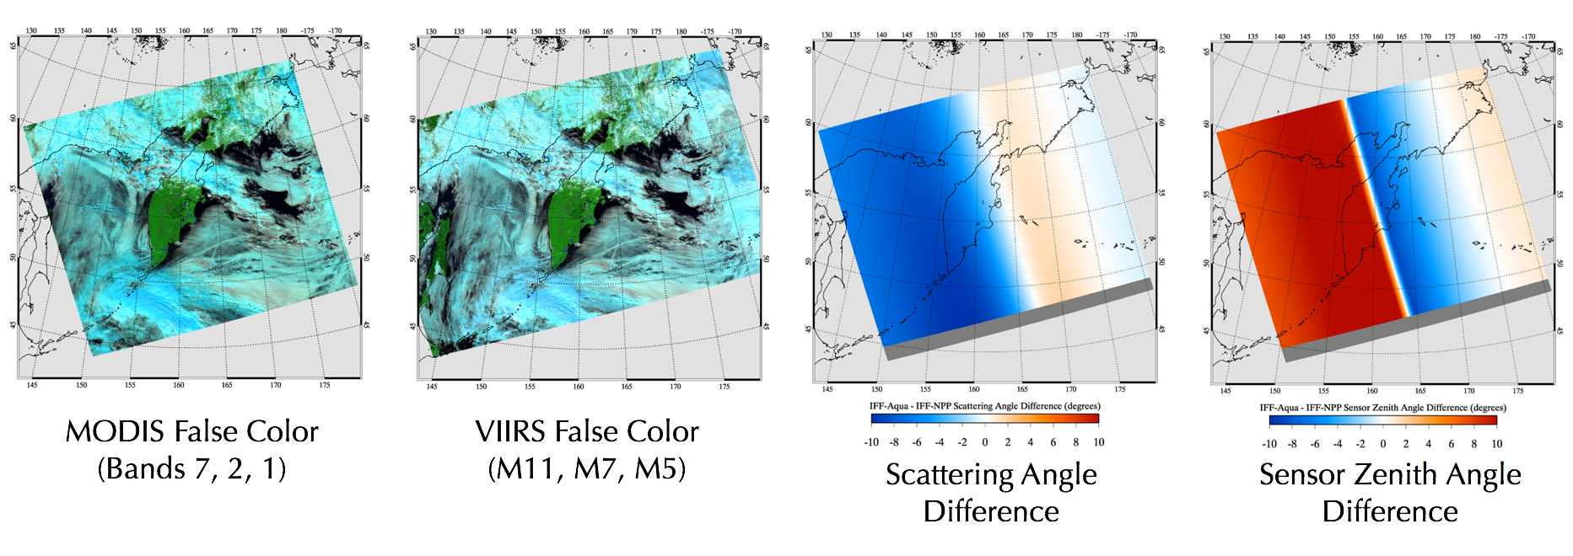
MODAWG MODIS & VIIRS L2 Comparisons
Using common IFF L1B files from Atmosphere SIPS
6 July 2014, Kamchatka Peninsula, near simultaneous overpass (0200 UTC) and ground track
Cyan => ice phase clouds

Slide 15
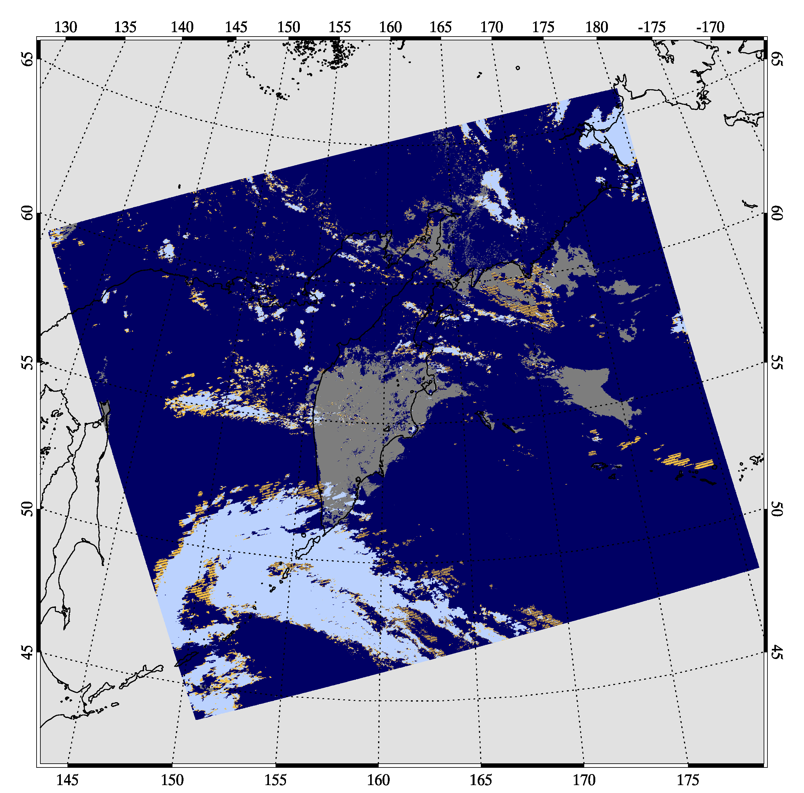
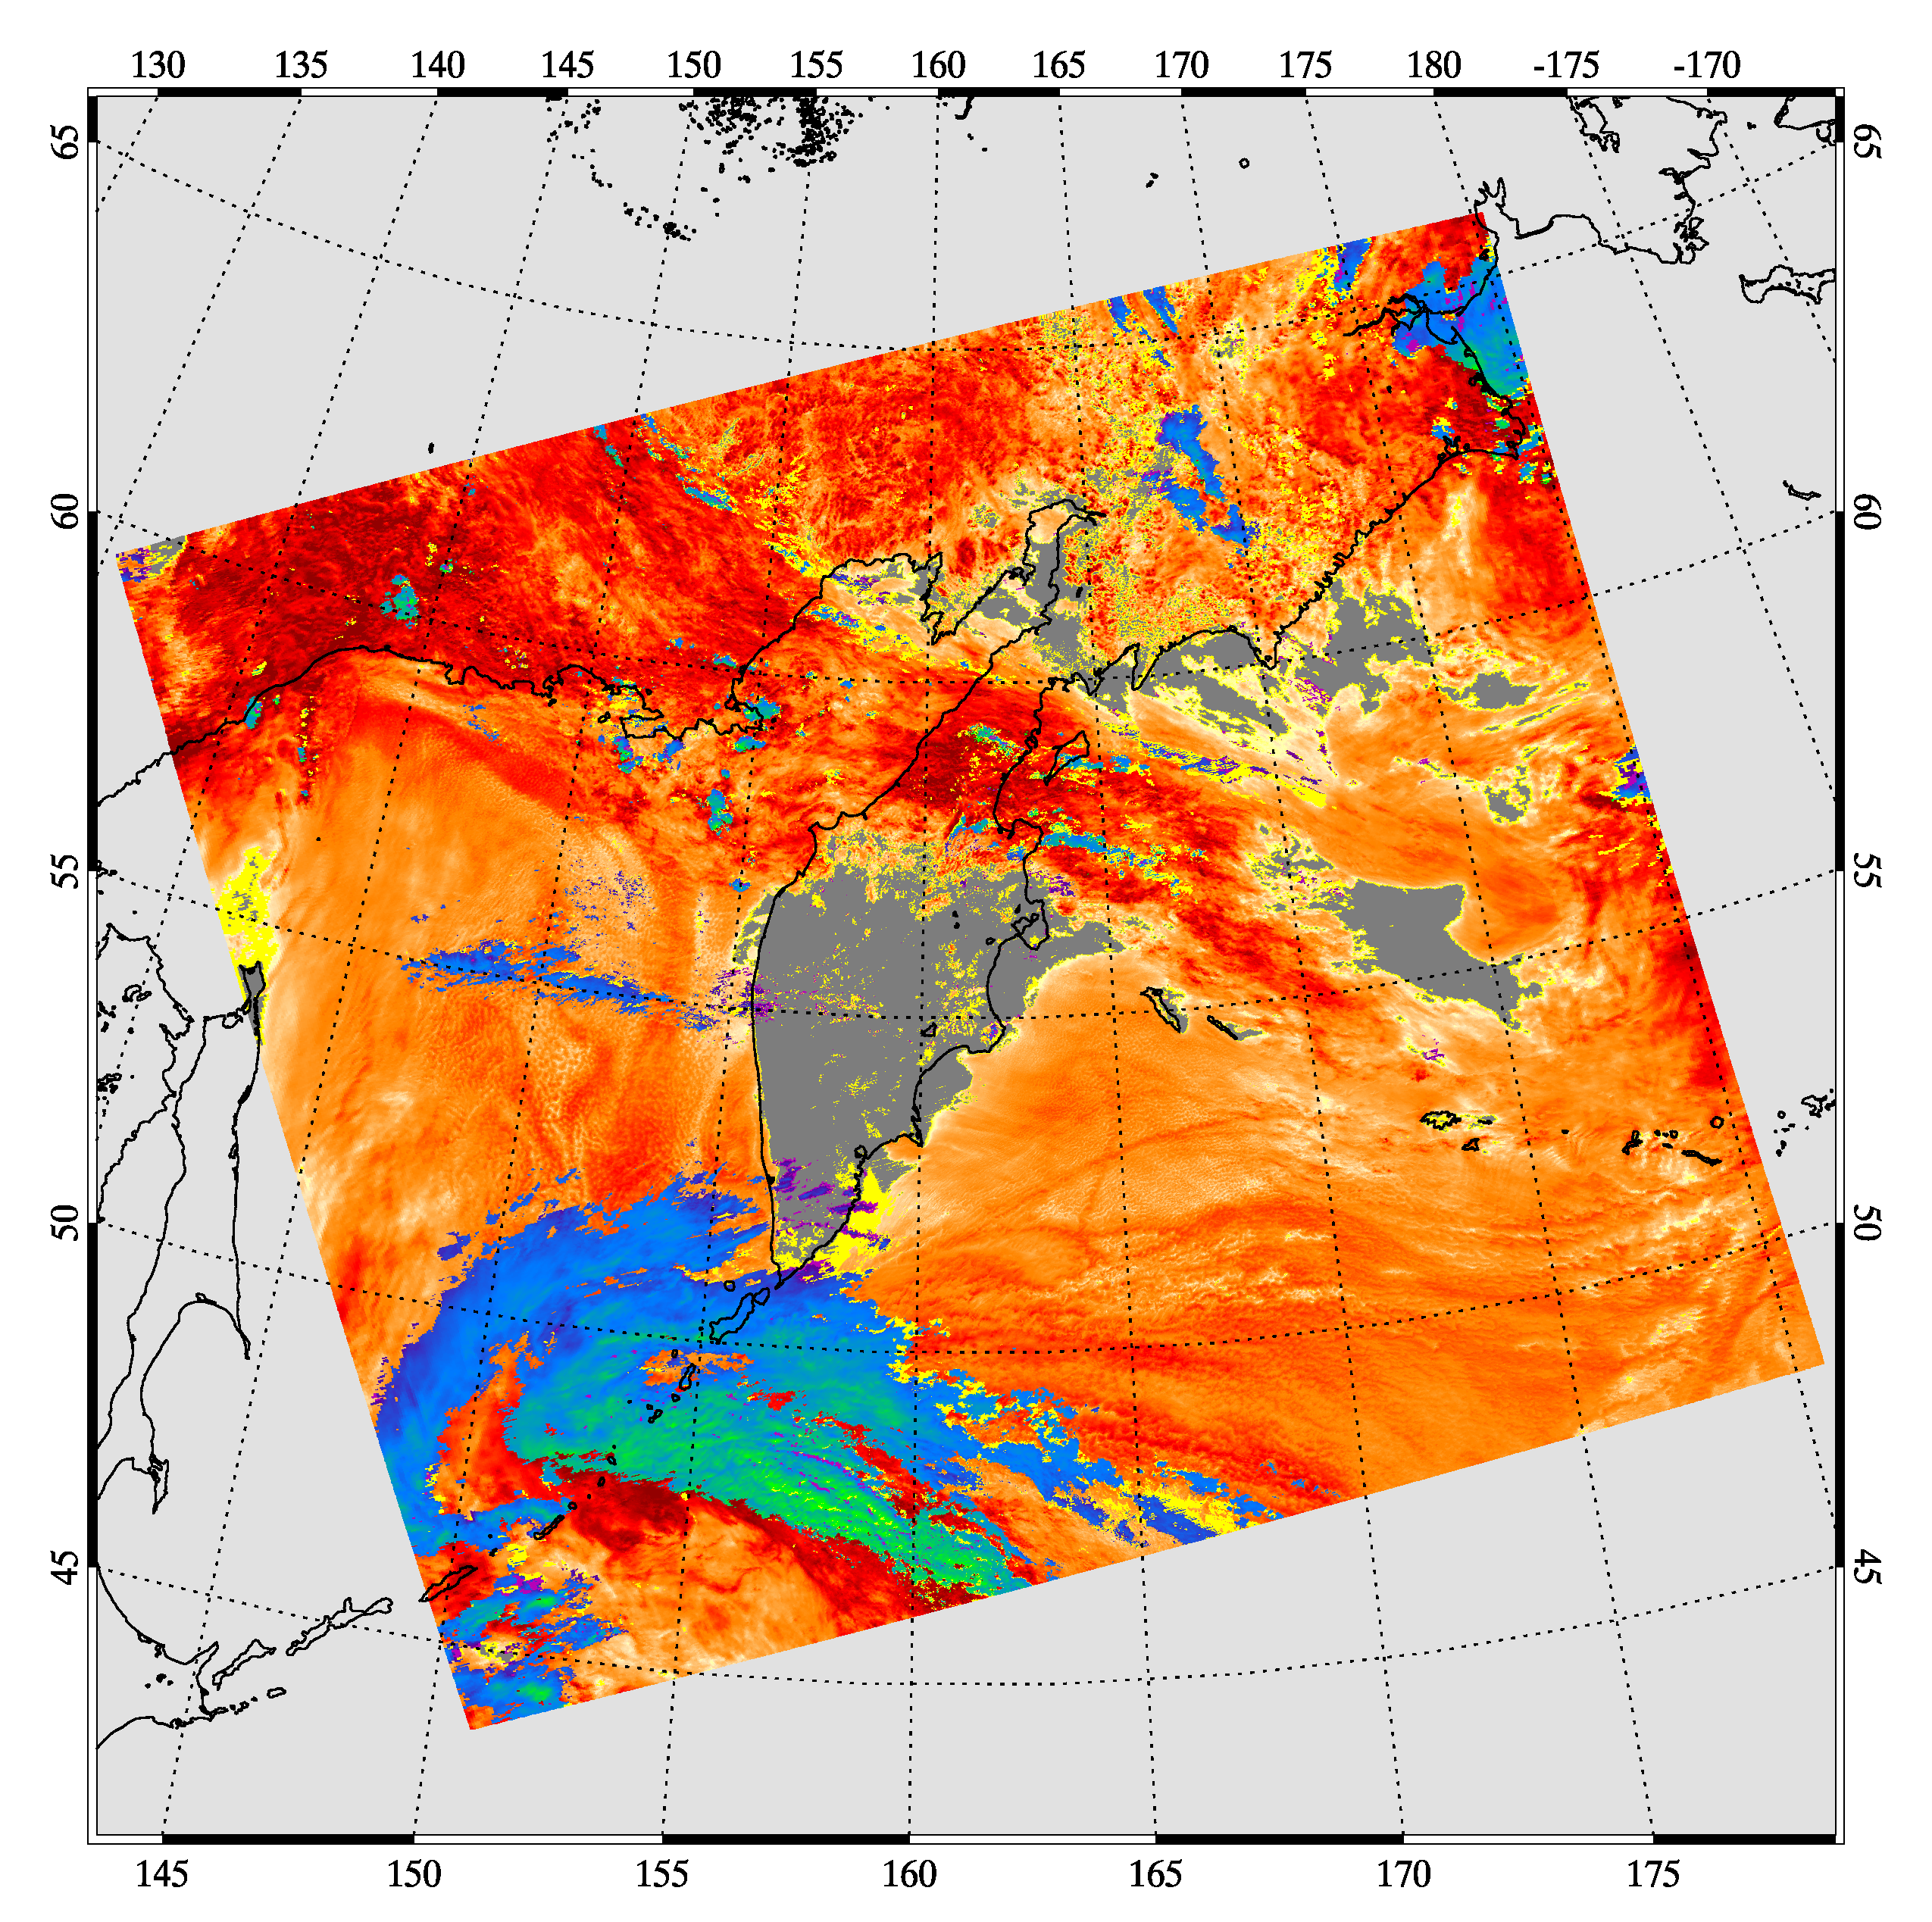
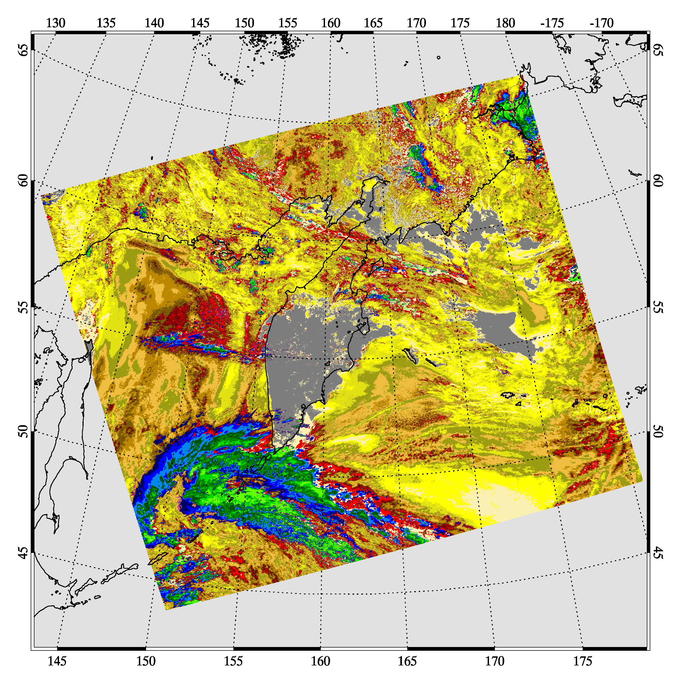
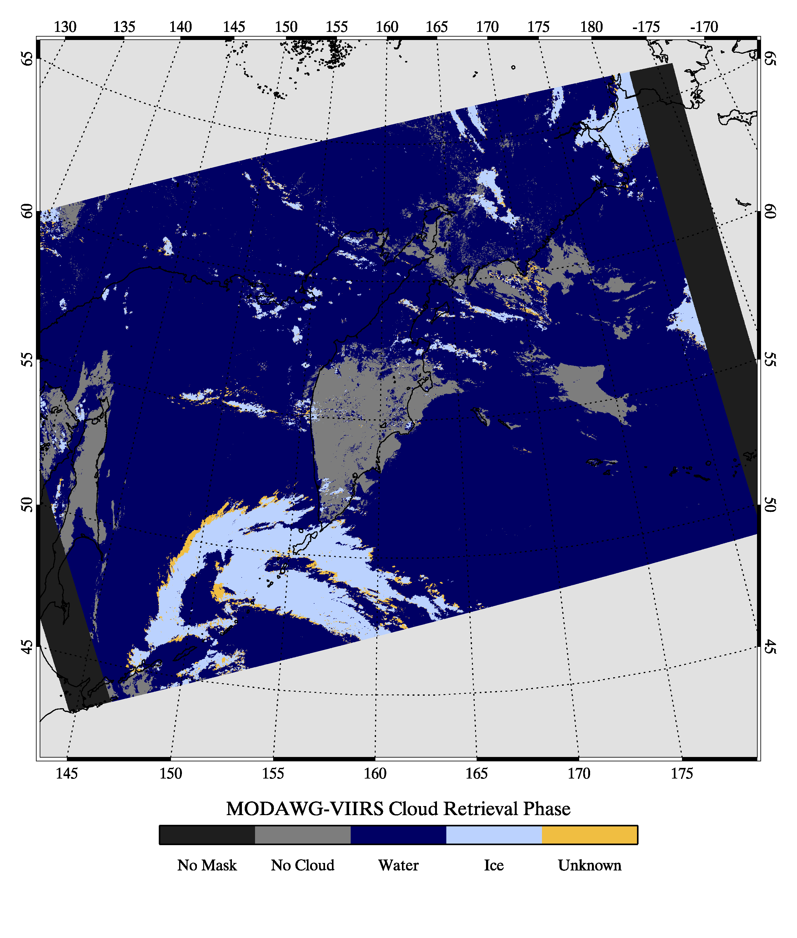
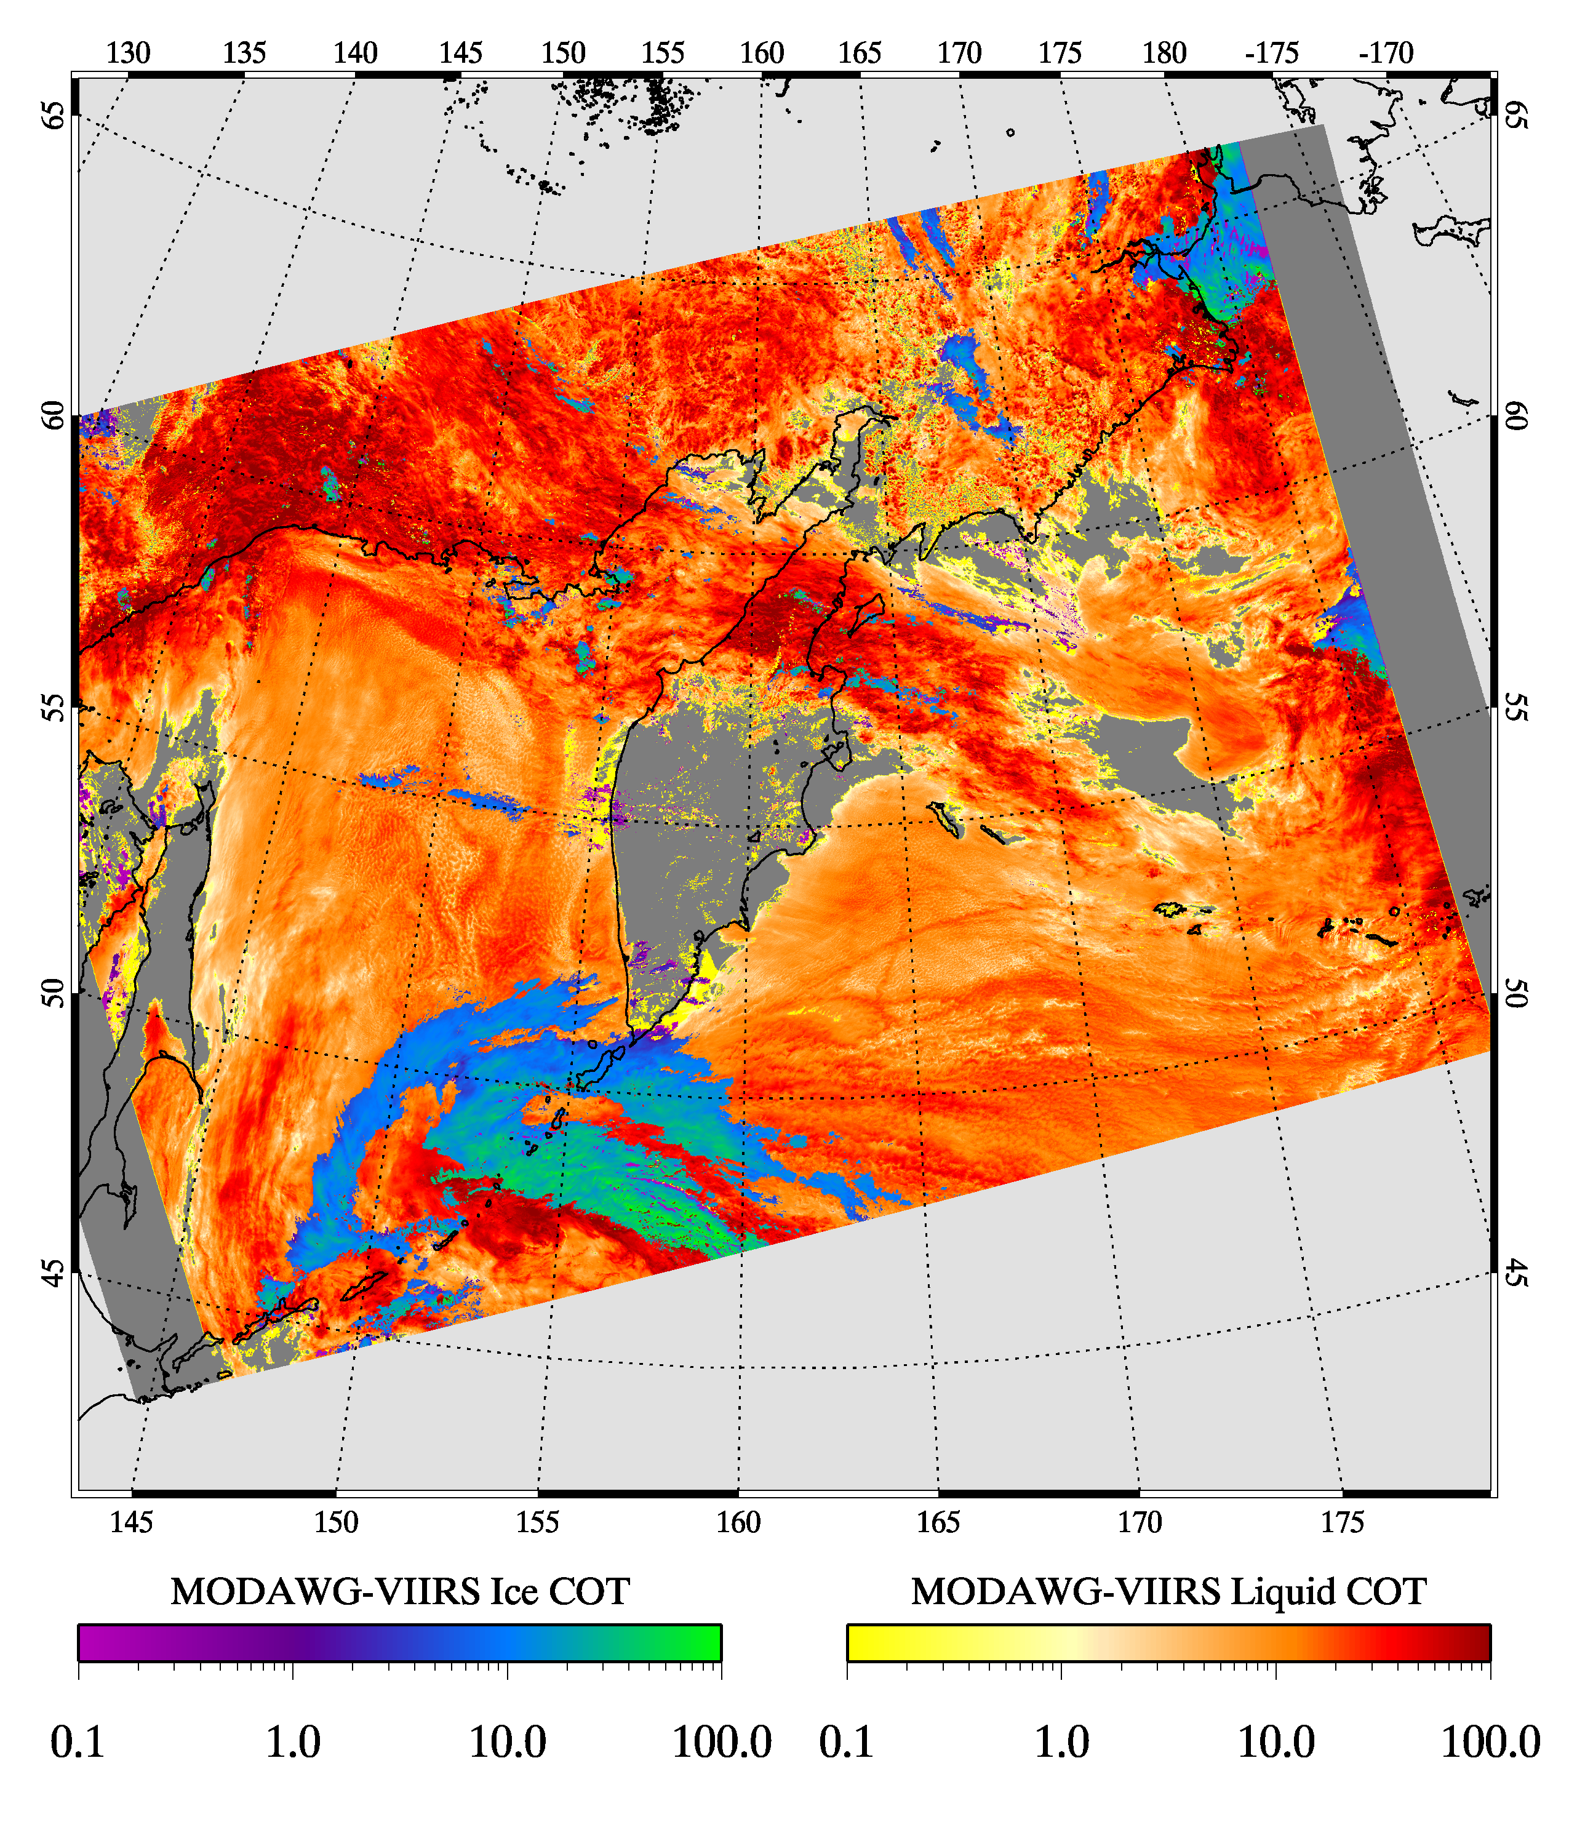
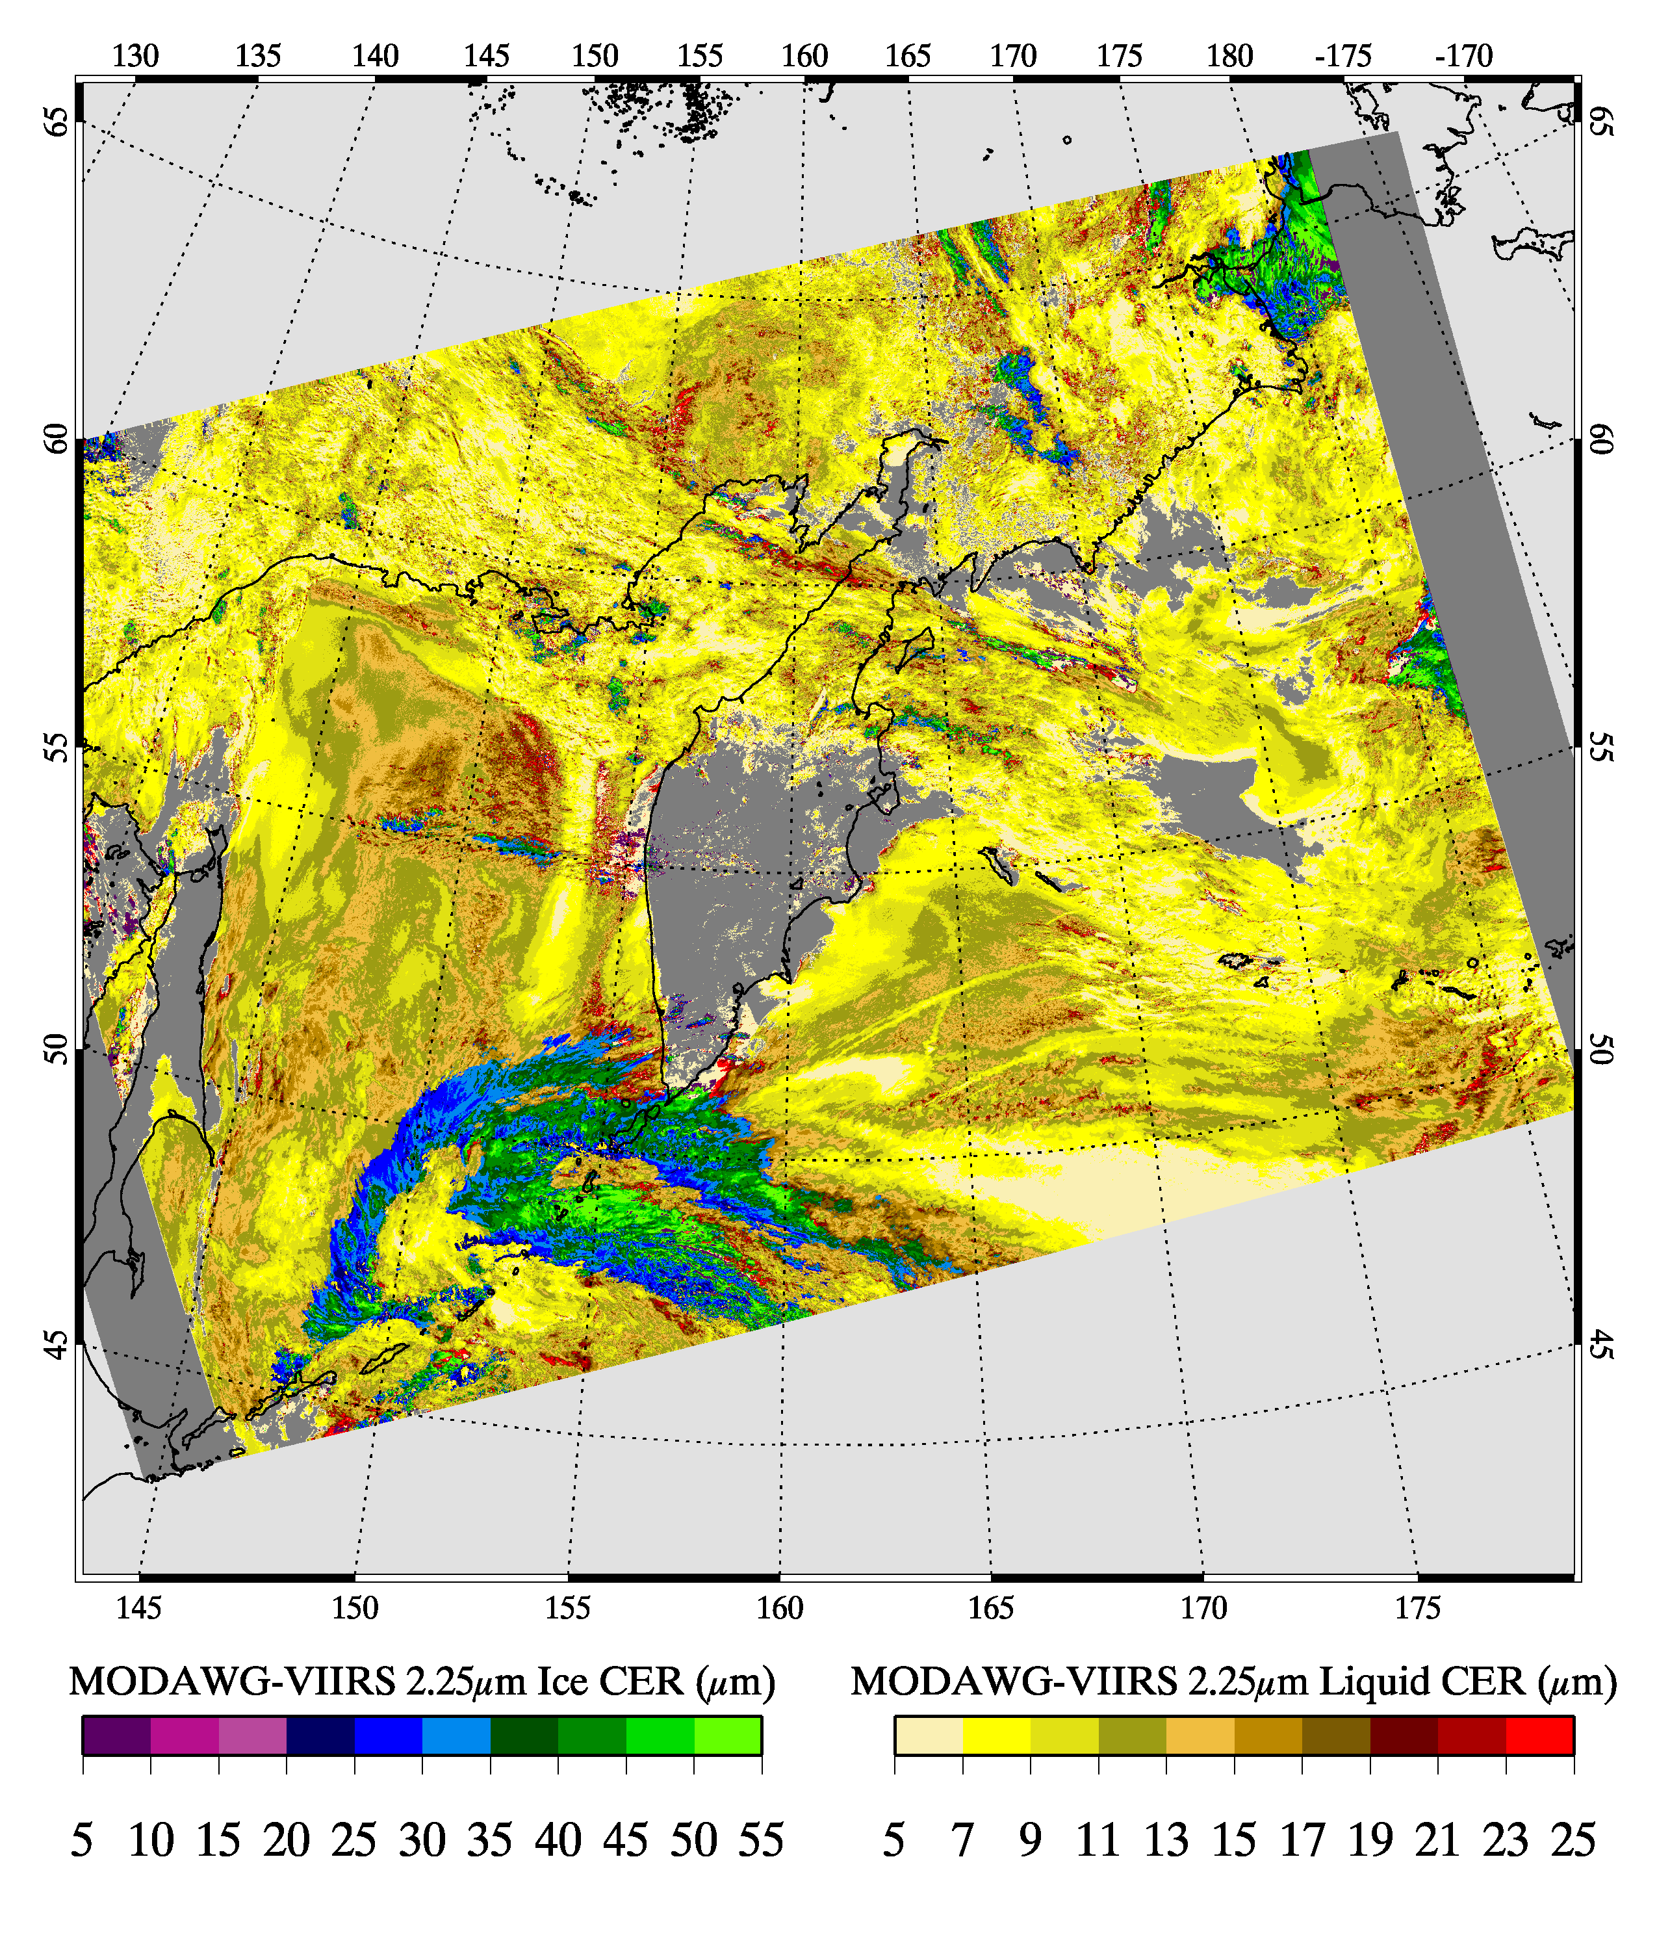
Phase
COT
CER_2.2 (µm)
MODAWG
MODIS
liquid & ice
MODAWG
VIIRS
liquid & ice
Ice
Liquid
Notes:
Gray bars at VIIRS swath edges represent the limits to the LUTs we generated

Slide 16
L1 Radiometric Intercomparison Challenges:
MODIS (blue) &
VIIRS (green) RSRs
0.86 µm
window
1.6 µm
window
2.1 µm
window
Notes:
Code LBLRTM

Slide 17
L1 Radiometric Intercomparisons
MODIS (blue) and VIIRS (green) 0.86 µm channel bandpasses

Slide 18
L1 Radiometric Intercomparisons
MODIS (blue) and VIIRS (green) 1.6 µm window bandpasses

Slide 19
L1 Radiometric Intercomparisons
MODIS (blue) and VIIRS (green) 2.2 µm window bandpasses

Slide 20
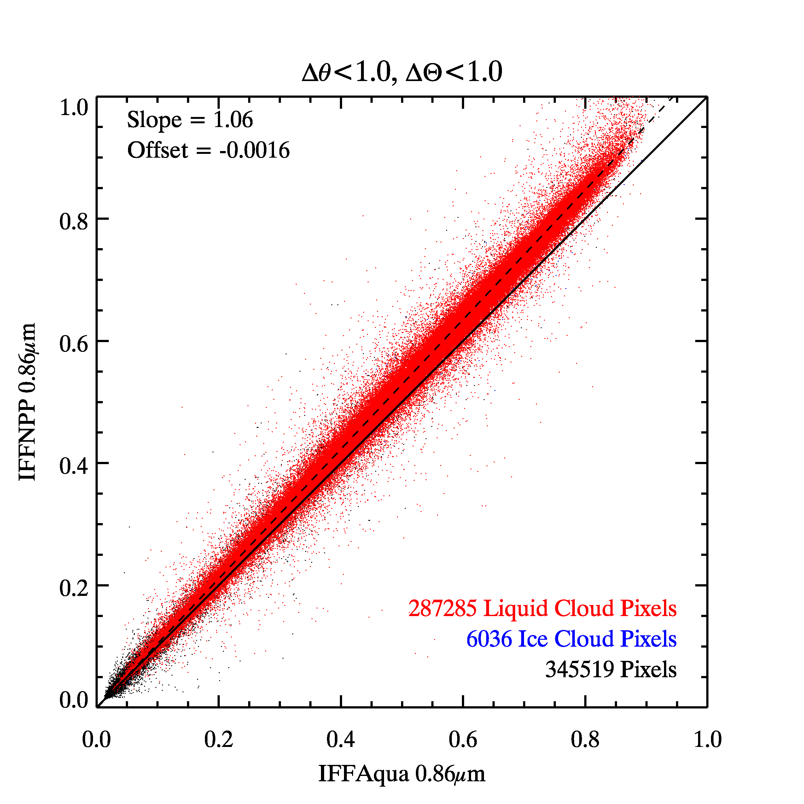
L1 Radiometric Intercomparisons
0.86 µm reflectance scatterplot for similar solar/view geometry (≤1°)
+6% offset
(≈ 2-3% expected
due to RSRs)
VIIRS M7 (IFF)
• Liquid
• Ice
MODIS B2 (IFF)
Notes:
Left two panels: B2 (MODIS) and M7 (VIIRS) spectral response functions and collocated pixel radiometric comparison over relatively homogeneous low marine water clouds (red points) in the 6 July 2014 IFF granule. Right two panels: same, but for B5 (MODIS) and M8 (VIIRS). Pixel collocLeft two panels: B2 (MODIS) and M7 (VIIRS) spectral response functions and collocated pixel radiometric comparison over relatively homogeneous low marine water clouds (red points) in the 6 July 2014 IFF granule. Right two panels: same, but for B5 (MODIS) and M8 (VIIRS). Pixel collocations in the scatter plot were limited to the same zenith view and scattering angles. The Expected regression slope corresponding to atmosphere and cloud spectral properties are given in the figures.ations in the scatter plot were limited to the same zenith view and scattering angles. The Expected regression slope corresponding to atmosphere and cloud spectral properties are given in the figures.

Slide 21
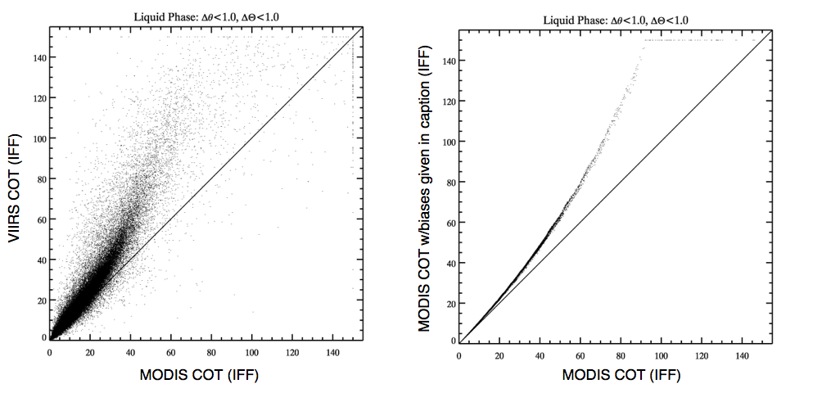
MODAWG Cloud Optical Thickness (COT) Intercomparisons for liquid water clouds
+3%
The impact on COT of a 3% bias in the MODIS B2 (0.86 µm) implies that the significant VIIRS COT bias at large values in the left panel is explained by a radiometric bias.
Notes:
Left panel: Retrieved MODAWG cloud optical thickness (COT) scatterplot for the liquid water pixel collocations described in the above figures.
Right panel: Based on reflectance differences determine as in above, the impact on COT of a 3% and 4% high bias in the MODIS B2 (0.86 µm) and B7 (2.1 µm) channels, respectively. The significant VIIRS COT bias at large values in the left panel is explained by the radiometric bias.

Slide 22
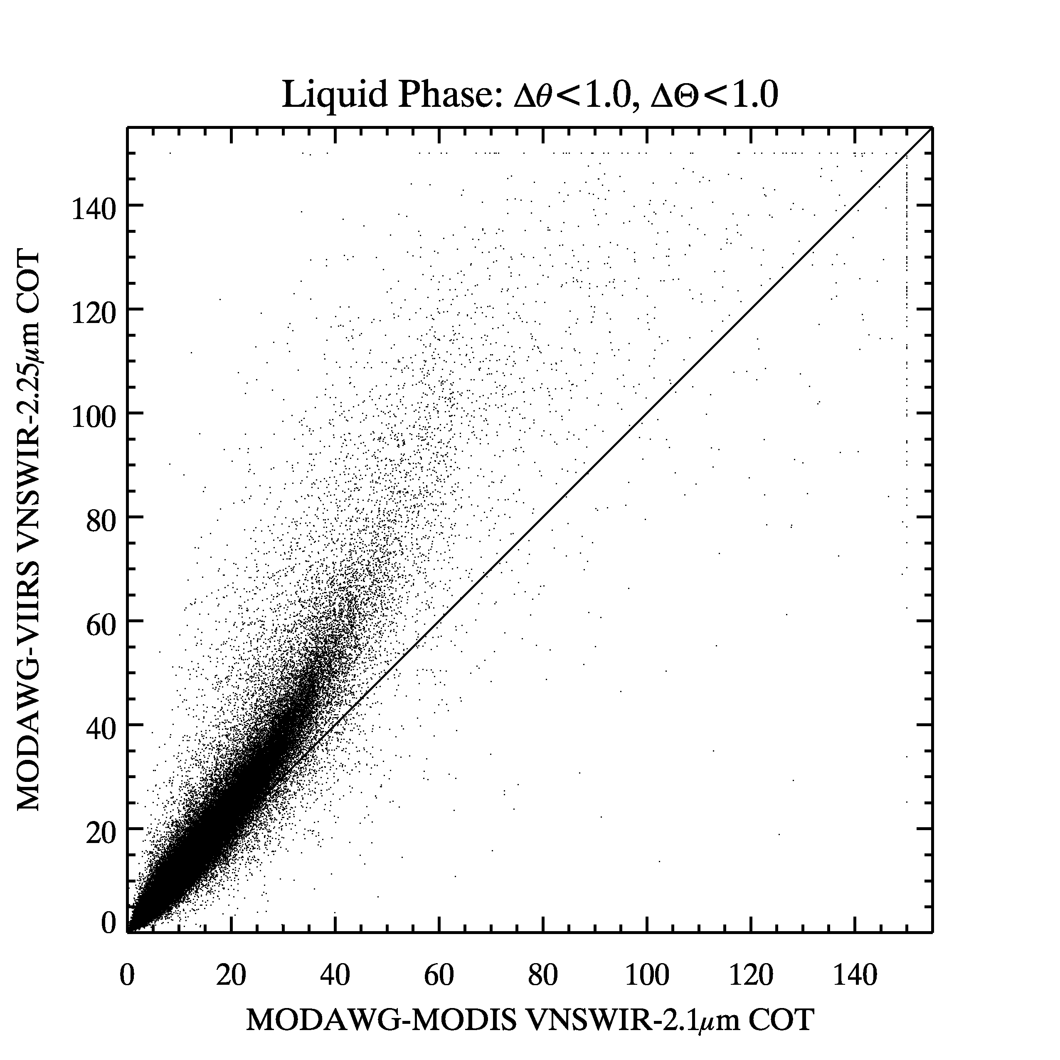
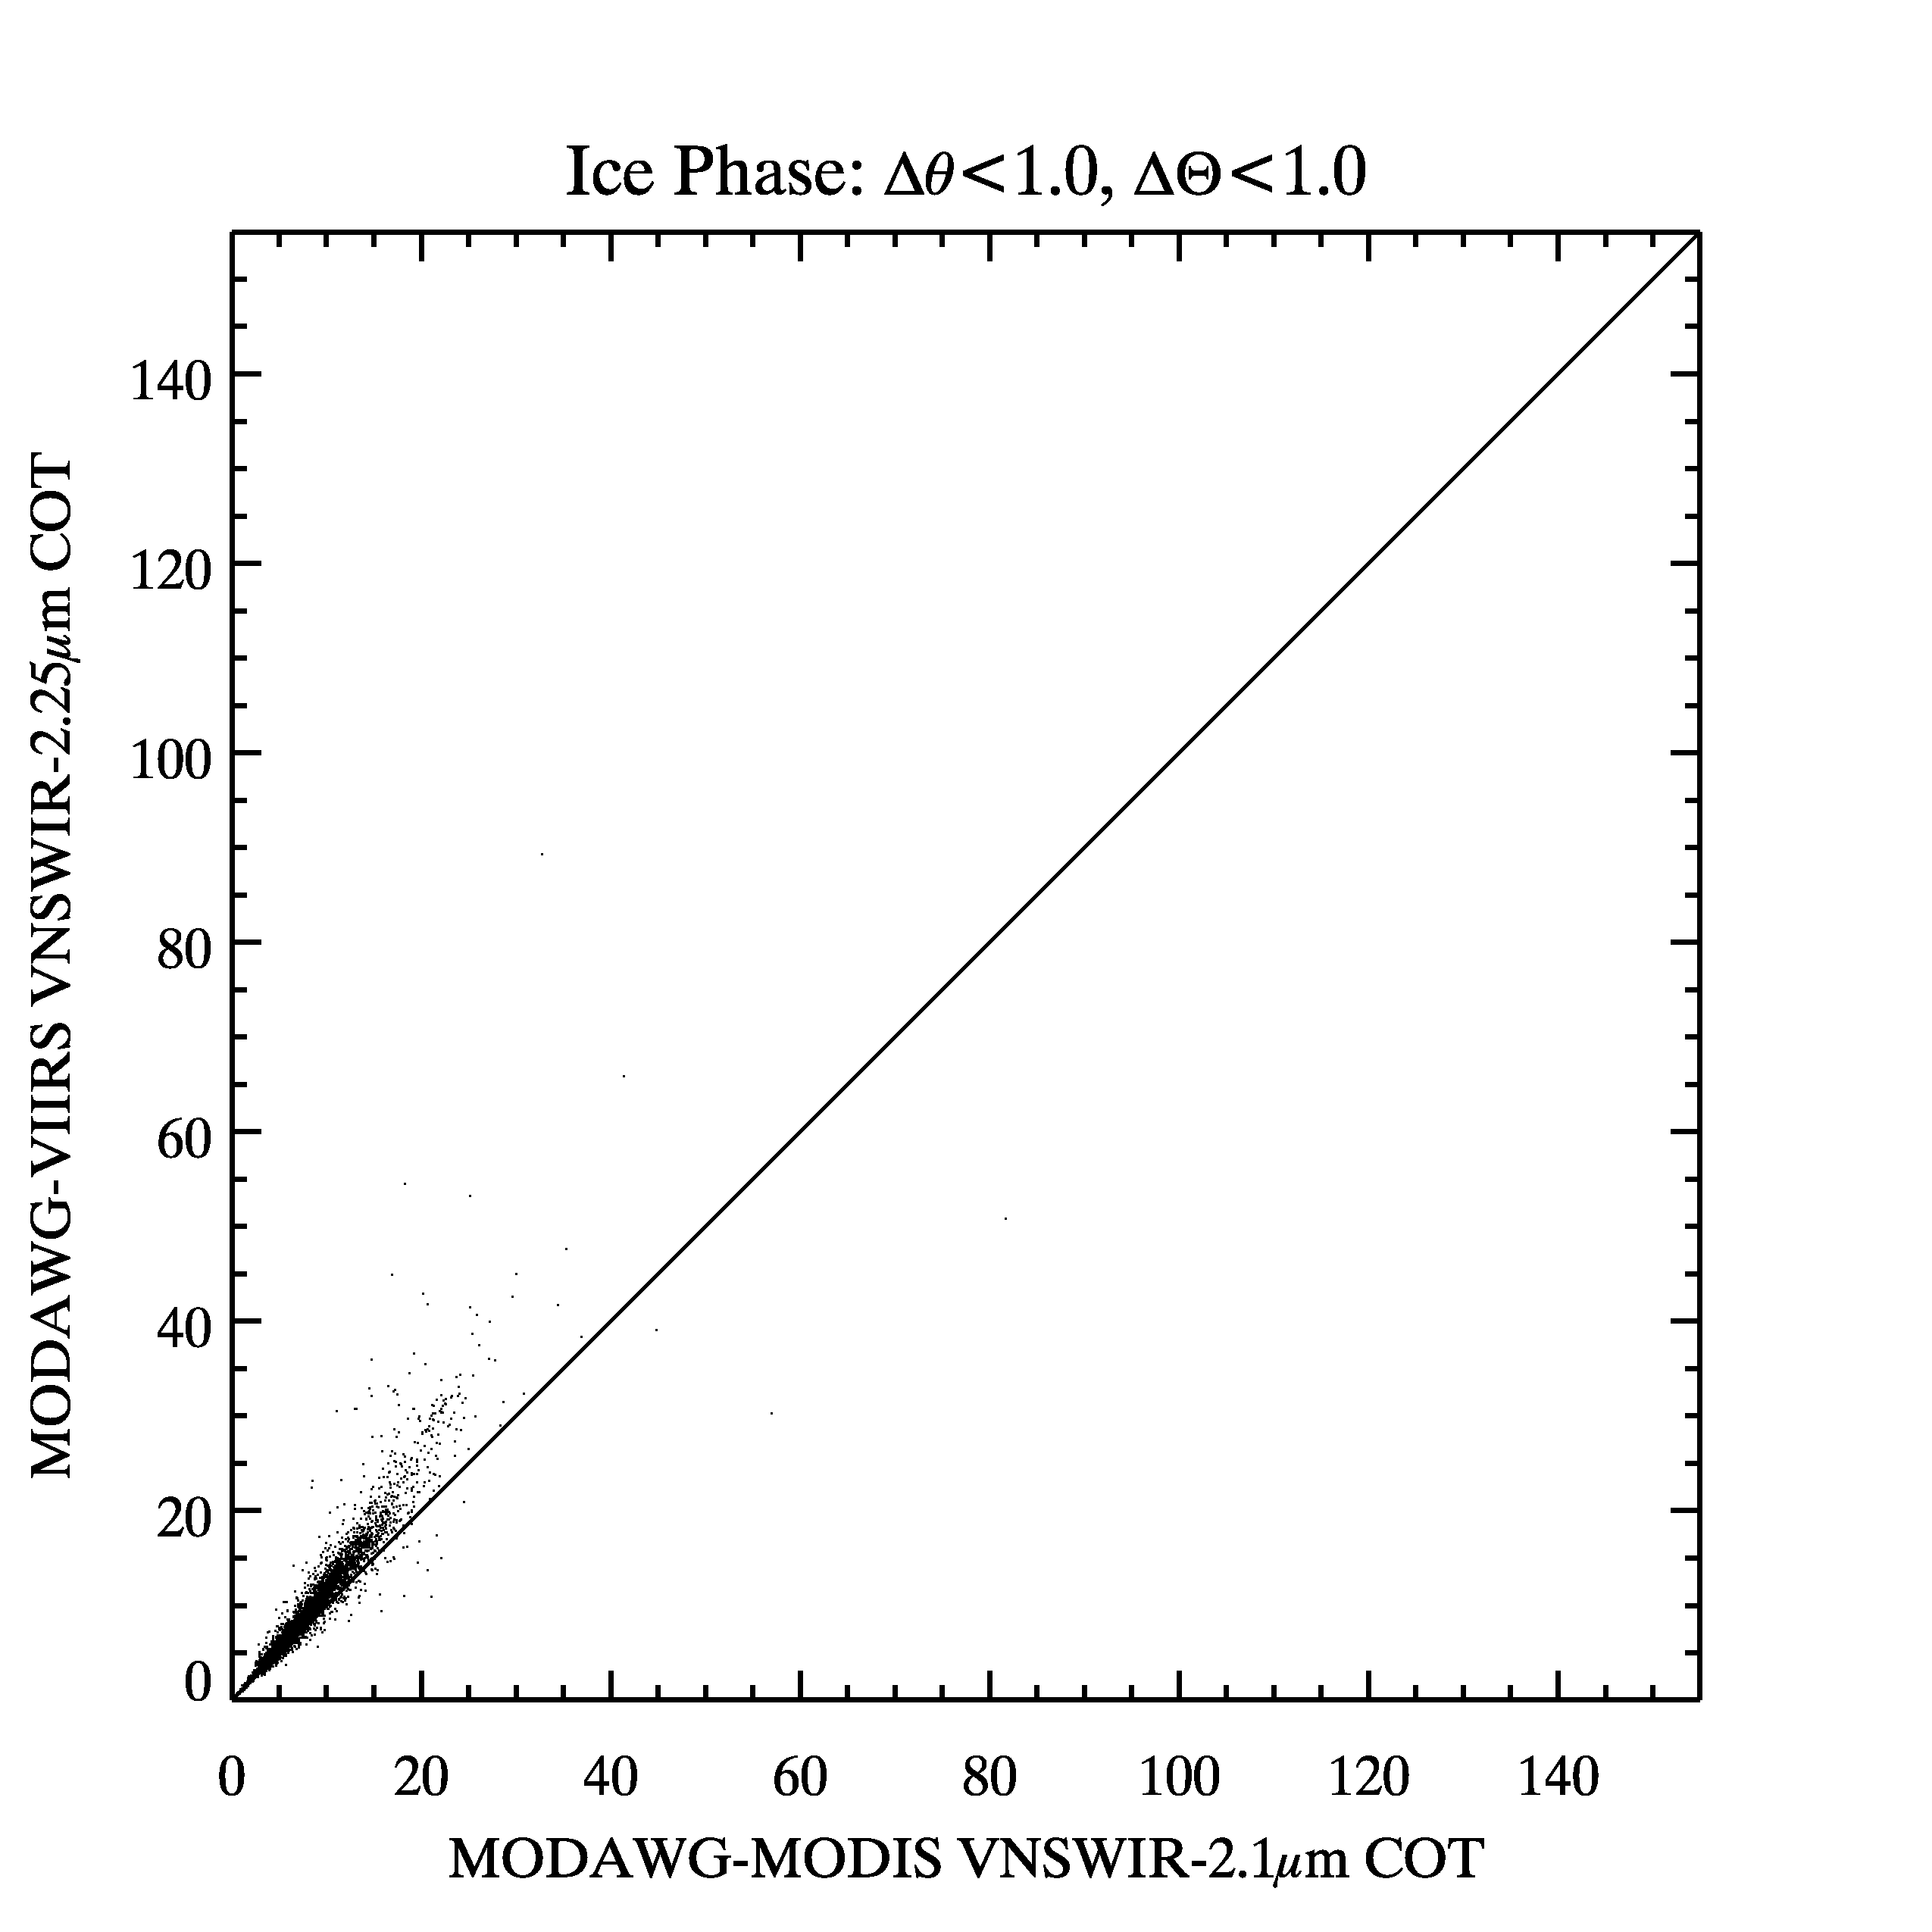
MODAWG COT Intercomparisons:
solar/view angle match <1°
Liquid phase
Ice phase
Notes:
0200 IFF granule

Slide 23
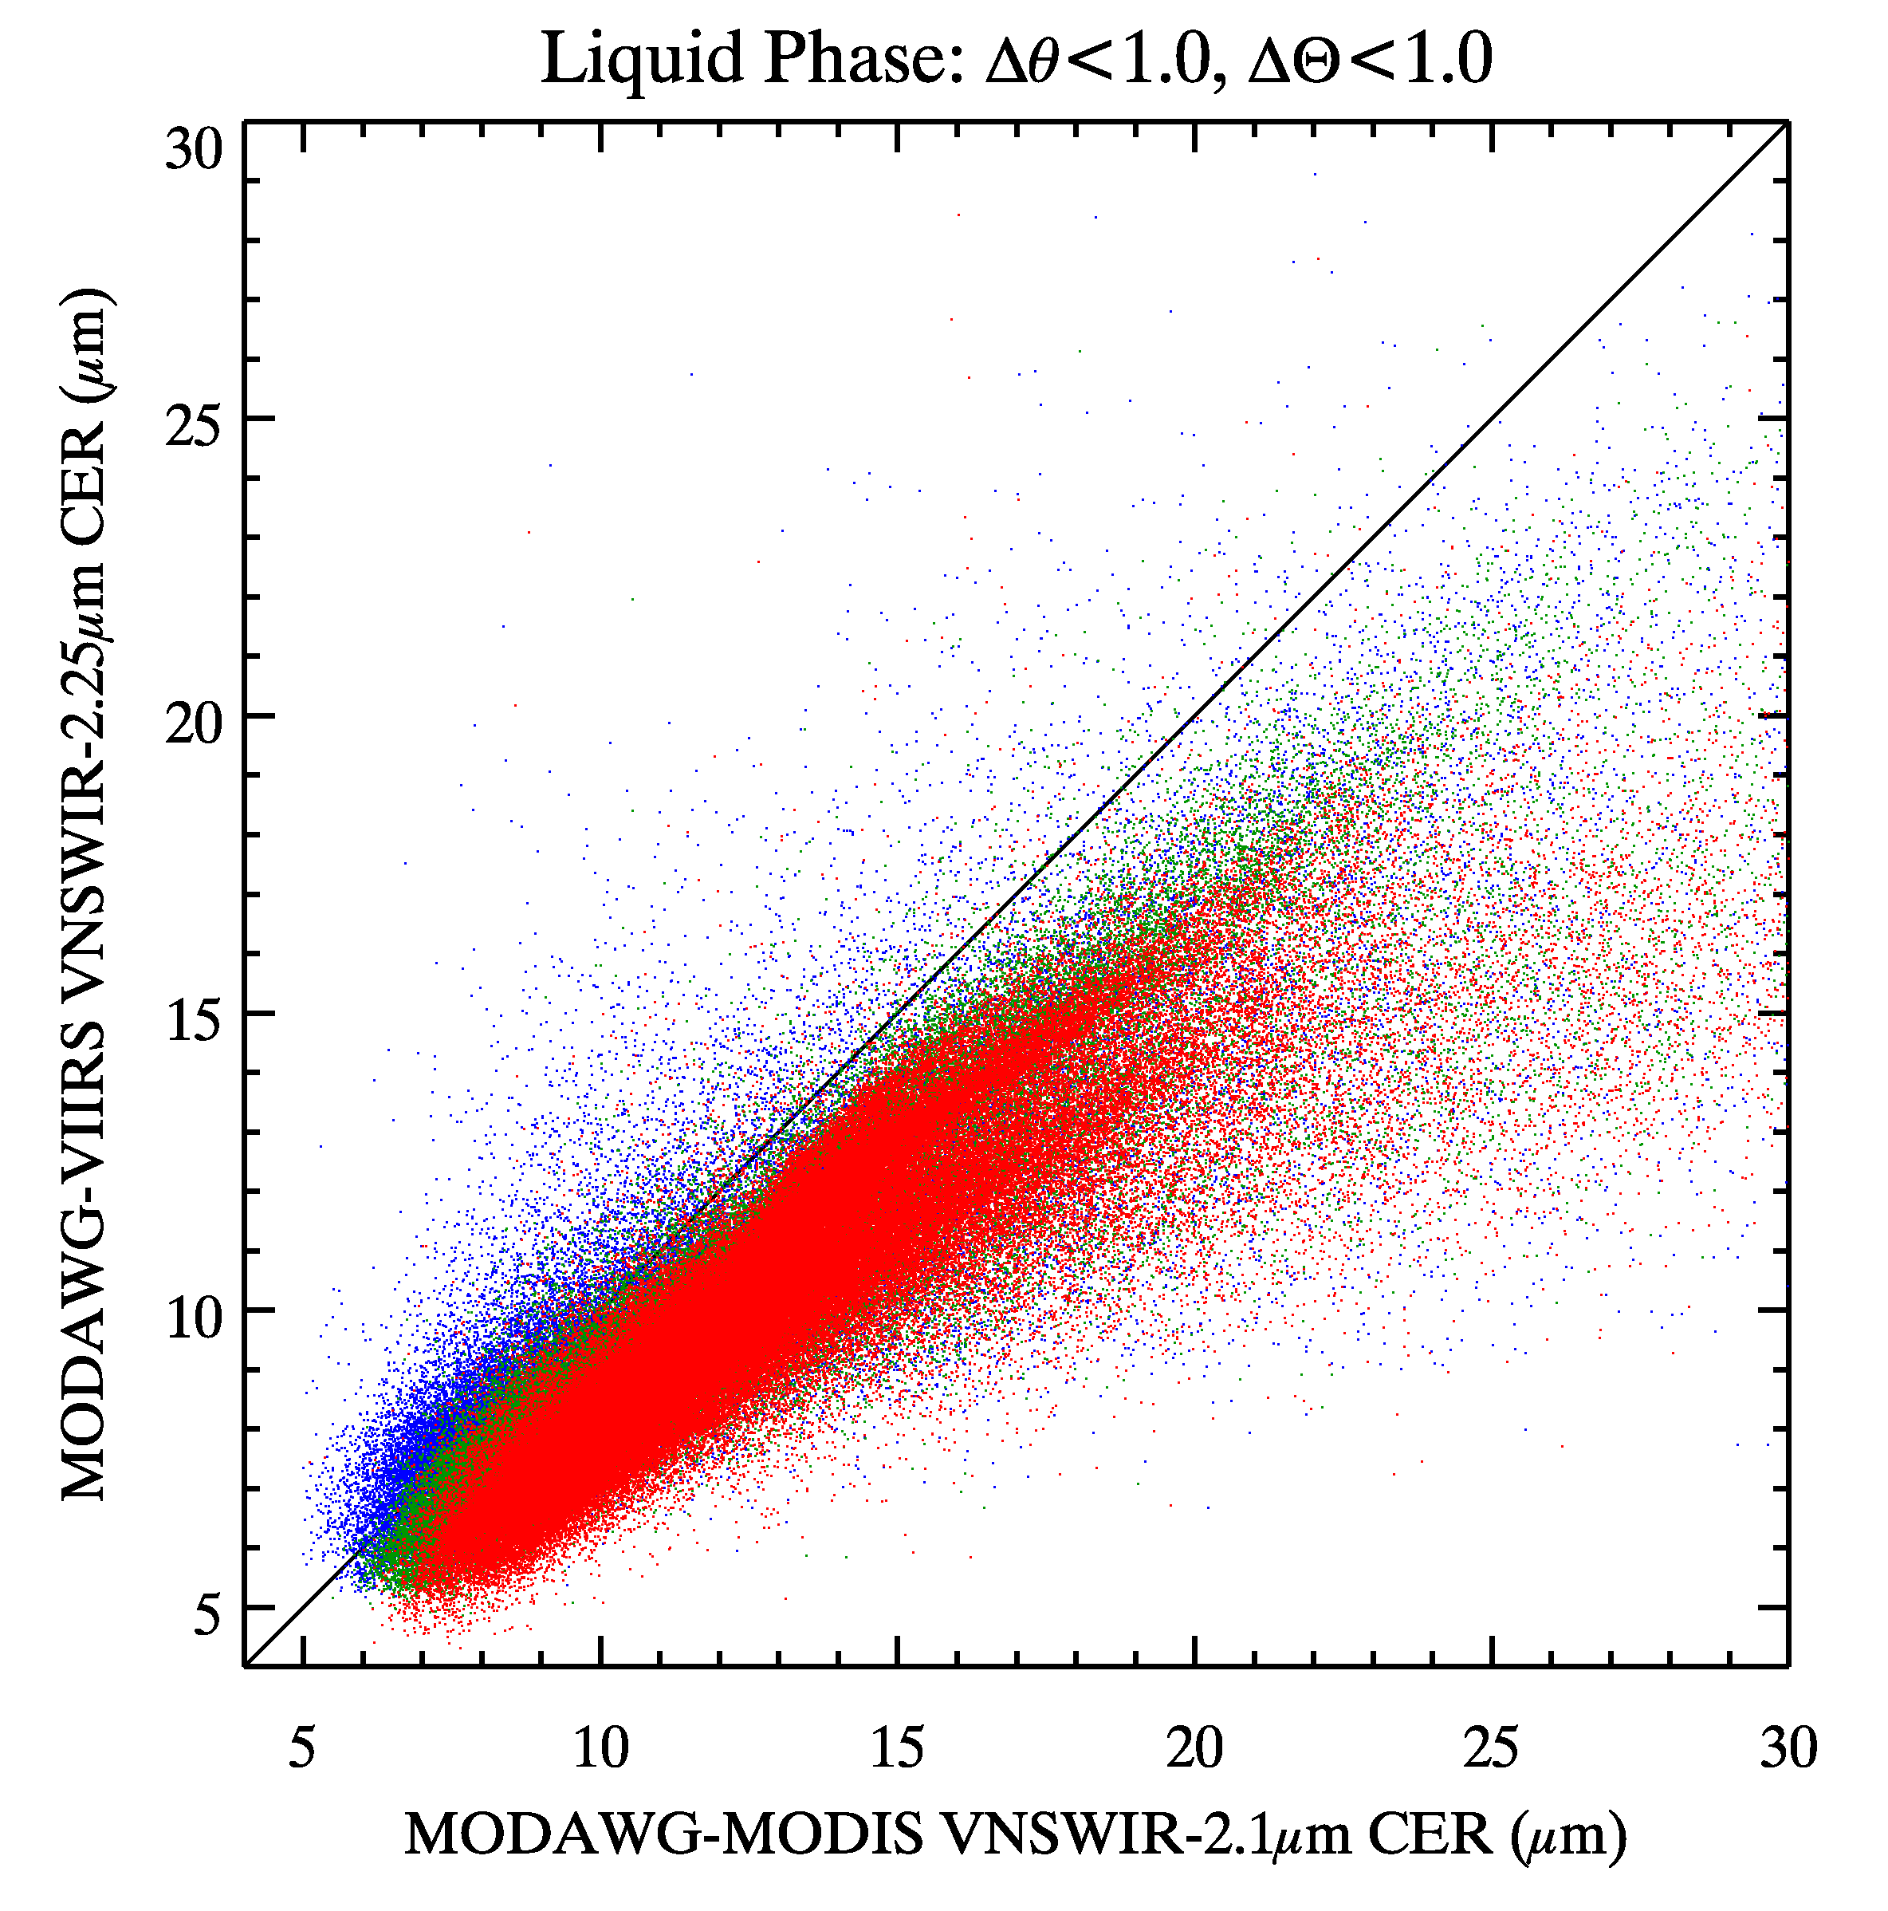
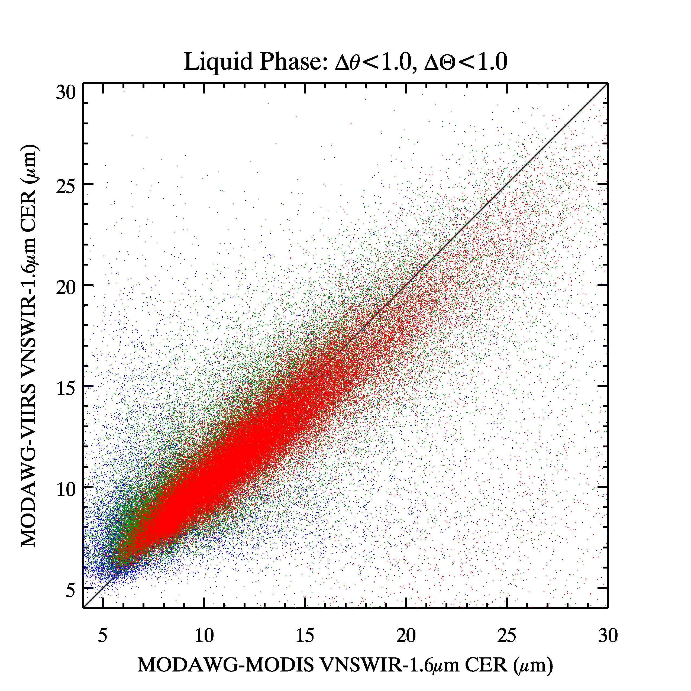
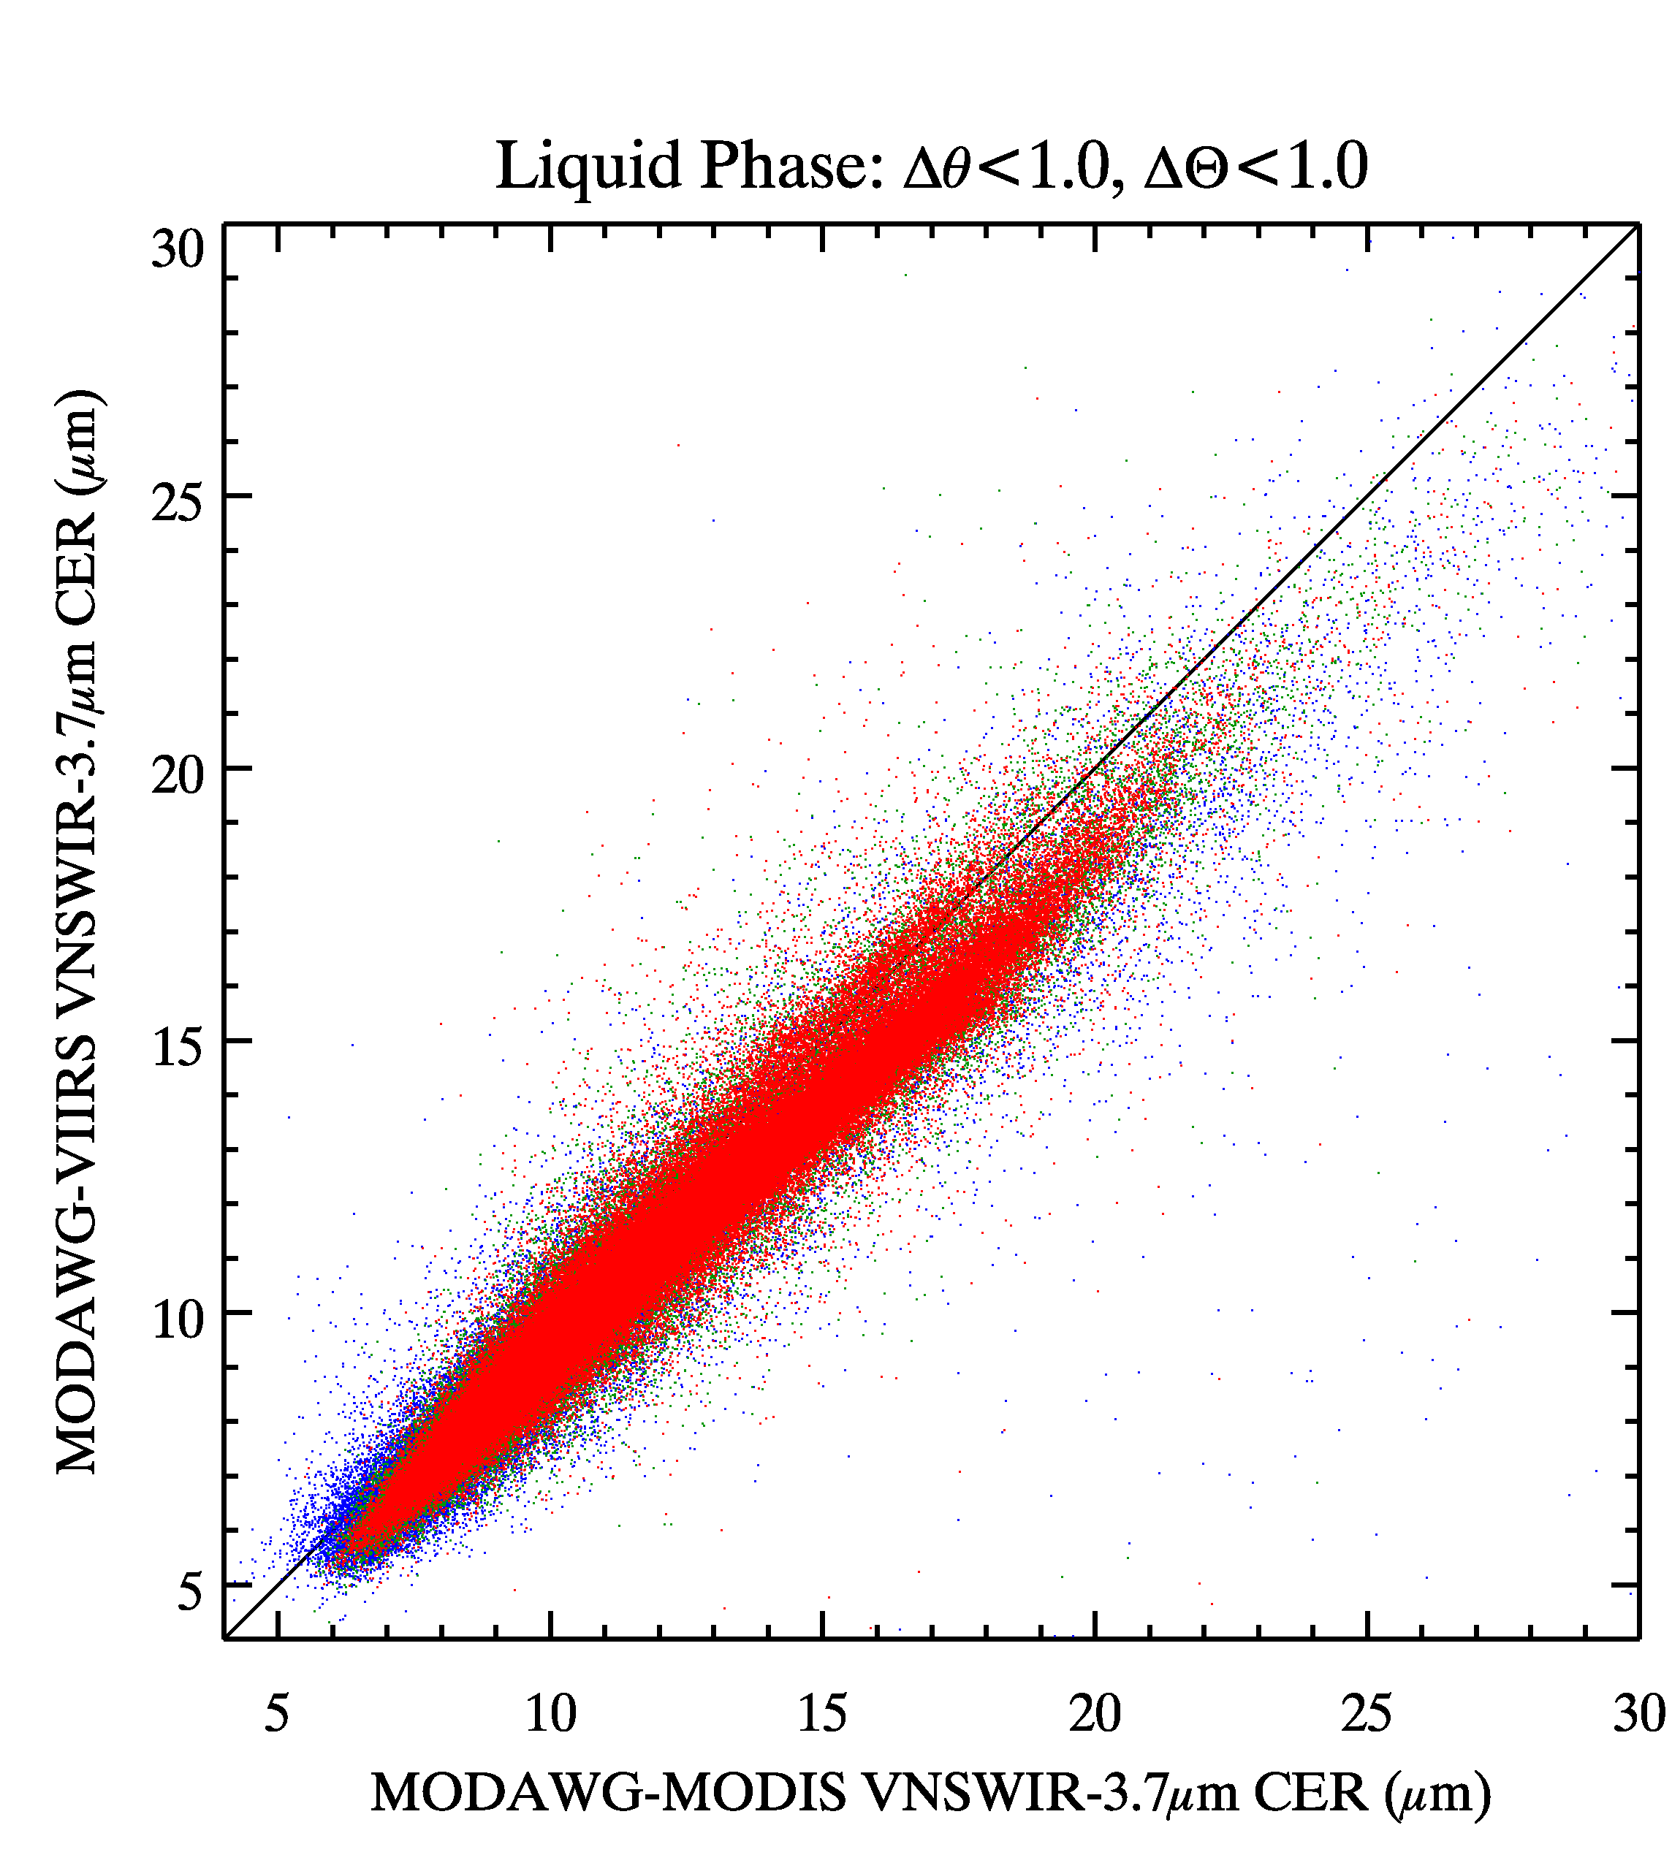
MODAWG CER Intercomparisons:
Liquid clouds, solar/view angle match <1°
2.2 µm
window
1.6 µm
window
retrieval
3.7 µm
window
optically
thickest cloudy
pixels
Notes:
0200 IFF granule

Slide 24
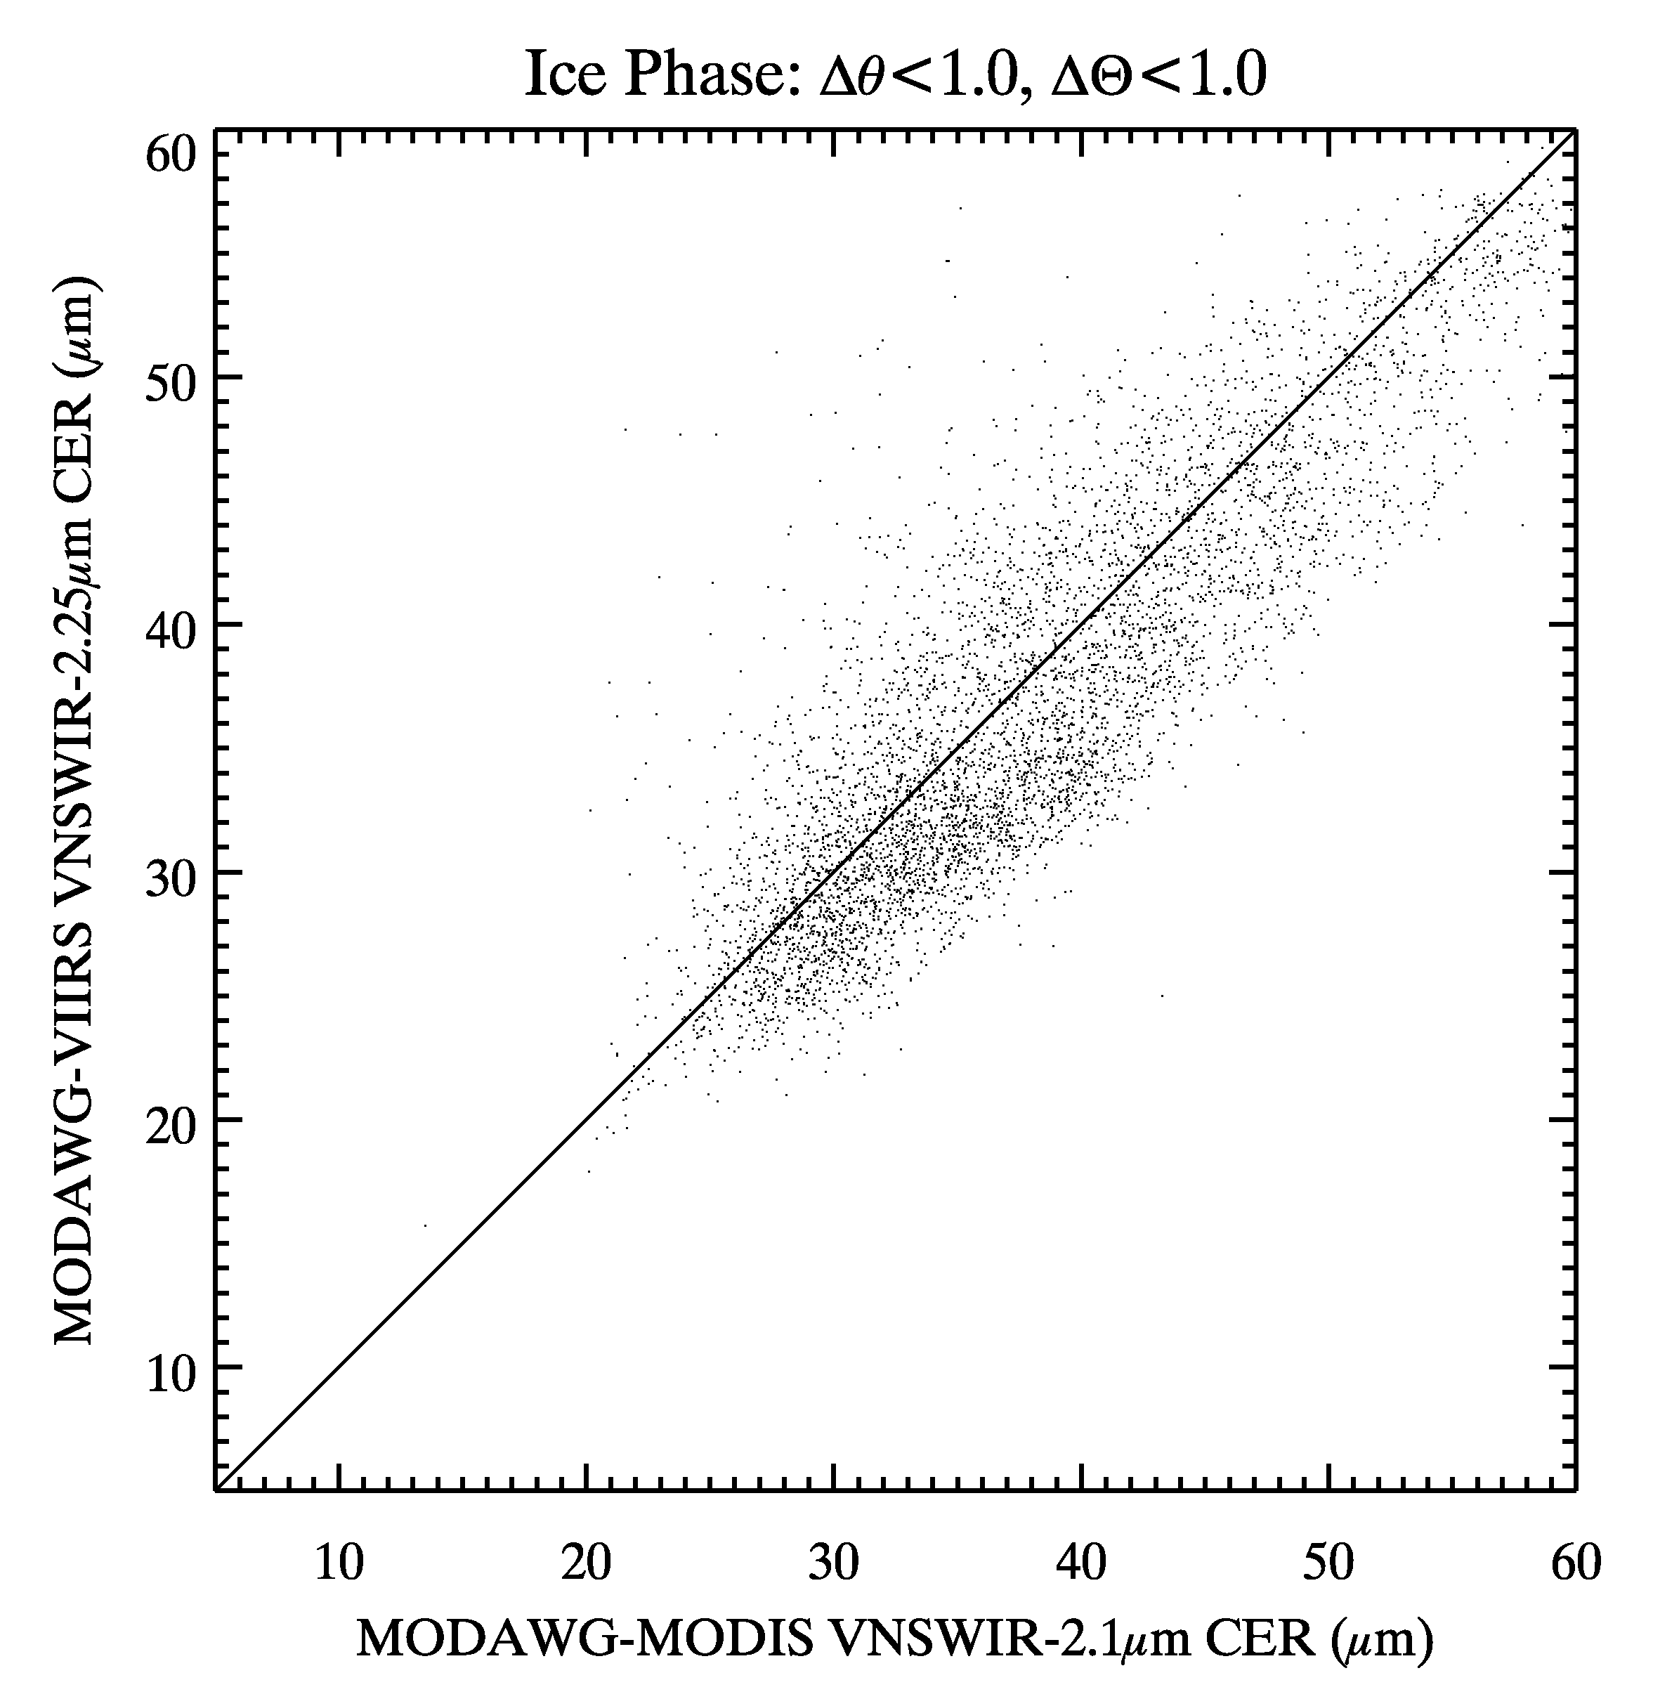
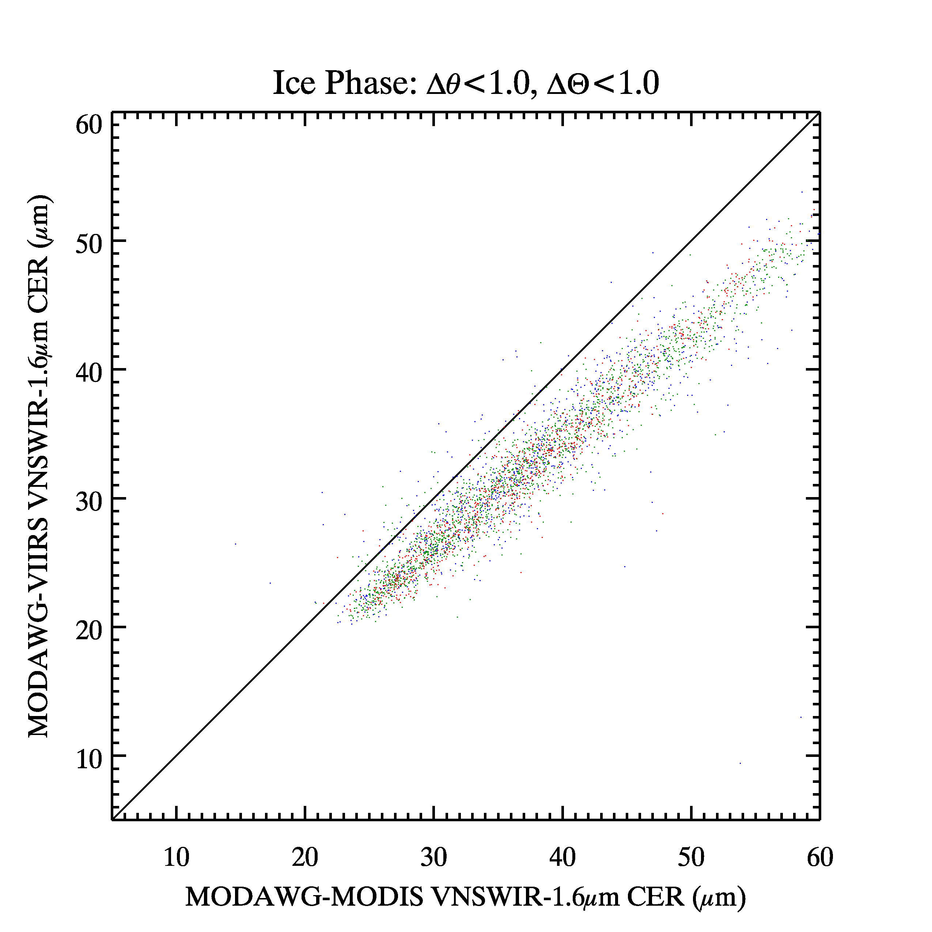
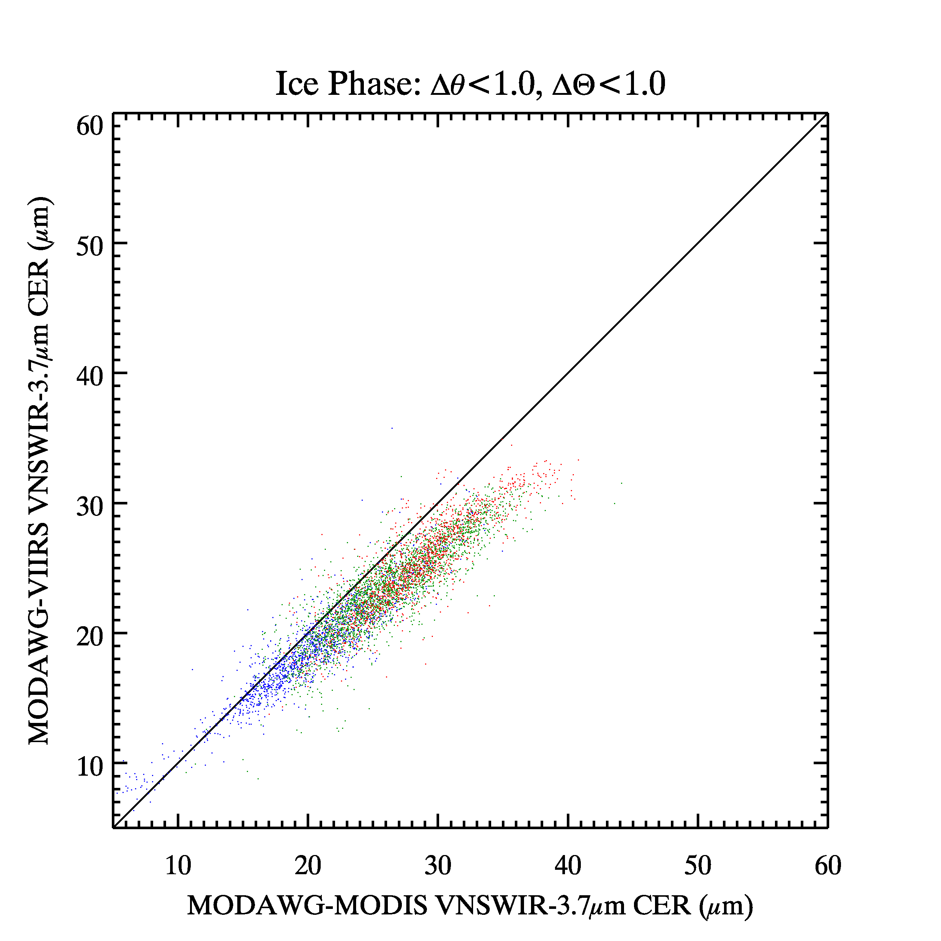
MODAWG CER Intercomparisons:
Ice clouds, solar/view angle match <1°
2.2 µm
window
1.6 µm
window
retrieval
3.7 µm
window
Notes:
0200 IFF granule

Slide 25
MODAWG Global Gridded Mask & CTP: Day Only
MODIS C6
MODAWG_MODIS
MODAWG_VIIRS
Cloud
Fraction

Slide 26
MODAWG Global Gridded Mask & CTP: Day Only
MODIS C6
MODAWG_MODIS
MODAWG_VIIRS
Cloud
Fraction
Cloud-Top
Pressure (hPa)
Cloud-Top
Height (km)

Slide 27
MODAWG Global Gridded COT
MODIS C6
MODAWG_MODIS
MODAWG_VIIRS
COT Liquid
COT Ice

Slide 28
MODAWG Global Gridded COT
MODIS C6
MODAWG_MODIS
MODAWG_VIIRS
RF Liquid
RF Ice

Slide 29
MODAWG Global Gridded CER: Liquid Clouds
MODIS C6
MODAWG_MODIS
MODAWG_VIIRS
CER_1.6µm
CER_2.1µm
CER_3.7µm

Slide 30
MODAWG Global Gridded CER: Ice Clouds
MODIS C6
MODAWG_MODIS
MODAWG_VIIRS
CER_1.6µm
CER_2.1µm
CER_3.7µm

