Slide 1

Whats new with MODIS NPP and GPP
MODIS/VIIRS Science Team Meeting
May 20, 2015
Steven W. Running
Numerical Terradynamic Simulation Group
College of Forestry and Conservation
University of Montana

Slide 2
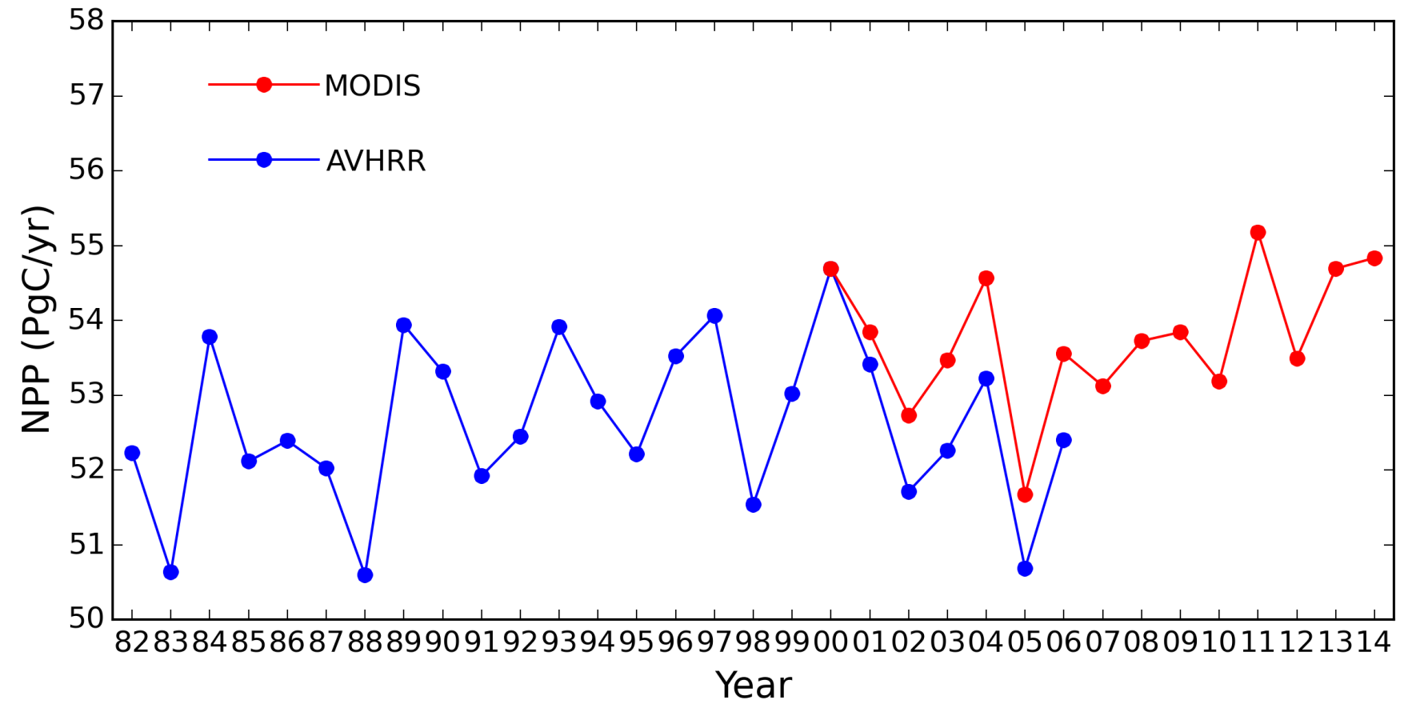
GLOBAL NPP TREND

Slide 3
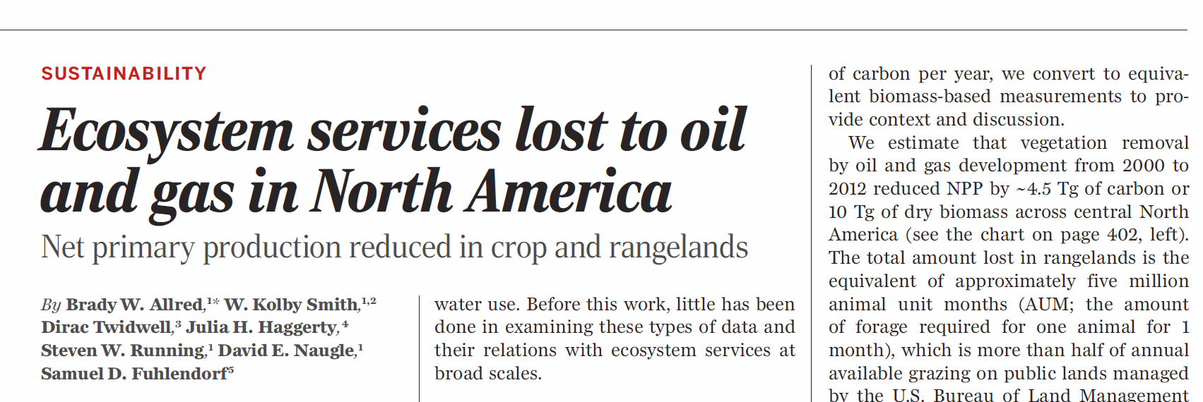
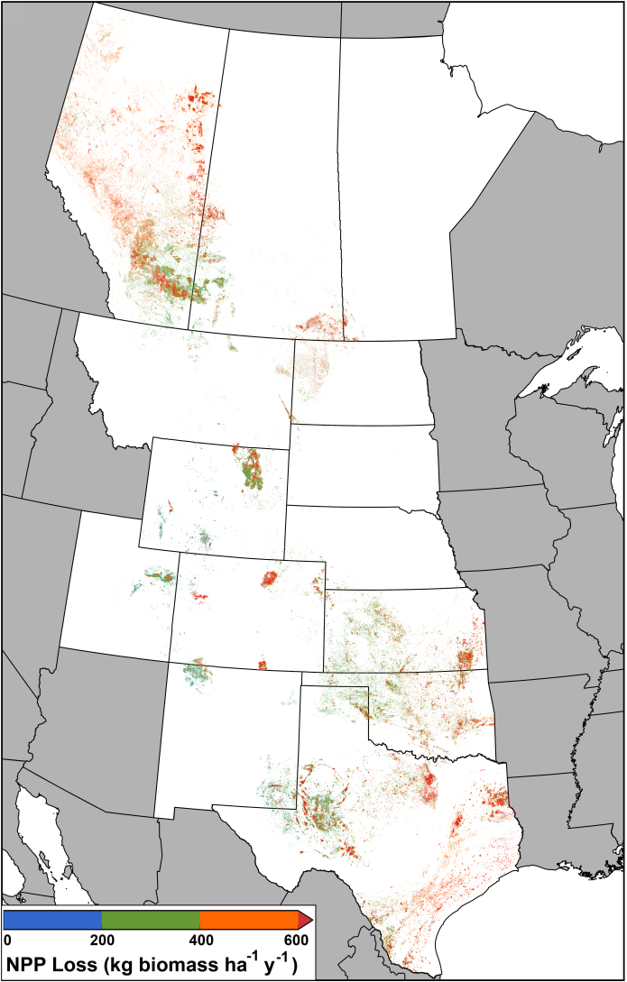
From 2000 – 2012
50,000 new wells / year
3 million ha land lost
4.5 Tg C of NPP lost / yr

Slide 4
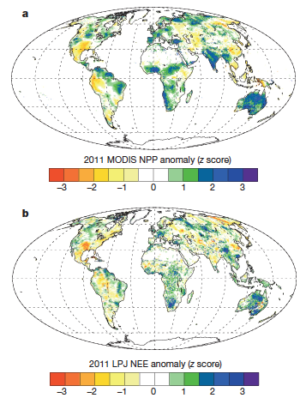
NPP driven carbon sink
For example, in Australia:
45% increase in NPP (LPJ and MODIS)
9% increase in Rh (LPJ)
29% decrease in fire emissions from GFED & GFAS observations
Net effect
0.84 Pg C sink in Australia
Explained 60% of global anomaly
Semi arid regions explained 51% of total land sink in 2011
Climate attribution
Precipitation driven
Regional lag effects
  Enhanced soil moisture from 2010 precipitation in semi-arid regions
  Decrease in tropical Rh after 2010 drought
(Poulter et al 2014)

Slide 5
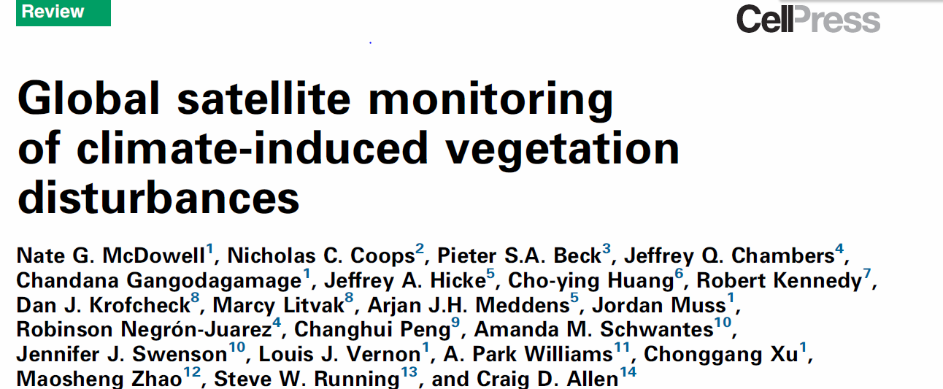

Slide 7
Spatial variability in LUE_{opt}
Croplands show largest LUE_{opt} variability.
MOD17 LUE_{max} < LUE_{opt} for CRO, GRA, DBF
MOD17 LUE_{max} > LUE_{opt} for CSH.
Aggregating LUE_{opt} variability within coarse plant functional type (PFT) classes leads to large model LUE and GPP error.
Spatially explicit estimation of optimal light use efficiency for improved satellite data driven ecosystem productivity modeling. Nima Madani, John S. Kimball, Steve W. Running. AGU 2014

Slide 8
Traits
Topography
Soil water
17 Tower Testing sites
Crop areas
Percent cover
Testing
Geo-statistical Generalized Additive Model
45 Tower Training sites
LUE_{opt}

Slide 10
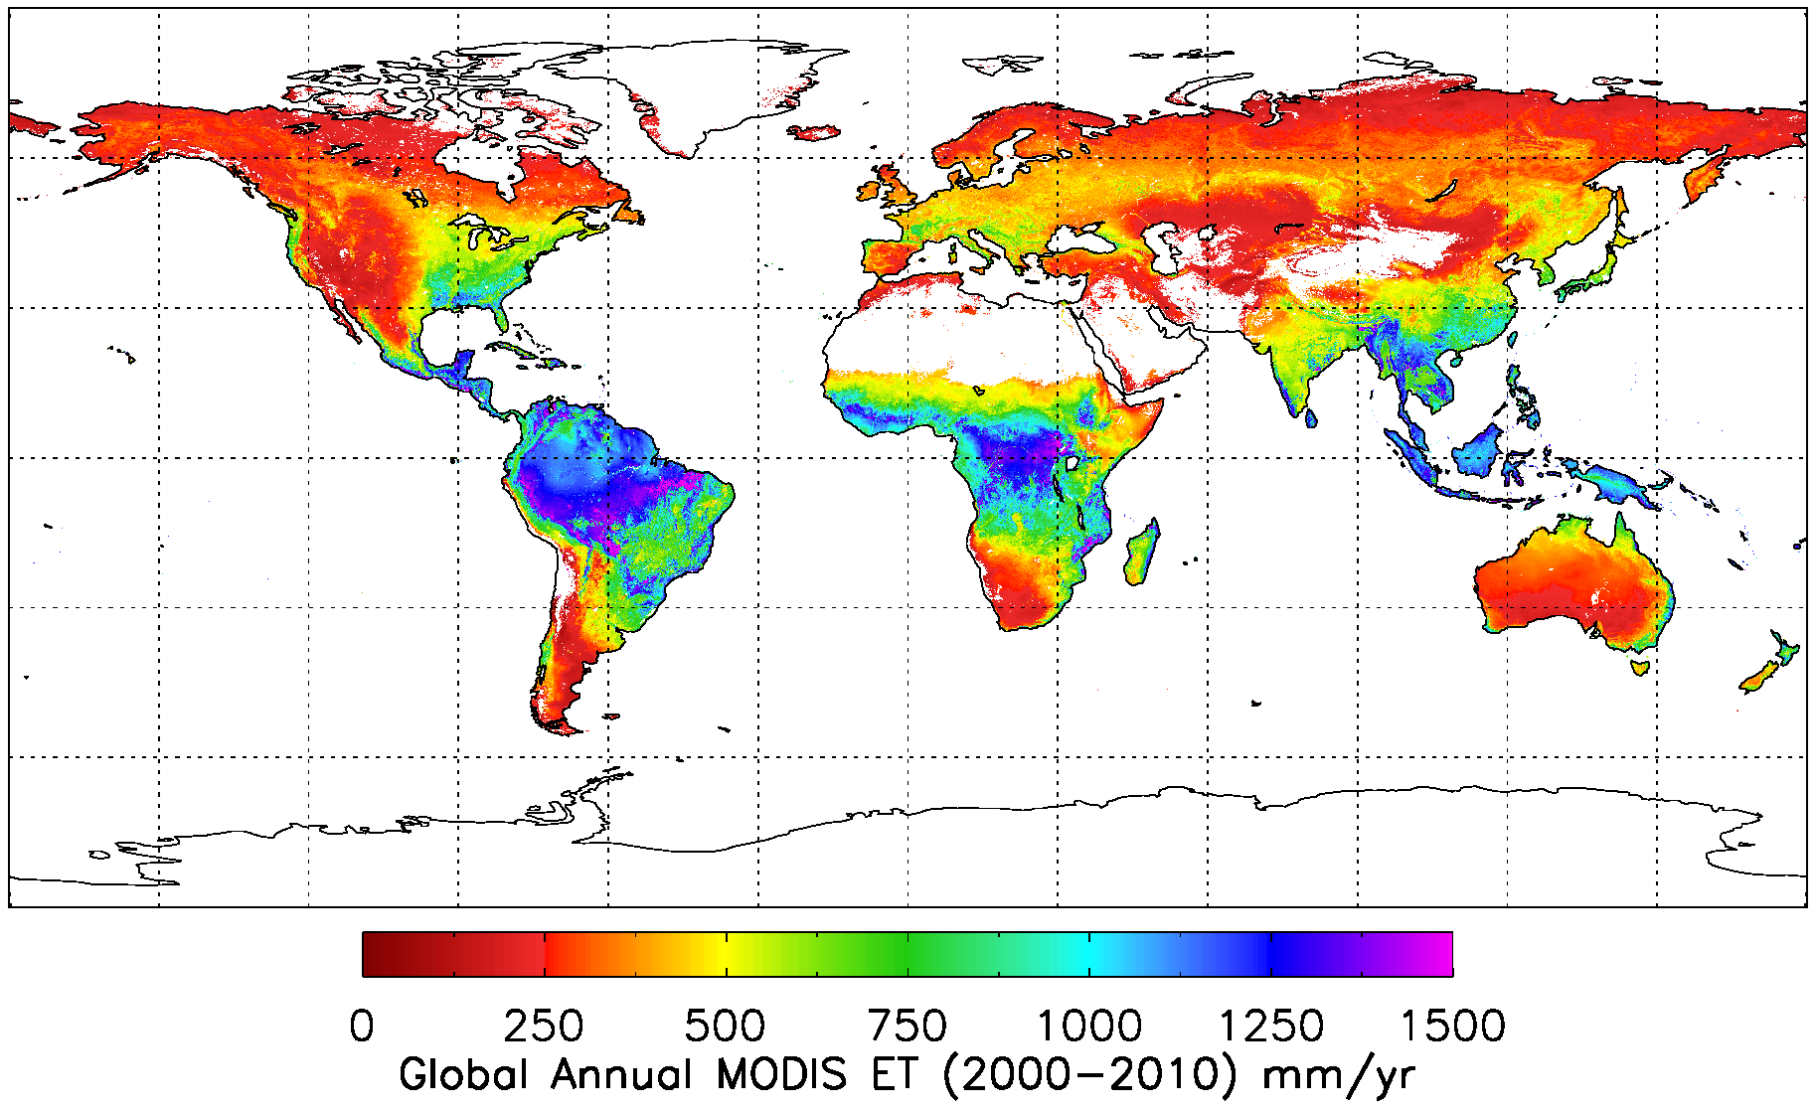
Global Annual 1-km ET over 2000-2010
Global average MODIS ET over vegetated land surface is 568.7 ± 358.2 mm yr⁻¹.

Slide 11
MOD 16/17 with 1km daily meteorology, with USGS

Slide 12
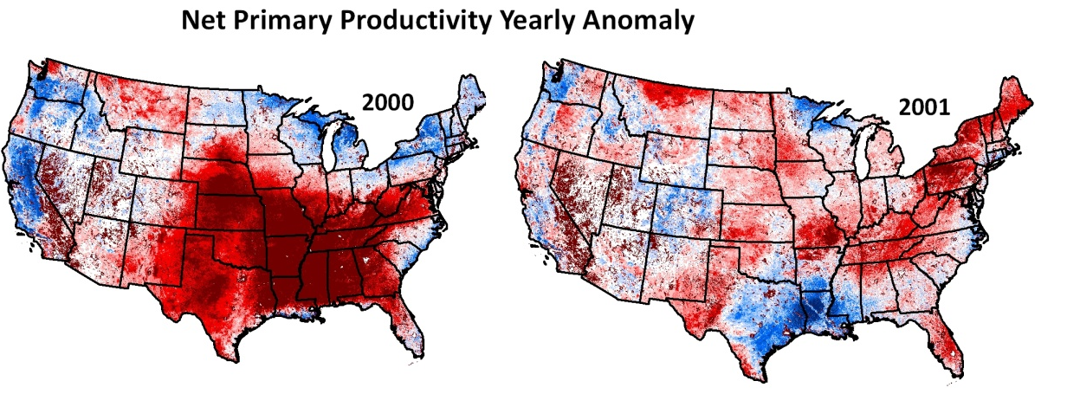
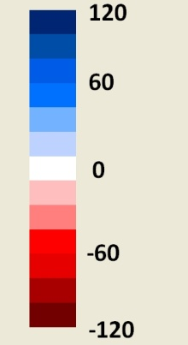
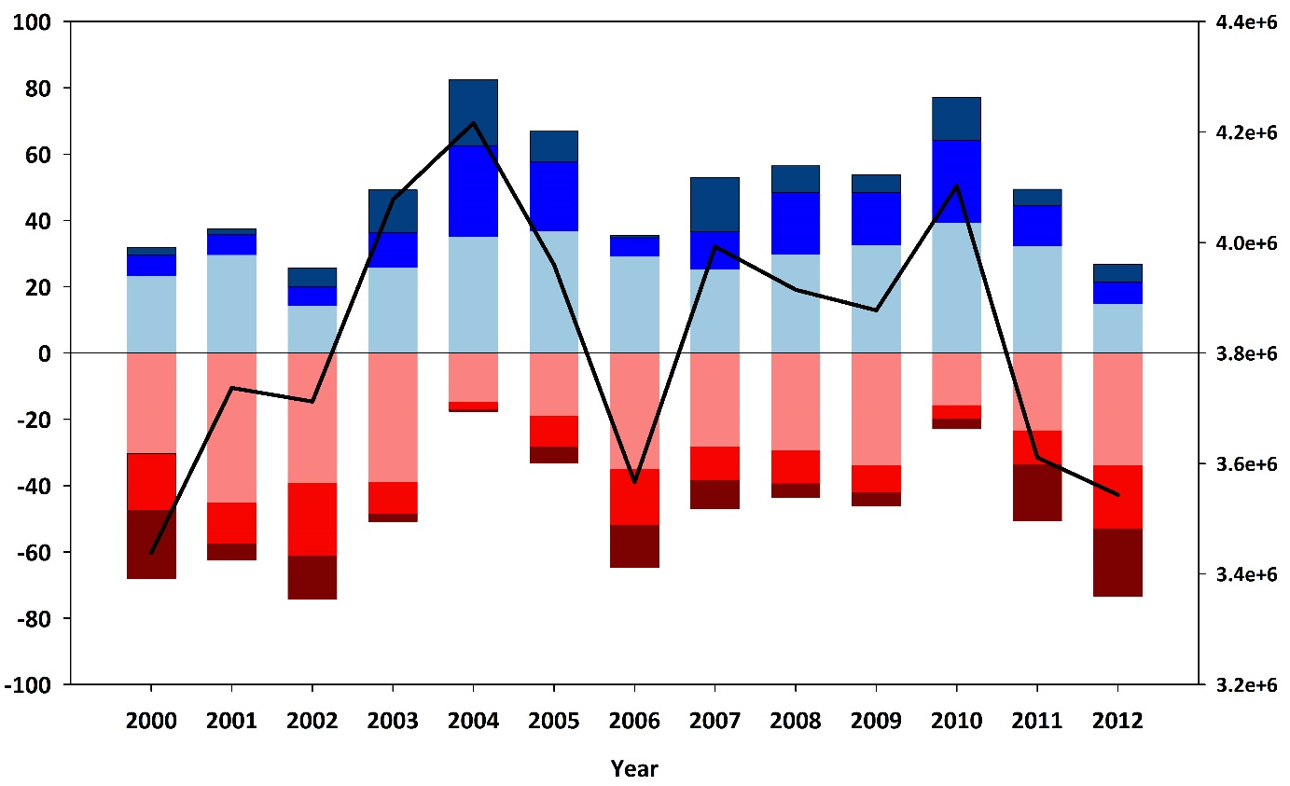

Net Primary Productivity Indicator
NPP (gC/m²)
Percentage of area above or below the 13-year NPP average
> 80 gC m² yr⁻¹
> 40 gC m² yr⁻¹
> 0 gC m² yr⁻¹
< 0 gC m² yr⁻¹
< -40 gC m² yr⁻¹
< -80 gC m² yr⁻¹

