Slide 1
Surface Reflectance over Land:
Extending MODIS to VIIRS
Eric Vermote
NASA GSFC Code 619
Eric.f.vermote@nasa.gov
.

Slide 2

A Land Climate Data Record
Multi instrument/Multi sensor Science Quality Data Records used to quantify trends and changes
81
82
83
84
85
86
87
88
89
90
91
92
93
94
95
96
97
98
99
00
01
02
03
04
05
06
07
08
09
10
11 12 13 14 15 16 17
N16
N17
AVHRR
N07
N09
N11
N09
N14
METOP
N16
SPOT VEGETATION
Terra
MODIS
Aqua
AVHRR (GAC) 1982-1999 + 2003-2006
MODIS (MO(Y)D09 CMG) 2000-present
VIIRS 2011 – 2025
SPOT VEGETATION 1999-2000
Sentinel 3 2014
NPP
VIIRS
JPSS 1
Sentinel 3
  Emphasis on data consistency – characterization rather than degrading/smoothing the data

Slide 3
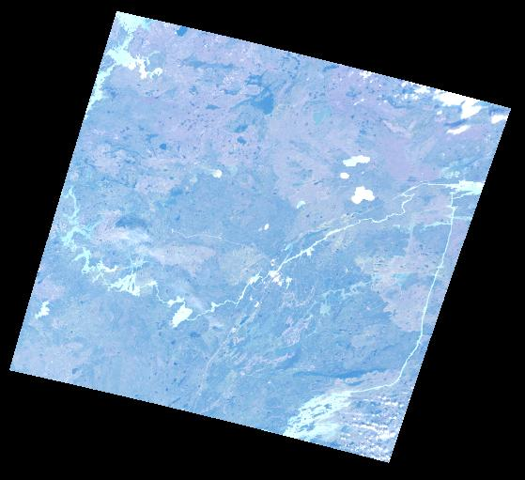
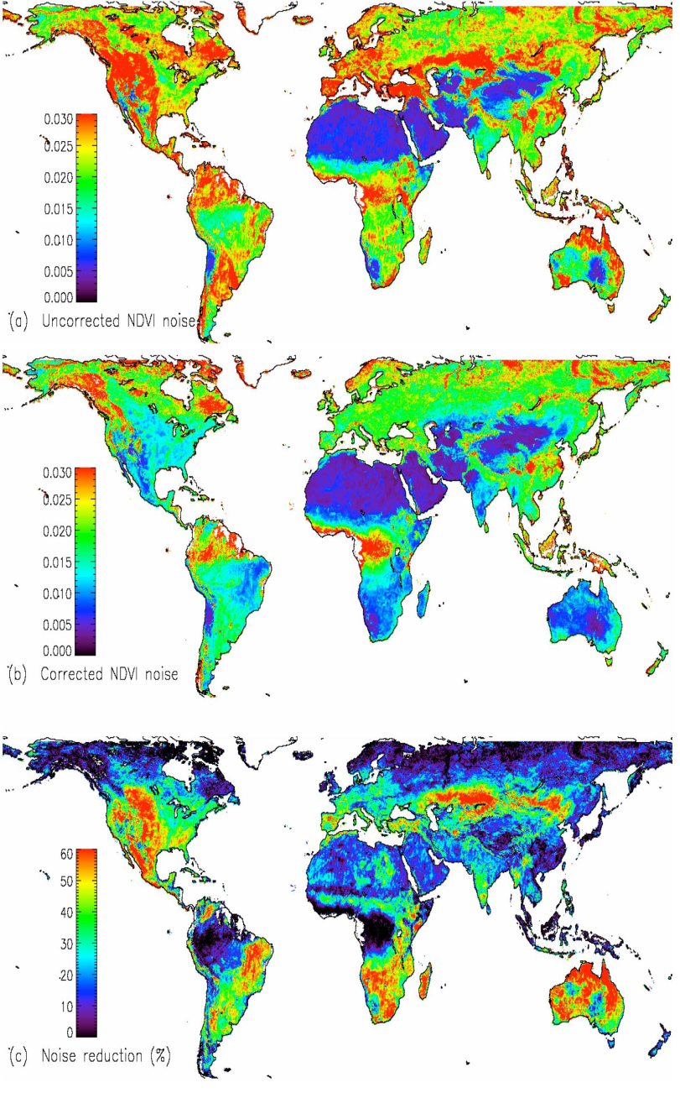
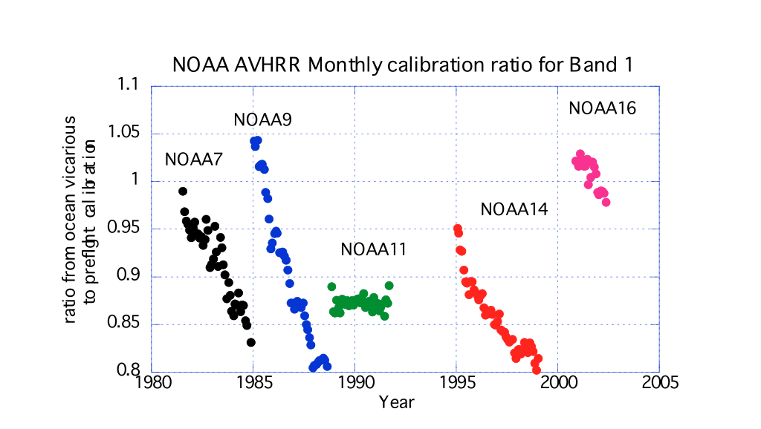
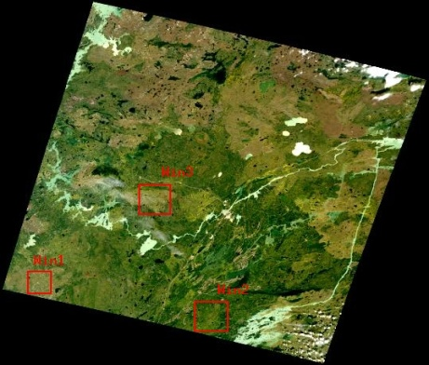
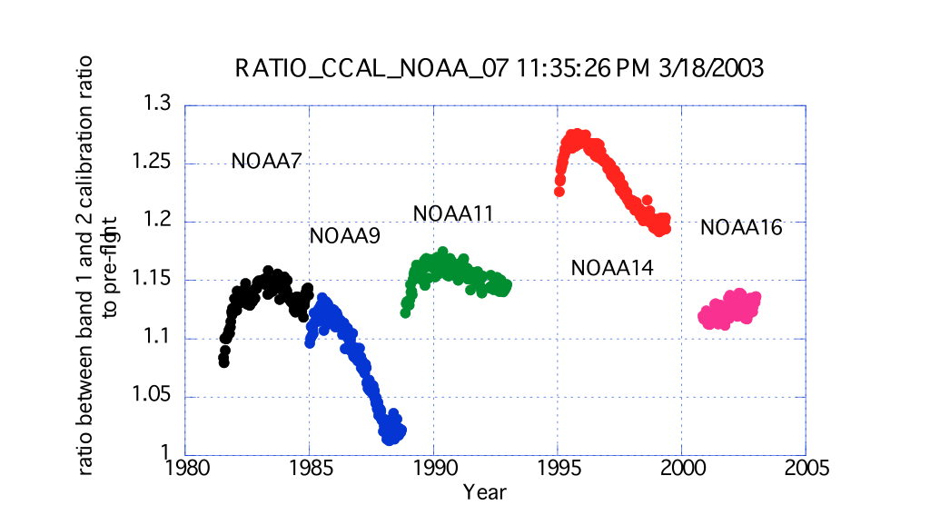
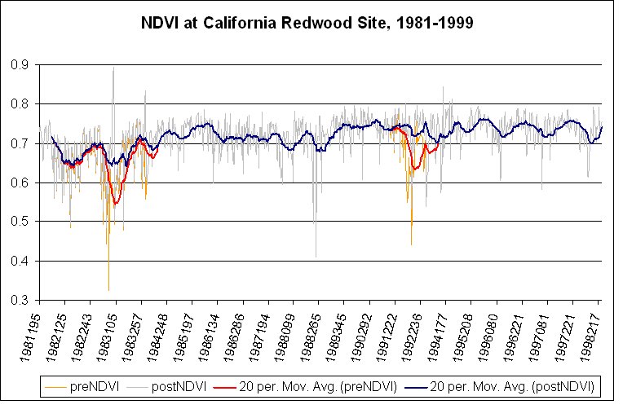
Land Climate Data Record (Approach)
Needs to address geolocation,calibration, atmospheric/BRDF correction issues
ATMOSPHERIC
CORRECTION
CALIBRATION
BRDF CORRECTION
Degradation in channel 1
(from Ocean observations)
Channel1/Channel2 ratio
(from Clouds observations)
El Chichon
Pinatubo

Slide 4
Goals/requirements for atmospheric correction
Ensuring compatibility of missions in support of their combined use for science and application (example Climate Data Record)
A prerequisite is the careful absolute calibration that could be insured by cross-comparison over specific sites (e.g. desert)
We need consistency between the different AC approaches and traceability but it does not mean the same approach is required – (i.e. in most cases it is not practical)
Have a consistent methodology to evaluate surface reflectance products:
  AERONET sites
  Ground measurements
In order to meaningfully compare different reflectance product we need to:
  Understand their spatial characteristics
  Account for directional effects
  Understand the spectral differences
One can never over-emphasize the need for efficient cloud/cloud shadow screening

Slide 5
Surface Reflectance (MOD09)
The Collection 5 atmospheric correction algorithm is used to produce MOD09 (the surface spectral reflectance for seven MODIS bands as it would have been measured at ground level if there were no atmospheric scattering and absorption).
The Collection 5 AC algorithm relies on
the use of very accurate (better than 1%) vector radiative transfer modeling of the coupled atmosphere-surface system
the inversion of key atmospheric parameters (aerosol, water vapor)
Home page: http://modis-sr.ltdri.org

Slide 6
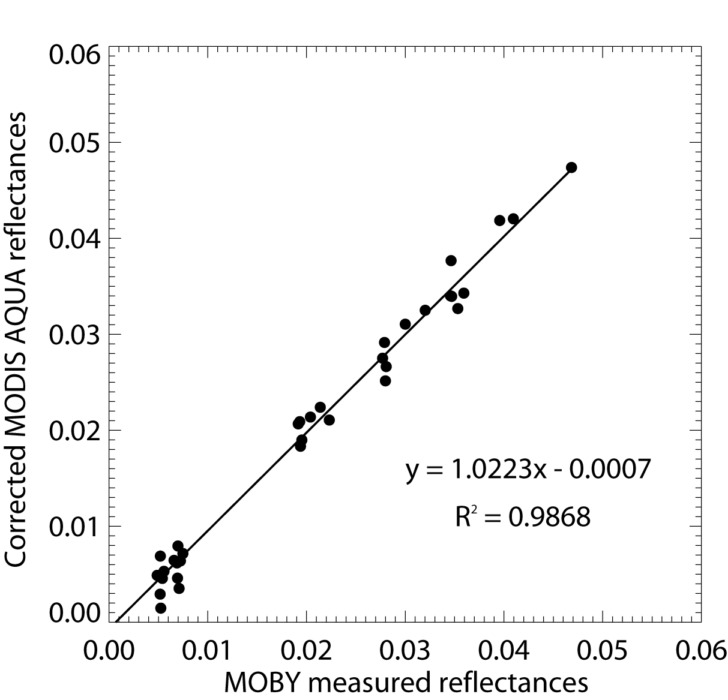
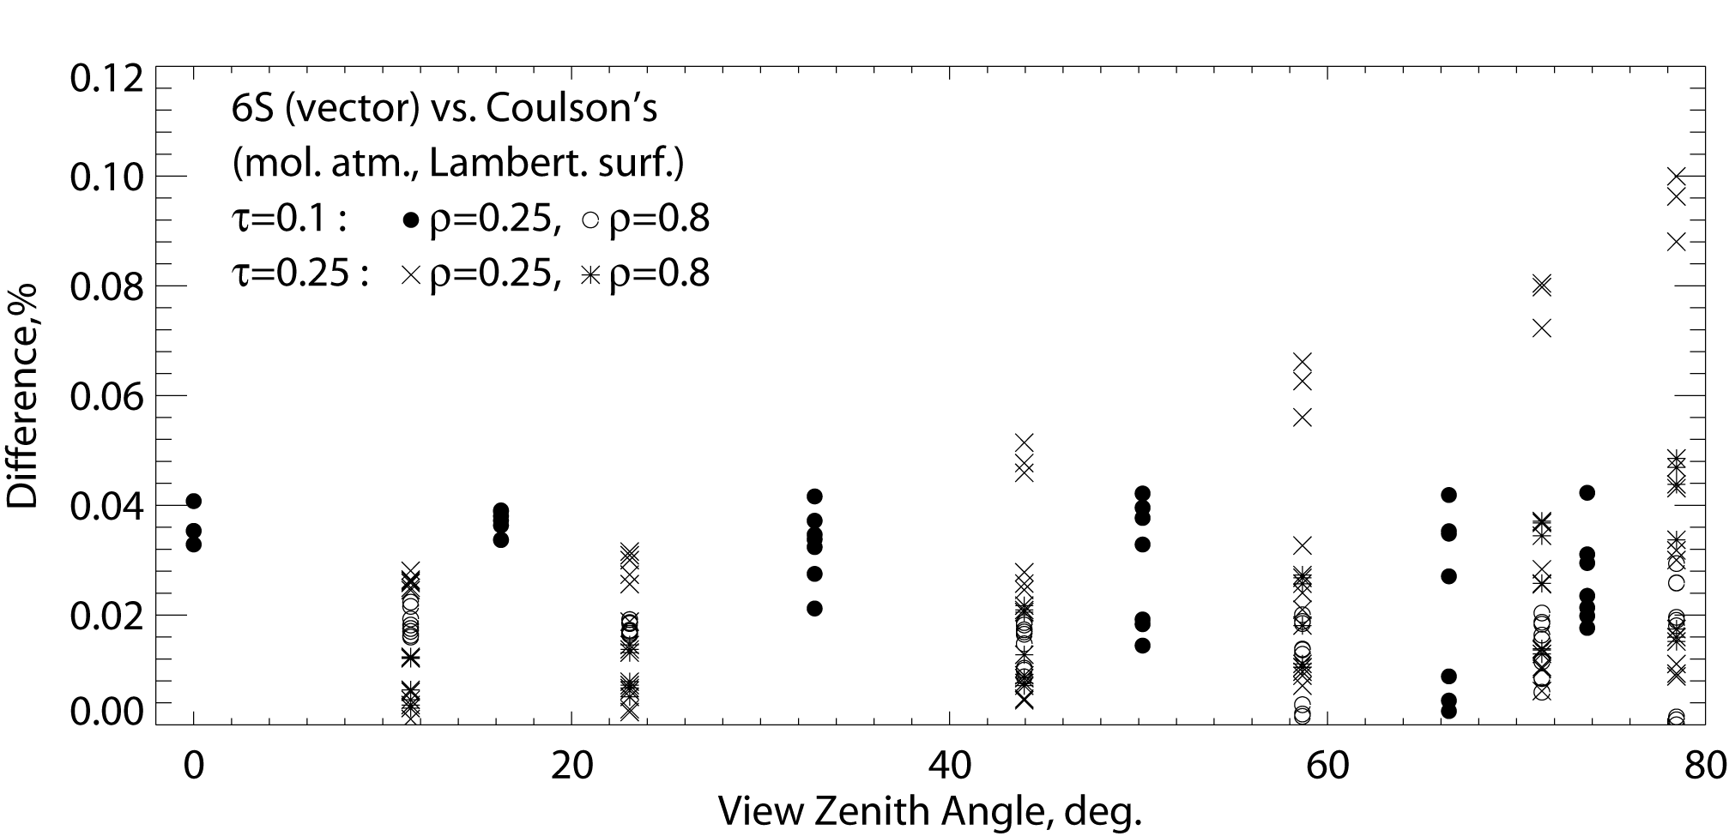
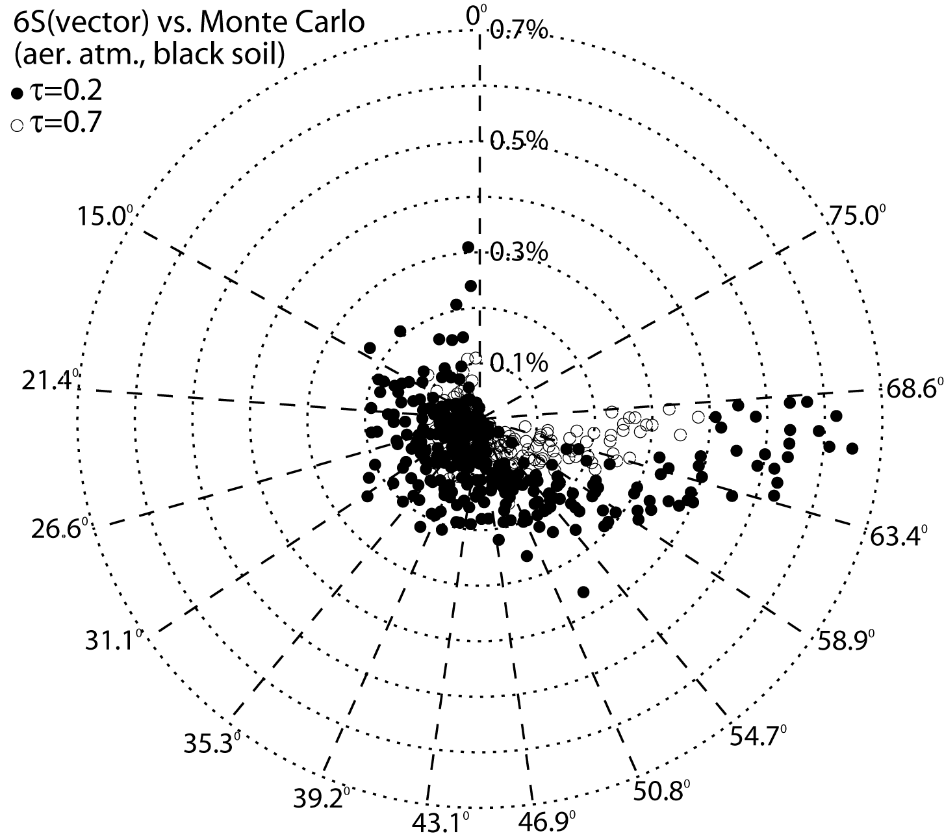
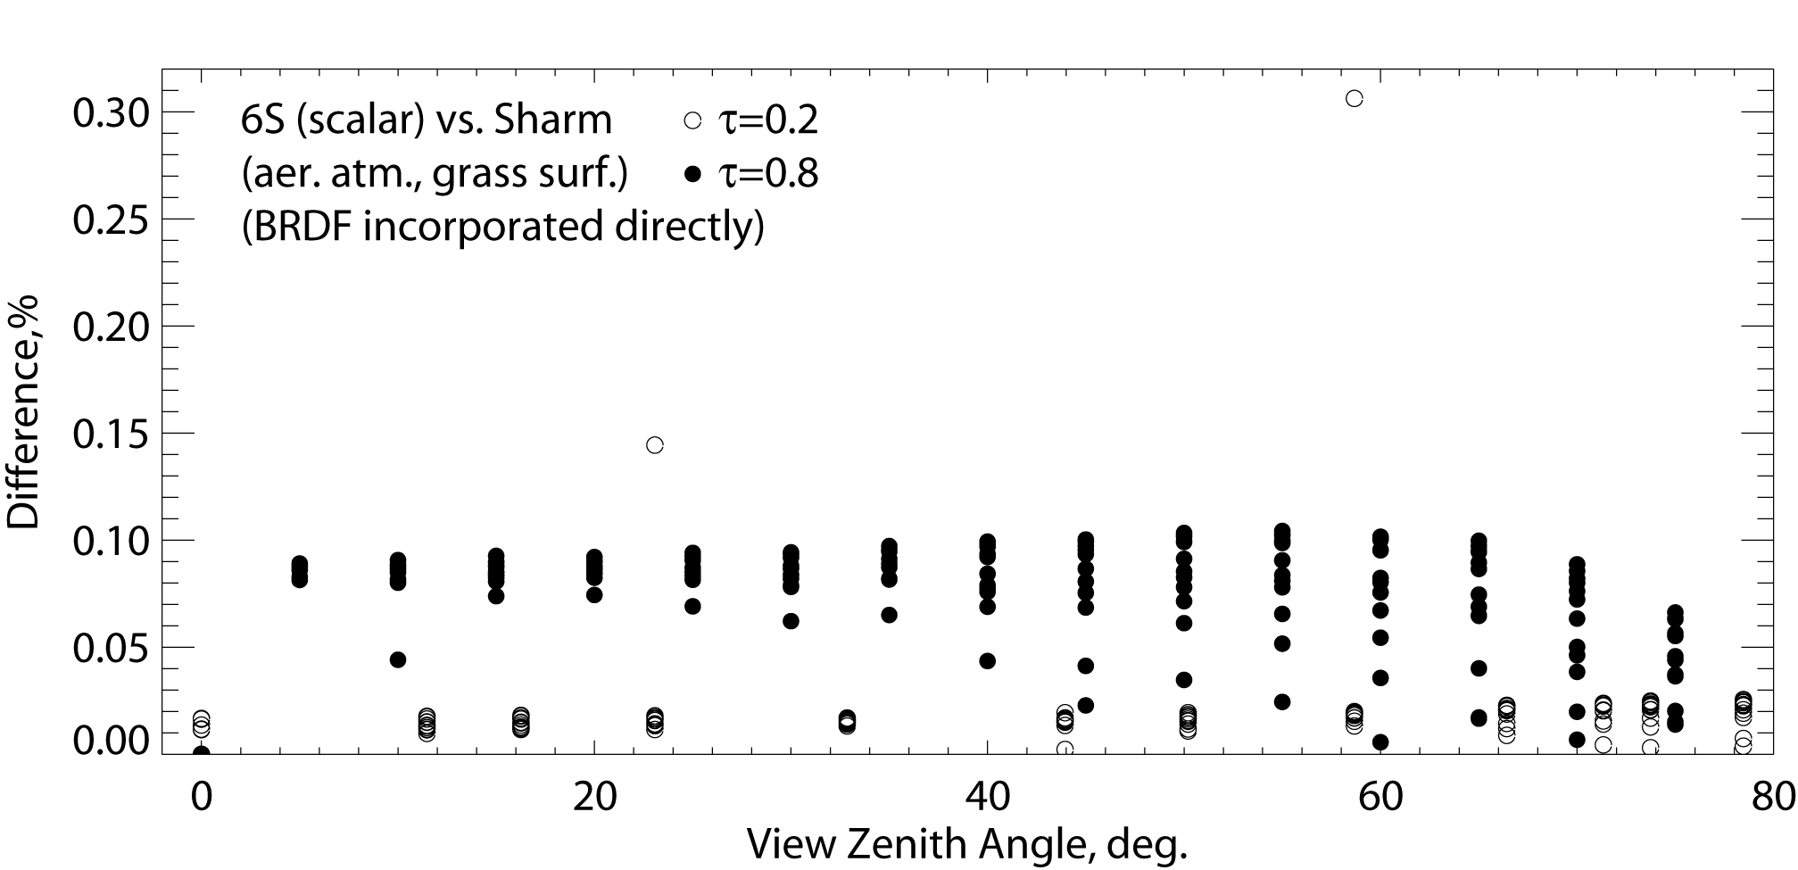
6SV Validation Effort
The complete 6SV validation effort is summarized in three manuscripts:
Kotchenova, S. Y., Vermote, E. F., Matarrese, R., & Klemm Jr, F. J. (2006). Validation of a vector version of the 6S radiative transfer code for atmospheric correction of satellite data. Part I: Path radiance. Applied Optics, 45(26), 6762-6774.
Kotchenova, S. Y., & Vermote, E. F. (2007). Validation of a vector version of the 6S radiative transfer code for atmospheric correction of satellite data. Part II. Homogeneous Lambertian and anisotropic surfaces. Applied Optics, 46(20), 4455-4464.
Kotchenova, S. Y., Vermote, E. F., Levy, R., & Lyapustin, A. (2008). Radiative transfer codes for atmospheric correction and aerosol retrieval: intercomparison study. Applied Optics, 47(13), 2215-2226.

Slide 7
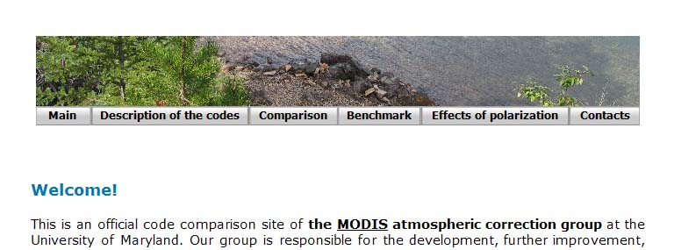
Code Comparison Project
RT3
Dave Vector
All information on this project can be found at http://rtcodes.ltdri.org
Vector 6S
SHARM
(scalar)
Monte Carlo
(benchmark)
Coulson’s tabulated values
(benchmark)

Slide 8
Overall Theoretical Accuracy from Error Budget
Overall theoretical accuracy of the atmospheric correction method considering the error source on calibration, ancillary data, and aerosol inversion for 3 τaer = {0.05 (clear), 0.3 (avg.), 0.5 (hazy)}:
The selected sites are Savanna (Skukuza), Forest (Belterra), and Semi-arid (Sevilleta). The uncertainties are considered independent and summed in quadratic.

Slide 9
Methodology for evaluating the performance of MOD09
To first evaluate the performance of the MODIS Collection 5 SR algorithms, we analyzed 1 year of Terra data (2003) over 127 AERONET sites (4988 cases in total).
Methodology:
Subsets of Level 1B data processed using the standard surface reflectance algorithm
comparison
Reference data set
Atmospherically corrected TOA reflectances derived from Level 1B subsets
If the difference is within ±(0.005+0.05ρ), the observation is “good”.
AERONET measurements
(τ_{aer}, H₂O, particle distribution
Refractive indices,sphericityeri)
Vector 6S
http://mod09val.ltdri.org/cgi-bin/mod09_c005_public_allsites_onecollection.cgi

Slide 10
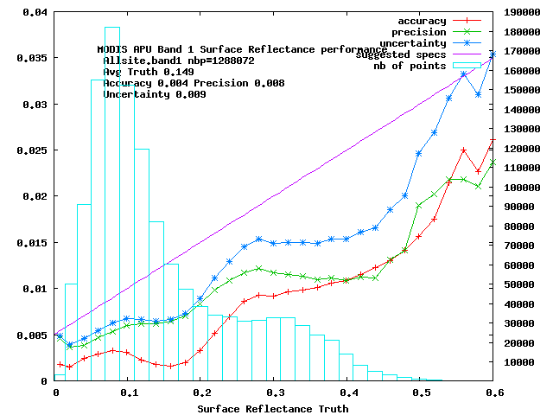
quantitative assessment of performances (APU)
1,3 Millions 1 km pixels
were analyzed for each
band.
Red = Accuracy (mean bias)
Green = Precision (repeatability)
Blue = Uncertainty (quadatric sum of
A and P)
On average well below magenta
theoretical error bar

Slide 11
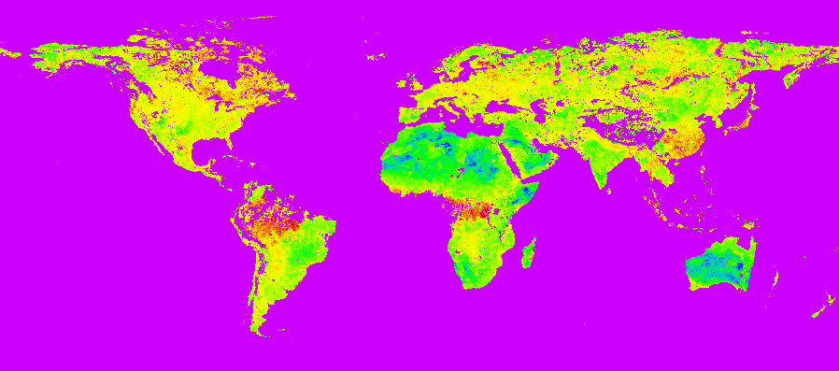

Improving the aerosol retrieval (by using a ratio map instead of fixed ratio) in collection 6 well reflected in APU metrics
ratio band3/band1 derived using MODIS top of the atmosphere corrected with MISR aerosol optical depth

Slide 12
Improving the aerosol retrieval in collection 6 reflected in APU metrics

Slide 13
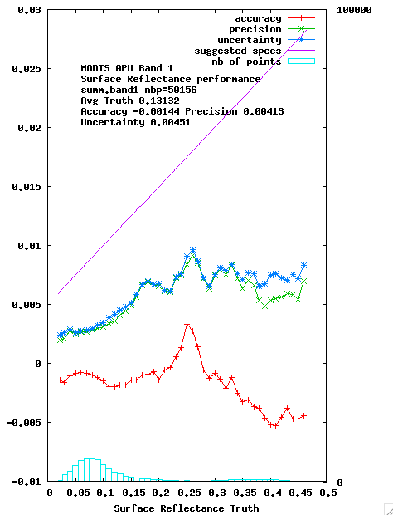
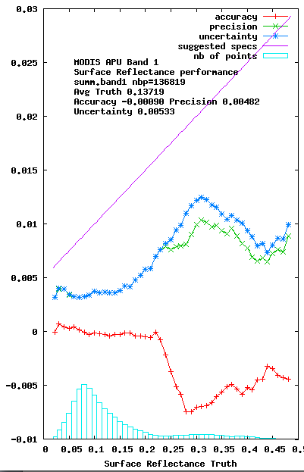
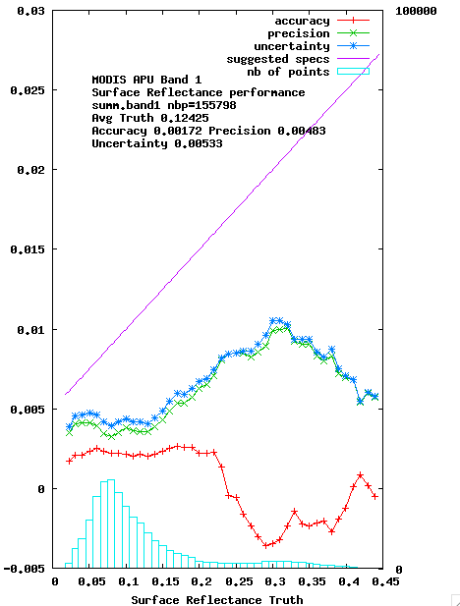
Terra and Aqua C6 reprocessed data performance analysis is on-going
Terra - 2000
Terra - 2005
Aqua- 2005

Slide 14
VIIRS Surface reflectance
the VIIRS SR product is directly heritage from collection 5 MODIS and that it has been validated to stage 1 (Land PEATE adjusted version)
MODIS algorithm refinements from Collection 6 will be integrated into the VIIRS algorithm and shared with the NOAA JPSS project for possible inclusion in future versions of the operational product .

Slide 15
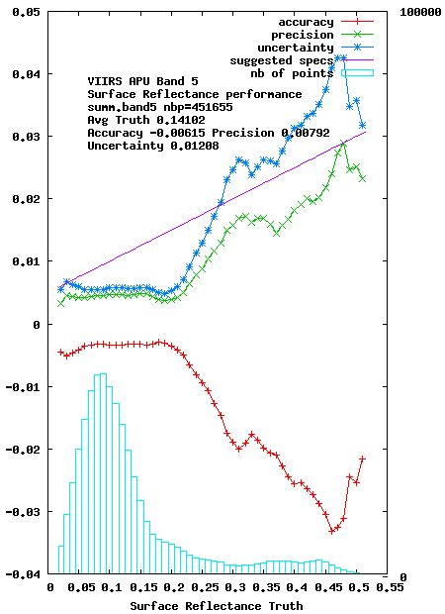
VIIRS C11 reprocessing evaluation
450000 pixels
were analyzed for each
band.
Red = Accuracy (mean bias)
Green = Precision (repeatability)
Blue = Uncertainty (quadatric sum of
A and P)
On average well below magenta
theoretical error bar
VIIRS SR (Vermote)

Slide 16
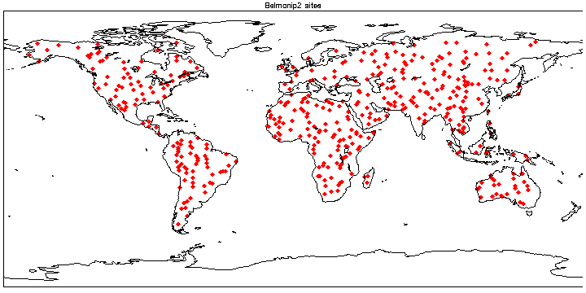
Cross comparison with MODIS over BELMANIP2
The VIIRS SR is now monitored at more than 400 sites (red losanges) through cross-comparison with MODIS.
VIIRS SR (Vermote)

Slide 17
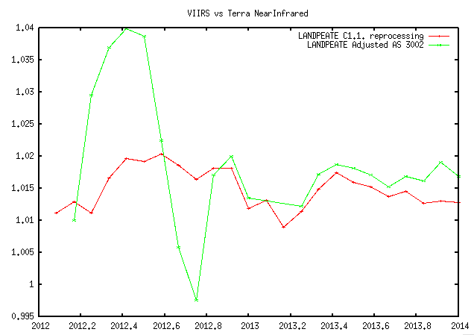
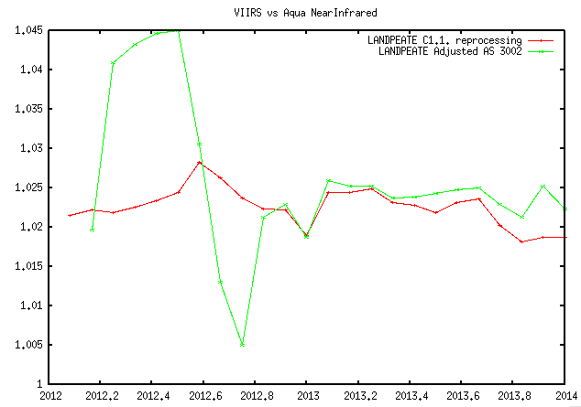
Results over BELMANIP2
VIIRS SR (Vermote)

Slide 18
Monitoring of product quality (exclusion conditions cloud mask using CALIOP)

Slide 19
The need for a protocol to use of AERONET data
To correctly take into account the aerosols, we need the aerosol microphysical properties provided by the AERONET network including size-distribution (%C_{f}, %C_{c}, C_{f}, C_{c}, r_{f}, r_{c}, σ_{r}, σ_{c}), complex refractive indices and sphericity.
Over the 670 available AERONET sites, we selected 230 sites with sufficient data.
To be useful for validation, the aerosol model should be readily available anytime, which is not usually the case.
Following Dubovik et al., 2002, JAS,*² one can used regressions for each microphysical parameters using as parameter either τ₅₅₀ (aot) or τ₄₄₀ and α (Angström coeff.).
The protocol needs to be further agreed on and its uncertainties assessed (work in progress)

Slide 20
Conclusions
Surface reflectance (SR) algorithm is mature and pathway toward validation and automated QA is clearly identified.
Algorithm is generic and tied to documented validated radiative transfer code so the accuracy is traceable enabling error budget.
The use of BRDF correction enables easy cross-comparison of different sensors (MODIS,VIIRS,AVHRR, LDCM, Landsat, Sentinel 2 ,Sentinel 3…)
AERONET is central to SR validation and a “standard” protocol for its use to be defined (CEOS CVWG initiative)
Cloud and cloud shadow mask validation protocol needs to be fully developed.

