Slide 1
Daily Monitoring of Crop Condition and Water Use using MODIS, Landsat and Geostationary Data
MODIS Science Team Meeting, June 6-10, 2016, Silver Spring, MD
Feng Gao¹, Martha Anderson¹, Christopher Hain², Liang Sun¹, Yang Yang¹, Yun Yang¹, Bill Kustas¹, Joe Alfieri¹, Rick Mueller³, Zhengwei Yang³, Dave Johnson³, Xiaoyang Zhang⁴
1. USDA-Agricultural Research Service , HRSL
2. University of Maryland and NOAA NESDIS
3. USDA National Agricultural Statistics Service
4. South Dakota State University
USDA is an equal opportunity provider and employer

Slide 2
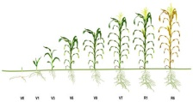
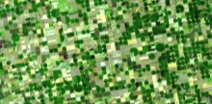

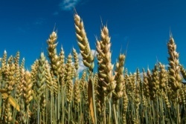
Objective: map crop progress, water use, and drought impacts at 30-m spatial resolution by fusing MODIS, Landsat and geostationary satellites
TOOLS
STARFM
Multi-sensor data
fusion
DMS
Thermal image
sharpening
APPLICATIONS
(daily/30 m)
ALEXI
Multi-scale ET
modeling
Crop phenology
metrics
ASSETS
SW/TIR
Crop water use
(Evapotranspiration)
GEO
Hourly 5km/5km
Crop stress
(drought early warning)
MODIS
Daily 250m/1km
Landsat
16 day 30m/100m
Impact on yield
Lsat-like
~20-60m/ --

Slide 3
Progress and Plan
Crop Condition and Water Use Monitoring
Year 1: Tools Development and System Integration
  STARFM data fusion system automation
  Evapotranspiration (ET) model integration and system automation
  Crop phenology programs evaluation
Year 2: System Testing and Results Validation
  a rain-fed agricultural area in central Iowa
  a vineyard field experiment (GRAPEX) site in Lodi, CA
  a managed pine plantation in NC
  a tile-drained agricultural landscape in SD
  an irrigated agricultural system in the Central Sands or WI
  the Walnut Gulch watershed, AZ
  several ARS Long-Term Agricultural Research (LTAR) sites including Mead, NE, the OPE3 and Choptank watershed sites in the lower Chesapeake Bay
Year 3: Application Extension and Yield Impact

Slide 4
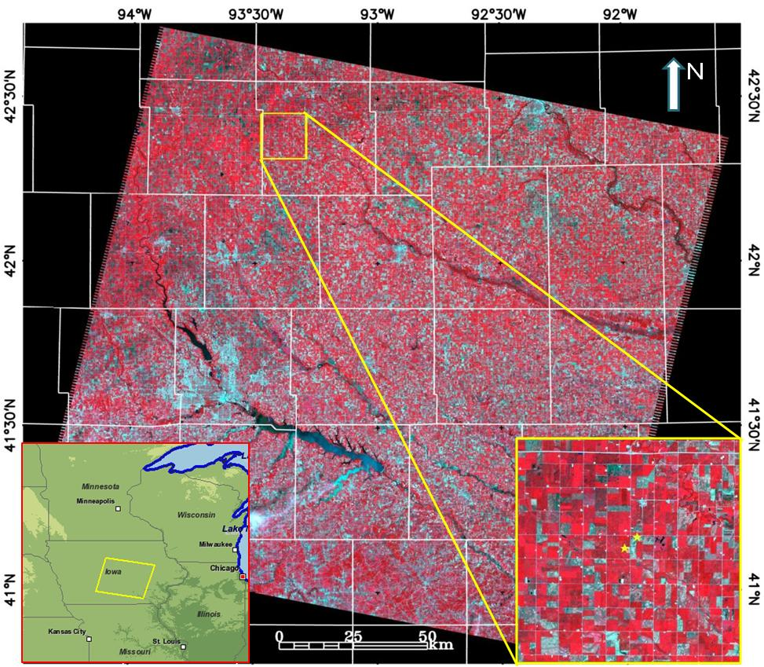
Case 1: central Iowa (~20 counties)
Crop Condition and Water Use Monitoring
Hardin
Fourteen years (2001-2014) of Landsat TM, ETM+ and OLI (p26r31) and MODIS (h10v04 and h11v04)
were fused to generate daily Landsat-MODIS surface reflectance at 30m resolution using STARFM

Slide 5
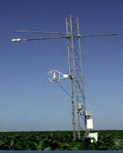
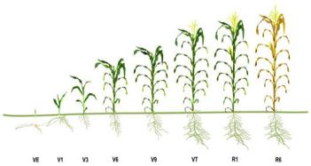

Mapping Crop Growth Stages using MODIS & Landsat
Landsat
Normalization
Lsat-like

Slide 6
Mapping Crop Growth Stages using MODIS & Landsat
MODIS
STARFM
Landsat
Normalization
Lsat-like

Slide 7
Mapping Crop Growth Stages using MODIS & Landsat
MODIS
STARFM
Landsat
Normalization
Lsat-like
Phenology

Slide 8
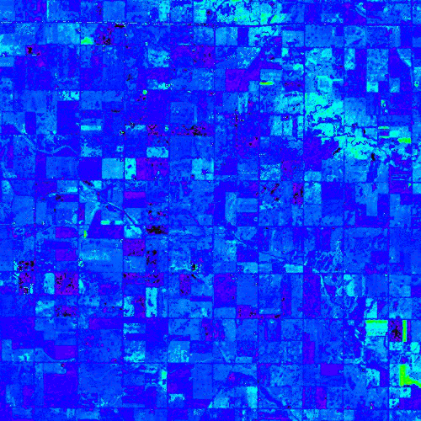
Crop Condition and Water Use Monitoring
0.0 0.5 1.0
Smoothed (double logistic function) Daily NDVI, Apr. 1 – Nov. 1, 2011

Slide 9
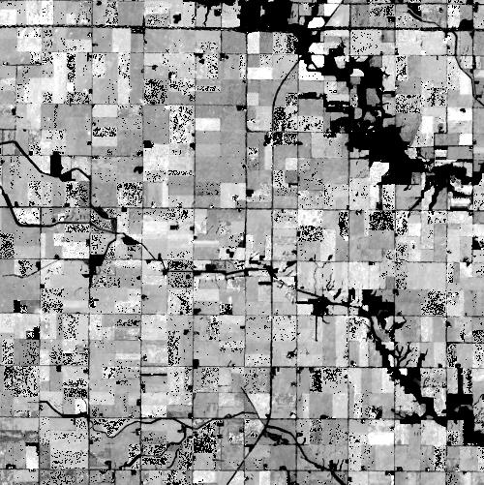
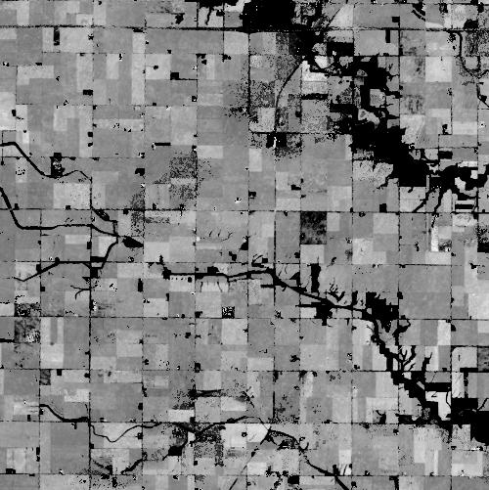
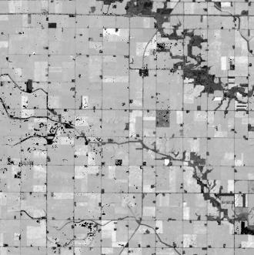
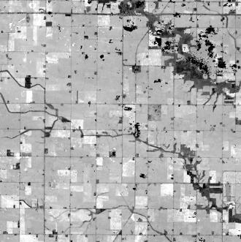
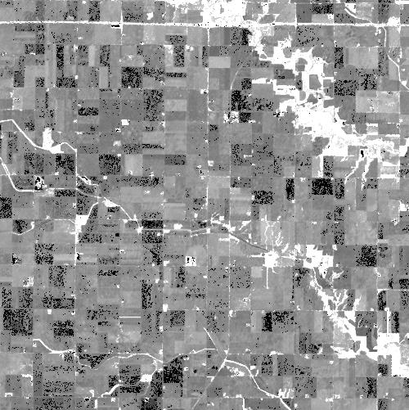
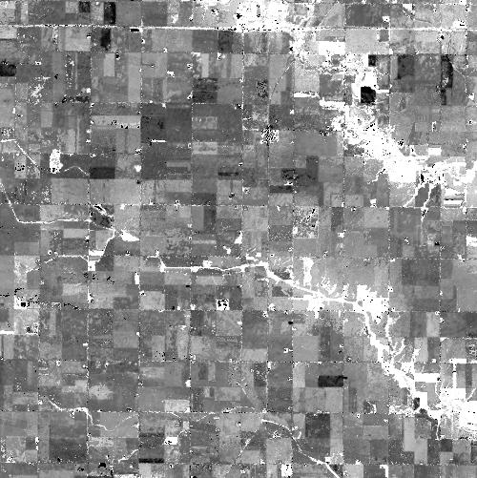
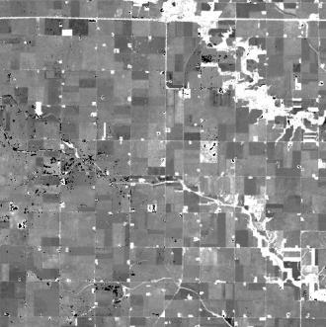
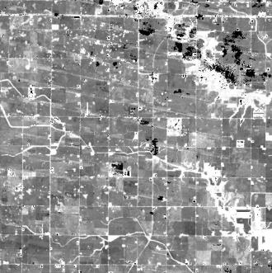
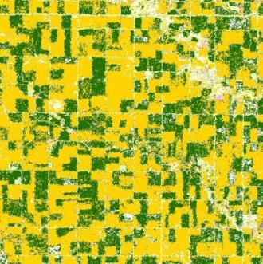
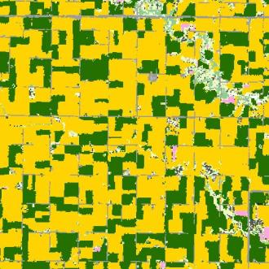
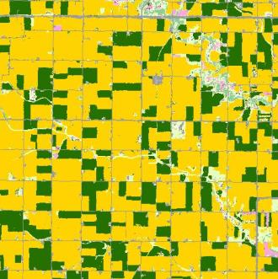
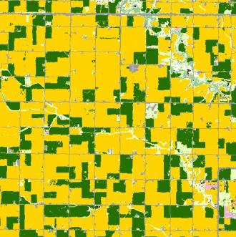
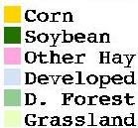
2001 2006 2011 2014
Apr May Jun
Greenup
Sep Oct
Dormancy
NASS
CDL

Slide 10
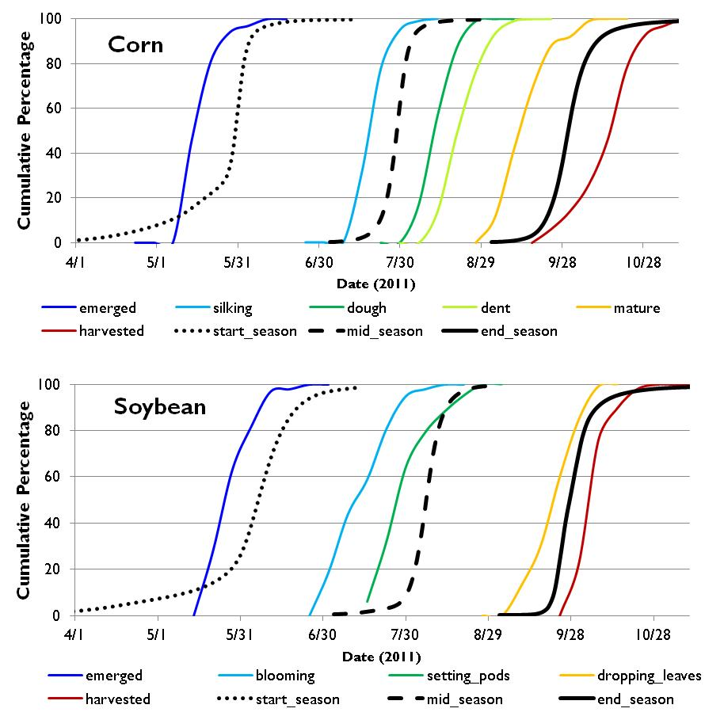
Phenology (RS) vs. Crop Growth Stages (NASS)
Crop Condition and Water Use Monitoring
crop growth stages from central Iowa (online 2011CP reports)

Slide 11

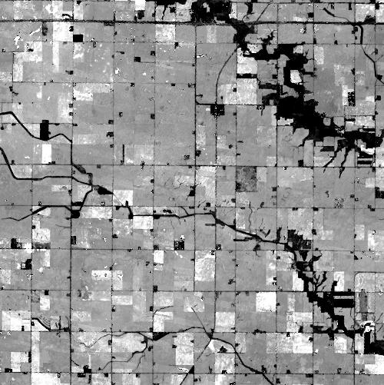
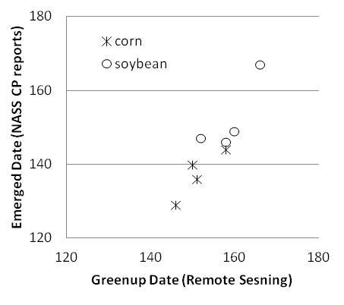
Remote Sensing Phenology
to
Crop Growth Stages
Greenup date
Relationship from previous years
Apr May Jun
Backcast Emerged Date (2014)

Slide 12
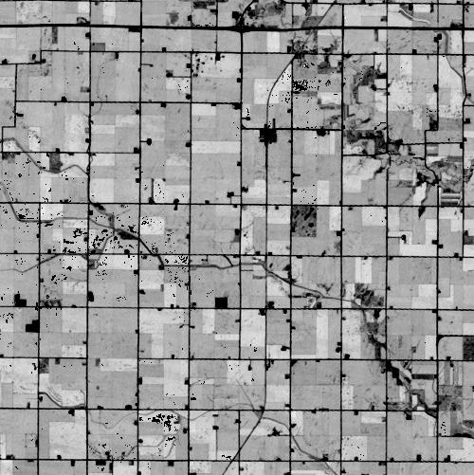
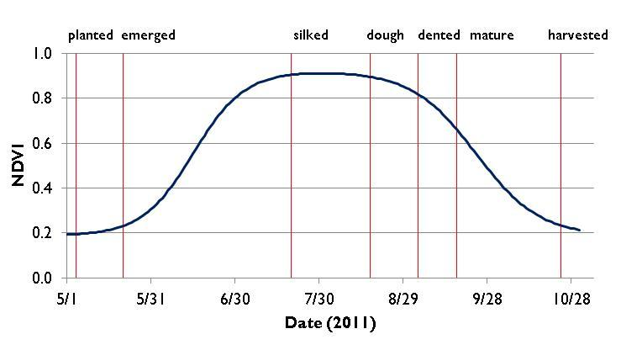
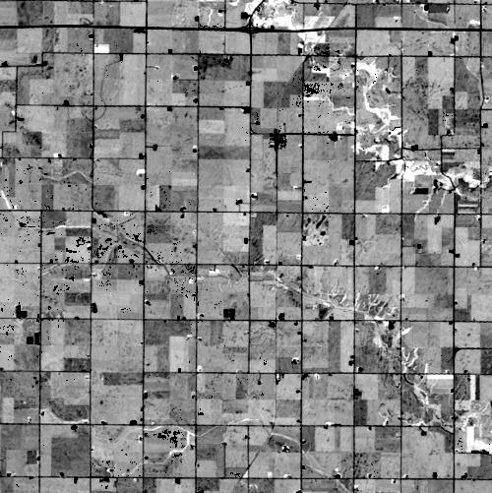
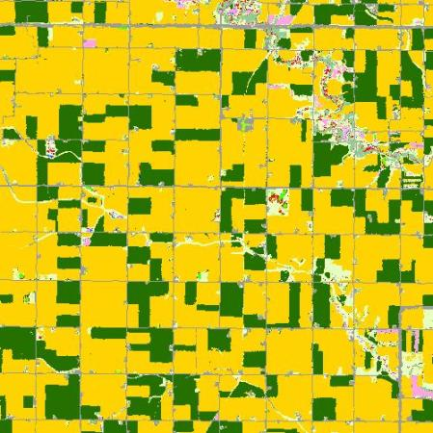
Phenology
start of season
end of season
emerged
silked
… …
0.7 0.8 0.9 1.0
max NDVI
greenup
cumulative NDVI
dormancy
NASS
CDL
(2011)
70 80 90 100

Slide 13
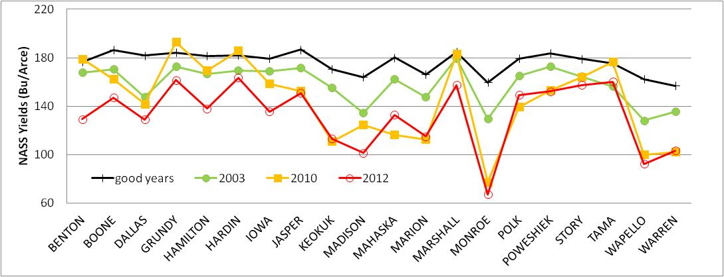
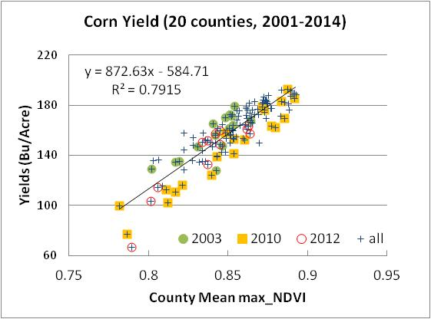
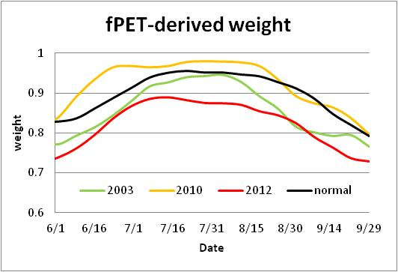
Corn yields and NDVI metrics (county level)
Crop Condition and Water Use Monitoring
Notes:
Good Years include 2004, 2005, 2007, 2009, 2011 and 2014

Slide 14
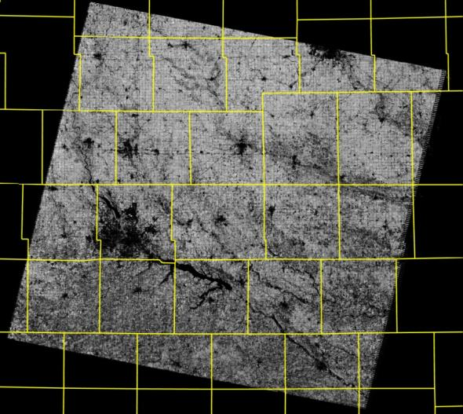
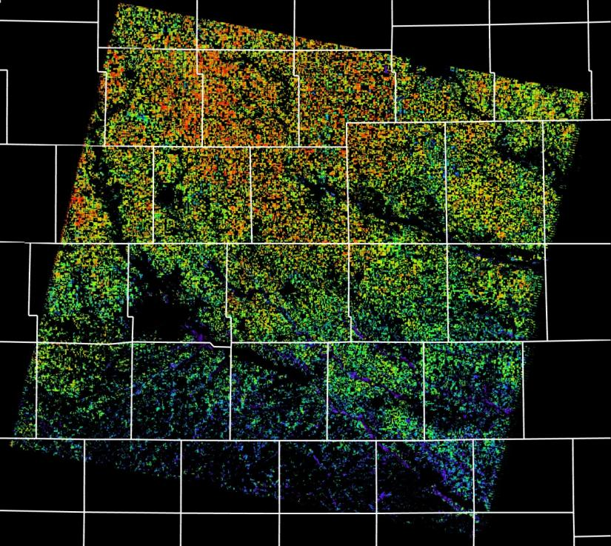
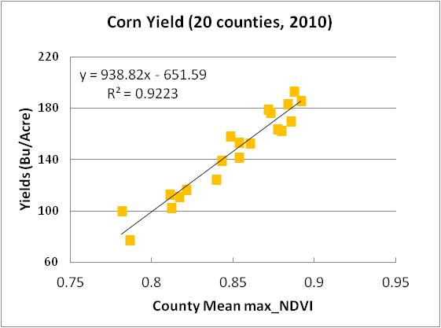
Estimated Yields at Field Scale
(corn, central Iowa, 2010)
Marshall
Monroe
max_NDVI
0.7 0.8 0.9 1.0
60 100 140 180 220 (Bu/Acre)
Notes:
Daily 30m resolution NDVI time-series was generated through fusing MODIS and Landsat surface reflectance for central Iowa from 2001 to 2014. Maximum NDVI were computed from the fused Landsat-MODIS NDVI time-series (upper left). The max_NDVI for each county were averaged for corn pixels (using USDA NASS cropland data layer in 2010) and compared to corn yield reported by USDA NASS at county level (lower right plot). A linear relation can be observed between mean max_NDVI and corn yield which implies the fused Landsat-MODIS captured the spatial variability of yield. The empirical relationship could be used to predict crop yield at field scale (right). Yield map on right was masked using CDL and only shows corn pixels. Two counties (Marshall and Monroe) were highlighted for showing the relationship between max_NDVI and yield.

Slide 15
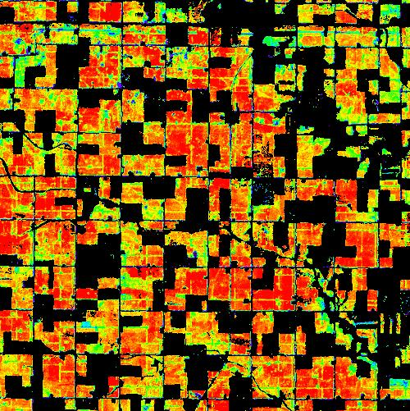
2010 Corn Yields (Bu/Acre) at South Fork
Crop Condition and Water Use Monitoring
-60 100 140 180 220+

Slide 16
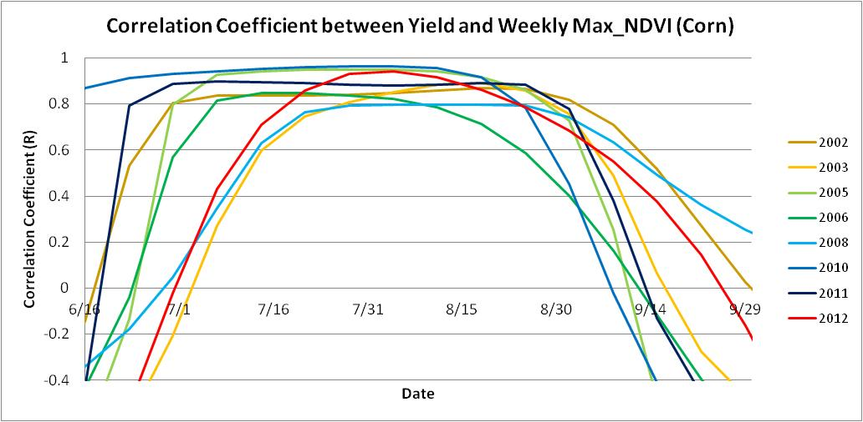
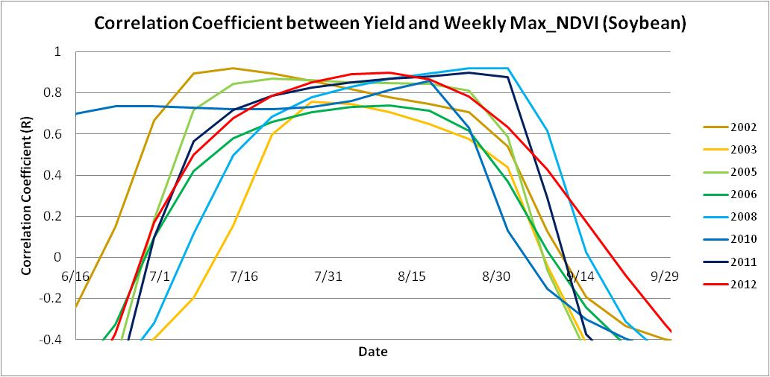
Acquisition Dates are Critical for Yield Modeling
Crop Condition and Water Use Monitoring
Notes:
Needs high temporal information from MODIS/VIIRS

Slide 17
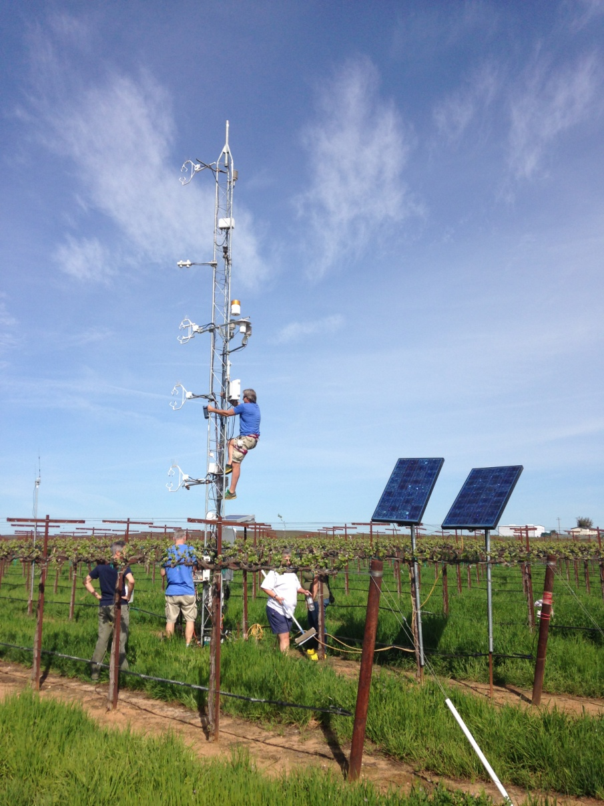
Crop Condition and Water Use Monitoring
Case 2: Gallo Vineyards, Lodi CA
(Grape Remote sensing Atmospheric Profiling & Evapotranspiration eXperiment)
  The two vineyards were heavily instrumented to measure meteorological, vegetation, and soil conditions including:
      meteorological quantities, e.g. wind speed, air temperature, and precipitation.
      surface energy balance.
      wind and friction velocity profiles.
      surface/canopy temperature.
      vine water use via sap flow sensors.
      soil temperature/moisture at multiple depths.
      leaf area index
      grape yield
Field measurements and remote sensing data were collected from 2013 to 2016
1
2

Slide 18
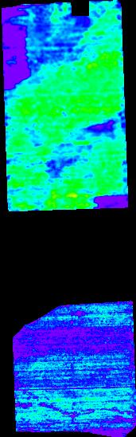
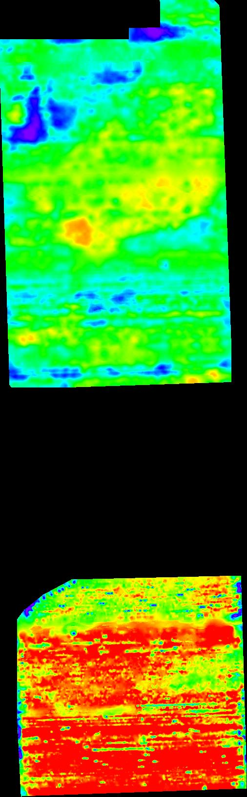
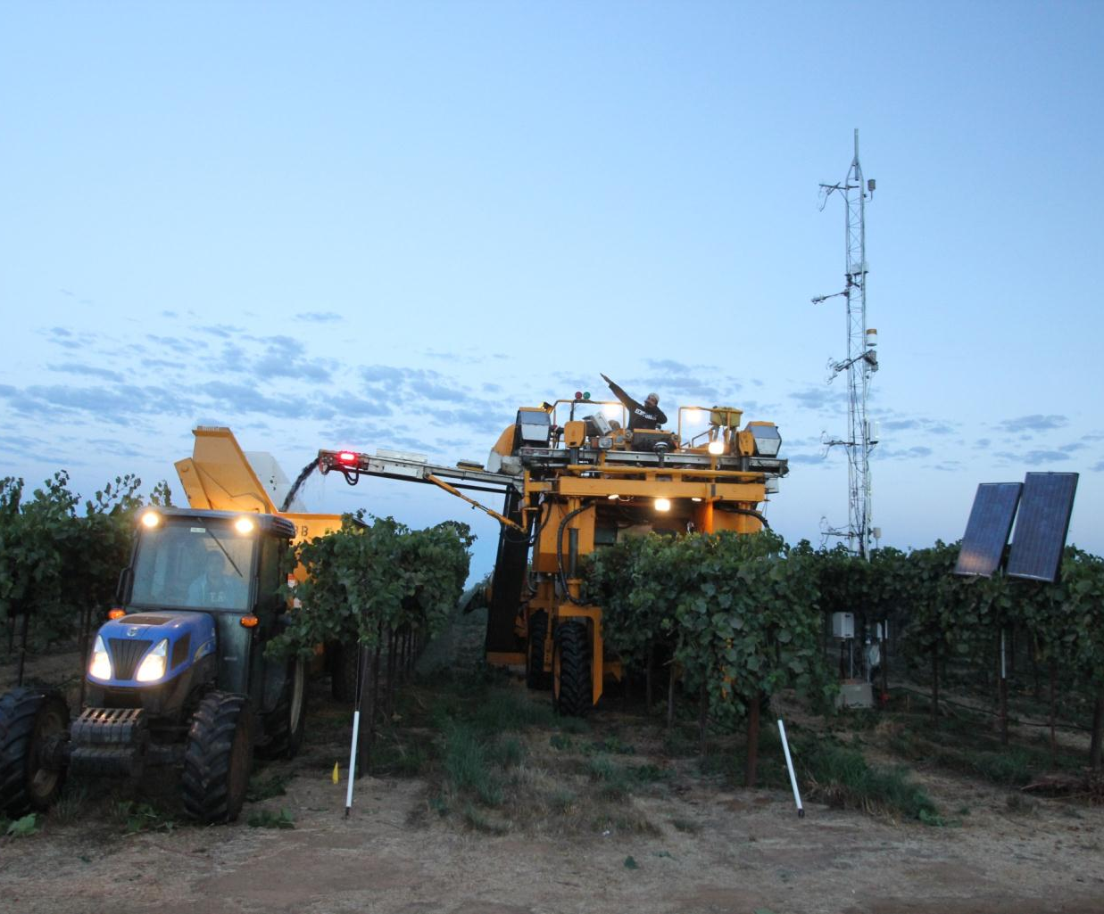
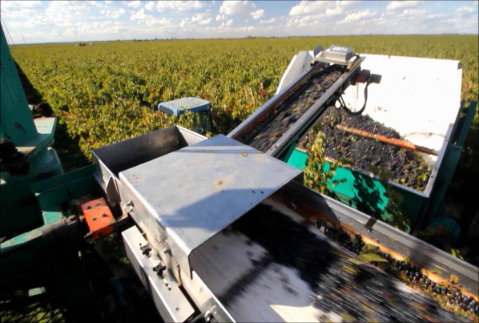
5 10 15 20
Yield
Monitoring
(tons/acre)
2013 (3m) 2014 (1m)
Notes:
Yield monitors consist of a combined GPS receiver and antenna as well as a specialized grape weighing and data recording system consisting of a load cell weight bridge, belt speed sensor and data logger.
2013 and 2014 yield maps look very different, particularly for the south vineyard…current work is on generating the high resolution ET map from 2014 to see if the flux map is correlated to these yield differences. This is an example of the utility of monitoring a site multiple years in order to capture the effects of variability in climate and plant conditions on water use and yield.

Slide 19
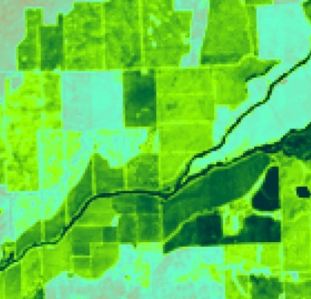
Crop Condition and Water Use Monitoring
4km
ALEXI ET (4km)
Observed ET
Landsat retrieval
Landsat-MODIS fusion
Precipitation
SITE 1:
Pinot Noir – 8 YR (2013)
Rainfall (mm/day)

Slide 20
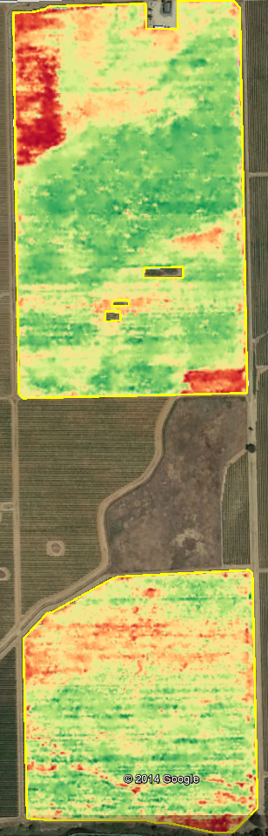
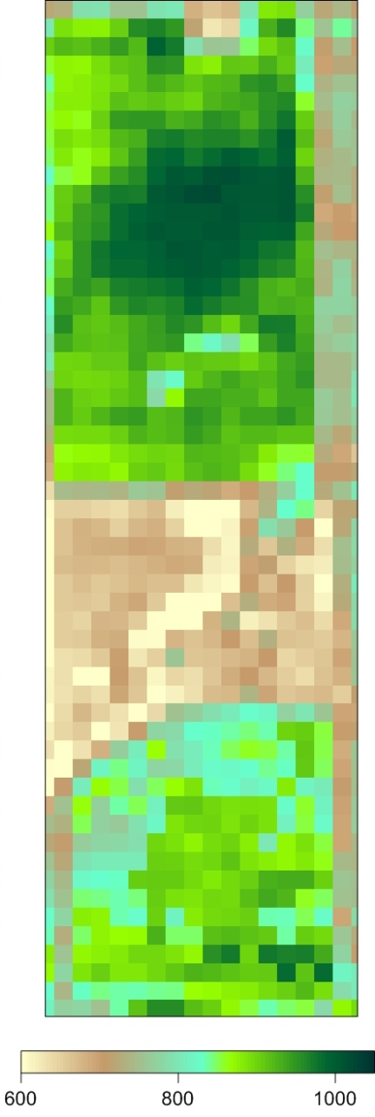
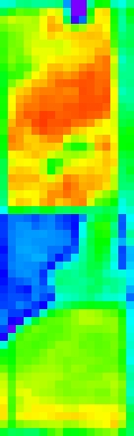
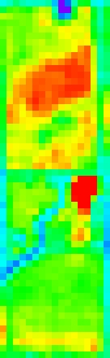
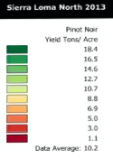

Crop Condition and Water Use Monitoring
2013 Yield
Landsat (30m)
Cumulative ET Cumulative LAI Max LAI

Slide 21
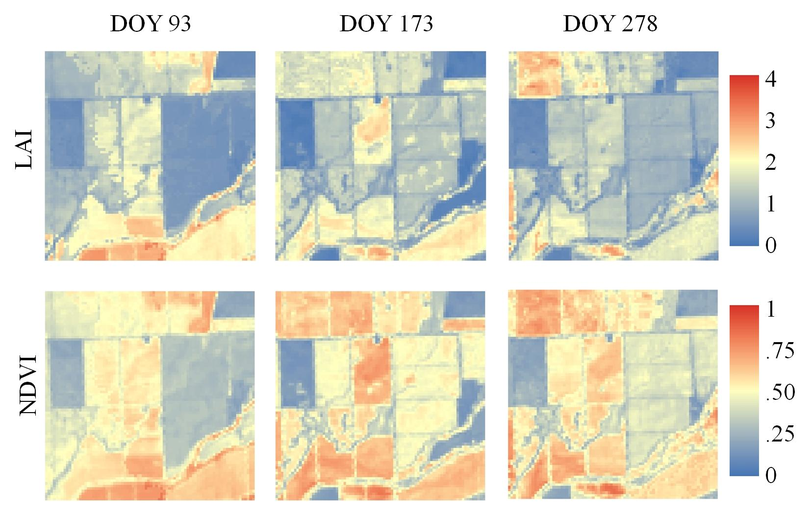
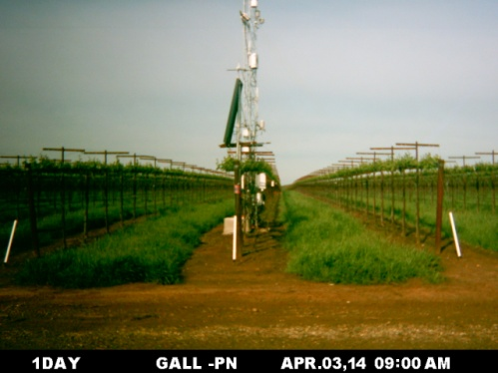
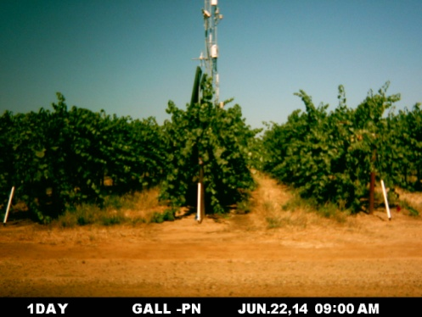

Crop Condition and Water Use Monitoring
Notes:
Landsat NDVI and LAI distribution, and ground pictures on the three selected dates in 2014.

Slide 22


Grape Yield Estimation
Crop Condition and Water Use Monitoring
5 10 15 20
(tons/acre)
Notes:
Correlation coefficients (R) between yield and daily NDVI and LAI vary on dates for two sites in 2013 and 2014.

Slide 23



Estimate Grape Yield at Gallo Vineyards (Lodi ,CA) using Landsat and MODIS Data Products
Site 1: 8-year Pinot Noir
(tons/acre)
Site 2: 5-year Pinot Noir
measured yield predicted yield (Landsat 30m)
Grape yield depends on vine condition and management (e.g. pruning)
Yield is harder to estimate but spatial variability are correlated to remote sensing observations
Possible to predict yield with the help of limited field measurements

Slide 24
Summary
Crop Condition and Water Use Monitoring
Integrated System
STARFM data fusion
DMS TIR image sharpener
ALEXI/DisALEXI ET modeling
LAI, Phenology …
Validation and Applications
Crop phenology
Daily crop water use and stress
Drought Impact and early warning
Yield estimation using time-series NDVI and ET (30m)
USDA is an equal opportunity provider and employer.

