Slide 1
Diffuse Attenuation and Secchi Depth Products from MODIS and VIIRS: Product of Ocean Transparency
ZhongPing Lee
University of Massachusetts Boston

Slide 2
Acknowledgements:
NASA Suomi National Polar-orbiting Partnership
NASA Ocean Biology and Biogeochemistry

Slide 3
Diffuse attenuation coefficient
Morel:
Austin&Petzold （1986）:

Slide 4
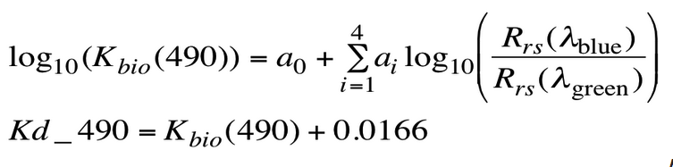
Austin&Petzold （1981）:
Rrs(λ_{blue}) = Rrs(486)

Slide 5
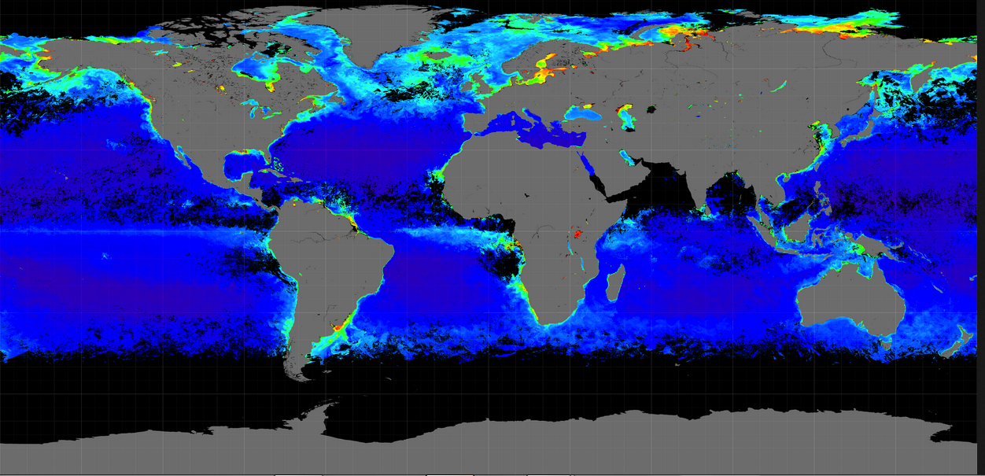
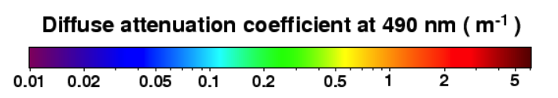
VIIRS K_{d}(490)

Slide 6
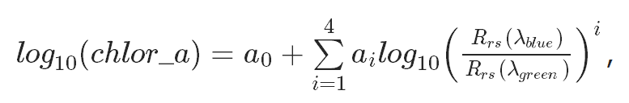
Rrs(λ_{blue}) = Rrs(443)>Rrs(486)
Notes:
yellow: pixels where R_{rs}(486)/R_{rs}(551) were used to derive both [Chl] and K_{d}(490)

Slide 7
The standard K_{d}(490) and Chl products are 100% co-vary in coastal waters; but …
AOP: sun angle dependent
Nearly independent of sun angle
The two sides do not match in optical attributes.

Slide 8
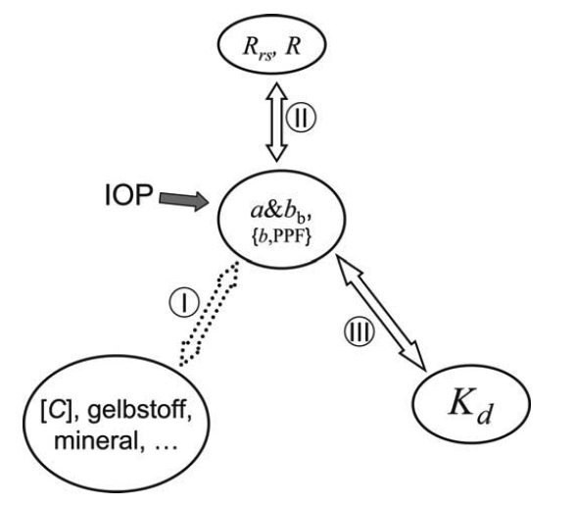
It is imperative to generate a more consistent, and un-equivocal, ocean color K product in the 21st century
（Lee et al 2005）
Notes:
f is the fraction of direct sunlight

Slide 9
Normalized diffuse attenuation coefficient (nK_{d}):
(Gordon 1989)
1.2
f?
Notes:
f is the fraction of direct sunlight

Slide 10
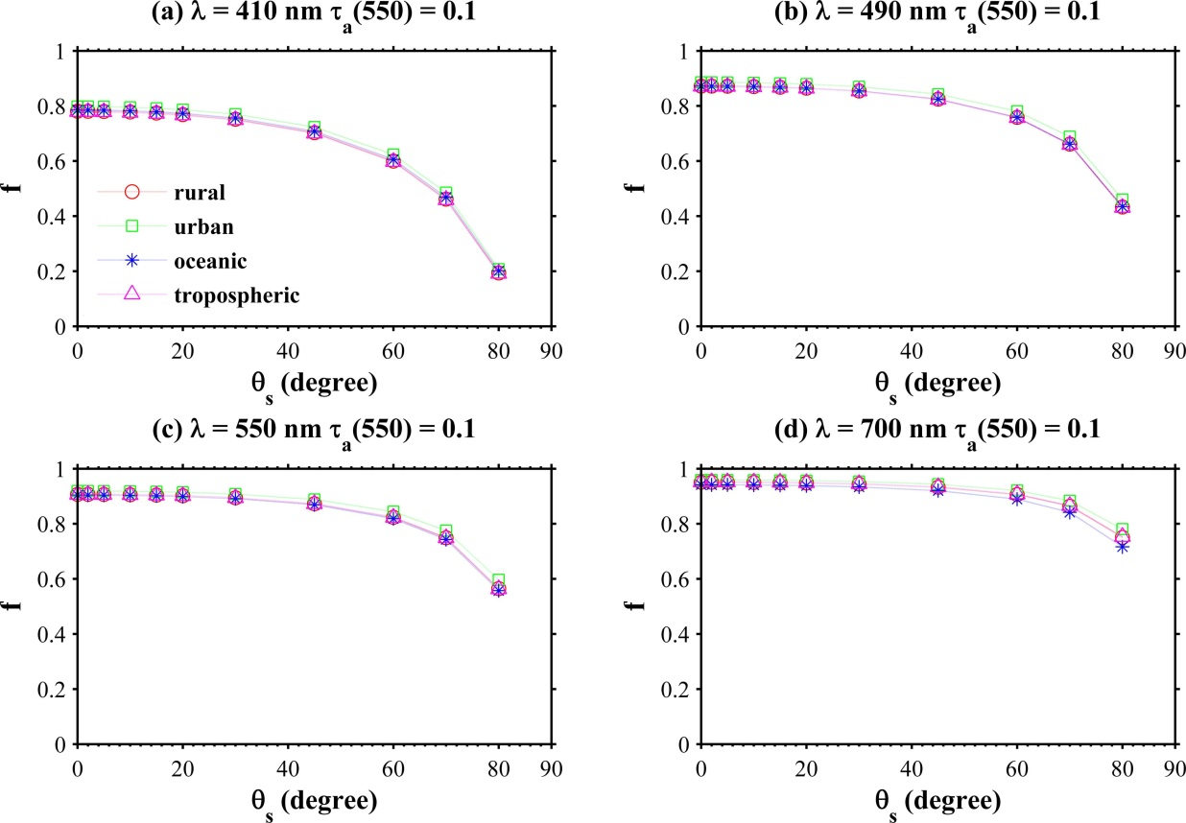
(Lin et al 2016)

Slide 11
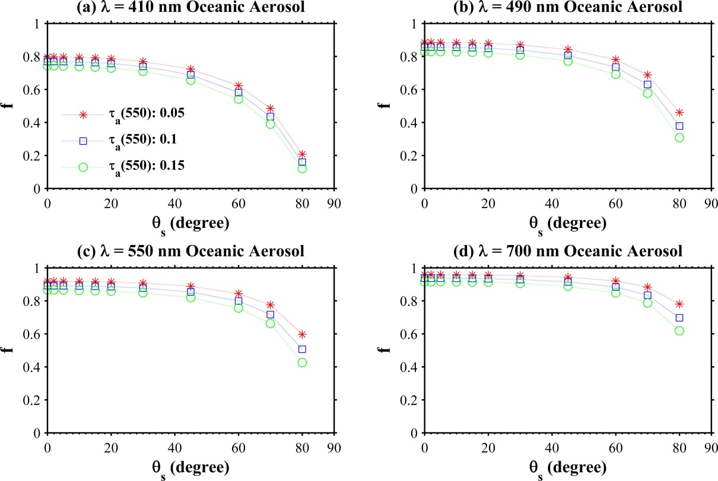
(Lin et al 2016)

Slide 12
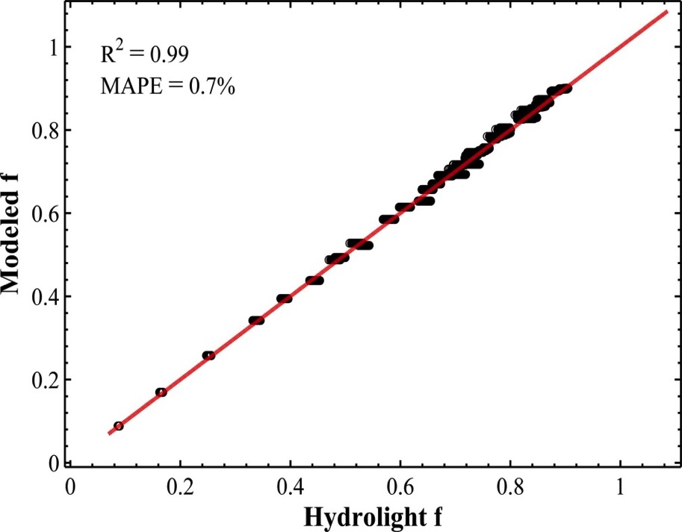
(Lin et al 2016)

Slide 13
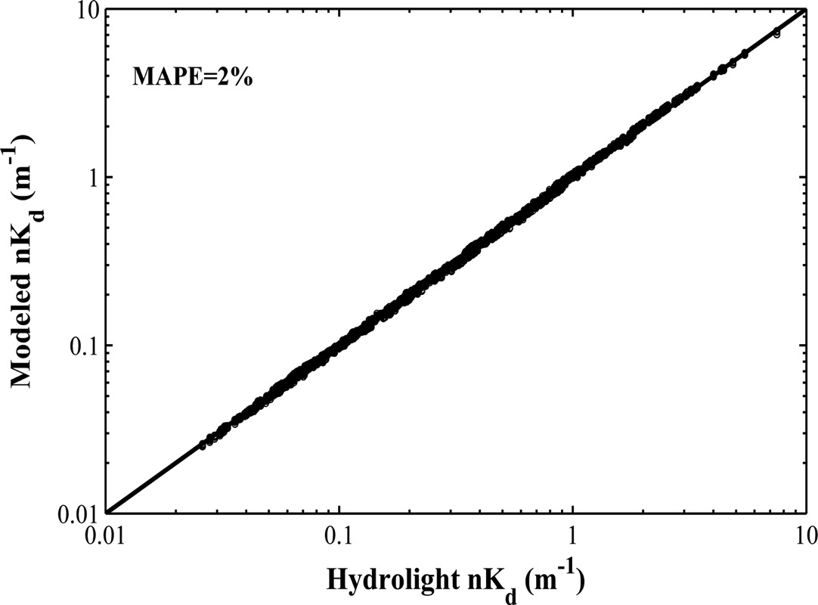
(Lin et al 2016)

Slide 14
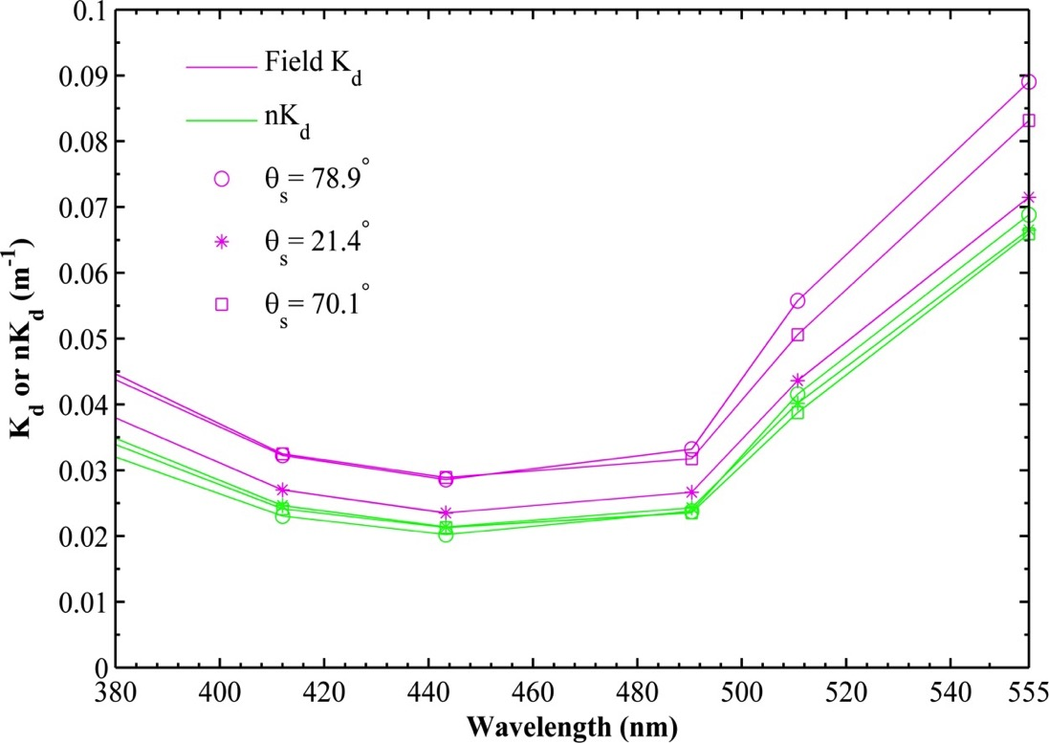
K_{d}&D₀
nK_{d}
(Lin et al 2016)

Slide 15
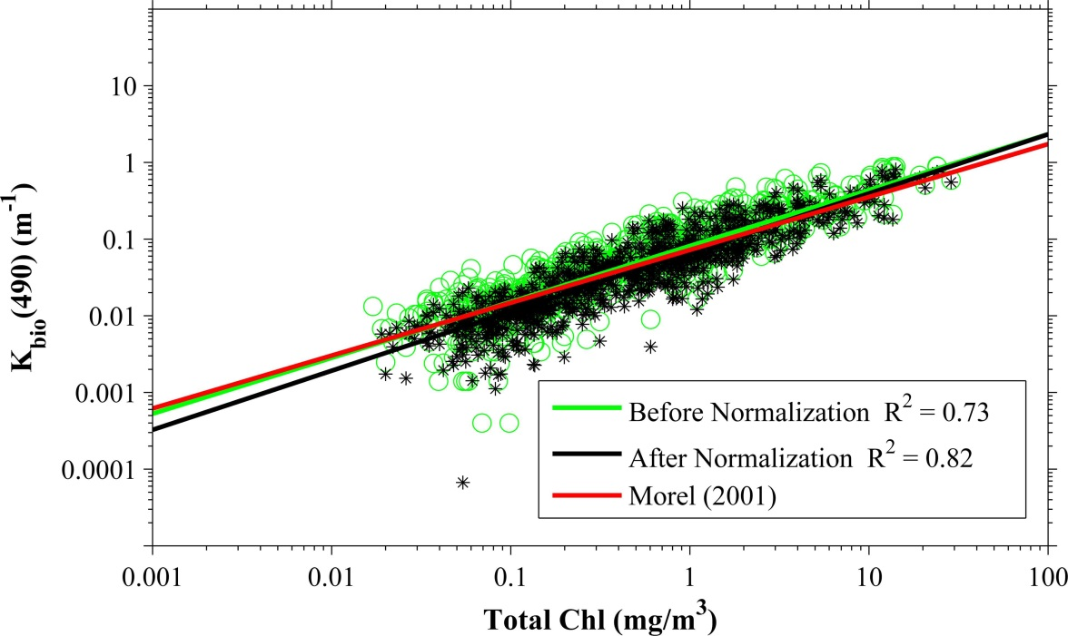
K vs Chl:
(Lin et al 2016)

Slide 16
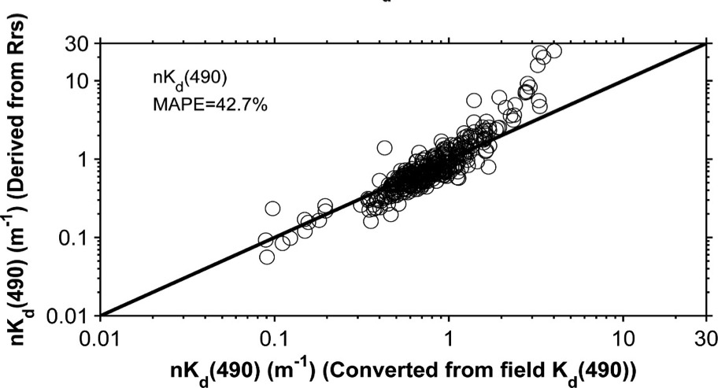
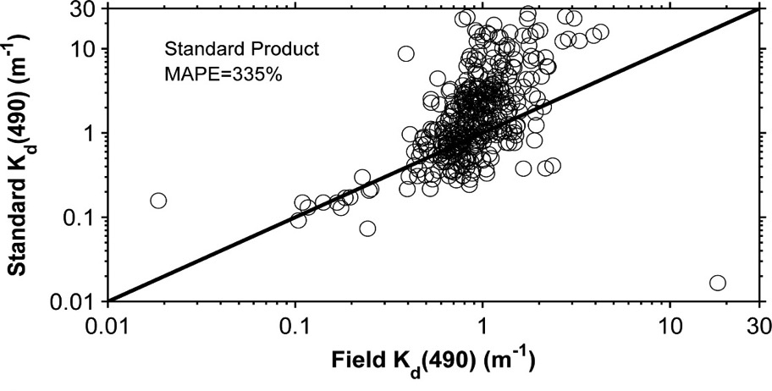
Remote Sensing nK_{d}:
R_{rs} → a&b_{b} → nK_{d}
(Lin et al 2016)
Notes:
Measurement in Chesapeake Bay

Slide 17
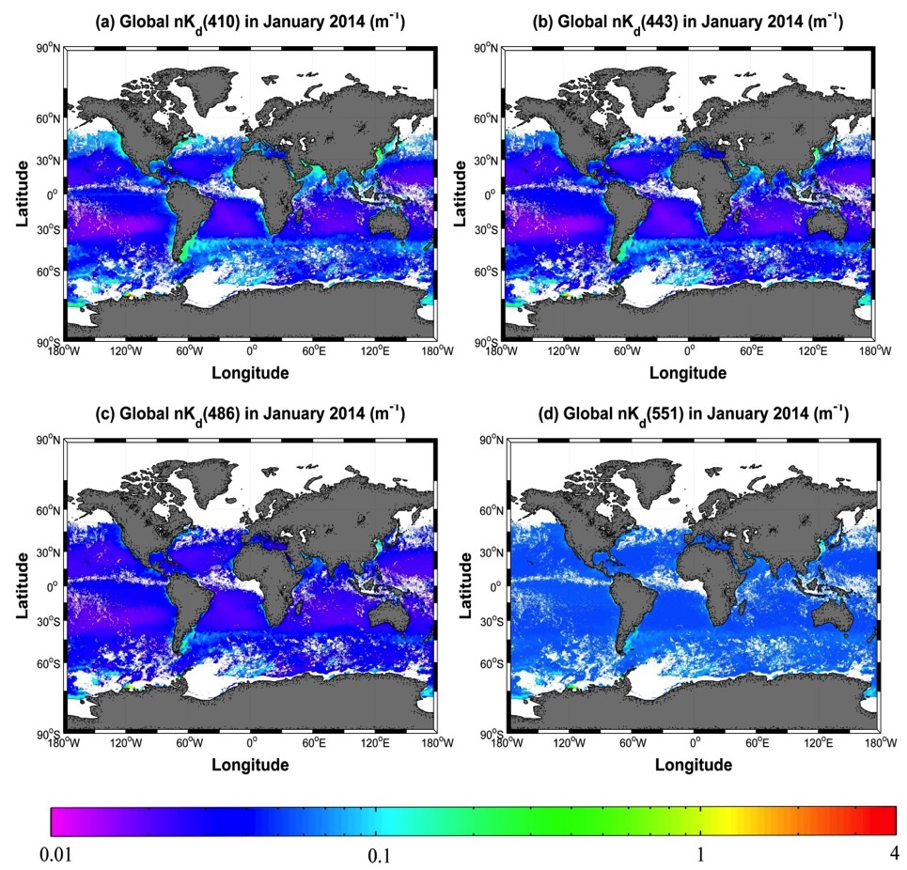
Global sample products from VIIRS:
(Lin et al 2016)

Slide 18
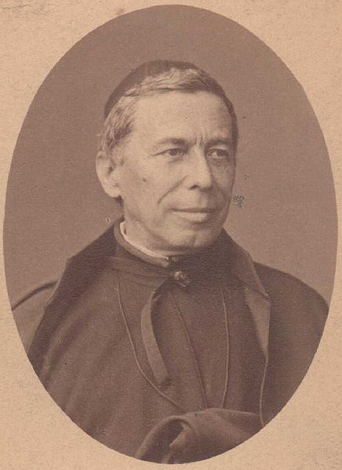
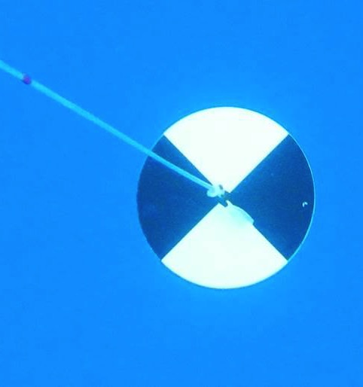
Application of nK_{d}(490)???
Water clarity/transparency …
Angelo Secchi
(1818-1878)

Slide 19
New theoretical relationship for Z_{SD}:
: attenuation coefficient in the transparent window
(Lee et al 2015)

Slide 20
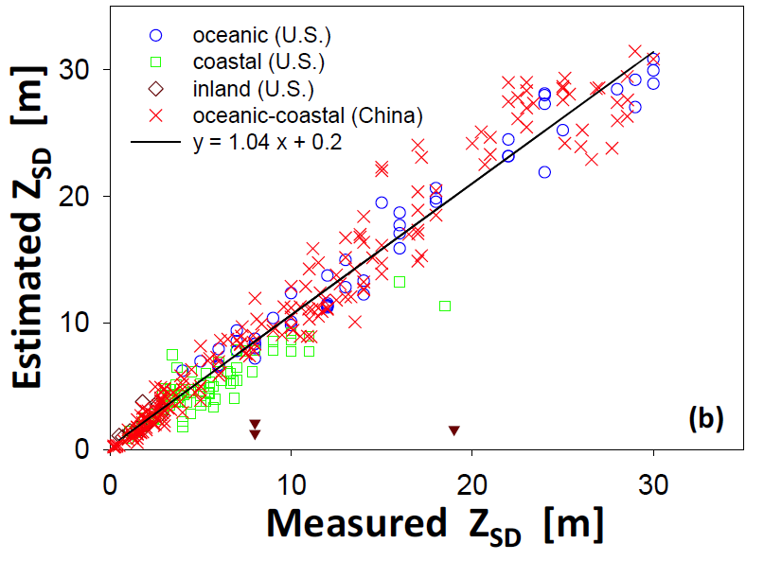
Verification of the new Secchi disk theory
QAA （2002）
Lee et al 2005
R_{rs} → a&b_{b} → K_{d}
(Lee et al 2015)

Slide 21

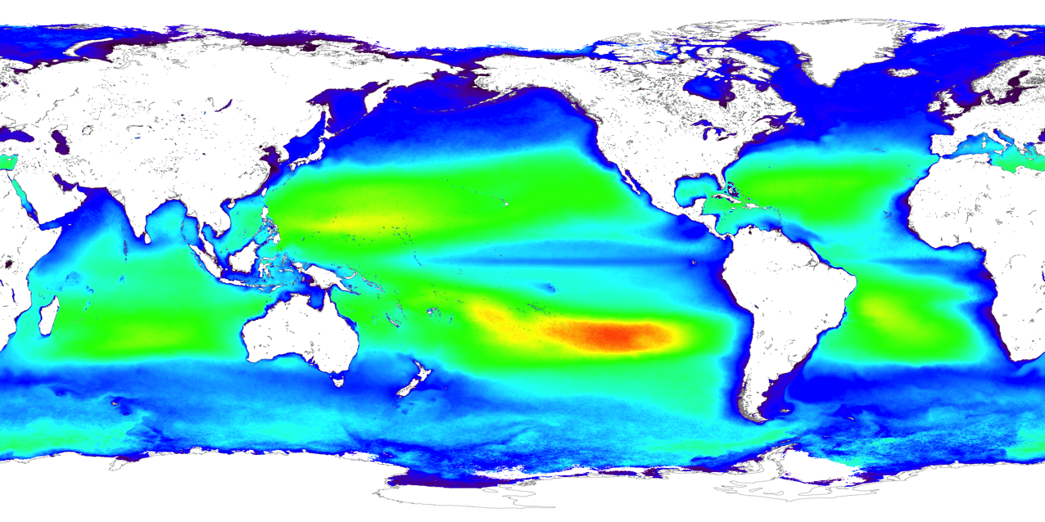
Global Z_{SD}
A much more straightforward product for water clarity!

Slide 22


Conclusions:
Traditional ratio-derived K_{d}(490) product overlooked its AOP characteristics; →
a) the empirical K_{d}(490) product has exactly the same spatial pattern as the Chl product in coastal region, which is not supported by ocean optics theory and observations
b) could be an “ vs ” comparison between satellite K_{d}(490) and insitu K_{d}(490)
2. nK_{d} corrects the AOP feature; →
It is much more accurate when it is derived following a mechanistic scheme;
3. Optical properties have a spectral dependence, thus nK_{d} at a single wavelength has limited applications. For representation of water clarity, it is better to use Secchi depth.
It is mid 2016 now, we should have long passed the empiricism-based practices for inversion of optical properties.

Slide 23
Thank you!

