Slide 1
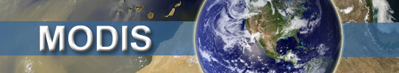

Stitching a MODIS-VIIRS time series of aerosol properties using the Dark Target algorithm:
Status in 2016
Robert C. Levy (NASA-GSFC)
Dark target group:
Shana Mattoo, Virginia Sawyer* and Richard Kleidman (SSAI/GSFC)
Falguni Patadia and Yaping Zhou* (Morgan State U / GSFC)
Pawan Gupta and Yingxi Shi* (USRA/GSFC)
Lorraine Remer (UMBC/JCET)
* New people in 2016.
And many, many, many others
MODIS/VIIRS Science Team Meeting: June 2016

Slide 2
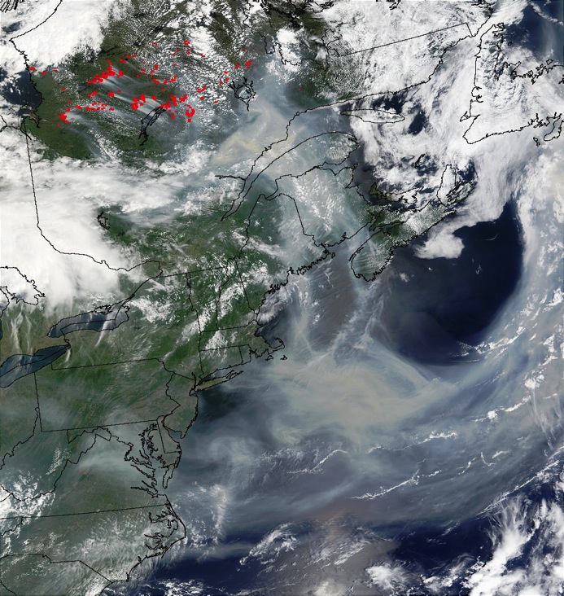
Aerosol from space as a climate record
Aerosol optical depth (AOD or τ)
“Essential Climate Variable” (ECV)
  Requires accuracy <±0.02
  Measured over multi-decades
Yet, mostly a “regional” problem.
Required uncertainty (per pixel) = <15%.
Also don’t forget that aerosol is an air quality problem as well.
Smoke transported over Eastern Canada/USA (8 July 2002)
http://earthobservatory.nasa.gov/

Slide 3
Outline
“Dark-target” (DT) remote sensing on MODIS
Terra vs Aqua (and calibration and trends)
DT applied to VIIRS (using Wisconsin IFF)
Challenges of MODIS→VIIRS continuity
Advancing the DT algorithm
Summary

Slide 4

Complicated TOA Signal: We want the AEROSOL
Gas + AEROSOL scattering (and absorption)
(path radiance)
clouds (%@(*%@!)
Indirect Transmission
(adjacency effect)
Multiple Reflection
Direct Transmission

Slide 5
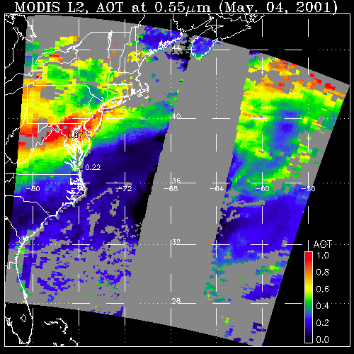
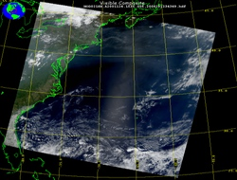
Dark Target (DT) aerosol retrieval
What a sensor observes
Attributed to aerosol (AOD)
May 4, 2001; 13:25 UTC
Level 1 “reflectance”
May 4, 2001; 13:25 UTC
Level 2 “product”
LAND
OCEAN
GLINT
AOD
1.0
0.0
There are many different “algorithms” to retrieve aerosol from MODIS
Ours is Dark Target (DT); “Established 1997” by Kaufman, Tanré, Remer, etc)
Separate algorithms: Ocean and Land
Both are multi-channel inversions
Products = AOD at 0.55 μm, spectral AOD, diagnostics
Notes:
Talk about DT mostly, but a little about DB.

Slide 6
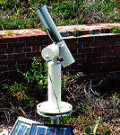
MODIS Collection 6 (10 km product):
“Validated since 2014”
All assumptions related to assumed aerosol properties, surface reflectance, lookup tables, and cloud masks were updated for C6
Collection 6 “Webinars”: http://aerocenter.gsfc.nasa.gov/ext/registration/
“dark-target” website: http://darktarget.gsfc.nasa.gov
MODIS product website: http://modis-atmos.gsfc.nasa.gov
Land: EE = ±(0.05 + 15%)

Slide 7
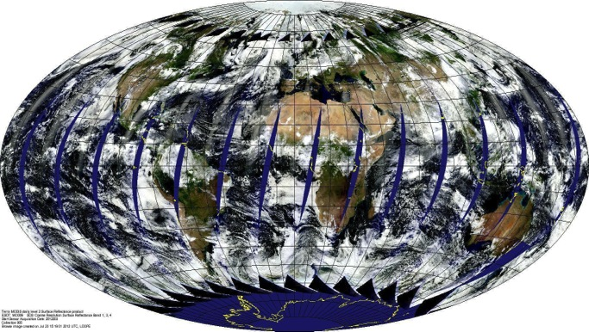
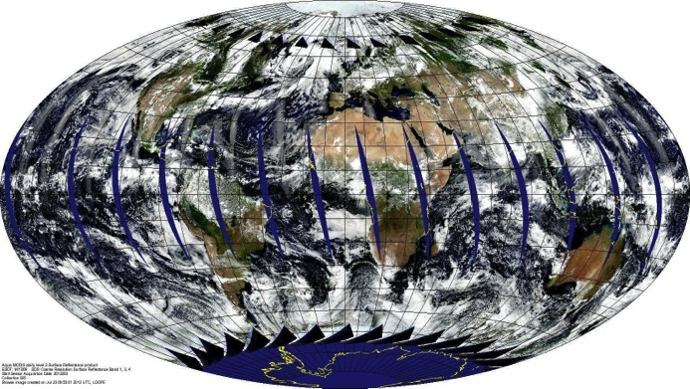
MODIS on Terra and Aqua
Validated AOD retrievals for both data sets
Terra (10:30, Descending)
Aqua (13:30, Ascending)
  Same instrument hardware (optical design)
  Same spatial and temporal sampling resolution
  Same calibration/processing teams
  Same aerosol retrieval algorithms
  The two MODIS instruments are Identical twins!
  Do they observe the world in the same way?

Slide 8
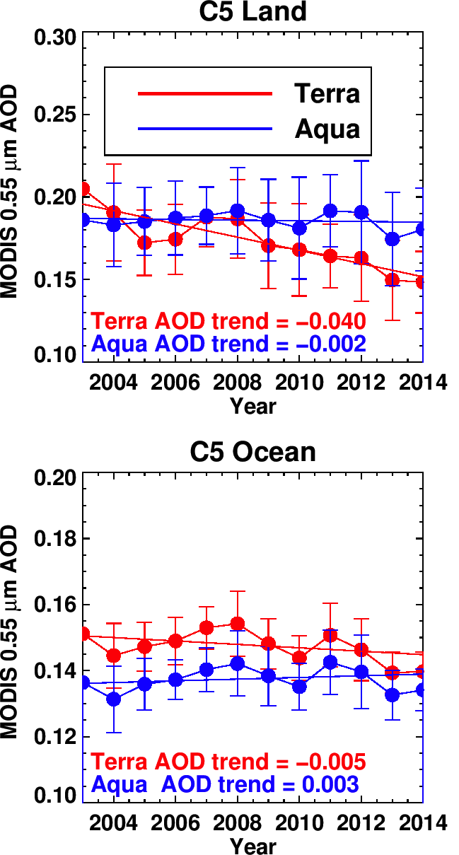
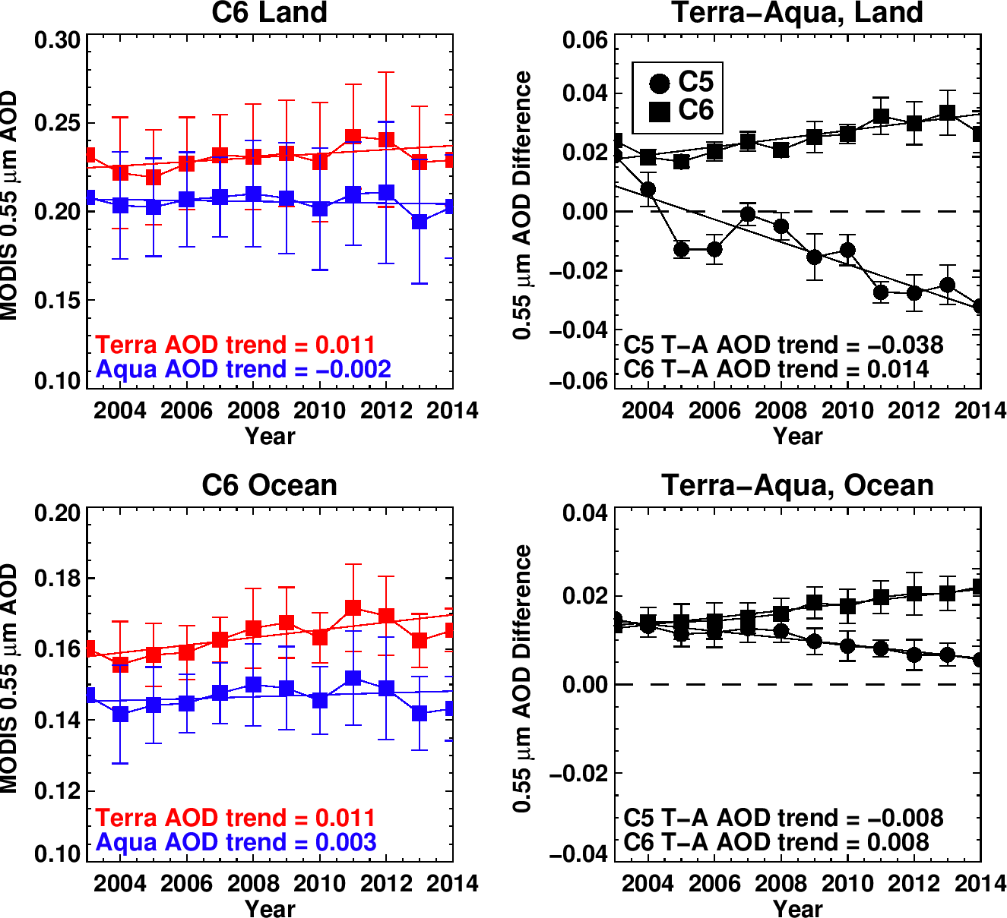
Time series of MODIS-derived AOD
Δτ = Terra - Aqua
LAND
OCEAN
C5
C6
Good news: Strong Δτ negative “trending” is reduced in C6
Bad news: 1) Δτ offset increases, and 2) there is now a positive trend

Slide 9
MODIS C6 (and calibration adjustments?)
Trending issues reduced with C6 product, but:
  Still significant offsets (13%) and
  Still residual co-trending (<0.01 / decade)
Why? Sampling? diurnal cycles? Cloud masking?
Calibration?
  Test different options
  “C6+” of Alexei Lypustin et al.,
  Ocean vicarious corrections
  Many others
  Me, playing on my own.
  Etc.
Still working on problem

Slide 10
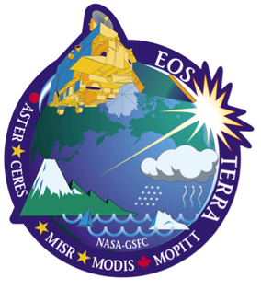
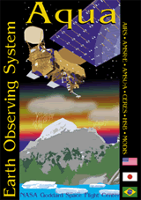
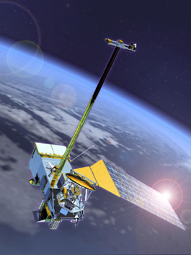
Beyond MODIS
Terra (16 years old) is driving in Maryland
Aqua (14) “seems” well behaved, but is a teenager
Both have well-exceeded their planned mission lifetimes
Calibration continues to get trickier, and there are end-of-lifetime plans
How do we make AOD climate data record? (20+ years of global AOD)?
VIIRS?
Visible-Infrared Imager Radiometer Suite
aboard Suomi-NPP
(and future JPSS)

Slide 11
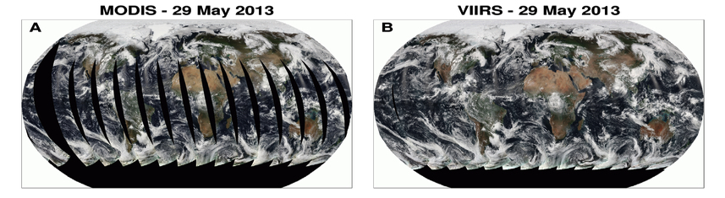
VIIRS versus MODIS
Orbit: 825 km (vs 705 km), sun-synchronous, over same point every 16 days
Equator crossing: 13:30 on Suomi-NPP, since 2012 (vs on Aqua since 2002)
Swath: 3050 km (vs 2030 km)
Spectral Range: 0.412-12.2μm (22 bands versus 36 bands)
Spatial Resolution: 375m (5 bands) 750m (17 bands): versus 250m/500m/1km
Wavelength bands (nm) / DT aerosol retrieval: 482 (466), 551 (553) 671 (645), 861 (855), 2257 (2113) → differences in Rayleigh optical depth, surface optics, gas absorption.
MODIS-Aqua – 29 May 2013
VIIRS-SNPP – 29 May 2013

Slide 12
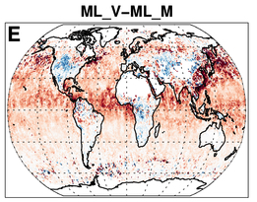
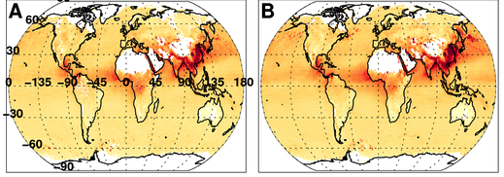
To develop “continuity”
Port the DT algorithm!
Wavelength bands & surface spectra
We use Intermediate File Formats (IFF) and tools developed at the “Atmosphere-SIPS”, at the University of Wisconsin
Deal with differences in wavelengths (gas corrections/Rayleigh, etc)
DT on VIIRS (compared with DT on MODIS):
  There is a systematic bias over ocean (VIIRS high by 20%).
  Déjà vu? Terra versus Aqua? (Terra high by 13%)
DT on MODIS
DT on VIIRS
Difference M - V
Levy et al., 2015

Slide 13
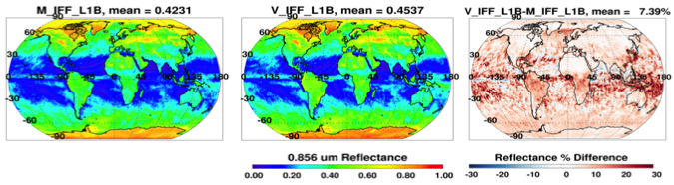
Comparing to AERONET and calibration
DT on MODIS: Ocean
DT on VIIRS has same great correlation as on MODIS, but 1.17 slope!
Could VIIRS biased by 2% in some bands?
2% high bias in 0.86 μm band is sufficient to give a 1.17 slope over ocean without the adding bias over land
DT on VIIIRS: Ocean
MODIS: 0.856 um Reflect
VIIRS: 0.861 um Reflect
VIIRS – MODIS Reflect
0.856 or 0.861 Reflectance
% Difference Reflectance

Slide 14
Calibration: Match files
Can we “prove” calibration differences? It’s hard!
  Differences in orbit → no true matches inside ±70° latitude
  Common geometry is very limited
  University of Wisconsin is creating “match” files for us to look at
  MODIS = master; VIIRS data if “close” in time and geometry
From Steve Platnick
“common” geometry/angles

Slide 15
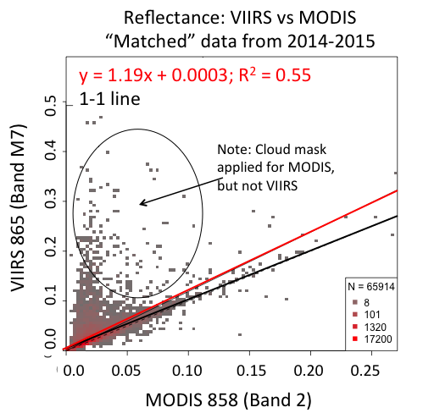
Calibration: Match files (2)
See Virginia Sawyer’s poster
  Slight differences in wavelength
  Slight differences in Rayleigh optical depths,
  Sometimes major differences in gas absorptions
  Clouds everywhere; hard to find mutual cloud free.
  And so far, both datasets are not cloud-masked equally.
Example: 0.86 μm channel over “clear” sky
T
1.0
0.8
0.6
0.4
0.2
0.0
Transmission
VIIRS M7
MODIS B2
0.80 0.82 0.84 0.86 0.88 0.90 (λ: μm)

Slide 16
Match files (3)
  Drifting orbits: confound it!
Plot drawn by Andy Sayer (GSFC), source data from Greg Quinn at SSEC Wisconsin.

Slide 17
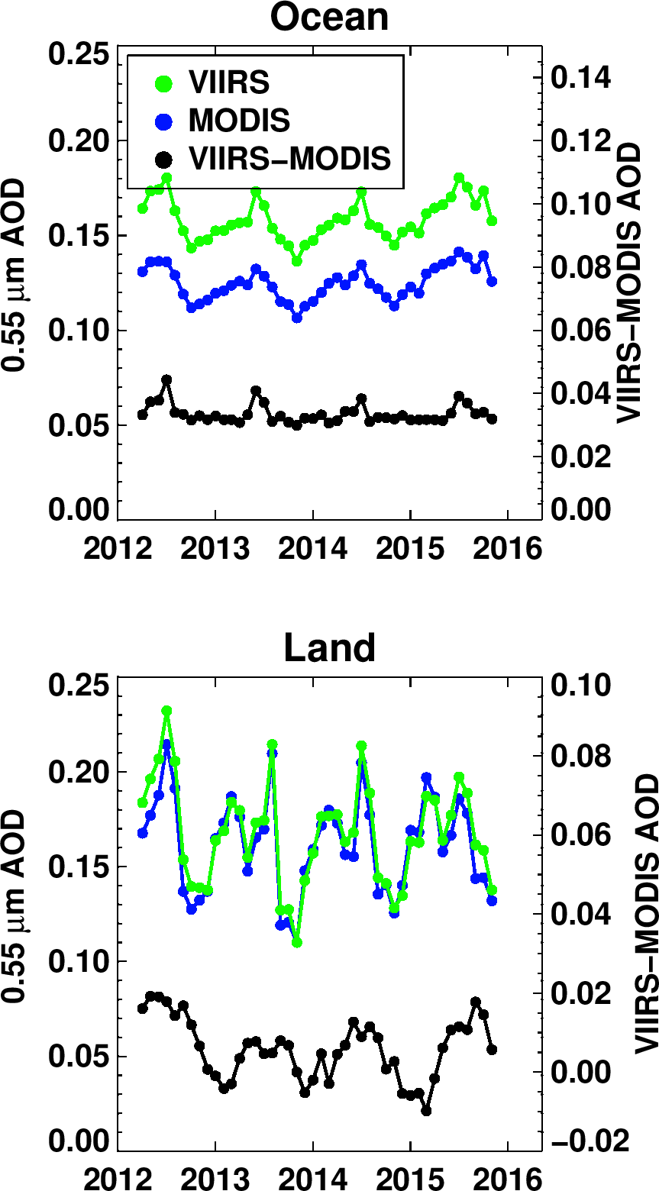
Current status: DT-VIIRS vs DT-MODIS
2012-2015.
Ocean: Consistent offset = 0.03 (20%) with spikes in summer
Land: Average offset is near zero, but seasonal dependence

Slide 18
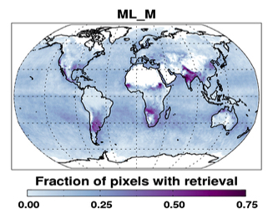
What is good enough for what?
Convergence: of gridded (Level 3 –like) data
  For a day? A month? A season?
  What % of grid boxes must be different by less than X?
    in AOD? In Angstrom Exponent? Size parameters?
Validation: Comparison with AERONET, etc?
“Retrievability”: Do algorithms
make same choices under
same conditions?
Other metrics?
MODIS (Aqua): MAM 2013

Slide 19
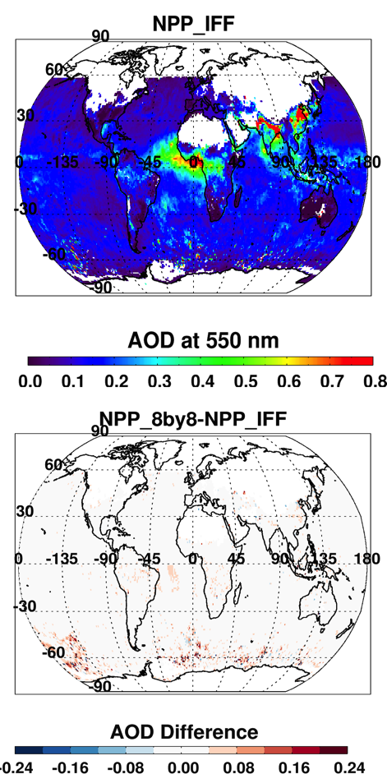
Loose ends
I-Bands:
  High resolution data (375 m) could help with cloud-masking/pixel selection
Decision on NxN pixel size:
  MODIS scans are units of 10 detectors (e.g. 10, 20, 40)
  VIIRS scans are units of 8 detectors (e.g. 8 or 16)
  Current MODIS-like is 10x10, but that mixes can lines for VIIRS
  Doesn’t make too much of a difference →
Land surface reflectance ratios (that exactly follow MODIS logic).
Cloud mask (thermal-infrared tests)
Formats, etc:
  We are reporting products in MODIS-like formats.
  Still awaiting science-team decision on archival formats, meta-data, etc.
  Hopefully worked out this week at M-V Science Team meeting!
AOD using 10x10
ΔAOD if using 8x8

Slide 20
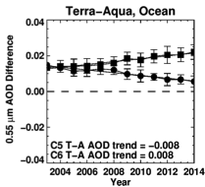
Summary (MODIS →VIIRS)
MODIS-DT Collection 6
  Aqua/Terra level 2, 3; entire record processed
  “Trending” issues reduced
  Still a 15% or 0.02 Terra vs Aqua offset.
  Terra/Aqua convergence improved with C6+, but bias remains.
  Other calibration efforts yield mixed results
VIIRS-DT in development
  VIIRS is similar, yet different then MODIS
  With 50% wider swath, VIIRS has daily coverage
  Ensures algorithm consistency with MODIS.
  Currently: 20% NPP vs Aqua offset over ocean.
  Only small bias (%) over land (2012-2016)
  Can VIIRS/MODIS create aerosol CDR?
Calibration for MODIS – VIIRS continues to fundamentally important.
It is not just Terra, or just Aqua, or just NPP-VIIRS (or future VIIRS, or…), it should be synergistic.
C6
VIIRS – MODIS (Aqua): Ocean

Slide 21
DT retrieval: Improvements
Improving coverage (two slides, one poster)
Removing bias over urban areas (one slide, one poster)
A better dust retrieval over ocean (one slide, one poster)
A new coastal retrieval (one slide)
Uncertainty “products” (too many slides to show)
Which updates will be in “forward” stream (e.g. a Collection 6.1), and which can go into reprocessing? (Wait for Collection 7?)

Slide 22
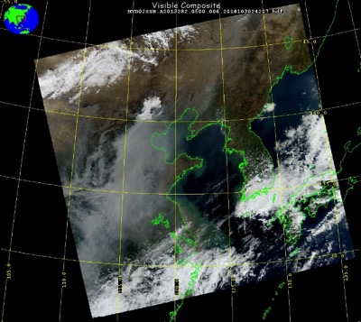
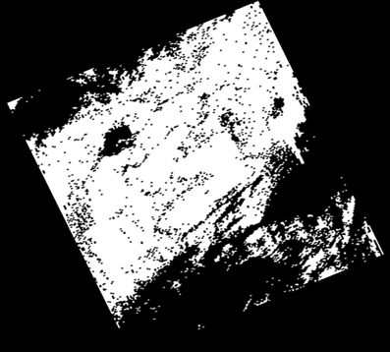
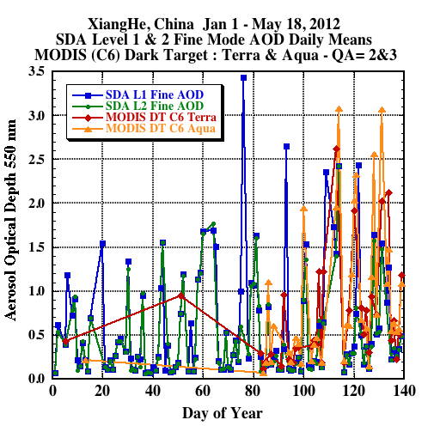
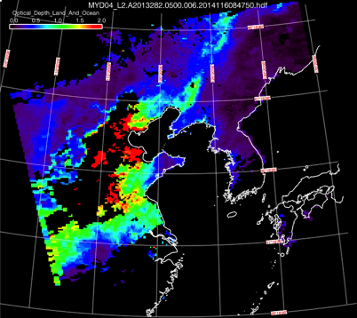
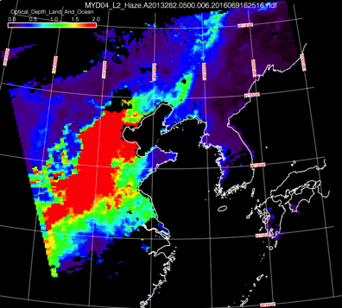
Improving coverage (1)
MODIS (C6) misses many AOD events during winter months (AERONET confirms not cloud)
Case study over Beijing area shows that our cloud mask is working
2013282.0500
Clear
Cloudy
Instead it is the “In-land water mask” that is preventing retrieval over Beijing.
C6 AOD
Modified AOD
Q: Can we relax masks, but not degrade global retrieval?
A: Maybe: Testing during current KORUS experiment (Korea)
Leiku Yang and Yingxi Shi

Slide 23
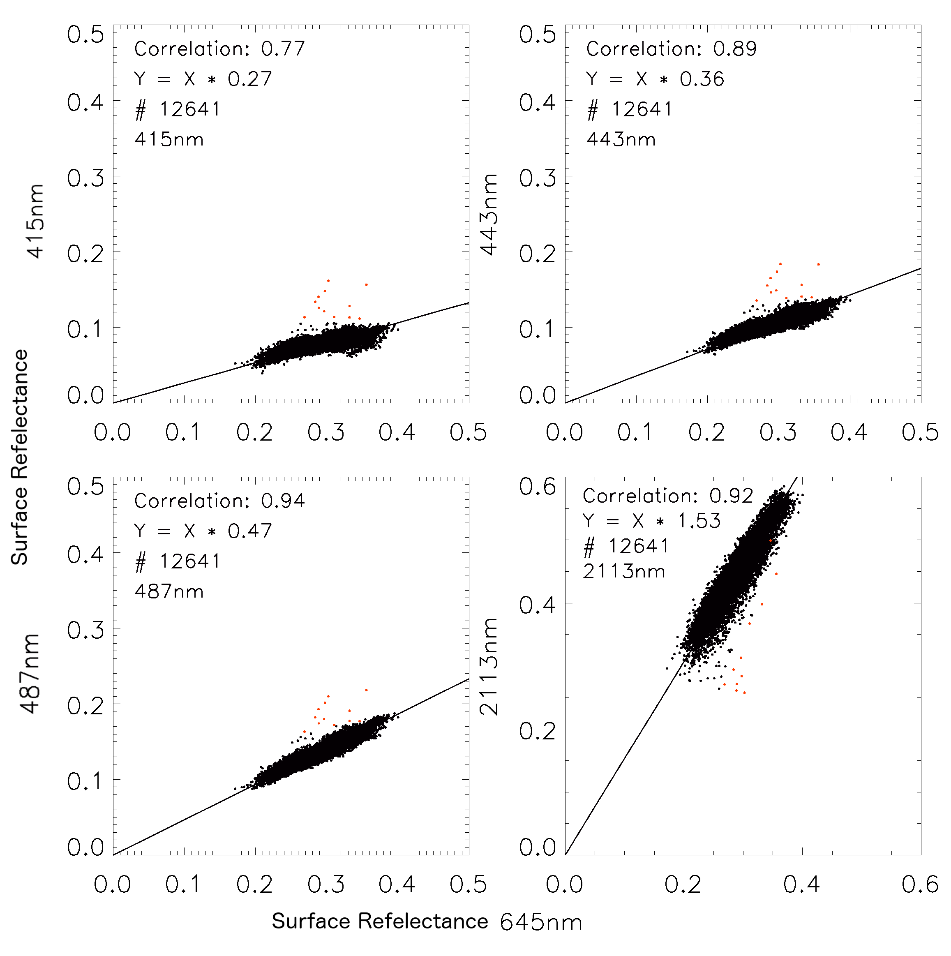
Improving coverage (2)
See Yingxi Shi’s poster
For MODIS, the Deep Blue (DB) algorithm is used for routine, single-look (pixel by pixel) retrieval over arid regions.
C6 includes a combined DT/DB product with non-optimized weightings for merging.
Using DT-like logic, we test use of SWIR (2113 nm) and red (645 nm) channels to estimate blue channel surface reflectance. We also look at DB channels (e.g., 412 and 443).
On right plots Atmospheric correction (AC). We also test MODIS reflectance (e.g. MOD09) and see similar slopes.
This is a first step towards a consistent aerosol retrieval across more of the world’s land surface.
Atmospheric Correction over Solar Village AERONET
415 nm
R=0.77
443 nm
R=0.89
Surface Reflectance other bands
487nm
R=0.94
2113 nm
R=0.92
Surface Reflectance 645 nm

Slide 24
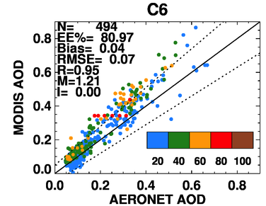
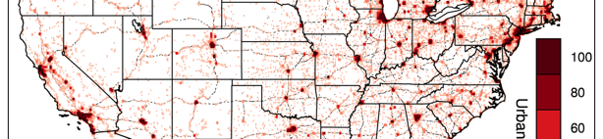
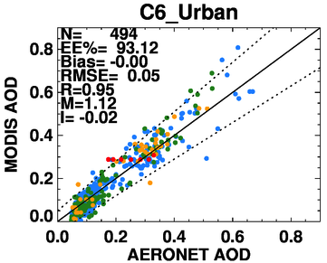
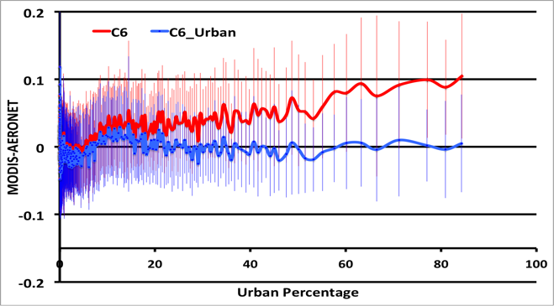
Characterizing / correcting urban surface bias
See Pawan Gupta’s poster!
(MDT AODs over urban surface are biased high w.r.t. AERONET)
Urban % in the U.S. (Cities)
Surface scheme is revised over urban areas by integrating land cover type information in the retrieval algorithm.
Urban %
Global implementation
AOD (MODIS-AERONET)
DISCOVER AQ – BAL/DC
Urban Percentage
Revised urban algorithm works very well in the US
Global implementation is challenging, but forthcoming
Gupta et al., (AMT in revision)
Notes:
Plot # 1: Showing that MDT AODs are positively biased over urban area – example from DISCOVER-AQ Baltimore/DC campaign
Plot # 2: Showing the land cover type information integrated into the new surface scheme
Plot # 3: Showing that new surface scheme remove most of the bias in AOD retrievals for same area
Plot # 4: Showing the removal of dependence of bias on the amount of under lying urban surface in the new retrieval

Slide 25
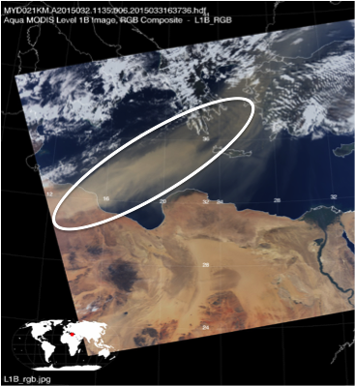
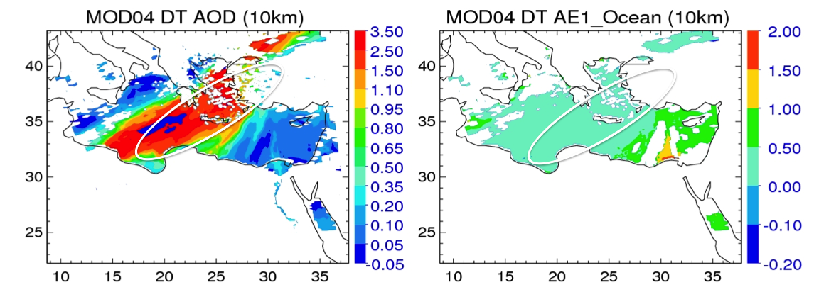
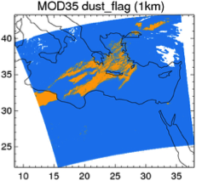
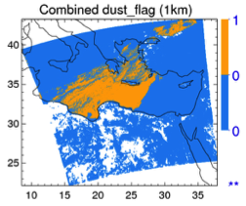
Improving dust retrieval over ocean
See Yaping Zhou’s poster
DT-Ocean algorithm uses VIS,NIR and SWIR bands for retrieval.
DT-O assumes spherical aerosol models, which leads to bias in retrievals of AOD and AE.
There are dust signatures in TIR and Deep Blue wavelengths and published dust-detection algorithms. Do they work for MODIS?
Then, we could use dust-detection to inform DT to choose non-spherical dust models instead
A dust image
Standard dust retrieval: high AOD, but moderate AE
“MCI” uses TIR plus “DAI” that uses DB

Slide 26
New AOD retrieval over coastal turbid water
Yi Wang, Jun Wang (Univ. of Nebraska), Rob Levy
Standard product
Most people live near coastlines!
So any extra information is important!
Standard product +
new retrieval
Validation

Slide 27
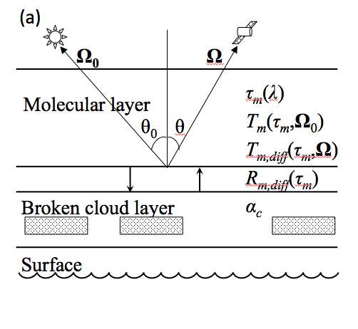
Correcting for reflectance enhanced by low clouds
Guoyong Wen, Sasha Marshak, Tamas Varnai, Rob Levy
Clouds close to clear (aerosol retrieval) pixels tend to enhance reflectance toward sensor, leading to biased AOD retrieval
These 3D effects include:
  Cloud / molecular interactions
  Cloud / surface interactions
  Cloud / aerosol interactions
  Etc.
The goal is to develop “simple” models to estimate the the sum of these interactions.
Re-submitted paper includes corrections for a and b.
Must be done for all wavelengths.
Can corrections for low cloud effects be applied to global MODIS aerosol retrieval?

Slide 28
DT retrieval: Fun stuff
Retrieval at high resolution for aerosol/clouds
Using UV wavelengths (motivated by PACE)
Retrieval on geostationary platform

Slide 29

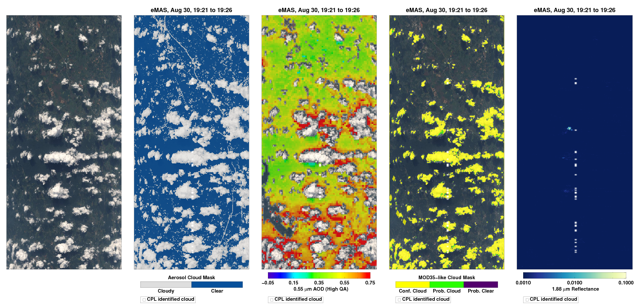
Using high-resolution to study aerosols near clouds
Panels are 100 km by 37 km: DT aerosol retrieval at 500 m
RGB Aerosol Cloud Mask AOD Wisc. Cloud Mask 1.88 μm Reflect
Segment is 19:21-19:26
0.0 0.35 0.75

Slide 30
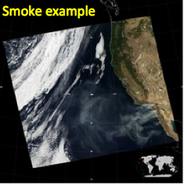
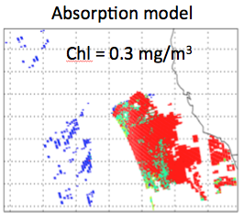
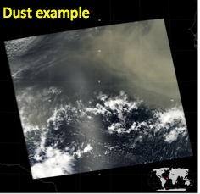
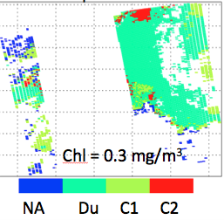
PACE development: Joining MODIS (VIS/NIR/SWIR) and OMI (UV)
Sensitivity to aerosol absorption!
See Remer and Mattoo poster!
Use MODIS ocean retrieval to constrain AOD and aerosol model.
Use OMI UV reflectances to choose one of 4 absorption scenarios.
Chooses mostly combustion (C2) for smoke case. [SSA_400~0.89]
Chooses mostly dust (Du) for dust case.
[SSA_400~0.83]

Slide 31
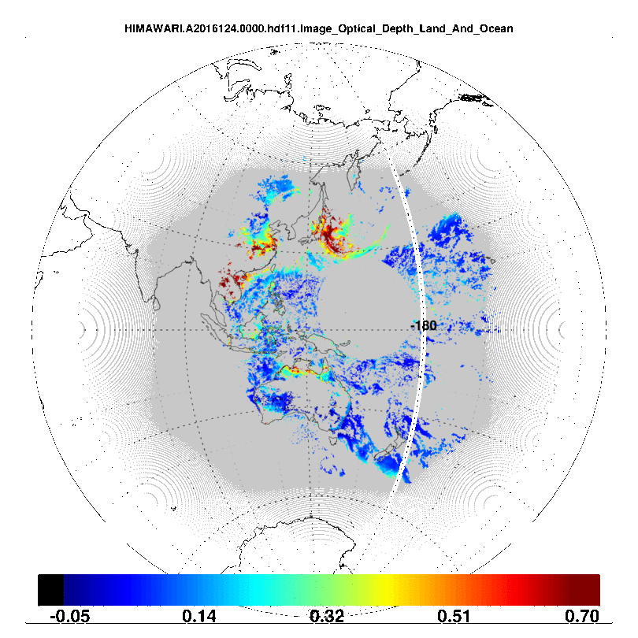
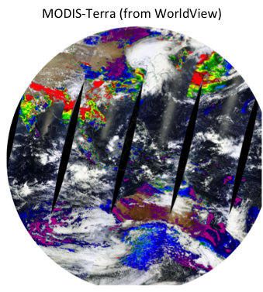
DT: Geostationary? and diurnal cycles
Himawari-8
May 3, 2016

Slide 32
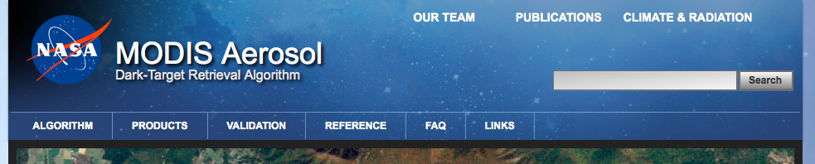
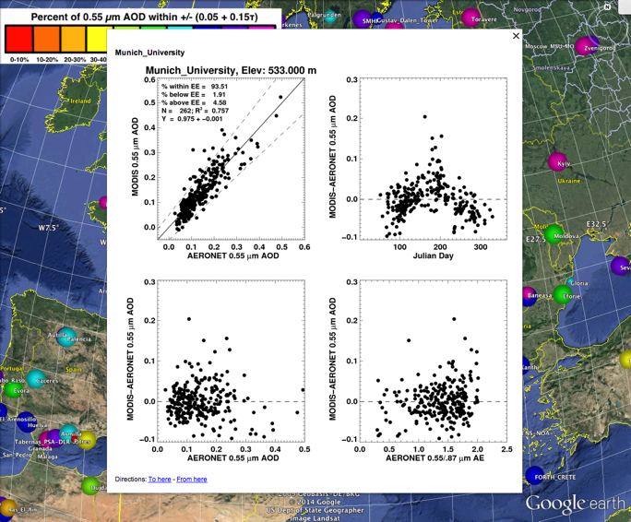
http://darktarget.gsfc.nasa.gov
Reference for all things “dark target”
  The algorithms and assumptions
  Examples
  Validation
  Primary publications
  Educational material
  FAQ
  Links to data access
THANK YOU!

