Slide 1
MODIS and CALIPSO observations of aerosol properties in partly cloudy conditions
Marshak (NASA GSFC),
T. Varnai (JCET), and W. Yang (GESTAR)

Slide 2
From Chapter 7 of IPCC AR5 report
“… aerosol measured in the vicinity of clouds is significantly different than it would be were the cloud field … not present”. …Thus “ascribing changes in cloud properties to changes in the aerosol remains a fundamental challenge.”

Slide 3
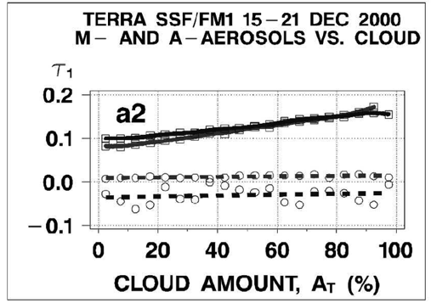
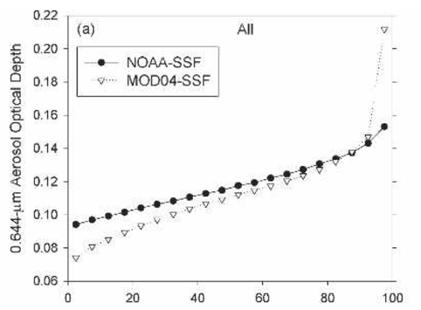
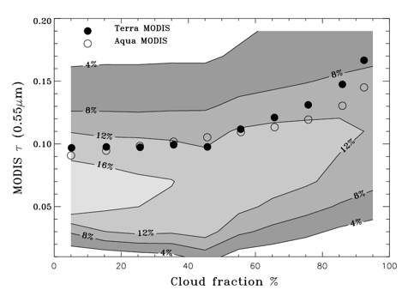
What happens to aerosol in the vicinity of clouds?
All observations show that aerosols seem to grow near clouds
or
(to be safer) “most satellite observations show a positive correlation between retrieved AOT and cloud cover”, e.g.,
Chand et al. (2012) using MODIS data found a 25% enhancement in AOT between CF 0.1-0.2 and CF 0.8-0.9.
Cloud Fraction (%)
from Ignatov et al., 2005
from Loeb and Manalo-Smith, 2005
from Zhang et al., 2005
Notes:
Ignatov et al. note that the correlation can be either real or artificial
Loeb and Manalo-Smith mentioned different meteorological conditions and RH
Zhang et al. claim that artifacts like cloud contamination or adjacency effect result in 10-20% overestimation in monthly AOT

Slide 4
What happens to aerosol in the vicinity of clouds?
However, it is not clear yet how much grows comes from (e.g., Quaas et al., 2010)
  aerosols swelling in the humid air surrounding clouds;
  cloud processing that enhances the number of aerosol particles through chemical or microphysical processes;
  undetected cloud particles;
  clouds scattering sunlight into nearby clear areas;
  instrument issues.
Notes:
Also different meteorology
Instrumental issues

Slide 5
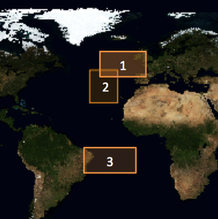
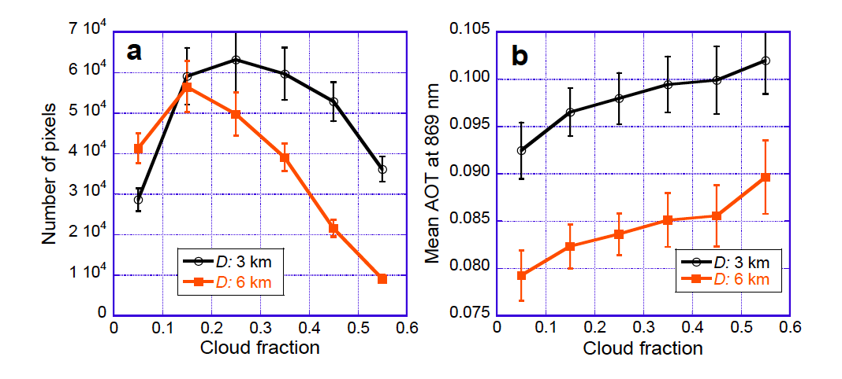
MODIS
(South of UK)
Number of pixels
AOT
for high CF: N(3km) > N(6km)
for low CF: N(3km) < N(6km)
- N(CF=0.5) < N(CF=0.3)
- AOT(3km) > AOT(6km)
- AOT(CF=0.5) > AOT(CF=0.1)

Slide 6
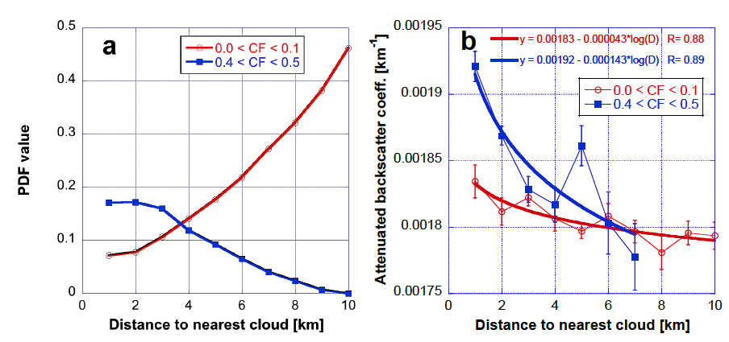
CALIPSO
(around the Azores)
Normalized number of samples
Backscatter
for high CF: N(3km) > N(6km)
for low CF: N(3km) < N(6km)
- far from clouds: N(CF=0.5) << N(CF=0.1)
- Backsct(2km) > Backsct (6km)
- Backsct(CF=0.5) > Backsct(CF=0.1)

Slide 7
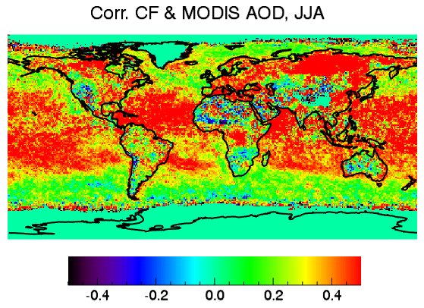
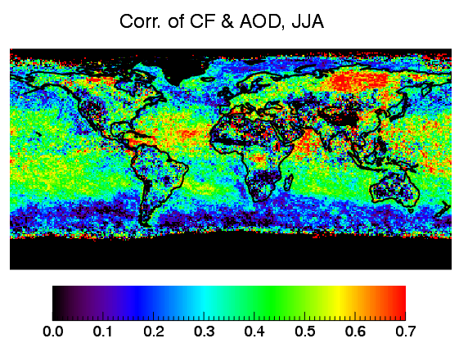
CF-AOD correlation
Two options for color scale
Though there are some variations, CF-AOD correlation is positive globally

Slide 8
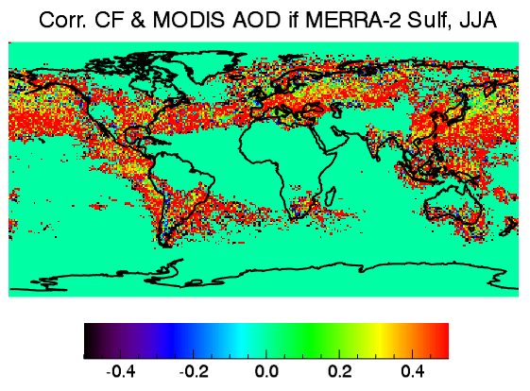
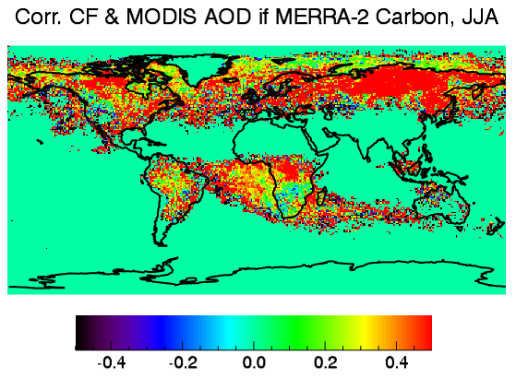
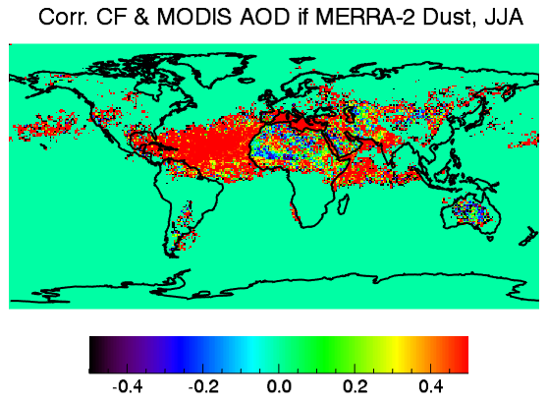
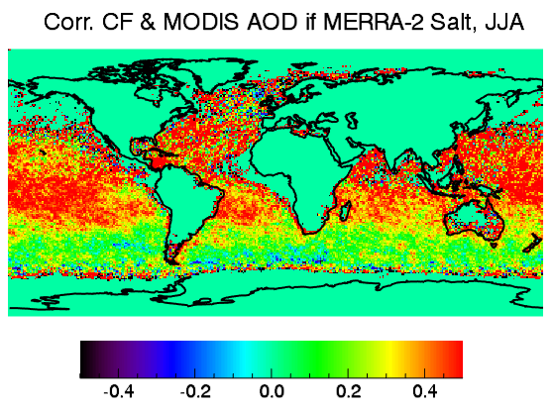
CF-AOD correlation
Sulfate
Carbon
Dust
Sea salt
Correlation is positive for all aerosol types

Slide 9
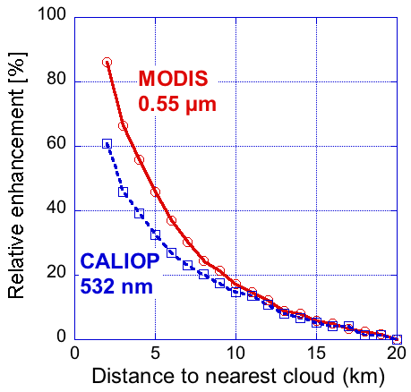
CALIPSO & MODIS
(relative enhancement)
Varnai et al., ACP 2013
A yearlong dataset based on co-located MODIS and CALIOP data analysis over oceans: 60°S - 60°N.
  Likely due to the 3D radiative effects of clouds (25-30%)

Slide 10
What’s about correlation between CF and particle size?

Slide 11
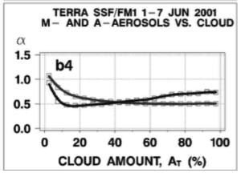
Cloud Fraction vs. Angstrom Exponent
from Ignatov et al., 2005
Global statistics included both positive and negative trends. The paper said that the reasons for positive trends were unclear, perhaps caused by artifacts.

Slide 12
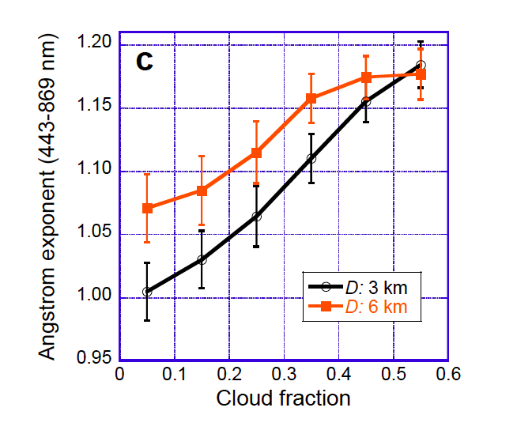
MODIS (ocean product):
South of UK
Angstrom Exponent
- AE(3km) < AE (6km)
- AE(CF=0.5) > AE(CF=0.1)

Slide 13
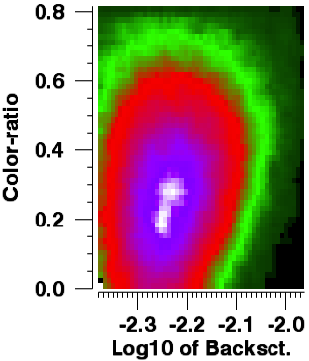
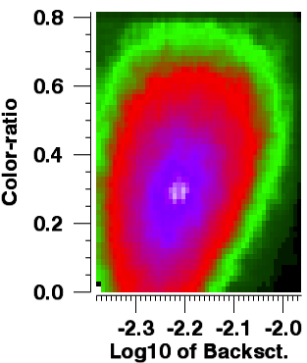

CALIPSO: Azores area
Low CF
High CF
CF < 0.2
N_{s}=123,564
CF > 0.2
N_{s}=122,916

Slide 14
CALIPSO
(around the Azores)
Total number of samples
- ColorRatio(1km) > ColorRatio(5km)
- ColorRatio(CF=0.5) > ColorRatio (CF=0.1)

Slide 15
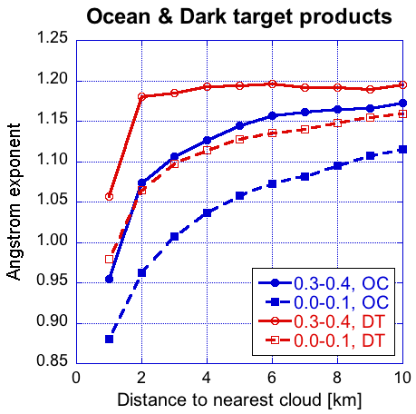
MODIS Angstrom Exponent
The same MODIS behavior occurs in all three MODIS products:
the ocean color,
the dark target
the deep blue
though they use dif. wavelengths, cloud masks, data selection methods, and algorithms.

Slide 16
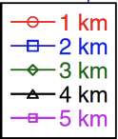
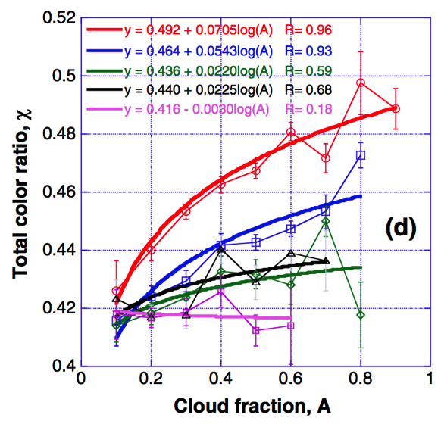
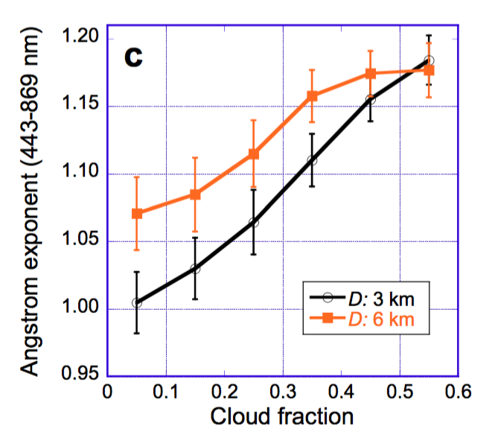
Aerosol size vs. CF in
MODIS and CALIPSO products
CALIOP MODIS
Fig. 3d in Yang et al. (2014)
Fig. 4c in Várnai and Marshak (2015)
Why does particle size decrease with CF for MODIS even though it increases for CALIOP?

Slide 17
MODIS Level 3 data
Positive correlation between CF & AE is widespread though not universal

Slide 18
What’s about ground-based measurements?
AERONET during DRAGON

Slide 19
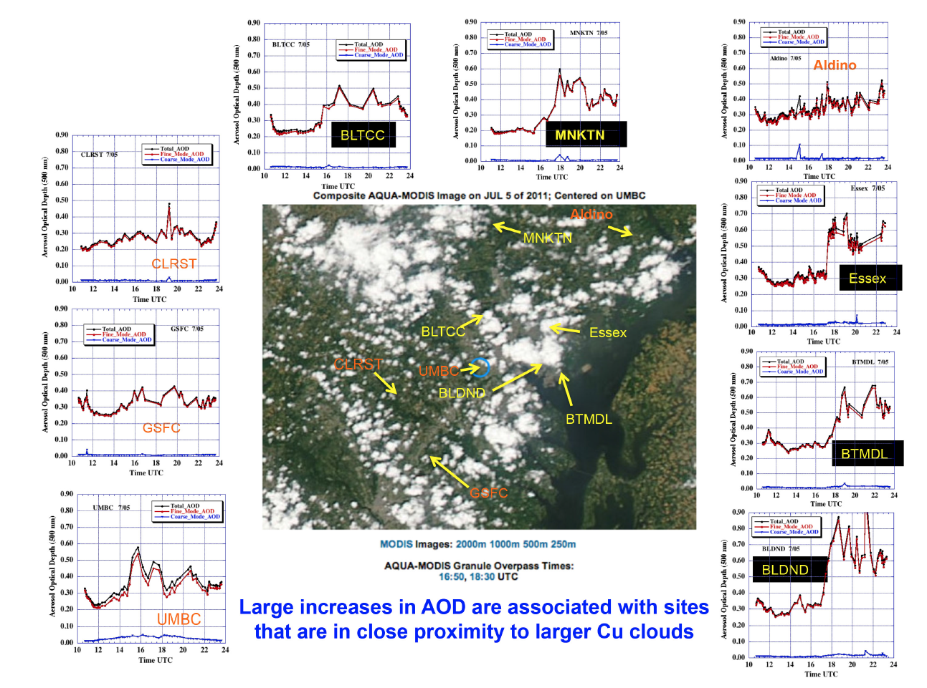
Courtesy of Tom Eck

Slide 20
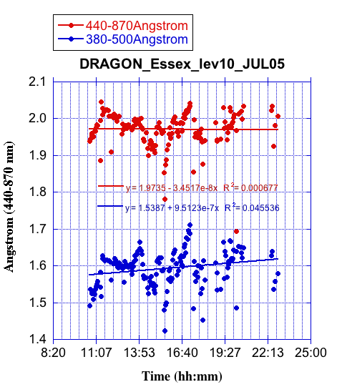
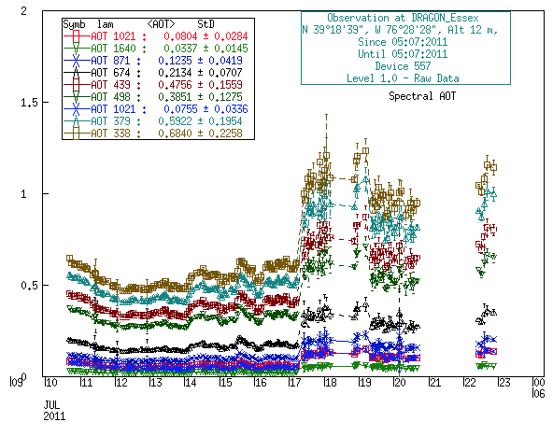
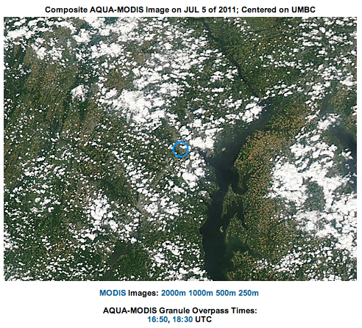
Courtesy of Tom Eck
ESSEX
Aerosol Optical Depth (AOD)
Large jump in AOD (~0.3 at 440 nm) at the DRAGON Essex site occurred just after solar noon on July 5. However, the AE (440-870 nm) remains very high (>1.9) suggesting possible new particle formation in the cloud environment since a particularly dense cluster of clouds is seen in the vicinity of the Essex site.
Essex

Slide 21
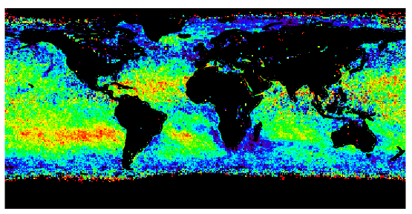
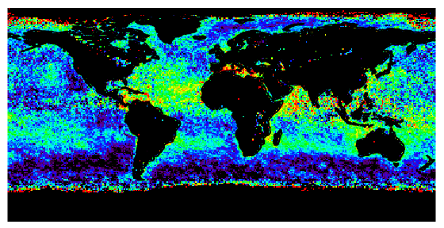

Coarse & small mode AOD vs. CF in Level 3 data
Small mode
Coarse mode
Correlation of CF & AOD
The AOD increase with CF is stronger for small mode than for coarse mode
=> AE increases with CF
Why?
small mode is more hygroscopic,
coarse mode aerosol is at altitudes less affected by cloud-related humidity increase,
cloud processing creates small aerosols,
Implication: The primary reason for CF-AOD correlations is NOT cloud contamination

Slide 22
Take home messages
Both MODIS and CALIOP always show a positive correlation between AOD (or BKS) and CF;
For both CALIOP and MODIS the relationship between particle size (measured by CR and AE, resp.) and CF is much more complex;
All three MODIS products (dark target, ocean color, deep blue) show that in many large regions effective particle size decreases with increasing CF;
CALIOP does not support this relationship; it shows a positive correlation between CF and aerosol particle size;
Possibilities for the opposite behavior of MODIS & CALIOP data include differences in data selection (cloud masking or CAD) or CF calculations.
Acknowledgments:
NASA Radiation Sciences Program;
- NASA Terra/Aqua Project;
NASA CALIPSO/CloudSat Project;

Slide 23
Thank you !

Slide 24

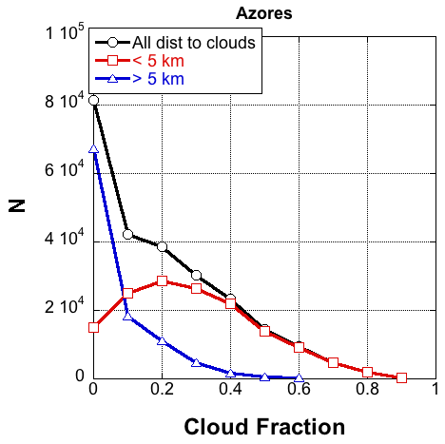
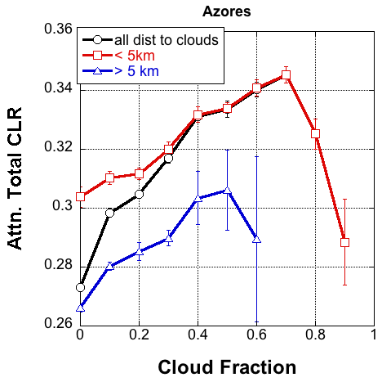
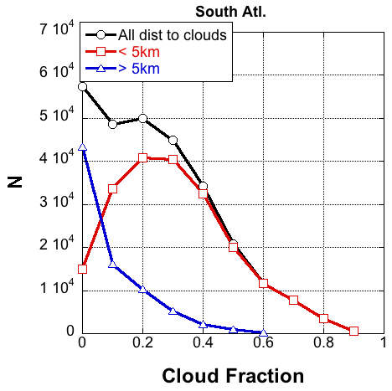
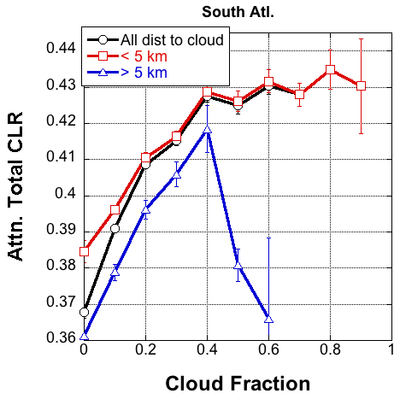
CALIPSO: Azores and South Atlantic
Sep-Nov 2007-2011
Azores
South Atl.

Slide 25
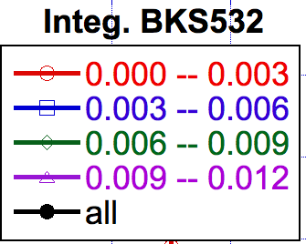
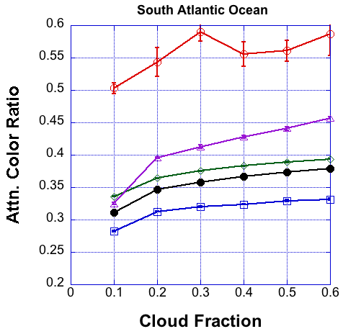
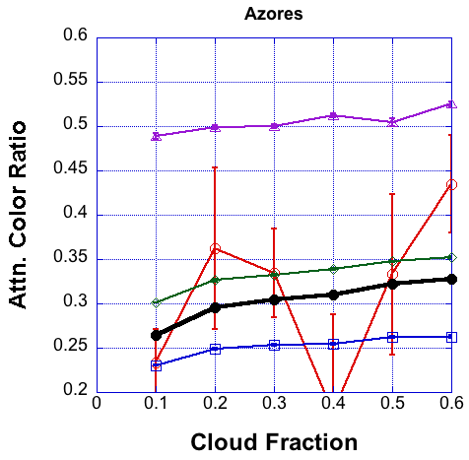
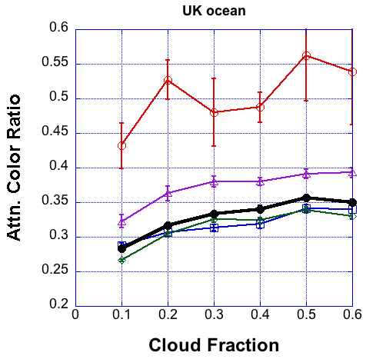
CALIPSO: color ratio for dif. BKS

Slide 26
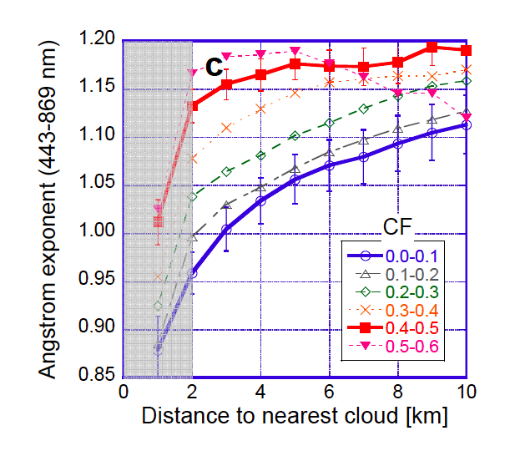
MODIS (ocean product):
South of UK
Angstrom Exponent
- AE(dist_to clouds) ⬆
- AE(CF) ⬆
- AE(3km) < AE (6km)
- AE(CF=0.5) > AE(CF=0.1)

