Slide 1




Impact of Terra MODIS PVLWIR Crosstalk on L1 and L2 Products
Chris Moeller, Richard Frey, Eva Borbas, Bryan Baum, Paul Menzel, Steve Ackerman: CIMSS, Univ. Wisconsin - Madison
Steve Platnick (and others): GSFC
Jack Xiong, Truman Wilson (and others): MCST
MODIS/VIIRS Science Team mtg
June 6-10, 2016
Notes:
Lots of contributors
15+ years interaction with MCST.

Slide 2
Terra MODIS PVLWIR Crosstalk
Evidence of PVLWIR crosstalk in L1B
  Prelaunch testing
  On-orbit observations
Impact on Wisconsin’s L2 products
  MOD35 (Cloud Mask)
  MOD07 (Integrated Water Vapor)
  MOD06 (Cloud Particle Phase, Cloud Top Pressure)
Mitigation efforts
  MCST-led effort to implement crosstalk correction in L1B; coordinated with Wisconsin
  Temporarily adjust cloud test thresholds in MOD35 to minimize false cloud
Notes:
Big picture:

Slide 3
Terra MODIS Crosstalk/OOB (CFPA)
* S/MWIR Electronic Cross Talk mitigation is included in 5um optical leak correction

Slide 4
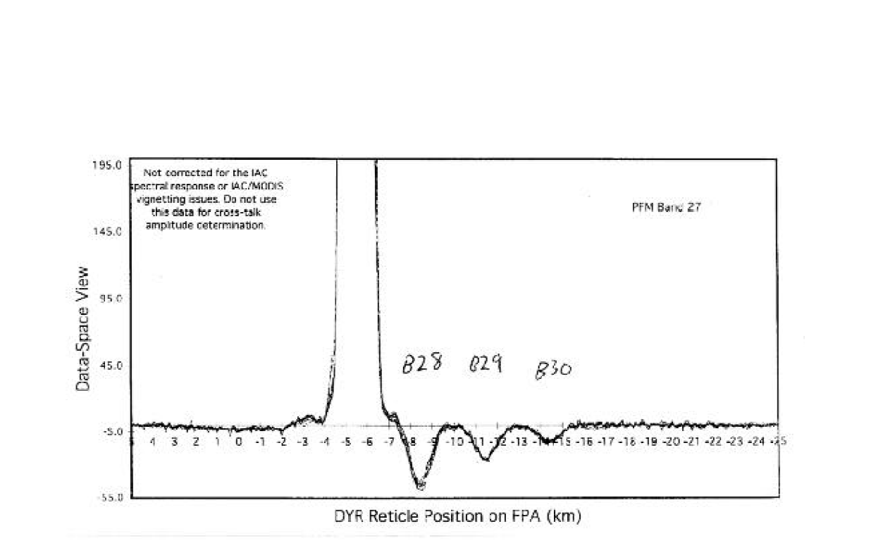
Earliest Evidence:
Terra MODIS (PFM) Pre-launch Testing
Band 27
Signal
Deep negative signal is signature of electronic crosstalk
Positive
Signal
Negative
Signal
Spatial Position Along Focal Plane (Scan Direction)
From June 2000 MCST Calibration Workshop

Slide 5
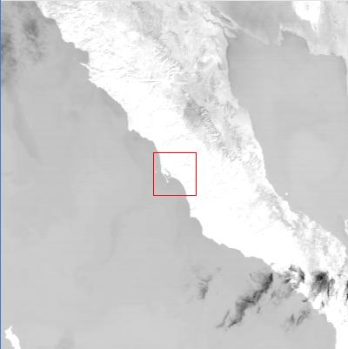
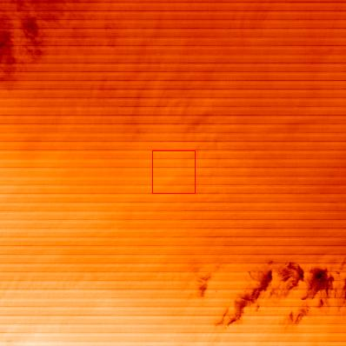
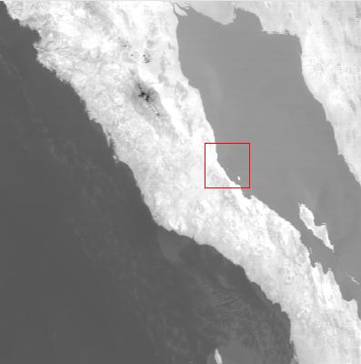
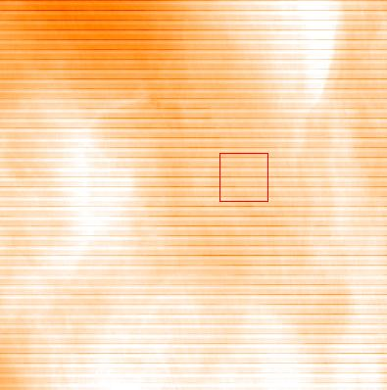
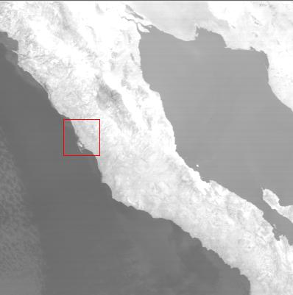

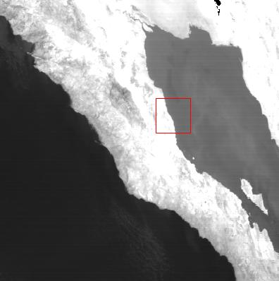
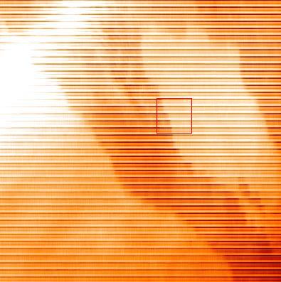
Terra Band 27 & 29 Earth Scenes
2000355.1850
2002200.1840
B29
B27
2004240.1825
2010174.1840
Brightness Temperature L1B images for Baja Peninsula (no stretching applied)
Borrowed from MsWG_2010_12_15_Xtalk.ppt (MCST)
Notes:
3 striking elements:
Baja shows up in B27
Baja shows up as signal minimum in B27
Striping intensity is increasing

Slide 6
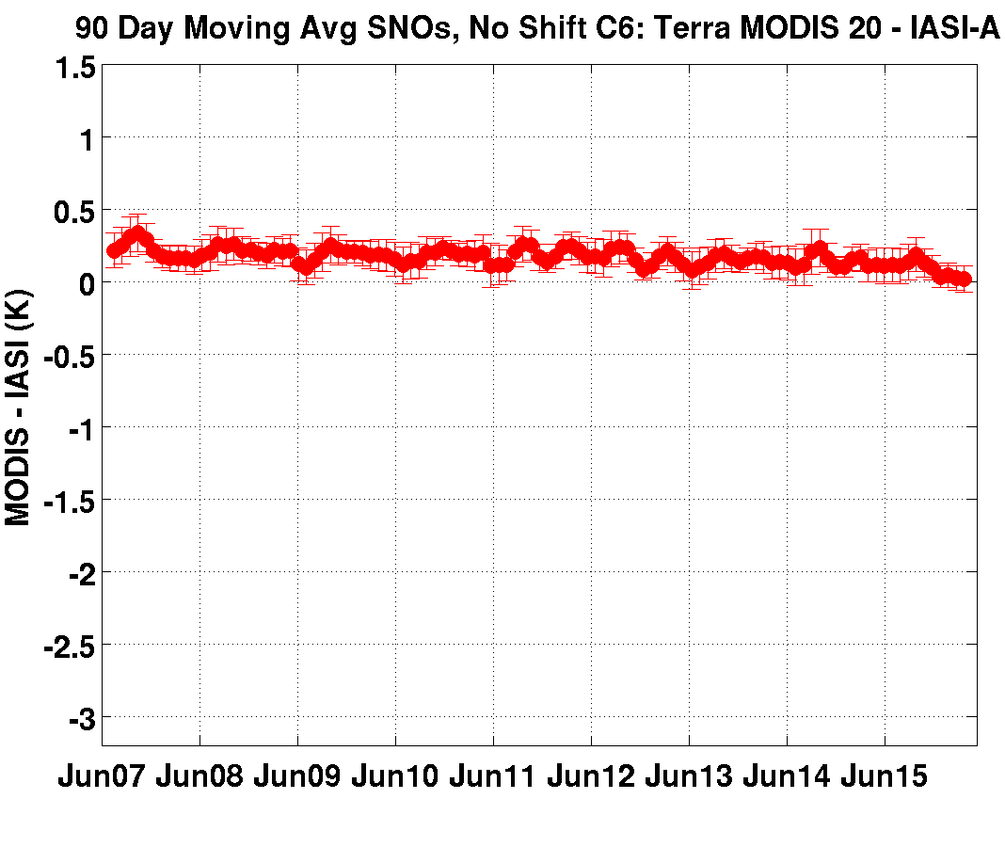
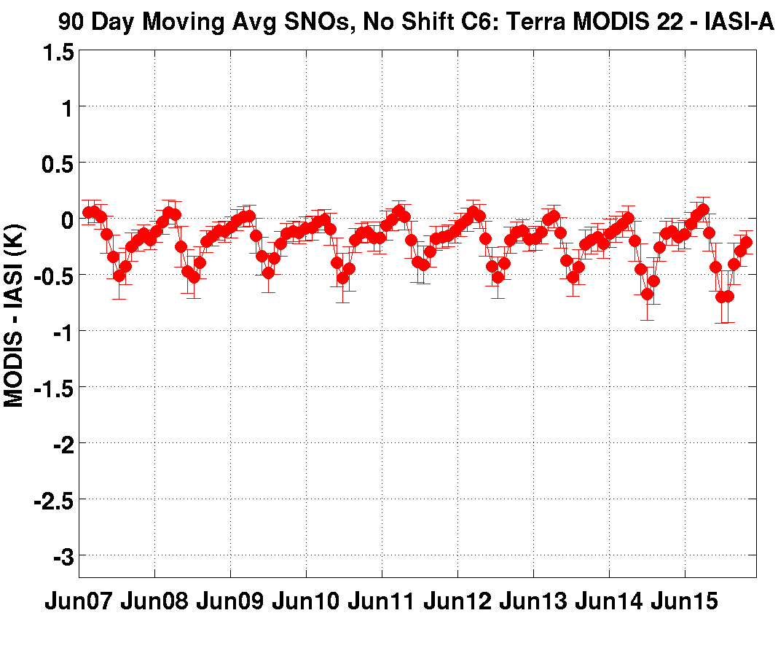
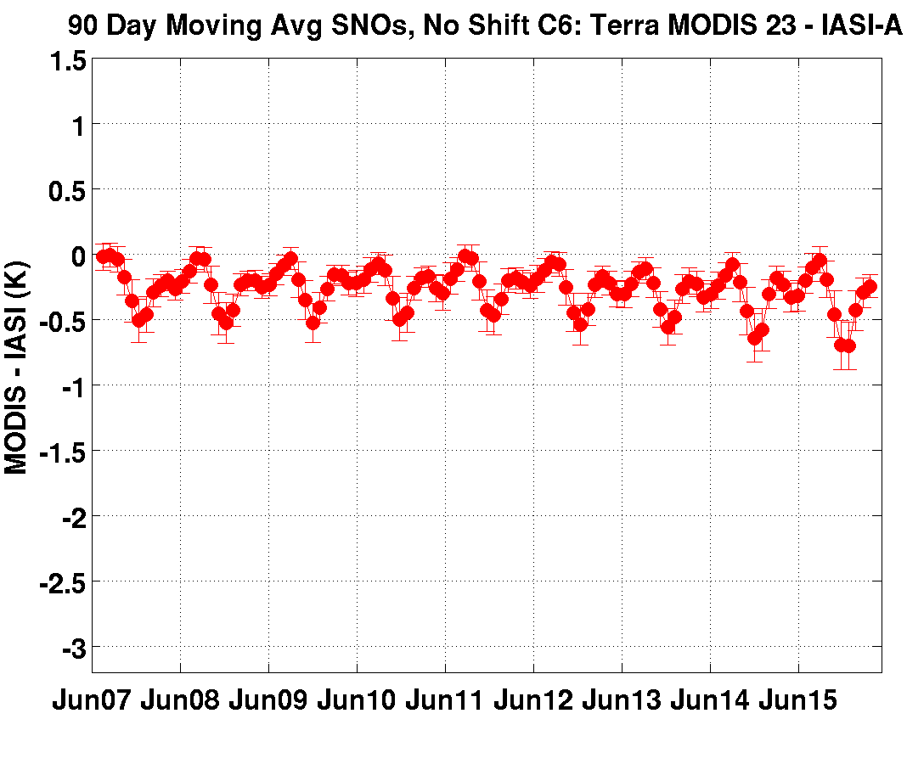
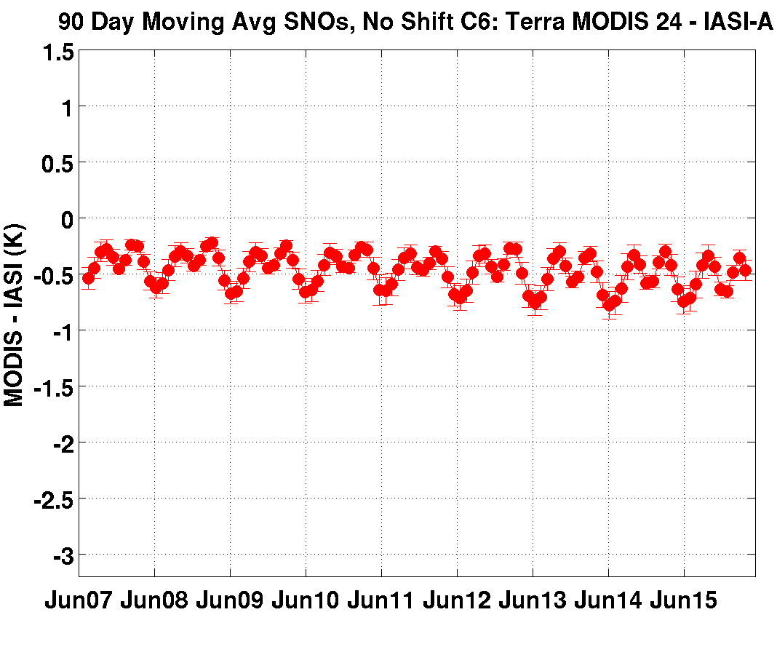
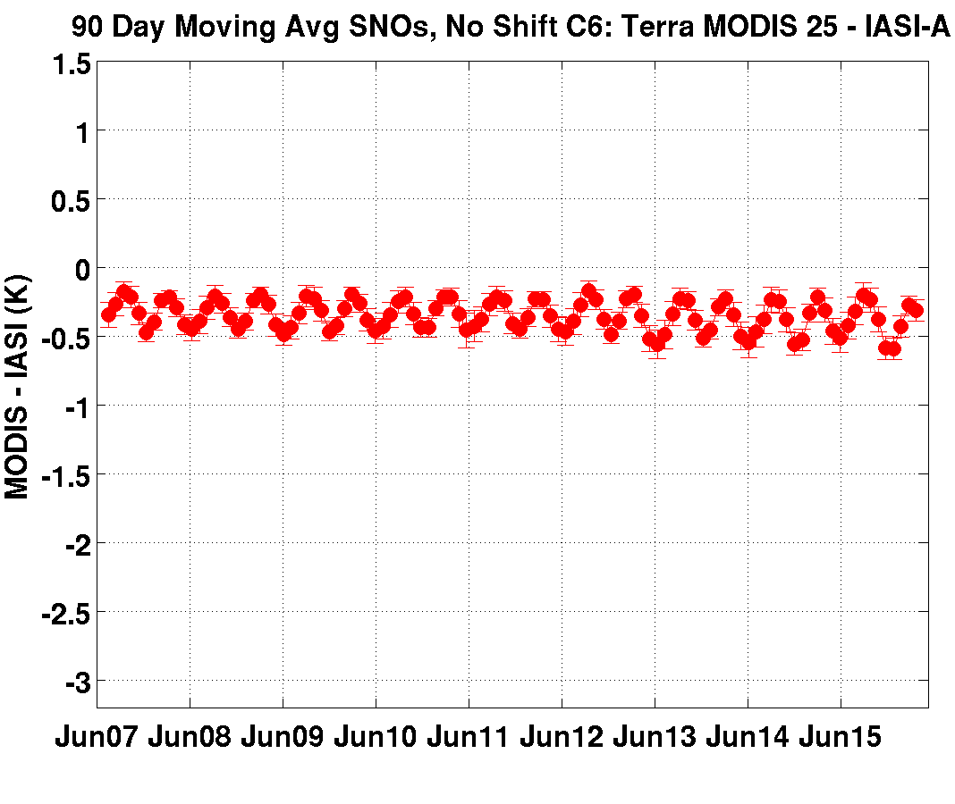
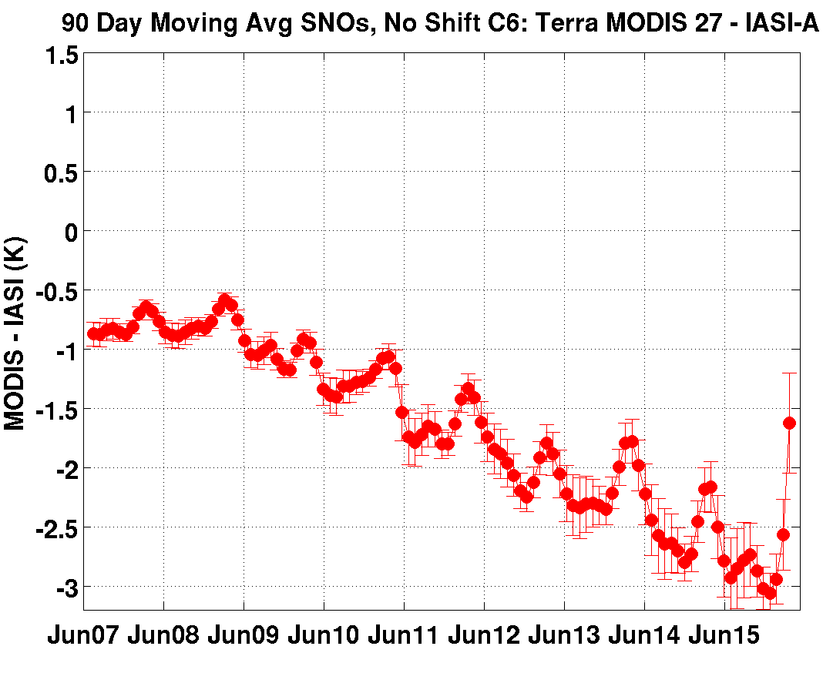
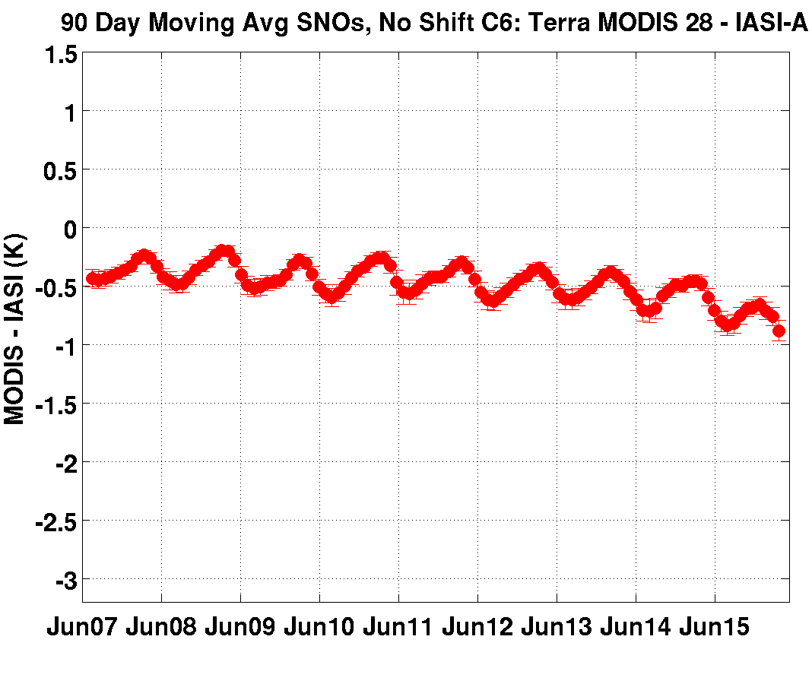
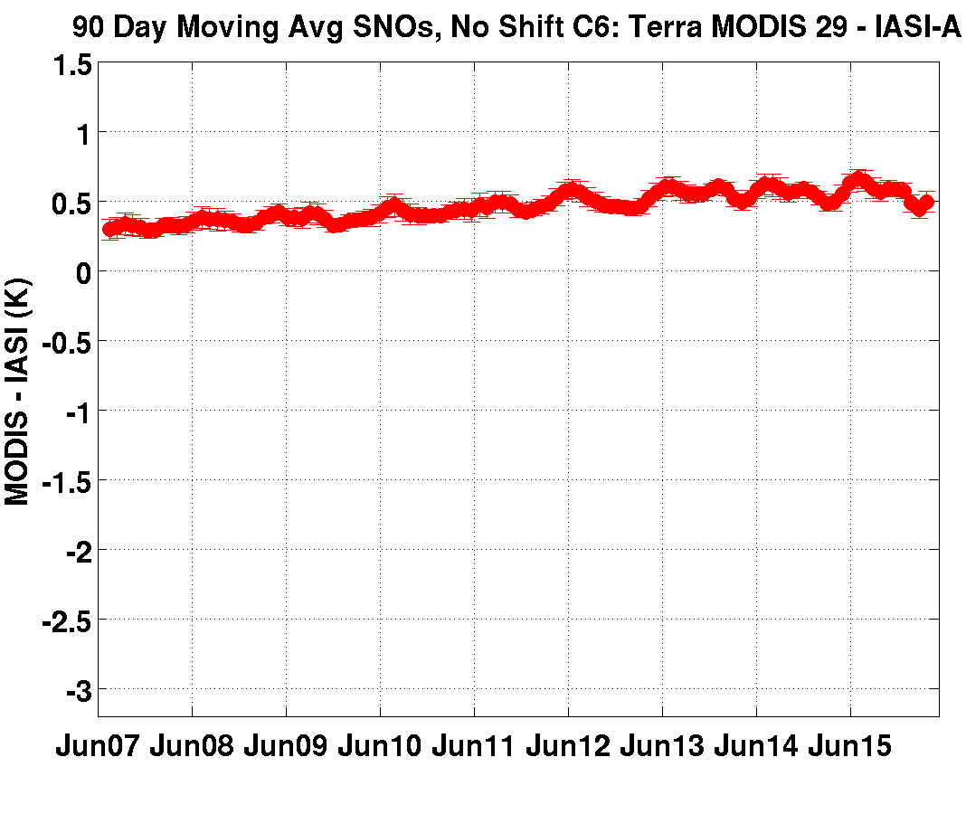
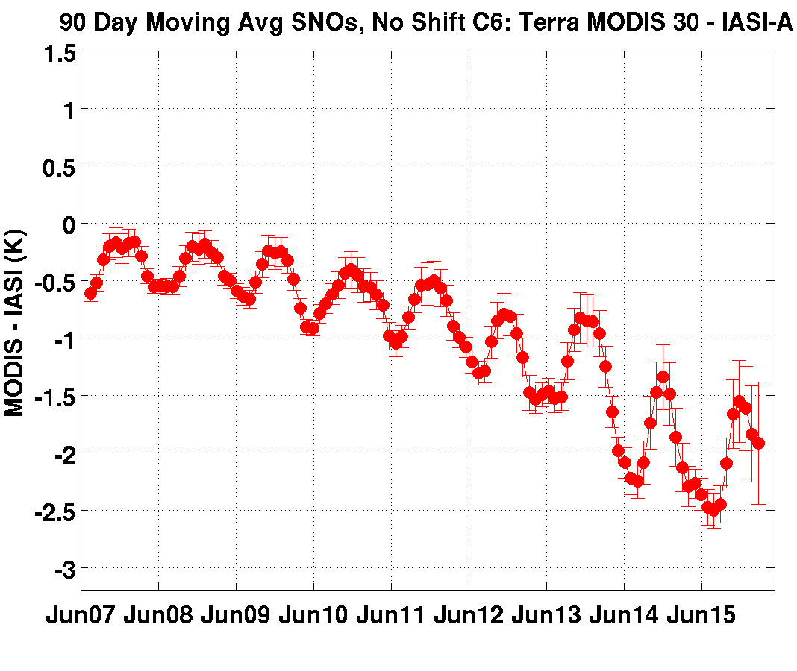
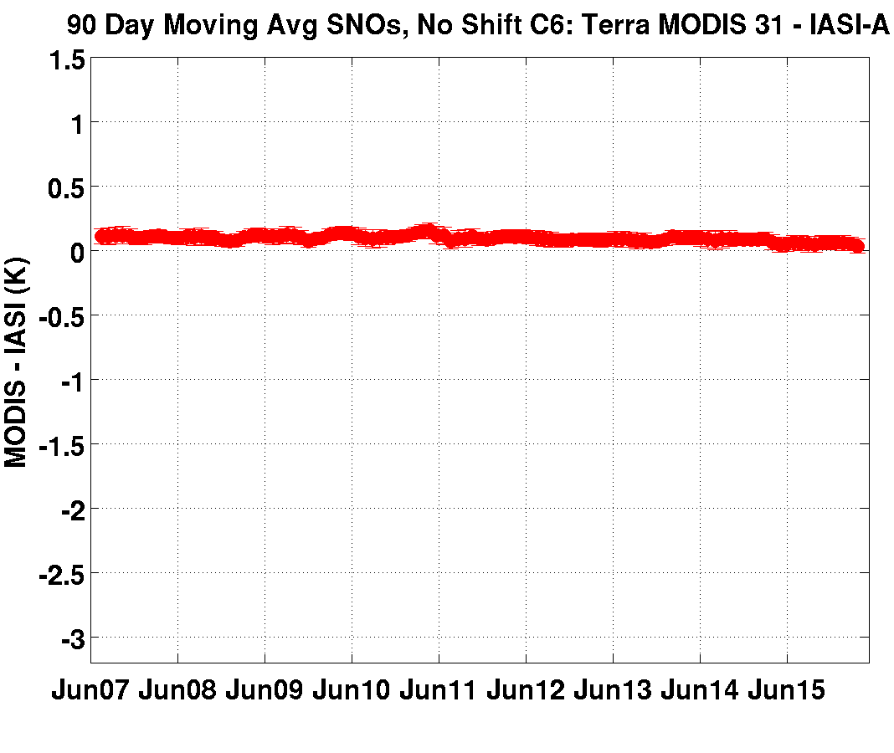
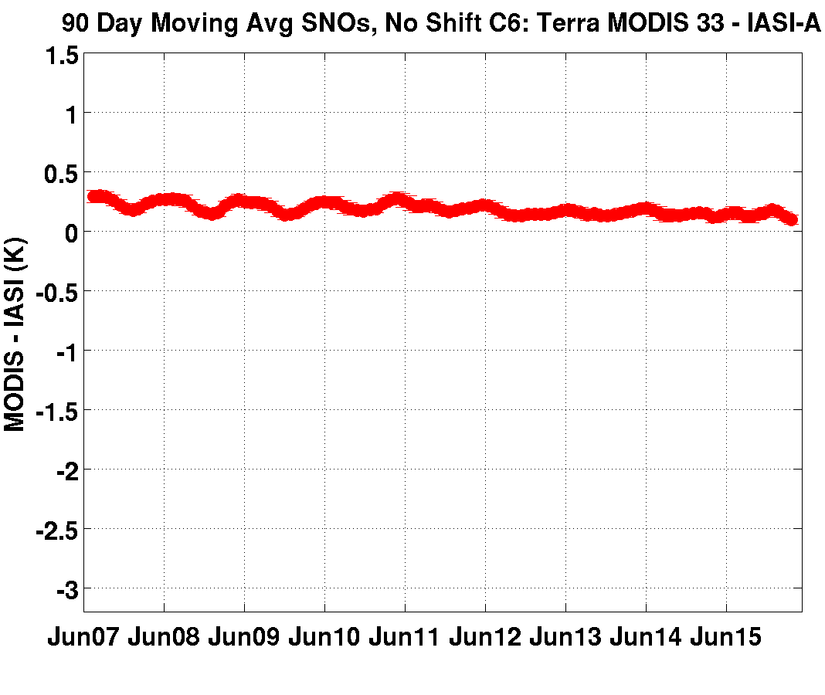
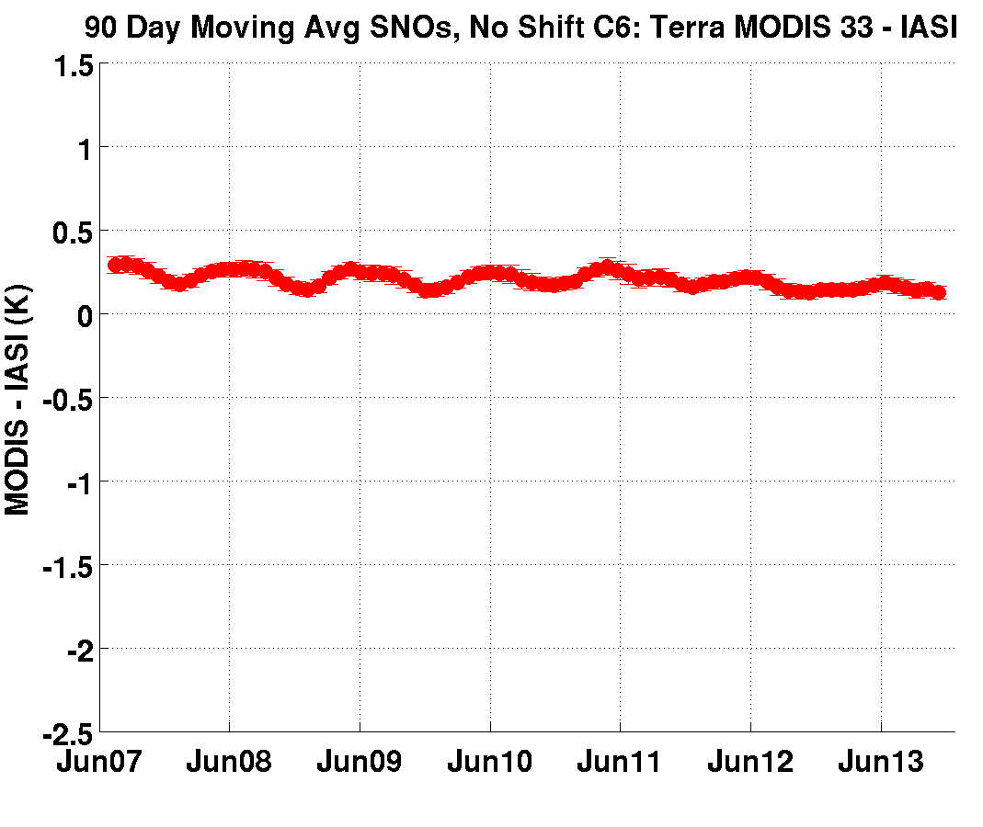
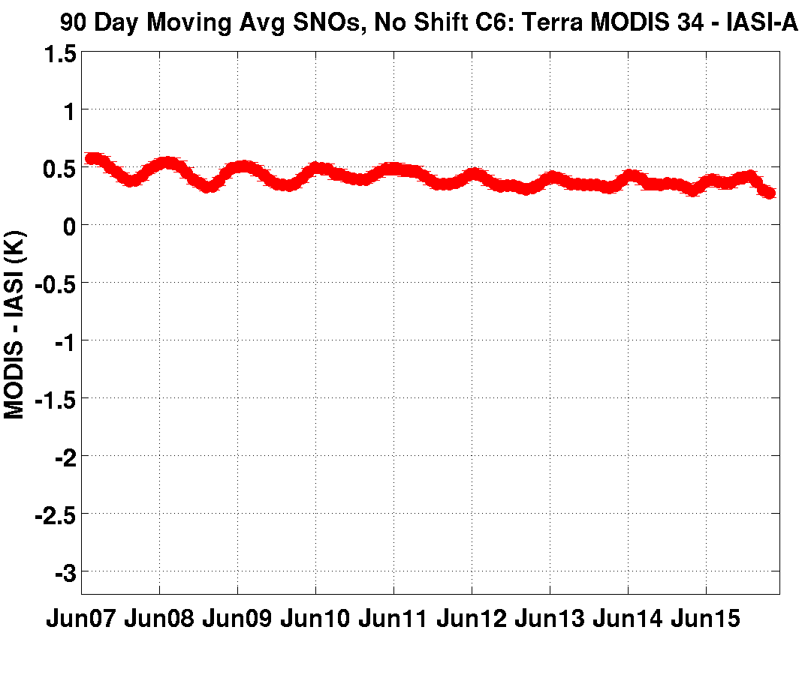
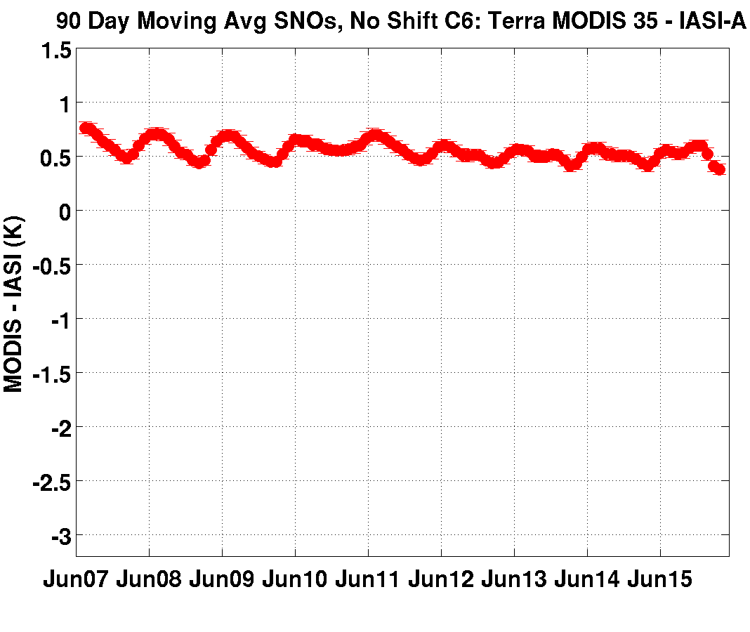
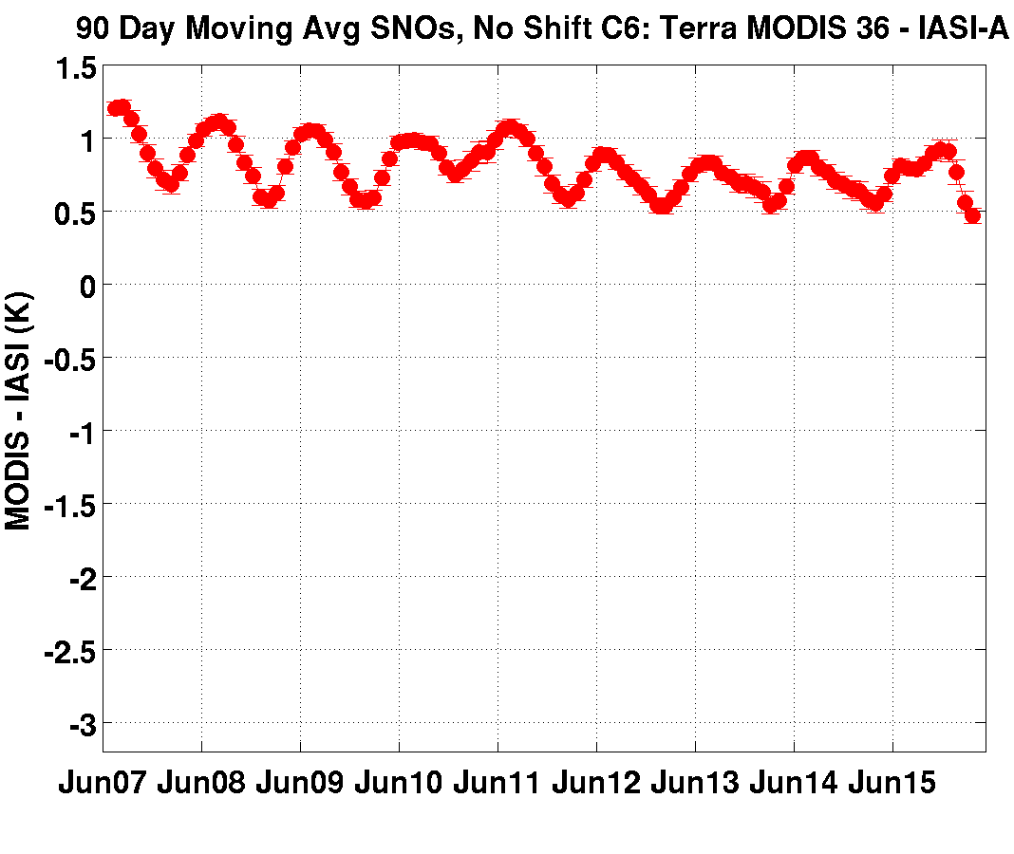
Terra MODIS – MetOpA IASI Long Term Trends
(SNOs from June 2007 – May 2016; Collect 6)
Long term trends very small except bands 27 - 30
1.5
MODIS – IASI (K)
20
22
23
24
25
-3.2
Jun 2007
TIME →
May 2016
-2.0 K
-0.4 K
-1.3 K
0.3 K
27
28
29
31
30
32
33
34
35
36
90 Day Moving Window Average Computed at 30 Day Interval
Notes:
Explain the scale (too hard to see).

Slide 7
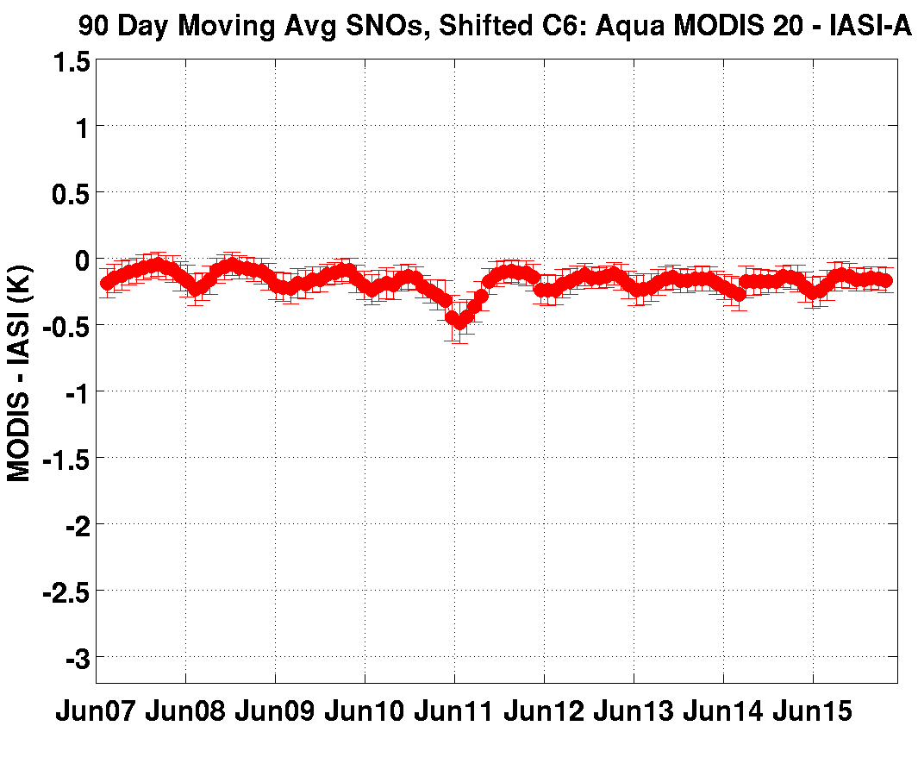
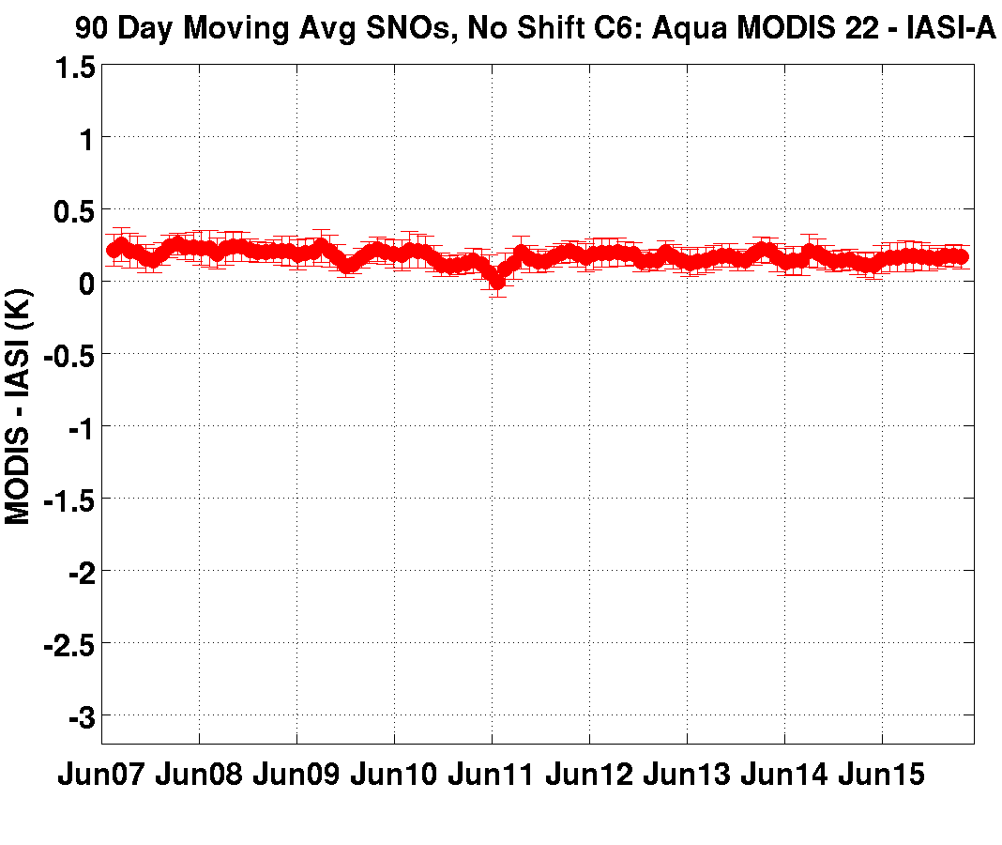
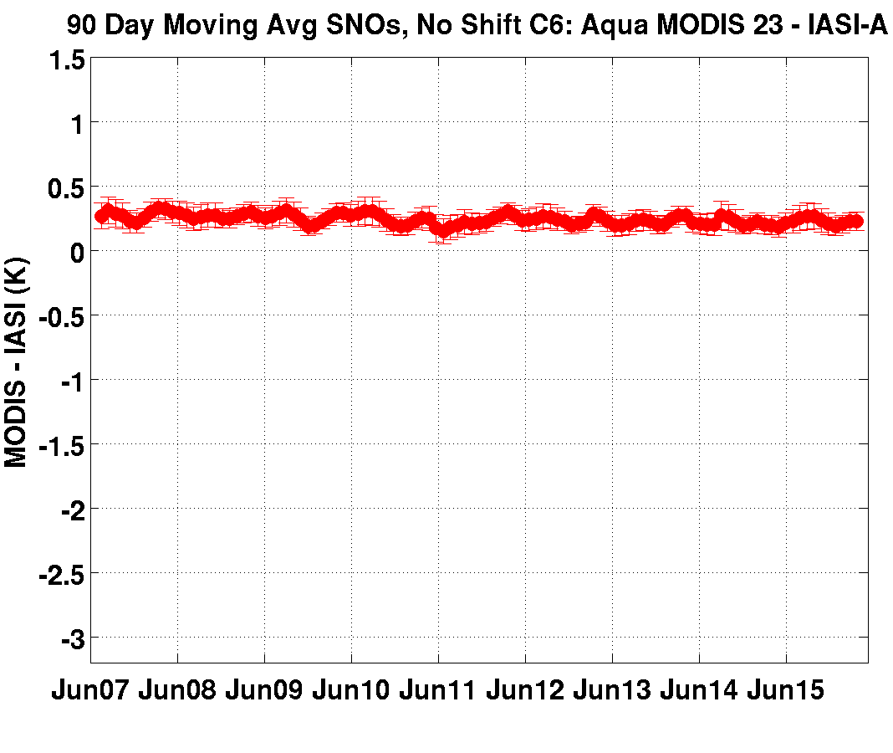
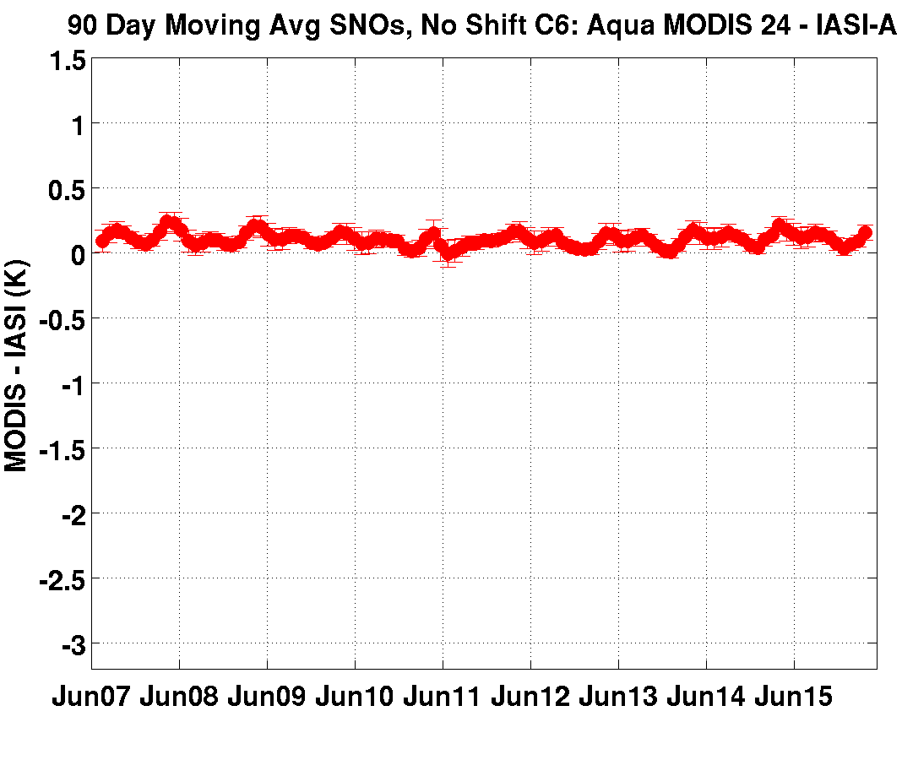

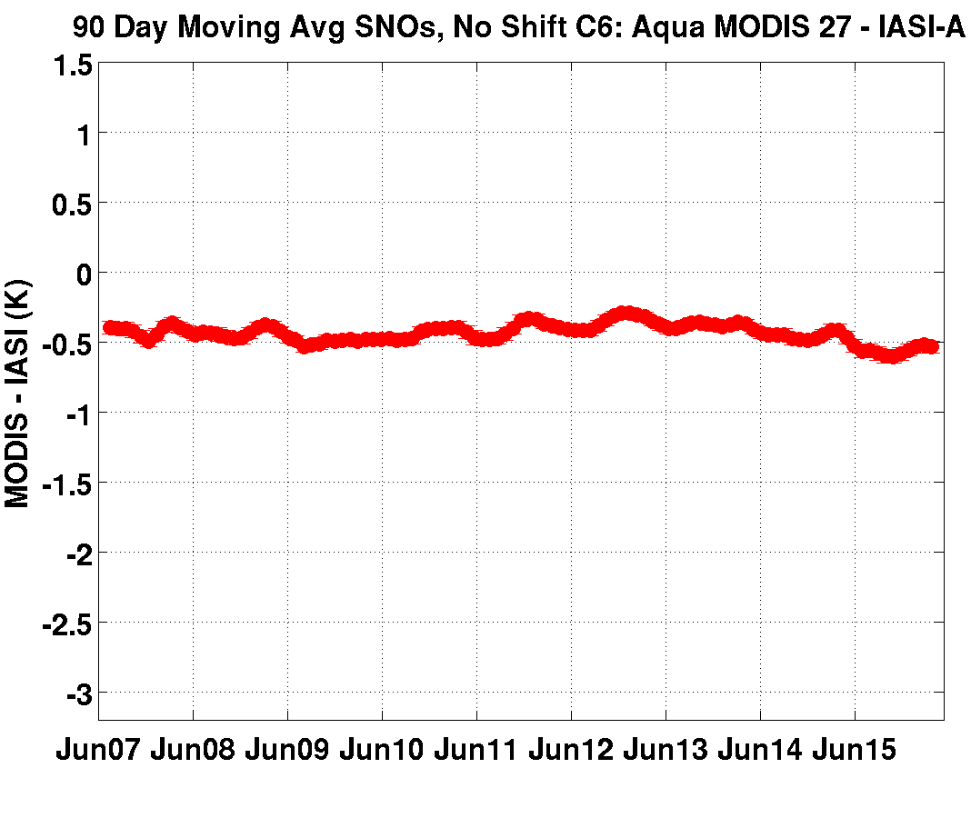
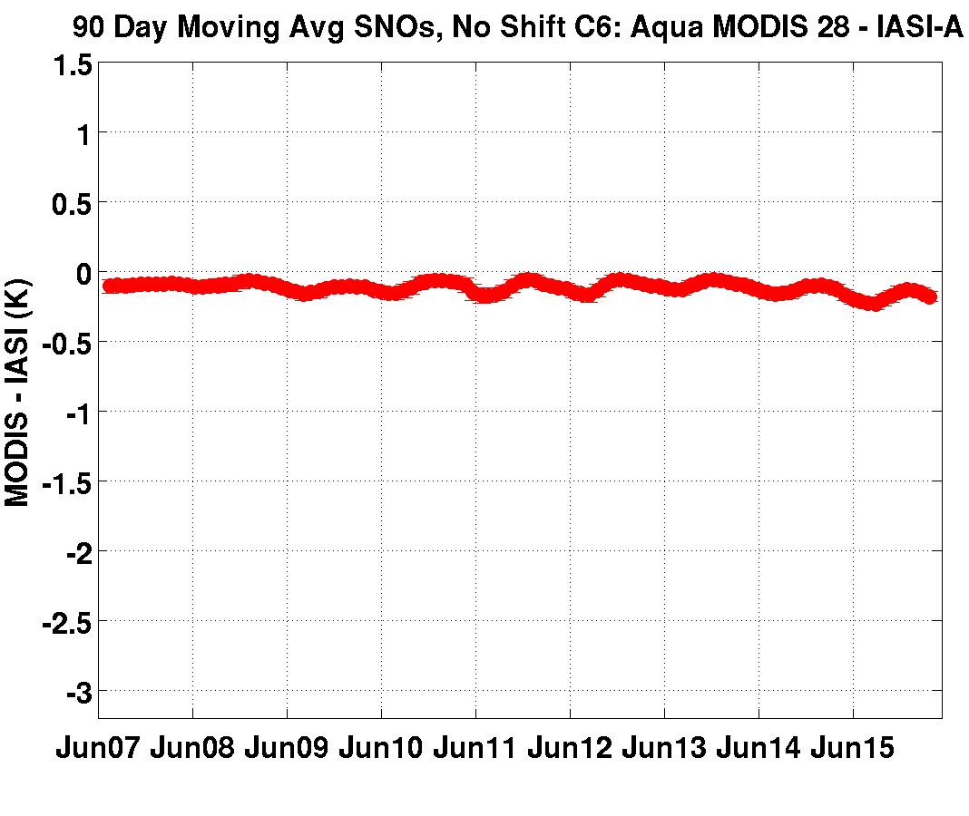
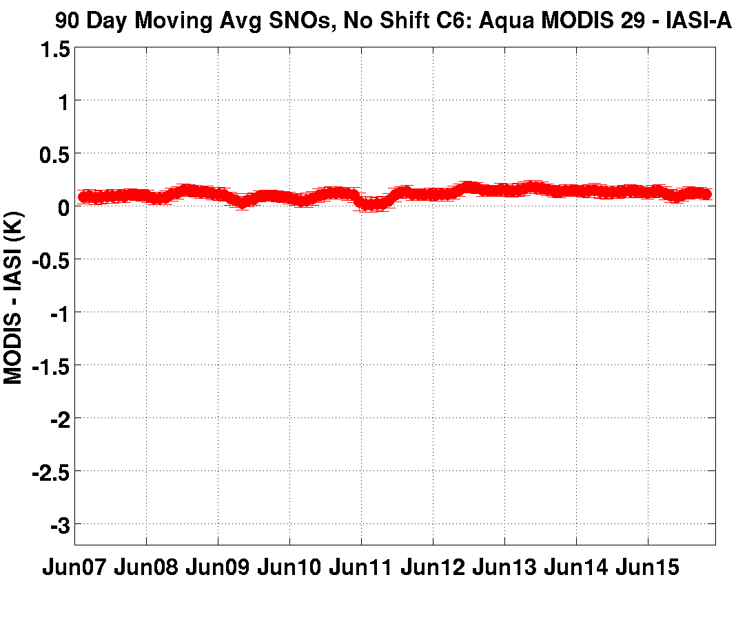
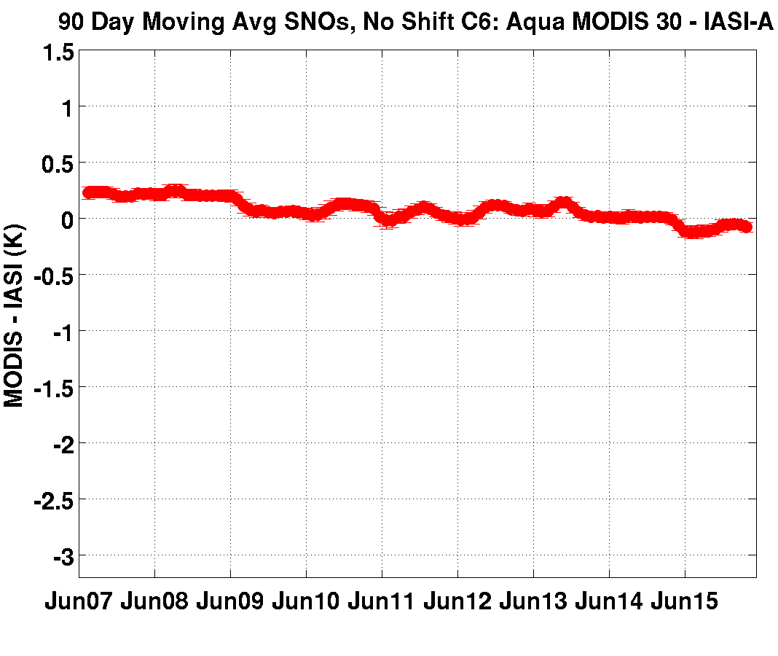
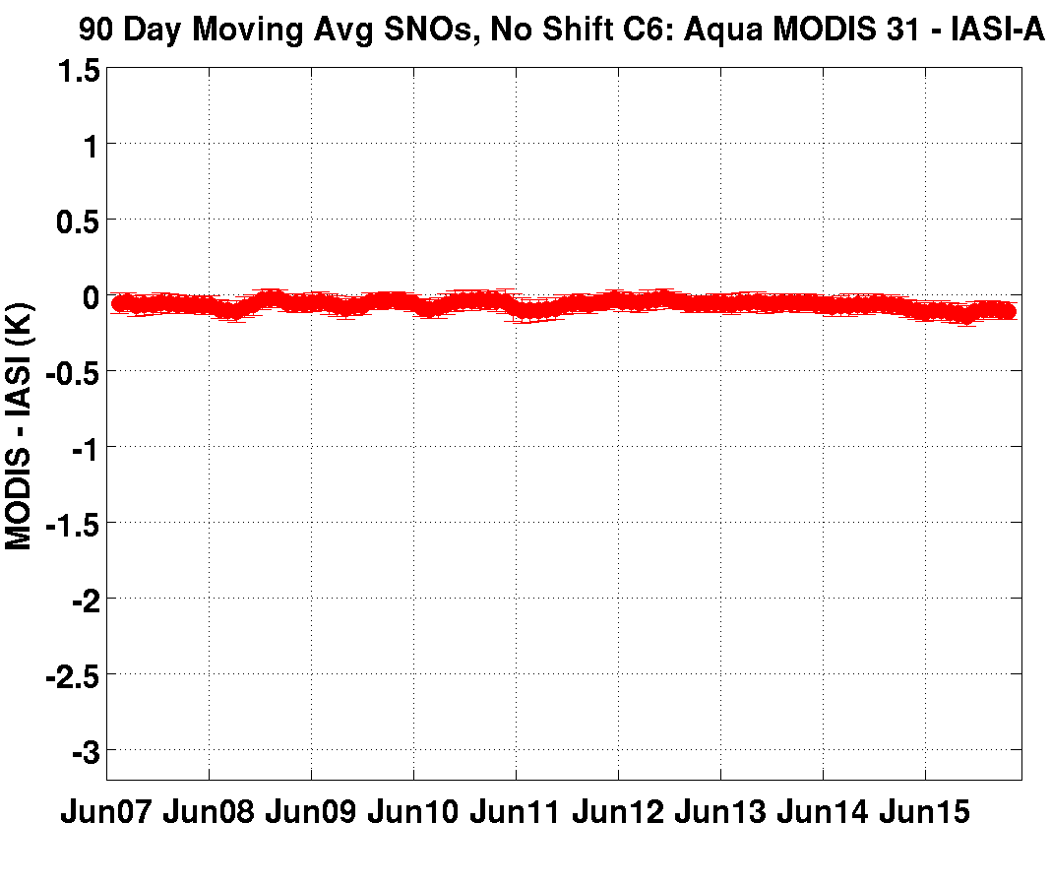
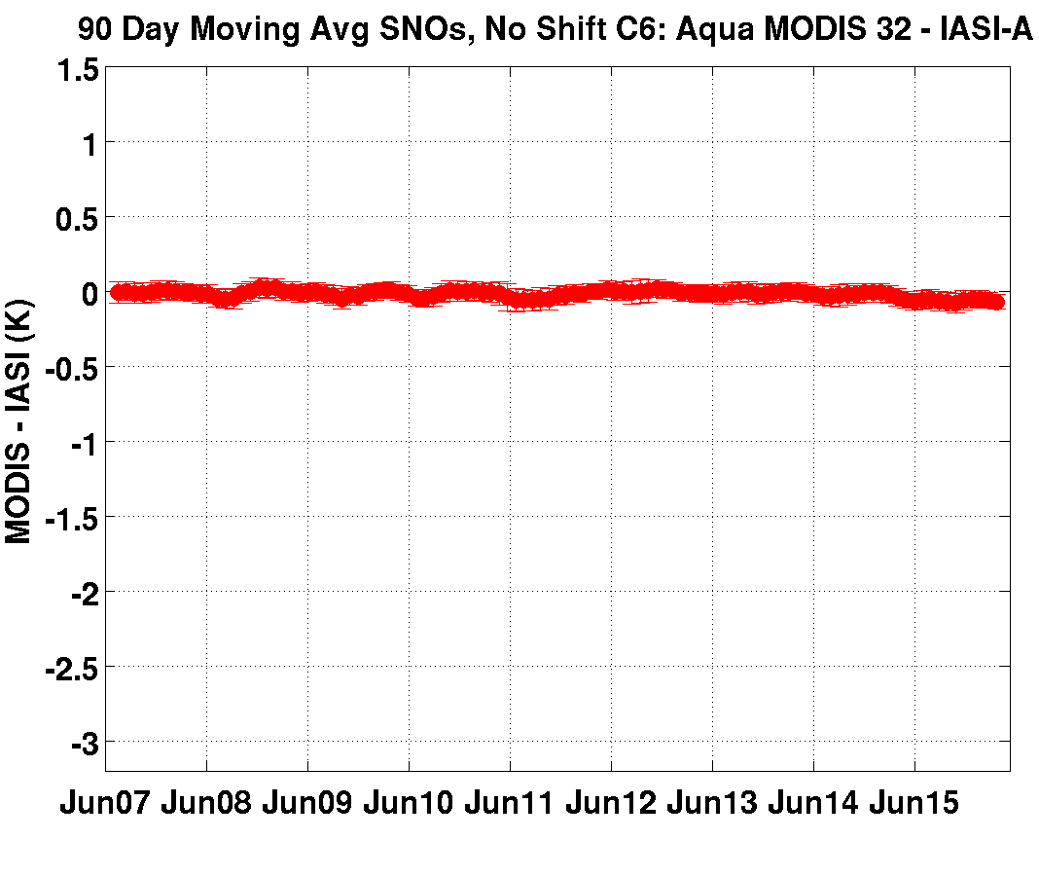
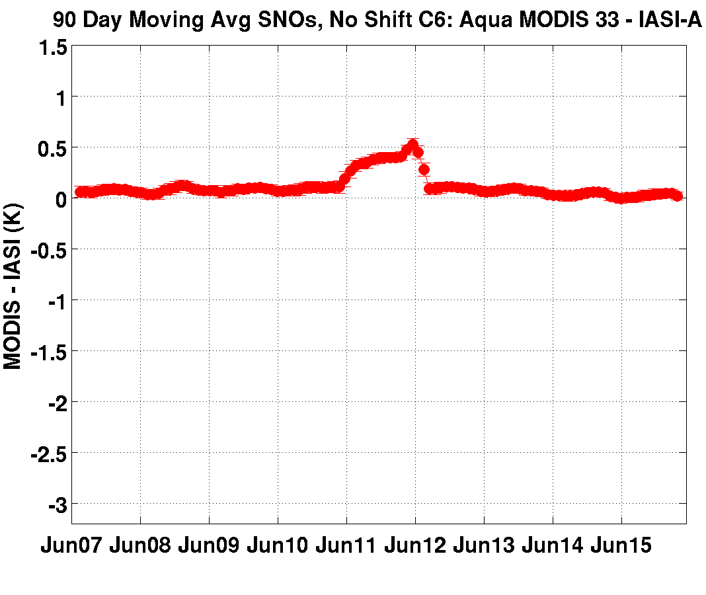
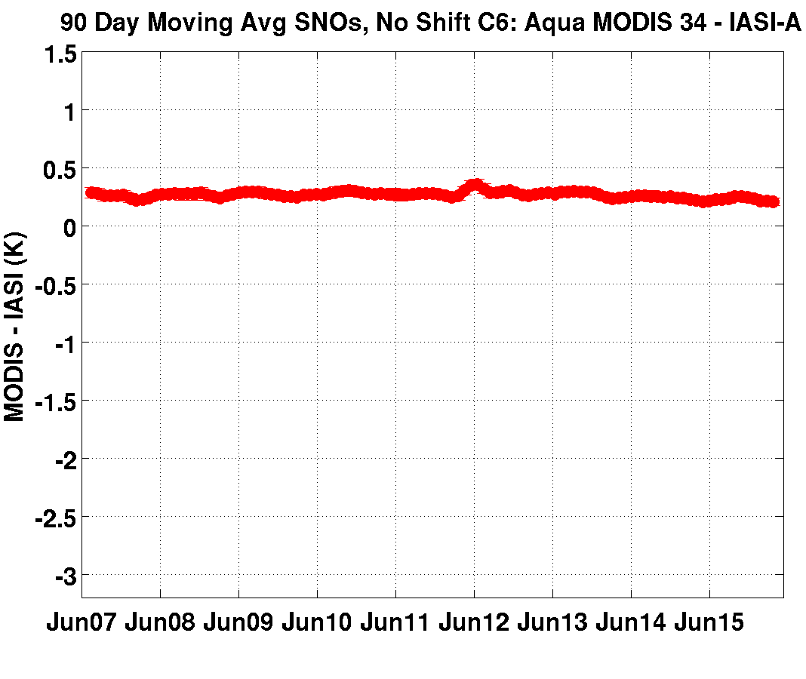
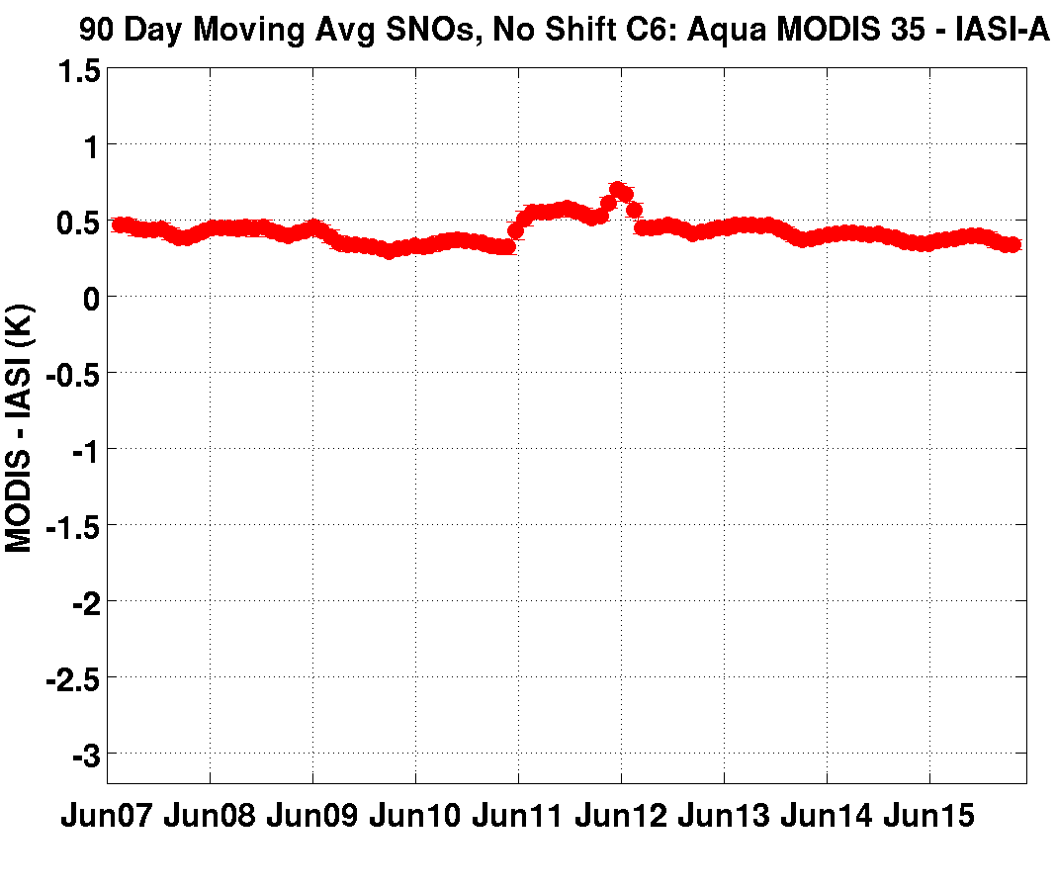
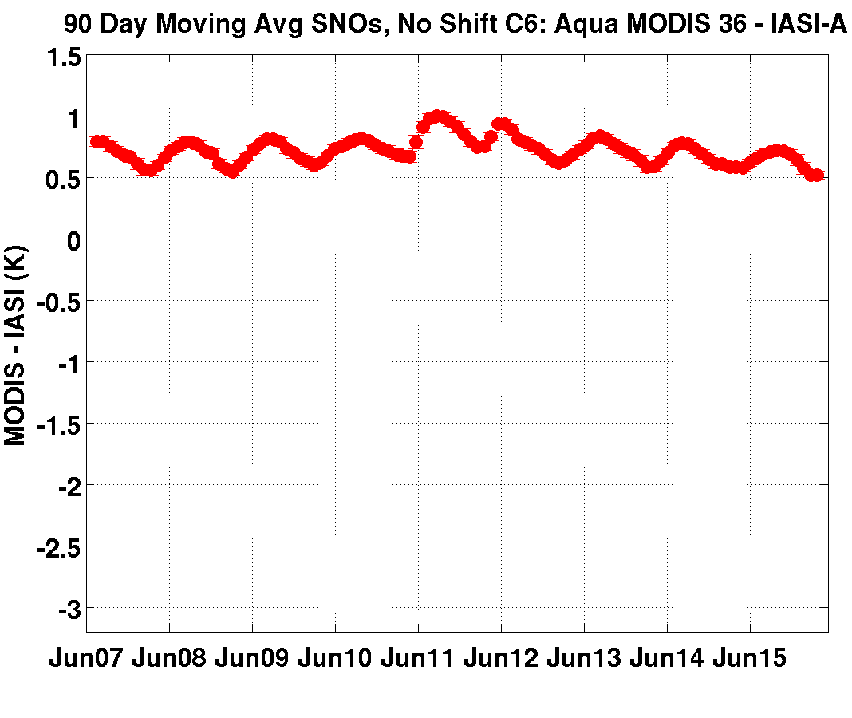
Aqua MODIS – MetOpA IASI Long Term Trends
(SNOs from June 2007 – May 2016; Collect 6)
Long term trends very small except band 30
1.5
MODIS – IASI (K)
20
22
23
24
25
-3.2
Jun 2007
TIME →
May 2016
-0.3 K
27
28
29
31
30
32
33
34
35
36
90 Day Moving Window Average Computed at 30 Day Interval

Slide 8
From Simon Hook, JPL

Slide 9
PVLWIR Crosstalk Impact in Wisconsin’s
Terra MODIS L2 Products
Cloud Mask (MOD35)
  B29-B31 BTD ice cloud test, ocean
  B27-B31 BTD nighttime polar cloud test
  B27 BT threshold high opaque cloud test
  B29-B28 BTD opaque cloud test, night ocean
Integrated Water Vapor (MOD07)
  B27-29 contribution to moisture, B30 to ozone
  False cloud in Cloud Mask reduces number of retrievals
Cloud Top Properties (MOD06)
  B29-B31 BTD contribution to Cloud Particle Phase retrieval (1- and 5-km)
  B28-B31 BTD contribution to Cloud Particle Phase retrieval (1-km)
  False cloud in Cloud Mask causes false Cloud Top Pressure retrieval
Notes:
B29-B31 test increases cloud (false cloud). BTD > 0 = 0% confidence clear (cannot be restored)
B27-B31 test increases cloud (false cloud). If BTD > 10K, then cloud result restored to clear. Xtalk reduces the BTD.
B27 BT test increases cloud (false cloud). This test doesn’t contribute much to the cloud mask.
B29-B28 test decreases cloud (false clear). Important over extra-tropical cold oceans for stratus and mid level.
Of these B29-B31 test by far has greatest influence

Slide 10
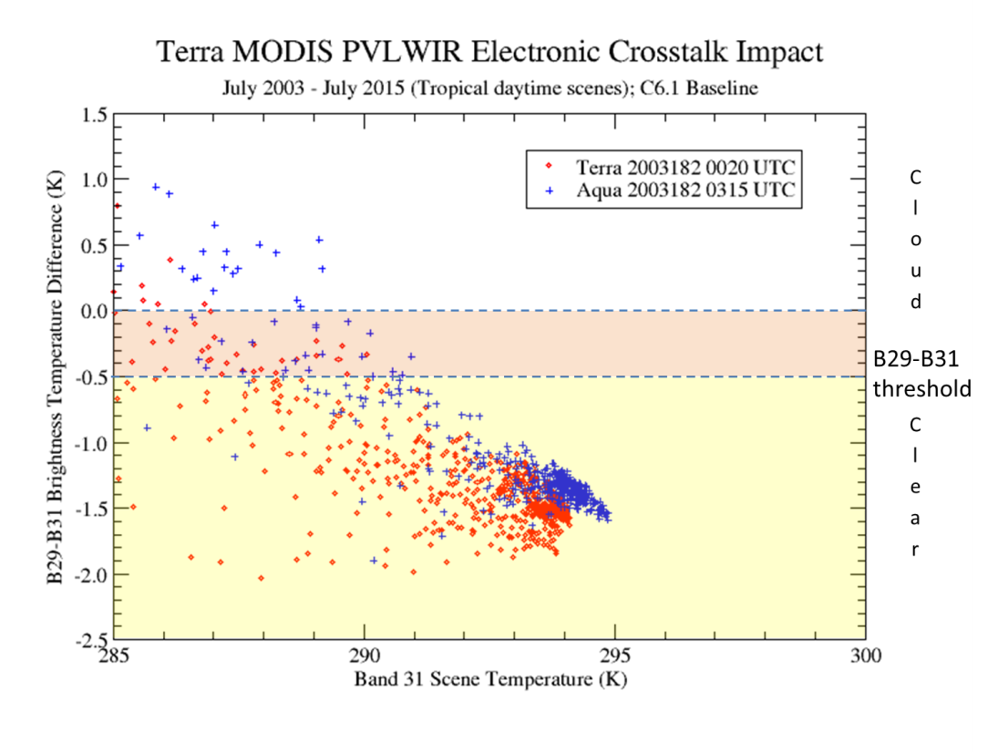
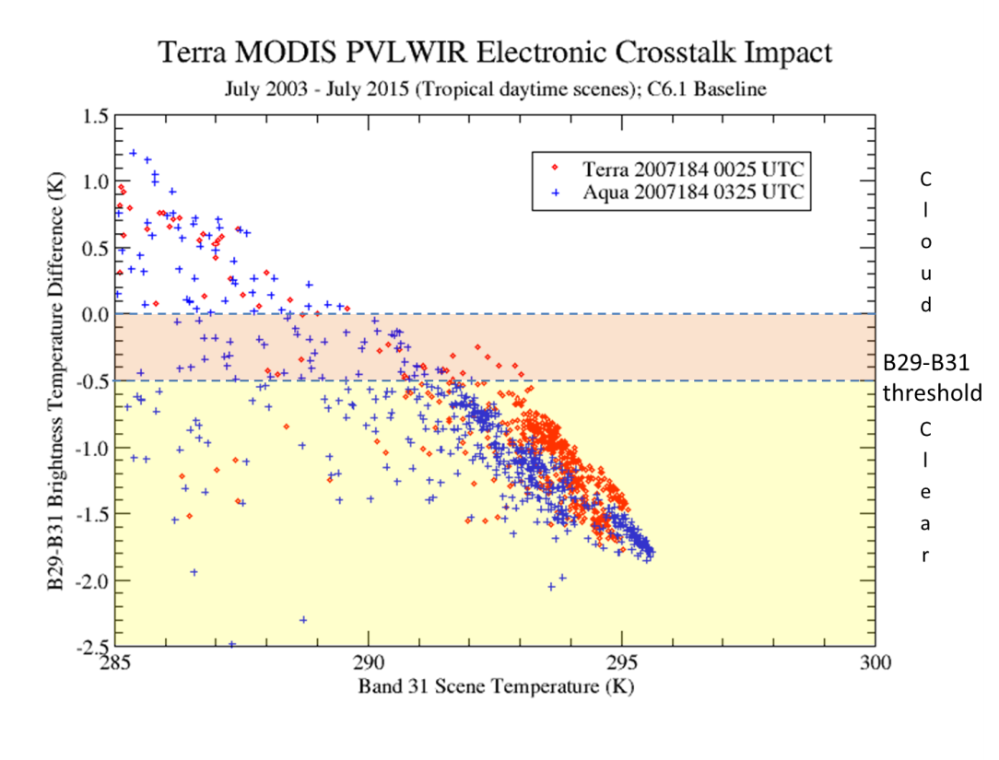
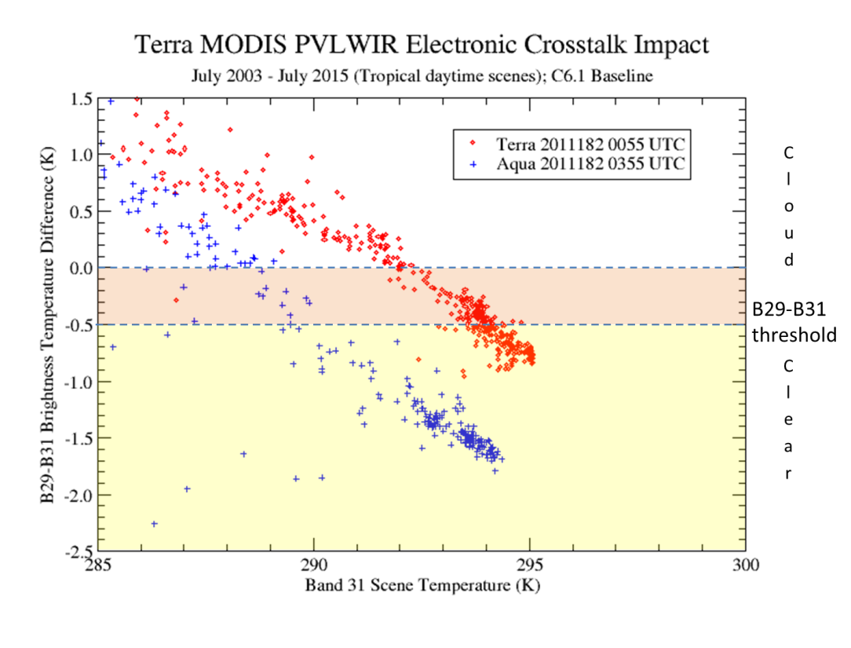
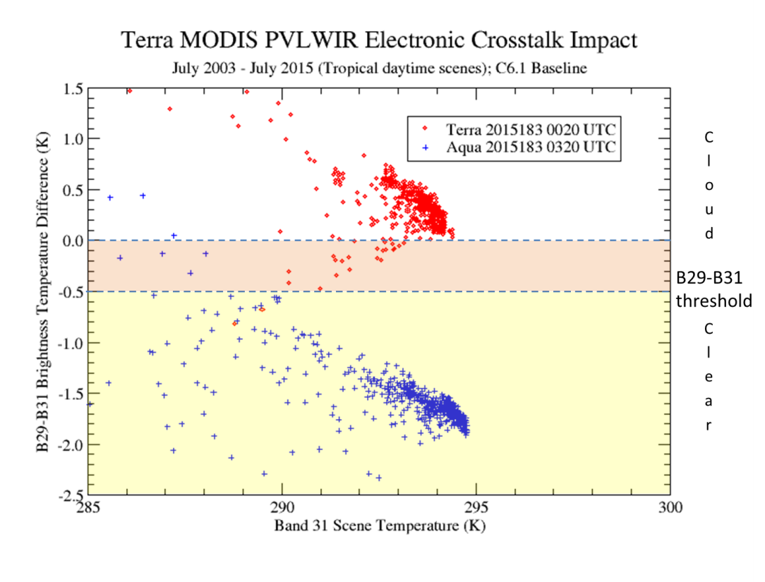
MODIS PVLWIR Crosstalk Impact
2003
2007
2011
2015

Slide 11
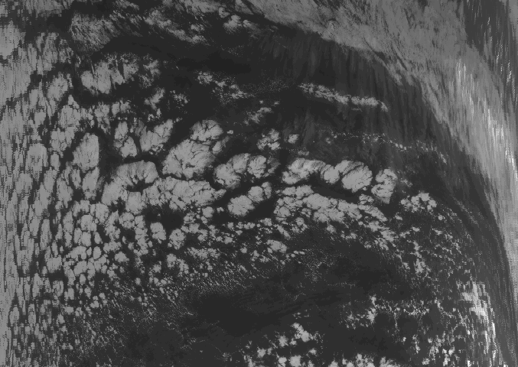
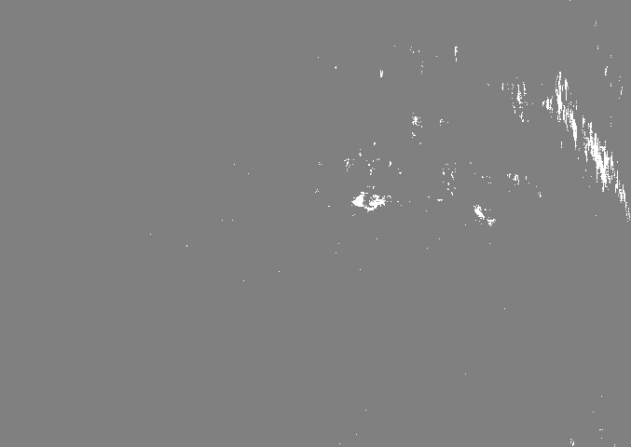
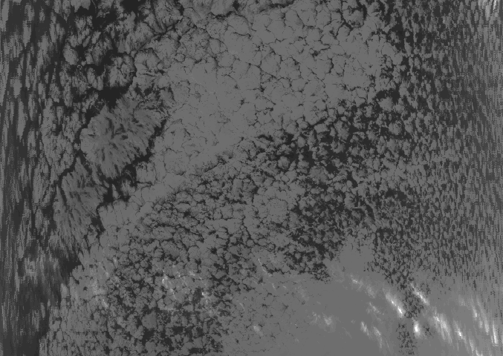
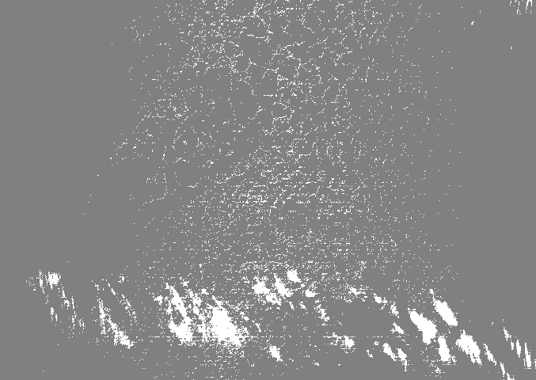
Subtropical Eastern Pacific Ocean
16:55 UTC 01 July 2003
Ice Cloud Detection Test
Negligible false ice cloud
17:10 UTC 01 July 2013
False cloud showing up
Terra Band 31
8.6-11 µm BTD Cloud Test

Slide 12
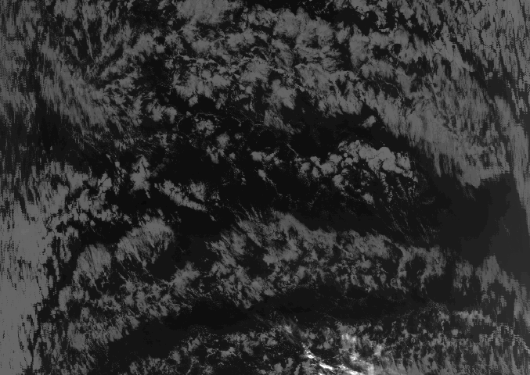
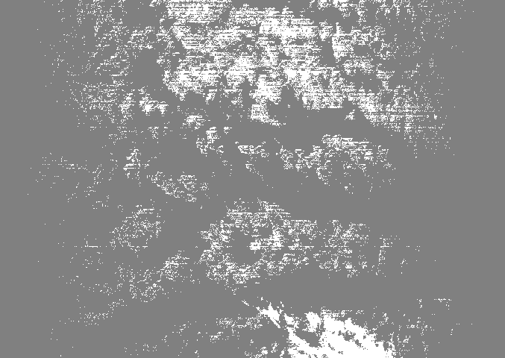
Subtropical Eastern Pacific Ocean
16:55 UTC 01 July 2003
Ice Cloud Detection Test
Negligible false ice cloud
16:45 UTC 01 July 2014
Abundant false ice cloud!
False ice cloud prevalent
Terra Band 31
12
Terra Band 31
B29-B31 BTD Cloud Test

Slide 13
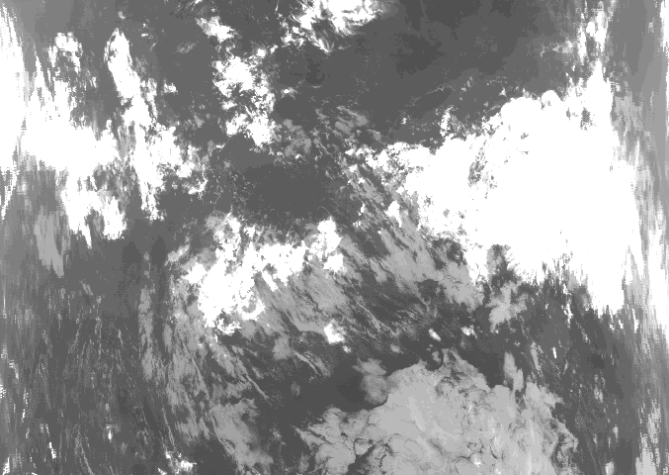
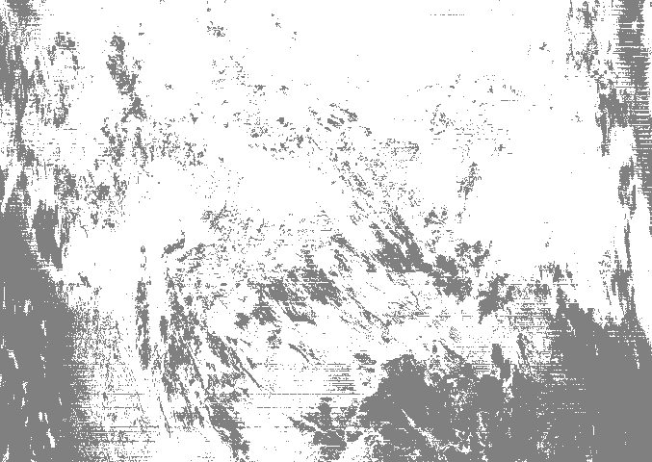
Subtropical Eastern Pacific Ocean
16:55 UTC 01 July 2003
Ice Cloud Detection Test
Negligible false ice cloud
16:40 UTC 15 April 2015
Abundant false cloud!
Terra Band 31
13
Terra Band 31
B29-B31 BTD Cloud Test

Slide 14
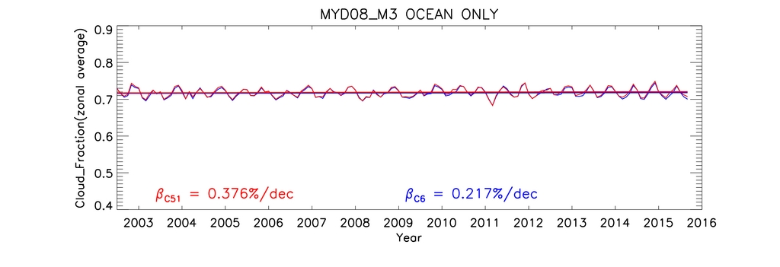

Aqua Monthly Mean Ocean Cloud Fraction, 60S-60N
Terra Monthly Mean Ocean Cloud Fraction, 60S-60N
From Starry Manoharan, http://modis-atmos.gsfc.nasa.gov./IMAGES/08_Timeseries.html

Slide 15

Terra Monthly Mean Land Cloud Fraction, 25S-25N
Terra Monthly Mean Ocean Cloud Fraction, 25S-25N
From Starry Manoharan, http://modis-atmos.gsfc.nasa.gov./IMAGES/08_Timeseries.html

Slide 16
PVLWIR Crosstalk Impact in Wisconsin’s
Terra MODIS L2 Products
Cloud Mask (MOD35)
  B29-B31 BTD ice cloud test, ocean
  B27-B31 BTD nighttime polar cloud test
  B27 BT threshold high opaque cloud test
  B29-B28 BTD opaque mid-level and high cloud test, ocean
Integrated Water Vapor (MOD07)
  B27-29 contribution to moisture, B30 to ozone
  False cloud in Cloud Mask reduces number of retrievals
Cloud Top Properties (MOD06)
  B29-B31 BTD contribution to Cloud Particle Phase retrieval (1- and 5-km)
  B28-B31 BTD contribution to Cloud Particle Phase retrieval (1-km)
  False cloud in Cloud Mask causes false Cloud Top Pressure retrieval

Slide 17


Time series of the Aqua MYD07 high, middle and low layer monthly mean integrated water vapor (IWV)
High Layer
High IWV
IWV
(mm)
MODIS 30-60 S Latitude
MODIS 30-60 N Latitude
MODIS -30 - +30 Latitude
Middle Layer
Middle IWV
IWV
(mm)
Low Layer
Low IWV
IWV
(mm)

Slide 18

Time series of the Terra MOD07 high, middle and low layer monthly mean integrated water vapor (IWV)
High Layer
High IWV
IWV
(mm)
MODIS 30-60 S Latitude
MODIS 30-60 N Latitude
MODIS -30 - +30 Latitude
Middle Layer
Middle IWV
IWV
(mm)
Low Layer
Low IWV
IWV
(mm)

Slide 19
PVLWIR Crosstalk Impact in Wisconsin’s
Terra MODIS L2 Products
Cloud Mask (MOD35)
  B29-B31 BTD ice cloud test, ocean
  B27-B31 BTD nighttime polar cloud test
  B27 BT threshold high opaque cloud test
  B29-B28 BTD opaque mid-level and high cloud test, ocean
Integrated Water Vapor (MOD07)
  B27-29 contribution to moisture, B30 to ozone
  False cloud in Cloud Mask reduces number of retrievals
Cloud Top Properties (MOD06)
  B29-B31 BTD contribution to Cloud Particle Phase retrieval (1- and 5-km)
  B28-B31 BTD contribution to Cloud Particle Phase retrieval (1-km)
  False cloud in Cloud Mask causes false Cloud Top Pressure retrieval

Slide 20




Subtropical Eastern Pacific Ocean
06:10 UTC 01 July 2003
Cloud Particle Phase Result
17:35 UTC 03 July 2015
Ice
Water
Uncertain
No retrieval
Excessive “Ice” and “Uncertain” retrievals
Terra Band 31

Slide 21




Subtropical Eastern Pacific Ocean
20:25 UTC 16 February 2016
Cloud Top Pressure Result
False Low Level
Cloud Retrievals
Terra Band 5
= 900 1000 HPa
; No retrieval
Confident Clear
Probably Clear
Probably Cloud
Confident Cloud
B29-B31 BTD Test Causing Much False Cloud in Cloud Mask
Terra Band 31
Terra Final Cloud Mask Result

Slide 22
Summary of Impact on Terra MODIS L2
Abundant false cloud in tropics in Cloud Mask.
False positive trend in Cloud Fraction
False negative trend in middle level Integrated Water Vapor.
Increase in “Ice” and “Uncertain” (mixed) and reduction in “Water” Cloud Particle Phase retrievals.
False “Low” cloud retrievals in Cloud Top Properties.

Slide 23
Ongoing Mitigation Efforts
No correction currently in C6 L1B processing.
MCST deriving crosstalk correction coefficients using monthly lunar views supplemented with daily earth scenes.
MCST generating crosstalk-corrected L1B granules which are being reviewed by Wisconsin.
Aqua radiances as guidance on “Truth”.
Cloud Mask tests using B27, 29 have been disabled through threshold adjustments in forward processing.

Slide 24




Terra MODIS July 1, 2015, 1345 UTC (TWP Moist Case)
B29
B31
B29-B31 Cloud Mask Result
(Before xtalk correction)
Much false cloud evident in Terra MODIS Cloud Mask B29-B31 test using C6.1 (baseline) band 29 radiances

Slide 25




Aqua MODIS July 1, 2015, 1630 UTC (TWP Moist Case)
B29
B31
B29-B31 Cloud Mask Result

Slide 26

Cloud
B29-B31 threshold
Clear
Aqua

Slide 27

Cloud
B29-B31 threshold
Clear
Aqua

Slide 28
Path Forward
Additional B29 pre-Safe Mode case studies in different regions of the World (underway)
Global day(s) L1B test data set using “maturing” B29 crosstalk correction coefficients, likely with PGE03 as well
Apply methods to B27, B28, and B30.
Develop and evaluate post-Safe Mode crosstalk correction
Implement in forward processing (TBD)
Reprocess entire Terra MODIS data record (TBD)

Slide 29
Summary
Electronic Crosstalk in Terra MODIS bands 27-30 likely root cause of drift in PVLWIR L1B radiances.
Impact has shown up in Cloud Mask (MOD35), Integrated Water Vapor (MOD07), Cloud Phase and Cloud Top Pressure (MOD06) products, placing at risk the climate quality status of these geophysical products.
Mitigation strategy underway, led by MCST. Global efficacy TBD, but encouraging results in B29 testing in the tropics. Post-Terra Safe Mode behavior under study.

Slide 30
Backup
PVLWIR crosstalk behavior before and after Feb 2016 Terra Safe Mode
  Increase in crosstalk amplitude countered by adjustment in crosstalk correction coefficients of all bands
  Early testing suggests that adjusted crosstalk correction coefficients effective at removing most of the crosstalk signal (similar to before Safe Mode)
  More lunar cycles needed to track and confirm behavior

Slide 31


Impact of Feb 2016 Terra Safe Mode
Lunar data
Uncorrected
Crosstalk Corrected

Slide 32

Impact of Feb 2016 Terra Safe Mode
Lunar data:
Uncorrected
Crosstalk Corrected

