Slide 1


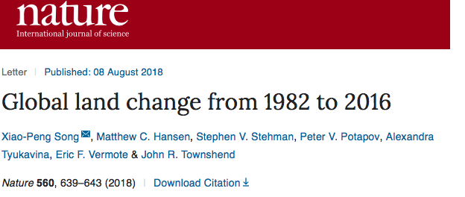
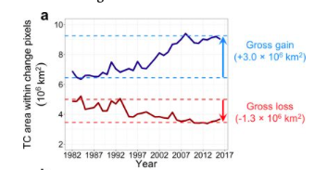
Status of MODIS SR
MODIS SR Product suite
Collection 6: (Released in 2015)
Bands 1 through 7
250m, 500m, 0.05 deg.
Daily, 8 days
Status and Updates:
MODIS SR collection 6 ( LaSRC: Land Surface Reflectance Code) is the basis for a variety of SR product (VIIRS, AVHRR, Landsat, Sentinel 2) assuring consistency and traceability in the SR products from multiple satellites/instruments.
Validation stage IV (AERONET) and cross-comparison with MODIS is on-going.
Known Issues:
None
Recent Publications:
Doxani, G., Vermote, E., Roger, J.C., Gascon, F., Adriaensen, S., Frantz, D., Hagolle, O., Hollstein, A., Kirches, G., Li, F. and Louis, J., 2018. Atmospheric correction inter-comparison exercise. Remote Sensing, 10(2), p.352.
Skakun, S., Franch, B., Vermote, E., Roger, J.C., Becker-Reshef, I., Justice, C. and Kussul, N., 2017. Early season large-area winter crop mapping using MODIS NDVI data, growing degree days information and a Gaussian mixture model. Remote Sensing of Environment, 195, pp.244-258.
Breon F.M., Vermote E.F., Murphy E., Franch B., (2015) Measuring the directional variations of land surface reflectances from MODIS, IEEE transactions on Geoscience and Remote Sensing, 53 (8), 4638-4649.
“Contrary to popular opinion, tree cover increased by 2.24 million square kilometers (more than 850,000 square miles), an increase of about 7 percent during the time period.”
Notes:
This is the result of a net loss in the tropics being outweighed by a net gain elsewhere on the planet. At the same time, global bare ground cover has decreased by 1.16 million square kilometers (about 500,000 square miles) or some 3 percent, most notably in agricultural regions in Asia.

Slide 2


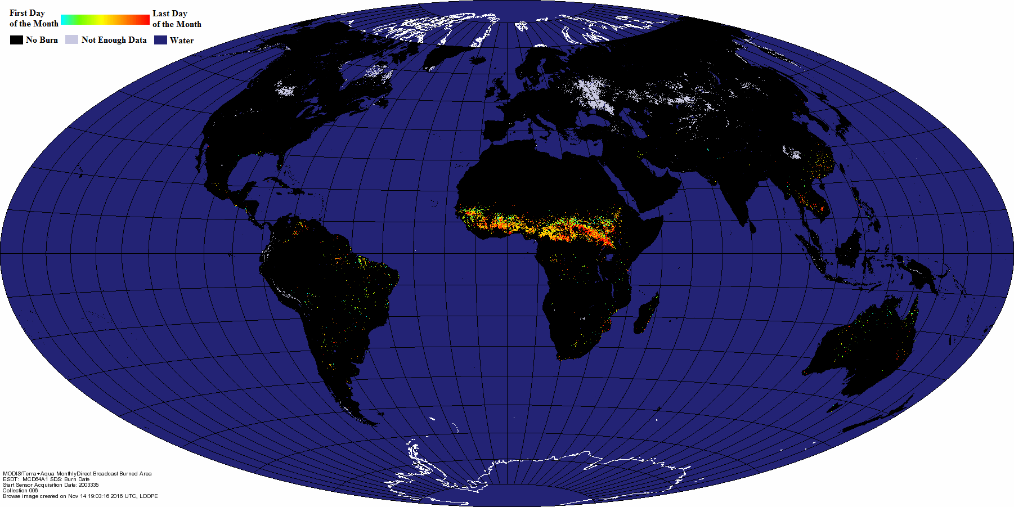
Development of a Global Burned Area
Earth System Data Record
Louis Giglio¹, Luigi Boschetti², David Roy³, Varaprasad Bandaru¹, Chris Justice¹
¹University of Maryland, ²University of Idaho, ³South Dakota State University
December 2003 MODIS Burned Area Product

Slide 3

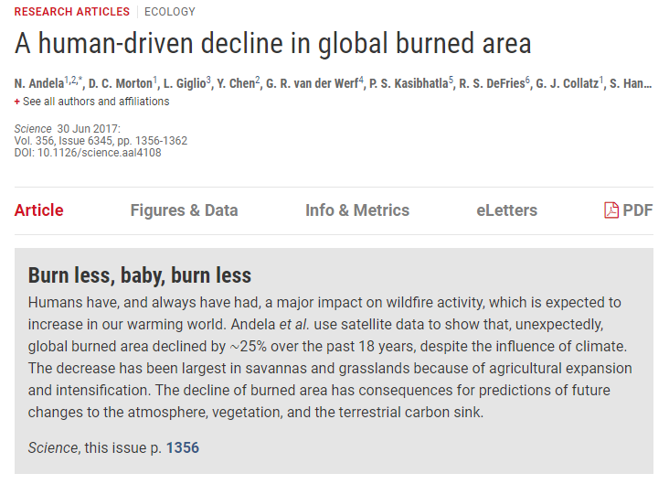
Status of MODIS Burned Area
MODIS Burned Area Product
Collection 6: (released 2017)
    MCD64A1: Monthly L3 500 m SIN Grid
    MCD64CMH: Monthly CMG (released 2018)
Status and Updates:
Stage-2 validation complete.
Stage-3 validation in preparation.
Known Issues:
Edge fix for 26 tiles (patch 6.0.8).
Recent Publications:
Giglio, L., Boschetti, L., Roy, D. P., Humber, M. L., and Justice, C. O., 2018, The Collection 6 MODIS burned area mapping algorithm and product. Remote Sensing of Environment, 217:72–85.
Humber, M. L., Boschetti, L., Giglio, L., and Justice, C. O., 2018, Spatial and temporal intercomparison of four global burned area products, International Journal of Digital Earth.
Andela et al., 2017, A human-driven decline in global burned area. Science, 356:1356-1362.

Slide 4
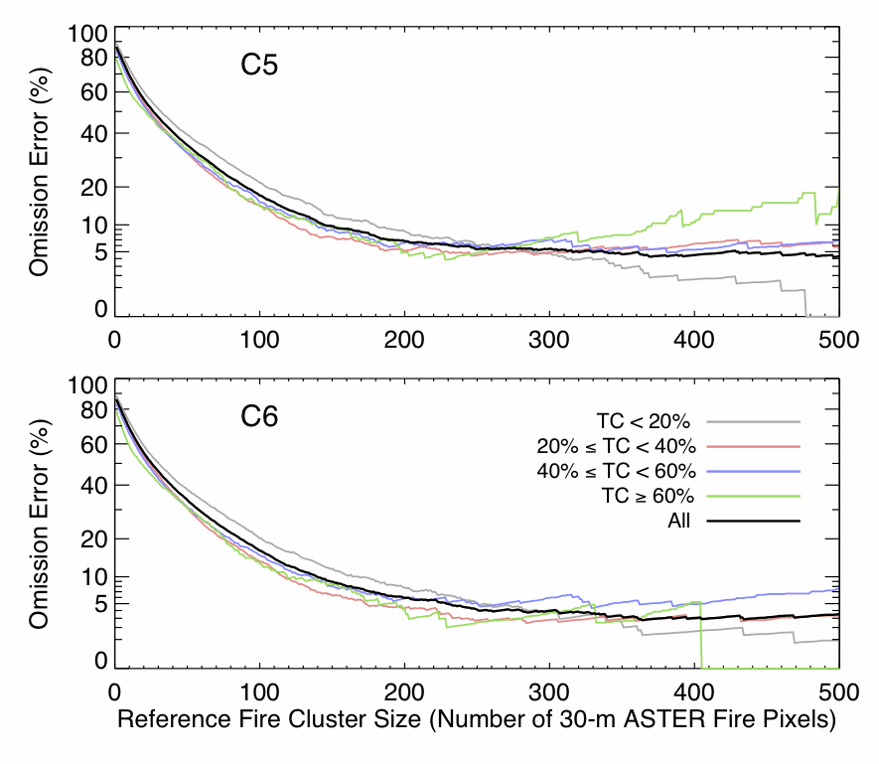
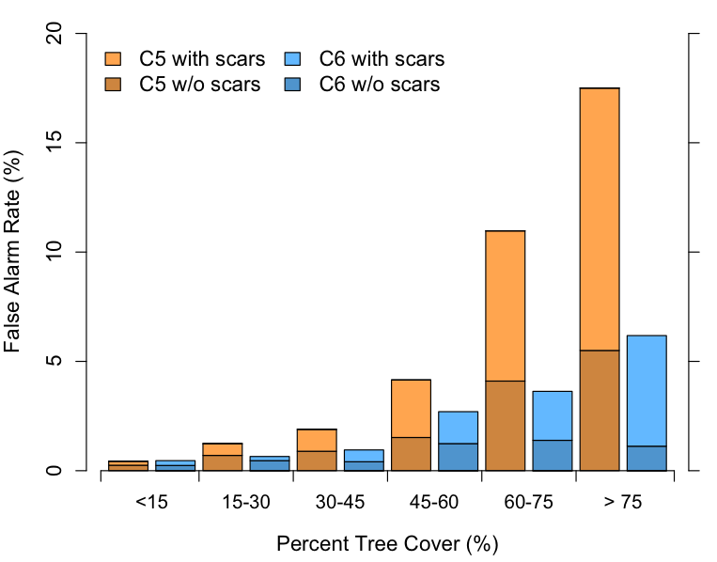
Status of MODIS Active Fire
MODIS Active Fire Products
Collection 6: (released 2015)
    MOD14/MYD14: Terra/Aqua L2 Swath
    MOD14A1/MYD14A1: L3 Daily 500-m SIN Grid
    MOD14A2/MYD14A2: L3 8-day 500 m SIN Grid
    MCD14ML: Monthly fire locations
Status and Updates:
Widely used mature product.
Stage-2 validated.
Known Issues:
None.
Recent Publications:
Giglio, L., Schroeder, W., and Justice, C. O., 2016, The collection 6 MODIS active fire detection algorithm and fire products. Remote Sensing of Environment, 178, 31-41.

Slide 5
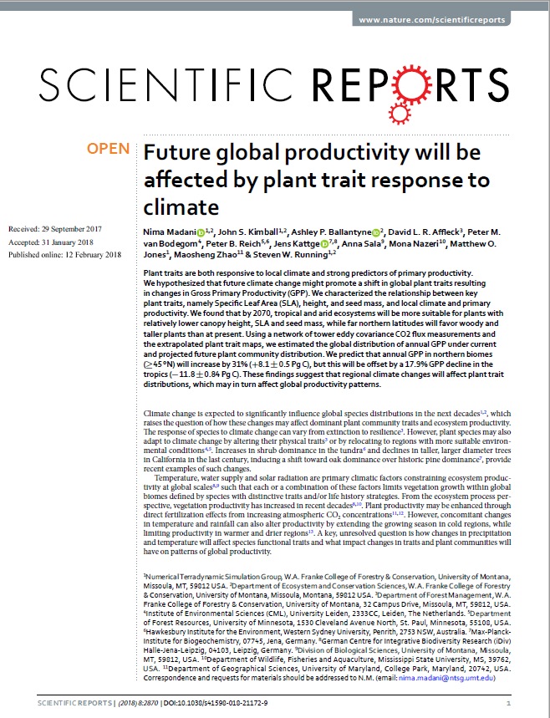
Status of MODIS GPP/NPP, ET/PET products and an LST for fun.
MODIS GPP/NPP and ET/PET products.
Collection 6:
    MOD17A3H: MODIS/Terra Annually L4 500 m SIN Grid
    MYD17A3H: MODIS/Aqua Annually L4 500 m SIN Grid
    MOD17A2H: MODIS/Terra 8-day L4 500 m SIN Grid
    MYD17A2H: MODIS/Aqua 8-day L4 500 m SIN Grid
    MOD16A3: MODIS/Terra Annually L4 500 m SIN Grid
    MYD16A3: MODIS/Aqua Annually L4 500 m SIN Grid
    MOD16A2: MODIS/Terra 8-day L4 500 m SIN Grid
    MYD16A2: MODIS/Aqua 8-day L4 500 m SIN Grid
Status and Updates:
Creation of an optimized FPAR/LAI climatology.
This climatology will be used to obtain gap free GPP/NPP and ET/PET products for the upcoming collection 6.1.
Known Issues:
Important gaps due to cloud contamination in heavily clouded areas.
Recent Publications:
Alvaro Moreno, Gustau Camps-Valls, Jens Kattge, Nathaniel Robinson, Markus Reichstein, …, Steven W. Running (2018). A methodology to derive global maps of leaf traits using remote sensing and climate data, Remote Sensing of Environment, 218, 69-88.
Madani, N., Kimball, J. S., Ballantyne, A. P., Affleck, D. L., Bodegom, P. M., Reich, P. B., ... & Zhao, M. (2018). Future global productivity will be affected by plant trait response to climate. Scientific reports, 8(1), 2870.
He, M., Kimball, J. S., Maneta, M. P., Maxwell, B. D., Moreno, A., Beguería, S., & Wu, X. (2018). Regional Crop Gross Primary Productivity and Yield Estimation Using Fused Landsat-MODIS Data. Remote Sensing, 10(3), 372.
Jones, M. O., Running, S. W., Kimball, J. S., Robinson, N. P., & Allred, B. W. (2018). Terrestrial primary productivity indicators for inclusion in the National Climate Indicators System. Climatic Change, 1-14.
David J. Mildrexler, Maosheng Zhao, Warren B. Cohen, Steven W. Running, Xiaopeng Song, Matthew O. Jones. 2018, Thermal Anomalies Detect Critical Global Land Surface Changes. J. Applied Meteorology and Climatology, 57, 391-411.

Slide 6

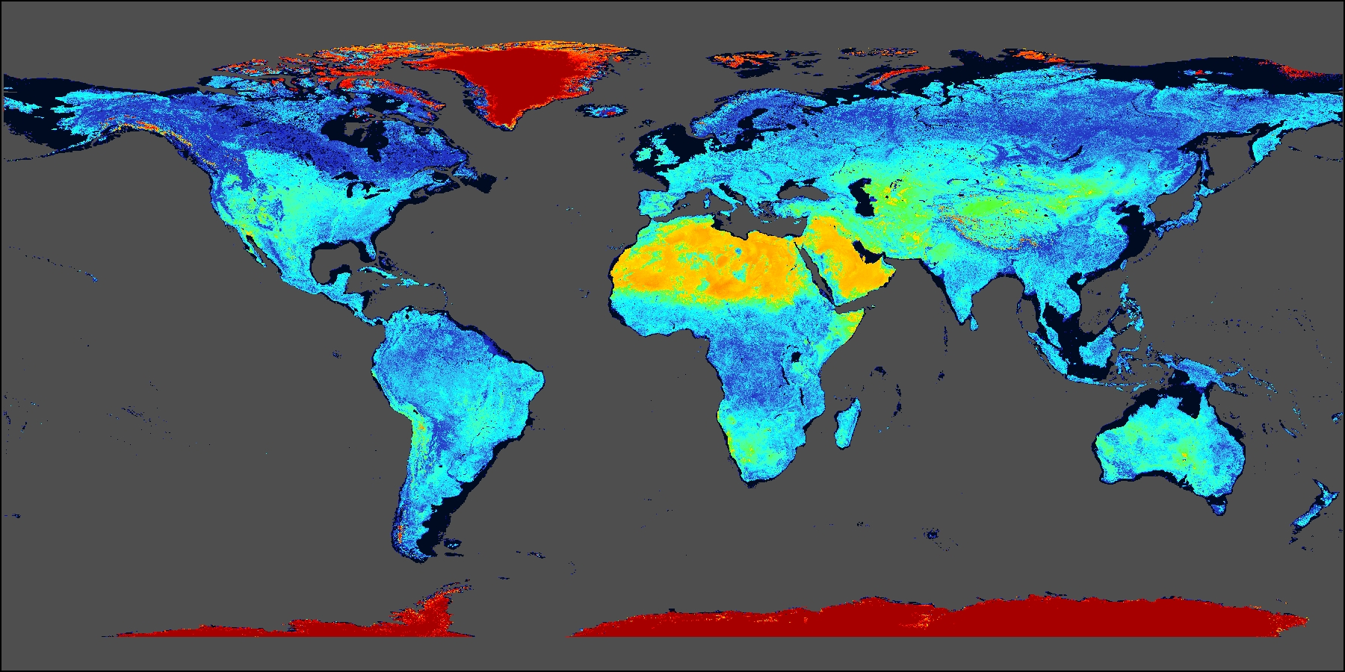
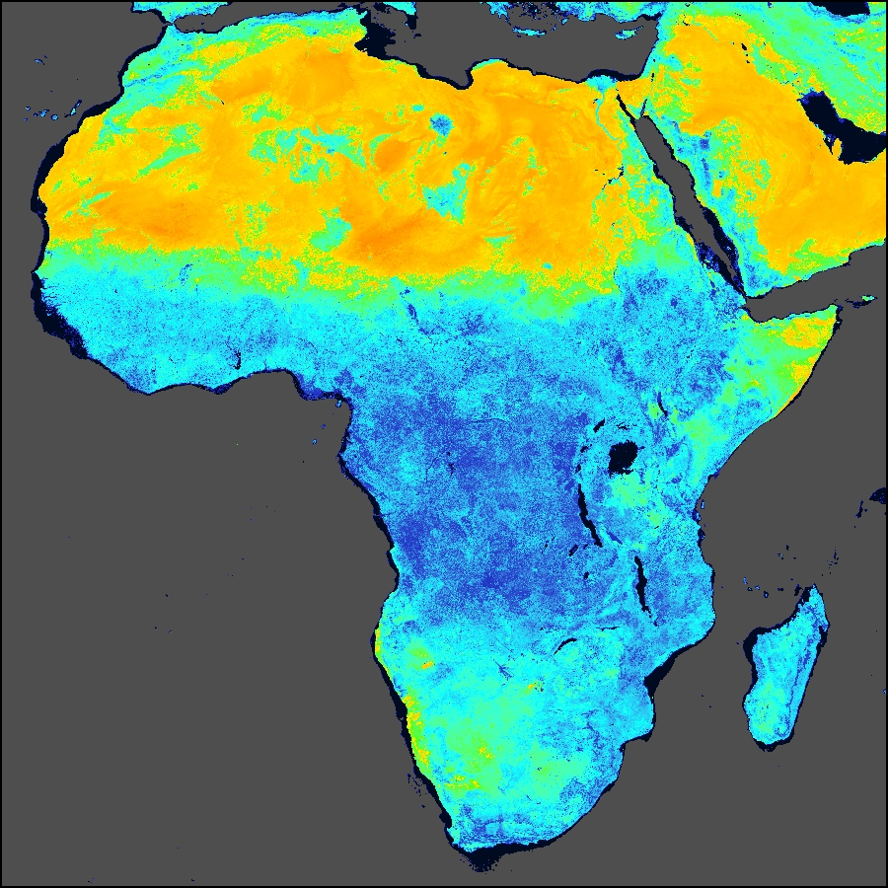
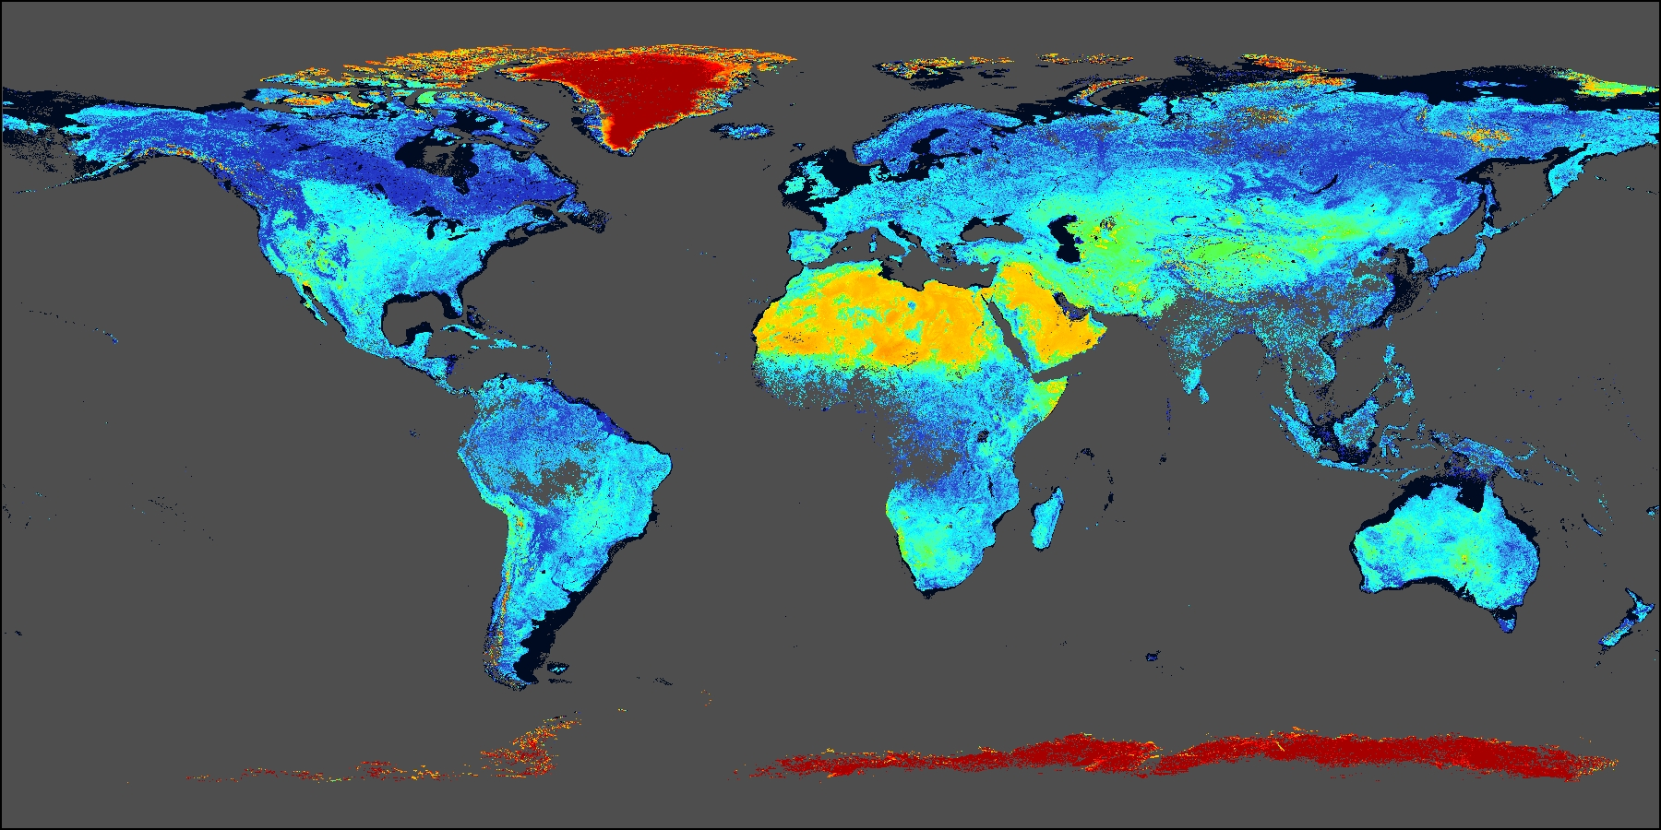
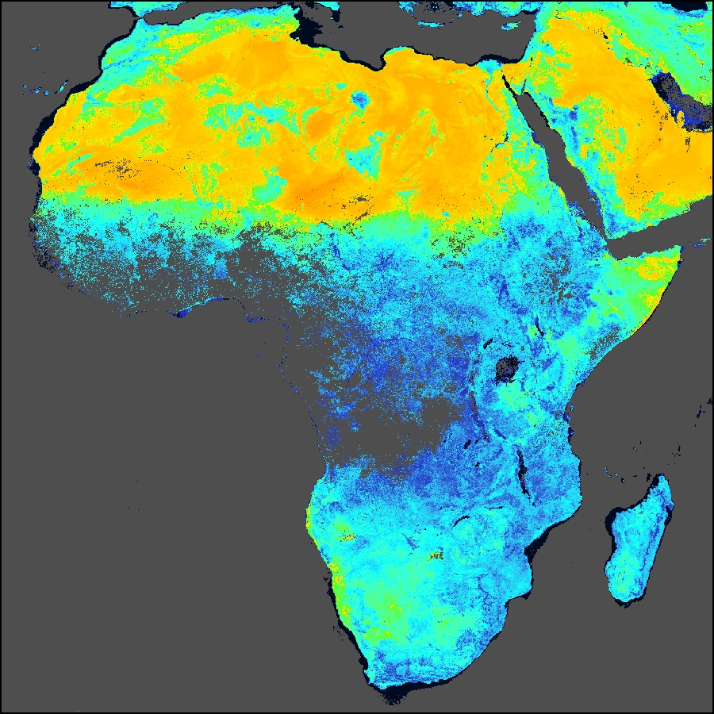
Status of Terra/Aqua MODIS BRDF, Albedo and NBAR
    MODIS BRDF Albedo NBAR Products
    Collection V006:
    MCD43A: 500 m SIN grid
    MCD43A1: BRDF/Albedo Model Parameters
    MCD43A2: BRDF/Albedo Quality
    MCD43A3: Albedo
    MCD43A4: NBAR
    MCD43C: 0.05 degree CMG
    MCD43C1: CMG BRDF/Albedo Model Parameters
    MCD43C2: CMG BRDF/Albedo Model Snow-Free Parameters
    MCD43C3: CMG Albedo
    MCD43C4: CMG NBAR
    MCD43D: 30 Arc-Second CMG (1 – 40)
    MCD43GF: CMG Gap-Filled Snow-Free
Status and Updates:
New daily retrievals are being used extensively for phenology studies.
Snow free Gap Filled V006 products (MCD43GF) are under production
Known Issues:
None
Recent Publications:
Wang, Z., Schaaf, C. B., Sun, Q., Shuai, Y., & Román, M. O. (2018). Capturing Rapid Land Surface Dynamics with Collection V006 MODIS BRDF/NBAR/Albedo (MCD43) Products. Remote Sensing of Environment, 207(February), 50–64. https://doi.org/10.1016/j.rse.2018.02.001
Sun, Q., Wang, Z., Li, Z., Erb, A., & Schaaf, C. B. (2017). Evaluation of the Global MODIS 30 Arc-Second Spatially and Temporally Complete Snow-Free Land Surface Albedo and Reflectance Anisotropy Dataset. International Journal of Applied Earth Observation and Geoinformation, 58, 36–49. https://doi.org/10.1016/j.jag.2017.01.011
MCD43GF: DOY250, 2010
Shortwave Broadband WSA
MCD43D61: DOY250, 2010
Shortwave Broadband WSA

Slide 7
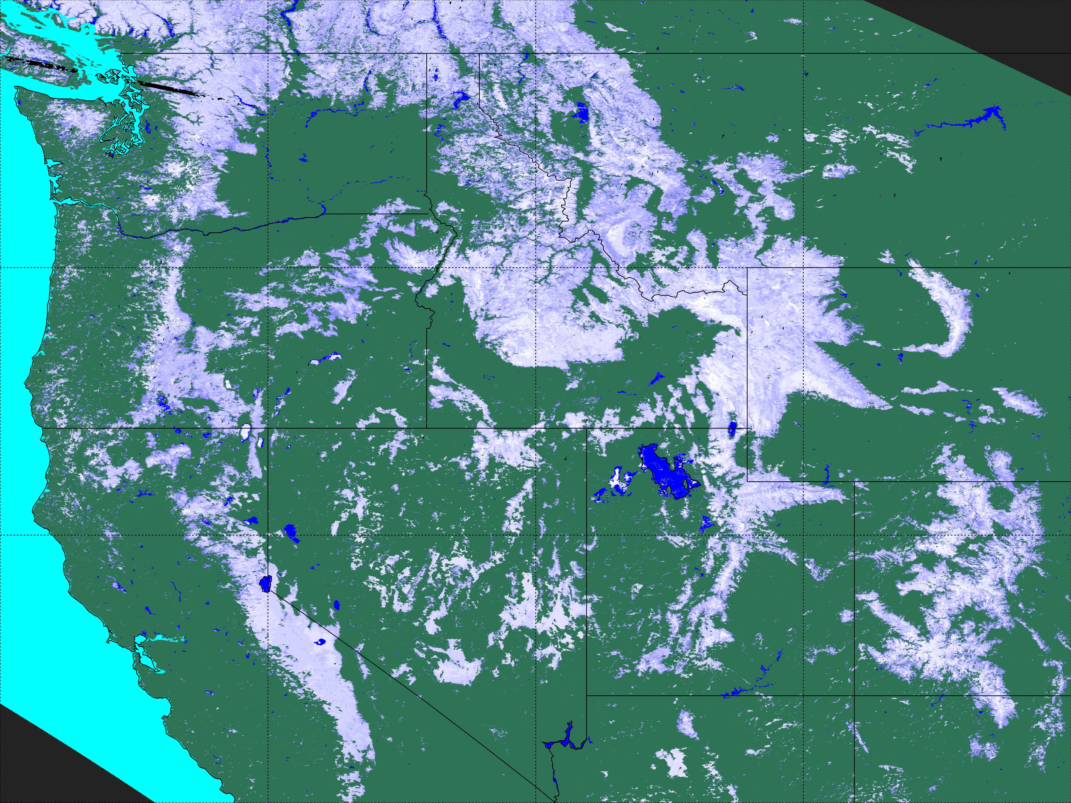
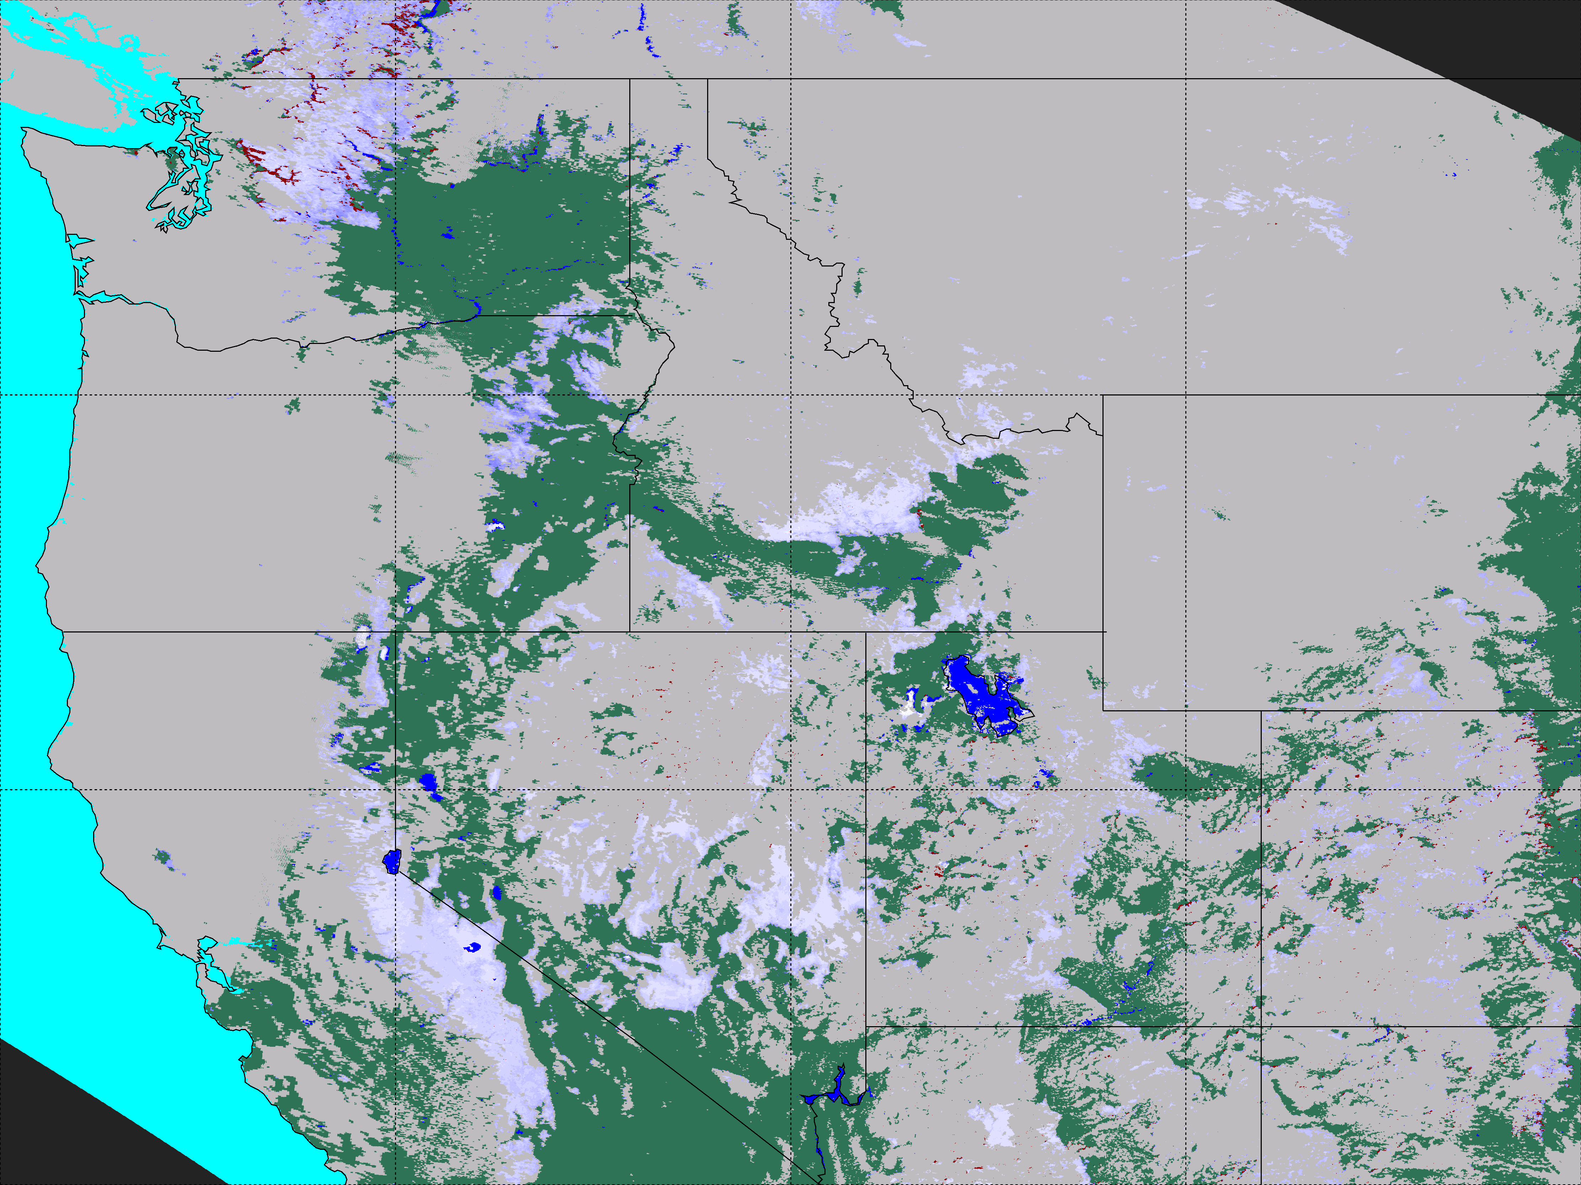
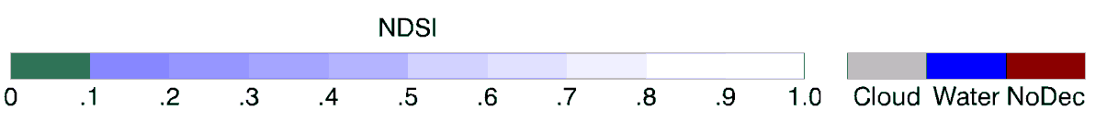
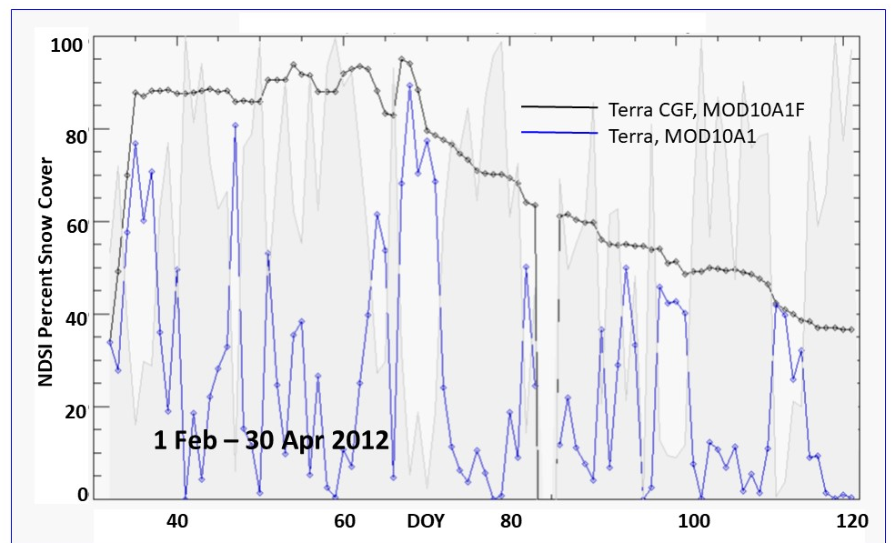
Generating continuous time series of daily snow cover
with the MODIS Cloud-Gap-Filled (CGF) Product
Dorothy Hall¹ and George Riggs²
¹ESSIC / University of Maryland, ²SSAI
Cloud-Gap Filled Daily Snow Map
Daily Snow Map with Cloud
19 March 2012
Cloud
(A)
(B)
Comparison of Terra CGF and the standard Terra snow maps
(C)
The cloud-gap filled (CGF) MODIS product provides a consistent and continuous cloud free snow cover map (A) compared to the daily snow cover product (B) that has clouds which cause gaps in a time series of snow observations. The CGF maps are able to capture snow buildup and depletion (C), for example in Wind River Range, Wyoming, 1 Feb to 30 April 2012 (C).

Slide 8
Status of MODIS Cryosphere Products
Dorothy Hall¹ and George Riggs²
¹ESSIC / University of Maryland, ²SSAI
MODIS Snow Cover Product
Collection 6.1:
    New -- M*D10A1F: Daily Cloud-gap-filled product MODIS/Terra/Aqua L3 500 m SIN Grid
    M*D10_L2 revised algorithm and data content, improved snow cover detection
Status and Updates:
Snow cover algorithm: revised low visible reflectance screen and added two algorithm QA bit flags
Product user guides updated for C6.1
Known Issues:
Investigating cloud/snow confusion and affect of aerosols on the snow cover algorithm
Recent Publications:
Hall, D.K., R.I. Cullather, J.C. Comiso, N.E. DiGirolamo, S.M. Nowicki and B.C. Medley, 2018: A multilayer IST – albedo product of Greenland from MODIS, Remote Sensing [Special Issue: Remote Sensing of Essential Climate Variables and their Applications]. Feature Paper. 10(4), 555; https://doi:10.3390/rs10040555.
Hall, D.K., A. Frei and N.E. DiGirolamo, 2018: On the frequency of lake-effect snowfall in the Catskill Mountains, Physical Geography, https://doi:10.1080/02723646.2018.1440827.
Riggs, G.A., D.K. Hall and M.O. Román, 2017: Overview of NASA’s MODIS and Visible Infrared Imaging Radiometer Suite (VIIRS) snow-cover Earth System Data Records, Earth System Data Records, 9:765-777, https://www.earth-syst-sci-data-discuss.net/essd-2017-25/.
A unique MODIS multi-layer Greenland IST and surface albedo product was generated by our team and is archived at NSIDC.

Slide 9

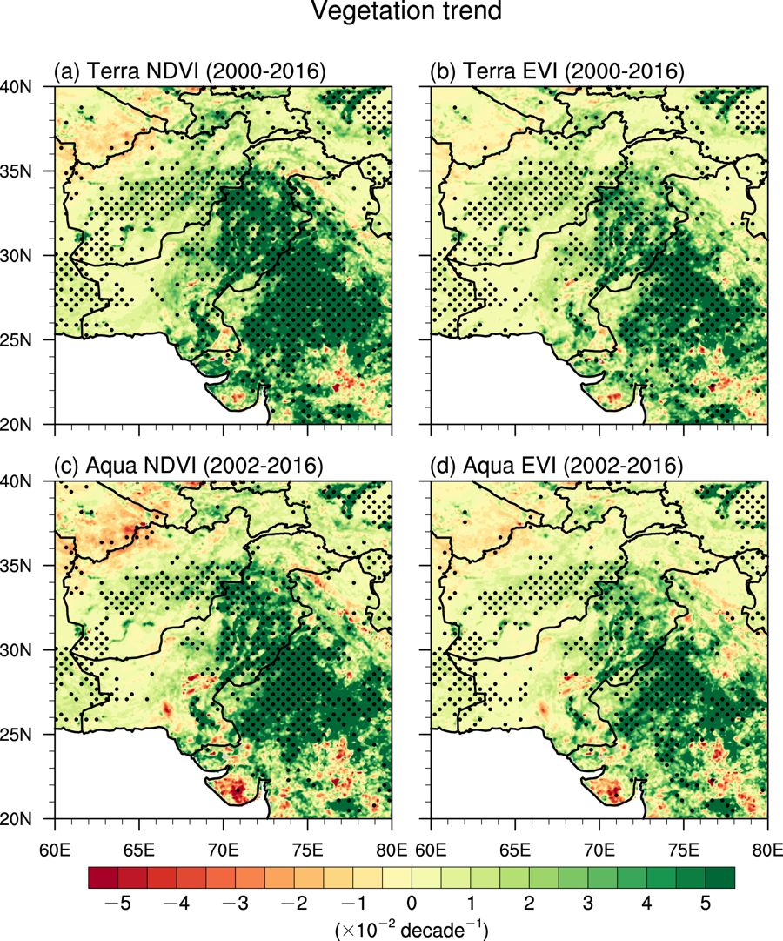
Status of MODIS Long Term VI Time Series
MODIS VI Suite (in its 19th year)
Collection 5: (Suspended in 2018)
Collection 6: (Released in 2015)
Collection 7: (In prep)
Status and Updates:
Improved QA compositing scheme
Multiple and ongoing algorithm adjustments to deal with changes in upstream products and/or issues
Ongoing opportunistic validation (using NEON data)
Known Issues:
The 2010 (C6) decision to use pre-composited 8-day surface reflectance inputs is causing spatial consistency issues that will be addressed in C6.1/C7
Recent Publications:
Jarchow, C. J., Didan, K., Barreto-Muñoz, A., et al. (2018). Application and Comparison of the MODIS-Derived Enhanced Vegetation Index to VIIRS, Landsat 5 TM and Landsat 8 OLI Platforms: A Case Study in the Arid Colorado River Delta, Mexico. Sensors, 18(5), 1546.
EL-Vilaly, M. A. S., Didan, K, et al. (2018). Characterizing Drought Effects on Vegetation Productivity in the Four Corners Region of the US Southwest. Sustainability, 10(5), 1643.
El-Vilaly MA, Didan K, et al. Vegetation productivity responses to drought on tribal lands in the four corners region of the Southwest USA. Frontiers of Earth Science. 2017 May:1-5. DOI 10.1007/s11707-017-0646-z
Peng D, Zhang X, Wu C, Huang W, et al. Intercomparison and evaluation of spring phenology products using National Phenology Network and AmeriFlux observations in the contiguous United States. Agricultural and forest meteorology. 2017 Aug 15;242:33-46.
MODIS NDVI/EVI product suite continues to lead and drive science and applications with more than 12,000 publications mentioning and/or using the MODIS NDVI/EVI time series, with multiple high end journal articles appearing annually.
Jin, Q., & Wang, C. (2018). The greening of Northwest Indian subcontinent and reduction of dust abundance resulting from Indian summer monsoon revival. Scientific reports, 8(1), 4573.

Slide 10
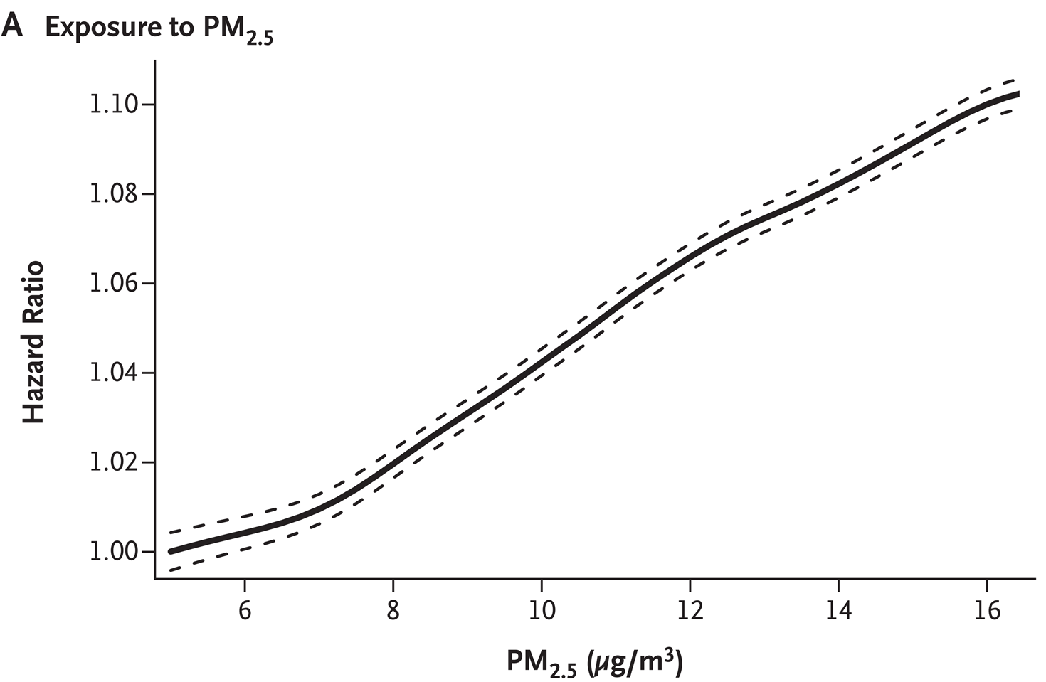
Advancing MODIS-VIIRS Climate Data Records with Algorithm MAIAC
Alexei Lyapustin¹, Yujie Wang², Sergey Korkin³, Dong Huang⁴
¹NASA GSFC; ²UMBC; ³USRA; ⁴SSAI
(C)
(A)
(B)
MAIAC MODIS algorithm improves the quality of cloud/snow detection, aerosol retrievals and atmospheric correction. (A) Chen et al., (2017) showed improvement in LAI retrieval when using MAIAC surface reflectance as input; (B) Di et al. (2017) shows the risk of mortality curve as a function of air quality at PM_{2.5} levels well below the National Ambient Air Quality Standards (35μg/m³). National daily 1km PM_{2.5} for this study (2000-2012) was obtained using MAIAC AOD from MODIS.
Risk of death (7.3%) at 10μg/m³ increase in PM_{2.5} (Di et al., Air Pollution and Mortality in the Medicare Population, The New England Journal of Medicine, doi: 10.1056/NEJMoa1702747)

Slide 11
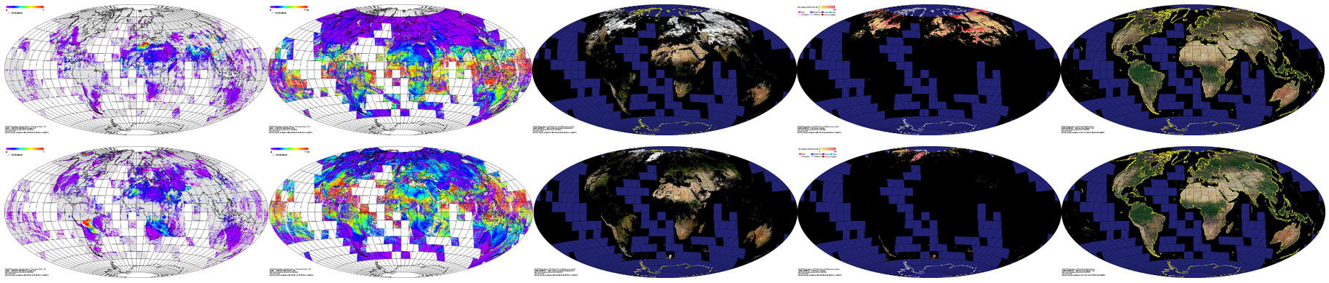
Status of MODIS MAIAC
(MCD19)
AOD Column WV RGB SR SnowFrac, 1km RGB K_{iso} (RTLS)
DOY 230 DOY 60, 2005
MCD19 Product Suite
Collection 6: (Released in Spring of 2018)
    MCD19A1: Surface Reflectance
      Daily L3 1 km: BRF in bands 1-12; Snow grain size and snow fraction;
      Daily L3 500 m: BRF in bands 1-7;
    MCD19A2: Atmospheric properties
      Daily L3 1 km: CM, AOD, CWV, Plume Injection Height (for detected smoke)
    MCD19A3: BRDF/Albedo
      8-Day L3 1 km: RTLS BRDF, instantaneous albedo in bands 1-8;
Status and Updates:
Fixing known issues for C6.1
Known Issues:
Regional aerosol models cause AOD discontinuity in 3 regions (Sahel, Southern Africa, West India)
Detection of sea ice
Seasonality of aerosol models (to add)
Missing some bright salt pans
Recent Publications:
Lyapustin et al., 2018. MODIS Collection 6 MAIAC Algorithm, Atm. Meas. Techniques, doi:10.5194/amt-2018-141.
Cooper et al., 2018. Assessing snow extent data sets over North America to inform and improve trace gas retrievals from solar backscatter, Atm. Meas. Techniques, doi:10.5194/amt-11-2983-2018.
Liang F. et al., 2018. MAIAC-based Long-term Spatiotemporal Trends of PM2.5 in Beijing China, Science of The Total Environment, doi: 10.1016/j.scitotenv.2017.10.155.
Chen et al., 2017. Prototyping of LAI and FPAR Retrievals from MODIS Multi-Angle Implementation of Atmospheric Correction (MAIAC) Data. Remote Sensing, doi:10.3390/rs9040370

Slide 12
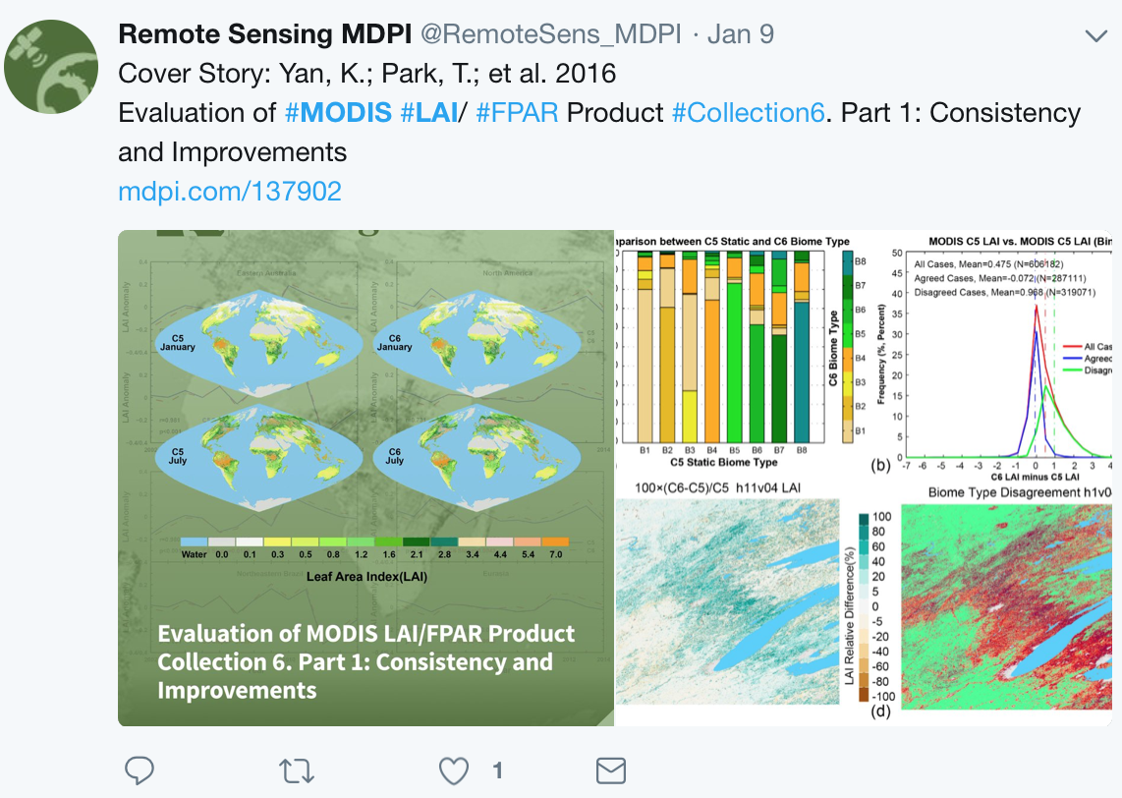

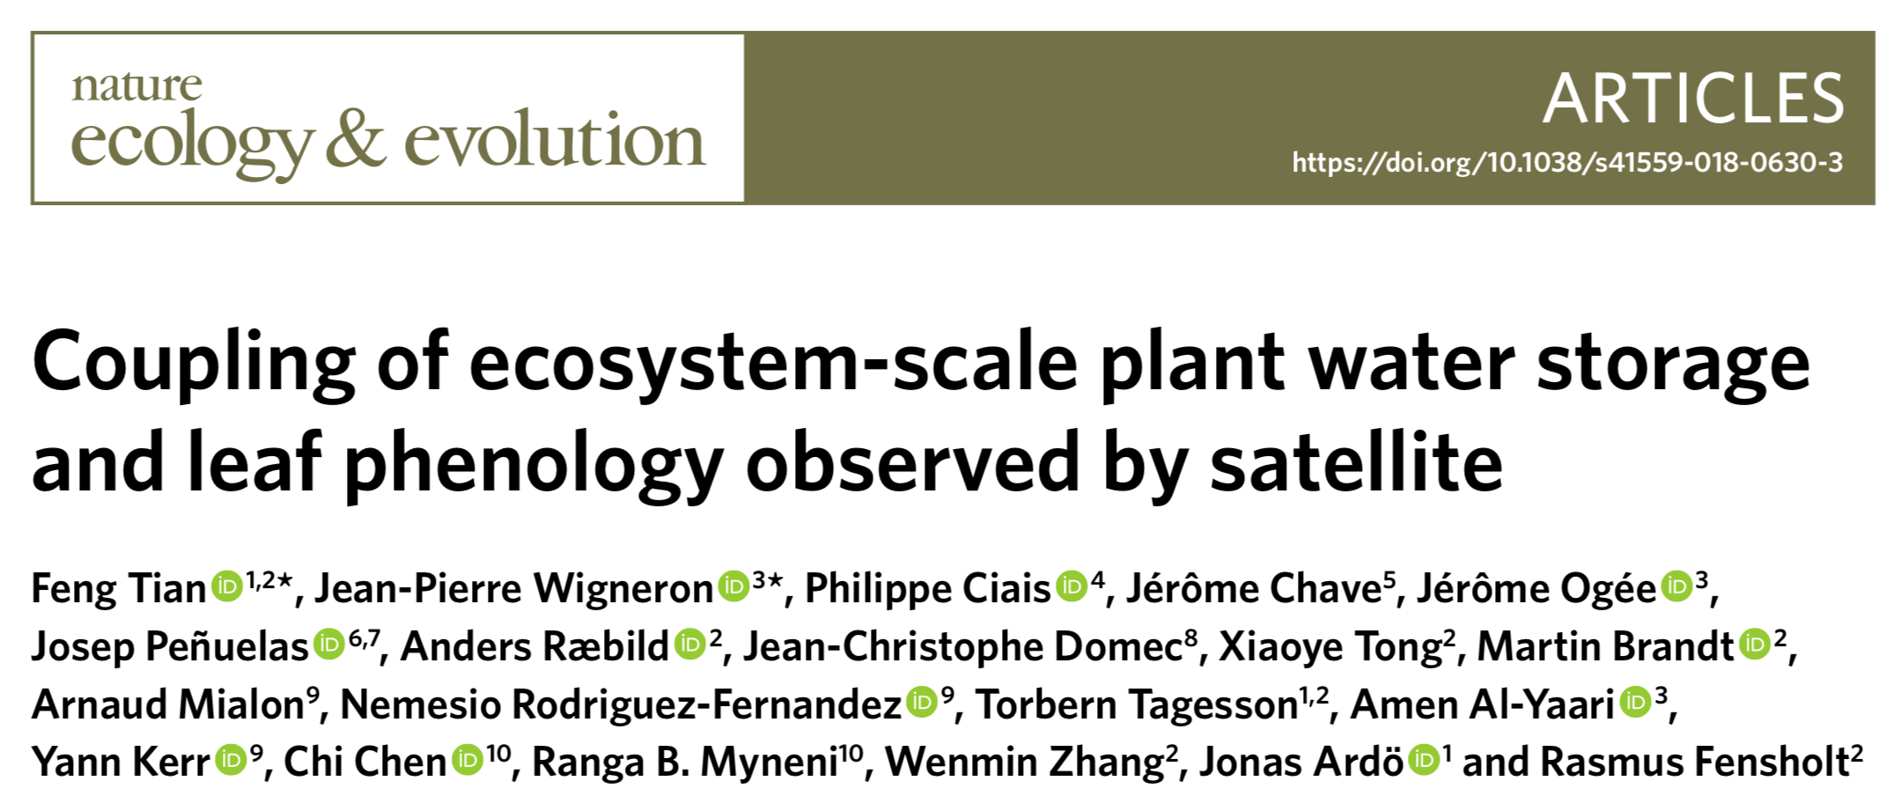
Status of MODIS LAI/FPAR
MODIS LAI/FPAR Product
Collection 6: (Released in 2015)
    MOD15A2H: MODIS/Terra 8-Day L4 500 m SIN Grid
    MYD15A2H: MODIS/Aqua 8-Day L4 500 m SIN Grid
    MCD15A2H: MODIS/Terra+Aqua 8-Day L4 500 m SIN Grid
    MCD15A3H: MODIS/Terra+Aqua 4-Day L4 500 m SIN Grid
Status and Updates:
L2G–lite 500 meter surface reflectance used as input, instead of reflectance at 1km resolution MODAGAGG .
New multi-year land cover product at 500m resolution, in place of the 1km resolution static land cover product.
Known Issues:
N/A.
Recent Publications:
Chen et al., (under review). China and India lead in greening of the world through land-use management. Nature Sustainability.
Xu et al., 2018. An integrated method for validating long-term leaf area index products using global networks of site-based measurements. Remote Sens. Environ., doi:10.1016/j.rse.2018.02.049
Chen et al., 2017. Prototyping of LAI and FPAR Retrievals from MODIS Multi-Angle Implementation of Atmospheric Correction (MAIAC) Data. Remote Sensing, doi:10.3390/rs9040370

Slide 13
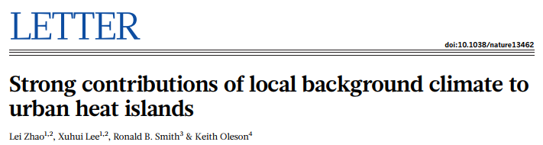
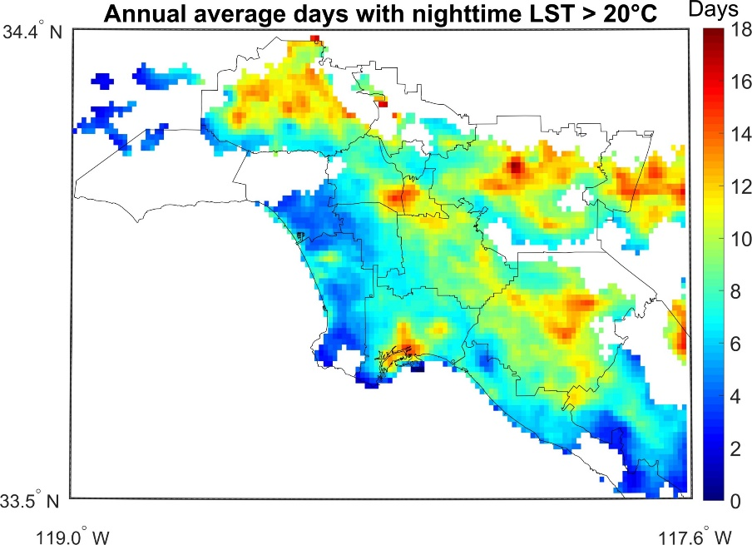
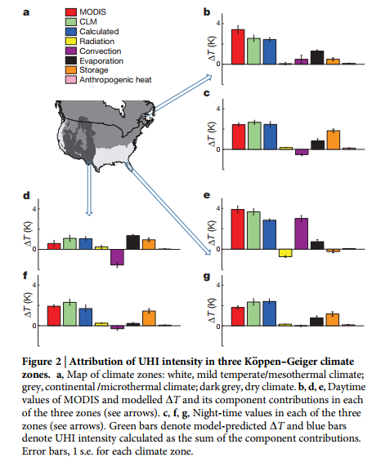
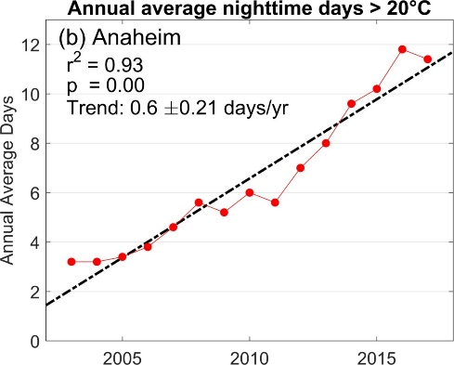
MODIS LST Detects Rising Temperatures and Heat Wave Trends in Urban Environments
Los Angeles
Hulley et al. 2018, RSE
New MOD21 LST product can pinpoint current and future communities that are most vulnerable to the detrimental effects of heat waves and extreme heat in urban areas. Heat vulnerability maps derived from this data can advise local governments on effective climate adaption and mitigation strategies.

Slide 14
Status of MODIS LST&E
Status and Updates:
New LST&E product in Collection 6, reprocessing underway at MODAPS. Release Fall 2018
All issues with product/code resolved. All attributes, metadata, browse images cleared by LPDAAC
MOD21 LST&E Products:
Collection 6: (Release Fall 2018)
    MxD21 L2: Daily 5-min L2 Swath 1km
    MxD21A1: Daily L3 Global 1km
    MxD21A2 8-day L3 Global 1km
Collection 6.1: (Release 2019)
    MxD21C1: Daily 0.05 degree Climate Modeling Grid (CMG)
    MxD21C2: 8-day 0.05 degree Climate Modeling Grid (CMG)
    MxD21C3: Monthly 0.05 degree Climate Modeling Grid (CMG)
Known Issues:
Limited support through next funding cycle resulting in semi-orphaned products.
LST&E (MxD11/MxD21) have 10 different product types! Results in user confusion, reduced usability.
No support or plan forward to retire MxD11 suite of products. Requires analyzing and comparing MxD11/MxD21 products. Potential to reduce to 5 product types from MxD21 (JPL product).
Publications/Documentation:
Hulley, G. C., Malakar, N., Islam, T., Freepartner, R, (2017), NASA’s MODIS and VIIRS Land Surface Temperature and Emissivity Products: A Consistent and High Quality Earth System Data Record, IEEE TGRS, DOI: 10.1109/JSTARS.2017.2779330.
Malakar, N. K., and G. C. Hulley (2016), A water vapor scaling model for improved land surface temperature and emissivity separation of MODIS thermal infrared data, Remote Sensing of Environment, 182, 252-264
User guide and ATBD available at: https://modis.gsfc.nasa.gov/data/dataprod/mod21.php

