Slide 1
MODIS and VIIRS
Data metrics and use cases
by Kara Gergely and Paul Moth

Slide 2
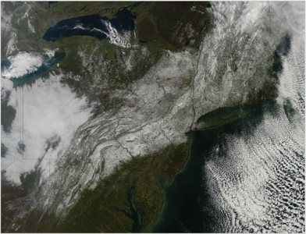
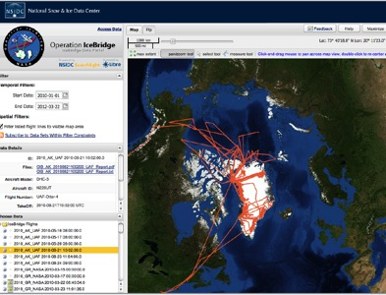
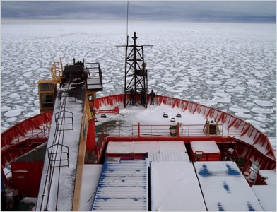
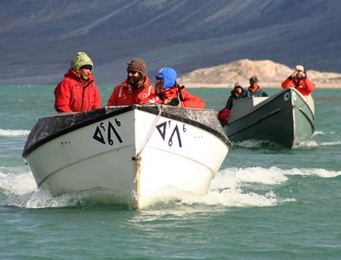
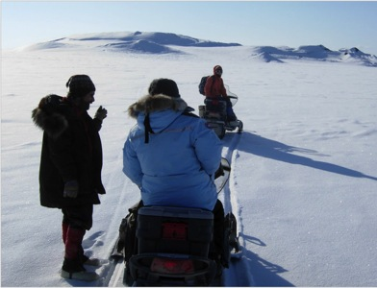
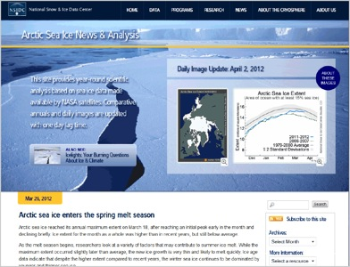





manages and distributes scientific data
provides
tools for
data access
researches the cryosphere
and data science
supports local and traditional knowledge
educates the public about
the cryosphere
supports data users
Notes:
Images:
Column 1, top: The Moderate Resolution Imaging Spectroradiometer (MODIS), on the NASA Terra satellite, captured this image after a major snowstorm over the northeastern U.S., on October 30, 2011.
Column 1, center: The research vessel Aurora Australis navigates through a field of pancake ice near Antarctica.
Column 1, bottom: Researchers collecting snow data in the Alaskan Arctic discuss their next move.
Column 2, top: An interactive mapping tool helps researchers locate the flight paths of Operation IceBridge airborne instruments and access the data.
Column 2, center: Scientists work with community members in Clyde River, Nunavut, Canada.
Column 3, bottom: Arctic Sea Ice News & Analysis shares science and data on this critical climate indicator with a broad audience.
Slide updated 10/31/2012

Slide 3

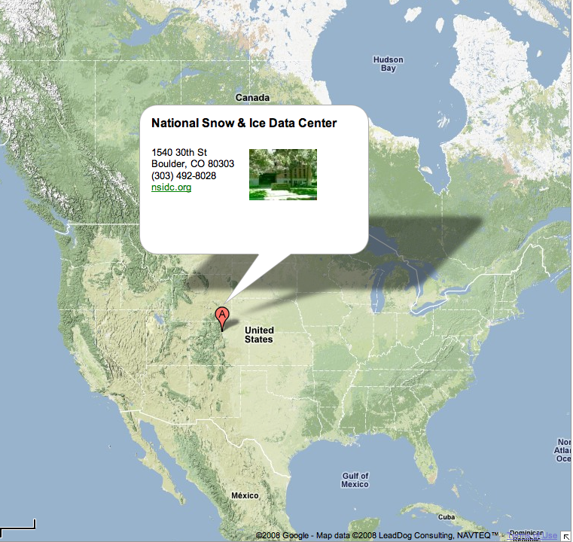



Affiliations
Cooperative Institute
for Research in Environmental Sciences
World Data System
Sponsors

Slide 4
MODIS Global Distribution
316,000 GBs and 217 million science files distributed since 2000

Slide 5
MODIS Global Distribution
Distributed to ~125 countries since 2000
Top 10 | # of Users
United States | 3935
China | 2842
Iran | 1134
Germany | 854
United Kingdom | 798
Canada | 717
Pakistan | 624
Italy | 601
India | 538
Chile | 423

Slide 6
MODIS Global Distribution

Slide 7
MODIS Users by Product
4974 MODIS users in prior year
Shortname | Longname | # of Users
MOD10_L2 | MODIS/Terra Snow Cover 5-Min L2 Swath 500m | 238
MOD10A1 | MODIS/Terra Snow Cover Daily L3 Global 500m Grid | 2,356
MOD10A2 | MODIS/Terra Snow Cover 8-Day L3 Global 500m Grid | 1,388
MOD10C1 | MODIS/Terra Snow Cover Daily L3 Global 0.05Deg CMG | 295
MOD10C2 | MODIS/Terra Snow Cover 8-Day L3 Global 0.05Deg CMG | 143
MOD10CM | MODIS/Terra Snow Cover Monthly L3 Global 0.05Deg CMG | 594
MOD29 | MODIS/Terra Sea Ice Extent 5-Min L2 Swath 1km | 130
MOD29E1D | MODIS/Terra Sea Ice Extent and IST Daily L3 Global 4km EASE-Grid Day | 80
MOD29P1D | MODIS/Terra Sea Ice Extent Daily L3 Global 1km EASE-Grid Day | 108
MOD29P1N | MODIS/Terra Sea Ice Extent Daily L3 Global 1km EASE-Grid Night | 22
MYD10_L2 | MODIS/Aqua Snow Cover 5-Min L2 Swath 500m | 70
MYD10A1 | MODIS/Aqua Snow Cover Daily L3 Global 500m Grid | 775
MYD10A2 | MODIS/Aqua Snow Cover 8-Day L3 Global 500m Grid | 200
MYD10C1 | MODIS/Aqua Snow Cover Daily L3 Global 0.05Deg CMG | 110
MYD10C2 | MODIS/Aqua Snow Cover 8-Day L3 Global 0.05Deg CMG | 47
MYD10CM | MODIS/Aqua Snow Cover Monthly L3 Global 0.05Deg CMG | 198
MYD29 | MODIS/Aqua Sea Ice Extent 5-Min L2 Swath 1km | 99
MYD29E1D | MODIS/Aqua Sea Ice Extent and IST Daily L3 Global 4km EASE-Grid Day | 67
MYD29P1D | MODIS/Aqua Sea Ice Extent Daily L3 Global 1km EASE-Grid Day | 70
MYD29P1N | MODIS/Aqua Sea Ice Extent Daily L3 Global 1km EASE-Grid Night | 32

Slide 8
VIIRS Distribution Since 2017
240,000 GBs and 204,232 science files distributed to 19 countries
 | # of Users | Volume (GBs) | Files
VIIRS | 95 | 14003 | 204,232
VNP10 | 55 | 1385 | 55,030
VNP29 | 18 | 8760 | 98,660
VNP30 | 36 | 3858 | 50,542

Slide 9
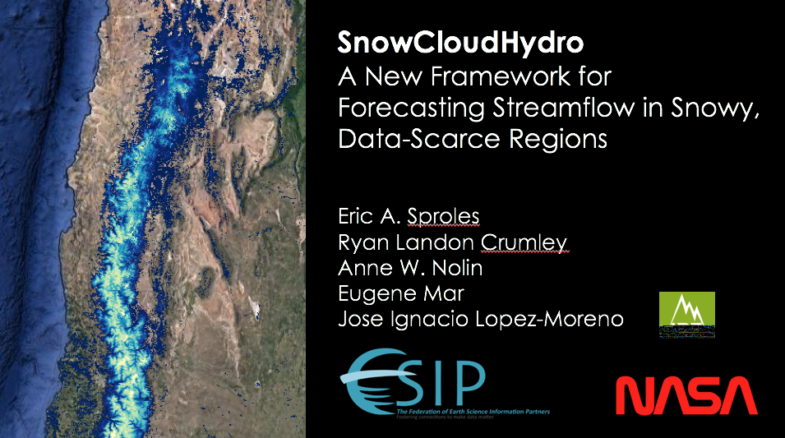
NSIDC MODIS Use Case

Slide 10
NSIDC MODIS Use Case
Using Google Earth Engine to assess monthly snow cover frequency and previous months streamflow to predict the next months stream flow (Sproles et al., 2016)
Assist water managers, scientists, and local populations in determining stream flow for water storage, agriculture, water use, etc.
Cloud is particularly useful in these remote regions where data and bandwidth are inconsistent or unavailable

Slide 11
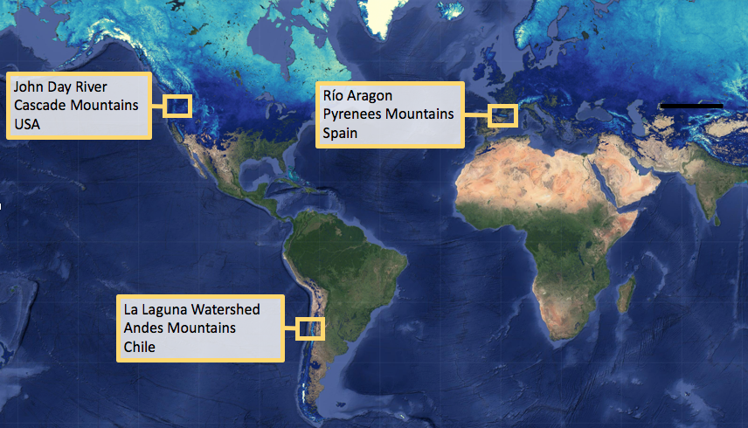
NSIDC MODIS Use Case

Slide 12
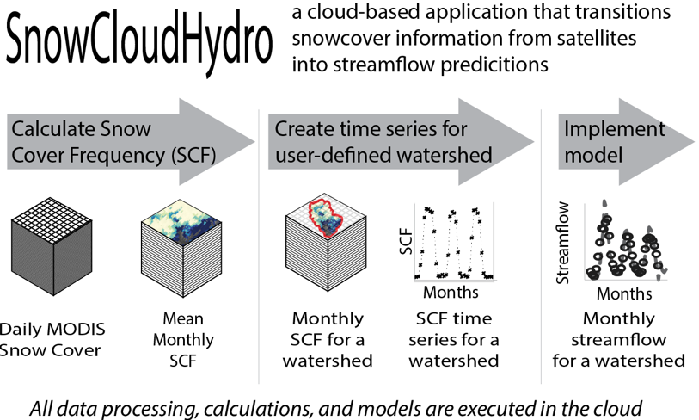
NSIDC MODIS Use Case

Slide 13
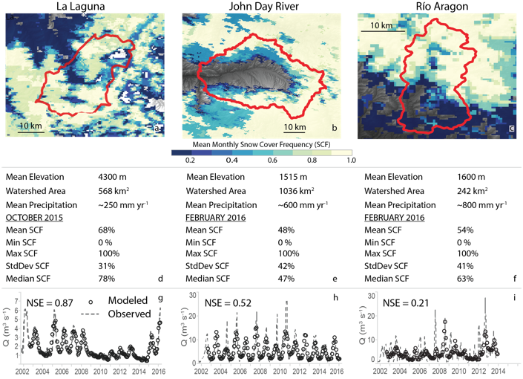
NSIDC MODIS Use Case

Slide 14
NSIDC MODIS Use Cases
Wyoming Game and Fish Department using snow cover data to gauge severity of winters as it relates to big game herds
Calibration of parameters in snow-runoff models using MODIS snow cover
Franz, K. J., & Karsten, L. R. (2013). Calibration of a distributed snow model using MODIS snow covered area data. Journal of Hydrology, 494, 160–175. https://doi.org/10.1016/j.jhydrol.2013.04.026
He, Z. H., Parajka, J., Tian, F. Q., & Blöschl, G. (2014). Estimating degree-day factors from MODIS for snowmelt runoff modeling. Hydrology and Earth System Sciences, 18(12), 4773–4789. https://doi.org/10.5194/hess-18-4773-2014
Published research: https://nsidc.org/data/modis/research.html
kara.gergely@nsidc.org
  paul.moth@nsidc.org

