Slide 1
Objective of the Land Session
Agenda
Response to Paula’s Topics/Suggestions
MODIS C6 and 6.1 – update /housekeeping
VIIRS Delivery
LPDAAC and NSIDC Distribution Status – product use
VIIRS and Sentinel 3 Surface Reflectance
NOAA S-NPP and NOAA-20 Land Products
Land Product Strategy - Initial Discussion (topic for a Land Products Workshop Spring 2019)
HQ Land Perspective (Hank Margolis)
Any other business?

Slide 2
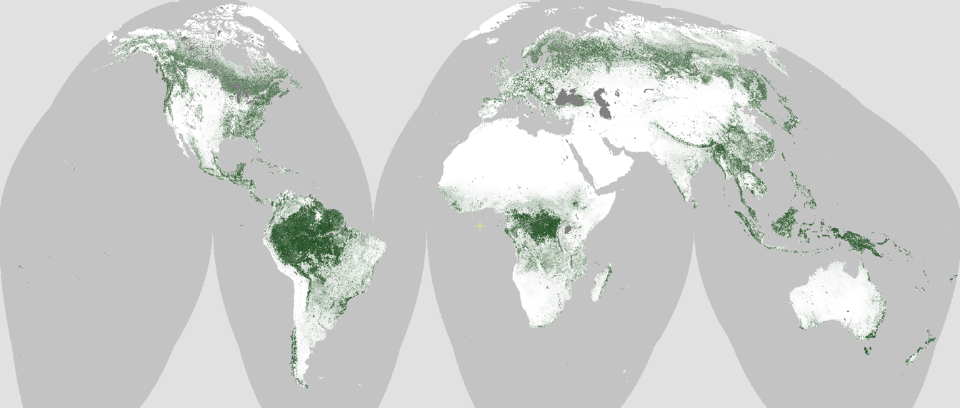
MODIS MOD44B Vegetation Continuous Fields:
A Functional Baseline for Biogeochemical Parameterizations Charlene DiMiceli¹, John Townshend¹, Robert Sohlberg¹ ¹University of Maryland
Figure 1.
MODIS VCF
Percent Tree
Cover
Figure 1: MODIS VCF Percent Tree Cover layer (MOD44B, Collection 6.0) for 2016 at 250m resolution.
Increasing numbers of users in diverse research fields depend on MODIS Vegetation Continuous Fields (VCF) to provide fundamental fractional cover data. VCF products are unique in providing three complimentary fractional cover layers: tree cover, non-tree vegetation and bare ground, globally and annually. Our primary goal is to extend these crucial fractional cover products to VIIRS production to ensure to the community.
Figure 2.
Growing
number of
user citations
referencing
MODIS VCF.
Figure 2: Google Scholar citations w. the phrase “MODIS Vegetation Continuous Fields” / “MODIS VCF.” 2140 total citations since 2000 and the present.

Slide 3
Name: Charlene DiMiceli, Geographical Sciences, University of Maryland E-mail: cdimicel@umd.edu Phone: 301-780-3967
Scientific significance, societal relevance, and relationships to future missions: Vegetation fractional cover is one of the most widely used characterizations of the land surface; it provides fundamental data for monitoring deforestation, parameterizing climate and carbon models and researching climate change among many other applications. MODIS VCF products are unique in providing not just fractional tree cover, but also non-tree vegetation and bare ground layers. VCF products are a necessary input for the creation of Landsat-resolution tree cover products (Hansen et al. 2013). VIIRS will eventually replace MODIS for the long term land data record. It is therefore, imperative to incorporate VCF products into the VIIRS product suite in order to continue to provide the user community with these crucial datasets.
References:
DeFries, R. S., J. R. G. Townshend, and M. C. Hansen. “Continuous Fields of Vegetation Characteristics at the Global Scale at 1-km Resolution.” Journal of Geophysical Research 104, no. D14 (1999): 16911–16923.
DeFries, R. S., and Jonathan Cheung-Wai Chan. "Multiple criteria for evaluating machine learning algorithms for land cover classification from satellite data." Remote Sensing of Environment 74, no. 3 (2000): 503-515.
Defries, R. S., M. C. Hansen, and J. R. G. Townshend. “Global Continuous Fields of Vegetation Characteristics: A Linear Mixture Model Applied to Multi-year 8 Km AVHRR Data.” International Journal of Remote Sensing 21, no. 6–7 (January 2000): 1389–1414.
Hansen, M.C, R.S DeFries, J.R.G Townshend, R Sohlberg, C DiMiceli, and M Carroll. “Towards an Operational MODIS Continuous Field of Percent Tree Cover Algorithm: Examples Using AVHRR and MODIS Data.” Remote Sensing of Environment 83, no. 1–2 (November 2002): 303–319.
Hansen, M.C., R.S. DeFries, J.R.G. Townshend, M. Carroll, C. DiMiceli, and R.A. Sohlberg. “Development of 500 Meter Vegetation Continuous Field Maps Using MODIS Data.” 1:264–266. IEEE, n.d. http://ieeexplore.ieee.org/lpdocs/epic03/wrapper.htm?arnumber=1293745.
Hansen, Matthew C., DeFries, Ruth S., Townshend, John R. G., Carroll, Mark, DiMiceli, Charlene, and Sohlberg, Robert A. “Global Percent Tree Cover at a Spatial Resolution of 500 Meters: First Results of the MODIS Vegetation Continuous Fields Algorithm.” Earth Interactions 7, no. 10 (October 2003): 1–15.
Hansen, Matthew C., and Ruth S. DeFries. “Detecting Long-term Global Forest Change Using Continuous Fields of Tree-Cover Maps from 8-km Advanced Very High Resolution Radiometer (AVHRR) Data for the Years 1982-99” Ecosystems 7, no. 7 (July 9, 2004): 695–716.
Hansen, Matthew C., Peter V. Potapov, Rebecca Moore, Matt Hancher, S. A. Turubanova, Alexandra Tyukavina, David Thau et al. "High-resolution global maps of 21st-century forest cover change." science 342, no. 6160 (2013): 850-853.
Notes:
3

Slide 4
Discussion for Week/Break Outs
Goal: Earth System Data Records - Continuity (MODIS to VIIRS2038)
Data product/algorithm identification, including gaps for each mission/sensor
SIPS resources needed, tied to Category 1 and Category 2 data products
Continuity to JPSS – was in original solicitation and was tabled. SIPS have processing funds for EOS data product continuity as per the last SIPS meeting, but question is to whether the PIs could work assessment of JPSS-1 data products with small investment…
SIPS were not included but if they were recompeted, and there was the opportunity for the competing institutions/SIPS to come in with an expansion of capability to support, say, non-NASA satellite data processing, would this be helpful or useful or not welcome at all?
Reprocessing – “staged delivery”
ATBD process, old, new, evolution of ideas? ATBD/Data Product Documentation and Reviews: Documentation on web sites lacking for Sensor/Team/ATBDs/Data – new (and existing?) users (especially in the applied/operational world) need to find the details
Quantify instrument and measurement performance (e.g. calibration, stability)
MCST and VCST continuity
Need to be able to validate our space-based estimated Earth system properties
Acquired from multiple sensors / datasets - Aerosols, Clouds, Ocean Chemistry/Biology – PACE (and land capabilities?) + EV’s and DS?

Slide 5
Discussion for Week/Break Outs
Suomi NPP VIIRS – “assessments” of continuity data products (& new)
Are all VIIRS created equal (MODIS-T v. MODIS-A) if continuity to JPSS
Does VIIRS have the capability to produce all MODIS/EOS continuity data products?
If it does not, what is the solution?
If it does, then great, but there may be challenges to producing a given product (no PI to maintain/improve, time needed for assessment and continuity, etc.)
Uncertainties associated with data products (more to come…)
NOAA Data products – different? Better? Worse? Funding?
Orphaned algorithms and other activities that were not recommended/proposed: Do we continue to produce these without an algorithm PI to manage?
For the products that we can attempt MODIS to VIIRS continuity, sounds as if many of these efforts are pushing ahead; however, quality assessments are underway in parallel, and it may be some time….
Algorithm developers and validation investigators should continue to address important deficiencies in key data products (uncertainties
Evolution to measurement teams and blend with MODIS-VIIRS Team (w/other mission teams)

Slide 6
Response to Paula’s discussion request
Current Land Proposals - are we clear on where the land products fit ?
2.1 Sensor Fusion
2.2 New Data Products - Evaluation, Testing, SIPS Integration and Test
(Cat 2. Data Plan daily archive volume, processing cycles, ancillary data and software.)
2.3 Continuity Product Creation (Standard Cat 1. )
2.4 NRT (LANCE) – are there any new LANCE products (Diane)?
Does the Land SIPS have the information it needs.
VIIRS Negotiated status –
Ranga LAI 1yr TE (incl. code to generate LAI/FPAR LUTS)
Glynn LST/E 1yr (code deliveries)
Louis VIIRS BA 3yrs (Algorithm porting and interface with VCST)

Slide 7
Response to Paula’s discussion request
Orphaned Products to be managed by Land SIPS
VI,
LAI/FPAR?
LST – next step to reduce number of products?
Landcover – MODIS >NOAA VIIRS Annual ?
Increased science presence in QA – LDOPE
SIPS increasingly involved in coding
Senior Review MODIS Maintenance ($M13.05)
What is the work load ?
Who is benefiting from the Land Calibration work (LSR + Thermal) ?
VIIRS Readiness for Senior Review 2020
Efficiencies w. MODIS Maintenance?
Readiness of New Data Products?

Slide 8
Response to Paula’s discussion request
Ocean SIPS will – “establish a new set of product documentation for the current standard product suite of MODIS & VIIRS, and maintain that level of documentation going forward”
What does the Land community really need to understand and use the data (User Guides – anything else?)
MODLAND + VIIRS Land Website Integration (SIPS)
LAND SIPS recompete
To include non-NASA data processing ?
Sentinel 3 (AM OLCHI, SLSTR) – where would the algorithm testing and product development to be done ?
EV’s and Decadal Survey Missions - TBD?
A new Land SIPS infrastructure – open code, cloud compute, traceability
MCST/VCST Calibration
How do the two MODIS Senior Review Funded Products contribute?
Validation and Uncertainties – leveraging CEOS LPV ?

Slide 9
Ocean Product Lifecycle: from concept to standard product
LAND is more complex than Oceans – more products / dependencies
PI develops new algorithm or modification, demonstrates feasibility, perhaps publishes results.
If PI and Ocean Team Leader agree, PI works with SIPS to implement in NASA processing code and to develop a test plan for verification and large-scale testing.
If PI is satisfied with implementation tests, and SIPS confirms that required computing resources are available, evaluation products and documentation will be produced and distributed, and the algorithm will be incorporated into SeaDAS.
PI works with SIPS to develop or update the Product Description Document (to be hosted under “evaluation products”).
SIPS/DAAC begins production and distribution of product
PI performs assessment of results (validation, global dist., trends)
Before the next mission reprocessing opportunity, PI/SIPS/DAAC and Program Management review the performance evaluation, documentation, and appropriateness for standard production.

Slide 10
Some Concerns
“Algorithm developments for Standard Products may be important, but they do not generate much excitement on the part of reviewers or program managers.”
What does NASA want to do re. land products?
All products require algorithm development
What does ‘the community’ need/want in terms of Land Products
Who are the ‘champion users’ ?
Missions to Measurements redux – BUT the Missions have the money – so how will that work? - refocus MEASURES with Science Oversight.
EOS NASA Land Products – MODIS/VIIRS, ASTER, MISR
New IT infrastructure – SMAP, HLS,
Coming – ICESAT 2 Ecostress, GEDI, NISAR

Slide 11
Land Team Foci for this Meeting
MODIS + VIIRS product maintenance > Senior Review
Securing Data Continuity MODIS> VIIRS> NOAA 20 >
Towards Long-term Land Earth Science Data Records
Missions > Measurements Redux
Greater focus on multi-instrument products and science
International instruments (e.g. Sentinel 3 a/b AM orbit)
Experimental Products (Evaluation/Test) > Standard Products
Sustained Production (at the end of funding cycle)
Need for QA Metadata and QA Process
Product Validation on limited budgets (leverage CEOS LPV)
Evolving the Land SIPS for multi-instrument data
IT Infrastructure
Increased Science Stewardship for Orphaned Products
User’s Guides as Living Documents (dynamic URLs, DOIs)
Strategy for
Land Products
Workshop
Spring 2019
Community
Input
Next Funding
Cycle

