Slide 1
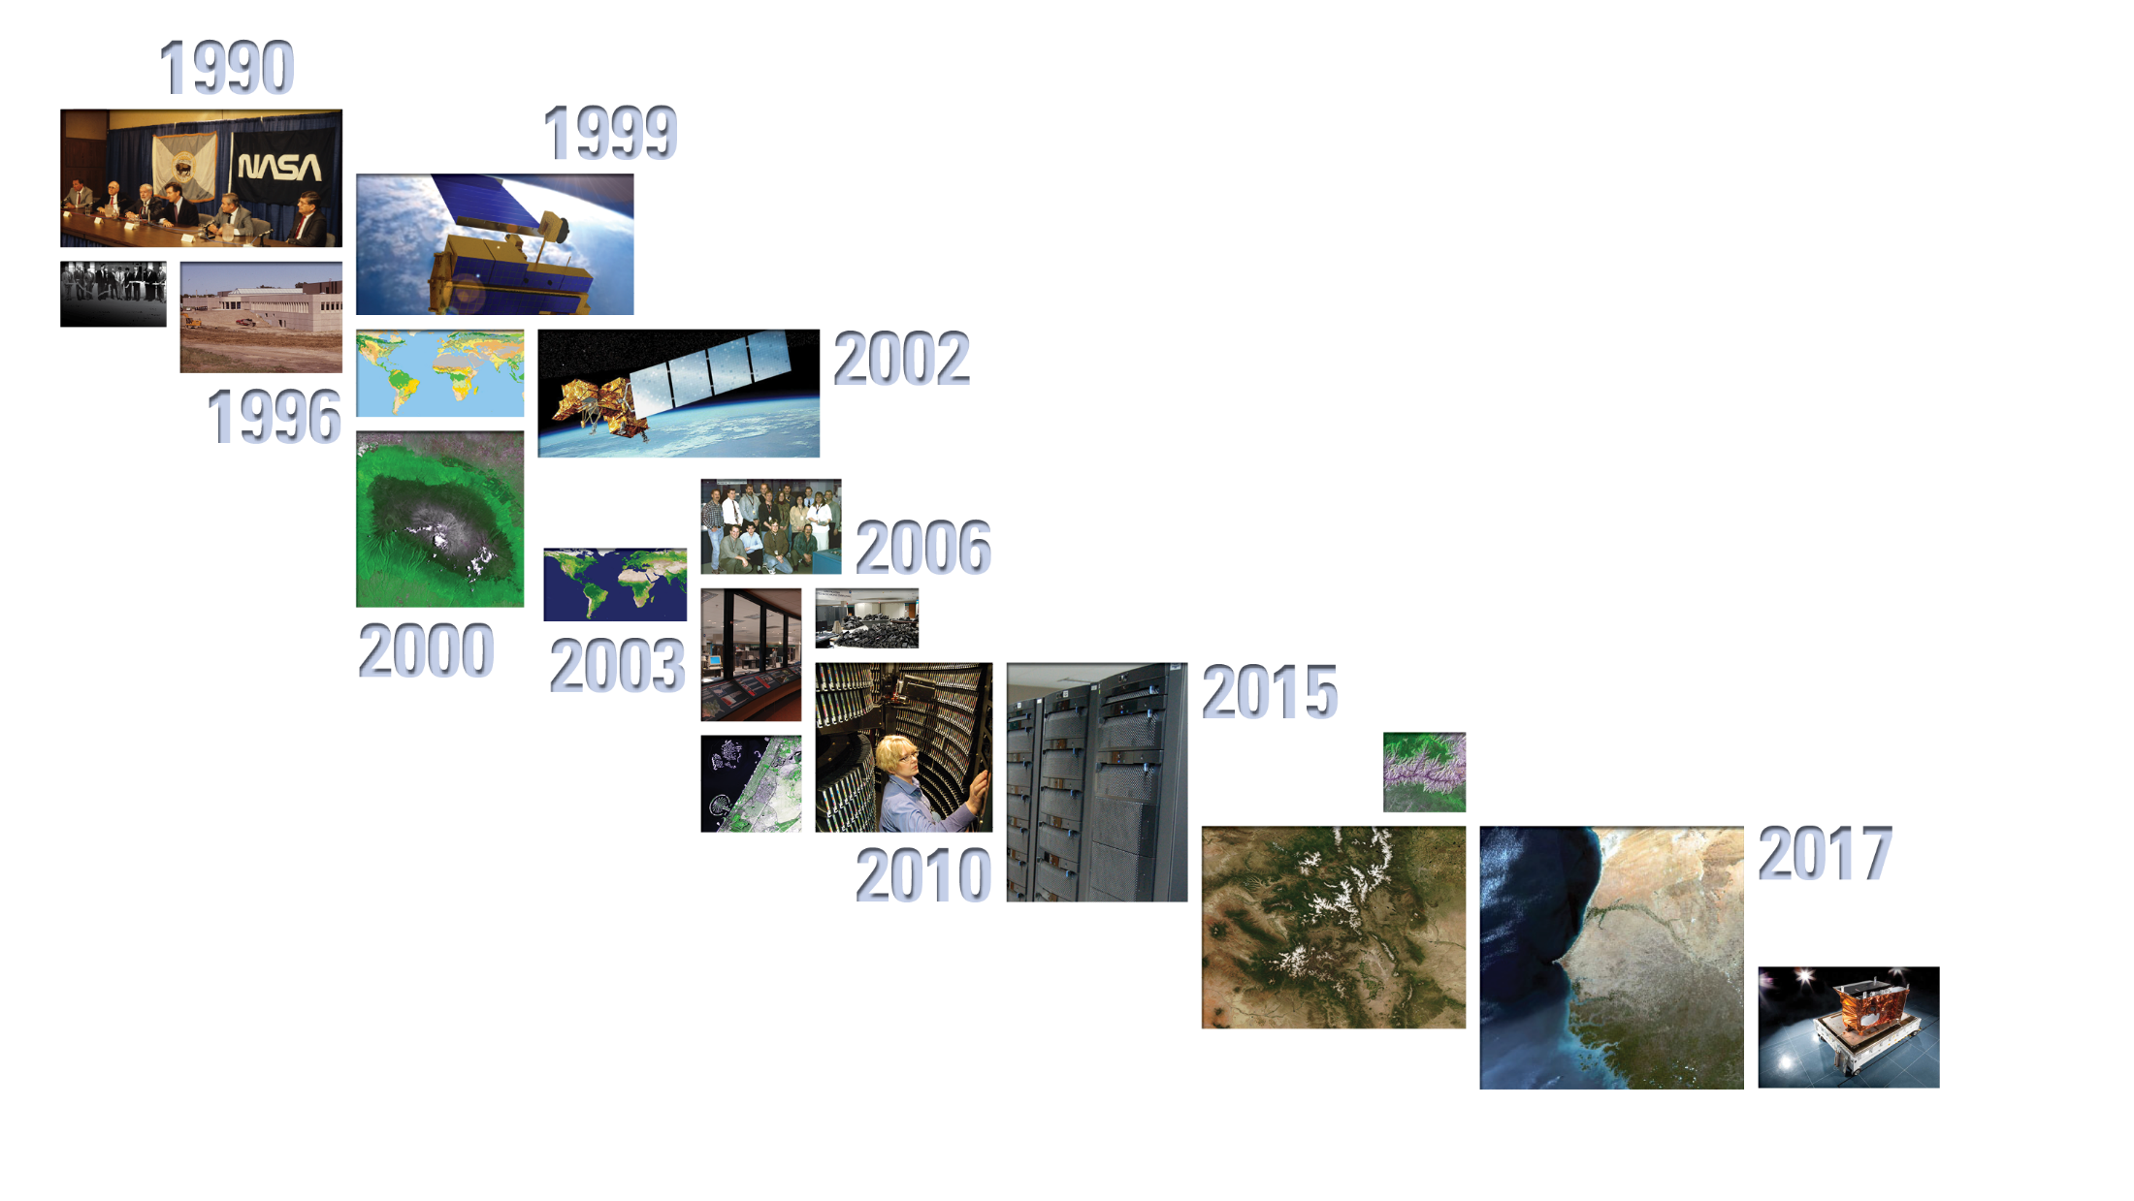
LP DAAC Updates
Tom Maiersperger
USGS EROS / NASA LP DAAC
MODIS / VIIRS Science Team Meeting
October 16, 2018

Slide 2
LP DAAC Overall User Satisfaction Trend

Slide 3
LP DAAC MODIS Land Data Distribution (thru 9/2018)
Midpoint of volume distributed (9.22 PB) occurred in May 2015
In the last year, distribution is averaging ~ 300TB and ~16M files/month
In 2019, cumulative volume distribution will exceed 20 petabytes and cumulative file distribution will exceed one billion

Slide 4
LP DAAC MODIS Land Data Distribution – 1 Year Detail
For period October 1, 2017 – September 30, 2018
n = 16,530

Slide 5
LP DAAC MODIS Land Data Distribution – 1 Year Detail
For period October 1, 2017 – September 30, 2018
Eight products had > 1,000 unique users:
Product | Shortname | Version | Unique Users
MODIS/Terra Vegetation Indices 16-Day L3 Global 250m SIN Grid | MOD13Q1 | 6 | 3,547
MODIS/Terra+Aqua Land Cover Type Yearly L3 Global 500m SIN Grid | MCD12Q1 | 51 | 1,948
MODIS/Terra Land Surface Temperature/Emissivity Daily L3 Global 1km SIN Grid | MOD11A1 | 6 | 1,836
MODIS/Terra Surface Reflectance 8-Day L3 Global 500m SIN Grid | MOD09A1 | 6 | 1,716
MODIS/Terra Land Surface Temperature/Emissivity 8-Day L3 Global 1km SIN Grid | MOD11A2 | 6 | 1,582
MODIS/Terra Net Evapotranspiration 8-Day L4 Global 500m SIN Grid | MOD16A2 | 6 | 1,310
MODIS/Terra Vegetation Indices 16-Day L3 Global 500m SIN Grid | MOD13A1 | 6 | 1,085
MODIS/Terra Surface Reflectance Daily L2G Global 250m SIN Grid | MOD09GQ | 6 | 1,034
12 products had 500-999 unique users
57 products had 100-499 unique users
78 products had 10-99 unique users
118 products had 1-9 unique users

Slide 6
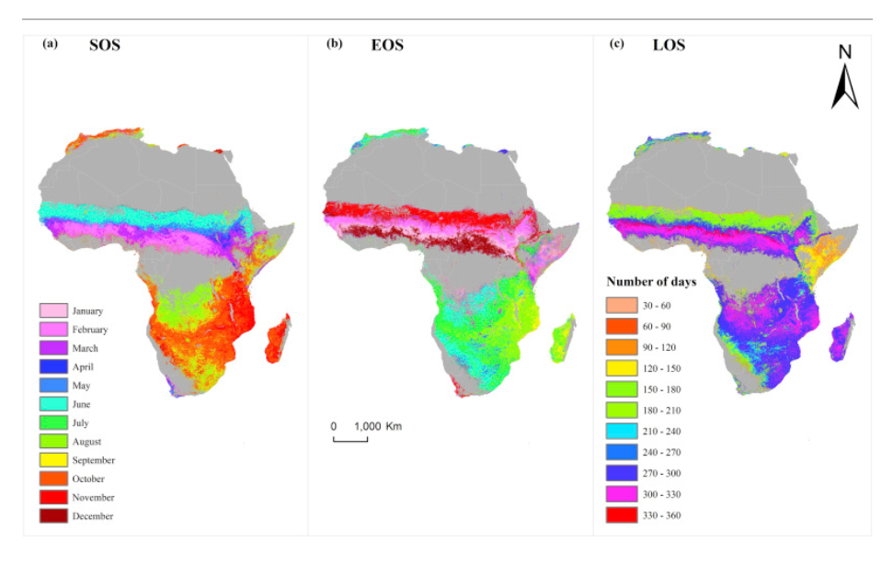
Adole, T., Dash, J., & Atkinson, P. M. (2018). Characterising the land surface phenology of Africa using 500 m MODIS EVI. Applied Geography, 90, 187–199. https://doi.org/10.1016/j.apgeog.2017.12.006
The LSP of the major vegetation types in Africa was described for the first time using...12 years (2001–2012) MODIS land cover data (MODIS MCD12Q1) and EVI derived from the MODIS MOD09A1 product.
The maps of LSP parameters (SOS, EOS, LOS) produced here represent the finest spatial resolution and most detailed maps of the phenology of Africa to-date.
The inter-annual variability of all LSP parameters for all of Africa was reported for the first time.

Slide 7
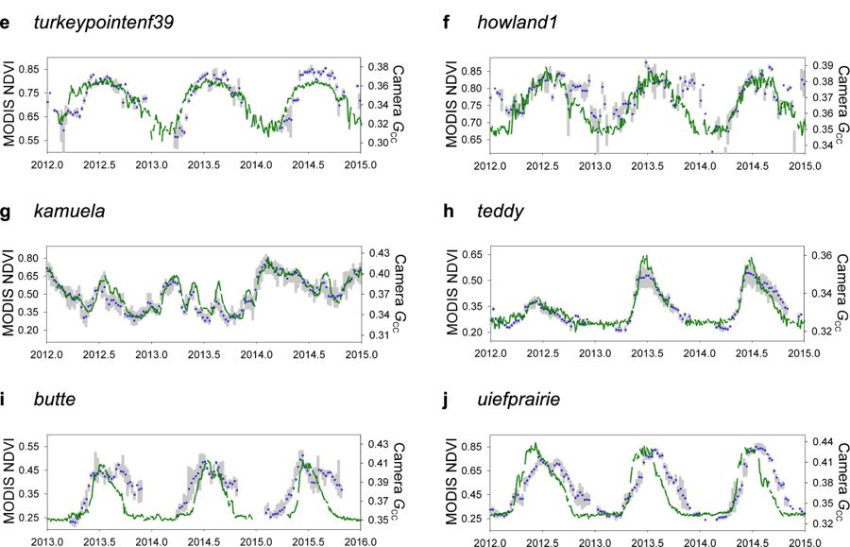
Richardson, A. D., Hufkens, K., Milliman, T., & Frolking, S. (2018). Intercomparison of phenological transition dates derived from the PhenoCam Dataset V1.0 and MODIS satellite remote sensing. Scientific Reports, 8(1). https://doi.org/10.1038/s41598-018-23804-6
Multi-scale monitoring of vegetation phenology
Time series intercomparison of phenological transition dates, MODIS vegetation indices

Slide 8
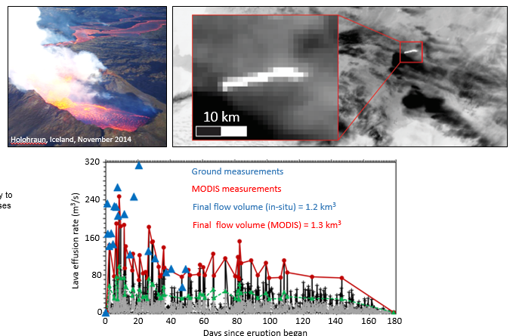
Bonny, E., Thordarson, T., Wright, R., Höskuldsson, A., & Jónsdóttir, I. (2018). The Volume of Lava Erupted During the 2014 to 2015 Eruption at Holuhraun, Iceland: A Comparison Between Satellite- and Ground-Based Measurements. Journal of Geophysical Research: Solid Earth, 123(7), 5412–5426. https://doi.org/10.1029/2017jb015008
Predicting the end of lava flow forming volcanic eruptions - MODIS allows us to measure the thermal emission from the active lava flow (below, right), and how this varies with time. This is proportional to the lava effusion rate, and we often see the predicted waxing-waning effusion rate pattern in MODIS time-series. The MODIS-derived effusion rates compare well to those estimated on the ground (bottom)

Slide 9
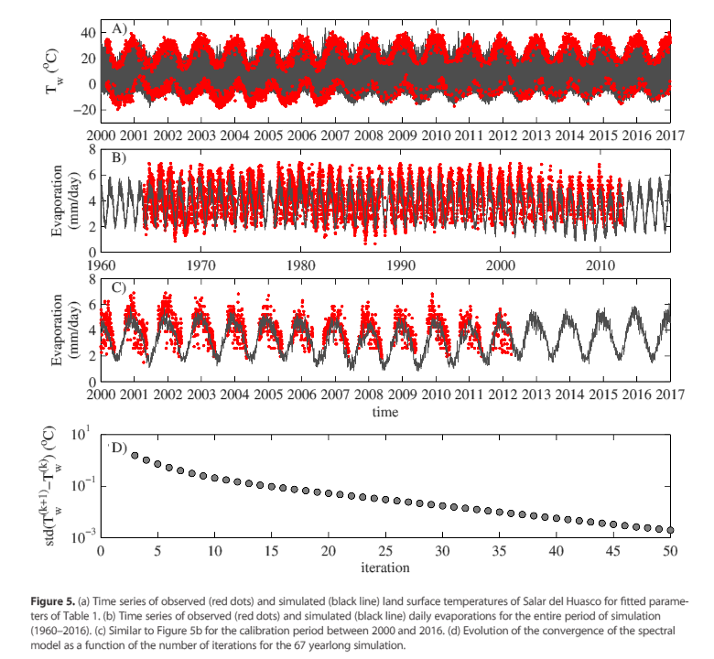
de la Fuente, A., & Meruane, C. (2017). Spectral model for long-term computation of thermodynamics and potential evaporation in shallow wetlands. Water Resources Research, 53(9), 7696–7715. https://doi.org/10.1002/2017wr020515
…model solves for water and sediment temperature, as well as heat, momentum, and mass exchanged with the atmosphere.
The parameters of the model (water depth, thermal properties of the sediments, and surface albedo) and the atmospheric downscaling were calibrated using the MODIS product of the land surface temperature
…suitable tool for assessing the global climate change effects on shallow wetlands whose thermodynamics is forced by heat exchanges with the atmosphere and modulated by the heat‐reservoir role of the sediments.

Slide 10
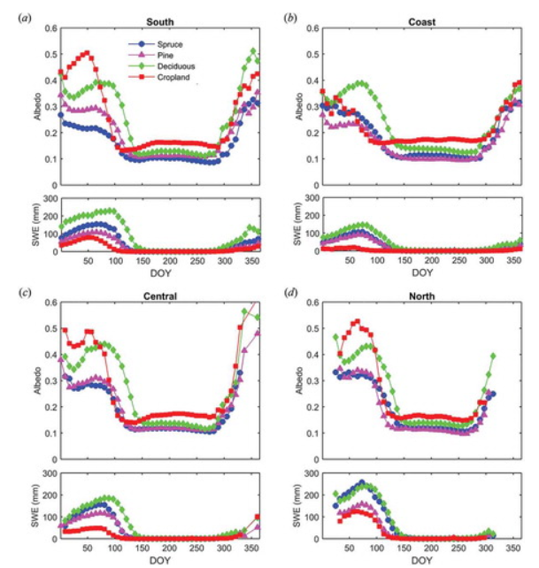
Cherubini, F., Vezhapparambu, S., Bogren, W., Astrup, R., & Strømman, A. H. (2017). Spatial, seasonal, and topographical patterns of surface albedo in Norwegian forests and cropland. International Journal of Remote Sensing, 38(16), 4565–4586. https://doi.org/10.1080/01431161.2017.1320442
…use satellite retrievals of Moderate Resolution Imaging Spectroradiometer (MODIS) surface albedo (MCD43A3), high-resolution land-cover maps, and meteorological records to characterize climatological albedo variations in Norway across latitude, seasons, land-cover type (deciduous forests, coniferous forests, and cropland), and topography.
By integrating satellite measurements and high-resolution vegetation maps, our results provide a large semi-empirical basis that can assist future studies to better predict changes in a fundamental climate-regulating service such as surface albedo.

Slide 11
Aguiar, D., Mello, M., Nogueira, S., Gonçalves, F., Adami, M., & Rudorff, B. (2017). MODIS Time Series to Detect Anthropogenic Interventions and Degradation Processes in Tropical Pasture. Remote Sensing, 9(1), 73. https://doi.org/10.3390/rs9010073
Time series of MODIS EVI2 data have the potential to be used for detecting degradation processes in tropical pastures, as well as anthropogenic interventions (i.e., renewal/recovery and reformation).

Slide 12
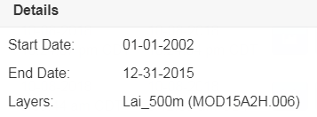
Application for Extracting and Exploring Analysis Ready Samples (AppEEARS)

Slide 13
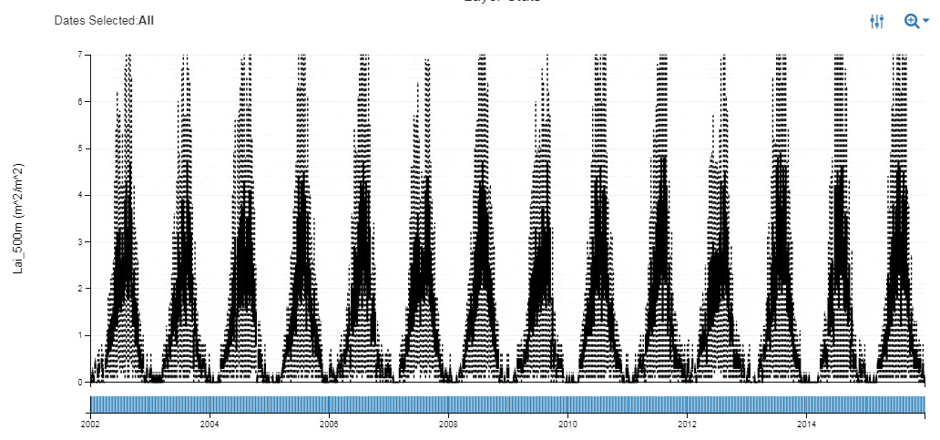
Application for Extracting and Exploring Analysis Ready Samples (AppEEARS)

Slide 14
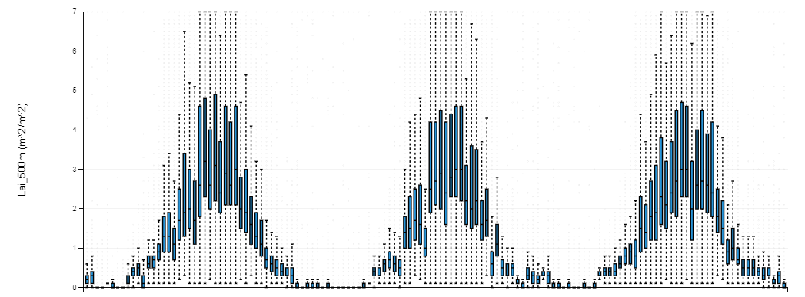
Application for Extracting and Exploring Analysis Ready Samples (AppEEARS)

