Slide 1
VIIRS and Sentinel 3 Surface Reflectance
Eric Vermote
NASA Goddard Space Flight Center, Code 619, Greenbelt, MD 20771, United States
Eric.f.vermote@nasa.gov

Slide 2
A Land Climate Data Record
Multi instrument/Multi sensor Science Quality Data Records used to quantify trends and changes
81
82
83
84
85
86
87
88
89
90
91
92
93
94
95
96
97
98
99
00
01
02
03
04
05
06
07
08
09
10
11 12 13 14 15 16 17
METOP
AVHRR
N07
N09
N11
N09
N14
N16
N18
N19
SPOT VEGETATION
Terra
MODIS
Aqua
AVHRR (GAC) 1982-1999 + 2002-present
MODIS (MO(Y)D09 CMG) 2000-present
VIIRS 2012 – present
SPOT VEGETATION 1999-2000
Sentinel 3 2016
NPP
VIIRS
JPSS 1
Sentinel 3
Emphasis on data consistency – characterization rather than degrading/smoothing the data

Slide 3
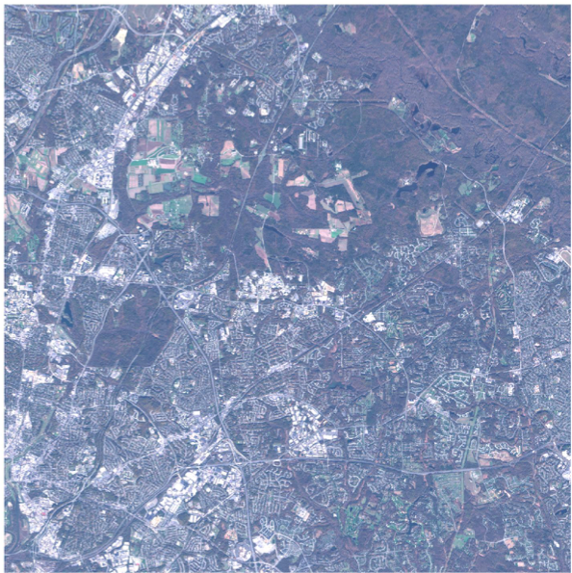
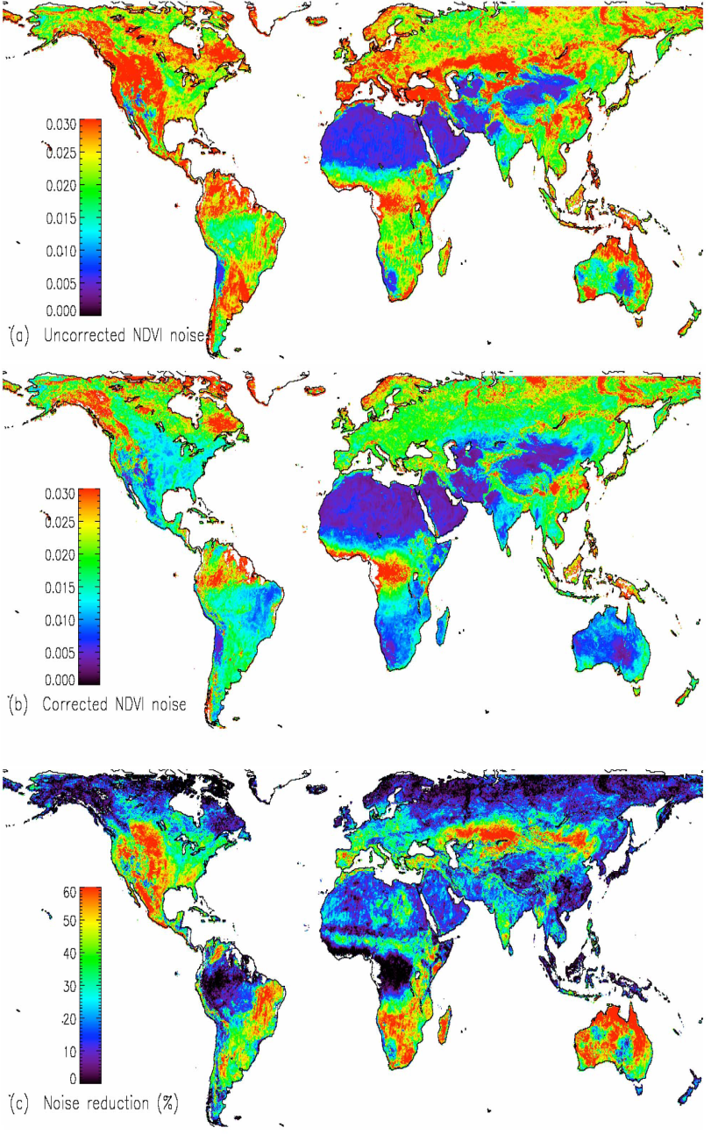
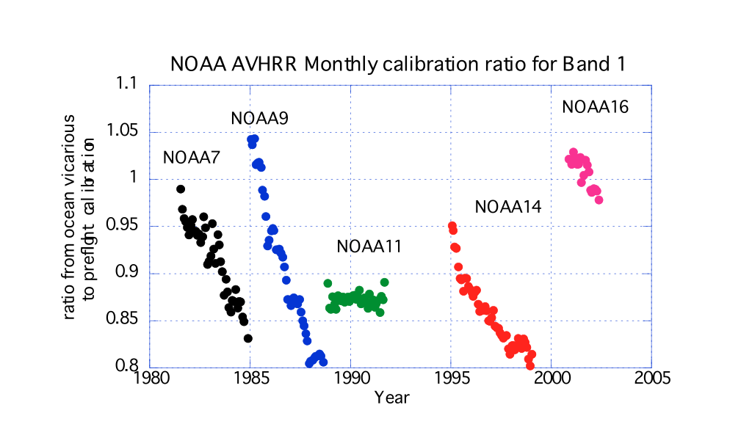
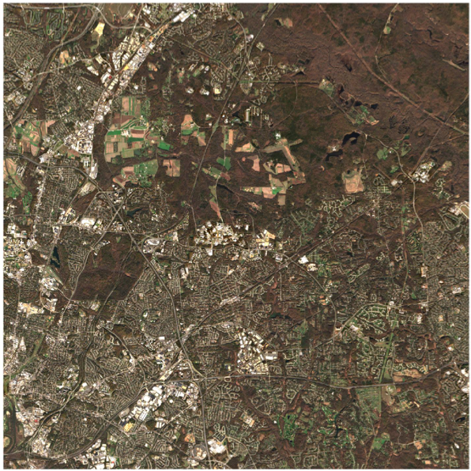
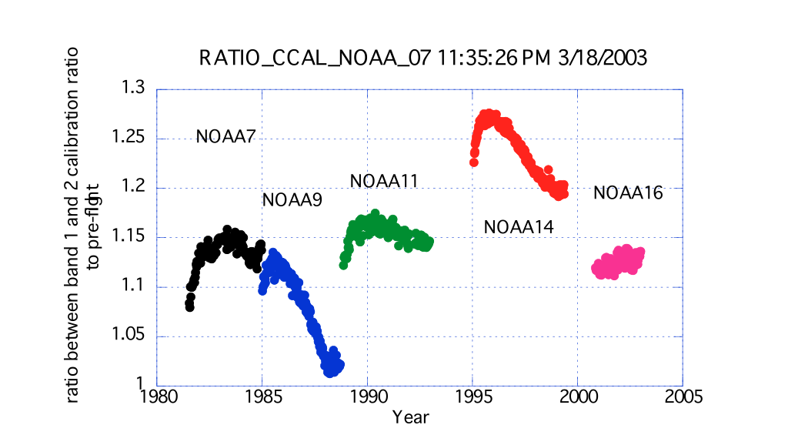
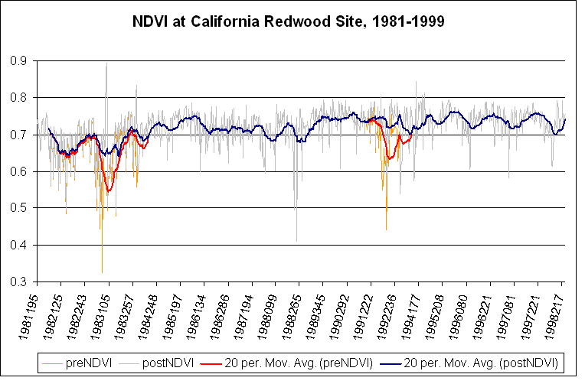
Land Climate Data Record (Approach)
Needs to address geolocation,calibration, atmospheric/BRDF correction issues
ATMOSPHERIC CORRECTION
CALIBRATION
BRDF CORRECTION
Degradation in channel 1
(from Ocean observations)
Channel1/Channel2 ratio
(from Clouds observations)
El Chichon
Pinatubo

Slide 4
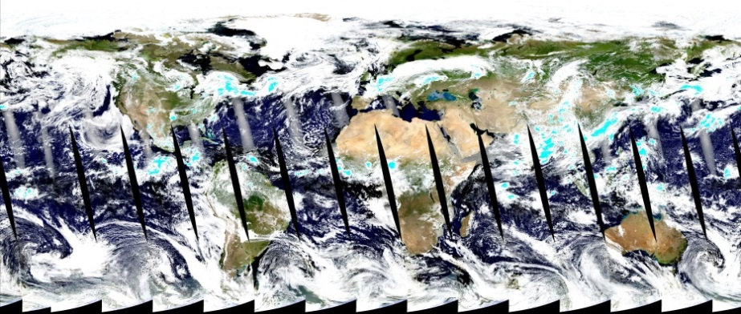
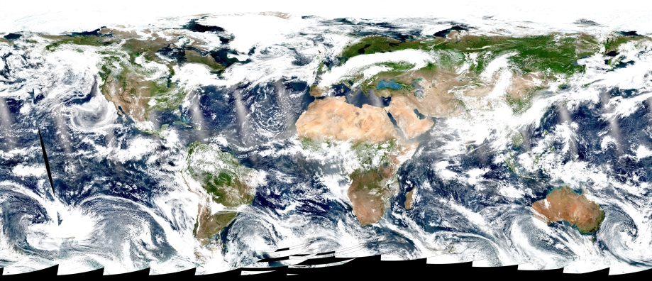
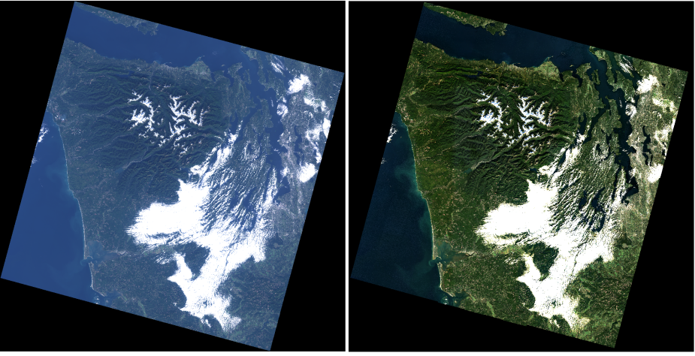
Atmospheric correction (AC)
Estimate of the surface spectral reflectance, as would have been measured at ground level if there were no atmospheric scattering or absorption
Generic approach for AC for multiple sensors
AC products for EO sensors:
MODIS (Terra, Aqua)
Products: MOD09, MYD09
VIIRS (S-NPP)
Products: VNP09
OLI (Landsat-8) and MSI (Sentinel-2)
LaSRC algorithm/product
Harmonization Landsat / Sentinel 2 (HLS) project
USGS’ on demand SR product for OLI
A true color composite of MODIS/Aqua (top) and VIIRS/S-NPP (bottom) images acquired on July, 1, 2017
(Vermote et al., 2016, RSE)

Slide 5
Generic approach for aerosol inversion and atmospheric correction
Reading Inputs, LUT and Ancillary data
ρ_{surf} determined (*) using ρ_{atm}, T_{atm} and S_{atm}
from LUT assuming AOT, Aerosol model and knowing pressure, altitude, water vapor, ozone…
Using the relationship between the blue surface reflectance (490 nm) and the red surface reflectance (665 nm) known from MODIS, we are able to retrieve the AOT.
We loop the AOT until (ρ_{surf} blue / ρ_{surf} red)_{MSI} = (ρ_{surf} blue / ρ_{surf} red)_{MODIS}
Aerosol
Opt. Thick.
and
Aerosol model
for each pixel
The retrieved AOT is used to compute
the surface reflectance at 443 and 2190 nm.
The aerosol model is then derived by minimizing the residual.
Surface reflectance
for each pixel
and
each band
Computation of surface reflectances
for all channels
ρ_{surf} determined (*) using ρ_{atm}, T_{atm} and S_{atm} from LUT knowing AOT, Aerosol model, pressure, altitude, water vapor, ozone…
with

Slide 6
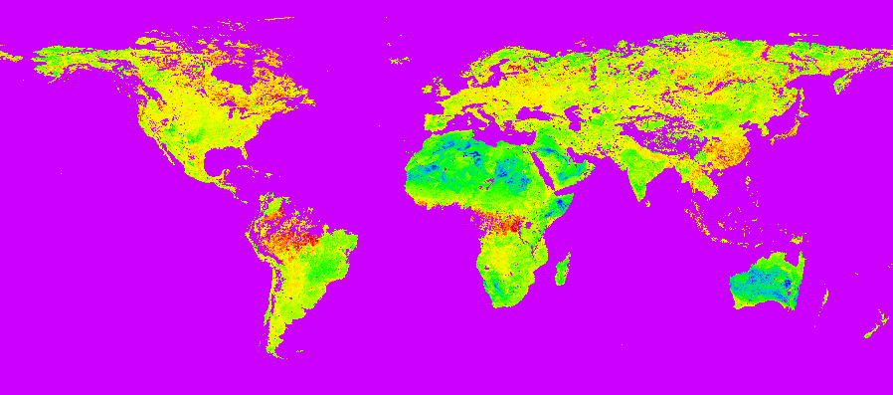
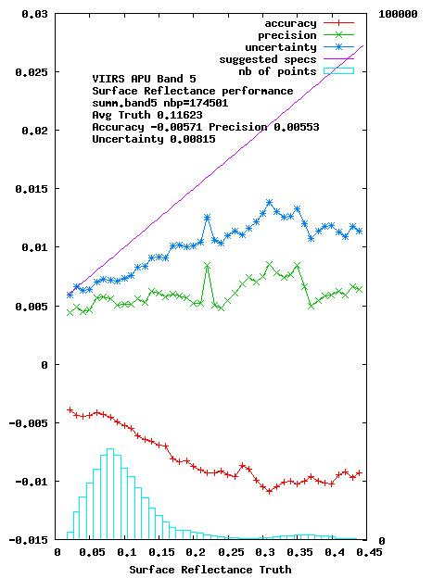
Generic approach also used for performance evaluation (AERONET)
ratio blue/red derived using MODIS top of the atmosphere corrected with MISR aerosol optical depth

Slide 7
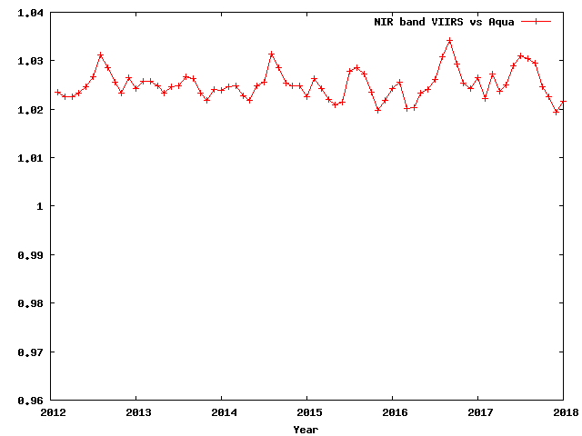
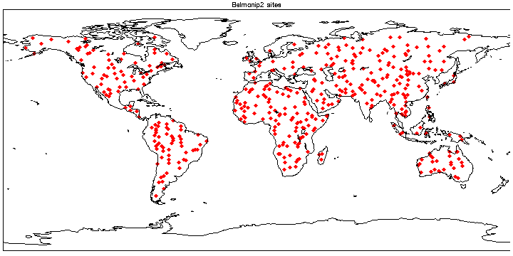
Performances can be confirmed by comparison with MODIS
Automated monthly VIIRS cross comparison (over BELMANIP sites) with MODIS Aqua from 2012. the stability of both VIIRS and MODIS Aqua is excellent in both red and NIR as shown (+/- 0.5%).

Slide 8
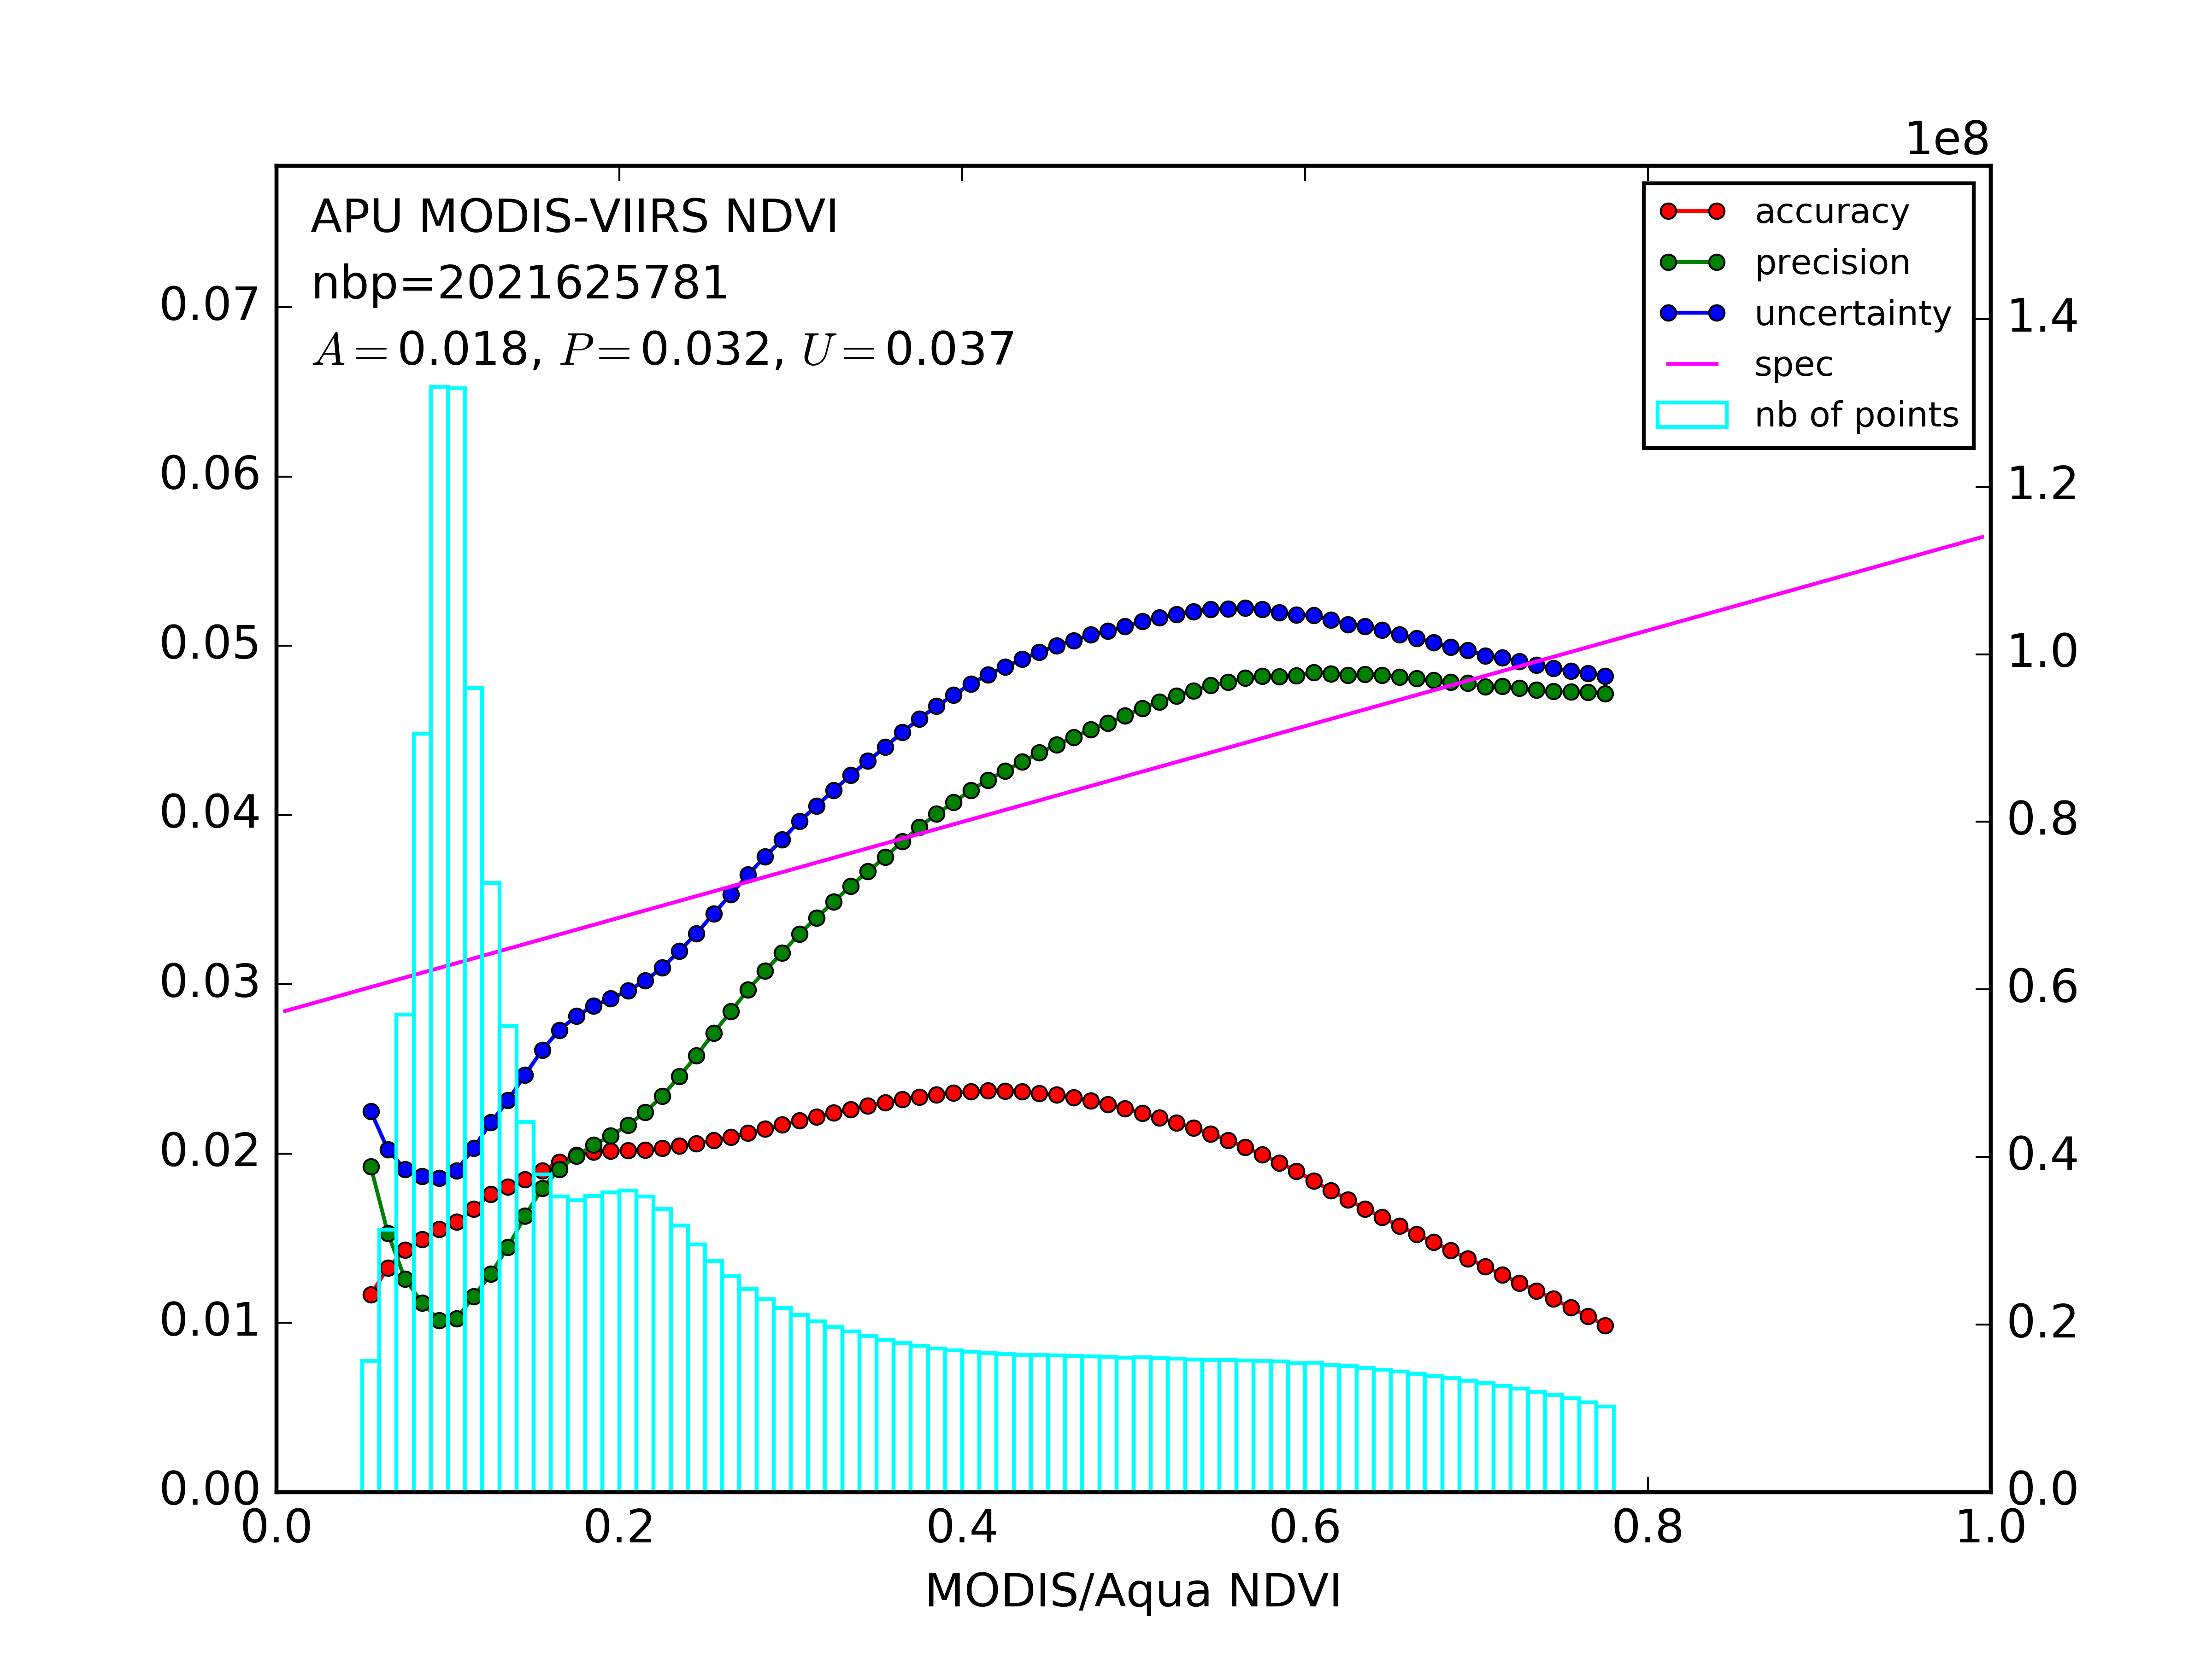
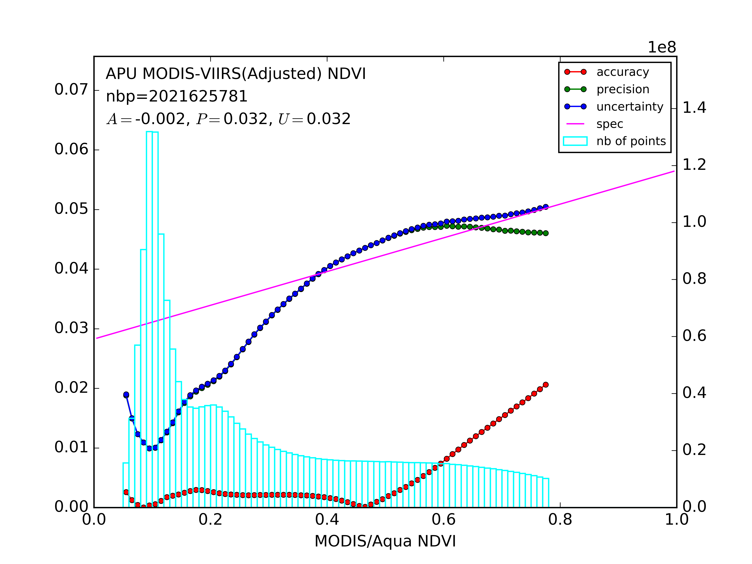
Performances can be confirmed by comparison with MODIS
Comparison (in terms of APU) of NDVI’s derived from MYD09CMG and VNP09CMG surface reflectance products at global scale (approximately 2×10⁹ pixels) for 2012–2016 without (left) and with (right) spectral adjustment of red and NIR bands. The light blues bars show the number of points used in each bin of NDVI values from MODIS (used as a reference). The APU values are computed for points in each bin and being shown in red (accuracy), green (precision) and blue (uncertainty).

Slide 9
Performances can be confirmed by comparison with MODIS
NDVI anomalies at 0.05° spatial resolution for the state of Iowa (US) derived from MODIS/Aqua (left), and adjusted VIIRS (right) data on August 21, 2012. Anomalies were computed by subtracting NDVI values from the median NDVI values for 2002–2016 derived from MODIS/Aqua.

Slide 10
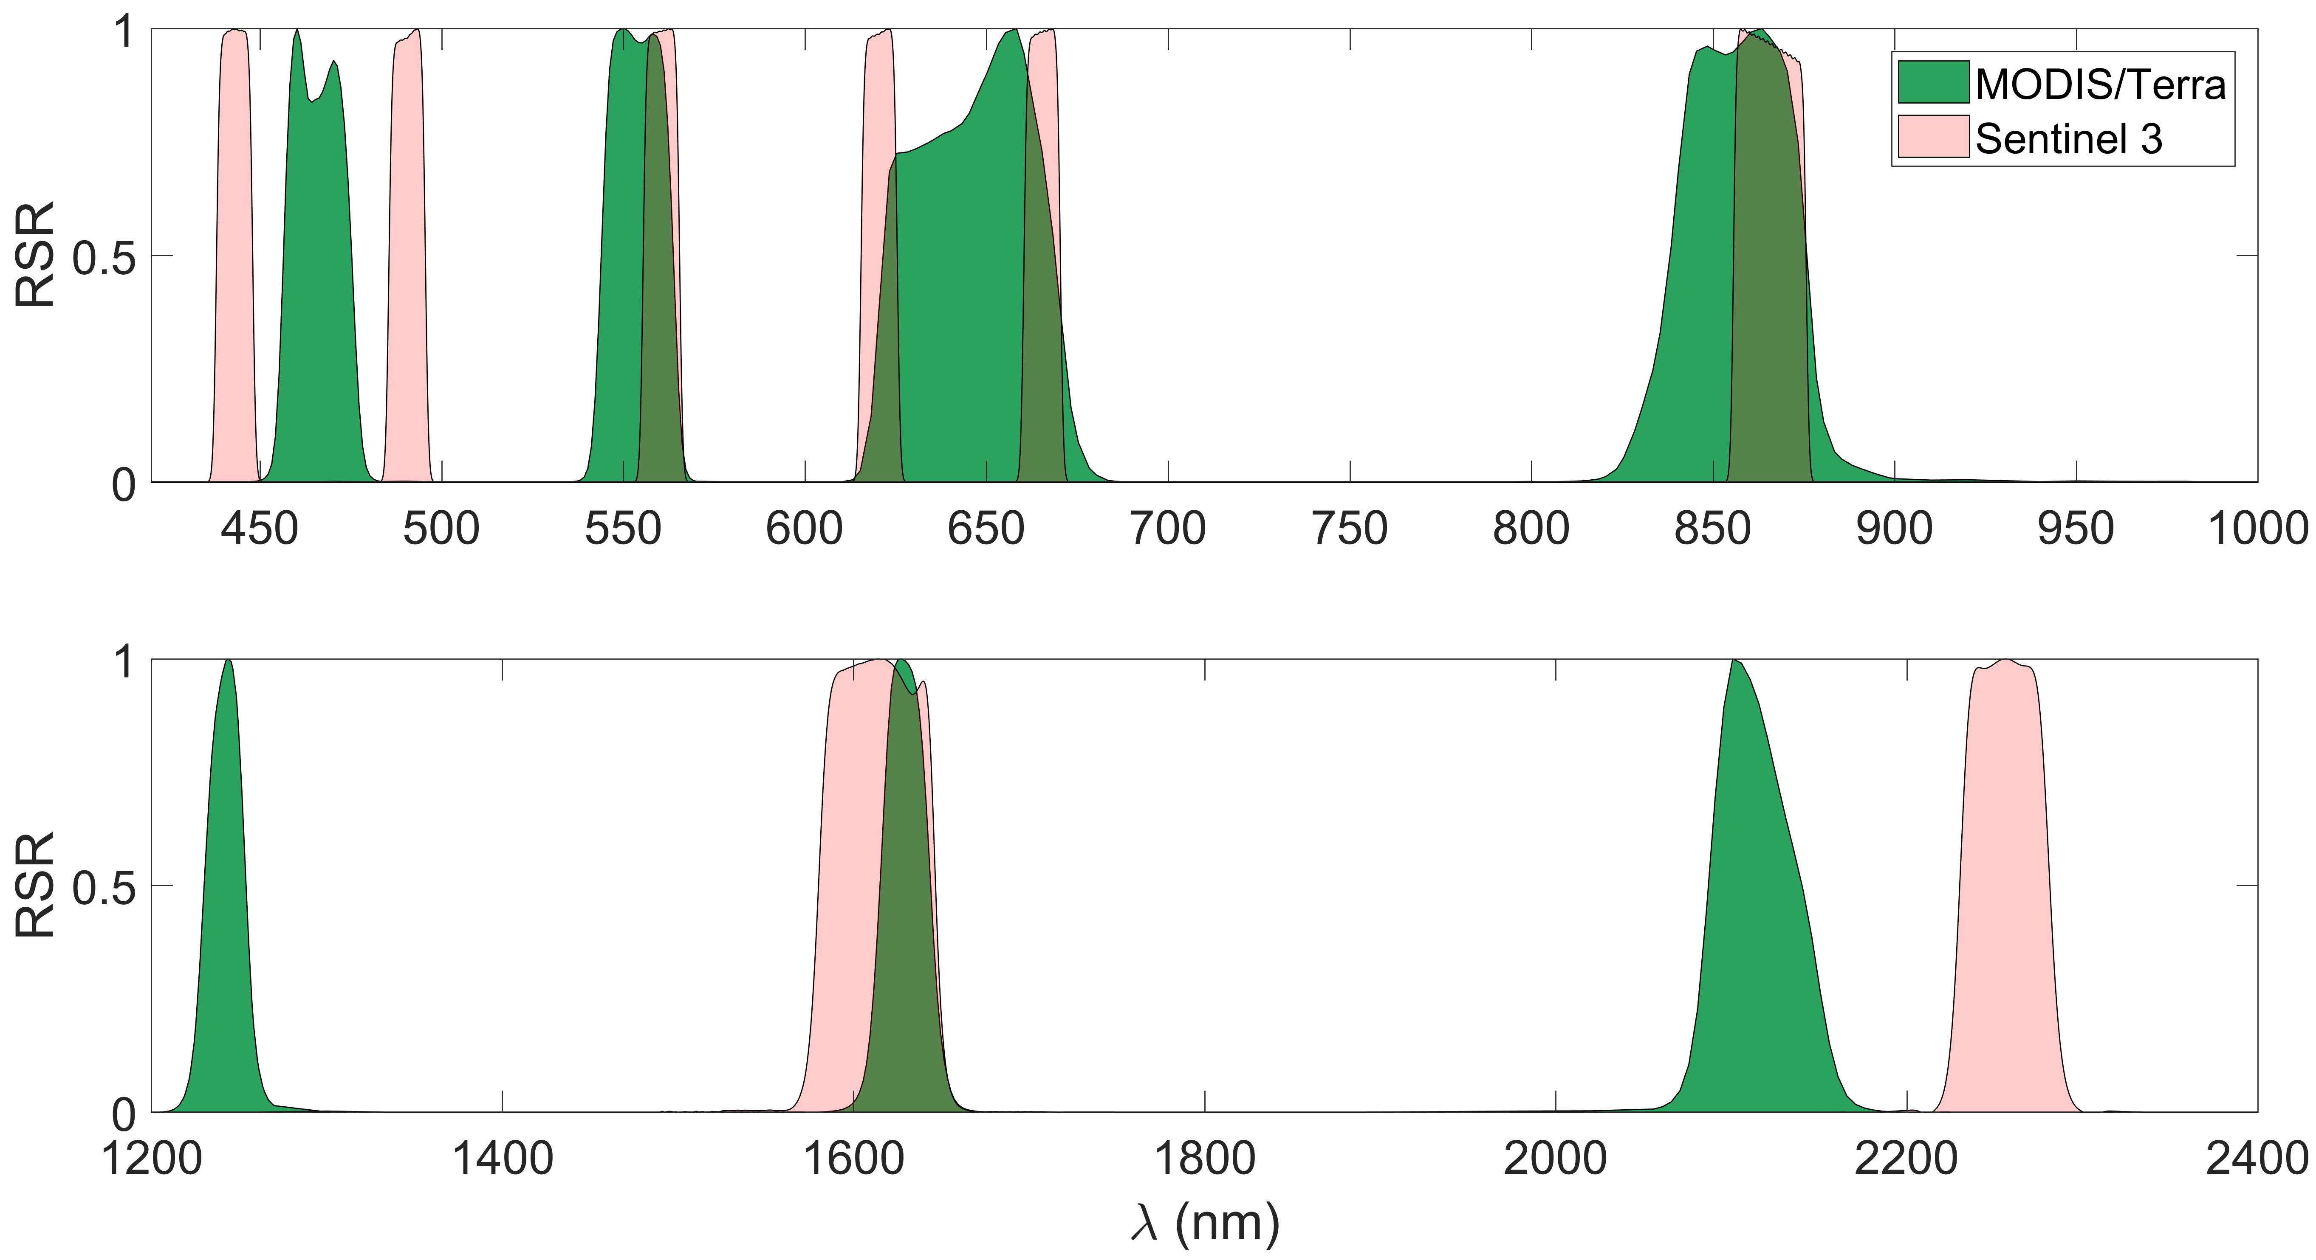
MODIS vs Sentinel-3 (OLCI/SLSTR): Land
b3
b4
b1
b2
SYN03 Oa03
SYN04 Oa04
SYN06 Oa06
SYN07 Oa07
SYN08 Oa08
SYN14 Oa17
b5
SYN20 S5
SYN21 S6
b6
b7
OLCI = Ocean and Land Colour Instrument (Oa)
SLSTR = Sea and Land Surface Temperature Radiometer (S)

Slide 11
Data
MODIS/Terra (MOD09.CMG) vs Sentinel-3 Synergy (S3A_SY_2_SYN)
Spatial resolution:
MODIS: CMG 0.05 deg
S3: product at 300 m aggregated to CMG
BRDF correction:
MODIS and S3 are BRDF corrected using the VJB method (Vermote et al. 2009 TGRS)
Filters (masks):
MODIS (clouds, shadows, high aerosols)
Sentinel-3 (built-in no data)
Over USA, dates: 2018 August 1-4

Slide 12
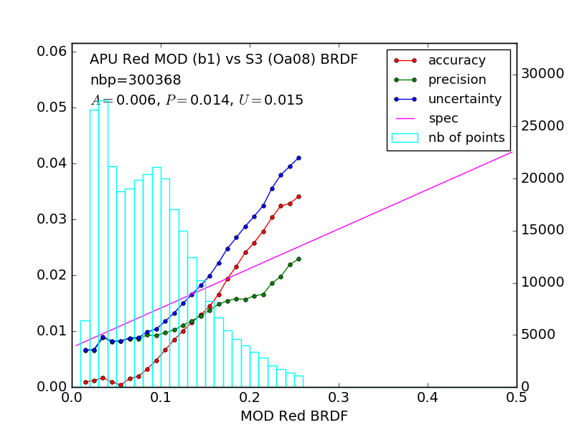
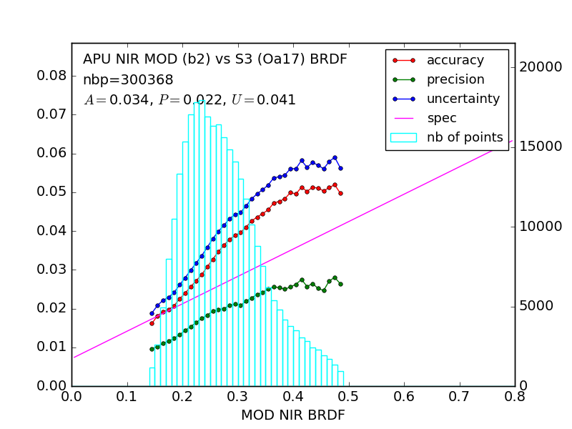
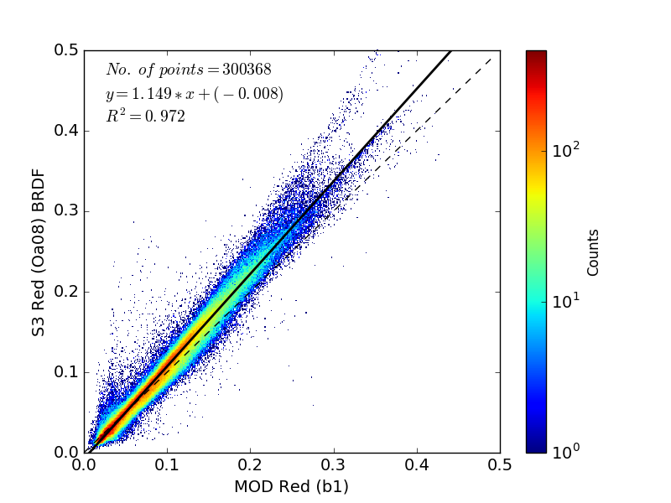
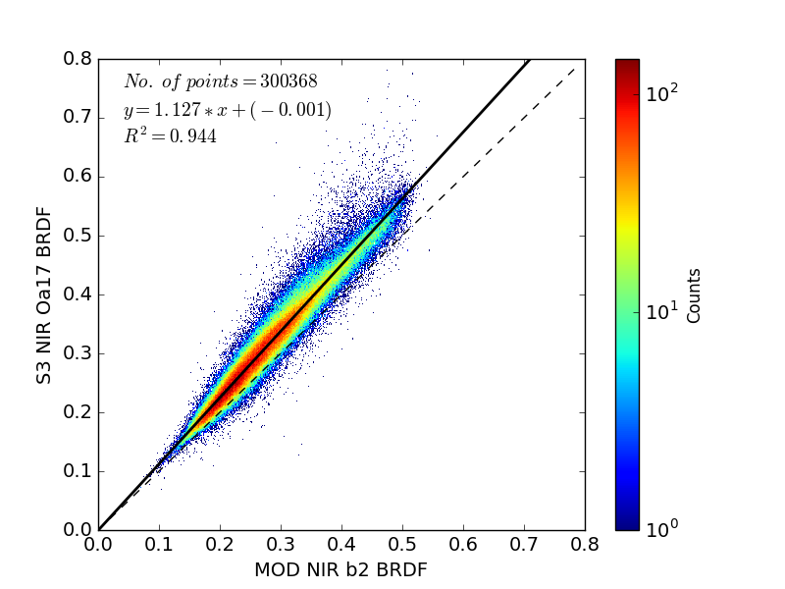
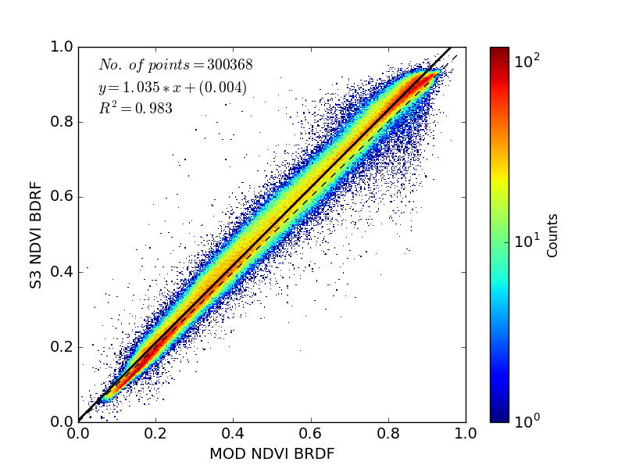
MOD-S3: Red, NIR, NDVI comparison
Red: band1 (MOD), Oa08 (S3)
NIR: band2 (MOD), Oa17 (S3)
NDVI

Slide 13
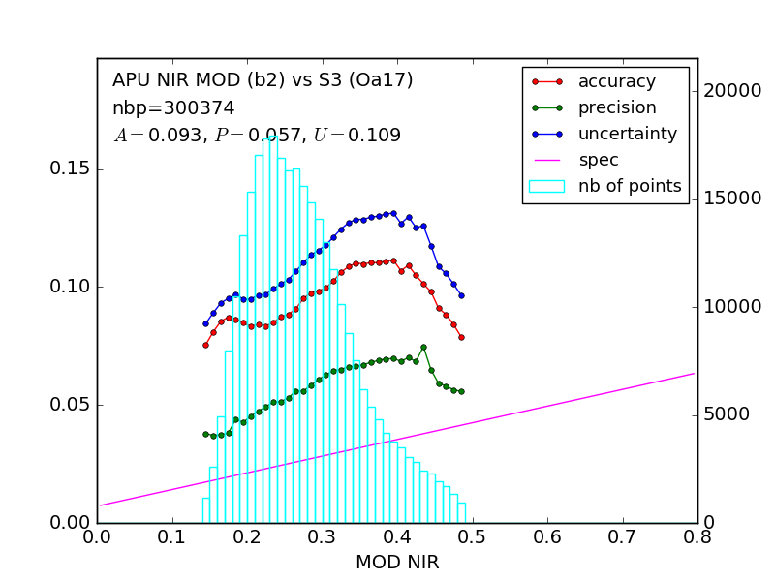
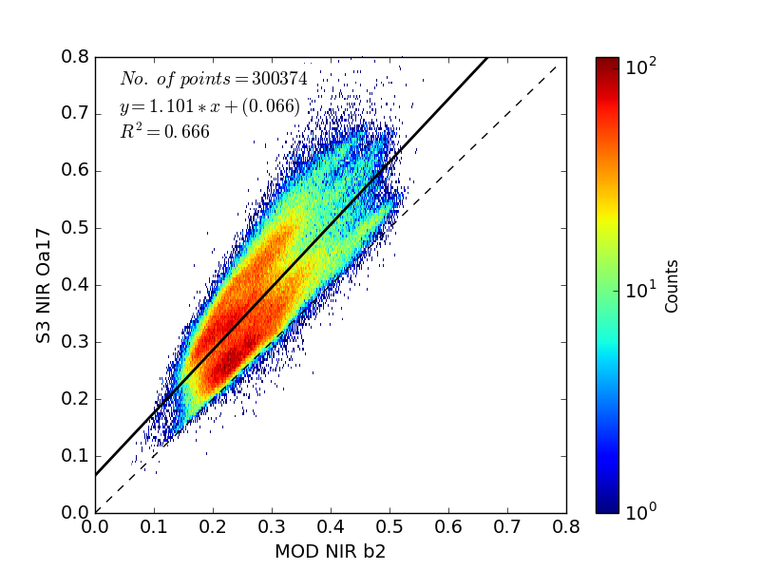
S3: effect of BRDF on NIR (Oa17)
Without BRDF correction
BRDF corrected

Slide 14
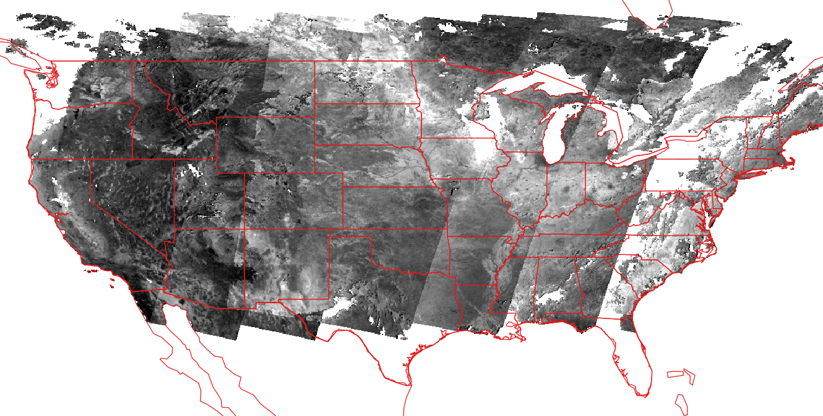
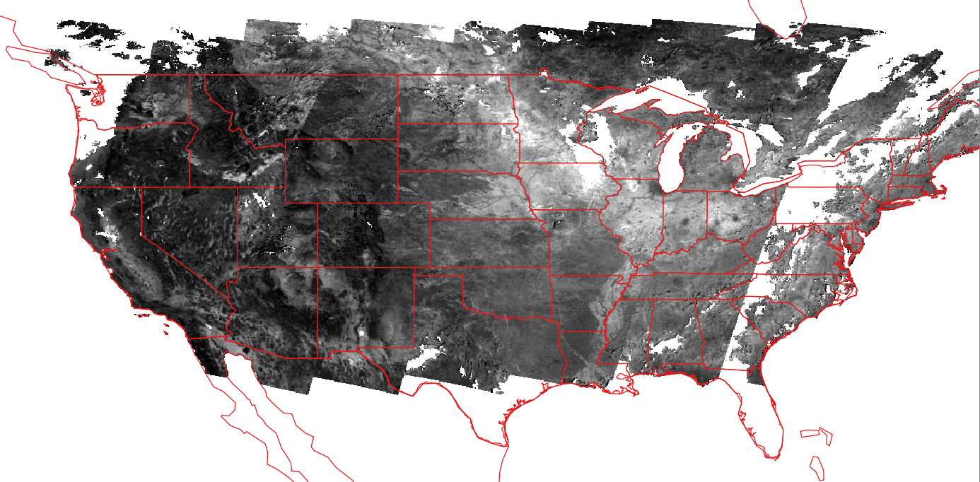
S3 NIR (Oa17) composite (2018 Aug 1-4)
Aggregated to CMG 0.05 deg
SR stretched from 0.15 to 0.65
No BRDF
BRDF corrected

Slide 15
Conclusions
Surface reflectance code (LaSRC) is mature and pathway toward validation and automated QA is clearly identified.
Algorithm is generic and tied to documented validated radiative transfer code so the accuracy is traceable enabling error budget.
The use of BRDF correction enables easy cross-comparison of different sensors (MODIS,VIIRS,AVHRR, LDCM, Landsat, Sentinel 2 ,Sentinel 3…) and ensure that there is consistency between datasets.

