Slide 1
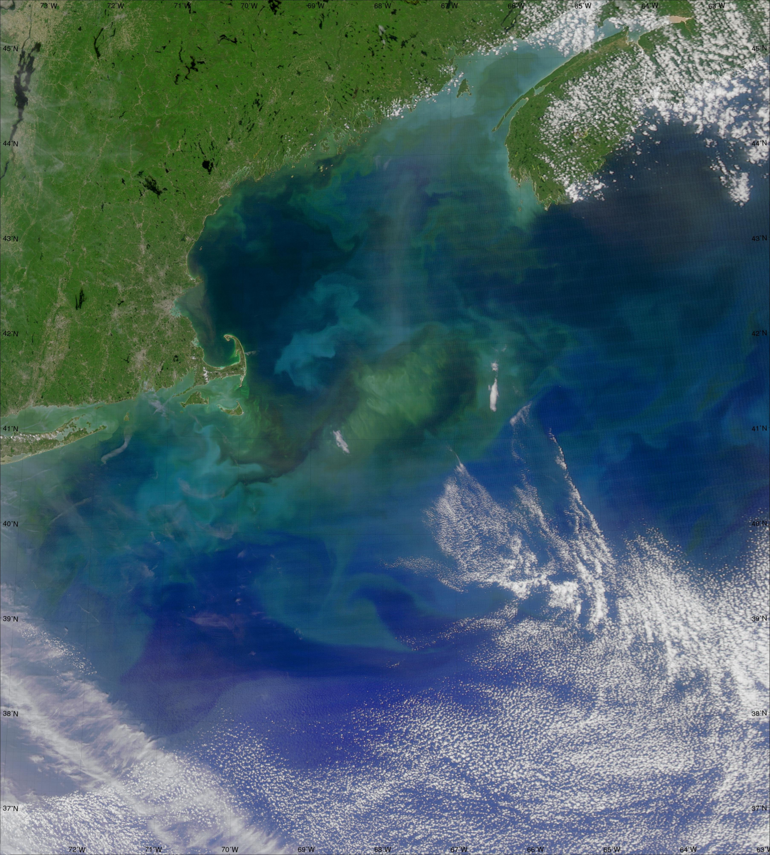
Particulate Inorganic Carbon from MODIS and VIIRS
Barney Balch
Bigelow Laboratory for Ocean Sciences
East Boothbay, ME
bbalch@bigelow.org

Slide 2
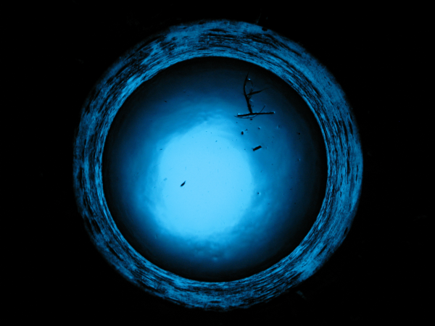
Coccolithophores are strong drivers of ocean biogeochemistry and optics; affect CO₂ balance…
View through the ship’s moon-pool, inside hanger (no skylight reflections)
Emiliania huxleyi
Ophiaster sp.
Emiliania huxleyi
Papposphaera sp.
Calcidiscus leptoporous
Annual MODIS AQUA PIC
Great Calcite Belt
Notes:
(Left) 2014 PIC average image (Right)
a (upper left) Most ubiquitous species, Emiliania huxleyi; this and Gephyrocapsa oceanica have been cultured extensively and their life-cycle is well worked out (Klaveness 1972, Green et al 1996, Houdan et al. in press). The dominant phase is diploid, non-motile and usually heterococcolith-bearing (= C-cells), although naked mutants often occur in culture (= N-cells). The alternate phase is haploid, scale-bearing and motile (= S-cells). There is no holococcolith stage.
Coccolith structure: Coccoliths are placoliths with Emiliania-type structure,
b (upper right) Ophiaster sp. Appendages formed from strings of highly modified antapical coccoliths (osteoliths). The appendages have some similarity to those of Michaelsarsia but are formed antapically rather than apically, there are no whorl coccoliths and the body coccoliths are smaller and simpler.
C (lower left) Papposphaera lepida or P. obpyrimidalis: Family PAPPOSPHAERACEAE Jordan & Young 1990; Minute (cells typically 4-6 μm), lightly-calcified coccolithophores. Mainly recorded from high-latitudes (Arctic and Antarctic), but many additional undescribed low-latitude spp occur (Thomsen & Buck 1998; Østergaard & Thomsen in prep.; Cros & Fortuño 2002; our obs.).
D (lower right) Calcidiscus leptoporous coccolith- One of larger species, important in sediments; Calcidiscacae; Holococcolith form (Syracolithus quadriperforatus)

Slide 3
Activities since I presented last…
Algorithm work
Validation activities
New insights/publications

Slide 4
Algorithm news
Algorithm maintenance- Continued updating look-up table for PIC algorithm with new shipboard values for PIC, acidified backscattering vs chlorophyll relationship
Algorithm applied to both MODIS and VIIRS imagery (not exact wavelength match).
Algorithm revisions (Calcite.c) passed to the Ocean SIPS (Bryan Franz) for reprocessings
New PIC algorithm- Color index algorithm

Slide 5
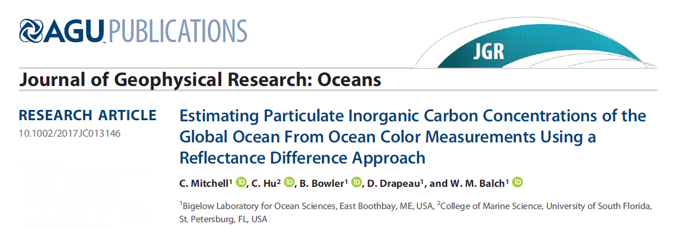
New PIC algorithm Published
Differencing algorithm, PIC-CI (CI= Color Index)
Differences in the remote sensing reflectance (Rrs) at green (547nm), red (667nm), and near-infrared (NIR) wavebands (748nm and 869nm).
Three color indices explain >90% of the variance in PIC.
No Rrs(NIR) in the standard ocean color data products, so we prefer color index determined from only two bands:
PIC-CI = Rrs (547) – Rrs(667).
New two-band color index algorithm appears more accurate. Need for more implementation as a “test” or “provisional” product.

Slide 6
Principle of the CI approach…
Hold ap440 constant; vary PIC
Good band for PIC, no effect of chl.
Rrs(λ) (sr⁻¹)
Hold PIC constant; vary ap440
Wavelength(λ; nm)
Notes:
Remote sensing reflectance spectra for (a) varying PIC concentrations and (b) varying particulate absorption, used here as a proxy for phytoplankton
biomass, with the three color indices defined in the text represented graphically. Note there is a slight wavelength offset (5 nm) between the spectra within each plot to avoid overlap of error bars.

Slide 7
The new PIC-CI algorithm shows improved r² and reduced RMSE over current algorithm
R² = 0.51; RMSE=0.12; mean abs. diff = 0.34 log units
PIC-CI algorithm
Algo PIC (mol m⁻³)
PIC-2B/3B algorithm
R² = 0.32; RMSE= 0.14; mean abs diff =0.43 log units
Ship PIC (mol m⁻³)

Slide 8
Algorithm comparison
PIC- 2B/3B
PIC- CI

Slide 9
Validation activities

Slide 10
Atlantic Meridional Transect Cruises
We completed and processed AMT cruises 25 and 26; providing PIC, coccolithophore enumeration and coccolithophore SEM’s; above-water radiometry; inherent optical properties (spectral absorption, attenuation, backscattering)
Paper in revision (Global Biogeochemical Cycles) summarizing our AMT cruise work

Slide 11
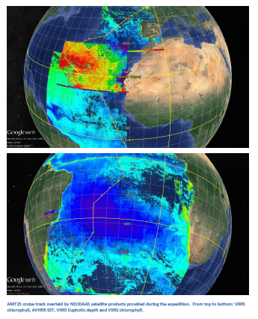
AMT Cruise Tracks #25 & #26
AMT 25
AMT 26

Slide 12
R/V Endeavor July 2018 NSF-funded cruise Ran GNATS line Largest cocco bloom (in area) in NE Continental Shelf in 30y!
MODIS Aqua; PIC-CI algorithm
R/V Endeavor 616

Slide 13
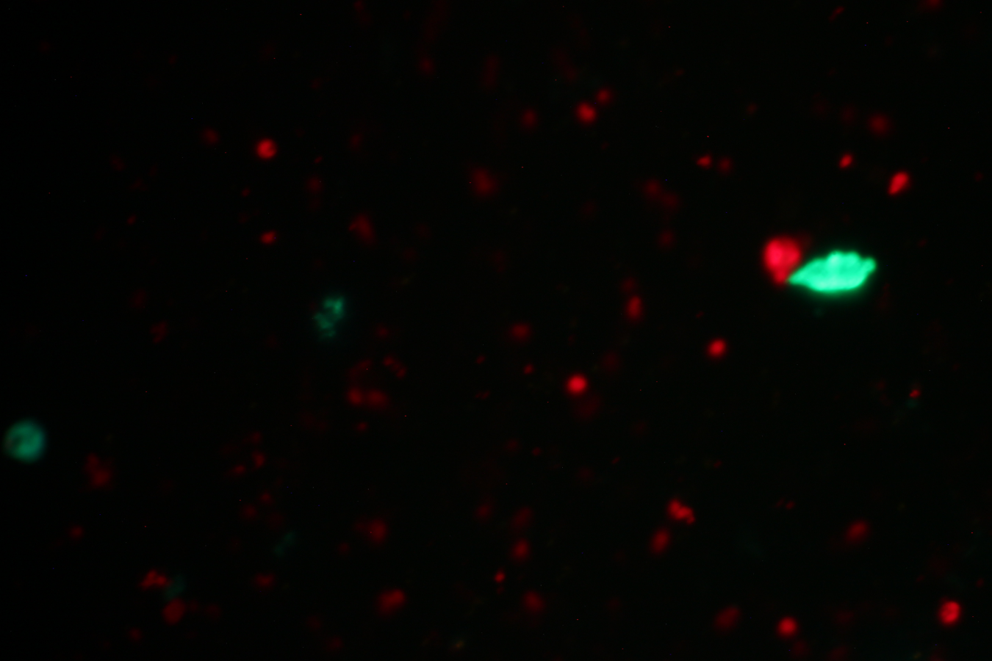
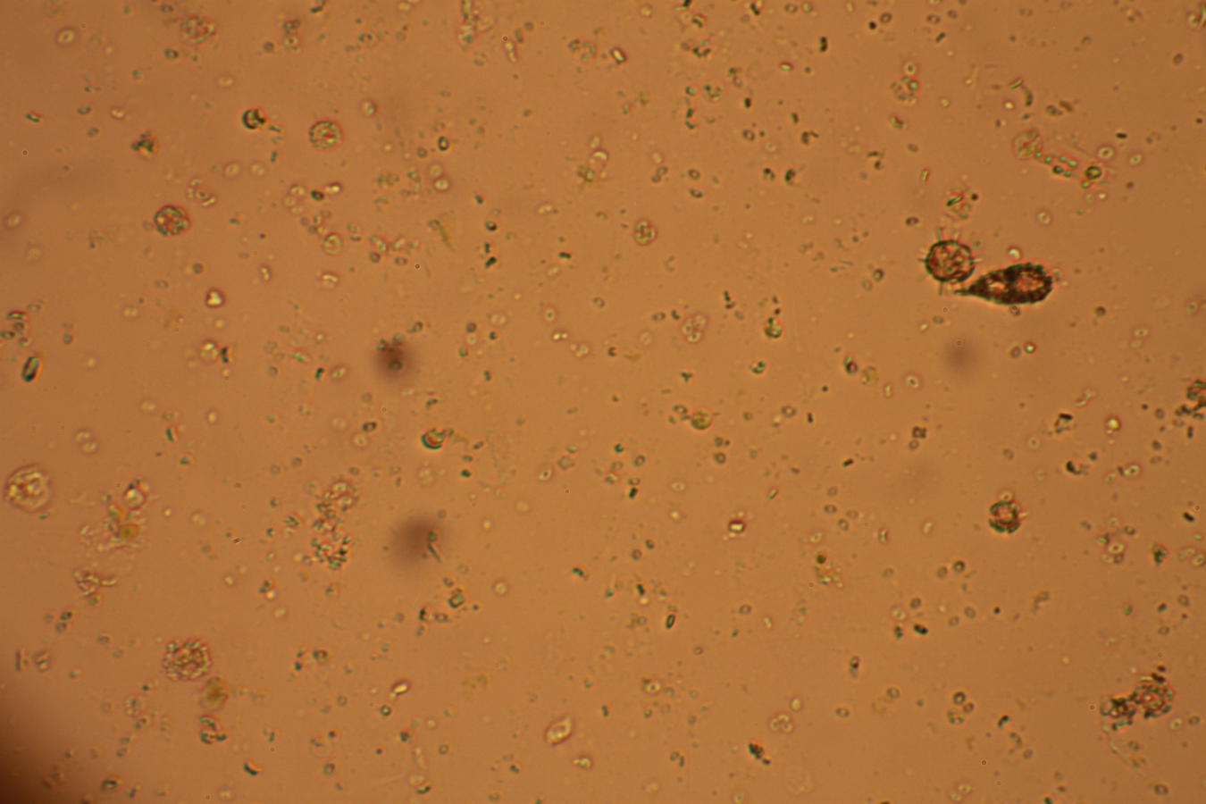
Coccolithophore bloom: What was in the water?
10μm

Slide 14
New validation data-
PIC 2B/3B Algorithm
(mol m⁻³)
3 years ago- 74 validated stations with ICPOES
Now 374 absolutely validated stations with ICPOES
VIIRS data distributions show continuity with MODIS
Relative error for VIIRS distribution nonetheless greater than for MODIS (because highest PIC concentration validated by VIIRS was still 10X lower than for MODIS
PIC-CI Algorithm
(mol m⁻³)
MODIS VIIRS

Slide 15
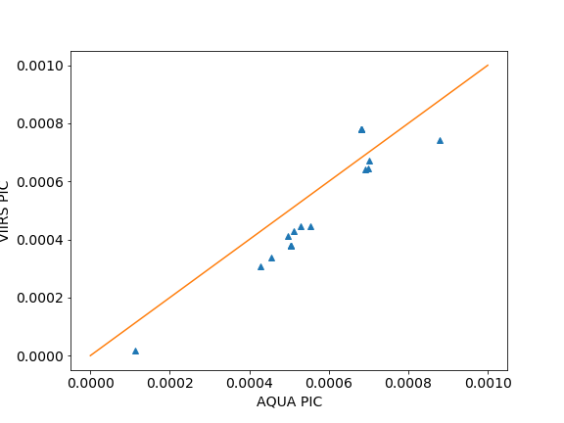
Sensor intercomparison validation stations for two AMT cruises and one GCB cruise
1:1
PIC-CI
VIIRS PIC (moles m⁻³)
R² =0.89; P<0.00001
MODIS AQUA PIC (moles m⁻³)
Notes:
Bias, but slope is same. Filter

Slide 16
New Insights
1) Great Calcite Belt; new focus on the GCB and Sub-Antarctic Mode Water

Slide 17
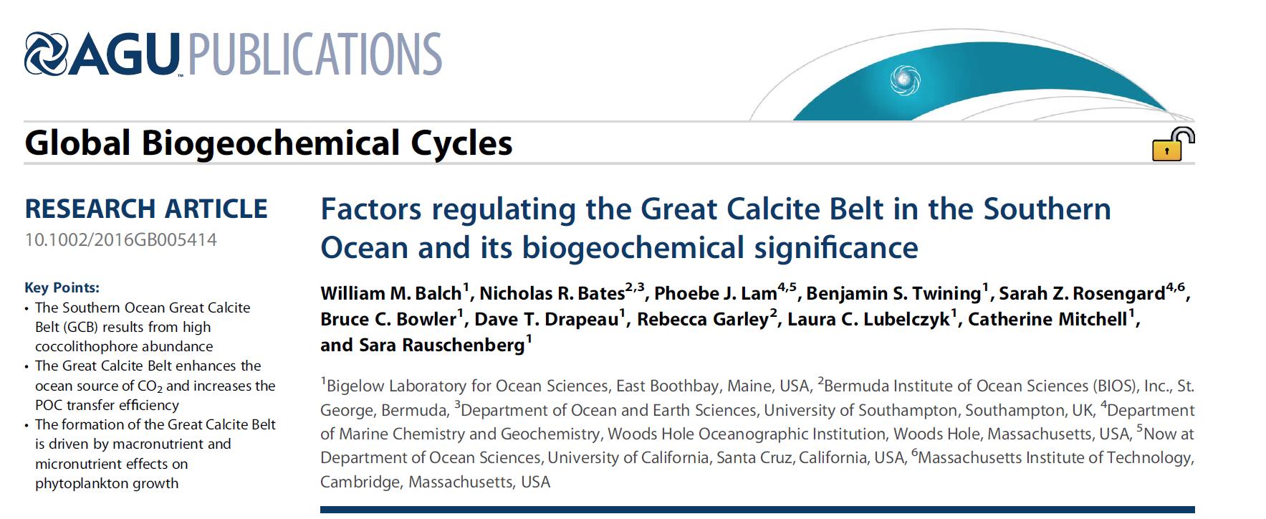
Publication on Great Calcite Belt…
Demonstrate for the GCB:
Its appearance in high-velocity waters of the Antarctic Circumpolar Currrent
Macronutrient requirements for growth (nitrate, silicate)
Trace element requirements (iron, zinc)
Consequences for efficiency of carbon export

Slide 18
Plot surface PIC concentration in temperature/salinity space
Surf.PIC
(mol m⁻³)
0.01
0.003
0.001
0.0003
0.0001
0.00003
Isopleths of density; sigma theta
PIC global December
30
25
20
15
10
5
0
18
19
20
21
22
27
28
Temperature (ºC)
23
29
24
30
25
SAMW; σ_{θ} 26.5-27.1
Cerovečki et al., 2013
26
31
30 31 32 33 34 35 36 37 38 39
Salinity

Slide 19
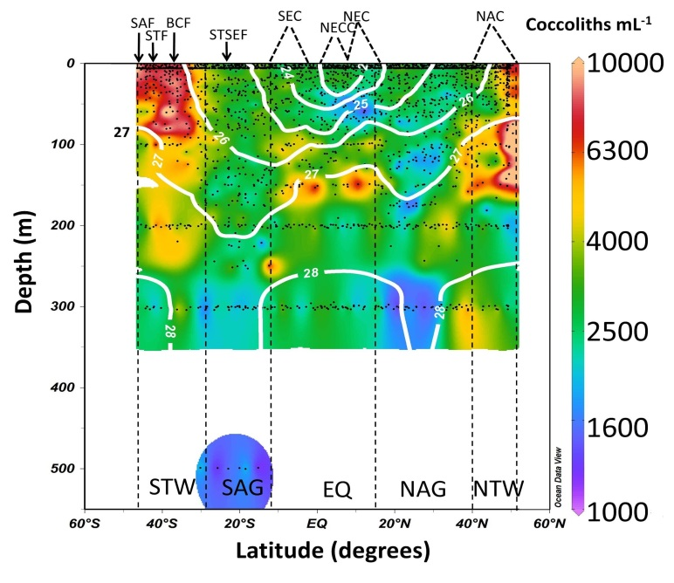
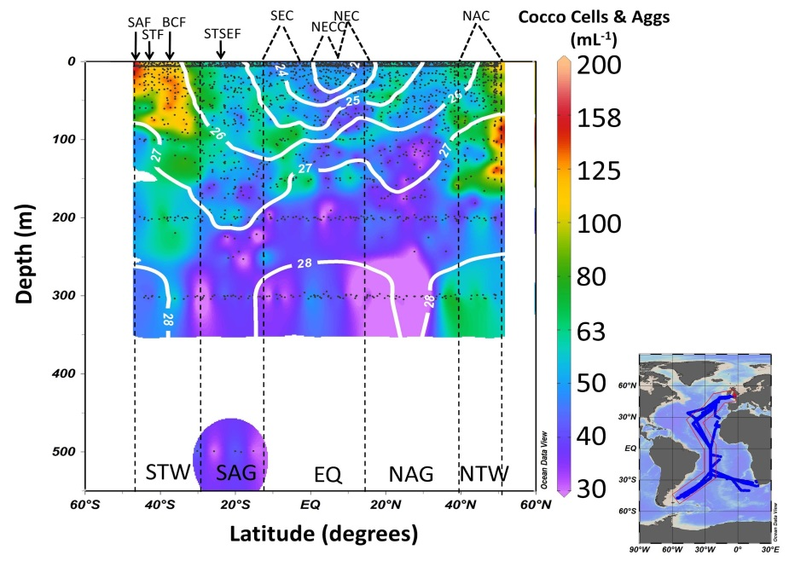
Atlantic coccolithophores carried North from Great Calcite Belt in SAMW
SAMW
40 years
****NOTE*** Low surface concentrations at Equator!

Slide 20
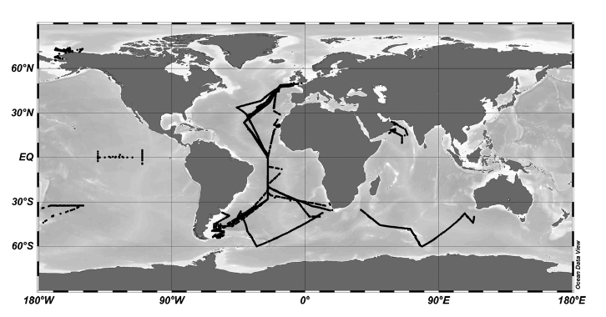
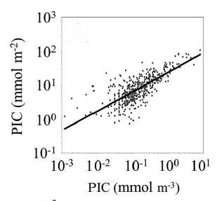
New Pub: Algorithm to convert surface PIC to integral euphotic PIC (Balch et al., 2018)
2018
Euphotic PIC (mmol m⁻²)
Surf. PIC (mmol m⁻³)

Slide 21
New pub: Algorithm for coccolithophore calcification (Hopkins & Balch, 2018)
2018
Based on Behrenfeld carbon based productivity model (Behrenfeld et al., 2005)
PIC production = f [PIC; μ] h(I₀); g(Z_{eu})
Assumes: μ is a function of temperature and irradiance
E. huxleyi calcite production is the major contributor to satellite-derived PIC concentration.
Calcification rate decreases as a function of light availability through the water column.
G(Z_{eu}) is based on Balch et al. (2018) relationship between surface and integrated PIC

Slide 22
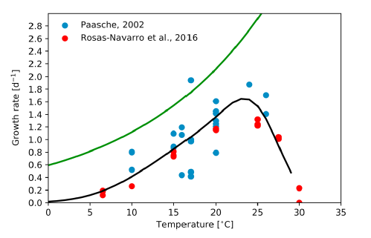
Components of Hopkins and Balch (2018) calcification algorithm
Growth Rate (d⁻¹)
G(Z_{eu})
Temp(ºC)
Euphotic PIC (mmol m⁻²)
Where T^{opt} =20ºC; T^{low}_{scale}=2ºC;
T ^{high}_{scale}=~24ºC
Balch et al., 2018
Surf. PIC (mmol m⁻³)
Notes:
Figure 1. Coccolithophore temperature-growth rate relationship. Blue
circles represent data from Paasche (2002). Red circles are data from Rosas-
Navarro et al. (2016). Green line represents maximum growth rate
determined from Eppley (1972). Black line is best fit to experimental data
(see equation (6)).

Slide 23
Performance of Hopkins & Balch (2018) calcification algorithm
Depth (m)
Calcification Rate (mg C m⁻² d⁻¹)
Notes:
Figure 6. Modeled calcification rate (green line) compared with measured calcification rate (blue dots) at (a) 2.0°S, 110°W in
Dec 2004; (b) 3.0°N, 110°W in Dec 2004; (c) 50.4°S, 10.8°W in Feb 2011; and (d) 50.2°S, 56.3°W in Jan 2011. Error bars
indicate one standard deviation of triplicate calcification rate measurements.

Slide 24
New global predictions of integrated euphotic calcification
Apr-Jun
Jul-Sept
Oct-Dec
Jan-Mar
Average, global, euphotic zone depth-integrated calcification rate is estimated to be
1.42 ± 1.69 Pg particulate inorganic carbon/year with the oceanic gyres contributing the
greatest influence.
Notes:
Figure 3. Modeled seasonal depth-integrated calcification rate (mg C · m
2 · day
1). (a) Northern Hemisphere spring
(Southern Hemisphere autumn); (b) Northern Hemisphere summer (Southern Hemisphere winter); (c) Northern
Hemisphere autumn (Southern Hemisphere spring); (d) Northern Hemisphere winter (Southern Hemisphere summer).
Areas in white represent pixels with no data, water column depths <200 m, or waters <2°C.

Slide 25
VIIRS: 30 September, 2018; True Color
Ocean Station Papa
X
Site of EXPORTS first field study: Note turquoise coccolithophore populations at SubArctic Front

Slide 26
Summary
Continued algorithm maintenance of 2B/3B merged algorithm
Validation Activities AMT cruises and NW Atlantic: quadrupled in situ data on PIC
New publications from the Balch group at Bigelow Laboratory:
New PIC-CI algorithm (Mitchell et al., 2016)
Factors affecting the Great Calcite Belt (Balch et al., 2016)
Relating surface PIC to euphotic PIC (Balch et al., 2018)
New algorithm for estimating global calcification (Hopkins and Balch, 2018)
Thank you!

Slide 28
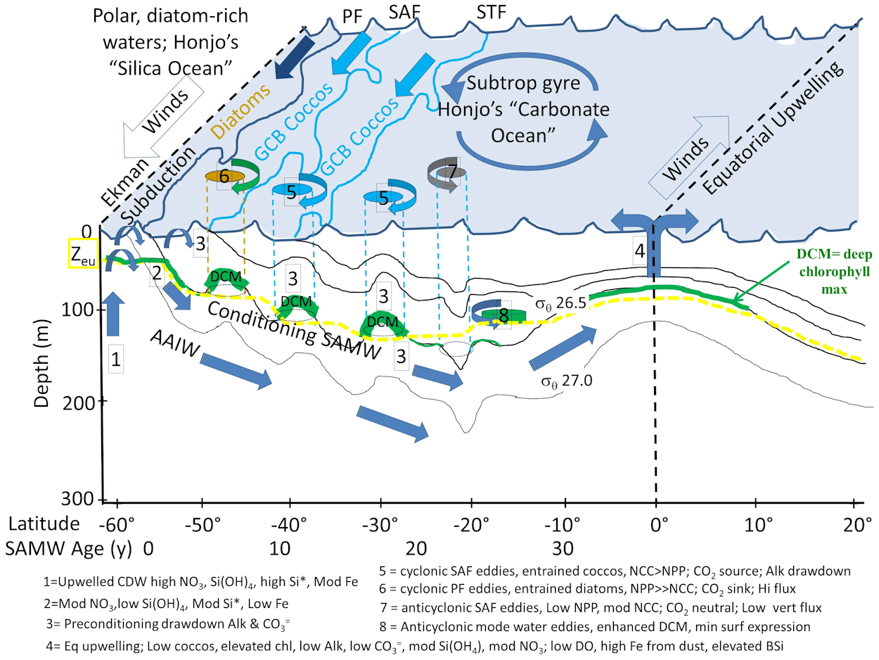
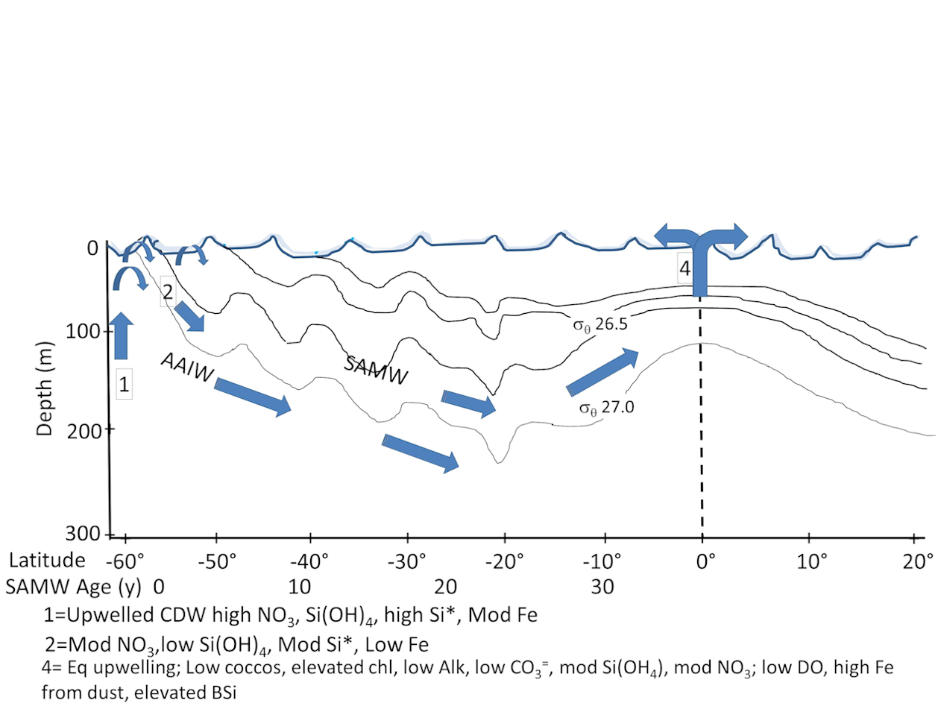
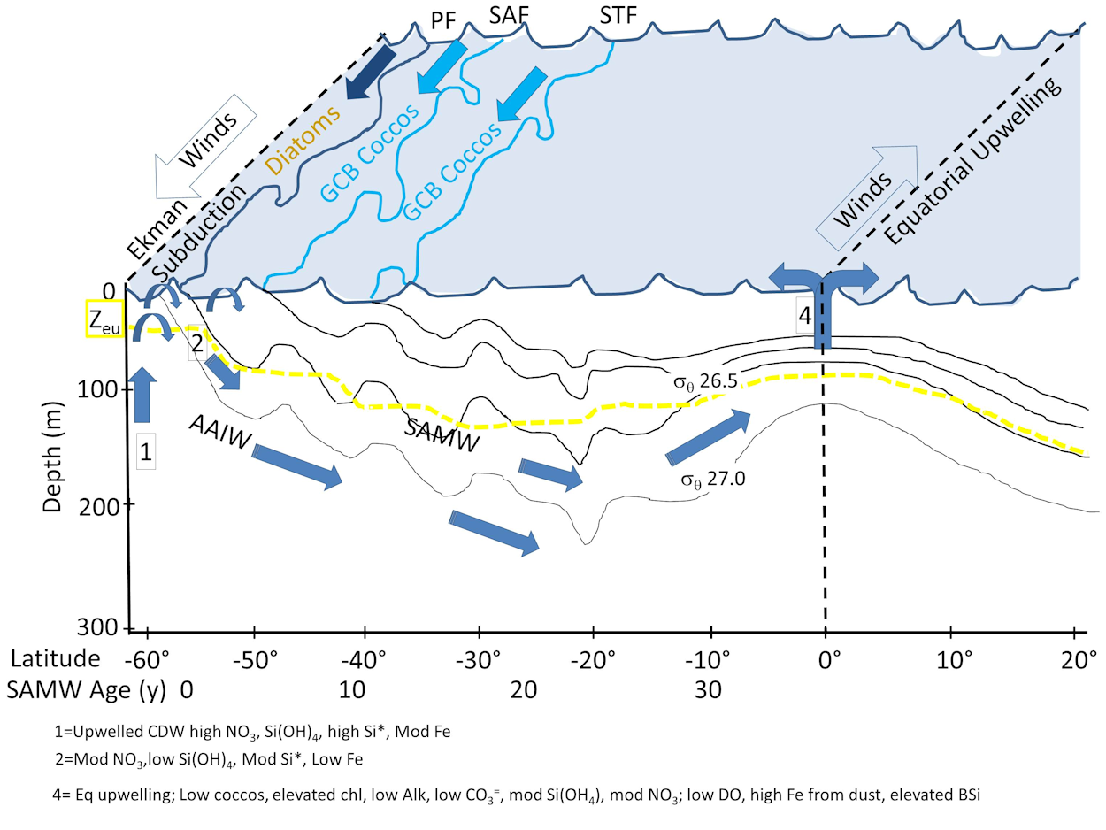
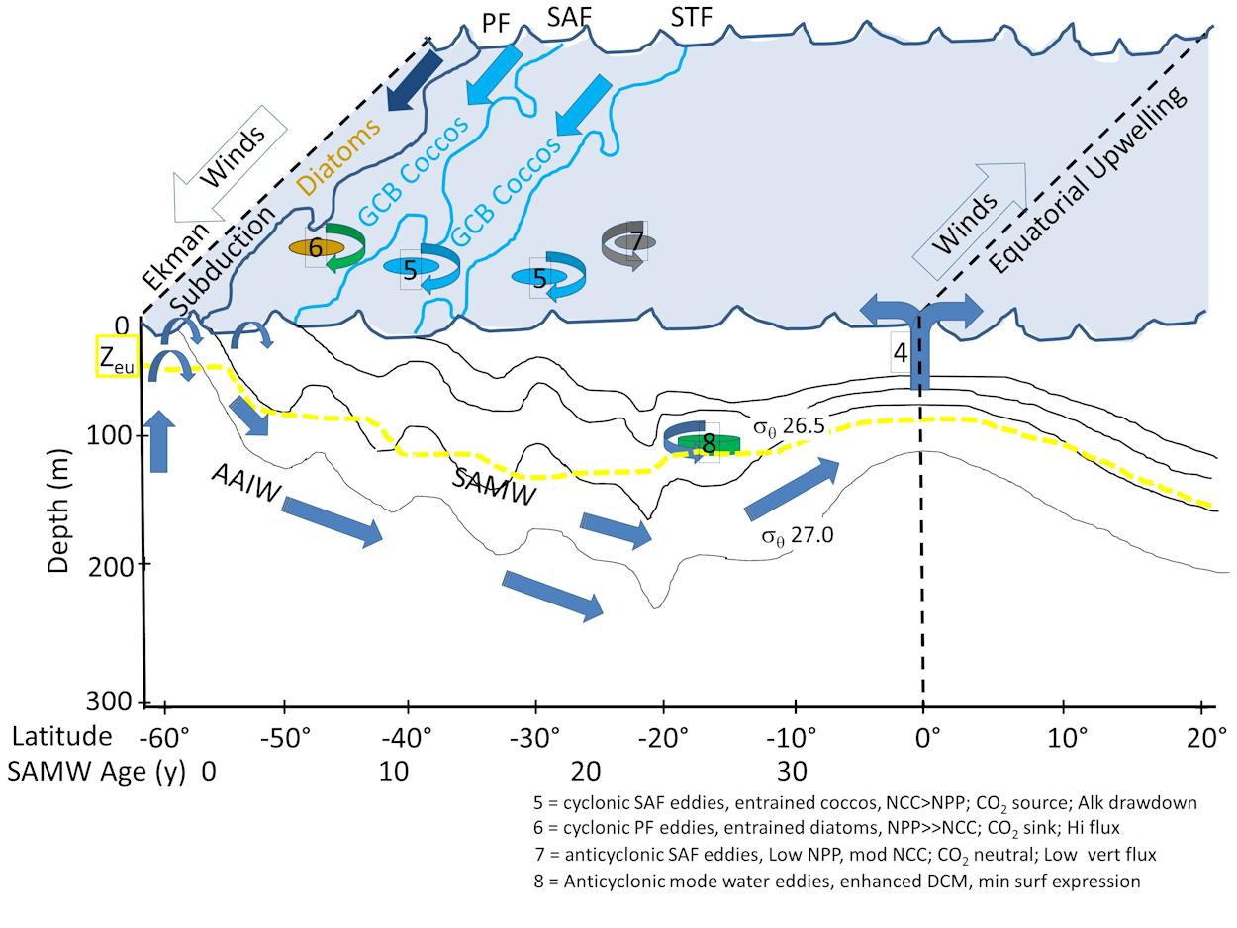
Conceptual View of Subantarctic mode water export… “So what?”

Slide 29
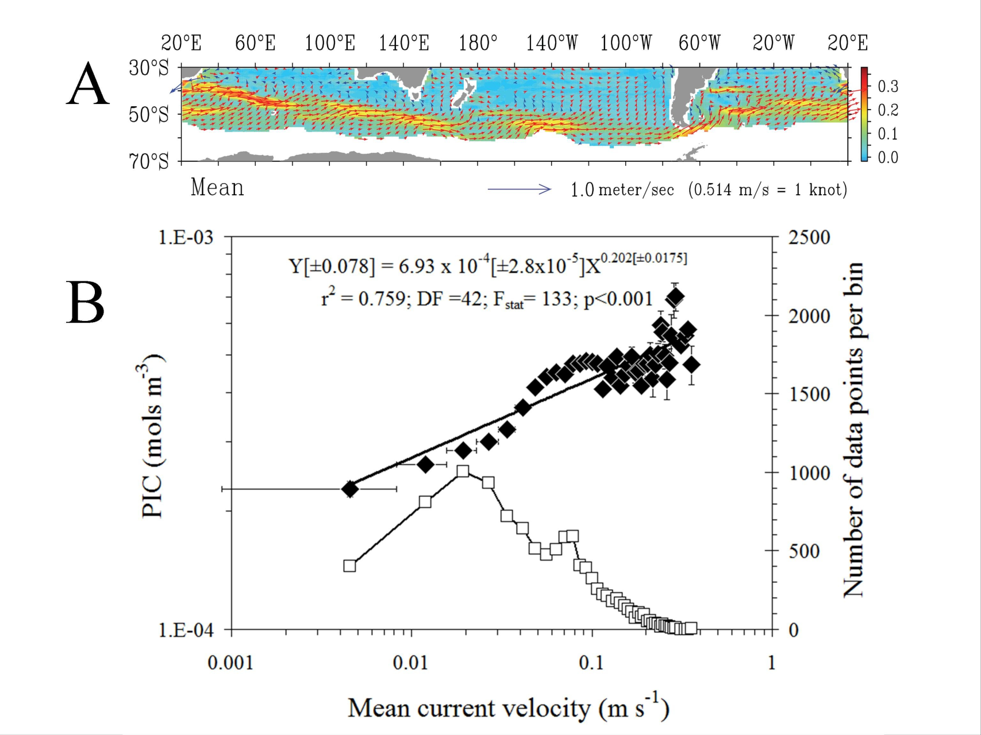
Great Calcite Belt sits in high-velocity circumpolar currents of the Southern Ocean…likely sites of high Ekman pumping
Balch et al., 2016; GBC
Notes:
OSCAR Current velocities
The OSCAR product is a direct computation of global surface currents using satellite sea surface height, wind, and temperature. Currents are calculated using a quasi-steady geostrophic model together with an eddy viscosity based wind-driven ageostrophic component and a thermal wind adjustment. The model calculates a surface current averaged over the top 30m of the upper ocean.

Slide 30
Divided our PIC data into two bins Algorithm development & validation

Slide 31
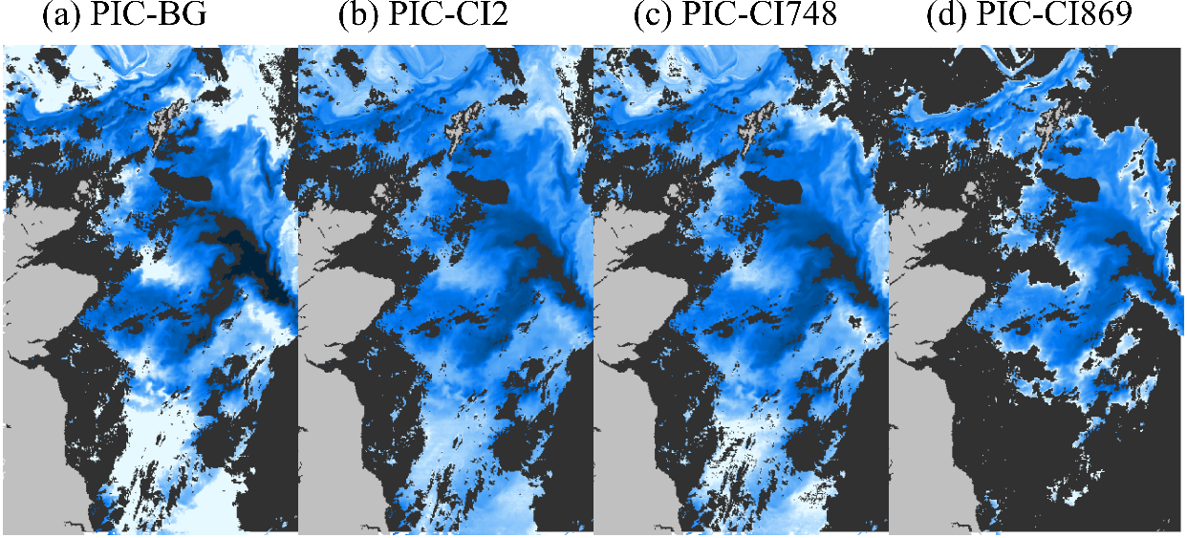
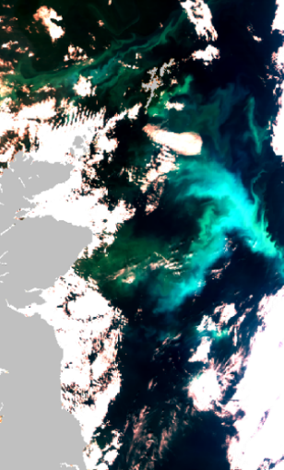
More comparisons…
Clouds
Quasi-true color image of the North Sea on 5th June 2003
PIC concentration in the North Sea, 5th June 2003.

Slide 32
New global predictions of surface calcification
Apr-Jun
Jul-Sept
Oct-Dec
Jan-Mar
Calcification rates are generally highest in the Pacific subarctic and N. Atlantic in N. hemisphere summer and in the Great Calcite Belt and W. African upwelling in S. Hemisphere summer.
Notes:
Figure 2. Modeled seasonal surface calcification rate (mg C · m3 · day1). (a) Northern Hemisphere spring (Southern Hemisphere autumn); (b) Northern Hemisphere summer (Southern Hemisphere winter); (c) Northern Hemisphere autumn (Southern Hemisphere spring); (d) Northern Hemisphere winter (Southern Hemisphere summer). Areas in white
represent pixels with no data, water column depths <200 m, or waters <2°C.

