Slide 1
CLIMCAPS: Use of AIRS/AMSU and CrIS/ATMS Continuity Product for Cloud Feedback Studies
Monday, Oct. 15, 2018
MODIS/VIIRS, Session 1: 11:25 EDT
Chris Barnet
NASA S-NPP Sounder Discipline Lead
NOAA/JPSS Senior Advisor for Atmospheric Sounding
STC Senior Scientist
Notes:
Presenter: Chris Barnet, Science and Technology Corporation
Authors: Christopher D. Barnet, Nadia Smith, Ashley Wheeler
The AIRS/AMSU (Atmospheric Infrared Sounder; Advanced Microwave Sounding Unit) onboard the EOS/Aqua was launched in 2002. CrIS/ATMS (CrossTrack Infrared Sounder; Advanced Technology Microwave Sounder) onboard Suomi NPP was launched in 2011 and was also launched on the first Joint Polar Sounding System (JPSS) satellite in 2017. Demonstrating data continuity between these three platforms has become a priority especially since EOS/Aqua is well past its design lifetime. Additionally, with future JPSS satellites, this record of soundings will be extended into future decades and will enable important scientific research on atmospheric processes at large spatial and temporal scales. The AIRS/AMSU and CrIS/ATMS have many differences in instrument design, spatial sampling, spectral coverage and resolution. Instruments also degrade with time. It is only with careful and transparent error characterization that systematic effects can be accounted for, and preferably minimized, in retrieved sounding products.
We have developed the Community Long-term Infrared Microwave Coupled Product System (CLIMCAPS) to achieve a seamless record of satellite soundings. A CLIMCAPS sounding is comprised of a set of parameters that characterizes the full atmospheric state and includes profiles of temperature, moisture, cloud height and fraction, surface products, and many trace gas species. The information content of sounders, such as AIRS, CrIS, AMSU and ATMS, is a function of lapse rate, the quantity of absorbers such as clouds, moisture and trace gases, as well as the instrument’s sensitivity. Information content can vary vertically, spatially, and temporally. CLIMCAPS uses the NASA Modern-Era Retrospective Analysis for Research (MERRA) as an a-priori to stabilize the temperature and moisture in low information content domains across the Aqua, S-NPP, JPSS-1 (now called NOAA-20), and future JPSS satellites. We will demonstrate the unique properties of the CLIMCAPS algorithm that enables continuity and error characterization with the Aqua and S-NPP data record. This presentation will focus on the value of the coupled microwave and infrared products for cloud feedback studies as well as the ability of this algorithm to support user-developed cloud parameter retrievals.

Slide 2
Creating a hyperspectral sounding continuity product
We have 5 operational thermal sounder suites at this time
There are numerous differences in these sounding suites
Instruments are different
Spectra resolution, sampling and noise
Spatial sampling
Degradation over time
Algorithm differences
NOAA algorithms became operational ~1 year after launch and have asynchronous maintenance schedules (e.g., training datasets are different)
9:30/1:30 orbits co-location w/ insitu is different (affects regression training and makes validation more difficult)
Sensitivity to a-priori assumptions
Sensitivity to meteorology (e.g., clouds at 9:30 vs 1:30 am/pm)
Sensitivity to seasonal and climate changes (e.g., 8% increase in CO₂, 2002-2017)
Satellite | Instruments | Overpass | Launch dates
Aqua | AIRS, AMSU | 1:30 | 2002
Metop | IASI, AMSU, MHS | 9:30 | 2008, 2012, …
S-NPP, JPSS | CrIS, ATMS | 1:30 | 2011, 2017, …
Continuity was not the primary design criteria of the modern satellite sounding suite
Notes:
ERSL/GMD global CO2 372 ppm in 2002, 402 ppm in 2016, 30 pppm/372 ~= 8% increase
Could be induced by algorithm
Operational in 2009 for Metop-A and 2012 for S-NPP, 2014 for Metop-B
e.g., operational constraints prohibit a common training of T(p) and q(p) regression
..or.. meteorology at 9:30 is different than 1:30
9:30 T & clouds are closer to diurnal average, 1:30 max extremes
Marine stratocumulus tend to be more filled-in at 9:30 am
Oceans are cloudier at 9:30 am, Land is ~20% cloudier at 1:30 pm
..or.. due to instrument differences
4 FOV IASI CCR’s have lower contrast than 9 FOV CCR’s
IASI spectral resolution, spatial sampling, NEDN
ATMS spatial and spectral sampling is better than AMSU/MHS
..or.. due to poor validation datasets
Aliasing between over-pass time and synoptic model or RAOB launch time
1:30 am/pm overpass tends to select Europe/Hawaii 0,12Z
9:30 am/pm overpass tends to select mid-Atlantic, Japan, and Australia 0,12Z
A common RAOB dataset doesn’t help
Forcing Metop and S-NPP to use same RAOBS forces a systematic 4 hour time of day difference

Slide 3
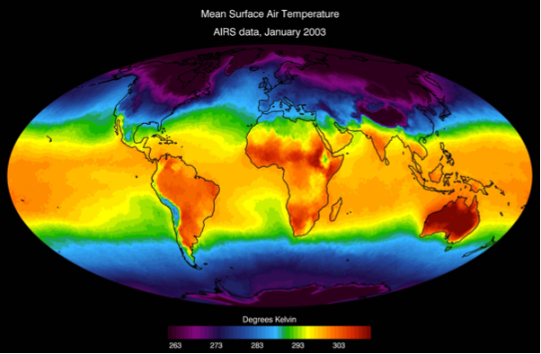
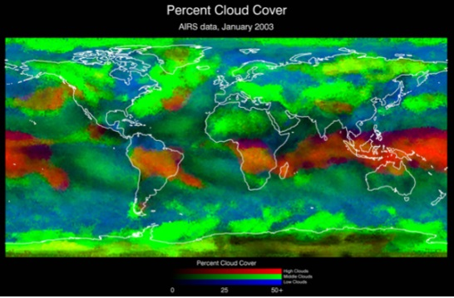
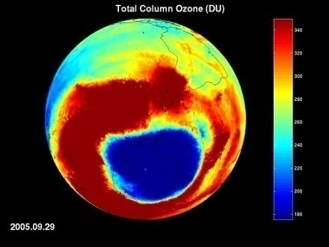
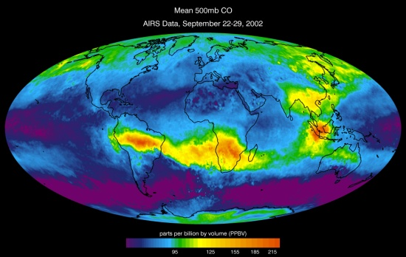
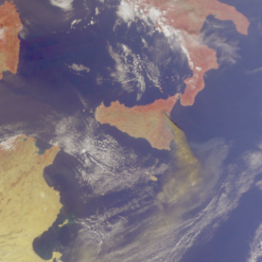
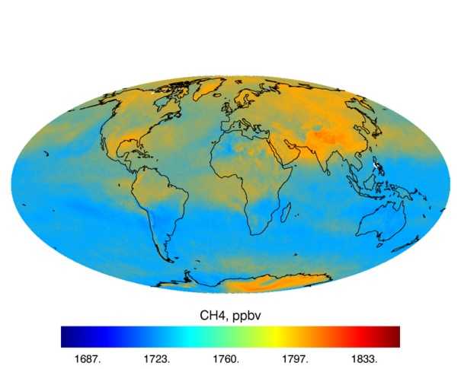
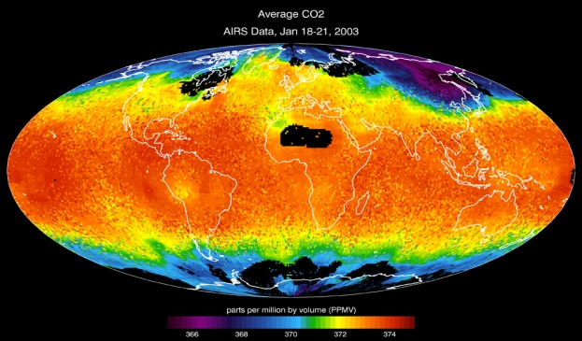
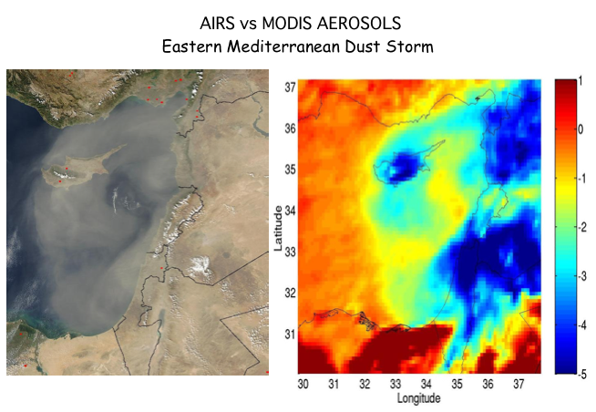
Example of retrieval products (AIRS v.5 & 6 products are shown)
Temperature Profiles
Water Vapor Profiles
Clouds
Ozone
CO
SO2
Methane
CO2
Dust
3

Slide 4
We are attempting to meet the needs of 3 communities
WEATHER
Extreme events
Risk - Commercial (Air Traffic, Energy)
CLIMATE
Processes
Feedbacks
Long-term trends
COMPOSITION
Monitor GHG’s
Air Quality

Slide 5
What are the areas of our current sounding research?
NOAA-Unique Combined Atmospheric Processing System (NUCAPS) is supporting real-time weather and air quality applications (Metop 9:30 and S-NPP/JPSS 1:30 orbits).
Air traffic safety.
Pre-convective forecasting
Wildfire management and air quality.
Hurricane forecasting.
Ozone recovery and use of ozone at STE indicator.
The NASA Continuity product will focus on developing a long-term (2002-2040’s) record for Aqua/AIRS+AMSU and S-NPP/JPSS CrIS+ATMS
Study how to build and document continuity records.
Transparent, instrument agnostic approaches.
Choose the appropriate a-priori for NASA applications.
Create a baseline global product suite for EOS-era
Communicate the strengths and caveats of the product

Slide 6
CLIMCAPS retains many components of the AIRS Methodology
Employs cloud clearing
Uses spatial information to correct for clouds
Allows other state components (SST/LST, T(p), q(p), ε(υ), O₃(p), CO(p), CO₂, CH4, SO₂, HNO₃, N₂O etc.) to be derived independently of clouds from spectral information
A-priori used for cloud clearing is extremely important.
Iteration of cloud clearing causes biases and confounds error characterization … CLIMCAPS does not iterate cloud clearing
Uses all space sounding assets
Microwave radiances used for both for T(p) & q(p) information content and quality control
Imager data is implicitly used via IR emissivity a-priori
Retains the embedded information content (IC) analysis.
Maximizes the weight of observations when IC is high
Enables diverging from Merra-2 when necessary.

Slide 7
CLIMCAPS differs in the choice of a-priori for T, q, O3
Concern | Statistical Model | Re-analysis model
Satellite data is used twice | YES: All channels are used in NN and regressions. Subset of the same exact channels are re-used. | →zero Weight of obs is extremely small w.r.t. 6 hour window and all other instruments.
Vertical sub-structure | Derived from ECMWF statistics and only our obs. The a-priori contribution in the solution cannot be quantified. | Derived from ensemble of many instruments and model dynamics. Contribution is partitioned via error propagation, dXdX^{T}
Latency | Zero – it is a static training | Re-analysis: ~1 month GMAO FP: ~4 to 7 hours
Spatial consistency | Clouds and other signals cause “spatial speckle” that can induce large gradients at 100 km scale. | Constrained by model dynamics (including thermal wind) and is spatially consistent.
Temporal consistency (NOTE NN and regressions are “trained” from specific instruments within specific year(s).) | Non-graceful response to instrument changes (e.g. , degradation, AIRS/CrIS transition) and state changes (climate, volcanoes, or anything outside the domain of its training) | Stated goal is to mitigate obs. discontinuities. Can have artifacts due to instrument changes: O3: MLS in 10/2004; T/q: Metop 2009, 2013, S-NPP 2012, etc.
Notes:
Use of data: Take for example an observation that oocurs between 12UT and 15UT we would used a linear interpolation of Merra-2 at 12UT and 15UT. The 12UT analysis uses window from 09 to 15UT and the 15UT analysis uses data from 12UT to 18UT. So our a-priori would have that the data acquired from 12UT to 18UT but the specific observation we are looking in a particular retrieval would have very low weight.
The FP product
Discontinuitiies
Metop-2008, 2012
NPP 2012 NOAA-20 soon
Some of the discontinuities in Merra-2 (from p.8 o
2018\meetings\180907_gsfc\180907wargan_2017talk.pdf)
Time/period Source of discontinuity
1-31 March 1991 Missing NOAA-11 SBUV observations; no ozone data are assimilated
Late 1994 SBUV coverage limited to latitudes north of 30°S
1 October 2004 Introduction of EOS Aura data; SBUV data turned off
27 March -18 April 2011 MLS data outage
1 June 2015 Transition from Version 2.2 to Version 4.2 of MLS retrievals
1 May 2016 The 261 hPa MLS level turned off
29 May -13 June 2016 OMI data outage

Slide 8
CLIMCAPS differs from AIRS Science Team and NUCAPS
For 20+ years the sounder community has attempted to make a model-independent system.
NUCAPS and AIRS v.6 use statistical models as the a-priori.
CLIMCAPS uses Merra-2 reanalysis as a-priori for T(p) and q(p).
Hypothesis: the statistical step in AIRS Science Team methodology does not provide a stable or well characterized a-priori for continuity.
Merra-2 is a data driven system, does an incredible job with T(p).
Retrieval can benefit from the stability provided by the reanalysis.
For water vapor, hyperspectral infrared information content (IC) is high → departs strongly from the re-analysis.
CLIMCAPS uses the Combined ASTER & MODIS Emissivity over Land (CAMEL) as a-priori over land
CAMEL database has scene dependent uncertainties
Effectively brings in imager IC and high spectral resolution lab. data
Significant improvements in the estimate of geophysical errors and their propagation through the retrieval process.
Notes:
this work began in the 2000's. Had similar results using AIRS with
GFS as an a-priori
- presented at SPIE (5/5/2005) and ASTM (8/4/2005)
- however, lost NASA AIRS funding and was unable to continue

Slide 9
What about cloud products?
We use the clear state (derived from microwave plus IR cloud cleared radiances) to derive cloud parameters from the single IR FOV’s.
Solve for two cloud top pressures and effective cloud fraction.
Cloud cleared parameters and radiances .
In CLIMCAPS the cloud clearing is more stable due to the stability of Merra-2’s clear state
Post-process algorithms solve for cloud microphysical products.
Single-FOV cloud microphysical approaches need to partition errors between clouds and the clear state.
Errors in cloud forward models are still large.
Minimization of residuals force these errors into the clear state products → need to partition the errors.
They also tend to use forecast models as their a-priori.
We have multiple approaches for single FOV retrievals and these will be inter-compared to CLIMCAPS
One funded by TASNPP has climatological a-priori (Xiu Lu, LaRC)

Slide 10
Applications we are targeting for the NASA continuity product.
Topic | Potential applications for thermal sounding products
Fingerprinting (e.g., Santer 2018 Science, Pierrehumbert 2011 Phys. Today) | Improved stratosphere/troposphere allows better separate of O3 hole from GHG’s, N.H./S.H. gradients, polar amplification (downwelling thermal), Arctic moisture budget (Boisvert 2015 JGR)
PBL (Fetzer 2004 GRL, Hoogewind 2017 J.Clim) | Capping layer inversions, convection and stability. Most important for a thermal sounder is knowledge of when we have skill (i.e., averaging kernels).
UTH, double ITCZ (Tian 2015 GRL), ENSO, MJO | Stable and seasonally consistent T(p) will stabilize cloud clearing and q(p). Departures from Merra-2 will be more valuable than a derived state.
Ozone | Ozone hole; Intrusions and mid-trop O3 (Langford 2018 Atmos. Env); LS O3 trends (Ball 2018 ACP, Wargan 2018 GRL); CO/O3 ratio (Anderson 2016 Nat.Comm)
Carbon Dioxide (CO2) | Contribute to discussion of seasonal cycle amplitude (Barnes 2016 JGR), clear bias of OCO (Corbin 2008 JGR)., and stratospheric/troposphere CO2 gradient. (Separability of T/CO2 is improved with use of Merra-2 and AMSU/ATMS.
Carbon Monoxide | Long-term trends of CO (Worden 2013 ACP). Impact on OH (Gaubert 2017 GRL), Seasonal cycle (Park 2015 JGR) and CO/CO2 emission factors (Wang 2009 ACP)
Methane (CH4) | Monitoring of Amazon CH4 (Bloom 2016 ACP), Changes to Arctic emissions (Shakhova 2010 Science, Thornton 2016 GRL)
Other trace gases | Nitric Acid, Nitrous Oxide, Sulfur Dioxide, Isoprene, PAN, Acetylene, Methanol, etc – all benefit from stable cloud clearing and upstream derived T(p), q(p), etc.
Notes:
Anderson, D.C., R.J. Salawitch, T.P. Canty, R.R. Dickerson, B.H. Kahn, R.B. Pierce, A.M. Thompson and et al. 2016. A pervasive role for biomass burning in tropical high ozone/low water structures. Nature Communications v.7 doi:10.1038/ncomms10267, 15 pgs.
Ball, W.T., A. Alsing, D.J. Mortlock, J. Staehelin, J.F. Haigh, T. Peter, F. Tummon, R. Stub, A. Stenke, J. Anderson, A. Bourassa, S.M. Davis, D. Degenstein, S. Frith, L. Froidevaux, C. Roth, V. Sofieva, R. Wang, J. Wild, P. Yu11, J.R. Ziemke and E.V. Rozanov 2018. Evidence for a continuous decline in lower stratospheric ozone offsetting ozone layer recovery. Atmos. Chem. Phys. v.18 p.1379-1394. doi:10.5194/acp-18-1379-2018
Barnes, E.A., N. Parazoo, C. Orbe and A.S. Denning 2016. Isentropic transport and the seasonal cycle amplitude of CO2. J. Geophys. Res. v.121 doi:10.1002/2016JD025109, 19 pgs.
Bloom, A.A., T. Lauvaux, V. Yadav, R. Duren, S. Sander, J. Worden and D. Schimel 2016. What are the greenhouse gas observing system requirements for reducing fundamental biogeochemical process uncertainty? Amazon wetland CH4 emissions as a case study. Atmos. Chem. Phys. v.16 p.15199-15218. doi:10.5194/acp-16-15199-2016
Corbin, K.D., A.S. Denning, L. Lu, J.W. Wang and I.T. Baker 2008. Possible representation errors in inversions of satellite CO2 retrievals. J. Geophys. Res. v.113 D02301 doi:10.1029/JD008716, 11 pgs.
Fetzer, E.J., J. Teixeira, E.T. Olsen and E.F. Fishbein 2004. Satellite remote sounding of atmospheric boundary layer temperature inversions over the subtropical eastern Pacific. Geophys. Res. Lett. v.31 L17102 doi:10.1029/2004GL020174, 4 pgs.
Gaubert, B., H.M. Worden, A.F.J. Arellano, L.K. Emmons, S. Tilmes, J. Barre, S. Martinez Alonso, F. Vitt, J.L. Anderson, F. Alkemade, S. Houweling and D.P. Edwards 2017. Chemical Feedback From Decreasing Carbon Monoxide Emissions. Geophys. Res. Lett. v.44 p.9985-9995. doi:10.1002/2017GL074987
Hoogewind, K.A., M.E. Baldwin and R.J. Trapp 2017. The impact of climate change on hazardous convective weather in the United States: Insight from high-resolution dynamical downscaling. J. Climate v.30 p.10081-10100. doi:10.1175/JCLI-D-16-0885.1
Langford, A.O., R.J. Alvarez II, J. Brioude, S. Evan, L.T. Iraci, G. Kirgis, S. Kuang, T. Leblanc, M.J. Newchurch, R.B. Pierce, C.J. Senffa and E.L. Yates 2018. Coordinated profiling of stratospheric intrusions and transported pollution by the Tropospheric Ozone Lidar Network (TOLNet) and NASA AJAX: Observations and comparison to HYSPLIT, RAQMS, and FLEXPART. Atmospheric Environment v.174 p.1-14.
Park, K., Z. Wang, L.K. Emmons and J.E. Mak 2015. Variation of atmospheric CO, d13C, and d18O at high northern latitude during 2004-2009: Observations and model simulations. J. Geophys. Res. v.120 p.11024-11036. doi:10.1002/2015JD023191
Pierrehumbert, R.T. 2011. Infrared radiation and planetary temperature. Physics Today v.1 p.33-38.
Santer, B.D., S. Po-Chedley, M.D. Zelinka, I. Cvijanovic, C. Bonfils, P.J. Durack, Q. Fu, J. Kiehl, C. Mears, J. Painter, G. Pallotta, S. Solomon, F.J. Wentz and C.Z. Zou 2018. Human influence on the seasonal cycle of tropospheric temperature. Science v.361 10.1126/science.aas8806, 11 pgs.
Shakhova, N., I. Semiletov, A. Salyuk, V. Yusupov, D. Kosmach and O. Gustafsson 2010. Extensive methane venting to the atmosphere from sediments of the East Siberian Arctic shelf. Science v.327 p.1246-1250.
Thornton, B.F. and et al. 2016. Methane fluxes from the sea to the atmosphere across the Siberian shelf seas. Geophys. Res. Lett. v.43 p.5869-5877. doi:10.1002/2016GL068977
Tian, B. 2015. Spread of model climate sensitivity linked to double-Intertropical Convergence Zone bias. Geophys. Res. Lett. v.42 p.4133-4141.
Wang, H., D.J. Jacob, D.B.A. Jones, P. Suntharalingam, J.A. Fisher, R. Nassar, S. Pawson and J.E. Nielson 2009. Error correlation between CO2 and CO as constraint for CO2 flux inversions using satellite data. Atmos. Chem. Phys. v.9 p.7313-7323.
Wargan, K., C. Orbe, S. Pawson, J.R. Ziemke, L.D. Oman, M.A. Olsen, L. Coy and K.E. Knowland 2018. Recent decline in extratropical lower stratospheric ozone attributed to circulation changes. Geophys. Res. Lett. v.45 p.5166-5176. doi:10.1029/2018GL077406
- Trend in LS O3 is -1.67 DU/decade (Wargan 2018 GRL)
Worden, H.M., M.N. Deeter, C. Frankenberg, M. George, F. Nichitiu, J. Worden, I. Aben, K.W. Bowman, C. Clerbaux, P.F. Coheur, A.T.J. de Laat, R. Detweiler, J.R. Drummond, D.P. Edwards, J.C. Gille, D. Hurtmans, M. Luo, S. Martinez-Alonso, S. Massie, G. Pfister and J.X. Warner 2013. Decadal record of satellite carbon monoxide observations. Atmos. Chem. Phys. v.13 p.837-850.

Slide 11
What about trends?
Any trend in temperature in the a-priori will leave an imprint on the final thermal sounder product trend.
Infrared has cross-talk between CO₂ and T has been mitigated within CLIMCAPS (use of microwave, CO2 is solved for)
Uncorrected, a 3 ppm change in CO₂ will cause ~0.1 K in T(p)
Statistical operators extrapolate trends from their training
Induces a tendency to under-estimate trends.
CLIMCAPS has been optimized to move away from a-priori
Error estimates quantify IC added by sounder observations.
Measurements will depart if AIRS or CrIS disagrees with Merra.
TASNPP funded investigation of the derivation of trends from radiance differences (PI, Larrabee Strow)
Simplifies the a-priori assumptions.
Does not require solving for the full atmospheric state.

Slide 12
xCAPS is both an R2O and an O2R engine
NUCAPS is based on AIRS Science Team (AST) methodology (version 5.9) and leverages a NASA research investment to support NOAA operations (R2O)
NUCAPS-Metop has been operational since 2008
2008 to present Metop-A/IASI+AMSU+MHS + AVHRR
2012 to present Metop-B/IASI+AMSU+MHS
2/2013 to present, NUCAPS/S-NPP operational
7/2018 to present, NUCAPS/NOAA-20 operational (in DB)
NUCAPS is fully capable of running AIRS+AMSU (but doesn’t)
NUCAPS has many operational users (T, q, O₃, CO, and CH₄)
CLIMCAPS leverages NUCAPS & AST development (O2R)
Continuity benefits diurnal Metop/NOAA-2x continuity
CLIMCAPS has benefited from NUCAPS O2R investment
NUCAPS can benefit from CLIMCAPS R2O investment

Slide 13
Choosing the cross-over point for Aqua to S-NPP
Nominal or Full spectral resolution (NSR or FSR)
Dec. 4, 2014 S-NPP/CrIS was put into FSR mode
Nov. 2, 2015 S-NPP/CrIS FSR extended spectral mode
Transition from AMSU+HSB to ATMS
Aqua/AMSU Chl.7 has never been used
Aqua/HSB was lost on Feb. 5, 2003
Aqua/AMSU degradation: Chl.4 (2007) and Chl.5 (2009-2011)
Aqua/AMSU Chl.1 and 2 lost in 10/2016
ATMS scan reversals: began 7/14/15 (1/day), 8/9/16 (2x/orbit)
Recommendation (based on discussions w/ L. Strow):
Use AIRS+AMSU from 9/1/2002 to 8/31/2016
Use “pristine” AIRS channels that were well behaved
Use AMSU 1, 2, 3, 6, 8, 9, 10, 11, 12, 13, 14, 15
Use S-NPP CrIS.FSR+ATMS from 9/1/2016 to 8/31/2018
12/10/2015-9/31/2016 overlap periods of Aqua/S-NPP
Use NOAA-20 CrIS.FSR+ATMS from 9/1/2018 to …
Adequate overlap periods of S-NPP and NOAA-20 exist

Slide 14
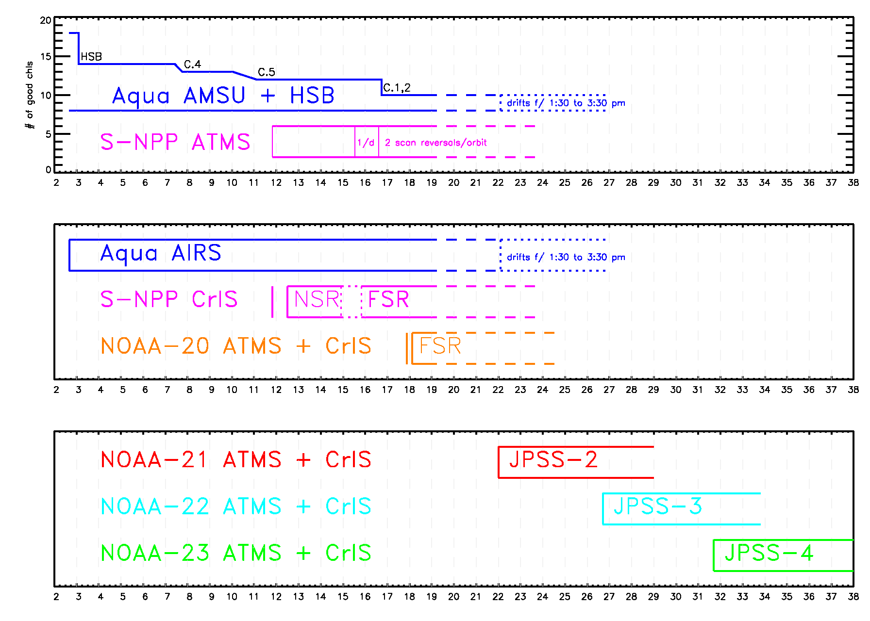
Choosing the cross-over points for Aqua, S-NPP, and beyond
Aqua
S-NPP
NOAA-20
NOAA-21
NOAA-22
NOAA-23

Slide 15
How we plan to organize the sounding community
Aqua/AIRS/AMSU is a project.
AIRS Version.6 used a neural network a-priori
S-NPP/NOAA-20 is a ROSES competed SIPS.
With the Terra-Aqua-Suomi-NPP (TASNPP) selection these two worlds have been intertwined
Joao Teixeira is the AIRS Project Lead
Bryan Baum is the S-NPP Science Team Lead
Chris Barnet is the S-NPP Sounder Discipline Lead
We are now working towards a common goal of producing a EOS/S-NPP/JPSS continuity product.
AIRS v.6.x will be maintained for use by science community.
AIRS Science Team is evaluating CLIMCAPS as a candidate for Version.7.
We are working towards having a GLOBAL baseline (CLIMCAPS) sounding product begin production at GES-DSIC by Oct. 2019 for Aqua, S-NPP, and NOAA-20

Slide 16
CLIMCAPS supports building a continuity dataset NOW
Provide an archive of these measurements as a baseline for the future.
Reasonable mitigation of instrument artifacts.
Characterization with error covariance propagation and averaging kernels.
Full suite of trace gases (O₃(p), CO(p), CO₂, CH4, SO₂, HNO₃, N₂O).
Build a long-term record so that TASNPP researchers can:
Use the record for understanding climate processes and change.
Document our best understanding of the information content.
9/2002-8/2016 AIRS + AMSU → 9/2016-8/2035 CrIS-FSR + ATMS
1:30 am/pm using Aqua, S-NPP, NOAA-20 to 23
With sufficient overlap period of 2012-present
Future work (next ROSES cycle?).
Reprocessing using a Common Hyperspectral InfraRed Product (CHIRP) radiance dataset (transform AIRS, IASI, CrIS to common spectrum).
Create a Metop long-term dataset: 2008 to 2040’s.
Metop-A, -B, -C at 9:30 am/pm with IASI, AMSU, MHS.
Follow-on (EPS-SG/IASI-NG) has been approved for 2021-2040.
Notes:
Larrabee: pick Sep. 2016, so we have even years

Slide 17
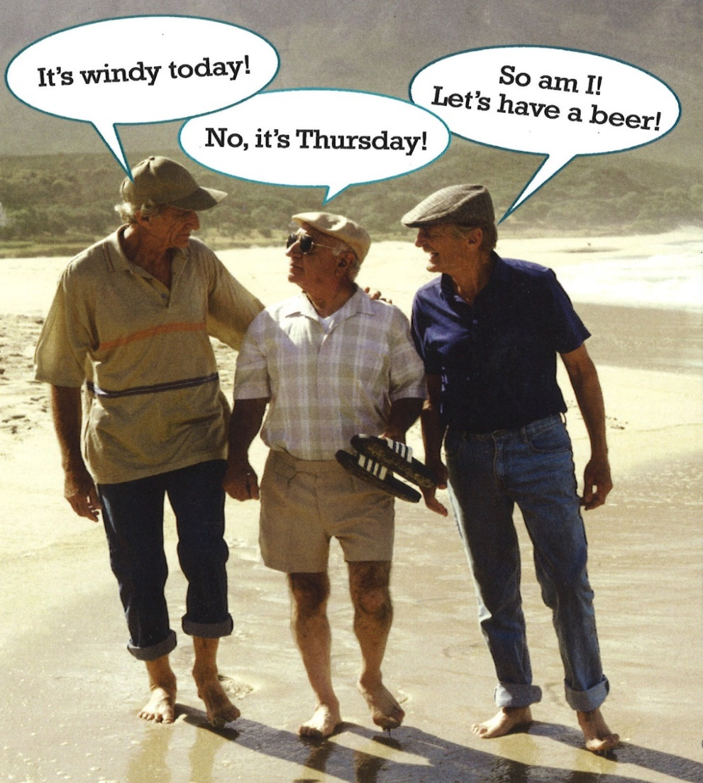
Questions?
CLIMCAPS is a NASA continuity product system
CLIMCAPS uses Merra-2 as a-priori for T(p) and q(p), CAMEL for ε(ν), static climatologies for trace gases.
CLIMCAPS retrieves soundings in clear and partly cloudy scenes.
CLIMCAPS has diurnal, seasonal and inter-annual and inter-satellite stability.
CLIMCAPS propagates partitions a-priori and retrieval error estimates.
CLIMCAPS is designed to support community needs.
So …. How can CLIMCAPS support your research?

Slide 18
Recent Terra-Aqua-S-NPP ROSES Cycle: 2018-2021
The TASNPP ROSES solicitation focused primarily on the continuity of the EOS mission. In addition, the solicitation cited
Improvements to estimates of information content (e.g. error covariance matrix and averaging kernels).
Improvements in the boundary layer.
“All data products must be focused on an application that can be justified as meeting NASA’s applied science goals or a unique unmet operational data need that fits within the NASA program objectives and mission. For Suomi NPP, to prevent duplication of efforts pursued by NOAA, NASA will only support the upgrade, refresh and operation and maintenance of EOS Continuity algorithms and supporting systems.” ROSES A.37 solicitation p.9-10.
The Panel Review selected CLIMCAPS as the “core” algorithm.
Numerous science applications that will be dependent on the upstream level-1 or level-2 products were selected.

Slide 19
Summary of the Algorithms Selected by the ROSES S-NPP Panel in 2018
PI, last name | PI, first name | affiliation | instruments | summary of topic
Barnet | Chris | STC | Aqua AIRS/AMSU & S-NPP and NOAA-20 CrIS/ATMS | Continuity products for T(p), q(p), O3(p), other trace gases, surface and cloud top pressure and fraction.
Cady-Pereira | Karen | AER | CrIS Level-1 | CrIS Single FOV NH3 Product
Elsaesser | Gregory | Columbia | AIRS Level-2 T/q at high spatial resolution | Convective transition in storms.
Henze | Daven | U.Colo. | CrIS NH3 product | NH3 Inversion Model
Huang | Xianglei | U.Mich. | AIRS, CrIS Level-1 CERES, CrIS, Merra(T,q) | cloud radiative effect
Lambrigtsen | Bjorn | JPL | AMSU, ATMS Level.1 | ATMS Level-1 and Level-2 T, q
Liu | Xu | LaRC | AIRS/AMSU Level.1 CrIS/ATMS Level.1 | S-FOV T,q,trace gas, surf, cloud CLARREO Climate Fingerprint
Milstein | Adam | MIT/LL | AIRS, CrIS, Level.1 | NN L2 alg tailored for PBL
Payne | Vivienne | JPL | CrIS Level.1 | Single FOV PAN Product
Reale | Oreste | USRA | AIRS, CrIS Level.1 and CCR's | Radiance DA: cloudy and cloud cleared targeted obs study
Ruston | Benjamin | NRL | AIRS, CrIS, CALIOP, MODIS, MISR | dust correction within radiance DA
Santek | David | U.Wisc | AIRS, CrIS Dual Regress (q, O3) | H2O,O3 winds
Soden | Brian | U.Miami | AIRS, CERES, MODIS | Radiative kernels to quantify CMIP6 fluxes
Strow | Larrabee | UMBC | AIRS, CrIS, IASI | Climate trends derived from delta radiances.
Tan | Ivy | UMBC | MODIS, AIRS, CERES, AMSR | cloud feedback
Tian | Baijun | JPL | AIRS/AMSU | CMIP5/6, compare w/ Merra
Wilcox | Eric | DRI | MODIS, AMSE-R, CloudSat, CALIPSO, OMI, AIRS, IASI | study of radiative heating by black carbon
Worden | Helen | UCAR | MOPITT, CrIS | Single FOV Carbon Monoxide retrieval product

Slide 20
Simplified Flow Diagram of the NUCAPS Algorithm
Climatological First Guess for all products
IR+MW Physical T_{s}, ε(ν), ρ(ν)
IR Physical CO(p)
Microwave Physical for T(p), q(p), LIQ(p), ε(f)
IR Physical HNO₃(p)
IR+MW Physical T(p)
IR Physical CH₄(p)
IR+MW Physical q(p)
Initial Cloud Clearing, η_{j}, R_{ccr}
IR Physical CO₂(p)
MIT
IR Physical O₃(p)
Statistical Operator for Ts, ε(ν), T(p), q(p)
IR Physical N₂O(p)
Final Cloud Clearing, η_{j}, R_{ccr}
IR Physical T_{s}, ε(ν), ρ(ν)
RET
IR+MW Physical T_{s}, ε(ν), ρ(ν)
FG
CCR
Note: Repeated physical steps always use same startup for that product, but it uses products and error estimates from other steps.
Improved Cloud Clearing, η_{j}, R_{ccr}
IR+MW Physical T(p)

Slide 21
Simplified Flow Diagram of the CLIMCAPS Algorithm
MERRA-2 (T, q, O3), CAMEL/Masuda (ε(ν)), climatologies (trace gases)
IR+MW Physical T_{s}, ε(ν), ρ(ν)
IR Physical CH₄(p)
IR Physical CO₂(p)
IR+MW Physical T(p)
Microwave-only Physical for T(p), q(p), LIQ(p), ε(f)
IR+MW Physical q(p)
IR Physical N₂O(p)
LIQ(p), ε(f)
IR Physical O₃(p)
Final Cloud Clearing, η_{j}, R_{ccr}
MIT
IR Physical CO(p)
+
IR Physical HNO₃(p)
RET
CCR
Initial Cloud Clearing, η_{j}, R_{ccr}
Note: Repeated physical steps always use same startup for that product, but it uses products and error estimates from other steps.
IR+MW Physical T(p)
FG

Slide 22
Preliminary assessment of using Merra-2 as a-priori
Product | How much does Merra-2 help?
CCR’s | Merra-2 T(p) stabilizes cloud clearing.
T(p) | Merra-2 ≈50-75% of IC, CLIMCAPS dXdX^{T}(H₂O,CO₂, O₃,…)
q(p) | Merra-2 contributes ≈25% of IC, CLIMCAPS dXdX^{T}(T,CH₄,…)
O3(p) | ≈1.5 d.o.f. in LS/UT Merra-2 O3(p) provides shape
CO | ≈1 d.o.f. in mid-trop, Merra-2 T(p) adds stability
CH4, CO2, N2O | ≈0.5 d.o.f. in mid-trop, Merra-2 T(p) adds stability
HNO3 | ≈1 d.o.f. in LS, MERRA-T(p) stabilizes the solution
A-priori is necessary because our solution is under-determined
Merra-2 is more stable than statistical operators
Merra-2 has less discontinuities than forecast models
Retrieval departures from Merra-2 are valuable in the context of continuity because we are exploiting more of the IC of the Aqua/S-NPP/NOAA-20 infrared/microwave satellites and account for dXdX^{T} of trace gases

Slide 23
Error covariance of the T(p) retrieval, δTδT^{T}
Error covariance & averaging kernels are related through the a-priori covariance
Error can be mapped through our physical retrieval such that the amount of the a-priori in our solution can be known and analyzed
The left panel is how much of the a-priori leaks through (~50% in this case)
Middle panel is the error covariance of the measurements
Right panel is the total error covariance of the temperature retrieval
Most of the scene-to-scene variability in the error will be from the fraction of the a-priori that leaks through – and that is a strong function of cloud homogeneity
Merra2 error in solution, (δTδT^{T})^{A}
Error in solution, from radiances (δTδT^{T})^{O}
Retrieval error:
δTδT^{T} = (δTδT^{T})^{A} + (δTδT^{T})^{O}
Notes:
G092 (real granule #181) FOR 0520
Plots are 45% (2.25 x 3.15%
Y-pos = 4.7” f/ top
X-pos = 0.4, 3.5, 6.6” from left

Slide 24
Error covariance of the q(p) retrieval, δqδq^{T}
The error from T(p) retrieval, δTδT^{T}, is used as error source when solving for water vapor, q(p)
In the case of water vapor, a greater fraction of the measurements are believed (i.e., ~25% of a-priori error propagates to solution)
Higher errors (e.g., cloud clearing or δTδT^{T}) will cause more of the water a-priori to leak through, especially near the surface
With CLIMCAPS we can quantify the sources of error in our retrieval.
Merra2 error in solution, (δqδq^{T})^{A}
Error in solution, from radiances (δqδq^{T})^{O}
Total retrieval error:
δqδq^{T} = (δqδq^{T})^{A} + (δqδq^{T})^{O}
We must be able to interrogate our scene dependent information content in order to understand it impact on level-3 or averaged products.

Slide 25
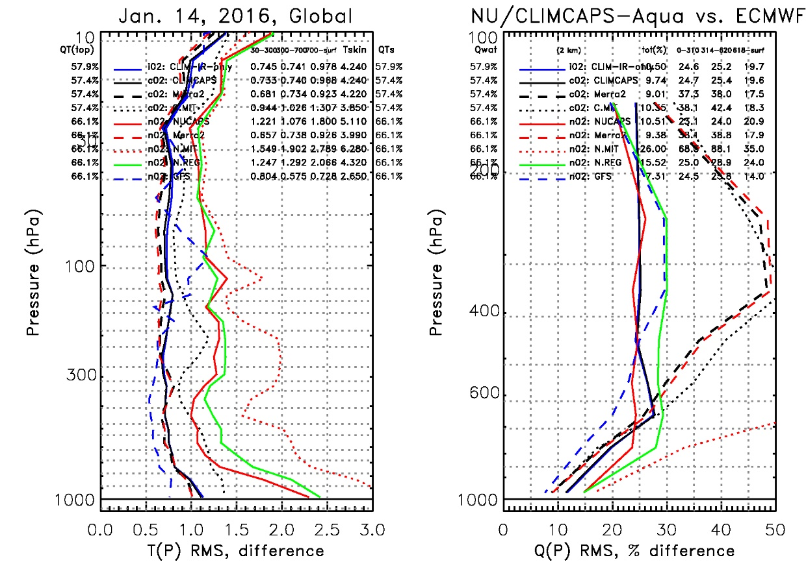
How much do we improve over Merra-2?
Statistics for the Jan. 14, 2016 focus day
CLIMCAPS T(p) is ~= MERRA T(p)
But CLIMCAPS q(p) ends up in same place as NUCAPS q(p) even though Merra-2 start-up significantly worse than NUCAPS regression.
AIRS (and S-NPP) DOES NOT add significant information content to T(p)
AIRS (and S-NPP) DOES add significant IC to q(p)
Black: CLIMCAPS-Aqua, Solid = AIRS+AMSU dotted: AMSU-only
Blue: CLIMCAPS-Aqua, Solid = AIRS-only
Red: NUCAPS-Aqua, Solid = AIRS+AMSU, dotted: AMSU-only
Green: NUCAPS-Aqua, Solid = AIRS+AMSU LINEAR regression
Dashed Black: Merra-2 for CLIMCAPS-Aqua QC
Dashed Red: Merra-2 / Blue: GFS for NUCAPS-Aqua QC
Notes:
160114aqua_focus_p03_rms.jpg

Slide 26
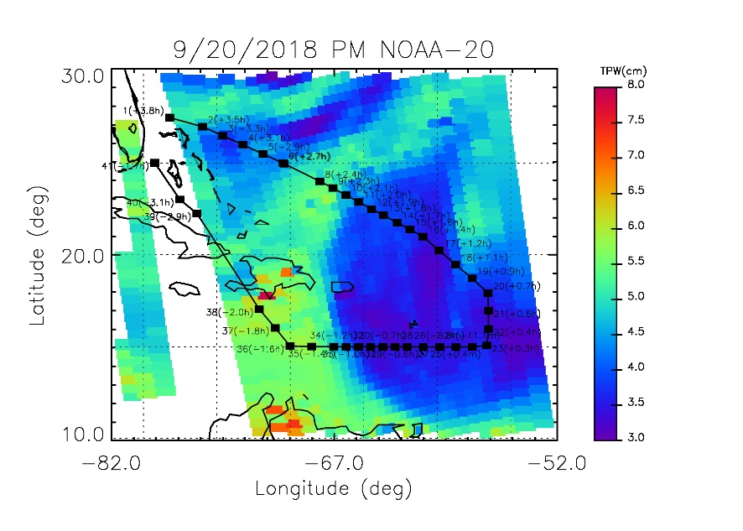
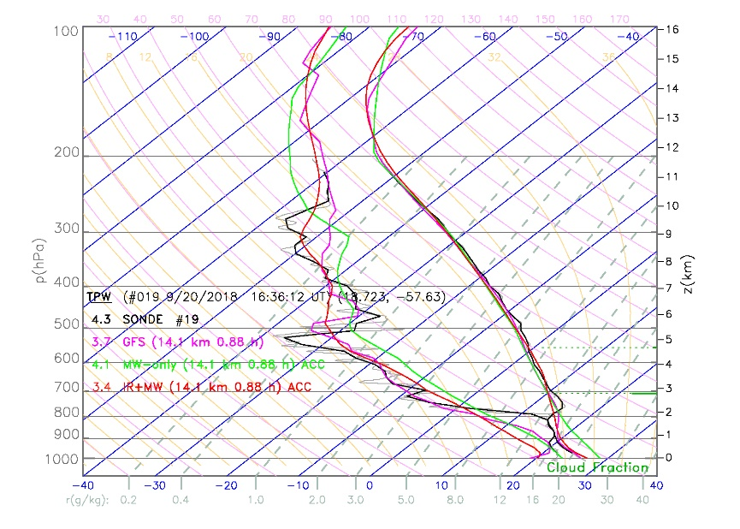
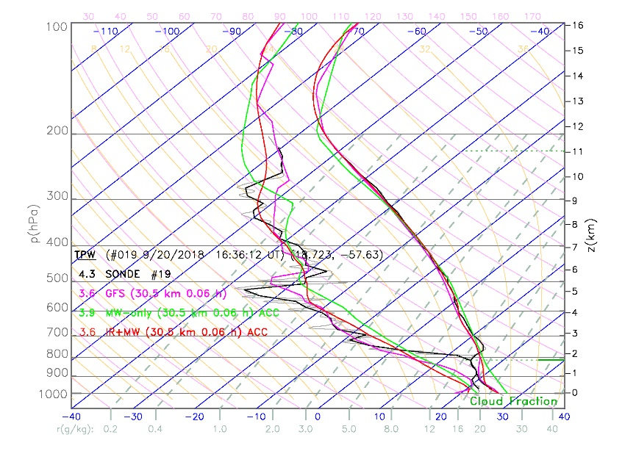
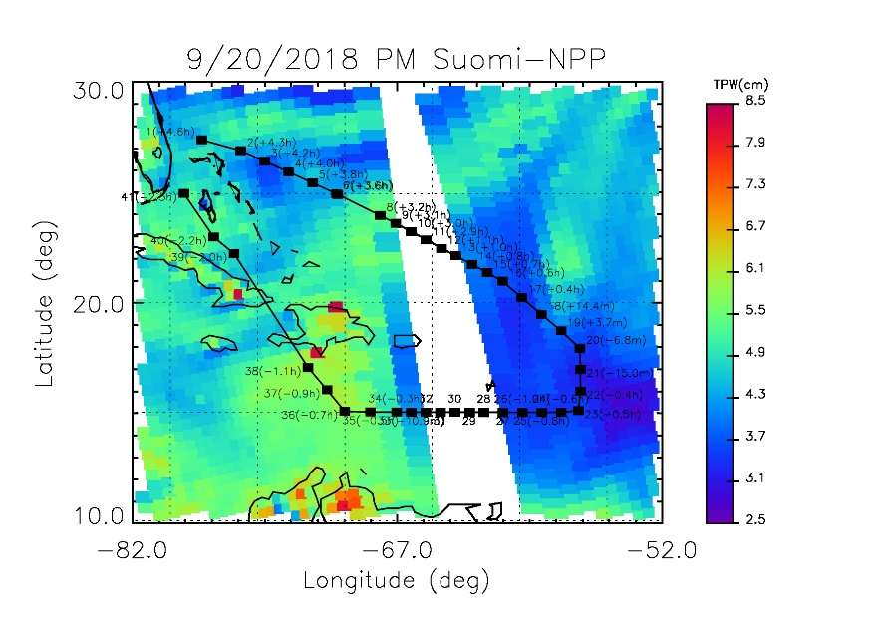
Saharan Air Layer field campaign 4-weeks ago
Sonde #19/41
16:36 UT
NOAA-20
NUCAPS
14.1 km
+54 min
19:10 UT
17:30 UT
S-NPP
NUCAPS
30.5 km
+3.7 min
18:20 UT
16:40 UT
Notes:
N2O: sonde(19) at 16.60 UT lat= 18.72 lon= -57.63 G= 8 F= 58
file= 8: time range = 172903 172933 #sondes= 4
NPP: sonde(19) at 16.60 UT lat= 18.72 lon= -57.63 G= 5 F= 96
file= 5: time range = 163927 163957 #sondes= 2

Slide 27
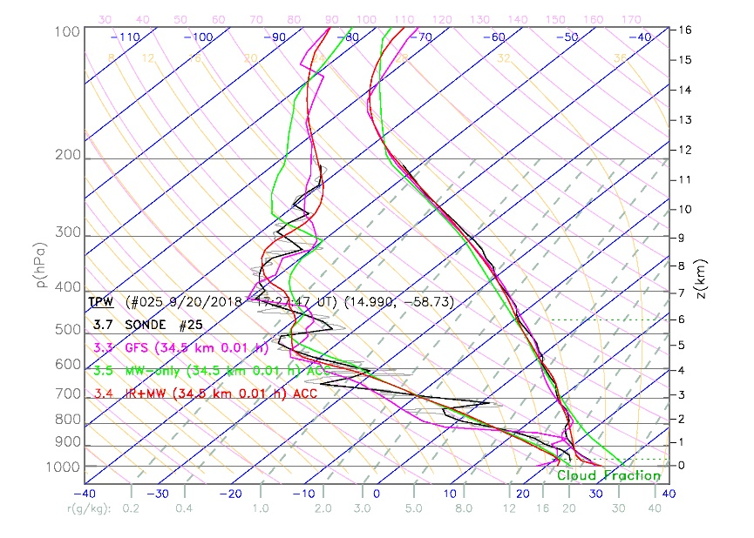
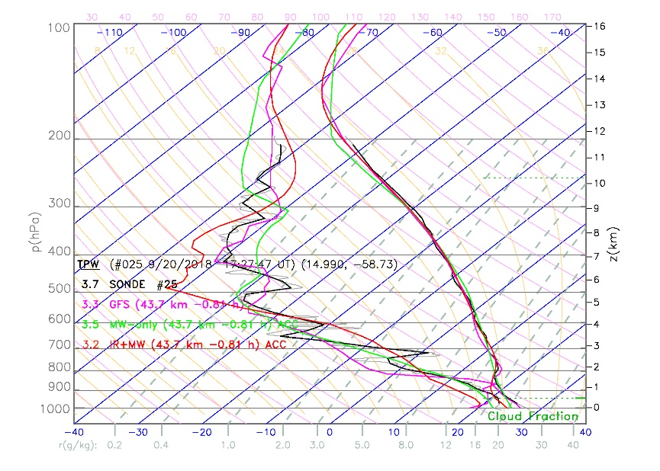
Saharan Air Layer field campaign 4-weeks ago
Sonde #25/41
17:28 UT
NOAA-20
NUCAPS
34.8 km
+0.4 min
19:10 UT
17:30 UT
S-NPP
NUCAPS
43.7 km
-49 min
18:20 UT
16:40 UT
Notes:
N20: sonde(25) at 17.46 UT lat= 14.99 lon= -58.73 G= 6 F= 55
file= 6: time range = 172759 172829 #sondes= 10
NPP: sonde(25) at 17.46 UT lat= 14.99 lon= -58.73 G= 4 F= 3
file= 4: time range = 163855 163925 #sondes= 7

Slide 28
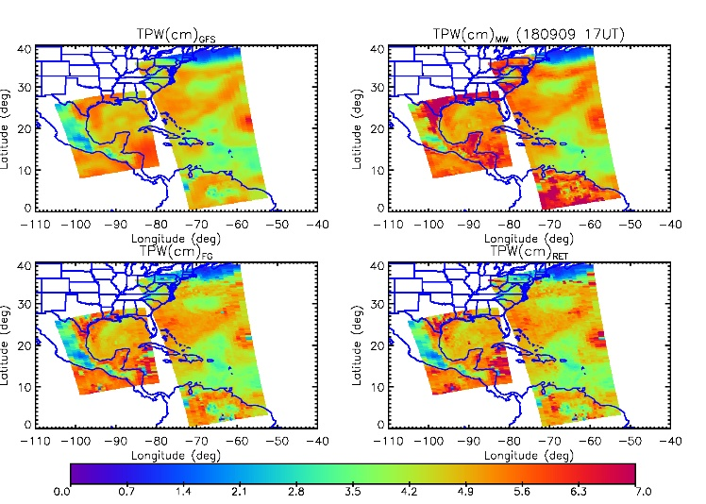
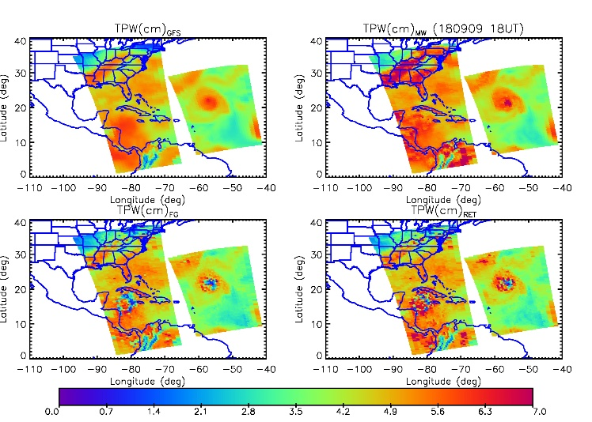
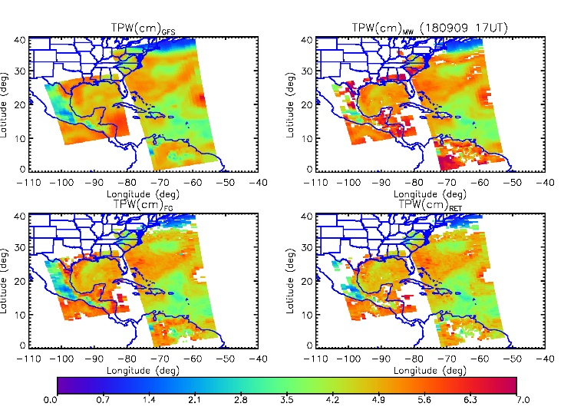
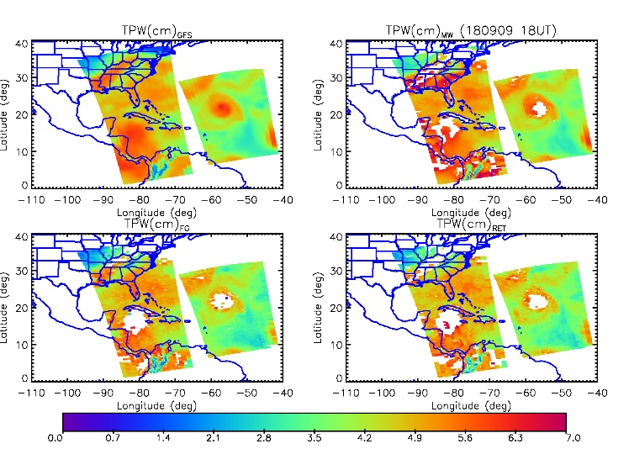
Hurricane Florence campaign, Sep. 9, 2018
NOAA-20 NUCAPS (no QC)
S-NPP NUCAPS (no QC)
Here is all the NUCAPS data that was available by direct broadcast (DB) on Sep. 9th.
We could go back and process from archive but I think it is important to show what we would have had in DB
Top is all data bottom is accepted only.
NOAA-20 (left) and S-NPP right)
At a given longitude NOAA-20 goes over 50 minutes before NPP.
4 panels are GFS (interpolated to satellite), microwave only (MIT), first guess (FG), and final retrieval (RET).
I have these plots from Sep. 9 to Sep. 20th.
NOAA-20 NUCAPS (with QC)
S-NPP NUCAPS (with QC)

Slide 29
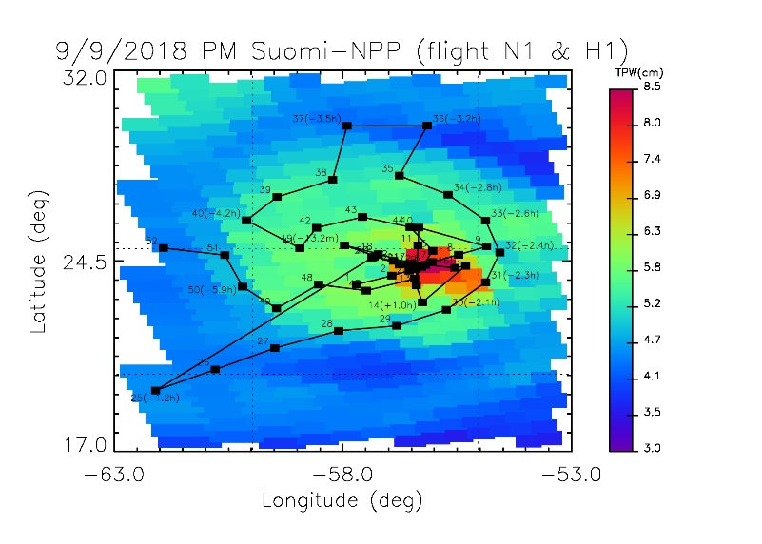
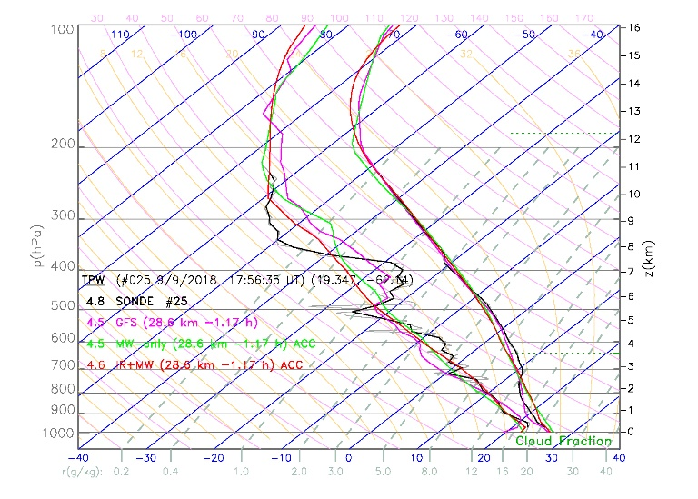
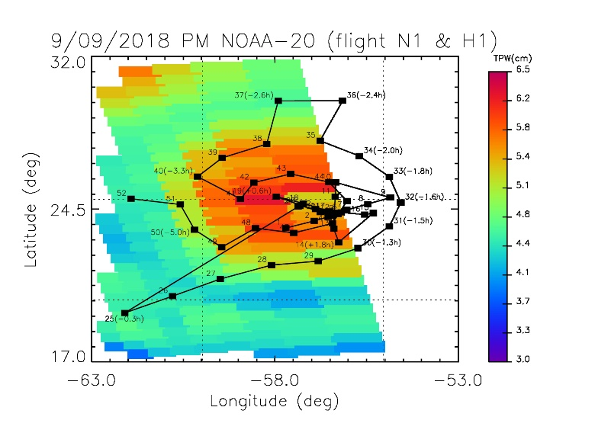
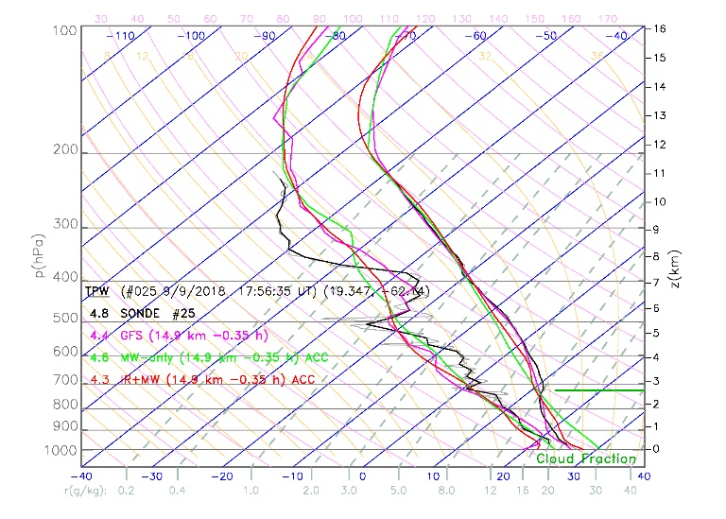
Hurricane Florence campaign, Sep. 9, 2018
Sonde #25 is shown here. This is from the “N1” flight which is a G-IV aircraft.
For both S-NPP and NOAA-20 in this case the closest matchup was an accepted NUCAPS retrieval
NPP is well centered spatially but the orbit occurred about 1.1 hour before sonde #25 was dropped. Therefore, we can look at all the sondes up to #24.
NOAA-20 overpass is closer in time (0.35 hour before sonde #25) but many sondes are in the gap of NOAA-20 and should be ignored.
This shows the value of having 2 satellites

Slide 30
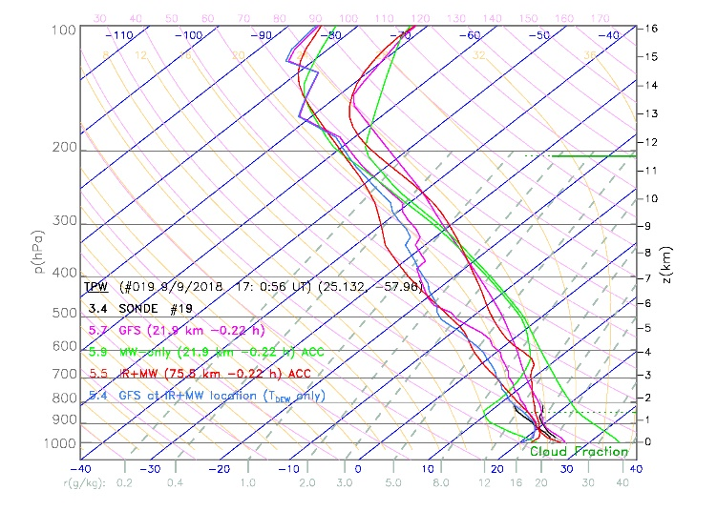
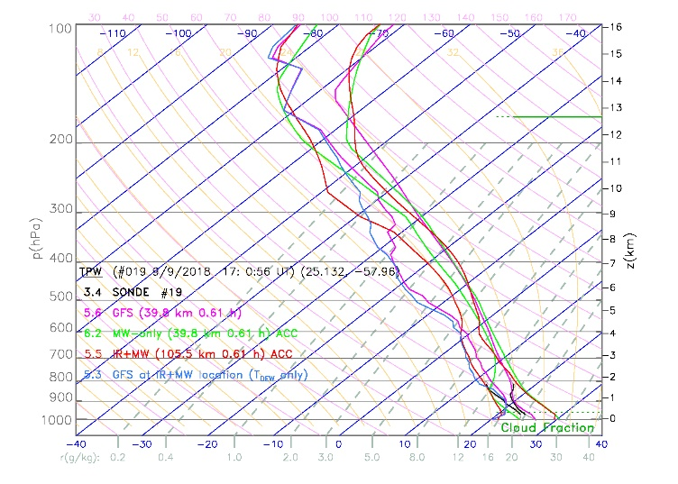
Hurricane Florence campaign, Sep. 9, 2018
Sonde #19 is shown here. This is from the “H1” flight which is a P-3 aircraft
S-NPP is well centered and the orbit occurred about 13 minutes before sonde #19 was dropped. For S-NPP the closest MIT was accepted but the closest accepted RET is 75 km away. GFS is plotted for both.
NOAA-20 overpass is also close in time (36 minutes after sonde #19). Again, closest RET was rejected, so one shown is ~100 km away.
Again, shows value of 2 satellites. In this case 2 views of same scene are both within ½ h.

Slide 31
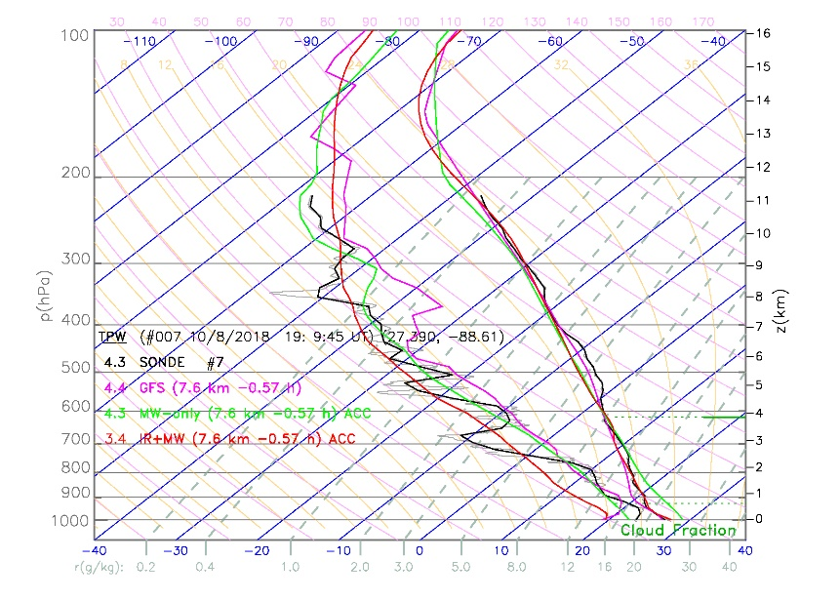
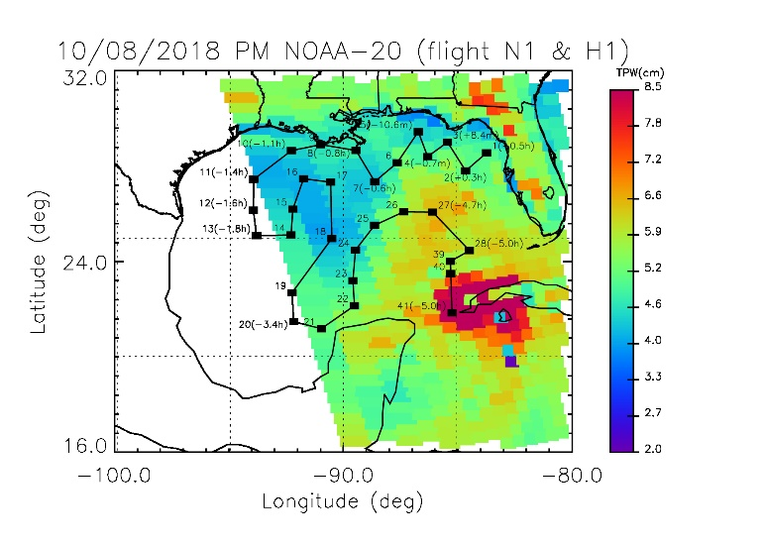
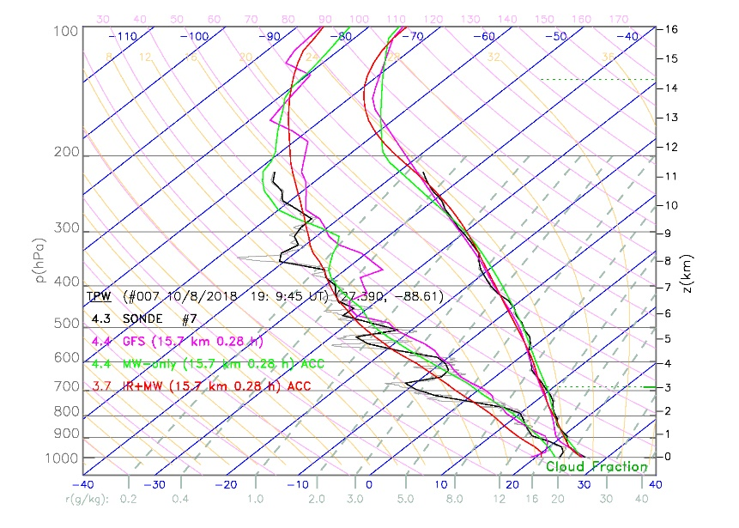
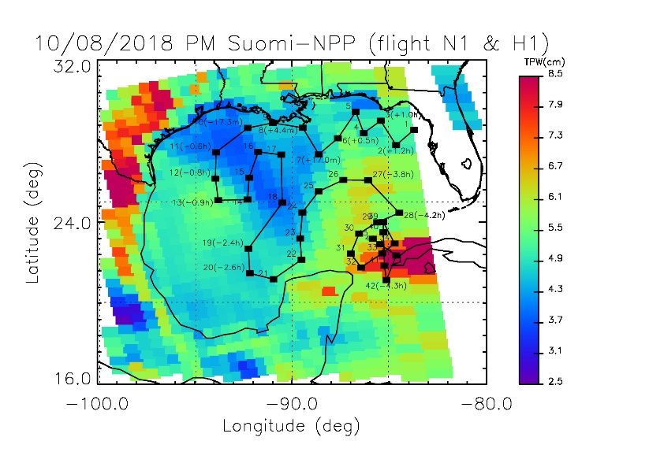
Hurricane Michael campaign, Oct. 8, 2018
Sonde #7
19:10 UT
NOAA-20
NUCAPS
7 km
-34 min
20:15 UT
18:35 UT
S-NPP
NUCAPS
15 km
+17 min
19:25 UT
Notes:
NOAA-20
========================NUCAPS file= 13: time range = 18:33:43 to 18:34:13 #sondes= 2
NUCAPS file= 14: time range = 18:34:15 to 18:34:45 #sondes= 7
NUCAPS file= 15: time range = 18:34:47 to 18:35:17 #sondes= 4
NUCAPS file= 16: time range = 18:35:19 to 18:35:49 #sondes= 8
NUCAPS file= 17: time range = 18:35:51 to 18:36:21 #sondes= 10
NUCAPS file= 18: time range = 18:36:23 to 18:36:53 #sondes= 0
sonde( 1) 18: 3:33 UT lat= 28.61 lon= -83.67 G= 16 F= 104 26 km 32.2 min
sonde( 2) 18:15:29 UT lat= 27.85 lon= -84.60 G= 16 F= 72 15 km 20.1 min
sonde( 3) 18:27:37 UT lat= 29.07 lon= -85.40 G= 17 F= 41 25 km 8.4 min
sonde( 4) 18:36:34 UT lat= 28.45 lon= -86.28 G= 17 F= 10 19 km -0.7 min
sonde( 5) 18:46:45 UT lat= 29.51 lon= -86.69 G= 17 F= 70 34 km -10.6 min
sonde( 6) 18:59:32 UT lat= 28.19 lon= -87.62 G= 17 F= 8 31 km -23.7 min
sonde( 7) 19: 9:45 UT lat= 27.39 lon= -88.61 G= 16 F= 96 7 km -34.0 min
sonde( 8) 19:22:44 UT lat= 28.72 lon= -89.44 G= 17 F= 66 41 km -46.6 min
sonde( 9) 19:34:19 UT lat= 28.96 lon= -91.00 G= 17 F= 94 8 km -58.1 min
sonde( 10) 19:44:35 UT lat= 28.70 lon= -92.30 G= 17 F= 93 21 km -68.3 min
sonde( 11) 20: 1:57 UT lat= 27.49 lon= -93.95 G= 17 F= 62 79 km -85.8 min
sonde( 12) 20:13: 7 UT lat= 26.18 lon= -93.98 G= 16 F= 92 127 km -1.6 hr
S-NPP
==========
NUCAPS file= 21: time range = 19:24:23 to 19:24:53 #sondes= 1
NUCAPS file= 22: time range = 19:24:55 to 19:25:25 #sondes= 10
NUCAPS file= 23: time range = 19:25:27 to 19:25:57 #sondes= 8
NUCAPS file= 24: time range = 19:25:59 to 19:26:29 #sondes= 7
NUCAPS file= 25: time range = 19:26:31 to 19:27: 1 #sondes= 10
NUCAPS file= 26: time range = 19:27: 3 to 19:27:33 #sondes= 5
NUCAPS file= 27: time range = 19:27:35 to 19:28: 5 #sondes= 0
sonde( 1) 18: 3:33 UT lat= 28.61 lon= -83.67 G= 25 F= 121 79 km 83.5 min
sonde( 2) 18:15:29 UT lat= 27.85 lon= -84.60 G= 25 F= 61 30 km 71.3 min
sonde( 3) 18:27:37 UT lat= 29.07 lon= -85.40 G= 26 F= 30 54 km 59.5 min
sonde( 4) 18:36:34 UT lat= 28.45 lon= -86.28 G= 25 F= 120 40 km 50.4 min
sonde( 5) 18:46:45 UT lat= 29.51 lon= -86.69 G= 26 F= 59 51 km 40.5 min
sonde( 6) 18:59:32 UT lat= 28.19 lon= -87.62 G= 25 F= 118 37 km 27.5 min
sonde( 7) 19: 9:45 UT lat= 27.39 lon= -88.61 G= 25 F= 57 15 km 17.0 min
sonde( 8) 19:22:44 UT lat= 28.72 lon= -89.44 G= 26 F= 26 31 km 4.4 min
sonde( 9) 19:34:19 UT lat= 28.96 lon= -91.00 G= 26 F= 54 20 km -7.1 min
sonde( 10) 19:44:35 UT lat= 28.70 lon= -92.30 G= 26 F= 52 4 km -17.3 min
sonde( 11) 20: 1:57 UT lat= 27.49 lon= -93.95 G= 25 F= 108 21 km -35.0 min
sonde( 12) 20:13: 7 UT lat= 26.18 lon= -93.98 G= 25 F= 18 29 km -46.5 min
sonde( 13) 20:22:39 UT lat= 25.10 lon= -93.83 G= 24 F= 77 23 km -56.4 min
sonde( 14) 20:34: 2 UT lat= 25.13 lon= -92.31 G= 24 F= 80 28 km -67.7 min
sonde( 15) 20:42:43 UT lat= 26.23 lon= -92.23 G= 25 F= 21 6 km -76.1 min
sonde( 16) 20:55:24 UT lat= 27.51 lon= -91.76 G= 25 F= 82 36 km -88.6 min

Slide 32
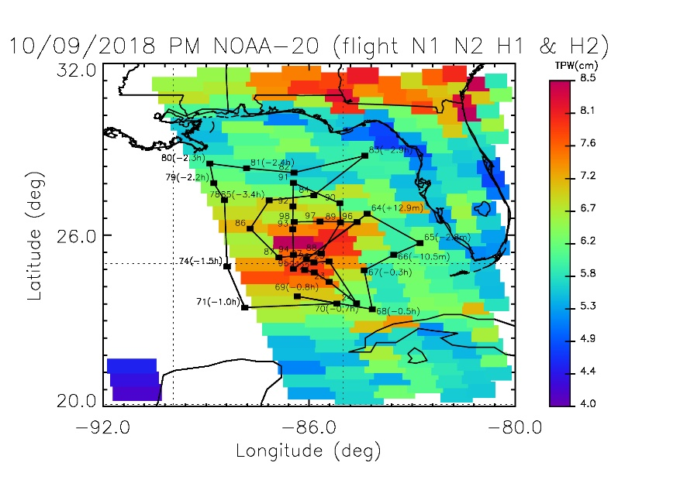
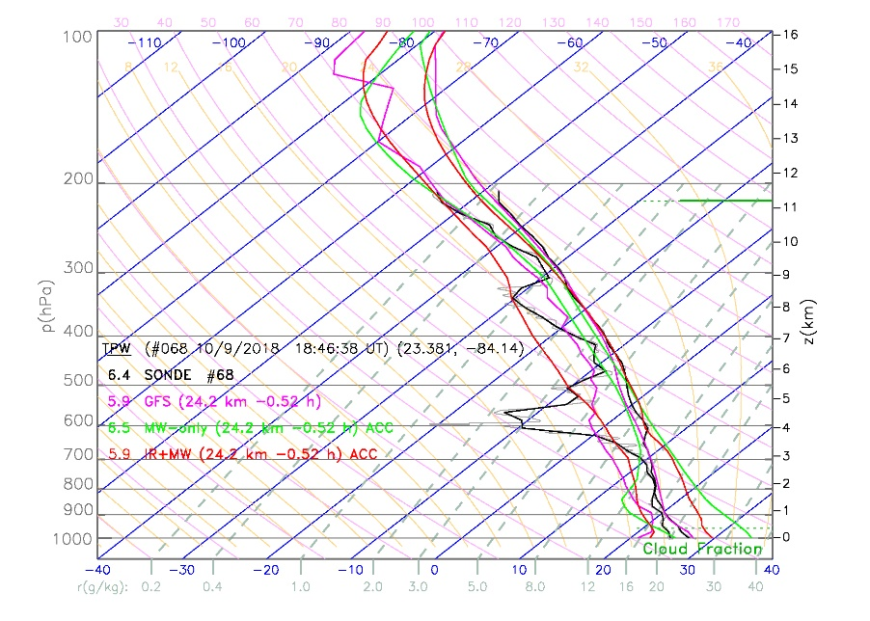
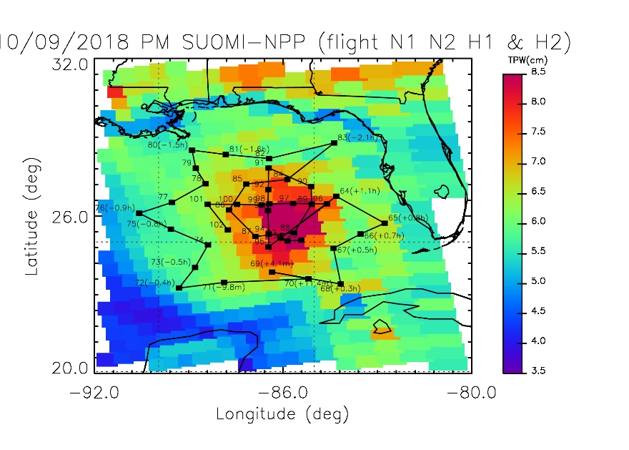
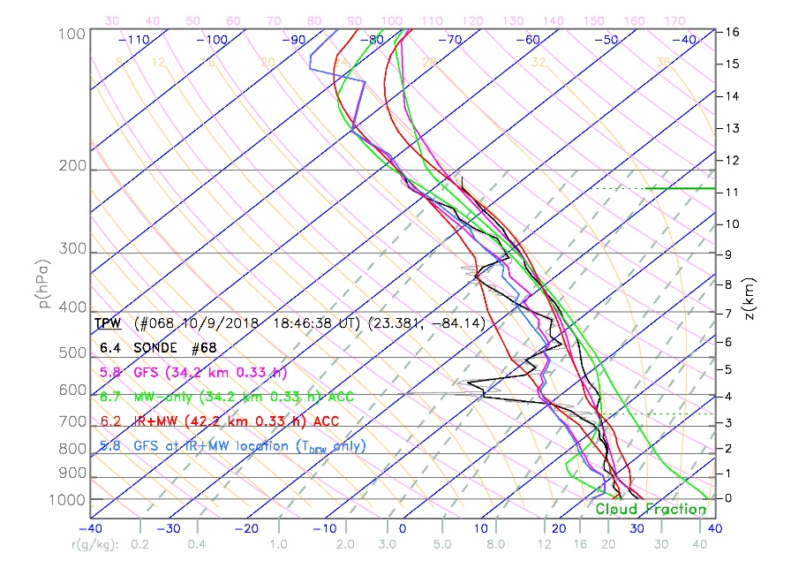
Hurricane Michael campaign, Oct. 9, 2018
Sonde #68
18:47 UT
NOAA-20
NUCAPS
24 km
-31 min
19:55 UT
18:15 UT
S-NPP
NUCAPS
34 km
+20 min
19:07 UT
Notes:
NOAA-20
========================
NUCAPS file= 24: time range = 18:15:27 to 18:15:57 #sondes= 5
NUCAPS file= 25: time range = 18:15:59 to 18:16:29 #sondes= 14
NUCAPS file= 26: time range = 18:16:31 to 18:17: 1 #sondes= 13
NUCAPS file= 27: time range = 18:17: 3 to 18:17:33 #sondes= 5
sonde( 27) 14:31:23 UT lat= 25.15 lon= -86.08 G= 25 F= 63 19 km 3.7 hr
sonde( 64) 18: 3:40 UT lat= 26.76 lon= -84.29 G= 26 F= 5 18 km 12.9 min
sonde( 65) 18:18:57 UT lat= 25.72 lon= -82.73 G= 25 F= 37 29 km -2.8 min
sonde( 66) 18:26:37 UT lat= 25.31 lon= -83.51 G= 25 F= 36 37 km -10.5 min
sonde( 67) 18:35: 8 UT lat= 24.76 lon= -84.38 G= 25 F= 4 42 km -19.1 min
sonde( 68) 18:46:38 UT lat= 23.38 lon= -84.14 G= 24 F= 34 24 km -31.0 min
sonde( 69) 19: 2:45 UT lat= 23.84 lon= -86.35 G= 24 F= 92 67 km -46.9 min
sonde( 70) 18:55:19 UT lat= 23.58 lon= -85.18 G= 24 F= 63 39 km -39.6 min
sonde( 71) 19:16:39 UT lat= 23.44 lon= -87.90 G= 24 F= 92 96 km -60.8 min
sonde( 74) 19:44:14 UT lat= 24.89 lon= -88.41 G= 25 F= 62 97 km -88.0 min
sonde( 78) 20:23:52 UT lat= 27.24 lon= -88.49 G= 26 F= 92 21 km -2.1 hr
S-NPP
========
NUCAPS file= 29: time range = 19: 6: 7 to 19: 6:37 #sondes= 1
NUCAPS file= 30: time range = 19: 6:39 to 19: 7: 9 #sondes= 10
NUCAPS file= 31: time range = 19: 7:11 to 19: 7:41 #sondes= 21
NUCAPS file= 32: time range = 19: 7:43 to 19: 8:13 #sondes= 10
sonde( 27) 14:31:23 UT lat= 25.15 lon= -86.08 G= 31 F= 23 26 km 4.6 hr
sonde( 64) 18: 3:40 UT lat= 26.76 lon= -84.29 G= 31 F= 86 32 km 63.9 min
sonde( 65) 18:18:57 UT lat= 25.72 lon= -82.73 G= 31 F= 28 12 km 48.3 min
sonde( 66) 18:26:37 UT lat= 25.31 lon= -83.51 G= 30 F= 117 6 km 40.5 min
sonde( 67) 18:35: 8 UT lat= 24.76 lon= -84.38 G= 30 F= 86 26 km 31.9 min
sonde( 68) 18:46:38 UT lat= 23.38 lon= -84.14 G= 29 F= 116 34 km 20.0 min
sonde( 69) 19: 2:45 UT lat= 23.84 lon= -86.35 G= 30 F= 52 9 km 4.1 min
sonde( 70) 18:55:19 UT lat= 23.58 lon= -85.18 G= 30 F= 24 4 km 11.4 min
sonde( 71) 19:16:39 UT lat= 23.44 lon= -87.90 G= 30 F= 49 19 km -9.8 min
sonde( 72) 19:28: 7 UT lat= 23.23 lon= -89.35 G= 30 F= 46 14 km -21.3 min
sonde( 73) 19:35:58 UT lat= 24.02 lon= -88.83 G= 30 F= 77 20 km -29.0 min
sonde( 74) 19:44:14 UT lat= 24.89 lon= -88.41 G= 31 F= 19 19 km -37.0 min
sonde( 75) 19:54:27 UT lat= 25.49 lon= -89.61 G= 31 F= 47 32 km -47.1 min
sonde( 76) 20: 4:31 UT lat= 26.11 lon= -90.62 G= 31 F= 105 8 km -56.9 min
sonde( 77) 20:13: 2 UT lat= 26.52 lon= -89.57 G= 32 F= 17 26 km -65.3 min
sonde( 78) 20:23:52 UT lat= 27.24 lon= -88.49 G= 32 F= 50 25 km -76.0 min
sonde( 79) 20:29:18 UT lat= 27.84 lon= -88.81 G= 32 F= 79 17 km -81.3 min
sonde( 80) 20:35:21 UT lat= 28.53 lon= -88.92 G= 32 F= 109 31 km -87.2 min
sonde( 81) 20:43:23 UT lat= 28.37 lon= -87.84 G= 32 F= 111 26 km -1.6 hr

