Slide 1
Integrating Multi-Platform Satellite Soil Moisture and Evapotranspiration Retrievals to Constrain Water and Energy Balance Coupling
Wade T. Crow, Fangni Lei, Martha C. Anderson
Hydrology and Remote Sensing Laboratory, USDA ARS
Thomas R. H. Holmes
Hydrological Sciences Laboratory, NASA GSFC
Christopher Hain
Earth Science Office, NASA MSFC
October 15-19, 2018
MODIS/VIIRS Science Team Meeting
MODIS Land Science Analysis

Slide 2
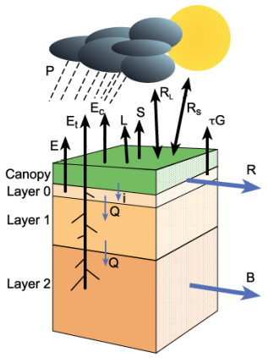
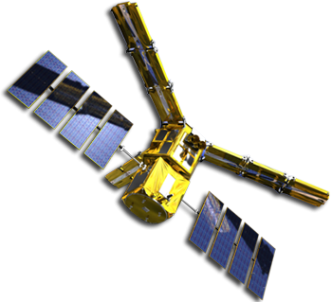
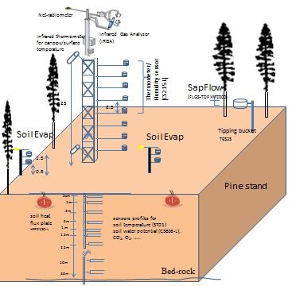
Motivation – Water and Energy Balance Coupling
Land-Atmosphere Interaction
Physical Model
Cross
Validation
Soil Moisture
In-situ
Remote Sensing
Evapotranspiration
Notes:
1. Importance of understanding land-atmosphere coupling, one key interaction is between soil water content and evapotranspiration which link the water and energy balances
2. Ways to understand water and energy components: ground-measurements, RS-based retrievals, numerical modeling. Benefits of satellite-based products as compared with in-situ observations

Slide 3
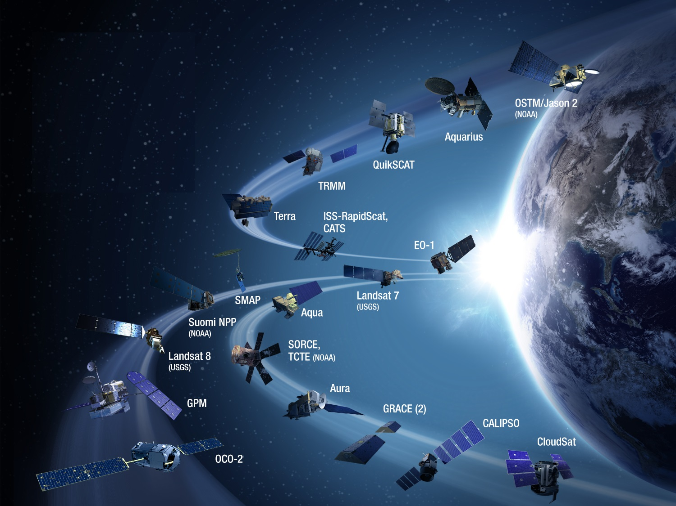
Motivation – Multi-Platform Remote Sensing
Meteorological Information
Satellite Constellations
Solar insolation
Precipitation
Atmospheric temperature
Wind speed
Humidity
…
Land Surface Characteristics
Soil moisture
Land surface temperature
Leaf area index
Landcover type
…
Multi-platform satellite soil moisture and evapotranspiration products
Notes:
Current multiple remote sensing sources for facilitating the understanding of water and energy balance cycles
Near-surface meteorological information, land surface characteristics

Slide 4
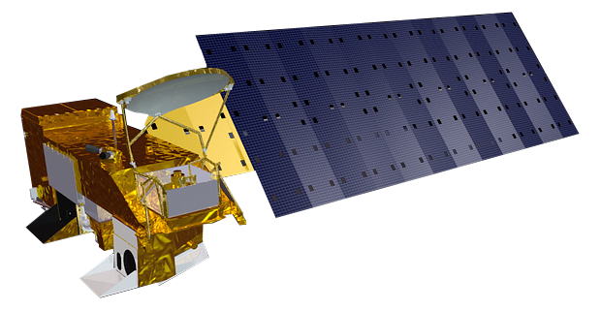
Motivation – Improving the Understanding
Here comes the question…
Are current land surface models accurate in characterizing the relation between soil moisture and evapotranspiration?
Key challenge:
Coupling estimates obtained from (relatively noisy) satellite retrievals are biased.
Our approach:
Obtain unbiased, observation-based global estimates of true coupling by integrating multi-platform soil moisture and evapotranspiration retrievals
Benchmarking
Notes:
Current multiple remote sensing sources for facilitating the understanding of water and energy balance cycles
What are the scientific questions being addressed and the scope of the proposed work?
Are current land surface models accurate in characterizing the relation between soil moisture and evapotranspiration?
Obtain unbiased, observation-based global estimates of true coupling by integrating multi-platform retrievals

Slide 5
Multi-Platform Land Products – Evapotranspiration
Atmosphere-Land Exchange Inverse
[Anderson et al., 2011]
Notes:
ALEXI framework

Slide 6
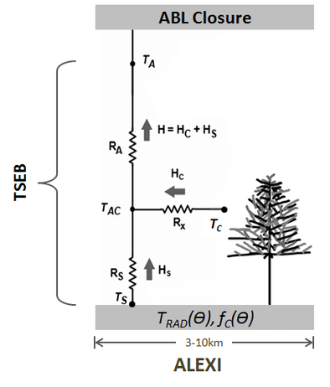
Multi-Platform Land Products – Evapotranspiration
Global ALEXI ET product from MODIS LST
Lapse Rate Profile
CFS-R [0.5°]
Radiation Fluxes
CFS-R CFSv2 [0.5°]
Wind Speed
CFS-R [0.5°]
Landcover Type
UMD [0.01°]
Albedo
MODIS MOD43C [0.05°]
Land Surface Temperature
MODIS MYD11C1[0.05°]
Leaf Area Index
MODIS MOD15A [0.01°]
Notes:
ALEXI-TIR
be prepared to describe EXACTLY how we use MODIS (looks like you will do that in Figure 7) and future plans for VIIRS

Slide 7
Multi-Platform Land Products – Evapotranspiration
MW-LST retrievals from Ka-band satellite sensors
[Holmes et al., 2015]
Notes:
ALEXI-MW

Slide 8
Multi-Platform Land Products – Evapotranspiration
[Holmes et al., 2018]

Slide 9
Multi-Platform Land Products – Soil Moisture
ESA CCI merged passive microwave soil moisture
MetOp-A/B ASCAT active microwave soil moisture
[Dorigo et al., 2017]
Notes:
Active and passive microwave soil moisture

Slide 10
Multi-Platform Land Products – Soil Moisture
Passive Microwave
Soil Moisture
[$m^{3}/m^{3}$]
Active Microwave
Percent of Saturation
[%]
Notes:
Two maps showing the soil moisture distribution

Slide 11
A Unified Approach to Integrate Products
Triple collocation-based coupling strength metric
X
PASSIVE
Y
ACTIVE
Z
MODEL
X
ALEXI-TIR
Y
ALEXI-MW
Z
MODEL
Soil Moisture
Evapotranspiration
Coupling Metric
$$R^{2}{\left[{SM}_{True},{ET}_{True}\right]}_{X,X}≡\frac{Cov{[{SM}_{X},{ET}_{X}]}^{2}Cov\left[{SM}_{Y},{SM}_{Z}\right]Cov[{ET}_{Y},{ET}_{Z}]}{Cov\left[{SM}_{X},{SM}_{Y}\right]Cov\left[{SM}_{X},{SM}_{Z}\right]Cov\left[{ET}_{X},{ET}_{Y}\right]Cov[{ET}_{X},{ET}_{Z}]}$$
[Crow et al., 2015]
Notes:
Method: TC, a unified metric for combining various sources of remote sensing products
Advantages with regard to traditional metric
Do not talk too much about details of TC

Slide 12
Discrepancy among Land Surface Models
Global Land Data Assimilation System
Noah v3.3
Community Land Model (CLM) v2.0
Variable Infiltration Capacity (VIC)
Catchment Land Surface Model (CLSM) F2.5
$$R^{2}[{SM}_{LSM}{ET}_{LSM}]$$
Noah
VIC
CLM
CLSM
Notes:
What are the project deliverables?

Slide 13
Direct coupling from multi-platform and LSMs
Remote Sensing
$$R^{2}[{SM}_{RS}{ET}_{RS}]$$
GLDAS LSMs
$$R^{2}[{SM}_{LSM}{ET}_{LSM}]$$
Notes:
What are the project deliverables?

Slide 14
Integrated multi-platform based coupling
Triple Collocation
$$R^{2}[{SM}_{TC}{ET}_{TC}]$$
GLDAS LSMs
$$R^{2}[{SM}_{LSM}{ET}_{LSM}]$$
Notes:
What are the project deliverables?

Slide 15
Benchmarking Land Surface Models
Biases in LSMs with regard to triple collocation-based estimates
Noah
VIC
CLM
CLSM
Notes:
What are the project deliverables?

Slide 16
Benchmarking Land Surface Models
Dry
Humid
Hot
Cold
Notes:
What are the project deliverables?

Slide 17
Key Science Highlights
Here come the answers…
Random errors in remote sensing products impede the direct comparison
Large discrepancies exist among various land surface models
Land surface models generally overestimate the soil moisture/evapotranspiration coupling strength along transitional climate regimes
Published on Water Resources Research
F. Lei, W. T. Crow, T. R. H. Holmes, C. Hain, M. C. Anderson (2018), Global Investigation of Soil Moisture and Latent Heat Flux Coupling Strength, Water Resources Research, doi:10.1029/2018WR023469
Notes:
Key Science Highlights (this one an optional item, since you are just beginning your investigations)

Slide 18
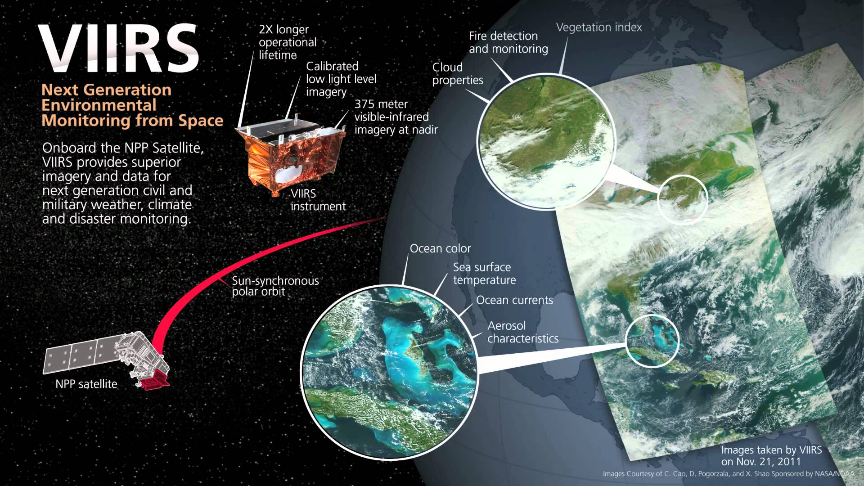
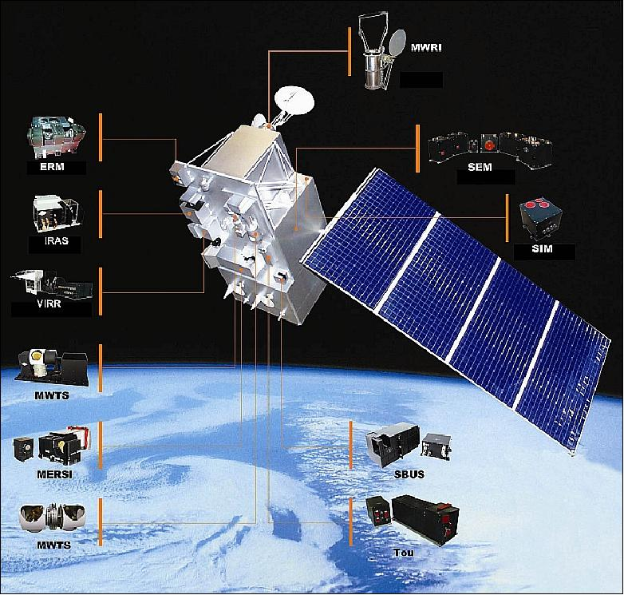
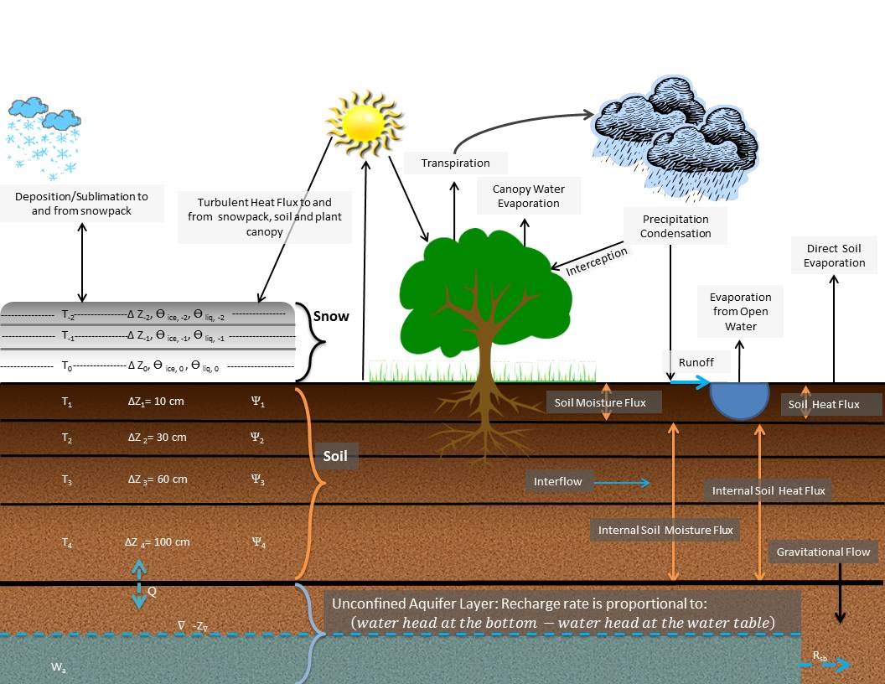
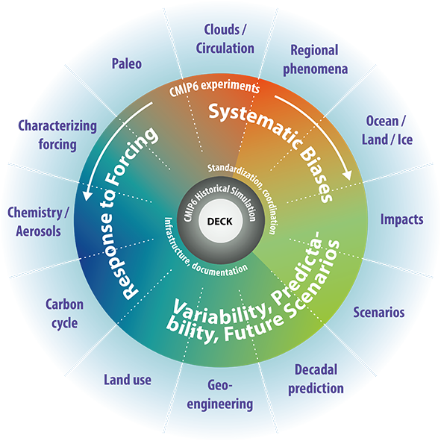
On-going Development
ALEXI
MW-LST
TIR-LST
FY-3B
Land Surface Model
CMIP5/6 LS3MIP
Noah-MP (modular)
from offline to coupled
Notes:
Any early initial issues (e.g., data gaps)?
(highlight VIIRS)VIIRS day-night LST for TIR, Fengyun-3B for MW-LST
Extend verification to the offline Noah-MP land surface model and use the results to improve the representation of SM/ET coupling in the model – via either parameter changes or various physics choices . Noah-MP is unique in that various physics packages (for example, a groundwater model) options are available to be turn on and turn off, and thus for addressing specific parameterization schemes.
LS3MIP of CMIP6, from off-line to coupled
From SM/ET to SM/Ta, ET/Ta

Slide 19
Thank you!

Slide 20
Back-up Slides
Notes:
Potential cross-correlation

Slide 21
Back-up Slides
Notes:
Ameriflux sites validation

Slide 22
Back-up Slides
Notes:
Variations across models and TC

Slide 23
Back-up Slides
Remote Sensing
$$R^{2}[{SM}_{RS}{ET}_{RS}]$$
GLDAS LSMs
$$R^{2}[{SM}_{LSM}{ET}_{LSM}]$$
Notes:
Anomaly time series

Slide 24
Back-up Slides
Triple Collocation
$$R^{2}[{SM}_{TC}{ET}_{TC}]$$
GLDAS LSMs
$$R^{2}[{SM}_{LSM}{ET}_{LSM}]$$
Notes:
Anomaly time series

