Slide 1


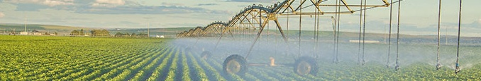
Mapping Water Use, Phenology and Productivity in Agricultural Landscapes by Fusing Multi-Sensor Data Products
NASA MODIS/VIIRS Science Team Meeting
Silver Spring, MD, October 15-19, 2018
P.I.: Feng Gao, Hydrology and Remote Sensing Lab, USDA-ARS
Science P.I.: Martha Anderson, Hydrology and Remote Sensing Lab, USDA-ARS
Co. I: Bill Kustas, Hydrology and Remote Sensing Lab, USDA-ARS
Co. I: Joe Alfieri, Hydrology and Remote Sensing Lab, USDA-ARS
Co. I: Christopher Hain, NASA-Marshall Space Flight Center
Co. I.: Jason Otkin, University of Wisconsin
Co. I.: Hadi Jaafar, American University of Beirut
USDA is an equal opportunity provider and employer

Slide 2
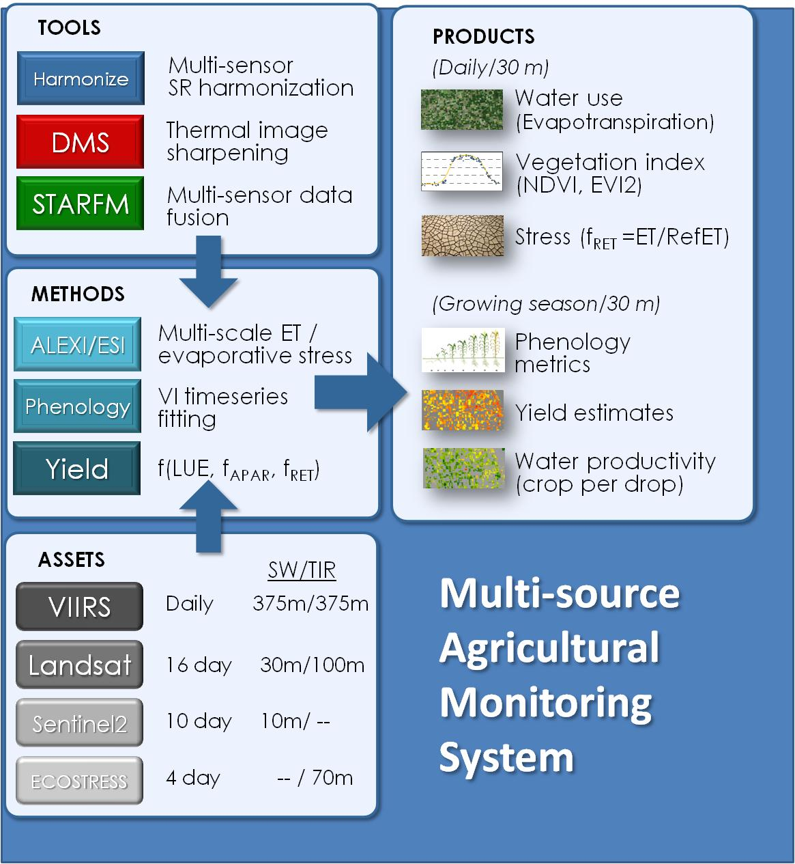
Objectives:
Prototype methods for routine production of high spatiotemporal resolution
evapotranspiration
vegetation index
phenology
yield products
using a multi-sensor data fusion approach

Slide 3
Summary of Previous Work
Surface Reflectance Data Fusion System
Landsat, MODIS
Evapotranspiration Data Fusion System
GOES, MODIS and Landsat
Crop Phenology Mapping
retroactive phenology using full year of Landsat and MODIS
Yield Anomaly and ESI

Slide 4
Proposed Improvements
Surface Reflectance Data Fusion System
Landsat, MODIS, Sentinel-2, VIIRS
Evapotranspiration Data Fusion System
Landsat, Sentinel-2, VIIRS, ECOSTRESS
Crop Phenology Mapping
real-time crop growth stages using partial year of L8, S2, MODIS/VIIRS
Yield Products using VI, ET and phenology

Slide 5
Technical Approach
Extend applications to more crop types (e.g., wheat, cotton, hay, vineyards etc.)
Adapt ET and SR data fusion system to rangeland and pasture ecosystems
Focus primarily on the USDA-ARS LTAR sites
Supply irrigation management for vineyard operation in California (GRAPEX experiment)
Collaborate on international studies (Czech Republic, Lebanon, Brazil and Spain)
Utilize cloud computing (USDA-ARS SCINet, Google Earth Engine, Amazon Web Services etc.) for large area mapping

Slide 6
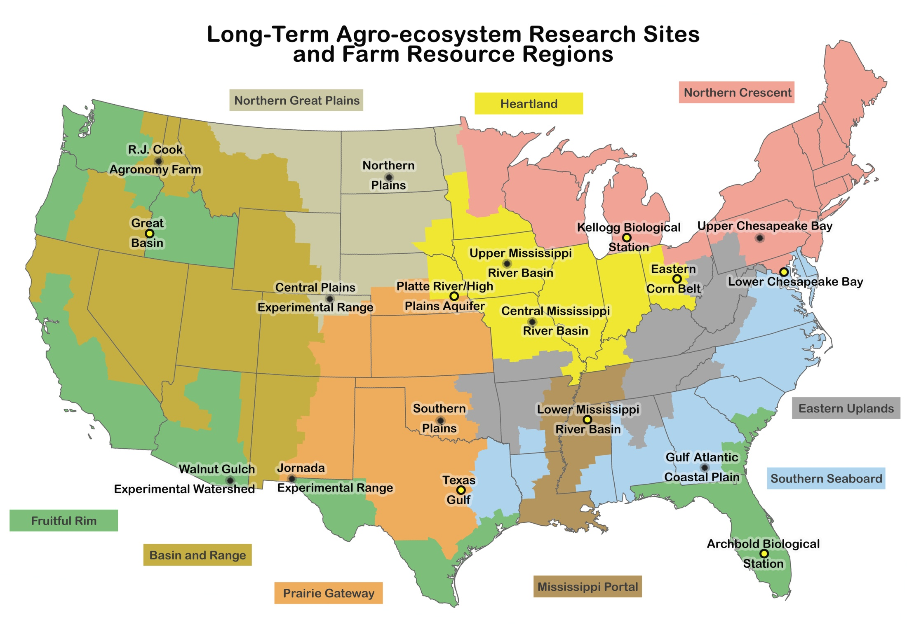
Agricultural sites
Rangeland sites
High Plains
Rosemount
BARC
Choptank
Mead
Ames
Bondville
CPER
Central Valley
Jornada

Slide 7
First Year Progress
Refine tools and methods for new data products
  VIIRS
  Sentinel-2
  ECOSTRESS
Apply data fusion results for assessing
  yield variability
  water productivity
  Land use and water use change

Slide 8
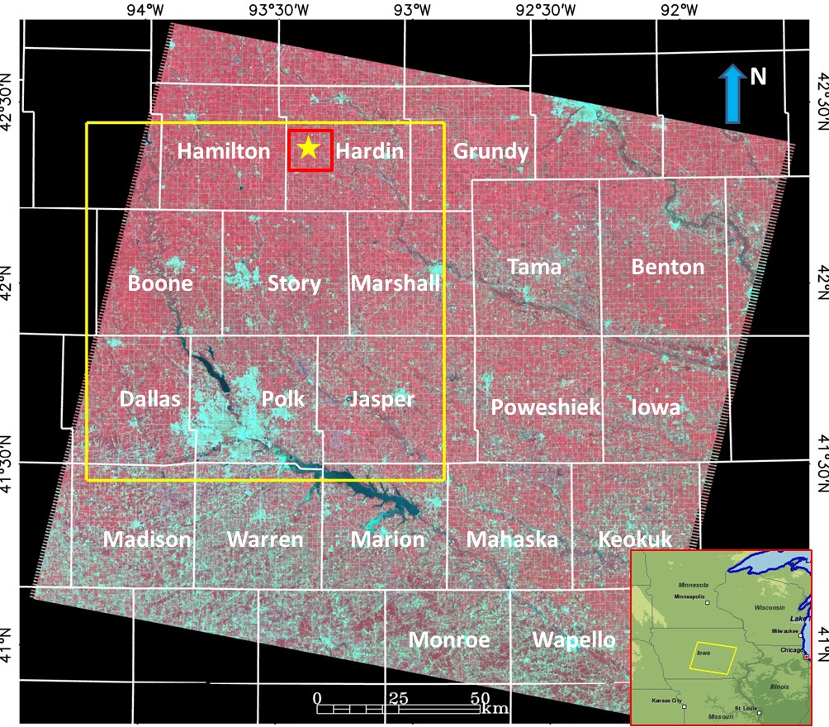
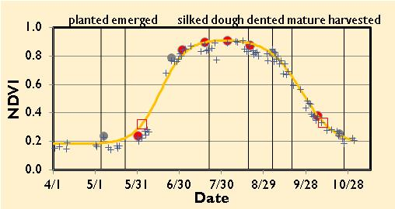
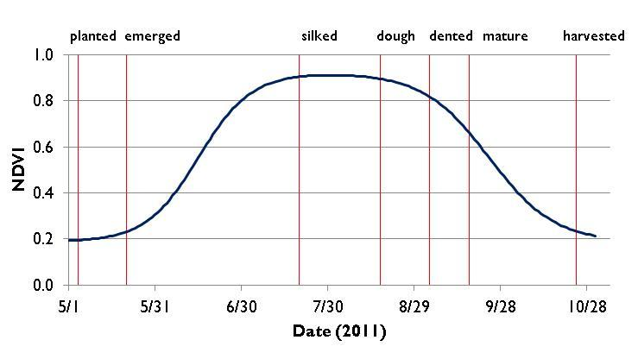
Assessing the Variability of Corn and Soybean Yields in Central Iowa
Phenology
start of season
end of season
emerged
silked
… …
max VI
greenup
cumulative VI
dormancy

Slide 9
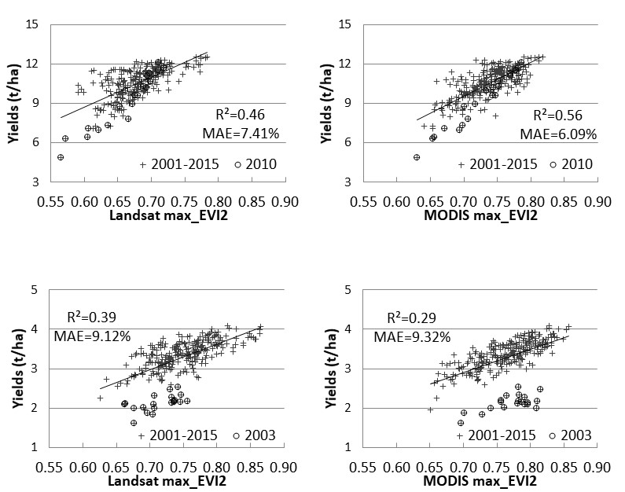
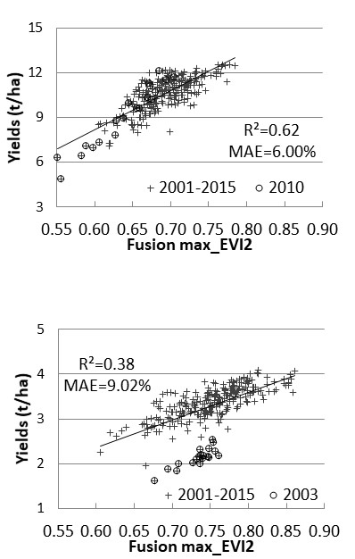
Added-value from Landsat-MODIS data fusion
Corn
Dataset | R²_t | RMAE_t
 | Corn (2001–2015)
Landsat | 0.46 | 7.41
MODIS | 0.56 | 6.09
Landsat–MODIS | 0.62 | 6.00
 | Soybean (2001–2015)
Landsat | 0.39 | 9.12
MODIS | 0.29 | 9.32
Landsat–MODIS | 0.38 | 9.02
 | Soybean (2001–2015, excluding 2003)
Landsat | 0.47 | 6.14
MODIS | 0.63 | 5.28
Landsat–MODIS | 0.58 | 5.45
 | Soybean (2003 only)
Landsat | 0.34 | 6.49
MODIS | 0.46 | 5.65
Landsat–MODIS | 0.72 | 3.82
Landsat MODIS
Landsat-MODIS Data Fusion
Soybean
Notes:
Corn and soybean yields and maximum two-band enhanced vegetation index (EVI2) for each county and year using Landsat only (left), MODIS only (middle), and Landsat–MODIS data fusion results (right). The fused data showed better explanatory ability even at the very coarse county level. The circles show samples from the flood year (2010) for corn (top) and the drought year (2003) for soybean (bottom). Statistics in the plots were computed using all available samples.
For corn, the fused Landsat–MODIS data showed better relationships, especially compared to the Landsat data alone. For soybean, the results from Landsat and the fused Landsat–MODIS were similar when using all of the samples from 2001–2015. However, when the samples from 2003 (drought year) were excluded, statistics for MODIS and fused Landsat–MODIS were substantially improved. Even though 2003 for soybean was different from the rest of the years, the spatial variability for 2003 was still well captured by the data fusion results.

Slide 10
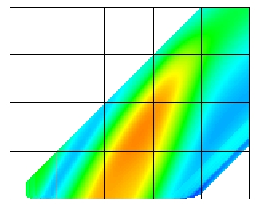
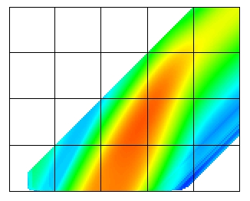
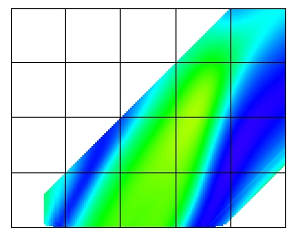
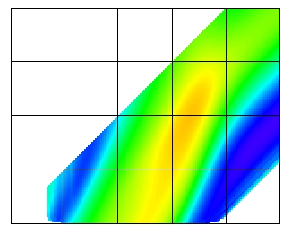
Optimal Time Window for Yield Prediction
R²(corn, NDVI) R²(corn, EVI2)
0 30 60 90 120
150 180 210 240 270 300
150 180 210 240 270 300
0.0 0.1 0.2 0.3 0.4 0.5 0.6 0.7
R²(soybean, NDVI) R²(soybean, EVI2)
0 30 60 90 120
150 180 210 240 270 300
150 180 210 240 270 300
Notes:
R² of the yield with the cumulative NDVI (left) and EVI2 (right) for corn and soybean. The x-axis represents the end date and the y-axis represents the interval. The high R² areas (highest 10%) are highlighted by black contours.
For central Iowa, the time window from day 180 (end of July) to 250 (early September) was good for both corn and soybean yield predictions.

Slide 11
Fusing Landsat, Sentinel-2 and MODIS/VIIRS
Polk: 23% corn; Others: 38-55%
Notes:
Relationship between yield and maximum EVI2 for Landsat-8 (L8), Sentinel-2 (S2), the Harmonized Landsat-8 and Sentinel-2 (HLS), and MODIS-L8-S2 (MLS) data fusion for corn and soybeans from 2016–2017.

Slide 12
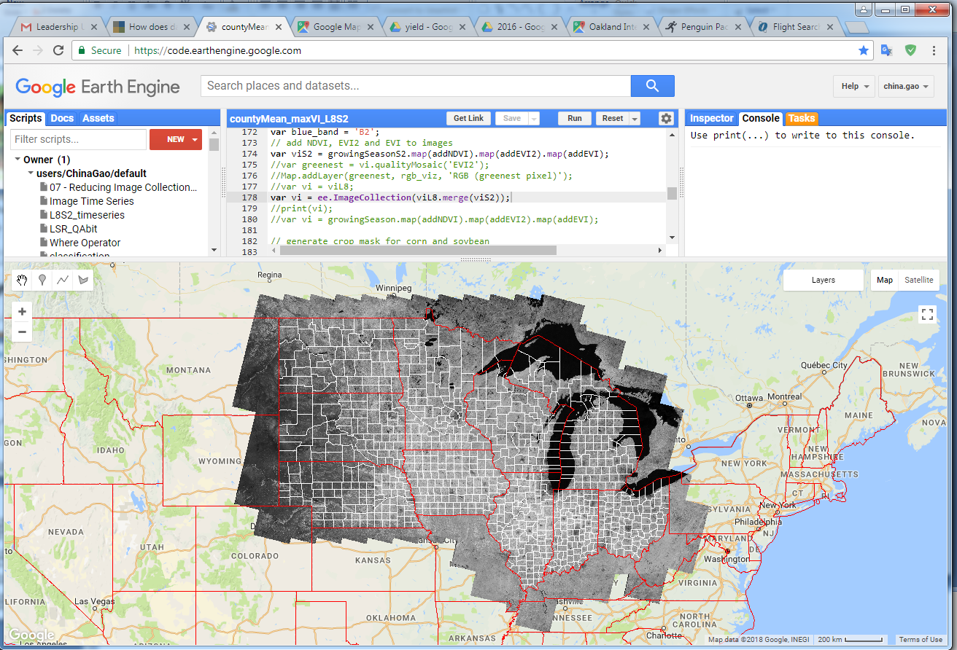
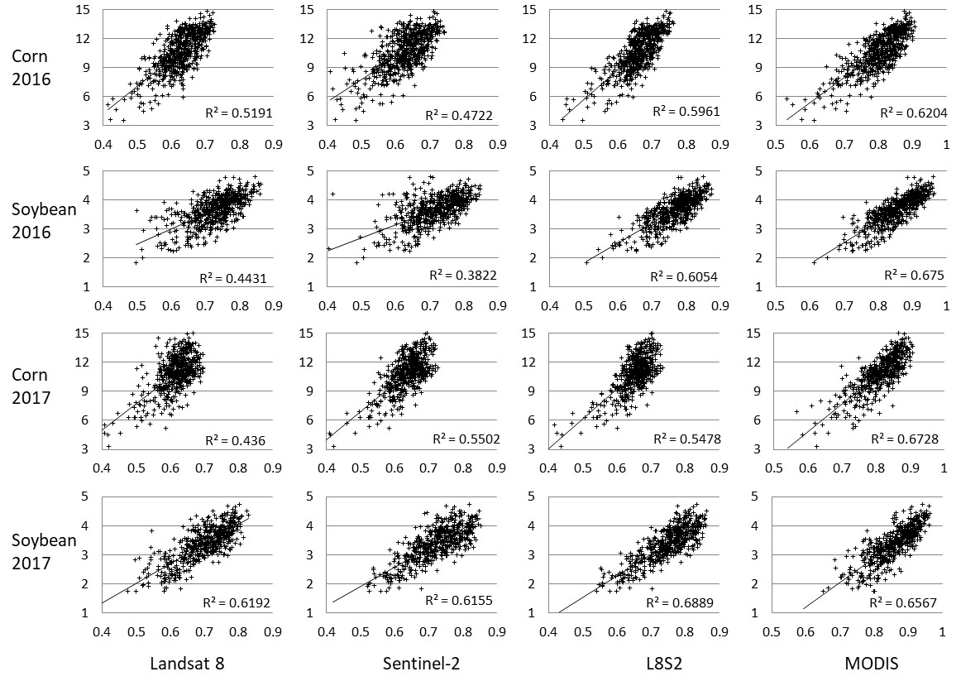
Yield Variability from Landsat-8, Sentinel-2 and MODIS (GEE)

Slide 13
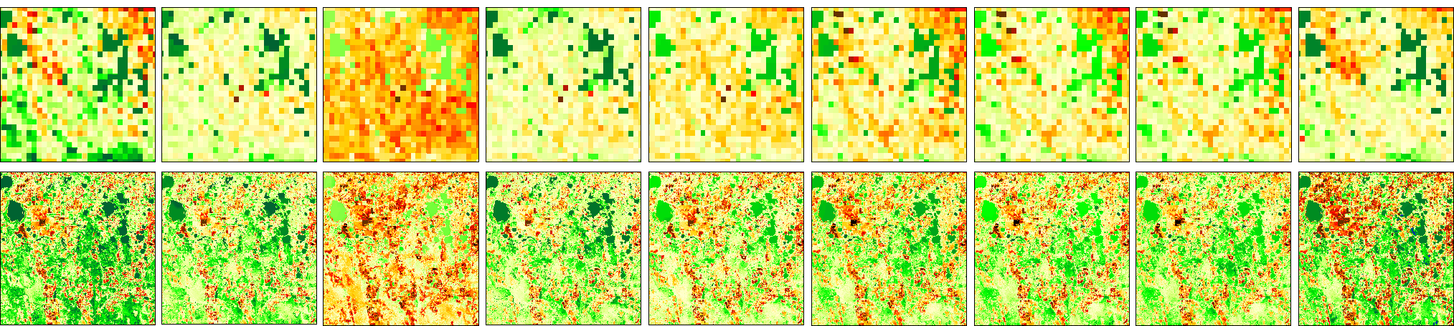
Daily ET at 30m resolution by fusing
VIIRS/Landsat/S2/ECOSTRESS
DOY 328
329
330
331
332
333
334
335
336
VIIRS
(375m)
FUSION
(30m)
DIRECT
DIRECT
STARFM
DIRECT
STARFM
STARFM
DIRECT
DIRECT
DIRECT
TIR:
L7(L7sr)
VIIRS(S2Asr)
ECO(FUSEsr)
VIIRS(S2Bsr)
ECO(FUSEsr)
L8(L8sr)
SR:
L7
S2A
Fusion
S2B
Fusion
L8
Harmonized with VIIRS
Daily ET – Orlando, FL

Slide 14
ECOSTRES and Sentinel-2
ECOSTRESS: 5 TIRS bands, no VNIR, ~3 days repeat at ~60m
Sentinel-2: no TIRS, 13 VNIR and SWIR bands, 5 days repeat at 10-20m
Combining ECOSTRESS and Sentinel-2 data allows more frequent ET estimation at field scales
Sharpening LST imagery using VNIR and SWIR images (modified Data Mining Sharpening approach)

Slide 15
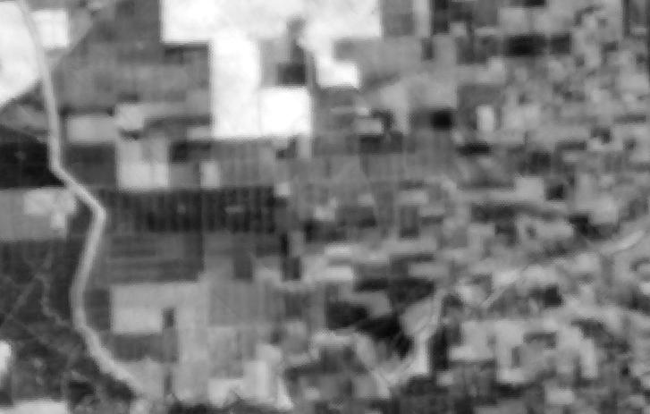
ECOSTRES LST (GRAPEX Ripperdan site)
305 315 325 335 (K)
8/5/2018

Slide 16

Sharpened LST (30m)
305 315 325 335 (K)

Slide 17
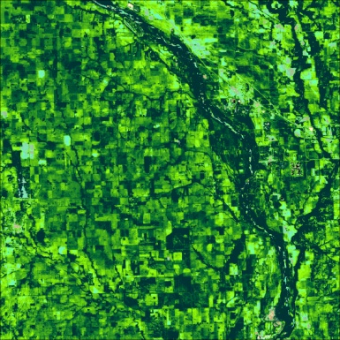
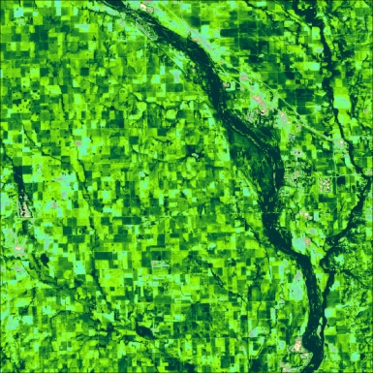
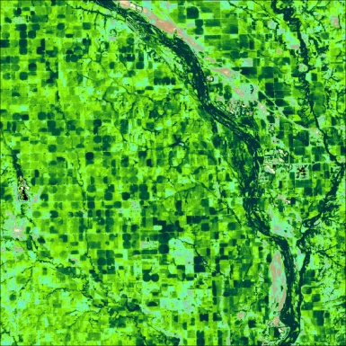
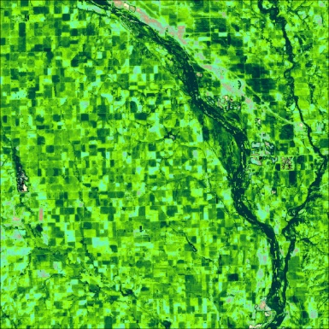
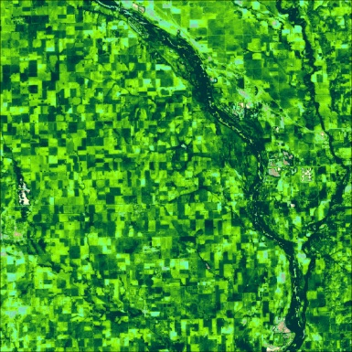
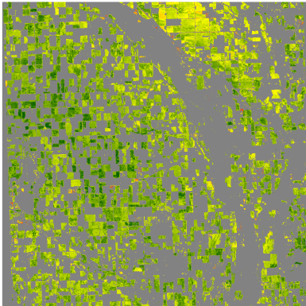
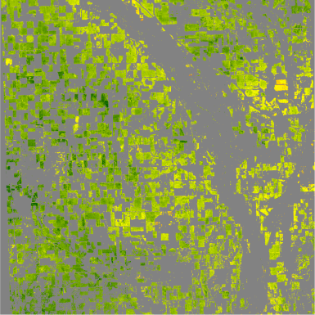
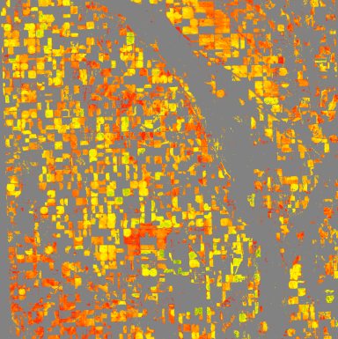
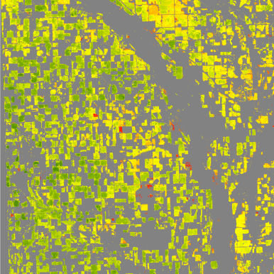

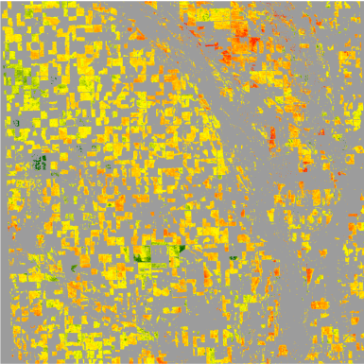
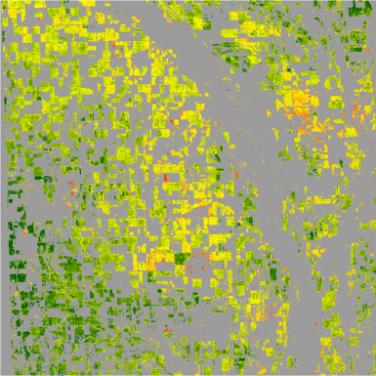
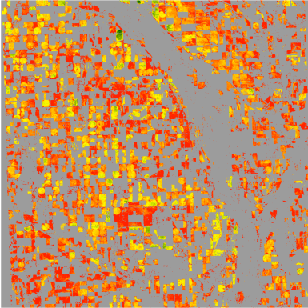
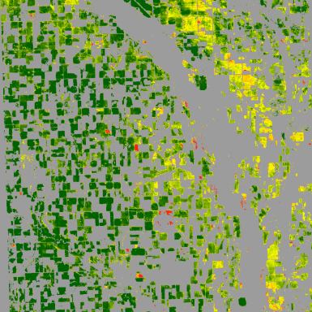
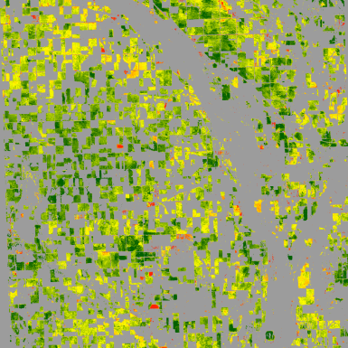
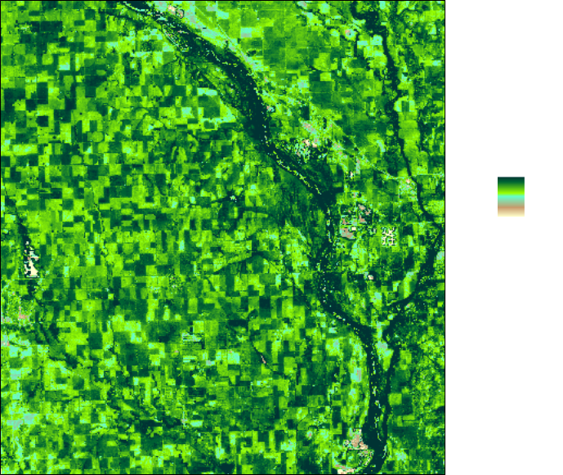

Yield and Water Productivity
2010
2011
2012
2013
2014
ET
Yield
WP
800
Seasonal
evapotranspiration
(mm)
15
Corn
yield
(Mg/ha)
0.02
Crop water
productivity
(Mg/ha-mm)
200
2
0.01

Slide 18
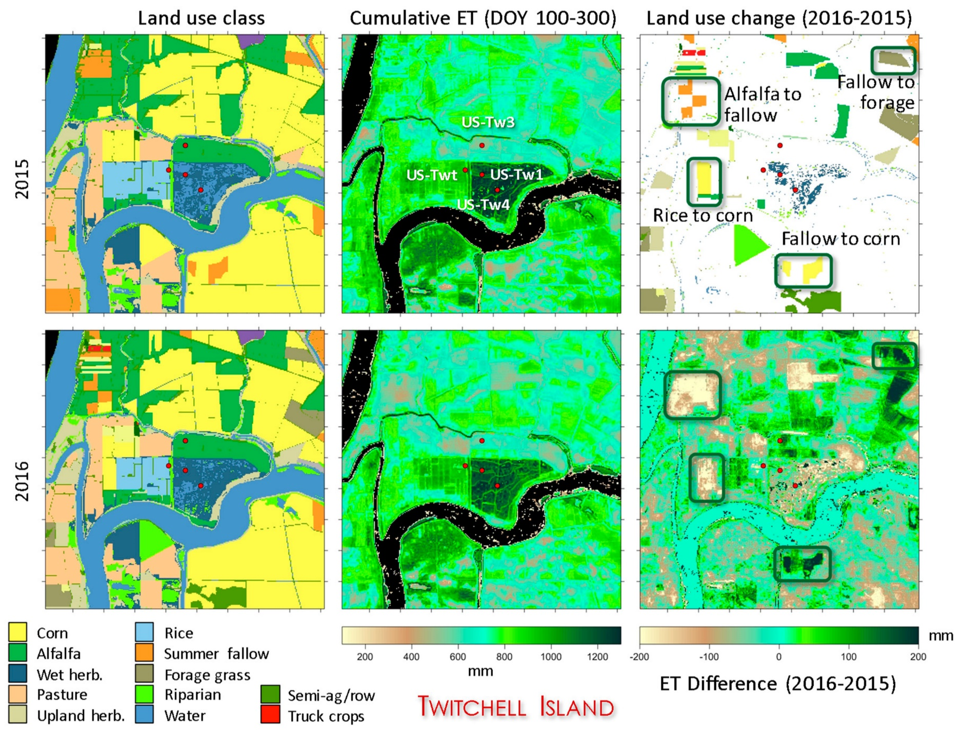
Land-use & Water-use Change
Notes:
Many of the largest changes in water use are associated with changes in crop type or land management. For example, decreases in ET are evidenced in areas where land use changed from alfalfa to fallow and from rice to corn. Fallowed fields in 2015 that were converted to crop production in 2016 show large increases in seasonal ET. A patch in the northeast corner of the subset area with >200 mm increase in ET in 2016 was not associated with recorded land-use change (reported as corn in both years), which might indicate either an error in classification or a change in water management strategy.

Slide 19
Expected Contributions to MOIDS/VIIRS
Demonstrate synergistic value of multiple sensors for research and operational uses
  Daily 30-m SR and VI, combining Landsat, S2 and MODIS/VIIRS SR data
  Phenology extraction tools for crop and rangeland
  A streamlined 30-m, daily ET and water stress mapping algorithm, utilizing sharpened TIR products from Landsat, MODIS/VIIRS and ECOSTRESS
  A prototype field-scale yield mapping tool, combining information from the phenology, VI, ET and water stress datacubes
  Field-scale water productivity maps for evaluating crop water use efficiency and yield gaps over agricultural landscapes
Provide inputs to the MODIS/VIIRS program relevant for agricultural applications

