Slide 1


Investigation of anthropogenic aerosol effects on ice and mixed-phase clouds and associated precipitation based on satellite observations
PI: Yu Gu Co-I: Kuo-Nan Liou, Bin Zhao (University of California Los Angeles)
Status:
Investigated the impact of aerosols on micro- and macro-physical properties of ice clouds.
Elucidated the modulation of the aerosol impacts by meteorological conditions, aerosol type, and ice cloud type.
Needed Products:
MODIS, CALIPSO, CloudSat
Objective:
This project will provide a comprehensive assessment of the impact of aerosols, especially anthropogenic aerosols, on properties of ice and mixed-phase clouds and the associated precipitation, using observations from multiple satellites, including MODIS, CALIPSO, and CloudSat.
Related Publications:
Zhao, B.*, Y. Gu*, K. N. Liou, Y. Wang, X. Liu, L. Huang, J. H. Jiang, and H. Su, 2018: Type-dependent responses of ice cloud properties to aerosols from satellite retrievals. Geophys. Res. Lett., 45, 3297-3306, DOI 10.1002/2018GL077261 (*corresponding author).
Zhao, B.*, K. N. Liou, Y. Gu*, J. Jiang, Q. Li, R. Fu, L. Huang, X. Liu, X. Shi, H. Su, and C. He, 2018: Impact of aerosols on ice crystal size. Atmos Chem Phys, 18, 1065-1078, DOI 10.5194/acp-18-1065-2018 (*corresponding author).

Slide 2


Type-dependent Aerosol Impact on Ice Clouds from Satellite Retrievals
Yu Gu, Bin Zhao, and Kuo-Nan Liou
Joint Institute for Regional Earth System Science and Engineering
Department of Atmospheric and Oceanic Sciences,
University of California, Los Angeles, California 90095, USA
MODIS/VIIRS Science Team Meeting, 10/15/2018

Slide 3
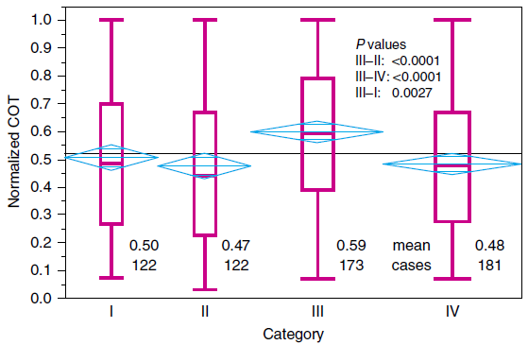
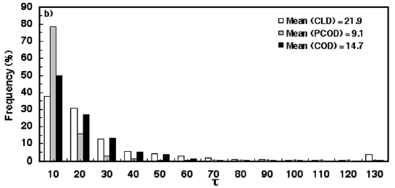
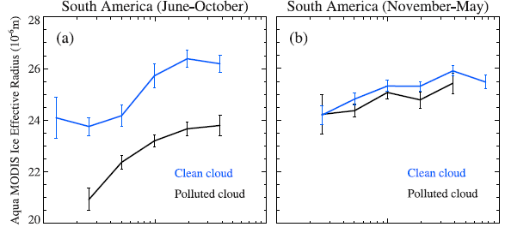
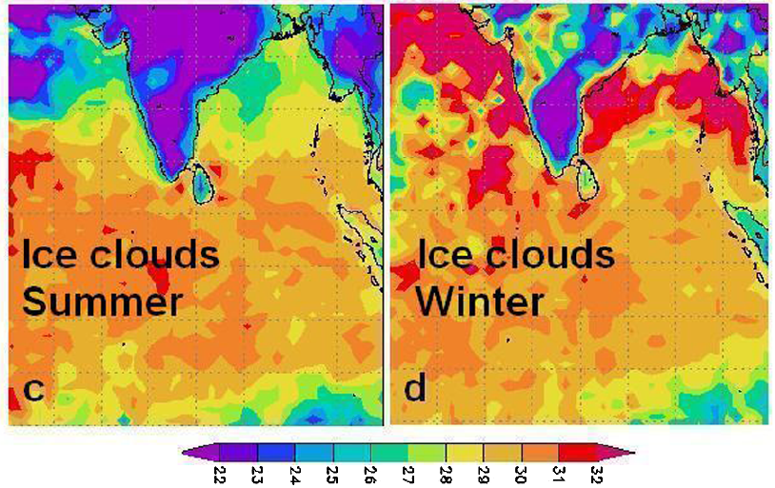
Limited and conflicting observational evidence for the aerosol impact on ice clouds
Global aerosol-ice cloud radiative forcing: [-0.67, 0.70 W/m²]
(Fan et al., 2016; IPCC, 2013; Liu et al., 2009)
COT
COT
w/o aerosols
w/ aerosols
w/ aerosols
Tesche et al., 2016
Huang et al., 2006
R_{ei}
R_{ei}
Relatively clean
Polluted
R_{ei}/μm
Jiang et al., 2008
Chylek et al., 2006

Slide 4

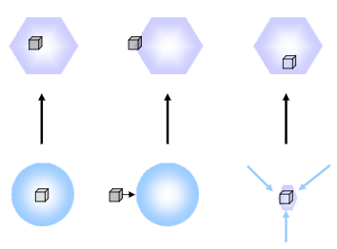
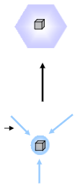
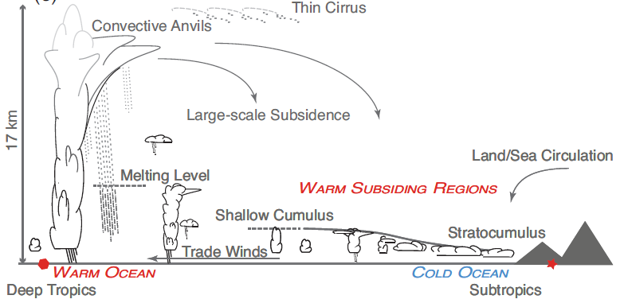
Possible reasons for disagreement: aerosol and ice cloud types
Homogeneous nucleation
Most aerosol types
Dust √
Biological √
BC ?
OA ?
……
Heterogeneous nucleation
INP
Key scientific question:
What’s the impact of various aerosol types on the physical properties of two ice cloud types?
In-situ formed
Absorbing vs. nonabsorbing aerosols
Convection-generated vs. in-situ formed ice clouds
Convection-generated

Slide 5
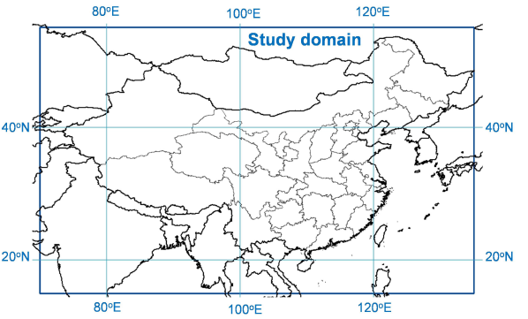
Sources of satellite data
Time period: 2007-2015 (9 years)
Spatial coverage: East Asia (15º-55º N, 70º-135º E)
Satellite/ Sensor | Product | Variable
Aqua/ MODIS | MYD04 (Level 2, Collection 6) | AOD
 | MYD06 (Level 2, Collection 6) | R_{ei}, ice cloud fraction (ICF), cloud phase, etc.
CALIPSO/ CALIOP | 05kmMLay (Level 2, V4.10) | Aerosol/cloud layer number, feature classification flags, QA flags, cloud top/base height, layer base temperature, layer aerosol/cloud optical depth
 | 05kmAPro (Level 2, V 4.10) | Meteorological parameters
CloudSat/ CPR | 2C-ICE (Level 2, Version P1_R04) | Ice water path (IWP), vertically resolved ice water content
-- | NCEP ds083.2 | Meteorological parameters

Slide 6
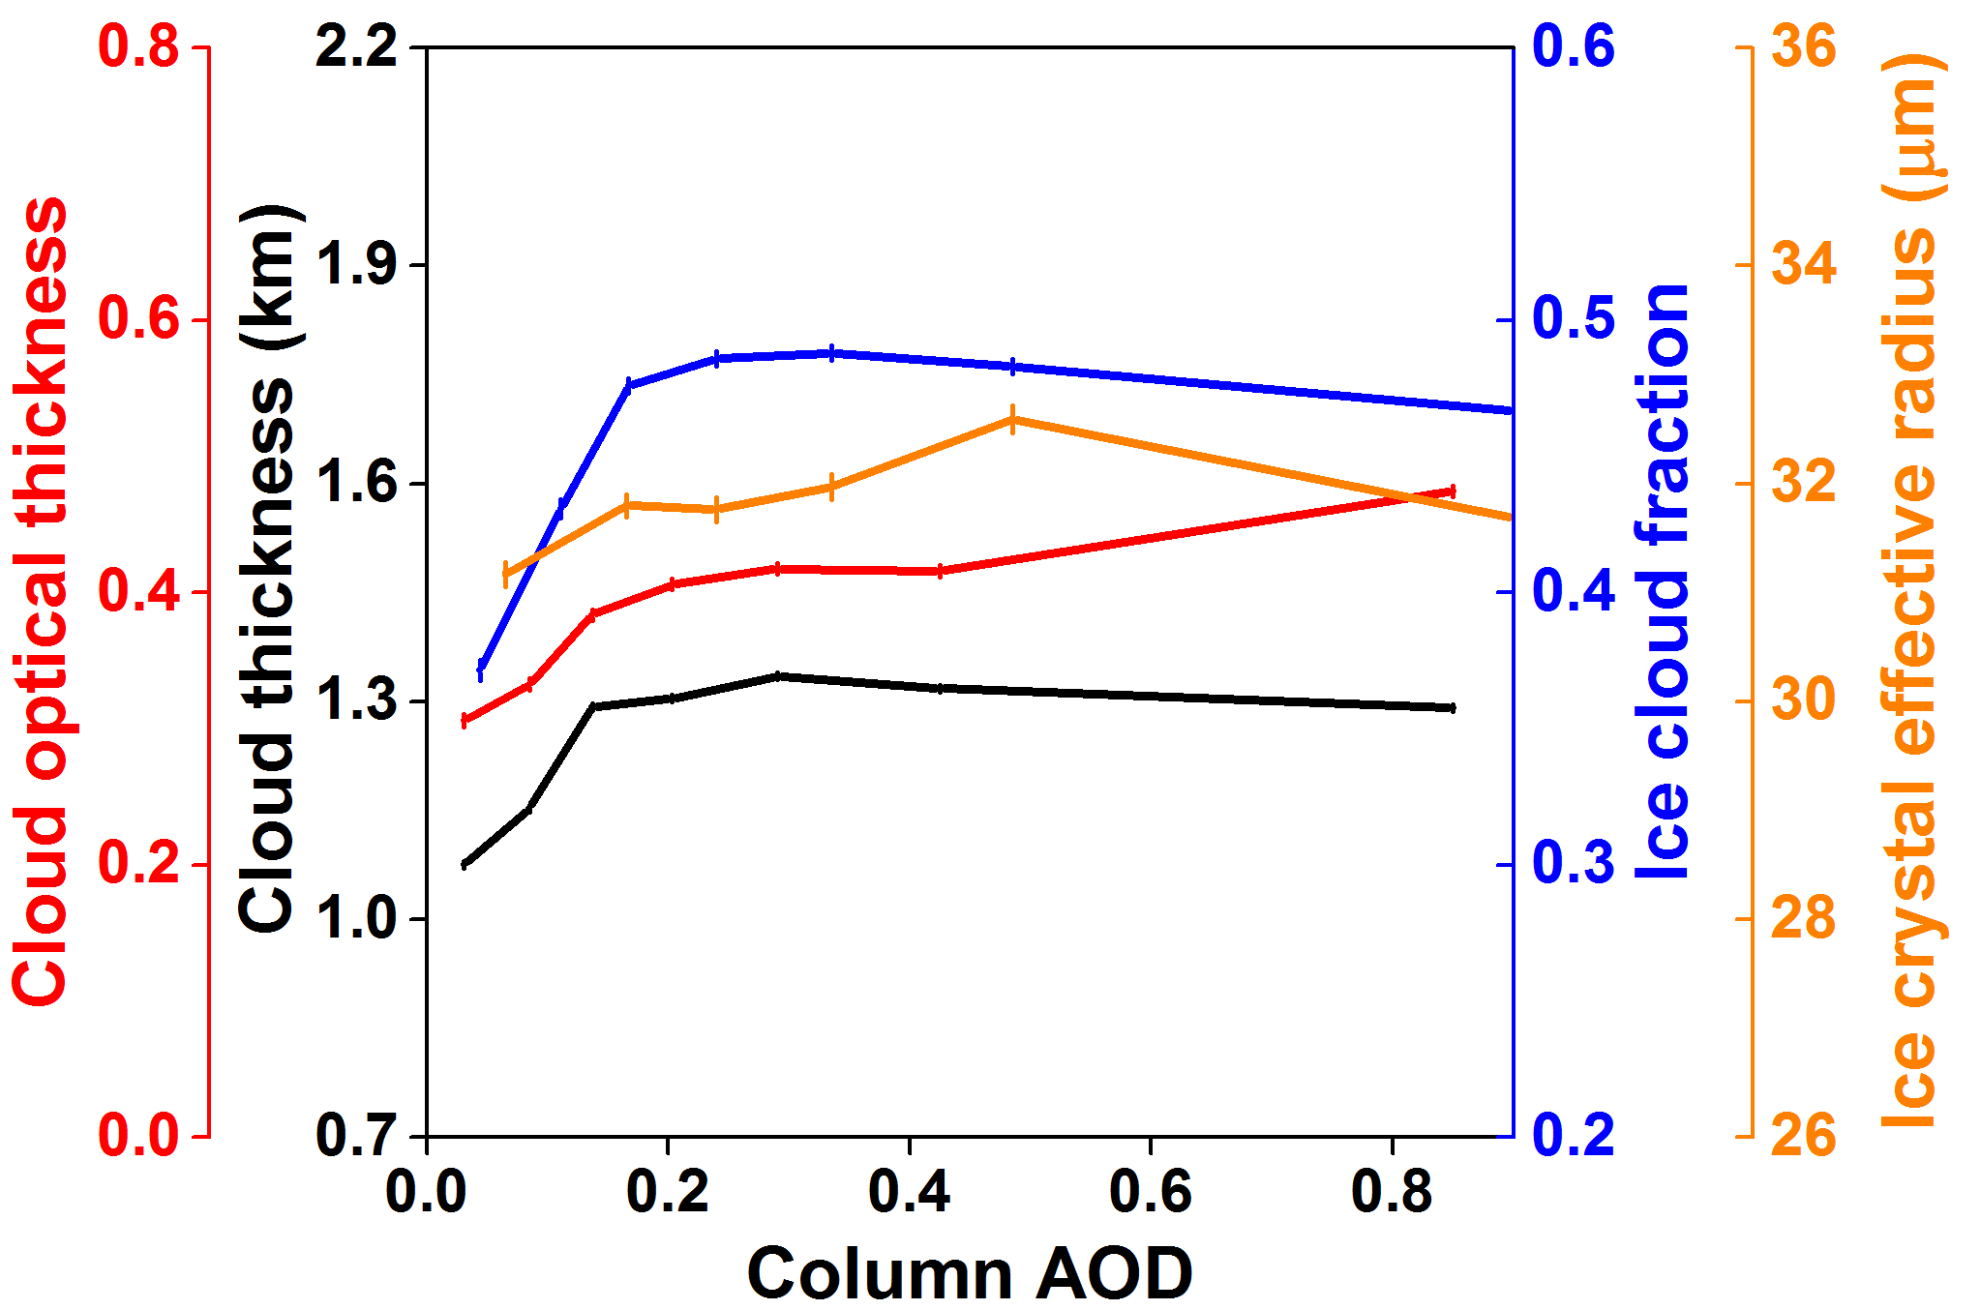
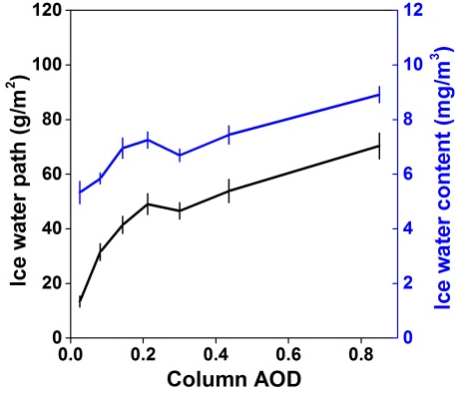
Overall changes in ice cloud properties with aerosols
Zhao et al., 2018 ACP; 2018 GRL
Cloud thickness, COT, ice cloud fraction (ICF), ice water path (IWP), and ice water content (IWC) all increase rapidly with AOD < 0.3, and level off at higher AOD.
R_{ei} increases with AOD < 0.5, and decreases slightly with further AOD increase.
Exclude the impact of meteorological covariation and cloud contamination of aerosol retrievals.

Slide 7
Aerosol effects or meteorological effects?
Meteorological parameters that can potentially affect ice cloud formation and evolution:
  Relative humidity averaged between 100 and 440 hPa (RH100−440hPa)
  Convective available potential energy (CAPE): an indicator of convective strength
  Middle cloud layer temperature
  Wind speed and direction at ice cloud height and at surface
  Vertical velocity below and at ice cloud height
  Vertical wind shear.

Slide 8
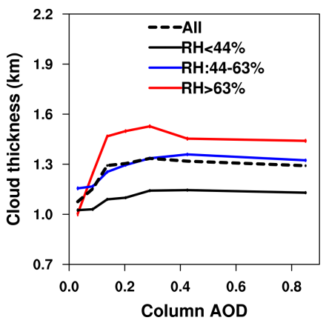
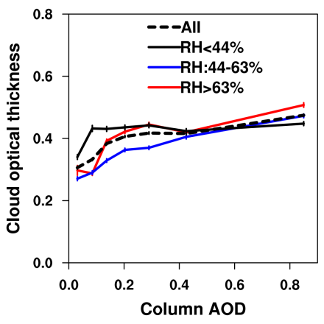
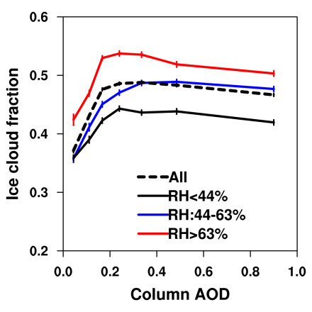
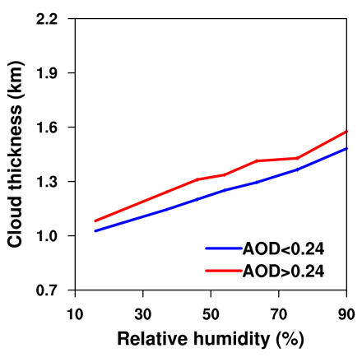
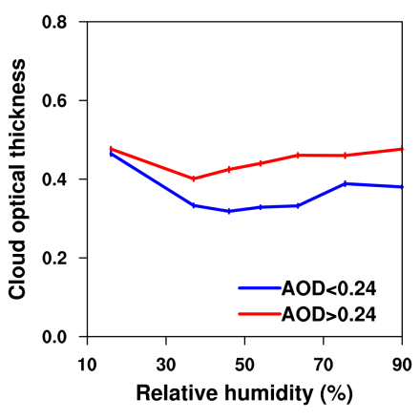
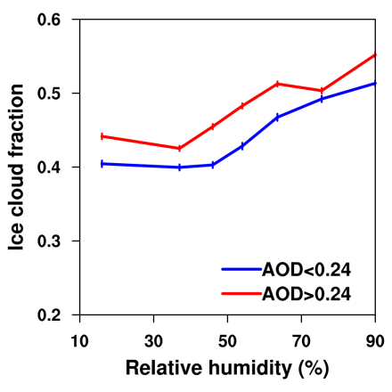
Aerosol effects or meteorological effects?
Cloud optical thickness (COT)
Ice cloud fraction (ICF)
Cloud thickness
Zhao et al., 2018 GRL

Slide 9
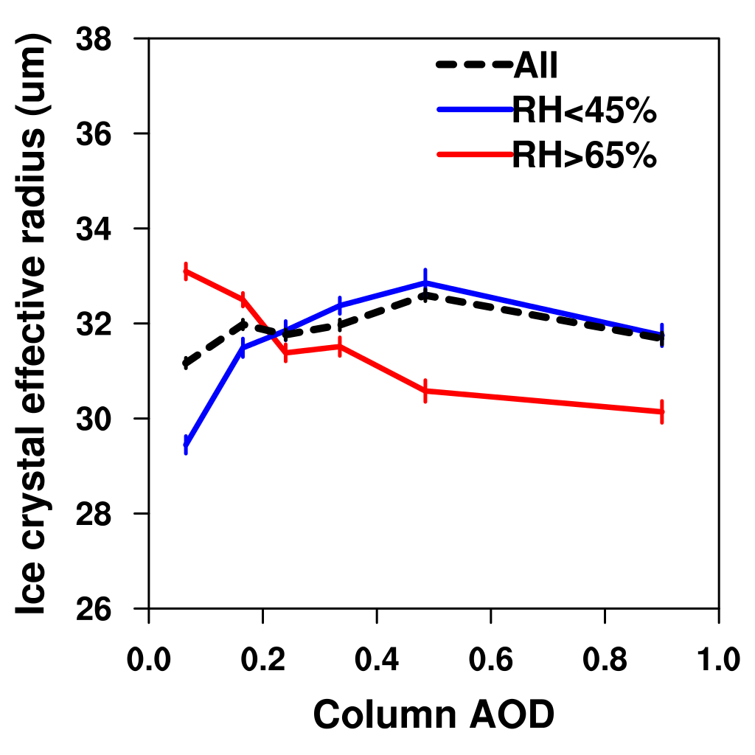
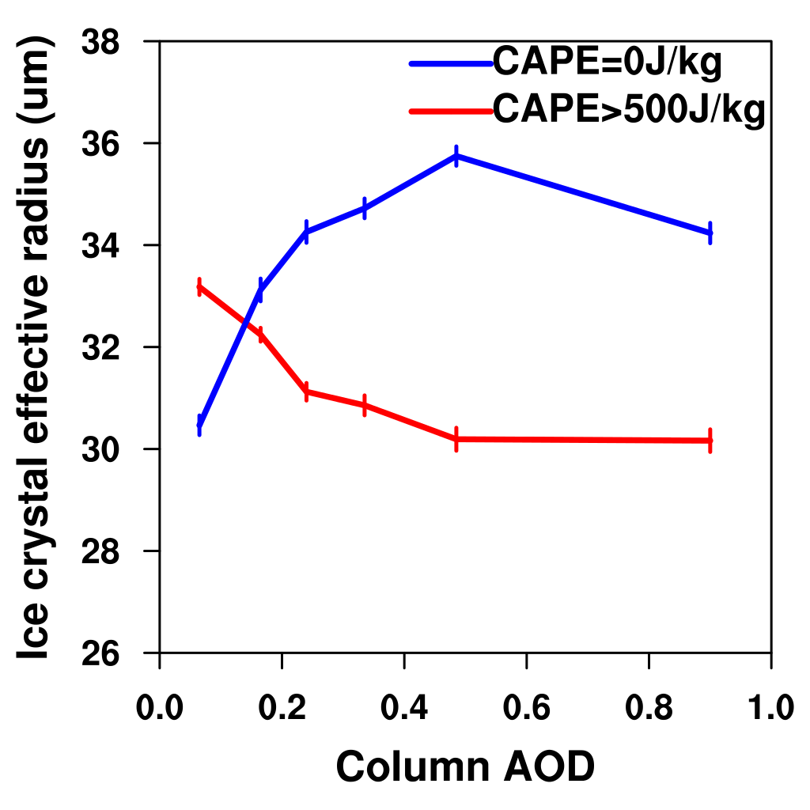
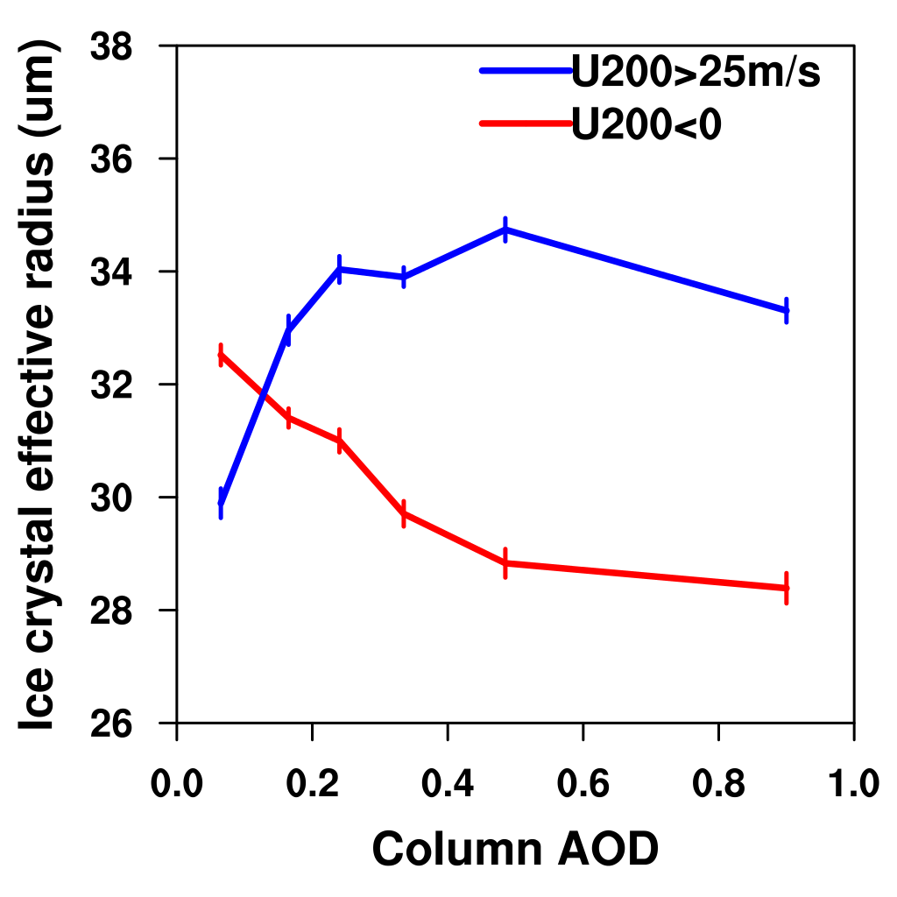
R_{ei}-AOD relationships modulated by meteorology
RH_{100-440 hPa}
CAPE*
U200*
Zhao et al., 2018 ACP
R_{ei} decreases significantly with increasing AOD for high-RH_{100-440 hPa}/high-CAPE/negative-U200, consistent with the rule of “Twomey effect”. In contrast, however, for low-RH_{100-440 hPa}/low-CAPE/positive-U200, R_{ei} increases rapidly with AOD.
Both the positive and negative correlations between R_{ei} and AOD are primarily attributed to the aerosol effect.
RH_{100-440hPa}, CAPE, and U200 are all closely related to the amount of water vapor in the upper atmosphere.
*CAPE: convective available potential energy
U200: U-component of wind speed at 200 hPa

Slide 10
Modeling support for the water vapor modulation
Cloud parcel model simulation
  Homogeneous nucleation of sulfate solution droplets
  Deposition nucleation on externally mixed dust (prescribed to be 0.0075% of sulfate)
  Immersion nucleation of coated dust droplets (prescribed to be 0.0025% of sulfate)
  Other processes: depositional growth, sublimation, and sedimentation
Finding: water vapor modulates the relative importance of different ice nucleation modes, leading to the opposite aerosol impacts between moist and dry conditions
Dash: het fraction
Solid: N_{i}
pv: initial water vapor mass mixing ratios
Zhao et al., 2018 ACP

Slide 11
Classification of ice clouds using CALIPSO
Classify ice clouds based on their connection to deep convective clouds
  Convection-generated ice clouds: consist of ice cloud profiles that are directly connected to deep convective profiles.
  In-situ ice clouds: at least 95% of the cloud consists of continuous ice cloud profiles which are at least 25 km in horizontal direction, and none of the remaining profiles are deep convection type.
Zhao et al., 2018 ACP; Riihimaki and McFarlane, 2010

Slide 12
Distribution of properties of two ice cloud types
Profile number:
Convection-generated
1407104 (51.1%)
In-situ formed
1269272 (46.1%)
Others
75471 (2.7%)
Zhao et al., 2018 ACP

Slide 13
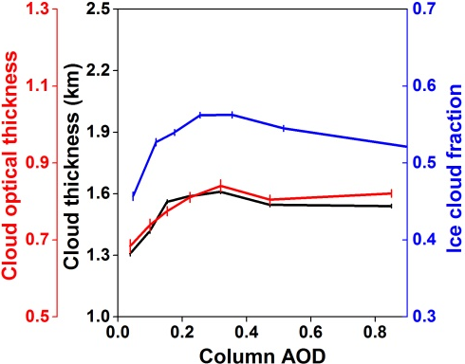
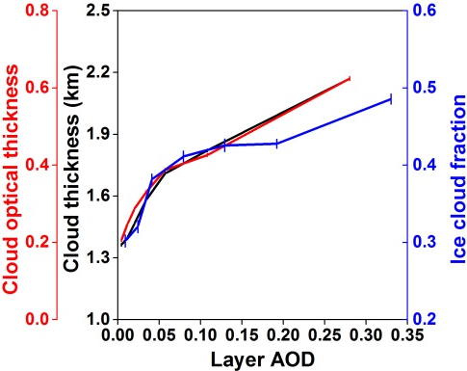
Responses of properties of two ice cloud types to aerosol loading
Convection-generated ice clouds
In-situ formed ice clouds
Zhao et al., 2018 GRL
For convection-generated ice clouds, COT, cloud thickness, and ICF increase with small-to-moderate aerosol loadings (AOD < 0.3), and decrease with further aerosol increase.
For in-situ formed ice clouds, however, these cloud properties increase monotonically and more sharply with aerosol loadings.

Slide 14
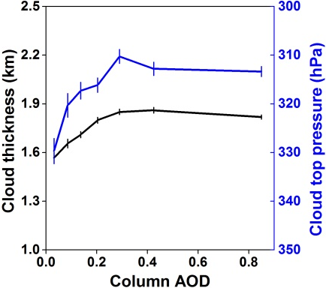
Mechanisms for the aerosol impact: convection-generated ice clouds
Convection-generated ice clouds
Deep convective clouds
Small aerosol loading
Large aerosol loading
Invigoration of deep convection (Rosenfeld et al., 2008)
Inhibition of deep convection (Rosenfeld et al., 2008)
Evaporation due to absorptive heating (Koren et al., 2008)
Clouds increase with AOD
Clouds decrease with AOD

Slide 15
Mechanisms for the aerosol impact: in-situ ice clouds
Increased aerosol loading
In-situ formed ice clouds
if homo dominates
if hete dominates
More numerous and smaller ice crystals, therefore reduced sedimentation rates
More ice crystals at similar size
R_{ei}
R_{ei}
Increased ice water content

Slide 16
Impact of different aerosol types on COT
All ice clouds
For convection-generated ice clouds, an increase in loadings of dust and anthropogenic pollution aerosols generally enhances COT; however, an increase in smoke reduces COT.
For in-situ ice clouds, an increase in layer AOD of any aerosol type results in significant increase in COT.
Convection-generated ice clouds
In-situ ice clouds
Zhao et al., 2018 GRL

Slide 17
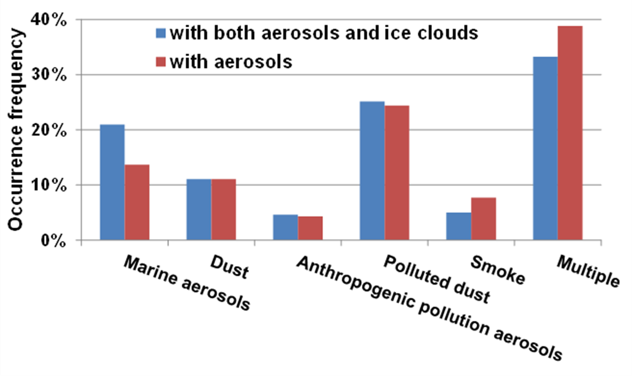
Impact of different aerosol types on R_{ei}
high
RH_{100-440hPa}
low
RH_{100-440hPa}
Occurrence frequencies of different aerosol types distinguished by CALIPSO. The red columns are calculated based on all profiles with valid AOD during 2007-2015, and the blue columns are calculated based on only the profiles with coexisting aerosols and single-layer ice clouds.
An increase in loadings of dust, anthropogenic pollution aerosols, or polluted dust reduces R_{ei} under moist conditions, but enlarges R_{ei} under dry conditions.
Considering the similar frequencies of these aerosol types coexisting with ice clouds, it is very likely that dust and anthropogenic pollution aerosols have similar ice nucleating abilities.

Slide 18
Take-home message
What’s the impact of various aerosol types on the physical properties of two ice cloud types?
Cloud fraction and optical thickness of convection-generated ice clouds increase with small-to-moderate aerosol loadings (<0.3 AOD), but decrease with further aerosol increase. For in-situ formed ice clouds, however, these cloud properties increase monotonically and more sharply with aerosol loadings.
The responses of R_{ei} to aerosol loadings are modulated by water vapor amount: A signiﬁcant negative correlation between Rei and aerosol loading in moist conditions, consistent with the “Twomey effect” for liquid clouds; A strong positive correlation between the two in dry conditions.
An increase in loadings of dust, anthropogenic pollution aerosols, and their mixture generally enhances COT of both ice cloud types. These aerosol types also exert similar effects on R_{ei}, implying that they all contain substantial amount of INPs.
An increase in loadings of smoke aerosols reduces COT of convection-generated ice clouds.

Slide 19
Acknowledgment
Thank you for your attention!
NASA ROSES TASNPP (Grant 80NSSC18K0985)
References:
Zhao, B.*, Y. Gu*, K. N. Liou, Y. Wang, X. Liu, L. Huang, J. H. Jiang, and H. Su, 2018: Type-dependent responses of ice cloud properties to aerosols from satellite retrievals. Geophys. Res. Lett., 45, 3297-3306, DOI 10.1002/2018GL077261 (*corresponding author).
Zhao, B.*, K. N. Liou, Y. Gu*, J. Jiang, Q. Li, R. Fu, L. Huang, X. Liu, X. Shi, H. Su, and C. He, 2018: Impact of aerosols on ice crystal size. Atmos Chem Phys, 18, 1065-1078, DOI 10.5194/acp-18-1065-2018 (*corresponding author).

