Slide 1
Biomass Burning and Aerosol Characteristics in India
Pawan Gupta (STI/USRA at MSFC),
Robert Levy (GSFC),
Anton Darmenov (GSFC),
Falguni Patadia (GESTAR/USRA/GSFC),
Lorraine Remer (UMBC/GSFC), and
Krishna P. Vadrevu (SERVIR/MSFC)
Collaborator: Mukesh Sharma (Indian Institute of Technology, Kanpur, India), Yogesh Kant (Indian Institute of Remote Sensing, Dehradun, India)
MODIS/VIIRS Science Team Meeting, Oct 15-19, 2018, Silver Spring, MD

Slide 2
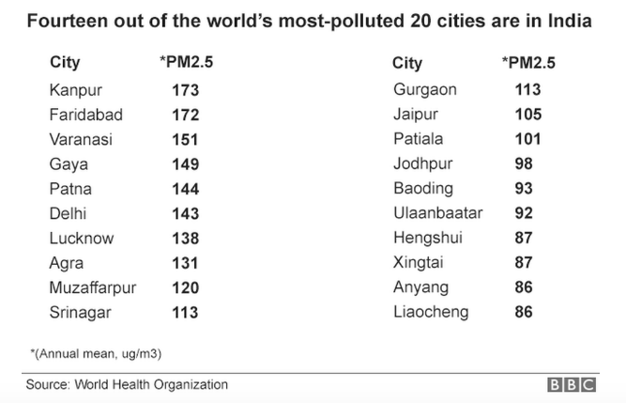
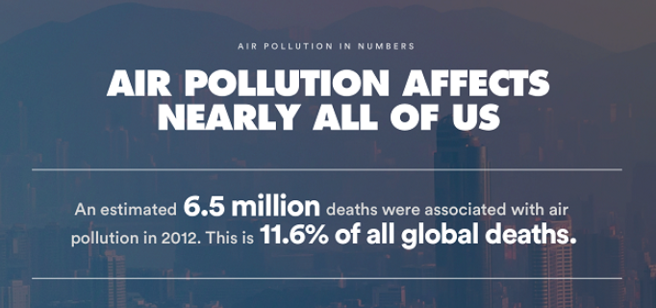
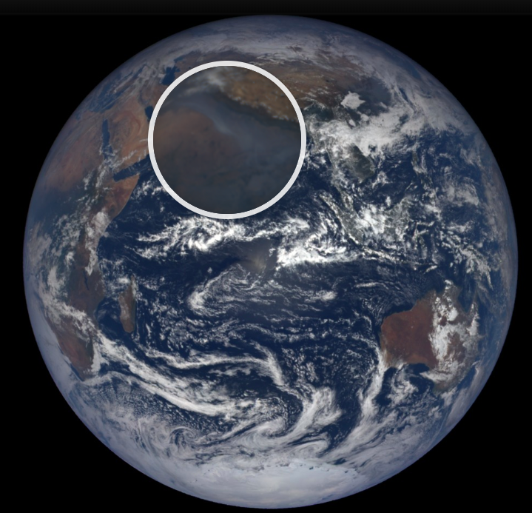
Introduction
WHO Report
Can be seen from a million miles away
Surface

Slide 3
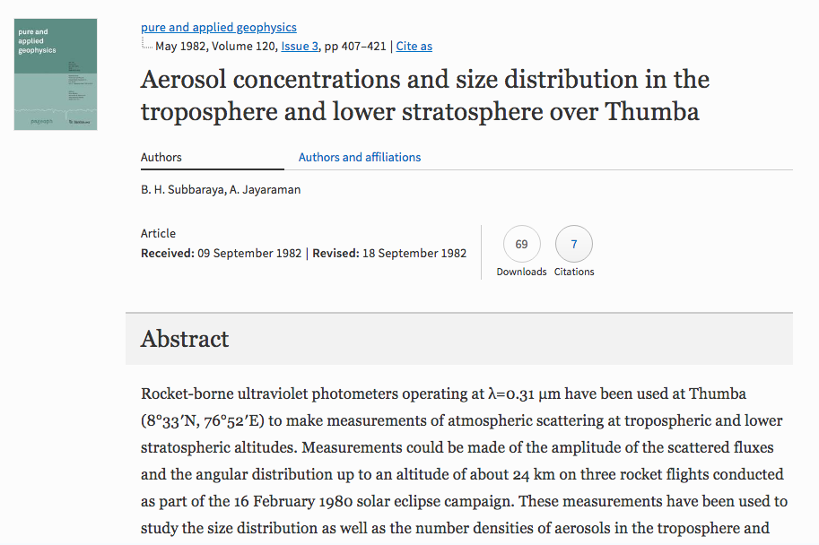
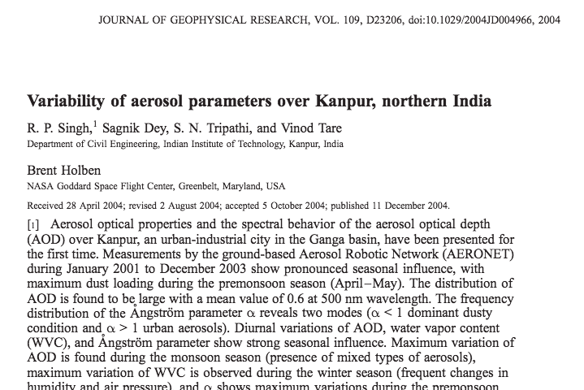
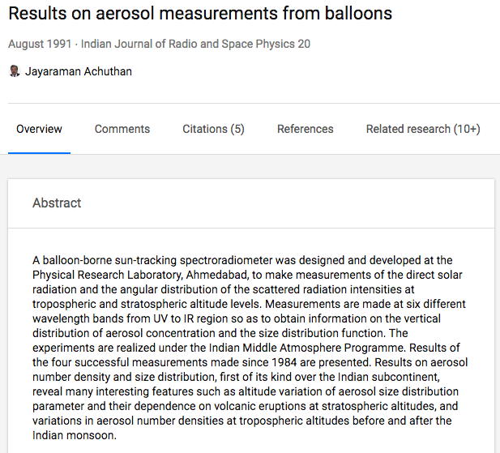
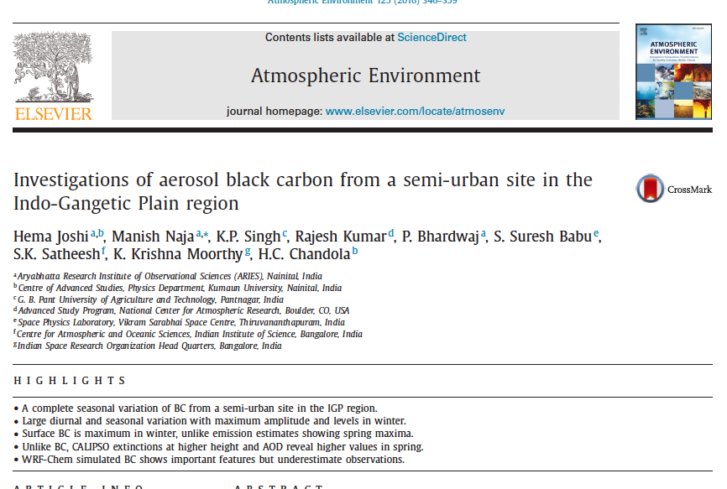
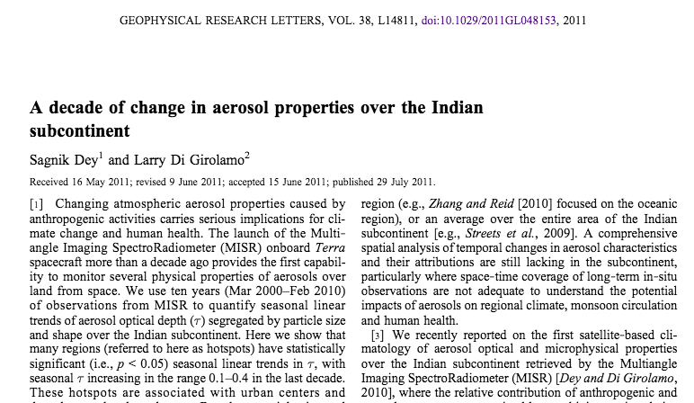
Four plus decades of research over India
Aerosol Properties
1982
Photometery aboard rocket
INDOEX field campaign
Regional field campaign
Decadal change in aerosols from satellite
2004
1991
2011
2010
Notes:
Photometers on 3 rocket flights during solar eclipse campaign in 1980
balloon-borne sun-tracking spectroradiometer measurements of the direct solar radiation and the angular distribution of the scattered radiation intensities
Then came the famous INDOEX field campaign : aod , n( r), flux measured simultaneously. Spatial gradients quantified

Slide 4
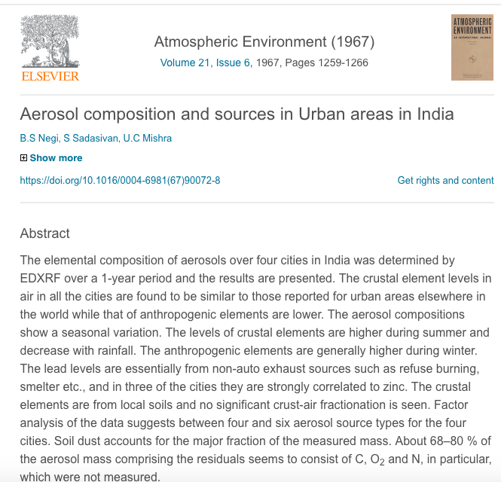
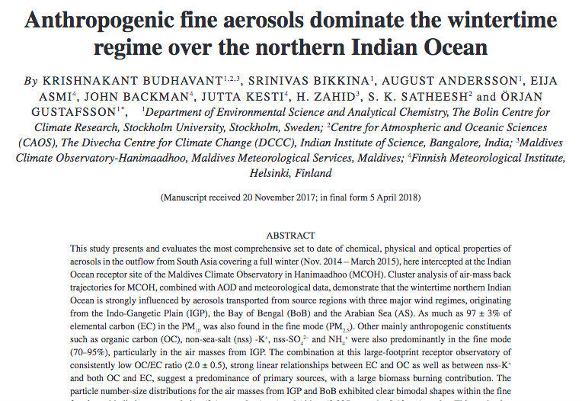
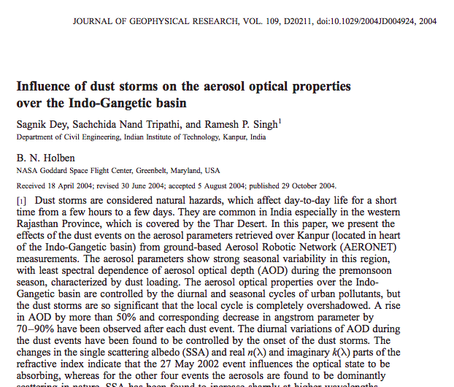
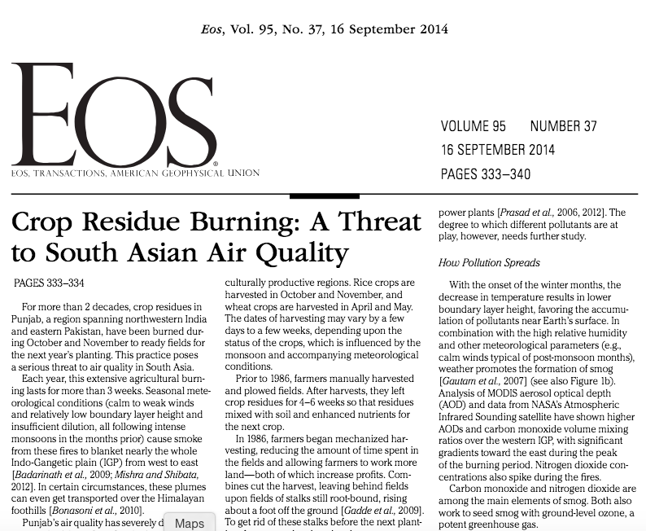
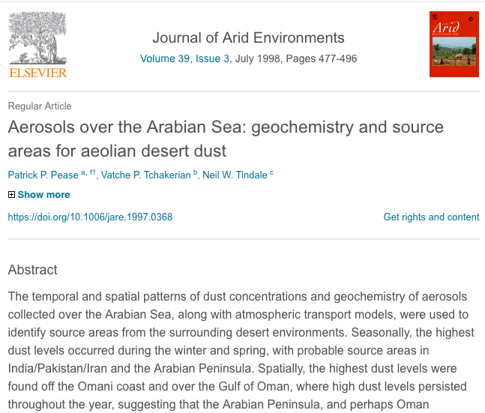
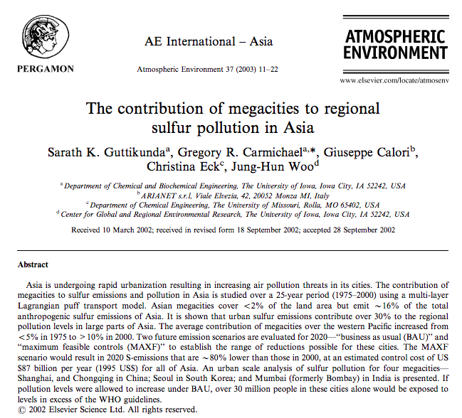
Four plus decades of research over India
Aerosol Properties
1967
Aerosol Sources
2004
Several studies have been published that identify dust , biomass burning , biofuels, vehicular and industrial pollution as dominant sources of aerosols in the region but their relative contribution remain unknown
2018
2003
1998
Notes:
Several studies have been published that identify dust , biomass burning , biofuels, vehicular and industrial pollution as dominant sources of aerosols in the region

Slide 5
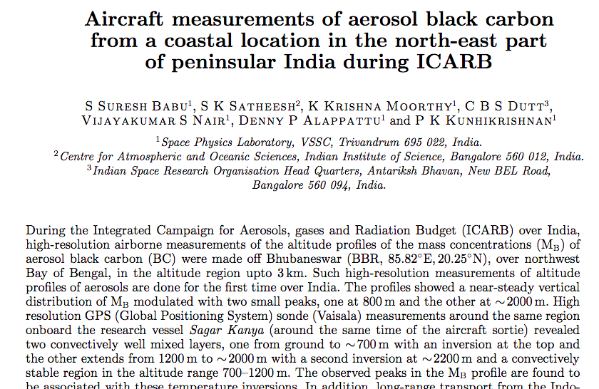
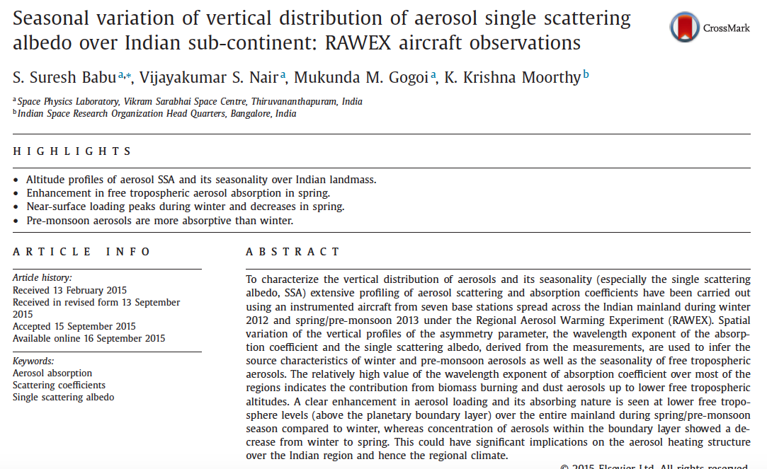
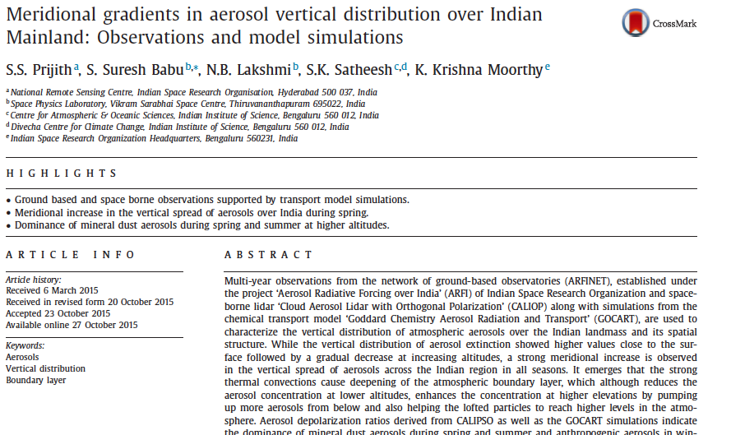
Four plus decades of research over India
Aerosol Properties
Aerosol Sources
1991
2015
Vertical Distribution
2008
2015
Over the year aircrafts have been used to measure vertical profiles of aerosols and its properties along with CALIPSO over last decade
Notes:
Over the year aircrafts have been used to measure vertical profiles of aerosols and its properties and ofcouse there is CALIPSO

Slide 6
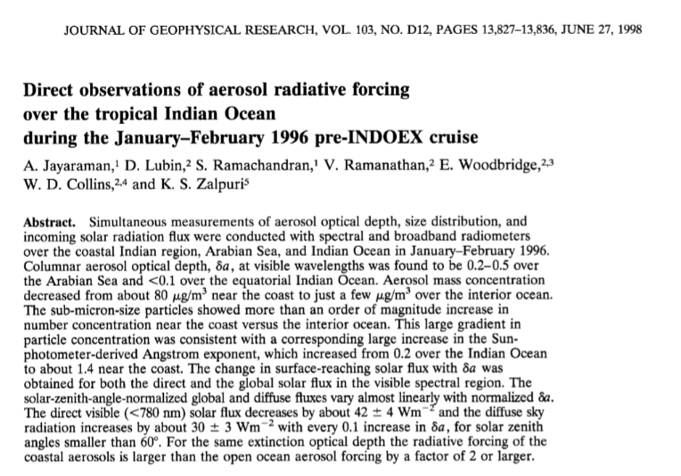
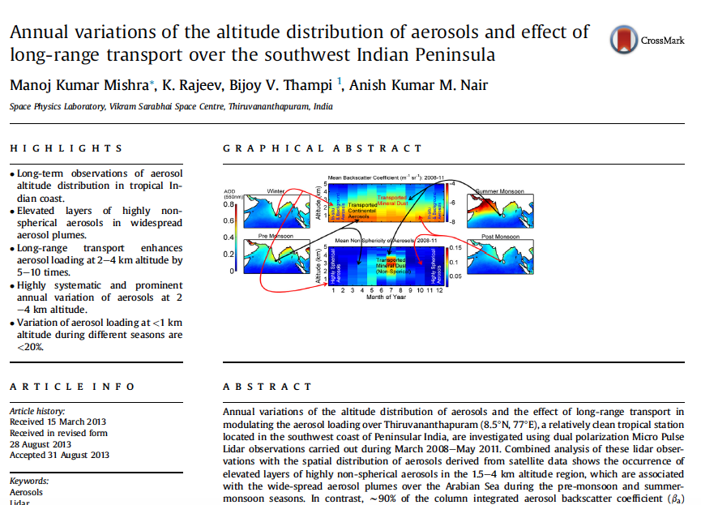
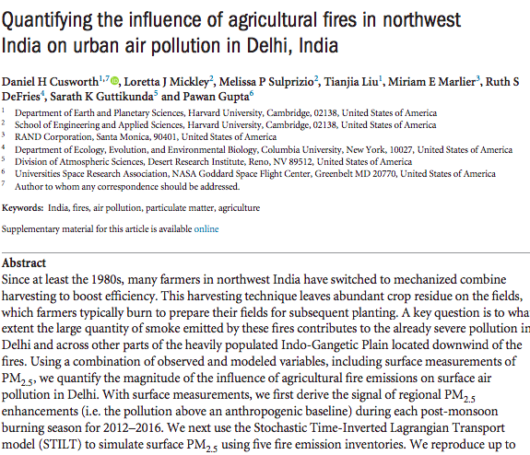
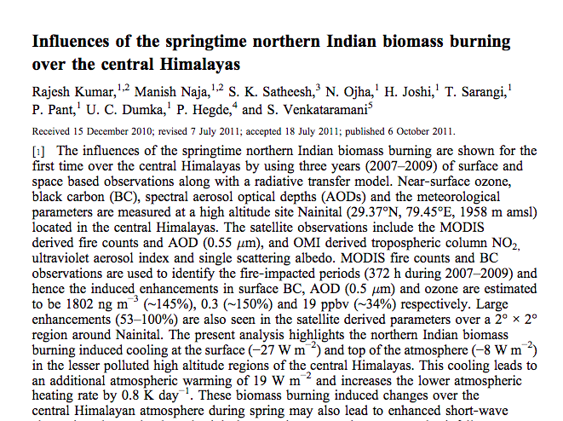
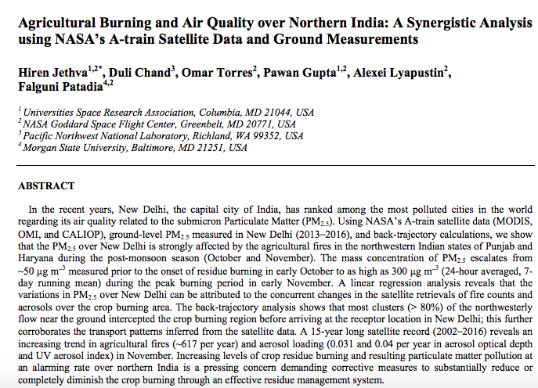
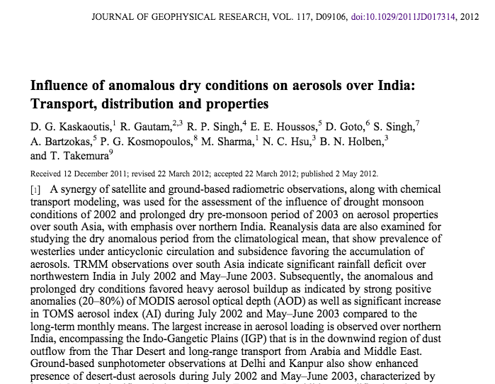
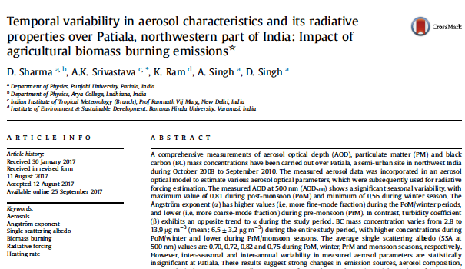
Four plus decades of research over India
1998
Aerosol Properties
Aerosol Sources
Vertical Distribution
Transport
Focused on spring-summer time dust and postmonsoon smoke transport
2012

Slide 7
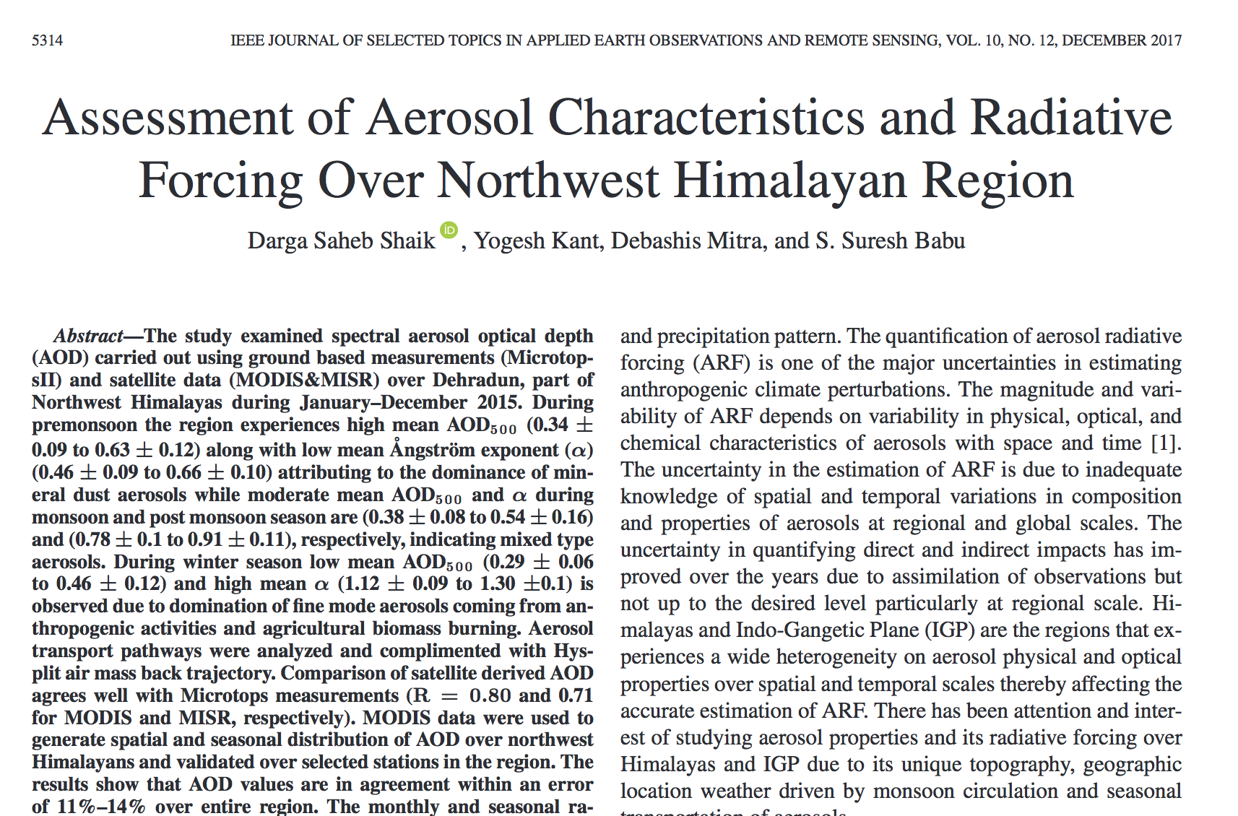
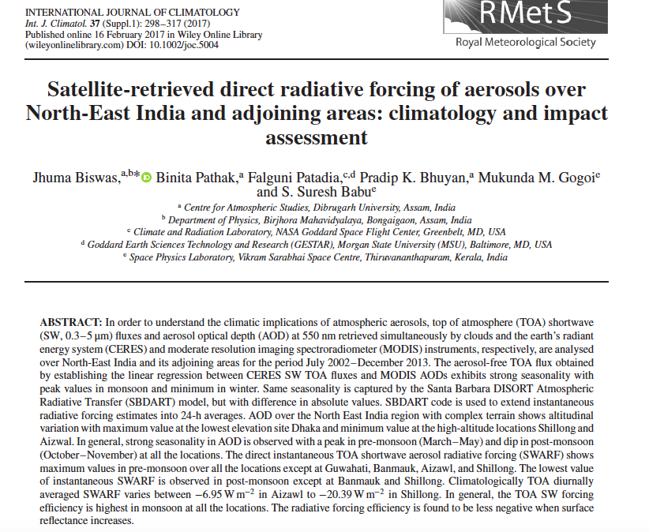
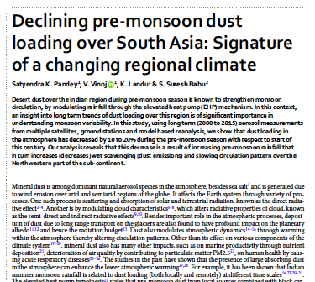
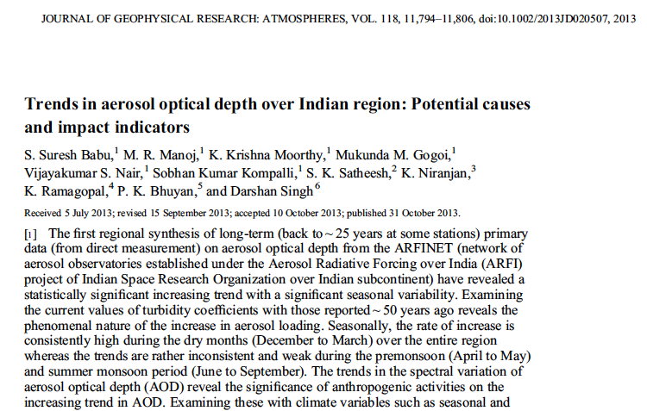
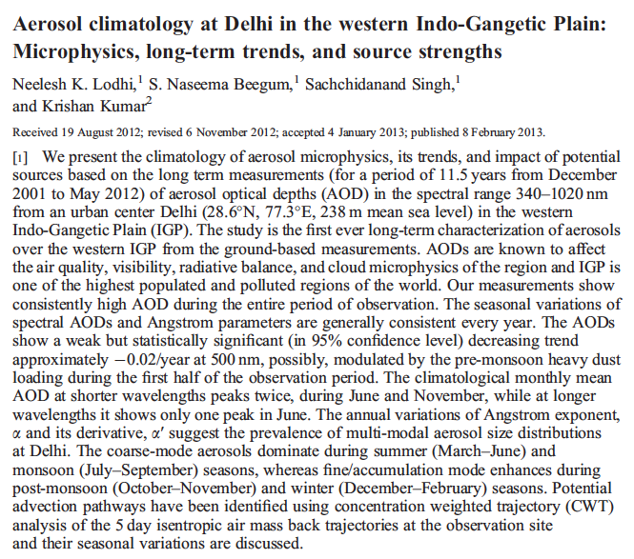
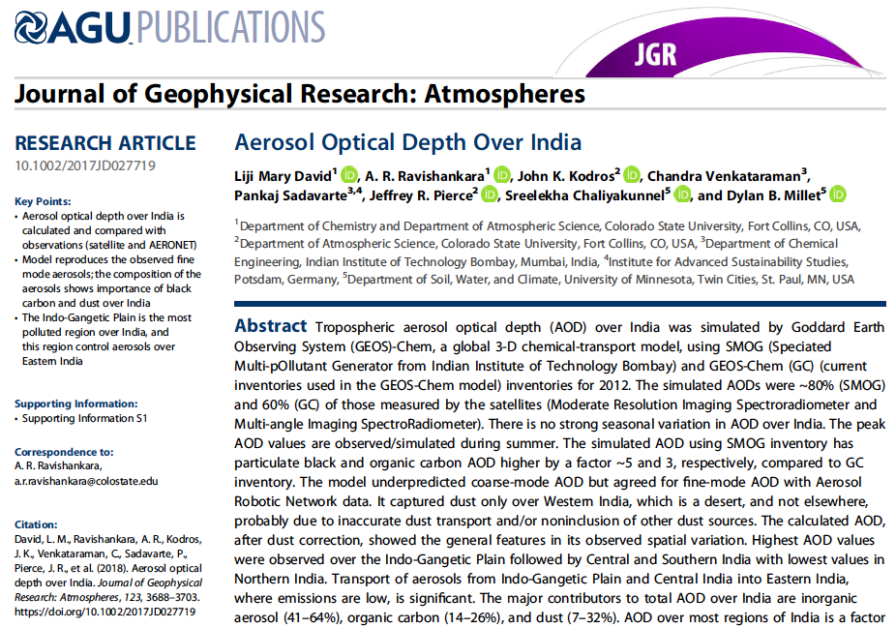
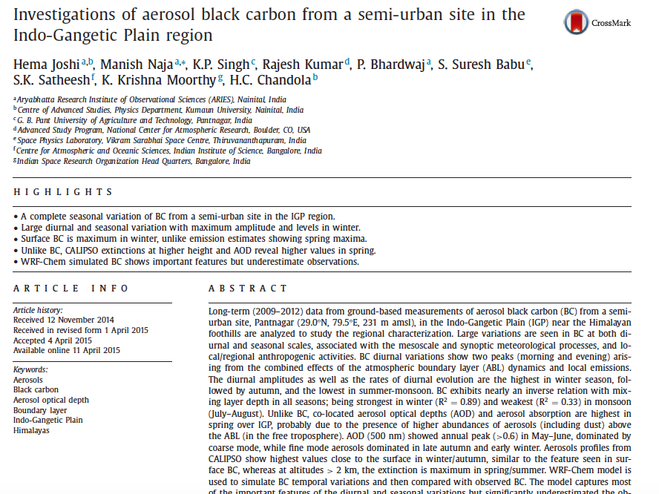
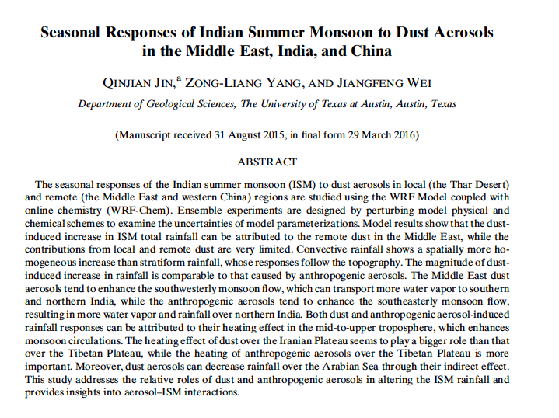
Four plus decades of research over India
Aerosol Properties
Aerosol Sources
Vertical Distribution
Transport
Impacts
In order to understand the changing nature of aerosols and its implications for AQ and regional radiation budget, continuous monitoring of aerosols is required
Notes:
Level 3 data for model evaluation
Long-term aerosols – over particular regions / places
Process / impact studies using may be limited to a year , events (dust) or region
Forcing from satellites – limited to events, region
In order to understand the changing nature of aerosols and its implications for AQ and regional radiation budget, continuous monitoring of aerosols is required

Slide 8
Moving Forward

Slide 9
Characterizing Nearly Two Decades of Biomass Burning Over The Indian Sub-Continent Using Satellite, Surface and Model Simulations
MODIS
Aerosols
Fires
VIIRS
Aerosols
Fires
CERES
Flux
Impact of Fires on Atmospheric Aerosols
Task#4
Spatial and Temporal Fire Burning Trends
Task#3
Satellite Product Evaluation
Task#1
Task#5
Column to Surface Relationships and Air Quality
Task#6
Estimation of Aerosol Direct Radiative Effects
Task#7
Long-term Trends in PM2.5, AOD and ARE
Task#2
Special Aerosol Retrievals
Satellite Measurements
Model Simulations
Surface Measurements
GSFC
MSFC
USRA
UMBC
TEAM
IIT
ISRO
Biomass Burning and Aerosol Characteristics over Indian Sub-Continent
Outcome
Online Visualization and Analysis Tool
Capacity Building
Scientific Publications
PM2.5 Mass Con.
AERONET
Regulatory Measurements
Low-Cost Measurements
AOD
Size Distribution
Absorption
GEOS-5
Emissions
Specific Fire Event Simulations
Biomass burning impact Analysis
Notes:
The science objective is to holistically quantify the impact of biomass burning on air quality and radiative forcing over Indian sub-continent using surface, satellite and model simulations

Slide 10
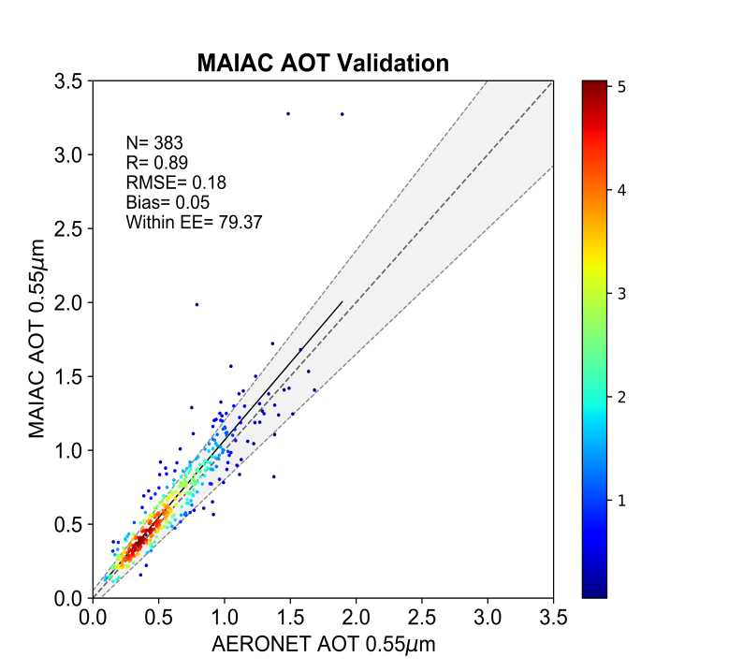
Aerosol Data & Validation - India
Gupta et al.,
Sathe et al.,
Sathe et al.,
We plan to validate MODIS (DT, DB, MAIAC) and VIIRS (750 m) AODs before using for AQ &Radiative forcing

Slide 11
High Resolution Gridded Product
Visualization tool for this data is under development
Notes:
Due to mixer of surface types and changing nature of vegetation cover over the region, the standard dark target and deep blue merged product often misses area of interests, therefore we are working on alternative approach to create a high resolution 10km level 3 AOD data sets for the region.
Absence of high resolution level 3 gridded product often become limiting factors for many researchers

Slide 12
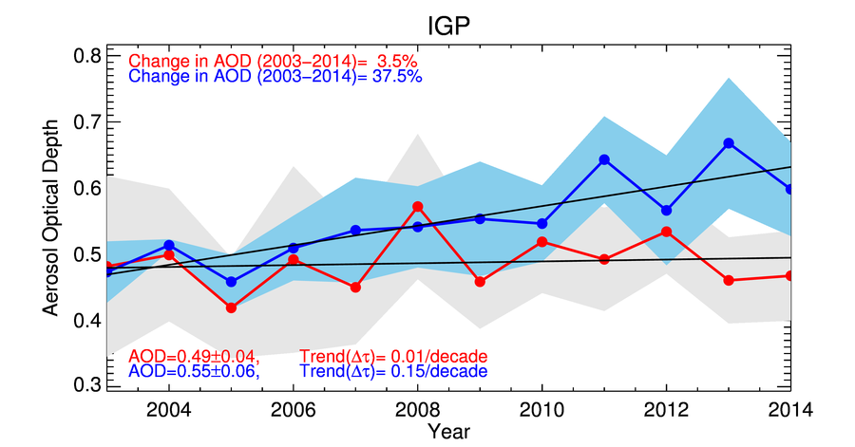
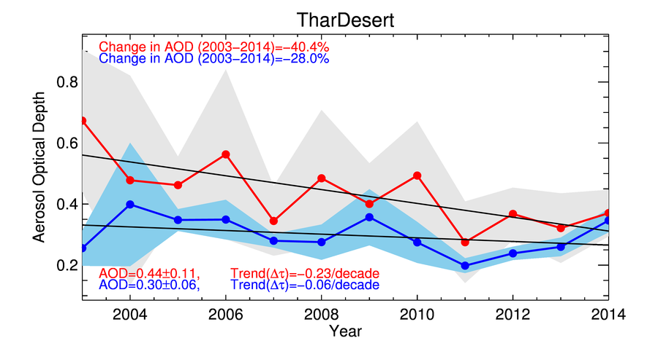
Regional Contrast in Aerosol Trends
2003-2007
2008-2014
IGP is highly influenced by mineral dust during premonsoon and sea salt during monsoon, while during postmonsoon fine mode aerosols dominate
Postmonsoon
Aerosol Optical Depth at 550 nm
Premonsoon
Postmonsoon
Premonsoon
Notes:
This region is bordered by the Himalayas to the north, Vindhyan Satpura ranges to the south, Thar desert and the Arabian Sea in the west and the Bay of Bengal in the east. D

Slide 13
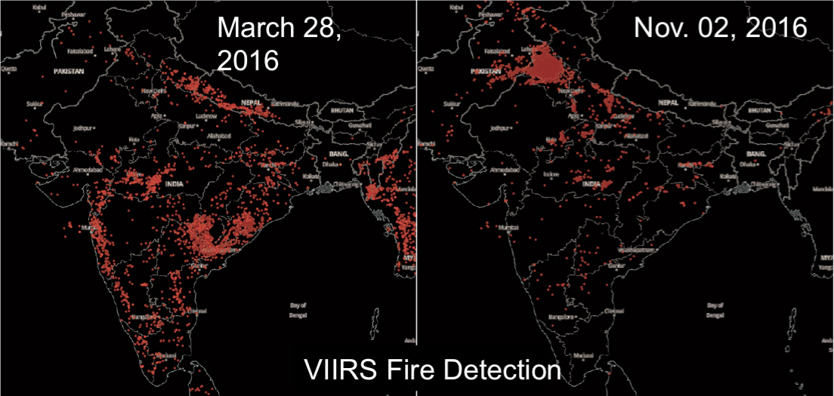
Seasonal Pattern of Fires
VIIRS fires detected on March 28, 2016 (left) and Nov. 2, 2016 (right). In March we see much burning in central and southern India (agricultural and open fires) and some fires in the IGP and Nepal (forest fires). On Nov 2nd, 2016 the fires have migrated to Northern India, and Pakistan (Image Generated using Worldview).
Agricultural fires show bimodal trend corresponding to Rice-Wheat residue burning
Residue burning
Residue burning
Vadrevu et al., 2011. Env. Pollution
Notes:
The main rice growing season is the 'Kharif'. It is known as Winter rice as per the harvesting time. The sowing time of winter (Kharif) rice is July-August and is harvested in October-November.
Wheat is sown during November-December and harvested during April-May.
High fire counts from MODIS correspond to Residue burning season.

Slide 14
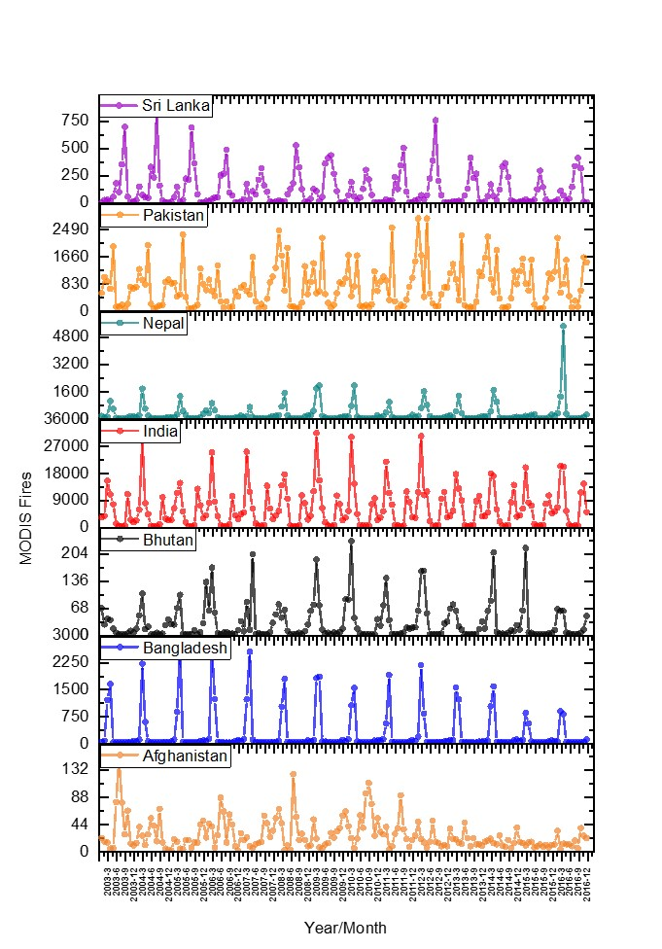
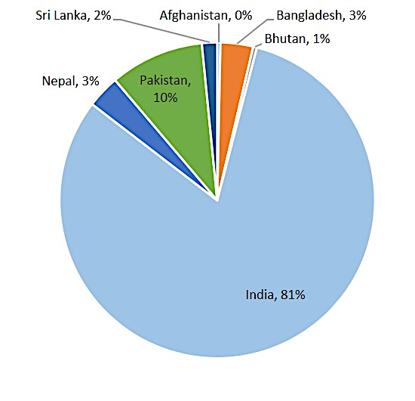
Vegetation Fires in South Asia
2003 2007 2011 2015
Trends in vegetation fires over different South Asian countries suggests a decreasing trend
(Vadrevu et al., 2018 ERL, submitted).
India accounts for 81% of the total vegetation fires in South Asia.

Slide 15
Surface vs Column
Leveraging NASA Citizen Science Project – Deploying Low-Cost AQ sensors in India

Slide 16
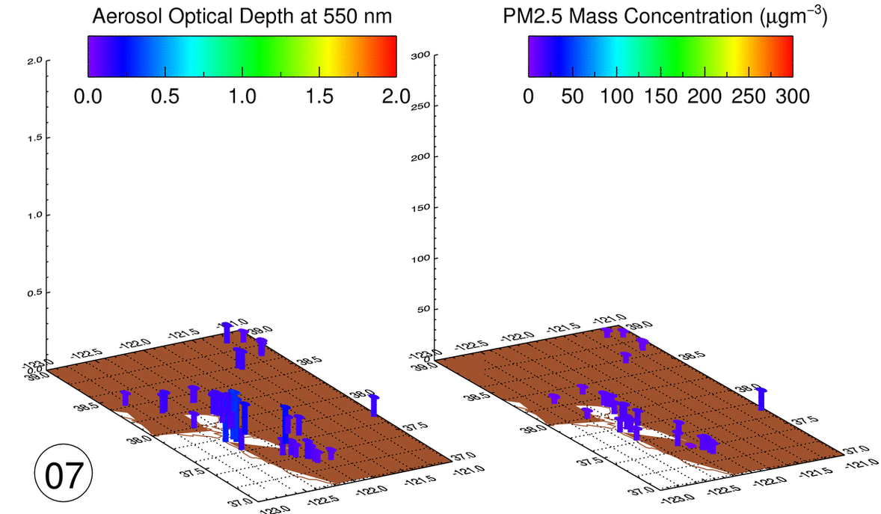
Impact of Biomass Burning on Air Quality
Satellite and Surface Measurements Respond to Change in Air Quality During Fires in CA
VIIRS Fire Counts & PM2.5 – Delhi, India
Satellite
Surface
Gupta et al., 2018

Slide 17
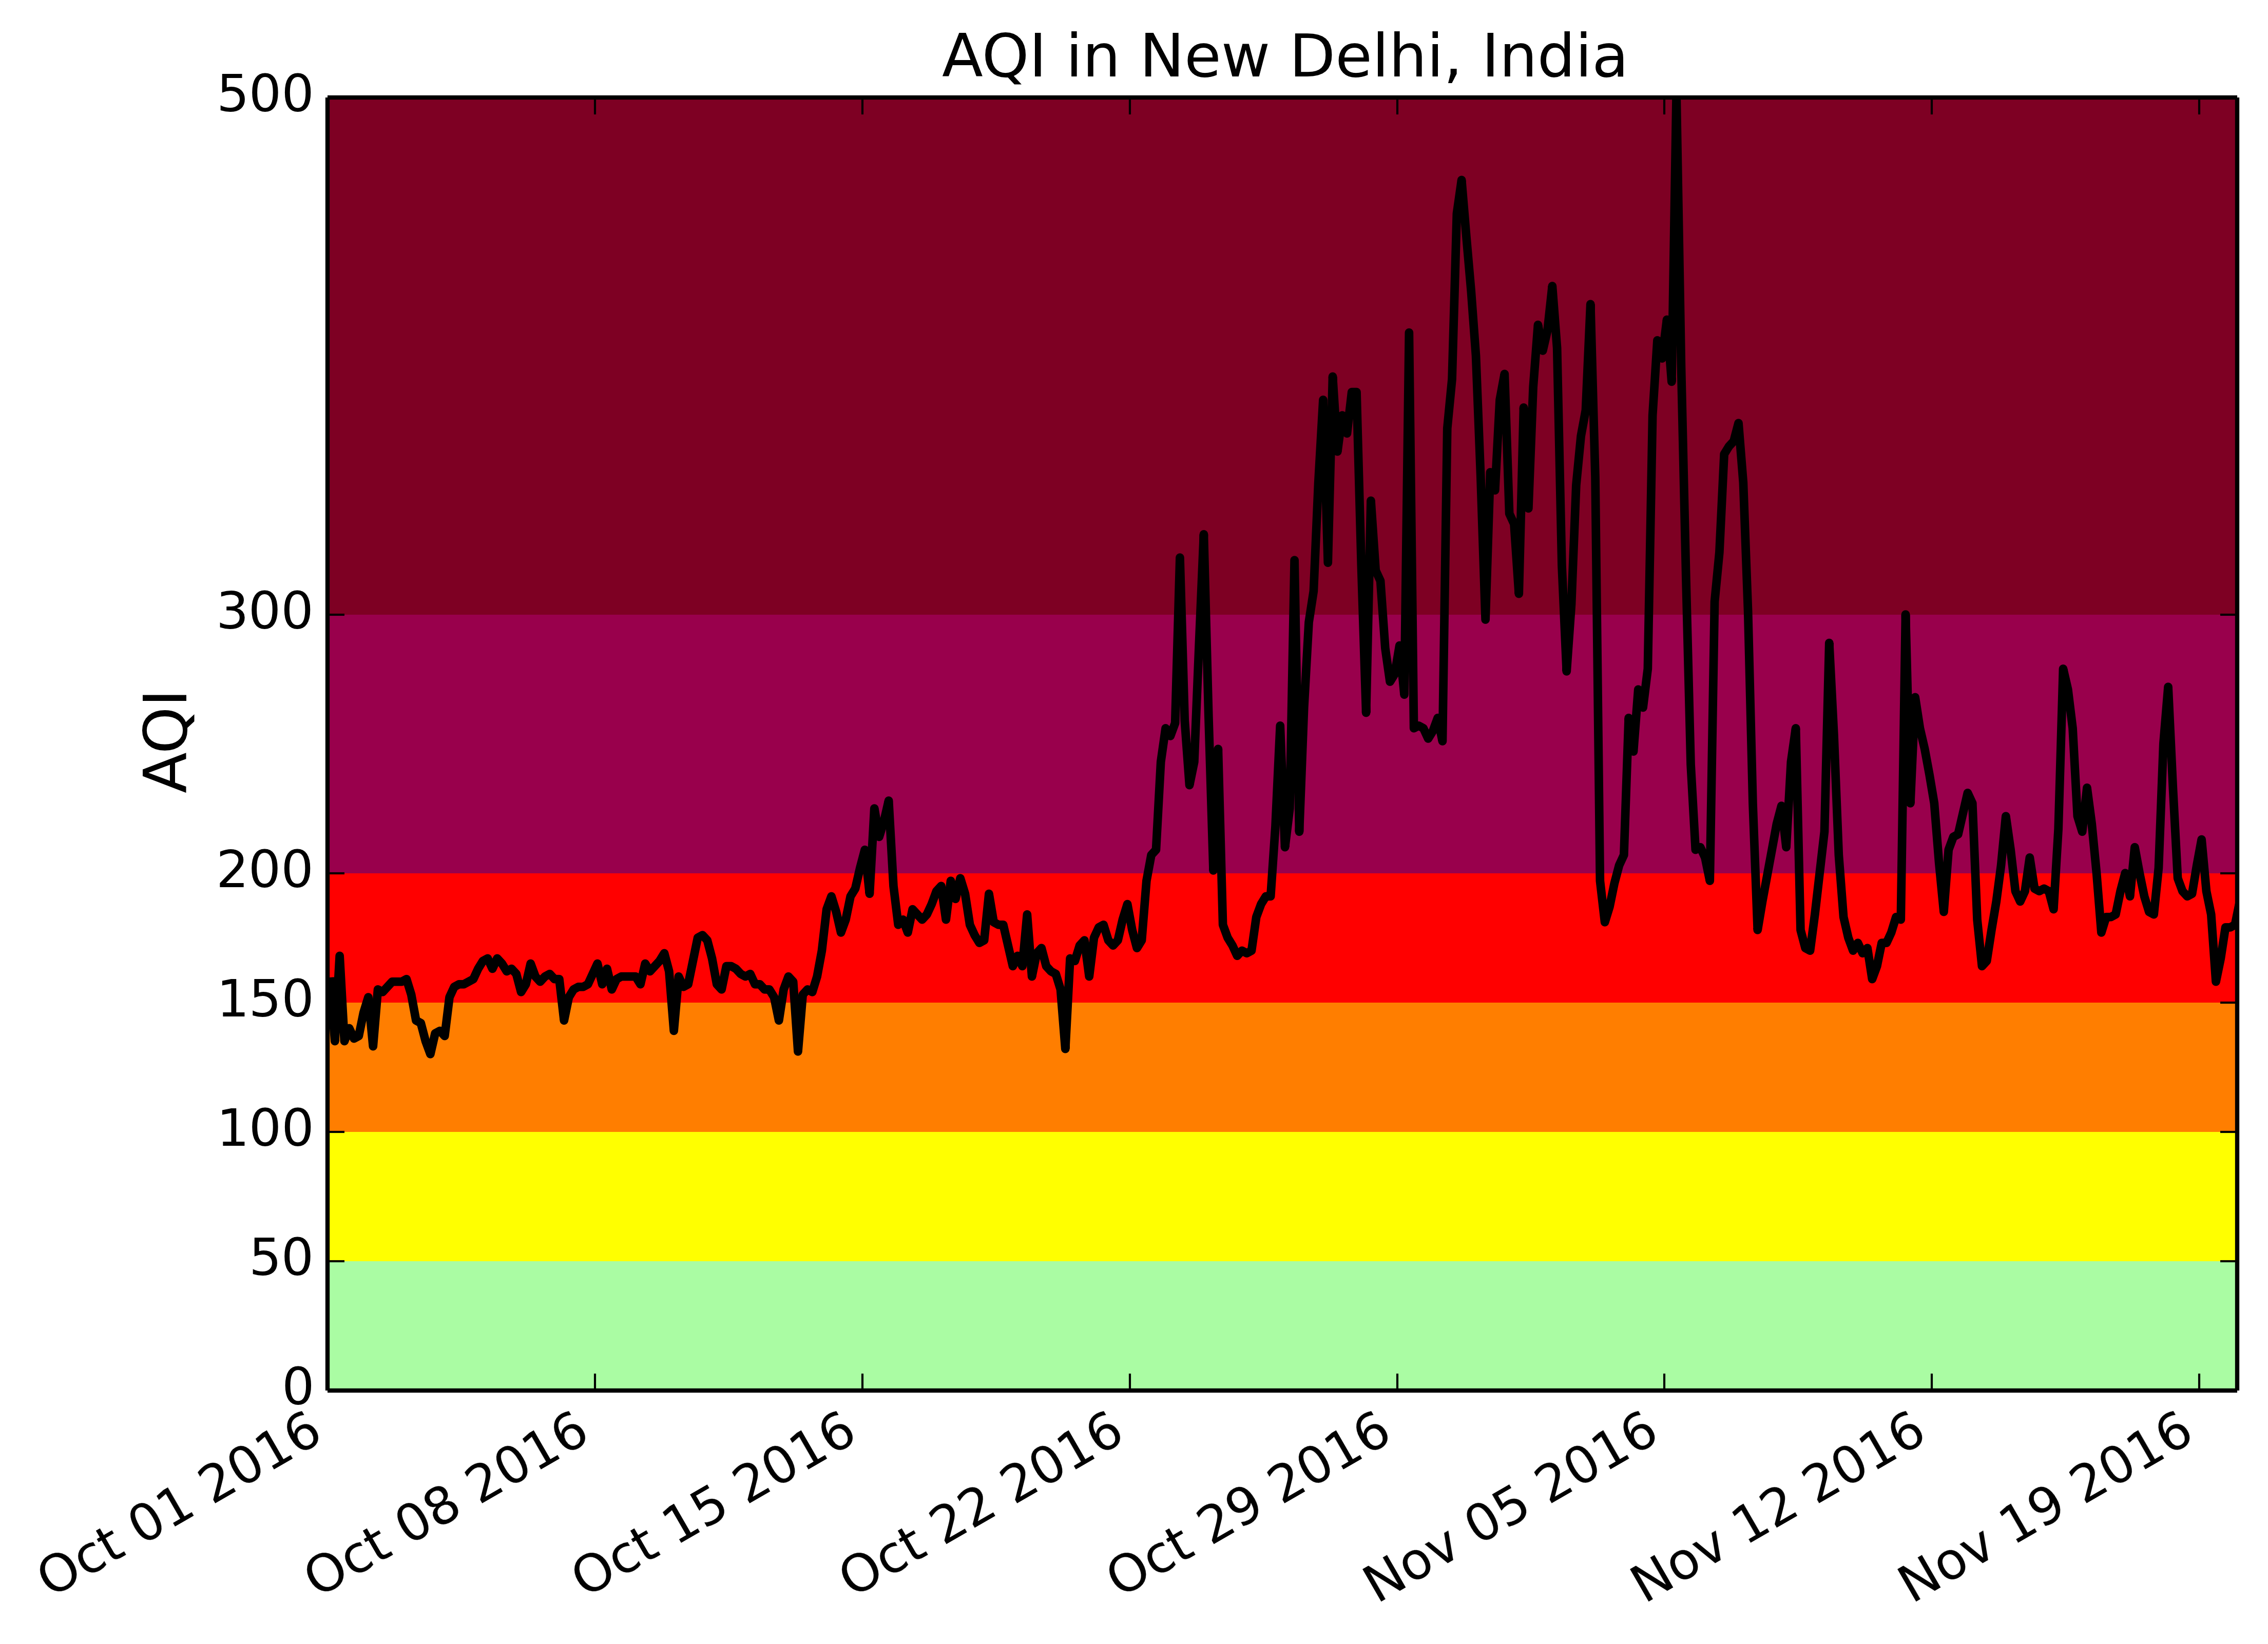
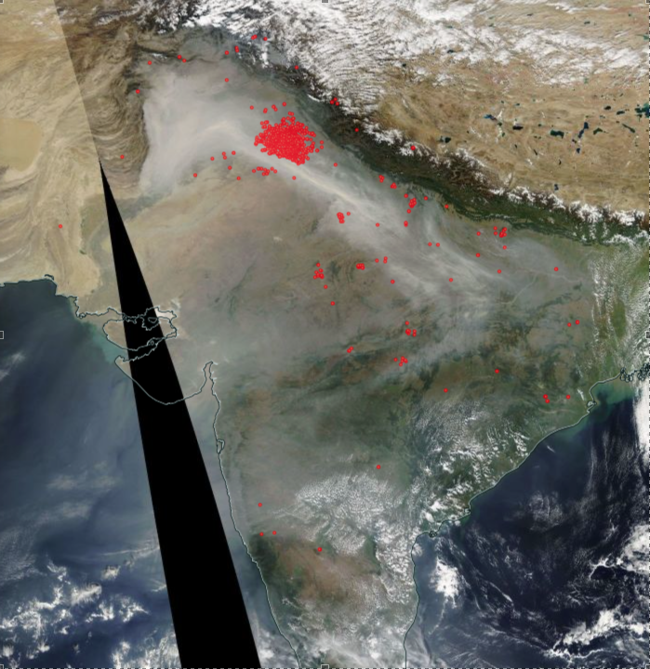
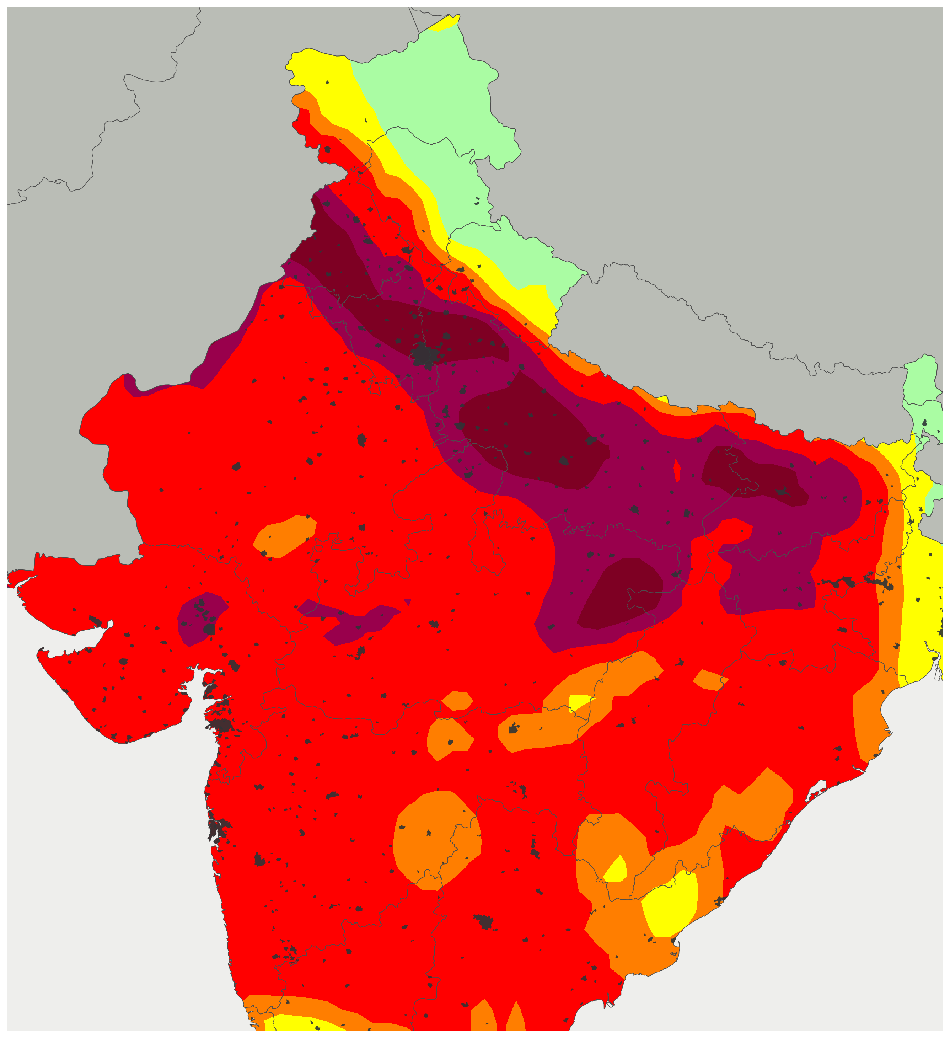
Model Simulation - November 06, 2016
GEOS/FP combined (PM, SO2 and CO) air quality index (AQI)
07:30Z
Hazardous
Very unhealthy
Unhealthy
Unhealthy for sensitive groups
Moderate
Agricultural fires
Good
From; Darmenov et al.,
Goals:
Estimate contributions due to fires, dust and other sources
Identify biases in the forward model
Correct the biases in PM2.5 and find the contribution of the fires to the AQIs
GEOS experiments
Experiment 1: Full set of emissions
Experiment 2: No biomass burning emissions

Slide 18
Challenges & Approaches
Various visual satellite images and correlation analysis suggests the impact of fires on aerosol loading, there is little direct proof.
during the post monsoon season, aerosols originate not only from crop burning, but also from domestic heating (due to cold temperature) and industrial & vehicular pollution.
during the spring/summer fire season, dust is added to the mix, which create another layer of complexity and requires a different approach.
Long-term background aerosol climatology. This background should include all “normal” particle producing activity, with fires adding an “abnormal” positive perturbation to these values.
Explore multiple spectral/spatial tests to identify and retrieve smoke aerosol optical depth
CALIPSO climatology of aerosol typing will also be explored
Model simulations with improved emission data sets
Notes:
Under such a complex mixture with significant contributions from each source, it will be very difficult to completely separate the smoke aerosols from other types

Slide 19
Summary
The ISC is suffering from overwhelming burdens of particulate air pollution and creating significant radiative perturbations to the regional and perhaps global energy balance.
How much of this burden is due to smoke from fires?
How has the contribution from biomass burning changed over the years?
How can we inform policy decisions that will begin to mitigate this burden and perturbation?
- With nearly two decades of satellite aerosol and fire detection products, advanced global modeling system, combined with a network of ground measurements in the region, we aim to begin to answer some of these questions.

