Slide 1
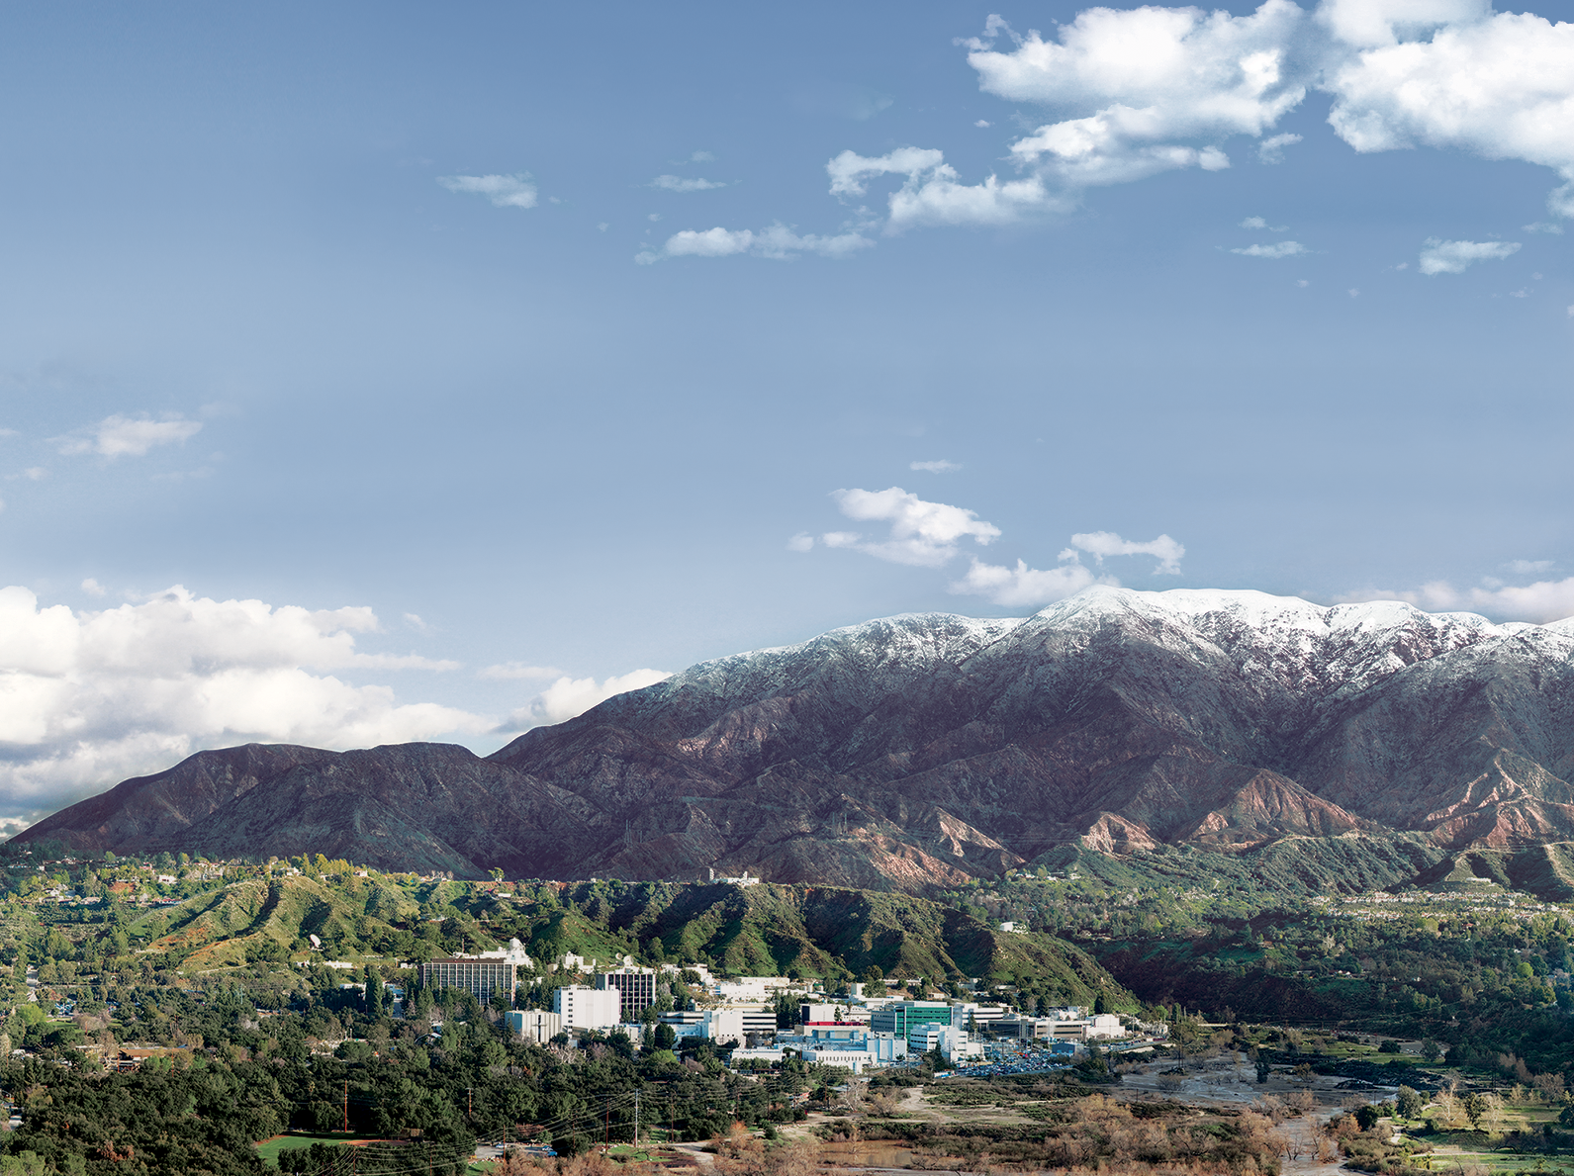
National Aeronautics and Space Administration
VIIRS Land Surface Temperature and Emissivity Continuity
Glynn Hulley, Robert Freepartner
MODAPS and LSIPS Team
Jet Propulsion Laboratory, California Institute of Technology, Pasadena, CA
(c) 2018 California Institute of Technology. Government sponsorship acknowledged.
MODIS/VIIRS Science Team Meeting, Silver Spring, MD, Oct 2018

Slide 2
Outline
Algorithm and product status
Validation
VIIRS-MODIS Continuity
New Science

Slide 3
Proposed development/refinement | Product(s) | Status
Implement new L2 and L3 gridded LST&E algorithms (2014-2018) | MxD21 VNP21 | Complete In processing at MODAPS/LSIPS
Produce L3 Climate Modeling Grid (CMG) products | MxD21C1-C3 VNP21C1-C3 | On schedule for MODIS C6.1
Improve atmospheric correction Replace MERRA2 with GEOS5 Higher resolution and latency | MxD21 VNP21 | On schedule for MODIS C6.1
Produce emissivity product for midwave IR bands Critical for sounding community (e.g. CLIMCAPS) Continuity of MEaSUREs LST&E | MxD21 VNP21 | ?
Reduce overall number of MODIS LST products (currently 10) Retire MxD11 suite Complete analysis study on differences between MxD21/MxD11 products | MxD21 MxD11 | ?
Notes:
Physical TES algorithm fully exploit all thermal bands of MODIS/VIIRS and produce LST and dynamic emissivity products

Slide 4
VNP21 Product Suite
Earth Science Data Type (ESDT) | Product Level | Data Dimension | Spatial Resolution | Temporal Resolution | Map Projection
VNP21 | L2 | 3232 lines by 3200 pixels | 750m at nadir | Swath, Twice-daily | None, (lat, lon tagged)
VNP21A1D/ VNP21A1N | L3 | 1200 rows by 1200 columns | 1 km | Day and Night | Sinusoidal
VNP21A2 | L3 | 1200 rows by 1200 columns | 1 km | Eight day | Sinusoidal
VNP21C1 | L3 | 3600 by 7200 global | 0.05 deg | Daily | Climate Modeling Grid
VNP21C2 | L3 | 3600 by 7200 global | 0.05 deg | Eight day | Climate Modeling Grid
VNP21C3 | L3 | 3600 by 7200 global | 0.05 deg | Monthly | Climate Modeling Grid
Notes:
Ensuring continuity with MODIS LST we use the same product data types

Slide 5
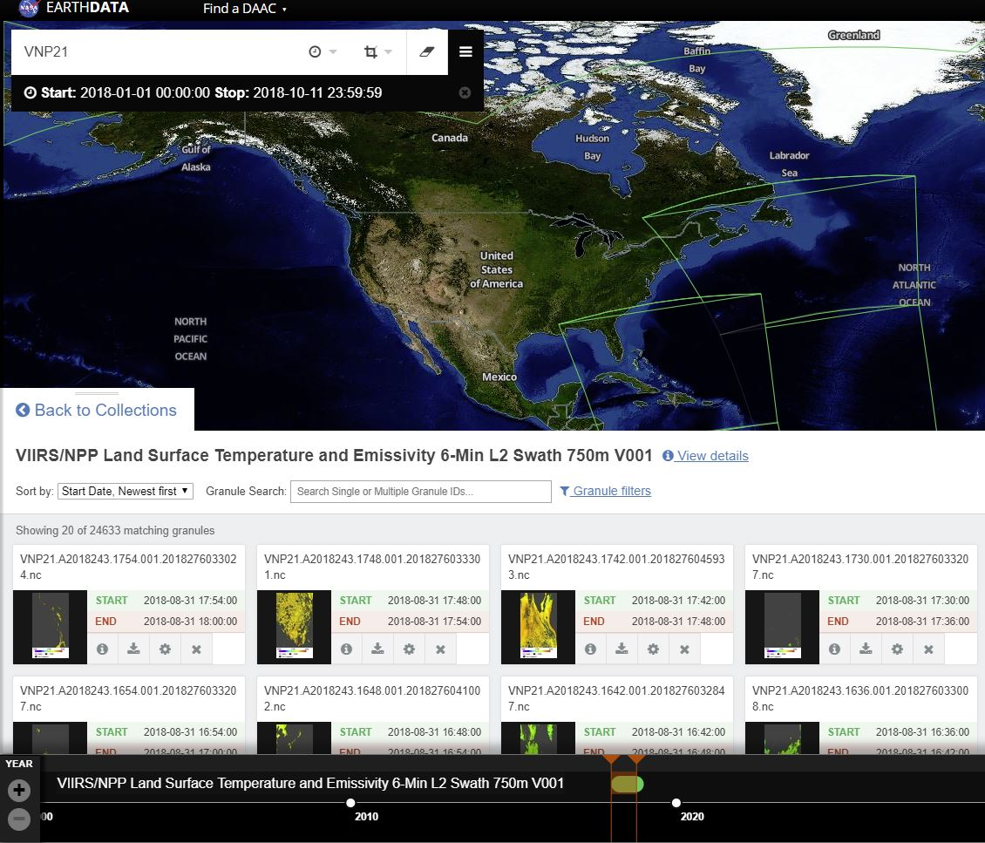

Slide 6
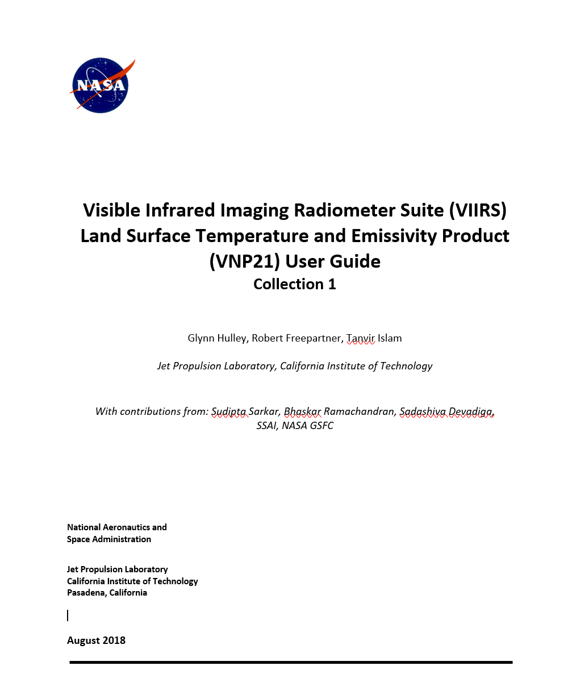
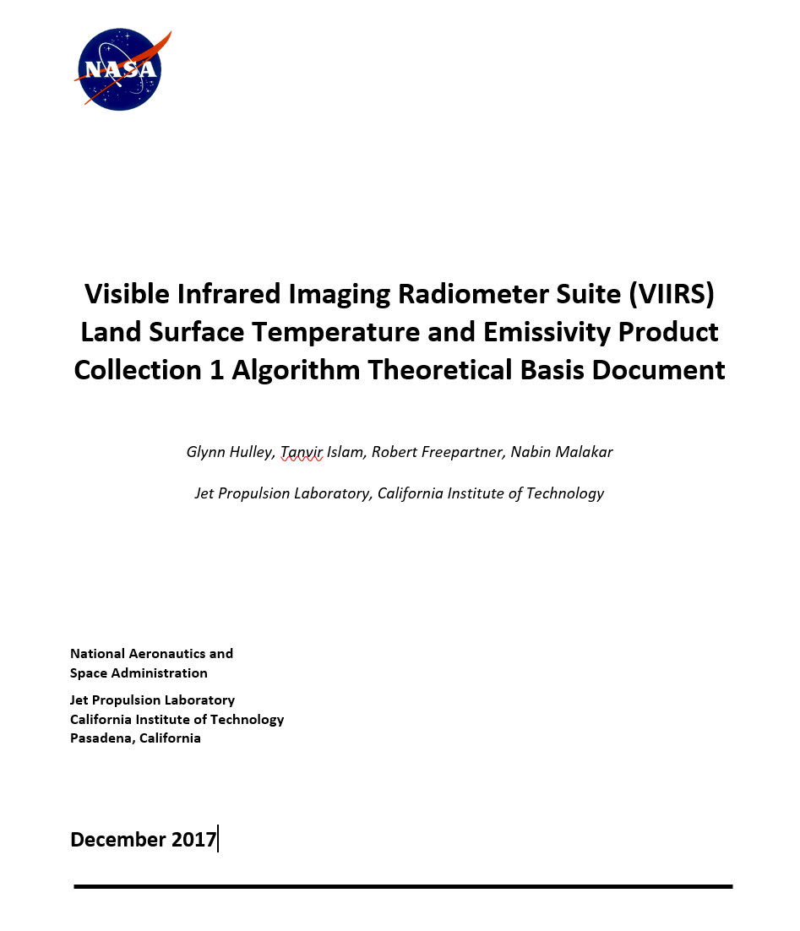
Hulley, G. C., Malakar, N., Islam, T., Freepartner, R, (2018), NASA’s MODIS and VIIRS Land Surface Temperature and Emissivity Products: A Consistent and High Quality Earth System Data Record, IEEE TGRS, DOI: 10.1109/JSTARS.2017.2779330.
Islam, T. G. C. Hulley, N. Malakar, R. Radocinski, S. Hook, P. Guillevic (2017), A physics-based algorithm for the simultaneous retrieval of land surface temperature and emissivity from VIIRS thermal infrared data, IEEE Transactions on Geoscience and Remote Sensing, 55, 563-576

Slide 7
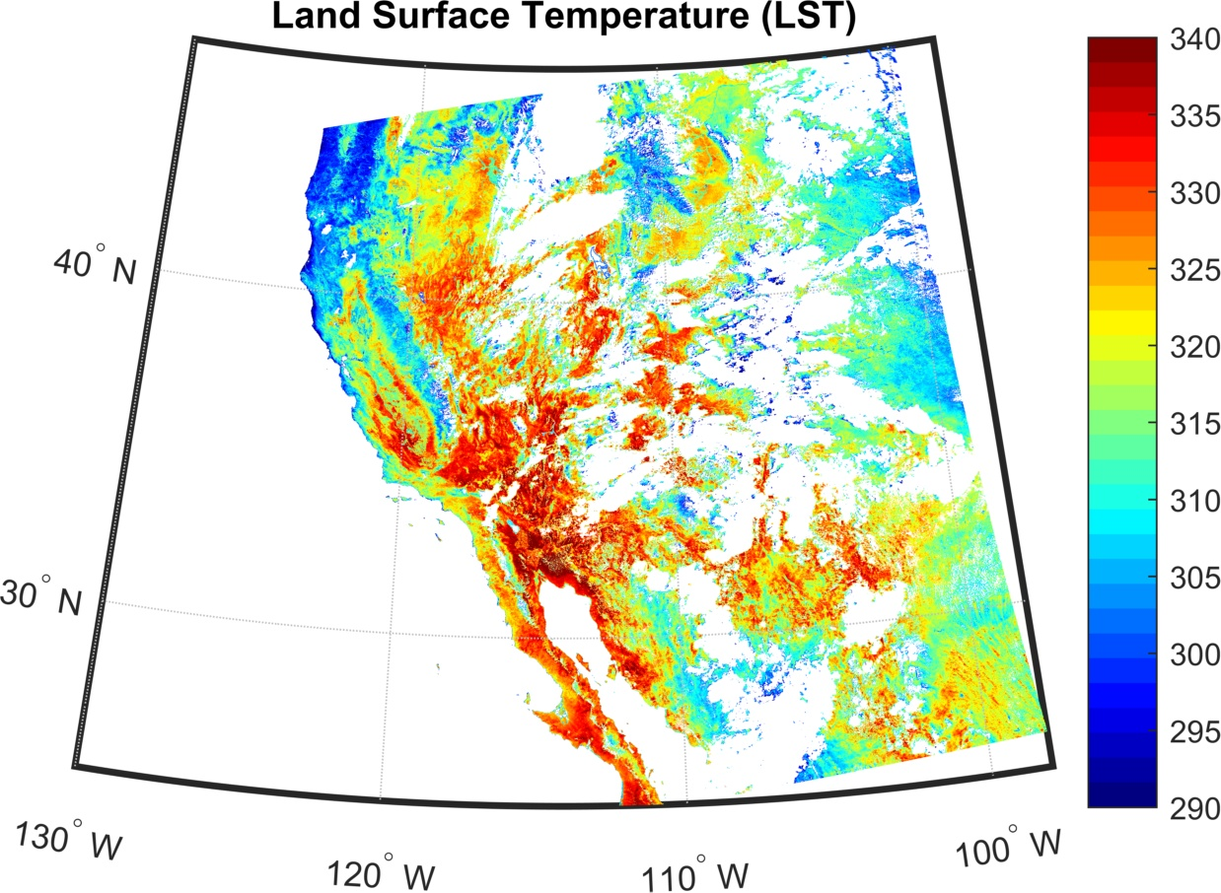

Slide 8
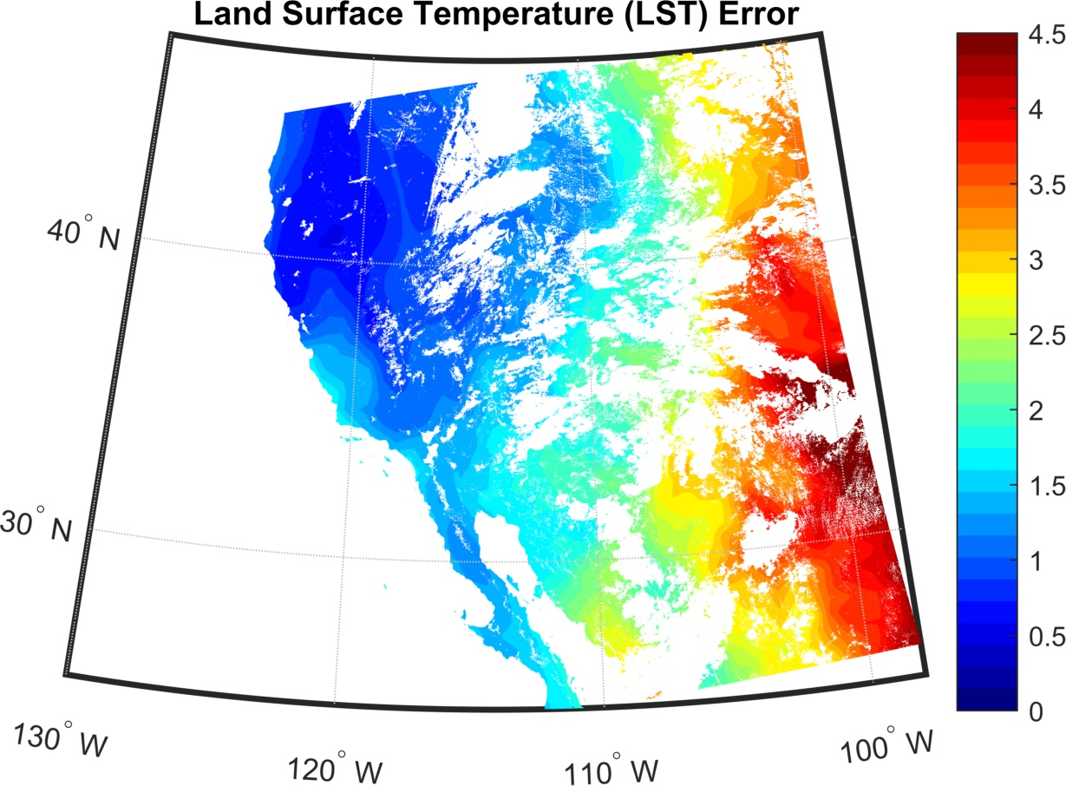

Slide 9
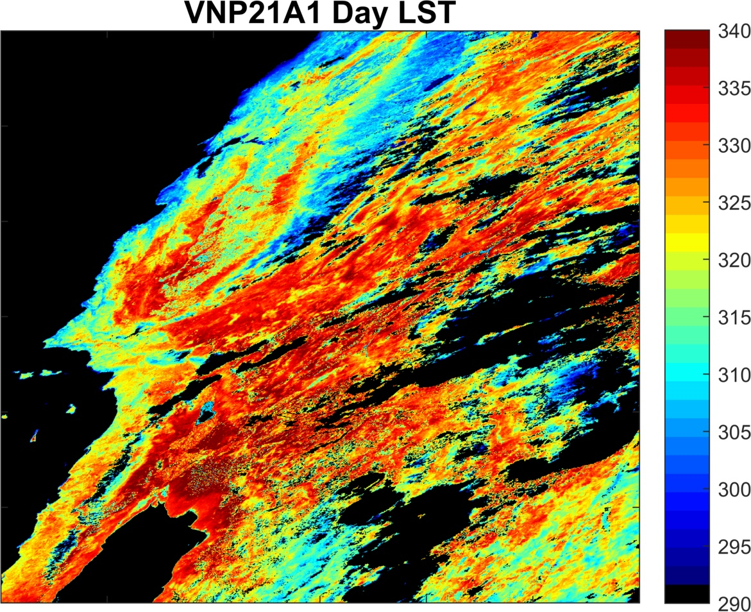
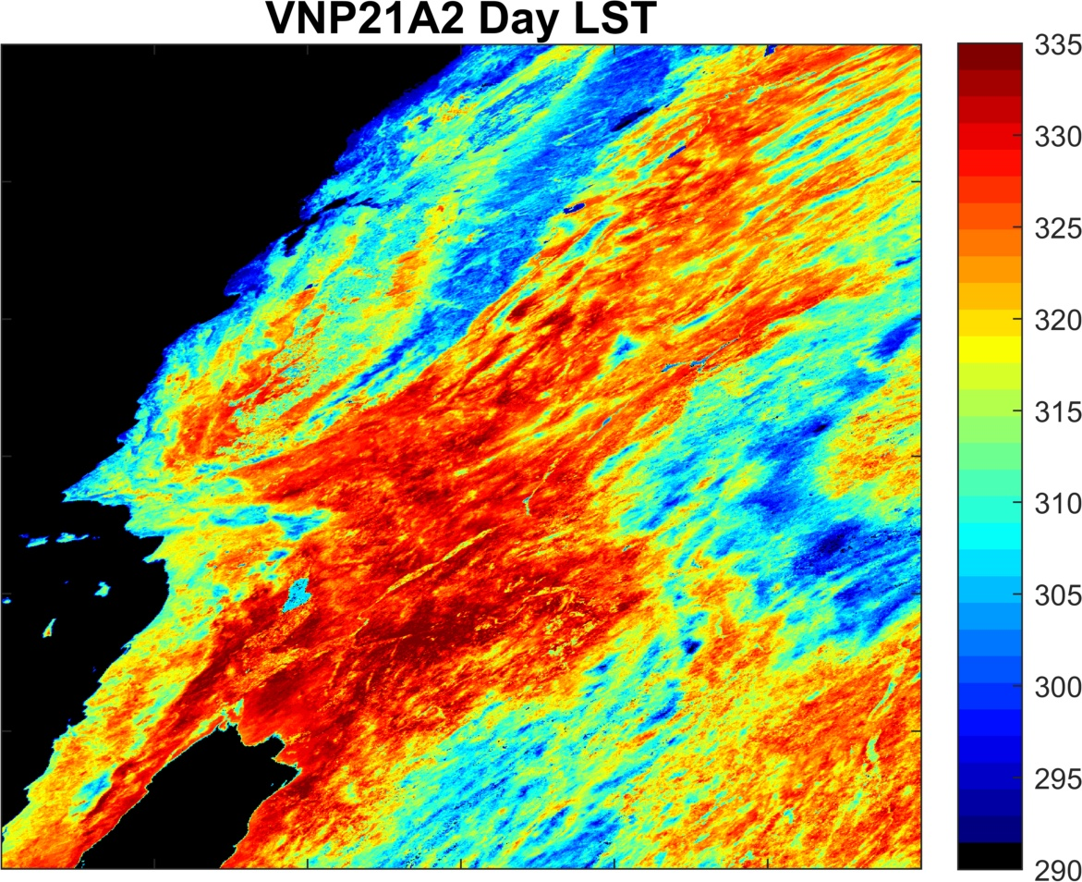
VNP21A1/A2 Daily (left) and 8-day (right)
Daytime Land Surface Temperature (LST)
h08v05

Slide 10
VNP21A1 Daily Emissivity (h08v05)
VNP21A2 8-day Emissivity (h08v05)

Slide 11
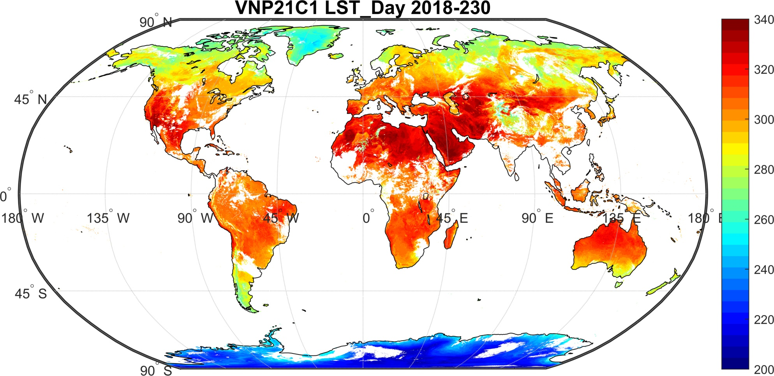
Climate Modeling Grid (CMG) Products

Slide 12
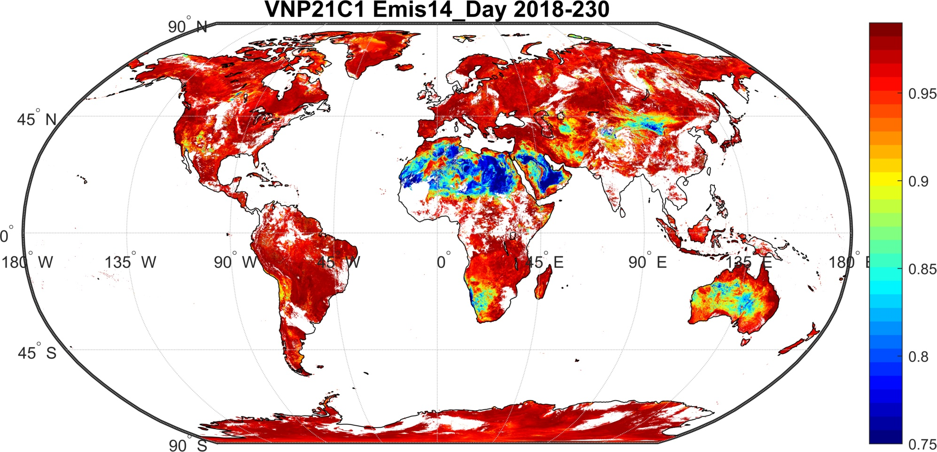
Climate Modeling Grid (CMG) Products
8.55 micron

Slide 13
Outline
Algorithm and product status
Validation
VIIRS-MODIS Continuity
New Science

Slide 14
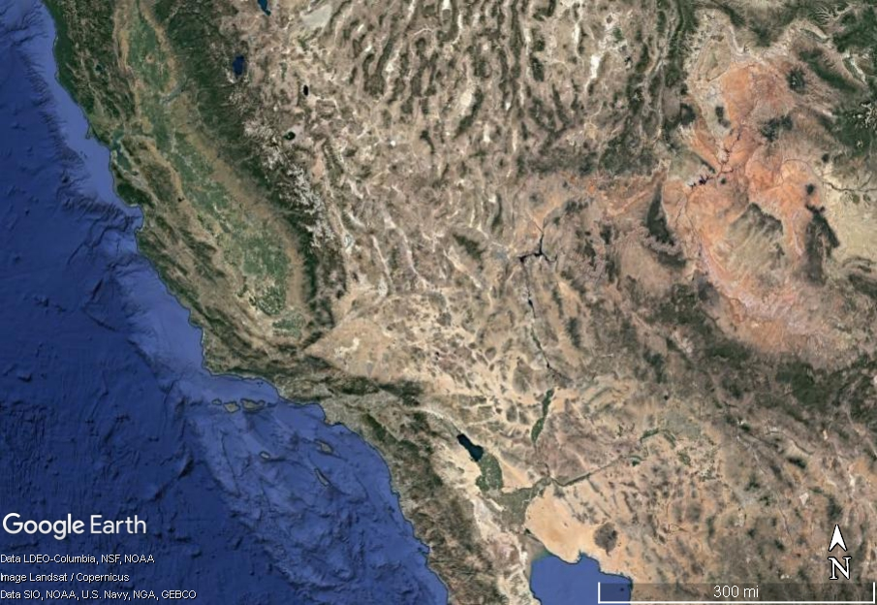
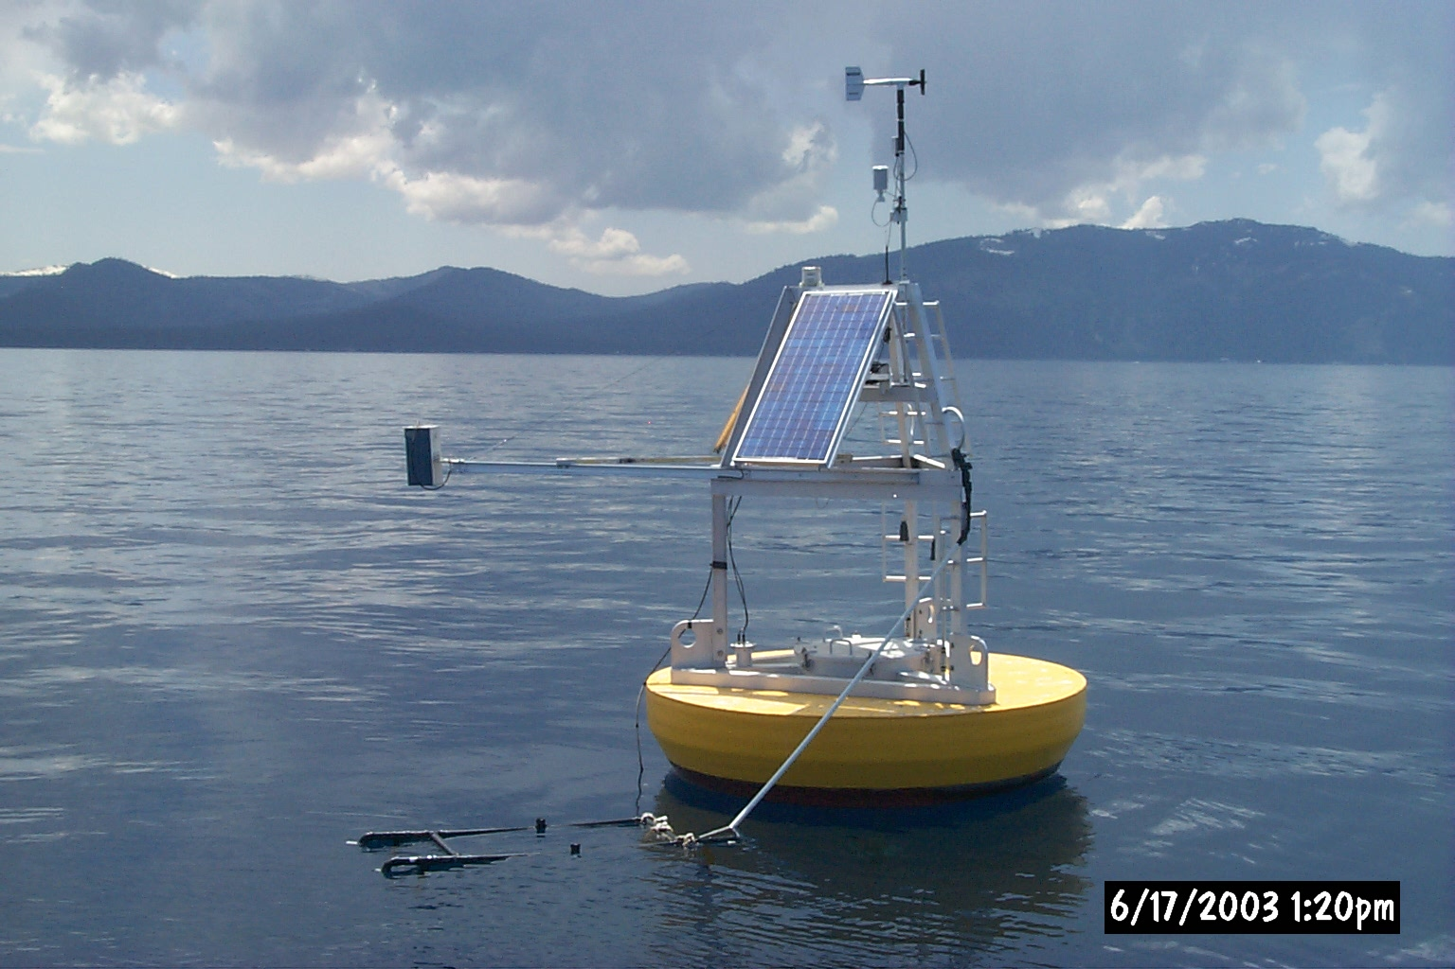
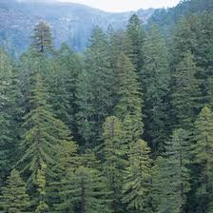
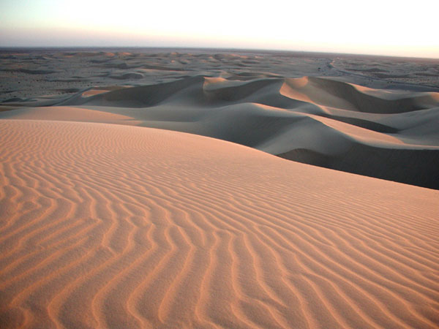
Stage-1 Validation Sites: California
Tahoe
Redwood NP
Algodones Dunes

Slide 15
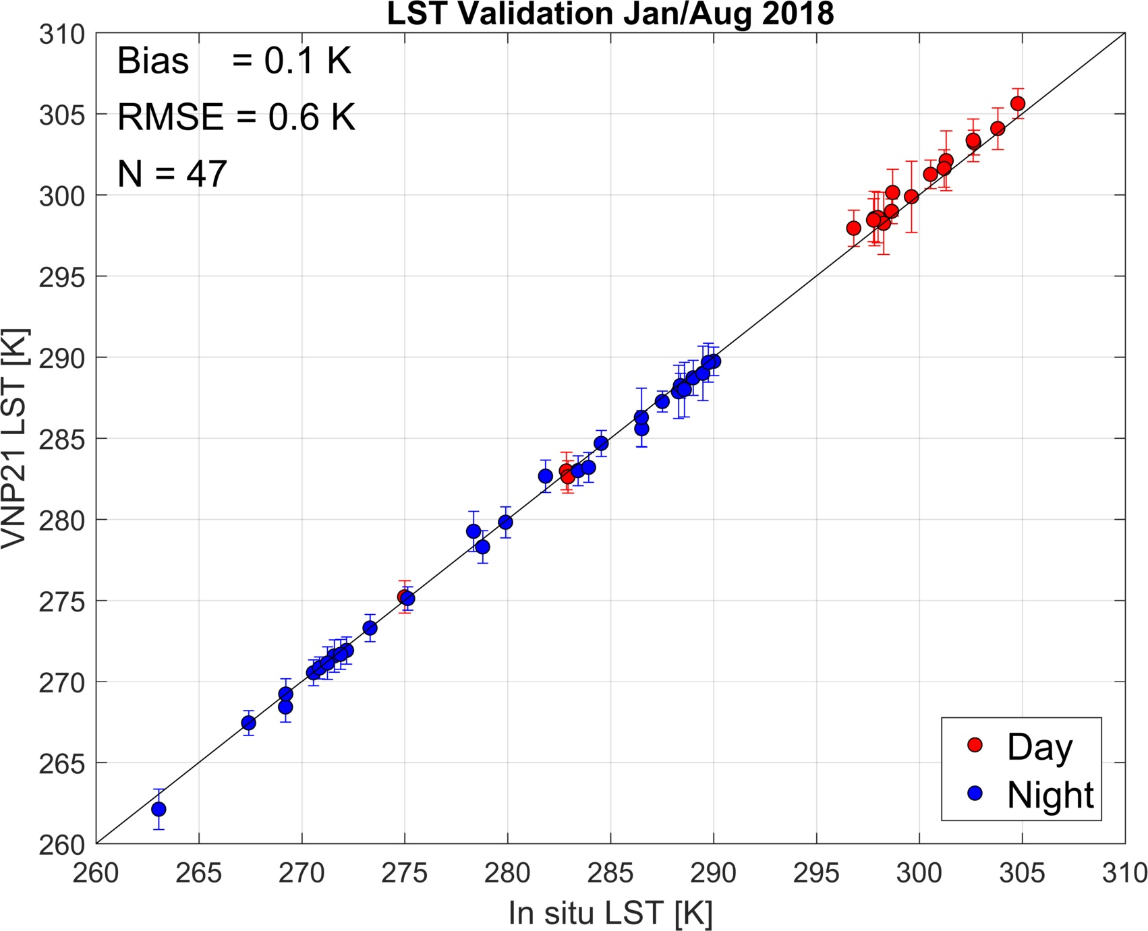
Redwood NP

Slide 16
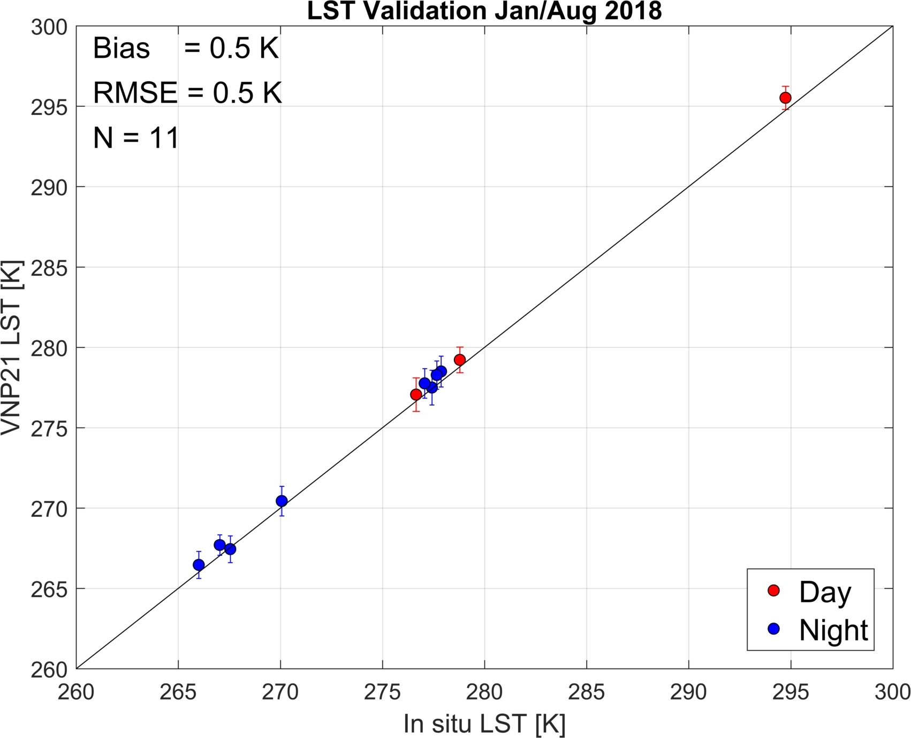
Tahoe

Slide 17
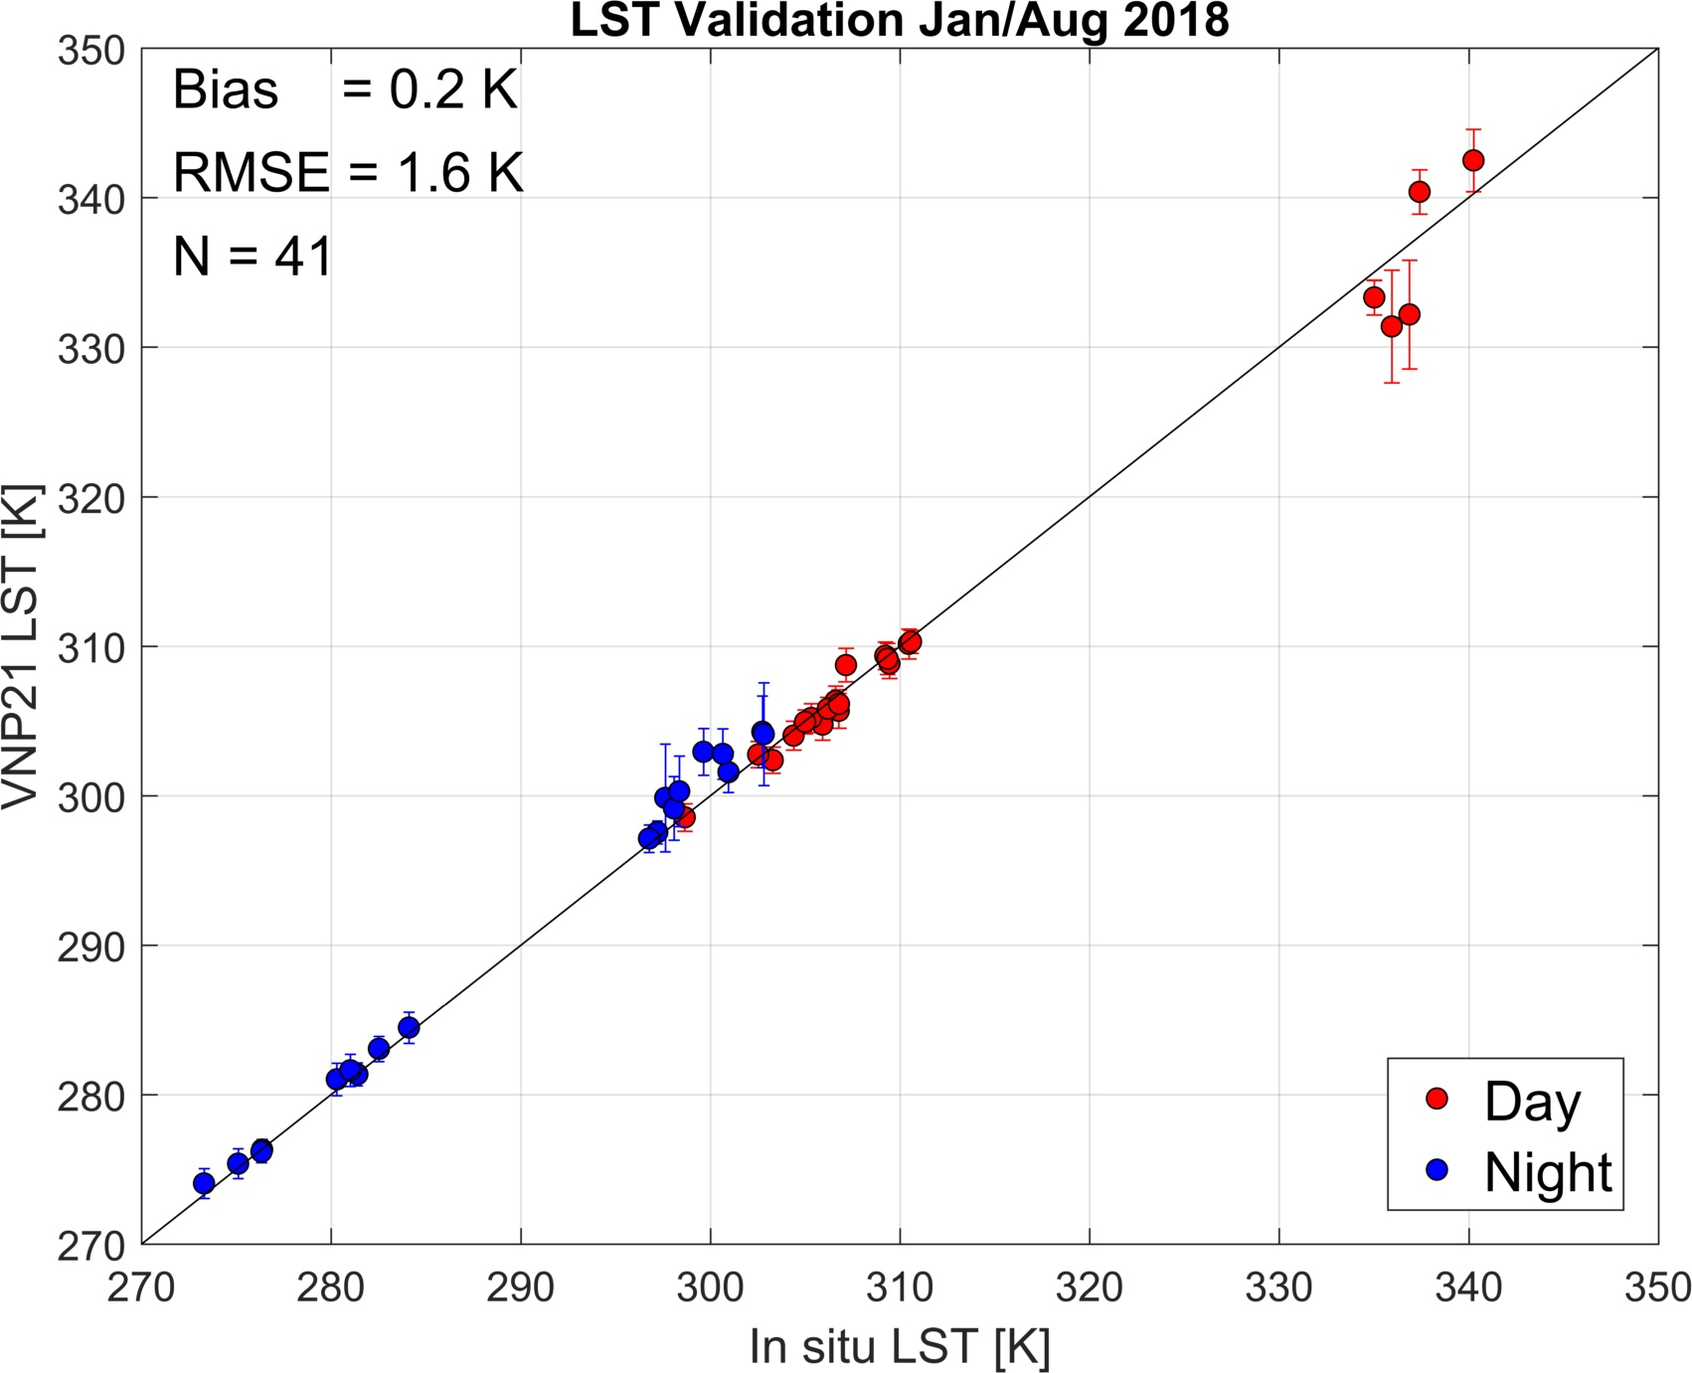
Algodones Dunes
SVA = 65˚
PWV = 4.5 cm
Smoke from wildfires

Slide 18
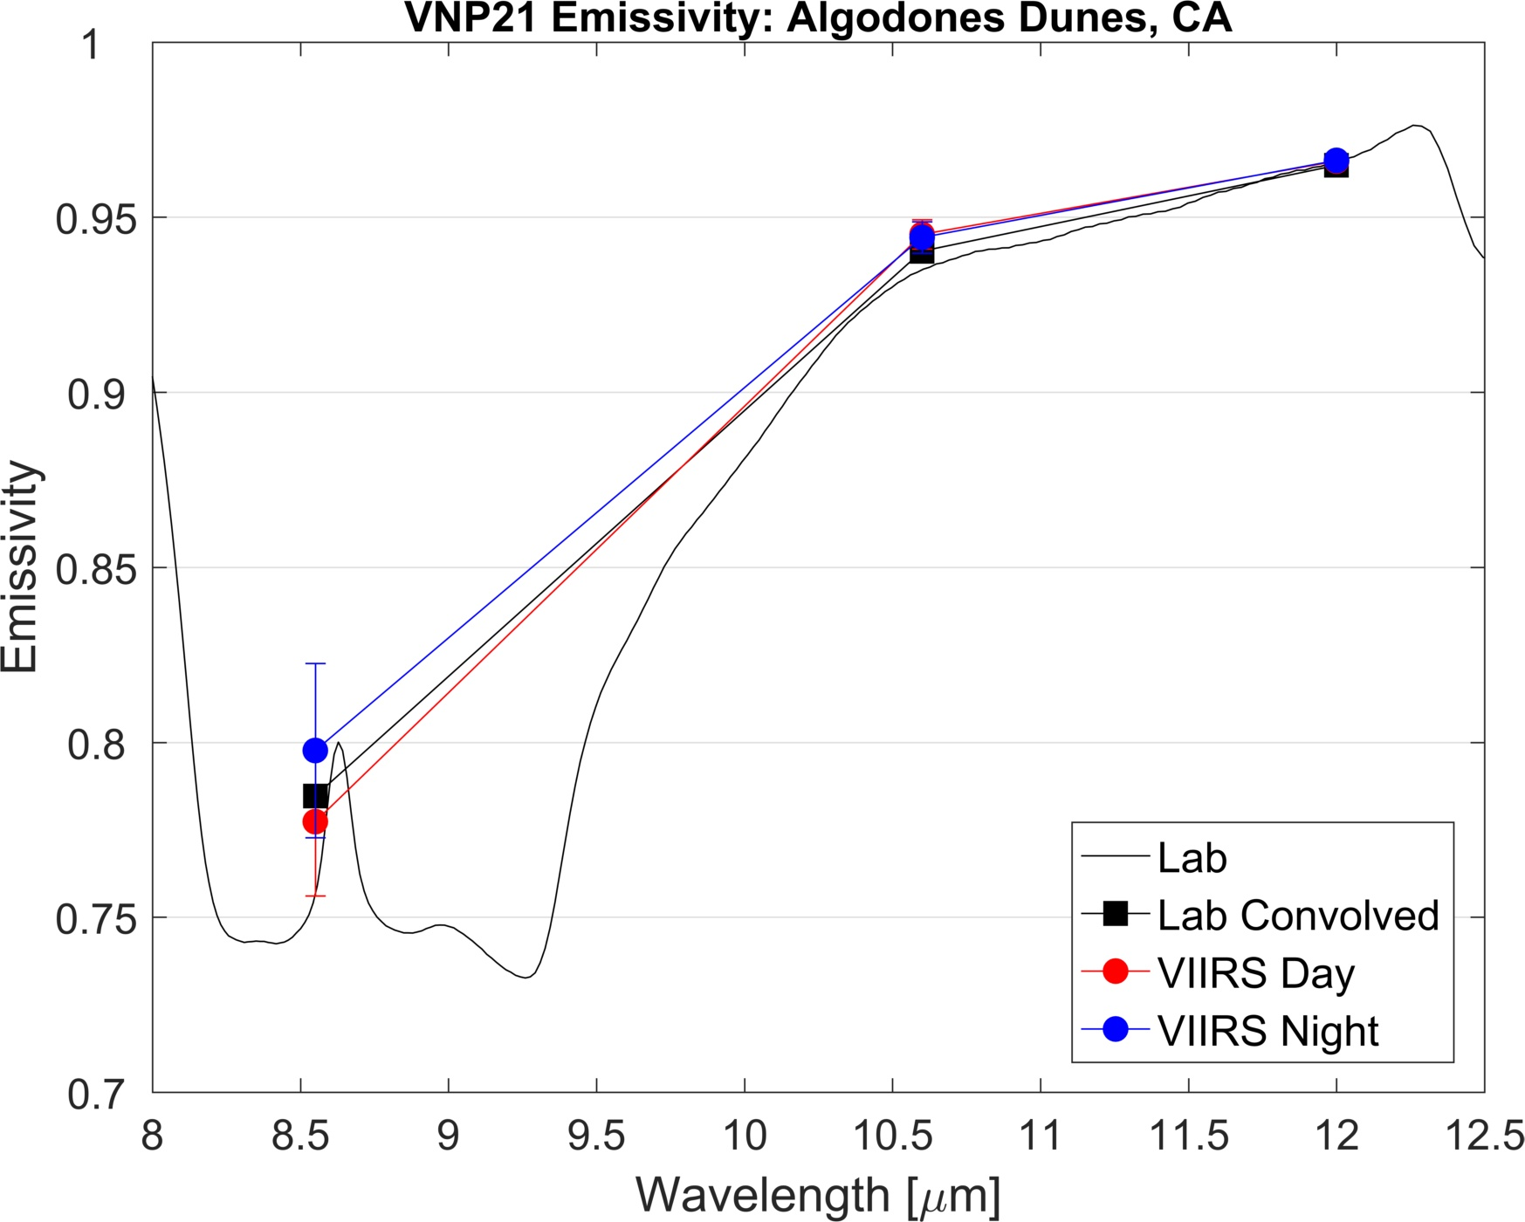
Algodones Dunes

Slide 19
Outline
Algorithm and product status
Validation
VIIRS-MODIS Continuity
New Science

Slide 20
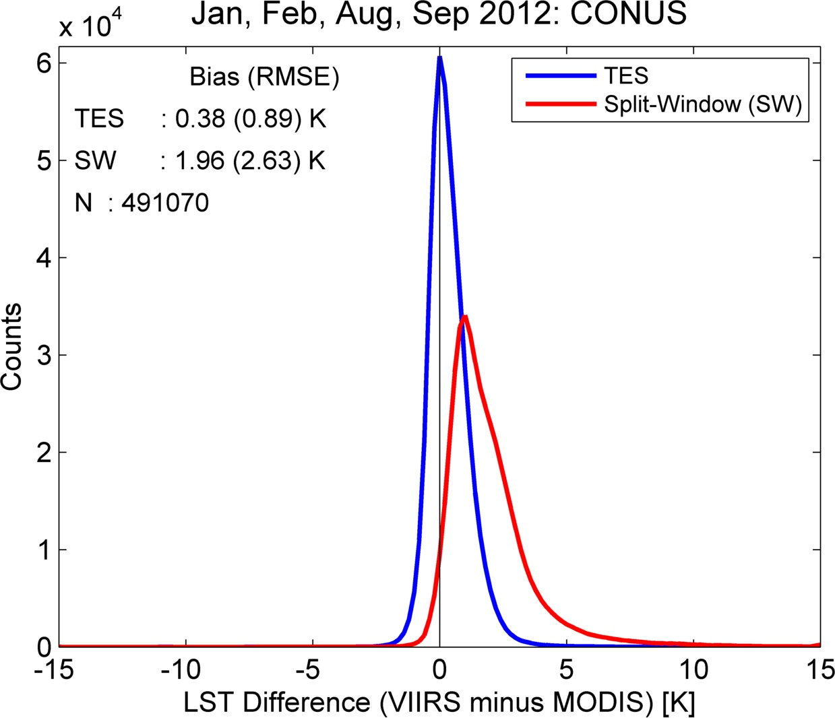
54 scenes CONUS
JFM, ASO 2012
SNO’s
LST continuity VIIRS/MODIS Aqua
MYD21/VNP21
MYD11/VLSTO
Hulley et al. 2018
Notes:
Then looked at seasonal differences

Slide 21
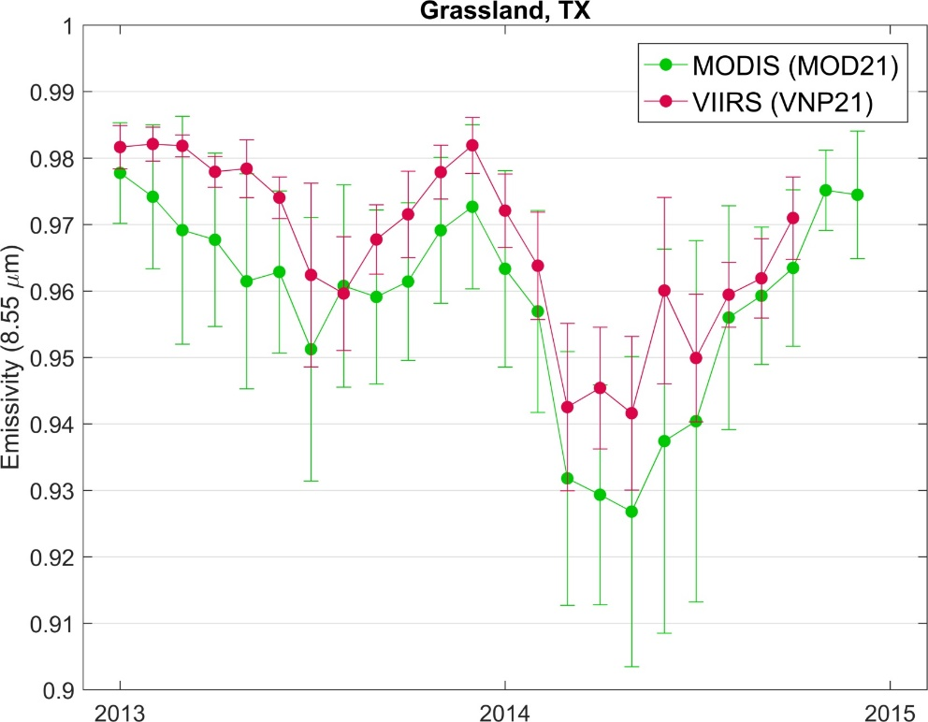
Emissivity Continuity
Reduced grassland cover due to low winter rainfall 2013
Hulley et al. 2018

Slide 22
Outline
Algorithm and product status
Validation
VIIRS-MODIS Continuity
New Science

Slide 23
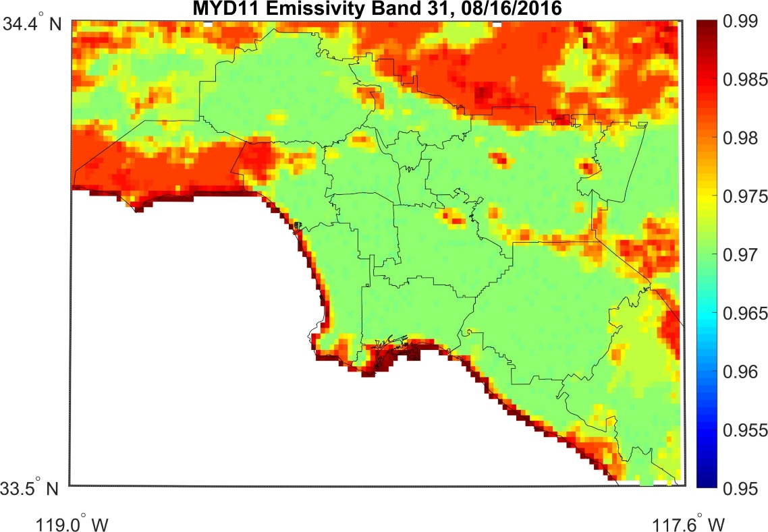
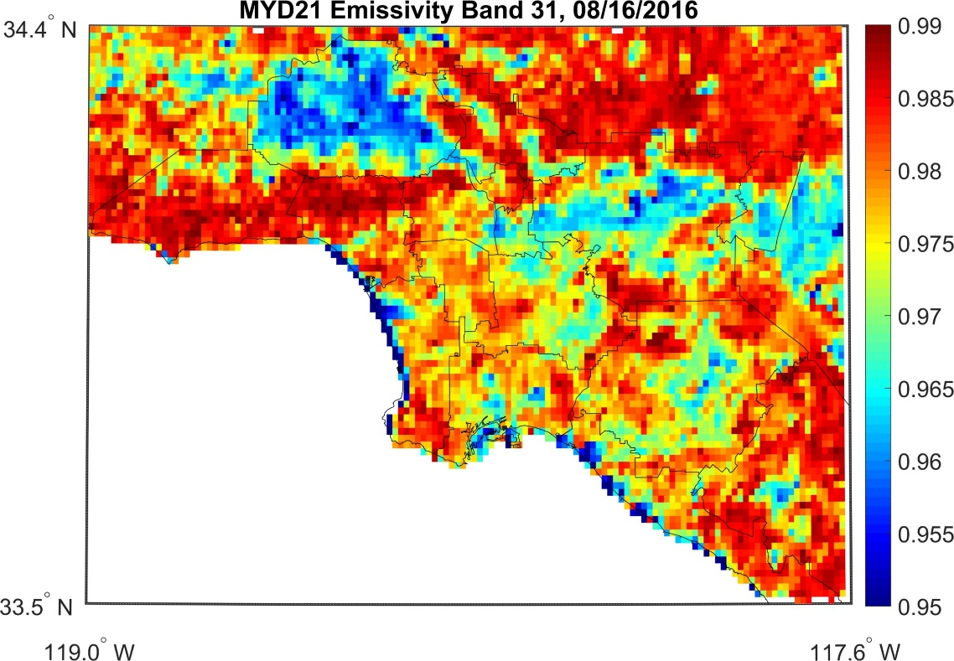
Urban Emissivity Variation
MxD11 Classification
MxD21 TES
11 µm
11 µm
Los Angeles
Split-window approaches, e.g. MYD11 assume fixed emissivity over different land classes, e.g. Urban emissivity = 0.97 (green)
MYD21 physically retrieves the emissivity state of land surface
Notes:
Urban class does not change relevant to droughts, urban expansion/changes, soil moisture changes, vegetation health, state etc.

Slide 24
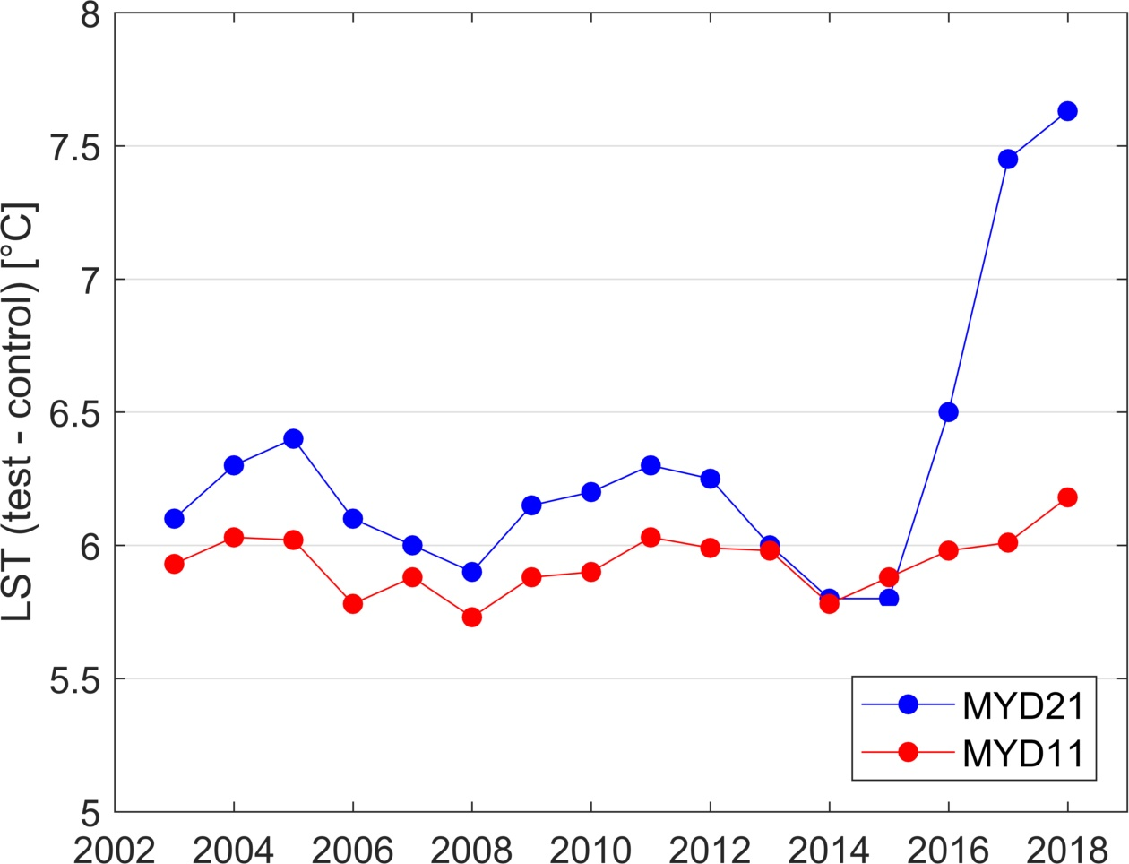
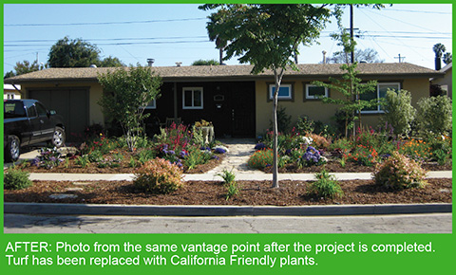
1.5 ˚C temperature rise since turf removal program started in 2014
San Fernando Valley
Turf Removal Program 2014
Notes:
Converted lawns into more drought-tolerant, sustainable plants and land cover (less irrigation)– resulting in increased temperature
Illustrates why emissivity – multispectral information is critical for retrieving accurate temperature – and provides information on land cover land use change.

Slide 25
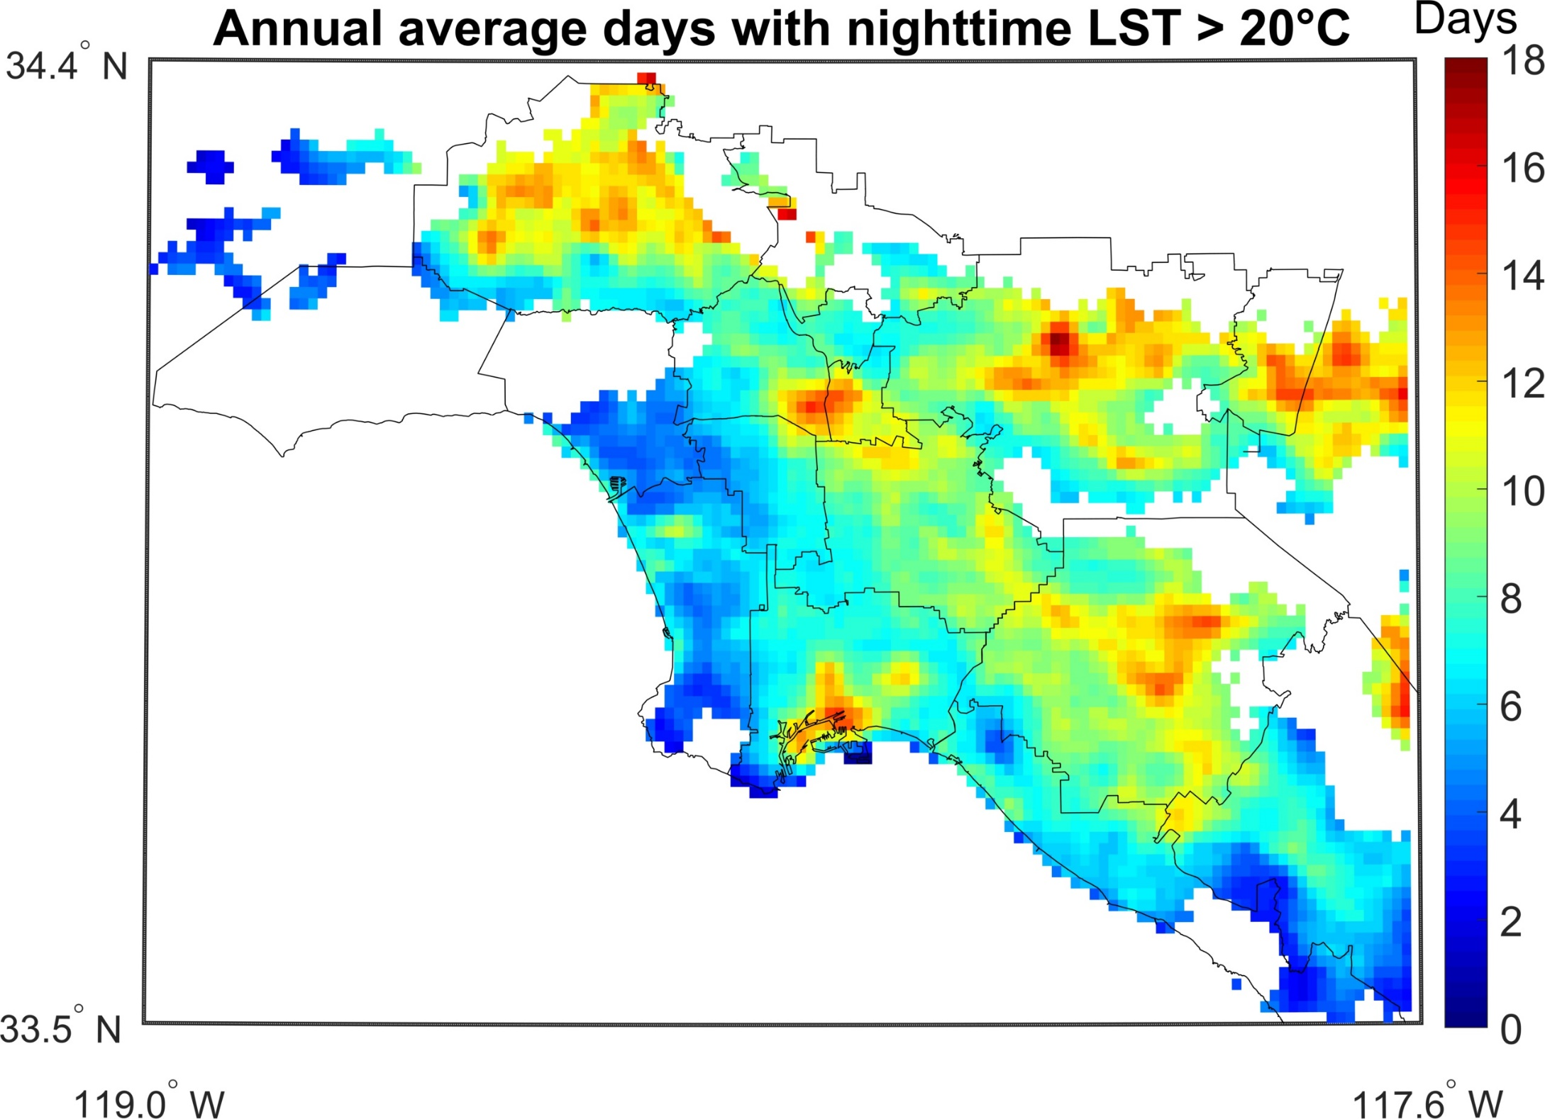
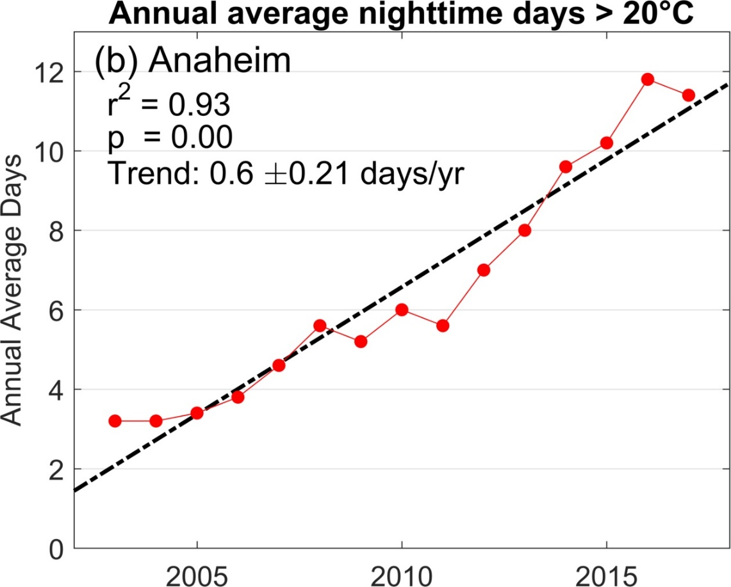
MODIS Aqua LST 2002-2018
Hulley et al. 2018
Notes:
Shrinking of diurnal cycle is typical global warming signal.

Slide 26
Summary
MxD21 and VNP21 algorithms implemented at MODAPS and Land-SIPS and in reprocessing
MxD21/VNP21 uncertainties at ~1 K level for LST and ~1.5% for emissivity
MXD21/VNP21 continuity demonstrated at the ~0.5 K level
Urgent user need to reduce overall number of MODIS LST products (currently 10 product types including MxD11 and MxD21)

Slide 27
VNP21 | Land Surface Temperature and Emissivity (LST&E) Product Status
Status | Undergoing final science test at LSIPS. Once complete, review by LDOPE, science team, and LPDAAC Reprocessing to begin after review. Note: VNP21 LST&E algorithm is identical to MxD21 LST&E algorithm. Hulley et al. 2017, NASA’s MODIS and VIIRS Land Surface Temperature and Emissivity Products: A Long-Term and Consistent Earth System Data Record
Documentation | Complete; ATBD and User Guide https://viirsland.gsfc.nasa.gov/Products/NASA/LSTESDR.html
LST&E Products | Daily 5-min L2 Swath 1km Daily L3 Global 1km 8-day L3 Global 1km
Validation Status | Stage 1: https://lpvs.gsfc.nasa.gov/LSTE/LSTE_home.html ±1 K accuracy demonstrated over U.S. sites (Islam et al. 2017)
Future plans | 1. Produce Climate Modeling Grid (CMG) products VNP21C1 – Daily 0.05 deg gridded LST&E VNP21C2 – 8-day 0.05 deg gridded LST&E VNP21C3 – Monthly 0.05 deg gridded LST&E 2. Produce Emissivity products for mid-IR bands M12, M13 Ensure continuation of LST&E MEaSUREs products (JPL) Used by atmospheric sounding community as first guess in air temperature/water vapor retrievals

Slide 28
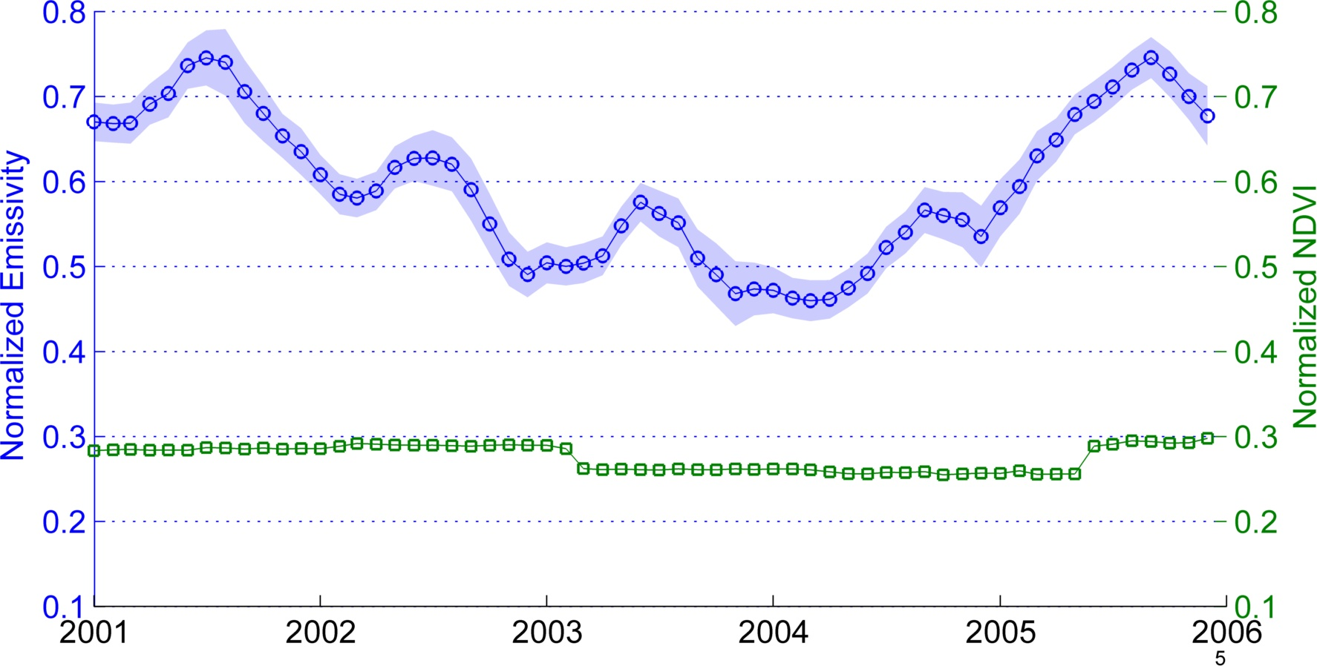
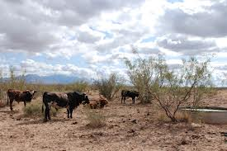
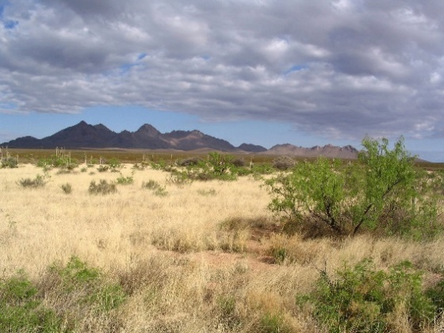
Land Cover Change Detection
MOD21 Band 29 (8.55 µm) Emissivity, Jornada Experimental Range
Recovery
Overgrazing

Slide 29
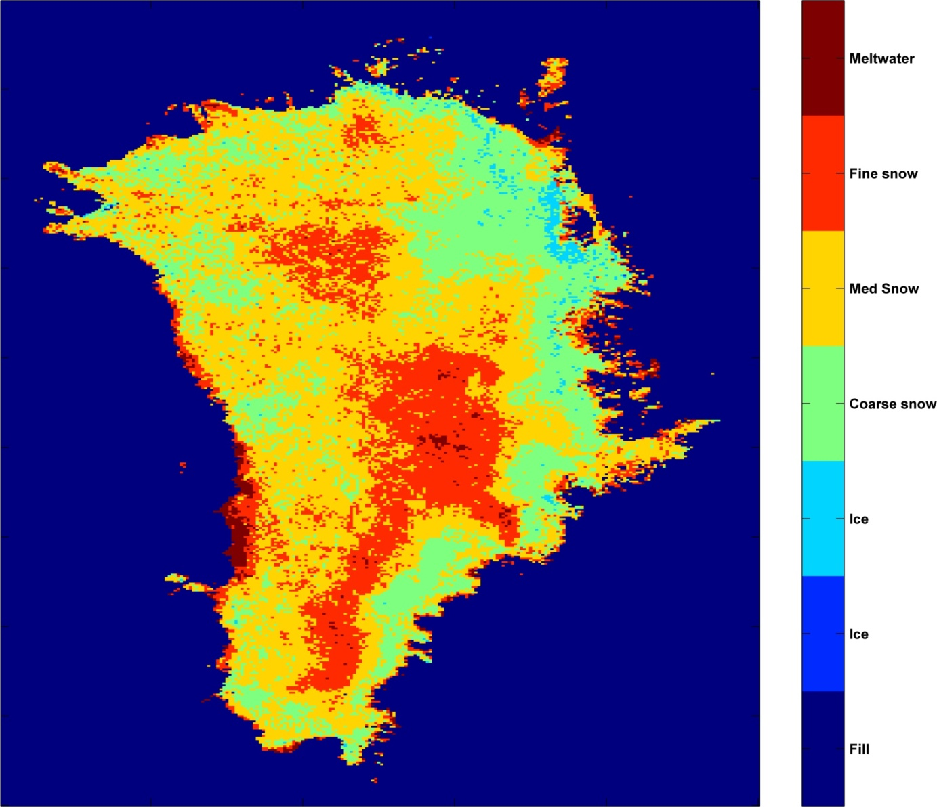
Cryosphere Studies
MOD21 Band 32 (12 µm) Emissivity, Greenland, August 2004
Extreme
Melt Zones
Incipient
Melt Zones
Hulley et al. 2014

Slide 30
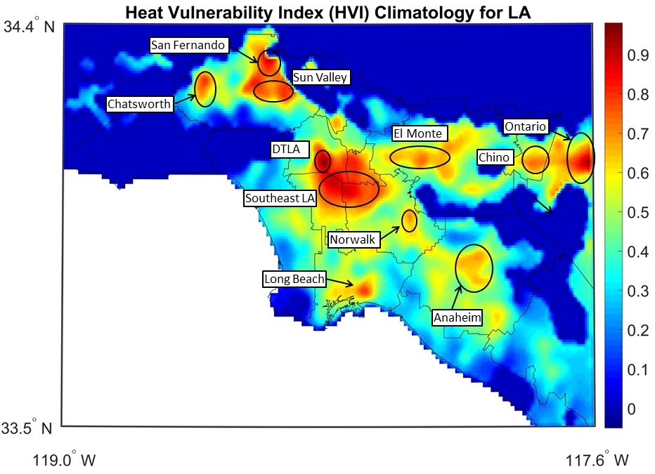
MODIS Heat Vulnerability Index (HVI)
NASA LCLUC
ECOSTRESS Applications project
Hulley and Shivers, 2018
Notes:
HVI values fall within distinct regions or hotspot vulnerable areas, where exposure and sensitivity together are maximized.

Slide 31
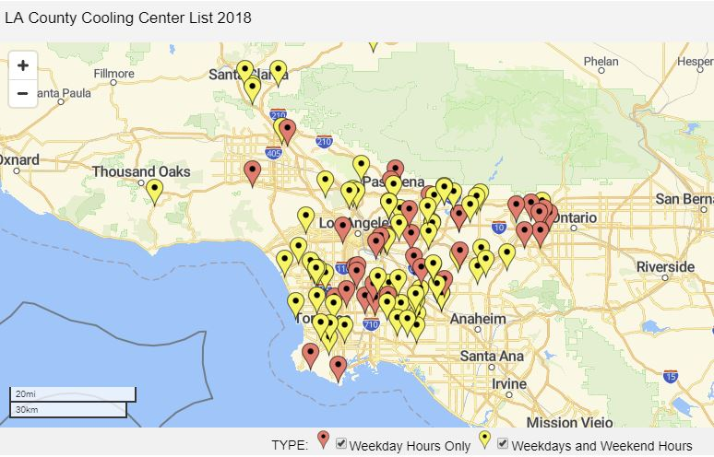
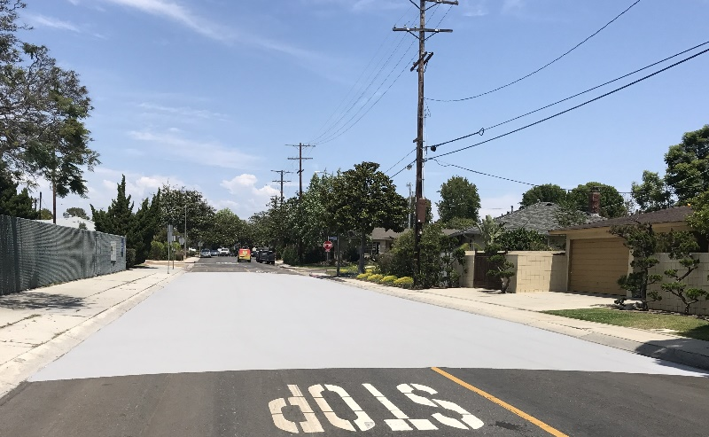
Heat advisories and mitigation
Identify optimal locations for cooling centers
Heat mitigation
Advise on realistic health advisories

Slide 32
Outline
Algorithm and product updates
Validation
Product unification (MOD11+MOD21)
Continuity

Slide 33
LST Uncertainty Model
Hulley et al. 2012
a_{i} = Regression coefficients dependent on surface type (gray, bare, transition)
SVA = Sensor view angle
TCW = Total column water estimate (cm), e.g. from MOD07, NCEP
Combined LST is weighted mean:
TCW

Slide 34
MODIS LST Validation Summary
MOD11 larger uncertainty over bare regions
(3-5 K)
MOD11 more stable over graybodies (higher precision)

Slide 35
Outline
Algorithm and product updates
Validation
Product unification
Continuity

Slide 36
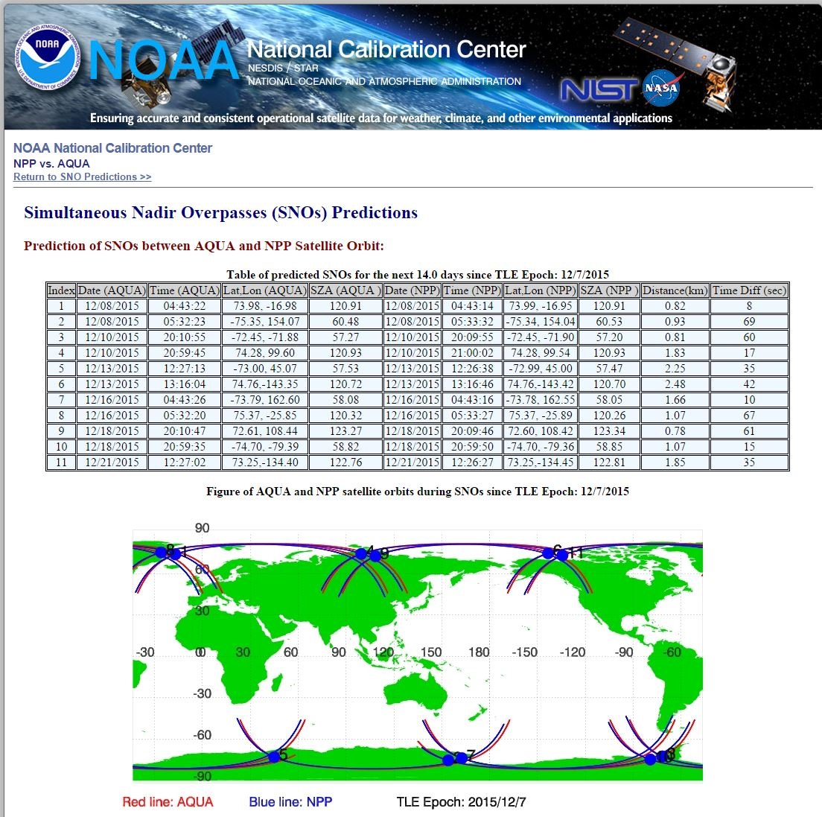
MODIS Aqua/VIIRS Matchups for 2012 over Contiguous US:
Winter (Jan, Feb): 24 granules
Summer (Aug, Sep): 30 granules
Observation Criteria:
Time: <10 min
Angular separation: <2°
View angles < 10º

Slide 37
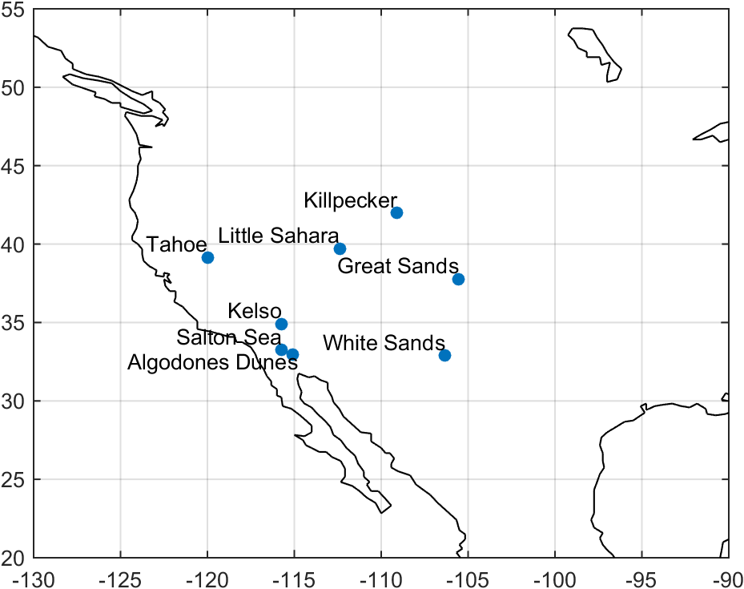
LST&E Validation Sites (Stage 1)
Redwood
Texas Grassland
Temperature-based and Radiance-based validation methods
(Wan et al. 2008, Guillevic et al. 2012, Schneider et al. 2013, Hulley et al. 2012, Hook et al. 2007)

Slide 38
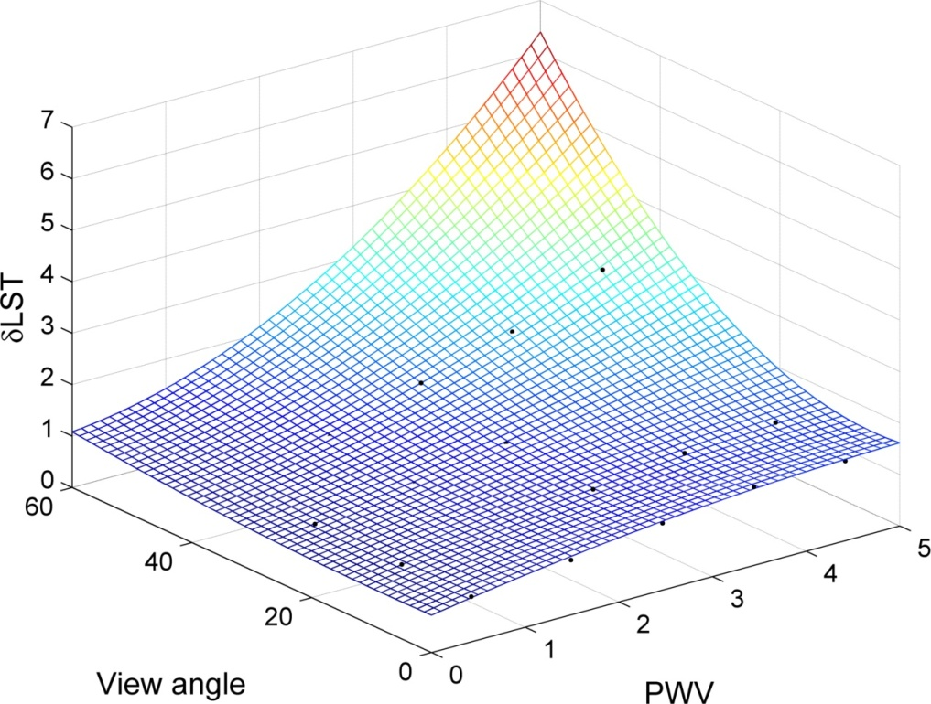
Uncertainty Analysis
Hulley et al. 2012
a_{i} = regression coefficients dependent on surface type (gray, bare, transition)
SVA = sensor view angle
TCW = total column water estimate (cm), e.g. from MERRA2, NCEP

Slide 39
