Slide 1
Investigating the influence of volcanic sulfate aerosol on cloud properties using MODIS data along A-Train tracks
Jay Mace, Sally Benson, Adam Abernathy
Photo Credit: Brocken Inaglory
Active marine volcanoes often emit varying amounts of SO2 into the MBL over periods of many years. Example: Kilauea
Build on work by Yuan et al. (2011) and Eguchi et al. (2011)

Slide 2
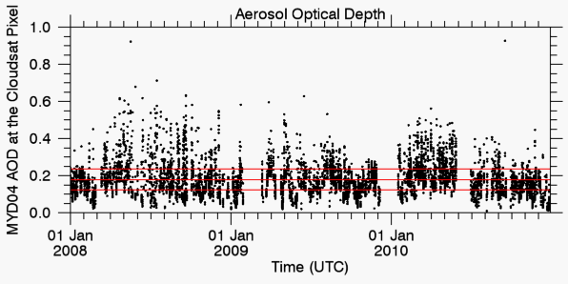
Time series of MOD04 AOD from Kilauea
Time series of MOD04 AOD from Heard Island (53 South, 75 East)

Slide 3
What we want to know something about….
1st Aerosol Indirect Effect:
Twomey (1974)
Holding water content fixed, increased CCN results in a cloud with a higher droplet number and smaller droplets. This results in a cloud that is more reflective. The cloud field then has a higher albedo.
2nd Aerosol Indirect Effect:
Albrecht (1989)
The Twomey effect interrupts the formation of precipitation in clouds resulting in clouds that rain less and live longer resulting ultimately in higher cloud fraction and higher albedo.

Slide 4
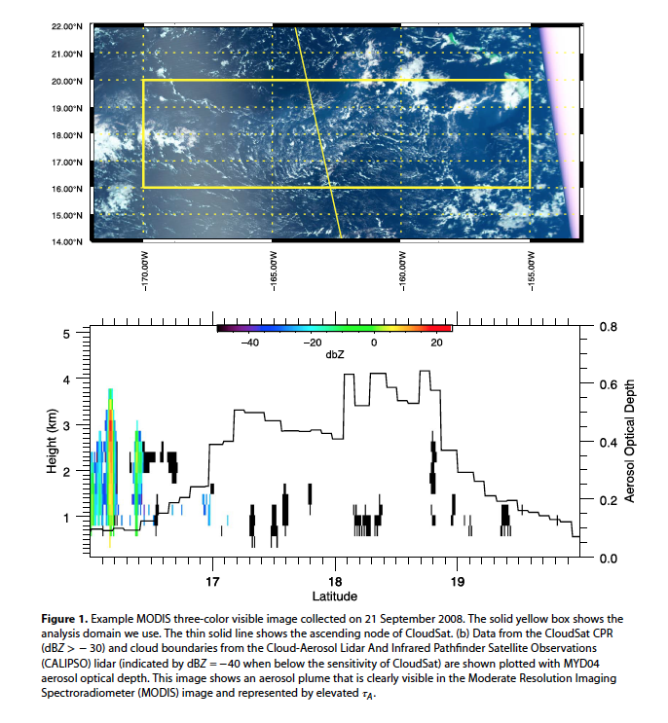
Our thinking (Mace and Abernathy, 2016, GRL):
Look at the data within the plume and use the natural variability of the volcanic AOD.
Take advantage of the cloudsat radar and calipso lidar to characterize cloud boundaries, we examined the statistics of
MYD AOD
L1B radiances (1km)
250 m cloud fraction (recorded in MYD35 Cloud Mask)
Microwave (AMSR) Wind Speed
CloudSat Z
Calipso Cloud top
.
Along overpasses of the analysis domain over 3 years – tested for decorrelation of the events from the meteorology

Slide 5
Heard Island, 53 South, 73 East
Photo Credit: NASA / GSFC / Jeff Schmaltz / MODIS Land Rapid Response Team

Slide 6
Ambrym-Vanuatu AOD and cloud top PDF
Kilauea AOD and cloud top PDF
Note 2 distinct cloud populations – shallow (not seen by CloudSat) and deeper (precipitating)
Kilauea has more range in AOD than Ambrym-Vanuatu

Slide 7
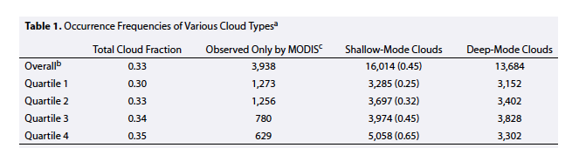
Tabular Results:
Shallow Mode Clouds: Those not observed by CloudSat (precipitation not yet developed)
Deep Mode Clouds: Those that were observed by CloudSat (usually precipitating)
Kilauea
We see systematic changes from Quartile 1 to 4:
Overall cloud fraction increases
MODIS-only clouds decrease
Shallow mode clouds increase
Deep mode clouds don’t change in coverage

Slide 8
From Q1 to Q4:
Deep clouds get deeper
MODIS/CALIPSO clouds get deeper

Slide 9
Kilauea
Ambrym
From low to high aerosol the 0.55 um reflectance increases. Similar increase in near IR.

Slide 10
Now – control for 250 m cloud fraction
We find that the reflectance in sub overcast pixels is nearly insensitive to AOD - nearly entirely explained by 250 m cloud fraction until the pixel is overcast
1st AID

Slide 11
Summary:
Partially cloudy 1km domains show increasing coverage fraction with AOD.
Evidence for 1st AID can be identified in the overcast 1km pixels but not in the partially cloudy pixels
We also find a distinct deepening of the clouds with increasing AOD
No increase in Z in the deeper clouds. Suggests that the polluted clouds deepened just enough to overcome the inhibition of the autoconversion process.
Fraction of 1 km pixels that have MYD06 Retrieval
1st AID

Slide 12
Heard Island, 53 South, 73 East
Future:
Expand to other island volcanoes that offer unique opportunity to learn about A-C-P interaction
Develop trajectory approach to track the volcanic plumes (especially important in mid latitudes)
Use CloudSat, Calipso, MODIS, VIIRS, to examine sensitivity of precipitation processes in downstream clouds.
Virtual Volcanoes???
Photo Credit: CSIRO Marine National Facility

Slide 13
Heard Island, 53 South, 73 East
Photo Credit: CSIRO Marine National Facility

