Slide 1
Assessment of Relative Shortwave Radiometry between S-NPP VIIRS and Aqua MODIS
NASA Goddard Space Flight Center
Kerry Meyer, Steven Platnick
CIMSS/SSEC, University of Wisconsin
Robert Holz and the Atmosphere SIPS Team

Slide 2
Statement of Need
Long-term climate data records require merging the observational records of multiple instruments (e.g., MODIS/VIIRS)
Many remote sensing geophysical products are physically based and rely on absolute radiometry
  E.g., cloud top/optical properties, aerosol optical properties, etc.
For geophysical product continuity between sensors, relative radiometry (and radiometric stability) is fundamental
  Much more challenging for solar channels where the absolute reflectance specifications can be greater than the expected climate change signals
For cloud optical properties, relative radiometric offsets (even those within specified instrument uncertainties) have induced large non-linear inter-sensor retrieval differences

Slide 3
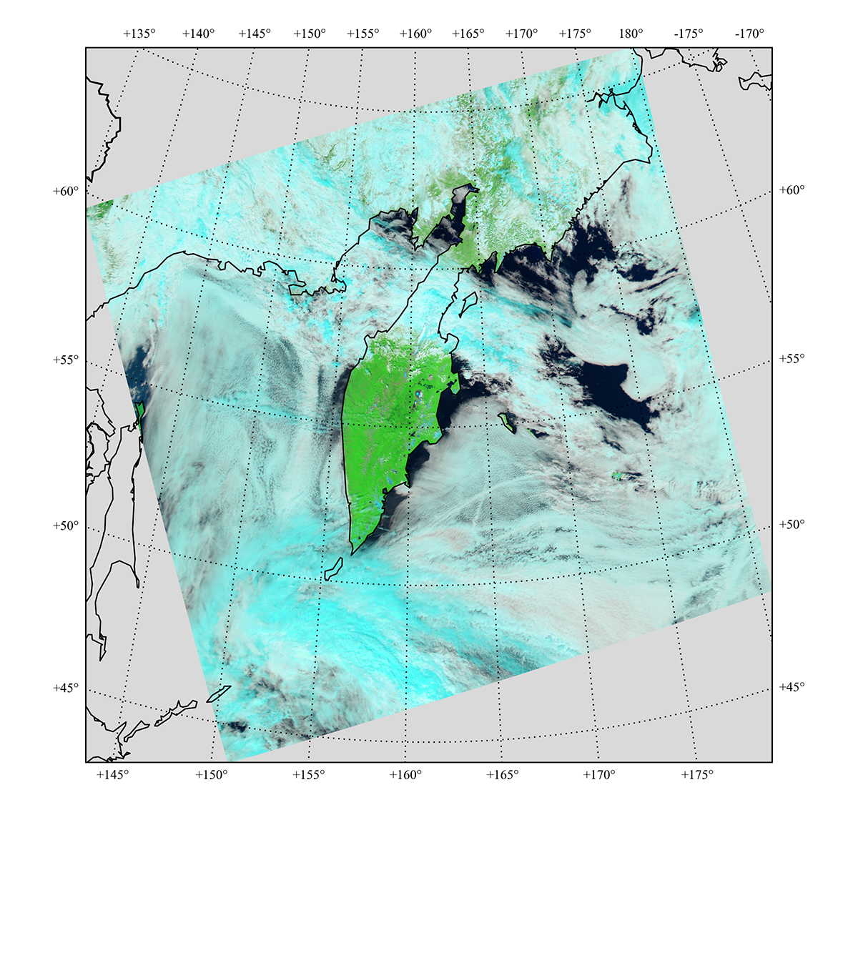
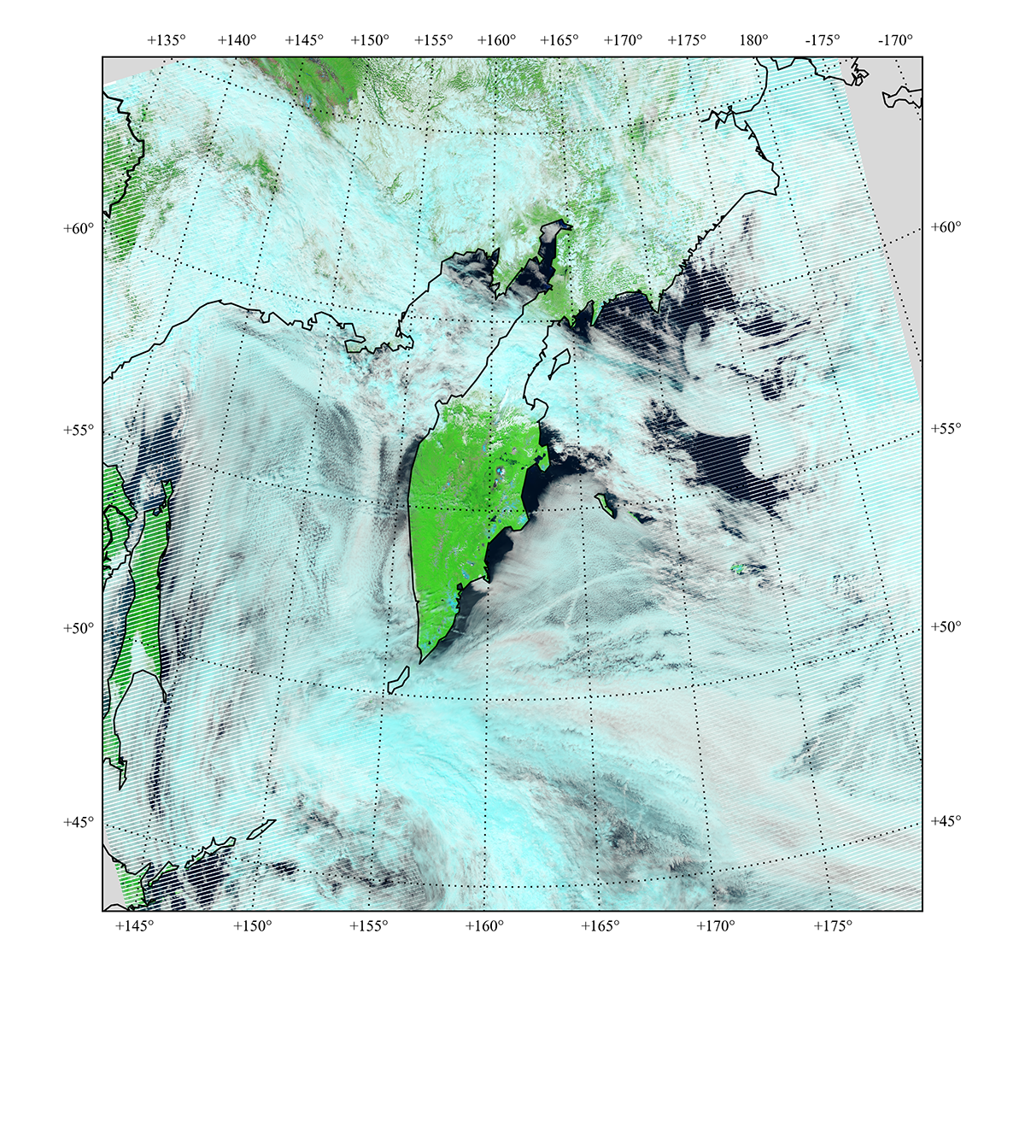
Initial MODIS/VIIRS Cloud Optical Property Comparisons
6 July 2014
Aqua MODIS (B7-B2-B1)
0200 UTC
SNPP VIIRS (M11-M7-M5)
0154, 0200 UTC

Slide 4
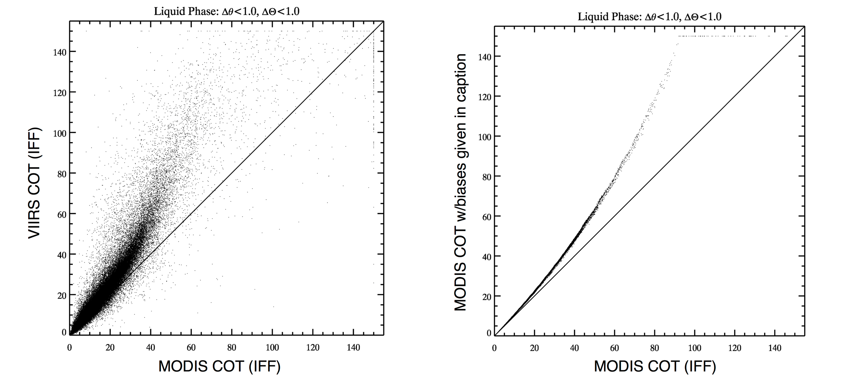
Initial MODIS/VIIRS Cloud Optical Property Comparisons
6 July 2014
MODIS COT
(R[0.86µm] × 1.03)
VIIRS COT
COT = Cloud Optical Thickness
MODIS COT
MODIS COT
MODIS COT

Slide 5
Statement of Problem
COT retrieval differences strongly imply radiometric offsets between Aqua MODIS and SNPP VIIRS solar reflectance channels
  Relative radiometric differences can also impact cloud particle size retrievals (CER) and thermodynamic phase determination as well as certain cloud mask tests
Offsets also found by other Atmosphere algorithm teams (e.g., Aerosol Deep Blue [Sayer et al., 2017])
Cloud Optical Property Solar Spectral Channels
MODIS | VIIRS | Primary Retrieval Parameter
0.66µm (B1) | 0.67µm (M5) | COT over land
0.86µm (B2) | 0.87µm (M7) | COT over water
1.24µm (B5) | 1.24µm (M8) | COT over snow/ice
1.64µm (B6) | 1.61µm (M10) | CER; supplemental COT over snow/ice coupled with 2.13/2.25µm
2.13µm (B7) | 2.25µm (M11) | CER

Slide 6
Plan of Action
Cloud and Aerosol algorithm team consensus: Radiometric adjustment factors to either MODIS or VIIRS are necessary in order to reconcile observed retrieval differences
Each algorithm team pursued independent radiometric adjustment analyses, though closely collaborated with each other
  Adjustment factors derived by all teams applied to VIIRS since MODIS is the reference record
Atmosphere SIPS offered critical support for these efforts via creation of MODIS-VIIRS match files

Slide 7
Starting Point: Atmosphere SIPS Match Files
Files contain co-located MODIS and VIIRS data
  March 2012 – April 2018
  MYD02 L1B vs NASA VIIRS L1B v2
    All spectral channels included (solar + IR)
  Key MYD35 and MYD06 geophysical parameters (cloud mask, cloud top and optical properties)
  Includes only those co-located pixels having similar observations times and sun-satellite view geometries
For further details on Atmosphere SIPS match file support – see poster by Greg Quinn.

Slide 8
Cloud Algorithm Team Analysis
Stricter co-located pixel filtering:
  MODIS and VIIRS view zenith and scattering angles match to within ±1º
  Liquid phase clouds over oceans, ±60º latitude, low heterogeneity scenes
Methodology:
  MODIS COT,CER + VIIRS reflectance LUT => VIIRS expected top-of-cloud reflectance at pixel-level
  MODIS (MYD06) CTP + VIIRS L1B + atmospheric correction => VIIRS observed top-of-cloud reflectance at pixel-level
  Monthly VIIRS expected vs VIIRS observed spectral top-of-cloud reflectance joint histograms => Monthly VIIRS radiometric adjustment factors
  Final VIIRS radiometric adjustment factors derived from time series of monthly values

Slide 9
Example: MODIS B2 vs VIIRS M7
vs C6.1
vs C6

Slide 10
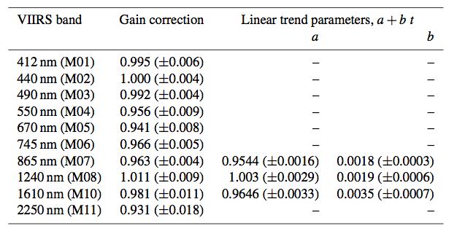
Final Radiometric Adjustments
Aerosol DB Team Adjustments
(vs C6, including trends)
Cloud Team Adjustments
VIIRS Channel |  | M5 (0.67µm) | M7 (0.87µm) | M8 (1.24µm) | M10 (1.61µm) | M11 (2.25µm)
Radiometric Adjustment (Expected VIIRS TOC/Observed) | vs C6 | 0.94 | 0.96 | 0.98 | 0.98 | 0.97
 | vs C6.1 | 0.95 | 0.97 | 0.99 | 0.98 | 0.97
Sayer et al. [2017]
Radiometric adjustments are applied to VIIRS L1B internally by each algorithm.
For cloud products, this occurs prior to cloud mask → cloud top → cloud optical property algorithm chain.

Slide 11
Impacts of Adjustments
Liquid COT
Aqua MODIS (B7-B2-B1)
0200 UTC

Slide 12
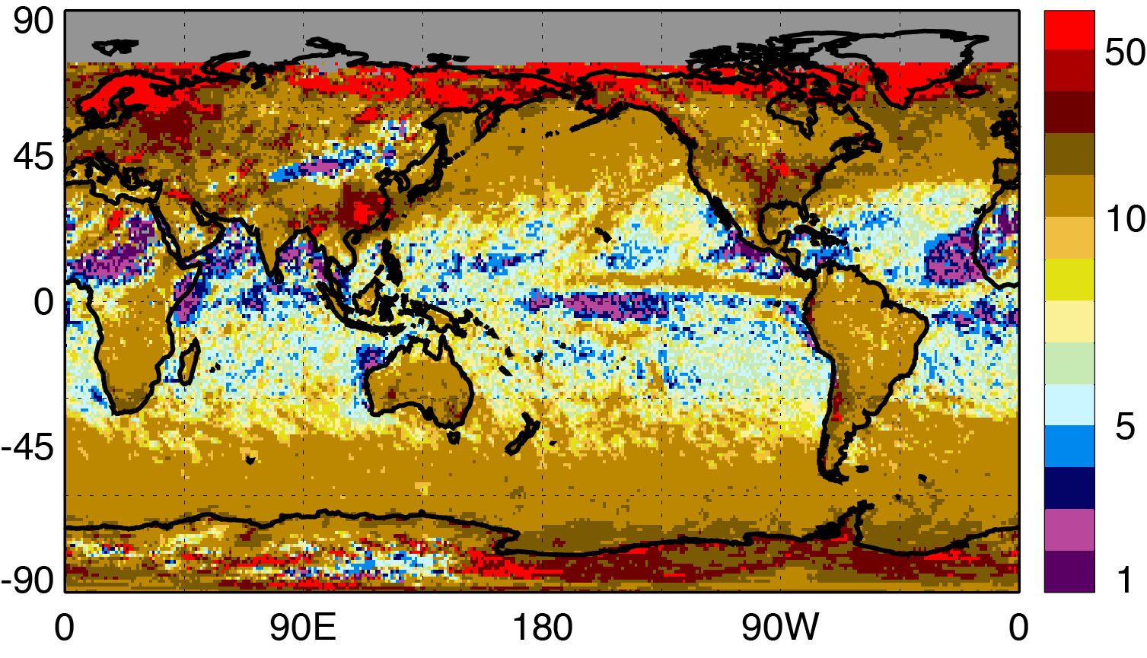
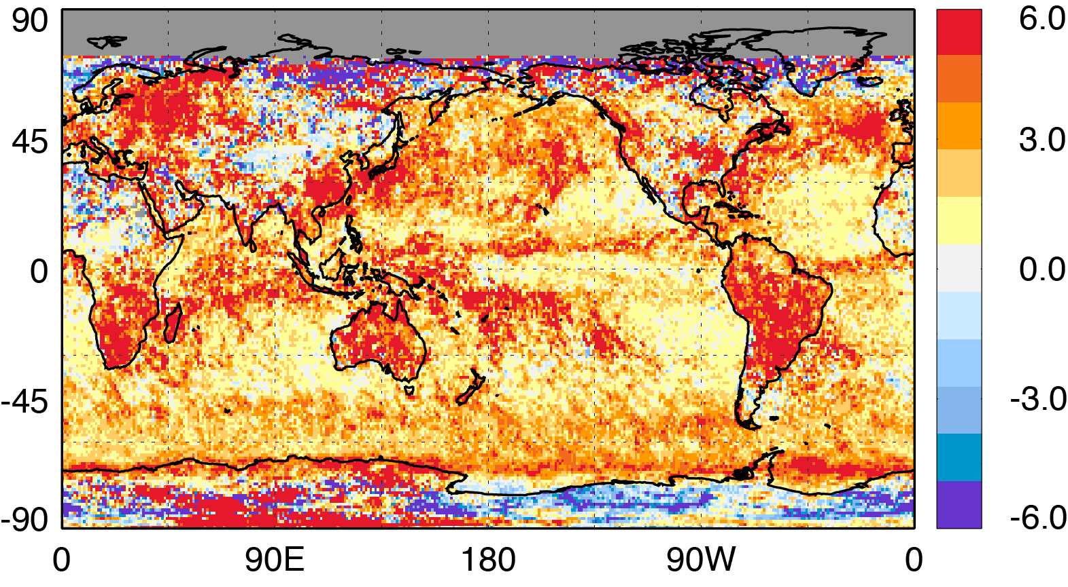
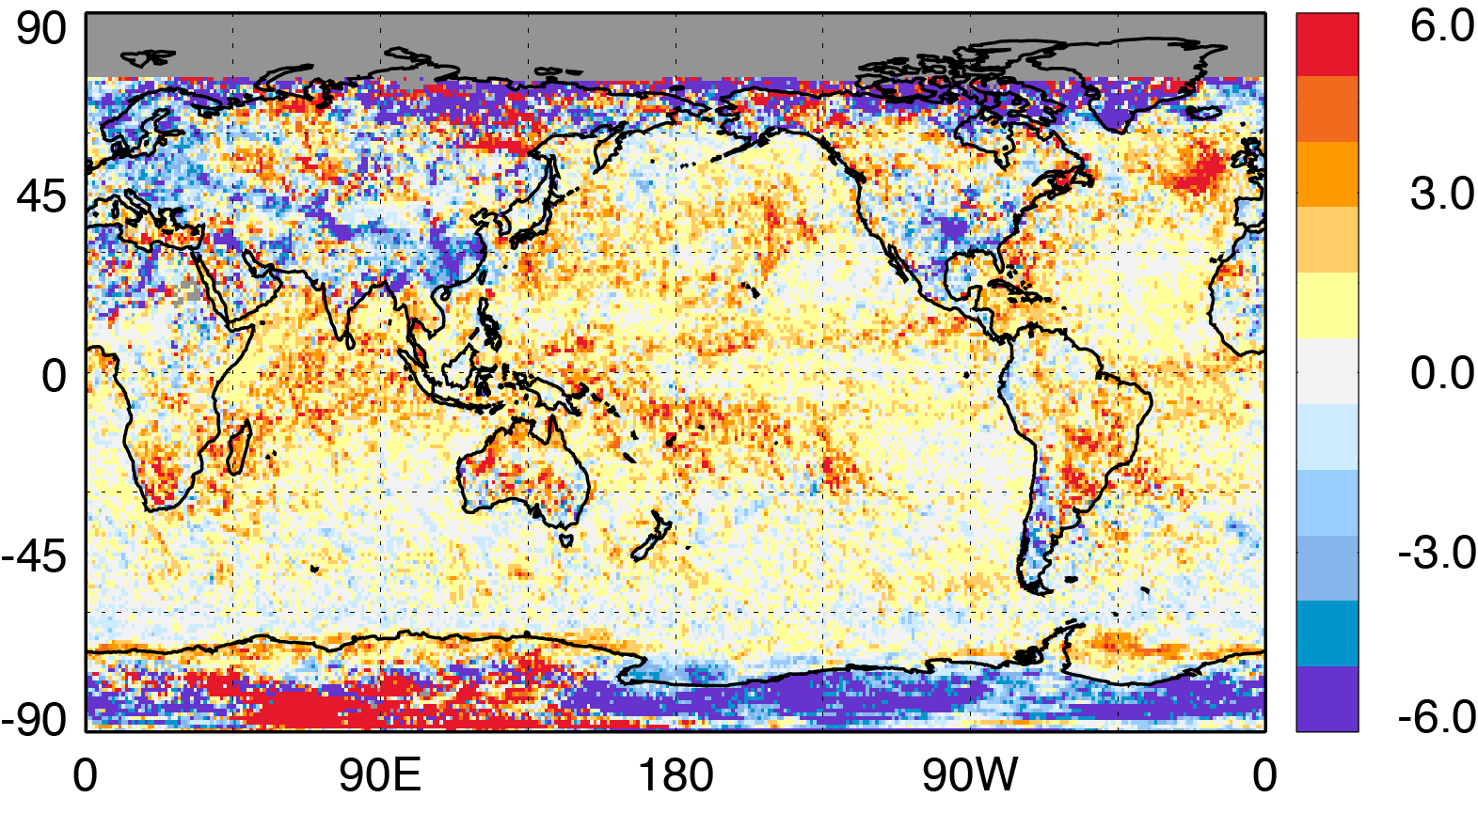
Impacts of Adjustments
CLDPROP Liquid Phase COT
February 2014
(Data from initial C6-based adjustment factor test)
CLDPROP MODIS
MODIS – VIIRS
MODIS – VIIRS_{adj}

Slide 13
Summary
Radiometric adjustment factors to key solar reflectance channels necessary to reconcile observed retrieval differences
  Important to note that both instruments can be within their absolute calibration specifications yet still exhibit a radiometric offset that can impact inter-sensor geophysical product continuity
Cloud Team derived VIIRS adjustment factors using Atmosphere SIPS-produced match files
  Adjustments generally consistent with Aerosol DB team for overlapping channels
  Applied to VIIRS since MODIS is the reference record
Improvement seen in COT retrieval continuity, though other factors continue to confound
  See Steve Platnick’s talk this afternoon for additional CLDPROP details

Slide 14
Challenges Moving Forward
Potential disconnects between different L2 algorithm teams who are applying independent radiometric adjustments
MODIS and VIIRS stability cannot be assessed independently, as changes to one or both instruments can adversely affect product continuity
  Updates to relative radiometric adjustments should be derived and applied as necessary.
  Note: We’re also tracking absolute sensor stability via independent L1B aggregations (see Starry Manoharan’s poster).
For the cloud products, processing paradigm may need rethinking
  Forward processing near real-time (NRT) only, climate archive processing replacing NRT following periodic radiometric assessments?

Slide 15
vs C6.1
vs C6
Ongoing Challenge: Accounting for temporal radiometric drifts in one or both instruments.

Slide 16
Challenges Moving Forward
Potential disconnects between different L2 algorithm teams who are applying independent radiometric adjustments
MODIS and VIIRS stability cannot be assessed independently, as changes to one or both instruments can adversely affect product continuity
  Updates to relative radiometric adjustments should be derived and applied as necessary.
  Note: We’re also tracking absolute sensor stability via independent L1B aggregations (see Starry Manoharan’s poster).
For the cloud products, processing paradigm may need rethinking
  Forward processing near real-time (NRT) only, climate archive processing replacing NRT following periodic radiometric assessments?

