Slide 1
TIR-Based Volcanic SO₂ Science Products for Terra, Aqua, and Suomi NPP
Vincent J. Realmuto, Jet Propulsion Laboratory, California Institute of Technology
© 2018, California Institute of Technology.
Government sponsorship acknowledged.

Slide 2
Objectives
Develop a prototype system for the automated detection and mapping of volcanic SO₂ plumes based on multispectral TIR image data
Validate system and data products through analysis of MODIS, VIIRS, and ASTER data records for the long-lived (29 August 2014 – 27 February 2015) eruption of Bardarbunga Volcano, Iceland
Prepare and submit Algorithm Theoretical Basis Documents (ATBD) to MODIS, VIIRS, and ASTER Projects for future inclusion of plume detection and mapping system in corresponding Product Generation Systems (PGS)
Input Data Products
L1 radiance data from MODIS, SNPP-VIIRS, and ASTER
Emissivity data base (ASTER GED, MODIS MOD21, VIIRS VNP21)
Atmospheric profiles (radiosonde, AIRS, MODIS, NCEP, MERRA-2)
Digital Elevation Models
Future Access to NOAA-20 VIIRS

Slide 3
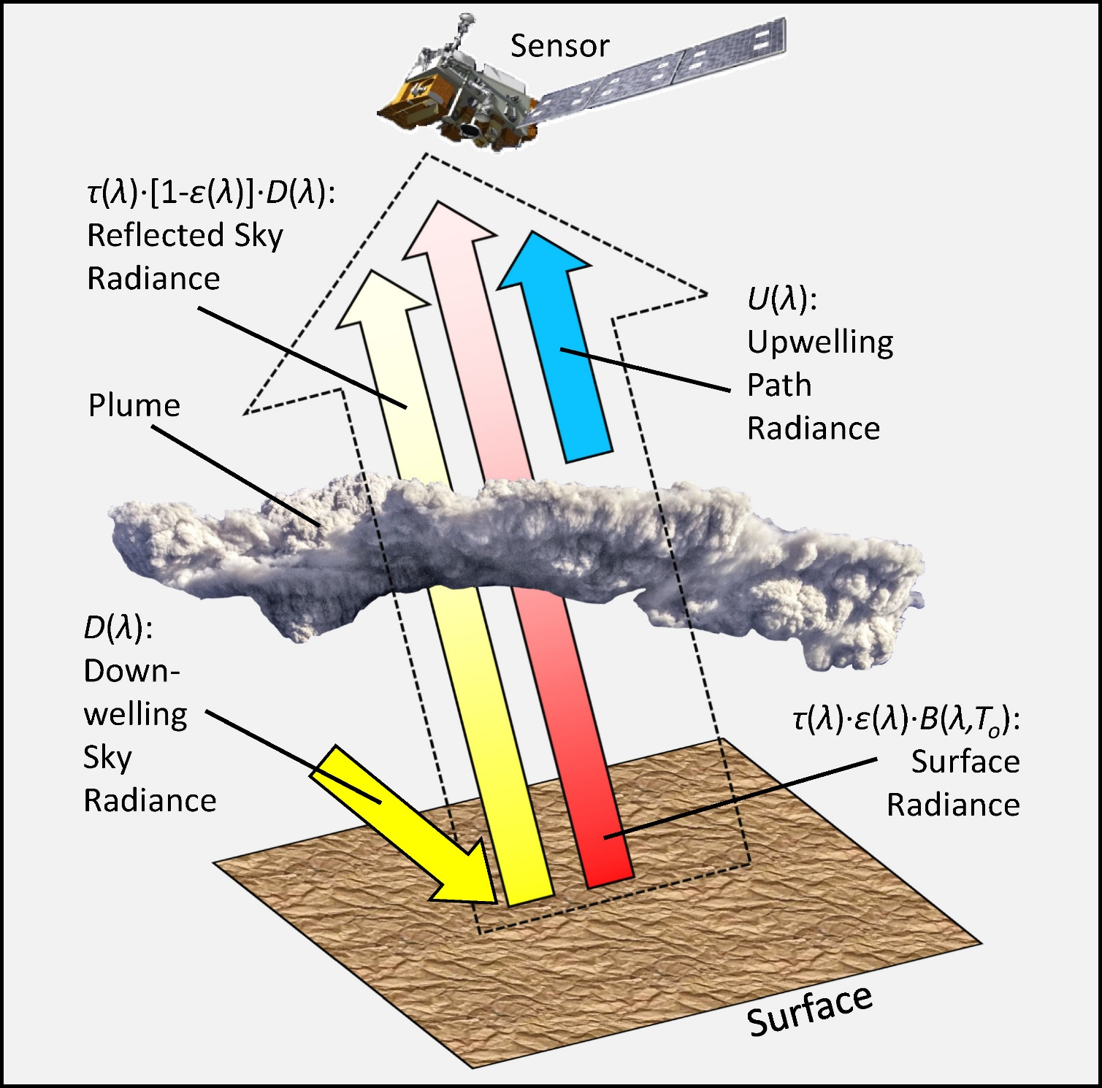
TIR Remote Sensing of Volcanic Plumes
Detect plumes through transmission [t(λ)] - the attenuation of surface radiance passing through the plume enroute to the sensor
The observed radiance (outlined arrow) includes the surface radiance (red arrow), reflected sky radiance (yellow arrow), and upwelling path radiance (blue arrow)
Transmission, sky radiance [D(λ)], and path radiance [U(λ)] are estimated through radiative transfer (RT) modeling

Slide 4
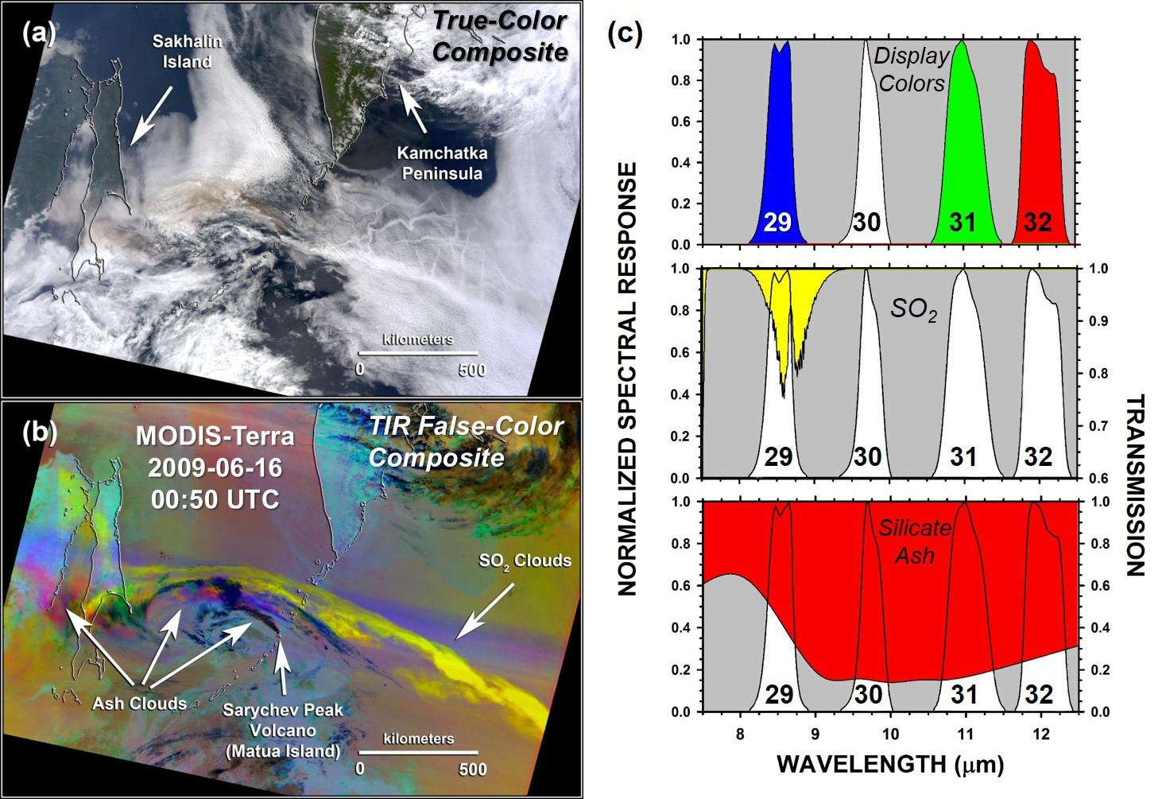
MODIS-Terra Sarychev Peak Volcano 16 June 2009 (00:50 UTC)
True-color composite. Volcanic plumes and meteor-ological clouds have similar appearance at visible wavelengths
(b) False-color composite of TIR data from Channels 32, 31, and 29, displayed in red, green, and blue. SO₂ plumes appear yellow, while the display colors of ash plumes range between red and magenta
(c) Transmission spectra of SO₂ (middle) and silicate ash (bottom), superimposed on the spectral response of MODIS Channels 29, 30, 31, and 32

Slide 5
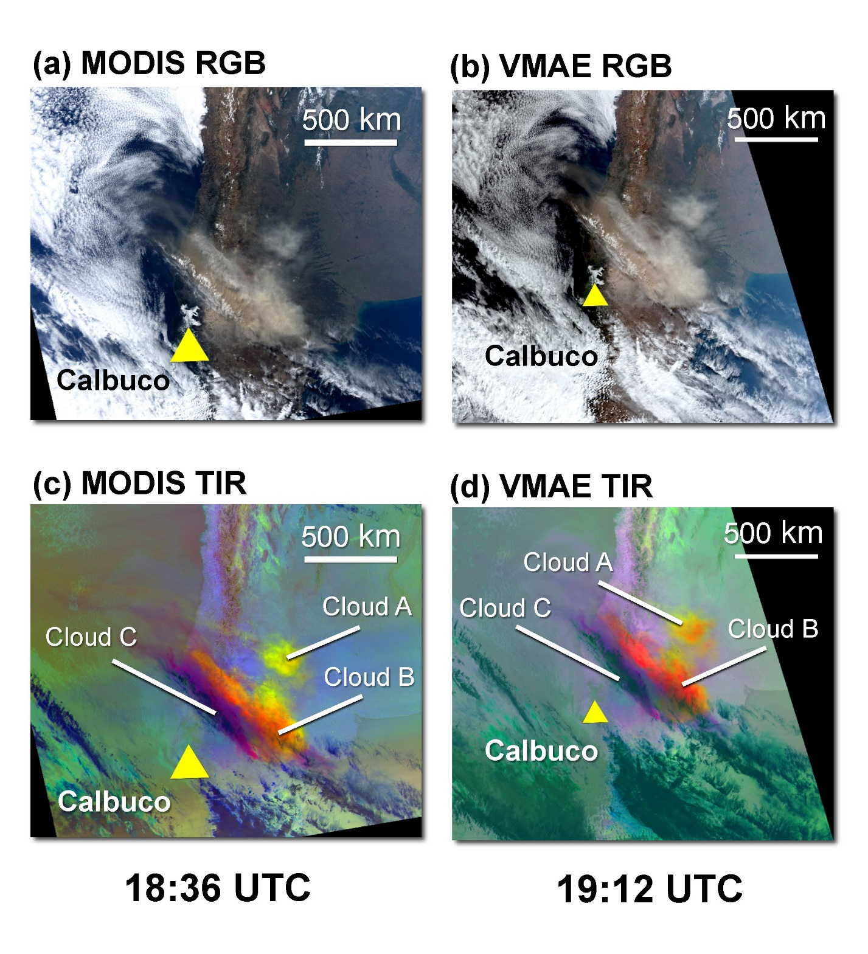
Calbuco Volcano (Chile): 2015-04-23
18:35 UTC (Aqua) / 19:12 UTC (SNPP)
MODIS/VMAE TIR provides spatial context + coarse spectral information:
Cloud A - Dominated by SO₂ (yellow display color)
Cloud B - Mixture of SO₂ and ash (orange display color)
Cloud C – Mixture of ash and ice crystals (purple display color)
AIRS/CRIS Spectroscopy provides fine spectral information:
Enables unique identification of plume components
Ash features highlighted in red
SO₂ features highlighted in yellow

Slide 6
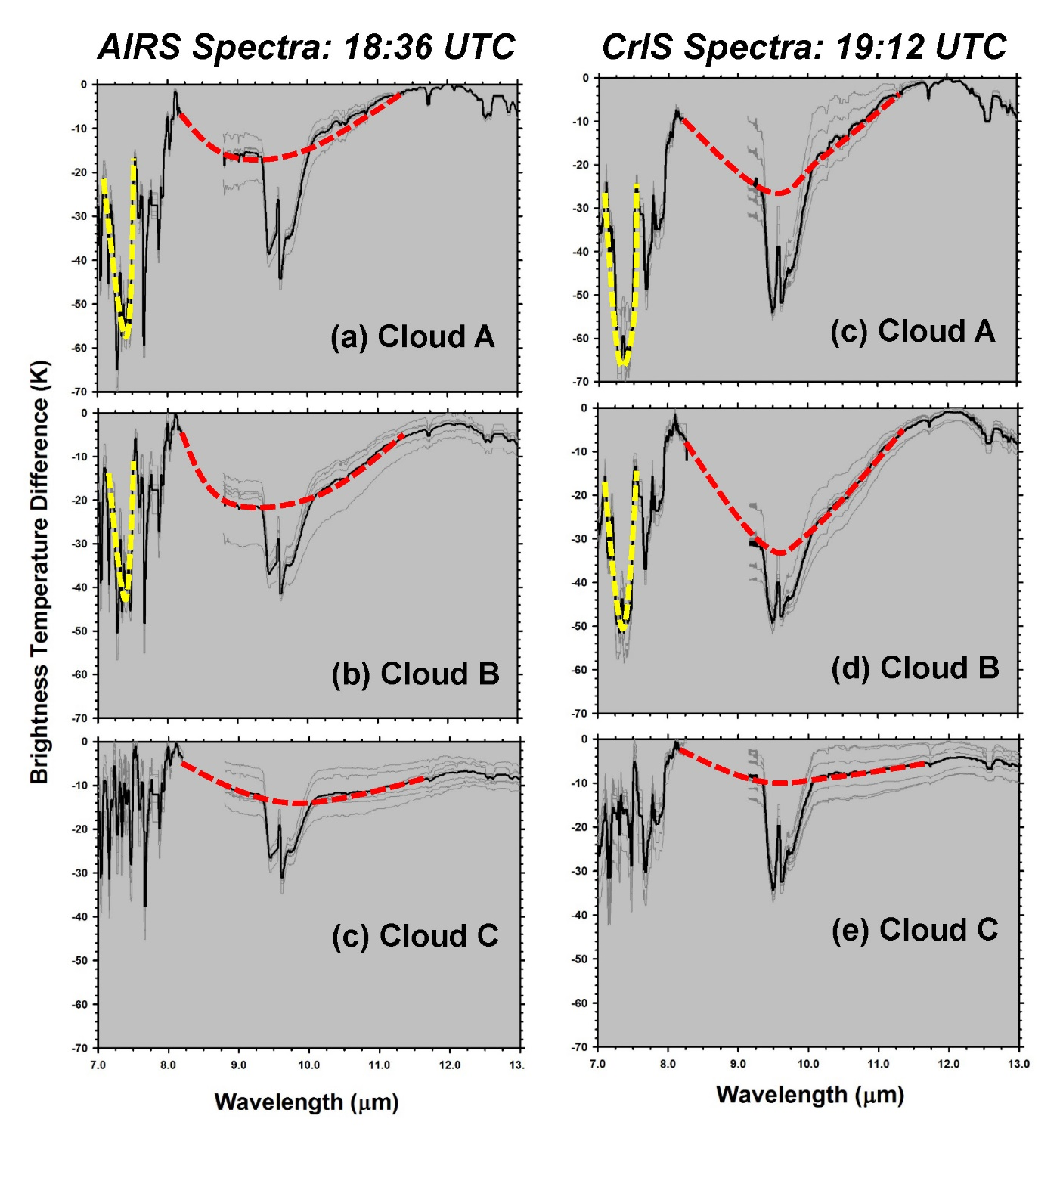
Calbuco Volcano (Chile): 2015-04-23
18:35 UTC (Aqua) / 19:12 UTC (SNPP)
MODIS/VMAE TIR provides spatial context + coarse spectral information:
Cloud A - Dominated by SO₂ (yellow display color)
Cloud B - Mixture of SO₂ and ash (orange display color)
Cloud C – Mixture of ash and ice crystals (purple display color)
AIRS/CRIS Spectroscopy provides fine spectral information:
Enables unique identification of plume components
Ash features highlighted in red
SO₂ features highlighted in yellow

Slide 7
Effects of Temperature and Emissivity

Slide 8
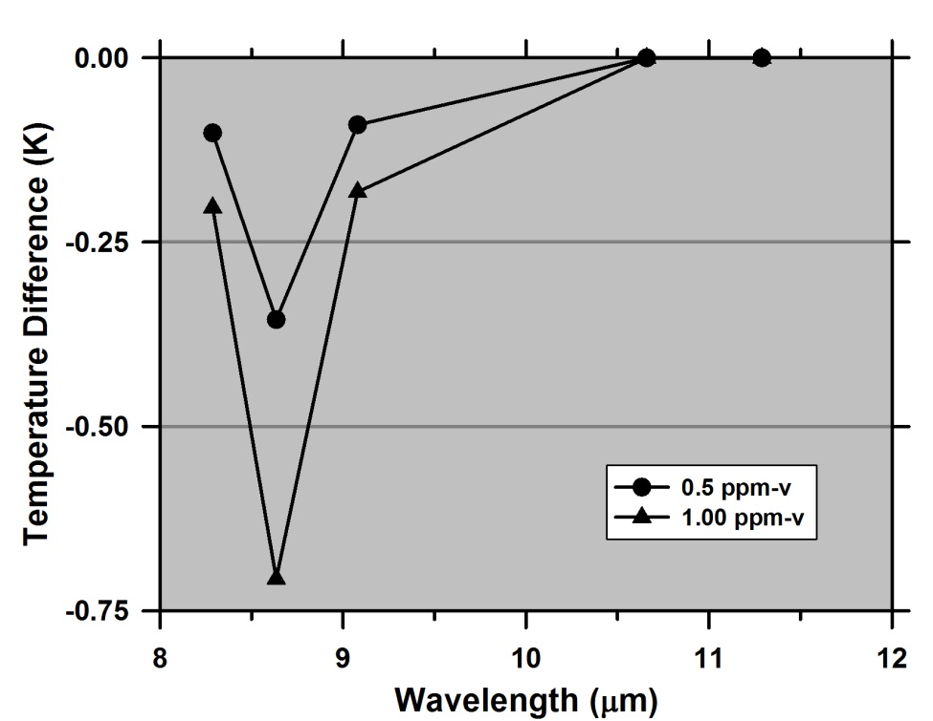
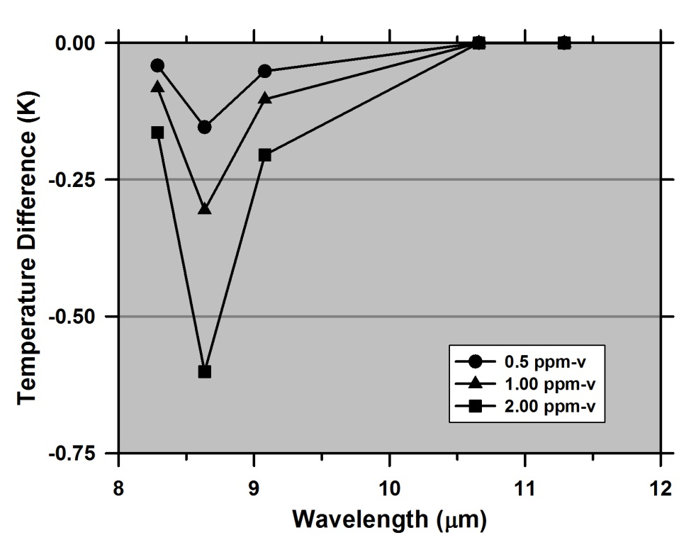
Sensitivity to Gas vs. Temperature Contrast
Detection Threshold: Apparent Change in Temperature Must Exceed NEΔT of Instrument
0.5 K: Realistic In-Flight NEΔT for ASTER or MODIS
Land vs. Sea Surface: 20 K Decrease in Surface Temperature = 2X Increase in Detection Threshold
Land Surface
T_{s} = 320 K
Elevation = 950 m
Sea Surface
T_{s} = 300 K
Apparent Change in Temperature (K)
Apparent Change in Temperature (K)

Slide 9
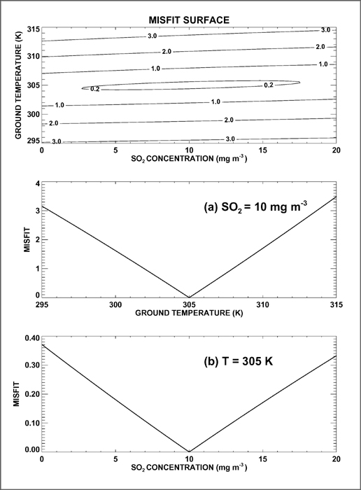
Retrieval of Surface Temperature and Gas Concentration
Temperature is Well-Constrained by TIR Radiance Measurements, Relative to the Constraint on Gas Concentration
Simultaneous Retrieval of Temperature and Gas Concentration is Difficult:
Misfit Surface Resembles Broad Valley (“Hard Taco Shell”)
Rapid Convergence on Temperature Estimate
Little to No Convergence on Concentration Estimate
Cascading (Serial) Retrieval is a Better Approach
Estimate Surface Temperature
Estimate Gas Concentration
(a)
(b)
Steep Gradient to ‘True’ Temperature
Shallow Gradient to ‘True’ SO₂ Concentration

Slide 10
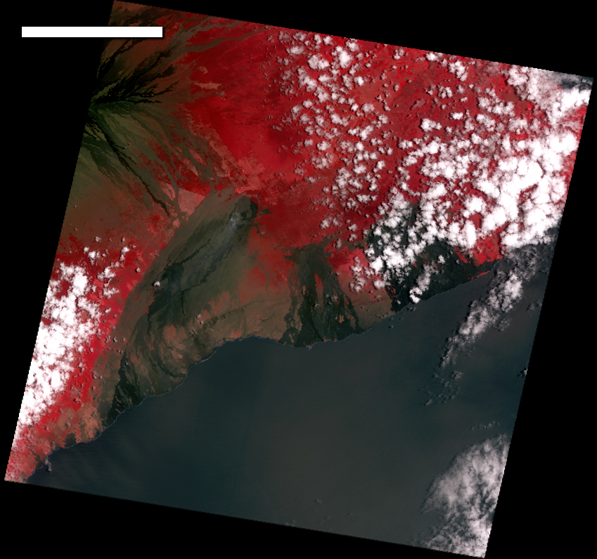
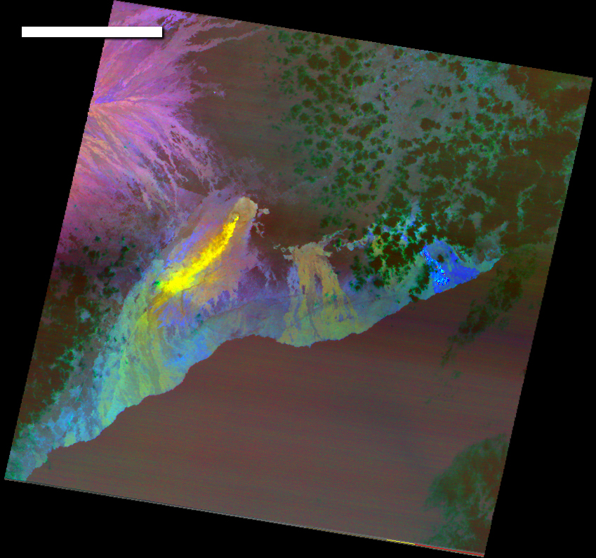
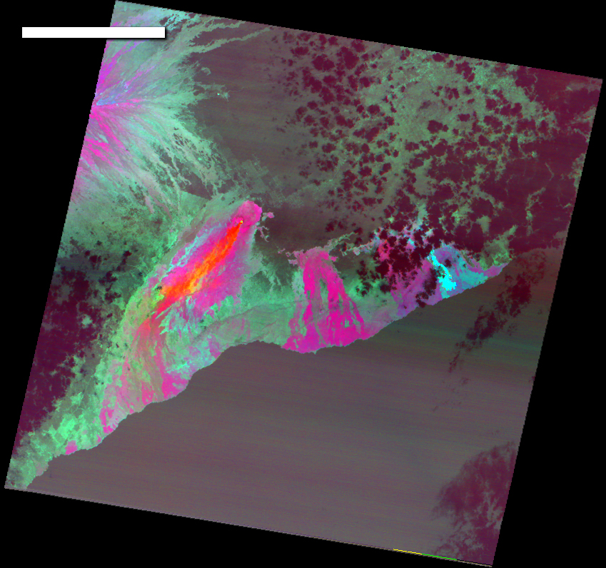
18 km
18 km
18 km
False-color composite of ASTER VNIR data
False-color composite of TIR data designed to detect SO₂ absorption. SO₂ plume appears in yellow
False-color composite of TIR data designed to accentuate emissivity variations within lava flows. The spectral variations in emissivity overlap the SO₂ absorption

Slide 11
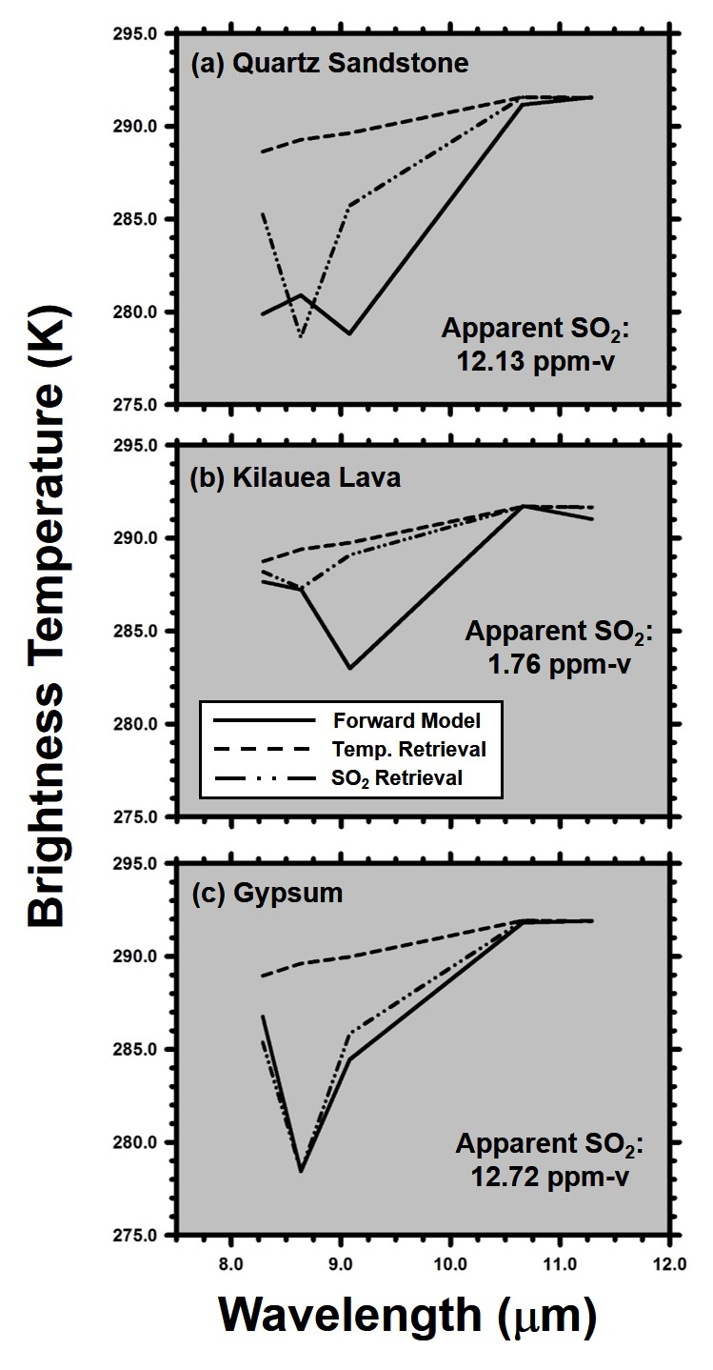
Surface Emissivity is a Confounding Factor for SO₂ Detection
As a rule, the assumption of Blackbody emissivity for exposed (non-vegetated) surfaces will lead to false detections of SO₂
Solid Lines: Model spectra generated for SO₂-free atmospheric profiles over simulated surface compositions of (a) quartz sand-stone, (b) pahoehoe lava from Kilauea Volcano, and (c) gypsum
Dashed Lines: Attempts to fit the model spectra, assuming the surfaces are Blackbodies (emissivity = 1), by varying only surface temperature fail
Broken Lines: The fit improves if SO₂ is introduced as a free parameter, with the penalty of false, or apparent, SO₂ detections
The false detections are largest for sandstone and gypsum, due to the overlap between emissivity minima and SO₂ absorption

Slide 12
Temperature and Gas Concentration Retrieval Procedures

Slide 13
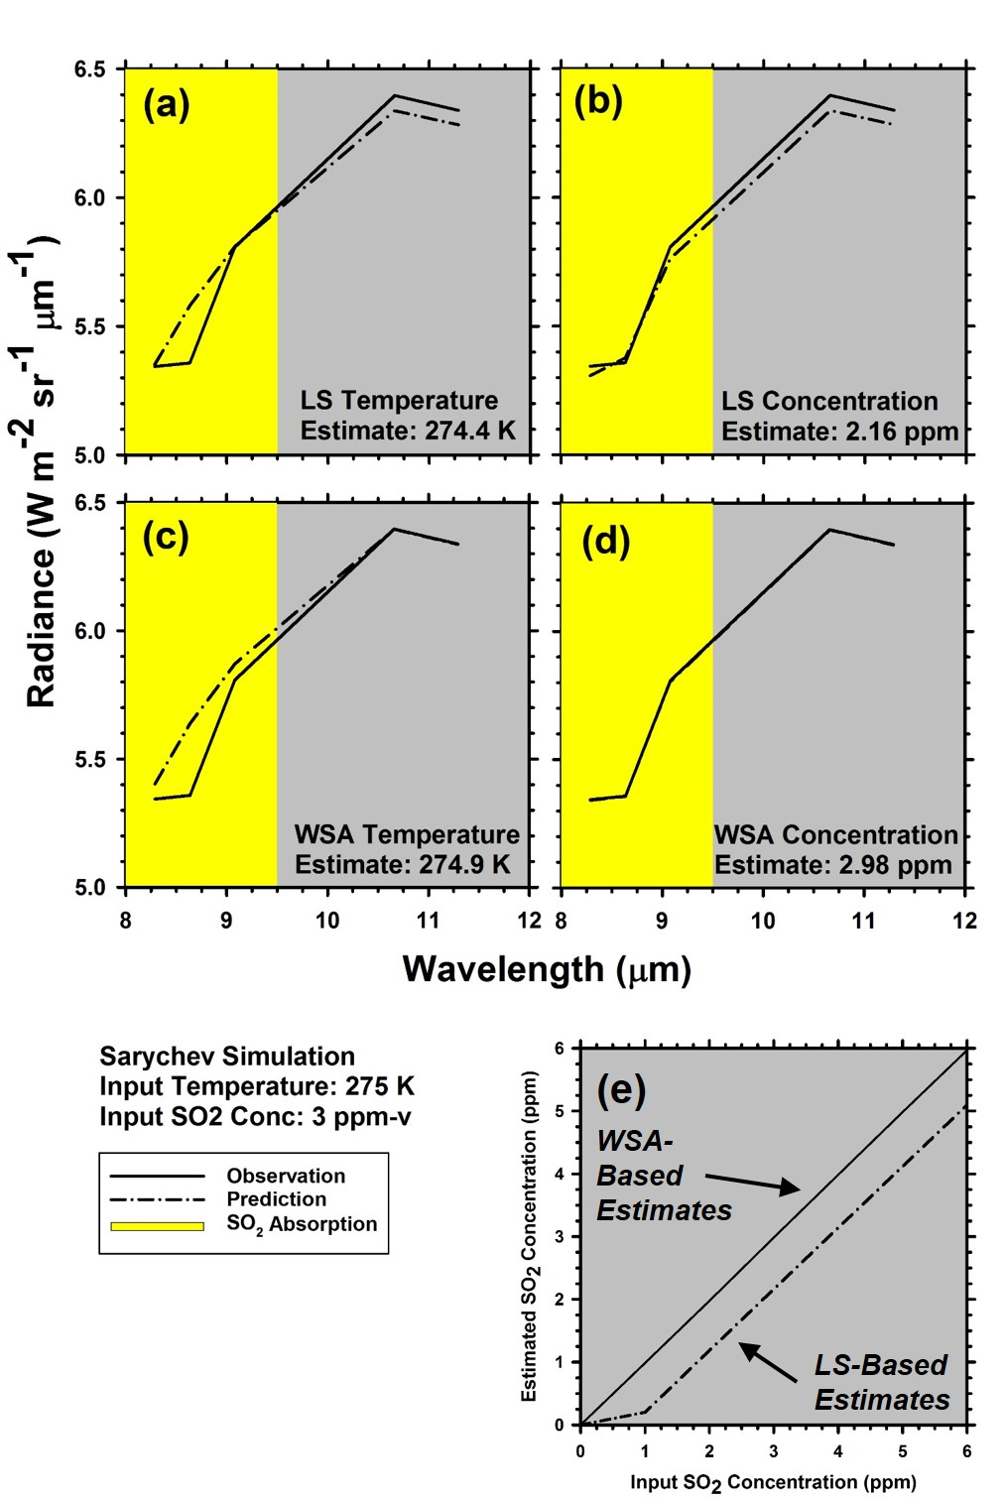
Misfit Calculation:
Least Squares vs. Weighted Spectral Angle
Least Squares (LS):
Designed to Fit Noisy Data
Equal Weight to Outliers
Not Ideal for Temperature Estimation
Weighted Spectral Angle (WSA):
Observed and Model Radiance Spectra Represented as Vectors in Data Space
Minimize Angle Between Vectors (Spectral Angle)
Minimization Weighted to Favor Solutions with Model Spectrum > Observed Spectrum
Optimum Temperature Estimate Given Imperfect Knowledge of Atmospheric Composition

Slide 14
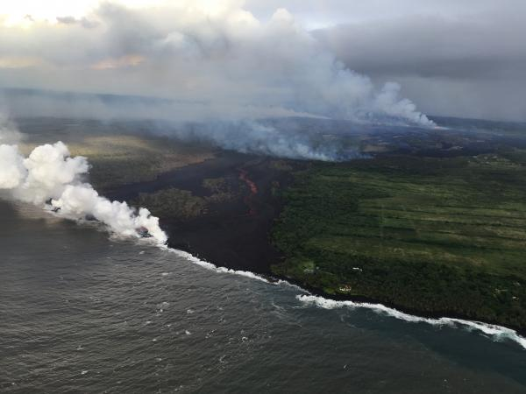
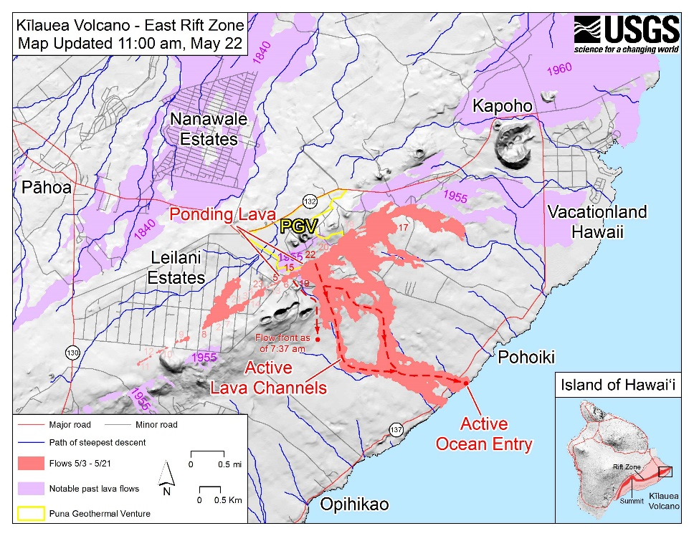
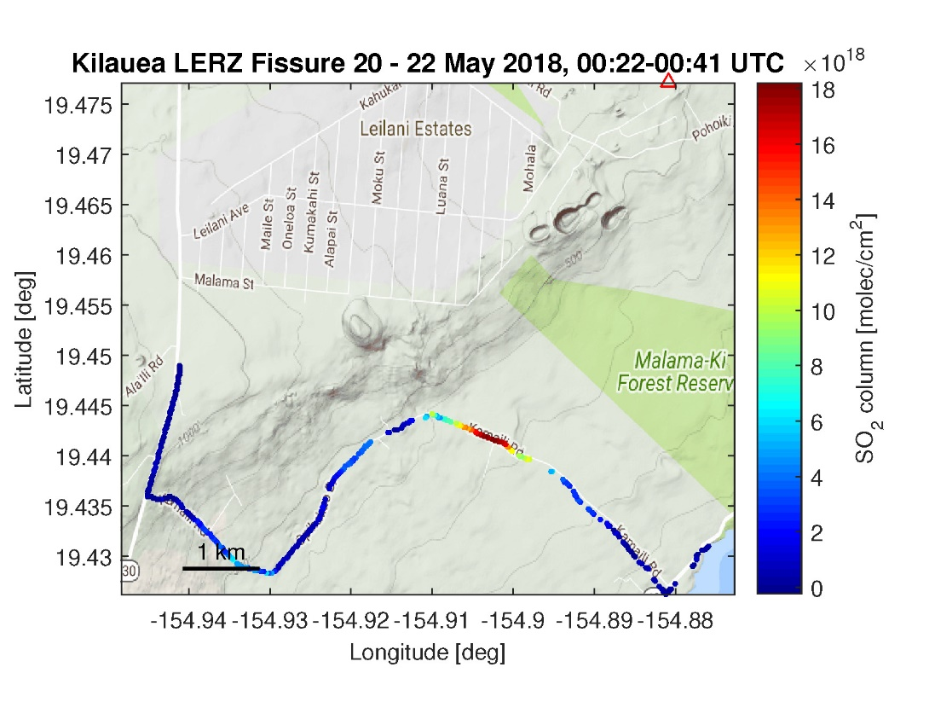
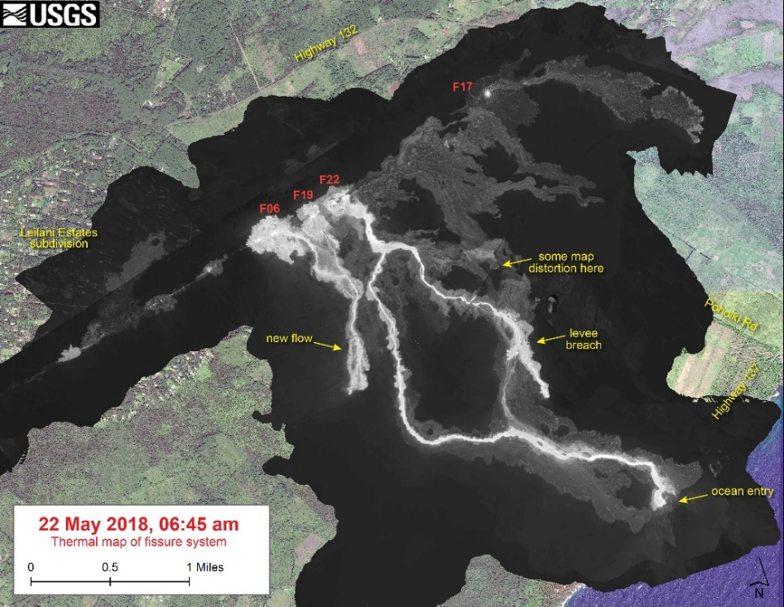
Comparison with Field Measurements
Kilauea Eruption
22 May 2018
Data courtesy of USGS/HVO. Data analyses are preliminary, and not for distribution.

Slide 15
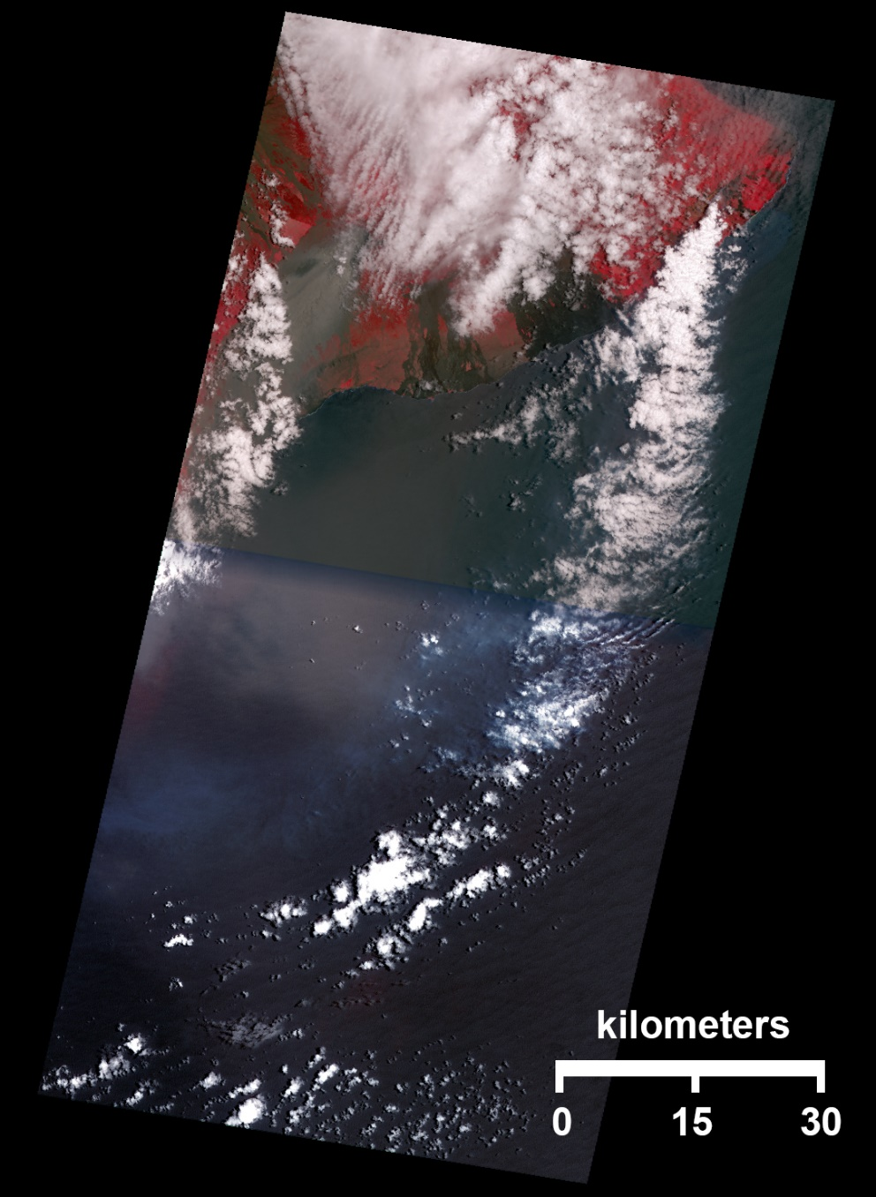
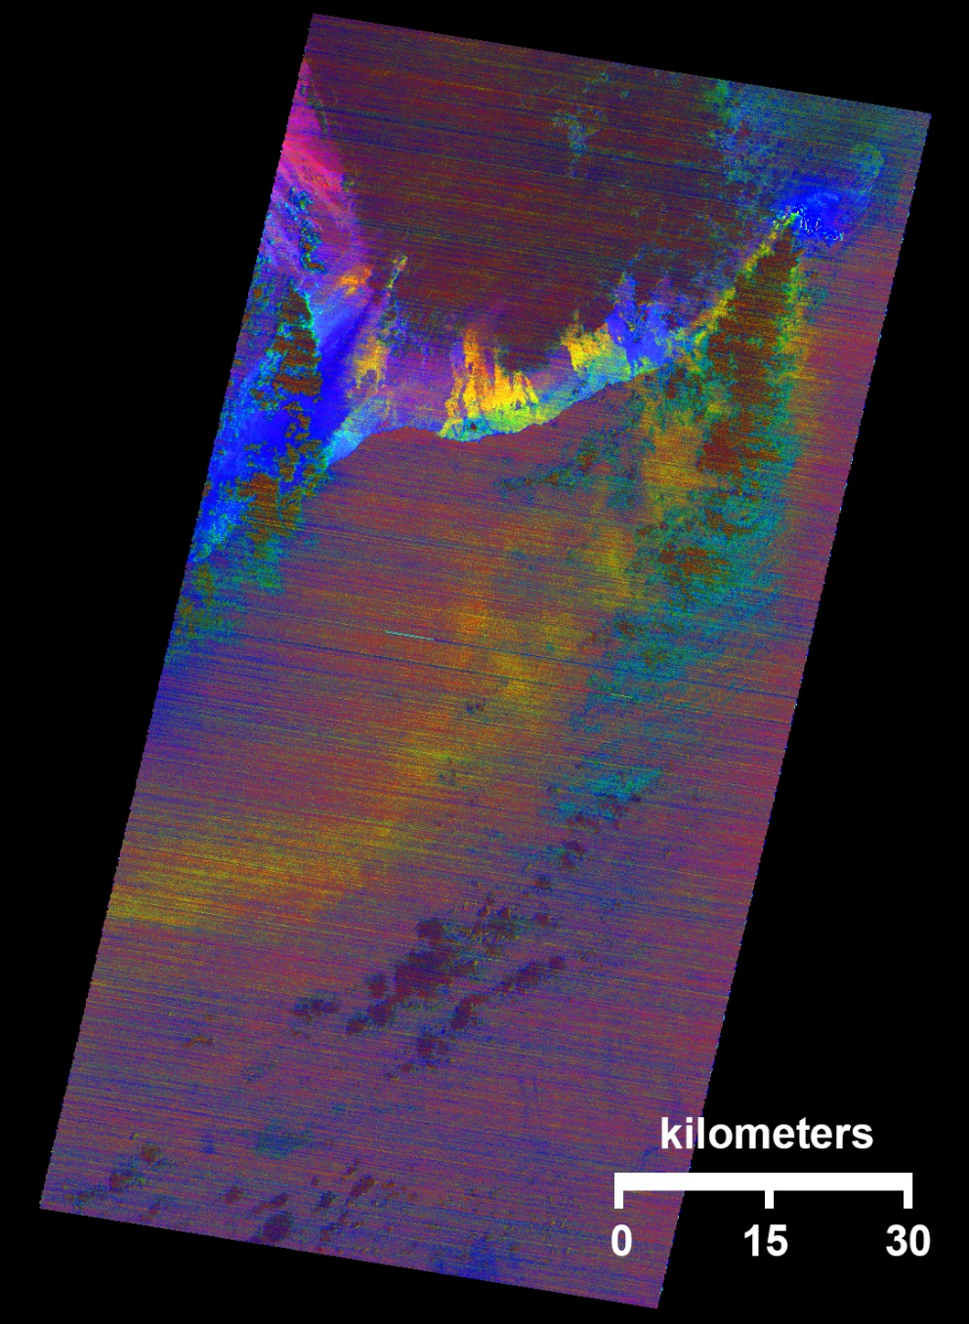
ASTER VNIR
ASTER
TIR
2018-05-22 / 21:01 UTC

Slide 16
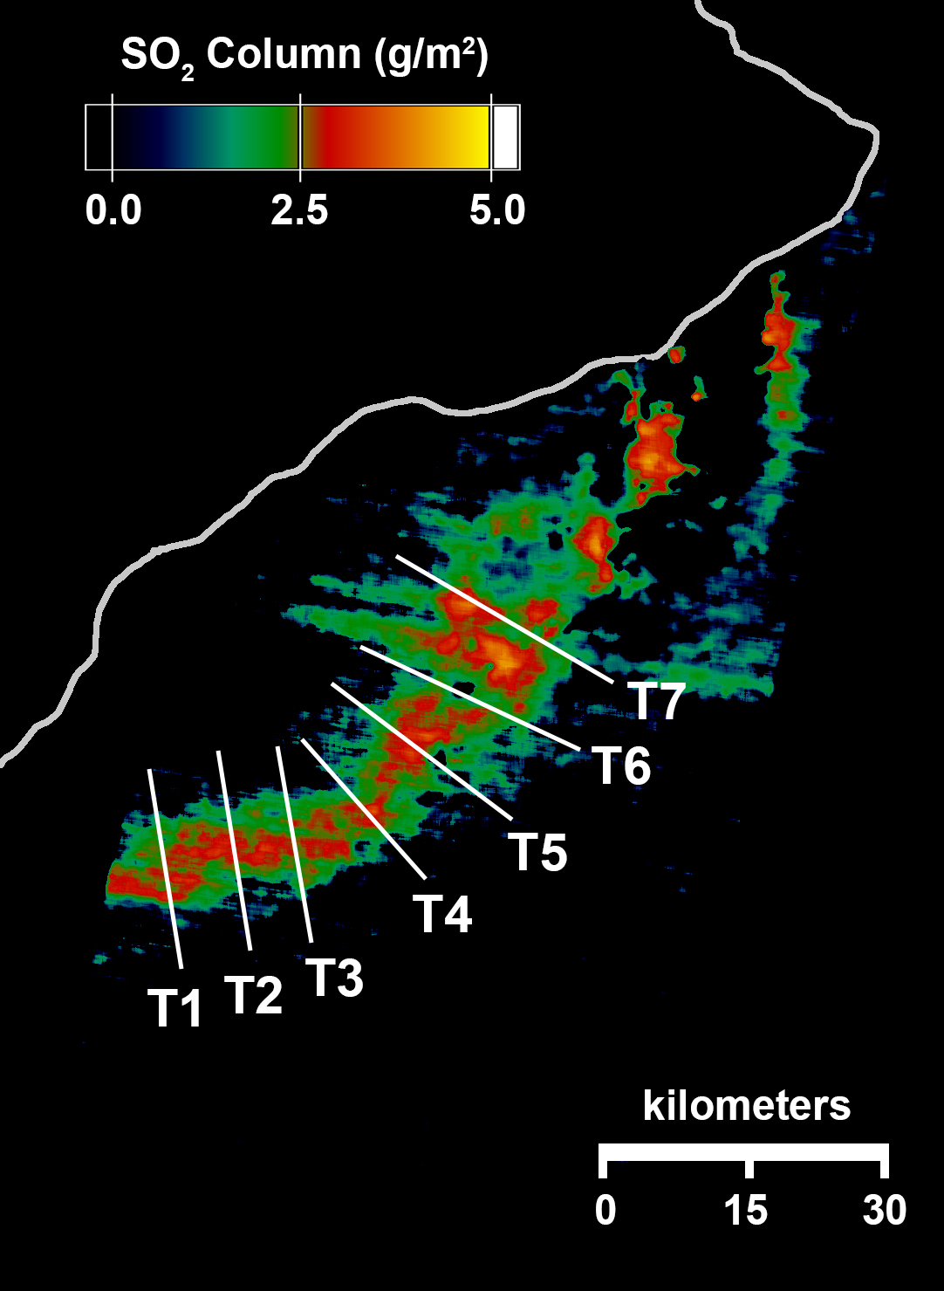
150-190 g/m²
HVO Integrated Transects (kg/m)* | ASTER Integrated Transects (kg/m)
37.52 | T1: 25.37
30.34 | T2: 20.75
45.03 | T3: 24.20
38.10 | T4: 19.94
Ave: 37.75 ± 5.2 | T5: 25.90
*USGS/HVO data analyses are preliminary, and not for distribution | T6: 23.98
 | T7: 41.00
 | Ave: 25.88 ± 6.5

Slide 17
Towards an Automated Plume Detection and Mapping System

Slide 18
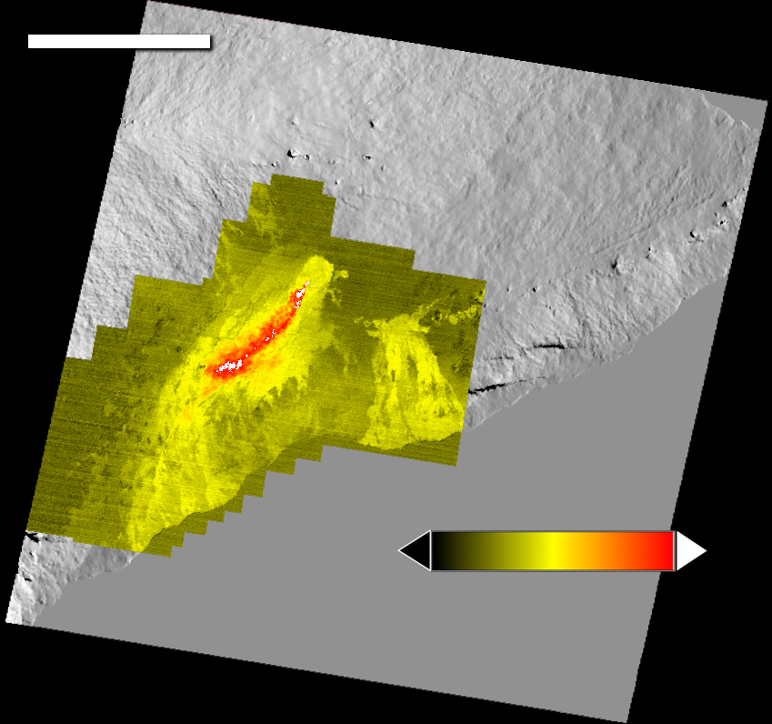
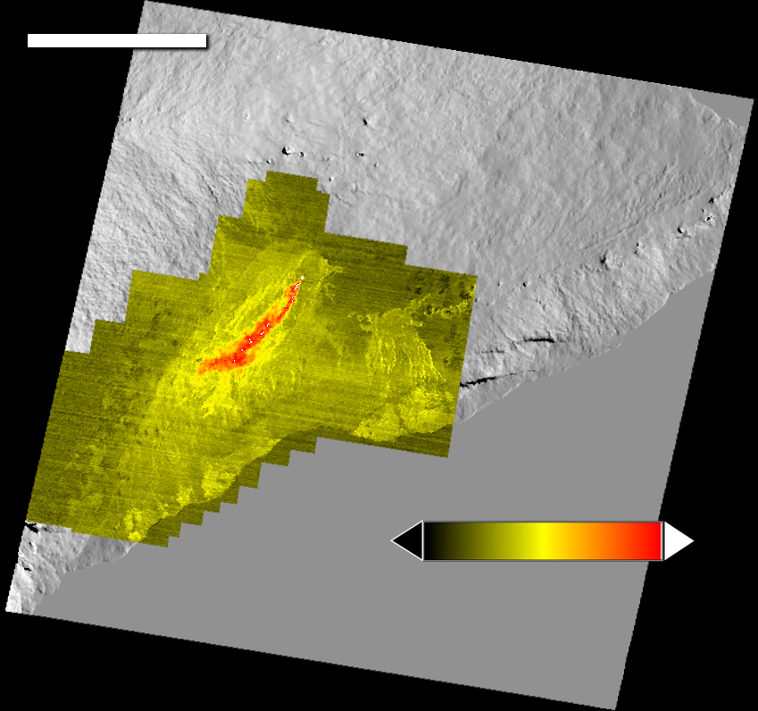
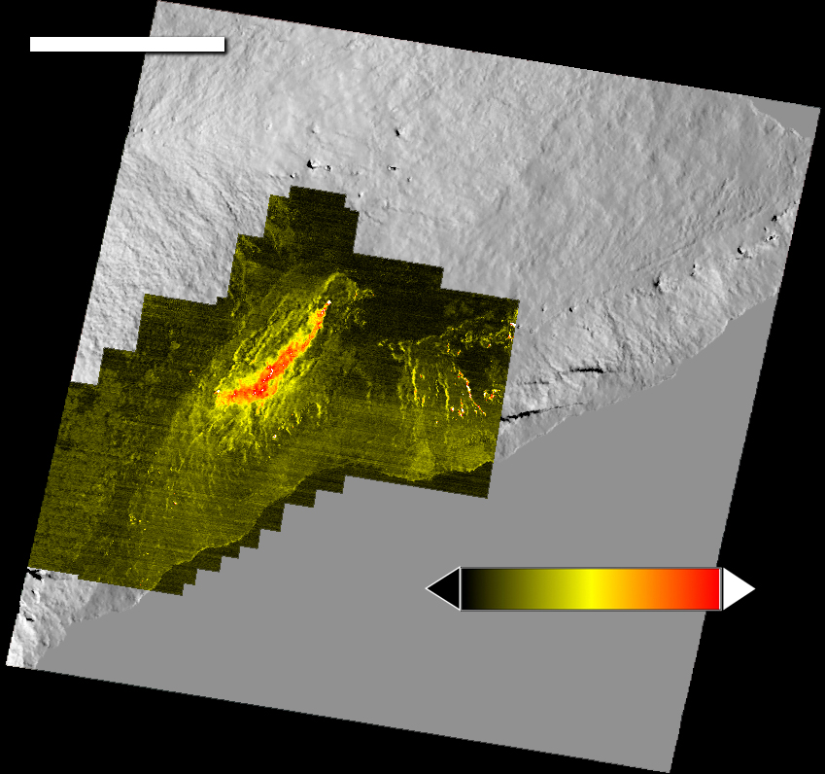
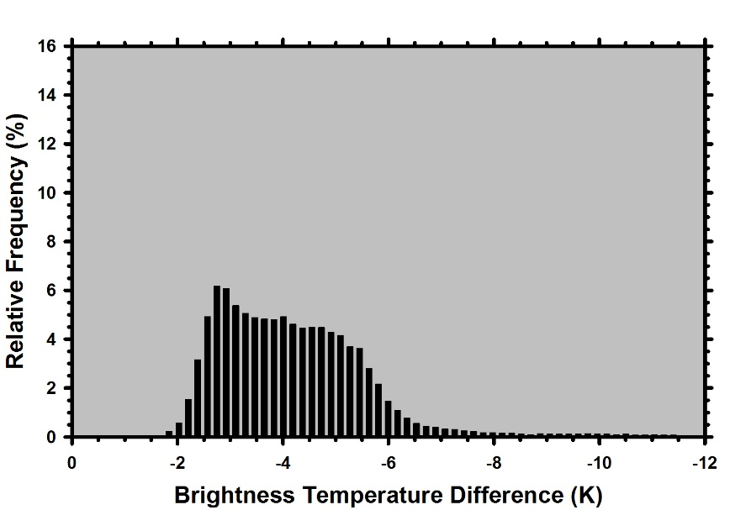
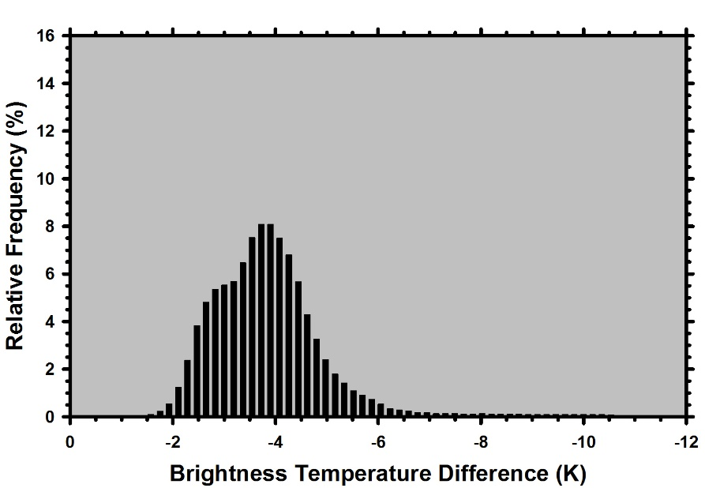
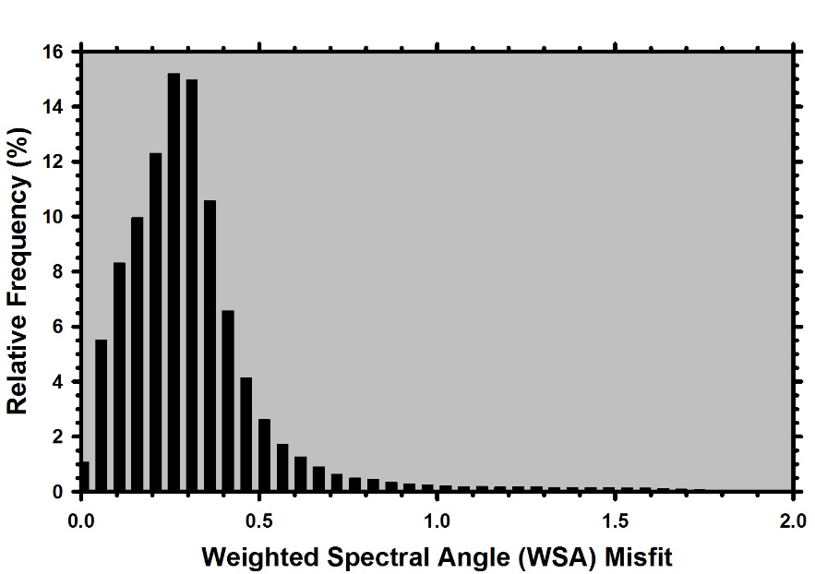
18 km
18 km
18 km
0 -12
BTD (K)
0 -12
BTD (K)
0 2
Misfit
“Conventional” BTD Offset (bias) of 2K Uniformly random
(b) BTD Following Emissivity Correction Offset of 2K Mode ~ -4K
(c) Temperature Retrieval Misfit Zero Offset 90% of misfit values are < 0.5

Slide 19
Flow Chart for Automated Plume Detection and Mapping System
Cloud Detection
Surface Temperature Map
Compare temperature contrast at each pixel to max. temperature contrast over all pixels
L1 Radiance Product
Emissivity Database
Digital Elevation Model
Atmospheric Profiles
RT-Based Retrieval of Surface Temperature
RT-Based Retrieval of Gas Concentration
Retrieval Mask
Misfit Threshold
Surface Temperature Misfit Map
Compare misfit at each pixel to maximum misfit over all pixels

Slide 20
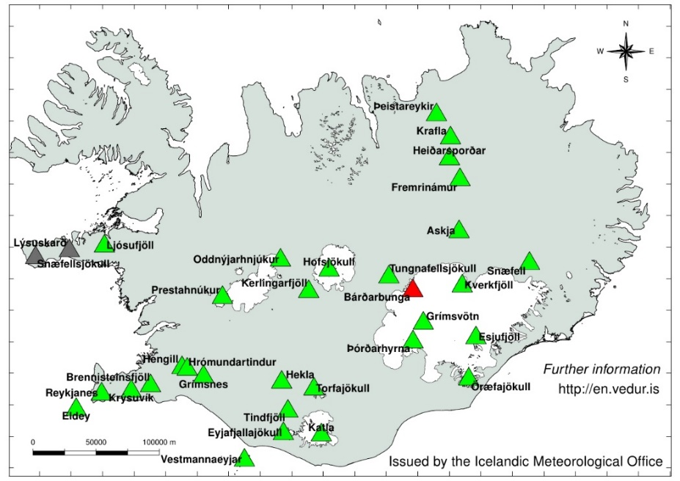
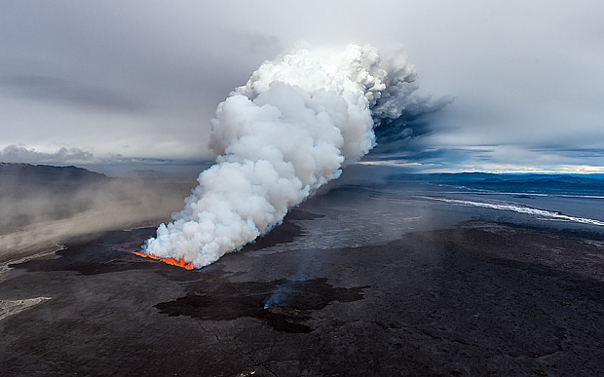
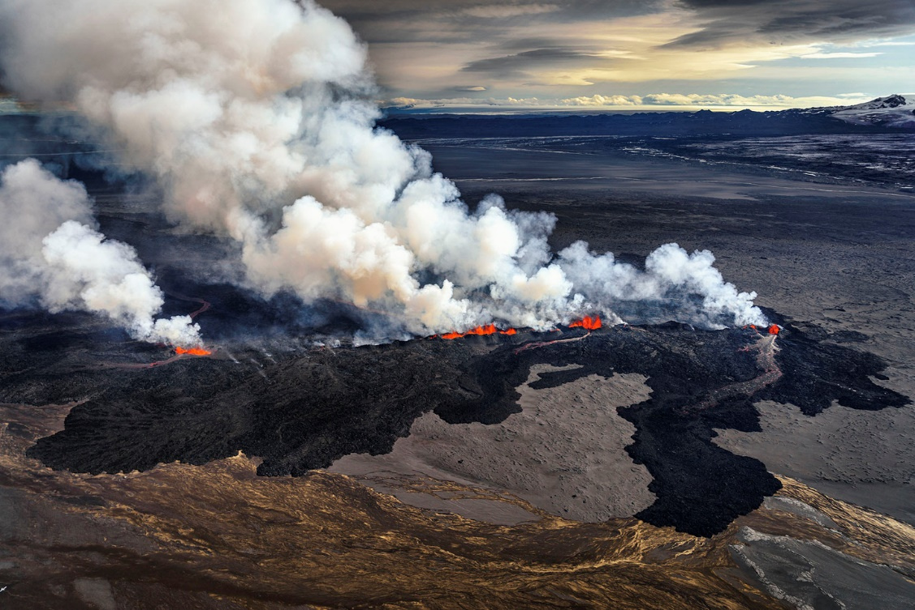
Holuhraun Fissure Eruption, Bardarbunga Volcano, Iceland
Active between 29 August 2014 and 27 February 2015
SO₂ emission rates estimated at ~105 Mg/day based on SEVIRI (geostationary), OMI, and IASI
1 September 2014
Looking to the NE
3 September 2014 Looking to the SE

Slide 21
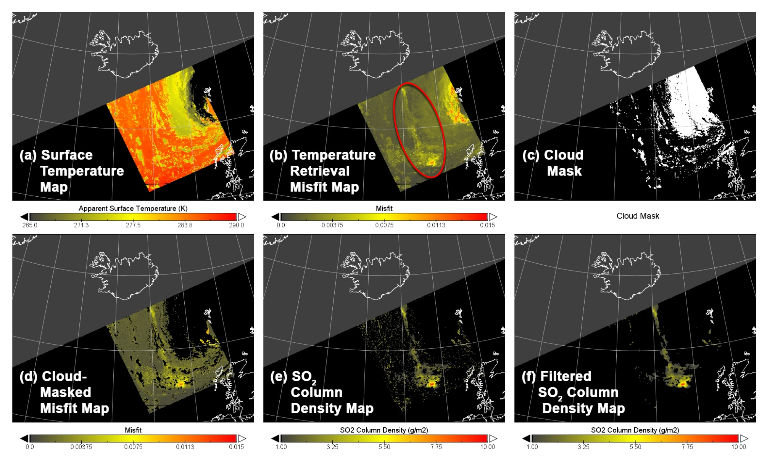
Surface temperature es-timation does not consider volcanic plumes or met. clouds Misfit map shows the locations of plumes (red oval) and met clouds Met clouds are identified by comparing apparent surface temperature with air temperature at plume altitude Combination of cloud mask and misfit map improves the detection of volcanic plumes Estimation of SO₂ column density is confined to the locations identified by the masked misfit map SO₂ map is filtered to minimize the “holes” cor-responding to the locations of met clouds.
Bardarbunga Volcano (Iceland) / VIIRS-VMAE / 2014-09-05

Slide 22
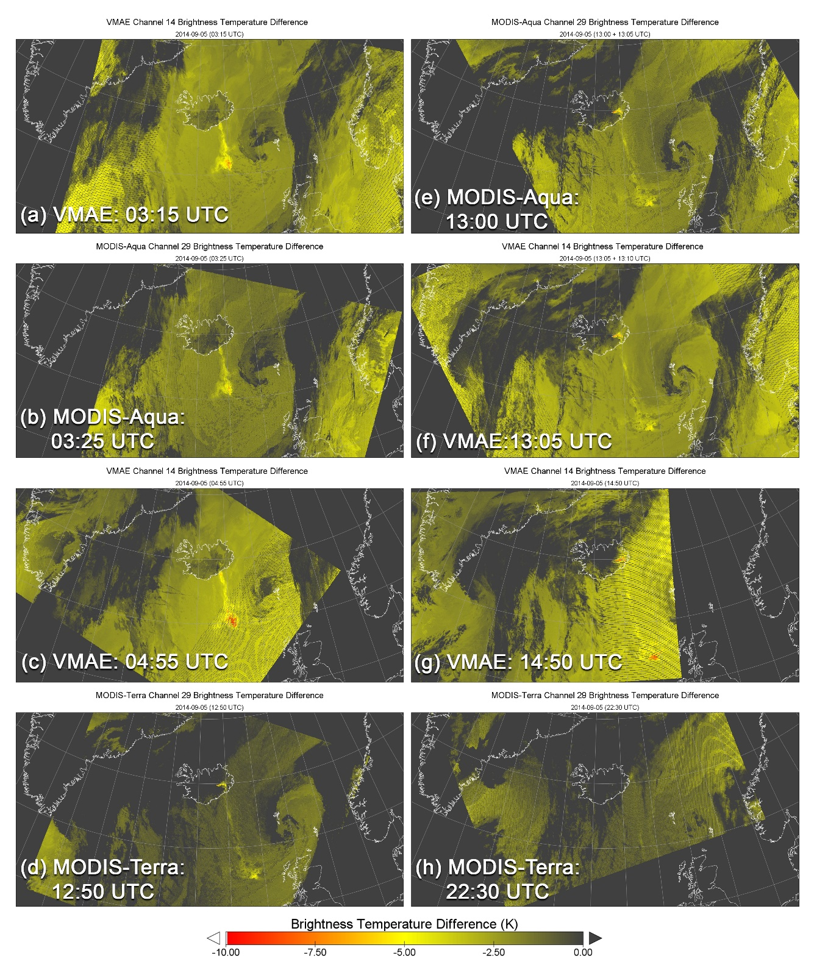
Bardarbunga Eruption Plumes 2014-09-05
Investigation will focus on the combined
EOS and SNPP data records for the Bardarbunga (Iceland) Eruption
MODIS and VMAE nadir observations of Bardarbunga plumes provide a unique combination of spatial and temporal resolutions:
Eight nadir observations acquired on 2014-09-05
Documents plume dispersion on time scales from minutes to hours

Slide 23
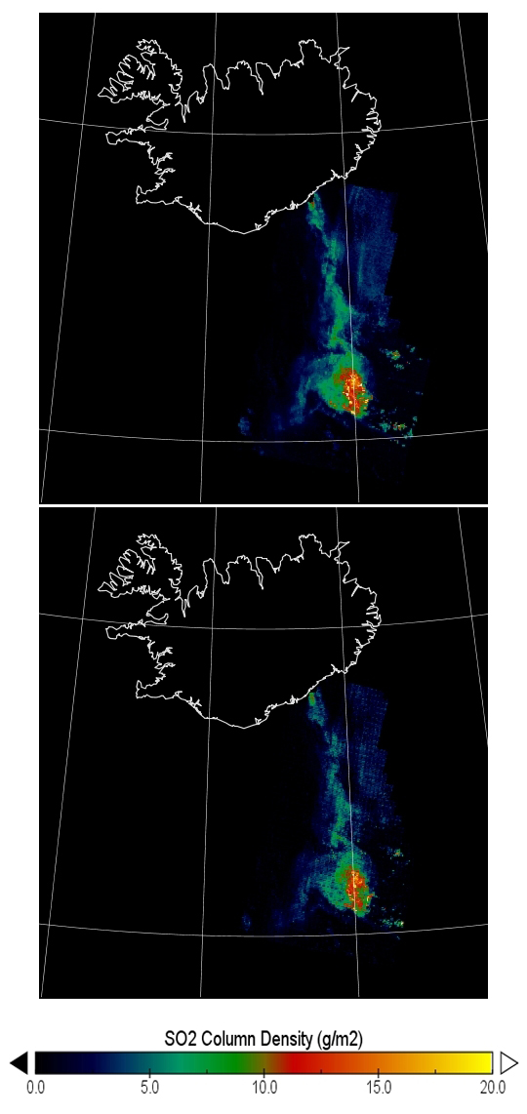
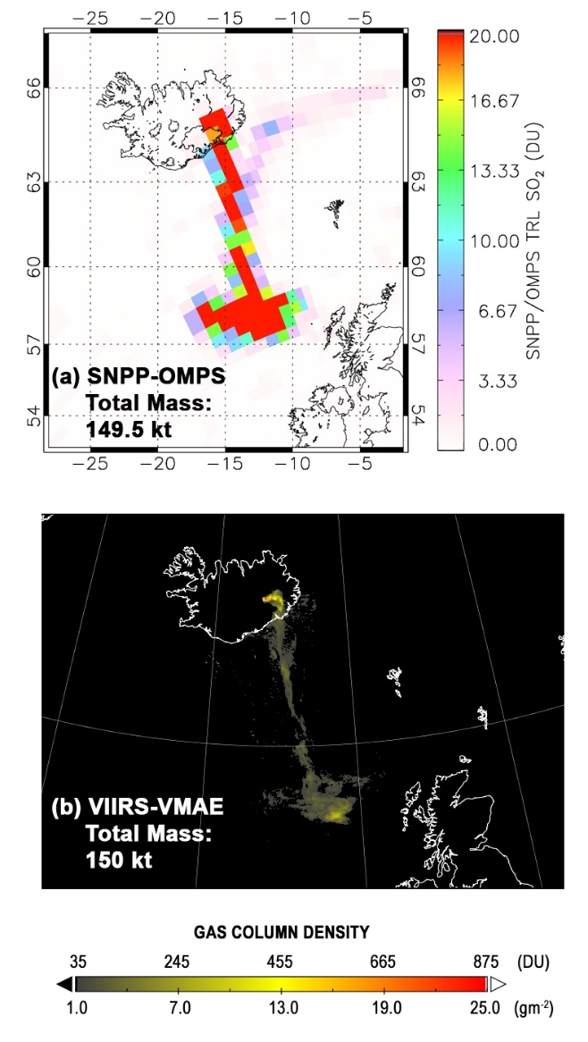
2014-09-05
03:15/03:25 UTC
(Night-time)
SO₂ retrievals based on (a) VMAE
and (b) MODIS-Aqua observations are virtually identical
Validates the use of VMAE data to
augment and extend MODIS-based data
records
2014-09-05
13:06 UTC (Daytime)
OMPS (UV) and VIIRS (TIR) Collocated on S-NPP and NOAA-20 Platforms
Contemporaneous Retrievals of Total SO₂ Mass from S-NPP are in Excellent Agreement (149.5 vs. 150 kt)
(a) VMAE 03:15 UTC
(b) MODIS 03:25 UTC

Slide 24
Thank You for Your Attention…

