Slide 1

Developing a Long-term Global Reservoir Product Series by Fusing Multi-Satellite Observations
Huilin Gao, Gang Zhao, Yao Li
Department of Civil&Environmenatl Engineering
Texas A&M University
November 11/18-21, 2019
MODIS/VIIRS Science Team Meeting

Slide 2
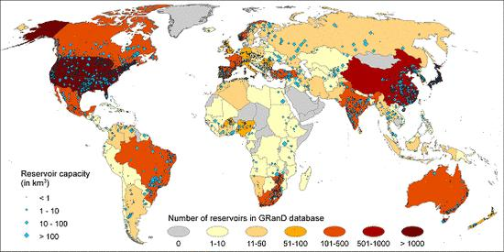

Global Reservoirs
Global Reservoir and Dam (GRanD) Database
Global capacity > 6200 km³
Chao et al., 2008
Lehner et al., 2011

Slide 3
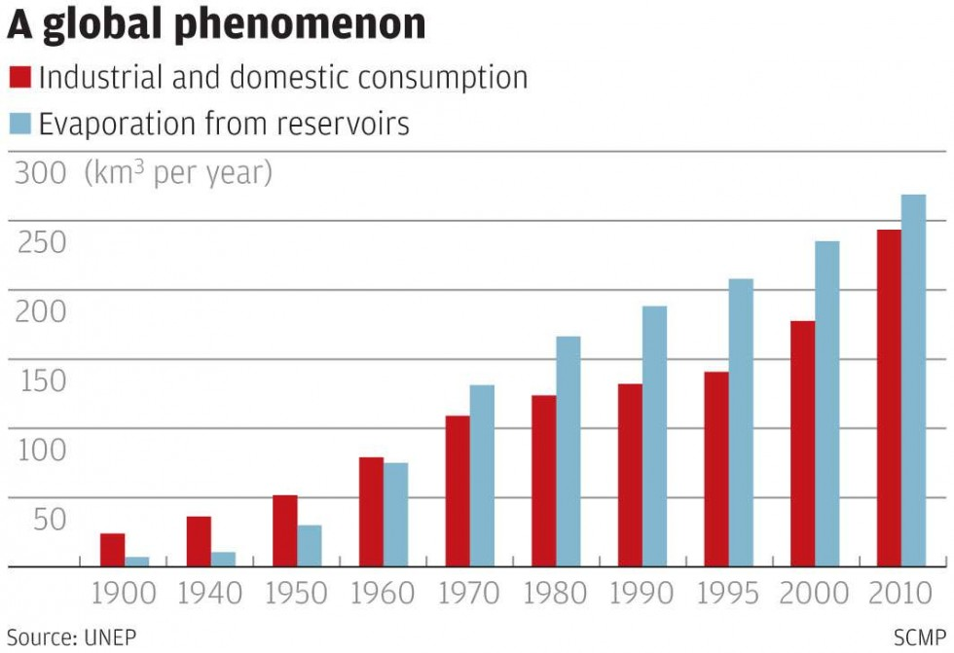
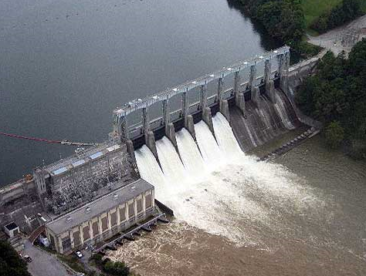

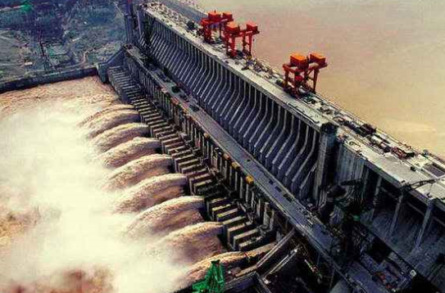
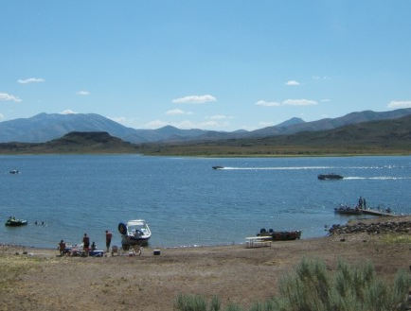
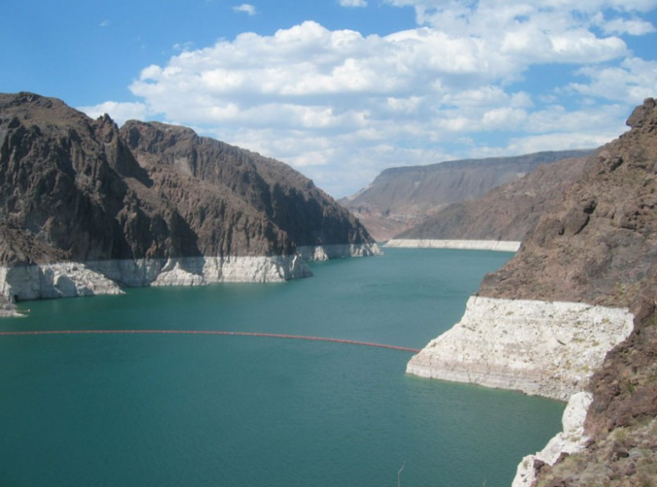
Reservoir Storage vs. Reservoir Evaporation
Evaporation > Industrial + Domestic
~265 km³ in 2010
Hydropower
Irrigation/water supply
Flood control
Recreation
Lake Mead annual evaporation =791,000 acre-feet
https://www.flickr.com/photos/89241789@N00/172762894

Slide 4
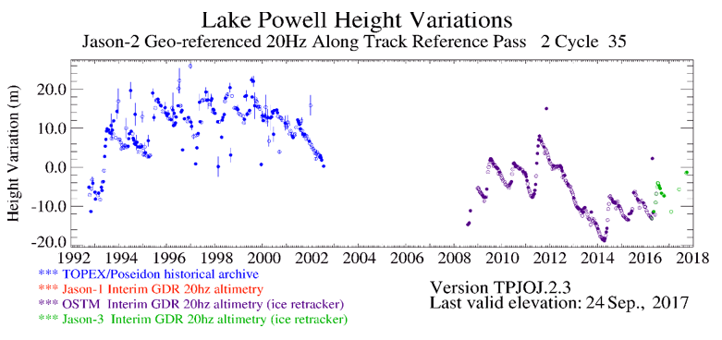
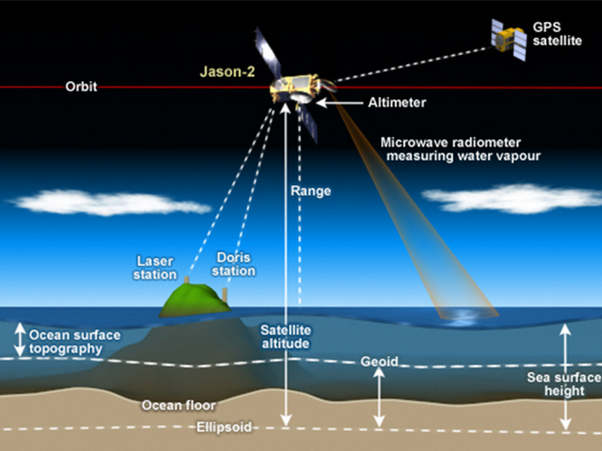


Motivation
FUTURE NEEDS.
Uniform, coherent, and long-term measurements.
Friedrich et al., 2017 BAMS

Slide 5
Objectives
To generate a comprehensive, coherent, and long term global reservoir product series at improved spatial coverage (and at improved temporal resolution) by combining MODIS/VIIRS observations with data from other satellite sensors.
Develop a long term reservoir storage variation dataset under all-weather conditions.
Generate a first long term record of the reservoir evaporation rate and the evaporation loss.
Validate the reservoir product series and quantify the uncertainties associated with the datasets.

Slide 6
Reservoir Storage Variations
Elevation
Altimetry
(Radar/Lidar)
Storage variations
A-E relationship
Area
MODIS/VIIRS
V_{o} = V_{c} – (A_{c}+A_{o})(h_{c}-h_{o})/2
A-E relationship at Lake Mead
Satellite combination | A-E relationship | Sample number | R²
Radar-MODIS (RM) | y = 0.146x + 285.18 | 118 | 0.92
Radar-Landsat (RL) | y = 0.158x + 280.57 | 58 | 0.96
ICESat-MODIS (IM) | y = 0.152x + 281.33 | 14 | 0.91
ICESat-Landsat (IL) | y = 0.199x + 263.15 | 10 | 0.99
5

Slide 7
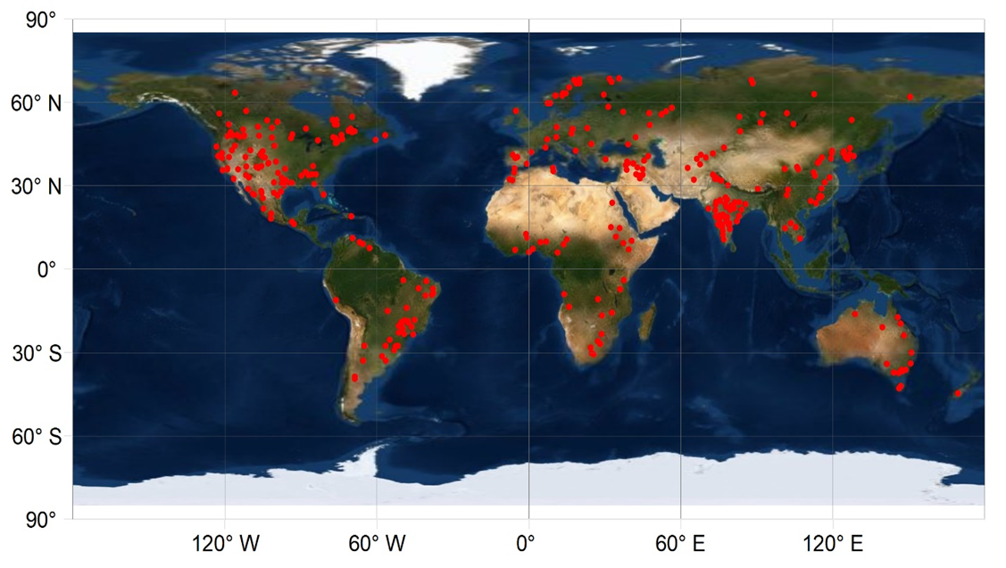
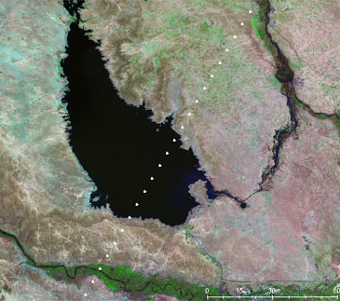
Spatial Coverage of the Dataset
347 reservoirs (3123 km³ , 50% of global capacity)
60 km
4 km
ICESat altimeter track
Radar altimeter track

Slide 8
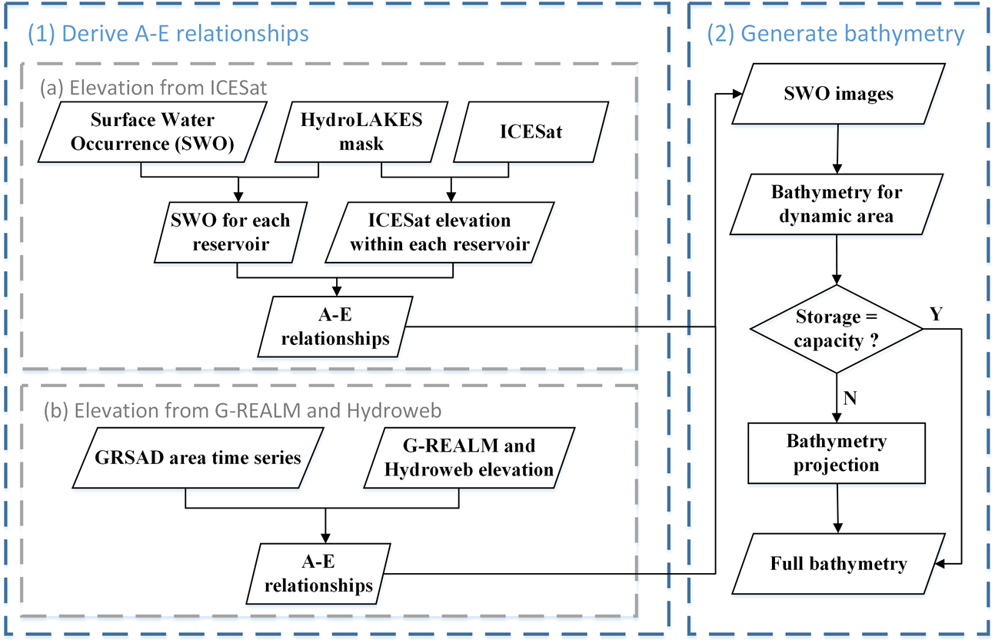
Algorithm for Bathymetry (A-E relationship)
Data
Landsat-based water classfications
Surface Water Occurrence (SWO) from Global Surface Water (GSW) dataset (Pekel et al., 2016)
Global Reservoir Surface Area Dataset (GRSAD) (Zhao and Gao, 2018)
Stallite altimetry dataset
ICESat/GLAS lidar altimetry dataset
Global Reservoir and Lake Monitor (G-REALM)
Hydroweb
(Li et al., 2019)
(Gao et al., 2012)

Slide 9
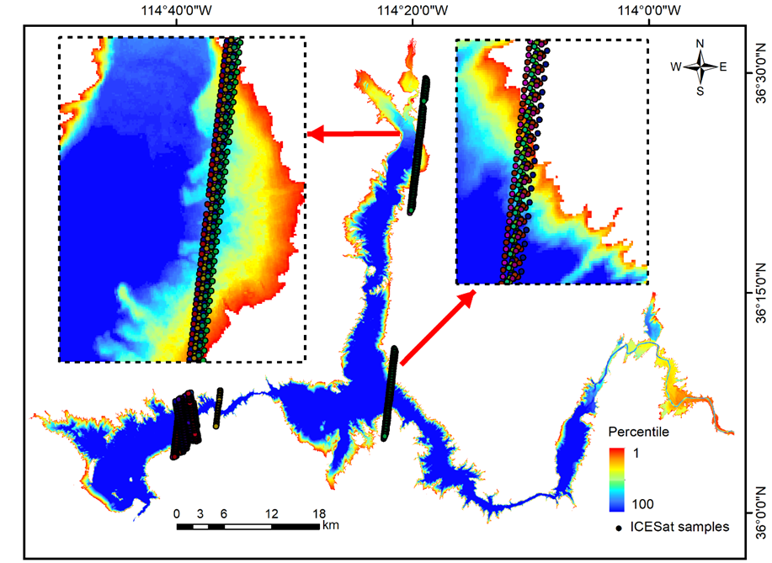
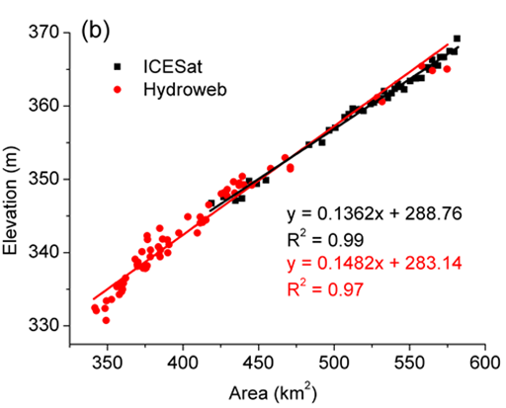
Bathymetry Results
Derive A-E relationships

Slide 10
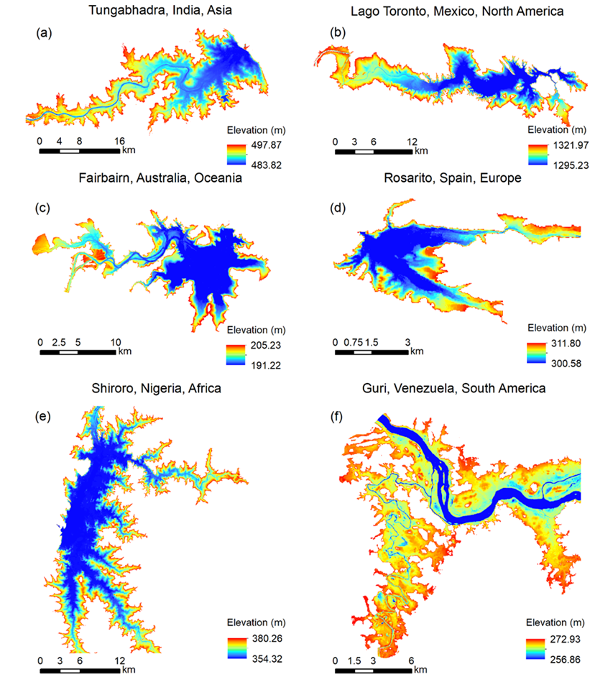
Bathymetry Results

Slide 11
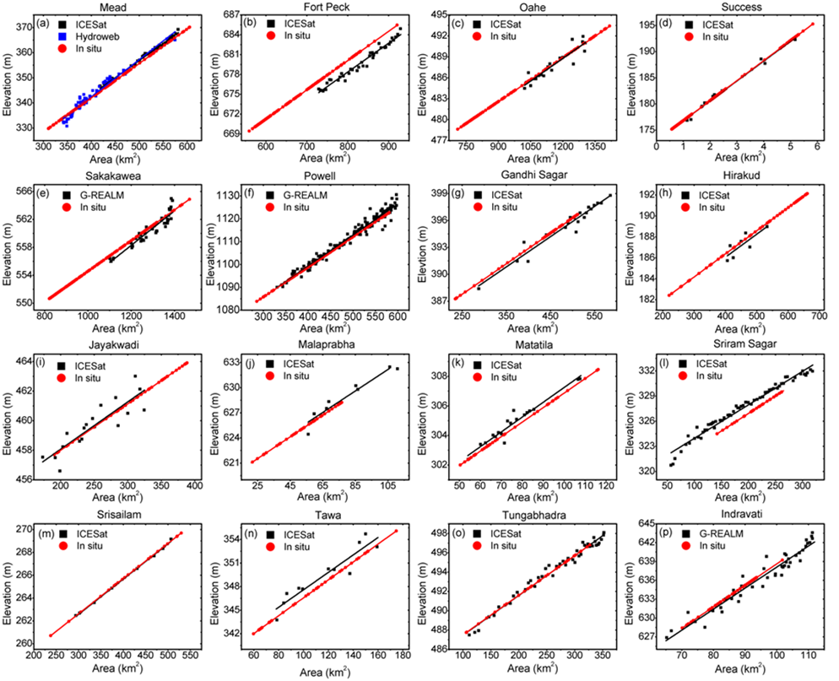
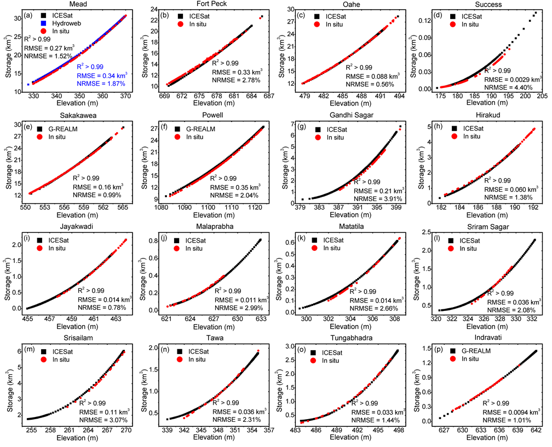
Validations of A-E & E-V Relationships
A-E relationships
E-V relationships
Li et al, RSE, in review.

Slide 12
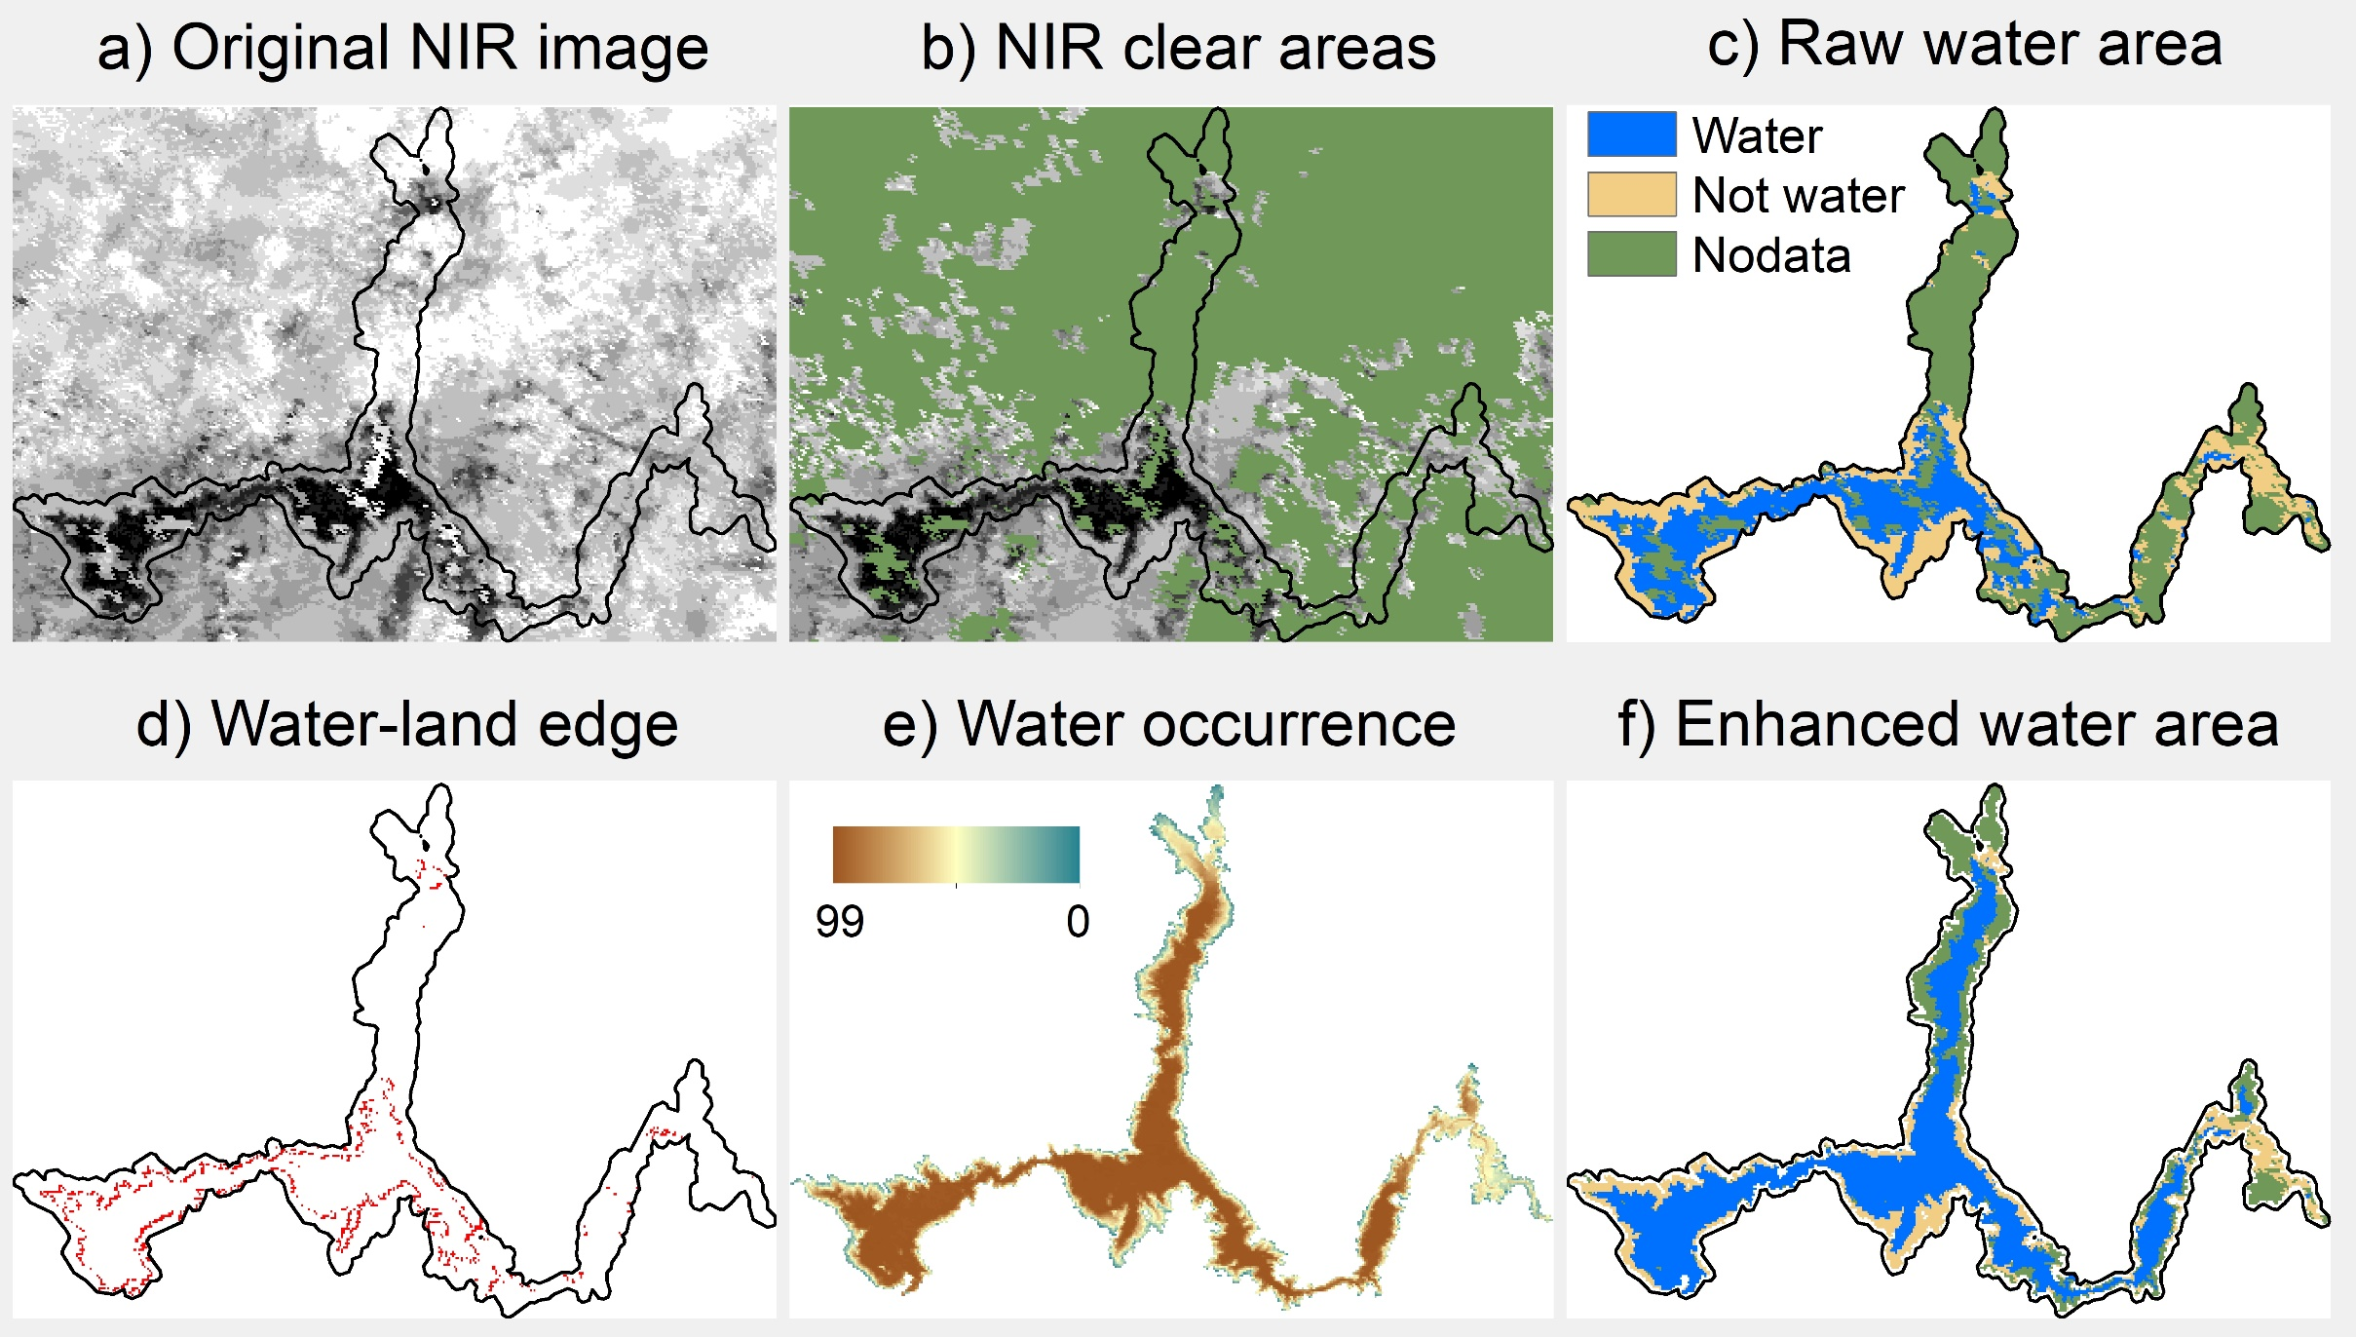
Lake area based on MODIS classification

Slide 13
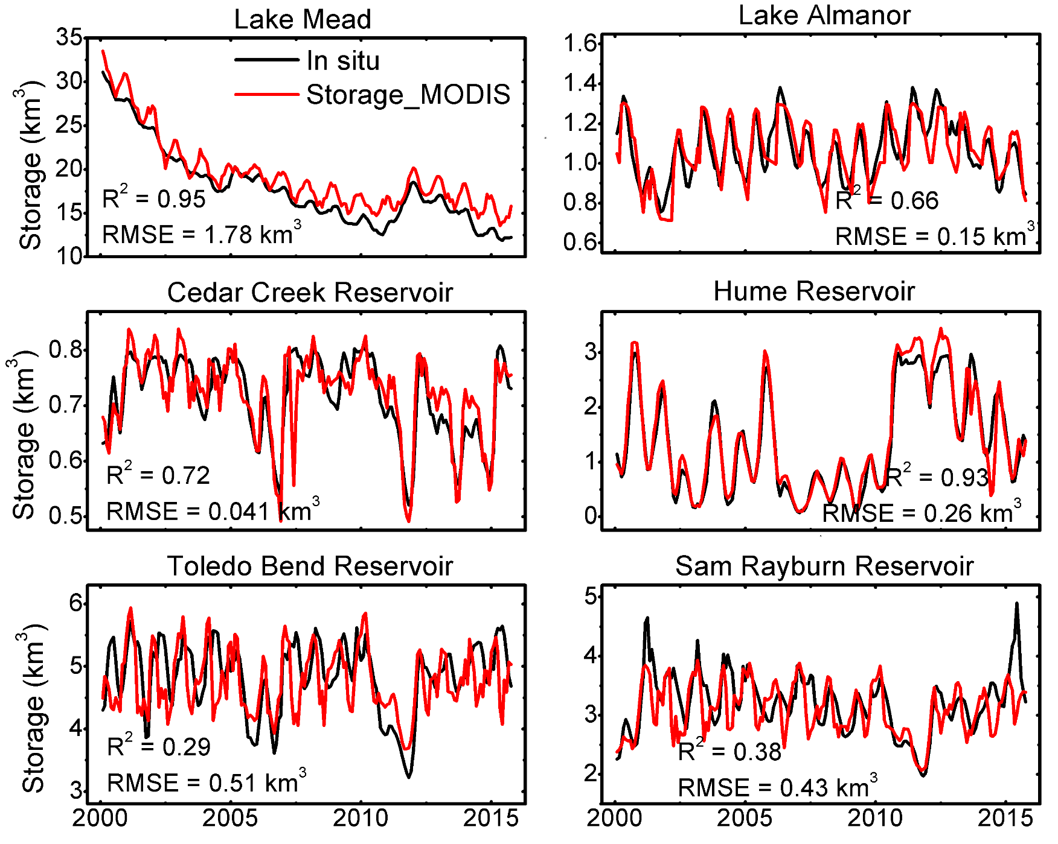
Validation of the MODIS-based Storage

Slide 14
Reservoir Evaporation Estimation
Elevation
Altimetry
(Radar/Lidar)
Storage variations
Area-elevation curve
Area
MODIS/VIIRS
V_{o} = V_{c} – (A_{c}+A_{o})(h_{c}-h_{o})/2
Evaporation loss
Area X evaporation rate
Evaporation rate
MODIS LST, area
+ meteorology data

Slide 15
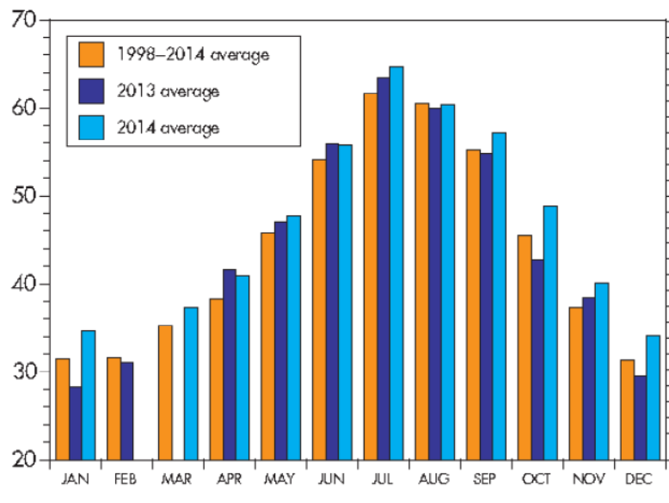
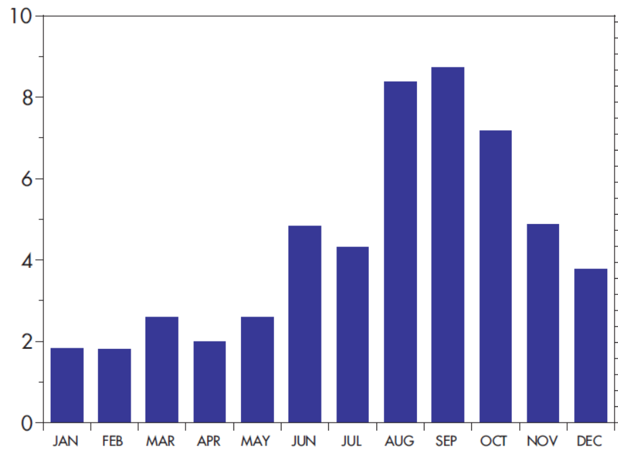
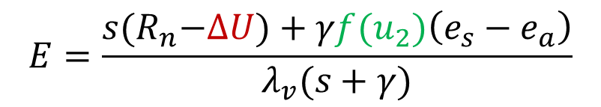
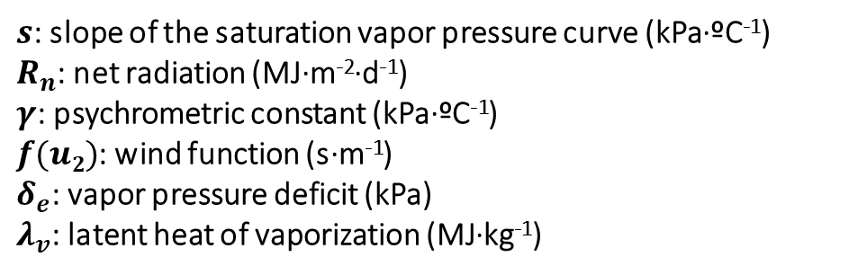
Heat Storage Effect on the Evaporation Rate
Jul
Heat storage effect:
Spring and Summer – absorb heat
Fall and Winter – release heat
Air Temperature (ºF)
Penman Equation
$$E=\frac{s{(R}_{n}−∆U)+γf(u_{2})\left(e_{s}−e_{a}\right)}{λ_{v}(s+γ)}$$
Lake Tahoe 2014
Sep
Wind function
Evaporation (inch)
$s$: slope of the saturation vapor pressure curve (kPa·ºC⁻¹)
$R_{n}$: net radiation (MJ·m⁻²·d⁻¹)
$γ$: psychrometric constant (kPa·ºC⁻¹)
$f(u2)$: wind function (s·m⁻¹)
$δ_{e}$: vapor pressure deficit (kPa)
$λ_{v}$: latent heat of vaporization (MJ·kg⁻¹)

Slide 16
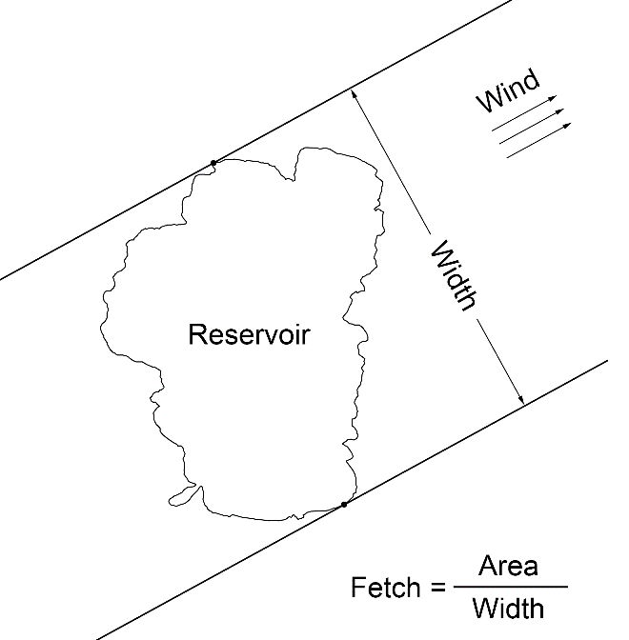
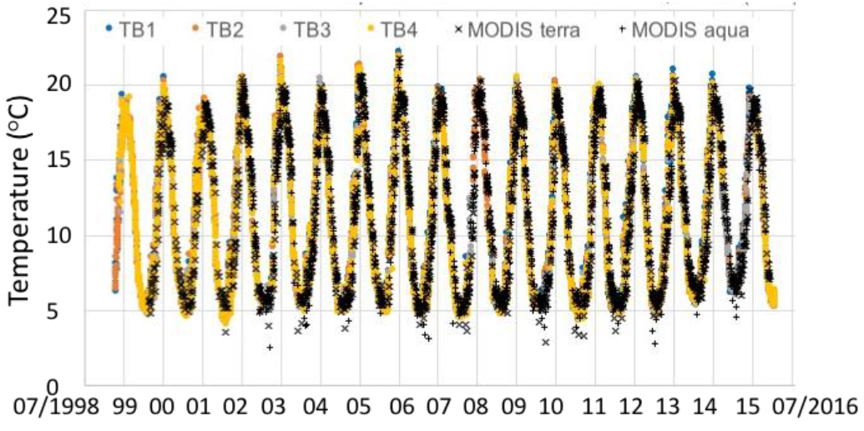

Improving the Estimation of Reservoir Evaporation Rate
$$f\left(u_{2}\right)=λ_{v}(2.33+1.65u_{2})L^{−0.1}$$
Lake Tahoe
(McJannet et al. 2012)
Dynamic
MODIS Area
(Friedrich et al., 2017)
(L)
Zhao and Gao, RSE, 2019.
15

Slide 17
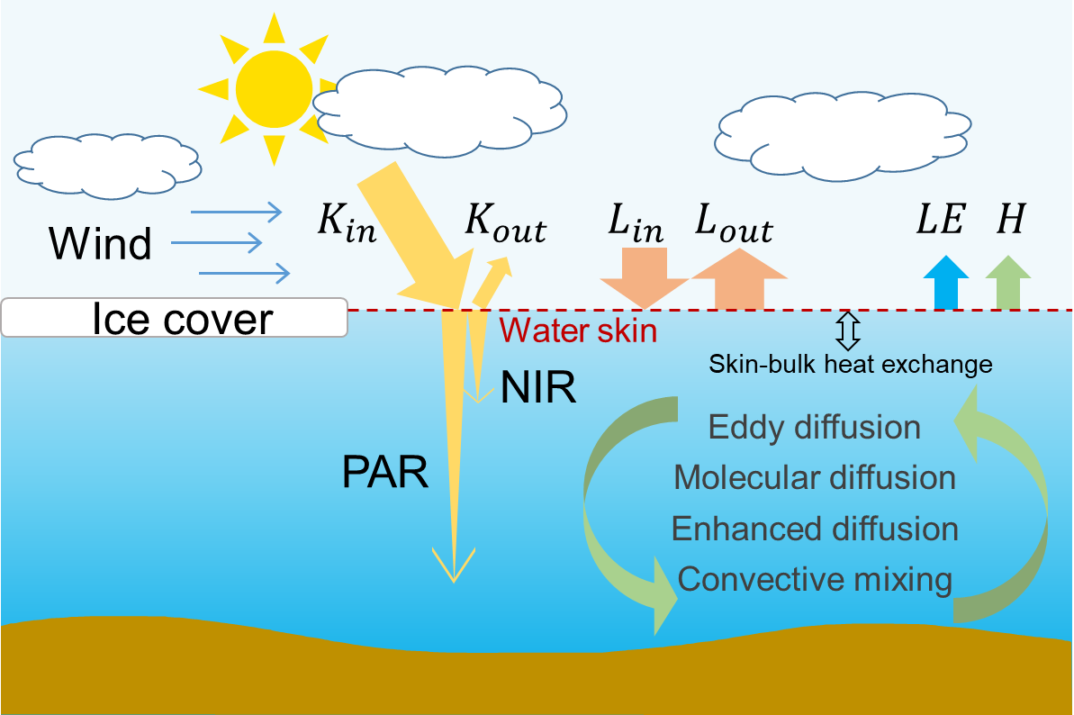
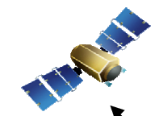
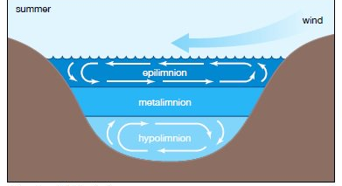
Improving the Estimation of Reservoir Evaporation Rate
Lake Temperature Evaporation Model (LTEM)
Translate MODIS LST to
temperature profile &
Calculate evaporation rate
16

Slide 18
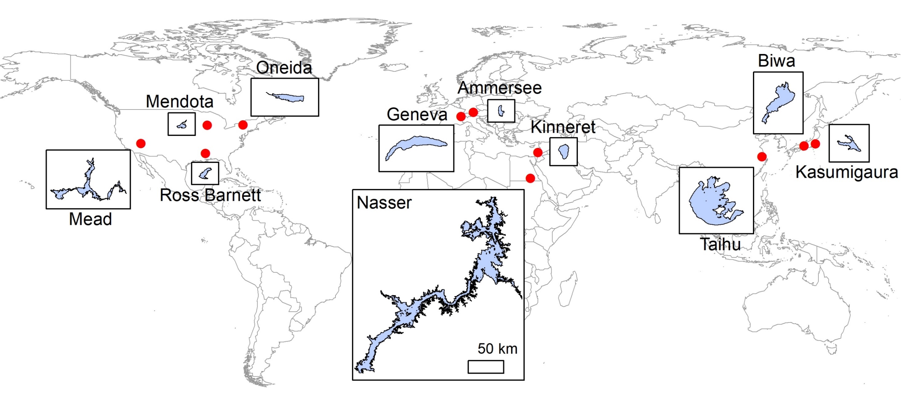
Evaporation Validation Locations
17

Slide 19
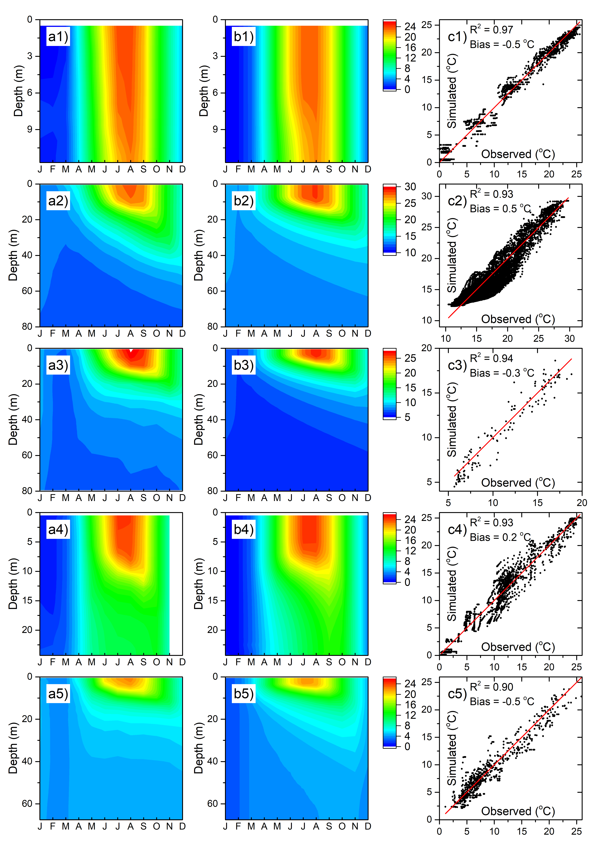
Temperature Profile Validation Results
Oneida Lake
Lake Mendota
Lake Mead
Lake Ammersee
Lake Biwa
Good agreement for mixing depth and temperature seasonality
Overall, long-term biases range from -0.5 °C to 0.5 °C
Monthly value biases range from -5.4 °C to 6.0 °C
18

Slide 20
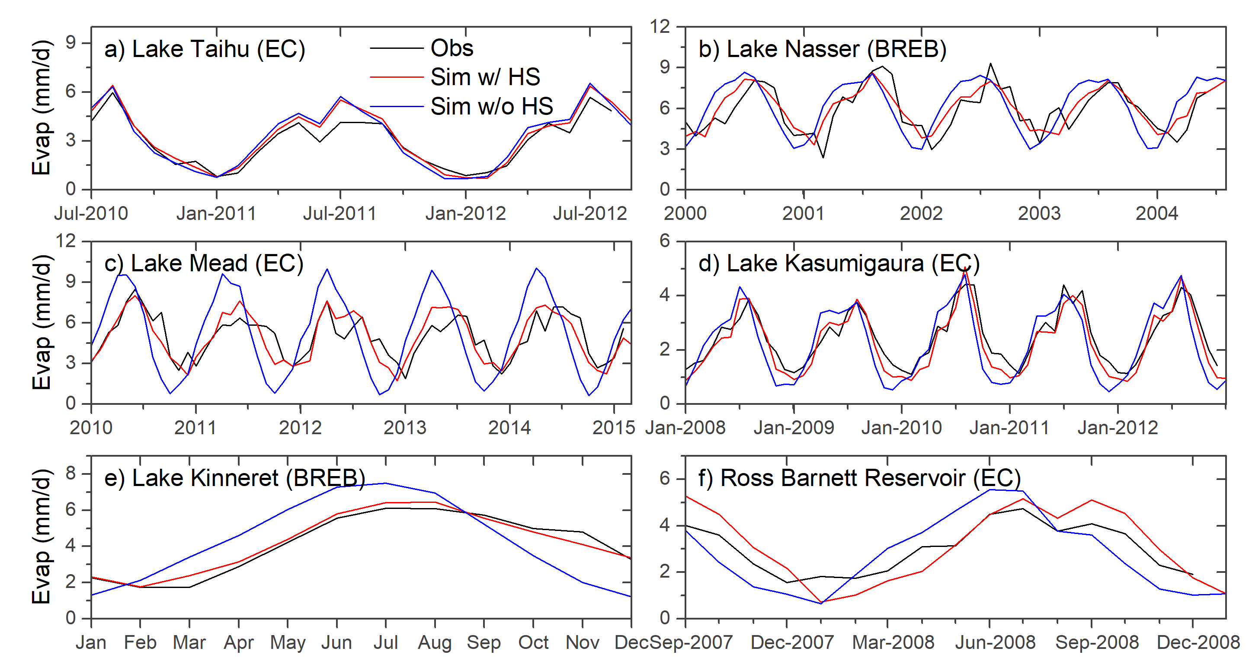
Evaporation Rate Validation Results
Average R² increase: 0.28
More improvement for deep lakes (e.g. Mead: 0.44)

Slide 21
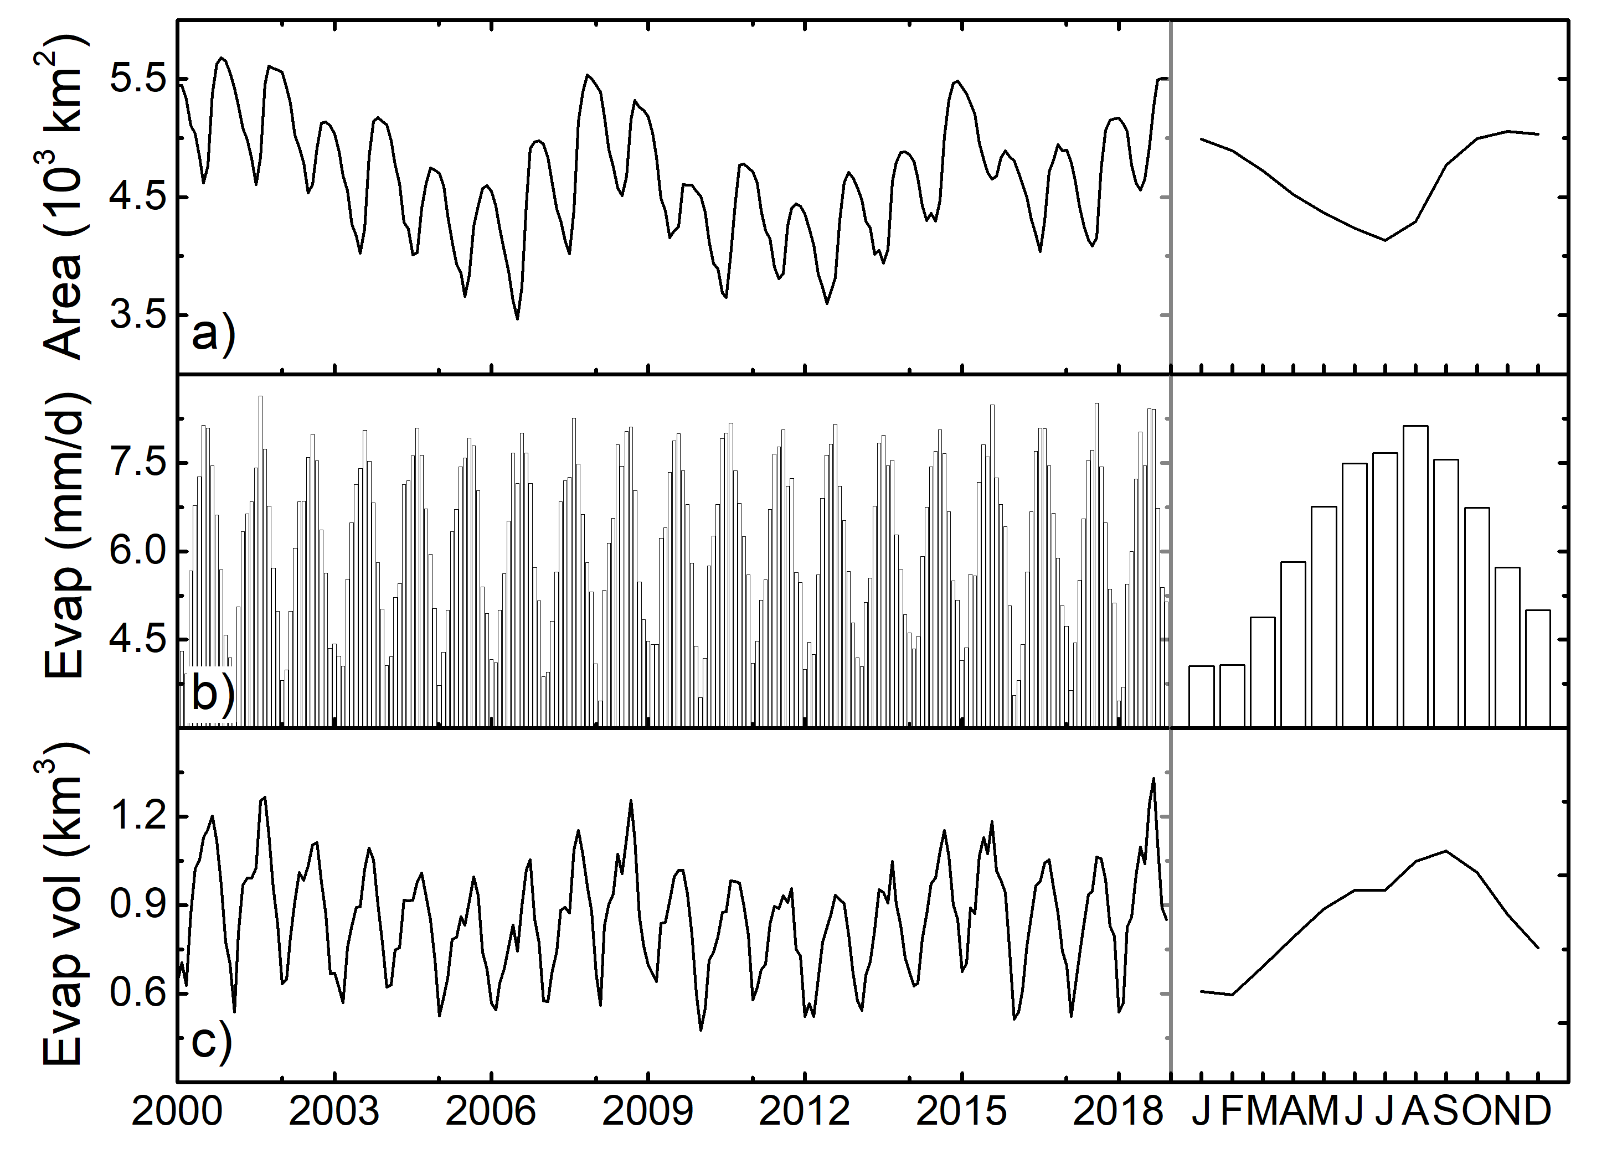
Evaporation Results for Lake Nasser
Zhao and Gao, Estimating lake temperature profile and evaporation losses by leveraging MODIS LST data (in prep)

Slide 22
Summary
By leveraging MODIS observations along with satellite altimetry data, the spatial and temporal coverage of remotely sensed global reservoirs can be significantly improved.
High quality A-E relationship can be achieved using Landsat and altimetry data.
By using MODIS LST to calculate the heat storage and considering fetch as a function of the dynamic lake area, reservoir evaporation rate can be better .
Both the storage and evaporation algorithms have been validated using in situ data.
Future work will focus on applying the algorithms to generate reservoir storage and evaporation product using both MODIS and VIIRS.
Li et al., A high-resolution bathymetry dataset for global reservoirs using multi-source satellite imagery and altimetry, Remote Sensing of Environment, in review.
Zhao and Gao, Estimating reservoir evaporation losses for the United States: Fusing remote sensing and modeling approaches, Remote Sensing of Environment, 226, 109-124, 2019.

