Slide 1
VIIRS Continuity Snow and Ice
George Riggs
SSAI
Dorothy Hall
Earth System Science Interdisciplinary Center (ESSIC) / University of Maryland College Park, MD
Mark Tschudi
CCAR, University of Colorado, Boulder
MODIS/VIIRS Science Team Meeting
18-21 November 2019
College Park, MD

Slide 2
S-NPP Collection 1 (C1) Data Products
LSIPS C1 -- 19 January 2012 to present archived at NSIDC
VNP10 Snow cover extent, 375m, 6 min swath, HDF5 with netCDF Climate Forecast Version 1.6 (CF-1.6) conventions for relevant attributes and georeferenced (lat and lon data included)
VNP10A1 Daily snow cover extent, 375m, tile, HDF-EOS5 with netCDF Climate Forecast Version 1.6 (CF-1.6) conventions for relevant attributes and both HDF-EOS5 grid structure and CF-1.6 projection.
VNP29 Sea ice cover 375m, 6 min swath, HDF5 with netCDF Climate Forecast Version 1.6 (CF-1.6) conventions for relevant attributes and georeferenced (lat and lon data included)
VNP30 Sea ice surface temperature (IST) 750m, 6 min swath, HDF5 with netCDF Climate Forecast Version 1.6 (CF-1.6) conventions for relevant attributes and georeferenced (lat and lon data included)
Algorithms are the same as MODIS C6 algorithms.
L1B input products are the LSIPS versions, HDF-EOS4

Slide 3
S-NPP Collection 2 (C2) Data Products
VNP10 Snow cover extent, 375m, 6 min swath, HDF5 with netCDF Climate Forecast Version 1.6 (CF-1.6) conventions for relevant attributes and georeferenced (lat and lon data included)
VNP10A1 Daily snow cover extent, 375m, sinusoidal tile, HDF5-EOS with CF-1.6 conventions for relevant attributes and georeferenced, HDF-EOS5 grid structure and CF-1.6 variable and attributes.
VNP10A1F Cloud-gap-filled (CGF) Daily snow cover extent, 375m, sinusoidal tile, HDF5-EOS with CF-1.6 conventions for relevant attributes and georeference HDF-EOS5 grid structure and CF-1.6 variable and attributes.
VNP29 Sea ice cover 375m, 6 min swath, HDF5 with CF-1.6 conventions for relevant attributes and georeferenced (lat and lon data included)
VNP30 Sea ice surface temperature (IST) 750m, 6 min swath, HDF5 with CF-1.6 conventions for relevant attributes and georeferenced (lat and lon data included)
L1B input products are NASA L1B C2, HDF5.
Products are in HDF5 and HDF-EOS5 hybrid

Slide 4
Algorithm and Data Product Revisions
Revised the L2 PGEs to read in NASA L1B C2, HDF5 products.
The VNP10 snow cover detection algorithm was revised to reduce the occurrence of no decision results. (Revision made in both the MODIS and VIIRS algorithms.)
The cloud mask cloud confidence flags of probably cloudy and probably clear were added to the VNP10 QA algorithm bit flags variable, so are available for investigation of cloud/snow discrimination. (This was also done in MOD10 C6.1.) The QA bit flag order changed to be consistent with MOD10 products.
Coded an algorithm to read in the ASIPS Cloud Mask Product CLDMSK_* to support investigation/evaluation of that cloud mask.
Consistent use of CF-1.6 conventions for relevant attributes and georeference variables and attributes through all product levels.
Revised/updated the product user guides!!!

Slide 5
Algorithm and Data Product Format Challenges
Significant effort to revise PGEs to output products in HDF5 and HDF-EOS5 hybrid formats.
Adoption of netCDF CF-1.6 conventions for relevant attributes, flag values and flag masks, and georeference in products has taken notable amount of effort. (Apply these lessons learned to MODIS C7 HDF5, HDF-EOS5 formats.)
Including netCDF CF-1.6 conventions allows for more tools/libraries to read and project the products, which enhances their usability.
HDF-EOS5 – hybrid L3 products include the HDF-EOS heritage grid data structure for Sinusoidal projection AND CF-1.6 georeference variable and attributes for Sinusoidal projection. Tools such as HEG and Panoply will read and project these products using the different georeference data.

Slide 6
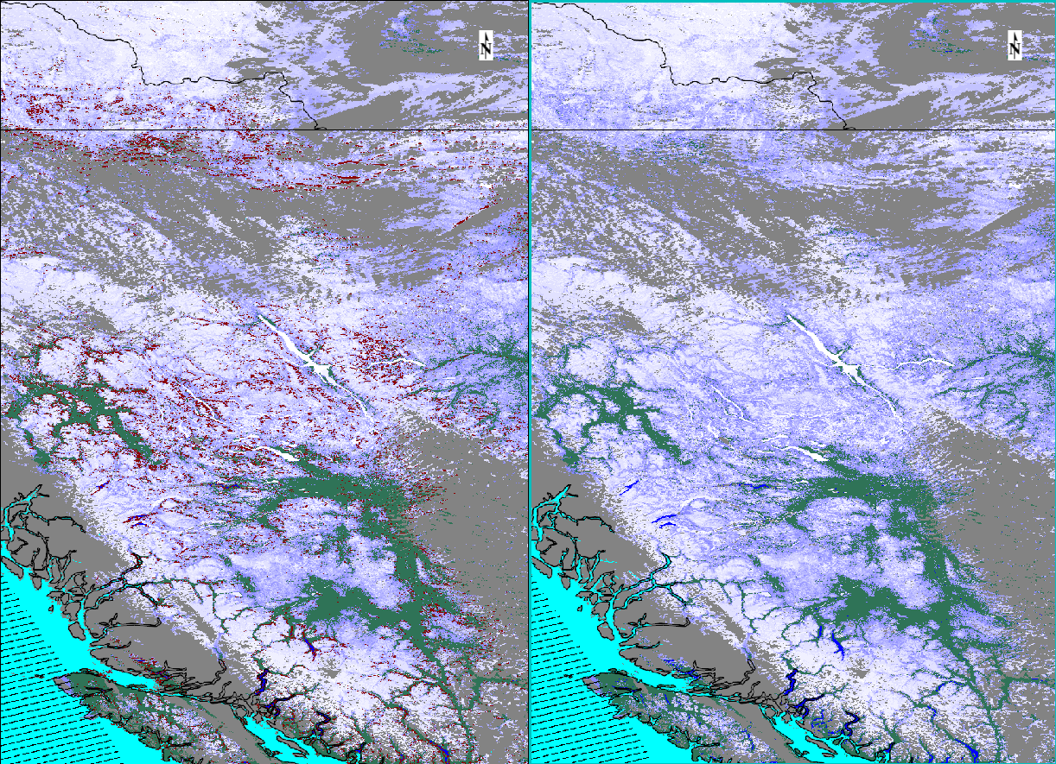
VNP10 revised low visible reflectance screen
VNP10.A2017093.2042.* C1
With restrictive, low visible reflectance screen many situations of low illumination resulted in a no decision result, red in these images.
VNP10.A2017093.2042.* C2
With revised, less restrictive, low visible reflectance screen situations of low illumination are detected as snow or not snow which improved quality of the snow cover area product.
British Columbia, Lake Williston near center of image.

Slide 7
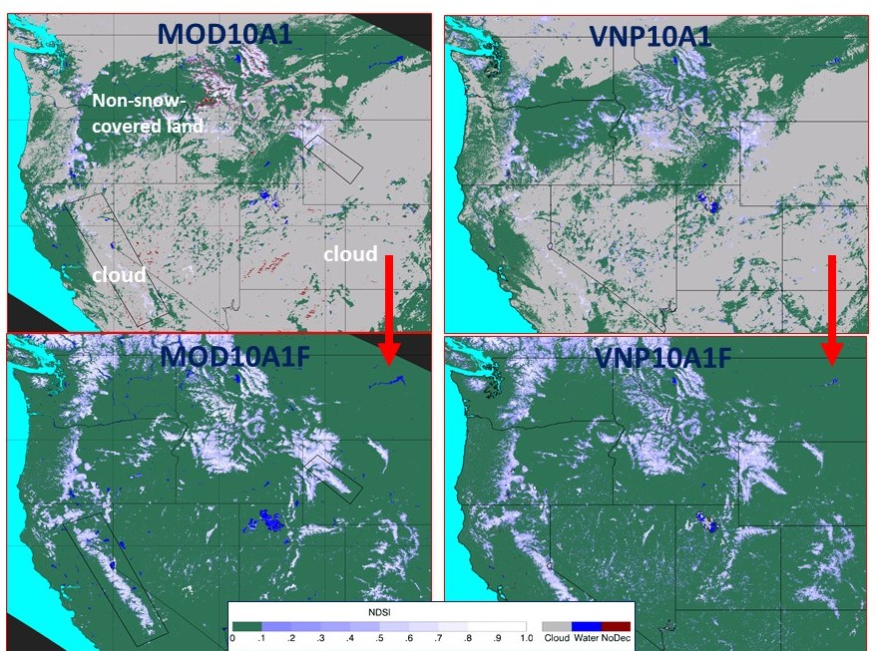
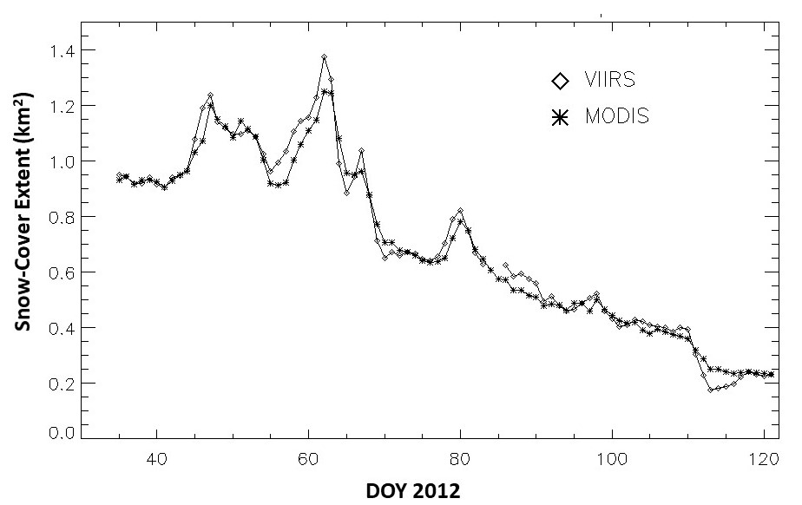
Cloud Gap Filled (CGF) VIIRS VNP10A1F and MODIS MOD10A1F Products
A
B
R = 0.99
A: Examples of MODIS and VIIRS standard and cloud-gap filled (CGF) snow maps on 14 April 2012 for a study area in the western United States/southwestern Canada. Top row: MODIS MOD10A1 C6.1 (left) and VIIRS VNP10A1 C2 snow maps showing extensive cloud cover. Bottom row: Cloud-free MOD10A1F C6.1 CGF map (left) and VNP10A1F C2 (right) CGF map products corresponding to the daily MODIS and VIIRS snow maps in the top row.
B: Time series showing differences in snow-cover extent derived from Terra MODIS and S-NPP VIIRS cloud-gap filled (CGF) snow maps for a 3-month period, February – April 2012.
Hall, D. K., Riggs, G. A., DiGirolamo, N. E., and Román, M. O.: MODIS Cloud-Gap Filled Snow-Cover Products: Advantages and Uncertainties, Hydrol. Earth Syst. Sci. Discuss., https://doi.org/10.5194/hess-2019-123, in press, 2019.

Slide 8
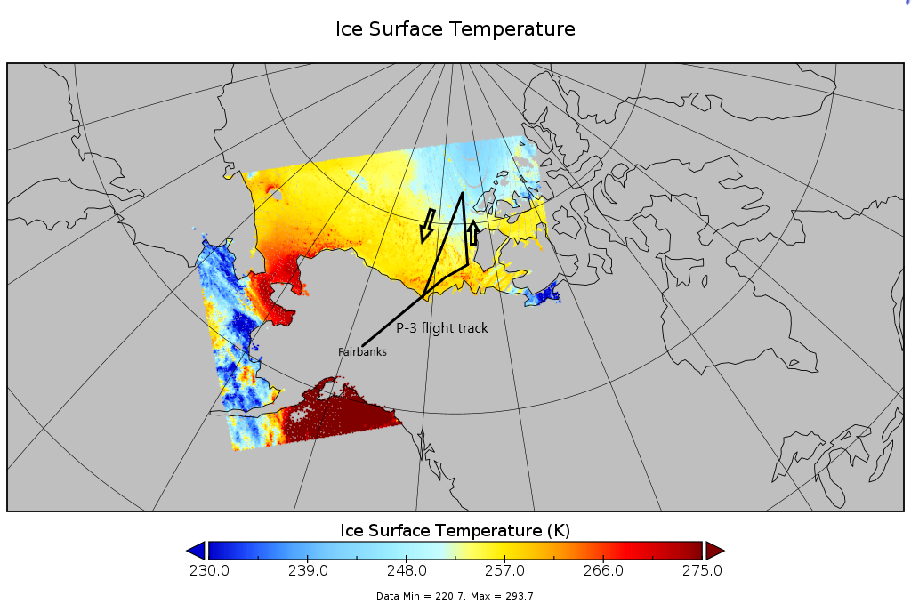
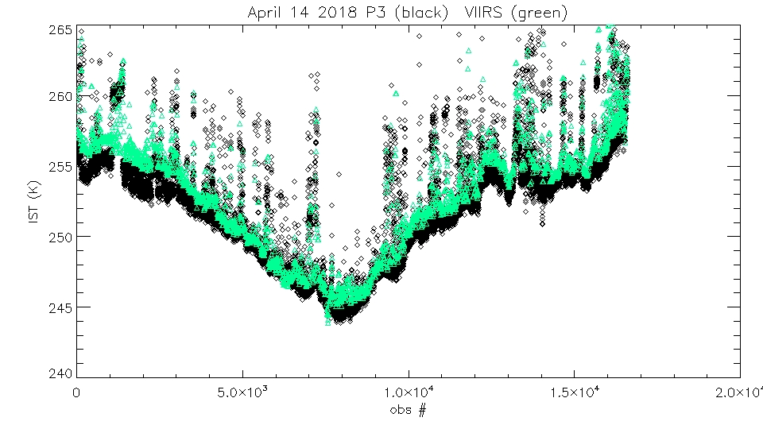
VIIRS Ice Surface Temperature (IST) VNP30 with S-NPP NASA L1B input validated to Stage 1
Validated VNP30 with Operation Ice Bridge (OIB) flight data from the P3 KT-19 Skin Surface Temperature Sensor.
VNP30.A2018102.2136.
P3 KT-19 IST (K) VIIRS IST (K)
mean = 252.212 mean = 253.241
std dev = 3.94913 std dev = 4.10846

Slide 9
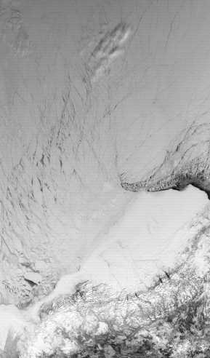
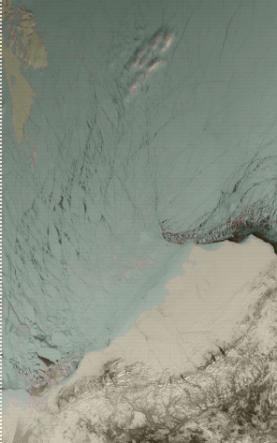
VIIRS Sea Ice Cover VNP29 with S-NPP NASA L1B input validated to Stage 1
In the image to the right, the NASA VIIRS Sea Ice Cover (VNP29) product is overlain in green, and we see that the sea ice is correctly identified, while the land ice is omitted from the product. Also note that open water, such as the flaw lead off the northern coast of Alaska, is visually seen as open ocean, but there is some thin ice marked by the sea ice cover product.
Beaufort Sea
Alaska
NASA VIIRS VNP02MOD Band 1 reflectance (left), with NASA VIIRS Sea Ice Cover Product (VNP29) overlain in green on right. Image acquired on April 14, 2018, 2136 UTC.

Slide 10
JPSS-1 (NOAA-20) Snow Cover Data Product VJ110
Significant issue for snow cover (VJ110) product is the VIIRS noisy detector (#29) in band I03, critical for snow cover detection.
This noisy detector causes stripes of erroneous snow cover across a swath greatly decreasing the quality of the VJ110 and subsequently VJ110A1 and VJ110A1F. This problem varies with viewing conditions and landscape conditions.
The noisy detector problem had to be corrected to improve quality of the snow cover products.
VCST added attributes and flag values for noisy detectors in the NASA L1B C2 product.
Major revision of PGE507 producing VNP10 or VJ110 was done.
Revised the processing flow of the algorithm and added a function to average over a noisy detector: noisy detector(s) in any I0* band used as input.
Revised the I/O functions for L1B inputs .
Revised storage/processing of variables in memory.
Added attributes with data on noisy detectors in VJ110

Slide 11
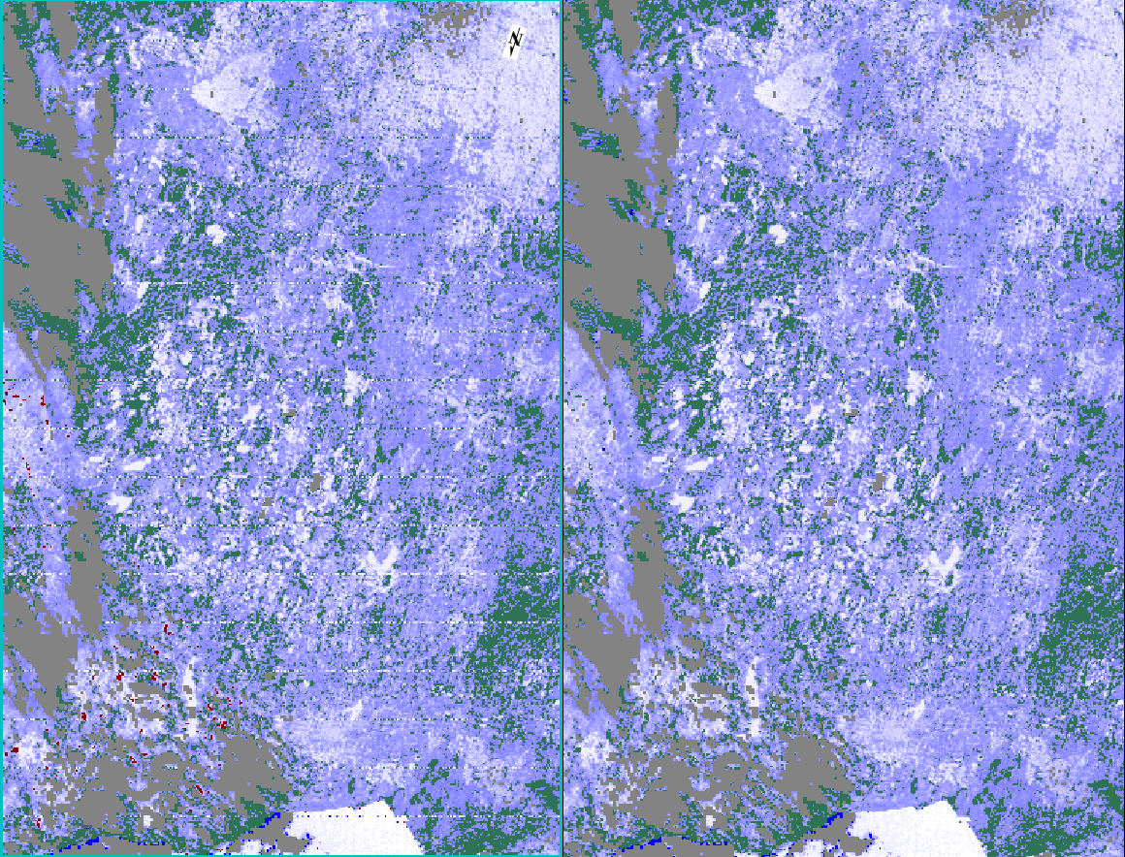
PGE507 Revised for Noisy Detector
VJ110
With function averaging over noisy detector corrects for noisy detector caused snow cover errors
VJ110
Band I03 noisy detector (#29) causes stripes of erroneous snow cover
100
NDSI SNOW COVER
10
LAND
CLOUD
LAKE/RIVER
NO DECISION
VJ110.A2018351.1824 (17 December 2018, region of northern Wisconsin)

Slide 12
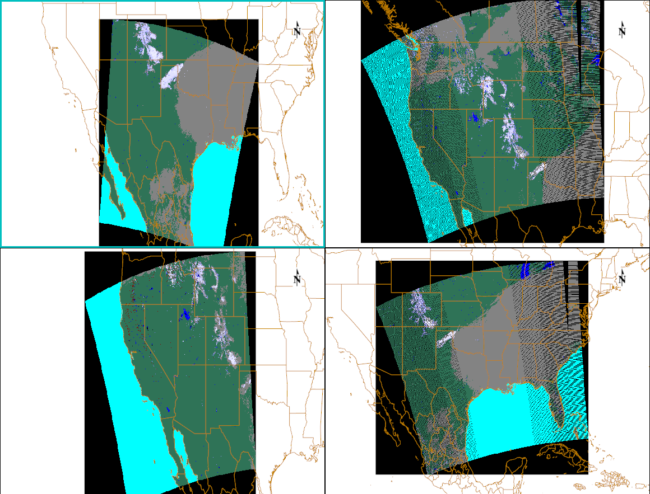
Currently
Four sensors views of snow cover daily
TERRA MODIS MOD10_L2.A2019298.1730.
S-NPP VIIRS VNP10.A2019298.2006.
Snow cover detected in same location.
Possible to combine the four products to create a daily snow cover
Notable differences in cloud mask among the four sensors cloud mask algorithms/products need to be investigated.
Revise how the cloud mask products are used to alleviate cloud commission errors on snow.
NDSI SNOW COVER
1
100
LAND
CLOUD
NO DECISION
LAKE/RIVER
OCEAN
AQUA MODIS MYD10_L2.A2019298.2045.
NOAA-20 VIIRS VJ110.A2019298.1912

Slide 13
future
Continue investigating ways to reduce cloud/snow discrimination.
Which cloud mask data product CLDMSK_L2_MODIS_Aqua, CLDMSK_L2_VIIRS_SNPP, VNP35_L2, to use and effect on continuity of products.
Data product format guidelines or requirements. File structure, local and global attributes, PI generated or by LSIPS or DAAC or some combination.
VIIRS daily IST– is there a better way to produce a daily product, e.g. a diurnal IST, to replace the compositing method used in the MODIS IST product?
The rise of Google Earth Engine – how to track data product usage metrics? How are products supported in GEE?

