Slide 1
Generating consistent and continuous long-term global surface reflectance product suite from Suomi-NPP VIIRS and EOS MODIS
S. Skakun, E. Vermote, J.-C. Roger (NASA GSFC / UMD)

Slide 2
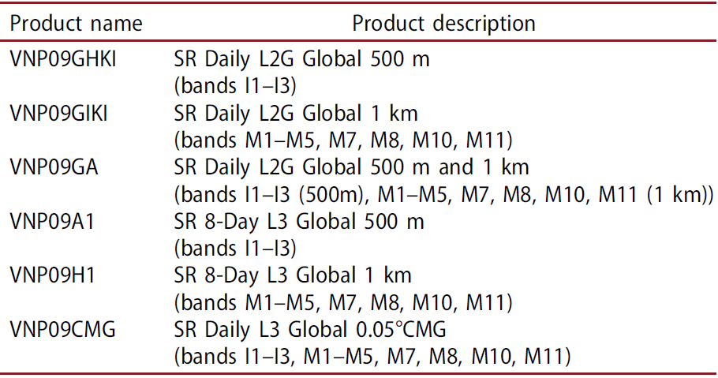
Status of VIIRS SR
VIIRS SR Product
Collection 1: (Released in 2017)
Publications:
Skakun, S., Justice, C. O., Vermote, E., & Roger, J. C. (2018). Transitioning from MODIS to VIIRS: an analysis of inter-consistency of NDVI data sets for agricultural monitoring. International Journal of Remote Sensing, 39(4), 971-992.
Pahlevan, N., Sarkar, S., Devadiga, S., Wolfe, R. E., Román, M., Vermote, E., ... & Xiong, X. (2016). Impact of spatial sampling on continuity of MODIS–VIIRS land surface reflectance products: a simulation approach. IEEE Transactions on Geoscience and Remote Sensing, 55(1), 183-196.
Roger, J.-C., E. F. Vermote, S. Devadiga, and J. P. Ray 2016. “Suomi-NPP VIIRS Surface Reflectance User’s Guide.” V1 Re-processing (NASA Land SIPS).
Vermote, E., Justice, C., & Csiszar, I. (2014). Early evaluation of the VIIRS calibration, cloud mask and surface reflectance Earth data records. Remote Sensing of Environment, 148, 134-145.
Status and Updates:
Adapted from MODIS LaSRC (Land Surface Reflectance Code)
Validation stage III (AERONET) and cross-comparison with MODIS is on-going
Code was ported from S-NPP to JPSS1 and the Science Team evaluation will start shortly (BELMANIP2, AERONET)
Known Issues:
High Aerosol Flag (fixed and will be integrated)
NDVI anomalies at 0.05° spatial resolution for the state of Iowa (US) derived from MODIS/Aqua (a), and adjusted VIIRS (b) data on August 21, 2012. Anomalies were computed by subtracting NDVI values from the median NDVI values for 2002–2016 derived from MODIS/Aqua
The derived uncertainties (for surface reflectance and VIs) related to the combined use of MODIS and VIIRS products are being estimated and reported to user community to further quantify uncertainties for high level products, e.g. crop yield models.

Slide 3
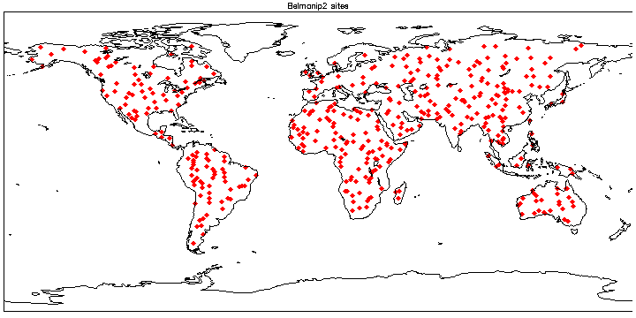
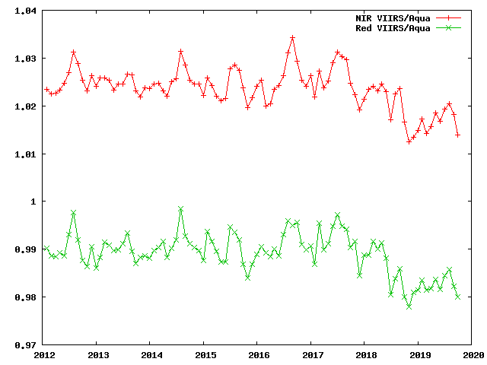
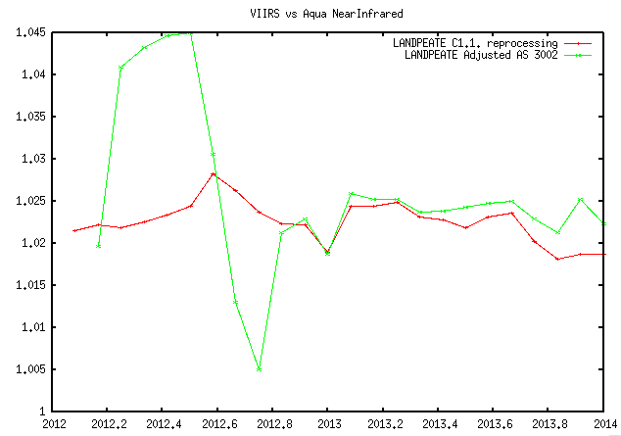
Continuous monitoring of data
BELMANIP sites
VIIRS vs Aqua near-infrared and red (Ver 1)
(A)
(C)
VIIRS vs Aqua near-infrared
(B)
(A) The cross comparison of the VIIRS and MODIS Aqua SR products for the BELMANIP2 sites.
(B) The plots show that the NASA reprocessing of VIIRS (C1.1) is in a good agreement with MODIS.
(C) Continuous monitoring of Version 1 to ensure data stability/consistency.
This analysis shows how the VIIRS SR product can secure the Long Term data continuity from the MODIS global Land record which is crucial for the NASA Earth Science mission.

Slide 4
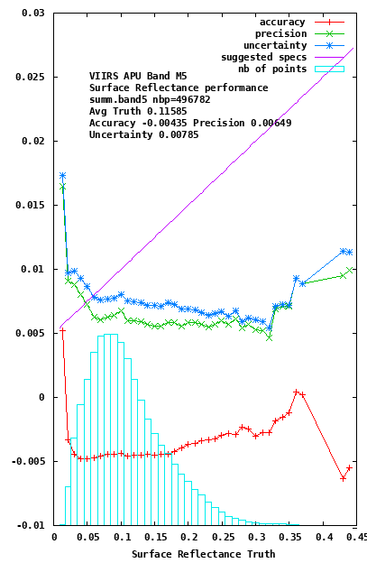
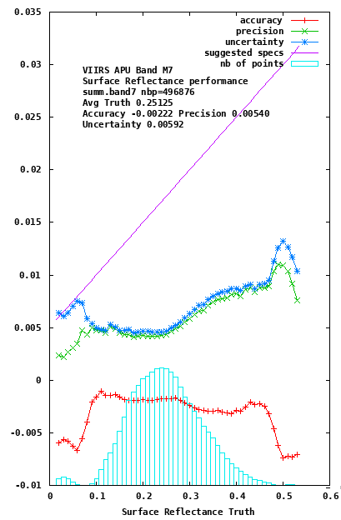
VIIRS SR Validation stage III (AERONET)
VIIRS band M5 (red)
VIIRS band M7 (NIR)
Performance of the VIIRS surface reflectance product for 2018 over >200 AERONET sites for M5 (Red) and M7 (NIR)

Slide 5
High Aerosol Flag issue
The high aerosol flag was set using an approximation on the path radiance for MODIS and VIIRS
The approximation caused problem mainly on bright surface at high view angle
For Landsat 8 and Sentinel-2 LaSRC, a more robust approach has been used
We ported the Landsat and Sentinel 2 approach to MODIS and VIIRS

Slide 6
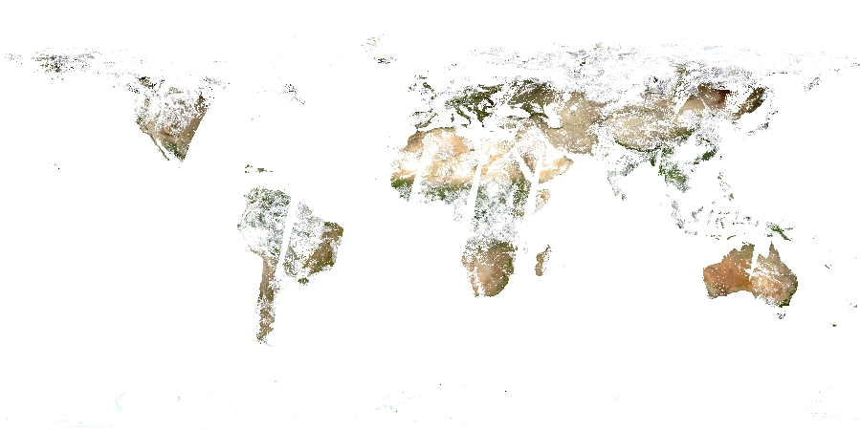
Old High Aerosol Flag Terra

Slide 7
New High Aerosol Flag Terra

Slide 8
Old High Aerosol Flag Aqua

Slide 9
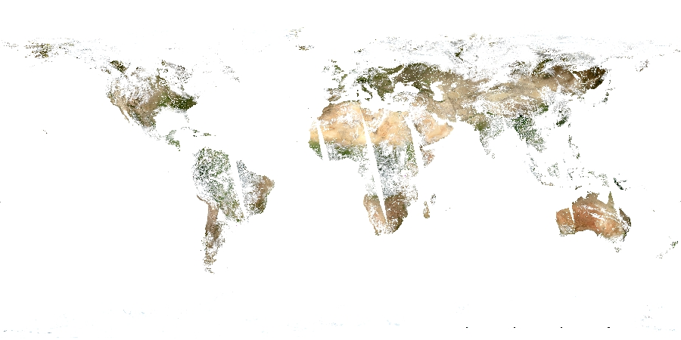
New High Aerosol Flag Aqua

Slide 10
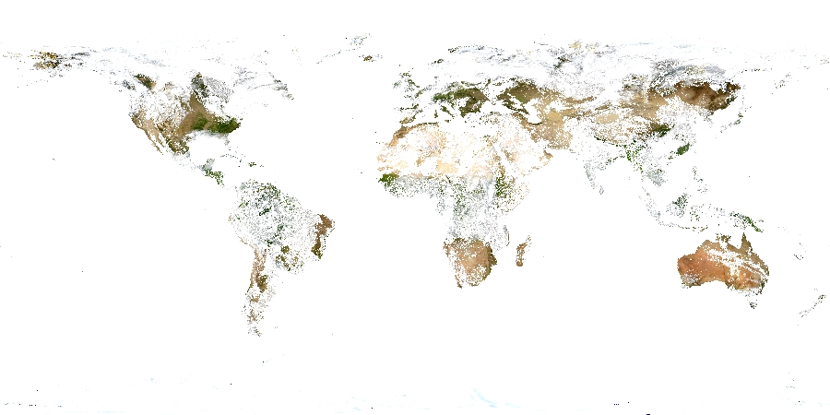
Old High Aerosol Flag VIIRS

Slide 11
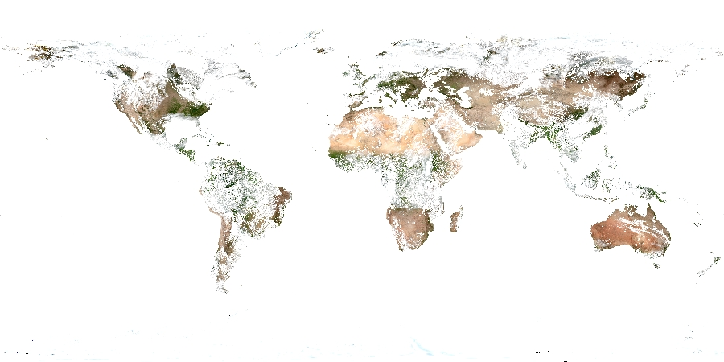
New High Aerosol Flag VIIRS

Slide 12
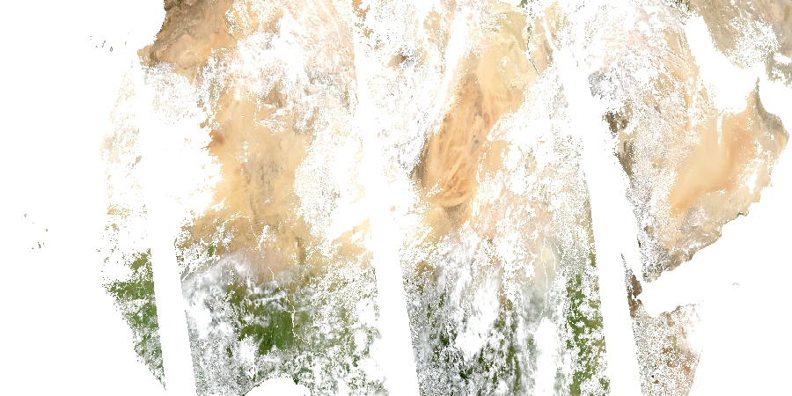
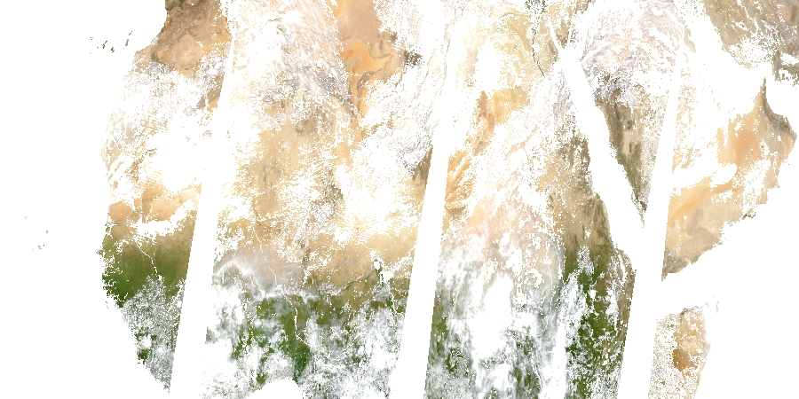
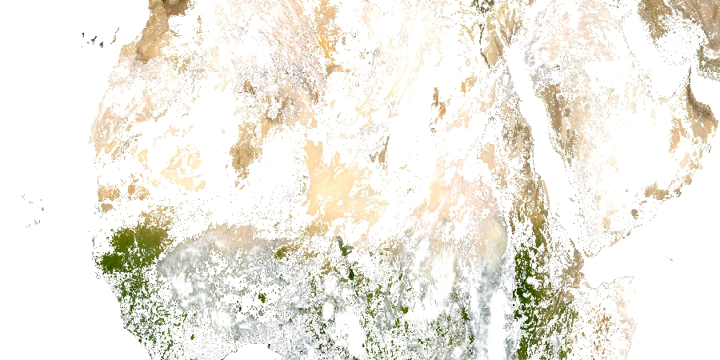
Old high aerosol flag
Aqua
Terra
VIIRS

Slide 13
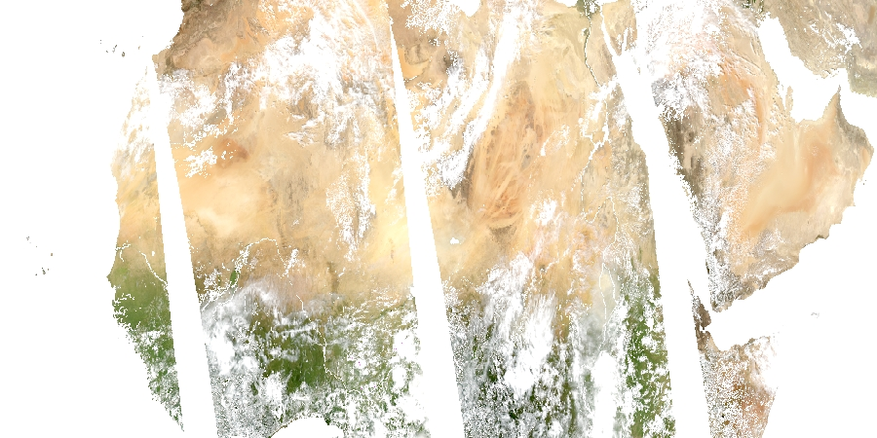
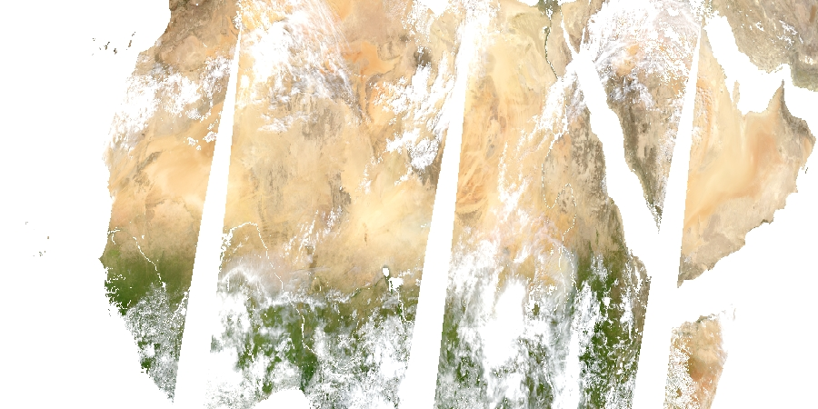
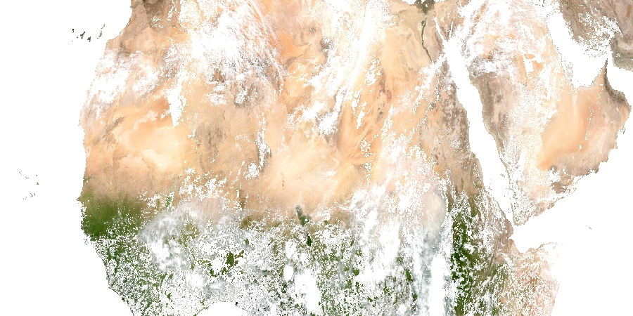
New high aerosol flag
Aqua
Terra
VIIRS

Slide 14
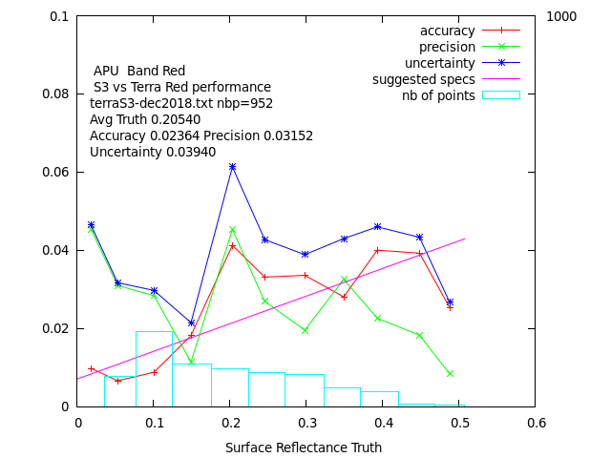
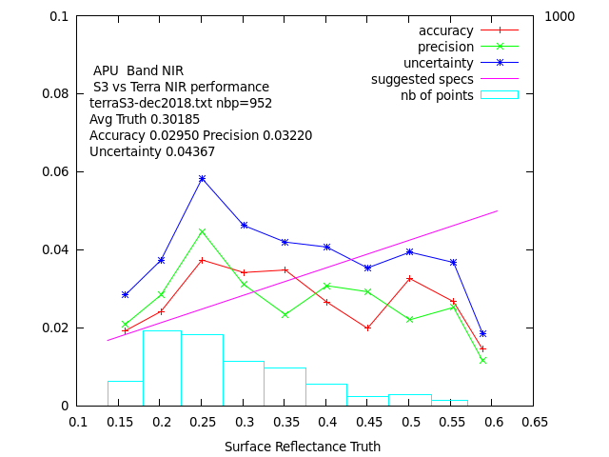
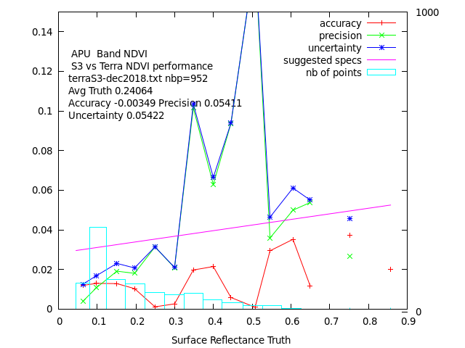
Sentinel 3: Continuity for Morning observation beyond Terra ?
S3 vs Terra (red)
S3 vs Terra (NIR)
S3 vs Terra (NDVI)
There is room for improvement in the S3 SR performance (before it can be used)
Further investigations could include:
Aerosol validation
Comparison of S3 SR to AERONET reference SR
Application of LaSRC to S3

Slide 15
Conclusions
Continuous monitoring of VIIRS is ongoing to ensure data stability/consistency
BELMANIP sites, AERONET validation
Porting to JPSS is under way
Year 2018 fully processed
Need further validation
High aerosol have been fixed
Will be incorporated into the next collections:
MODIS Collection 6.1
VIIRS Collection 2

