Slide 1
Updates of the NASA Ocean Optics Protocols (OOPs; ca. 2002-2003)
Will encompass field measurements not addressed in NASA OOPs
Under the auspices of IOCCG to encourage broad international acceptance
Intended to be “living documents” – to be revised as necessary
New Series of IOCCG Publications (available only on-line as pdf files)*
Prepared by subject matter experts
Peer-reviewed by the scientific community
Protocols will have DOIs and archived at IODE Ocean Best Practices
https://www.oceanbestpractices.net
Thus far, largely supported by NASA and shepherded by NASA GSFC staff plus contributing authors
recent support from IOCCG, OCB, EUMETSAT and JAXA
* https://ioccg.org/what-we-do/ioccg-publications/ocean-optics-protocols-satellite-ocean-colour-sensor-validation/

Slide 2
Process in IOCCG in situ Measurements Protocols Development
Post Protocol on IOCCG website for Peer Review (60+ days)
Notify community through IOCCG, TOS, OCB, NASA e-mail lists, etc.
Comments received by lead authors or editors
Assemble a Team of Subject Matter Experts
Obtain travel funds; hold workshop(s) to discuss and resolve challenges
Establish a protocol document draft outline
Writing of the protocol document
Contact lead/contributing authors often
Revision of Protocols Based on Public Comments
Identify lead/contributing authors
Hold public workshops/breakouts; present progress at conferences
Final Peer Review by Associate Editorial Peer Reviewers
Verify that authors adequately address public comments
Final Technical Revisions & Copy Editing/Proofreading
IOCCG obtains DOI and adds Front/Back cover pages
“Final” version posted to IOCCG website
Notes:
Plan is to semi-regularly update each set of protocols as knowledge/understanding and technology matures.

Slide 3

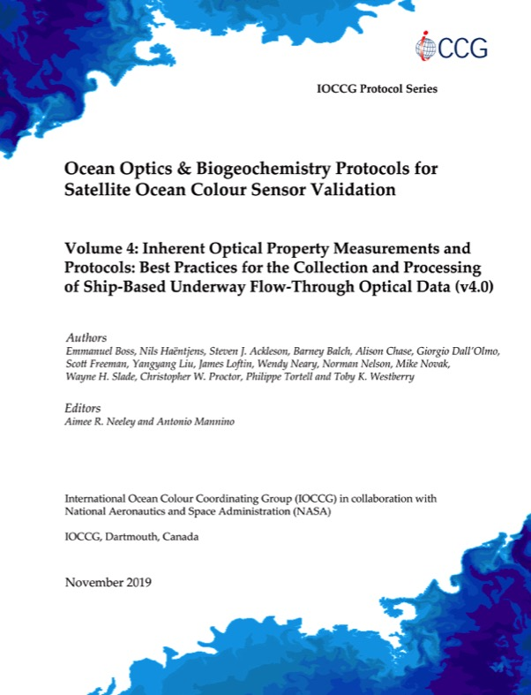
Status of Protocols
Vol. 1.0 Absorption
(particles)
COMPLETED
Nov. 2018
Vol. 2.0 Beam-c
COMPLETED
April 2019
Vol. 3.0 Radiometry for Validation
~COMPLETED
Nov. 2019
Vol. 4.0 Inline Flow-Through IOPs
COMPLETED
Nov. 2019
CDOM Absorption
Posted for public comment
Particulate Organic Carbon
Posted for public comment
Phytoplankton Taxonomy WG Data Reporting
Final writing
coming 2020
Scattering Properties
Writing Stage
late 2020 ?
Primary Productivity
Writing Stage
2020-2021
Noteworthy & Supplemental Topics on Ocean Colour Radiometry
Writing Stage
2020-2021
Notes:
Background – NO NEED TO TALK TO THIS
1. Aquatic Primary Productivity
Status: Workshop held 05-07 December 2019. Draft protocol in development.
Best practices for measurements of primary productivity derived from in situ/on-deck/laboratory radio/stable isotope incubations, dissolved oxygen concentrations (from incubations or autonomous platforms such as floats or gliders), oxygen-argon ratios, triple oxygen isotope, natural fluorescence, and FRRF/ETR/kinetic analysis.
2. Phytoplankton Taxonomic Working Group
Status: Workshops held June 2017, 2018, & 2019
Funded in 2017 through the U.S.-based Ocean Carbon and Biogeochemistry program to develop standards and practices for processing phytoplankton taxonomic and size class data collected from automated imaging technologies, including imaging-in-flow cytometry, and reporting these data types to public repositories.
Primary deliverables in process: A Technical Memorandum will outline recommended data processing, provenance, and data reporting practices for submitting phytoplankton taxonomic and size class data. Data file format standardization and organization will be established for data submission across public repository platforms.
3. Absorption Coefficient (Particles) Protocol
Status: Complete. An electronic version is available on the IOCCG website.
4. Inline Flow-through IOP protocol
Status: Review is complete. In final stages of production.
5. Beam-C protocol
Status: completed May 2019
6. Apparent Optical Properties protocol:
Status: final stages of production.
7. POC Protocol:
Status: to be Posted on IOCCG website for public comment
8. CDOM Absorption Protocol:
Status: 22 Oct 2019 Posted on IOCCG website for public comment
9. Scattering Protocol:
Status: Early writing stage

Slide 4

Discussion on Protocol Activities
Does current approach serve its purpose for updating NASA OOPs?
General feedback on protocol documents; peer review process
Protocol details for non-experts; graphics quality; organization; etc.
Future Protocols (for consideration)
Suspended Particulate Matter (in house lit. review?)
Dissolved Organic Carbon (in house lit. review?)
Phytoplankton community enumeration, identification, biovolume
Phytoplankton Carbon
HPLC Pigments update
Phycobilin Pigments
Particle Size Distribution
Particulate Inorganic Carbon
Fluorescence properties
Notes:
Background – NO NEED TO TALK TO THIS
1. Aquatic Primary Productivity
Status: Workshop held 05-07 December 2019. Draft protocol in development.
Best practices for measurements of primary productivity derived from in situ/on-deck/laboratory radio/stable isotope incubations, dissolved oxygen concentrations (from incubations or autonomous platforms such as floats or gliders), oxygen-argon ratios, triple oxygen isotope, natural fluorescence, and FRRF/ETR/kinetic analysis.
2. Phytoplankton Taxonomic Working Group
Status: Workshops held June 2017, 2018, & 2019
Funded in 2017 through the U.S.-based Ocean Carbon and Biogeochemistry program to develop standards and practices for processing phytoplankton taxonomic and size class data collected from automated imaging technologies, including imaging-in-flow cytometry, and reporting these data types to public repositories.
Primary deliverables in process: A Technical Memorandum will outline recommended data processing, provenance, and data reporting practices for submitting phytoplankton taxonomic and size class data. Data file format standardization and organization will be established for data submission across public repository platforms.
3. Absorption Coefficient (Particles) Protocol
Status: Complete. An electronic version is available on the IOCCG website.
4. Inline Flow-through IOP protocol
Status: Review is complete. In final stages of production.
5. Beam-C protocol
Status: completed May 2019
6. Apparent Optical Properties protocol:
Status: final stages of production.
7. POC Protocol:
Status: to be Posted on IOCCG website for public comment
8. CDOM Absorption Protocol:
Status: 22 Oct 2019 Posted on IOCCG website for public comment
9. Scattering Protocol:
Status: Early writing stage

Slide 5
Discussion on Protocol Activities
Future updates to current IOCCG protocols
Incorporate new technologies and research findings
Round robins for uncertainty assessment
Update frequency of ~2-4 years?
Apply field measurement uncertainties in computing propagated satellite data product uncertainties
To be ported into next-generation NOMAD or similar high-quality datasets
Notes:
Background – NO NEED TO TALK TO THIS
1. Aquatic Primary Productivity
Status: Workshop held 05-07 December 2019. Draft protocol in development.
Best practices for measurements of primary productivity derived from in situ/on-deck/laboratory radio/stable isotope incubations, dissolved oxygen concentrations (from incubations or autonomous platforms such as floats or gliders), oxygen-argon ratios, triple oxygen isotope, natural fluorescence, and FRRF/ETR/kinetic analysis.
2. Phytoplankton Taxonomic Working Group
Status: Workshops held June 2017, 2018, & 2019
Funded in 2017 through the U.S.-based Ocean Carbon and Biogeochemistry program to develop standards and practices for processing phytoplankton taxonomic and size class data collected from automated imaging technologies, including imaging-in-flow cytometry, and reporting these data types to public repositories.
Primary deliverables in process: A Technical Memorandum will outline recommended data processing, provenance, and data reporting practices for submitting phytoplankton taxonomic and size class data. Data file format standardization and organization will be established for data submission across public repository platforms.
3. Absorption Coefficient (Particles) Protocol
Status: Complete. An electronic version is available on the IOCCG website.
4. Inline Flow-through IOP protocol
Status: Review is complete. In final stages of production.
5. Beam-C protocol
Status: completed May 2019
6. Apparent Optical Properties protocol:
Status: final stages of production.
7. POC Protocol:
Status: to be Posted on IOCCG website for public comment
8. CDOM Absorption Protocol:
Status: 22 Oct 2019 Posted on IOCCG website for public comment
9. Scattering Protocol:
Status: Early writing stage

