Slide 1
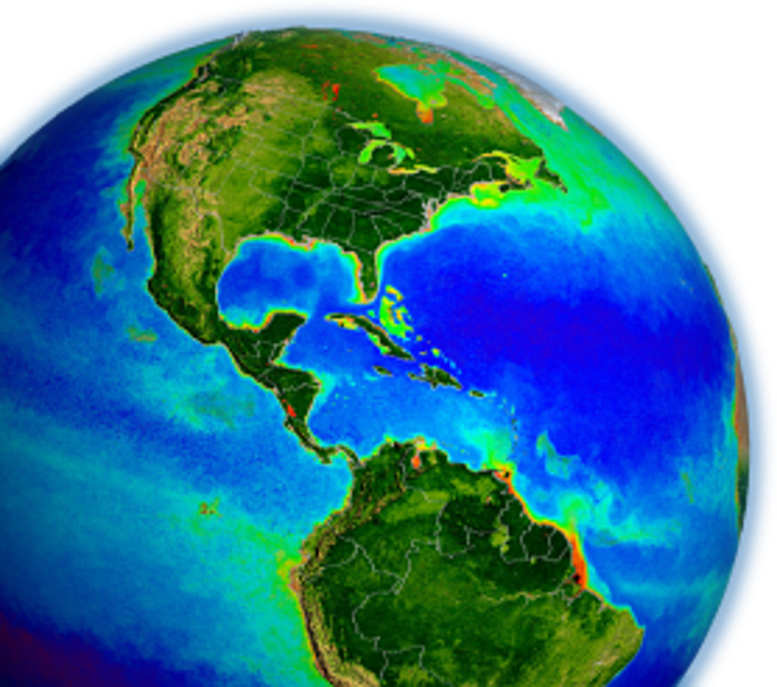
Updated Submission Reporting Requirements
New "Checklist" documents are being designed for commonly submitted data types
Outline
1) Quick overview of SeaBASS metadata
2) Briefly describe new requirements & page
3) Feedback?
Violeta is spearheading the development of a new algorithm development dataset (i.e., NOMAD) using SeaBASS datasets. With the need to add uncertainties, she has also been leading review of QC standards

Slide 2
Background, updated community protocols
New "Checklist" documents will help organize methods and processing details related to protocols best practices
Inherent Optical Property Measurements and Protocols: Absorption Coefficient (November 2018)
Beam Transmission and Attenuation Coefficients: Instruments, Characterization, Field Measurements and Data Analysis Protocols (April 2019)
Protocols for Satellite Ocean Color Data Validation: In situ Optical Radiometry (In Press)
Best Practices for the Collection and Processing of Ship-Based Underway Flow-Through Optical Data (In Press)
Measurement Protocol of Absorption by Chromophoric Dissolved Organic Matter (CDOM) and Other Dissolved Materials (DRAFT)
Noteworthy and Supplemental Topics on Ocean Colour Radiometry Protocols (DRAFT) (led Sanjuan & Craig)

Slide 3
Requirements for PACE algorithm development
Protocols updates need to be reflected on SeaBASS submission updates
Tighter QA/QC in view of PACE cal/val and algorithm development
Possibility of classification of datasets according to special characteristics (Optically shallow waters, HAB, NOMAD dataset)
Uncertainty traceability on all validation products
Measurement uncertainty up to 5%
Updated checklists and reporting requirements come as a result of community updates on measurements protocols as well as PACE mission requirements for validation, algorithm development and NOMAD

Slide 4
Documentation and metadata
Types of metadata in SeaBASS submissions
Metadata headers within data files
Keyword-value pairs (machine interpretable)
Comments (short text)
External Documents and Calibration Files
Explain how raw instrument measurements were collected and processed into your reported values (open-ended format)

Slide 5
Current documents requirements
Existing documentation requirements are written flexibly since there's no one size-fits-all approach
Should describe calibration equations and values, how the instruments were calibrated, and what types of corrections and data analysis were applied to create your reported values
No specific file formats are required
Due to open-ended format, essential details are often spread out in descriptions, or sometimes not provided...
​
= often time consuming or difficult to evaluate data quality details

Slide 6
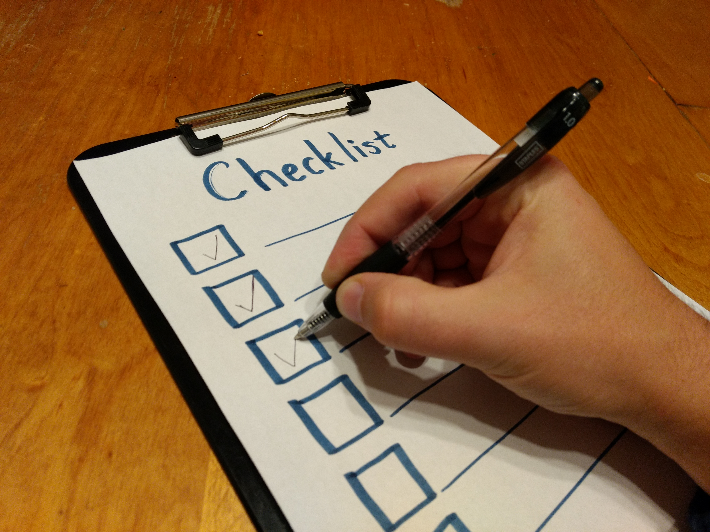
Data submission special requirements
https://seabass.gsfc.nasa.gov/wiki/data_submission_special_requirements
For commonly submitted measurements:
1) Checklists – new documentation templates
2) Special Notes – reminders & tips
3) Example Submissions
Goals:
improve SeaBASS data quality & consistency
make quality easier to assess
clarify reporting requirements to reduce unnecessary back and forth during data submission process

Slide 7
Data submission special requirements
Filter pad absorption (community protocol)
CDOM absorption (community protocol)
POC (community protocol draft)
HPLC and pigments
Radiometry (community protocol)
Developed with Field Support Group from Ocean Biology Processing Group, leading community protocols

Slide 8
Filter pad absorption
Sample collection
Water bottles, underway
Filtration vacuum
Blank filters
Replicates
Samples measured fresh, frozen,
Storage conditions (container, preservation method, temperature)
Sample measurement
Instrument make, model and accessories
Instrument calibration, performance tests and maintenance performed
Measurement method: transmittance, transmittance-reflectance, inside sphere…
Measurement protocol references (if any)
Air scans
Data analysis
Blank and air scans
Correction or null methods applied
Beta factor used with reference
Look at submission examples on SeaBASS website

Slide 9
CDOM
Sample collection
Niskin bottle, surface pump, bucket…
Location (coastal, offshore, estuarine, etc.) and depths
Filtration system: vacuum pump, peristaltic, syringe, vacuum jar, etc.) type of filter and pore size
Sample storage (e.g. refrigerated, frozen, acidified, etc.) and in what type of bottle (e.g. amber glass, high or low density poly-ethylene (HDPE, LDPE), Nalgene, etc.)
Sample measurement
Spectrophotometer used (dual or single beam, waveguide, integrating sphere, etc.), cuvette size (benchtop) , effective pathlength (on waveguide)
Instrument settings: (integration time, scan speed, slit width, smoothing, wavelength range and increment, etc.)
Samples re-filtered before the spectrophotometric analysis?

Slide 10
CDOM
Reporting
Raw scans of absorbance should be reported for each all measurements. When multiple scans measured, the average absorbance can be reported along with their standard deviation
Documentation file should be provided describing the methods for collection, filtration, analysis protocols
Absorption coefficient may be reported after null correction, smoothing, truncated wavelengths, etc. has been applied... Fully documented
Standardization on variable names for CDOM: wavelength, abs_ag, abs_ag_sd, ag

Slide 11
POC
Filter diameter and nominal pore size
Make and type (e.g., Whatman GF/F), filter pre-treated?
Sampling and processing
Method of filtration: filtration volume (volfilt), sample replicates, Standard deviation or % cv of replicates reported
Post sampling processing
Acidification step: Mode of application (i.e., fumes vs. solution)
Drying method and temperature (length of time in oven, desiccator, etc)
Elemental analysis
Instrument make and model, Calibration standard, Reference material used and performance metric results relative to reference
Blank corrections
DOC/DON adsorption (“filtrate”) blank correction should be measured and applied (Moran et al. 1999). Were samples blank corrected?

Slide 12
HPLC
Filled out by data submitter
Sample collection method​
- Filter type/pore size, Vacuum pressure, Replicates collected, Flash frozen?, Long term storage conditions
Filled out by HPLC Lab
Sample measurement and analysis
- Extraction, solvent, volume added/delivery method, disruption method, time, soak time, clarification method
HPLC analytical method
- Method reference, column temperature, mobile phase, Flow rate, Gradient, wavelengths monitored, spectra collected? If so, what wavelengths, Internal standard used, name
Instrument: Make and model, Injector type, Pump type, sample compartment refrigerated?, Heated/thermostatted column compartment? Detector type
Instrument calibration: Frequency, Source of standards, Single point or multi-point calibration, How are calibration factors (or response factors. RF) calculated? Is calibration accuracy monitored between calibrations?
If so, how and how often? Noise at each wavelength

Slide 13
Radiometry
Instrument
Model and manufacturer, instrument characteristics including spatial, spectral electrical and physical.
Report instrument characterization including spectral range, spectral resolution, spectral accuracy, field of view, linearity, cosine response, thermal response, immersion effects
Calibration: report absolute radiometric calibration for radiance and equation, and absolute calibration for irradiance and equation.
Deployment conditions
Deployment type: buoy mode, profiler (single cast), profiler (multi cast).
Deployment strategy, pressure tare, dark readings.
Remember to include "optional" metadata headers: Wind speed, Cloud cover, (Ship heading & SZA)

Slide 14
Radiometry
Data analysis
Conversion data counts to engineering units: conversions from raw binary optical data into counts. Apply calibration equation.
Dark correction: specify the correction scheme used to correct light values for dark values.
Deglitch shutter data: specify deglitching scheme used for dark values, if any
Smooth shutter darks: specify, if any.
Interpolate shutter darks as a function of measurement time to match the number of dark and light data measurements.
Dark correction of light data
Temperature correction of light data. Report temperature correction equation.
Time interpolation if any (better not interpolated). Detail interpolation scheme applied.
Notes:
Add marlon report

Slide 15
Feedback
Please refer to SeaBASS website for detailed requirement on submission guidelines for each validation product.
Enforced QA/QC is required for algorithm development within PACE for uncertainty estimates.
Data collection and processing can account for significant error budget.
SeaBASS will require a full traceability on acquisition methods and data processing to ensure quality standards.
Submission guidelines open for feedback and suggestions from the community to revisit according to protocols update.
https://seabass.gsfc.nasa.gov/wiki/data_submission_special_requirements
Notes:
Link seabass requirement submissions to IOCCG standards?

