Slide 1
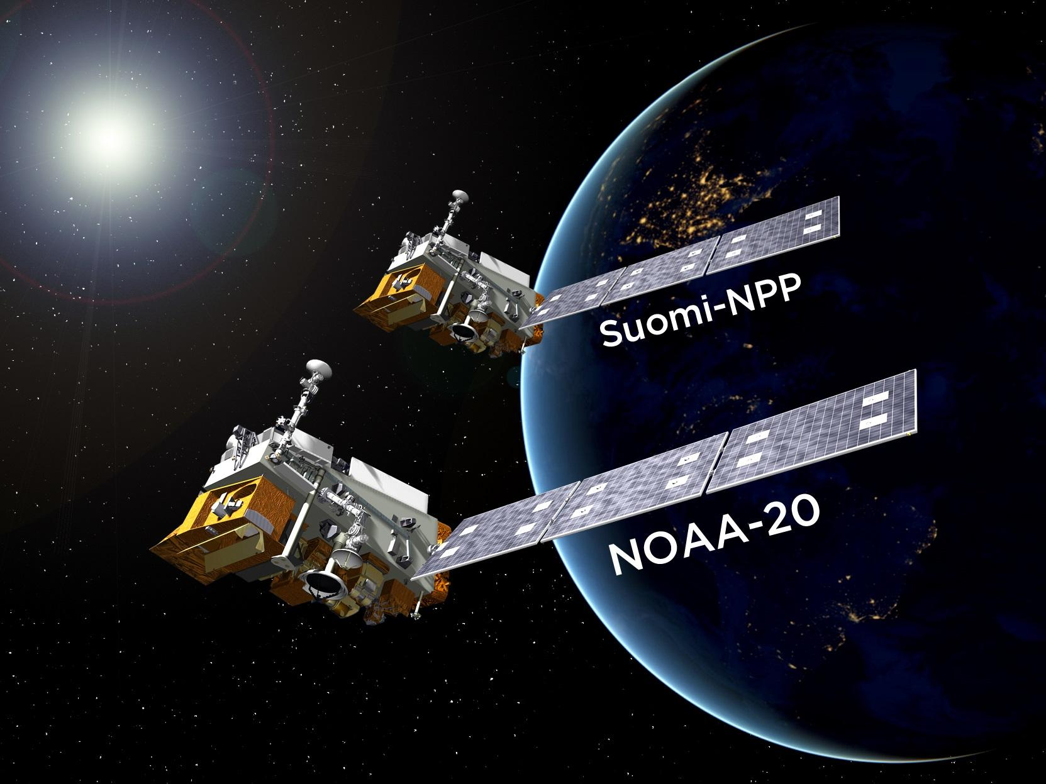

NOAA’s Suomi NPP and NOAA-20 Land Product Update
Ivan Csiszar
NOAA NESDIS Center for Satellite Applications and Research (STAR)
with material from the JPSS Science Teams and the NOAA JPSS Program Office

Slide 2
Current trends and priorities
NOAA-20 products in operations, reaching validated maturity
All operational land products in NDE / OSPO
Enterprise algorithm development continues
  Improve efficiency and increase consistency
  Common code base, common algorithmic elements, one delivered code package (DAP), system-specific interfaces
    Implementation details and development stage vary largely by product
Product development is organized by system-agnostic product lines
Land management is organized into three science teams
  Land product development
    core products i.e. (SR), VI, albedo, LST – STAR lead: Bob Yu
  Land product applications
    Soil moisture, surface type, ET, vegetation health – STAR led: Jerry Zhan
  Fires
    VIIRS, GOES-R etc. fire – STAR lead: Ivan Csiszar
Increasing use of AI, machine learning and cloud processing
More agile observing constellation, using NOAA and non-NOAA assets
New Metop-SG science team and product development

Slide 3
https://www.nesdis.noaa.gov/sites/default/files/asset/document/POES_Flyout_April_2019_Signature.pdf

Slide 4
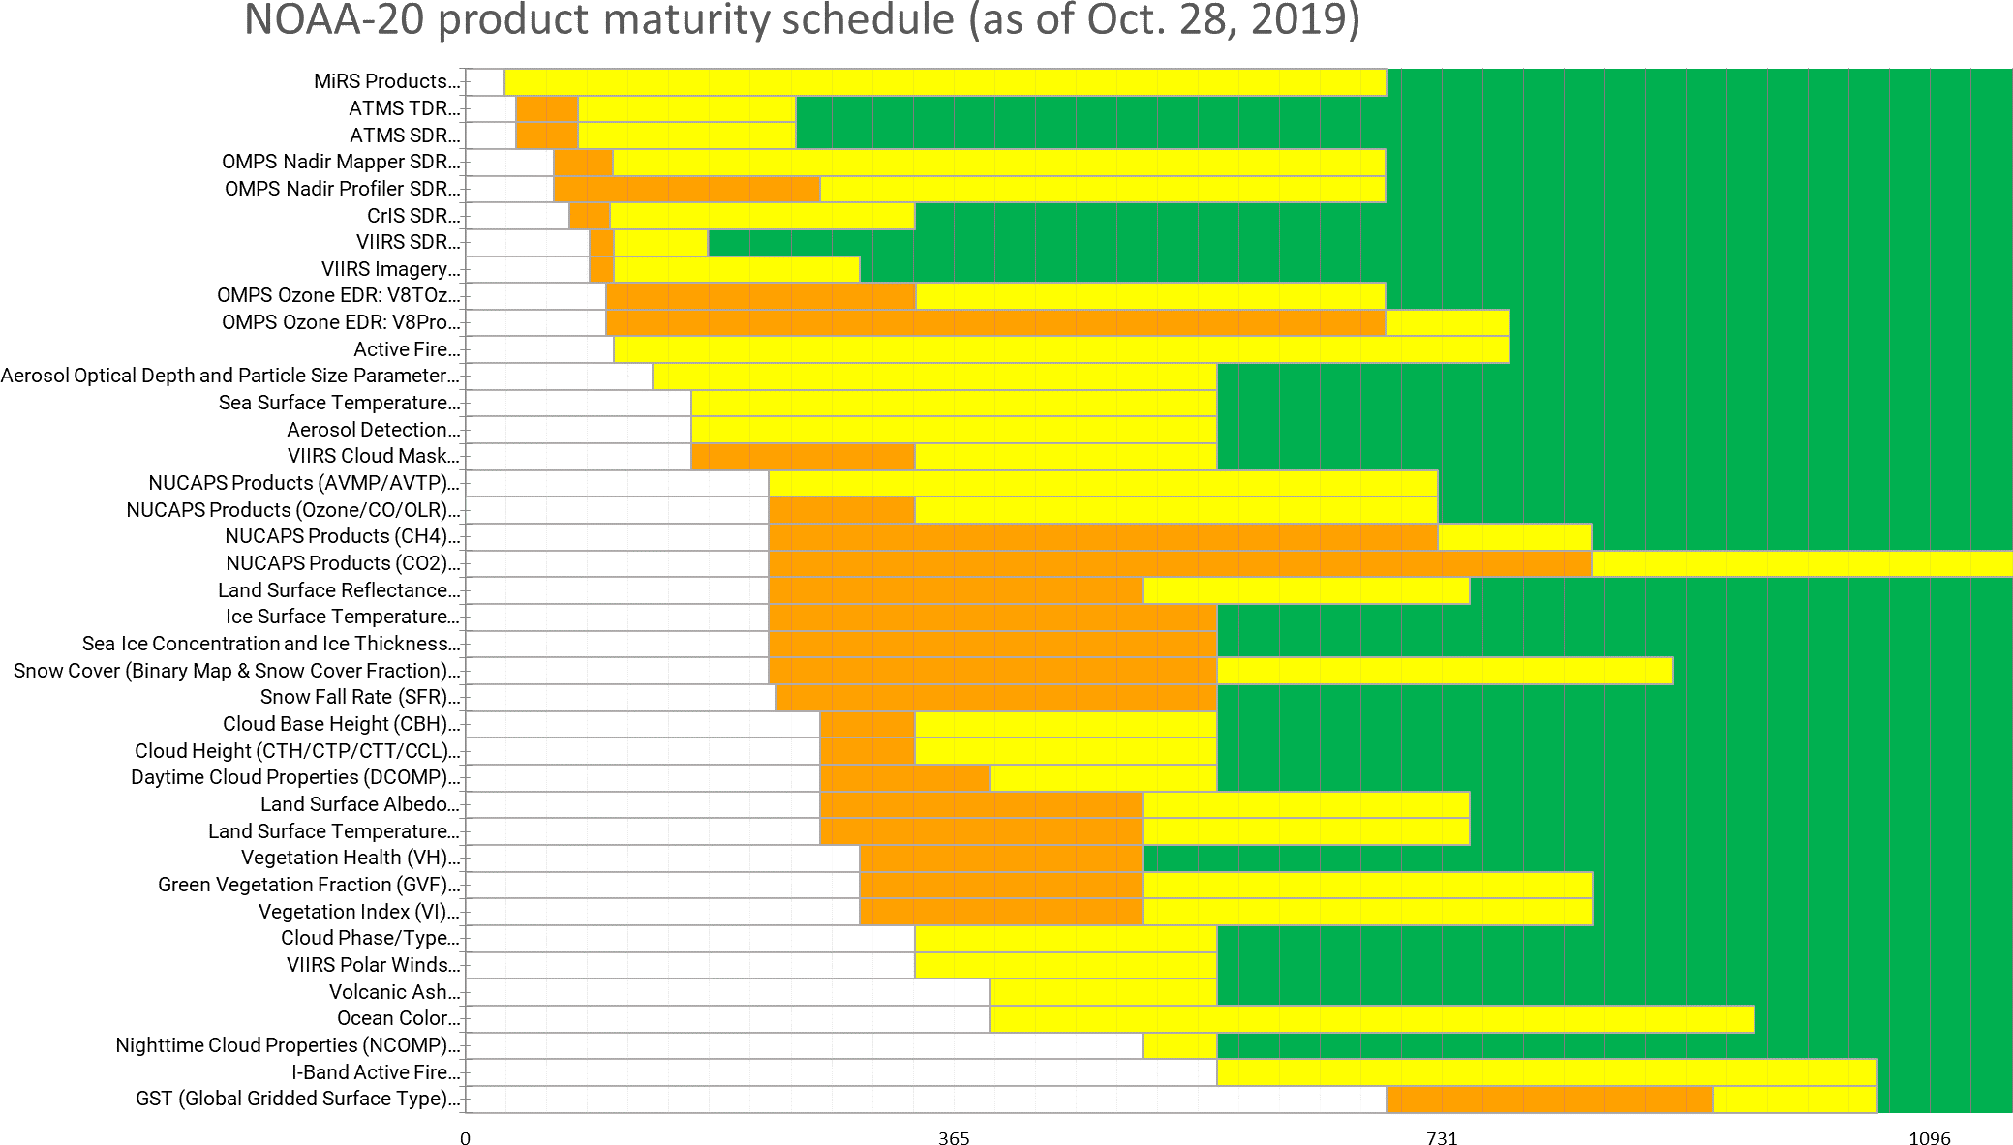
NOAA-20 products: STAR cal/val maturity schedule
(as of Nov 18, 2019)
Total Precipitable Water
Cloud Liquid Water
Rainfall Rate
Ice Concentration
Land Surface Emissivity
Land Surface Temp.
Snow Water Equivalent
Snow Cover
(Snowfall Rate [SFR] listed separately)
Beta
Provisional
Validated
Recent changes
Nov. 21, 2019 Maturity Review
Based in part on STAR JPSS Algorithm Maturity Matrix
https://www.star.nesdis.noaa.gov/jpss/AlgorithmMaturity.php
Cloud Cover/Layers
Cloud Top Pressure
Cloud Top Temp.
Cloud Top Height
Cloud Optical Depth
Cloud Particle Size Distr.
Cloud Optical Depth
Cloud Particle Size Distr.
Cloud Optical Depth
Cloud Particle Size Distribution

Slide 5
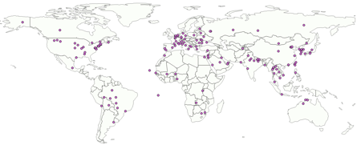
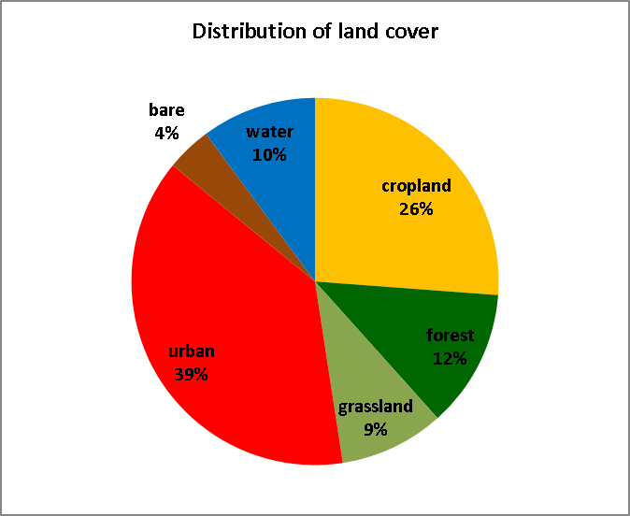
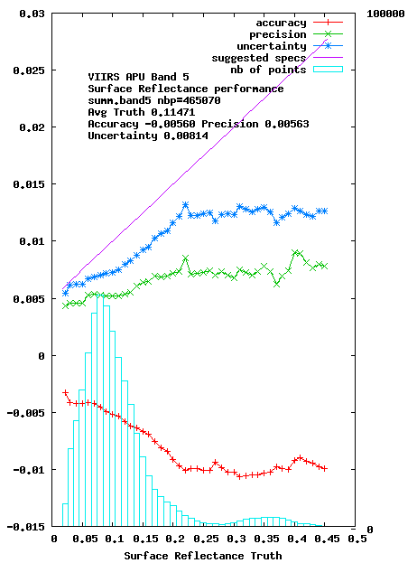
Surface Reflectance Accuracy assessment: AERONET validation
AERONET data
  Very accurate atmospheric correction around the AERONET site (9km x 9km)
EXAMPLE
Estimates of BRDF corrected surface reflectance for VIIRS band M5
AERONET Sites (left) and the associated Land cover distribution (right) used for SR validation.
Atmospherically corrected TOA reflectances derived from Level 1 subsets
comparison
Subsets of Level 1 data processed using the standard surface reflectance algorithm
Reference data set
AERONET measurements
(τ_{aer}, H₂O, particle distribution
Refractive indices, sphericity)
Vector 6S
E. Vermote et al., NASA & UMD

Slide 6
AERONET sites included in the validation of the NDE surface reflectance product (39 sites)
https://aeronet.gsfc.nasa.gov
Site | lat,lon | Site | lat,lon | Site | lat,lon | Site | lat,lon
Arica, Chile | 18S,70W | Dakar, Senegal | 14N,16W | Kanpur, India | 26N,80E | Santa Cruz, Tenerife | 28N,16W
Ascension Island | 7S,14W | El Arenosillo, Spain | 37N,6W | Lake Argyle, Australia | 16S,128E | Sede Boker, Israel | 30N,34E
Banizoumbou, Niger | 13N,2E | Evora, Portugal | 38N,7W | Lecce, Italy | 40N,18E | Sevilleta, New Mexico | 34N,106W
Barcelona, Spain | 41N,2E | Granada, Spain | 37N,3W | Lille, France | 50N,3E | Table Mountain, CA | 34N,117W
Beijing, China | 39N,116E | GSFC, Greenbelt | 38N,76W | MD Science Center, Baltimore | 39N,76W | Toulon, France | 43N,6E
Billerica, Massachusetts | 42N,71W | IER-Cinzana, MALI | 13N,5W | Messina, Italy | 38N,15E | Tucson, Arizona | 32N,110W
Brookhaven National Lab, Upton, NY | 40N,72W | Ilorin, Nigeria | 8N,4E | Monterey, California | 36N,121W | Santa Barbara, California | 34N,119W
Cabo da Roca, Portugal | 38N,9W | IMS-METU-ERDEMLI, Turkey | 36N,34E | OHP Observatoire, France | 43N,5E | Ussuriisk, Russia | 43N,132E
CCNY, New York | 40N,73W | Ispra, Italy | 45N,8E | Rimrock, Idaho | 46N,116W | Wallops Island, Virginia | 37N,75W
CEILAP-BA, Argentina | 34S,58W | Izana, Spain | 28N,16W | Rome-Tor Vergata, Italy | 41N,12E
E. Vermote et al., NASA & UMD

Slide 7
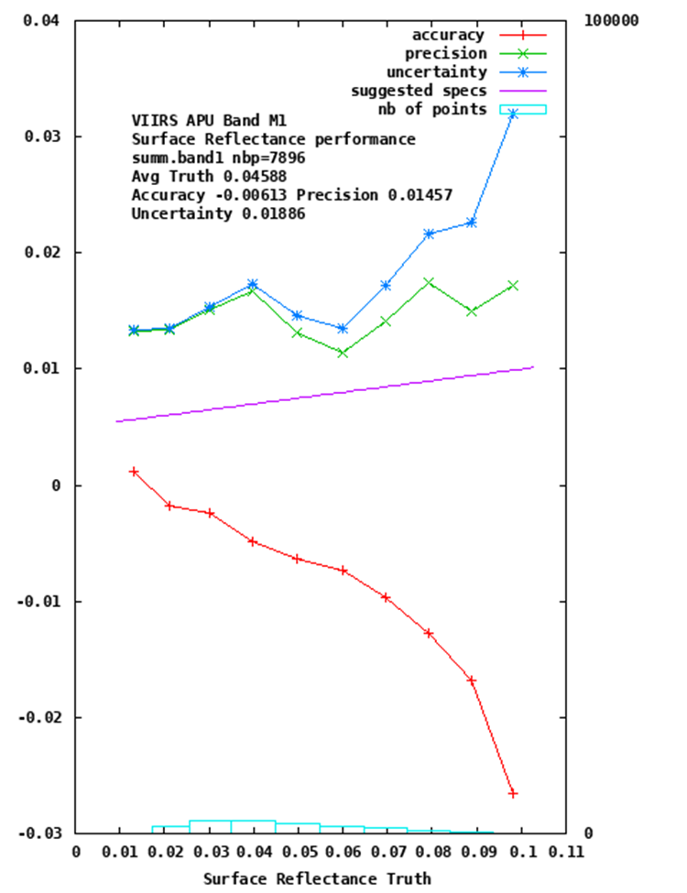
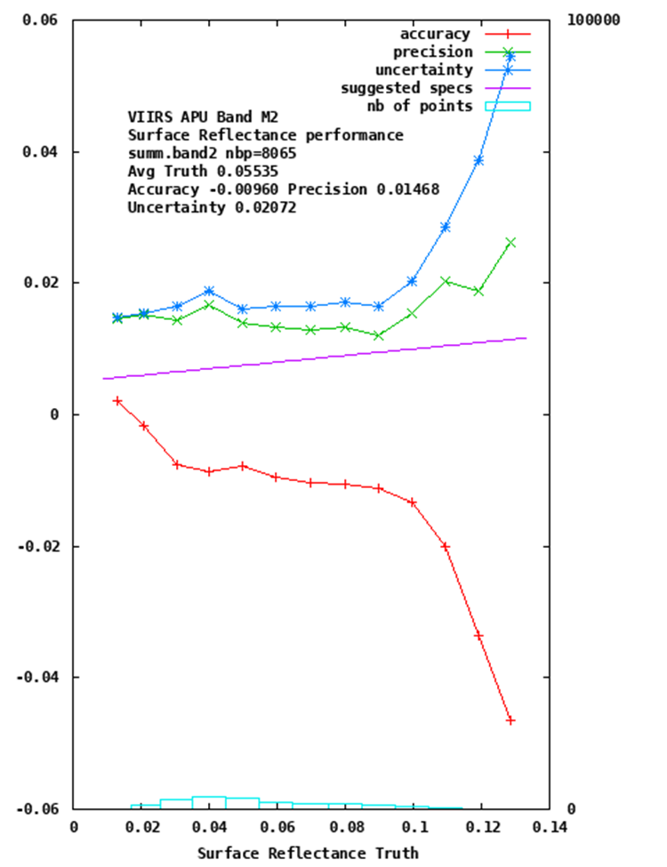
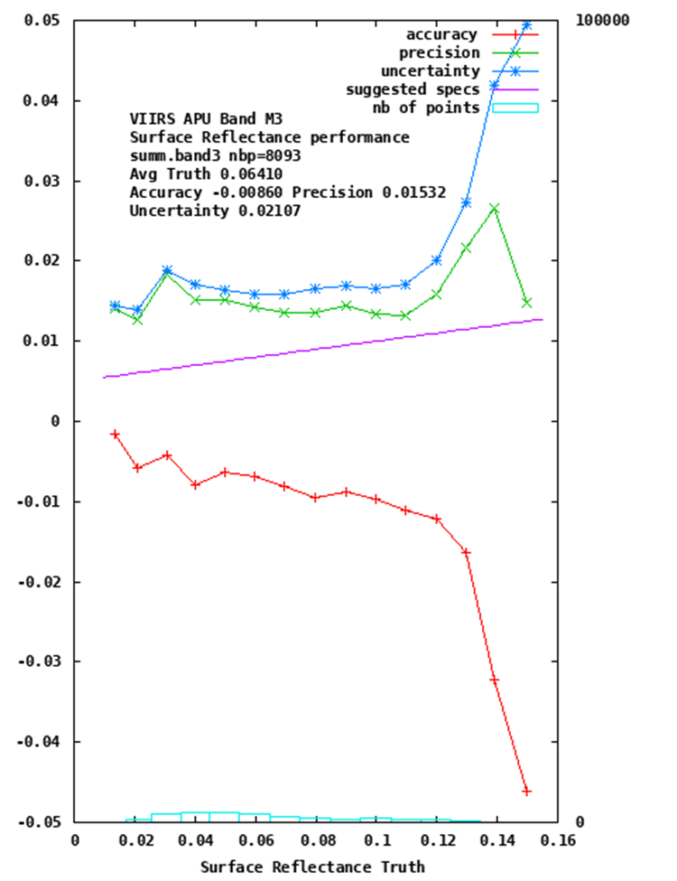
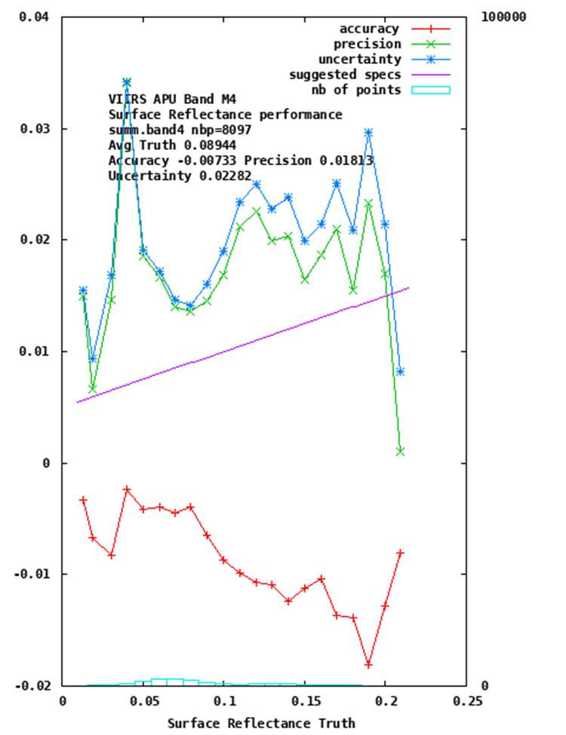
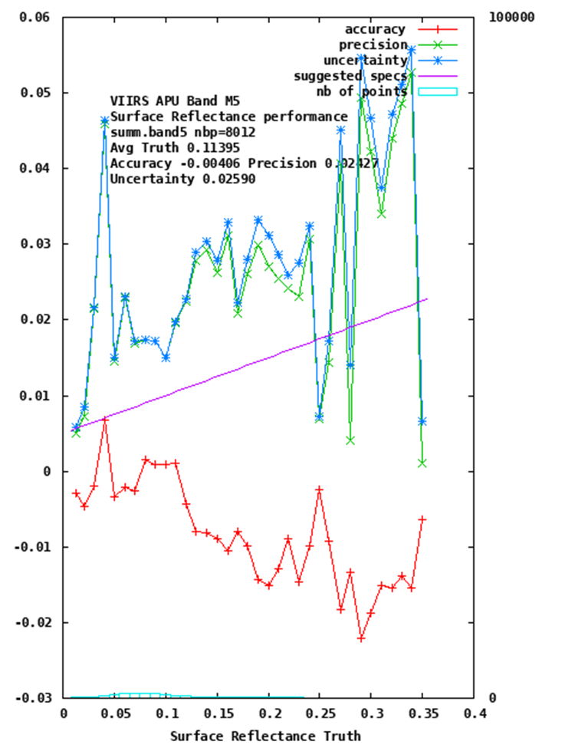
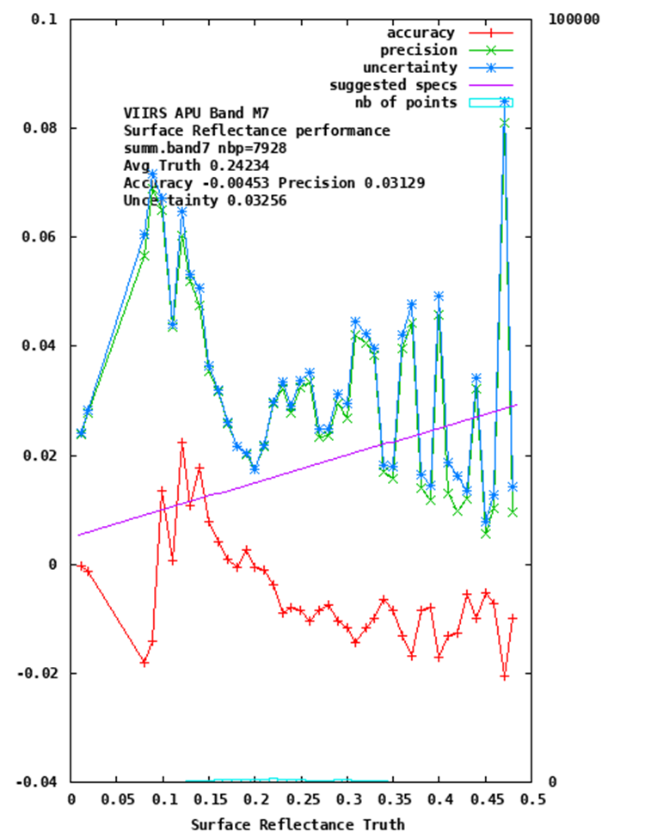
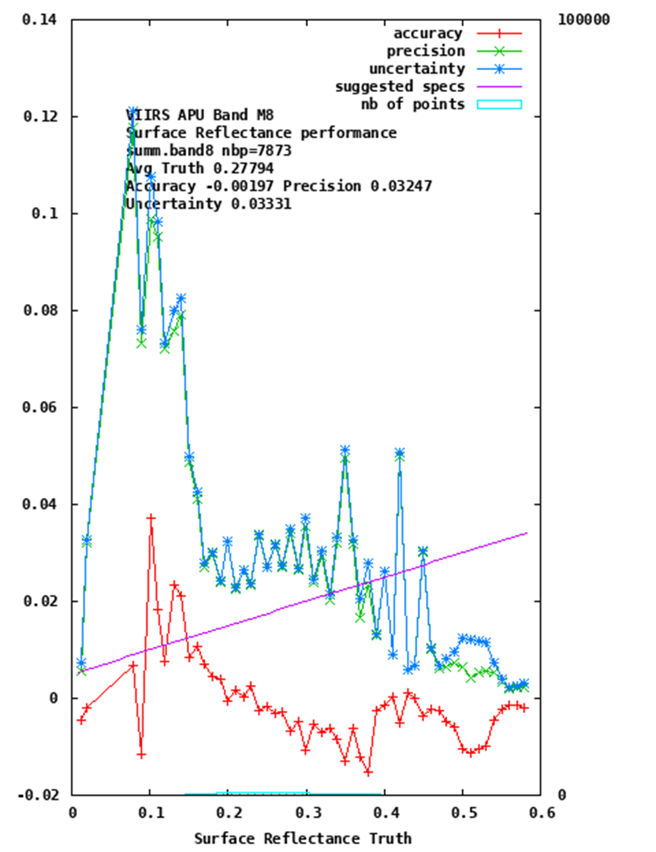
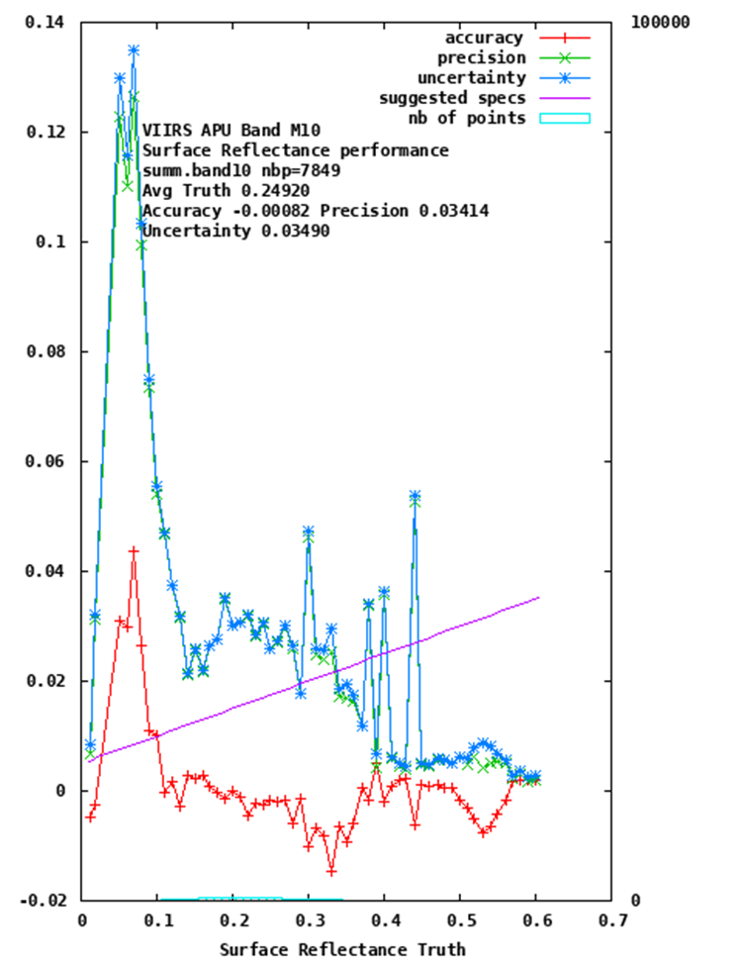
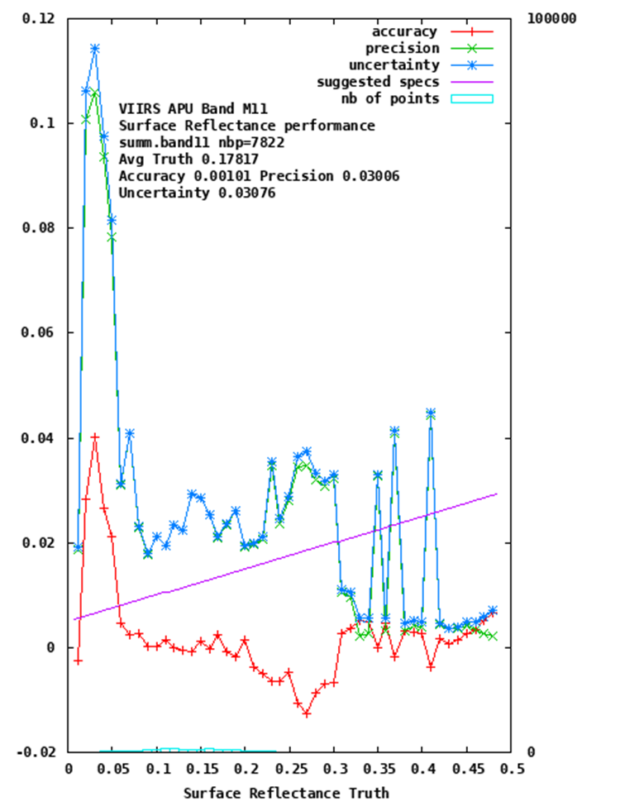
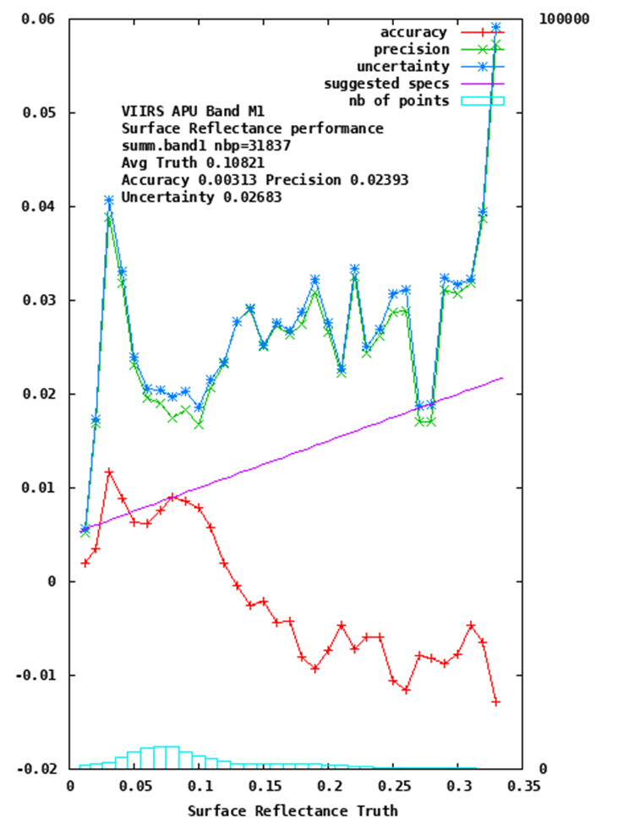
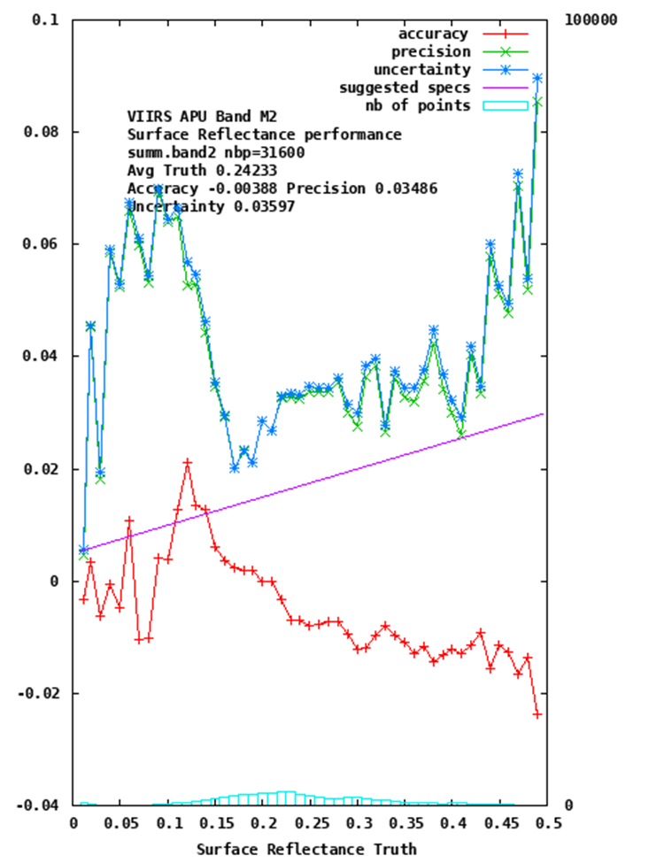
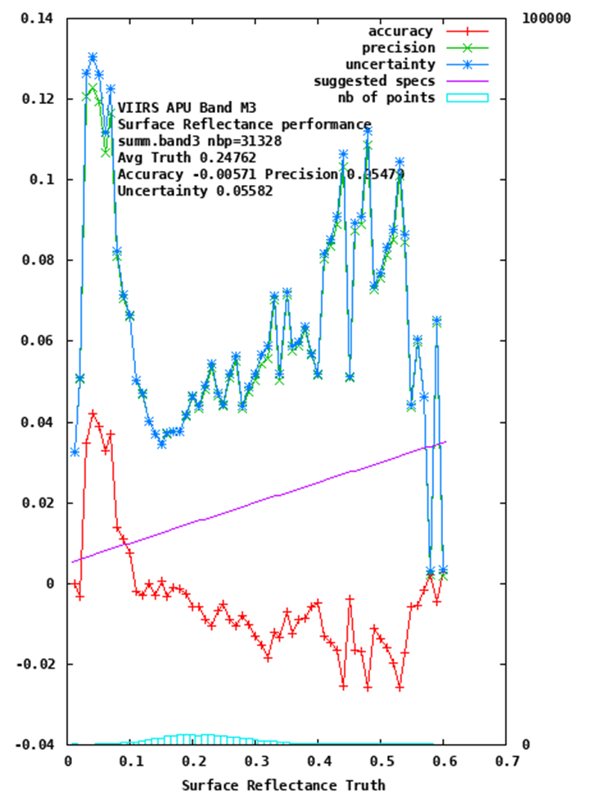
I1
I2
I3
NOAA-20 VIIRS Surface Reflectance is now provisional and in operations – validated review in early 2020

Slide 8


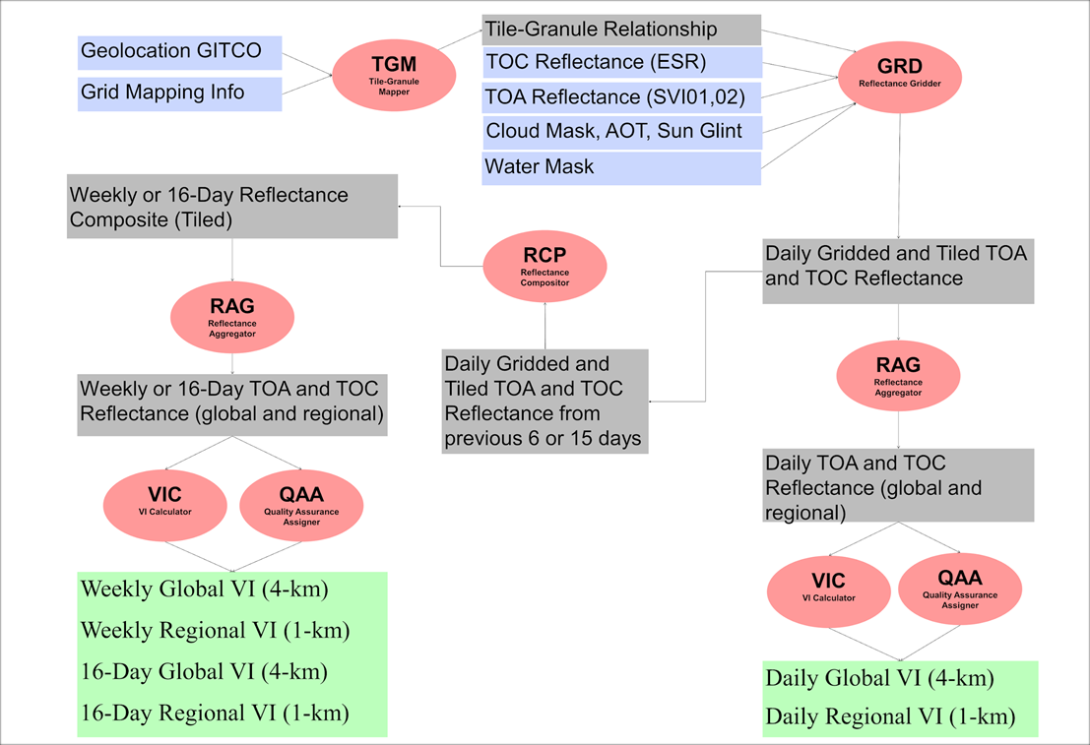
NOAA JPSS VI Product Overview
Vegetation Product System-Layer Data Flows
VI System layer Software Units
  Tile-Granule Mapper (TGM)
  Reflectance Gridder (GRD)
  Reflectance Compositor (RCP)
  Reflectance Aggregator (RAG)
  VI Calculator (VIC)
  Quality Assurance Assigner (QAA)
Surface reflectance band M3 (488 nm )
Surface reflectance band I1 (640 nm)
Surface reflectance band I2 (865 nm)
Top of the atmosphere reflectance band I1 (640 nm)
Top of the atmosphere reflectance band I2 (865 nm)
C₁, C₂ and L are constants
Y. Yu et al., NOAA & IMSG@NOAA

Slide 9
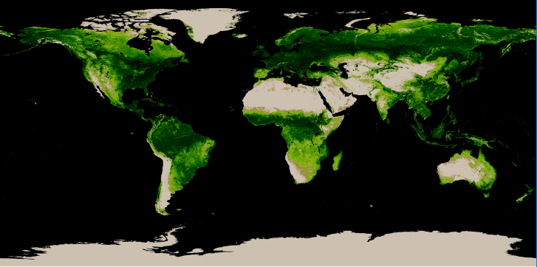
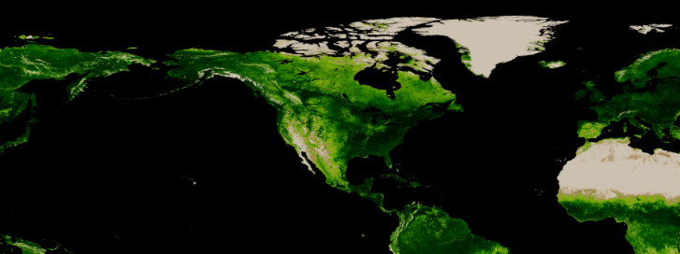
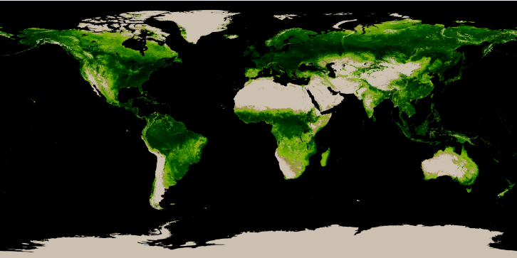
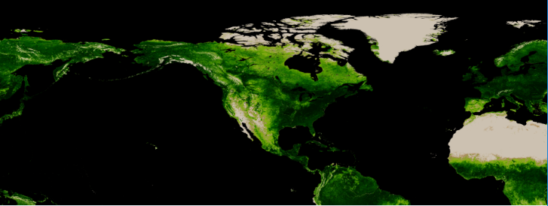
VIIRS GVF Product
Regional 1-km GVF (Jun 30 – July 6, 2019)
Suomi NPP
weekly GVF
Global 4-km GVF (Jun 30 – July 6, 2019)
Regional 1-km GVF (Jun 30 – July 6, 2019)
NOAA-20
weekly GVF
Global 4-km GVF (Jun 30 – July 6, 2019)
Real-time VIIRS GVF data are input to the NOAA NCEP EMC RAPv4 and HRRRv3 models.
Y. Yu et al., NOAA & IMSG@NOAA

Slide 10
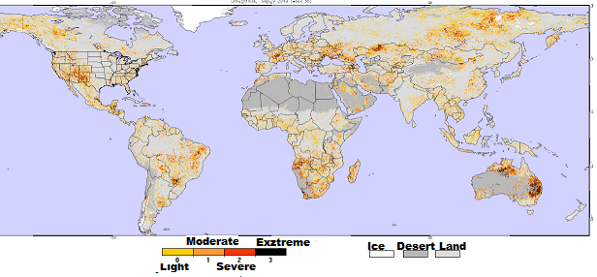
Drought Area & Intensity from NOAA-20/VIIRS Vegetation Health
August 2019
Drougt from Vegetation Health
F. Kogan et al., NOAA & IMSG@NOAA

Slide 11
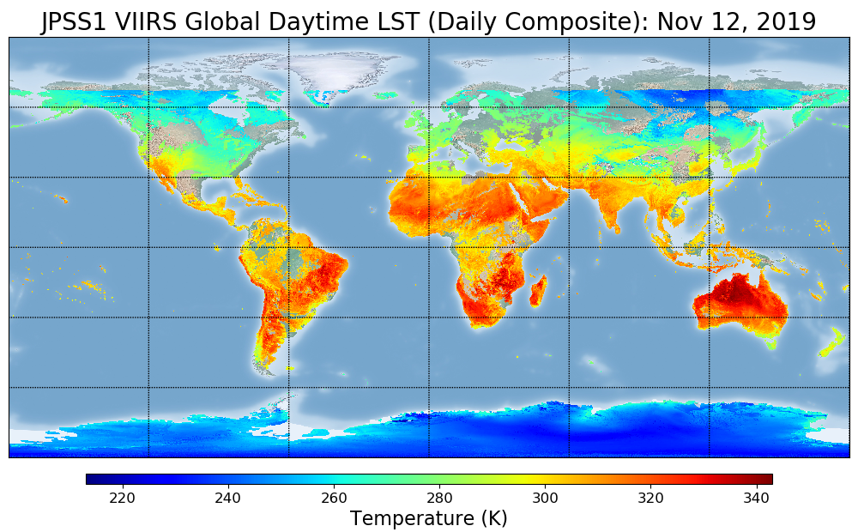
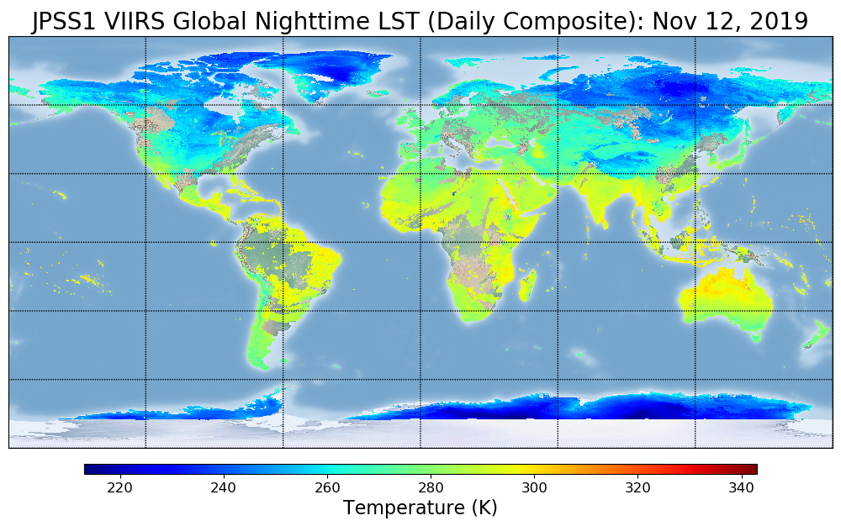
VIIRS LST Product overview
Enterprise NOAA 20 VIIRS LST
  Based on split window technique
  Emissivity is explicitly used in the retrieval formula. Emissivity input is from NOAA STAR emissivity product. The spectral emissivity and broadband emissivity at pixel level is included in the LST output.
  LUT is derived based on the updated comprehensive simulation database. LUT has dimension of day/night, view zenith angle and total column water vapor
  Operational Status
  NOAA 20 VIIRS LST has been available since 09/18/2019. It is in the updated version v1r2 with most recent updates implemented.
  Also available at SCDR under data type “VIIRS-LST” for STAR internal users and interested groups.
Y. Yu et al., NOAA & UMD

Slide 12
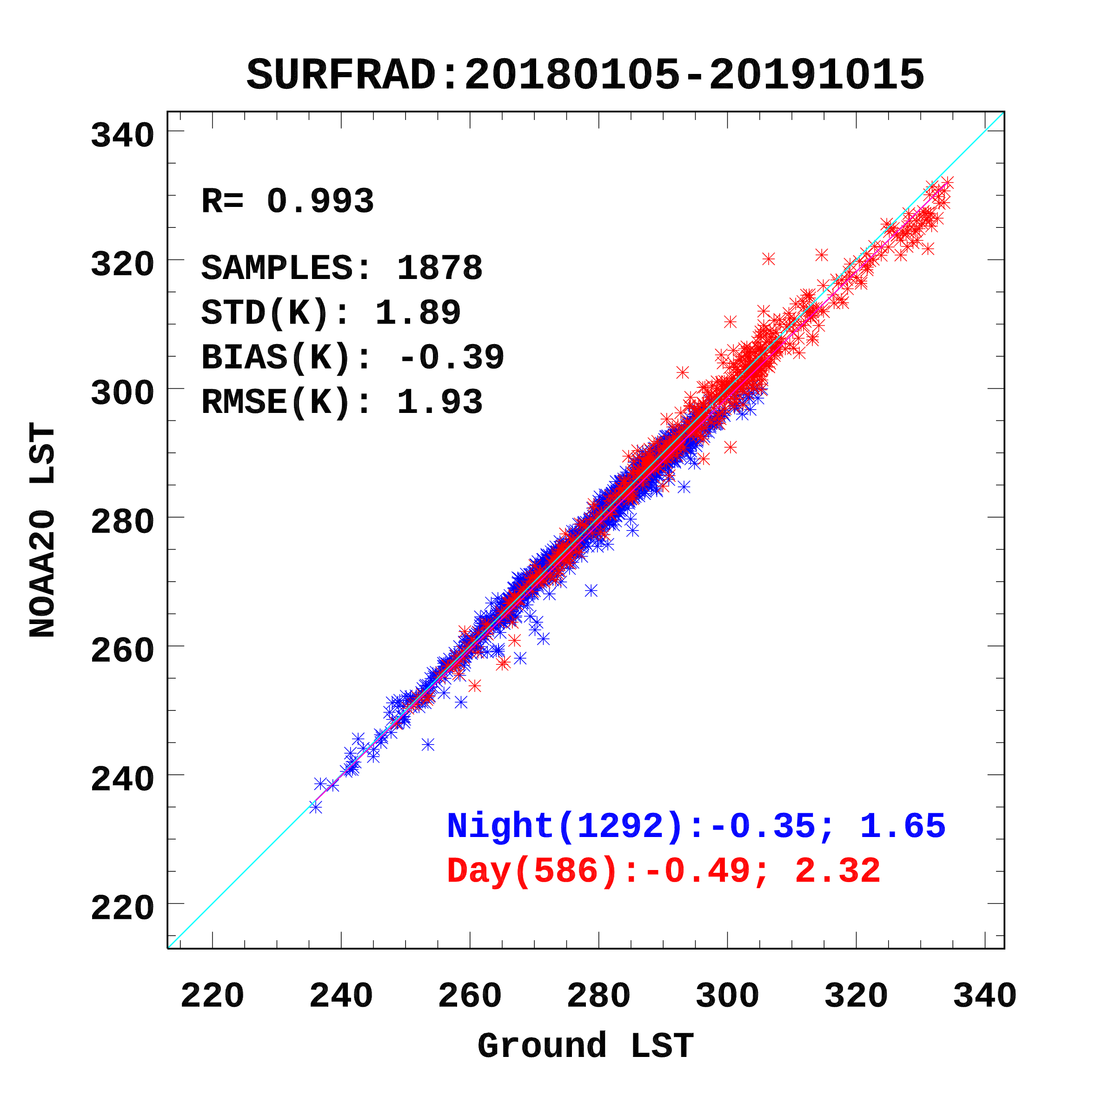
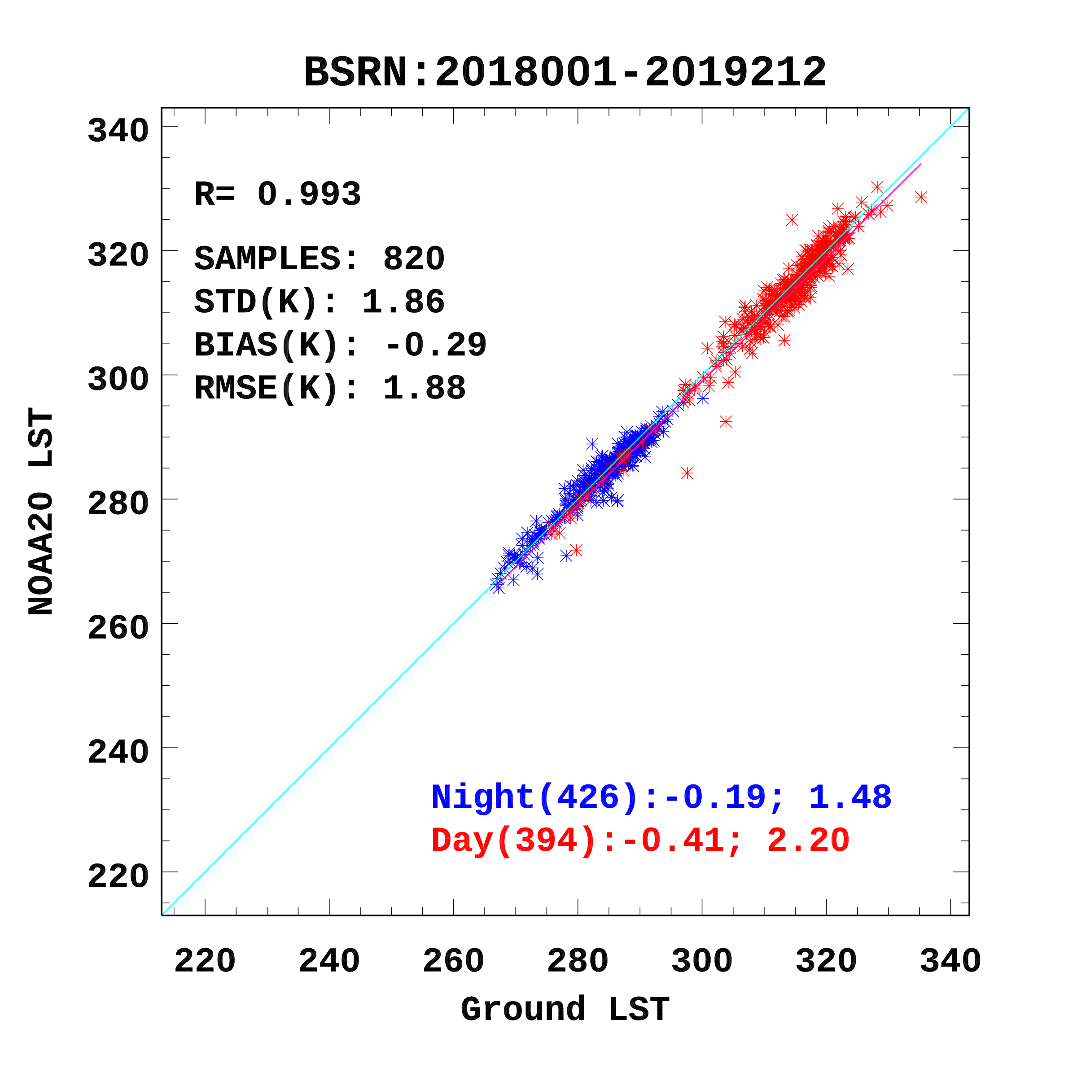
Ground data validation-SURFRAD and BSRN
Data coverage
Six sites of SURFRAD network over continental US for time period from Jan., 2018 to Oct., 2019.
Two sites of BSRN in Netherland and Namibia for time period from Jan. , 2018 to Jul. 2019 (due to the ground data availability).
Validation results
The close agreement is observed from the ground validation indicating that the VIIRS LST has a good quality with an accuracy of -0.39 K and -0.29K, precision of 1.89 K and 1.86 K for SURFRAD and BSRN, respectively
The underestimation over DRA site is related to the site characterization and representativeness.
1.4 K
Y. Yu et al., NOAA & UMD

Slide 13
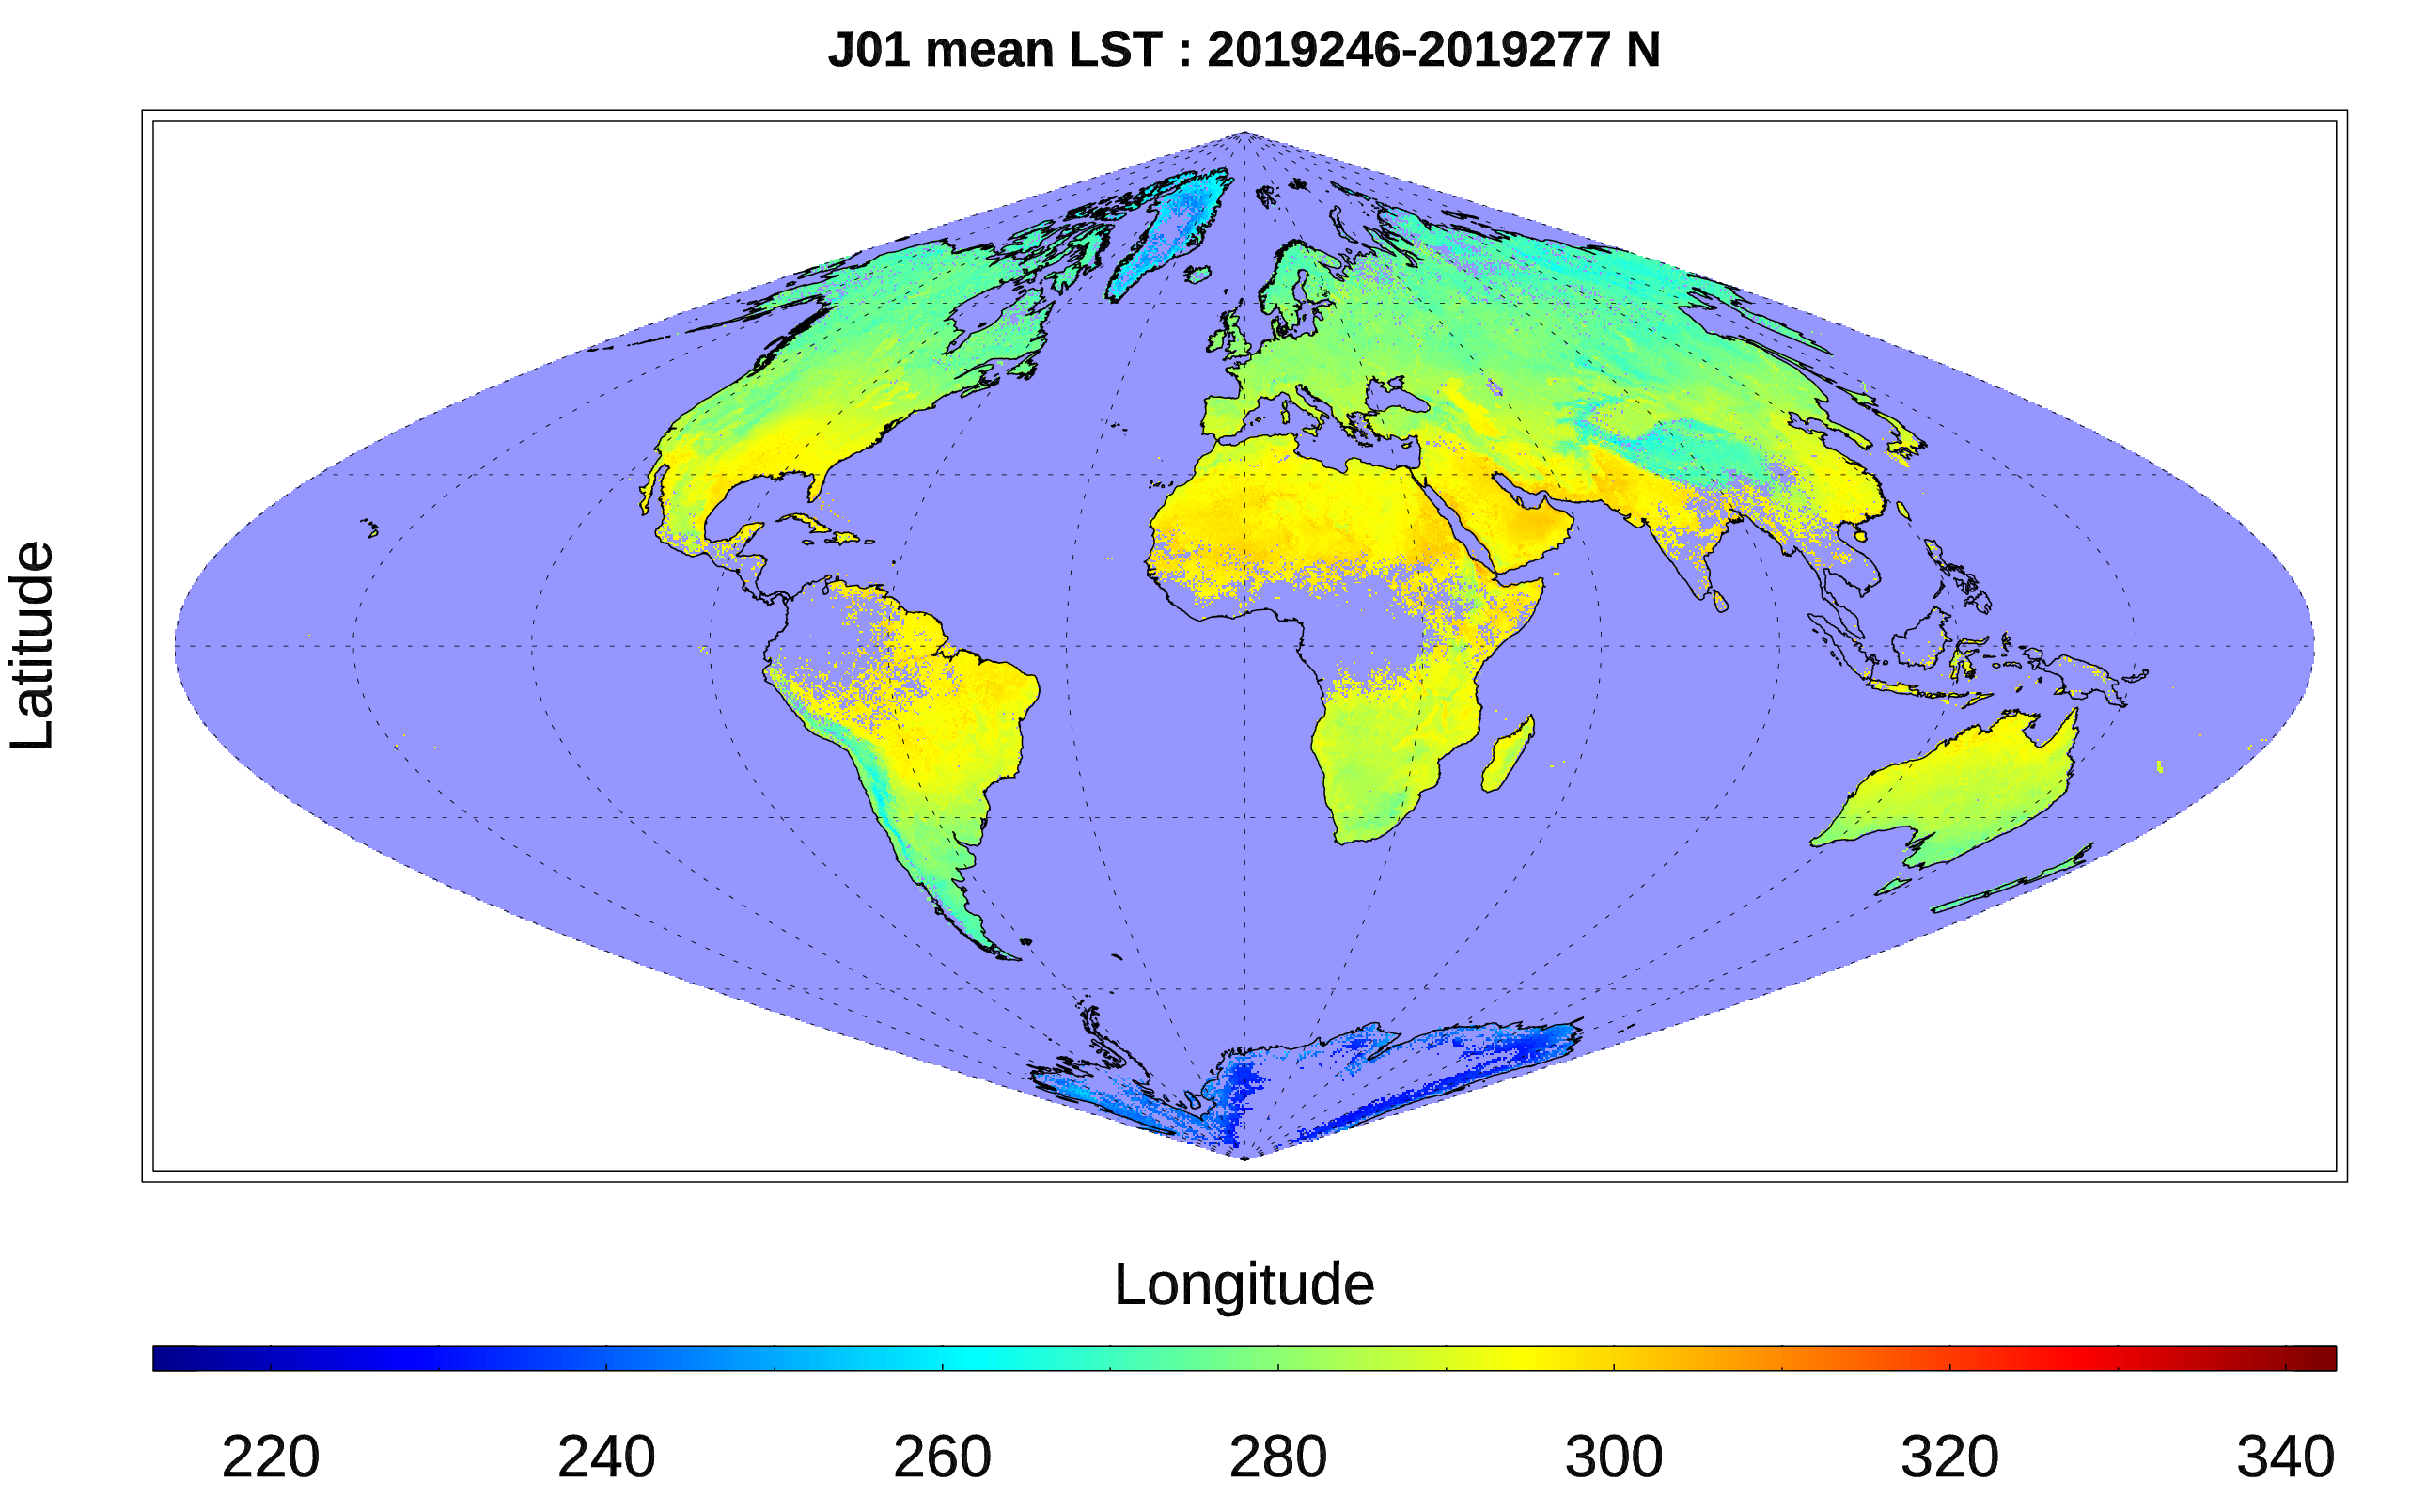
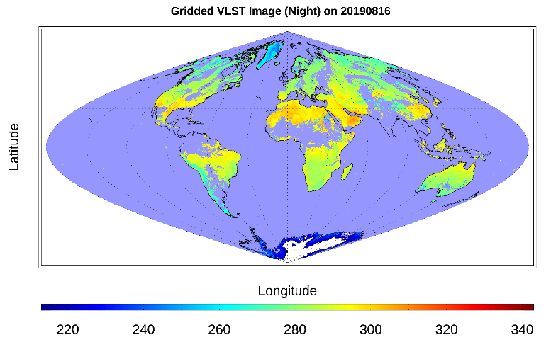
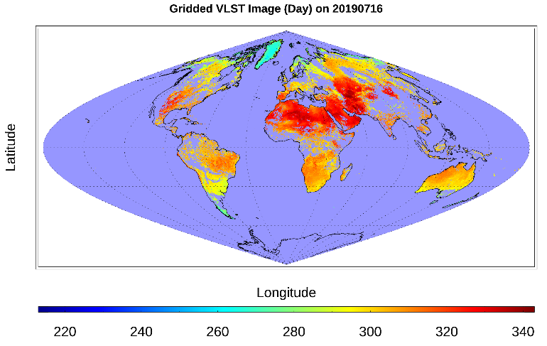
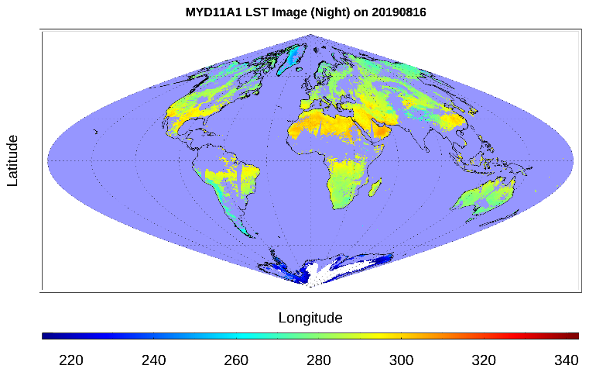

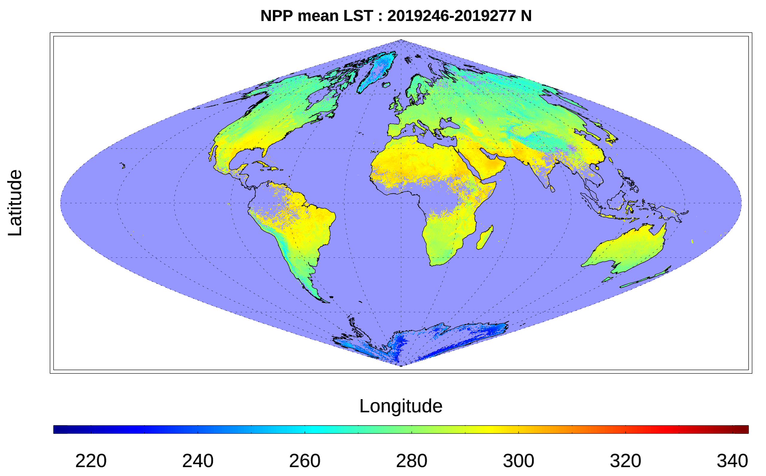
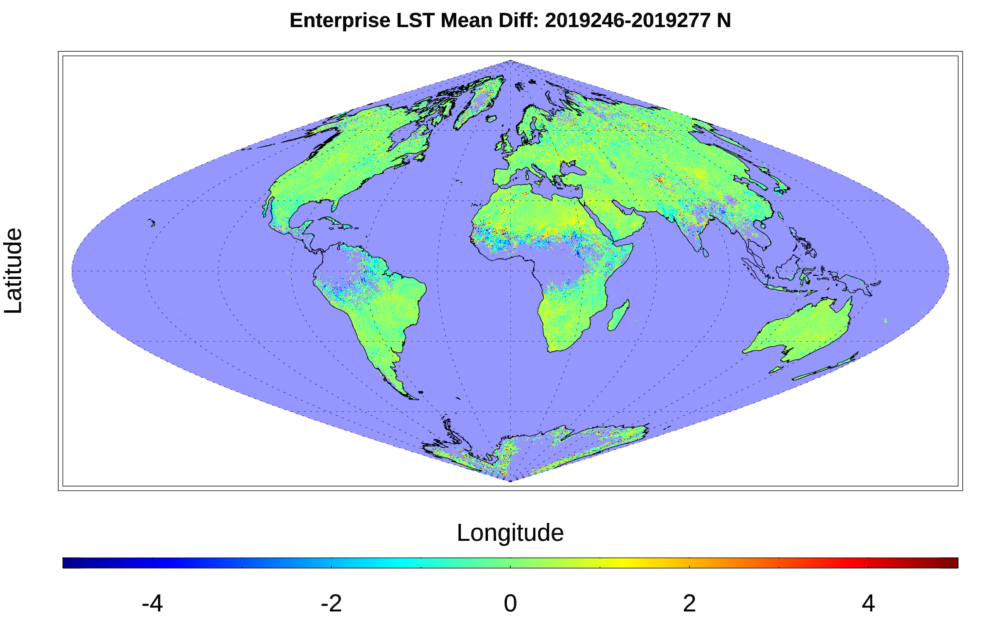


NOAA 20 vs SNPP VIIRS LST NOAA20 VIIRS LST vs MODIS LST
NOAA-20 Mean LST
Nighttime
Daytime
L3 NOAA 20 VIIRS LST
L3 NOAA 20 VIIRS LST
Suomi NPP Mean LST
MYD11A1
MYD11A1
Enterprise Gridded LST Mean Diff
MYD21A1
MYD21A1

Slide 14
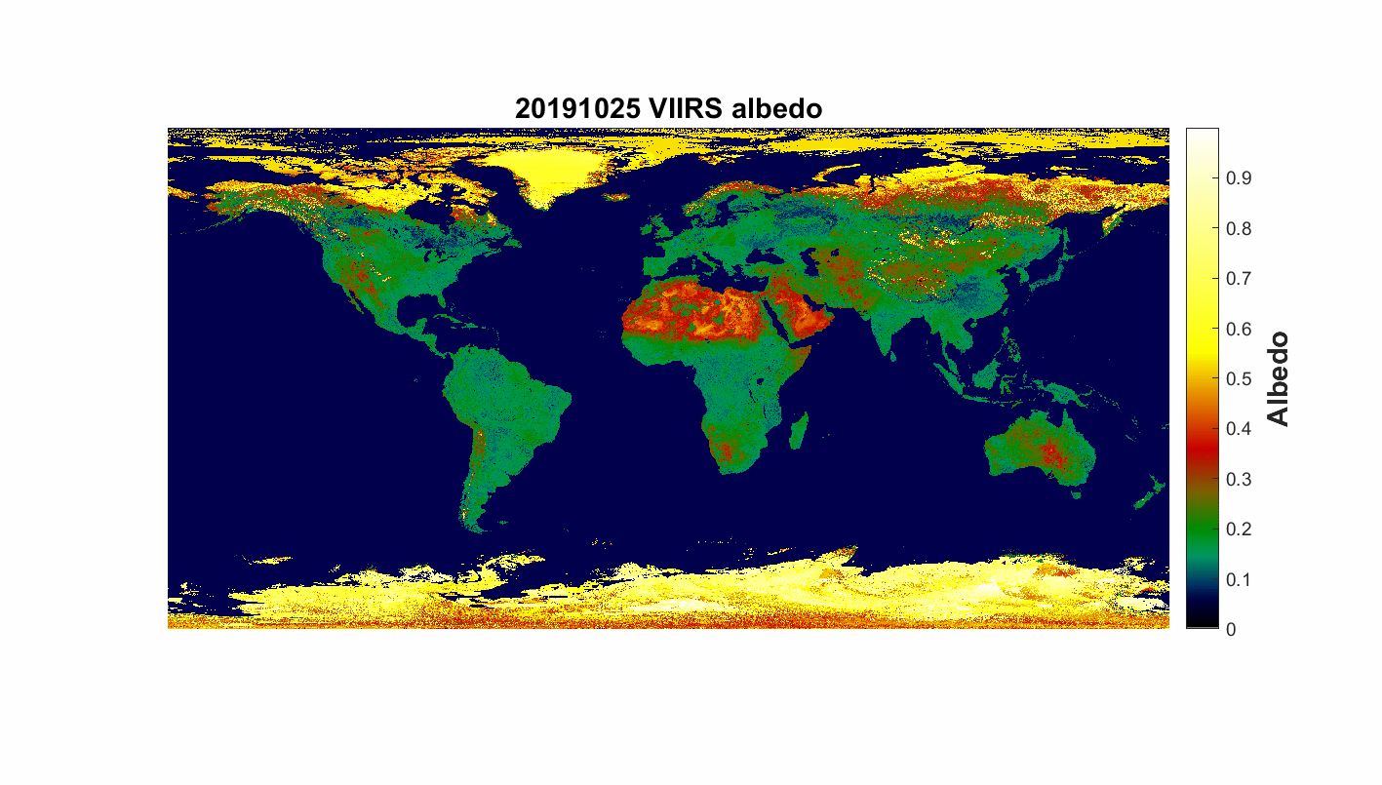
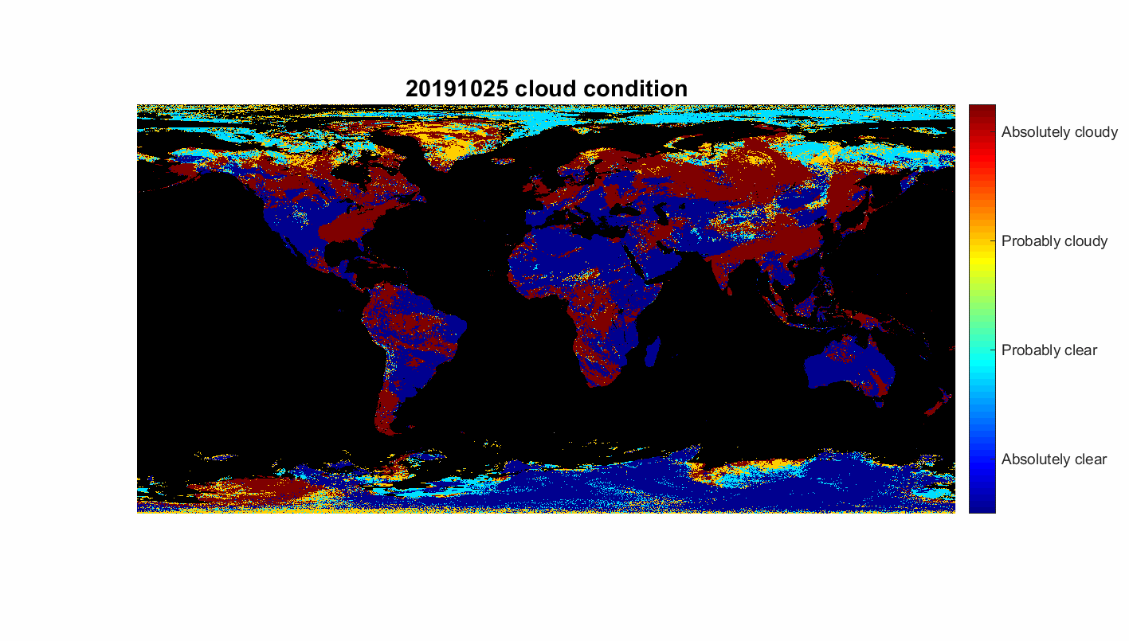
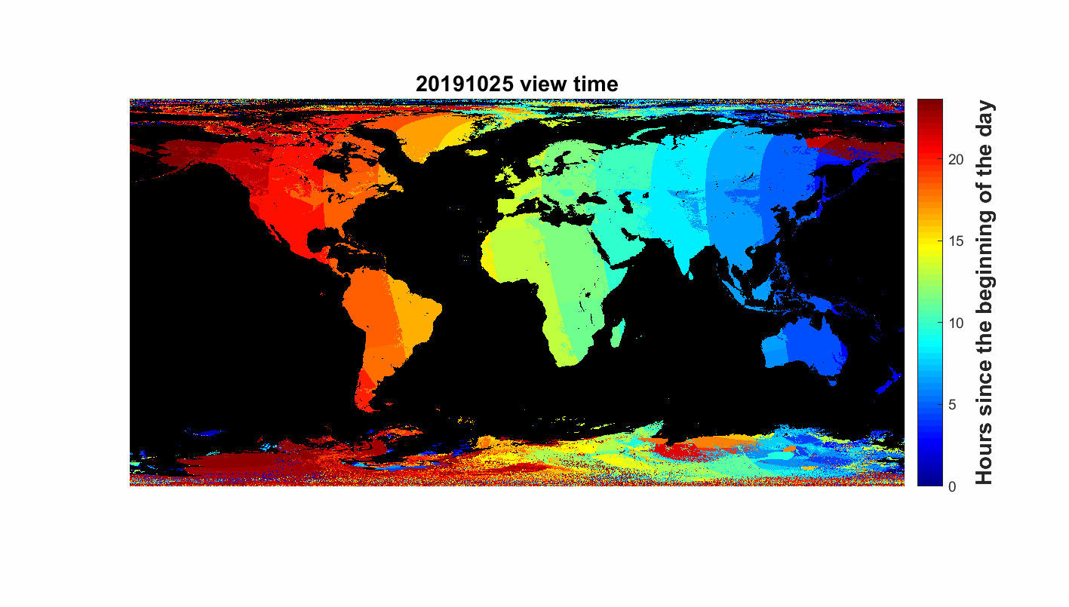
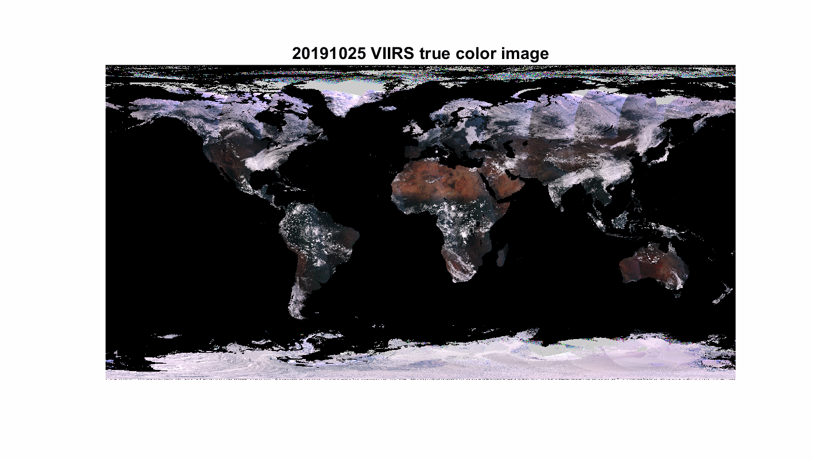
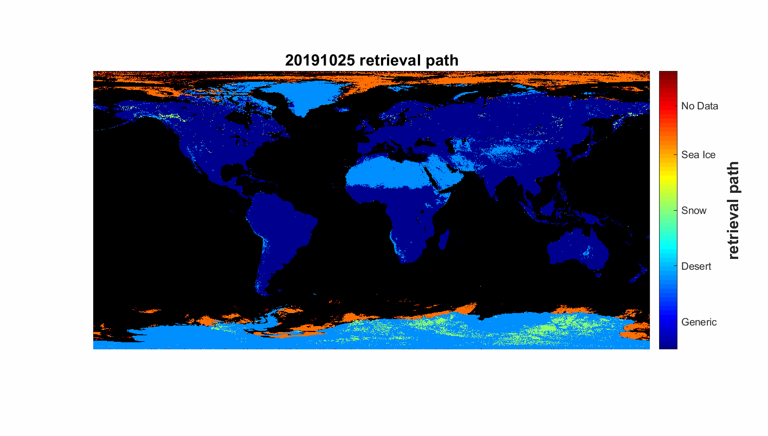
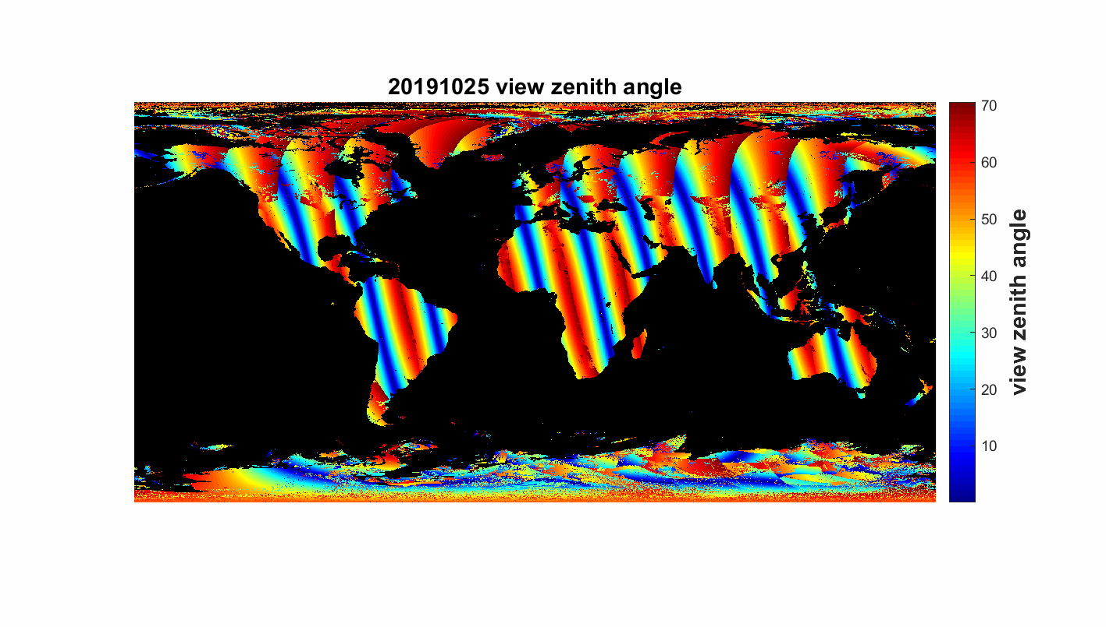
Visual inspection of NOAA-20 SURFALB: Global
Data size:
Global map examples in Oct 25, 2019 ~ Nov 10, 2019
NOAA-20 Global Composite SURFALB
  NOAA-20 VIIRS SURFALB product example, generated by the local production. The current result satisfies the provisional maturity review requirements.
Y. Yu et al., NOAA & UMD
Notes:
c

Slide 15
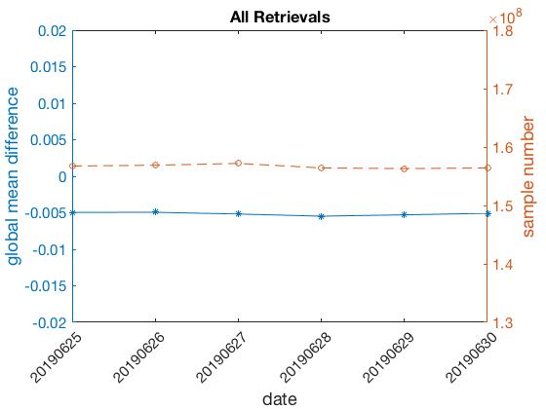
NOAA-20 vs. S-NPP
Algorithm performance evaluation
06/30/2019
Single-day comparison
Test case: 06/25/2019~06/30/2019
Comparison on daily basis: The NOAA-20 and S-NPP VIIRS albedo matches well with a global bias around 0.005 in June.
Y. Yu et al., NOAA & UMD

Slide 16
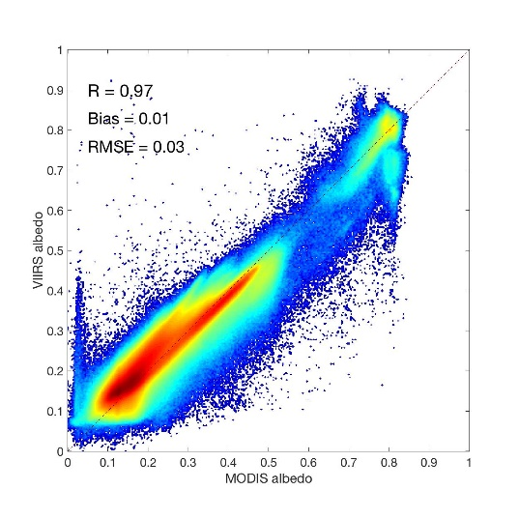
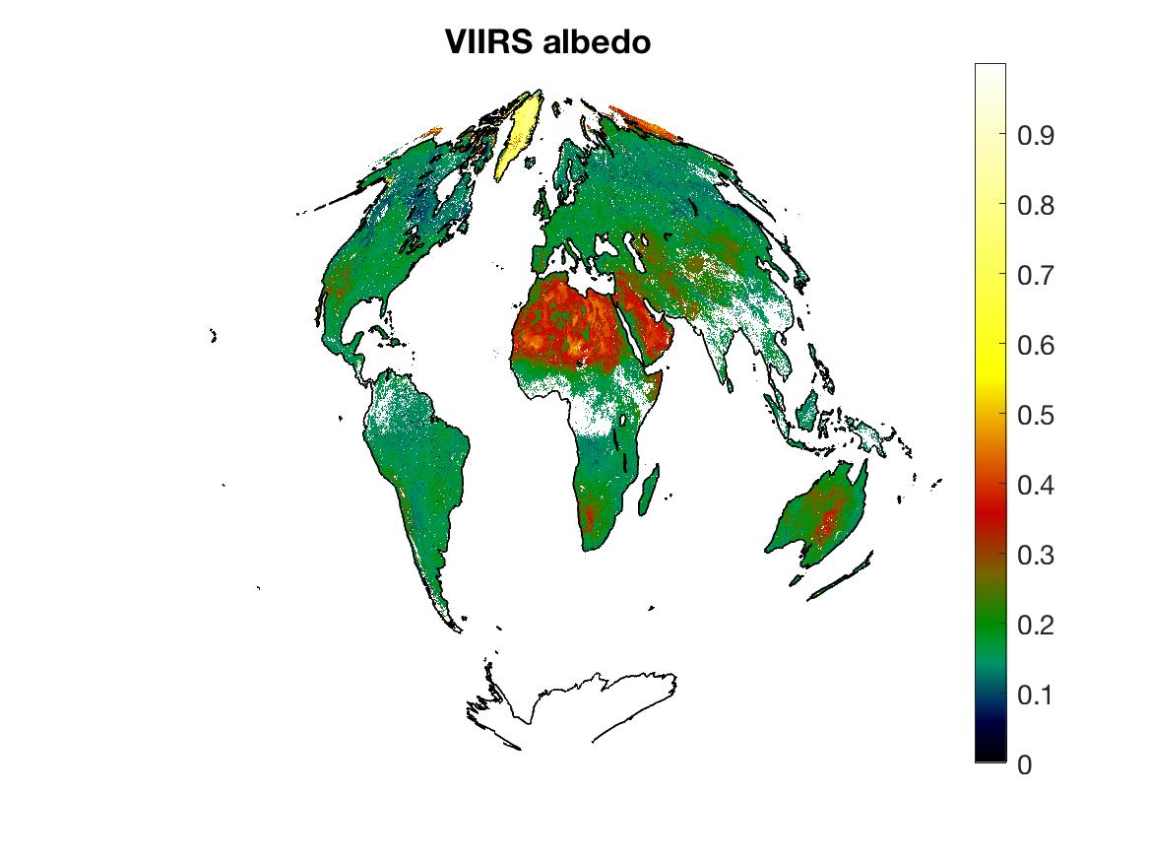
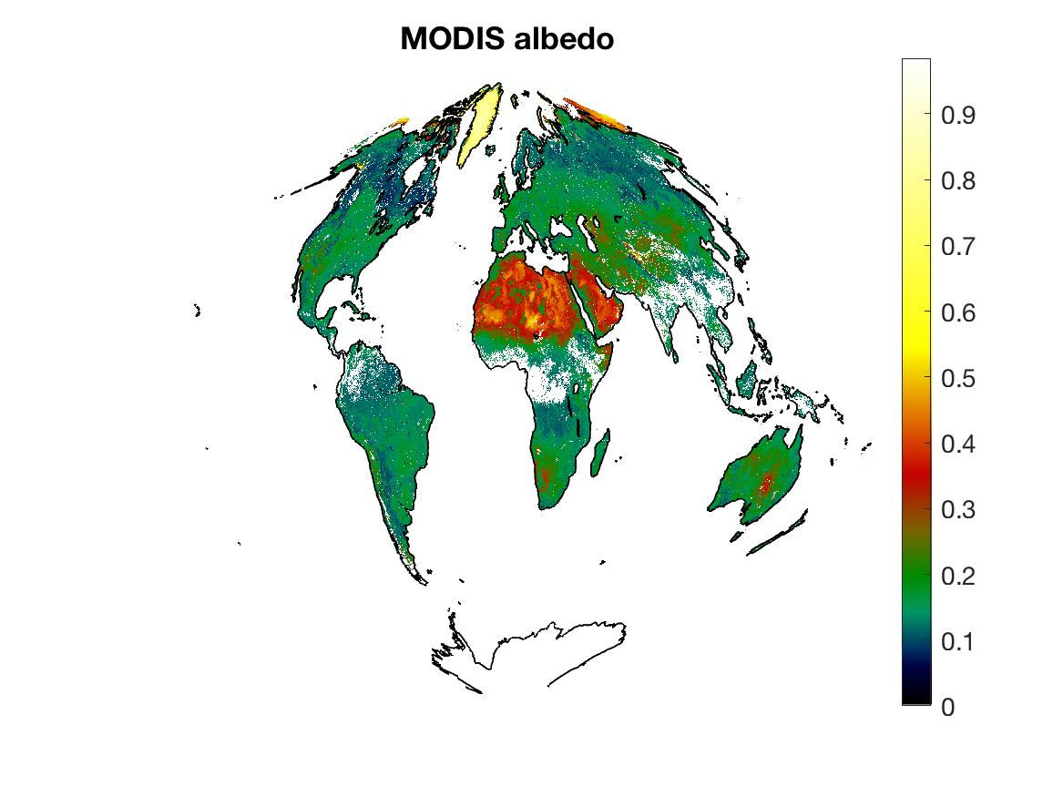
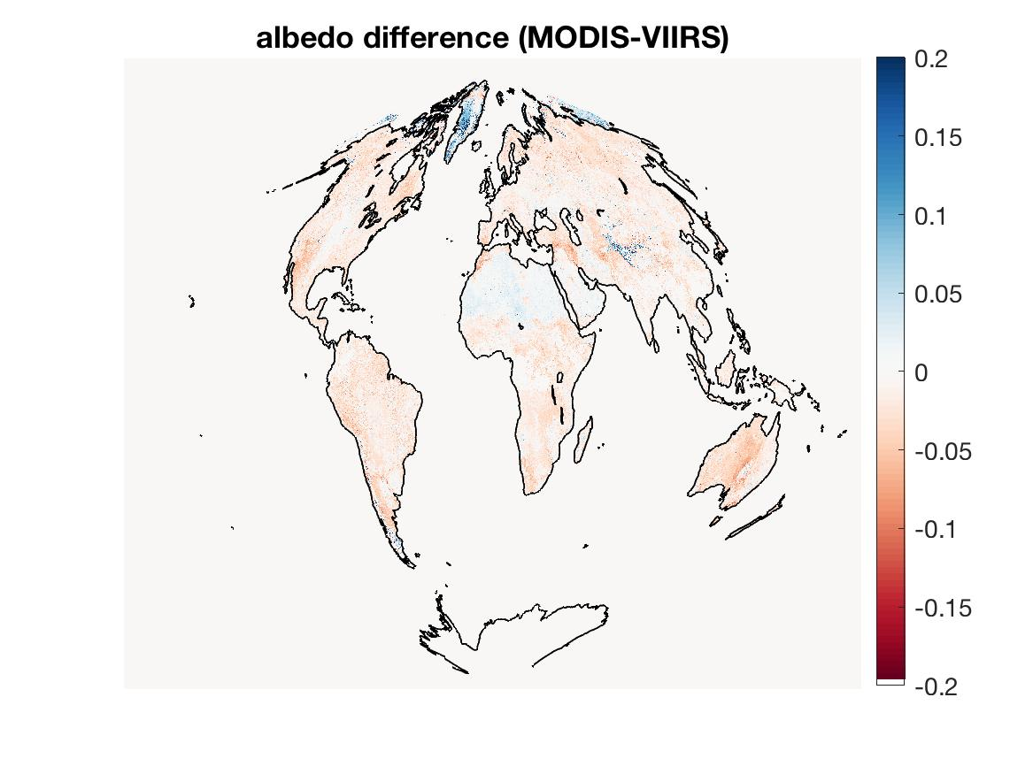
NOAA-20 vs. MODIS global
Algorithm performance evaluation
Global 20190630
Comparison between high-quality retrievals over globe shows that the NOAA-20 and S-NPP VIIRS SURFALB are generally consistent.
Y. Yu et al., NOAA @ UMD

Slide 17
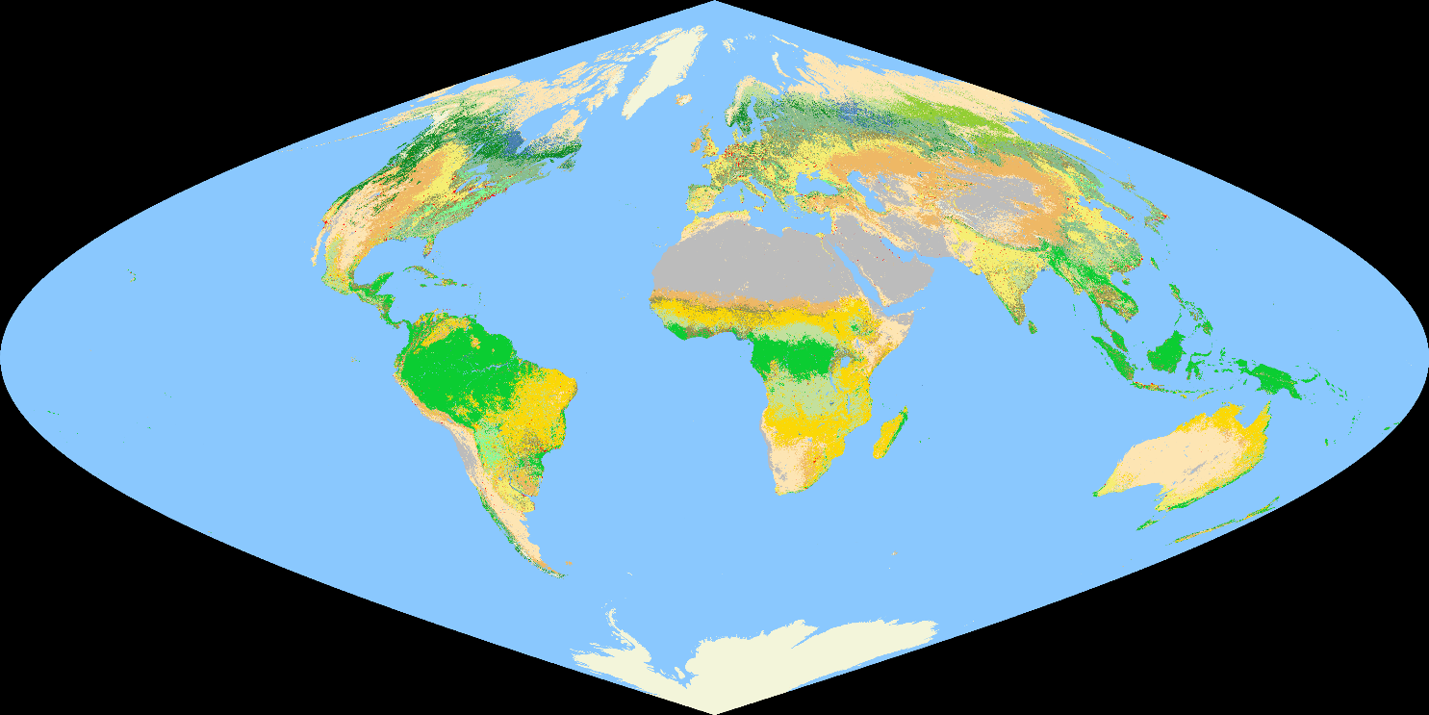
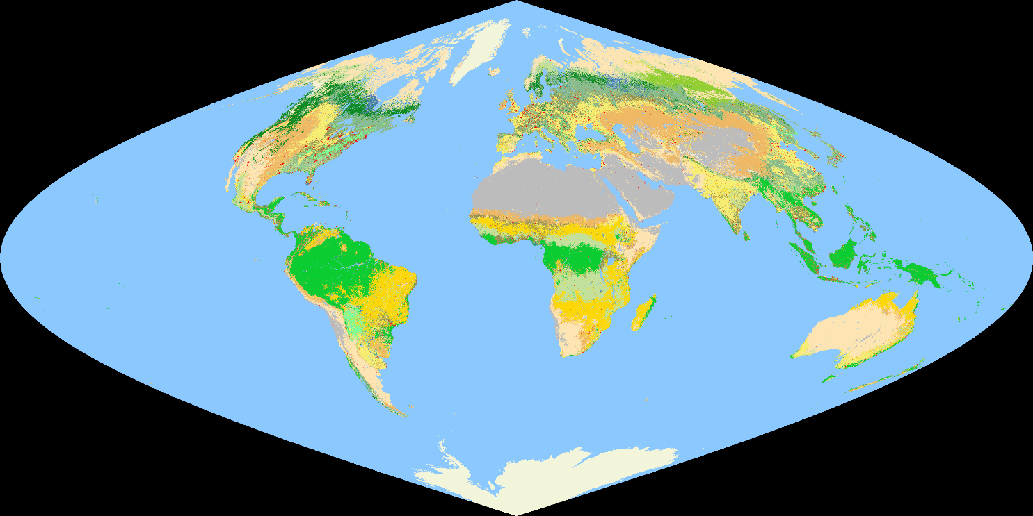
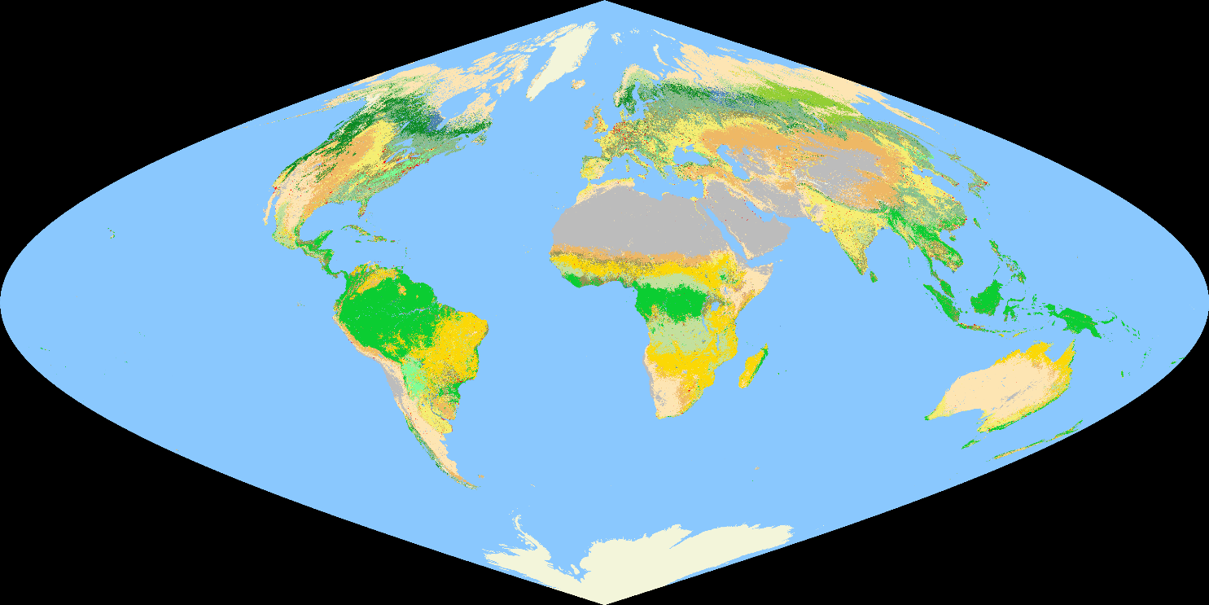



Annual Surface Type Products From VIIRS
2018
2012
  Overall Accuracies: 76% - 78%
  Available from: ftp://ftp.star.nesdis.noaa.gov/pub/smcd/JPSS/VIIRS-AST
X. Zhan et al., NOAA @ UMD
Notes:
Annual surface type (AST) products have been and will continue to be generated using VIIRS observations.
These products are produced using annual VIIRS observations and state of art global land cover mapping algorithms trained using large quantities of globally representative training data
AST products developed thus far have overall accuracies between 76% and 78%

Slide 18
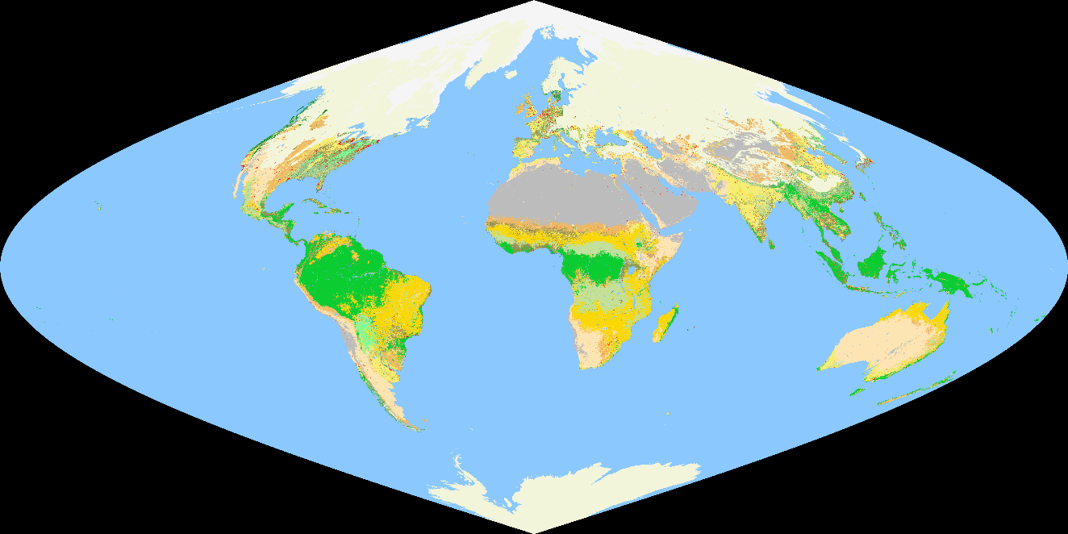
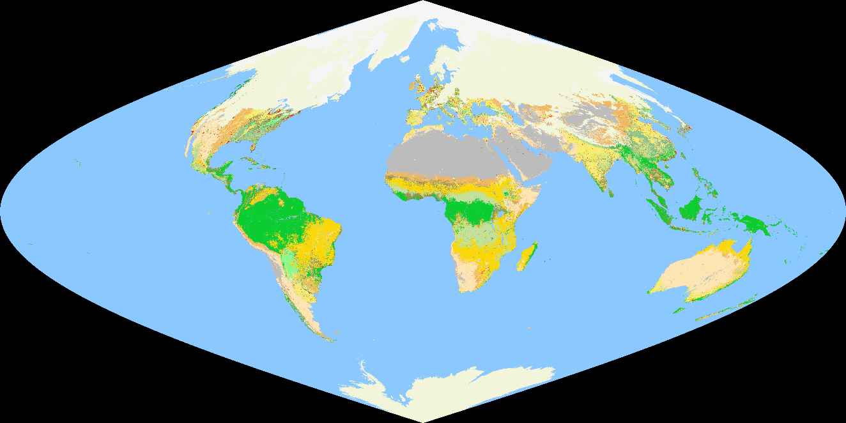
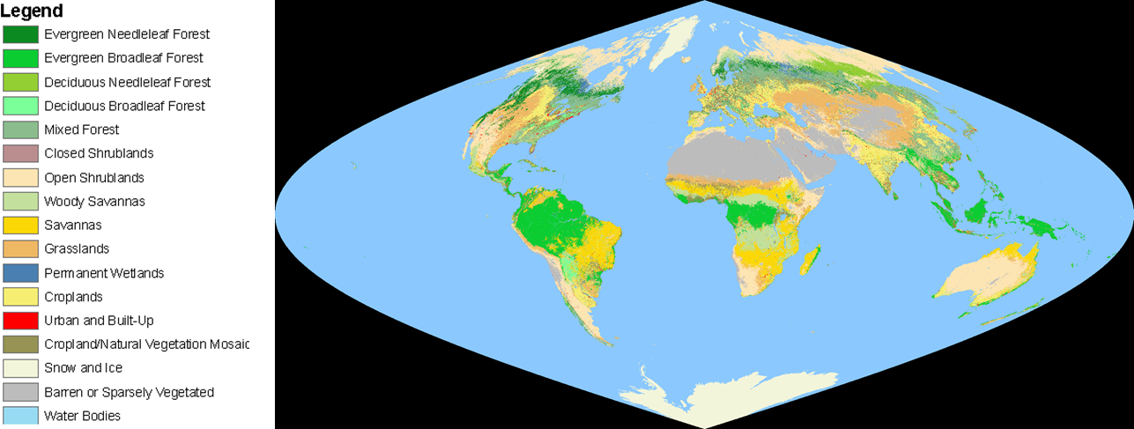


Daily Surface Type Product Suite for Sub-Annual Change Monitoring - A Prototype Product for Daily Snow/Ice Cover Changes
2019/01/05
2019/02/05
2019/04/05
2019/08/05
X. Zhan et al., NOAA @ UMD
Notes:
Large scale changes in surface cover conditions can occur at seasonal or sub-seasonal intervals. These short time changes can affect weather/climate processes by altering surface temperature, albedo, ET, and other surface properties. Future surface type products will be updated on seasonal to near daily basis to capture these changes.
The maps on this slide were created by integrating 2019 daily snow products produced by the Interactive Multisensor Snow and Ice Mapping System (IMS) with the 2018 AST product. Each daily map reflects that day's snow cover condition and the latest (2018) condition for all other surface types.

Slide 19


Land Product Characterization System: A tool for comparative analysis of satellite data and products
Kevin Gallo: NOAA/NESDIS/STAR
kevin.p.gallo@noaa.gov
John Dwyer: USGS/EROS
Greg Stensaas: USGS/EROS
Ryan Longhenry: USGS/EROS
S-NPP VIIRS surface reflectance now included within LPCS for comparison with Landsat, and Terra and Aqua MODIS sensor data.
K. Gallo et al., NOAA & USGS

Slide 20


S-NPP daily surface reflectance (and derived NDVI) available within LPCS.
n-IR channel
USCRN Station: Shabbona, IL
20 X 20 km spatial sample
L 8 OLI, Terra and Aqua MODIS, and S-NPP VIIRS
4 to 11 dates, 1 May – 30 Sept. 2017
K. Gallo et al., NOAA & USGS

Slide 21

Suomi NPP VIIRS I-band fire
July 2, 2019
https://www.star.nesdis.noaa.gov/jpss/mapper/

Slide 22

NOAA-20 VIIRS I-band fire
July 2, 2019
https://www.star.nesdis.noaa.gov/jpss/mapper/

Slide 23

AQUA MODIS fire
July 2, 2019
https://worldview.earthdata.nasa.gov/

Slide 24
Camp Fire, CA M-band vs. I-band
750m (M-band)
375m (I-band)
The VIIRS I-band product provides improved spatial detail to support fire behavior and spread modeling and monitoring.

Slide 25



VIIRS M-band vs. I-band FRP
750m
375m
VIIRS and MODIS active fire data are used in operational NOAA smoke and air quality modeling and monitoring systems
I. Csiszar et al., NOAA & IMSG@NOAA

Slide 26





False fire detections from solar farms
Suomi NPP, 11/26/2018
https://worldview.earthdata.nasa.gov/
Suomi NPP, 11/10/2018
NOAA-20, 11/18/2018
Suomi NPP, 11/26/2018
https://www.star.nesdis.noaa.gov/jpss/mapper/

Slide 27



Persistent anomalies and false alarms
An example of a false alarm caused by reflection from the Topaz Solar Farm in California. NOAA-20, 11/18/2018
1. Oil/gas
2. Volcanos
3. Solar farms (currently only for the HMS domain – extended North America)
4. Everything else (industrial buildings, power plants, unknown etc.)
Potential persistent anomaly mask

Slide 28

Mapping JPSS and MetOp-SG Products
S. Kalluri et al., NOAA & GST@NOAA, IMSG@NOAA, UMD etc.

Slide 29
MetImage-VIIRS Comparison
Highlighted bands are unique to each instrument.
METImage Band | Central Wavelength (μm)
VII-4 | 0.443
VII-8 | 0.555
VII-12 | 0.67
VII-15 | 0.752
VII-16 | 0.763
VII-17 | 0.865
VII-20 | 0.914
VII-22 | 1.24
VII-23 | 1.38
VII-24 | 1.63
VII-25 | 2.25
VII-26 | 3.74
VII-28 | 3.96
VII-30 | 4.04
VII-33 | 6.72
VII-34 | 7.33
VII-35 | 8.54
VII-37 | 10.69
VII-39 | 12.02
VII-40 | 13.35
VIIRS Band | Central Wavelength (μm)
M-1 | 0.412
M-2 | 0.445
M-3 | 0.488
M-4 | 0.551
I-1 | 0.64
M-5 | 0.672
M-6 | 0.746
M-7/I-2 | 0.865
M-8 | 1.24
M-9 | 1.38
M-10/I-3 | 1.61
M-11 | 2.25
M-12/I-4 | 3.74
M-13 | 4.05
M-14 | 8.55
M-15 | 10.76
I-5 | 11.45
M-16 | 12.01
DNB | 0.5-0.9
“violet blue”
“true color blue”
Dual bands at similar wavelength to M6, but not prone to saturation
375 m visible band
VNIR band with some water vapor absorption
VIIRS has 5 high resolution Imagery channels (I-bands), 16 moderate resolution channels (M-bands) and a Day/Night Band (DNB)
20 VIR/IR channels all at 500m spatial resolution
Upper- and Lower-level IR water vapor bands
375 m IR window
Low-light visible
“CO₂ band”
S. Kalluri et al., NOAA & GST@NOAA, IMSG@NOAA, UMD etc.

Slide 30
Summary
Migration of VIIRS land products out of IDPS is complete
  Enterprise algorithms, new upstream products
NOAA-20 product development, evaluation and delivery is ongoing
  products are reaching validated maturity
Increasing end use
  GVF and LST in NWP, active fire in air quality monitoring and modeling
Enterprise algorithm development
  Common algorithm and code base for polar and geostationary data
Formal Metop-SG program
  Evaluation, enterprise algorithms when deemed necessary to support NOAA’s mission

Slide 31
For more information visit
NOAA JPSS at https://www.jpss.noaa.gov/
STAR JPSS at https://www.star.nesdis.noaa.gov/jpss/
NOAA’s Comprehensive Large Array-data Stewardship System (CLASS) at https://www.bou.class.noaa.gov/saa/products/welcome
GOES-R Program, Products etc. https://www.goes-r.gov/

