Slide 1
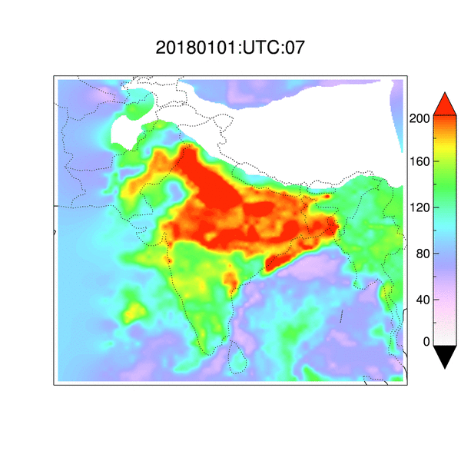
Long-term Trends in Aerosols & Fires over Indian Sub-Continent
PM2.5 (µgm⁻³)
Pawan Gupta (STI/USRA at MSFC),
Robert Levy (GSFC),
Anton Darmenov (GSFC),
Falguni Patadia (GESTAR/USRA/GSFC),
Lorraine Remer (UMBC/GSFC), and
Krishna P. Vadrevu (SERVIR/MSFC)
Collaborator: Mukesh Sharma (Indian Institute of Technology, Kanpur, India), Yogesh Kant (Indian Institute of Remote Sensing, Dehradun, India), Yogesh Sathe (The Automotive Research Association of India)
MODIS/VIIRS Science Team Meeting, Oct 19-21, 2019, UMD, MD

Slide 2
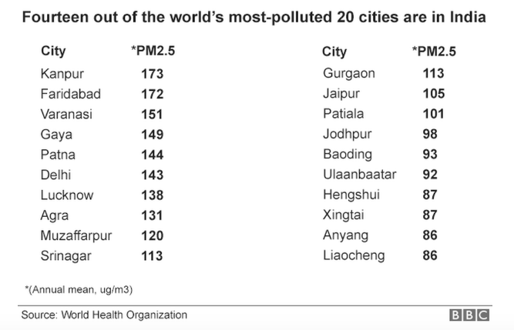
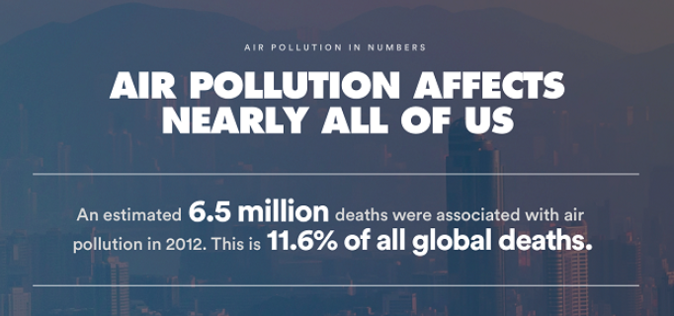
Motivation
WHO Report
And this story repeat every year post monsoon season

Slide 3
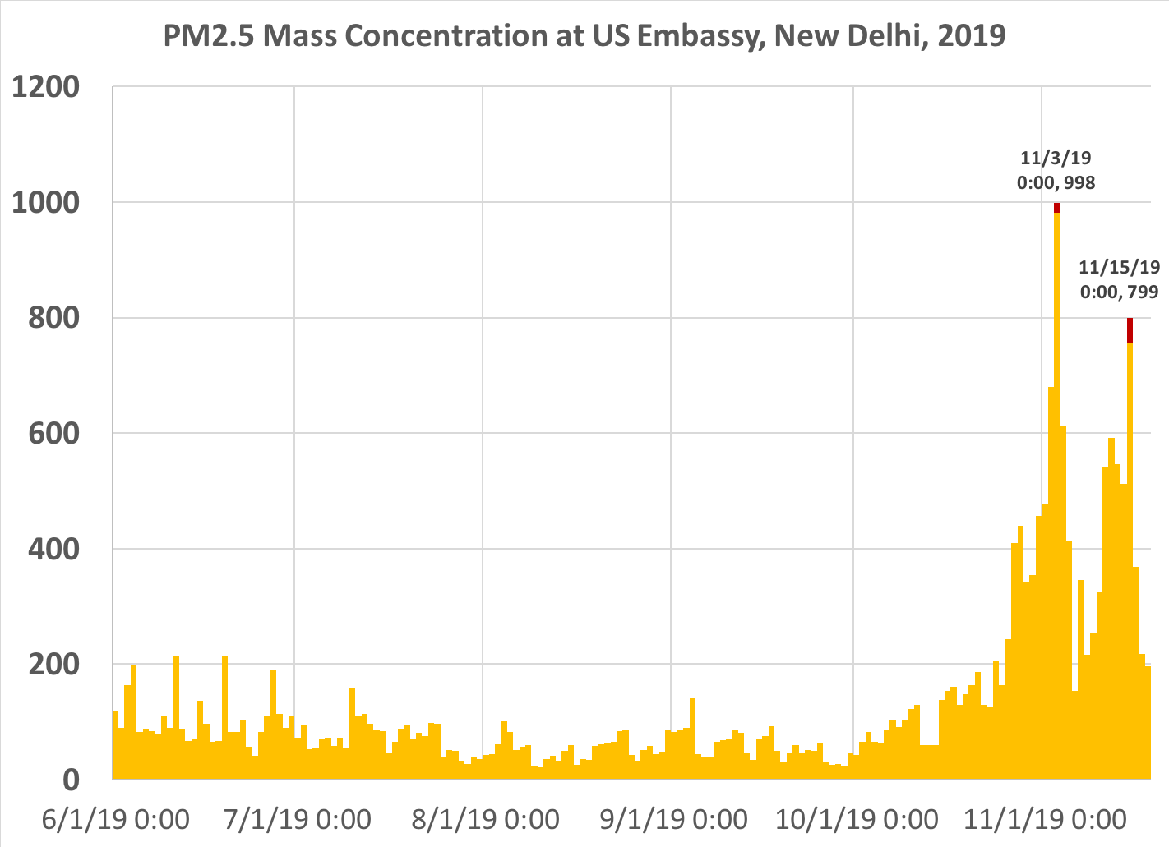
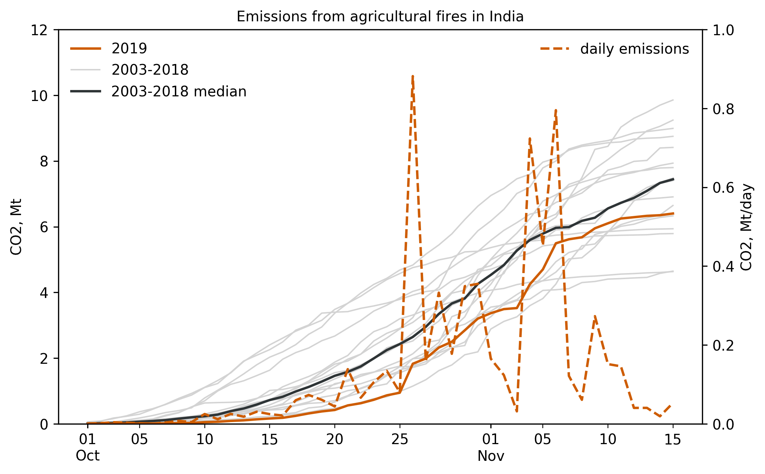
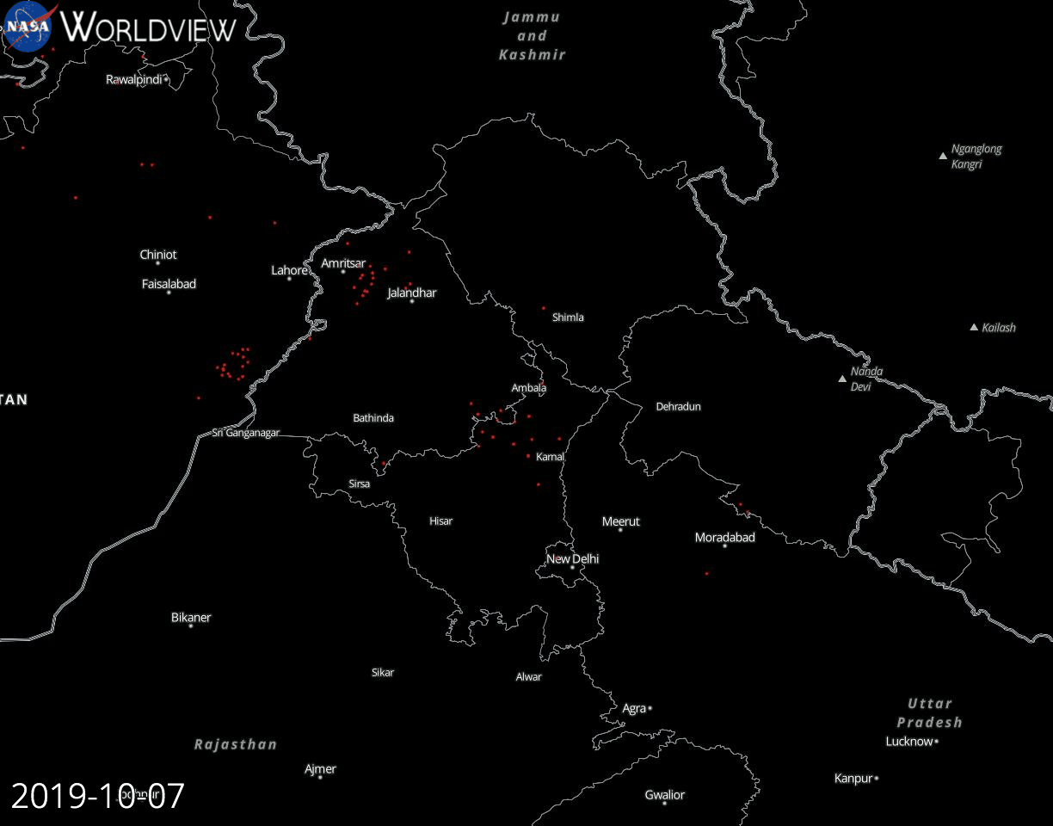
What is happening this year
By A. Darmenov
Emissions during the 2019 post-monsoon agricultural burning were lower than the 2003-2019 median

Slide 4
Characterizing Nearly Two Decades of Biomass Burning Over The Indian Sub-Continent Using Satellite, Surface and Model Simulations
MODIS
Aerosols
Fires
VIIRS
Aerosols
Fires
CERES
Flux
Impact of Fires on Atmospheric Aerosols
Task#4
Spatial and Temporal Fire Burning Trends
Task#3
Satellite Product Evaluation
Task#1
Task#5
Column to Surface Relationships and Air Quality
Task#6
Estimation of Aerosol Direct Radiative Effects
Task#7
Long-term Trends in PM2.5, AOD and ARE
Task#2
Special Aerosol Retrievals
Satellite Measurements
Model Simulations
Surface Measurements
GSFC
MSFC
USRA
UMBC
TEAM
IIT
ISRO
Biomass Burning and Aerosol Characteristics over Indian Sub-Continent
Outcome
Online Visualization and Analysis Tool
Capacity Building
Scientific Publications
PM2.5 Mass Con.
AERONET
Regulatory Measurements
Low-Cost Measurements
AOD
Size Distribution
Absorption
GEOS-5
Emissions
Specific Fire Event Simulations
Biomass burning impact Analysis
Notes:
The science objective is to holistically quantify the impact of biomass burning on air quality and radiative forcing over Indian sub-continent using surface, satellite and model simulations

Slide 5
Moving Forward - Validation

Slide 6
High Resolution Gridded Product
Gupta et al., - manuscript under preparation
Visualization tool for this data is available - https://tethys.servirglobal.net/apps/mkaqx/#
Notes:
Due to mixer of surface types and changing nature of vegetation cover over the region, the standard dark target and deep blue merged product often misses area of interests, therefore we are working on alternative approach to create a high resolution 10km level 3 AOD data sets for the region.
Absence of high resolution level 3 gridded product often become limiting factors for many researchers

Slide 7
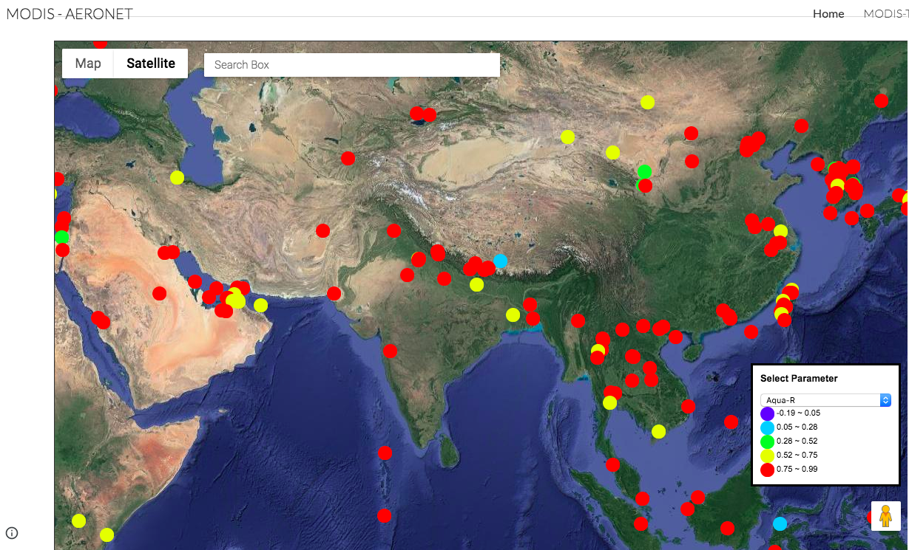
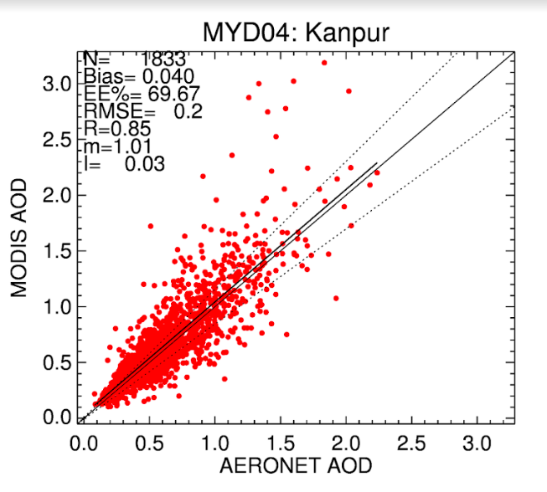
Level 3 (0.1x0.1) AOD Product - Validation
MODIS-Terra
MODIS-Aqua
R= 0.89
Bias =0.02
R= 0.89
Bias =0.01
https://sites.google.com/view/modisandaeronet/home?authuser=1

Slide 8
Application – Trend Analysis

Slide 9
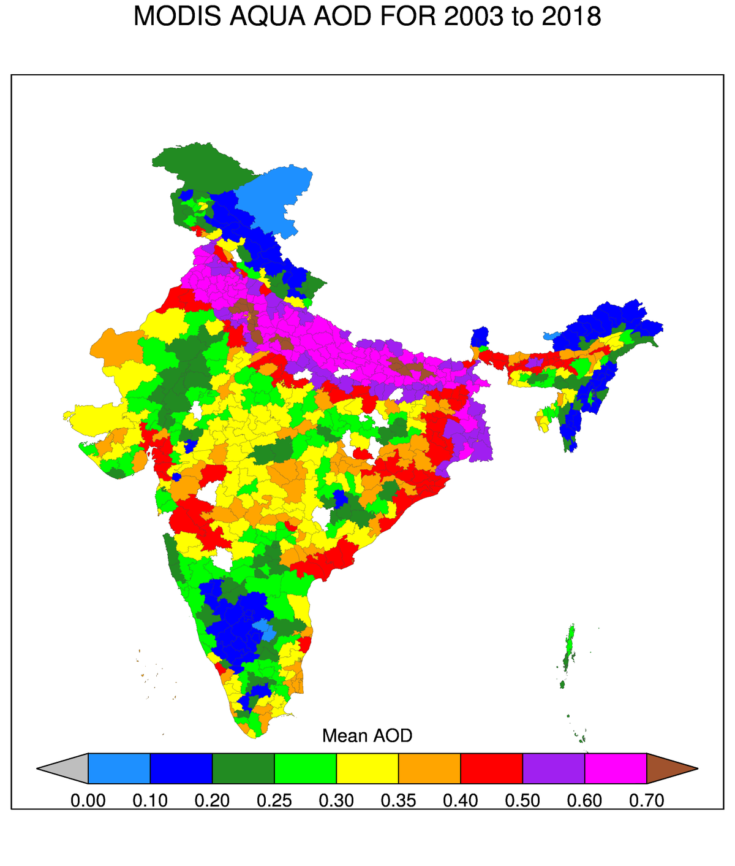
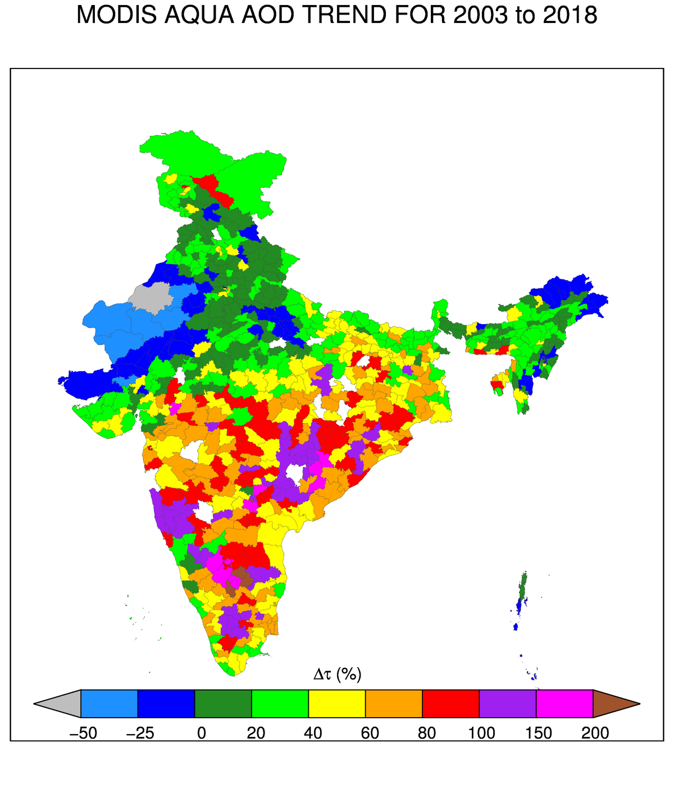
Long-term Aerosol Trends
Although mean AOD is highest in the northern India (i.e. IGP) trends in AOD in southern India are alarming.
Notes:
One of the objective of our project is to inform policy and decision maker through science quality data. Through our experience over the years with end-users community we have learnt that if you speak in their language message are more powerful. Often they don’t understand resolution or grid size and terms like spatial patterns. Therefore, we tried to extract information for administrative boundaries which they can related to and policies can be influenced.

Slide 10
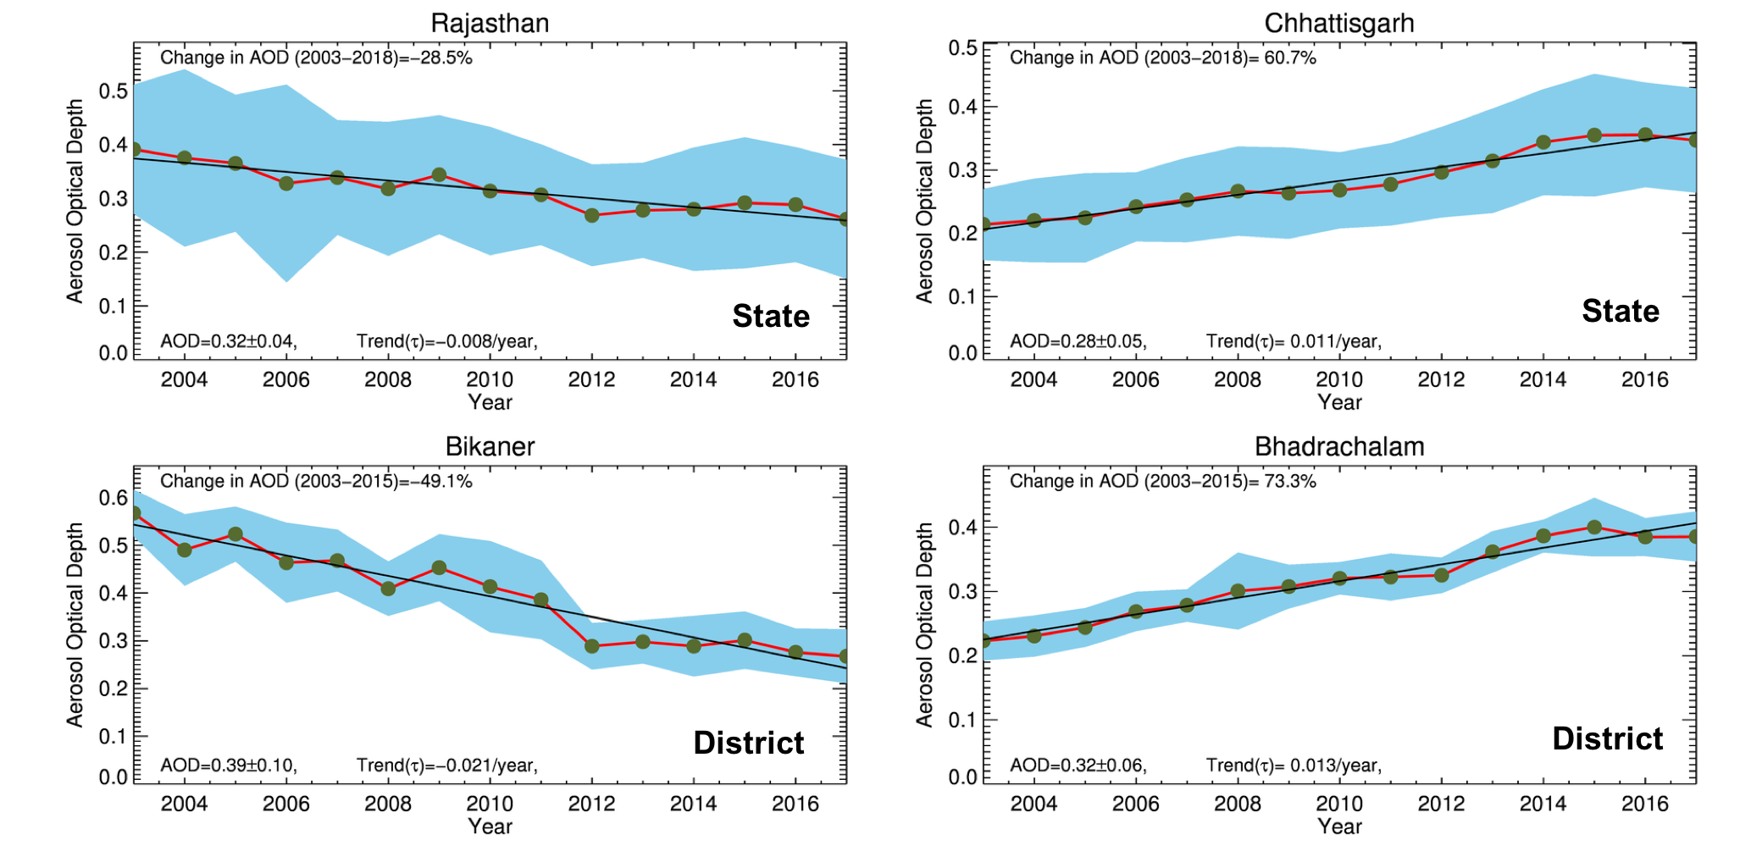
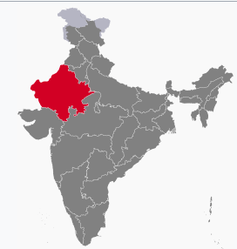
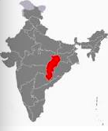
Aerosol Trends – Admin boundaries
Notes:
Badrachalam is in Telangana

Slide 11
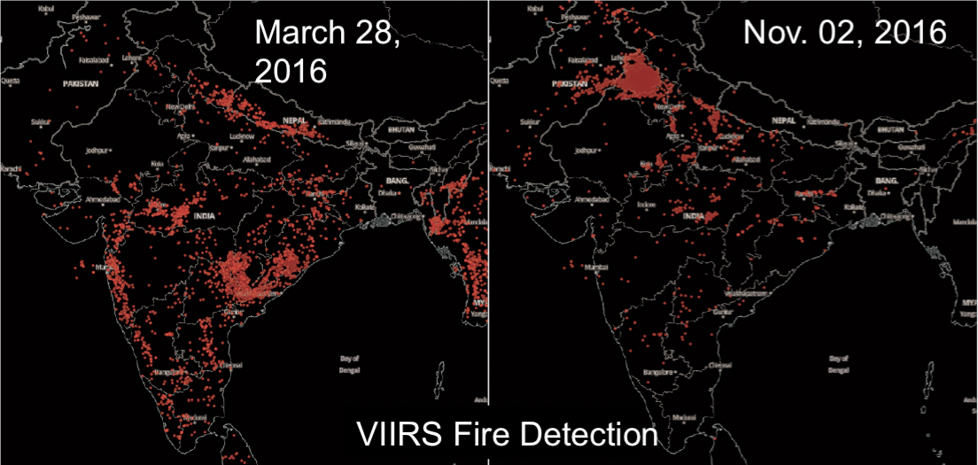
Seasonal Pattern of Fires
VIIRS fires detected on March 28, 2016 (left) and Nov. 2, 2016 (right). In March we see much burning in central and southern India (agricultural and open fires) and some fires in the IGP and Nepal (forest fires). On Nov 2nd, 2016 the fires have migrated to Northern India, and Pakistan (Image Generated using Worldview).
Agricultural fires show bimodal trend corresponding to Rice-Wheat residue burning
Residue burning
Residue burning
Vadrevu et al., 2011. Env. Pollution
Notes:
The main rice growing season is the 'Kharif'. It is known as Winter rice as per the harvesting time. The sowing time of winter (Kharif) rice is July-August and is harvested in October-November.
Wheat is sown during November-December and harvested during April-May.
High fire counts from MODIS correspond to Residue burning season.

Slide 12
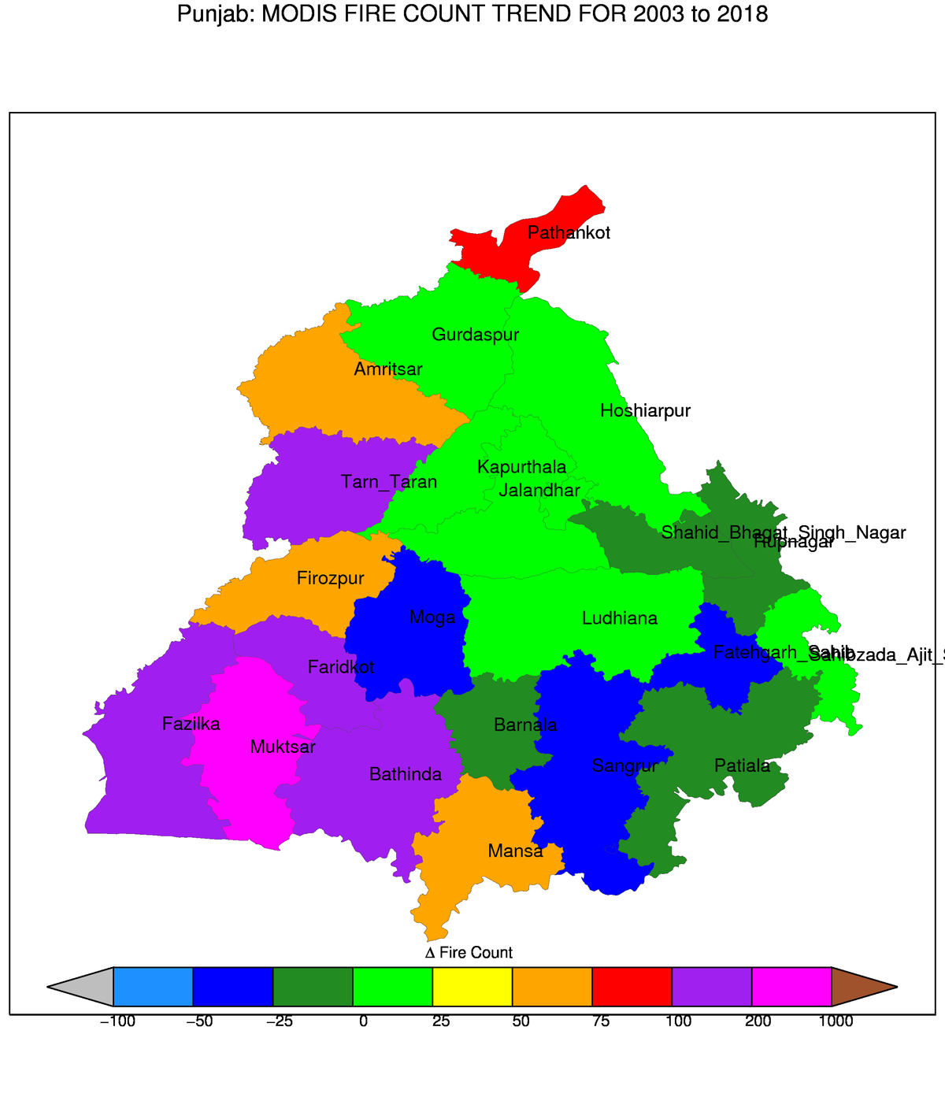
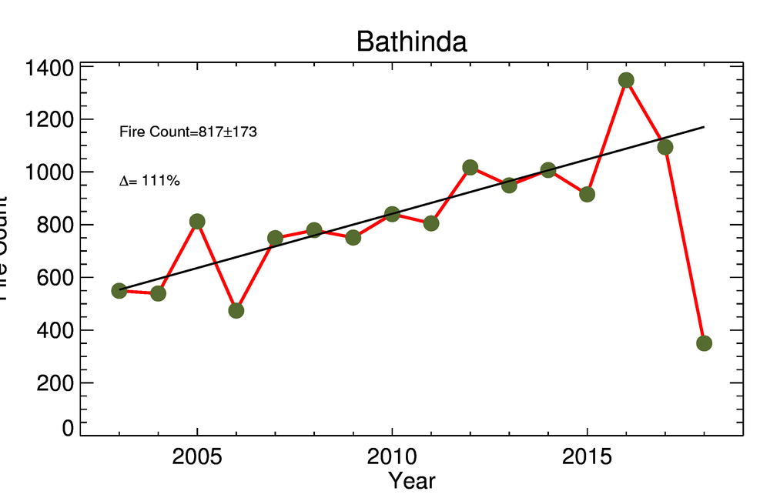
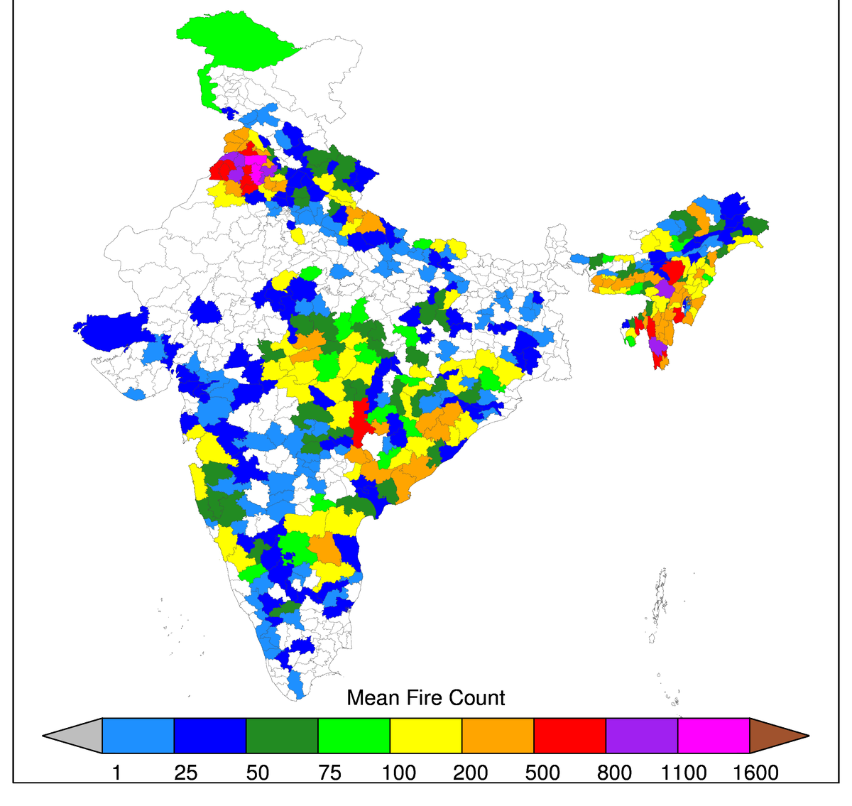
Punjab - Fires

Slide 13
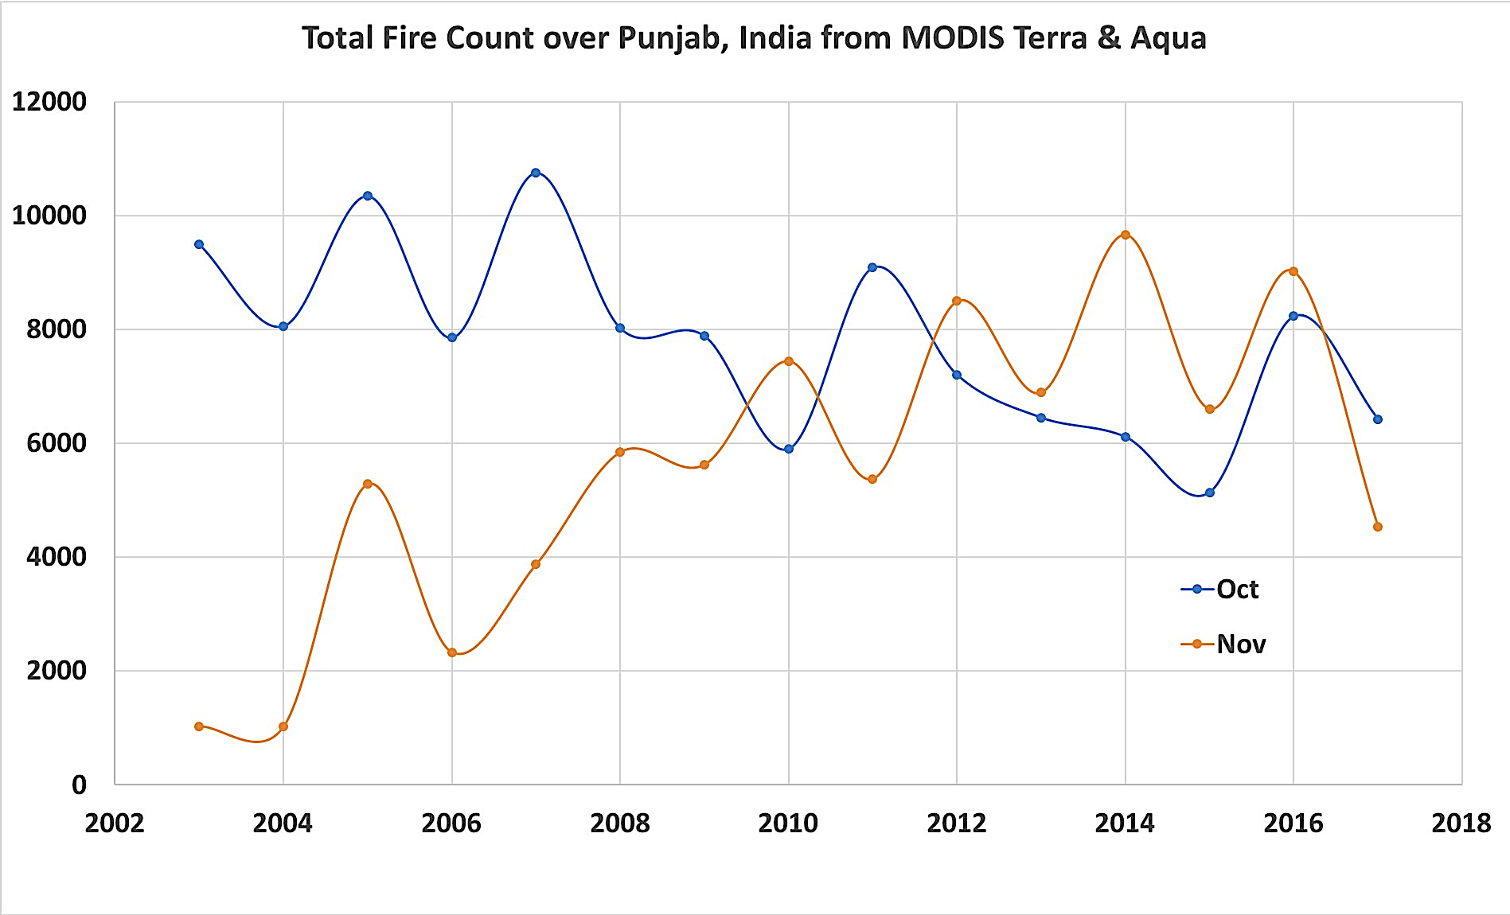
Fires Trends – Month by Month
Next step is to analyze fires and aerosol data together to understand inter-relationships

Slide 14
Application – Air Quality Estimation

Slide 15
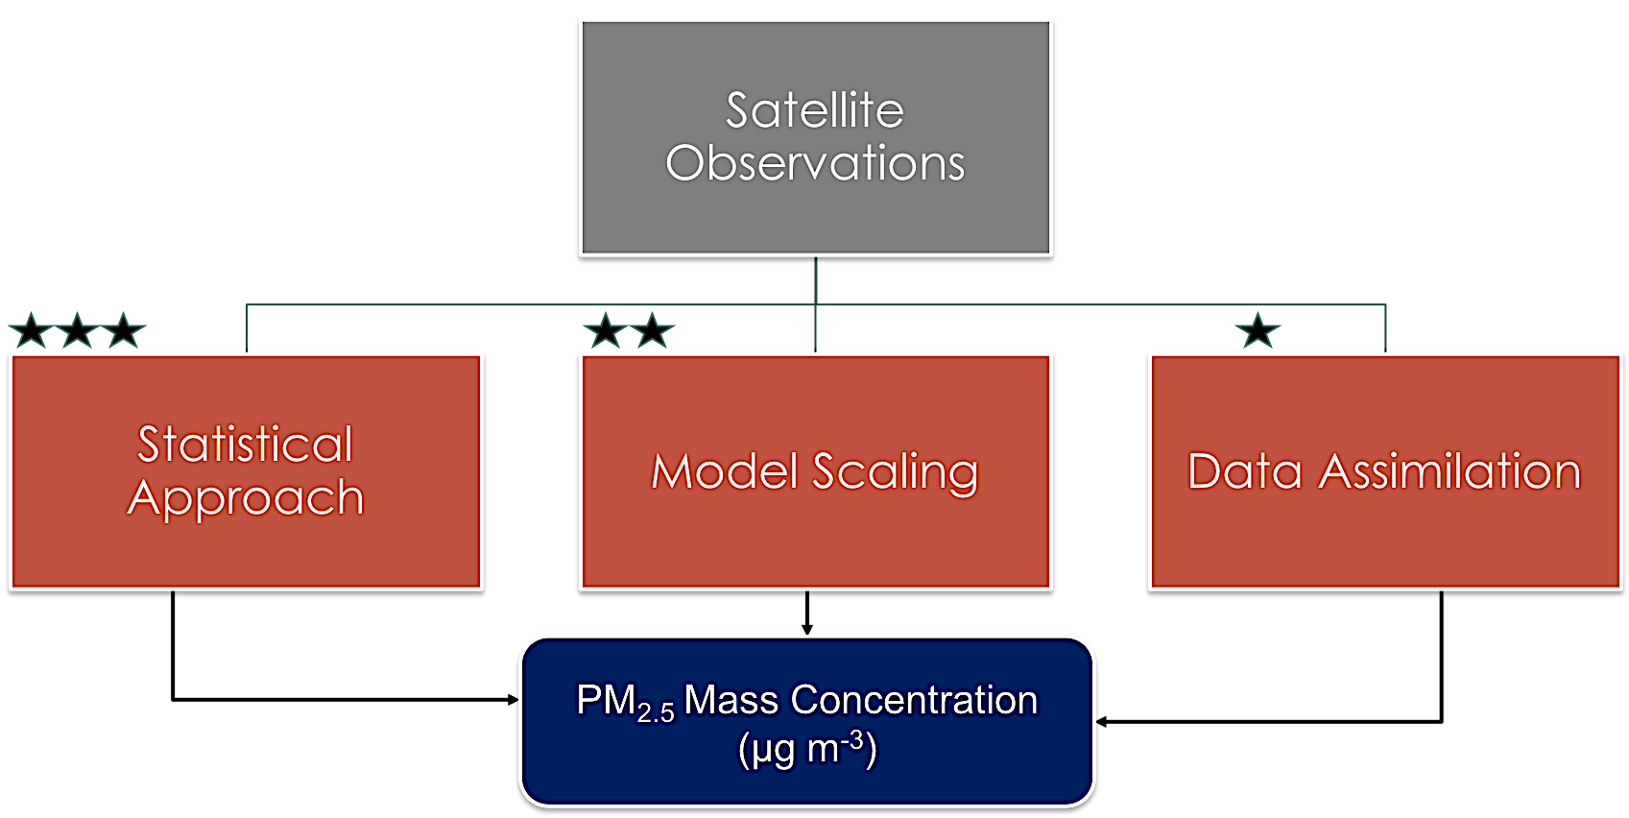
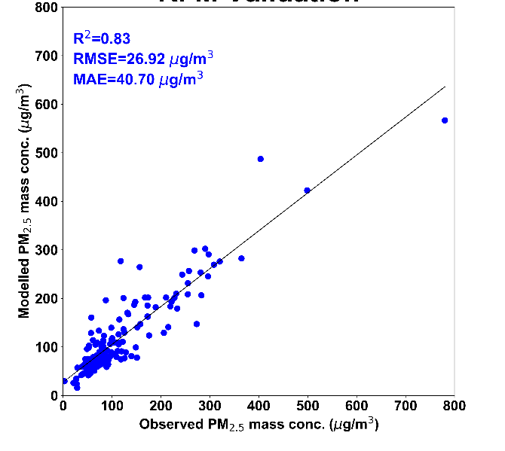
Air Quality Estimation – PM2.5
India
Delhi
R=0.84
R=0.91
Notes:
In absence of MODIS AODs, MERRA2 AODs are used.

Slide 16
Air Quality Estimation
November 18, 2018 – 7 UTC
NPP-VIIRS
MERRA2/ML Estimation
PM2.5 (µgm⁻³)

Slide 17
Air Quality Estimation
March 23, 2018 – 7 UTC
NPP-VIIRS
MERRA2/ML Estimation
PM2.5 (µgm⁻³)
More independent validation is ongoing
Plans to create a 20 years of PM2.5 records over the region

Slide 18
Upcoming – Lot more to do !!

Slide 19
Surface vs Column
Leveraging NASA Citizen Science Project – Deploying Low-Cost AQ sensors in India – Spring 2020

Slide 20
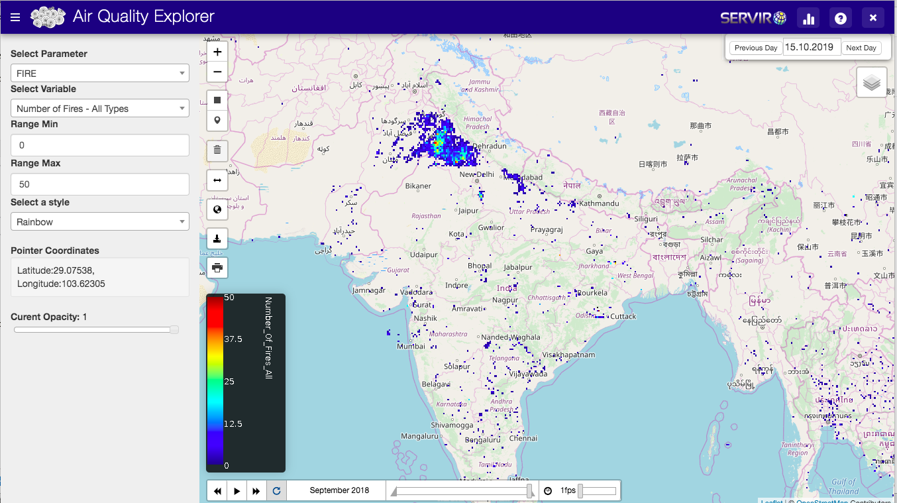
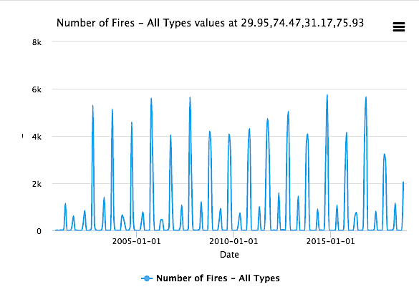
User Workshop & Visualization Tool Launch
Aerosol Validation –
https://sites.google.com/view/modisandaeronet/home?authuser=1
Visualization tool development
https://tethys.servirglobal.net/apps/mkaqx/.
A capacity building workshop with partners in India will be organized in spring 2020 in New Delhi.

Slide 21
GEOS Model Simulation to Quantify Fires Impact on Surface AQ
By A. Darmenov

