Slide 1
MODIS – SNPP VIIRS Land Science Overview
Chris Justice
Land Discipline Lead

Slide 2
Land Science Status
MODIS Terra launched Dec 18 1999
Almost 20 years of global data
MODIS Aqua launched May 4 2002
Kudos to the engineers and MCST
A suite of land products driven primarily by global modeling community
SR, VI,BRDF/Albedo, Surface Temperature, LAI/FPAR, NPP, ET, Fire/Burned Area, Snow and Ice/MAIAC
BRDF, LAI, Fire products rely on AM and PM observations
PI and LDOPE QA and Validation integral part of the land product activities
5 full record reprocessing of the data
Efficient data dissemination and user services – ESDIS: EDC, NSIDC, ORNL DAACs
Kudos to MODAPS, LAADS, LDOPE, Science Teams and the DAACs
Data also available via Google Earth Engine, Amazon S3
MODIS instruments and products in the NASA Senior Review
Terra orbit exit in view (2022) , Aqua A-Train exit fuel limitations (2022)

Slide 3
Land Science Status
SNPP VIIRS launched Oct 28, 2011
NPOESS Preparatory experience
JPSS-1/NOAA 20 launched Nov, 18 2017
BOTH missions with PM overpass
KUDOS to the IPO for pushing MODIS continuity
SNPP Radiometric Inter-comparisons with MODIS
A suite of NOAA operational land products driven primarily by NWS
SR, LST, Albedo, VI, Green Veg Fraction, Veg Health, Surface Type, Active Fire
IDPS>NDE
Data from NOAA CLASS system
A suite of NASA Science products focused on MODIS Continuity
SR, VI, BRDF/Albedo, LST, LAI/FPAR, Day Night Band, Active Fire, MAIAC
PI and LDOPE QA – little to no new validation, intercomparison with MODIS
Data dissemination and user services – ESDIS: LAADS, EDC, NSIDC, DAACs
Data processing of JPSS1 supported (V2 L1B) – dissemination via LAADS
currently porting SNPP Land Code to JPSS1
Evaluation of Sentinel 3 underway w. AM overpass (Vermote, USPI )

Slide 4
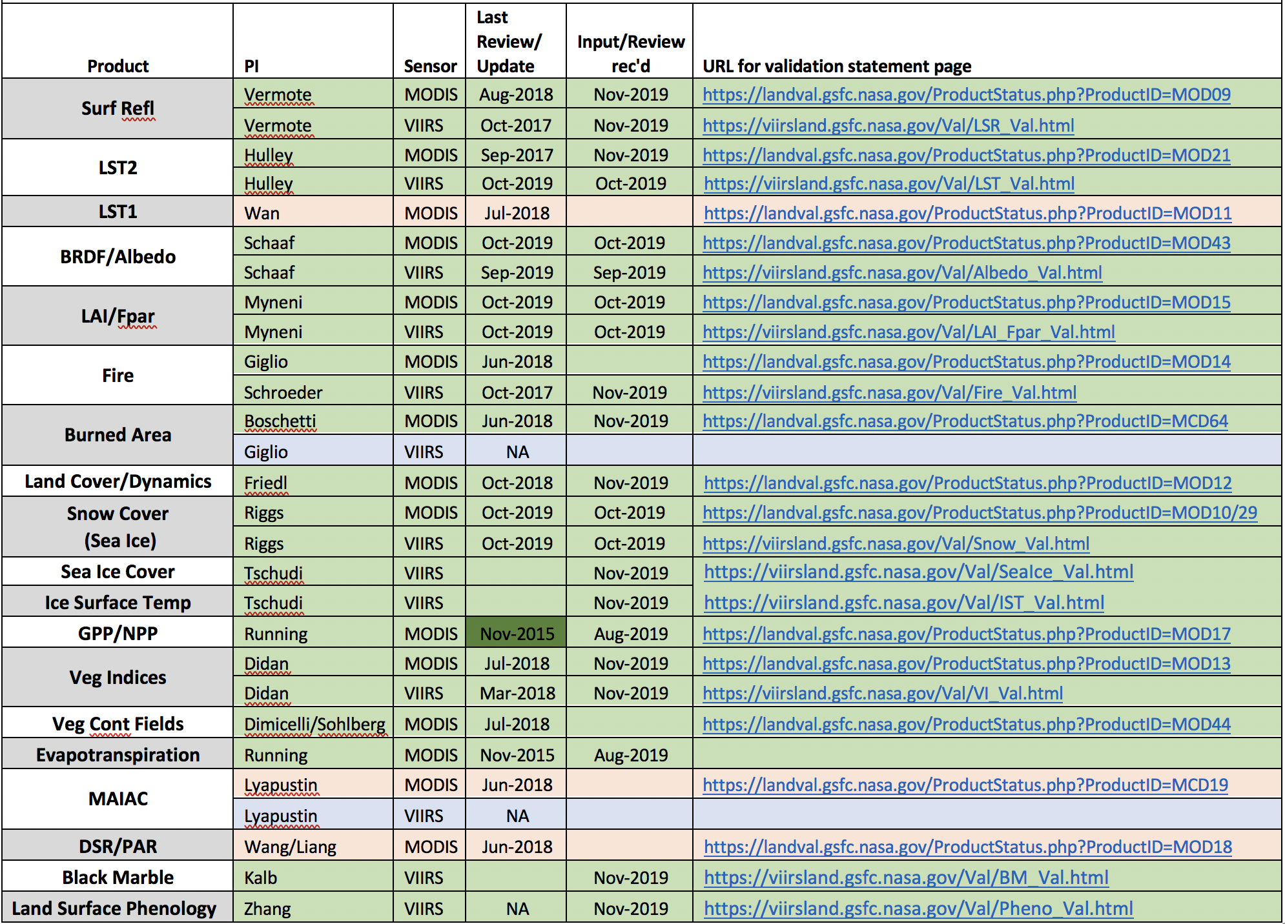
These are updated annually, so users know the current validation status of the MODIS and VIIRS products. Statements do not have to be updated annually, but the PIs need to verify the status information posted on their status pages are current.
Status of MODIS / VIIRS Land Product Validation Statements
Nickeson

Slide 5
MODIS – VIIRS contribution to the GCOS Essential Climate Variables (ECV’s)
Albedo (MODIS / VIIRS)
Fire Disturbance
Burnt Area (MODIS Only)
Active Fire (MODIS / VIIRS)
FRP (MODIS / VIIRS)
LAI (MODIS / VIIRS)
FAPAR, (MODIS / VIIRS)
Land Cover (MODIS Only)
LST (MODIS /VIIRS)
Snow (MODIS)
Surface Reflectance (Fundamental Data Record)
On going effort to update the CEOS ECV Inventory (Wenying Su, LARC) – “used to generate action plans for the space agencies”.
“Not meeting the GCOS requirements does not disqualify a dataset to be included in the ECV inventory”.

Slide 6
Land Science: Spatial/Temporal Resolution
MODIS /VIIRS /Sentinel 3 are coarse res’n – DAILY coverage
Landsat/Sentinel 1 and 2 are moderate resolution – global 3 day coverage becoming feasible but ……
Digital Globe/Planet are Very High - frequency – daily but…
and so btw was AVHRR….
Multilevel Sampling - 1970’s remote sensing concept - approach now being extended to multiresolution time series
Multi-source Land imaging (MuSLI-LCLUC) Prototype Products
Burned Area (sub-saharan Africa), Albedo (circumpolar), Phenology (N. America) – the future is TBD
Global Moderate resolution land products are now being developed
Global Weld monthly/annual – 6 X 3 year epochs (MEASURES)
Landsat (GLCUC) yearly data record 2001-2020 (MEASURES)
State of cloud-enabled moderate resolution ‘global product’ anarchy

Slide 7
Role of Coarse Resolution Data in Land Science
Daily Global Products (250m-1km) basis for global monitoring and mapping (as appropriate)
Multi-year science quality global time-series and analysis – unique role of NASA
Focus on dynamic continuity products (AVHRR> MODIS>SNPP>JPSS1)
Input to Global Modeling and Assimilation input – GMAO, ECMWF
Critical Role in NASA Terrestrial Global and Climate Change Science e.g.
Quantifying impacts of extreme events – droughts/flooding, phenology, snow extent/timing
Quantifying interannual variability and trends – vegetation phenology and production, snow/ice, fire occurrence, burned area,
Quantifying landscape-scale change in vegetation, landcover, snow/ice extent

Slide 8
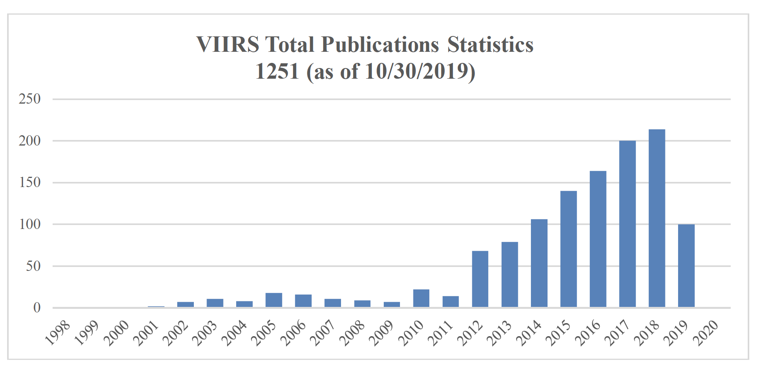
MODIS VIIRS Publications – as of 2019
Courtesy Vince Salomonson

Slide 9
Role of Coarse Resolution Data in Land Applied Science
Critical Role in NASA Applied Sciences Program (Societal Benefit Areas) e.g.
Agricultural Monitoring, Famine Early Warning e.g. Crop Mapping, Crop Condition, Crop Production – e.g. USDA, USAID, NASA Harvest, etc
Fire Management e.g. Fire Location and Extent – e.g. USFS, GWIS, etc
Flood Mapping – e.g. FEMA, UN ISDR etc
National agencies around the World use NASA MODIS data
MODIS/VIIRS Largest Downloads for LANCE NRT data access (see poster)
MODIS/VIIRS Direct Readout – NASA code sharing
Kudos to the Earth Observatory / Firms / GIBS-Worldview

Slide 10
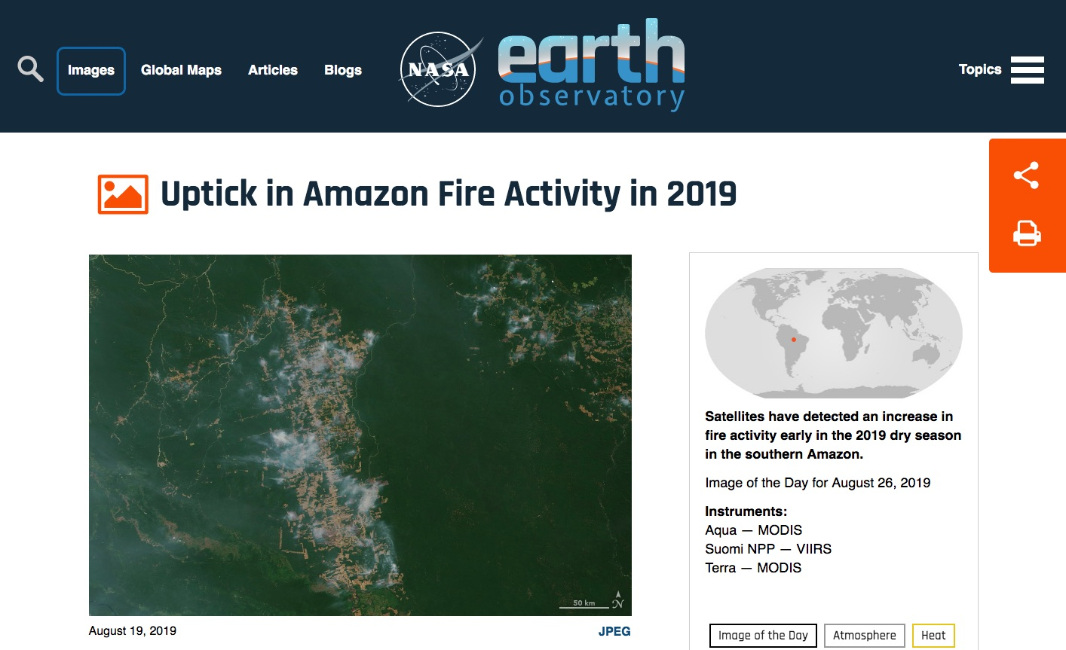
https://www.earthobservatory.nasa.gov/images/145498/uptick-in-amazon-fire-activity-in-2019

Slide 11
https://www.dailymail.co.uk/news/article-7416171/Amazon-sees-2-000-new-fires-48-hours-Brazilian-government-banned-burning.html
Notes:
The numbers are not cited anywhere in the article – 88.8k seems to refer to the number of fires in the Legal Amazon, NOT all of Brazil. 51.9% is way too high, we see < 10% using Matt’s tree cover data

Slide 12
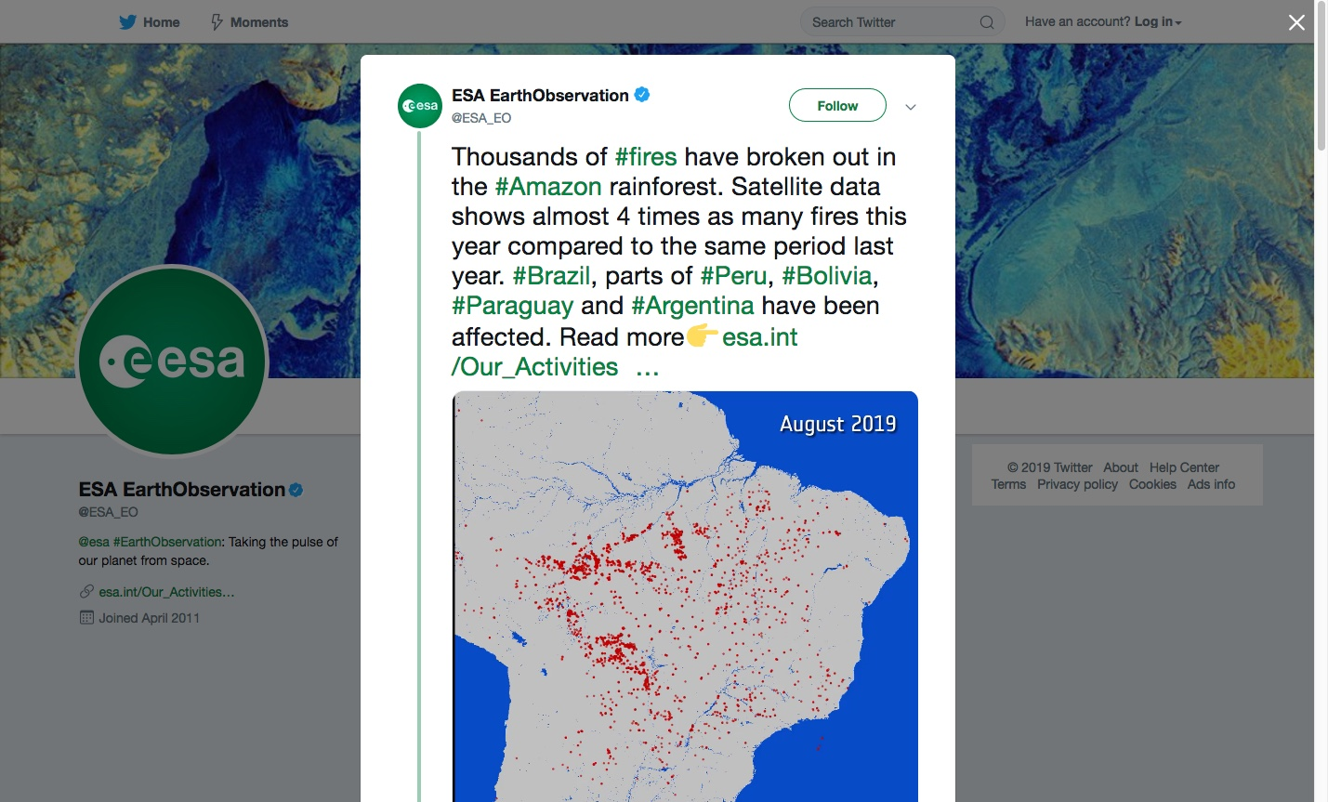
Notes:
https://twitter.com/ESA_EO/status/1166258864234401792

Slide 13
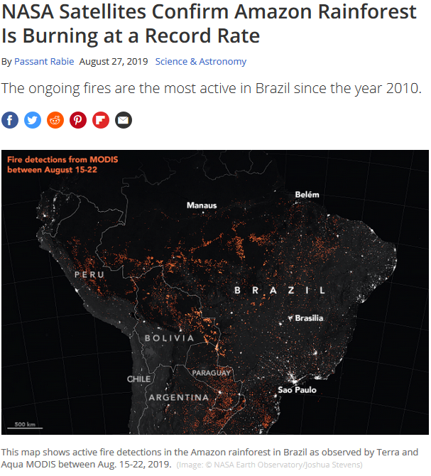
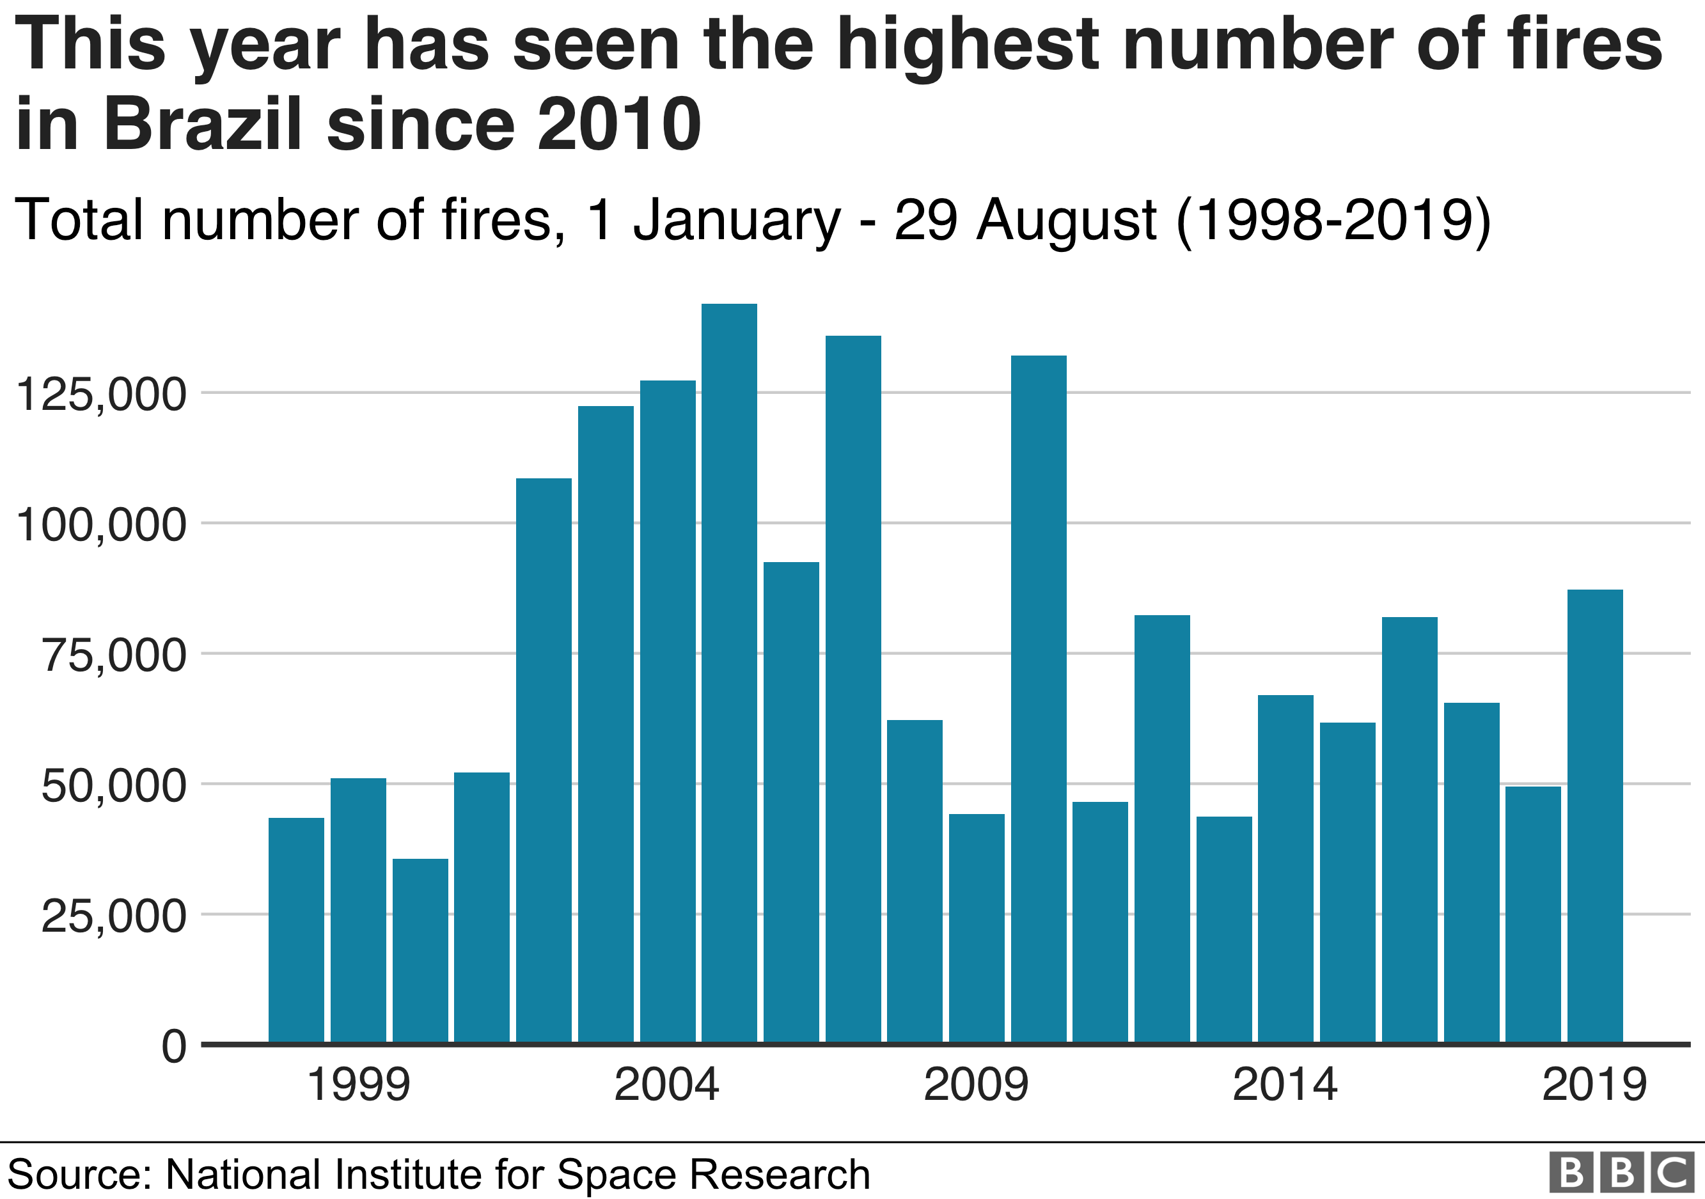
https://www.bbc.com/news/world-latin-america-49433767
https://www.space.com/amazon-rainforest-fires-2019-nasa-satellite-views.html

Slide 14
2019 Amazon MODIS/VIIRS Fires: Timeline of Early Events
August 10
“Day of Fire” – Origins in Novo Progresso
August 11
NASA Earth Observatory ("Fires in Brazil”)
Data credit: GFED
August 21-23
INPE reports a “record 72,843 fires this year, an 80 percent increase from last year”
Social media outcry – posts from Leonardo DiCaprio, Madonna, Kathy Griffin, etc.
Emphasis on “Lungs of the Earth”
August 24
44,000 troops deployed to fight fire spread
August 26
G7 Summit
Beginning of social media outcry: Earth Alliance (DiCaprio) donates $5m
NASA Earth Observatory (“Uptick in Amazon Fire Activity in 2019”)
Data credit: Global Forest Watch Fires, INPE, GFED, FIRMS
August 27
@ESA_EO tweet: “[…]Satellite data shows almost 4 times as many fires this year compared to the same period last year.[…]”
Data credit: Copernicus
August 29
60-day ban on burning by President Jair Bolsonaro
Mike Humber, UMD

Slide 15
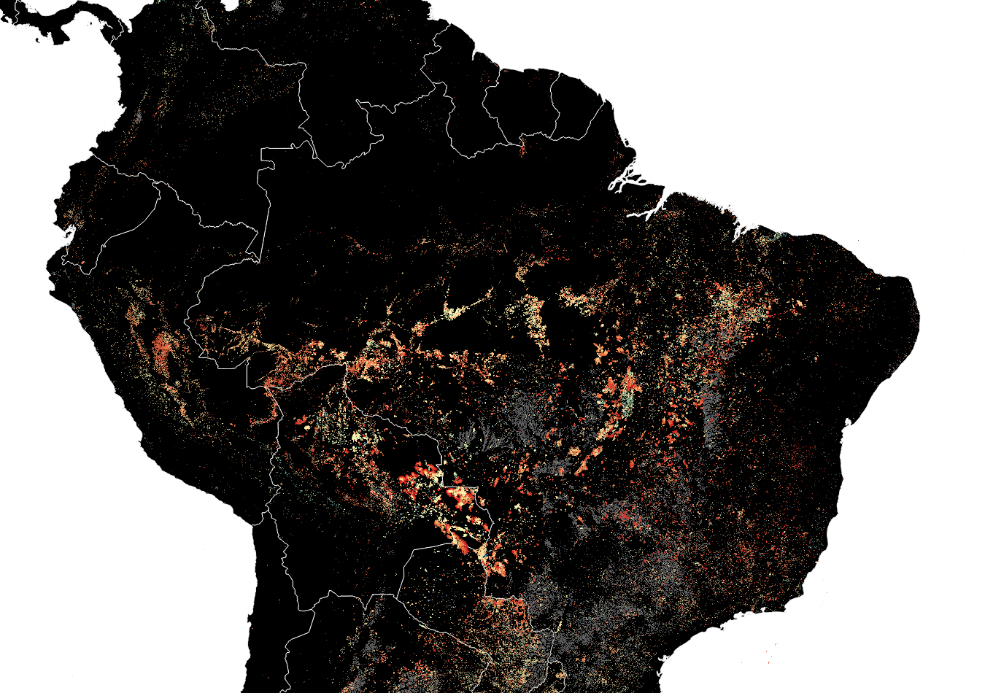
1 Jul 2019
1 Aug 2019
23 Sep 2019
Day of Active Fire Detection
Mike Humber
Matt Hansen UMD
Cropland

Slide 16
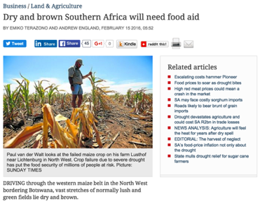
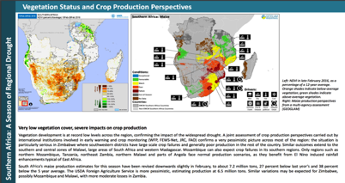
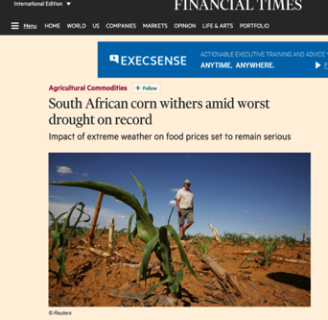
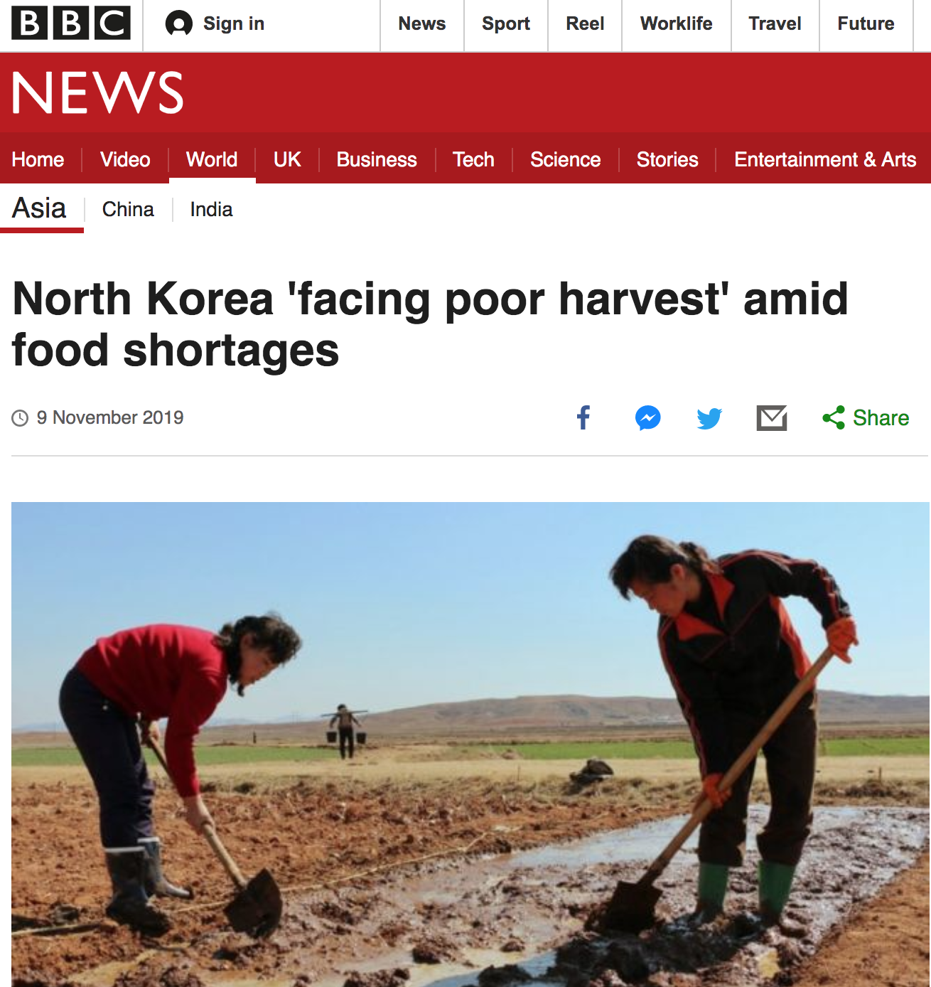
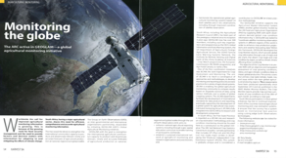
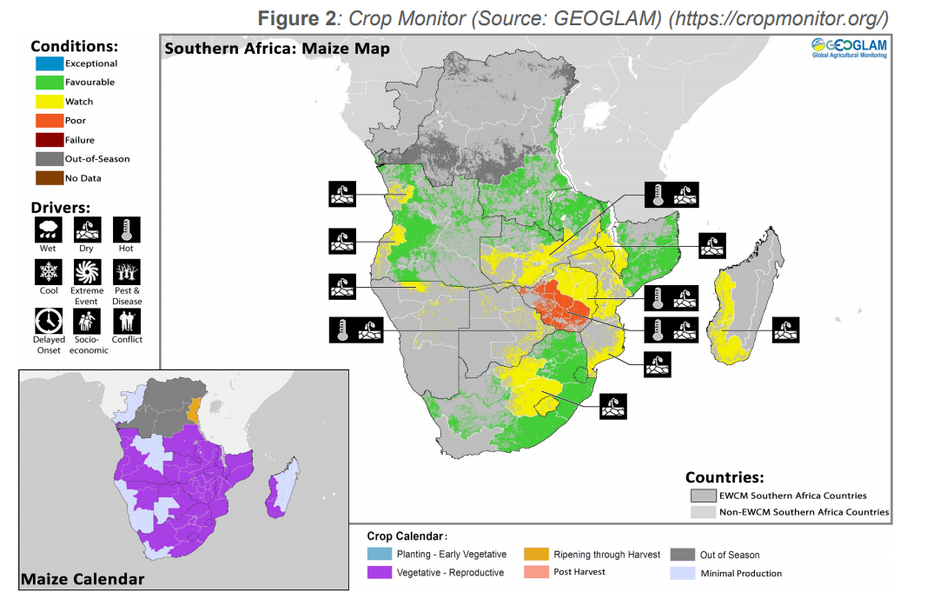
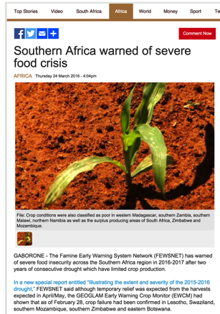
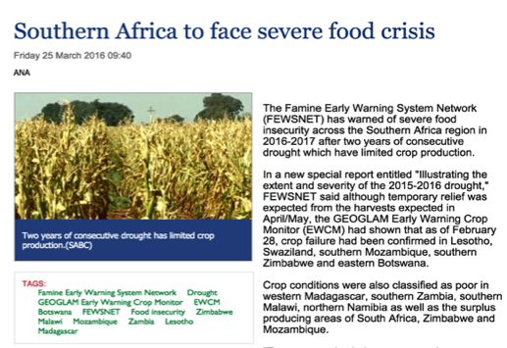
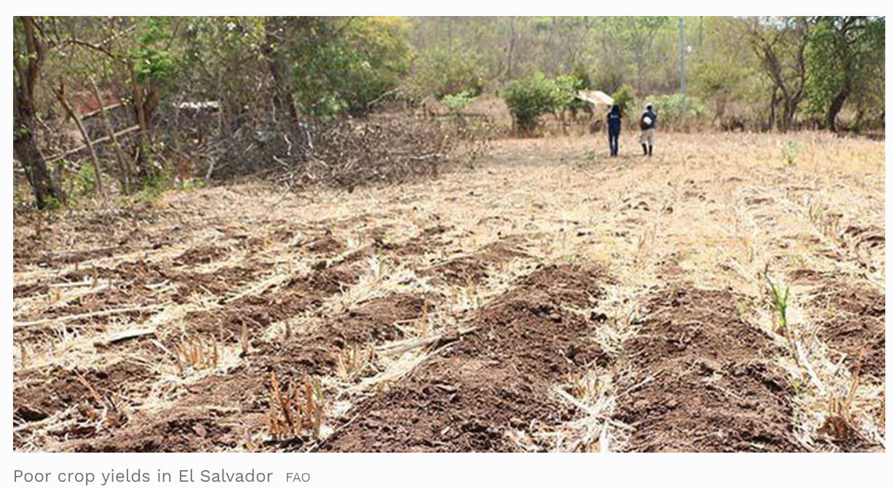
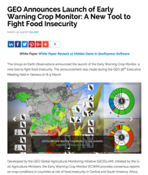
In the news..
WFP VAM Report
FEWS NET Special Report
MODIS SATELLITE-DERIVED INFORMATION USED TO INFORM DECISIONS ABOUT ALLOCATION OF SPECIFIC RESOURCES BY NATIONAL GOVERNMENTS & HUMANITARIAN ORGANIZATIONS
ARC, South Africa
Financial Times
Urgent Actions:
“There is urgent need for members states and development partners to determine the scale and extent of the possible impact of the prolonged dry spell on the agricultural season (crop and livestock) to inform appropriate response actions for food security and nutrition and build the resilience of vulnerable populations in the region. Recommended actions include increased monitoring of the situation, ascertaining available cereal stocks, fast-tracking of planned crop assessments and annual vulnerability assessments for early warning and early action and increasing off season production where possible.”
Joint Statement

Slide 17
August 2019
Monthly Consensus Bulletin used by Humanitarian / Aid Community
MODIS a major input on vegetation condition
https://cropmonitor.org/index.php/2019/08/08/crop-monitor-for-early-warning-august-2019/
NASA Harvest

Slide 18
Monthly Consensus Global Crop Condition Bulletin (November 2019)
provided to the Agricultural Market Information System (UNFAO)

Slide 19
Some Issues Raised at the TE Science Team session on Land Data Products
Continuing NASA’s global reputation for science quality global data products
NASA Land Data Product Activities more fragmented and relatively underfunded than before
Broad consultation needed on land products from Decadal Survey instruments
NASA encouraging integrated use of international data from ESA/JAXA – more missions and more funding (e.g. Copernicus, CCI)
Different approaches and different standards re. data products, documentation and quality
NASA Product Validation receiving much less funding across the board
CEOS Land Product Validation Sub-group – international forum for setting validation standards and protocols – coordinated resource sharing
NASA much less engaged in CEOS LPV than previously
International Validation Standards and Protocols more important than previously

Slide 20
Current MODIS/S-NPP activities
MODIS Maintenance part of the Senior Review – upcoming 2020
SNPP-VIIRS Production, Evaluation and Refinement underway
4 New MODIS/VIIRS Land Products in development
Sea Ice Leads
Global Reservoir Product
Night Lights Product
Volcanic Heat Flux Product
2 Multi-source Land Data Fusion Activities underway
Soil Moisture and Evapotranspiration
Snow Water Equivalent
Presentations on all of the above in the Land Discipline Session

Slide 21
In Summary
NASA Earth Sciences has a global reputation for science quality instruments, data and products
The MODIS products and now VIIRS continue to contribute to this reputation for science quality products
NASA’s coarse resolution daily data have an important role to play in the study of global and climate change and a continuing long term science data record is required to quantify and study the change
NASA’s coarse resolution products are also used by a number of organizations around the World for operational monitoring
There is a strong case for NASA to continue to develop and provide stewardship for a long term record of daily coarse resolution science quality data products
A long-term affordable implementation strategy needed to sustain the NASA coarse resolution products and to bridge from MODIS/S-NPP to the JPSS instruments

