Slide 1
Update on MODIS
Sea-Surface Temperatures
Peter J Minnett, Kay Kilpatrick, Goshka Szczodrak,
Gui Podestá, Francisco Raymo, Elizabeth Williams,
Miguel Izaguirre, Bingkun Luo, Chong Jia, Mercedes Mazza,
& Chirag Kumar - a finalist in the 78th Regeneron Science Talent Search
Rosenstiel School of Marine & Atmospheric Science
University of Miami
Contact: pminnett@rsmas.miami.edu

Slide 2
Overview
Reprocessing of MODIS SSTs by OBPG – R2019:
  New cloud screening – Alternating Decision Tree.
  CMC as reference field
  Aerosol Correction – additive term to atmospheric correction algorithm if aerosol threshold passed.
  High-Latitude Coefficients
SST algorithm improvements:
  High Latitude atmospheric correction algorithm – explicit emissivity correction.
  Optimal Estimation of MODIS SSTs.
Ship-borne radiometers for algorithm improvements and assessment of accuracies of satellite-derived SSTs:
  M-AERI deployments
  MODIS matchups
Assessment of MODIS SSTs, for CDRs:
  M-AERI accuracies.
  Drifting buoy accuracies.
  Pacific Saildrone cruise
  Arctic Saildrone deployments.
  Machine Learning Approach to determine Single Sensor Error Statistics.
Skin Layer Research
  Thermofluorescent Dyes to study Thermal Skin Layer.

Slide 3
Overview
Reprocessing of MODIS SSTs by OBPG – R2019:
  New cloud screening – Alternating Decision Tree.
  CMC as reference field
  Aerosol Correction – additive term to atmospheric correction algorithm if aerosol threshold passed.
  High-Latitude Coefficients
  Improved cloud over sea-ice identification
SST algorithm improvements:
  High Latitude atmospheric correction algorithm – explicit emissivity correction.
  Optimal Estimation of MODIS SSTs.
Ship-borne radiometers for algorithm improvements and assessment of accuracies of satellite-derived SSTs:
  M-AERI deployments
  MODIS matchups
Assessment of MODIS SSTs, for CDRs:
  M-AERI accuracies.
  Drifting buoy accuracies.
  Pacific Saildrone cruise
  Arctic Saildrone deployments.
  Machine Learning Approach to determine Single Sensor Error Statistics.
Skin Layer Research
  Thermofluorescent Dyes to study Thermal Skin Layer.

Slide 4
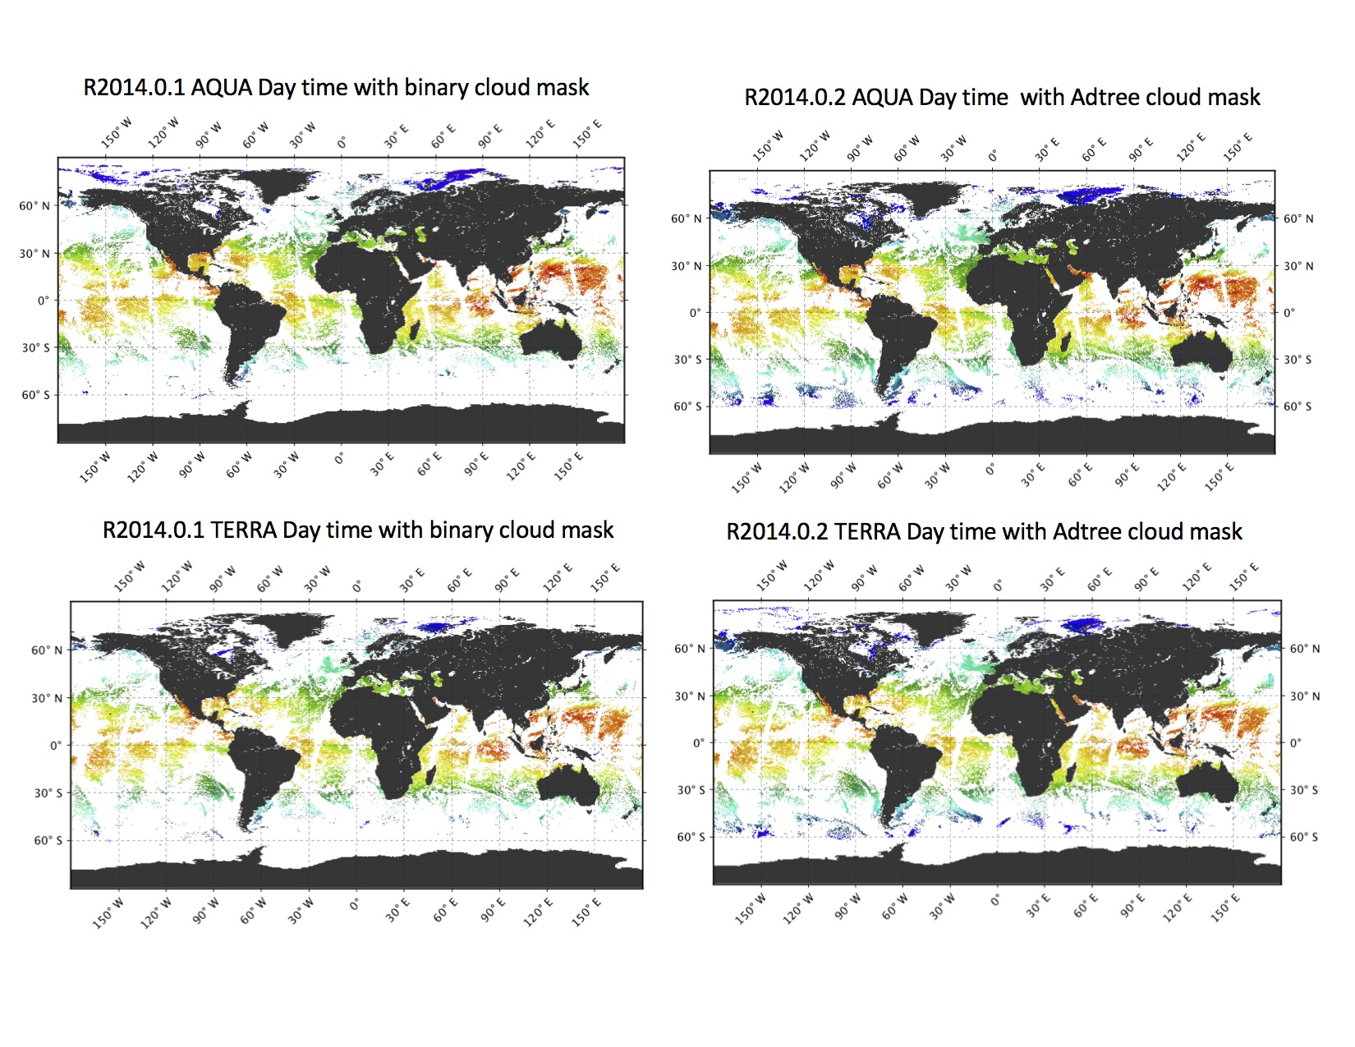
SST Algorithm Developments – Cloud Screening
New cloud mask developed – Alternating Decision Trees.
Kilpatrick, K.A., Podestá, G., Williams, E., Walsh, S., & Minnett, P.J. (2019). Alternating Decision Trees for Cloud Masking in MODIS and VIIRS NASA Sea Surface Temperature Products. Journal of Atmospheric and Oceanic Technology 36, 387-407. 10.1175/jtech-d-18-0103.1

Slide 5
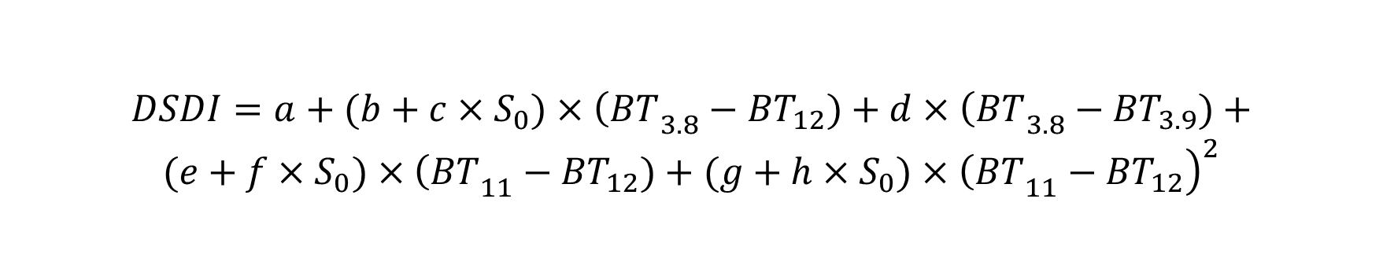
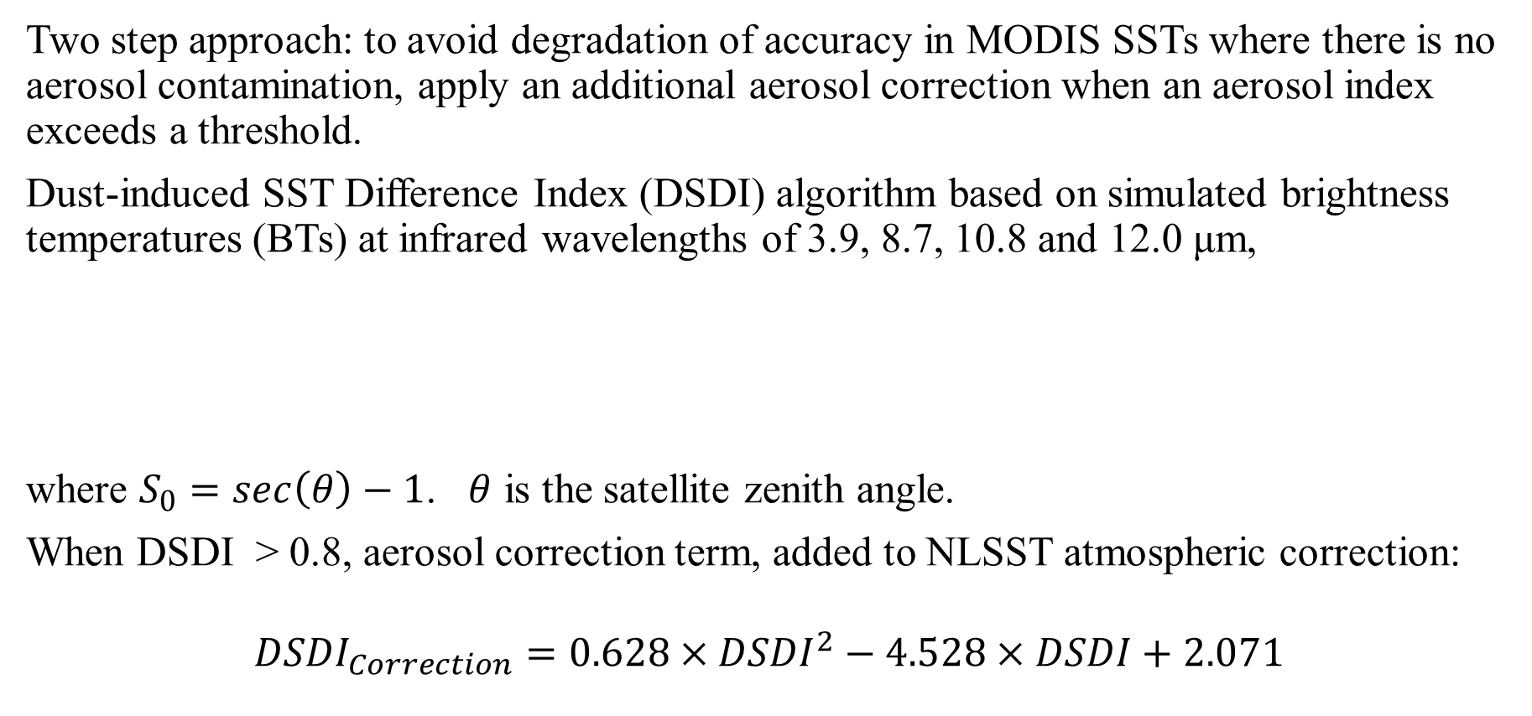
SST Algorithm Developments – Night-time Aerosol Effects
Two step approach: to avoid degradation of accuracy in MODIS SSTs where there is no aerosol contamination, apply an additional aerosol correction when an aerosol index exceeds a threshold.
Dust-induced SST Difference Index (DSDI) algorithm based on simulated brightness temperatures (BTs) at infrared wavelengths of 3.9, 8.7, 10.8 and 12.0 μm,
where $S_{0}=\sec\left(θ\right)−1$. $θ$ is the satellite zenith angle.
When DSDI > 0.8, aerosol correction term, added to NLSST atmospheric correction:
$${DSDI}_{Correction}=0.628×{DSDI}^{2}−4.528×DSDI+2.071$$
$$DSDI=a+(b+c×S_{0})×{\left(BT\right.}_{3.8}−{BT}_{12})+d×{\left(BT\right.}_{3.8}−{BT}_{3.9})+$$
$(e+f×S_{0})×{\left(BT\right.}_{11}−{BT}_{12})+$ $(g+h×S_{0})×{\left.{\left(BT\right.}_{11}−{BT}_{12}\right)}^{2}$

Slide 6
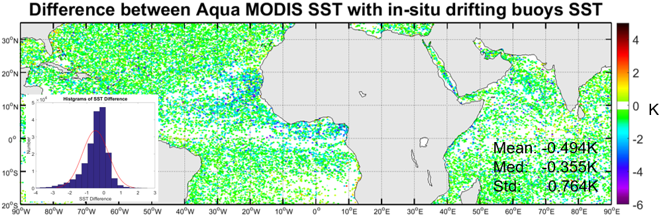
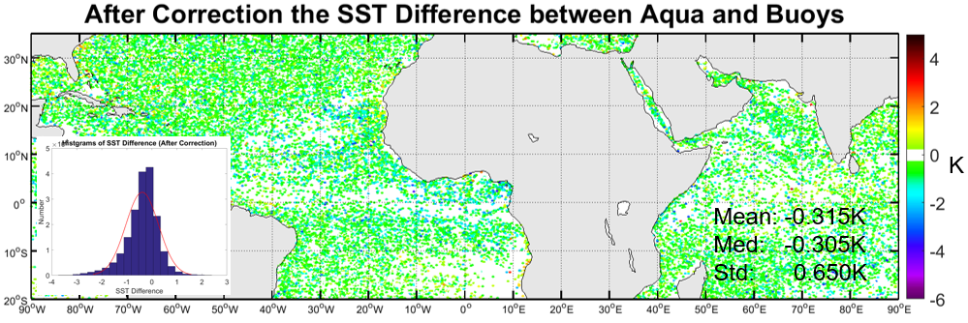
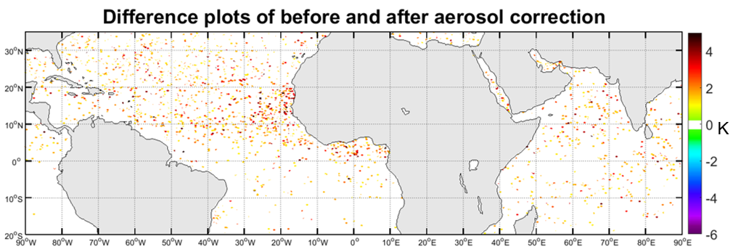
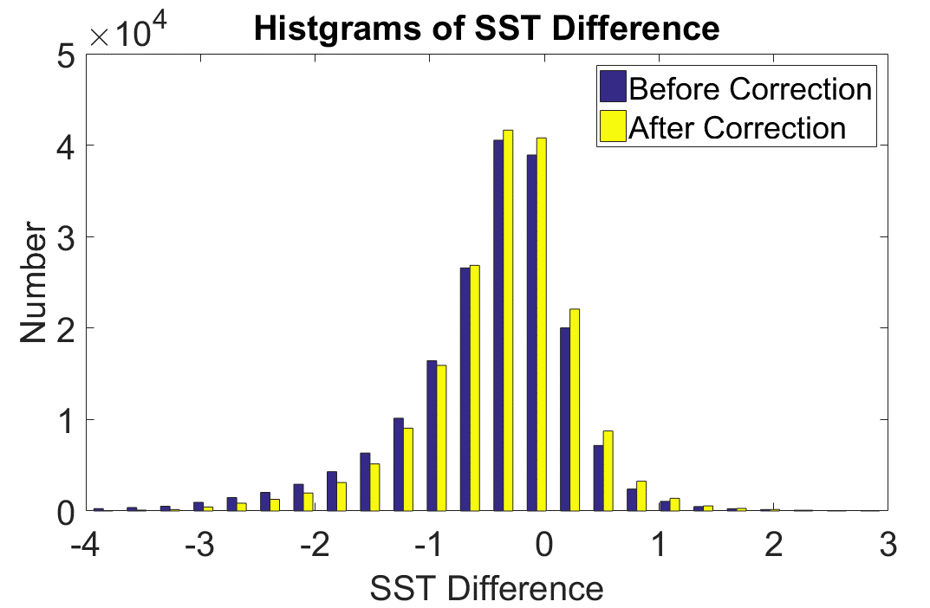
Quality Flag | N | Before correction (K) |  |  | After correction (K)
 |  | Mean | Median | STD | Mean | Median | STD
0 | 86092 | -0.217 | -0.190 | 0.458 | -0.203 | -0.185 | 0.447
1 | 47030 | -0.482 | -0.435 | 0.649 | -0.401 | -0.380 | 0.625
2 | 50919 | -0.974 | -0.830 | 1.003 | -0.678 | -0.612 | 0.845
All | 184041 | -0.494 | -0.355 | 0.764 | -0.315 | -0.305 | 0.650
Luo, B., Minnett, P.J., Gentemann, C., & Szczodrak, G. (2019). Improving satellite retrieved night-time infrared sea surface temperatures in aerosol contaminated regions. Remote Sensing of Environment 223, 8-20. https://doi.org/10.1016/j.rse.2019.01.009

Slide 7
High Latitude MODIS Coefficients

Slide 8
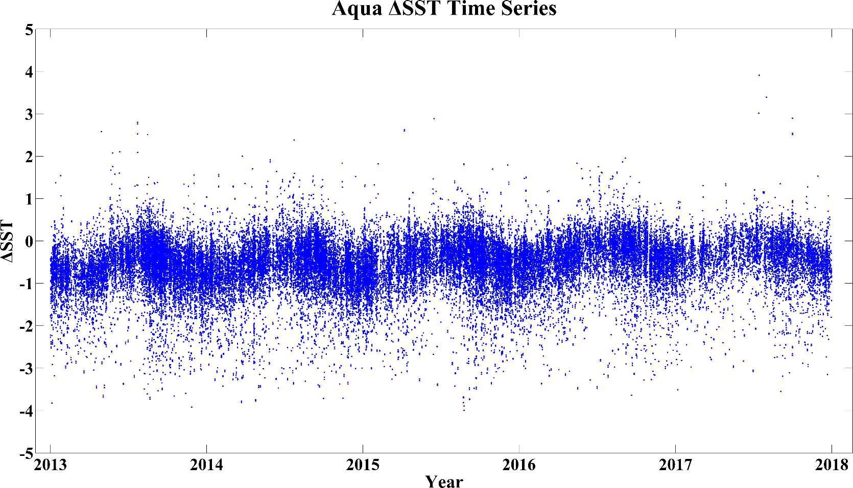
High Latitude MODIS Coefficients
Coefficients for north of 40ºN

Slide 9
High Latitude MODIS Coefficients
Coefficients for north of 60ºN

Slide 10
High Latitude MODIS Coefficients
Quality Level | N | Original coefficients |  |  |  | New coefficients
 |  | Mean | Median | STD | RSD | Mean | Median | STD | RSD
0 | 31604 | -0.535 | -0.495 | 0.536 | 0.441 | -0.163 | -0.134 | 0.467 | 0.395
1 | 9257 | -0.909 | -0.830 | 0.722 | 0.593 | -0.688 | -0.621 | 0.639 | 0.584
Total | 40861 | -0.620 | -0.555 | 0.604 | 0.489 | -0.282 | -0.217 | 0.557 | 0.460
Original: coefficient for latitudes >40ºN; New: coefficients for latitudes >60ºN.
Main difference between QL0 and QL1 is path length: QL1 for θ > 45º.
R2104 data with BDTree cloud screening.

Slide 11
Overview
Reprocessing of MODIS SSTs by OBPG – R2019:
  New cloud screening – Alternating Decision Tree.
  CMC as reference field
  Aerosol Correction – additive term to atmospheric correction algorithm if aerosol threshold passed.
  High-Latitude Coefficients.
  Improved cloud over sea-ice identification
SST algorithm improvements:
  High Latitude atmospheric correction algorithm – explicit emissivity correction.
  Optimal Estimation of MODIS SSTs.
Ship-borne radiometers for algorithm improvements and assessment of accuracies of satellite-derived SSTs:
  M-AERI deployments
  MODIS matchups
Assessment of MODIS SSTs, for CDRs:
  M-AERI accuracies.
  Drifting buoy accuracies.
  Pacific Saildrone cruise
  Arctic Saildrone deployments.
  Machine Learning Approach to determine Single Sensor Error Statistics.
Skin Layer Research
  Thermofluorescent Dyes to study Thermal Skin Layer.

Slide 12
High Latitude Atmospheric Correction
NLSST type atmospheric correction is based on the relationship between BT(λ)s and atmospheric humidity.
When atmosphere is very dry, this breaks down.
When atmospheric humidity is not the main cause of the temperature deficit, the surface emissivity may become important.

Slide 13
High Latitude Atmospheric Correction
MODIS MUDB, MERRA-2 fields and RTTOV radiative transfer model:
QL = 1
QL = 1
When atmosphere is moist, ε effects are smaller.
ε effects are greater at high θ, QL =1

Slide 14
High Latitude Atmospheric Correction
An emissivity correction requires an estimate of effective air temperature.
Use MERRA-2 near-surface air temperature as a proxy.
Emissivity correction can be devised and applied.
Quality Level | N | Before correction |  |  |  | After correction
 |  | Mean | Median | STD | RSD | Mean | Median | STD | RSD
0 | 31604 | -0.163 | -0.134 | 0.467 | 0.395 | -0.158 | -0.130 | 0.447 | 0.377
1 | 9257 | -0.688 | -0.621 | 0.639 | 0.584 | -0.397 | -0.350 | 0.596 | 0.496
Total | 40861 | -0.282 | -0.217 | 0.557 | 0.460 | -0.212 | -0.174 | 0.495 | 0.407
Aqua MODIS, night SST

Slide 15
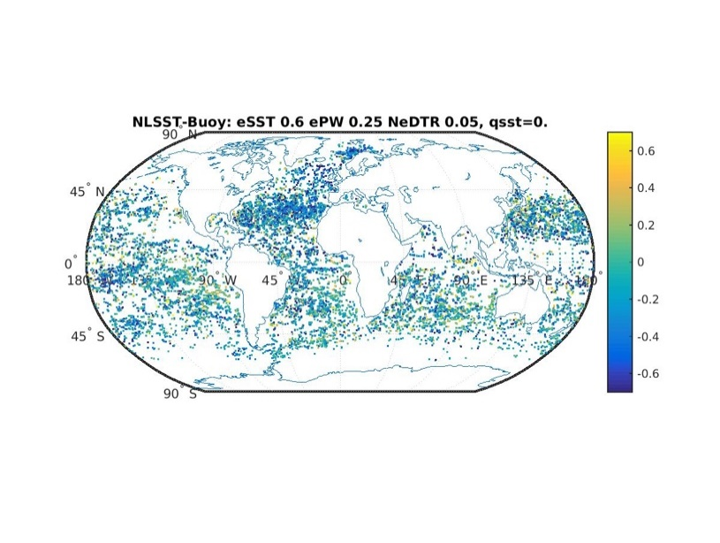
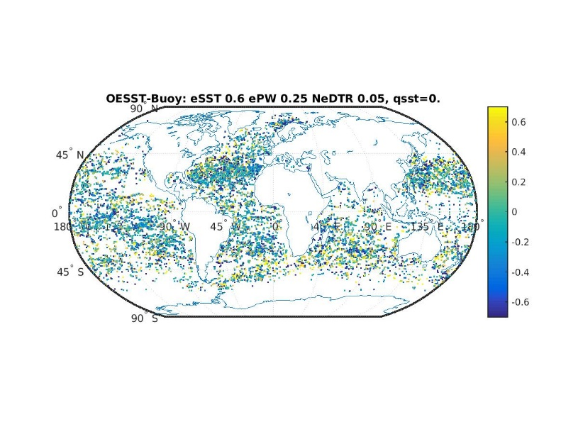
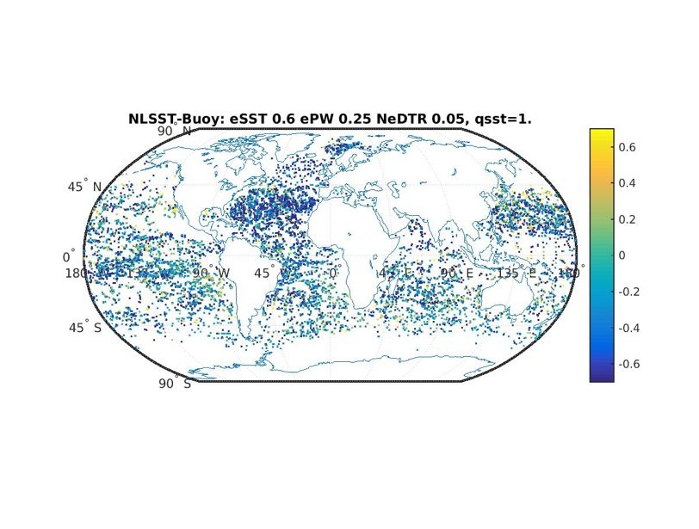
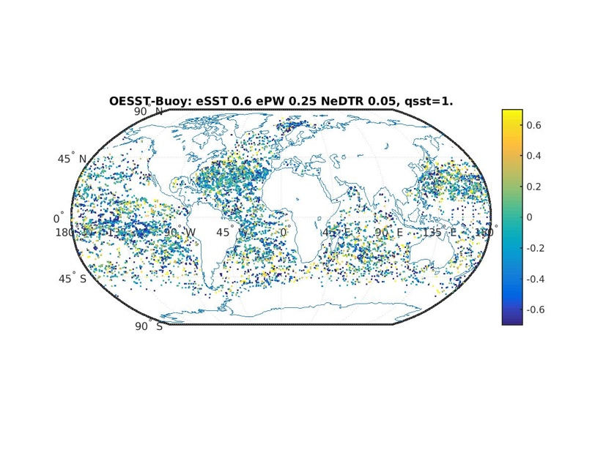
Combining NLSST and Optimal Estimation MODIS SSTs
Determine whether the combined NLSST and OE approach derives a more accurate SST_{skin} (for cloud free conditions) than currently available from MODIS NLSSTs.
Hybrid estimates may be less dependent on atmospheric variability than NLSST retrievals.
NLSST
OESST
MODIS SST_{skin} – in situ temperature difference for the 2009 match-up database data for NLSST and OESST Quality = 0 (top) and quality = 1 (bottom)
For Saharan outflow area | Day qf=0 |  | Day qf=1 |  | Night qf=0 |  | Night qf=1
 | Mean (Median) | Std (RStd) | Mean (Median) | Std (RStd) | Mean (Median) | Std (RStd) | Mean (Median) | Std (RStd)
ΔSSTOE | -0.18 (-0.15) | 0.68 (0.45) | -0.19 (-0.18) | 0.63 (0.58) | 0.01 (0.03) | 0.66 (0.47) | -0.06 (-0.04) | 0.70 (0.51)
ΔSSTNL | 0.03 (0.3) | 0.63 (0.58) | -0.08 (-0.04) | 0.76 (0.74) | -0.10 (-0.08) | 0.53 (0.53) | -0.32 (-0.29) | 0.75 (0.79)

Slide 16
Overview
Reprocessing of MODIS SSTs by OBPG – R2019:
  New cloud screening – Alternating Decision Tree.
  CMC as reference field
  Aerosol Correction – additive term to atmospheric correction algorithm if aerosol threshold passed.
  High-Latitude Coefficients
  Improved cloud over sea-ice identification
SST algorithm improvements:
  High Latitude atmospheric correction algorithm – explicit emissivity correction.
  Optimal Estimation of MODIS SSTs.
Ship-borne radiometers for algorithm improvements and assessment of accuracies of satellite-derived SSTs:
  M-AERI deployments
  MODIS matchups
Assessment of MODIS SSTs, for CDRs:
  M-AERI accuracies.
  Drifting buoy accuracies.
  Pacific Saildrone cruise
  Arctic Saildrone deployments.
  Machine Learning Approach to determine Single Sensor Error Statistics.
Skin Layer Research
  Thermofluorescent Dyes to study Thermal Skin Layer.

Slide 17
M-AERI deployments
M-AERI (Marine-Atmospheric Emitted Radiance Interferometer) is Fourier-Transform IR spectroradiometer with SI-traceable calibration. Initial installations began in 1996.
Three Mk2 M-AERI’s are deployed on Royal Caribbean Cruise Line ships.
One Mk3 to be deployed on the NOAA Ship Ronald H Brown for cruises in Atlantic December 2019 – July 2020.
M-AERIs now operate autonomously over satellite internet link.

Slide 18
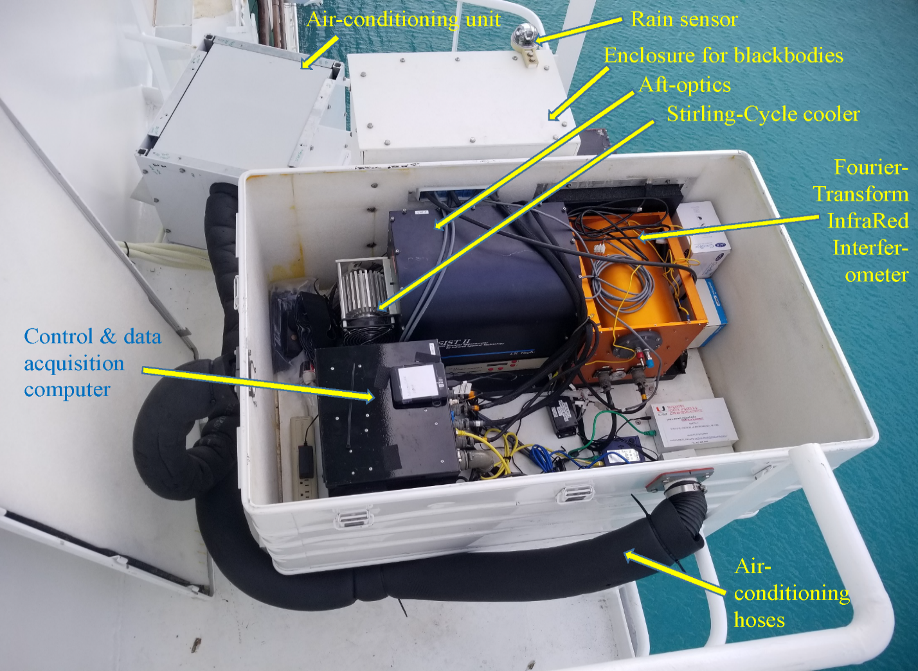
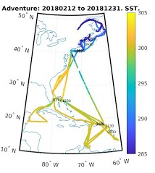
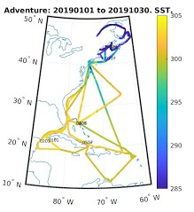
M-AERI Mk2 installed on the Adventure of the Seas.

Slide 19
Aqua MODIS to M-AERI matchups
Gross statistics of the comparison of skin SST derived from MODIS on Aqua and M-AERI measurements.
Ship | Year | Mean K | Median K | St. Dev. K | Robust St. Dev. K |  | N
Atmospheric correction algorithm: LW Bands 31 & 32 (SST)
Allure of the Seas | 2015 | -0.007 | 0.009 | 0.437 | 0.315 | 1124
Celebrity Equinox | 2016 | 0.068 | 0.111 | 0.474 | 0.342 | 1563
Atmospheric correction algorithm: MW Bands 22 & 23 (SST4)
Allure of the Seas | 2015 | -0.086 | -0.014 | 0.352 | 0.254 | 1153
Celebrity Equinox | 2016 | 0.084 | 0.125 | 0.375 | 0.270 | 1597
Highest quality, night-time data: confidently cloud-free & satellite zenith angle <45º.

Slide 20
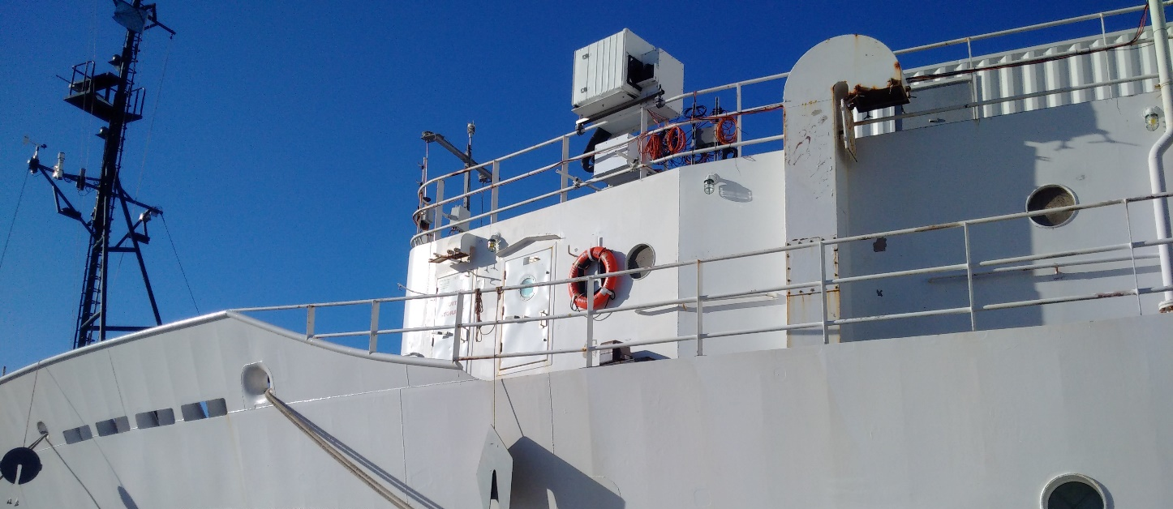
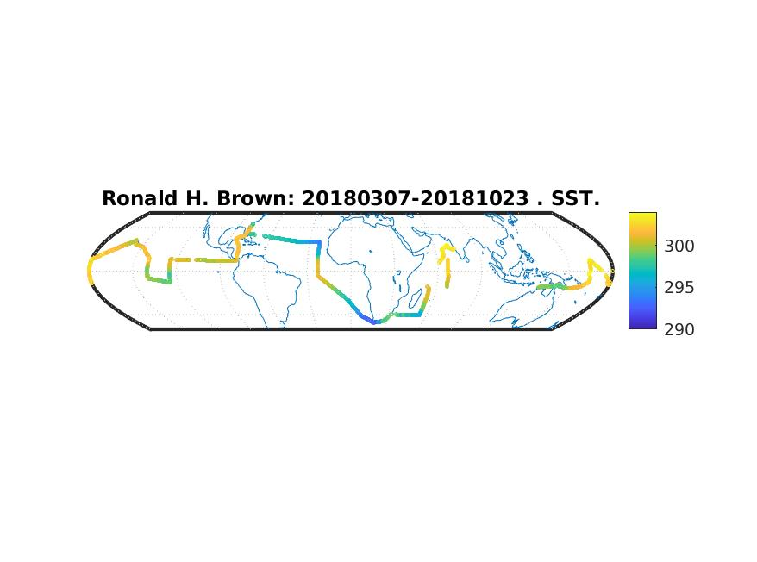
M-AERI on NOAA Ship Ronald H Brown
Track of the NOAA Ship Ronald H. Brown, colored by the SST_{skin} measured by the M-AERI-Mk3, scale at right in K. Gaps are due to rain, spray or instrument issues. The cruise started on Ft. Lauderdale, FL, on March 3, 2018 and ended in Charleston, SC, on October 23, 2018.
M-AERI-Mk3 will be installed on November 25, 2019, in Charleston, SC, with planned removal in July 2020 in San Diego, CA
M-AERI

Slide 21
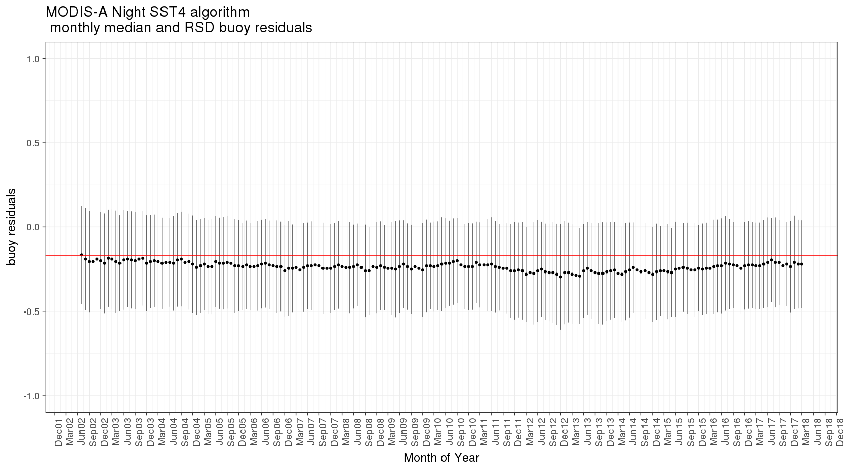
Aqua MODIS SST4 Median and RSD vs drifters

Slide 22
Aqua MODIS 11-22µm SST wrt buoy temperatures
Aqua MODIS Night SST R2019 wrt Buoys.
Date

Slide 23
Overview
Reprocessing of MODIS SSTs by OBPG – R2019:
  New cloud screening – Alternating Decision Tree.
  CMC as reference field
  Aerosol Correction – additive term to atmospheric correction algorithm if aerosol threshold passed.
  High-Latitude Coefficients.
  Improved cloud over sea-ice identification
SST algorithm improvements:
  High Latitude atmospheric correction algorithm – explicit emissivity correction.
  Optimal Estimation of MODIS SSTs.
Ship-borne radiometers for algorithm improvements and assessment of accuracies of satellite-derived SSTs:
  M-AERI deployments
  MODIS matchups
Assessment of MODIS SSTs, for CDRs:
  M-AERI accuracies.
  Drifting buoy accuracies.
  Pacific Saildrone cruise
  Arctic Saildrone deployments.
  Machine Learning Approach to determine Single Sensor Error Statistics.
Skin Layer Research
  Thermofluorescent Dyes to study Thermal Skin Layer.

Slide 24
Temperature Differences vs Assessment of Accuracy
Statistics shown here (and in many papers and reports) of differences between satellite and validating SSTs are often interpreted as an assessment of the accuracy of the satellite measurements – assumes contributions to the differences from the validating sensor and from the method of comparisons are negligible. This is not always the case.
To generate SST CDRs, a rigorous assessment of the accuracies of the measurements used to validate the satellite SST retrievals is needed.

Slide 25
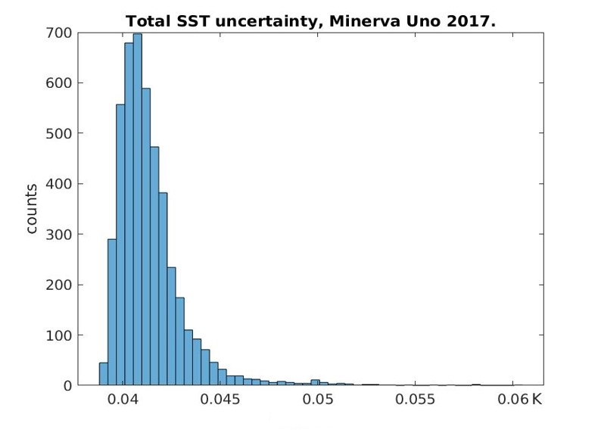
M-AERI Mk2 accuracies – CEOS NPL Workshop
At λ= 7.7 µm (1302 cm⁻¹)
Parameter | Type A Uncertainty Value [ K ] | Type B Uncertainty in [K] | Uncertainty in Brightness temp in K
Repeatability of Measurement Reproducibility of Measurement Linearity of radiometer Primary calibration Drift since calibration | 0.0349 0.0178 (0.0089) | 0.0003 0.0086 | 0.0349 0.0178 0.0003 0.0086 0
RMS total | 0.0392 (0.0360) | 0.0091 | 0.0402 (0.0372)
Theocharous, E., Fox, N.P., Barker-Snook, I., Niclòs, R., Santos, V.G., Minnett, P.J., Göttsche, F.M., Poutier, L., Morgan, N., Nightingale, T., Wimmer, W., Høyer, J., Zhang, K., Yang, M., Guan, L., Arbelo, M., & Donlon, C.J. (2019). The 2016 CEOS Infrared Radiometer Comparison: Part II: Laboratory Comparison of Radiation Thermometers. Journal of Atmospheric and Oceanic Technology 36, 1079-1092. 10.1175/jtech-d-18-0032.1

Slide 26
Drifting buoy thermometer accuracies
The underpinning of the MODIS SST algorithms to drifting buoy matchups places great importance on the accuracy of the buoy thermometers.
Thermometers are calibrated prior to deployment, but do they retain calibration at sea over months to years?
Drifting buoys from three manufacturers were moored off RSMAS dock for long-duration deployment to assess calibration drift and effects of bio-fouling.
A reference thermometer, with SI-traceable calibration, in a modified buoy provides a benchmark.

Slide 27
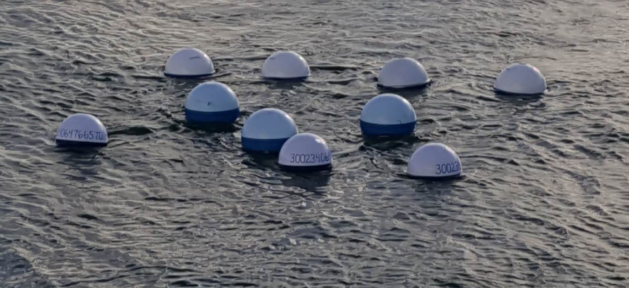
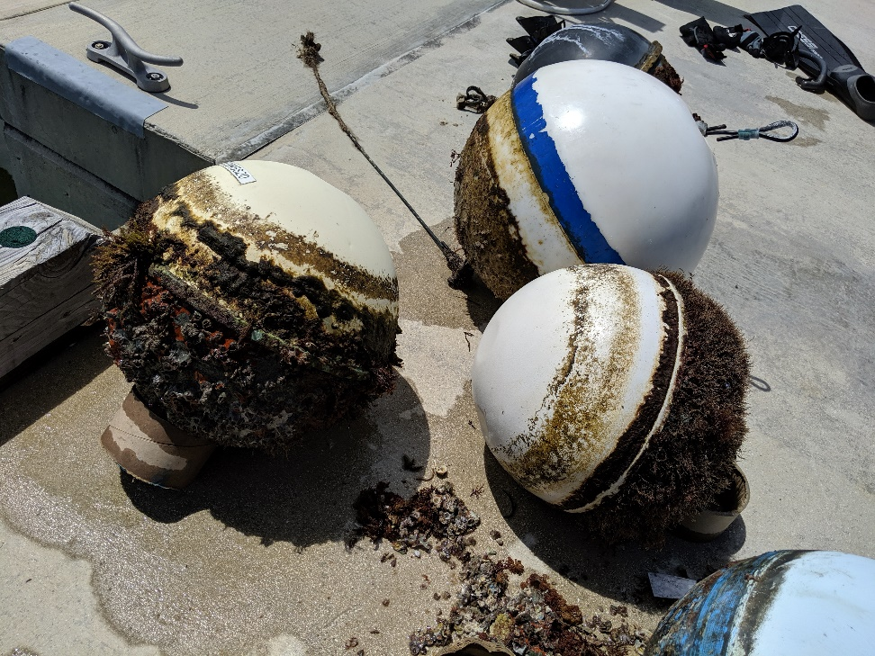
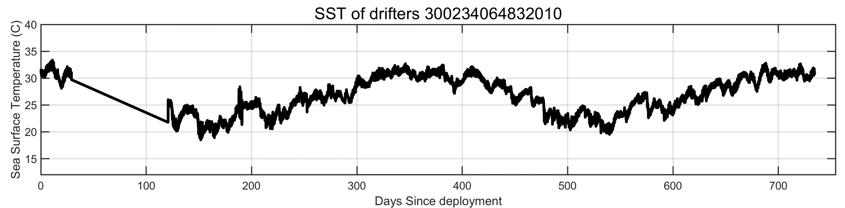
Hurricane
Irma

Slide 28
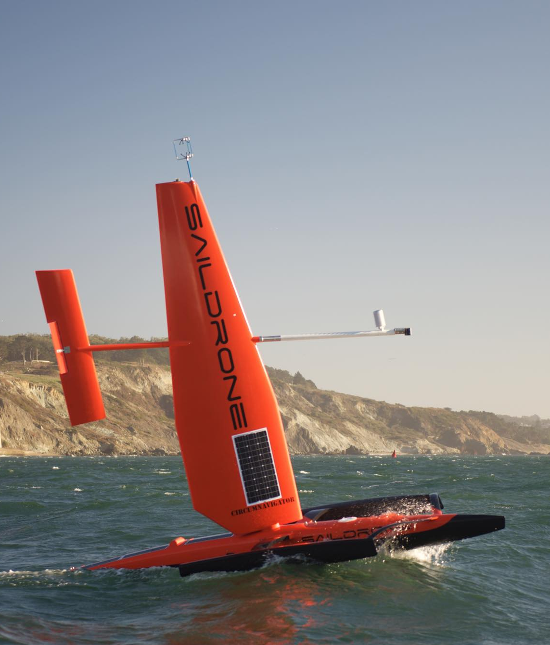
Saildrone deployments.
In the NOPP MISST-3* (Multi-sensor Improved SST) project, we will deploy Saildrones in the ice-free summer Arctic to provide data for improving SSTs from IR radiometers on satellites.
In a pilot project we deployed a Saildrone off the West Coast, 11 April – 10 June 2018, we added a subsurface CTD thermometer at ~30 cm.
Two Saildrones collect data in the Chukchi Sea in summer 2019. One minute sampling for 150 days each.
* PI: Chelle Gentemann, Earth & Space Research
CoIs: Mike Steele, APL, U Washington
Peter Minnett, RSMAS, U. Miami

Slide 29
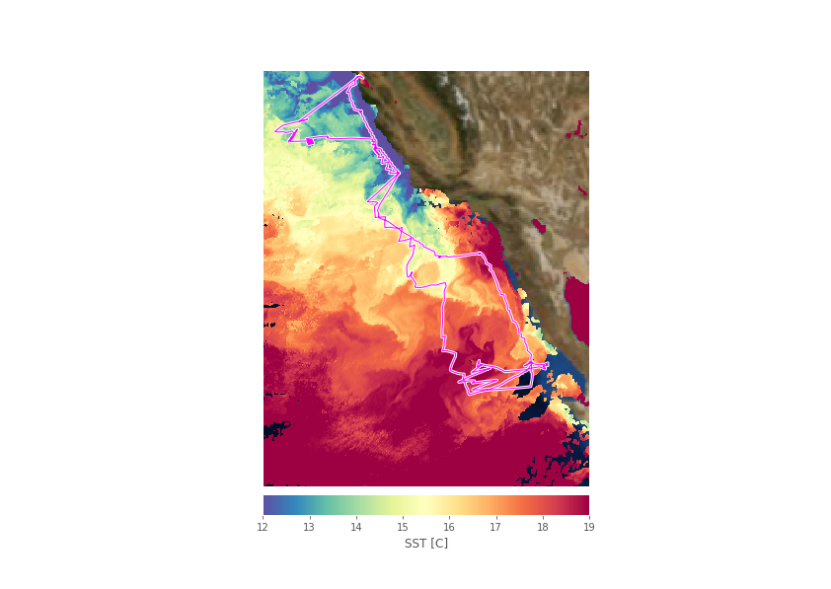
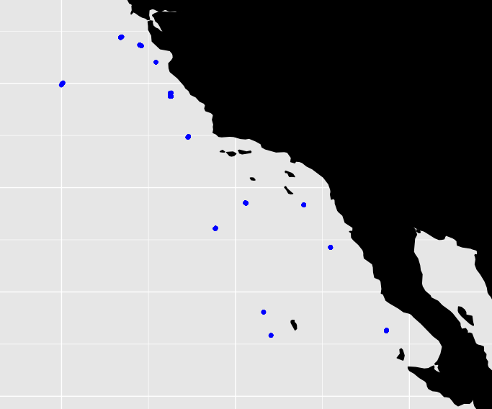
Saildrone: Aqua MODIS comparisons
Positions of Match-Ups.
Night best quality all records – multiple Saildrone temperatures in MODIS pixel
Median | St Dev | RSD | N
0.092 | 1.096 | 0.399 | 526
Night best quality unique – closest time Saildrone temperature in MODIS pixel.
0.154 | 0.870 | 0.248 | 39
Gentemann, C.L., Scott, J.P., Mazzini, P., Pianca, C., Akella, S., Minnett, P.J., Cornillon, P., Fox-Kemper, B., Cetinić, I., Chin, T.M., Gomez-Valdes, J., Vazquez-Cuervo, J., Tsontos, V., Yu, L., Jenkins, R., De Halleux, S., Peacock, D., & Cohen, N. (2019). Saildrone: adaptively sampling the marine environment. Bull. Amer. Met. Soc. In review

Slide 30
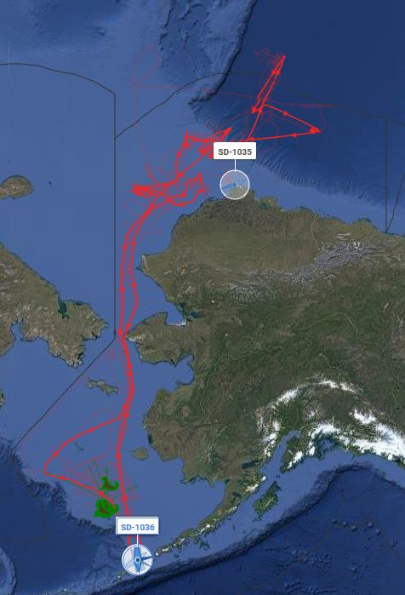
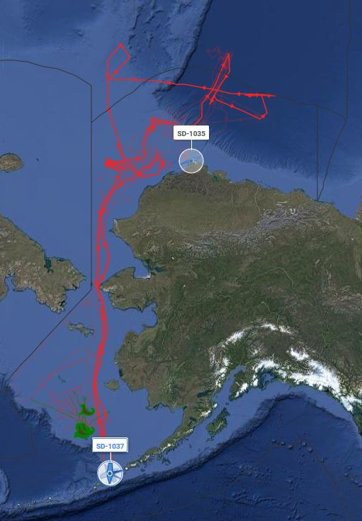
One minute measurements for 150 days each.
Include data from very close to melting ice.

Slide 31
Using Machine Learning for SSES
SSES – Single sensor error statistics; used to assign errors and uncertainties to each SST retrieval.
Current approach is to use the 7-dimensional hypercube containing means and standard deviations of matchups.
Cells are unevenly populated, some are empty. Discontinuities exist at cell boundaries.
Use ML approaches to provide better SSES.
Using 7 variables from MUDB, Random Forest and Cubic Decision Trees were developed.
Cubist is better. Eight rule sets were identified.

Slide 32
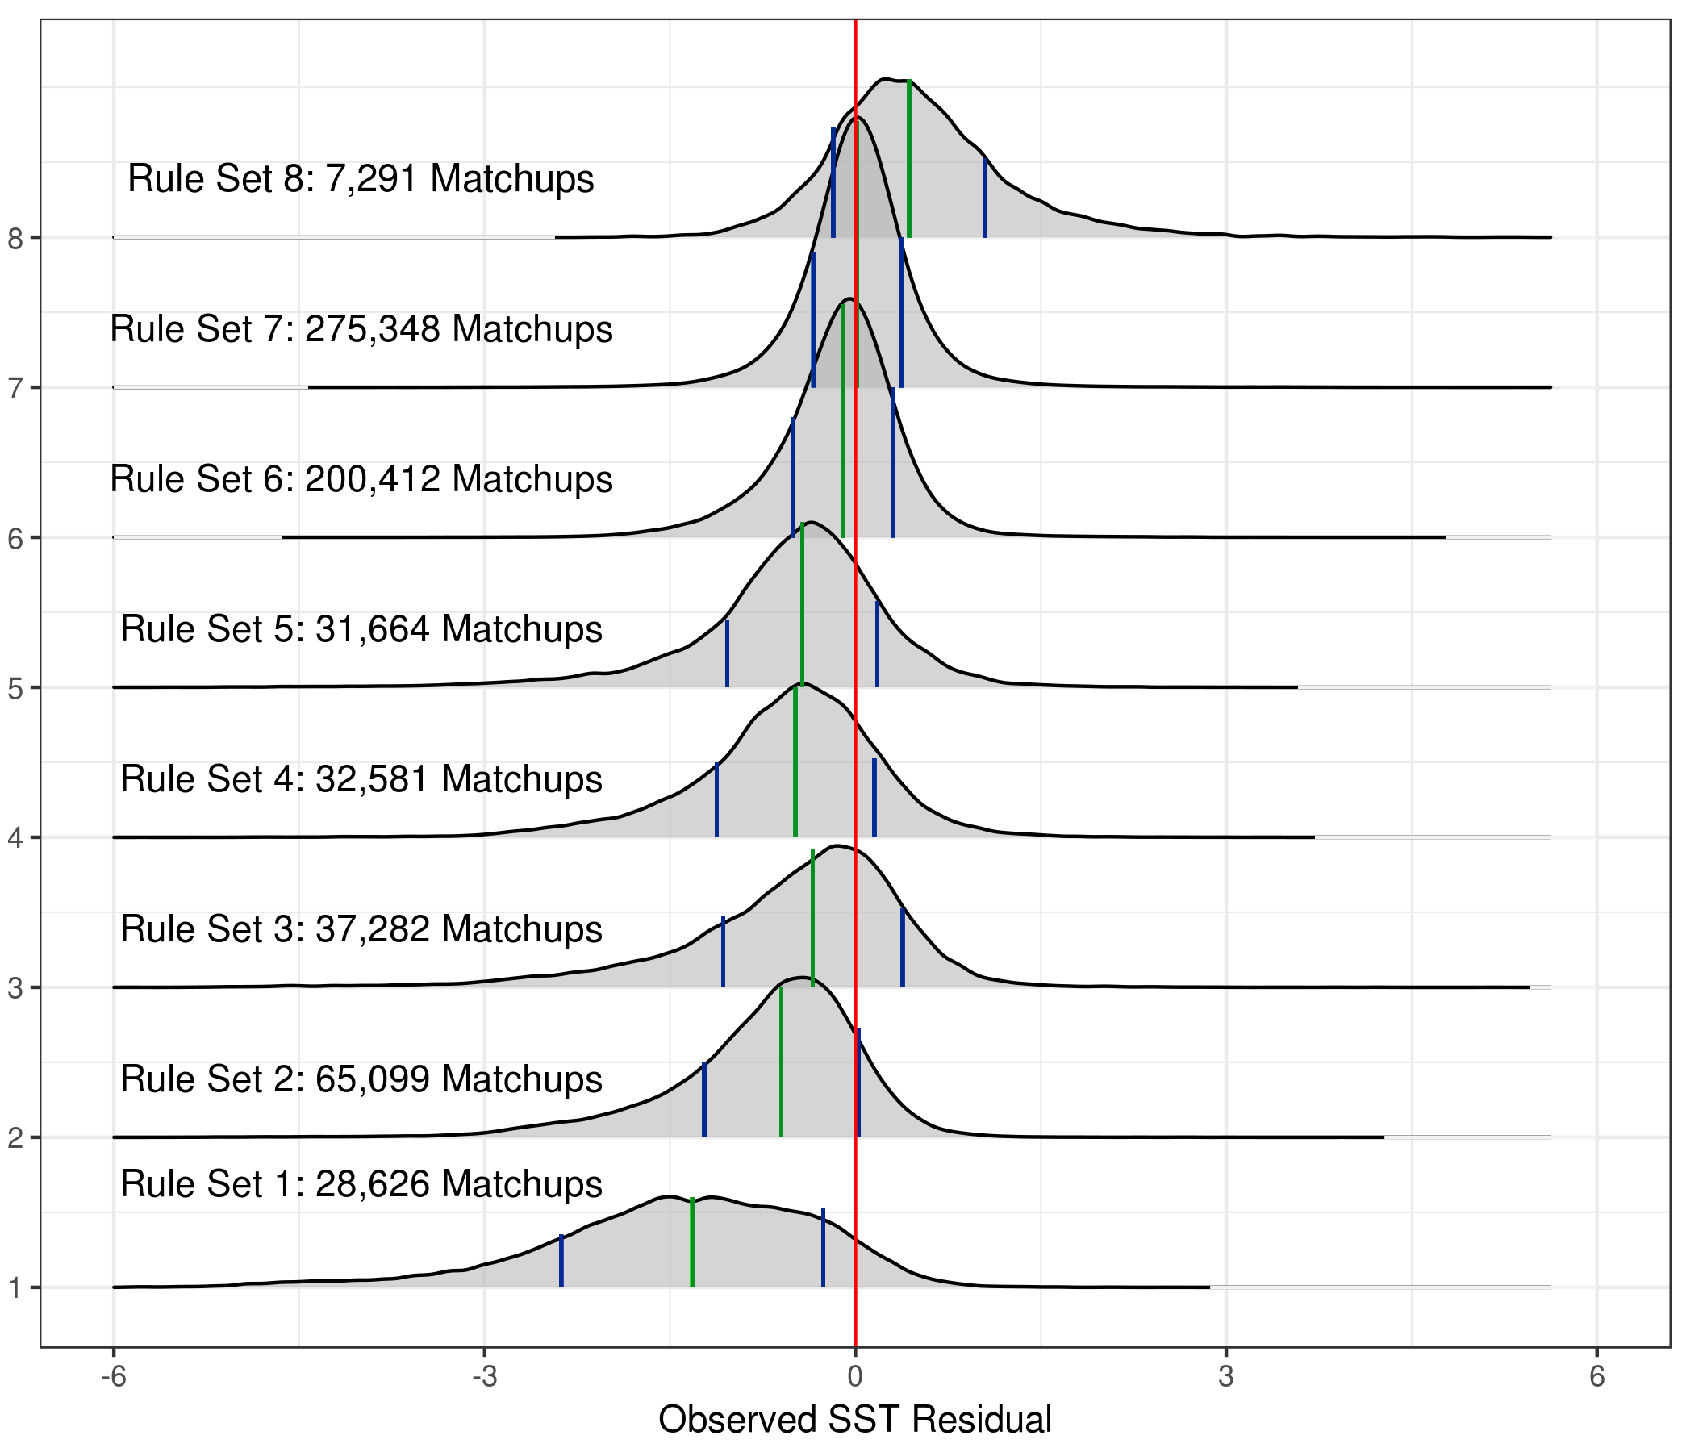
Cubist Rule Sets
Distribution of SST residuals wrt buoy temperatures in each Cubist Rule Set. The green lines are the median SST residual for the Rule Set and the blue lines are the median ± the MAD of SST residuals

Slide 33
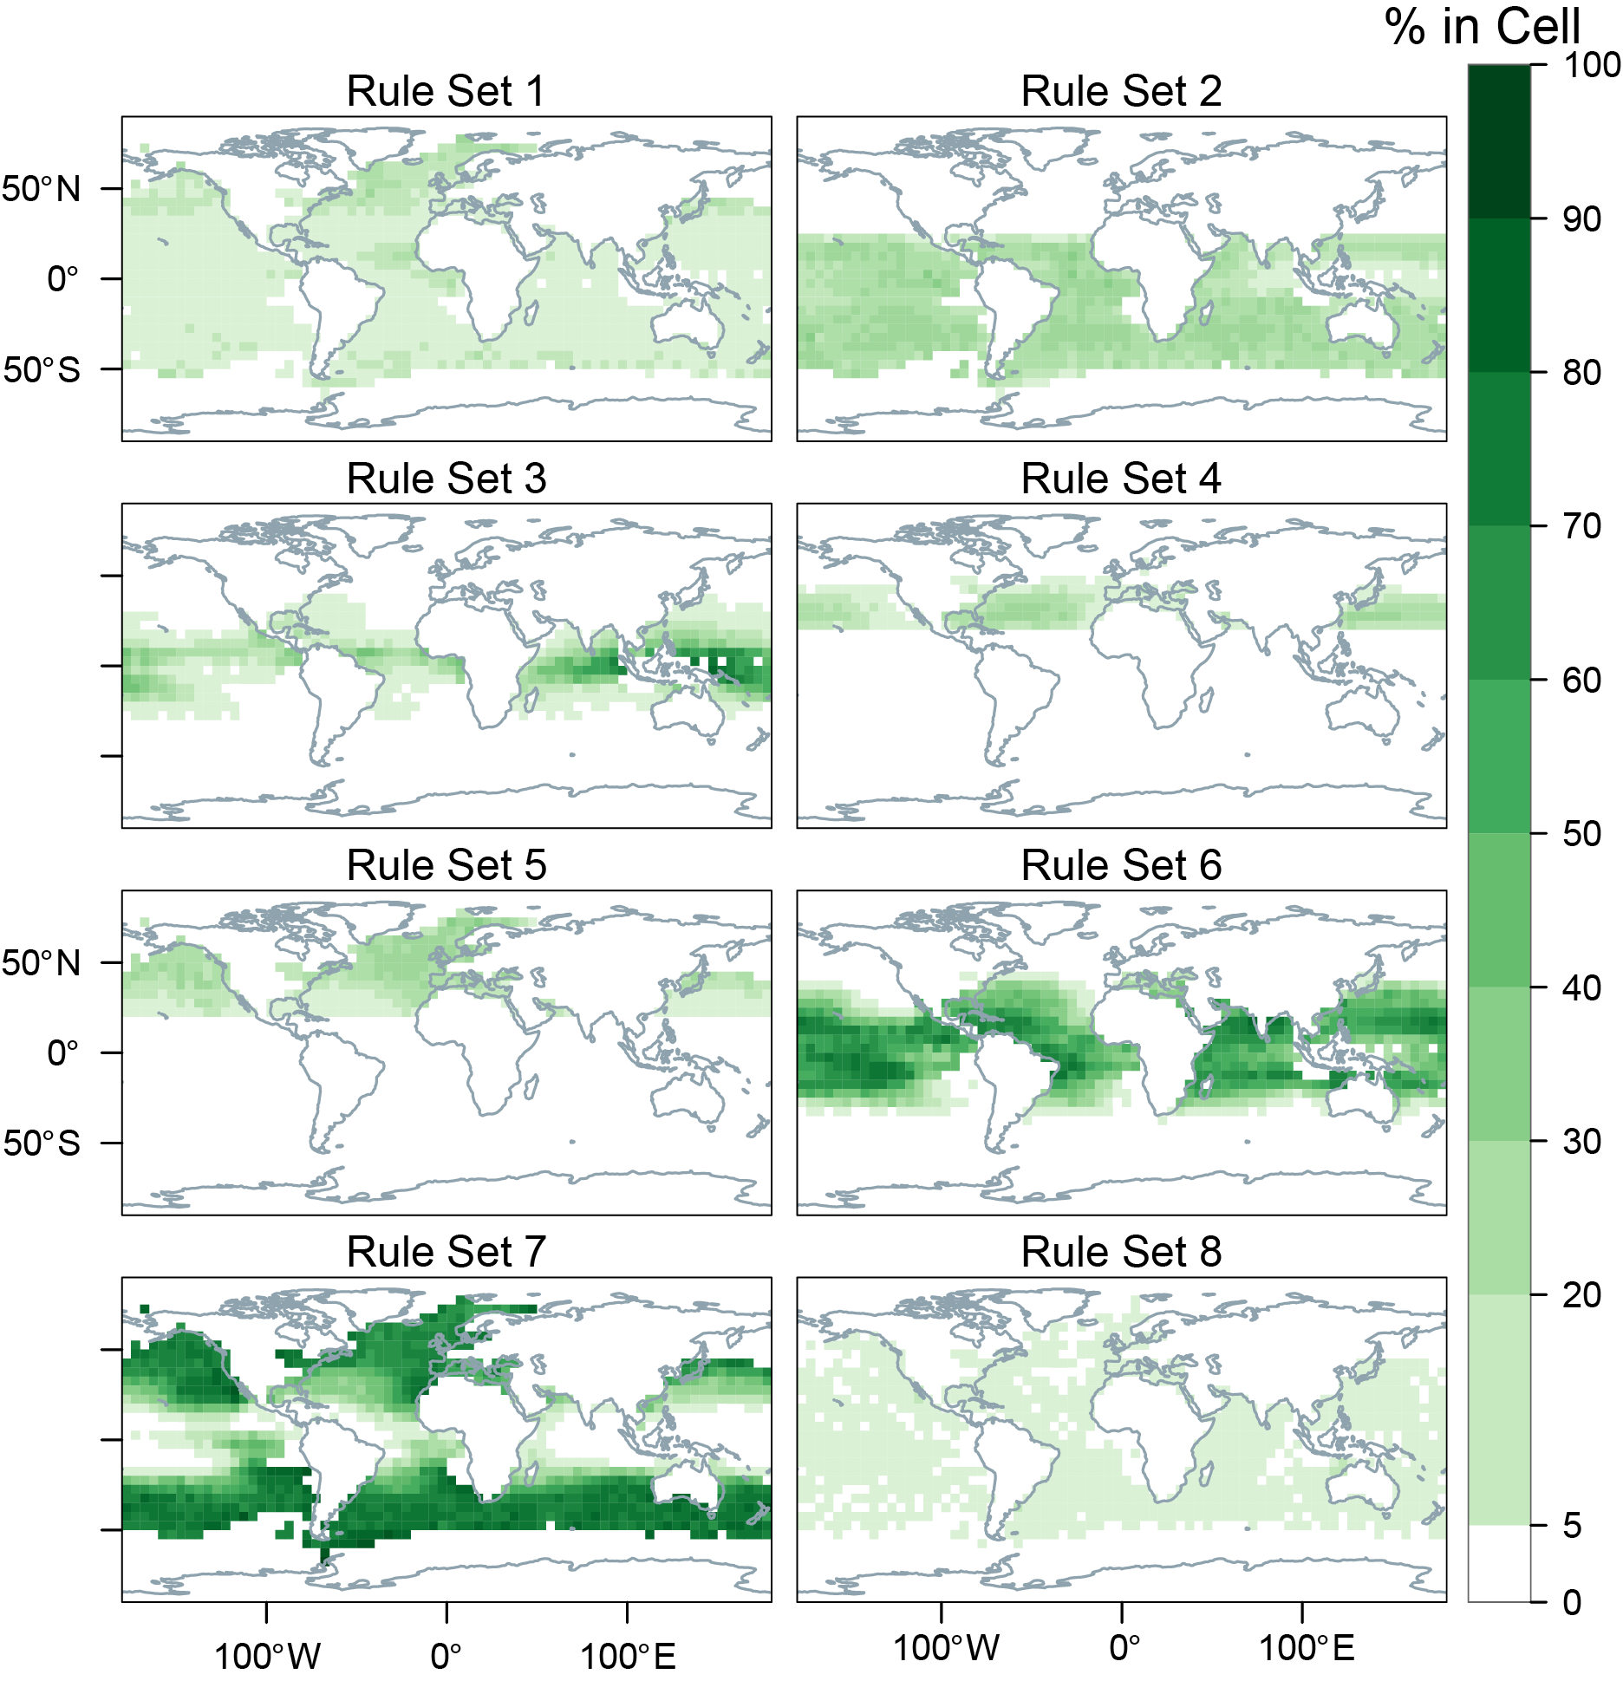
Geographic distribution of matchups in each Rule Set. Colors indicate the geographic prevalence of each Rule Set; the values indicate the percentage of all matchups within each spatial bin assigned to a specific Rule Set.
Kumar, C., G. P. Podestá, K. A. Kilpatrick, & Minnett., P.J. (2020). A Machine Learning Approach to Estimating the Error in Satellite Sea Surface Temperature Retrievals. In preparation.

Slide 34
Overview
Reprocessing of MODIS SSTs by OBPG – R2019:
  New cloud screening – Alternating Decision Tree.
  CMC as reference field
  Aerosol Correction – additive term to atmospheric correction algorithm if aerosol threshold passed.
  High-Latitude Coefficients.
  Improved cloud over sea-ice identification
SST algorithm improvements:
  High Latitude atmospheric correction algorithm – explicit emissivity correction.
  Optimal Estimation of MODIS SSTs.
Ship-borne radiometers for algorithm improvements and assessment of accuracies of satellite-derived SSTs:
  M-AERI deployments
  MODIS matchups
Assessment of MODIS SSTs, for CDRs:
  M-AERI accuracies.
  Drifting buoy accuracies.
  Pacific Saildrone cruise
  Arctic Saildrone deployments.
  Machine Learning Approach to determine Single Sensor Error Statistics.
Skin Layer Research
  Thermofluorescent Dyes to study Thermal Skin Layer.

Slide 35
Thermo-Fluorescent Dyes
From E. Theocharous, Optical Technologies & SC Team, NPL, Teddington, UK

Slide 36
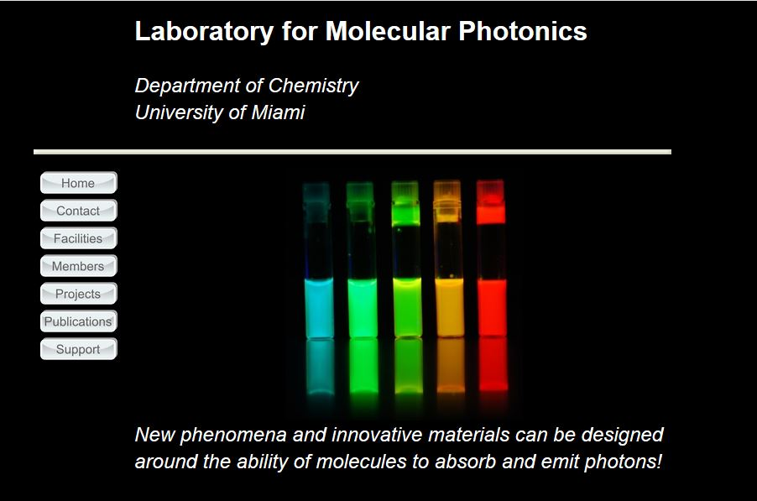
Thermo-Fluorescent Dyes
F. Raymo, U. Miami.

Slide 37
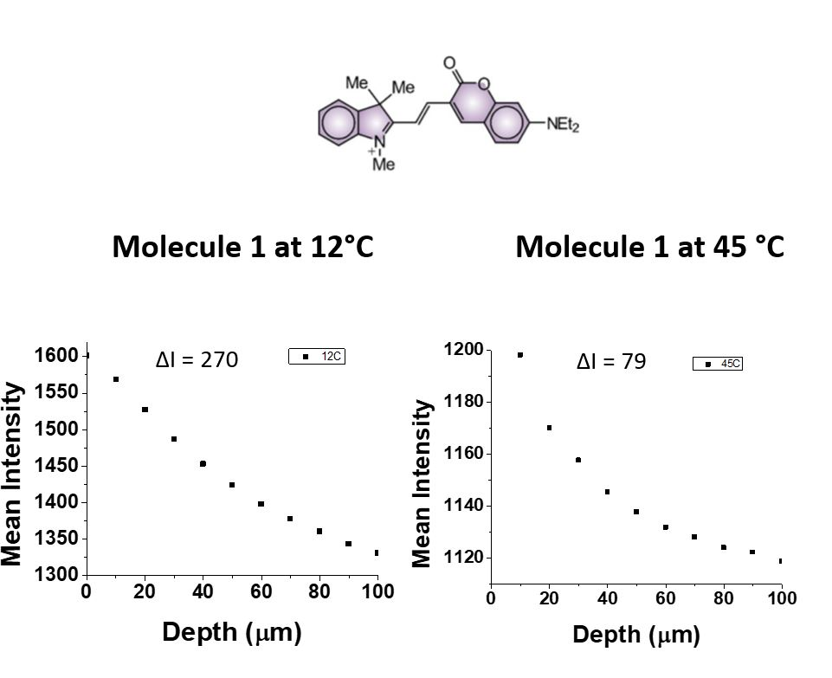
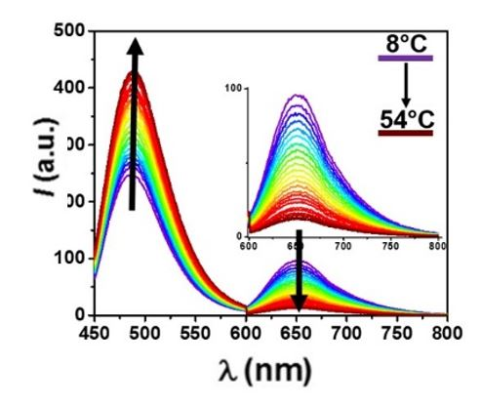
Thermo-Fluorescent Dyes
Can we use thermofluorescent dyes to measure the vertical structure of the thermal skin layer?
Yes!

Slide 38
Summary
Both MODIS’s are very stable instruments in the IR.
  Algorithm developments are improving accuracy; assessment of accuracy also improving.
Focus on refining high latitude SSTs (MISST-3) and in aerosol regions (Bingkun Luo has a NASA FINESST award).
Attempts to characterize stability of drifter temperatures.
Working to incorporate Saildrone data in assessment of satellite SST accuracies.
No lab rats were harmed in this research.

Slide 39
Publications in 2019
Centurioni, L.R., Turton, J., Lumpkin, R., Braasch, L., Brassington, G., Chao, Y., Charpentier, E., Chen, Z., Corlett, G., Dohan, K., Donlon, C., Gallage, C., Hormann, V., Ignatov, A., Ingleby, B., Jensen, R., Kelly-Gerreyn, B.A., Koszalka, I.M., Lin, X., Lindstrom, E., Maximenko, N., Merchant, C.J., Minnett, P., O’Carroll, A., Paluszkiewicz, T., Poli, P., Poulain, P.-M., Reverdin, G., Sun, X., Swail, V., Thurston, S., Wu, L., Yu, L., Wang, B., & Zhang, D. (2019). Global in situ Observations of Essential Climate and Ocean Variables at the Air–Sea Interface. Frontiers in Marine Science 6. 10.3389/fmars.2019.00419
Cronin, M.F., Gentemann, C.L., Edson, J., Ueki, I., Bourassa, M., Brown, S., Clayson, C.A., Fairall, C.W., Farrar, J.T., Gille, S.T., Gulev, S., Josey, S.A., Kato, S., Katsumata, M., Kent, E., Krug, M., Minnett, P.J., Parfitt, R., Pinker, R.T., Stackhouse, P.W., Swart, S., Tomita, H., Vandemark, D., Weller, A.R., Yoneyama, K., Yu, L., & Zhang, D. (2019). Air-Sea Fluxes With a Focus on Heat and Momentum. Frontiers in Marine Science 6. 10.3389/fmars.2019.00430
Kilpatrick, K.A., Podestá, G., Williams, E., Walsh, S., & Minnett, P.J. (2019). Alternating Decision Trees for Cloud Masking in MODIS and VIIRS NASA Sea Surface Temperature Products. Journal of Atmospheric and Oceanic Technology 36, 387-407. 10.1175/jtech-d-18-0103.1
Luo, B., Minnett, P.J., Gentemann, C., & Szczodrak, G. (2019). Improving satellite retrieved night-time infrared sea surface temperatures in aerosol contaminated regions. Remote Sensing of Environment 223, 8-20. https://doi.org/10.1016/j.rse.2019.01.009
Merchant, C.J., Minnett, P.J., Beggs, H., Corlett, G.K., Gentemann, C., Harris, A.R., Hoyer, J., & Maturi, E. (2019). Global Sea Surface Temperature. In G.C. Hulley, & D. Ghent (Eds.), Taking the Temperature of the Earth (pp. 5-55): Elsevier. 978-0-12-814458-9. https://doi.org/10.1016/B978-0-12-814458-9.00002-2.
Minnett, P.J. (2019). Upper Ocean Heat and Freshwater Budgets. In J.K. Cochran, H.J. Bokuniewicz, & P.L. Yager (Eds.), Encyclopedia of Ocean Sciences (Third Edition) (pp. 47-59). Oxford: Academic Press. 978-0-12-813082-7. https://doi.org/10.1016/B978-0-12-409548-9.11601-X.
Minnett, P.J. (2019). Upper Ocean Heat and Freshwater Budgets. In J.K. Cochran, H.J. Bokuniewicz, & P.L. Yager (Eds.), Encyclopedia of Ocean Sciences (Third Edition) (pp. 47-59). Oxford: Academic Press. 978-0-12-813082-7. https://doi.org/10.1016/B978-0-12-409548-9.11601-X.
Minnett, P.J., Alvera-Azcárate, A., Chin, T.M., Corlett, G.K., Gentemann, C.L., Karagali, I., Li, X., Marsouin, A., Marullo, S., Maturi, E., Santoleri, R., Saux Picart, S., Steele, M., & Vazquez-Cuervo, J. (2019). Half a century of satellite remote sensing of sea-surface temperature. Remote Sensing of Environment 233, 111366. https://doi.org/10.1016/j.rse.2019.111366
O’Carroll, A.G., Armstrong, E.M., Beggs, H.M., Bouali, M., Casey, K.S., Corlett, G.K., Dash, P., Donlon, C.J., Gentemann, C.L., Høyer, J.L., Ignatov, A., Kabobah, K., Kachi, M., Kurihara, Y., Karagali, I., Maturi, E., Merchant, C.J., Marullo, S., Minnett, P.J., Pennybacker, M., Ramakrishnan, B., Ramsankaran, R., Santoleri, R., Sunder, S., Saux Picart, S., Vázquez-Cuervo, J., & Wimmer, W. (2019). Observational Needs of Sea Surface Temperature. Frontiers in Marine Science 6. 10.3389/fmars.2019.00420
Theocharous, E., Fox, N.P., Barker-Snook, I., Niclòs, R., Santos, V.G., Minnett, P.J., Göttsche, F.M., Poutier, L., Morgan, N., Nightingale, T., Wimmer, W., Høyer, J., Zhang, K., Yang, M., Guan, L., Arbelo, M., & Donlon, C.J. (2019). The 2016 CEOS Infrared Radiometer Comparison: Part II: Laboratory Comparison of Radiation Thermometers. Journal of Atmospheric and Oceanic Technology 36, 1079-1092. 10.1175/jtech-d-18-0032.1

Slide 40
Papers in review or preparation
Gentemann, C.L., Scott, J.P., Mazzini, P., Pianca, C., Akella, S., Minnett, P.J., Cornillon, P., Fox-Kemper, B., Cetinić, I., Chin, T.M., Gomez-Valdes, J., Vazquez-Cuervo, J., Tsontos, V., Yu, L., Jenkins, R., De Halleux, S., Peacock, D., & Cohen, N. (2019). Saildrone: adaptively sampling the marine environment. Bull. Amer. Met. Soc. In review.
Jia, C., & P.J. Minnett (2020). Satellite Infrared Retrievals of Sea Surface Temperature at High Latitudes. In preparation.
Kumar, C., G. P. Podestá, K. A. Kilpatrick, & Minnett., P.J. (2020). A Machine Learning Approach to Estimating the Error in Satellite Sea Surface Temperature Retrievals. In preparation.
Luo, B., P. J. Minnett, M. Szczodrak, N. Nalli, & V. Morris (2020). Accuracy assessment of MERRA-2 and ERA-Interim sea-surface temperature, air temperature and humidity profiles over the Atlantic Ocean using AEROSE observations. In preparation.
Luo, B., P. J. Minnett, M. Szczodrak, & M.A. Izaguirre (2020). Long-term validation of Sentinel-3a SLSTR derived Sea Surface Skin Temperature products with shipborne M-AERI observations. In preparation.
Szczodrak, M., & P. J. Minnett (2020). Limits of Optimal Estimation of Sea Surface Temperature Retrievals from Satellite Infrared Radiometers measurements: examples from MODIS. In preparation.
Minnett, P.J., Kilpatrick, K., Podestá, G., Szczodrak, M., Izaguirre, M.A., Williams, E., Walsh, S., Evans, R.H., & Reynolds, R.M. (2020). Suomi-NPP VIIRS Sea Surface Temperature retrievals; algorithm evolution and accuracy assessment. Remote Sensing. In preparation.

Slide 41
Acknowledgements
Funding, primarily from NASA-PO, MODIS (Senior Review).
Support of OBPG at NASA GSFC OB.DAAC.
MCST for ensuring the MODIS science data quality.
RCCL Lines & NOAA: hosting instruments on ships.
Luca Centurioni (SIO) & Rick Lumpkin (NOAA-AOML): drifters.
NOPP, Saildrone Inc. & The Schmidt Family Foundation: funding Saildrone projects.

Slide 42
Thank you.

