Slide 1
Status of the Terra Mission
Robert Wolfe, Kurt Thome, Si-Chee Tsay,
MODIS/VIIRS Science Team Meeting
November 19, 2019

Slide 2
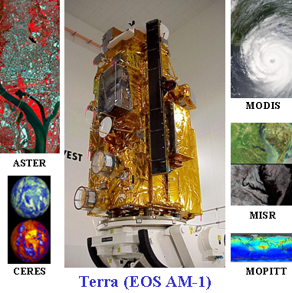
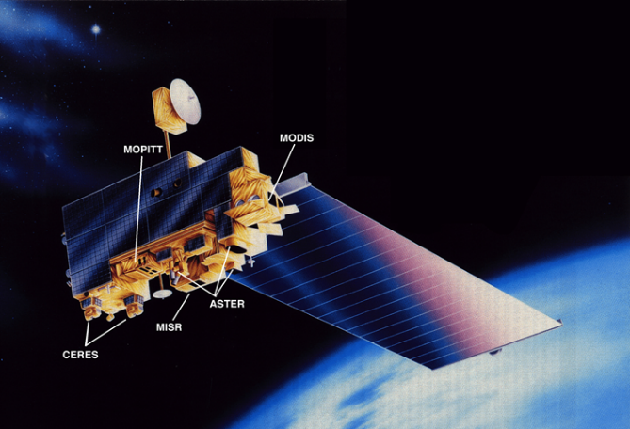
Terra team and sensors
ASTER
  Hi-resolution, multi-spectral images from 15 m to 90 m resolution, plus stereo
CERES
  Measures Earth’s shortwave, longwave, and net radiant energy budget
MISR
  Global multiangle images of aerosol, cloud, and surface characteristics
MODIS
  1-2 day global coverage in 36 wavelengths from 250 m to 1 km resolution
MOPITT
  Global measures of CO
Launch Date: December 18, 1999
705-km orbit
98.88 minute period
98.3 degree inclination
16 day repeat (233 orbits)
10:30 am crossing time descending orbit (originally 10:45 am)
Design Life : 6 years
AM constellation w/Landsat 7
The primary purpose of Terra is to enable the science community to address fundamental questions on causes and pace of global environmental change

Slide 3
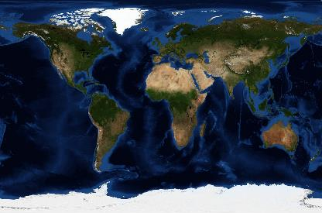
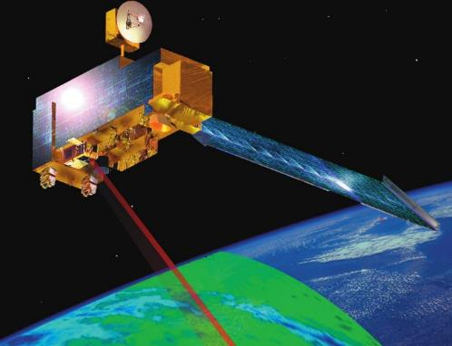











TERRA
YEARS
ORBITS
INSTRUMENTS
COUNTRIES
19+
5
3
The Flagship Earth Observing Satellite
100,000
The NASA Terra satellite was launched on 18 Dec. 1999. Today, Terra continues to provide important data that builds on 19 years of climate data records.
Terra has performed over 100,000 sun-synchronous orbits around the Earth at an altitude of 705 km.
Terra has five instruments that collect data on Earth’s atmosphere, climate, weather, carbon cycle, surface and interior, and water and energy cycles.
Terra is a multi-national satellite, carrying instruments from three international partners. The United States, Canada, and Japan work together to collect globally beneficial data.
DATA PRODUCTS
RESEARCH
USERS
PUBLICATIONS
INSTRUMENTS
REAL TIME
5
240
83
20,000
350,000
1,600,000
Terra’s suite of instruments provide 83 core data products to the worldwide scientific community, making significant scientific contributions that advance our understanding of Earth’s systems.
Over 20,000 journal articles using data from Terra’s five instruments have been published by scientists worldwide.
A total of 350,000 journal articles from around the globe cited work related to the Terra Mission, demonstrating the data’s broad utility.
Terra has 5 instruments that collect data on Earth’s atmosphere, climate, weather, carbon cycle, surface and interior, and water and energy cycles.
Terra data is directly broadcasted to 240 stations worldwide with over 1,000 users in near real time (every 2.5 hours), and is delivered to DoD, NOAA, USDA and more.
Terra data are being delivered to more than 1.6 million users around the world. The popular data has widespread applications and is easy to access. All of the data is free to users.

Slide 4
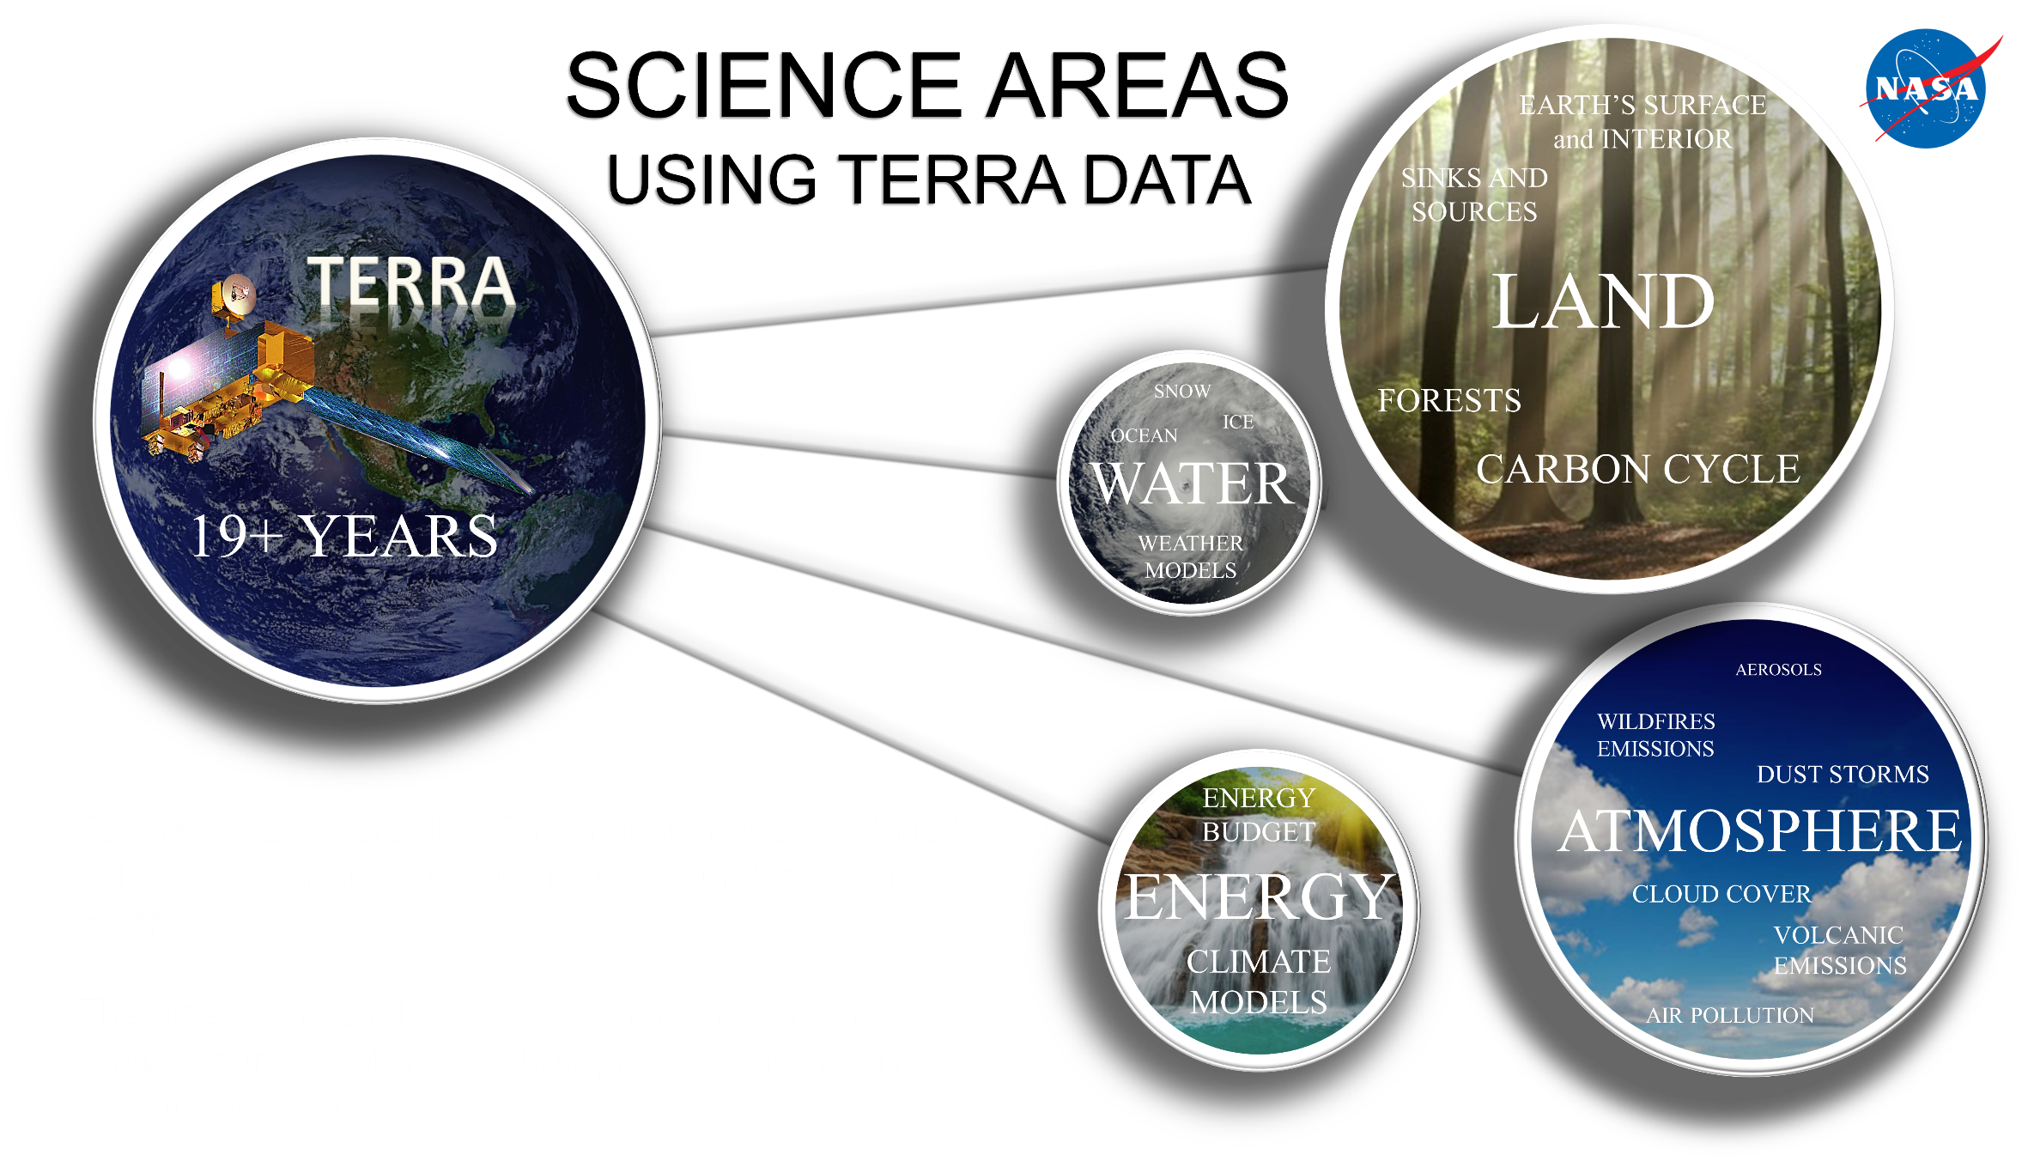

Slide 5
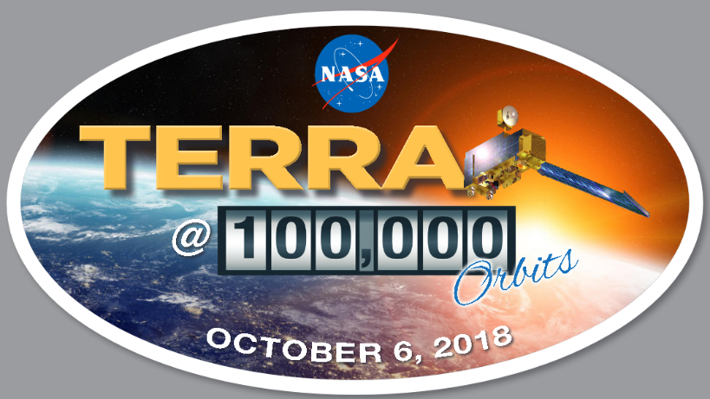
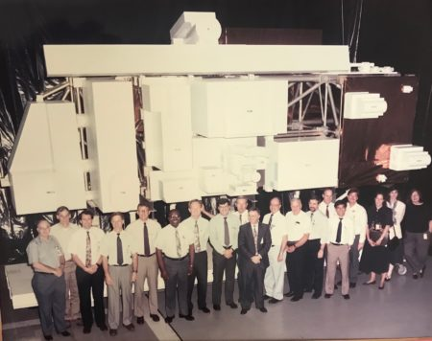
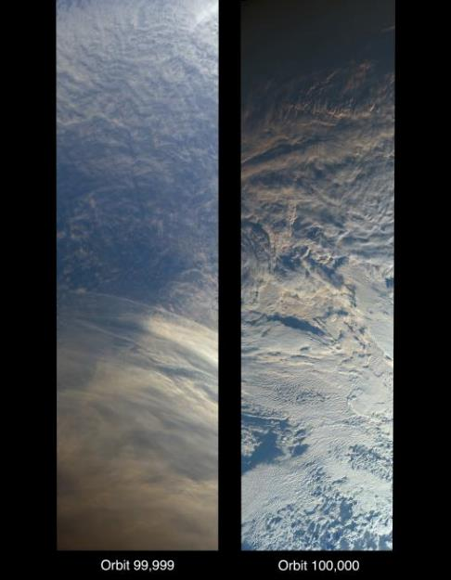
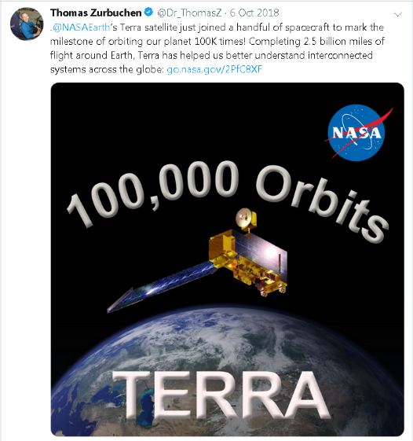
Terra’s 100,000th orbit
Opportunity to draw attention to the decades of dedicated work by the project’s talented engineers and scientists
Joins a handful of satellites to mark this orbit milestone, including the International Space Station, Landsat 5 and Landsat 7
Left is screenshot of Thomas Zurbuchen’s tweet of the event
Right shows shows end of orbit 99,999 with MISR's 70-degree backward-looking camera followed by MISR's first view from orbit 100,000, taken with the 70-degree forward-looking camera
NASA scientists, engineers and designers pose in front of a full-sized model of Terra
“A well-built spacecraft, talented people running it and making great science products, with lots of people using the data, that’s what has kept it running all these years.”
Dimitrios Mantziaras, Terra Mission Director

Slide 6
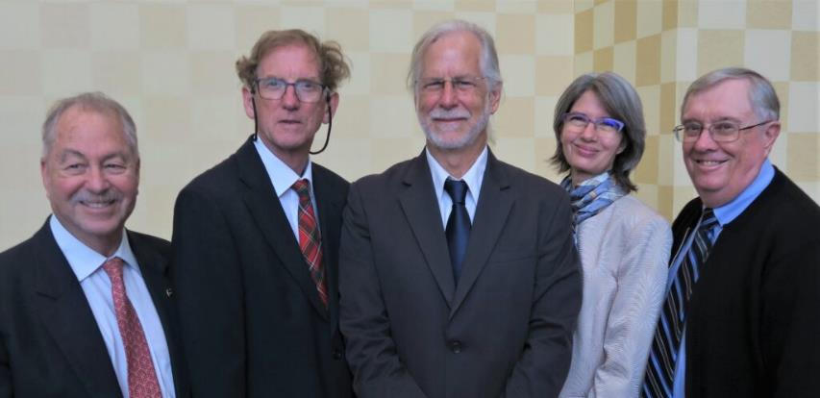
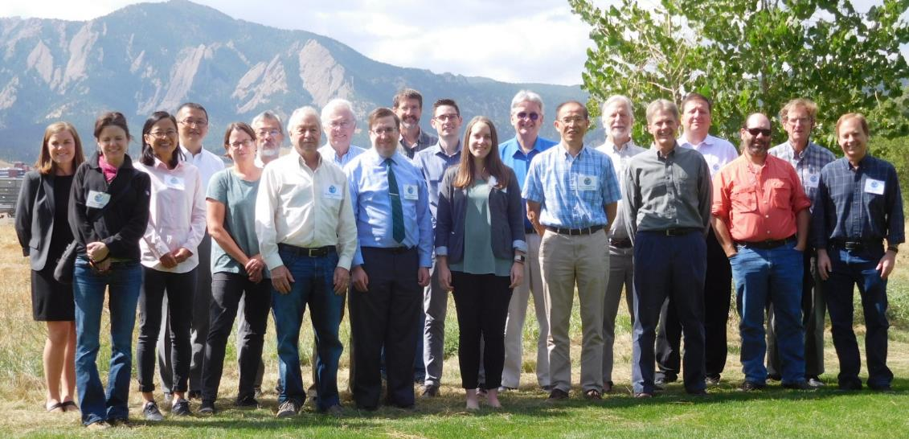
Terra Team received the 2019 William T. Pecora Team Award
Attending the Oct. 7 awards ceremony were Michael Abrams, James Drummond, Robert Wolfe, Marie-Josee Bourassa, and Vince Salomonson
Given in honor of Dr. William T. Pecora, Director of the USGS from from 1965-1971 and Under Secretary of the Interior
  Motivating force behind establishment of civil remote sensing of the Earth from space
  His vision and support helped establish what we know today as the Landsat satellite program
NASA’s Terra team was recognized with the 2019 group award for significant contributions in all areas of Earth science, with scientific impacts and a legacy that make it one of the most successful missions in NASA’s long line of Earth Observing System satellites. The Terra satellite was launched in 1999 and continues to provide a wide range of global environmental observations.
Terra at recent working group meeting in Boulder, CO September 2017

Slide 7
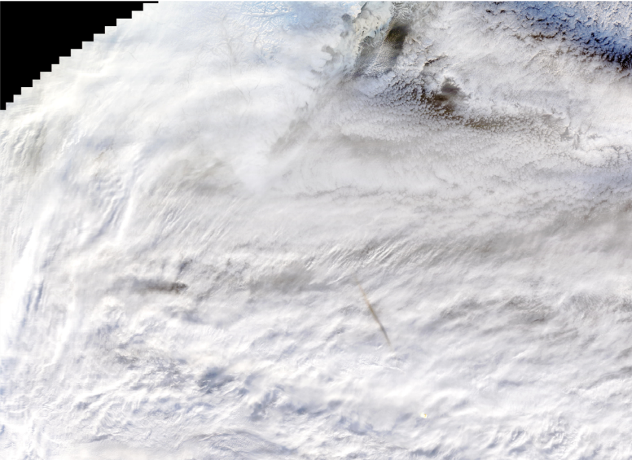
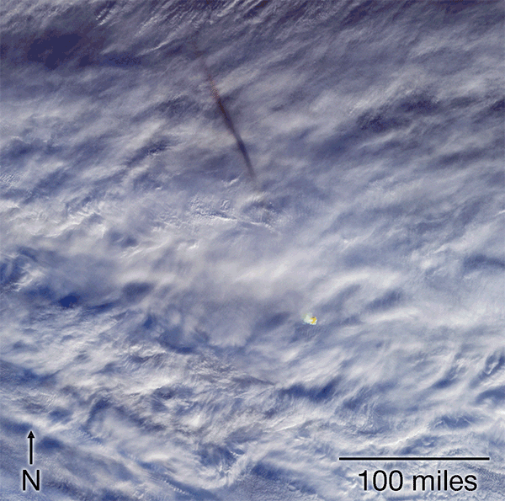
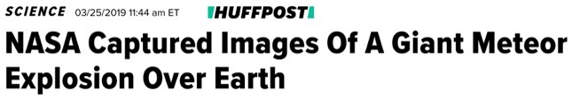
Terra and Planetary Science - Bering Sea Bolide
Dec. 18, 2018 "fireball" exploded above the Bering Sea
MODIS image of debris cloud shadow
The explosion unleashed ~173 kilotons of energy MISR stereo was used to calculate the height of the debris cloud: 28 km ASL
Images obtained minutes after the event
Terra scientists participated in the Planetary Defense Conference
Debris cloud
shadow
Fireball
MISR Images from 5 angles registered to height of meteor

Slide 8
What does the future hold for Terra?
No known life-limiting hardware on Terra at this time
Terra will continue operations at its current crossing time and altitude through the last inclination burns planned for March 2020
Terra will begin drifting after its final inclination maneuvers
  Crossing time will begin changing to an earlier time
  10:15 am is the current lower limit for Terra’s operation
Current plan is to exit the 705-km constellation when Terra’s crossing time reaches 10:15 am currently predicted for September 2022
After exit, Terra continues to drift in crossing time with altitude slowly decaying
  9:00 am crossing time is used as a placeholder based on passivation of EO-1
  Current predictions are for Terra to reach 9:00 am crossing time in Spring 2026
  Instruments on Terra can provide high-quality science data well beyond the 9:00 am crossing time
Remaining fuel used to lower perigee prior to spacecraft passivation

Slide 9
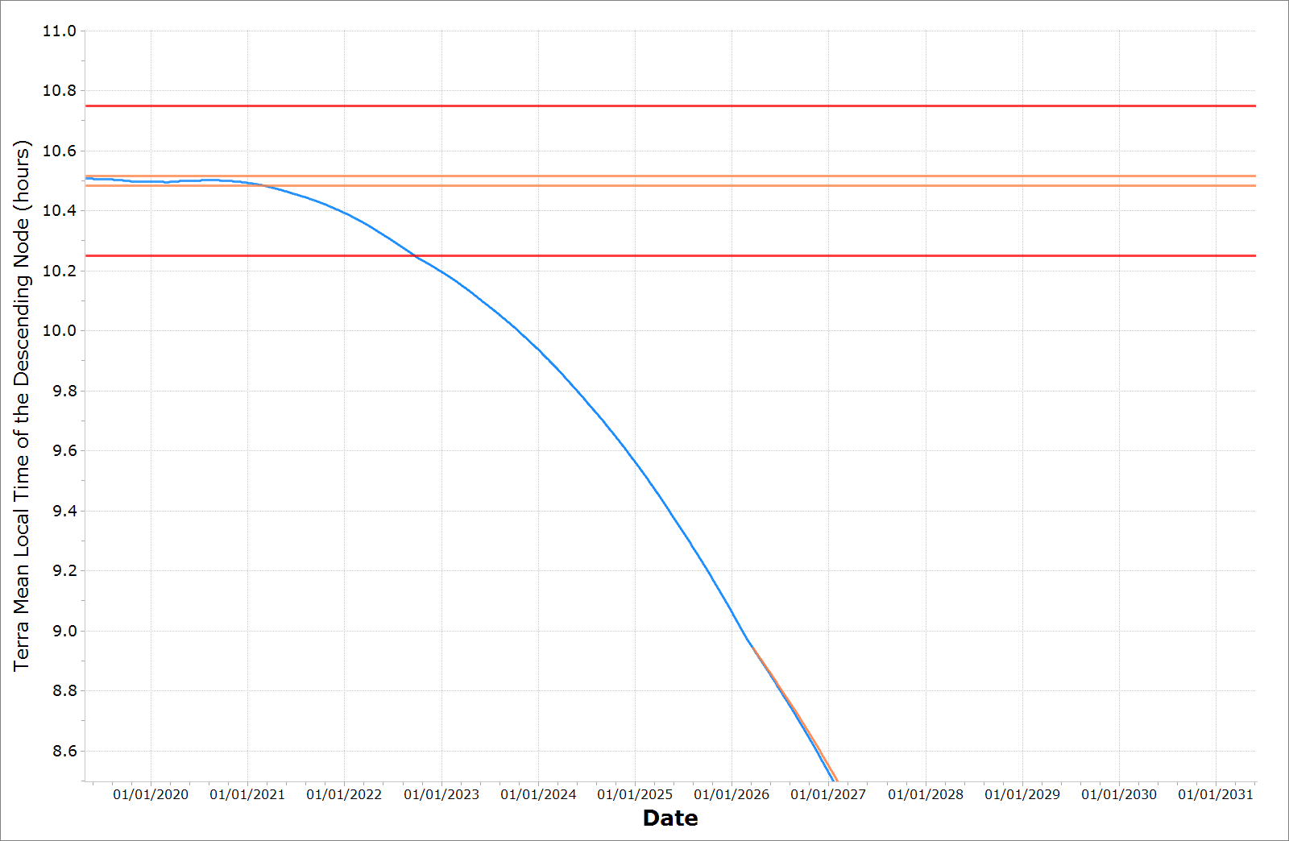
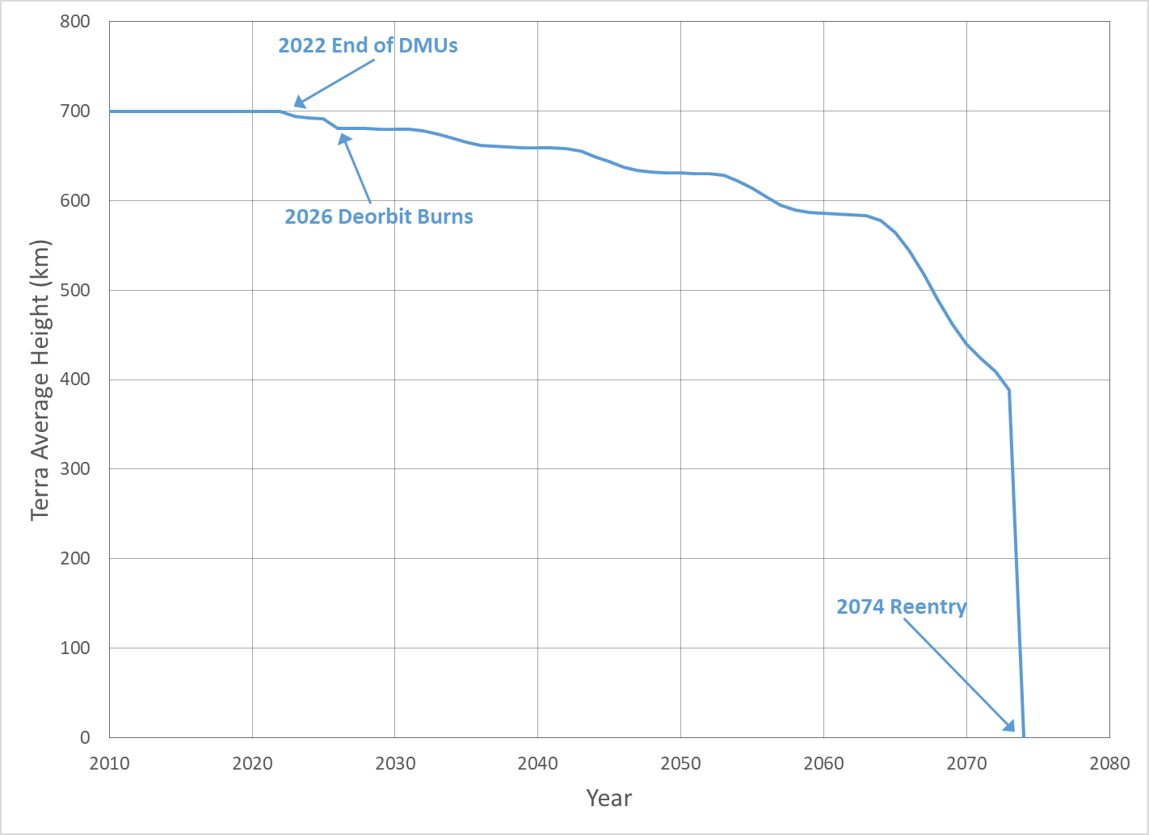
Maintain current crossing time through Spring 2020
Constellation exit assumed to be required when crossing time reaches 10:15 am
Passivation currently planned at 9 am crossing time (the EO-1 limit)
10:29AM MLT crossing
March 2021
Mission Requirement
Operational Range
10:15AM MLT crossing
Sept 2022 (Exit)
9:00AM MLT crossing
Feb 2026
(Perigee-Lowering)
Science
5th Deorbit Burn Trajectory
Decommissioning Plan | MLT Violation (10:29AM) | MLT Violation (10:15AM) | Exit Year | De-orbit Burns (#) | Apogee at Depletion (km) | Perigee at Depletion (km) | Crossing time 9:00AM MLT | EOM to Reentry (years) | Reentry Date
Baseline | Mar 2021 | Sept 2022 | 2022 | 5 | 691.1 | 667.0 | 2026 | 43 | 2069

Slide 10
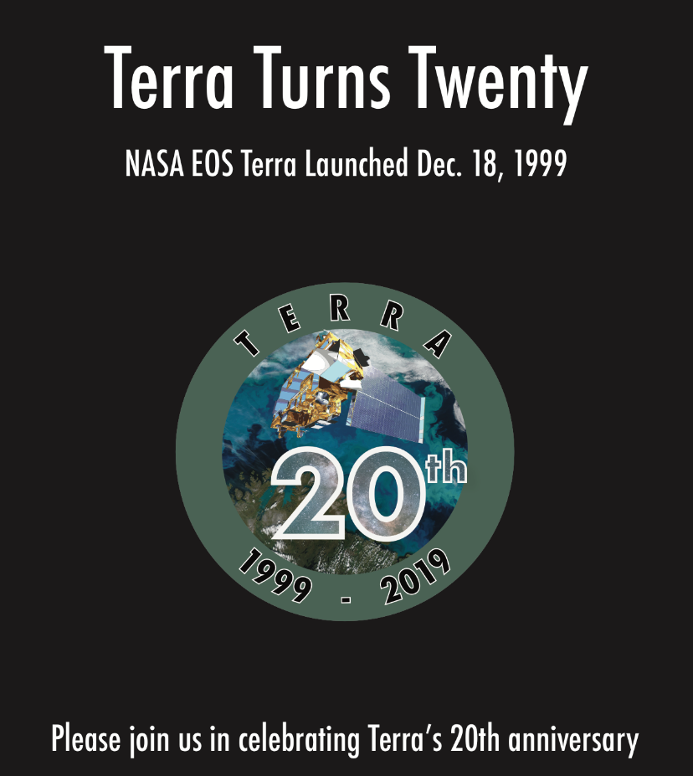
Terra@20 events
Events will take place in San Francisco during AGU the week of Dec. 8; GSFC the afternoon of Dec. 18; College Park the evening of Dec. 18; and Pasadena in February
AGU
  December 8, 2019 from 6-7 pm at the Marriott Union Square, Savoy Room
  December 10 for no host dinner at Harry’s Hunan
  Two oral sessions and one poster session on Dec. 9
GSFC
  December 18, 2019
  Building 33 Room H114
  3 – 5 pm
College Park Holiday Inn
  December 18, 2019
  6-9 pm
  No host buffet dinner
Pasadena
February 2020
Hosted by JPL as part of the MISR Science Team Meeting (Feb. 12-13)

Slide 11
2017 Senior Review
Senior Review Proposal is the place for making Terra’s case for continued operation
Science message is the primary basis for proposal evaluation
2017 was previous Senior Review
  Terra and Aqua were again highly ranked
  New feature was that the Terra/Aqua Algorithm Maintenance funding was included as part of the Senior Review Process
  Terra’s approach was that the project team members provided section inputs aligned with the different panels that evaluate the proposal
  Added extra work for the MODIS and CERES leads who had to interpret further the inputs they received from their team members

Slide 12
2020 Senior Review Proposal
Senior Review process is now on three-year centers
  Reduces the work load somewhat
  Increases the importance of an individual proposal
Changes in 2020 versus 2017
  Algorithm Maintenance support is being integrated into the project proposals
  Current budget assumes that Terra/Aqua/Aura will begin Phase F process at end of FY22 and project closeout at end of FY25
Terra’s 2020 proposal approach will follow the 2017 proposal organization but ensure that the impact to society is made clear
  Terra’s Senior Review proposal will include a request for additional funding in FY23-FY25 to continue operating and not begin Phase F
  Draft outline of Terra SR proposal and timeline for proposal development is planned to be done by 11/30

Slide 13
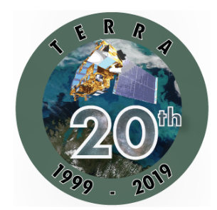
Terra continues to add to its 19-year legacy
Has met the original 18-year, planned data record for the three EOS AM platforms
Terra data record at its current crossing time reached 18 years in Spring 2020
Terra data continues to play a role as the baseline data set for comparisons for recent and future missions
  S-NPP, NOAA-20
  New Decadal Survey recommended measurements
  Earth Venture missions
Two decades on orbit takes a lot of effort
  Result of an excellent set of engineers, scientists, programmatic personnel in the 1980s and 1990s to develop Terra
  Teamwork by these same groups and periodically adding new and younger faces ensures Terra stays healthy and relevant

