Slide 1
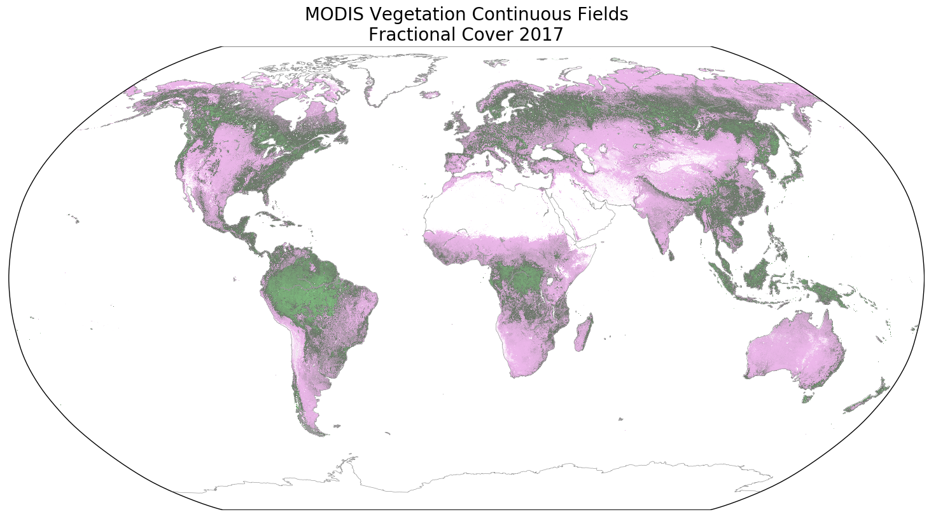
MODIS MOD44B Vegetation Continuous Fields:
A Functional Baseline for Biogeochemical Parameterizations Charlene DiMiceli (PI) and Robert Sohlberg
University of Maryland
100% Tree Cover
100% Non-Tree Vegetation
100% Non-Vegetated
Global fractional cover (Tree, Non-Tree, Bare).
Annual products year 2000 forward at 250 m.
Necessary component to create 30 m tree cover.
Improves spatial estimates of productivity, roughness, disturbance, surface water, etc.
2400 unique user citations since 2000.
Collection 6.1 products maintain high quality.
Overview paper submitted to Terra at 20.
New validation with GEDI currently underway.
Training data needs a temporal refresh.
Seeking to port software to VIIRS.
Preparing to proceed with C7 final processing.

