Slide 1
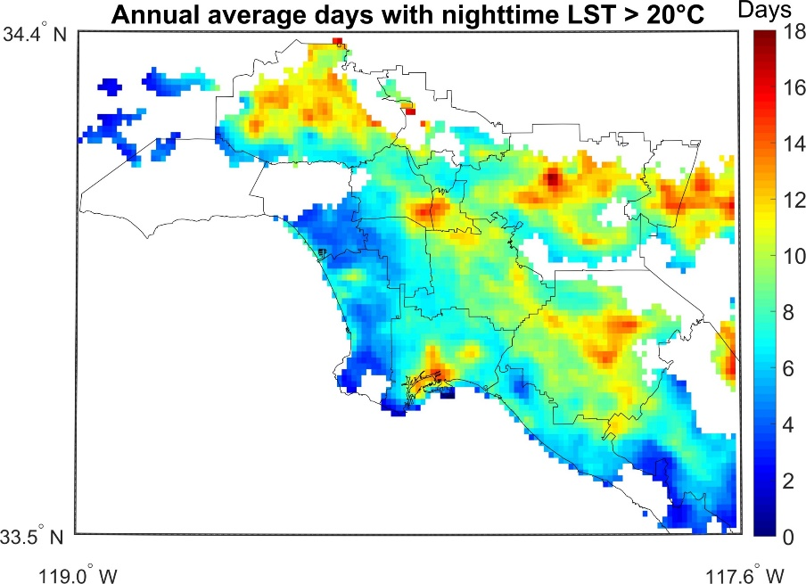
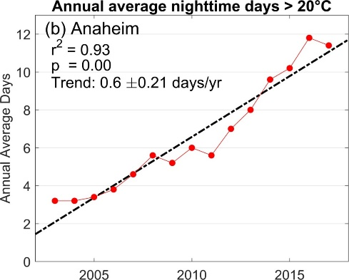
Status of MODIS LST&E (MxD21)
Status and Updates:
MODIS LST products had most downloads at LPDAAC during 2018-2020
MOD21 LSTE Terra products in C6 affected by b29 crosstalk
Issue is addressed in C6.1 with updated calibration
New CMG products available in C6.1 in addition to near-real time
processing with GEOS5 atmospheric data
MOD21 LST&E Products:
Collection 6: (Released Fall 2018)
MxD21 L2: Daily 5-min L2 Swath 1km
MxD21A1: Daily L3 Global 1km
MxD21A2 8-day L3 Global 1km
Collection 6.1: (in processing)
MxD21C1: Daily 0.05 degree Climate Modeling Grid (CMG)
MxD21C2: 8-day 0.05 degree Climate Modeling Grid (CMG)
MxD21C3: Monthly 0.05 degree Climate Modeling Grid (CMG)
Known Issues and Concerns:
Currently there are two product streams (MxD11/MxD21) with 10 different product types (could streamline to 6 products)
No plan forward to retire MxD11 suite of products
Validation shows similar accuracy over vegetated regions, with MxD21 having higher accuracy over arid/semi-arid
Recent Publications:
Hulley, G., Dousset, B., (2020), Spatio-temporal trends in urban extreme heat with new MODIS and VIIRS land surface temperature data, RSE, in review.
Yao, R., et al., (2020), A detailed comparison of MYD11 and MYD21 land surface temperature products in mainland China, Intl. Journal Digital Earth, DOI: 10.1080/17538947.2019.1711211
Hu, T., Hua, L., Biao et al., (2019), Influence of emissivity angular variation on land surface temperature retrieved using the generalized split-window algorithm, DOI: 10.1016/j.jag.2019.101917
Hulley, G., Shivers, S., Wetherley, E., & Cudd, R. (2019). New ECOSTRESS and MODIS Land Surface Temperature Data Reveal Fine-Scale Heat Vulnerability in Cities: A Case Study for Los Angeles County, California. Remote Sensing, 11(18).
Hulley et al. 2020, RSE

