Slide 1
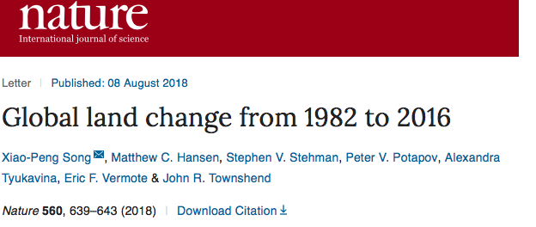
Status of MODIS Surface Reflectance (MOD09)
MODIS SR Product suite
Collection 6: (Released in 2015)
Bands 1 through 7
250m, 500m, 0.05 deg.
Daily, 8 days
Status and Updates:
MODIS SR collection 6 ( LaSRC: Land Surface Reflectance Code) is the basis for a variety of SR product (VIIRS, AVHRR, Landsat, Sentinel 2) assuring consistency and traceability in the SR products from multiple satellites/instruments.
Validation stage IV (AERONET) and cross-comparison with MODIS is on-going. ACIX-II (Landsat 8/ S2) is on-going.
Recent and relevant Publications:
G Santamaría-Artigas, A.E., et al., 2019. Evaluation of Near-Surface Air Temperature From Reanalysis Over the United States and Ukraine: Application to Winter Wheat Yield Forecasting. IEEE Journal of Selected Topics in Applied Earth Observations and Remote Sensing.
Villaescusa-Nadal, J.L., et al., 2019. Spectral Adjustment Model's Analysis and Application to Remote Sensing Data. IEEE Journal of Selected Topics in Applied Earth Observations and Remote Sensing.
Franch, B., et al., 2019. Remote sensing based yield monitoring: Application to winter wheat in United States and Ukraine. International Journal of Applied Earth Observation and Geoinformation, 76, pp.112-127.
Becker-Reshef, I., et al. , 2018. Prior Season Crop Type Masks for Winter Wheat Yield Forecasting: A US Case Study. Remote Sensing, 10(10), p.1659.
Doxani, G., Vermote, E., Roger, J.C., Gascon, F., Adriaensen, S., Frantz, D., Hagolle, O., Hollstein, A., Kirches, G., Li, F. and Louis, J., 2018. Atmospheric correction inter-comparison exercise. Remote Sensing, 10(2), p.352.
Skakun, S., Franch, B., Vermote, E., Roger, J.C., Becker-Reshef, I., Justice, C. and Kussul, N., 2017. Early season large-area winter crop mapping using MODIS NDVI data, growing degree days information and a Gaussian mixture model. Remote Sensing of Environment,
Google scholar citations containing MODIS surface reflectance
(as of June. 26, 20120) about 66000 total.

