Slide 1
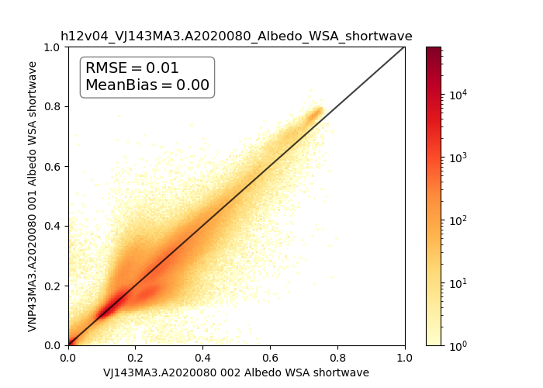
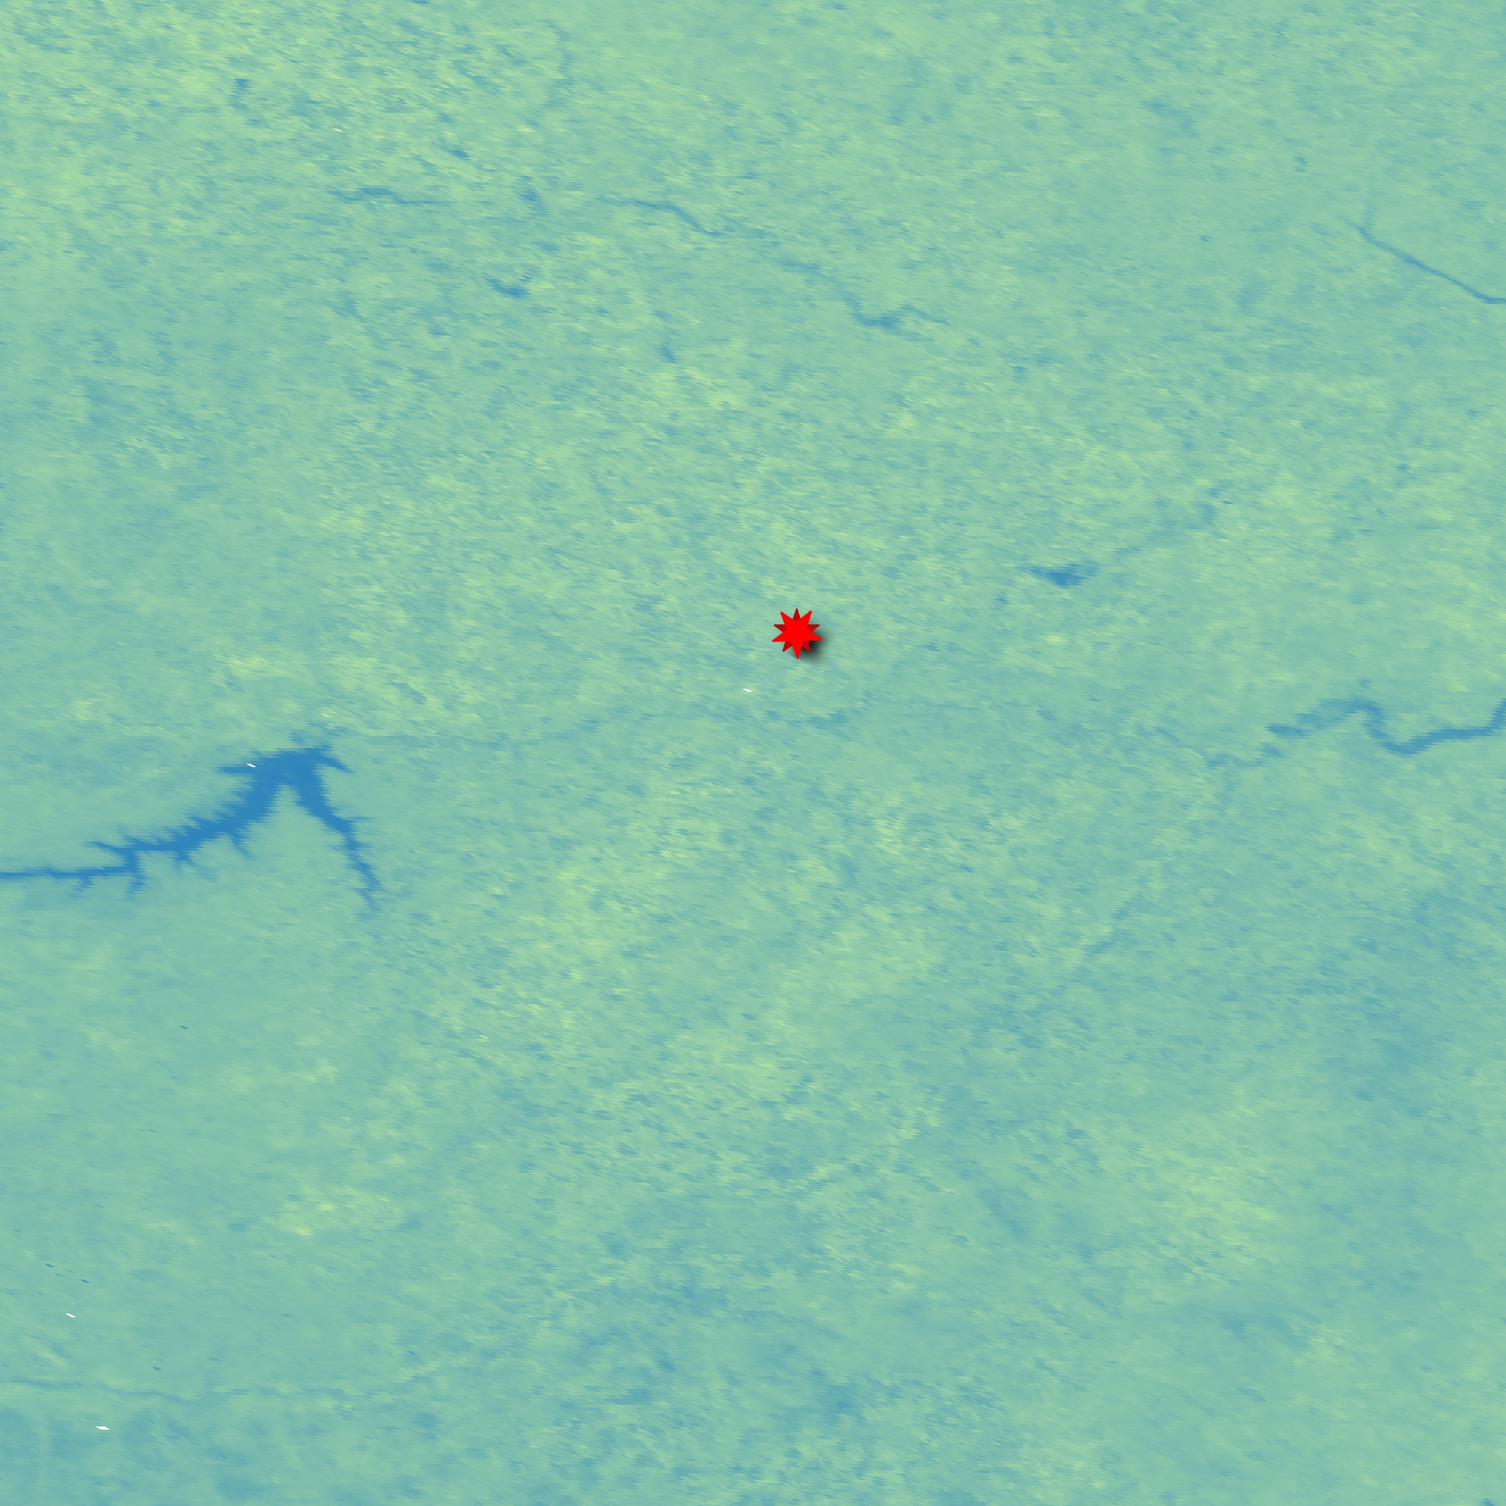
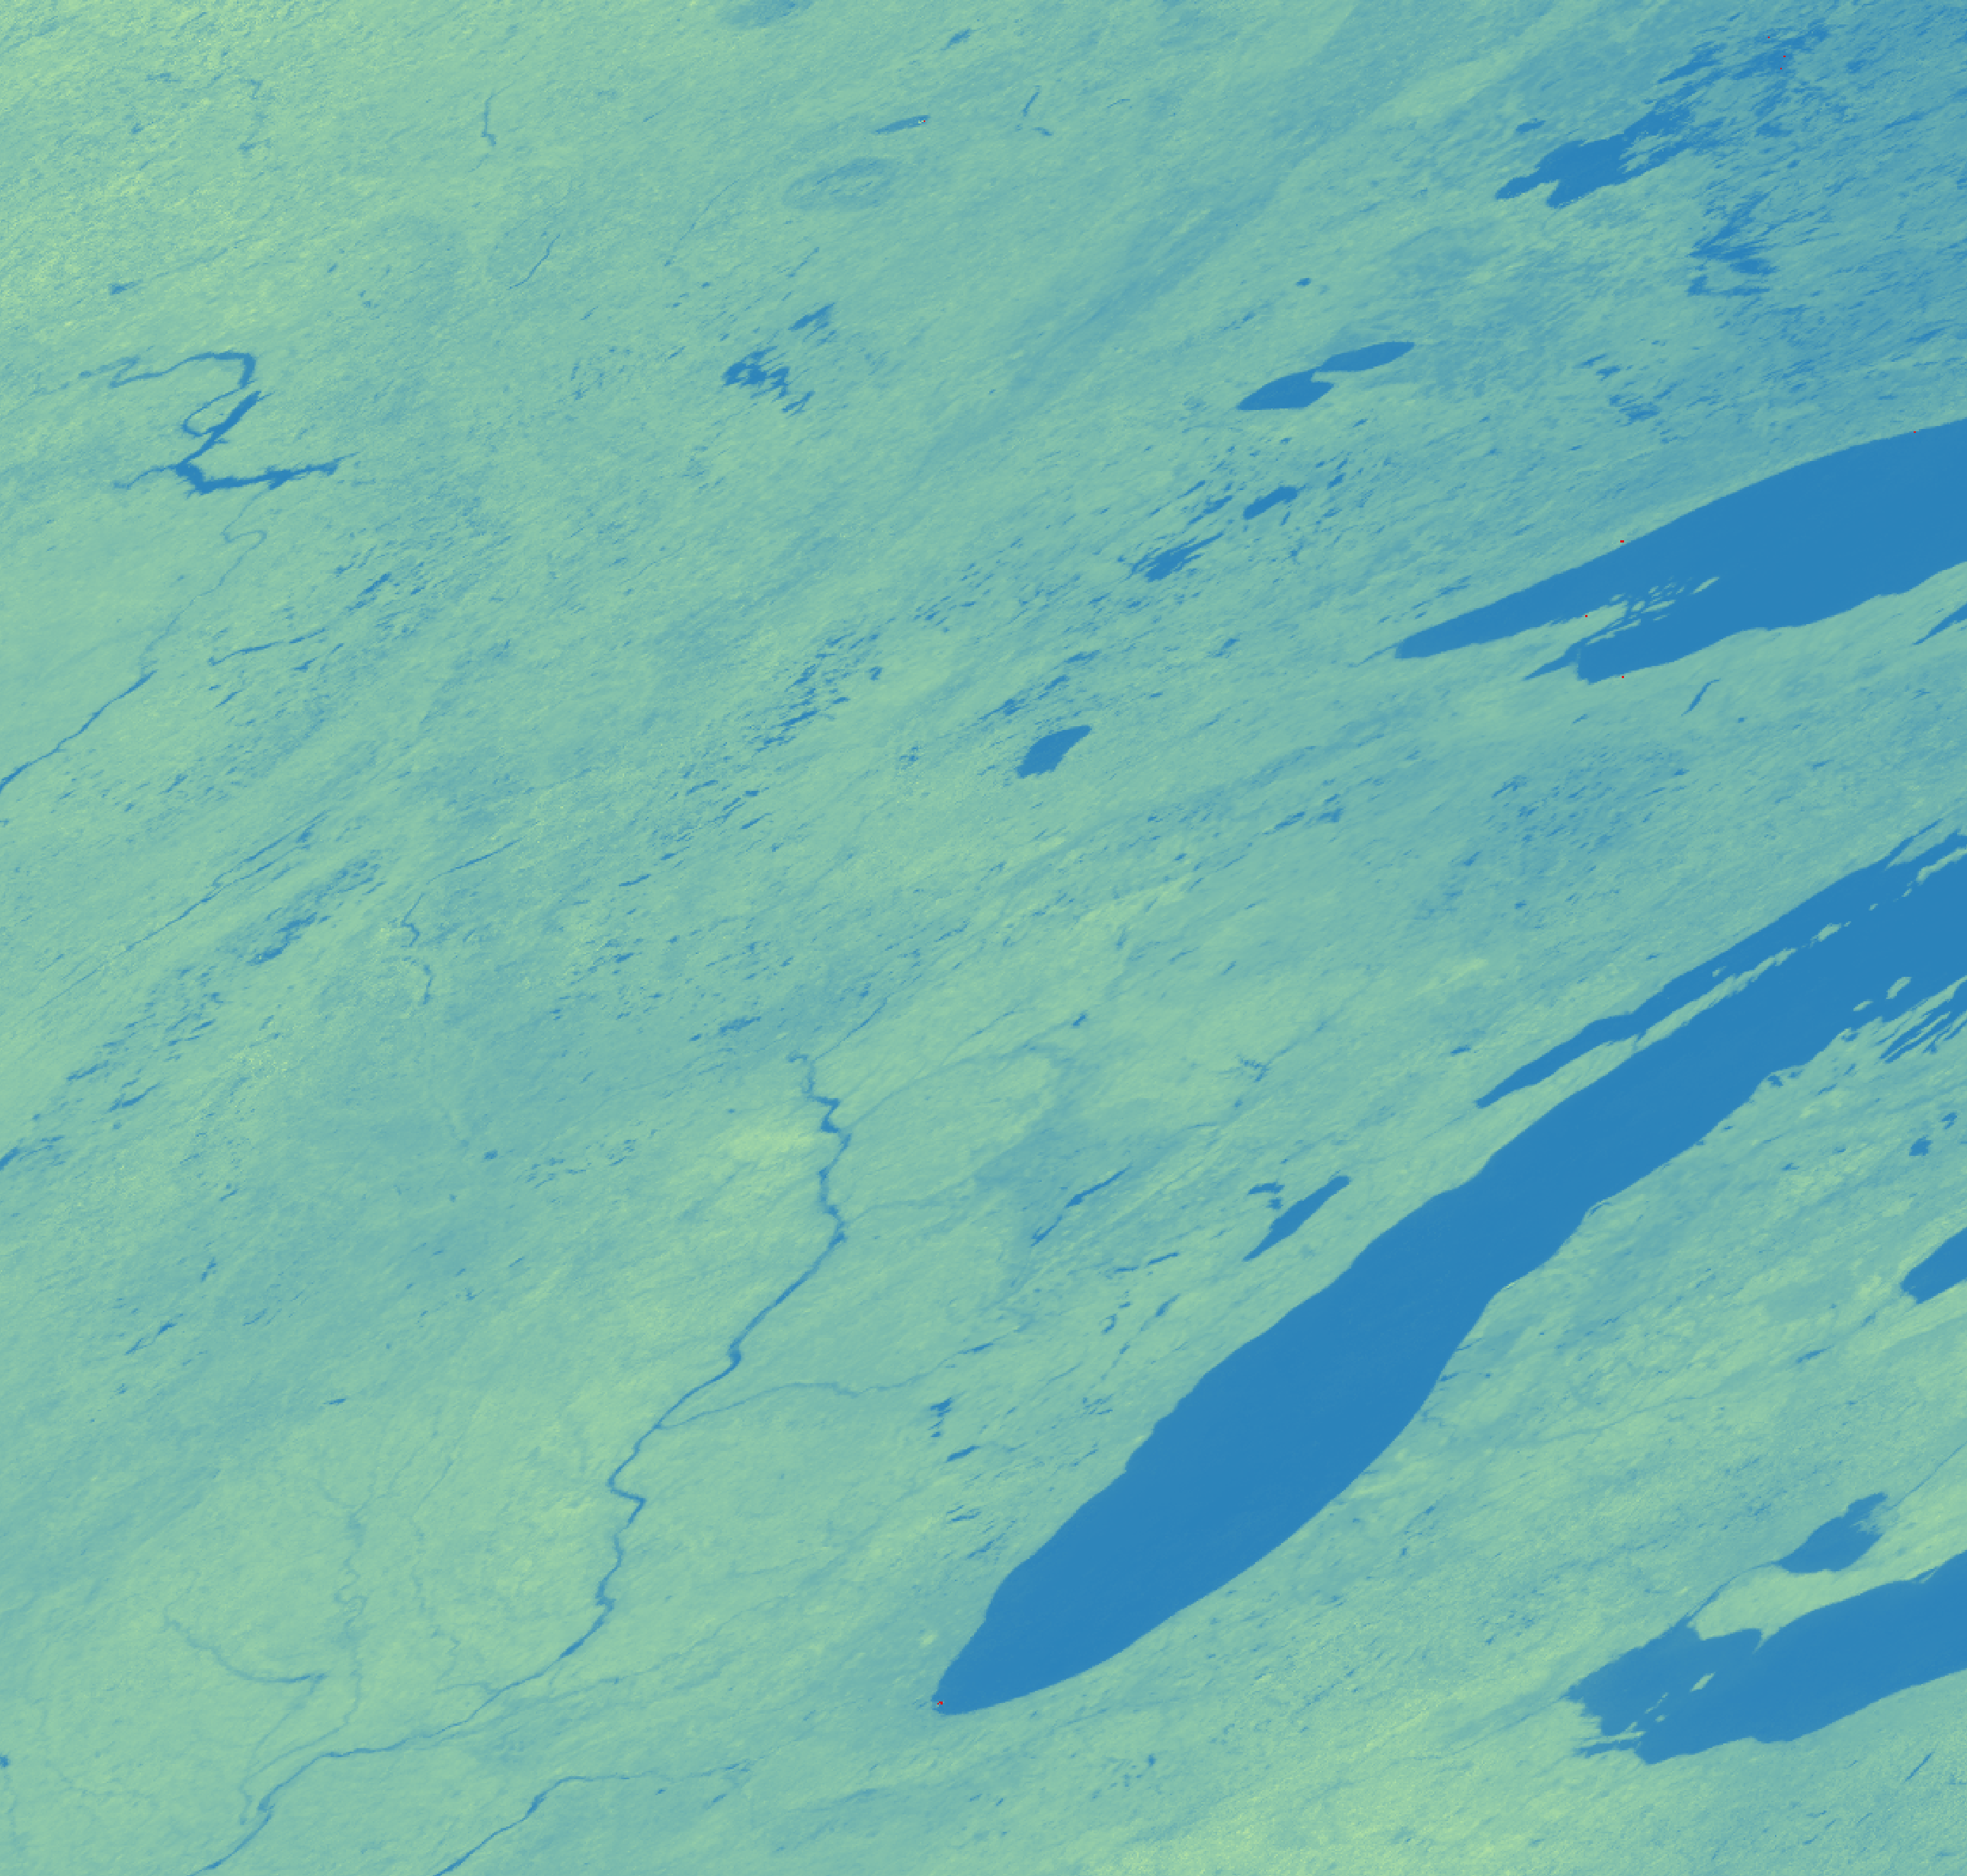
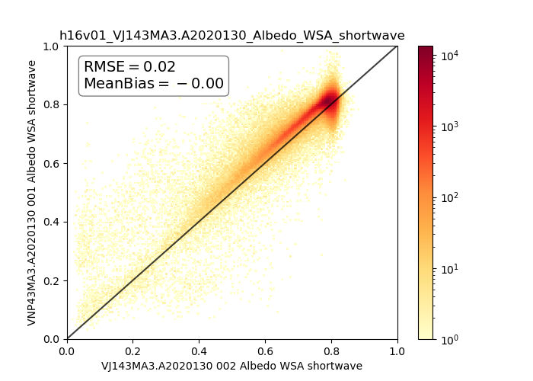
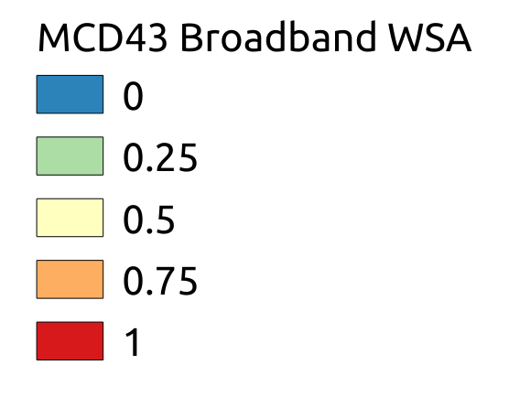
VJ143 BRDF, Albedo, and NBAR products
from JPSS-1/NOAA-20
Crystal Schaaf^{`1}, Arthur Elmes¹, Charlotte Levy¹, Angela Erb¹, Zhuosen Wang^{2,3} Qingsong Sun²
¹ School for the Environment, University of Massachusetts Boston, ² Terrestrial Information Systems Lab, NASA/GSFC, ³ Earth System Science Interdisciplinary Center, University of Maryland
JPSS-1 VIIRS BRDF, Albedo, NBAR, Products - Collections 1 and 2
The VNP product also provides daily BRDF model parameters, White Sky Albedo, Black Sky Albedo, NBAR values (and QA) for the I-bands (500m), and the M-bands, broadbands, and Day-Night Band (1km). All VNP43 products and documentation are distributed by the LPDAAC.
Fort Peck, MT SURFRAD Site
 | VNP43 | VJ143 | MCD43 | Stn
VNP43 | 0 | 0.01 | 0.01 | 0.07
VJ143 |  | 0 | 0.01 | 0.07
MCD43 |  |  | 0 | 0.02
Stn |  |  |  | 0
Harvard Forest, MA h12v04
Ft Peck, MT
NEON Tower Harvard Forest, MA
SW White Sky Albedo
Greenland h16v01

