Slide 1
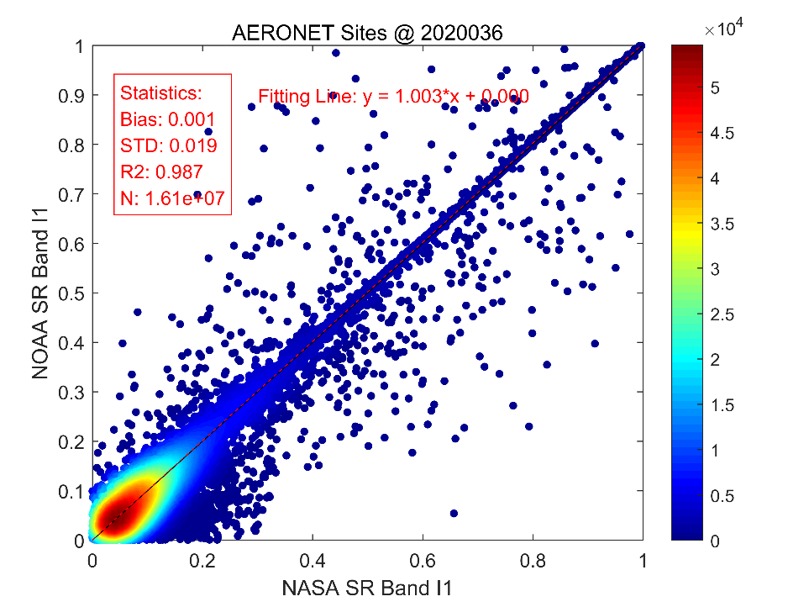
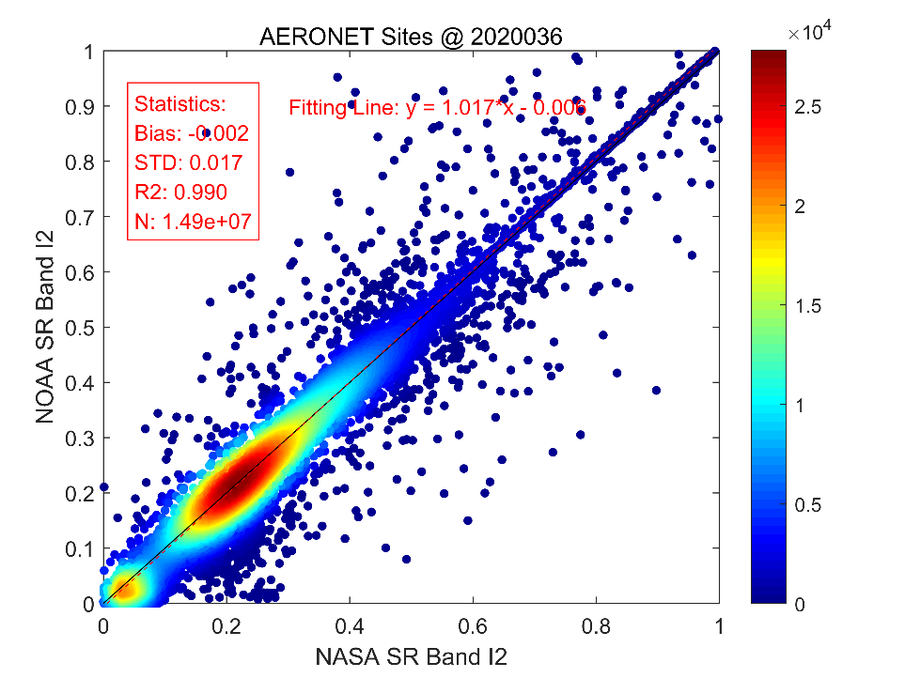
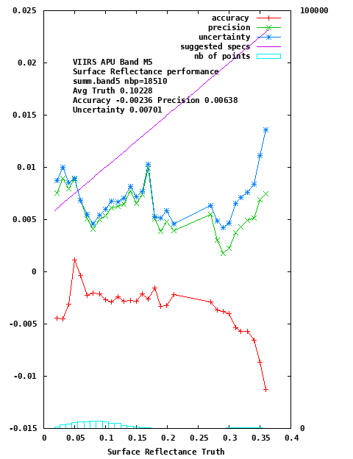
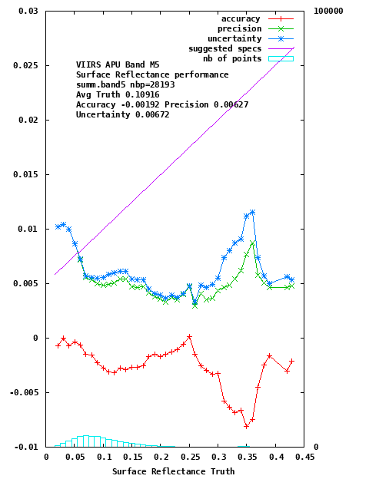
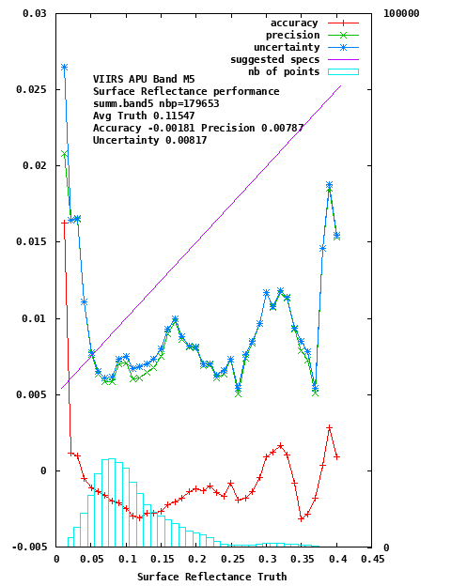
Status of VIIRS-J1 NOAA20 SR
VIIRS SR Product
VNP09 (level 2 Surface Reflectance), VNP09G1KI, VNP09GHKI, and VNP09GA (gridded daily product at 500m and 1km), VNP09A1 and VNP09H1 (gridded 8 day composite product at 500m and 1km), VNP09CMG (the daily global product in the climate modeling grid at 0.05deg).
Status and Updates:
Code was ported from NPP to JPSS1 and the Science Team evaluation has started evaluation validation (BELMANIP2, AERONET) in collaboration with the NOAA STAR Team (Ivan Csiszar)
the product passed the validated maturity review at NOAA on 6/18/2020
Known Issues:
None
SR NOAA-NASA Intercomparison (All Valid Range SR)
Acurracy, Precision and Uncertainty over AERONET of NOAA20 SR band M5 (Red)

