Slide 1
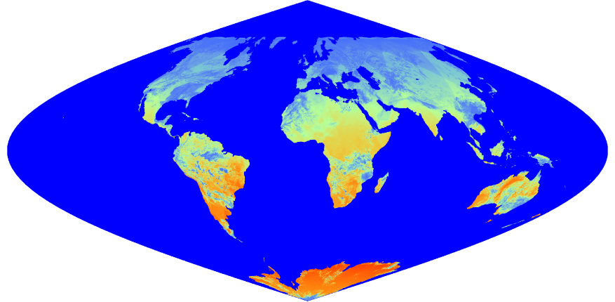
Status of VIIRS DSR and PAR Products
Products:
SNPP/VIIRS Daily L3 1km DSR SIN Grid
SNPP/VIIRS Daily L3 1km PAR SIN Grid
Initially planned as intermediate input to MCD18
To improve temporal observation frequency
Possibility of being released as independent products
Based on validation results
Status and Updates:
Operational production codes delivered in May 2020
Extensive assessment of VIIRS results underway
Documentation updates
Recent Publications:
Wang, D., Liang, S., Zhang, Y., Gao, X., Brown, M., & Jia, A. (2020). A new set of MODIS land products (MCD18): downward shortwave radiation and photosynthetically active radiation. Remote Sensing, 12,168
Brown, M., Skakun, S., He, T. & Liang, S. (2020). Intercomparison of machine-learning methods for estimating surface shortwave and photosynthetically active radiation. Remote Sensing, 12, 372
Huang, G., Li, Z., Li, X., Liang, S., Yang, K., Wang, D., & Zhang, Y. (2019). Estimating surface solar irradiance from satellites: Past, present, and future perspectives. Remote Sensing of Environment, 233, 111371
Figure. Global color-composite image (top) observed by SNPP/VIIRS on Jan. 11 2015 and the retrieved daily mean map (bottom) of land surface downward shortwave radiation from the VIIRS data.

